Slide 1
Oxidative Stress

Slide 2
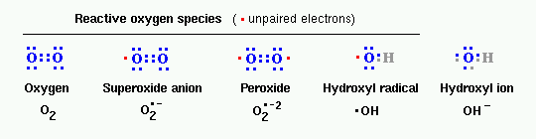
Oxidative Stress
O₂ is readily reduced to form one of many Reactive Oxygen Species (ROS)
ROS cause cellular damage
  DNA
  Protein
  Lipids
http://www.vivo.colostate.edu/hbooks/pathphys/misc_topics/ros.gif
Jamieson, Derek J. "Oxidative Stress Responses of the Yeast Saccharomyces cerevisiae." Yeast 14 (1998): 1511-527.

Slide 3
Oxidative Stress
Aerobic organisms utilize oxygen, so they have developed defense mechanisms to combat the effects of ROS
Oxidative Stress: When the concentration of ROS present in the cell exceeds the capacity of the cells ability to detoxify or to repair damages
Cell’s response to Oxidative Stress???
Jamieson, Derek J. "Oxidative Stress Responses of the Yeast Saccharomyces cerevisiae." Yeast 14 (1998): 1511-527.

Slide 4
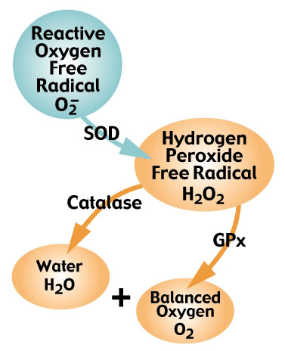
Role of H₂O₂
Hydrogen Peroxide is formed from an oxygen radical and considered to be an ROS because it has the ability to form ·OH in the presence of metal ions.
Defense mechanisms in Saccharomyces cerevisiae:
SOD: Superoxide dismutase
GPx: Glutathione peroxidase
http://www.fluidessentials.com/images/glisodin-chart.gif

Slide 5
Oxidative Stress: H₂O₂ Overload
When the [H₂O₂] exceeds the capacity of Catalase and Gulathione peroxidase, it can be reduced to form ·OH
The hydroxyl radical is highly reactive and can lead to:
        DNA Degradation
        Protein Peroxidation
        Lipid Peroxidation
Jamieson, Derek J. "Oxidative Stress Responses of the Yeast Saccharomyces cerevisiae." Yeast 14 (1998): 1511-527.

Slide 6
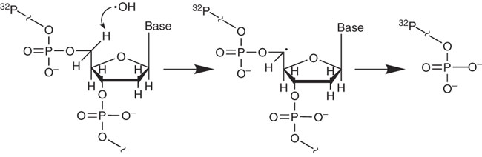
DNA Damage by ·OH
Removal of a Hydrogen atom from the deoxyribose leads to cleavage of the DNA backbone
http://www.nature.com/nprot/journal/v3/n6/full/nprot.2008.72.html
Balasubramanian, Bhavani, Wendy K. Pogozelski, and Thomas D. Tullius. "DNA Strand Breaking by the Hydroxyl Radical is Governed by the Accessible Surface Areas of the Hydrogen Atoms of the DNA Backbone." Proc. National Academy of Science 95 (1998): 9738-743.

Slide 7
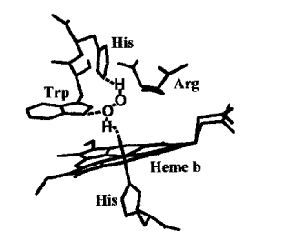
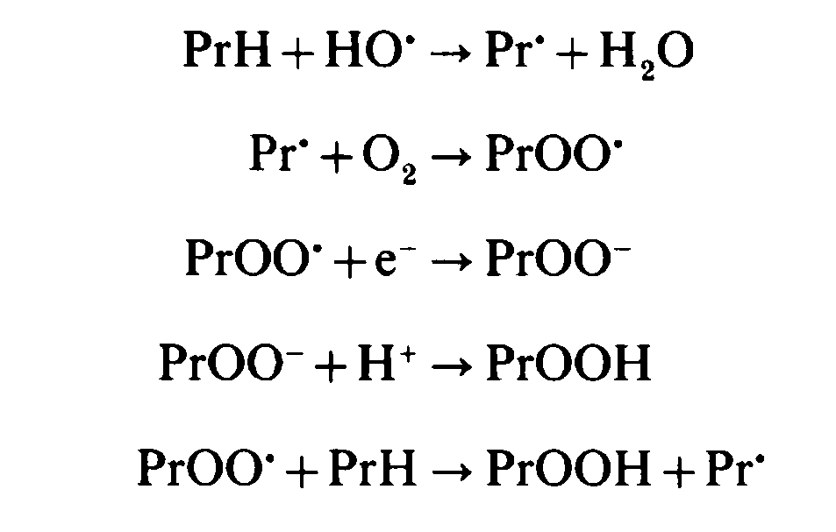
Protein Peroxidation by ·OH
Addition of hydroperoxide to an amino acid alters the
3-dimensional structure of the protein, disabling the
protein’s function
Gebicki, Silvia, and Janusz M. Gebicki. "Formation of Peroxides in Amino Acids and Proteins Exposed to Oxygen Free Radicals." Journal of Biochemistry 289 (1993): 743-49.

Slide 8
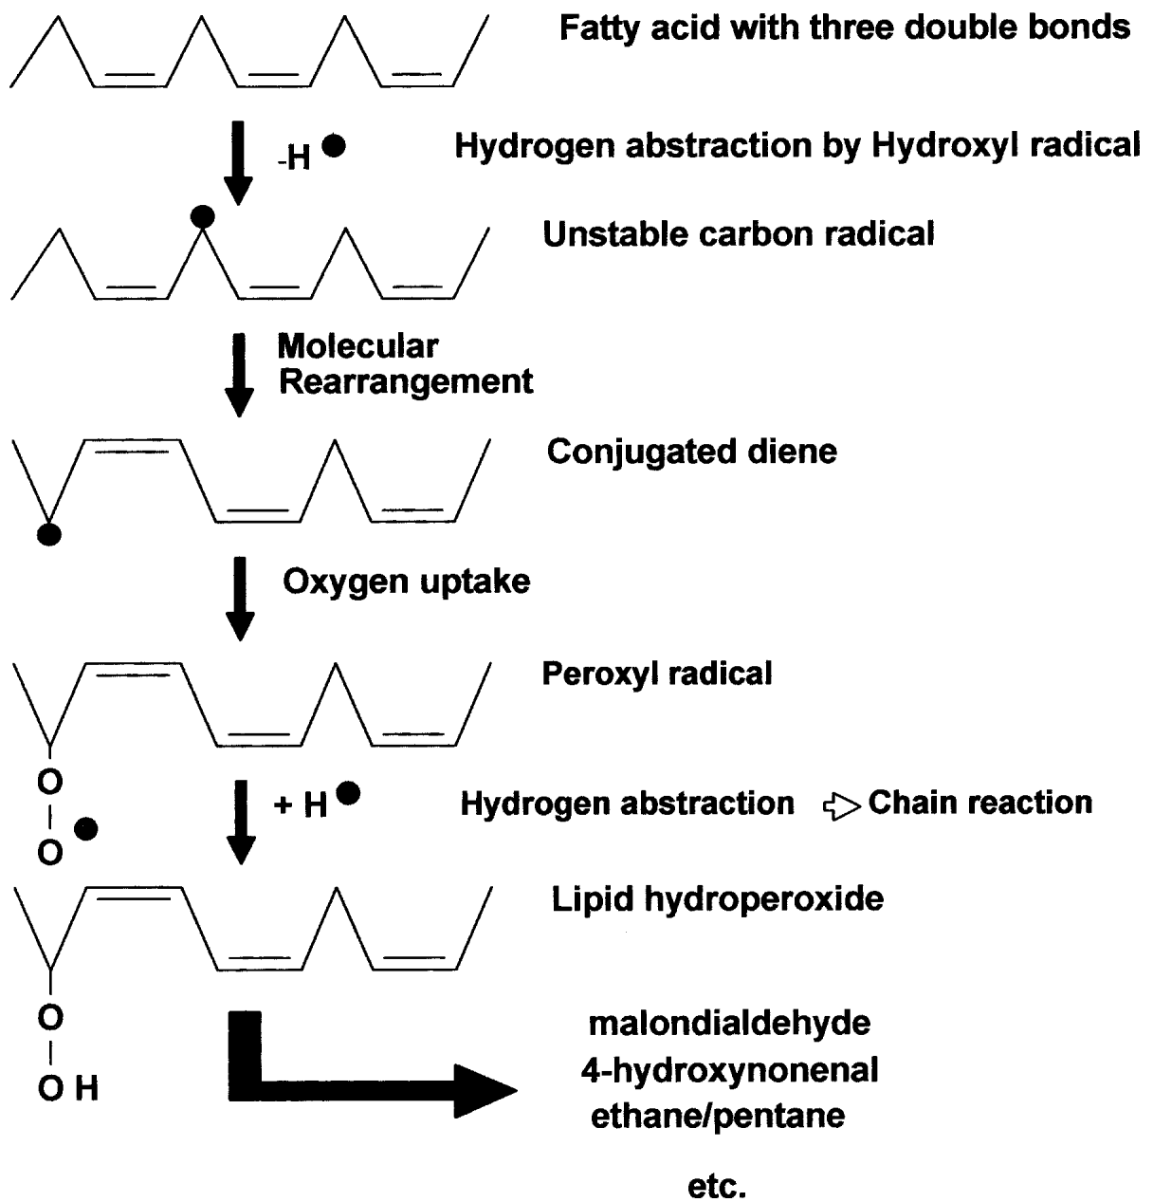
Lipid Peroxidation by ·OH
Removal of ·H⁻ and subsequent attack by ·O₂⁻ results in an altered fatty acid chain with an added hydroperoxide group.
Damages cell membranes
Mutagenic – Reacts with purines to form DNA adducts.
http://www.biochemsoctrans.org/bst/029/0358/bst0290358.htm
Buege, J. A., and S. D. Aust. "Microsomal Lipid Peroxidation." Methods Enzymology 52 (1978): 302-10.

Slide 9
What else happens?
Expectation: Oxidative Stress leads to an increase in production of proteins involved in radical scavenging and cell repair
So what happens to all of the other proteins in the cell?
        Cell Cycle?
        Energy Production?

Slide 10
What we are looking for…
Exposed S. cerevisiae to H₂O₂ for 1.5
Defense mechanisms:
  How does the protein composition change?
Basic cell function:
  How does the protein composition change?

Slide 11
Scheme 1 Simplified version of glycolysis showing the NADPH-producingsteps of the pentose phosphate pathway
Steps which are affected by S-thiolation are shown with black arrows. Inhibiting glycolytic fluxduring an oxidative stress would promote entry of glucose equivalents into the pentose phosphatepathway for NADPH production. 6GP, 6-phosphogluconate; R5P, ribulose 5-phosphate; DHAP,dihydroxyacetone phosphate.
Biochem. J. (2003) 374, 513–519

Slide 12
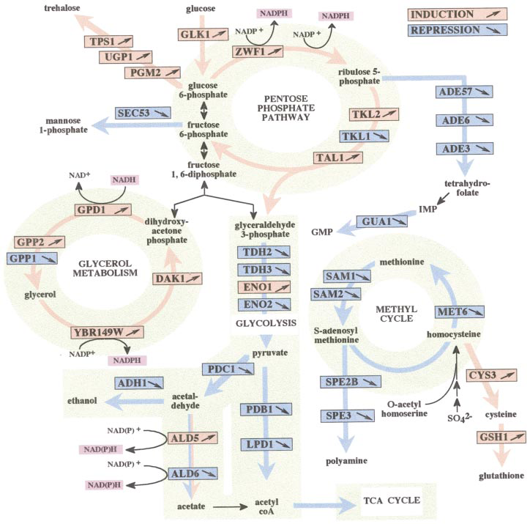
FIG. 6. Metabolic pathways altered during the H2O2 response. Only H2O2-responsive proteins are mapped. TCA, trichloroaceticacid.
THE JOURNAL OF BIOLOGICAL CHEMISTRY Vol. 273, No. 34, Issue of August 28, pp. 22480–22489, 1998

Slide 13
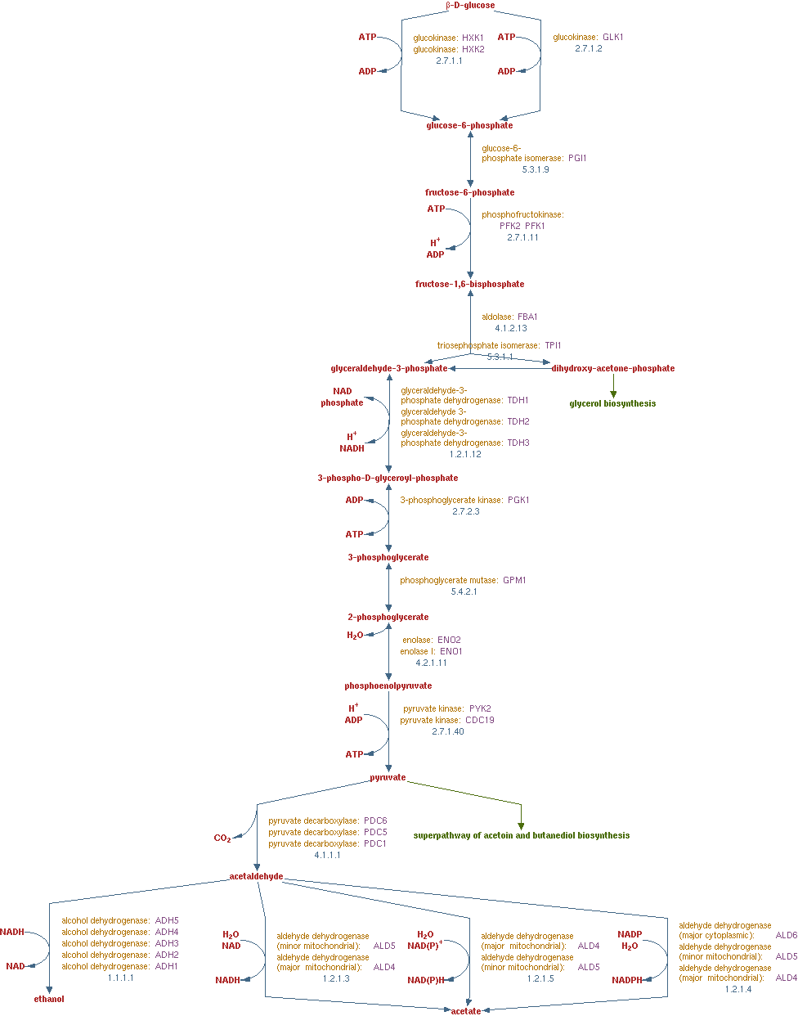

Slide 14
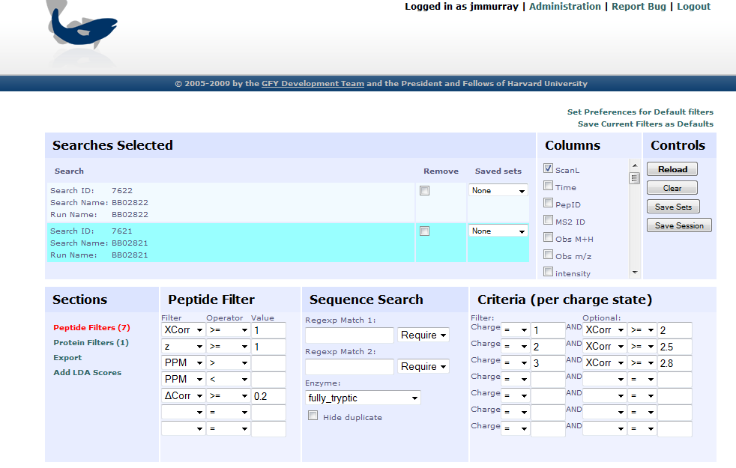

Slide 15
