Slide 1
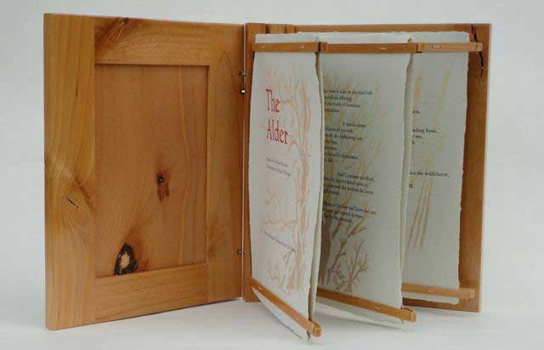
We live in exciting times. Because of the personal computer the book has been set free from servitude to information ... free to become an aesthetic object, a work of art.
Peter Thomas

Slide 2
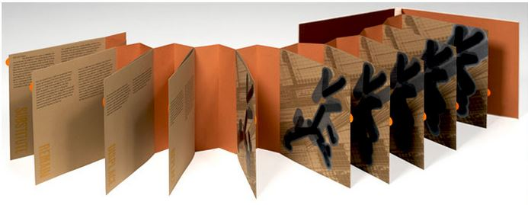
Artists' books take every possible form, participate in every possible convention of bookmaking, every possible "ism" of mainstream art and literature, every possible mode of production, every shape, every degree of ephemerality or archival durability....Artists' books are a unique genre...little bound by constraints of medium or form.
Johanna Drucker

Slide 3
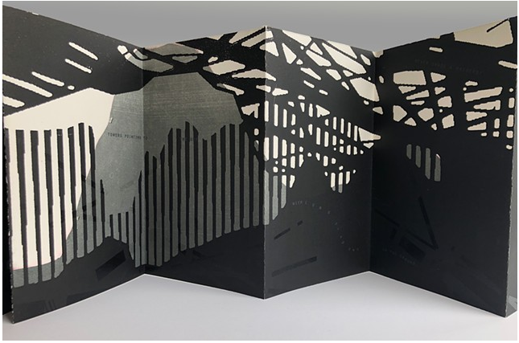
This is the inherent beauty of artist books - the provided structure allows the audience to alter or add to the meaning of the work through the viewing process.
Melissa Wagner-Lawler

Slide 4
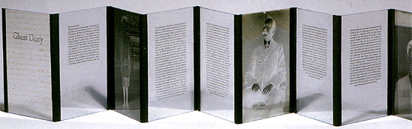
Coexisting words and images—the interdependency of the two great communication systems of literacy and visual communication—is the most powerful force of intellectual and emotional development we have. And the book form is the most potent way of housing that force.
Paul Johnson
Notes:
Definition

Slide 5
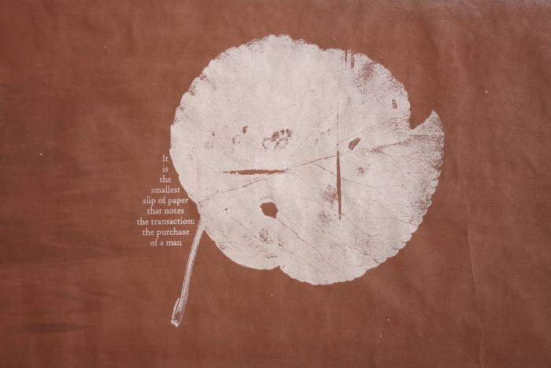
I am interested in engaging … the reader/viewer in a conversation about historical and contemporary racism…using printmaking techniques in the book form... I kind of try to seduce the reader through materials, color, tactility, pacing to kind of slow their initial impulse to sort of avoid or flee a conversation about race.
Tia Blassingame

Slide 6
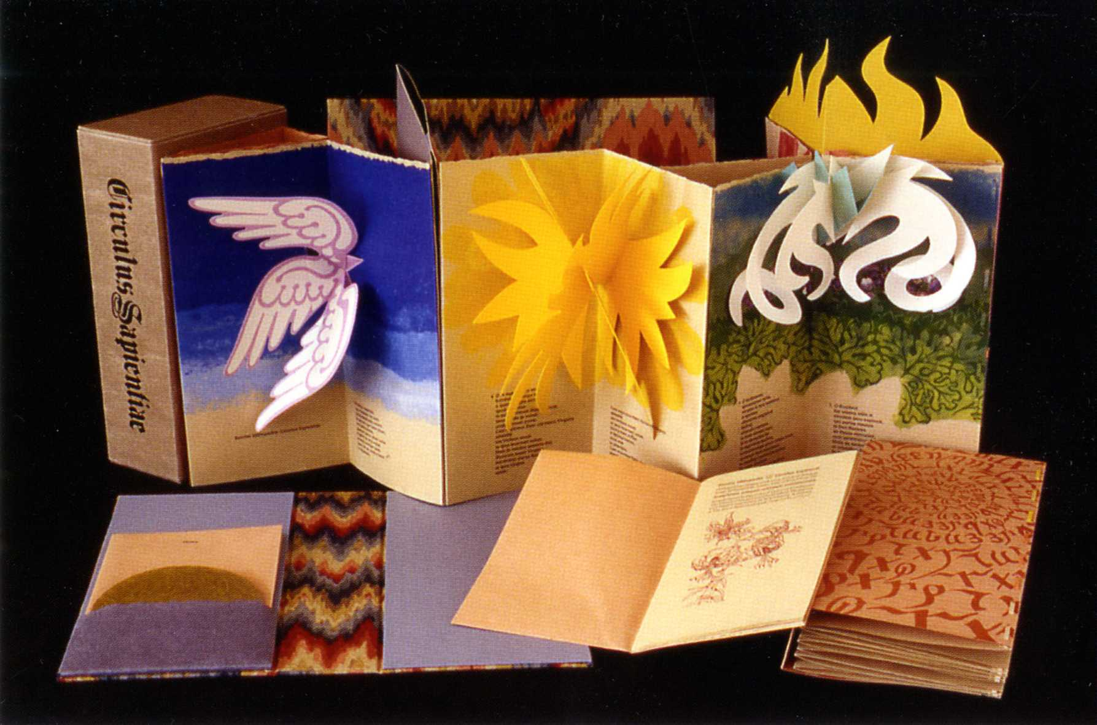
Over the past several decades, the UVM Library has quietly built one of the country’s best collections of artists’ books.
Vermont Quarterly, Spring 2006
Notes:
Definition

Slide 7
Collecting Artists’ Books at UVM: Selection criteria
Beautiful, well-made, will hold up in a library setting
Different, will add something to our collection, especially new subjects
Complements other works in the collection
Have a relationship with the artist
Supports UVM curriculum
Speaks to one or more of the librarians
Has a Vermont connection

