Slide 1
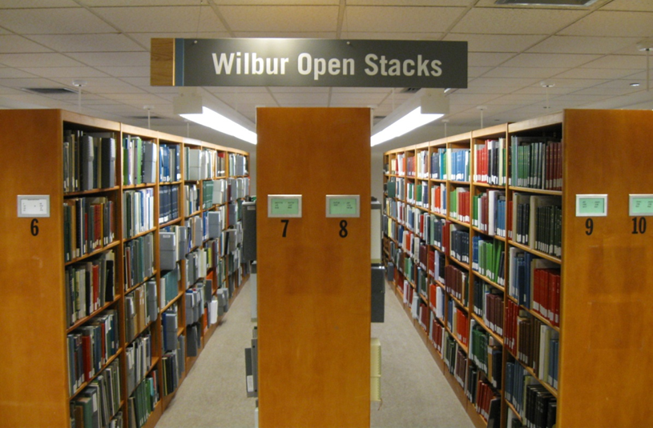
The Vermont Research Collection at Bailey/Howe Library
(also known as the Wilbur Collection of Vermontiana)
… Further the creation, application, and dissemination of knowledge by providing access to research materials relating to the study of Vermont…

Slide 2
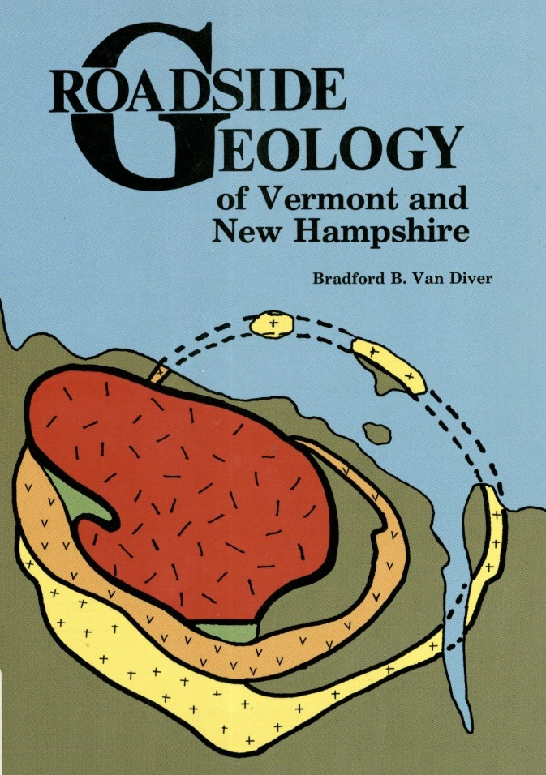
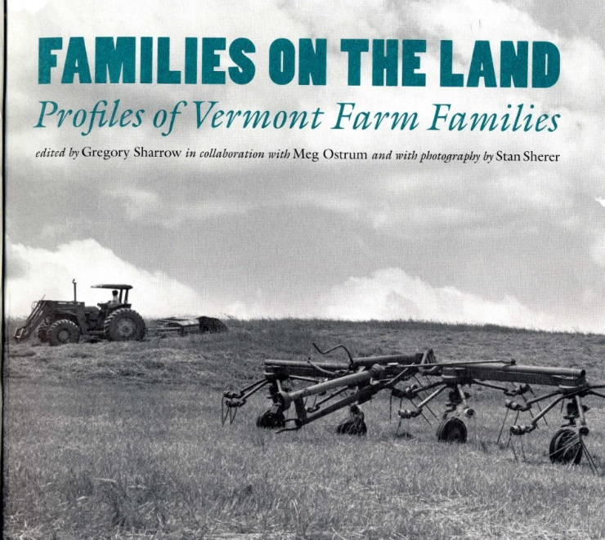
What does the Vermont Research Collection include?
All subjects, A-Z: Archaeology to zoology
All time periods: Prehistory to present
All formats: books, periodicals, newspapers, pamphlets, maps, photographs, manuscripts, film, audio
Scholarly and popular works
Primary, secondary, and tertiary sources

Slide 3
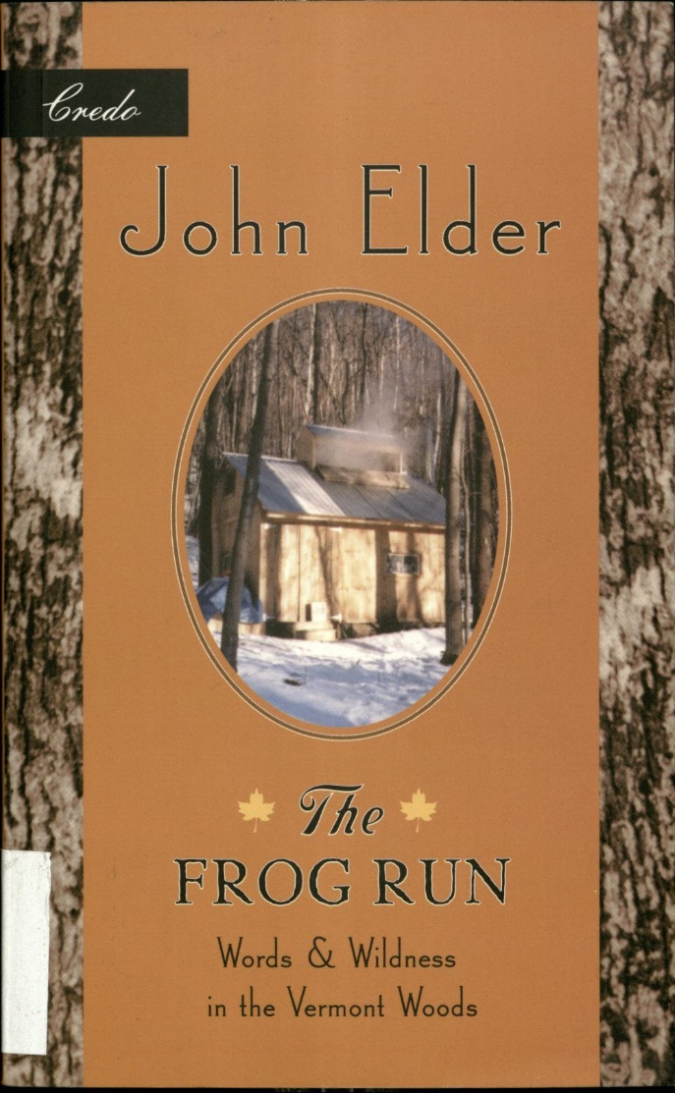
Where is the Vermont Research Collection located?
In Special Collections on the lower level of Bailey/Howe Library.
Some materials can be found online through the Center for Digital Initiatives, ScholarWorks@UVM, and the Vermont Landscape Change Program.
What are the hours?
Monday-Thursday 10-5, Friday 10-4:30
Note: All Vermont Research Collection materials must be
used in Special Collections.

Slide 4
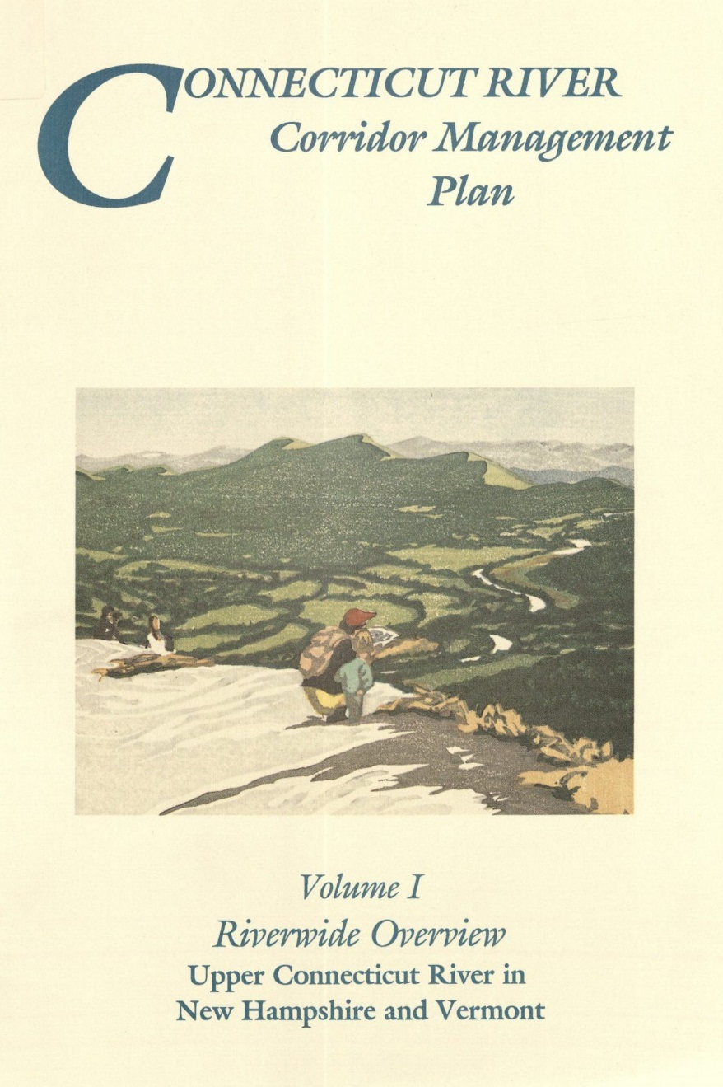
How do I locate material in the Vermont Research Collection?
Start with the library catalog.
Talk with Special Collections librarians, who know the collection and can connect you with resources that can be hard to discover.
Email: uvmsc@uvm.edu

