Slide 1
Back to Billings: Relocating UVM Special Collections
Jeffrey Marshall
Chris Burns
Prudence Doherty
Vermont Library Conference
May 22, 2019

Slide 2
Part 1: Planning

Slide 4
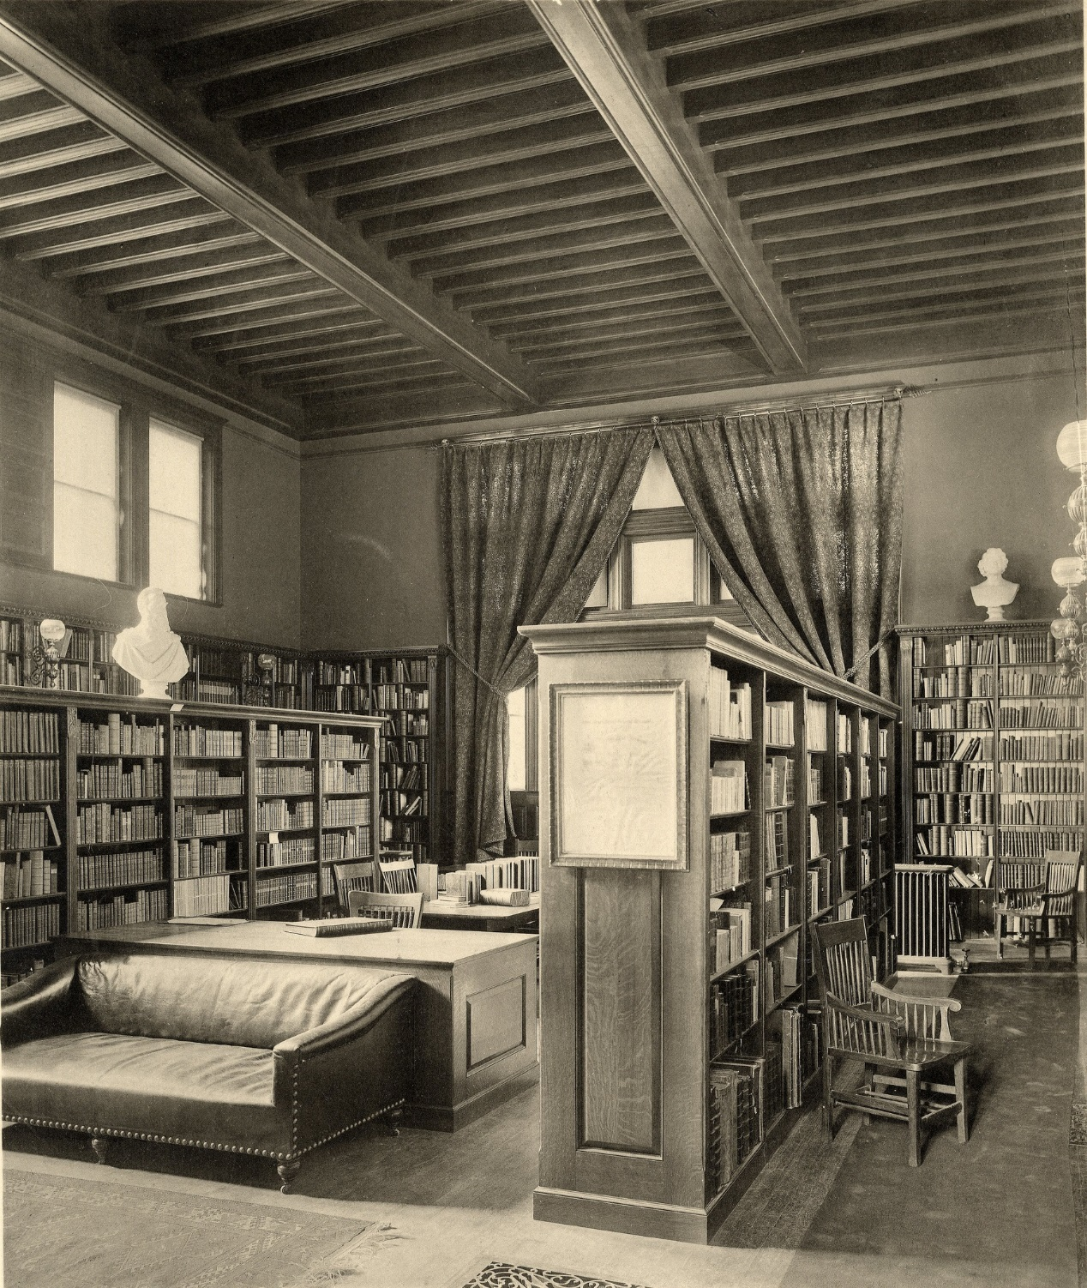

Slide 5
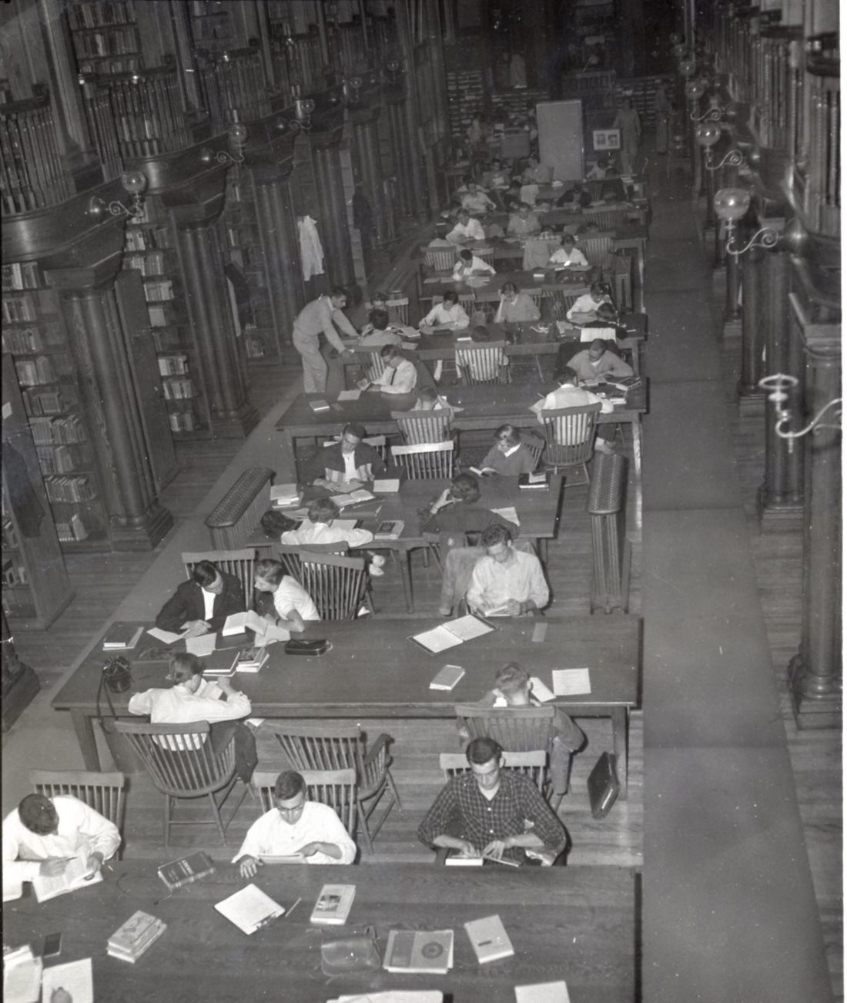

Slide 6
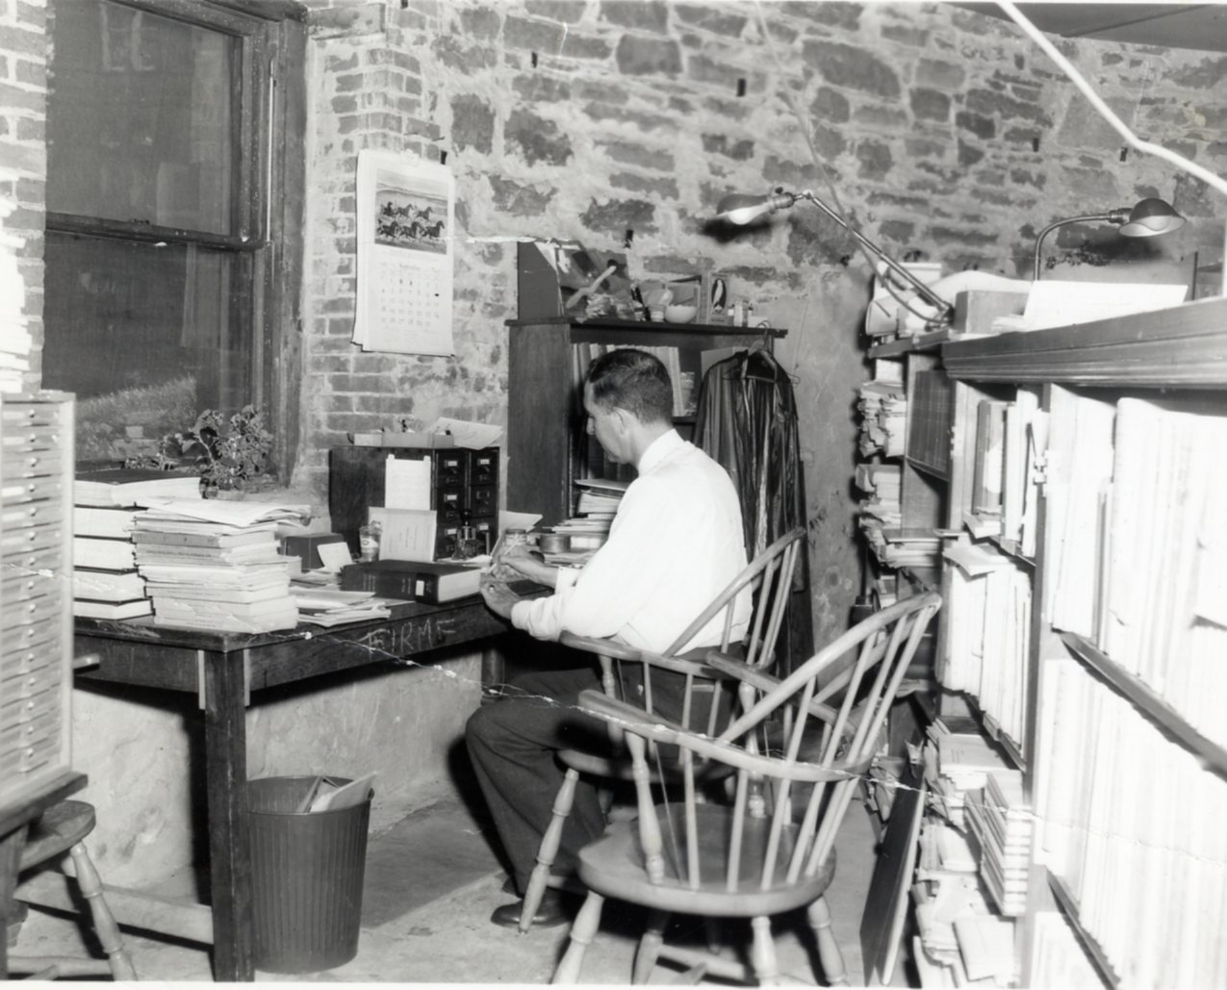
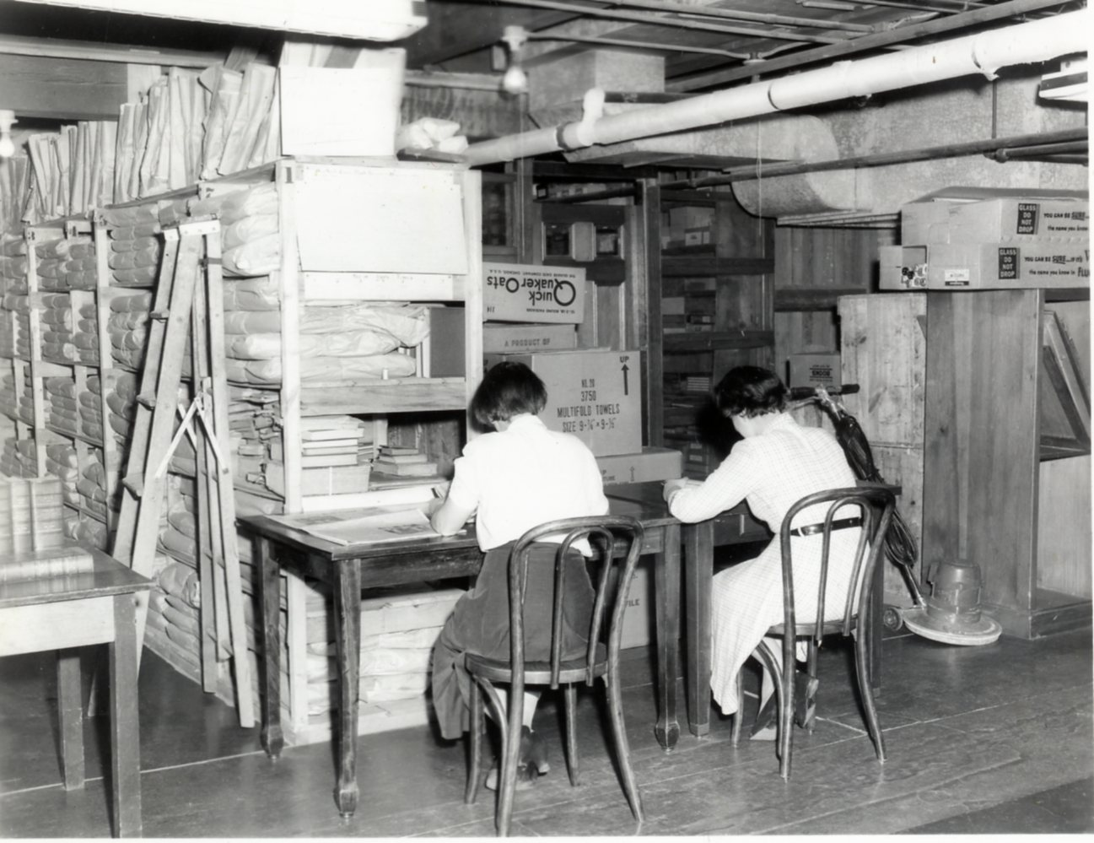

Slide 7
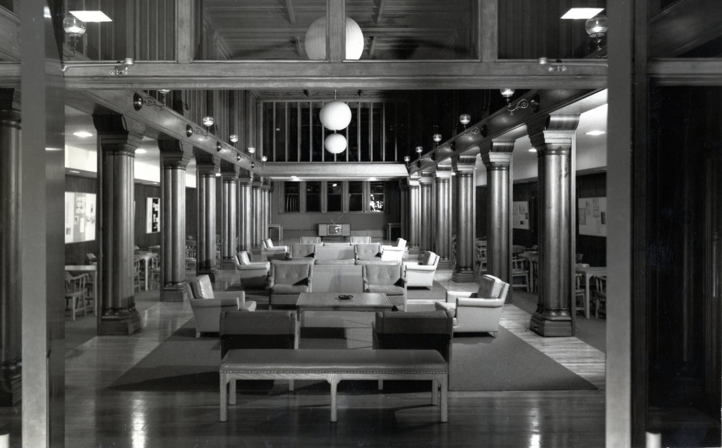

Slide 8
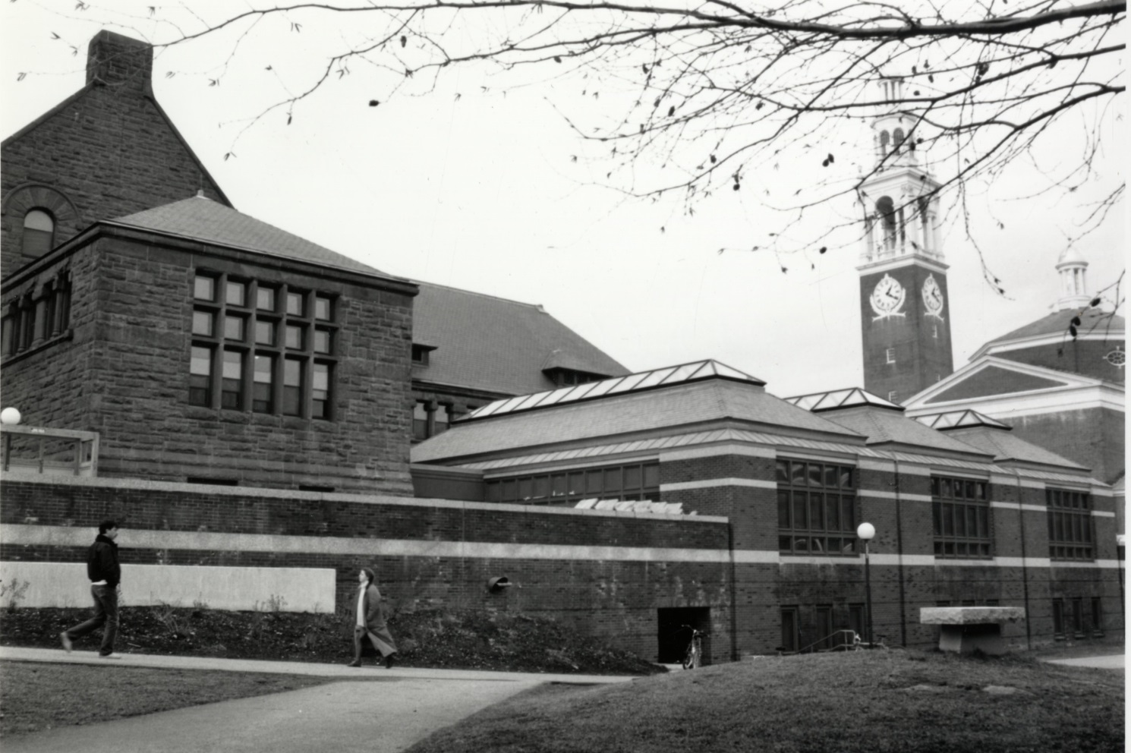

Slide 9
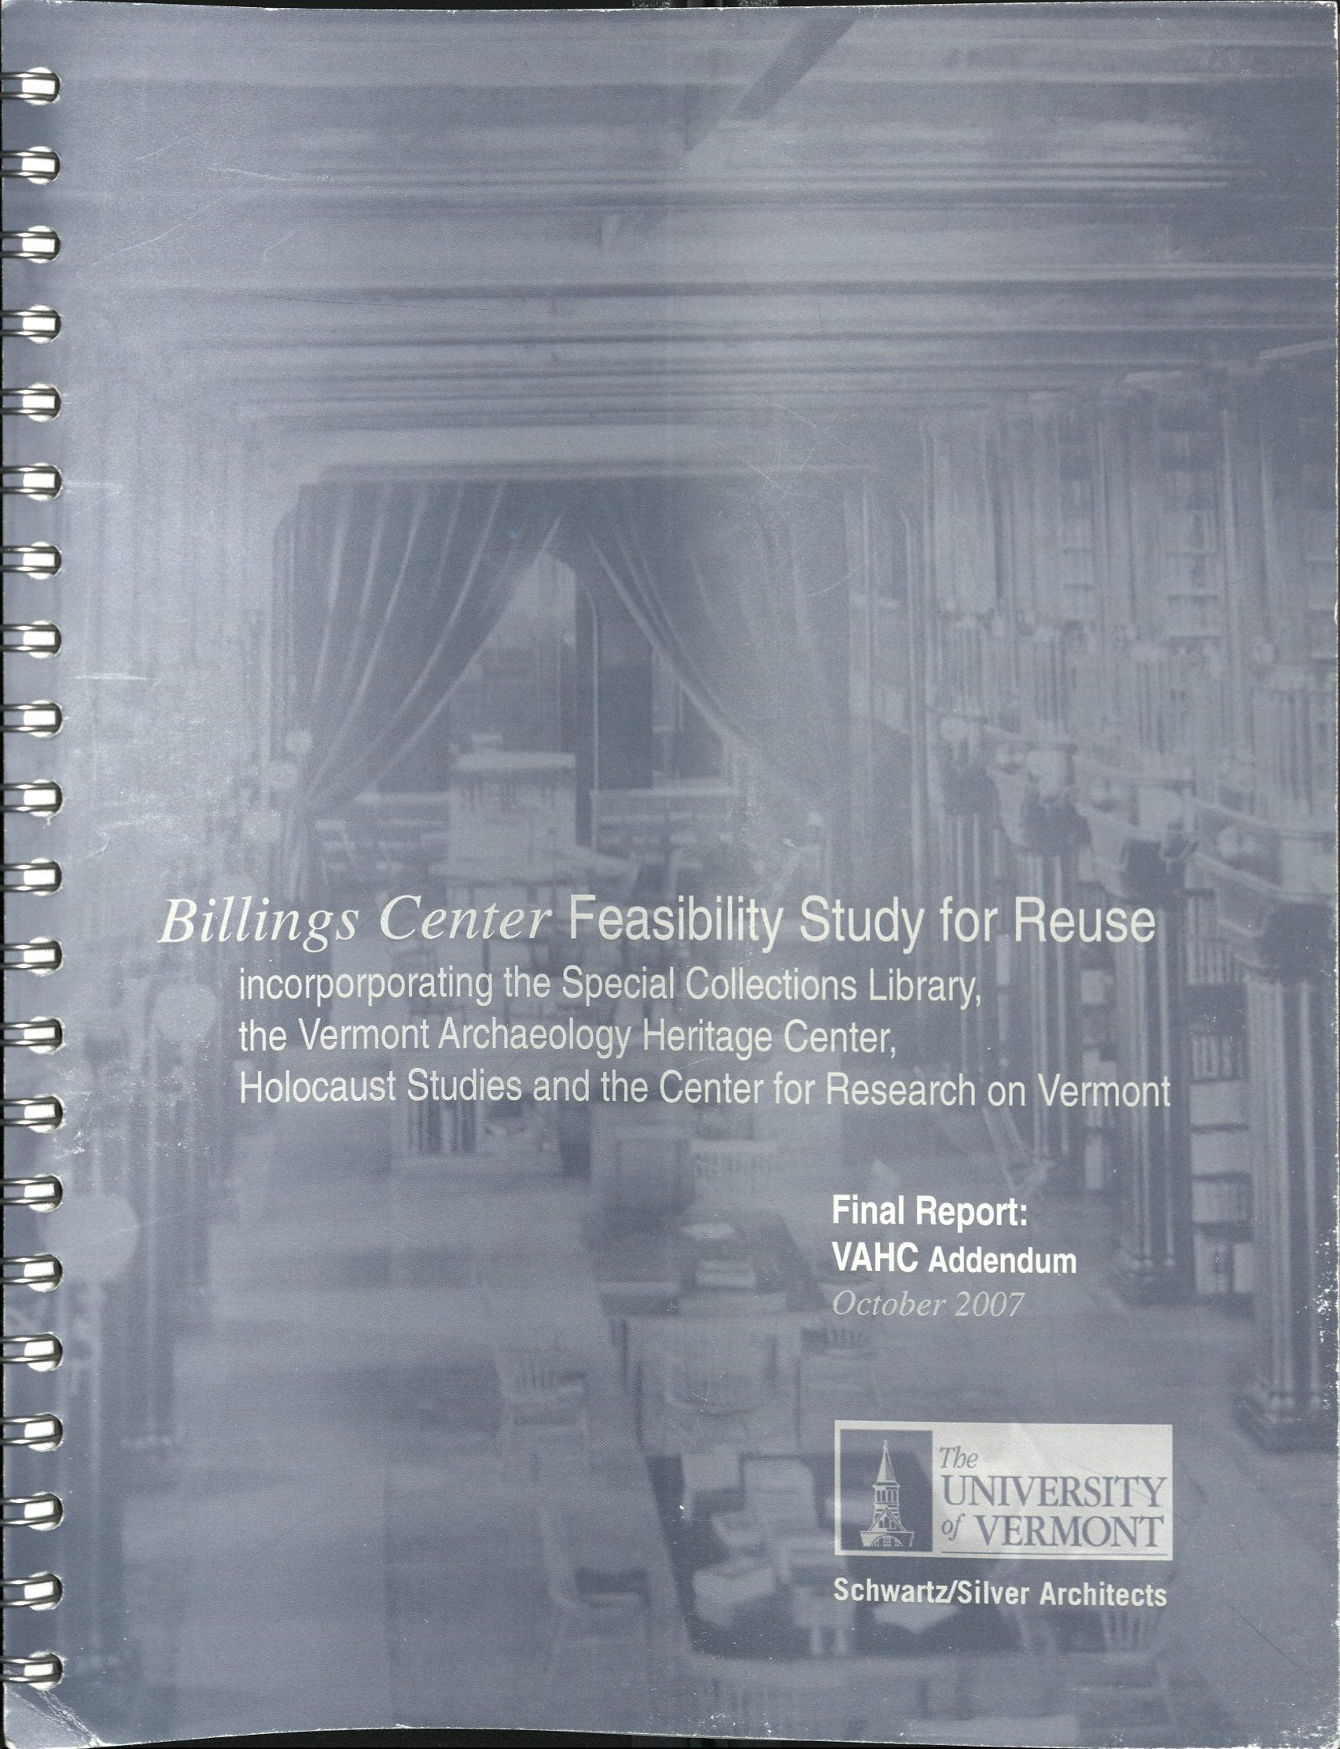

Slide 10
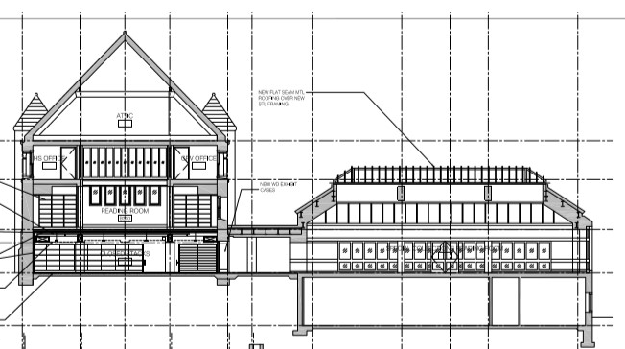

Slide 11
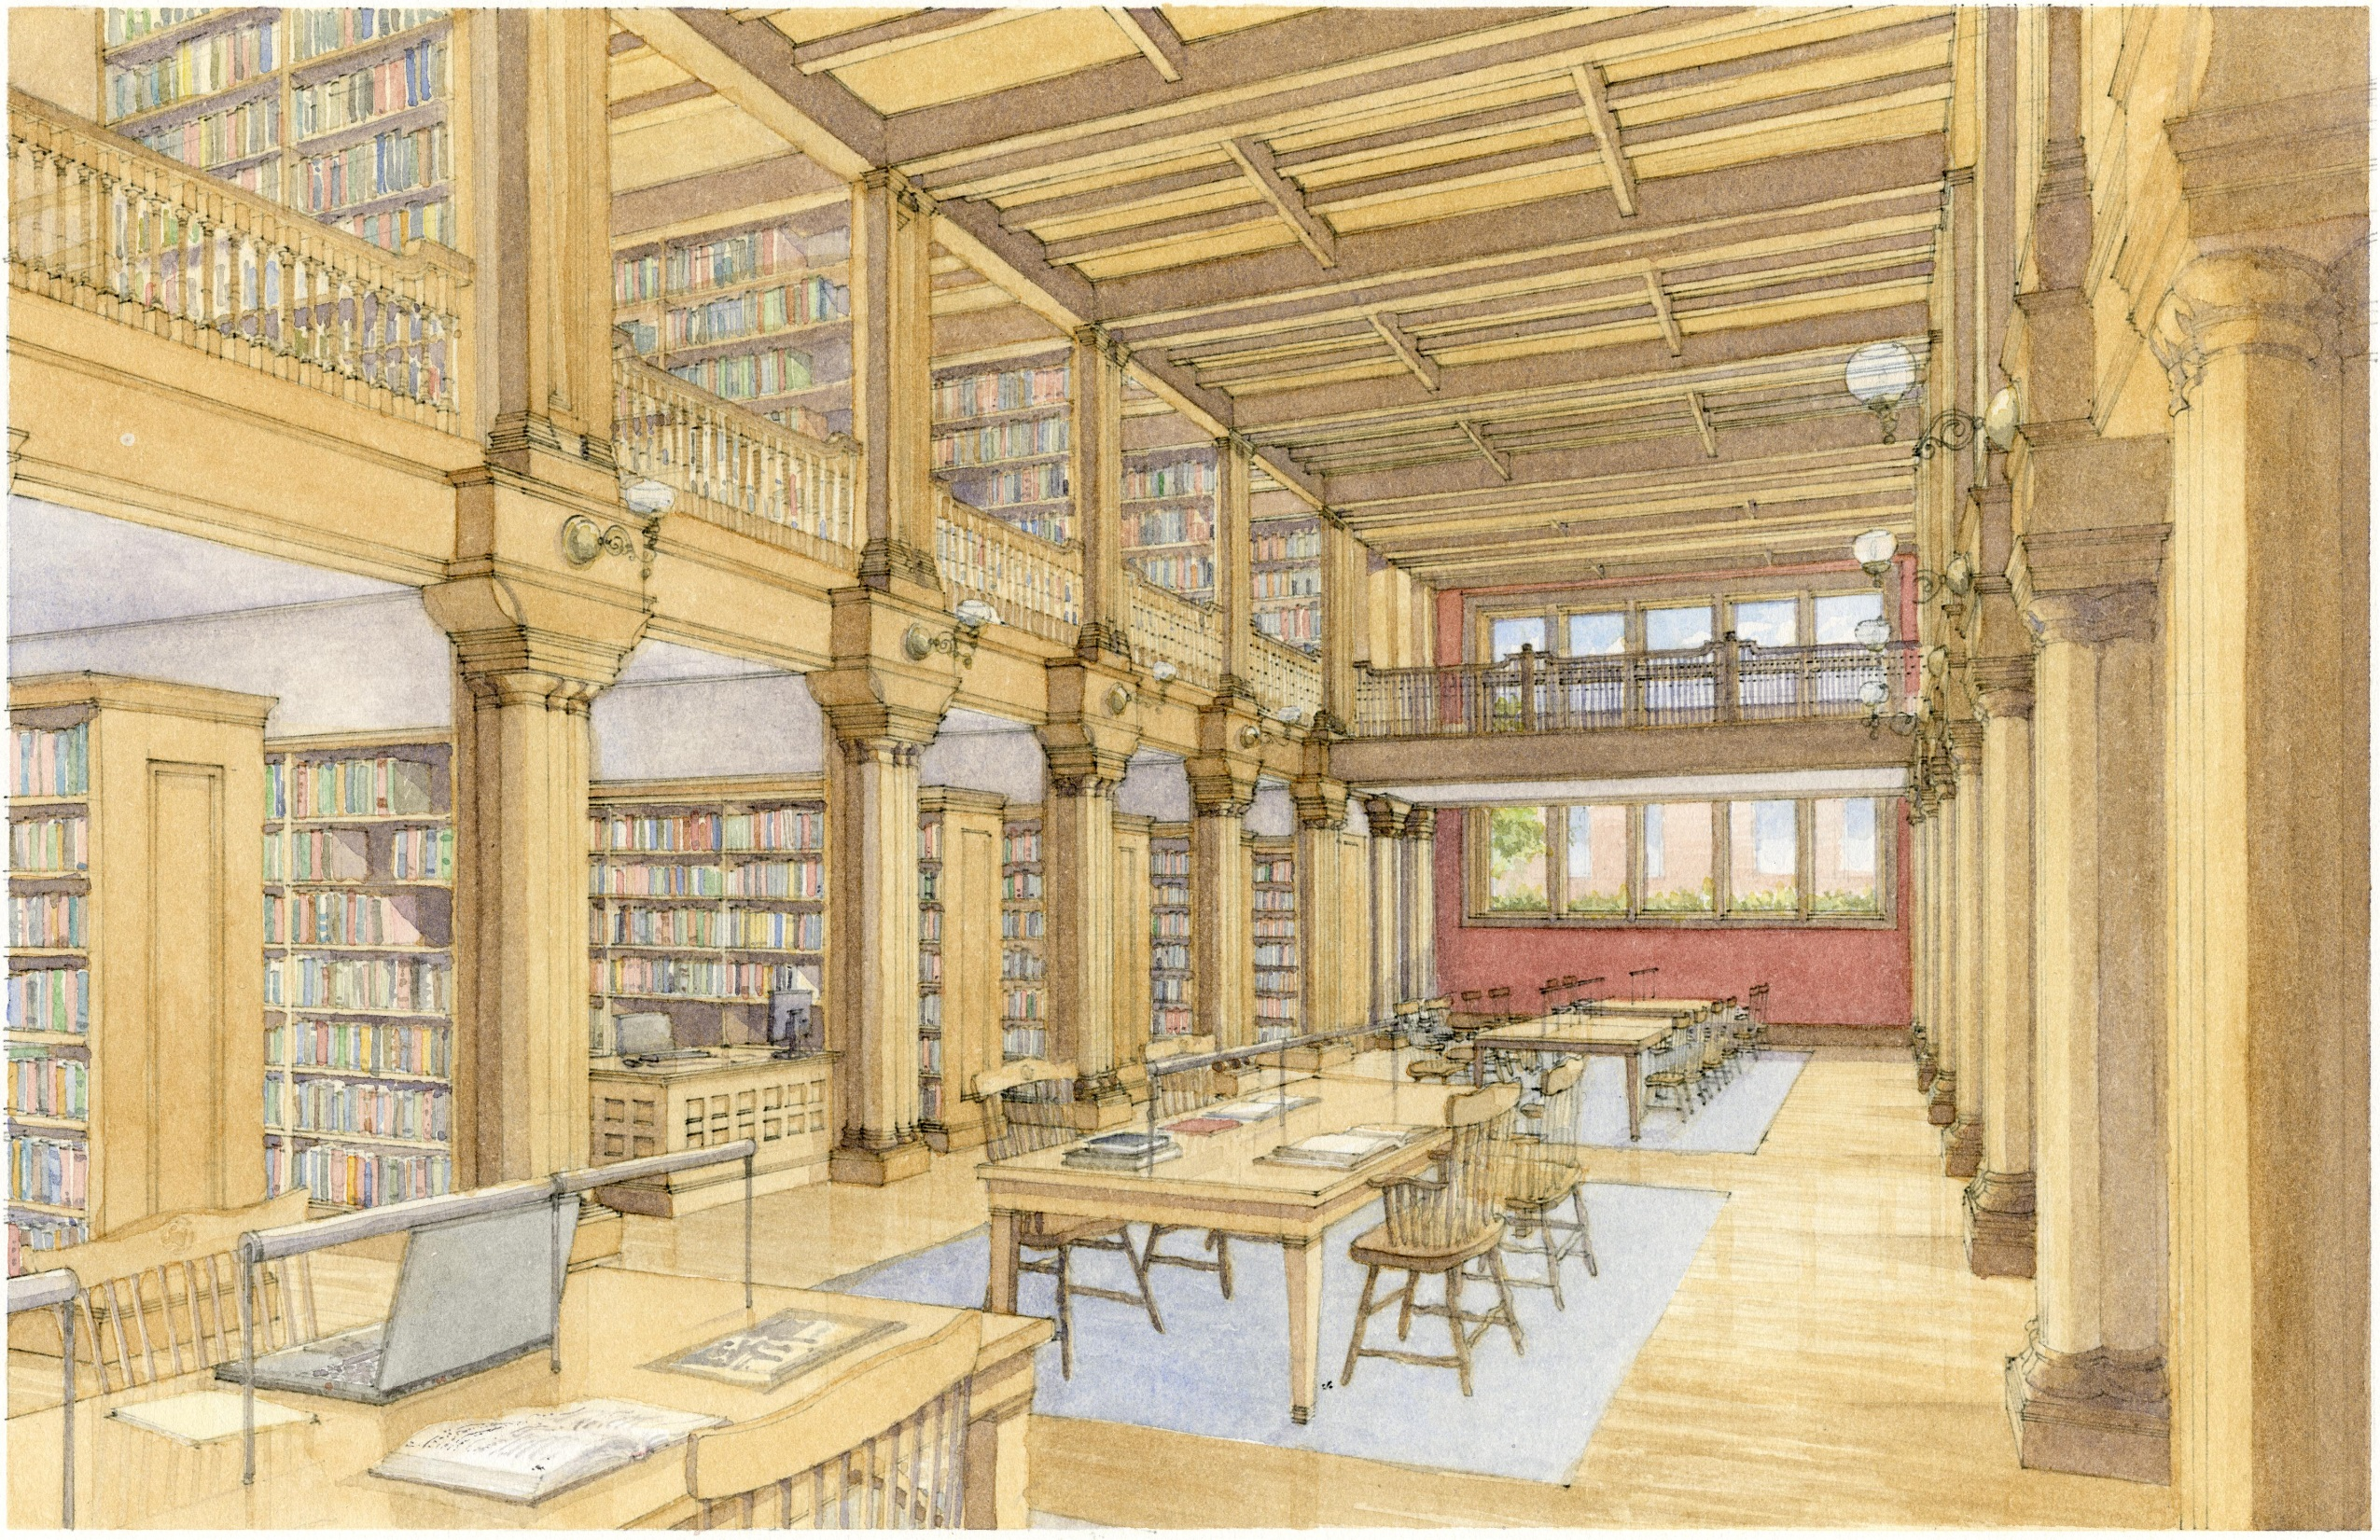

Slide 12
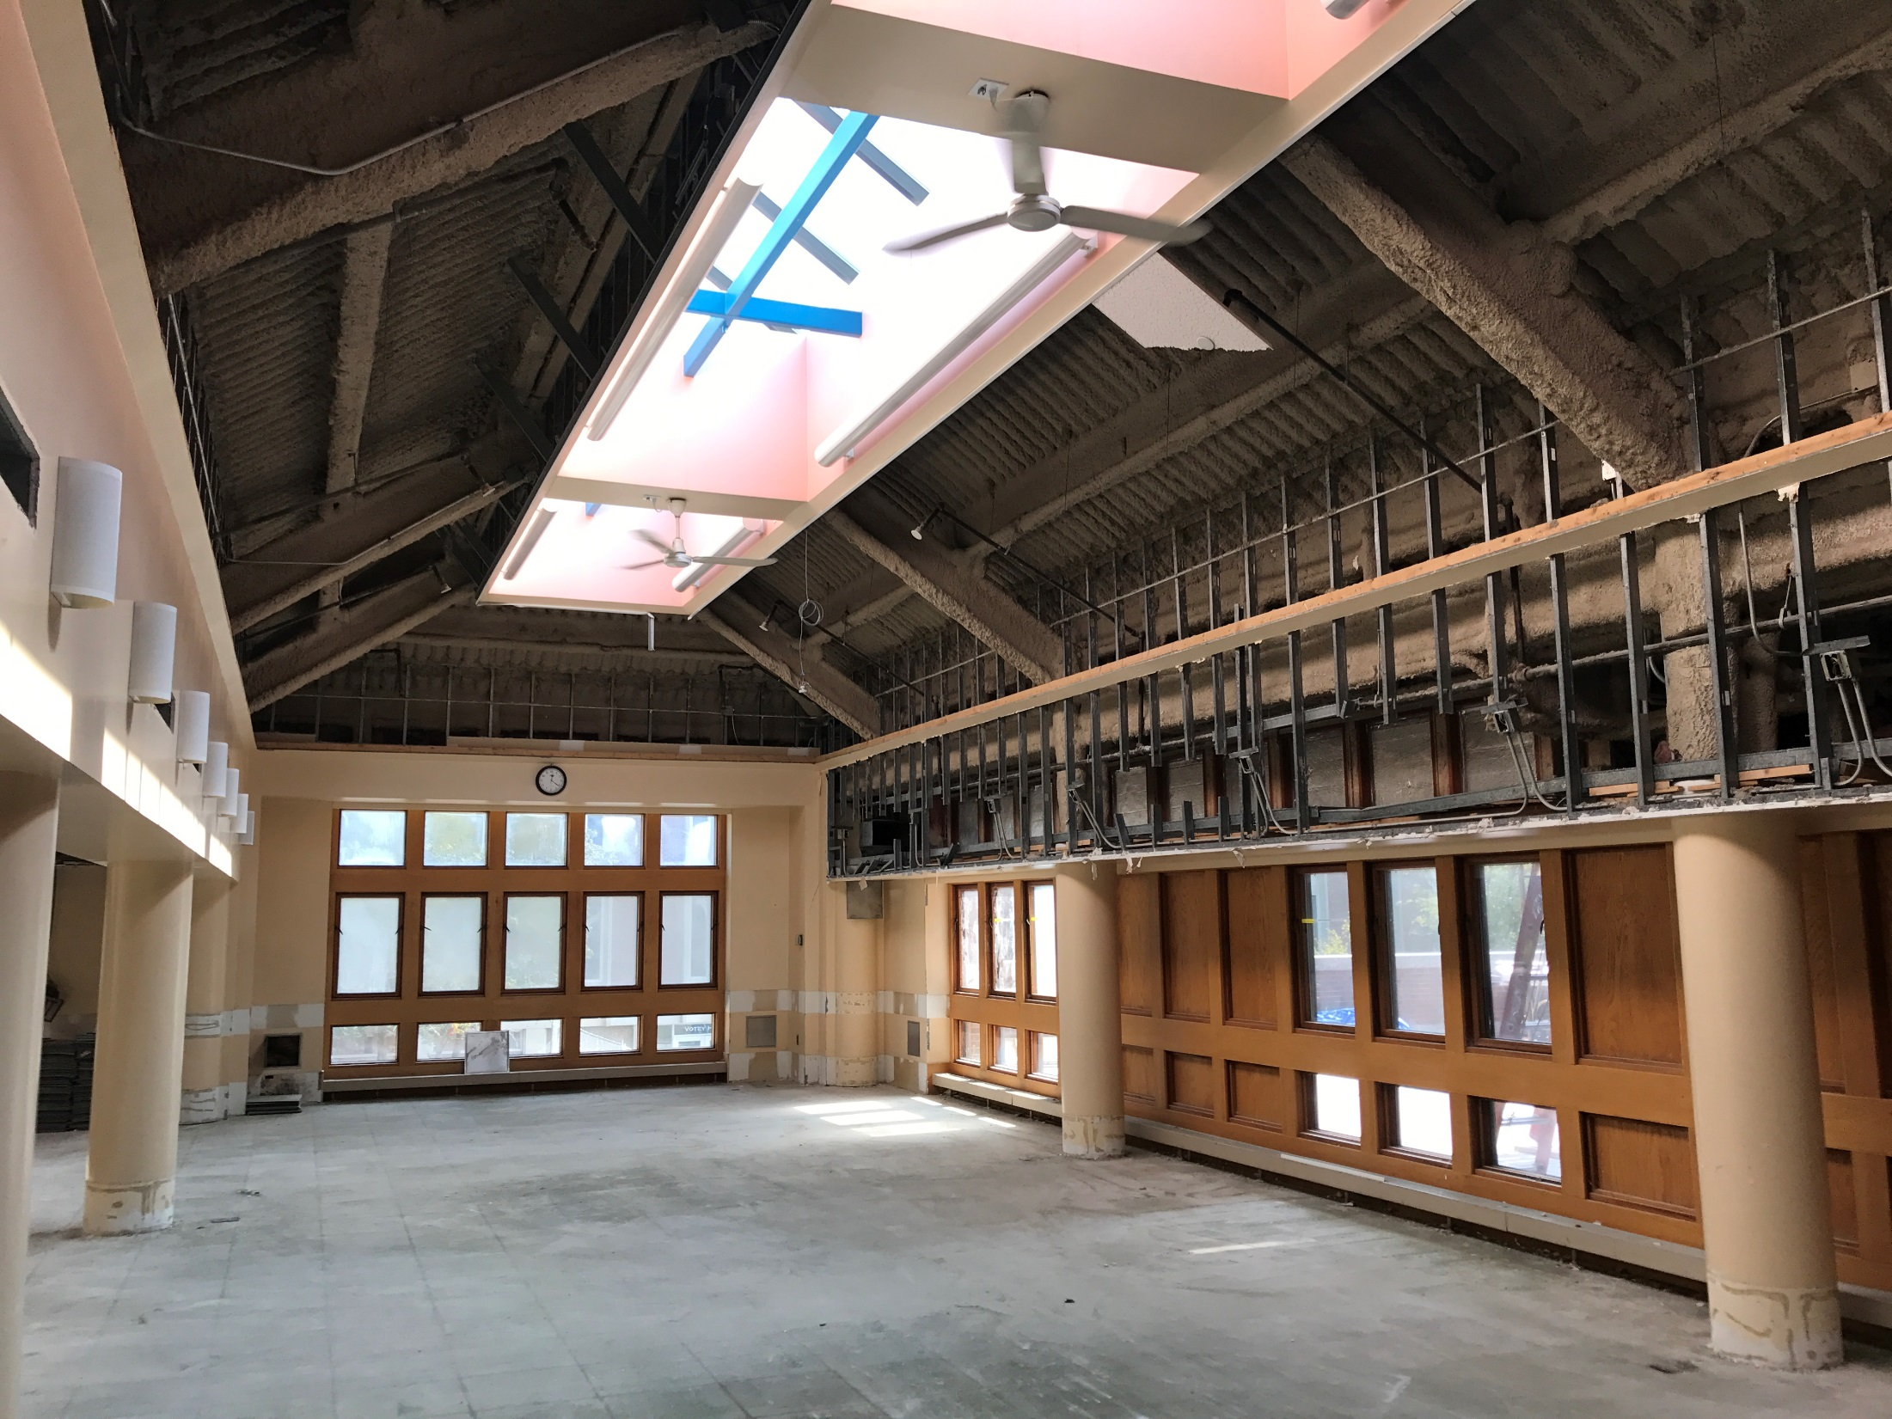

Slide 13
Part 2: Moving

Slide 14
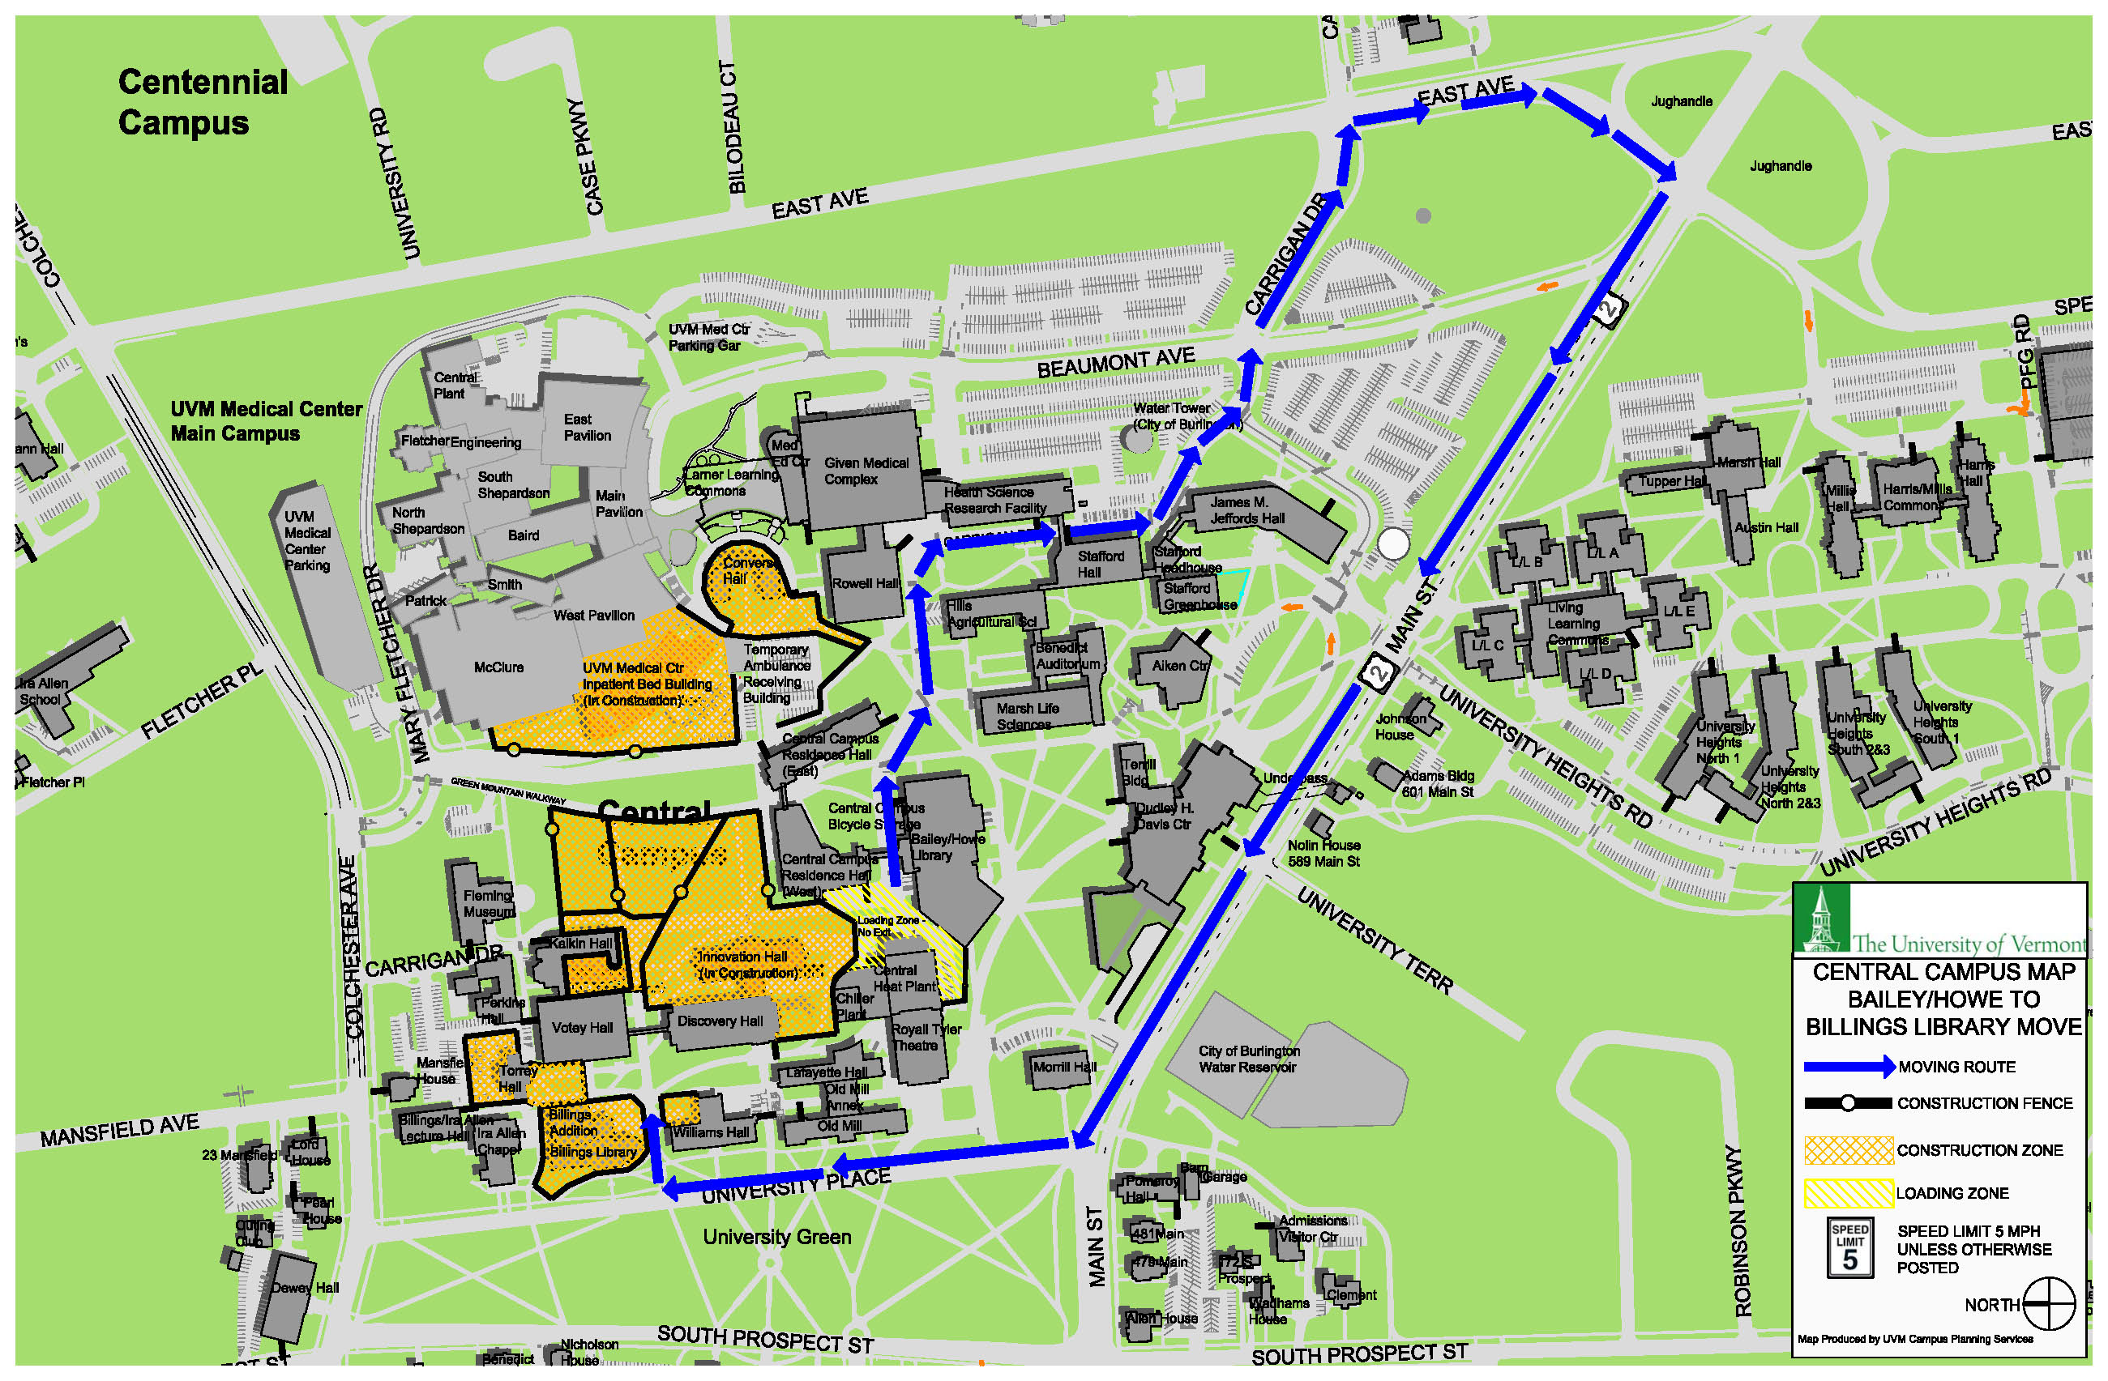

Slide 15
RFP
3.02 Scope of Work
The Wilbur open stacks are stored in the Bailey Howe Special Collections reading room and have reasonable access with 36” aisles. This portion of the collection can be loaded on carts and shrink wrapped for transit.
The Wilbur closed stack collection is stored with the rare collection and the aisles are approximately 30” wide.
The Rare Octavo, Quarto and Mini collection are stored in the closed stack area next to the reading room. These collections are in order but they are in a few different areas of the closed stacks. A large portion of the rare items will need to be packed for transit. The collection will travel through campus and Burlington streets. The distance is approximately 2 miles.
We have a small bound manuscript collection to be moved and it should be treated like the rare collection and packed accordingly.
There are seven maps cases with three sections each. Five drawers per sections. Drawers will need to be removed for transport. Contents will need to be protected in the drawers. Twenty-two filing cabinets that measure 28”x18”x60” are included and the contents will need to be protected during transit.
Please provide a detailed description of how you’ll pack the rare and fragile items for transit.

Slide 16
Estimated collection linear foot totals
Wilbur Octavo in open stacks, 2,572 linear feet.
Wilbur Quarto in open stacks, 351 linear feet.
Wilbur Octavo in closed stacks, 296 linear feet.
Wilbur Quarto in closed stacks, 65 linear feet.
Rare Octavo in closed stacks, 1,947 linear feet.
Rare Quarto in closed stacks, 533 linear feet.
Rare mini with micro film 91 linear feet.
Bound Manuscripts, 160 linear feet.
Manuscripts file boxes, 100 linear feet.

Slide 18
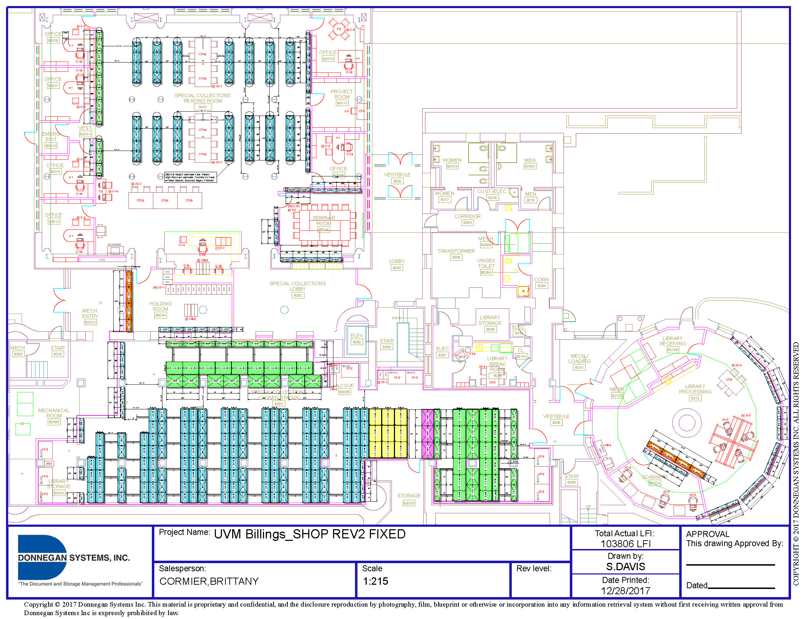

Slide 19
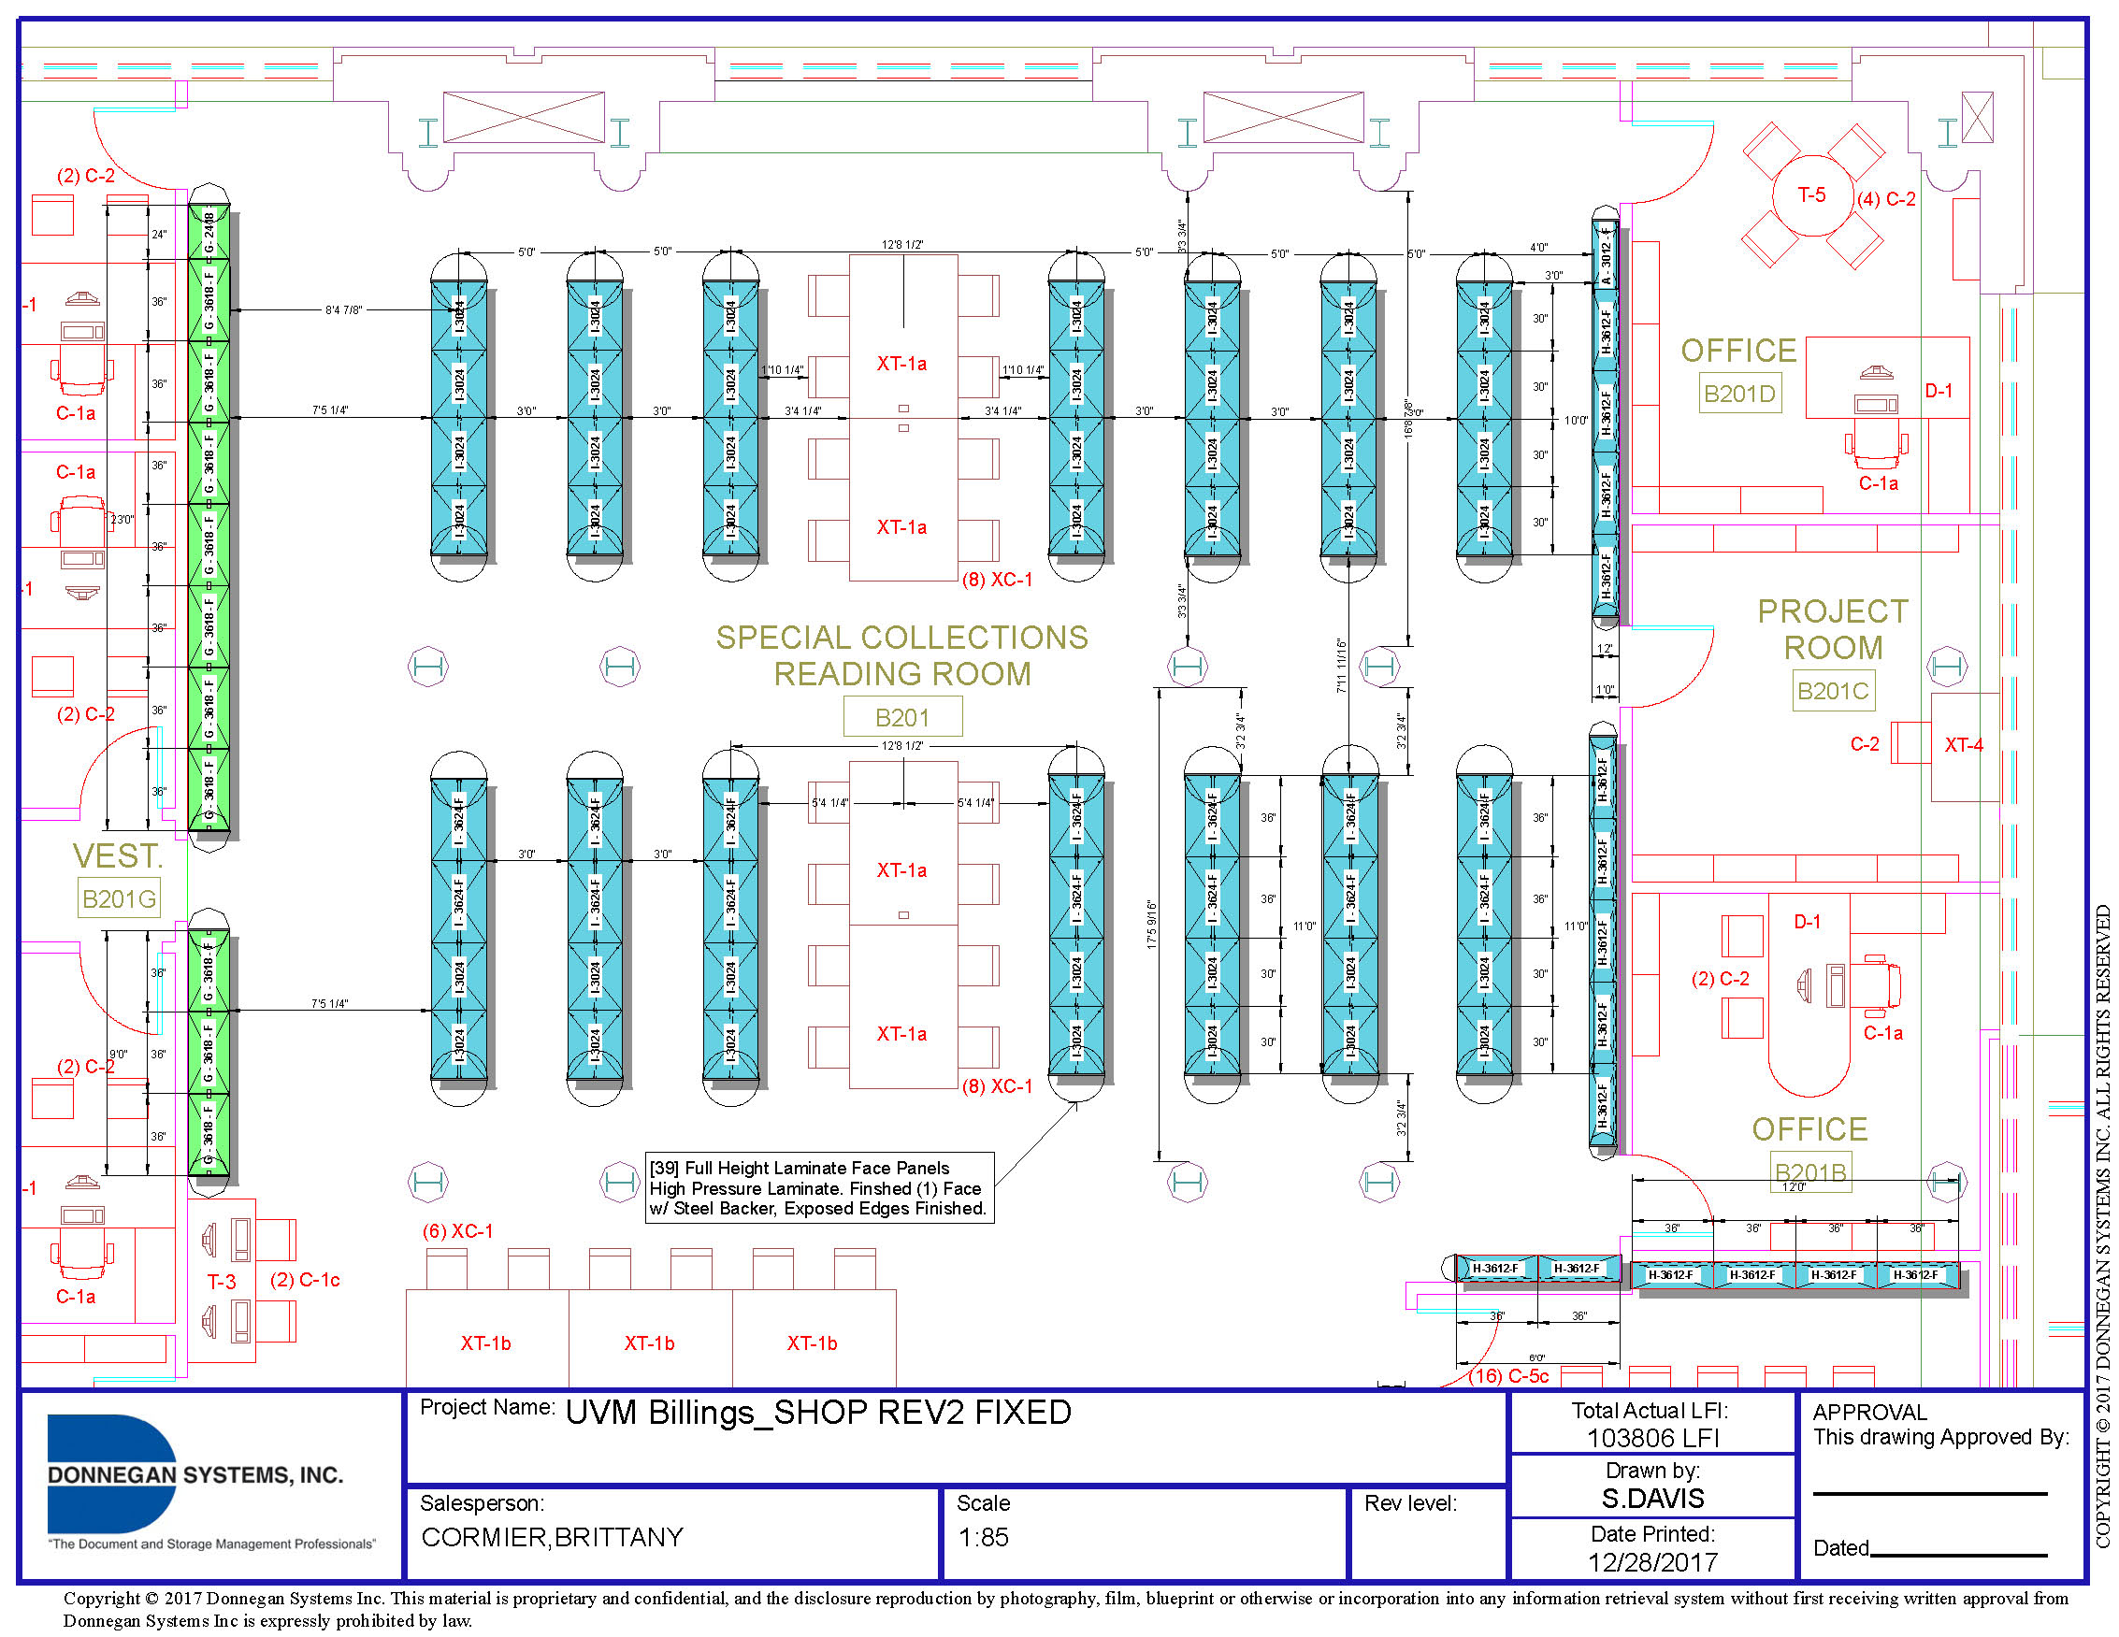

Slide 20
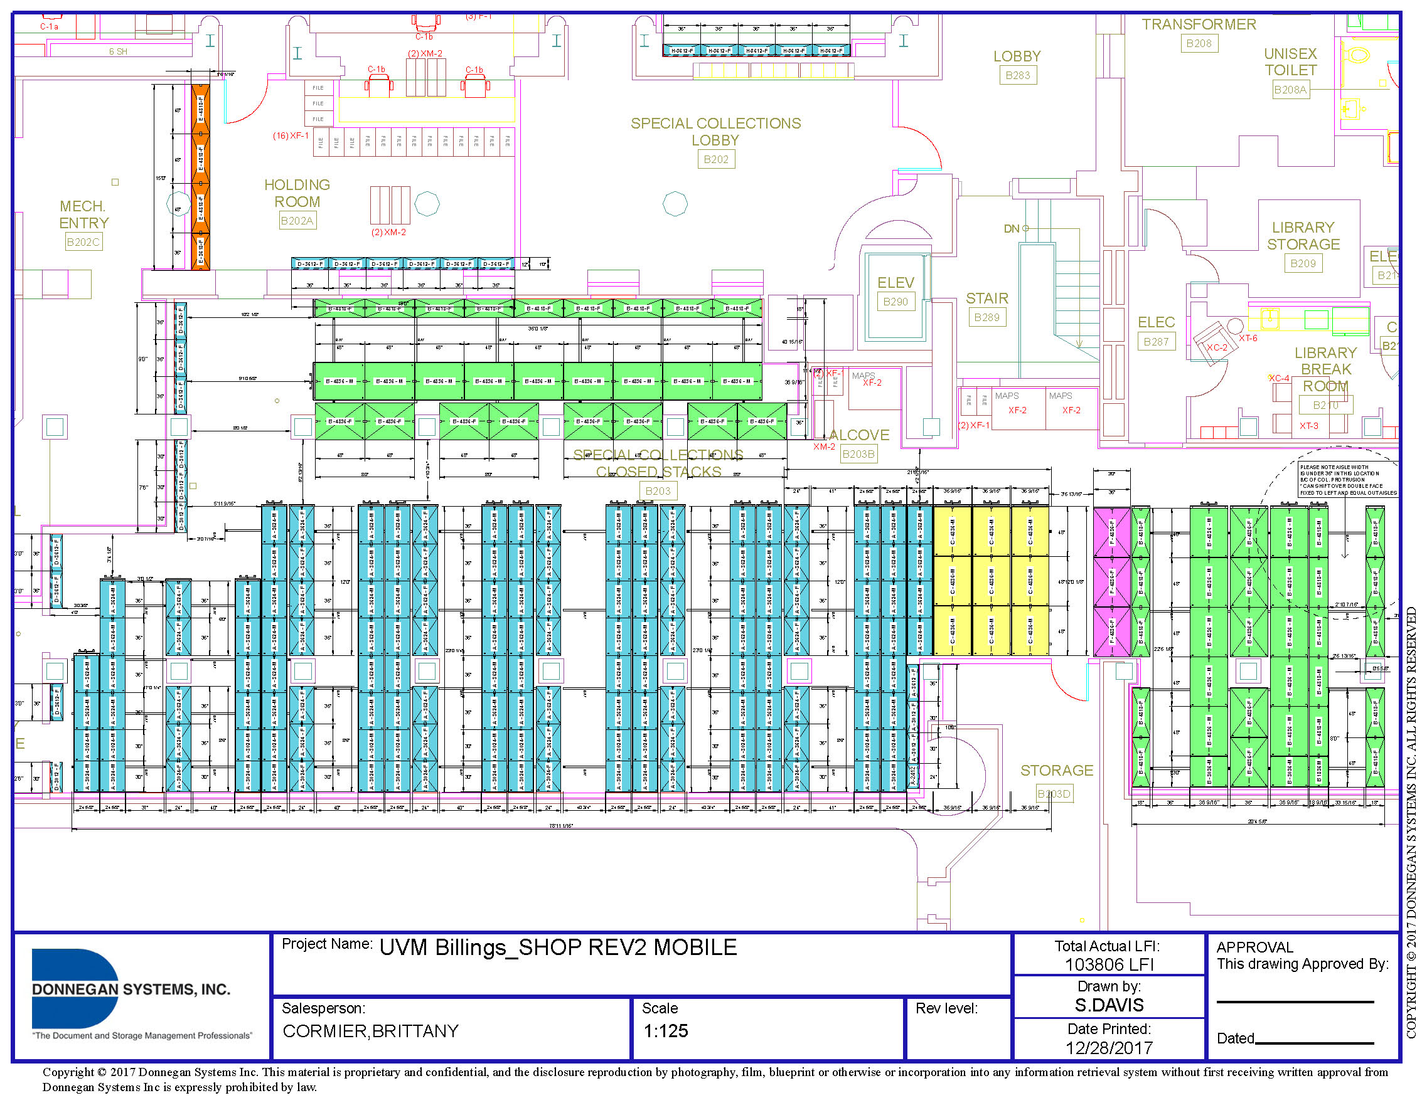

Slide 21
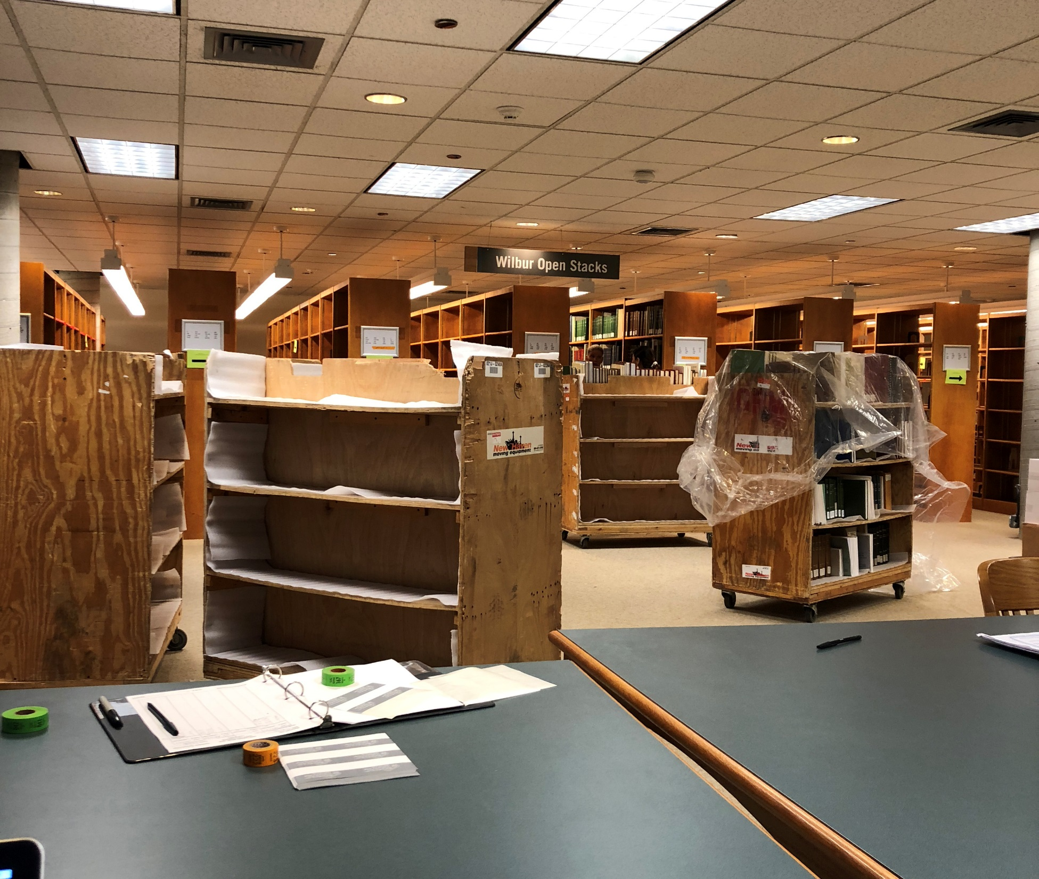

Slide 22
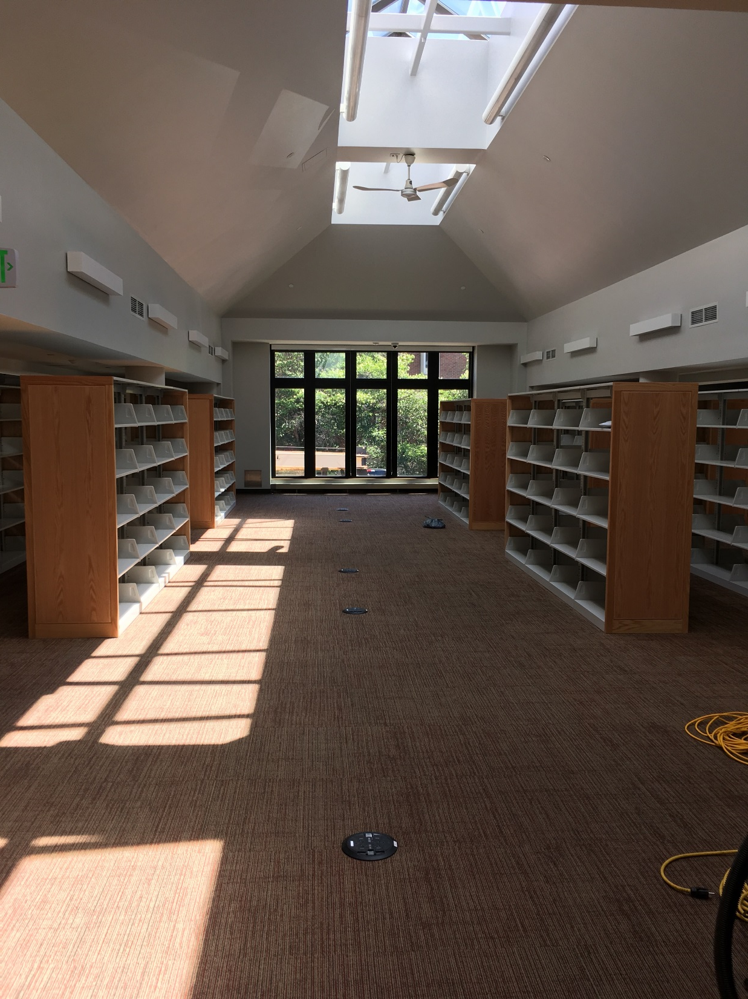

Slide 23
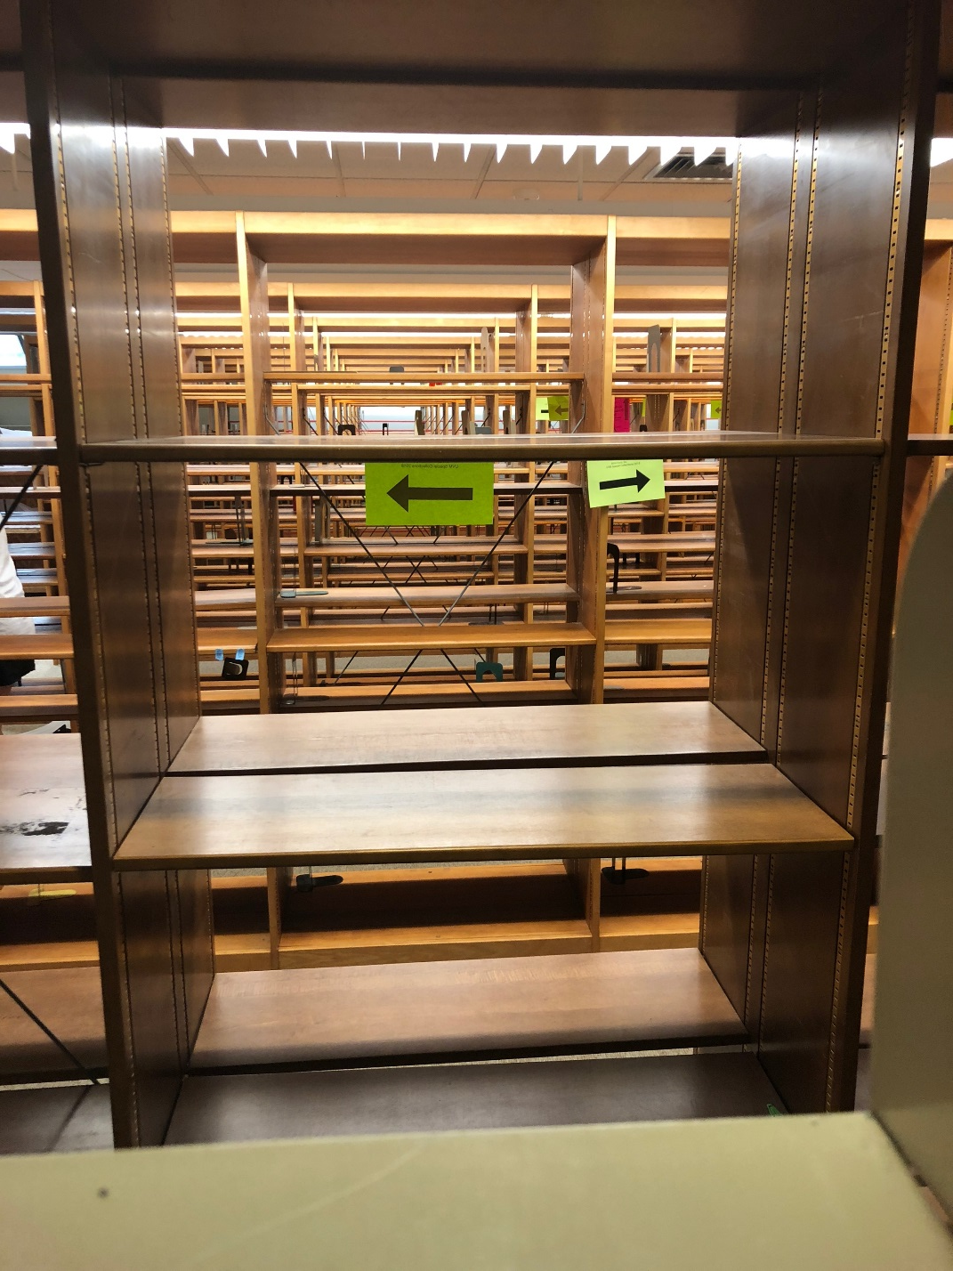
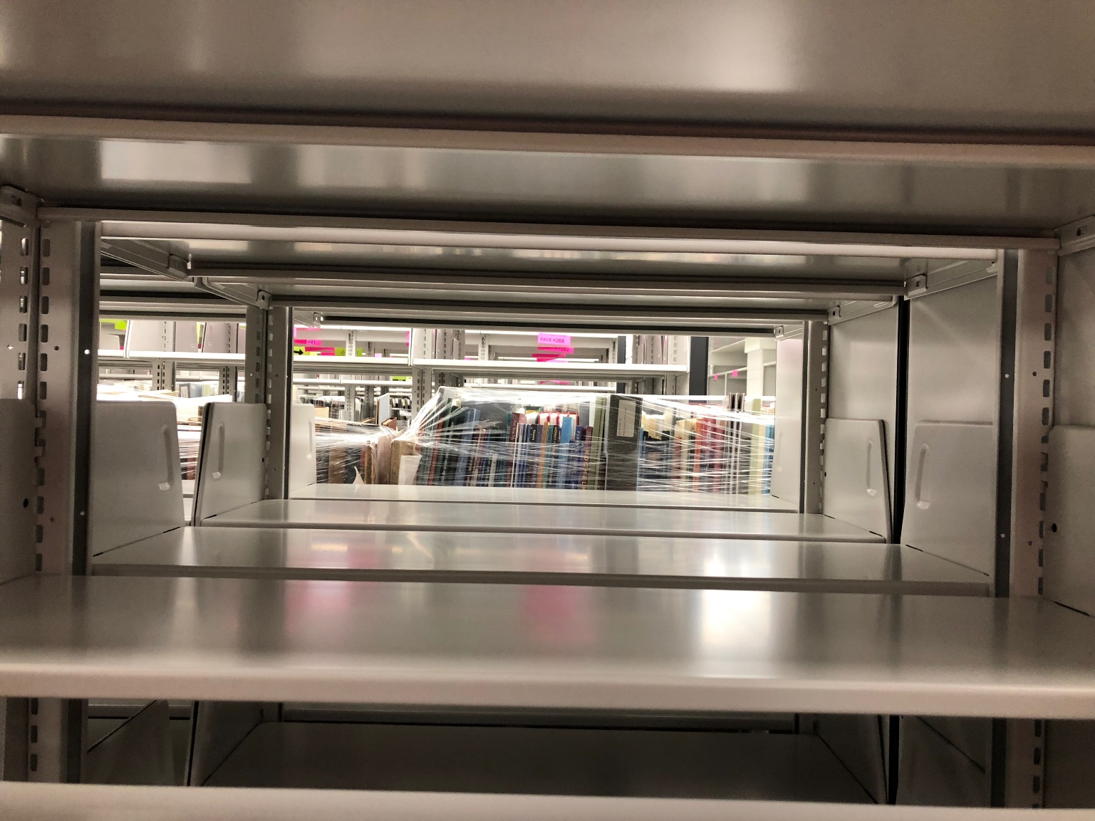

Slide 24
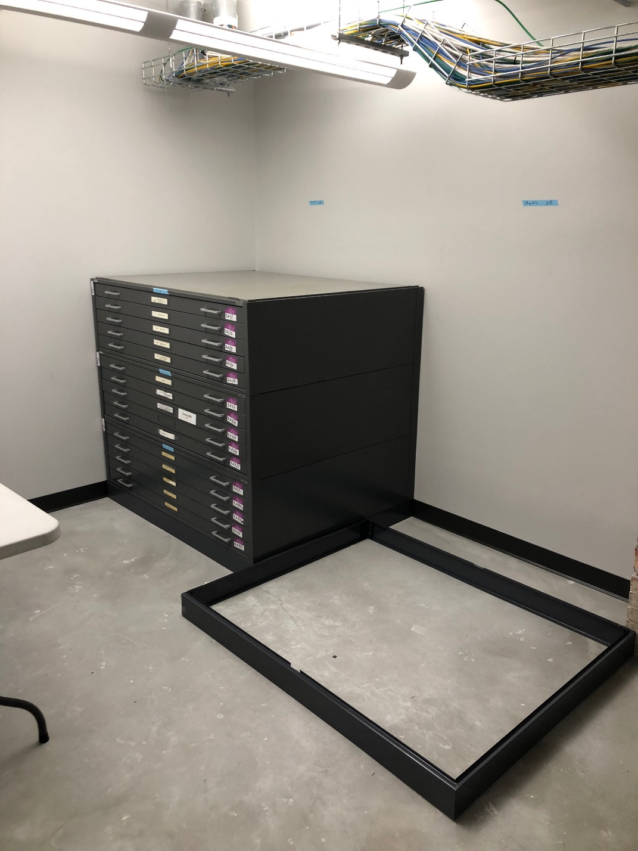
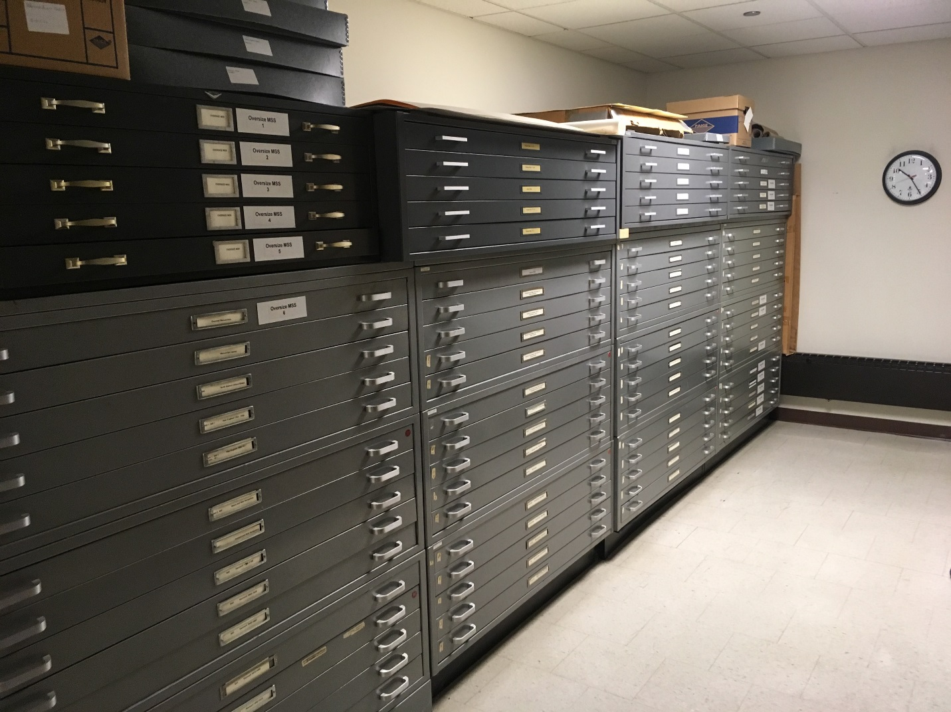

Slide 25
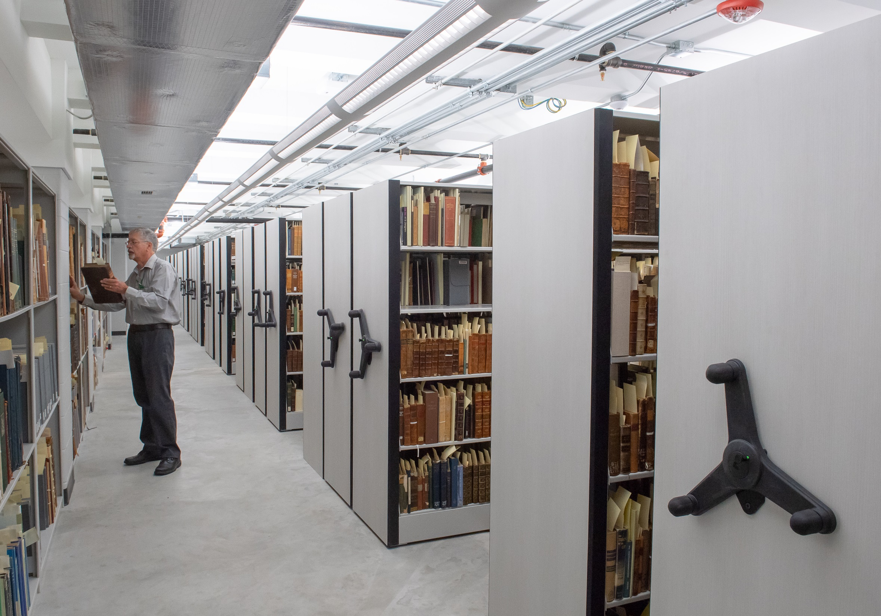

Slide 26
Part 3: Settling In

Slide 27
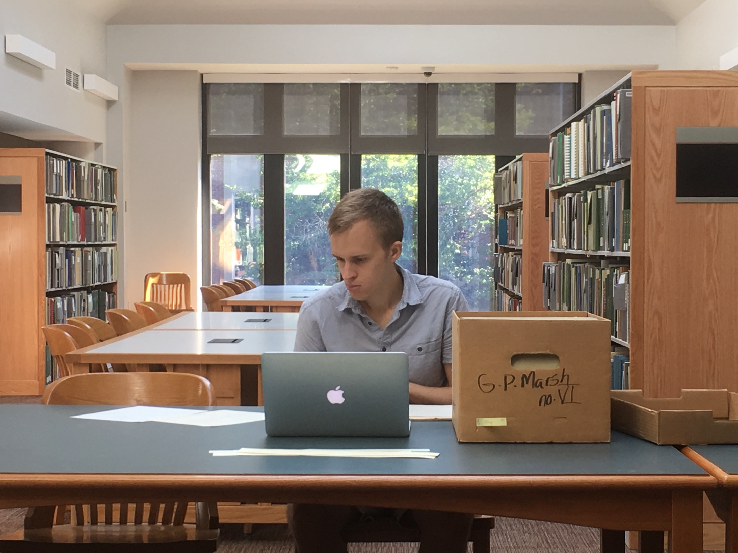

Slide 28
FALL
Why Studying the Middle Ages Matters in the Age of Global Warming (Sylvain Piron)
A Book, a Building, and the Future of Our World (David Lustgarten)
The Stewardship of History: Reconfiguring the Markings of Time (Michelle Burgess)
Folktales, Fairy Tales, Monsters, Myths & Legends: A Comics Workshop (Marek Bennett)
Preacher, Reformer, Witch-Hunter: Johannes Nider & the Religious World of the Late Middle Ages (Michael Bailey)
Do Unto Others as You Would Have Them Do Unto You: The Value of Proverbs in American Sociopolitical Discourse (Wolfgang Mieder)
Artists' Books Showcase (Vamp and Tramp)
SPRING
Memento mori: Sir Thomas Wyatt and the Problem of Periodization (Carl Martin)
Brown: Adventures in Being (Kevin Young)
Drawn from the Headlines...of the 1890s: Adventures in Comics and Digital Newspaper Archives (Luis Vivanco)
Mapping Lake Champlain: From the Dutch to the Digital (Staff)
Shakespeare's Birthday Celebration (Staff and Liz Fenton)
Afternoon Tea (Staff)

Slide 29
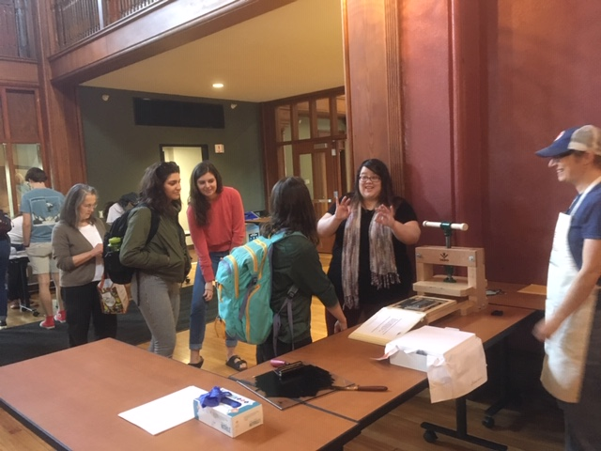
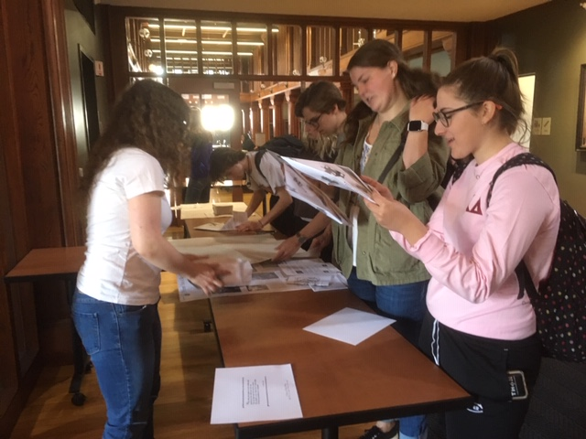

Slide 30
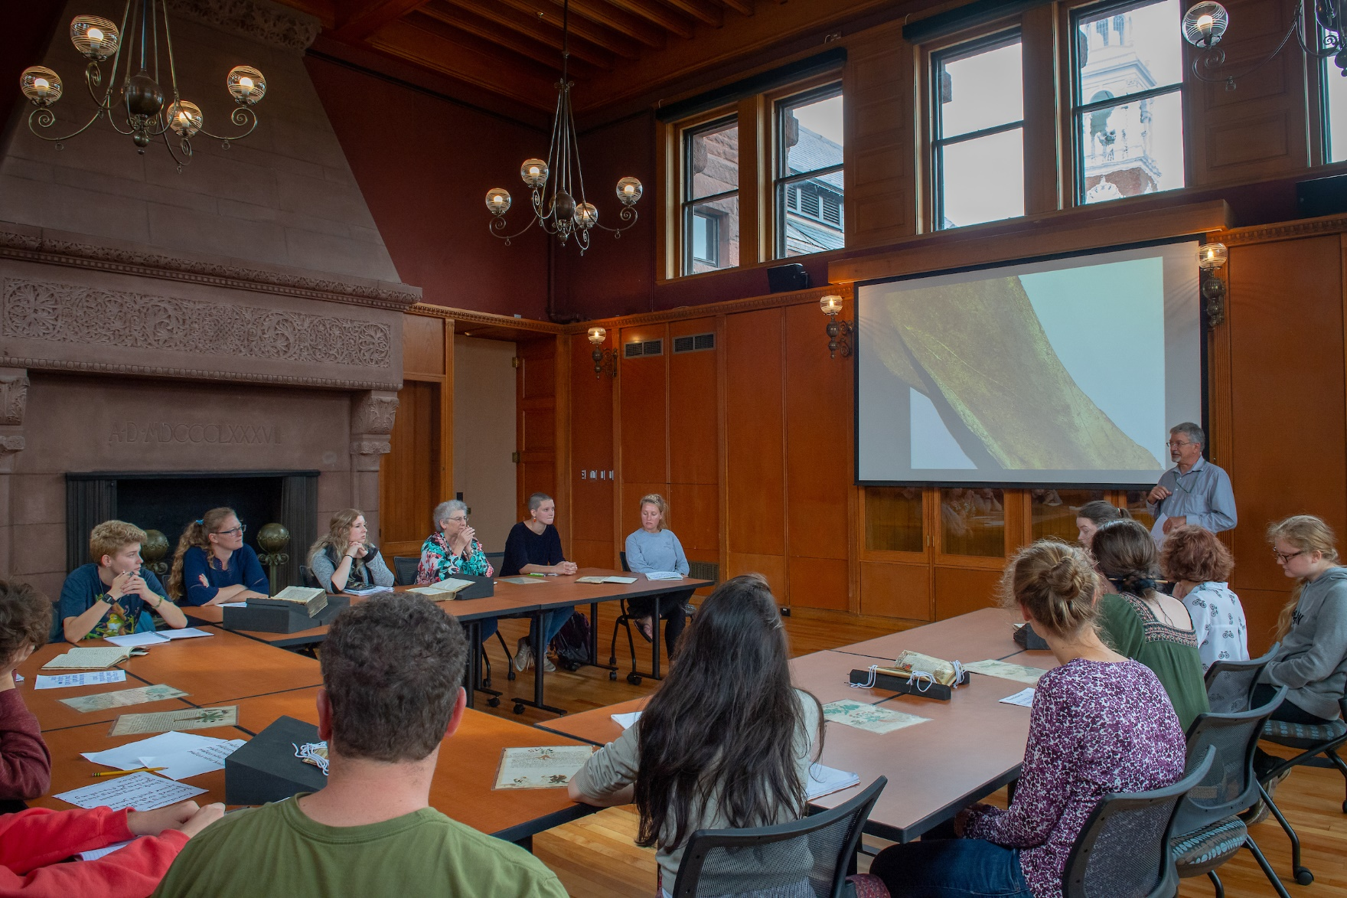

Slide 31
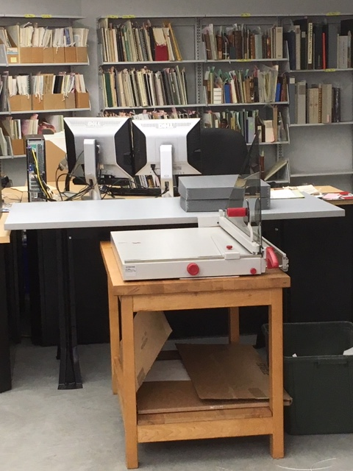
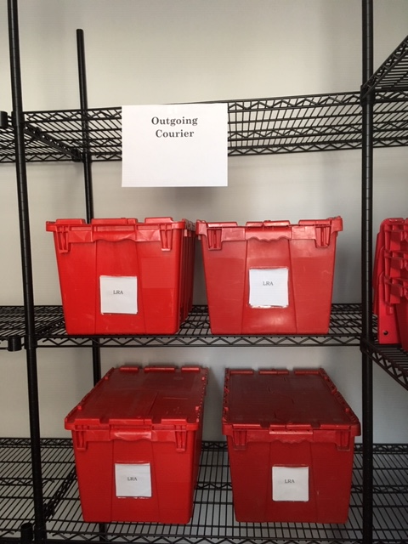

Slide 32
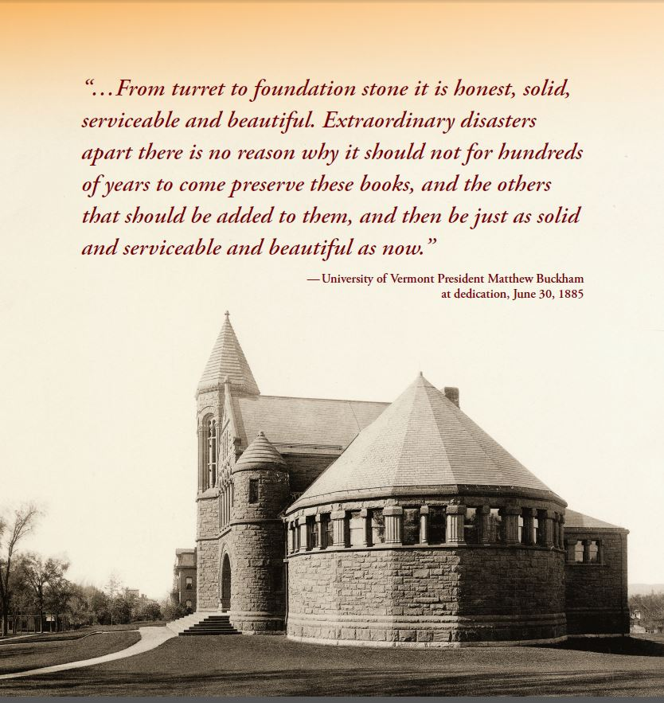

Slide 33
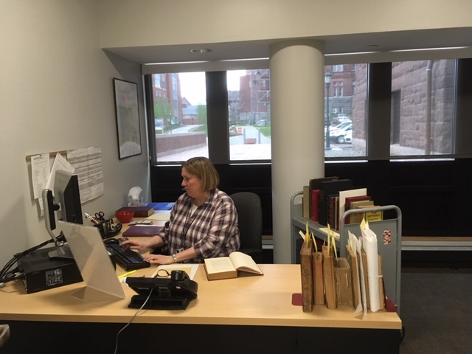

Slide 34
CONTACT US
Jeffrey Marshall
Director and Rare Books Curator
jeffrey.marshall@uvm.edu
Chris Burns
Manuscripts Curator and University Archivist
cburns@uvm.edu
Prudence Doherty
Public Services Librarian
pdoherty@uvm.edu

