Slide 1
All materials provided in this training, including the contents of linked pages, are provided for general informational purposes only. While we seek to provide links to current and authoritative information, neither UVM nor this office guarantees the accuracy of information accessible online; therefore, this information must not be relied upon as substitute for legal advice from a qualified attorney. Please contact the UVM Office of the General Counsel attorney to obtain current legal advice specifically responsive to your questions.
Americans with Disabilities Act (ADA)

Slide 2





Americans with Disabilities Act
Notes:
The ADA prohibits discrimination on the basis of disability in employment, State and local government, public accommodations, commercial facilities, transportation, and telecommunications. It also applies to the United States Congress. It prohibits discrimination in recruitment, hiring, promotions, training, pay, social activities and other privileges of employment. It restricts questions that can be asked about an applicant's disability before a job offer is made, and it requires that employers make reasonable accommodation to the known physical or mental limitations of otherwise qualified individuals with disabilities, unless it results in undue hardship.

Slide 3
ADA Title I: Employment
ADA requires employers with 15 or more employees to provide qualified individuals with disabilities an equal opportunity to benefit from the full range of employment-related opportunities available to others.

Slide 4
ADA Title I: Complaints
ADA complaints must be filed with the U. S. Equal Employment Opportunity Commission (EEOC) within 180 days of the date of discrimination, or 300 days if the charge is filed with a designated State or local fair employment practice agency. Individuals may file a lawsuit in Federal court only after they receive a "right-to-sue" letter from the EEOC.

Slide 5
Americans with Disabilities Act
To be protected by the ADA, one must have a disability or have a relationship with an individual with a disability. An individual with a disability is defined by the ADA as a person who has a physical or mental impairment that substantially limits one or more major life activities, a person who has a history or record of such an impairment, or a person who is perceived by others as having such an impairment. The ADA does not specifically name all of the impairments that are covered.

Slide 6
Examples of Physical and Mental Impairments
Back Impairments
Regarded as Disabled
Non-Paralytic Orthopedic
Depression
Record of Disability
Diabetes
Heart Condition
Anxiety
Cancer
Vision
Bi-Polar
Epilepsy
Asthma
Learning Disabilities
HIV
MS
Alcoholism
Allergies
Notes:
Examples of Physical and Mental Impairments include, but are not limited to:

Slide 7
Examples of Major Life Activities
Caring for oneself
Walking
Seeing
Hearing
Speaking
Breathing
Concentrating
Communicating
Reading
Performance of manual tasks
Standing
Sitting
Bending
Learning
Lifting
Thinking
Working
Notes:
Examples of Major Life Activities include, but are not limited to:

Slide 8
What is a substantial limitation?
Must show how impairment is substantially limiting
A temporary condition usually is not substantially limiting
Employee is evaluated based on the degree of impairment in comparison with the average person

Slide 9
What is a substantial limitation?
The determination of whether an impairment substantially limits a major life activity shall be made without regard to the following:
  Medication, medical supplies, equipment, or appliances, low-vision devices (which do not include ordinary eyeglasses or contact lenses), prosthetics including limbs and devices, hearing aids and cochlear implants or other implantable hearing devices, mobility devices, or oxygen therapy equipment and supplies
  Use of assistive technology
  Reasonable accommodations or auxiliary aids or services
  Learned behavioral or adaptive neurological modifications.

Slide 10
What is a substantial limitation?
Limitation must prevent employee from performing a wide range of jobs

Slide 11
During an Interview
Focus on person’s ability to do the job.
Discuss alternative ways to do the job.
Let the person tell you reasonable accommodations they may need.
Notes:
It is the responsibility of the interviewer to conduct a bias-free interview. Some suggestions for doing so include:

Slide 12
What does “otherwise qualified” mean?
If an individual has a disability, he or she must still be otherwise qualified for the job and able to perform its essential functions such as:
  Regular attendance
  Administrative duties

Slide 13
What are common accommodations?
Modifying schedule: adjust arrival and department time
Restructure position: reassign marginal functions
Provide tools: Long-handled broom, software
No requirement to provide new position

Slide 14
How to Seek a Workplace Accommodation
Bring request for accommodation to the supervisor or directly to ADA Liaison in Human Resource Services.
Begin the interactive process with ADA Liaison, a joint give and take to determine what accommodating needs might be.
Bring questionnaire addressing medical need for accommodating to health care provider and deliver responses to ADA Liaison.

Slide 15
How to Seek a Workplace Accommodation
Request for accommodation is evaluated with participation of Human Resource Services, General Counsel, the individual’s health care provider, supervisor and the individual. Accommodation request is not always the one chosen.
Accommodation is either agreed to or denied.
Accommodations may be revised from time to time using the same procedure.

Slide 16
All materials provided in this training, including the contents of linked pages, are provided for general informational purposes only. While we seek to provide links to current and authoritative information, neither UVM nor this office guarantees the accuracy of information accessible online; therefore, this information must not be relied upon as substitute for legal advice from a qualified attorney. Please contact the UVM Office of the General Counsel attorney to obtain current legal advice specifically responsive to your questions.
Confidentiality

Slide 17





Confidential Employee Information
Notes:
As a staff or faculty member of the University of Vermont, you are responsible for maintaining and protecting confidential employee information. The following are examples of the type of information that must be kept confidential:

Slide 18
Confidential Employee Information
Criminal Record
Financial Information and Social Security Number
Medical Information
  Must be maintained separately
  Includes family or household members
Personal Information
  Address, telephone number, age, date of birth
  Test scores, disciplinary action, performance ratings
Insurance Information
Job Application Information
  Work history, education, reasons for leaving previous jobs

Slide 19
Consequences for Inappropriate Disclosure
Unauthorized disclosure of drug test results may limit UVM’s ability to present the results as evidence in judicial proceedings.
Unauthorized disclosure of laboratory drug test results carries either a civil penalty of fines not less than $500 or more than $2,000 or a criminal penalty of a fine not less than $500 or than $1,000 and/or imprisonment for not more than six months

Slide 20
Consequences for Inappropriate Disclosure
Unauthorized disclosure of any confidential public health record is subject to a civil penalty fine of not less than $10,000 or more than $25,000, costs and attorney fees as determined by the court
Unauthorized disclosure of confidential public nursing home information can result in a fine of not more than $500 and/or imprisonment for six months

Slide 21
Consequences for Inappropriate Disclosure
Unauthorized disclosure of DNA samples shall result in imprisonment for not more than one year and/or a fine of not more than $10,000
Civil actions for defamation, publicity given to private life, libel, intentional infliction of emotional distress, etc.

Slide 22



Best Practices
Notes:
Always maintain medical information separately and securely from other personnel information. Never leave confidential information unattended – either hard copies left on your desk, or leaving your computer with open employee information on the screen

Slide 23
Best Practices
It is fine to discuss information with a manager with a “need to know” – disclose information that is necessary.
Emergency exceptions – if information is necessary to protect the health or safety of the employee or others, it is OK to disclose.
Notes:
Do not discuss confidential employee information with people who do not have a “need to know,” such as a manager or administrator making employment decisions.

Slide 24



Best Practices
Notes:
Do not discuss confidential information in a manner or setting that will not ensure confidentiality; i.e. in a cubicle, on speakerphone, in a hallway or other place where people may be walking by or overhear your conversation. Never engage in office gossip about an employee regarding any information that is confidential. Even when the employee speaks of her or his situation openly.

Slide 25
Best Practices
Remember it is the employee’s right to choose to whom, how, where and when to disclose confidential information (except in situations where it is necessary to disclose information to a manager for the manager to make an employment decision or in health and safety situations)
When in doubt: discuss with your supervisor or other appropriate Management Consultant.

Slide 26

Confidentiality Quiz #1
Notes:
Mark is your direct report. He comes to you with the news that he will need to take a medical leave for six weeks. He hands you a doctor’s note, which states that Mark has a serious medical condition requiring this absence. It does not provide the diagnosis.

Slide 27
Confidentiality Quiz #1
Should you ask Mark what the medical condition is?
  Yes
  No
Answer: b. No
Notes:
Should you ask Mark what the medical condition is?
The answer is b. no. You should not ask Mark about his condition. It is his right to keep that information to himself.

Slide 28
Confidentiality Quiz #1
If Mark shares his medical condition with you, what should you do next?
  Inform Human Resources of his condition
  Out of concern, tell Mark’s coworkers of his condition
  Let your manager know of Mark’s condition
  Do nothing
Answer: d. Do nothing
Notes:
If Mark shares his medical condition with you, what should you do next?
The answer is d. do nothing. You are required to keep your employee’s medical information confidential.

Slide 29


Confidentiality Quiz#2
Notes:
You are aware through the grapevine that Cindy’s husband has lost his job, has become depressed and is not seeking new employment effectively. Cindy seems preoccupied, losing her attention to detail and making careless mistakes in her work. You need to provide feedback to her about her performance.

Slide 30
Confidentiality Quiz#2
Should you tell Cindy that you know about her husband’s job loss and depression?
  Yes
  No
Answer: b. No
Notes:
Should you tell Cindy that you know about her husband’s job loss and depression? The answer is b. no. Unless Cindy shared that information with you, it is not appropriate to address.

Slide 31
Confidentiality Quiz#2
Should you focus on Cindy’s recent poor performance?
  Yes
  No
Answer: a. Yes
Notes:
Should you focus on Cindy’s recent poor performance? The answer is a. yes. Talk to Cindy about your observations regarding her work and its quality. Ask her what type of support she needs from you. If Cindy decides to tell you about her husband’s situation, you may remind her of UVM’s Employee Assistance Program or EAP.

Slide 32

Confidentiality Quiz#3

Slide 33
Confidentiality Quiz#3
What should you do in this situation?
  Encourage Skip to tell his parents of his enrollment status
  Tell Skip’s parents directly that he is no longer enrolled
  Slip a note under Skip’s parents’ front door with the information
  Do nothing
Answer: d. Do nothing
Notes:
What should you do in this situation? The answer is d. do nothing. A UVM student’s information, including his enrollment status, is considered confidential and is not to be shared. If confronted by Skip’s parents, you can remind them of the confidential nature of such information.

Slide 34

Confidentiality Quiz#4
Notes:
You are a supervisor. After hours, you have dinner with a fellow supervisor. She shares a personal story about one of her direct reports. You have a number of stories about your team as well.

Slide 35
Confidentiality Quiz#4
Since you’re not at work, is it OK to share your own story about your team with your colleague?
  Yes
  No
Answer: a. No
Notes:
Since you’re not at work, is it OK to share your own story about your team with your colleague? The answer is b. no. In order to protect confidential employee information, avoid gossip in and out of work.

Slide 36
All materials provided in this training, including the contents of linked pages, are provided for general informational purposes only. While we seek to provide links to current and authoritative information, neither UVM nor this office guarantees the accuracy of information accessible online; therefore, this information must not be relied upon as substitute for legal advice from a qualified attorney. Please contact the UVM Office of the General Counsel attorney to obtain current legal advice specifically responsive to your questions.
Equal employment opportunity/affirmative action

Slide 37
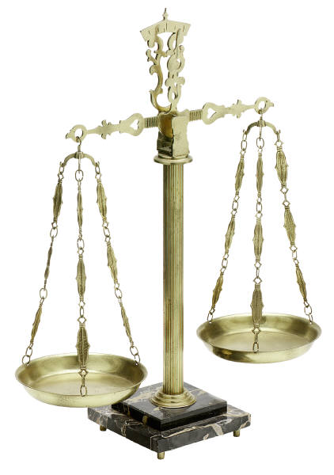
Equal Employment Opportunity Commission
The person’s
Race
Color
Religion
sex (including pregnancy)
national origin
age (40 or older)
disability
genetic information
Notes:
The U.S. Equal Employment Opportunity Commission (EEOC) is responsible for enforcing federal laws that make it illegal to discriminate against a job applicant or an employee because of the following:

Slide 38
Equal Employment Opportunity Commission
It is also illegal to discriminate against a person because the person complained about discrimination, filed a charge of discrimination, or participated in an employment discrimination investigation or lawsuit.

Slide 39
Equal Employment Opportunity/Affirmative Action
Recruiting and hiring the most qualified persons based on job requirements.
Treating applicants and employees in employment matters without regard to race, color, religion, ancestry, national origin, sex, sexual orientation, disability, age, positive HIV-related blood test results, status as a disabled or Vietnam Era Veteran, genetic information, or gender identity or expression.
Notes:
The University of Vermont is committed to a policy of equal employment opportunity and to a program of affirmative action. The University fulfills that policy by:

Slide 40
Equal Employment Opportunity/Affirmative Action
In addition, it is UVM’s policy that discriminatory harassment, sexual harassment nor harassment on the basis of other characteristics as protected by law, will not be tolerated.
Further, employees will not be subjected to harassment or retaliation for filing a complaint, assisting in or participating in an investigation regarding alleged discrimination.

Slide 41
Prohibited Practices
Job Advertisements and Recruitment
Application and Hiring
Job Referrals
Job Assignments and Promotions
Pay and Benefits
Discipline and Discharge
Employment References
Reasonable Accommodation and Disability
Terms and Conditions of Employment
Notes:
It is illegal for an employer to discriminate against a job applicant or employee in the following practices:

Slide 42
Best Practices
Employers can reduce the risk of discriminatory employment decisions by establishing written objective criteria for evaluating candidates for hire or promotion and applying those criteria consistently to all candidates.
In conducting job interviews, employers can ensure nondiscriminatory treatment by asking the same questions of all applicants for a particular job or category of job and inquiring about matters directly related to the position in question.

Slide 43
Best Practices
To prevent conflicts from escalating to the level of a Title VII violation, employers should immediately intervene when they become aware of objectively abusive or insulting conduct, even absent a complaint.
Employers can help reduce the risk of retaliation claims by carefully and timely recording the accurate business reasons for disciplinary or performance related actions and sharing these reasons with the employee.

Slide 44
Activities?
Notes:
***Suggestions for activities?***

Slide 45
Resources
http://www.eeoc.gov/
http://www.uvm.edu/policies/general_html/affirm.pdf

Slide 46
All materials provided in this training, including the contents of linked pages, are provided for general informational purposes only. While we seek to provide links to current and authoritative information, neither UVM nor this office guarantees the accuracy of information accessible online; therefore, this information must not be relied upon as substitute for legal advice from a qualified attorney. Please contact the UVM Office of the General Counsel attorney to obtain current legal advice specifically responsive to your questions.
Fair Labor Standards Act

Slide 47
Fair Labor Standards Act
Passed in 1938
Standards:
  Minimum Wage
  Overtime Pay
  Child Employment Practices
Exempt Categories:
  Outside Sales
  Administrative/Managerial
  Executive
  Professional
Notes:
Passed in 1938, the Fair Labor Standards Act, or FLSA, establishes minimum wage, overtime pay and child employment standards affecting employees in both the private and public sectors. Unlike most legislation, the FLSA has exempted the following categories from coverage:

Slide 48
Fair Labor Standards Act
Exempt (not covered)
Non-Exempt (covered)
Non-Exempt employees are eligible for overtime
FLSA also governs Child Labor
  Exemptions include Family Farms and Businesses
Notes:
The terms Exempt and Non-Exempt are used when referring to the job categories. Exempt categories are not covered by the act; Non-Exempt employees are. In addition, FLSA governs Child Labor

Slide 49

FLSA – Child Labor
Work is restricted for age 16 and younger
Restrictions are based on age, occupation, time of year, and hours to be worked
Notes:
The Child Labor provisions ensure that when young people work, it is safe and does not jeopardize their health, well-being or educational opportunities.

Slide 50





FLSA – Child Labor
Notes:
When the child is 14, she or he can work in an office, a grocery store, a retail store, a movie theater or at a gasoline service station.

Slide 51






FLSA – Child Labor
Notes:
A child may not work in communications or public utilities, construction or repair, outside the cab of a motor vehicle assisting in the transportation or delivery of goods, public messenger jobs or work rooms where products are manufactured mined or processed.

Slide 52
FLSA – Child Labor
Manufacturing and storing of explosives
Operating a motor vehicle or working outside the cab assisting in the transportation or delivery of goods
Mining
Exposure to radioactive substances
Meat packing or processing and all power driven meat slicing machines
Power driven circular saws, band saws, etc.
Roofing operations
Excavation operations
Notes:
When a child turns 16, she or he may work in any occupation that has not been declared hazardous by the Secretary of Labor. Those include the following: Once a child reaches the age of 18, she or he is no longer covered by the child labor provision.

Slide 53
FLSA Quiz #1
What is the current minimum wage in Vermont?
$7.25
$6.55
$8.15
$9.05
Answer: c. $8.15.
Notes:
What is the current minimum wage in Vermont? Is it a. $7.25? b. $6.55? c. $8.15? or d. $9.05? The answer is c. $8.15. The US Department of Labor regulations allow a state can set a different minimum wage as long as it is above the federal minimum wage, which is currently $7.25.
***What is UVM’s minimum wage? Is it different?***

Slide 54

FLSA Quiz #2
How much overtime does the Fair Labor Standards Act require the employer to pay?
Answer: zero
Monday
Tuesday
Wednesday
Thursday
Friday
Saturday
Sunday
8
8
8
8
--
Notes:
An employee is out sick on Monday and Tuesday, returns to work on Wednesday and works his regular 8 hour days through Friday and then works Saturday an additional 8 hours.
The answer is zero. The employee needs only to be compensated for hours “worked,” and in this case, only 32 hours were “worked.” However, UVM policy varies from the FLSA guidelines by considering the medical days as hours worked. Therefore UVM would pay 8 hours of overtime.

Slide 55
FLSA – Overtime
40+ Hours = $ x 1.5
Monday
Tuesday
Wednesday
Thursday
Friday
Saturday
Sunday
8
8
8
8
8
or 37.5+ = $ x 1.5
Monday
Tuesday
Wednesday
Thursday
Friday
Saturday
Sunday
7.5
7.5
7.5
7.5
7.5
Notes:
FLSA states that an employer must establish a standard work week. The work week must be a seven day period with 24 hours in each day. The employer may not change the work week to avoid paying overtime. The rate at which hours worked in excess of 40 during the week must be paid one and a half. UVM’s work week begins on Monday and ends on Sunday. In some cases at UVM, depending on the job, overtime may be paid after only 37.5 hours in a week.

Slide 56
FLSA – Overtime
Break times of less than 30 minutes count as hours of work
Uninterrupted breaks of 30 or more minutes do not count as time worked
Eating lunch at one’s desk is particularly problematic
Notes:
The Federal Labor and Standards Act also stipulates that breaks of less than 30 minutes must count as hours worked. Uninterrupted breaks of 30 minutes or more do not count as time worked. In some situations, like eating lunch at one’s desk, break and work time are indistinguishable. Therefore, UVM discourages the practice.

Slide 57
FLSA Quiz #3
Did this employee earn overtime?
Answer: no
Monday
Tuesday
Wednesday
Thursday
Friday
Saturday
Sunday
9.5
7.5
7.5
7.5
5.5
--
--
Notes:
In addition to the classification of exempt and non-exempt, employees at UVM are either salaried or hourly. In this quiz, a salaried employee with standard hours of 37.5 works the following schedule. Did this employee earn overtime?
The answer is no, the employee did not earn overtime. Although the employee worked an extra two hours on Monday, she shortened her work day on Friday by the same amount. Salaried employees are compensated for the total hours worked in a week, not the total hours worked in a day.

Slide 58
FLSA Quiz #4
Did this employee earn overtime?
Answer: yes – 2 hours of overtime
Monday
Tuesday
Wednesday
Thursday
Friday
Saturday
Sunday
9.5
7.5
7.5
7.5
5.5
--
--
Notes:
In this example, the same schedule is worked by an hourly employee. The employee’s standard hours are also 37.5 per week. Did this employee earn overtime?
The answer is yes, the employee earned two hours of overtime by working 9.5 hours on Monday. UVM policy and the United Electrical Radio and Machine Workers union contract provides overtime pay for hours worked in excess of the scheduled work day. For Temporary employees, the rule mirrors the FLSA policy, that overtime is paid when they exceed 40 hours in a given work week.

Slide 59
FLSA Quiz #5
How many hours of comp time did this employee earn?
Answer: 12 hours of comp time
Monday
Tuesday
Wednesday
Thursday
Friday
Saturday
Sunday
7.5
7.5
7.5
7.5
7.5
5
3
Notes:
An alternative to receiving overtime pay for extra hours worked is to earn time off. This is called compensatory time, also known as comp time. The employee in this quiz is supposed to work 37.5 standard hours per week. Based on the hours worked in this week, how many hours of comp time did this employee earn?
The answer is 12 hours of comp time. Like overtime, comp time is earned at the same premium as overtime. The extra hours worked are multiplied by 1.5. Therefore, the eight hours that the employee worked are multiplied by the premium of one and a half, which equals 12.

Slide 60
FLSA – Comp Time vs. Overtime Pay
Until a non-exempt staff member has accumulated 40 hours of compensatory time, she or he will be free to choose between compensation in dollars or in compensatory time.
After 40 hours of compensatory time has been accumulated, the supervisor may choose either to pay for overtime in dollars or comp time. However, it is always the employee’s right to choose to be paid in dollars.

Slide 61
FLSA – Comp Time vs. Overtime Pay
Accumulated comp time must not exceed 80 hours. Overtime must be paid in dollars until accumulated comp time falls below 80 hours.
Using comp time:
  If using two days or less, employee should notify the supervisor at least 72 hours ahead of time
  If using more than two days, employee should notify the supervisor at least two weeks in advance
  Using comp time must not unduly disrupt the operations of the department.
  When transferring to another college or department or when employment ends with UVM, the employee must be paid for all unused comp time in dollars.

Slide 62
FLSA Quiz #6
True or False
Management is responsible for hours of work and overtime. If the non-exempt employee can document overtime hours and management cannot, then the employee wins.
Answer: True
Notes:
Management must be diligent in ensuring that all time worked is documented accurately.

Slide 63


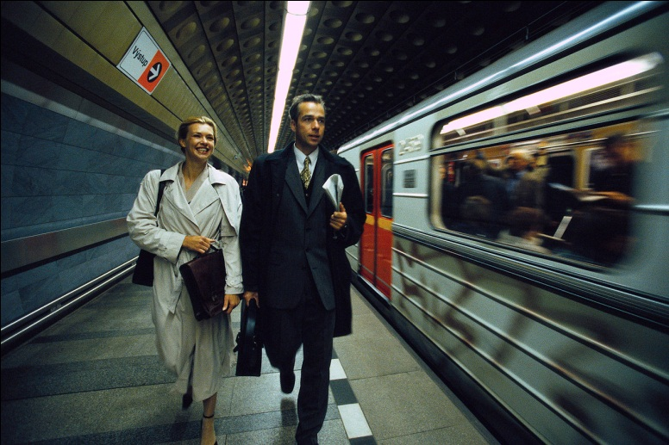
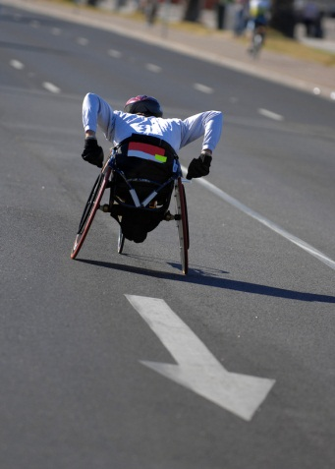


FLSA – Travel Time for Non-Exempt
Notes:
FLSA addresses compensation for a non-exempt employee’s travel. It specifies that time spent commuting to and from work is not considered time worked. However, there are special provisions for non-exempt employees who travel for business reasons such as attending a conference. It states that travel hours that cut across the work day are considered time worked and thus will be compensated.

Slide 64

FLSA – Travel Time for Non-Exempt
Monday
Tuesday
Wednesday
Thursday
Friday
Saturday
Sunday
8:00
to
4:30
8:00
to
4:30
8:00
to
4:30
8:00
to
4:30
8:00
to
4:30
8:00
to
4:30
8:00
to
4:30
Notes:
The US Department of Labor considers Saturday and Sunday part of an employee’s work week when she or he travels for business. If the employee’s schedule is 8:00 to 4:30, Monday through Friday, the same time over the weekend is recognized as potential work time.

Slide 65
FLSA Quiz #7
Employee travels to a conference on Sunday, leaving Burlington at 1:00 pm and arriving in Boston at 6:00 pm.
How many hours did the employee “work?”
Answer: 3.5
Notes:
Because the employee is eligible to be paid for travel time between 8:00 and 4:30, the employee is entitled to receive credit for travel between 1:00 and 4:30, or 3.5 hours.

Slide 66
FLSA #8
The day of the conference:
  The employee attends the conference events beginning Monday morning at 8:30 am.
  At Monday’s conference luncheon there is a keynote speaker .
  Last afternoon session concludes at 4:00 pm
  The employee prepares for a leisurely dinner with friends and returns to hotel at 7:00 pm.
For how many hours should the employee be compensated?
Answer: 7.5
Notes:
The employee is eligible to receive compensation for the time she spent in conference events. In this case, the employee’s work time was from 8:30 to 4:00, including the “working” lunch with the keynote speaker. The time spent preparing for and attending dinner is not compensated.

Slide 67
FLSA – Travel Time for Non-Exempt
Rather than return home in the morning, the employee decides to visit a museum and grab a late lunch. She departs Boston at 3:00 pm on Wednesday afternoon for the trip home.
The employee arrives in Burlington at 8:00 pm
How many hours are “worked?”
Answer: 1.5
Notes:
Since the employee leaves Boston at 3:00 and the work day ends at 4:30, the employee is entitled to only 1.5 hours of compensation.

Slide 68
Resources
http://www.dol.gov/whd/flsa/
http://labor.vermont.gov/?TabId=383

Slide 69
All materials provided in this training, including the contents of linked pages, are provided for general informational purposes only. While we seek to provide links to current and authoritative information, neither UVM nor this office guarantees the accuracy of information accessible online; therefore, this information must not be relied upon as substitute for legal advice from a qualified attorney. Please contact the UVM Office of the General Counsel attorney to obtain current legal advice specifically responsive to your questions.
UVM Medical Leave and FMLA/VPFLA/Military Leave

Slide 70
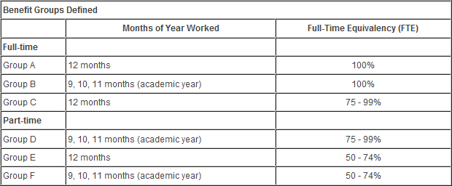
Benefits Groups
Notes:
To understand the amount of medical leave, also known as sick pay, that is available to you, you must identify to which benefits group you belong. Identify your group and press next to continue.
Employees in benefits group A earn the equivalent of one day per month or 12 days per year. If your standard hours are 7.5 per day, you will receive 90 hours per year. If your standard hours are 8 per day, you will receive 96 hours per year. Employees in benefits groups B through F are eligible for the same number of medical leave hours, but they are prorated based on the employees’ full time equivalent, or FTE. For example, an employee that works an 85% FTE of a 37.5 hour work week, receives 76.5 hours per year. An employee that works a 50% FTE of a 40 hour work week is entitled to 48 hours per year.
New employees automatically receive the equivalent of one year’s worth of medical leave on the day they are hired. These hours can be used immediately, however any probationary period that has been applied, can be extended by the amount of medical leave that is taken.
After one year of employment with UVM, new employees begin earning medical leave on a monthly basis.
Accrual of medical leave is unlimited, but unlike vacation time, unused hours are not paid out to the employee upon her or his leaving the University. Additionally, medical leave cannot be shared between employees.

Slide 71
When to Use UVM Medical Leave
During an illness
To attend medical/dental appointments
To actively care for a seriously ill immediate family member
  Spouse (or partner in a civil union)
  Child/Stepchild
  Parent/Stepparent
  Parent/Stepparent of your spouse (or partner)
For childbearing
Notes:
Medical leave, or sick pay, can be used in many different situations, including, but not limited to the following:

Slide 72

Family and Medical Leave Act (FMLA)
Notes:
The Family and Medical Leave Act, or FMLA, entitles eligible employees to take unpaid leave for specified family and medical reasons with a guarantee of continued health insurance coverage.

Slide 73
Family and Medical Leave Act (FMLA)
Twelve workweeks of leave in a 12-month period for:
  the birth of a child and to care for the newborn child within one year of birth;
  the placement with the employee of a child for adoption or foster care and to care for the newly placed child within one year of placement;
  to care for the employee’s spouse, child, or parent who has a serious health condition;
  a serious health condition that makes the employee unable to perform the essential functions of his or her job;
  any qualifying exigency arising out of the fact that the employee’s spouse, son, daughter, or parent is a covered military member on “covered active duty
Notes:
According to FMLA, eligible employees are entitled to the following:

Slide 74
Family and Medical Leave Act (FMLA)
OR
  Twenty-six workweeks of leave during a single 12-month period to care for a covered servicemember with a serious injury or illness who is the spouse, son, daughter, parent, or next of kin to the employee (military caregiver leave).

Slide 75
Vermont Parental and Family Leave (VPFLA)
Notes:
In addition to the Federal FMLA law, the State of Vermont has enacted the Vermont Parental and Family Leave Act or VPFLA. The law requires many employers, including UVM, to allow full-time employees to take up to 12 weeks per year of unpaid leave for pregnancy, birth, adoption or serious illness of themselves or close family members. Employers may not retaliate against employees who exercise their rights under the law and normally must reinstate employees in their jobs on return from leave.

Slide 76
Vermont Parental and Family Leave (VPFLA)
The parental leave section of the act applies to employers with 10 or more employees.
The medical leave section of the act applies to employers with 15 or more employees.
To qualify under the act employees must be continuously employed by the same employer for a period of one year for an average of at least 30 hours per week.
Notes:
VPFLA stipulations state the following:

Slide 77
Vermont Parental and Family Leave (VPFLA)
Vermont law also allows many employees to take up to 24 hours per year (4 hours per month) of short-term unpaid leave for routine medical and dental care, children’s academic needs, medical emergencies, and the like.

Slide 78
Differences between FMLA and VPFLA
FMLA
vs.
VPFLA
Notes:
There are significant differences between the Vermont Parental and Family Leave Act and the federal Family and Medical Leave Act (FMLA). In general, whichever of the two statutes provides greater protection for employees is the one that will apply.

Slide 79
Differences between FMLA and VPFLA
 | Federal Law | VT Law
Number of employees required for coverage | 50 or more employees (within 75 miles) | 10 or more employees (parental leave) or 15 or more employees (family & short term leave) – location of employees is irrelevant
How long must employee work to be eligible? | 12 months (minimum of 1250 hours) | 12 months (average of 30 hours per week)
Weeks of leave annually | 12 | 12
What is family leave? | Leave for birth or adoption of a child or placement of a child for foster care and in order to care for that child. | Leave for serious illness of employee or family member.

Slide 80
Differences between FMLA and VPFLA
 | Federal Law | VT Law
What is parental leave? | Not applicable – see above | Leave for pregnancy, birth or adoption of a child under age 16
What is parental leave? | Not applicable – see “what is family leave” above | Leave for pregnancy, birth or adoption of a child under age 16
What is medical leave? | Leave for serious health condition of employee, which prevents him/her from performing job duties or to care for family member with serious health condition | Not Applicable – see “what is family leave” above

Slide 81
Differences between FMLA and VPFLA
 | Federal Law | VT Law
What is a “serious health condition” or a “serious illness?” | A serious health condition is defined as one requiring inpatient care or continuing treatment by a health care provider. DOL regs. define this to include pregnancy or an incapacitating illness of more than 3 calendar days length. | A serious illness is defined as one requiring inpatient care or continuing treatment by a health care provider. There are not interpretive regulations, but DOL’s federal guidelines are persuasive because the statutory definitions are so similar.
For what family member can leave be taken? | Medical leave can be taken to care for the employee’s spouse, child or parent with a serious health condition. (Spouse probably does not include civil union partner). | Family leave can be taken for the serious illness of the employee’s child, stepchild or ward who lives with the employee, foster child, parent, spouse or parent of spouse. Spouse includes civil unions.

Slide 82
Differences between FMLA and VPFLA
 | Federal Law | VT Law
Can spouses working for the same employer each take leave based on the same condition/event? | Spouses working for the same employer may be limited to a total of 12 weeks of leave for the birth and care of a child, or the placement of a child for adoption of foster care or to care for such a child. | Yes. Each spouse is entitled to 12 weeks of leave annually.
Do benefits continue during leave? | Health insurance only | All benefits continue
Who pays for benefits during leave? | Employee/employer each pay the proportion toward health insurance that they did during regular work time. | Employee/employer each pay the proportion of all benefits that they did during regular work time.

Slide 83
Differences between FMLA and VPFLA
 | Federal Law | VT Law
Can employee use vacation, sick or other paid leave during leave? | No limitation on amount of such leave employee may use – Employer can require employee to use up such time. | May use up to 6 weeks (at employee’s option only) of accrued paid leave time during leave.
Reinstatement of employee required when leave ends? | Yes – unless employer can show that employee was terminated or denied reinstatement for reasons unrelated to the leave. | Yes – and employer has burden to prove by clear & convincing evidence that employee was terminated/not reinstated for permitted reasons.

Slide 84
Differences between FMLA and VPFLA
 | Federal Law | VT Law
Short term leave available? | No. | Yes, for a broad range of school, medical and professional activities for self, children and other relatives, up to 4 hours per 30 days, up to 24 hours per 12 months, in increments of 2 hours. (7 days’ notice required except in case of emergency).

Slide 85

The Uniformed Services Employment and Reemployment Rights Act (USERRA)
Notes:
The Uniformed Services Employment and Reemployment Rights Act, or USERRA, provides employees who are called up to perform military service with reemployment rights.

Slide 86
The Uniformed Services Employment and Reemployment Rights Act (USERRA)
Protects employees who are gone from work for up to five years.
Existing health plans must be offered to the employee for 18 months.
If leave is 90 days or less, the employer must promptly return the employee to the same job. Employees continue to accrue seniority during leave.
If leave is more than 90 days, the employer may substitute a different job with the same pay, status and seniority.
If leave lasts more than 30 days, the law provides job protection for returning employees for six to 12 months. During that time, the employee may only terminated for cause.

Slide 87

Vermont Military Service and Leave
Notes:
A member or applicant for membership in the National Guard shall not be denied initial employment, reemployment, retention of employment, promotion or any benefit of employment on the basis of service, application to service or obligation to serve.

Slide 88
Vermont Military Service and Leave
Any absence for military training or state active duty shall not affect the employee’s right to receive normal vacation, sick leave, bonus, advancement, and other advantages of employment normally anticipated in the employee’s position.
Notes:
Vermont Military Service and Leave

Slide 89
Staff Leave Requests
Do I say yes?
What type of leave do I grant?
Should documentation be required?
Notes:
As a manager, there are three questions you should ask yourself when you receive a staff leave request. Do I say yes? What type of leave do I grant? Should documentation be required?

Slide 90
Staff Leave Requests Quiz #2
John calls you at the beginning of his work day. His car won’t start. He wants the day off.
Li’s husband passes away and she needs bereavement leave. How much time is she allowed?
Notes:
***Please provide answers to each situation. Thank you.***

Slide 91
Staff Leave Requests
Sharon serves in the Vermont Guard
  She asks for two weeks of paid leave to attend military summer camp. This will be in addition to the two week summer vacation that you have already approved for Sharon
  Shortly after her vacation, Sharon’s cousin is injured in Iraq and she requests an additional 15 weeks of paid leave to care for her cousin while he is recovering from his wounds. What are your options?
Notes:
***Please provide answers to each situation. Thank you.***

Slide 92
Staff Leave Requests
Andrew needs 10 weeks of leave because he is adopting a child.
Senad requests 10 hours of leave over a six month period to attend teacher conferences and school functions for his two children.
Terri needs 12 weeks of leave to care for the father (who lives in Oregon) of her same sex partner.
Notes:
***Please provide answers to each situation. Thank you.***

Slide 93
Staff Leave Requests
Matasi wants to take March 19, 20 and 21 as his cultural holidays.
Anna asks to take every Wednesday and Friday off for kidney dialysis until she is able to get a kidney transplant.
Percy believes he is about to receive a disciplinary warning for a performance issue and discloses that he is depressed and need time off.
Notes:
***Please provide answers to each situation. Thank you.***

Slide 94
Staff Leave Requests
Ludmilla asks for a six month personal leave of absence to help her family open a restaurant.
Marty’s daycare center is closing for two weeks because the provider is recovering from surgery. Marty asks for leave to care for his child during this time. He wants to use his accrued medical leave to cover the time out.
Notes:
***Please provide answers to each situation. Thank you.***

Slide 95
Staff Leave Requests
Zelda, who is president of her union, asks for three days of paid leave to attend a national union meeting.
Maria’s grandchildren are in primary school and live nearby with their parents. She asks for occasional medical leave to care for the children when they are too sick to attend school
Notes:
***Please provide answers to each situation. Thank you.***

Slide 96
Staff Leave Requests
Nitesh works in Student Financial Services. He wants to become a yoga master and asks for three months of educational leave to become certified. Would your answer be different if Nitesh wanted three months of educational leave to take a study course for the CPA exam?
Notes:
***Please provide answers to each situation. Thank you.***

Slide 97
Staff Leave Requests
Phong suffers a serious workplace injury. Her doctor says she needs six months to recover. Phong will receive Workers Compensation. Do you run the clock on her annual FMLA entitlement and her UVM medical leave during the six months she is out of work? Can you ask for regular updates from Phong’s doctor?
Notes:
***Please provide answers to each situation. Thank you.***

Slide 98
VPFLA Resources
http://www.atg.state.vt.us/issues/employment-law/leave.php
Notes:
For more information regarding VPFLA, click on this link.

Slide 99
FMLA Resources
http://www.dol.gov/whd/fmla/
http://www.dol.gov/whd/fmla/finalrule/MilitaryFAQs.pdf
http://www.dol.gov/whd/fmla/finalrule/NonMilitaryFAQs.pdf
Notes:
For more information regarding FMLA, click on these links.

Slide 100
All materials provided in this training, including the contents of linked pages, are provided for general informational purposes only. While we seek to provide links to current and authoritative information, neither UVM nor this office guarantees the accuracy of information accessible online; therefore, this information must not be relied upon as substitute for legal advice from a qualified attorney. Please contact the UVM Office of the General Counsel attorney to obtain current legal advice specifically responsive to your questions.
Immigration Reform and Control Act of 1986 (IRCA)

Slide 101




Immigration Reform and Control Act of 1986
Notes:
The Immigration Reform and Control Act of 1986 was passed in order to control and deter illegal immigration to the United States. It stipulates the legalization of undocumented aliens who had been continuously unlawfully present since 1982, legalization of certain agricultural workers, sanctions for employers who knowingly hire undocumented workers, and increased enforcement at US borders.

Slide 102
IRCA & the I-9 Form
Requires the employee and employer to certify identity and eligibility to work
I-9 must be completed within 3 days of starting work
Signed by the employee and employer
Notes:
After an offer of employment has been made, IRCA requires the employee and employer to certify identity and eligibility to work in the United States. This is accomplished through the use of the I-9 Form. The I-9 must be completed within three days of an employee starting work with a new employer and it must be signed by both parties.

Slide 103
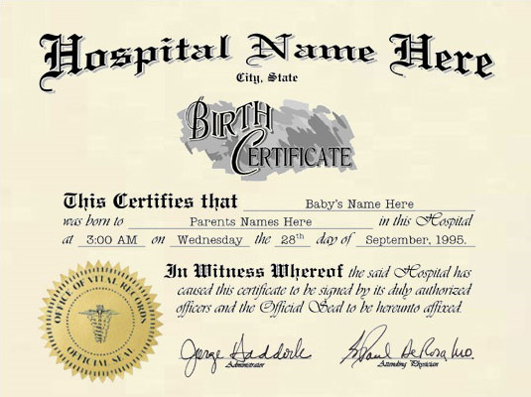
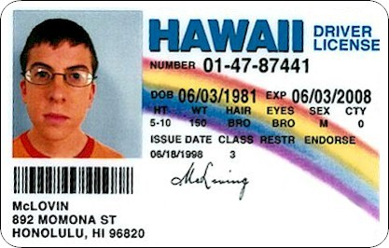



IRCA & the I-9 Form
Notes:
The I-9 Form specifies which documents employers may accept as proof of identity and eligibility to work in the US. A list of acceptable documents is provided on the form. They include, but are not limited to, a passport, a birth certificate, a social security card and a driver’s license. An employer may not ask for nor mandate a particular form of ID. They may only refer to the list. However, an employer may question a document if it believes it to be false.

Slide 104
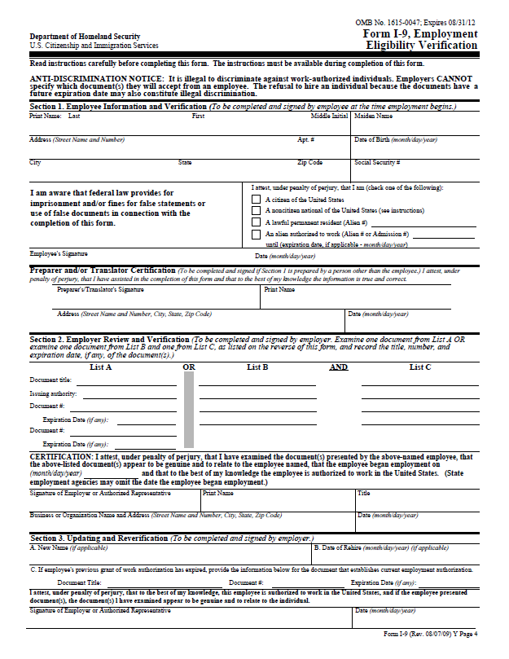
IRCA & the I-9 Form
Notes:
The employee must complete the top portion of the form on the first day of work. She or he has up to three work days to provide evidence of eligibility to work in the United States. Management needs to complete the certification section of the form by the third work day. Pay careful attention to the expiration date on the I-9 Form. Expired documents will be rejected.

Slide 105


IRCA & the I-9 Form
$250-$2000 for EACH hire 1st offense
$2000-$5000 for EACH hire 2nd offense
$3000-$10000 for more than two offenses
Notes:
Penalties for knowingly hiring unauthorized workers become increasingly more severe.

Slide 106
IRCA & the I-9 Form
$100- $1000 for each person hired without proper documentation
$3000 and/or jail time for engaging in a pattern or practice of violating the hiring/verification requirement
Notes:
Penalties for unintentional hiring are less severe, but are still significant.

Slide 107
All materials provided in this training, including the contents of linked pages, are provided for general informational purposes only. While we seek to provide links to current and authoritative information, neither UVM nor this office guarantees the accuracy of information accessible online; therefore, this information must not be relied upon as substitute for legal advice from a qualified attorney. Please contact the UVM Office of the General Counsel attorney to obtain current legal advice specifically responsive to your questions.
Nursing Mothers

Slide 108
Vermont H.641 – Nursing Mothers
For an employee who is a nursing mother for up to three years after the birth of a child, the employer shall:
  Provide uncompensated time throughout the day to express breast milk for her nursing child.
  Make a reasonable accommodation to provide appropriate private space that is not a bathroom stall or a small storage area.
Notes:
Vermont H.641 is an act related to Nursing Mothers in the workplace. It stipulates the following:

Slide 109
Vermont H.641 – Nursing Mothers
An employer may be exempted from the provisions if providing time for expressing breast milk would seriously disrupt the employer’s operations.
An employer shall not discriminate against an employee who exercises the rights provided under this section.

Slide 110
Vermont H.641 – Nursing Mothers
Any employer who violates the provisions of this subchapter shall be fined assessed a civil penalty of not more than $100.00 for each and every violation.

Slide 111
Strategic Direction
UVM’s Nursing Mothers policy supports the following goals in the University’s Strategic Plan:
  Diversity: Build a diverse and globally aware university community sustained by an inclusive, supportive, and just campus climate.
  Institutional efficacy: As an institution, model the highest standard of ethical conduct, public service, and strong commitment to lifelong learning.

Slide 112
Policy Elaboration
Upon return to work after the birth of a child and for three years thereafter, breastfeeding employees are allowed a flexible schedule that will provide reasonable time to express milk during work hours.

Slide 113
Role of the Employee
Role of the Employee
  Contacting WorkLife Services at (802) 656-0156 to obtain information regarding locations of designated private spaces for expression of milk on campus, if needed.
  Requesting and arranging with their supervisor appropriate and reasonable break times or flexible scheduling for expressing milk.

Slide 114
Role of the Supervisor
The supervisor shall be responsible for the following:
  Providing reasonable break times each day or make reasonable accommodations for flexible work schedules for employees wishing to express breast milk.
  Providing a private space with a lock on the door for expressing milk. A bathroom stall or storage area shall not serve as a lactation space. If employees prefer, they may also express milk in their own private offices.
  Assisting in providing a positive atmosphere of support for breastfeeding employees.

Slide 115
Nursing Mother Facilities at UVM
Facilities for nursing mothers are being identified across campus. Each of the locations provides private space where nursing mothers are welcome to pump or nurse. Rooms are equipped with appropriate signage, a comfortable chair, a small table and an electrical outlet. More rooms are being identified and will be added to the list as they become available.
Notes:
A private space within a nursing mother's building may also be used, if such a space exists. According to State law, the room shall not be a bathroom stall or a storage area and must have a lock on the door. Employees are encouraged to work with their supervisor to identify appropriate space within their building.

Slide 116
Activity – Map of Nursing Rooms
Include a map with dots. Rollover will reveal address and photo of room.

Slide 117
Links and Resources for Nursing Mothers
Links to the following information can be found here: http://www.uvm.edu/hrs/?Page=healthy/nursing/nursingresources.html
  Breastfeeding Information for New Mothers
  Back-to-Work Basics
  Community Breastfeeding Resources
  Free and Discounted Breast Pumps

Slide 118
All materials provided in this training, including the contents of linked pages, are provided for general informational purposes only. While we seek to provide links to current and authoritative information, neither UVM nor this office guarantees the accuracy of information accessible online; therefore, this information must not be relied upon as substitute for legal advice from a qualified attorney. Please contact the UVM Office of the General Counsel attorney to obtain current legal advice specifically responsive to your questions.
Union Organizing

Slide 119
Unions at UVM
The Chauffeurs, Teamsters, Warehousemen and Helpers Union, Local 597 (Teamsters)
  Police Officers
  Service Officers
  Dispatchers
Notes:
At the University of Vermont there are currently three unions representing four collective bargaining units. The Chauffeurs, Teamsters, Warehousemen and Helpers Union represents approximately 25 police officers, service officers and dispatchers in the University's Department of Police Services.

Slide 120
Unions at UVM
The United Electrical Radio and Machine Workers, Local 267 (UE)
  Service and Maintenance
    Physical Plant
    Print and Mail
    The University Bookstore
    Residential Life
    Other departments
Notes:
The United Electrical Radio and Machine Workers, Local 267 (UE) represents approximately 350 service and maintenance employees in various departments across campus including Physical Plant, Print and Mail, the University Bookstore, Residential Life, Athletics and other UVM departments.

Slide 121
Unions at UVM
United Academics/American Federation of Teachers (AAUP/AFT, referred to as UA)
  Full-Time
    Lecturers
    Clinical Faculty
    Extension Faculty
    Library Faculty
    Research Faculty
    Tenure Track and Tenured Faculty
  Part-Time
    Lecturers
    Clinical Faculty
    Library Faculty
    Research Faculty
Notes:
United Academics/American Federation of Teachers (AAUP/AFT, referred to as UA) represents two collective bargaining units: Approximately 680 full-time Lecturers, Clinical, Extension, Library, Research, Tenure Track and Tenured faculty (.75 or greater FTE appointments for 9, 10, 11 or 12 months); and Approximately 170 part-time Lecturers, Clinical, Extension, Library and Research faculty.

Slide 122
Prohibited Conduct Related to Union Organizing
Threaten employees with loss of jobs or adverse impact on benefits, pay increases, promotions, or working conditions if they unionize.
Notes:
University officials may not engage in certain conduct under the State Employees Labor Relations Act (SELRA). Specifically, they may not:

Slide 123
Prohibited Conduct Related to Union Organizing
Interrogate employees about their union activities. They may not ask employees who supports the union, who signed a union card, who attended a union meeting, or who will vote which way in the election. They may not ask employees directly about their personal opinions on the union or how they are going to vote.
Notes:
They may not:

Slide 124
Prohibited Conduct Related to Union Organizing
Punish employees by taking away compensation or creating unfavorable working conditions because they support a union.
Promise employees pay increases, improved benefits, promotions, special favors, or improved working conditions if they vote against the union.
Notes:
They may not:

Slide 125
Prohibited Conduct Related to Union Organizing
Discriminate against employees who are pro-union by separating them from other employees, nor may they intentionally assign undesirable tasks to them because of their union activities or sympathies. By the same token, anti-union employees are not entitled to favorable treatment.
Notes:
They may not:

Slide 126
Prohibited Conduct Related to Union Organizing
Spy on or engage in surveillance of employees, attend union meetings for the purpose of spying on union activities, or give the impression that employees are being monitored regarding their union activity.
Notes:
They may not:

Slide 127
Prohibited Conduct Related to Union Organizing
Discipline employees or cause an employee to be disciplined for engaging in lawful solicitation of employees conducted consistently with University solicitation policy. Employees are free to engage in union activity and solicitation during their non-working time and the non-working time of the employees being solicited. Non-working time includes lunch breaks, coffee breaks, and before and after work.
Notes:
They may not:

Slide 128
Prohibited Conduct Related to Union Organizing
Tell employees that they will be worse off if they unionize. On the other hand, officials are free to discuss the process of collective bargaining and that the outcome of negotiations cannot be predicted.
Notes:
They may not:

Slide 129
Permissible Conduct and Speech
University officials have certain rights under the law. They may:
Express their point of view about unionization and the particular organizing drive in question, as long as the rules above are followed. They may engage vigorously in a campaign to inform employees about the union, and unionization, and/or to persuade employees to vote against the union.
Notes:
University officials have certain rights under the law. They may:

Slide 130
Permissible Conduct and Speech
Inform employees that they have the legal right to decline to support or join a union, and to be free of threats or coercion from the union and its organizers.
Explain the process of unionization under State Employees Labor Relations Act (SELRA)
Notes:
They may:

Slide 131
Permissible Conduct and Speech
Advise employees that a union must be elected by a majority of those employee eligible to vote who do vote (just like a political election) and that, while not required, it is important to cast a vote. Officials may also advise that all employees in the voting unit will be bound by the results of the election.
Notes:
They may:

Slide 132
Permissible Conduct and Speech
Tell employees that, while the union cannot force them to join its organization, it will function as their exclusive bargaining representative if elected. Further, the union can negotiate an agency fee provision in the collective bargaining agreement that requires non-union members in the unit to pay up to 85% of union dues (with contract-based sanctions for non-payment).
Notes:
They may:

Slide 133
Permissible Conduct and Speech
Explain that the union will be the exclusive representative of all employees on all matters affecting their wages, hours and working conditions, and that the University will generally have to deal directly with the union in all of these areas, and not with employees individually.
Notes:
They may:

Slide 134
Permissible Conduct and Speech
Convey what collective bargaining is all about – that nothing “automatically” goes into a union contract; the University can make proposals for change as well as the union; bargaining does not necessarily begin with the current level of benefits and working conditions; and no one can predict the outcome of contract negotiations.
Notes:
They may:

Slide 135
Permissible Conduct and Speech
Describe the impasse procedures of SELRA and that, if no agreement is reached, the Vermont Labor Relations Board decided the final provisions of a contract between the University and a union, through its selection of the “last best offer” of one party on all items remaining in dispute.
Notes:
They may:

Slide 136
Permissible Conduct and Speech
Explain that during the negotiation process, the University will be prohibited in most circumstances from unilaterally changing the benefits and pay of unit employees.
Notes:
They may:

Slide 137
Permissible Conduct and Speech
Indicate to employees that, while the University is prohibited from making promises to employees during a campaign, the union is free to promise whatever it wants – even though it cannot guarantee anything
Remind employees of the pay, benefits and working conditions they currently enjoy, and how those compare to the pay, benefits and working conditions offered by other employers.
Notes:
They may:

Slide 138
Permissible Conduct and Speech
Highlight that classified UVM employees already have a statutory “just cause” provision for disciplinary discharges, as well as arbitration rights before the Vermont Labor Relations Board.
Notes:
They may:

Slide 139
Permissible Conduct and Speech
Continue to operate normally, i.e. officials need not tolerate insubordination by employees, and may continue to discipline employees, assign work, and otherwise exercise management rights, as long as they are not acting in a discriminatory fashion.
Notes:
They may:

Slide 140
Permissible Conduct and Speech
Present facts regarding the organizing union and its contracts elsewhere.
Notes:
They may:

Slide 141

Questions
http://www.uvm.edu/informed/
Notes:
If you have any questions about these ground rules or an other questions about unionization and your rights and responsibilities, please consult the University’s Informed Choice website at this address.

Slide 142
All materials provided in this training, including the contents of linked pages, are provided for general informational purposes only. While we seek to provide links to current and authoritative information, neither UVM nor this office guarantees the accuracy of information accessible online; therefore, this information must not be relied upon as substitute for legal advice from a qualified attorney. Please contact the UVM Office of the General Counsel attorney to obtain current legal advice specifically responsive to your questions.
Workers Compensation

Slide 143
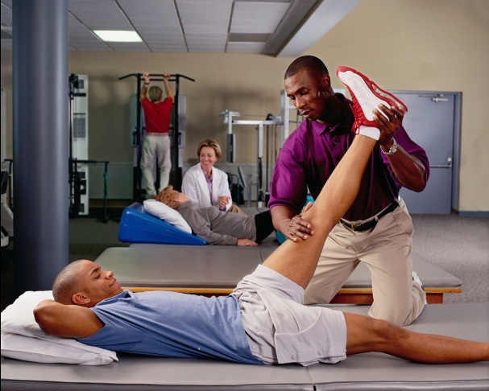



Worker’s Compensation Coverage
Doctor
Hospital
Physical Therapy
Prescription Medication
Medical Equipment
Alternative Treatment (i.e. massage therapy and acupuncture) if preapproved
Notes:
Worker’s Compensation covers expenses related to the treatment of work related injury or illness. Examples of covered expenses include, but are not limited to:

Slide 144


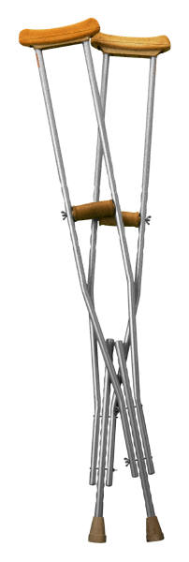


Worker’s Compensation Coverage
Notes:
Worker’s compensation also pays for lost wages as a result of a work-related injury or illness. The absence must be authorized by a doctor. Payments are subject to a three day waiting period and are approximately two thirds of your average weekly wage. In the event that an employee is unable to return to her or his pre-injury job after recovering, she or he may be eligible for vocational rehabilitation services.

Slide 145
Filing a Claim – Employee Responsibility
Notify your supervisor.
Tell your doctor that you were injured on the job.
If you are unable to work as a result of your injury, notify your supervisor.
If you are able to work part time or can work with temporary job modification, notify your supervisor.
Additional forms and contact with the insurance adjustor may be necessary.
Notes:
If you have a work-related injury or illness you must do the following:
Notify your supervisor as soon as possible and assist him or her in completing an employer's first report of injury. Send the completed form to risk management. Risk management must send the report to the department of labor and industry within 72 hours of the date of injury, subject to penalty for non-compliance.
Tell your doctor that you were injured on the job. Medical bills should be sent to risk management for payment under worker's compensation (not your health insurance plan). Receipts for out of pocket expense, such as prescription medication and equipment, should be sent to risk management for reimbursement under worker's compensation.
If you are unable to work as a result of your injury, notify your supervisor. Keep your supervisor informed of your progress and anticipated return to work date. You must provide your supervisor and risk management with a doctor's note which authorizes your absence from work.
If you are able to work part time or can work with temporary job modification please notify your supervisor and risk management. A temporary modified duty work agreement must be completed. This agreement specifies your doctor's restrictions and temporary work assignment as well as the time period your doctor recommends the restrictions should remain in place.
Additional forms and contact with the insurance adjustor may be necessary. Your claim is subject to investigation by the university's insurance adjustor. Complete all requested forms and return them to risk management as quickly as possible.

Slide 146
Filing a Claim – Supervisor Responsibility
Complete the employer's first report of injury and send it to risk management as soon as possible.
Communicate with risk management.
Communicate with your employee.
Consider providing temporary modified duty which will allow your employee to return to work.
Notes:
If your employee experiences a work-related injury or illness, you must do the following:
Complete the employer's first report of injury and send it to risk management as soon as possible. Risk management must send the form to labor and industry within 72 hours of the report of injury. As the supervisor, YOU are the employer. The employee has the responsibility to report the injury or illness and assist the supervisor in completing the employer's first report of injury. If the employee is unable to assist you, complete the form to the best of your ability. An employee has six months from the time an injury is known to be work related to report it, one year for an illness (such as carpal tunnel syndrome).
Communicate with risk management. Call the claims specialist if your employee is unable to work, or when they return to work, following a work related injury or illness. If you have information relative to the investigation of a worker's compensation claim, notify the claims specialist.
Communicate with your employee. Ask how they are doing, when they expect to come back to work, and keep them involved with what's happening at work. Statistics indicate this contact with the work place can assist the employee in recovering from an injury or illness.
Consider providing temporary modified duty which will allow your employee to return to work. Often, an employee who is unable to perform their usual work tasks can work in some capacity. View the necessary work tasks with a creative eye, or identify special projects the employee may be able to work on. Consider allowing your employee to return to work on a part time basis.

Slide 147
Activity?
Notes:
***Any suggestions for an activity?***

Slide 148
Resources
http://www.uvm.edu/~riskmgmt/?Page=insurance/workerscomp.html&SM=insurance/insuranceclaims_submenu.html

