Slide 1
Personal Identity

Slide 2
Agenda
The problem of personal identity
Qualitative vs. numerical identity
Two criteria for personal identity
Abnormal Cases
What’s at stake

Slide 3
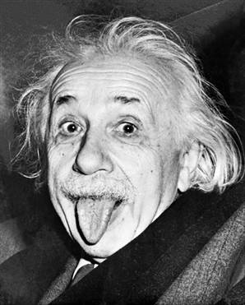
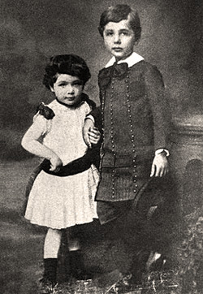
Some Simple Facts
People change.
ca. 1950’s
People endure.
1884

Slide 4
Some Simple Facts
You have more in common with your classmates than you do with your three-year-old self:
  physically;
  emotionally; and
  intellectually.
Yet you are identical to your three-year-old self, and distinct from your classmates.

Slide 5
Our Question
The problem of personal identity: In virtue of what does one and the same person persist through the radical changes she undergoes over the course of her life?

Slide 6
Agenda
The problem of personal identity
Qualitative vs. numerical identity
Two criteria for personal identity
Abnormal Cases
What’s at stake

Slide 7
Qualitative vs. Numerical Identity
“x and y are the same.”
Two ways of taking this claim:
Qualitative Identity
Numerical Identity
What is it?
Sameness of how x and y are: qualities, properties, features, etc.
Sameness of which individual x and y are: whether x and y are one and the same.
“You have the same pen I do.”
“Joe and I drive the same car.”
“Joe’s cookie is not the same as mine.”
“Your pen ≠ my pen.”
“My spouse’s car = my car.”
“Marilyn Monroe = Norma Jean Baker.”
Examples

Slide 8
Numerical Identity: 3 Features
Numerical identity …
… answers a “how many?” question.
  “MM = NJB” ≈ “MM and NJB are one.”
  “Your pen ≠ my pen” ≈ “Your pen and my pen are two.”
… implies qualitative identity.
  If MM = NJB, then every feature of MM is also a feature of NJB.
… is not implied by qualitative identity.
  Your pen and my pen have the same features, but your pen ≠ my pen.

Slide 9
Personal Identity is Numerical Identity
The problem of personal identity: In virtue of what does one and the same person persist through the radical changes she undergoes over the course of her life?
The problem of personal identity poses a question about numerical identity (not qualitative identity):
How come
this person
=
that person
?

Slide 10
Agenda
The problem of personal identity
Qualitative vs. numerical identity
Two criteria for personal identity
Abnormal Cases
What’s at stake

Slide 11
Two Proposals
“The Mind, or the Meat?”
B
A
Biological Criterion of Identity: A = B if and only if A is biologically connected in the right way to B.
Psychological Criterion of Identity: A = B if and only if A is psychologically connected in the right way to B.

Slide 12
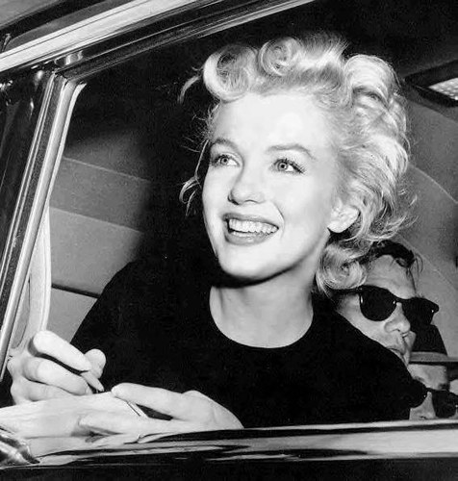
The Two Criteria Agree in Normal Cases
C
B
A
A and B
B and C
Biologically Connected?
✔
✗
Psychologically Connected?
✔
✗
Numerically Identical?
✔
✗

Slide 13
Agenda
The problem of personal identity
Qualitative vs. numerical identity
Two criteria for personal identity
Abnormal Cases
What’s at stake

Slide 14
Some Abnormal Cases I:
Multiple Personality Disorder
To B1 and B4, life as B2 was equivalent to death. From their point of view, they cease to exist when B2 was present, despite the fact that B2 claimed to be both of them. […] Sally, ... although not “killed” by the rise of B2, would have been “squeezed” (her own term) back to her passive status as a coexisting consciousness by a healthy B2. [Wilkes, p. 126]
Christine Beauchamp (Source: Kathleen Wilkes, Fugues, Hypnosis, and Multiple Personality, )

Slide 15
Some Abnormal Cases I:
Multiple Personality Disorder
B
A
A and B
Biologically Connected?
✔
Psychologically Connected?
✗
Numerically Identical?
?

Slide 16
Some Abnormal Cases II:
Split Brains
TAX ABLE
•
If, for example the [split-brain] patient is asked to fixate on a spot at the centre of the screen and the word TAXABLE is flashed so that the letters TAX fall to the left, and the letters ABLE to the right, of fixation, the right-handed patient with a disconnection syndrome will say he or she saw the word ABLE. Yet if asked to point to the word seen using the left hand, he or she will select the word TAX from a list of words that include both ABLE and TAXABLE. (Roland Pucetti, Two Brains, Two Minds?, p. 70)

Slide 17
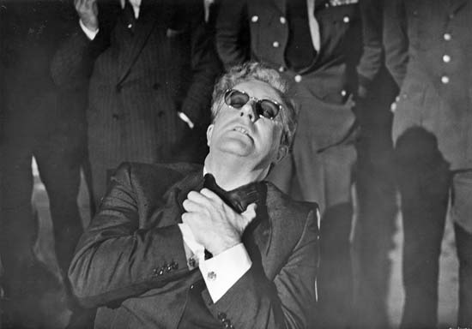
More Split Brains
[O]ne half of a formerly healthy (except prone to epileptic seizures in many cases) brain – the half that does not even think in language – [is] able to perform transparently intentional and purposeful acts like repeatedly throwing a newspaper to the floor during television commercials (the right hemisphere cannot read, and the newspaper does block its view of the TV screen); or slapping one’s face when it is time to get up and have breakfast. (Pucetti, p. 74)
Peter Sellers as Dr. Strangelove

Slide 18
Some Abnormal Cases II:
Split Brains
Righty
Lefty
Lefty and Righty
Biologically Connected?
✔
Psychologically Connected?
✗
Numerically Identical?
?

Slide 19
Some Abnormal Cases III:
The Teletransporter
I gotta be me!
I gotta be me!
Here
Mars

Slide 20
Some Abnormal Cases III:
The Teletransporter
I gotta be me!
I gotta be me!
B
A
Here
Mars
A and B
Biologically Connected?
✗
Psychologically Connected?
✔
Numerically Identical?
?

Slide 21
Biological and Psychological Criteria and Abnormal Cases
Biological and psychological criteria differ on abnormal cases:
  Biological Connection without Psychological Connection: multiple personality disorder, split brains.
  Psychological Connection without Biological Connection: teletransporter, “post-human” movement, etc.

Slide 22
Agenda
The problem of personal identity
Qualitative vs. numerical identity
Two criteria for personal identity
Abnormal Cases
What’s at stake

Slide 23
What’s at Stake I:
The Nature of Persons
You have both:
  a certain body and
  a certain psychology.
In principle:
  bodies can outlast/outnumber psychologies; and
  psychologies can outlast/outnumber bodies.
Which do you have essentially?
Are you essentially mind or meat?

Slide 24
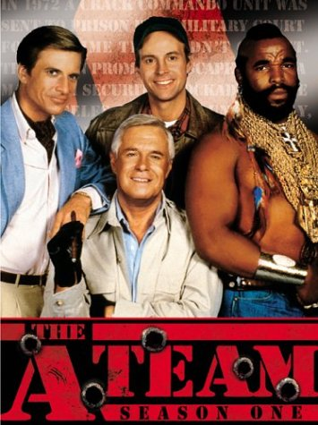
What’s at Stake II:
Moral and Legal Responsibility
A truism:
It is legitimate to punish A for a crime C only if
A = the person who committed C.
Imprisoned for a crime they didn’t commit…

Slide 25
What’s at Stake III: Prudence
A truism:
If A = B, then it is irrational for A NOT to be concerned for the happiness of B.
For example:
  Certain kinds of depression
  Future Tuesday indifference (Parfit)

Slide 26
What’s at Stake IV: Survival
A truism:
A survives changing into something B only if A = B.
For example:
  Do you survive Alzheimer’s Disease?
  Can you survive the death of your body?
  Would you survive teletransportation?

Slide 27
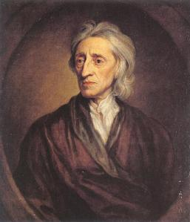
Locke’s Theory
John Locke (1632 - 1704)
Philosopher and Political Theorist.
Locke defended a psychological criterion of personal identity.

Slide 28
Agenda
Locke’s Psychological Criterion
Persons vs. (Human) Bodies
Non-Human Persons
Persons vs. (Human) Animals
Objections

Slide 29
Locke: Personal Identity is a Psychological Phenomenon
[I]n this alone consists personal identity, i.e., the sameness of a rational being; and as far as consciousness can be extended backwards to any past action or thought, so far reaches the identity of that person; it is the same self now it was then; and it is by the same self with this present one that now reflects on it, that that action was done. (pp. 39-40)
The English Translation: Being identical to A involves being “conscious of” what A did and thought.

Slide 30
Qualification needed!
MM
AE
MM is (in a perfectly ordinary sense) “conscious of” some of AE’s actions, but MM ≠ AE.
Lesson: The consciousness in question must be first-personal: “from the inside”.

Slide 31
Locke’s Criterion
What does “consciousness (from the inside) of a thought or action” come to?
In the present: Louis Armstrong: “Man, if you have to ask what it is, you'll never know.”
In the past: episodic memory (“from the inside”).
Locke’s Criterion: If A and B are persons existing at different times:
A = B if and only if A remembers* something B thought or did, OR B remembers* something A thought or did.
* “from the inside”

Slide 32
Why Think Locke’s Criterion is True?
Locke gives two different kinds of arguments:
  Arguments from cases (we’ll look at some later); and
  An argument from the nature of a person:
Locke: A person is just a “consciousness:” Something aware of its own thoughts and actions.
“same person” ≈ “same consciousness”
[A person] is a thinking intelligent being, that has reason and reflection, and can consider itself as itself, the same thinking thing, in different times and places; which it does only by that consciousness which is inseparable from things, and, as it seems to me, essential to it[.. . . ] (p. 39)

Slide 33
Agenda
Locke’s Psychological Criterion
Persons vs. (Human) Bodies
Non-Human Persons
Persons vs. (Human) Animals
Objections

Slide 34
Locke: Persons vs. Bodies I:
The Identity of Bodies
[I]f two or more atoms be joined together into the same mass … whilst they exist united together, the mass, consisting of the same atoms, must be the same mass, or the same body, let the parts be ever so differently jumbled. But if one of these atoms be taken away, or one new one added, it is no longer the same mass or the same body. (p. 35)
Body₌ : b1 = b2 if and only if b1 and b2 consist of exactly the same atoms.
Q: Why think Body₌ is true?
Locke : A body is just a bunch of atoms joined to one another.

Slide 35
Persons vs. Bodies II:
You ≠ your body
Body₌ : b1 = b2 if and only if m1 and m2 consist of exactly the same atoms.
An upshot: You are constantly acquiring a new body.
Some of your atoms fly off, and are replaced (or not) by others.
You will survive the destruction of your present body.
So: you ≠ your present body.
now
later

Slide 36
Agenda
Locke’s Psychological Criterion
Persons vs. (Human) Bodies
Non-Human Persons
Persons vs. (Human) Animals
Objections

Slide 37
Non-Human Persons I:
An Argument from Cases
Typically, persons are human.
Locke: But they need not be:
Humanity without rationality (and personhood)
Rationality (and personhood) without humanity.
I think I may be confident, that, whoever should see a creature of his own shape or make, though it had no more reason all its life than a cat or a parrot, would call him still a [hu]man [being]; or whoever should hear a cat or a parrot discourse, reason, and philosophize, would call or think it nothing but a cat or a parrot; and say, the one was a dull irrational [hu]man [being], and the other a very intelligent rational parrot. (p. 38)

Slide 38

Non-Human Persons II:
Eyewitness Testimony
An upshot: there can be non-human persons.
Perhaps there are! Some eyewitness testimony:
They asked [the amazing rational parrot], what it thought that man was, pointing to the prince. It answered, Some General or other. When they brought it close to him, he asked it, D'ou venez-vous? It answered, De Marinnan. The Prince, A qui estes-vous? The parrot, A un Portugais. The Prince, Que fais-tu? Je garde les poulles. The Prince laughed, and said, Vous gardez les poulles? The parrot answered, Oui, moi, et je sçai bien faire; and made the chuck four or five times that people use to make to chickens when they call them. (p. 38)

Slide 39
Non-Human Persons III:
The Point
Perhaps every person is a human being (and vice versa).
But, being a human being is not the same thing as being a person.
In principle:
  one could be a human being without being a person; and
  one could be a person without being a human being.

Slide 40
Agenda
Locke’s Psychological Criterion
Persons vs. (Human) Bodies
Non-Human Persons
Persons vs. (Human) Animals
Objections

Slide 41
Persons vs. Animals I:
Animal Identity
This also shows wherein the identity of the same [hu]man [being] consists; viz., in nothing but a participation of the same continued life, by constantly fleeting particles of matter, in succession vitally united to the same organized body. (pp. 36-7)
Animal₌: a1 = a2 if and only if a1 and a2 are bodies continuing the same life.
Q: Why think Animal₌ is true?
Locke : An animal is an organism: a system of parts organized to maintain itself and achieve certain ends.
[The ends: “The Four F’s”: fleeing, feeding, fighting and reproducing.]

Slide 42
Persons vs. Animals II:
Socrates Waking and Sleeping
One animal, two persons:
If the same Socrates waking and sleeping do not partake of the same consciousness, Socrates waking and sleeping is not the same person. And to punish Socrates waking for what sleeping Socrates thought, and waking Socrates was never conscious of, would be no more of right, than to punish one twin for what his brother-twin did, whereof he knew nothing, because their outsides were so like, that they could not be distinguished[.. . . ] (p. 46)

Slide 43

Socrates Waking ≠ Socrates Sleeping
Persons:
P1
zzzzzz….
P2
Argument:
P1 = P2 only if it is legitimate to blame/punish P1 for P2’s crime.
It is not legitimate to blame/punish P1 for P2’s crime.
(C) P1 ≠ P2

Slide 44
Two persons,
one animal:
Persons:
P1
P2
Animals:
A1
A
P1 and A are distinct.
Argument:
Suppose that Socrates never woke again.
Then, P1 would not survive. But A would.
That means: A can survive the death of P1.
So, A ≠ P1
(Same goes for P2).

Slide 45
Persons vs. Animals III:
The Prince and the Pauper
Two animals, one person:
For should the soul of a prince, carrying with it the consciousness of the prince’s past life, enter and inform the body of a cobbler, as soon as deserted by his own soul, every one sees he would be the same person with the prince, accountable only for the prince’s actions. (p. 44)

Slide 46

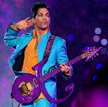
The person in the Prince’s body yesterday =
the person in the Cobbler’s body today:
My name is Prince! And I am funky!
My name is Prince! And I am funky!
Persons:
P1
P2
yesterday
today
Argument:
P1 ≠ P2 only if it is illegitimate to blame/punish P1 for P2’s crimes.
It is legitimate to blame/punish P1 for P2’s crime.
(C) P1 = P2

Slide 47
Two animals,
one person:
My name is Prince! And I am funky!
My name is Prince! And I am funky!
Persons:
P
P
Animals:
yesterday
today
A1
A1 ≠ P
Argument:
Suppose that A1 died yesterday.
Then, A1 did not survive. But P did.
That means: P can survive the death of A1.
So, A1 ≠ P
(Same goes for A2).
A2

Slide 48
Persons and Animals IV:
Lessons of the Cases
  Two cases:
  Socrates Waking/Sleeping: When one animal houses two consciousnesses, we judge there to be two persons;
  Prince/Pauper: When two animals house (successively) one consciousness, we judge there to be only one person.
  Our judgments of personal identity track psychological connectedness.
  Our judgments of personal identity do not track biological connectedness.
  This is a reason to accept a psychological criterion and reject a biological criterion

Slide 49
Persons and Animals V:
How many things?
I gotta be me!
Body B
Animal A
Person P
Locke thinks:
B ≠ A ≠ P.
There are three individuals in your chair.
You

Slide 50
Agenda
Locke’s Psychological Criterion
Persons vs. (Human) Bodies
Non-Human Persons
Persons vs. (Human) Animals
Objections

Slide 51
Objections: Agenda
Drunken Forgetfulness
Ordinary Forgetfulness
Implanted Memories
Reid’s Incoherence Objection

Slide 52
The Objection from Drunken Forgetfulness
But is not a man drunk and sober the same person? why else is he punished for the fact he commits when drunk, though he be never afterwards conscious of it? Just as much the same person as a man that walks, and does other things in his sleep, is the same person, and is answerable for any mischief he shall do in it. (p. 48)

Slide 53

The Objection from Drunken Forgetfulness
I <hic!> love you, man!
P1
What happened last night?
P2
This morning
Last night
Argument:
P1 ≠ P2 only if it is illegitimate to blame/punish P1 for P2’s crimes.
It is legitimate to blame/punish P1 for P2’s crime.
(C1) P1 = P2
(3) According to Locke’s Criterion, P1 ≠ P2.
(C) Locke’s Criterion is false.

Slide 54
Drunken Forgetfulness:
Locke’s Response
Human laws punish both, with a justice suitable to their way of knowledge; because, in these cases, they cannot distinguish certainly what is real, what counterfeit: and so the ignorance in drunkenness or sleep is not admitted as a plea. For, though punishment be annexed to personality, and personality to consciousness, and the drunkard perhaps be not conscious of what he did, yet human judicatures justly punish him, because the fact is proved against him, but want of consciousness cannot be proved for him. But in the great day, wherein the secrets of all hearts shall be laid open, it may be reasonable to think, no one shall be made to answer for what he knows nothing of; but shall receive his doom, his conscience accusing or excusing him. (p. 48)

Slide 55
Drunken Forgetfulness:
Locke’s Response
Locke “bites the bullet”:
It is illegitimate to blame/punish a person for what she does while blacked out.
Why think otherwise?
Locke: we couldn’t have a justice system that acknowledges this excuse.

Slide 56
Drunken Forgetfulness:
Against Locke’s Response
Our justice system requires (and gets) evidence about “state of mind” all the time.
Examples:
  People get convicted of first degree murder;
  People get exonerated from first degree murder.
If being blacked out exonerated someone, there is no bar in principle to proving it in court.

Slide 57
Objections: Agenda
Drunken Forgetfulness
Ordinary Forgetfulness
Implanted Memories
Reid’s Incoherence Objection

Slide 58
The Objection from Ordinary Forgetfulness
For whatsoever any substance has thought or done, which I cannot recollect, and by my consciousness make my own thought and action, it will no more belong to me, whether a part of me thought or did it, than if it had been thought or done by any other immaterial being anywhere existing. (p. 49)

Slide 59
The Objection from Ordinary Forgetfulness
This sandwich is yummy!
Personal identity is complicated!
Two months ago at lunch
now
Consider:
(OBVIOUS) Two months ago at lunch, you were having thoughts and feelings, and performing actions, which you do not now remember.

Slide 60
The Objection from Ordinary Forgetfulness
(OBVIOUS) Two months ago at lunch, you were having thoughts and feelings, and performing actions, which you do not now remember.
Argument:
According to Locke’s Criterion, (OBVIOUS) is not true.
(OBVIOUS) is true.
(C) So, Locke’s Criterion is false.

Slide 61
Ordinary Forgetfulness:
Locke’s Response
Locke bites the bullet:
For whatsoever any substance has thought or done, which I cannot recollect, and by my consciousness make my own thought and action, it will no more belong to me, whether a part of me thought or did it, than if it had been thought or done by any other immaterial being anywhere existing. (p. 49)
Yummy lead.

Slide 62
Objections: Agenda
Drunken Forgetfulness
Ordinary Forgetfulness
Implanted Memories
Reid’s Incoherence Objection

Slide 63
The Objection from Implanted Memories
But that which we call the same consciousness, not being the same individual act, why one intellectual substance may not have represented to it, as done by itself, what it never did, and was perhaps done by some other agent; why, I say, such a representation may not possibly be without reality of matter of fact, as well as several representations in dreams are, which yet whilst dreaming we take for true, will be difficult to conclude from the nature of things. (p. 42)

Slide 64
The Objection from Implanted Memories
Colonel Mustard
Miss Scarlet
Implanted memory
Colonel Mustard kills Mr. Boddy with the pistol in the conservatory.
Colonel Mustard implants his memory in Miss Scarlet.

Slide 65
The Objection from Implanted Memories
Colonel Mustard
Miss Scarlet
Implanted memory
Argument:
According to Locke’s Criterion, Miss Scarlet = the person who killed Mr. Boddy.
Miss Scarlet ≠ the person who killed Mr. Boddy.
(C) So, Locke’s Criterion is false.

Slide 66
Implanted Memories:
Locke’s Response
And that [memories of other people are never implanted in us], will by us, till we have clearer views of the nature of thinking substances, be best resolved into the goodness of God, who as far as the happiness or misery of any of his sensible creatures is concerned in it, will not, by a fatal error of theirs, transfer from one to another that consciousness which draws reward or punishment with it. (p. 42)
Locke’s Response:
God wouldn’t let that happen.

Slide 67
Implanted Memories:
Against Locke’s Reponse
Locke: God’s goodness prevents Him from allowing memories of others to be implanted.
Locke’s theological claim requires defense.
Even if memories are never in fact implanted, they could be.
Also: Why would it be bad for God to allow this?

Slide 68
Objections: Agenda
Drunken Forgetfulness
Ordinary Forgetfulness
Implanted Memories
Reid’s Incoherence Objection

Slide 69
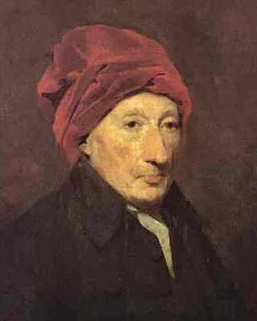
Reid’s Incoherence Objection
Thomas Reid (1710-1796)
Philosopher, esp. epistemology.
A defender of common sense and early critic of Hume.

Slide 70
Reid’s Objection:
The Case of the Old General
Suppose a brave officer to have been flogged when a boy at school for robbing an orchard, to have taken a standard from the enemy in his first campaign, and to have been made a general in advanced life; suppose, also, which must be admitted to be possible, that, when he took the standard, he was conscious of his having been flogged at school, and that, when made a general, he was conscious of his taking the standard, but had absolutely lost the consciousness of his flogging.

Slide 71
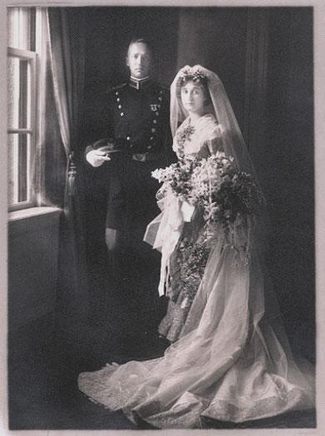

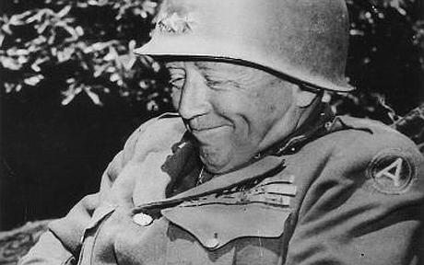
memory
1950
memory
1910
X
memory
1892

Slide 72
Reid’s Objection:
Transitivity
Numerical identity is transitive: If x = y and y = z, then x = z.
“remembers” is not transitive:
  The old general remembers the brave lieutenant;
  The brave lieutenant remembers the young boy; but
  The old general doesn’t remember the young boy.
x
=
y
y
=
z
X
x
y
y
z
remembers
remembers

Slide 73
Reid’s Objection:
Statement
S
B
G
According to Locke’s Criterion, G = S and S = B.
Transitivity: If G = S and S = B, then G = B.
(C1) So, according to Locke’s Criterion, G = B.
(3) According to Locke’s Criterion, G ≠ B.
(C) So, Locke’s Criterion is incoherent.

Slide 74
Reid’s Objection:
Locke Can’t Bite the Bullet
Notice: in response to the previous three objections, Locke could “bite the bullet”:
  Drunken forgetfulness: “the sober person ≠ the drunk person.”
  Ordinary forgetfulness: “You ≠ the person at lunch two months ago.”
  Implanted memories: “Ms. Scarlet = the person who killed Mr. Boddy.”
But Locke cannot “bite the bullet” on Reid’s objection: “G=B and G≠B” is utterly unintelligible.
Upshot: Reid’s objection is stronger than the others

Slide 75
Reid’s Objection:
How Should Locke Respond?
We have to give up Locke’s Criterion.
Definitions:
  p1 is directly psychologically connected with p2: p1 is conscious of (i.e. remembers) something p2 said or did, or vice versa.
  p1 is psychologically continuous with p2: there is a chain of direct psychological connections linking p1 to p2.
New Psychological Criterion: If A and B are persons existing at different times:
A = B if and only if A is psychologically continuous with B.

Slide 76
The General is Psychologically Continuous with the Boy.
According to the New Psychological Criterion, G = B
Direct connection
1950
Direct
connection
1910
Psychological continuity
1892

Slide 77
Psychological Continuity is Transitive
The New Psychological Criterion avoids Reid’s objection.
Psychological continuity, like identity, is transitive:
If p1 is psychologically continuous with p2, and
p2 is psychologically continuous with p3; then
p1 is psychologically continuous with p3.
P1
P2
P3
: Direct connection
: Psych. Continuity

Slide 78
Psychological Continuity and
Ordinary Forgetfulness
You are psychologically continuous with the person who ate lunch two months ago.
Two months ago at lunch
now

Slide 79
Psychological Continuity and
Drunken Forgetfulness
Last night
Locke sober is psychologically continuous with Locke drunk.
Yesterday morning
This morning

Slide 80
Psychological Continuity and Implanted Memories
Colonel Mustard
Miss Scarlet
[The objection is not avoided.]
Miss Scarlett is directly psychologically connected to Colonel Mustard.
So, she’s psychologically continuous with him too.
Implanted memory

Slide 81
Reid’s Incoherence Objection:
Summary
Locke’s Criterion succumbs to Reid’s Incoherence Objection.
Moving to psychological continuity keeps the spirit of Locke’s view, while avoiding the objection.
The New Psychological Criterion also avoids objections from drunken forgetfulness and ordinary forgetfulness.
But it does not avoid the objection from implanted memories.

