Slide 1
Passer in Catullus 2 and 3
Julian Ward Jones Jr.’s Argument for non-sexual intent.

Slide 2
Catullus
Born around 84 BC, died 54 BC at 29 or 30 years old
Wrote short poems and a variety of meter
Broke with more austere conventions of classical Latin poetry
Known for profane, licentious, and scandalous poems
Despite this, the strong emotion and eloquent composition he displayed led to critical acclaim

Slide 3
Catullus 2 and 3
These two poems are about his girlfriend Lesbia’s ‘pet sparrow’
Catullus 2 described the bird as a pet and playmate of Lesbia that he doesn’t delight in playing with himself
Possibility for double-entendre, yet there is much room for interpretation
Catullus 3 is a faux-eulogy for the pet
Important for potential allegorical meaning

Slide 4
The Debate Begins
In the late 1400s, Florentine scholar Angelo Poliziano opens the door for a possible ‘obscene allegory’ based on the final lines of one of Martial’s epigrams
donabo tibi passerem Catulli
Dutchman Isaac Voss is the first to explicitly state that passer refers to Catullus’ penis
Catullus 2 is about how much Lesbia loves having sex with him and how masturbation does not satisfy Catullus
Catullus 3 is about sexual exhaustion

Slide 5
Modern Scholarship
After centuries of these theories generally being unaccepted, they begin to gain some traction again in the 1970s
Scholars publish paper arguing for a sexual interpretation of the poems, other scholars publish rebuttals
Richard H. Hooper publishes a positive argument for the obscene in 1985; in 1998, Julian Ward Jones Jr. publishes an article specifically refuting Hooper’s piece
“In a classical Latin poet, we expect something in the context to signal the point if allegory is intended.”

Slide 6
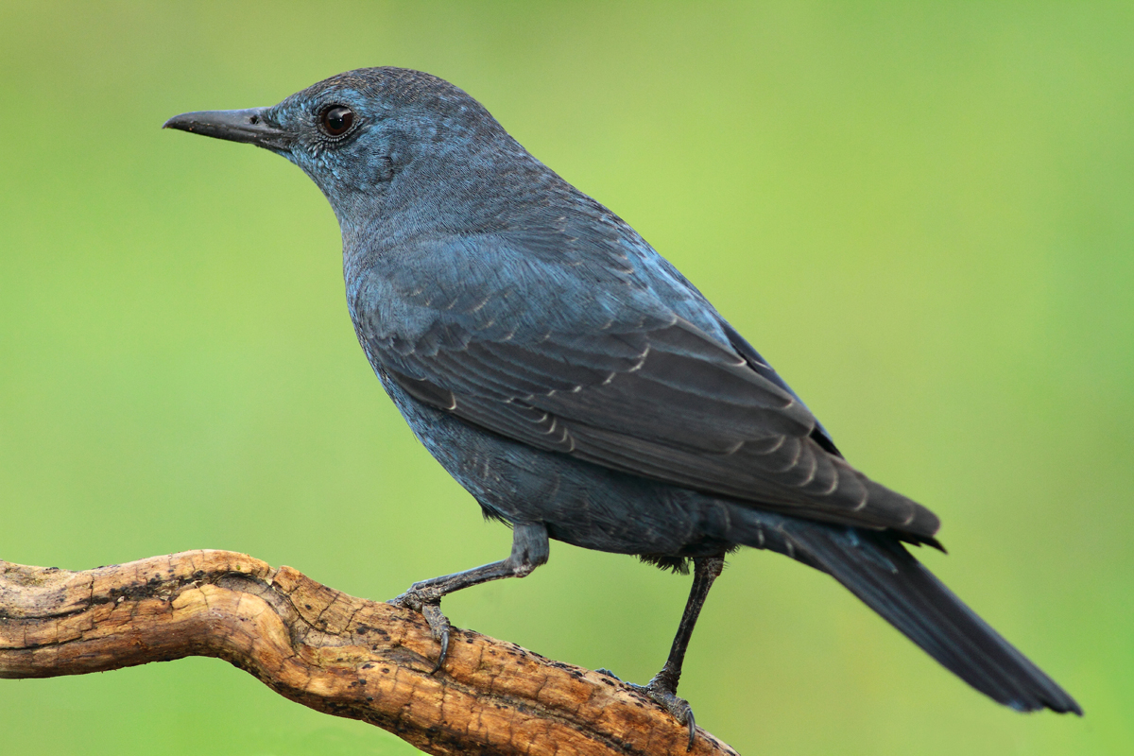
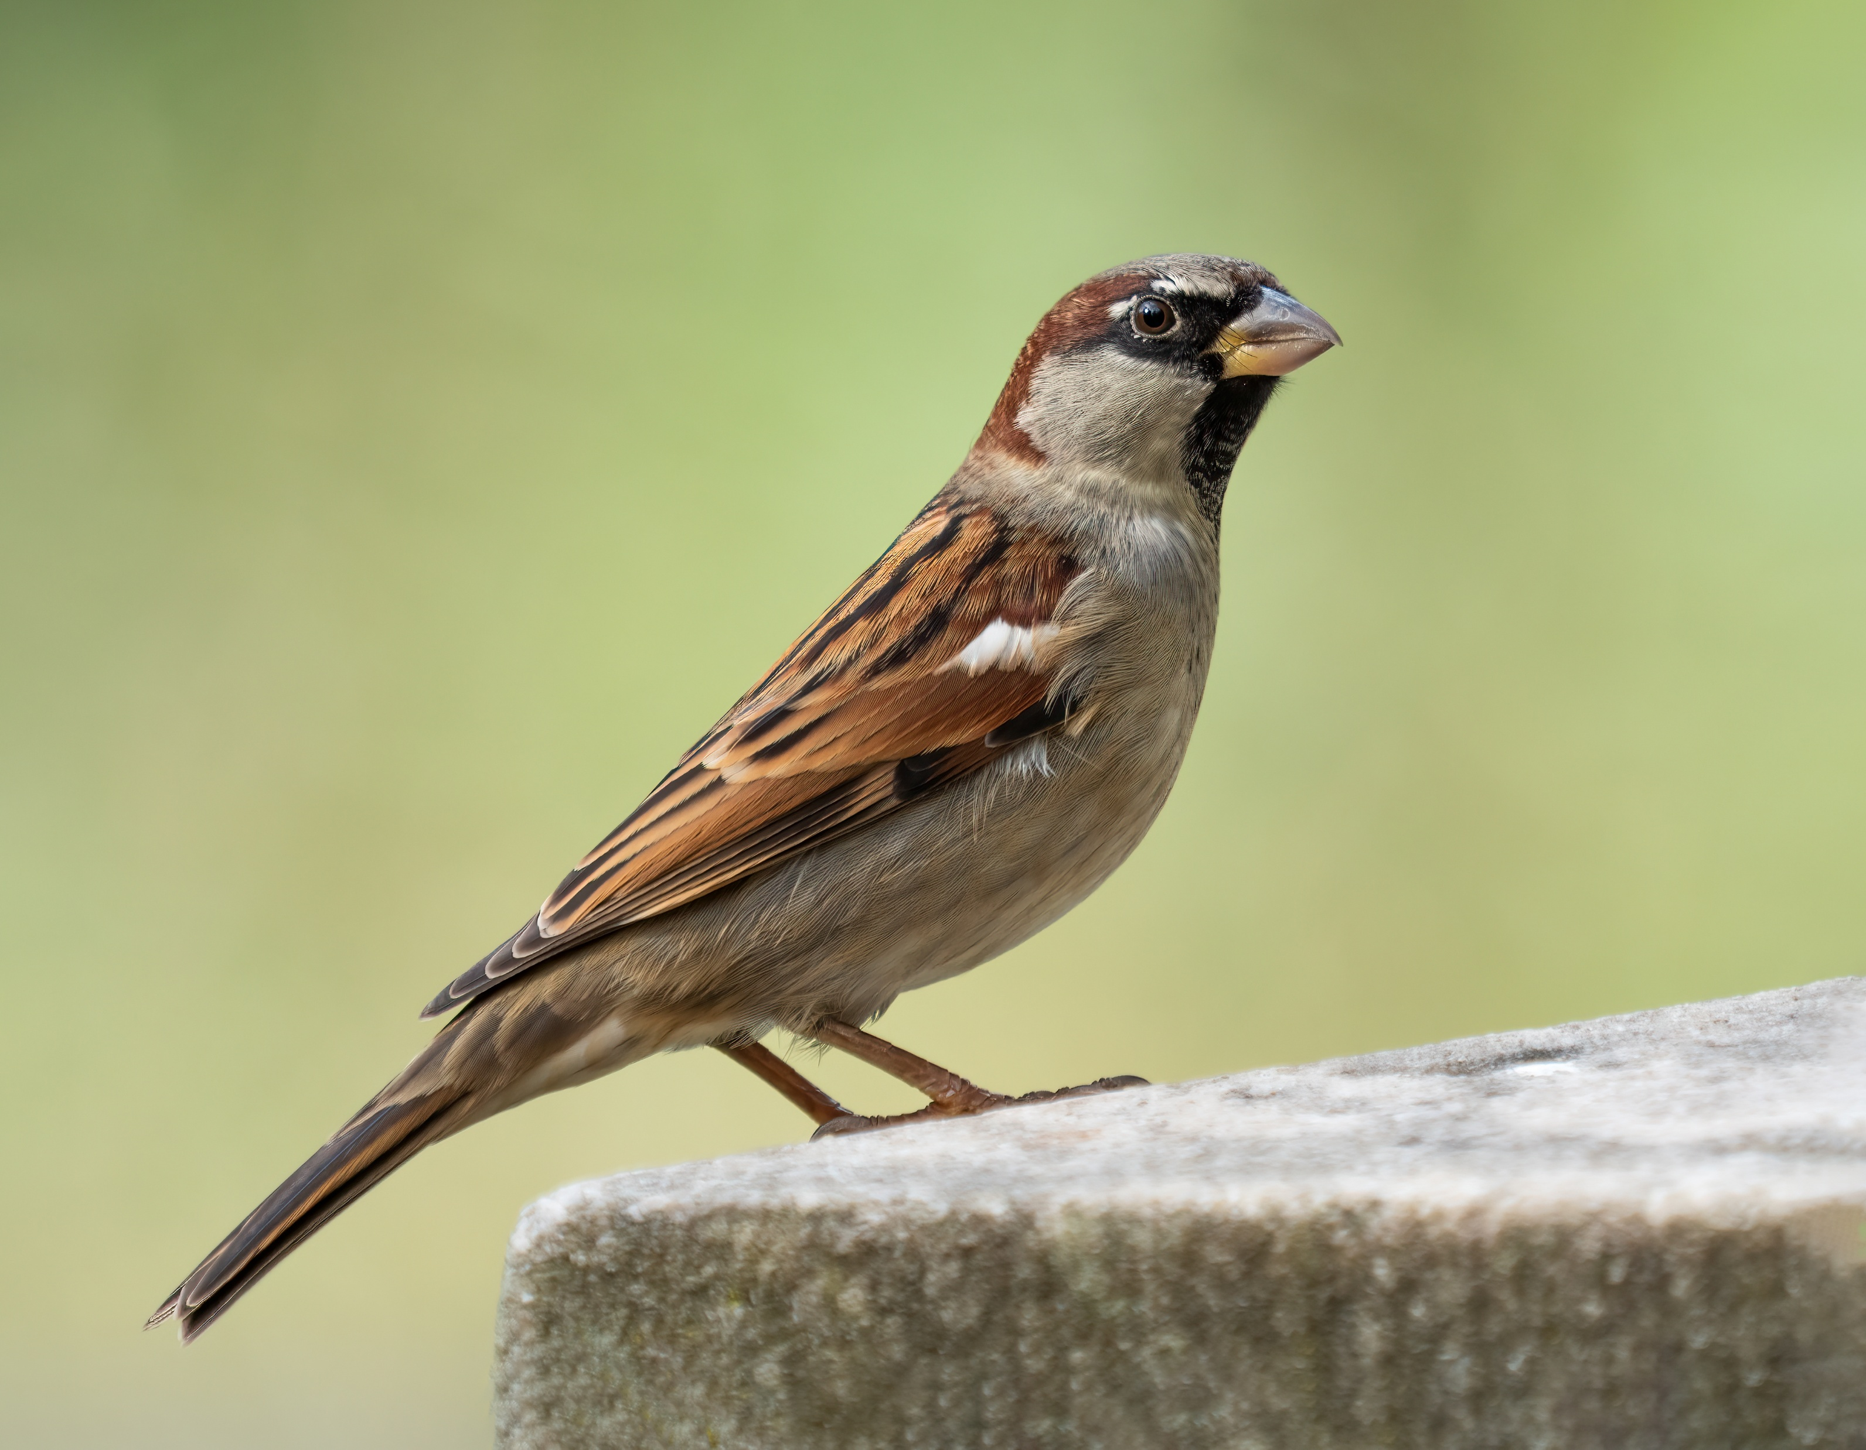
Passer as a Sparrow?
There is no record of sparrows being kept as pets prior to Catullus
Jones points out that ‘sparrow’ is “too restrictive” a translation since it is applied in modern Romance languages to many small birds and likely was in antiquity as well
The Oxford Latin Dictionary identifies Catullus’ passer as a blue thrush, apparently an easily tamed bird which forms attachments with owners.
Source: https://upload.wikimedia.org/wikipedia/commons/4/4d/Monticola_solitarius%2C_Spain_1.jpg
Source: https://upload.wikimedia.org/wikipedia/commons/9/9b/House_sparrow_male_in_Prospect_Park_%2853532%29.jpg

Slide 7
Sinu & Norat
In Catullus 2, in sinu tenere is often translated as something like “held in her bosom” or “between her thighs” and is used as an argument for a sexual meaning
Jones, as others, argues for the meaning “held/supported in her lap” as one would hold any other pet
In Catullus 3, Hooper asserts the line norat ipsam tam bene quam puella matrem (it knew her as well as a girl knows her own mother) is ‘sexually charged’ since norat can carry a sexual connotation
Jones argues this is too taboo, even for Catullus

Slide 8
Martial’s Epigram
Set during Saturnalia with Martial addressing “his cupbearer and homosexual companion Dindymus”
“Da nunc basia, sed Catulliana:
quae si tot fuerint quod ille dixit
donabo tibi passerem Catulli”
“Now give kisses, but Catullian ones: if they will be as many as Catullus said, I will give to you the sparrow of Catullus”

Slide 9
Sexual Meaning
Even Jones agrees that Martial is clearly making a sexual innuendo here.
Despite passer never explicitly meaning ‘penis’ in Latin, the Greek strouthos (also meaning sparrow and translated as passer in Latin) did have this double meaning
Jones argues that Martial likely knew this and intended to imbue the Latin passer with the same double-meaning as the Greek strouthos

Slide 10
Just a joke!
Jones also argues, however, that this is a double-meaning invented by Martial to make a joke
Passer was also the title of a collection of Catullus’ work popular in antiquity
Thus, in these final lines, Martial is playing a joke on Dindymus. “He will give Dindymus a passer, but it will be a Passer Catulli. Dindymus expects a mentula; is is promised a metrica!”

Slide 11
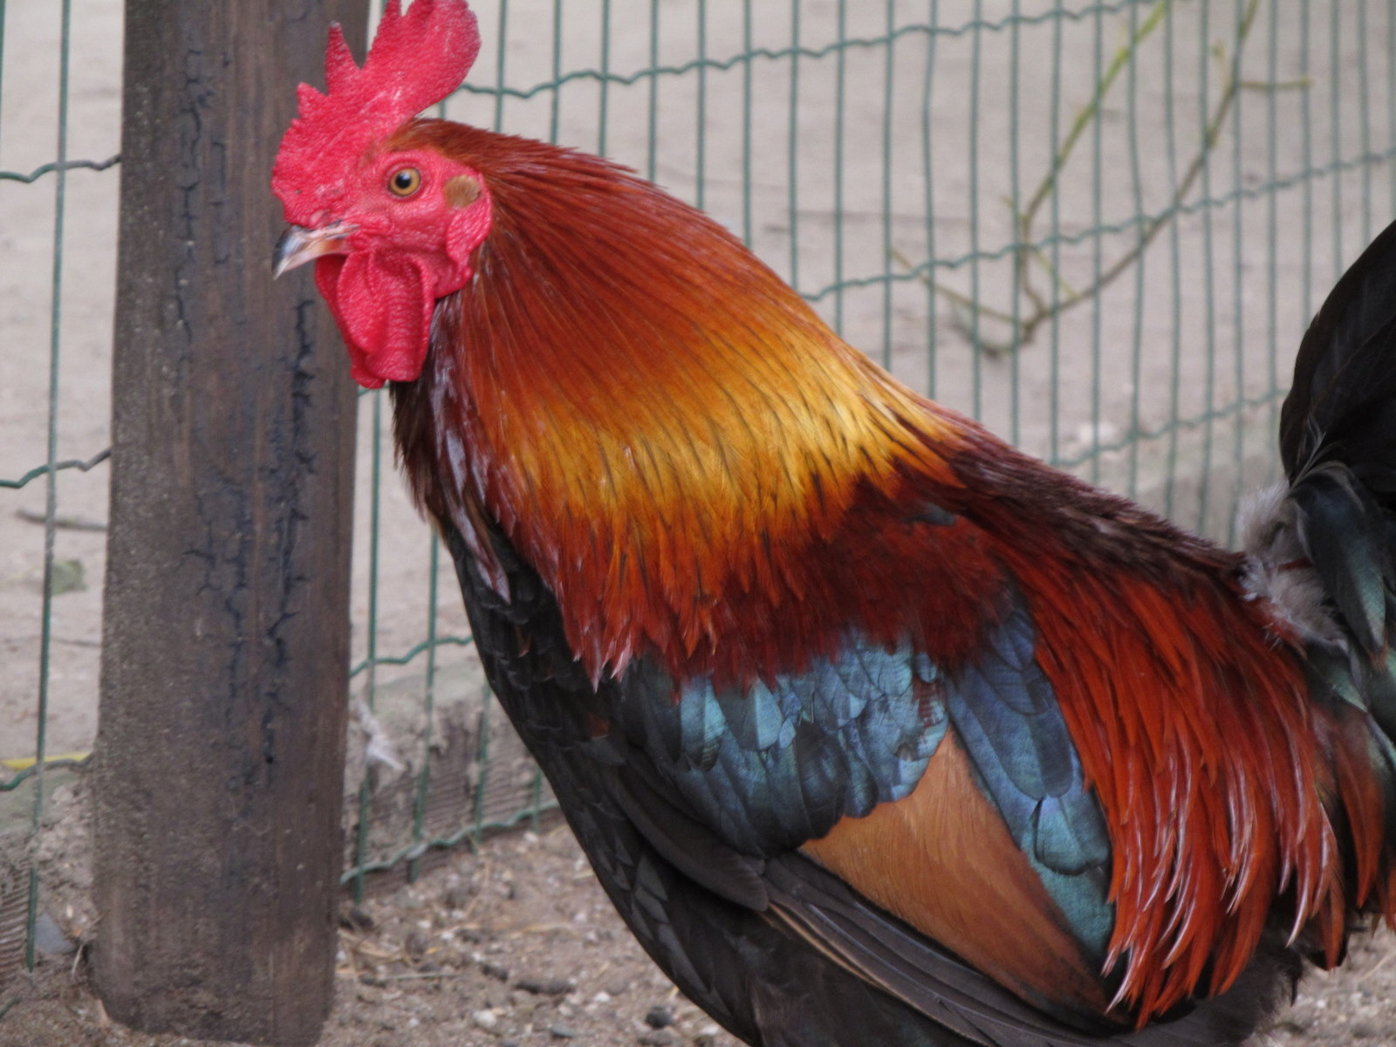
Jones’ Conclusion
“The traditional interpretation of poem 2 reflects correctly the poet’s intention and the passer is simply a passer.”
$$≠$$
Source: https://upload.wikimedia.org/wikipedia/commons/9/9b/House_sparrow_male_in_Prospect_Park_%2853532%29.jpg
Source: https://upload.wikimedia.org/wikipedia/commons/7/76/20110709_Harry_Malter_%280002%29.jpg

Slide 12
Some Issues
Authorial intent, which is what Jones argues for in his thesis, is by nature dubious for anyone but the author to say.
Passerem Cattuli could reference an obscene allegory that Martial read in Catullus 2 and 3.
Why can’t Catullus apply the double-meaning to passer that Martial does?
Why can’t Catullus break with the tradition of signaling an allegory in the context of the poem?
Wouldn’t in sinu tenere potentially be an indiciation of an allegory?

Slide 13
My Conclusion
Jones makes some good arguments against a sexual interpretation, but the arguments for it seem to be equally as strong. I do not think Catullus’ intent can be known.
=?
Source: https://upload.wikimedia.org/wikipedia/commons/9/9b/House_sparrow_male_in_Prospect_Park_%2853532%29.jpg
Source: https://upload.wikimedia.org/wikipedia/commons/7/76/20110709_Harry_Malter_%280002%29.jpg

Slide 14
Thank you!
Source
Jones, Julian Ward. “Catullus’ ‘Passer’ as ‘Passer.’” Greece & Rome, vol. 45, no. 2, 1998, pp. 188–94. JSTOR, http://www.jstor.org/stable/642982. Accessed 8 Apr. 2025.

