Slide 1
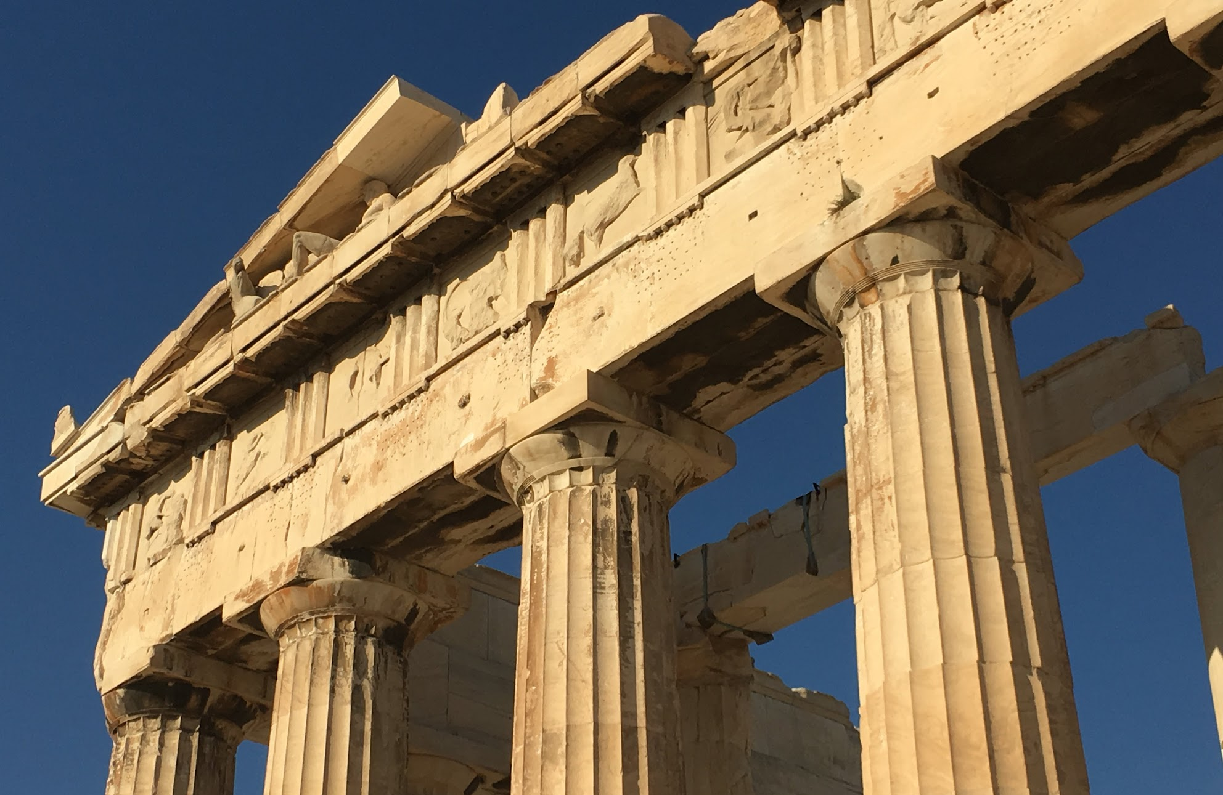
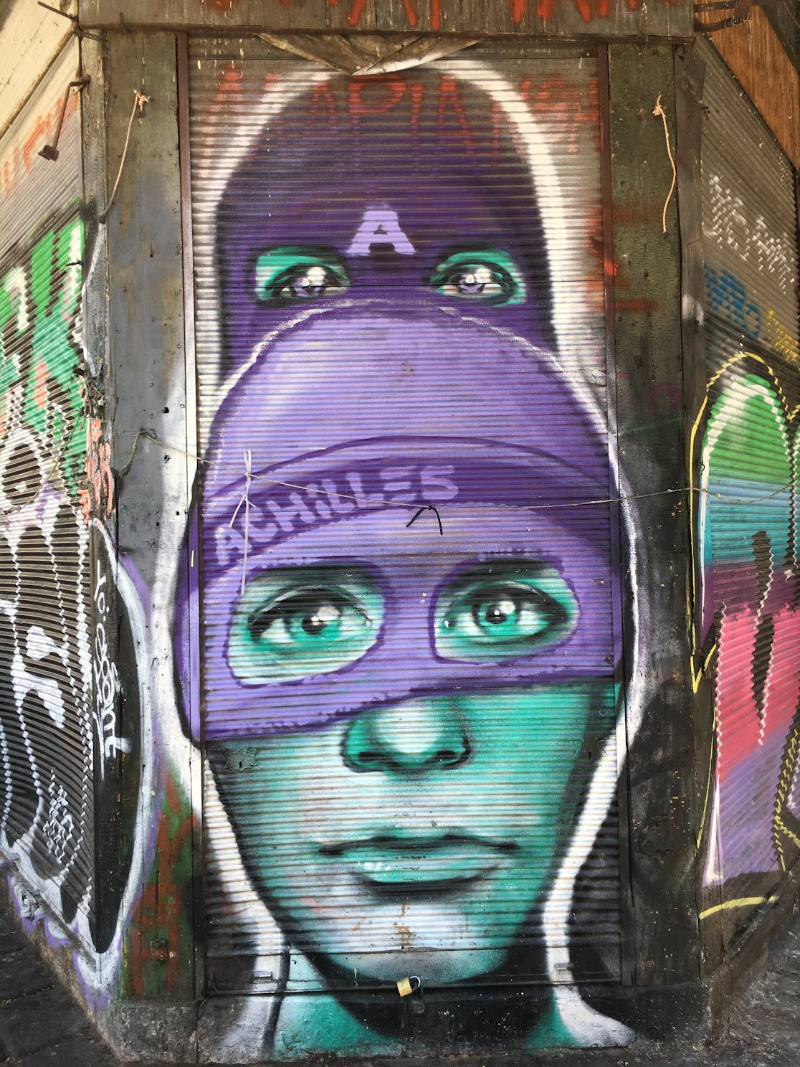
Ancient Greek History and Culture (in Greece!)
CLAS 2990/HST 2990 (3 credits)
May 18-June 26
Greece dates: May 27-June 14

Slide 2
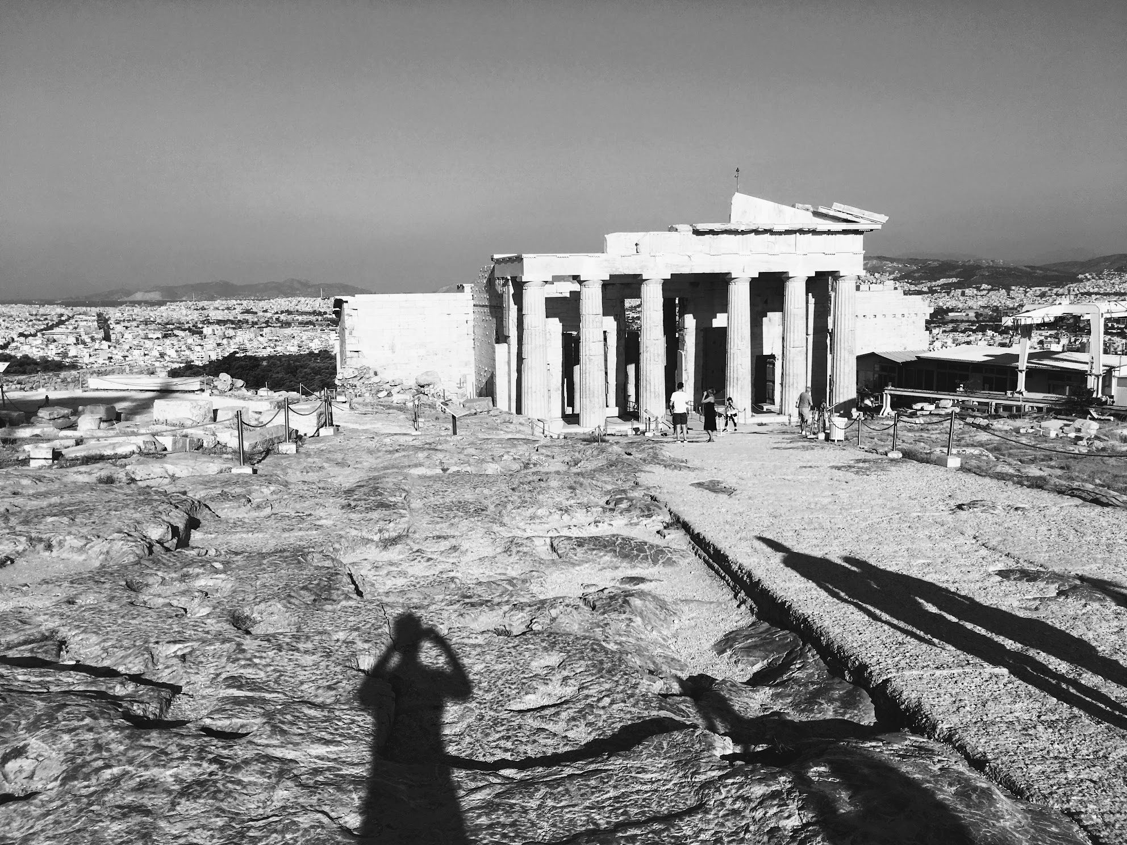
Summary
May 18-26: asynchronous learning
May 27-June 14: Greece
June 15-26: students work on final project asynchronously
Asynchronous means that students will be completing work on their own—no class meetings.

Slide 3

May 18-26: An Overview
Asynchronous learning.
Students will be asked to complete assignments.
All work will be submitted on Brightspace.
There will be no course meetings in person or remotely on Teams.
Assignments include:
  Readings and short answer questions from Camp, The Archaeology of Athens.
  Preparation of two presentations to be delivered on site in Greece. Students will be asked to prepare a handout for each.
  Selection of a research topic for the final project

Slide 4
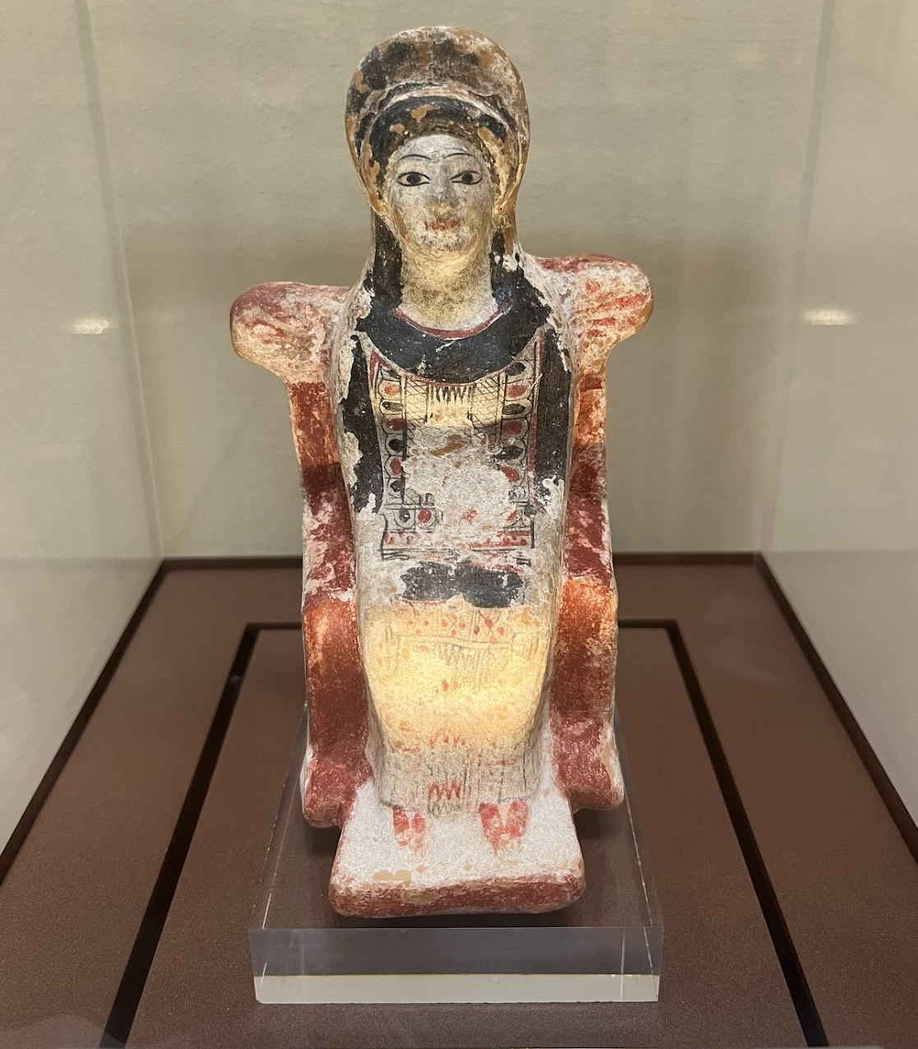
What is the final project?
An Academic Travel Guide!

Slide 5
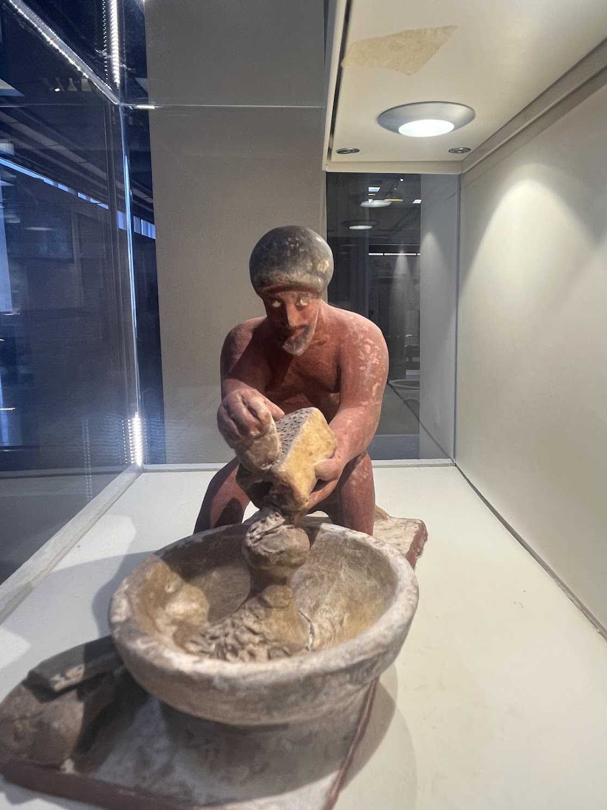
May 18-June 26
Final Project: Topic Selection
You will be asked to identify a topic and briefly explain why you have chosen it.
Topics may include (but are not limited to): vases, coins, city walls, temples, sacrifice, festivals , sporting events, theatre, a particular god, jewelry, the material culture of women’s lives, ancient warfare, sexuality, inscriptions, slavery

Slide 6
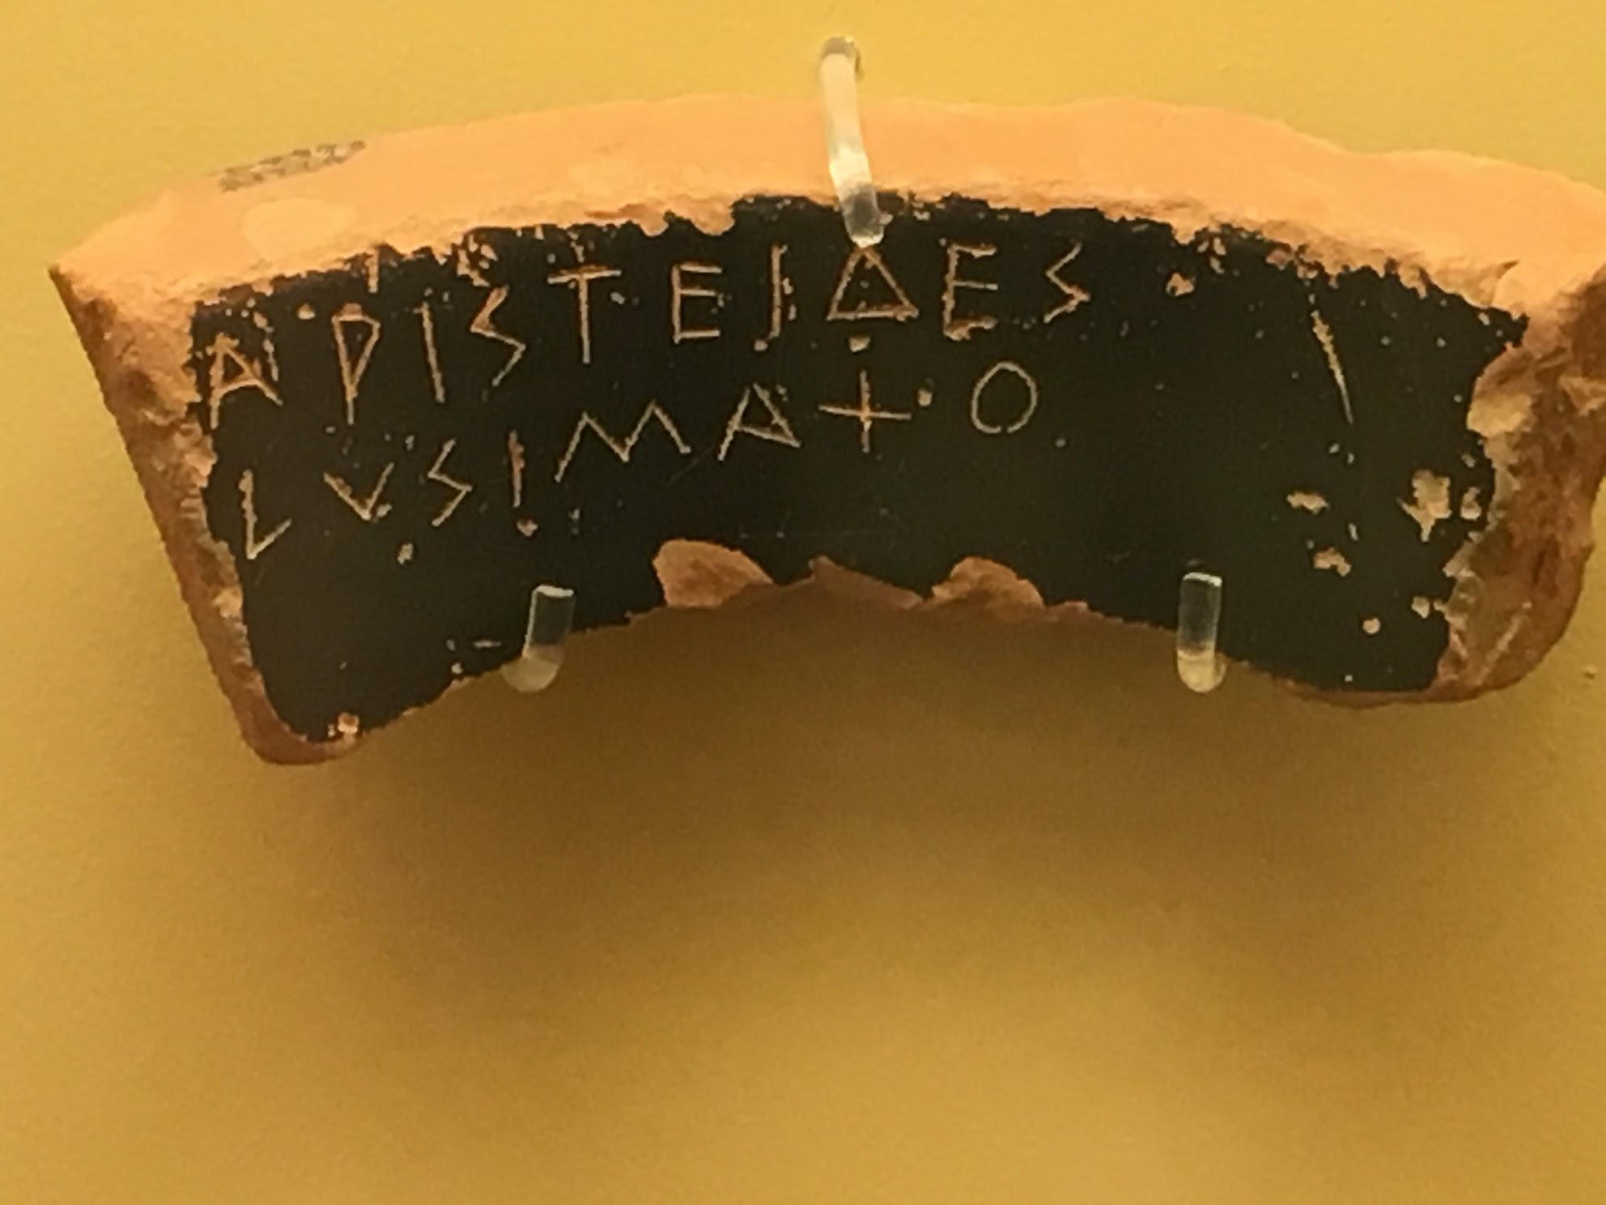
May 27-June 14: Greece
Final Project: Evidence Gathering
During our time in Greece, you will gather evidence related to your topic at museums and archaeological sites.
Evidence may include (but is not limited to): photos of objects at museums and sites, museum placards or site information, notes from course readings, notes from lectures on site, free time activities

Slide 7
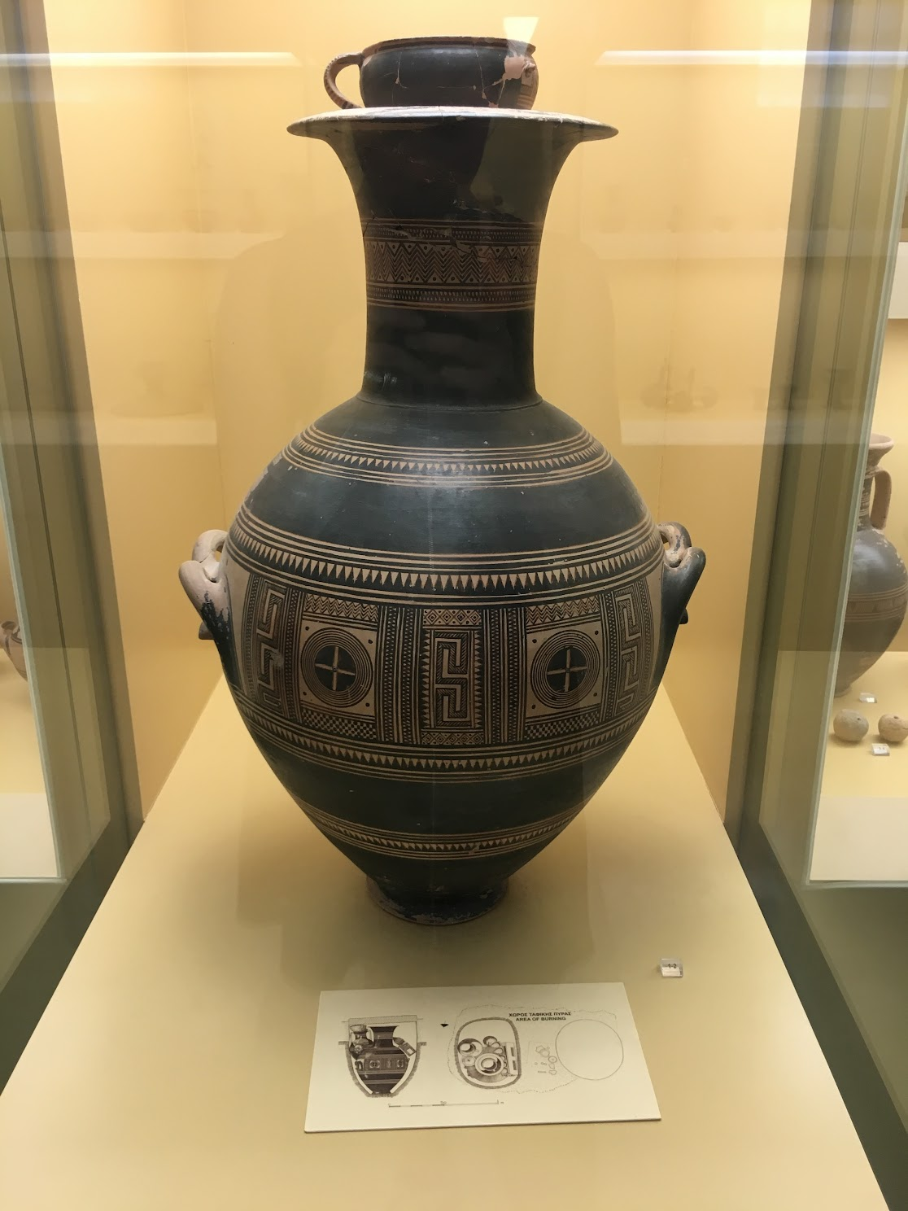
Jun 15-26
Final Project Work
Create a travel research guide on your topic!
You must engage with a minimum of five academic books and/or journal articles related to your topic for the written portion of your guide.
The final version of your academic travel guide will be due Friday, June 26, 11:59 pm on Brightspace.

Slide 8
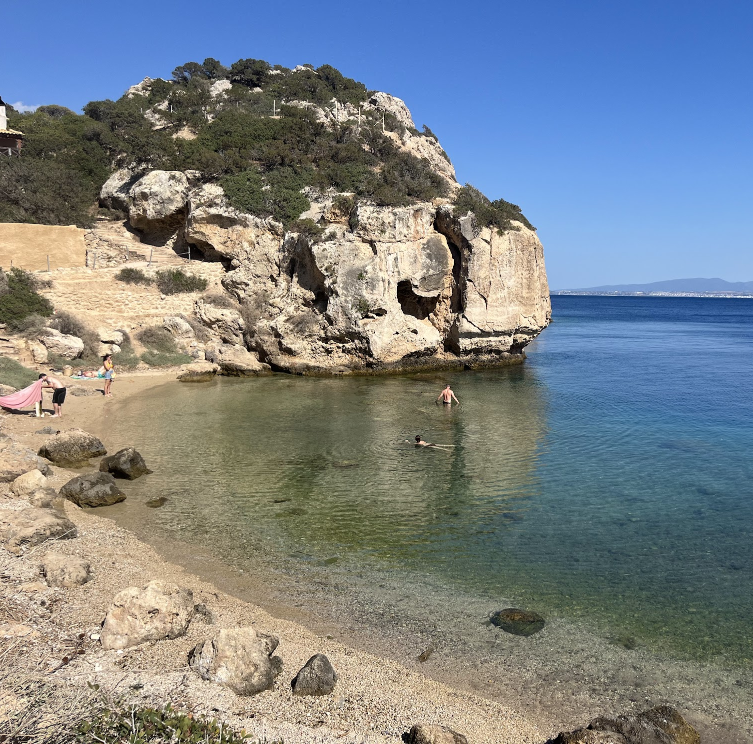
Greece
May 27-June 14
Students will be assigned readings for the day's activities each day
At the end of the day students will submit a reflection on the site visits
All classroom instruction will happen at archaeological sites or museums
At some sites and museums, students will be given worksheets and activities to complete

Slide 9
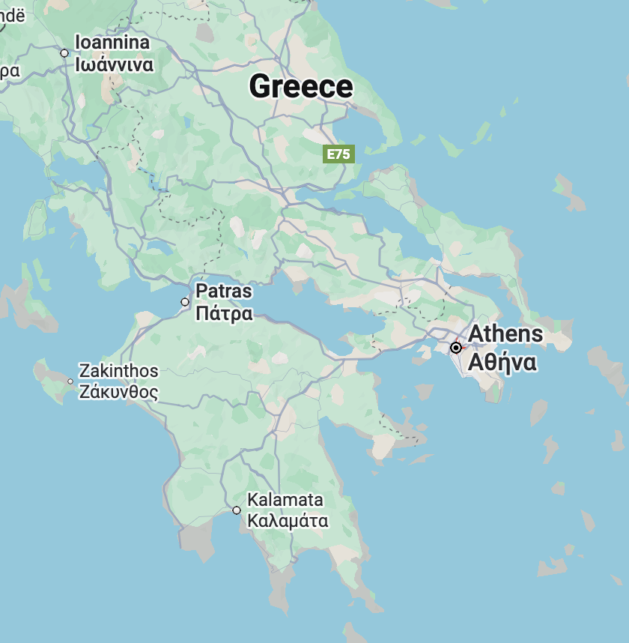
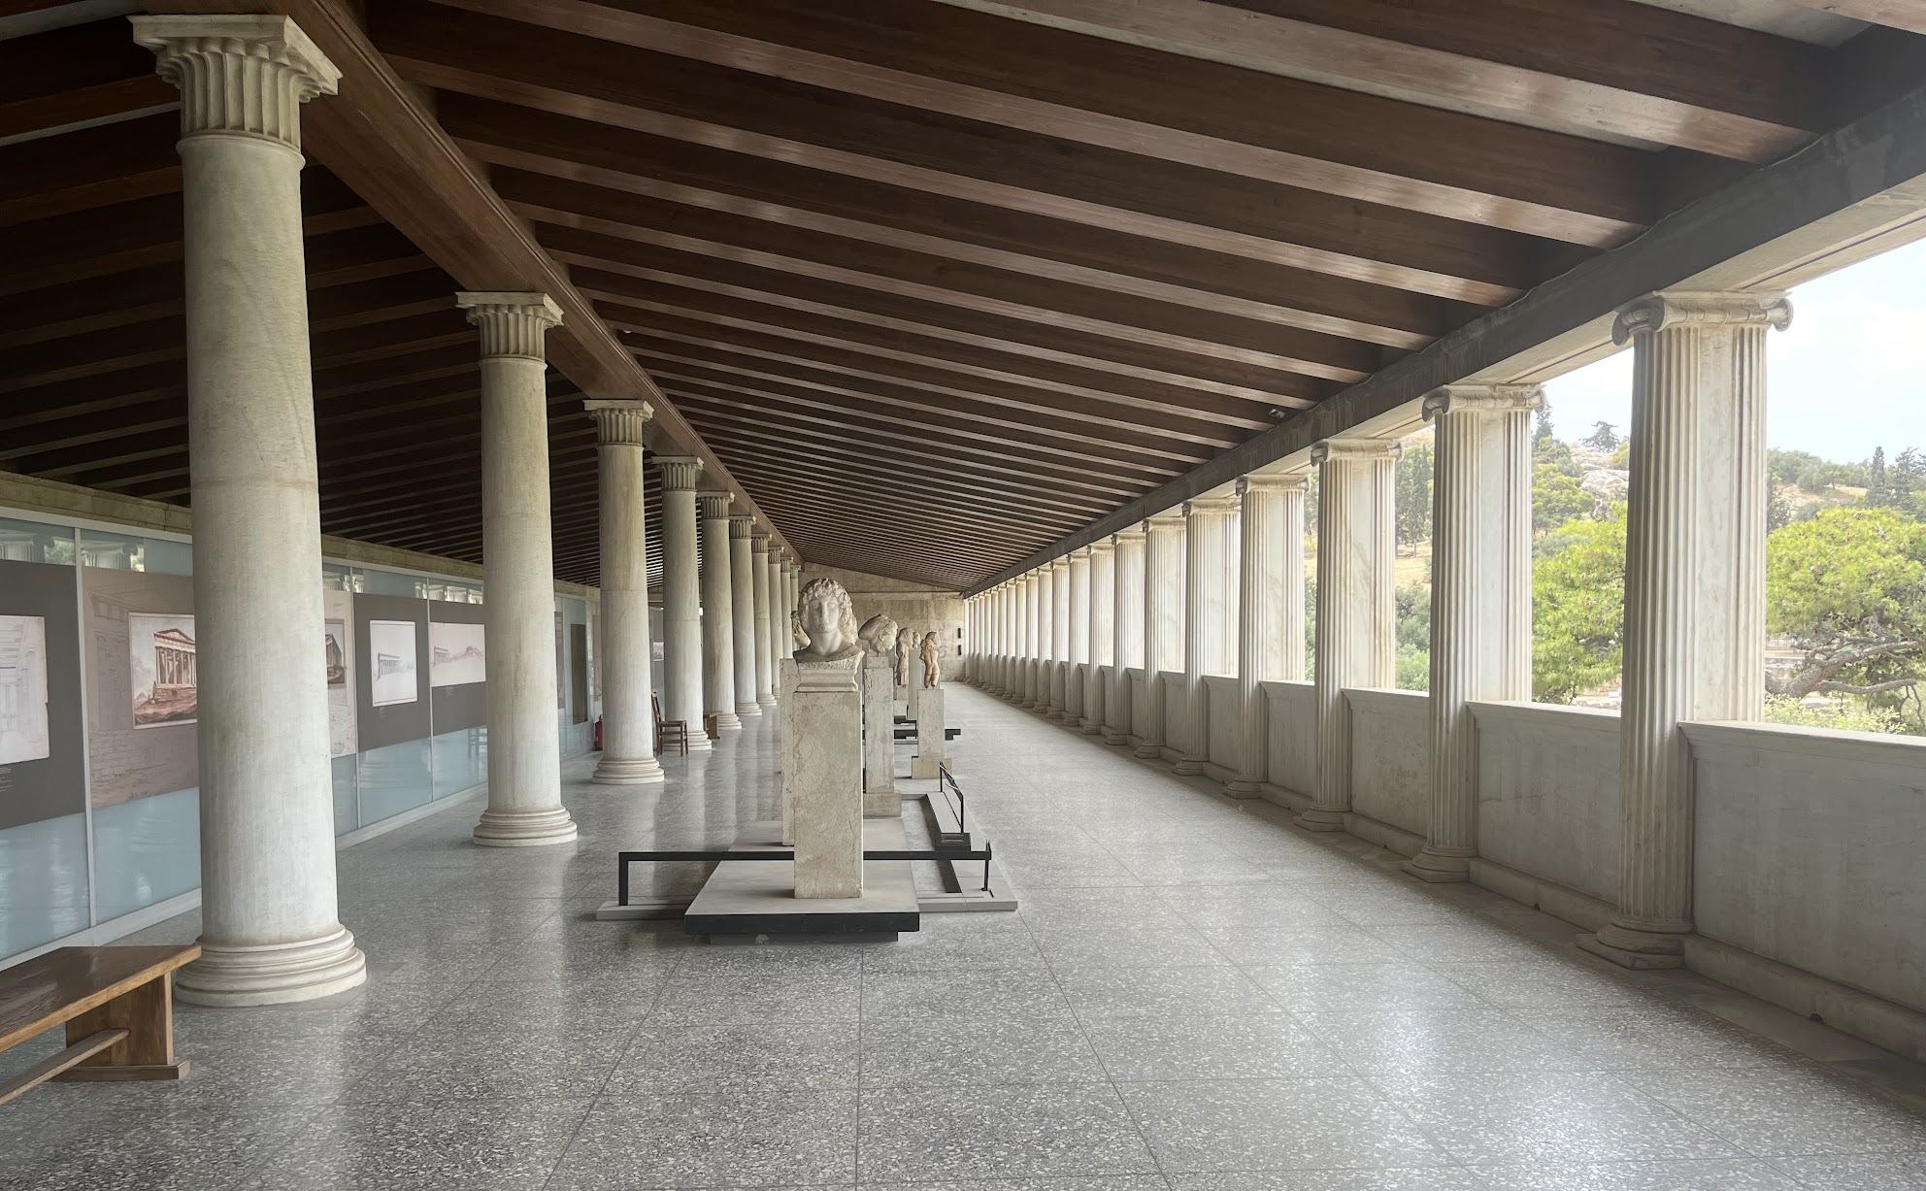
May 27-May 30
Base: Athens
Acropolis
Acropolis Museum
Agora
Cape of Sounion, Temple of Poseidon

Slide 10
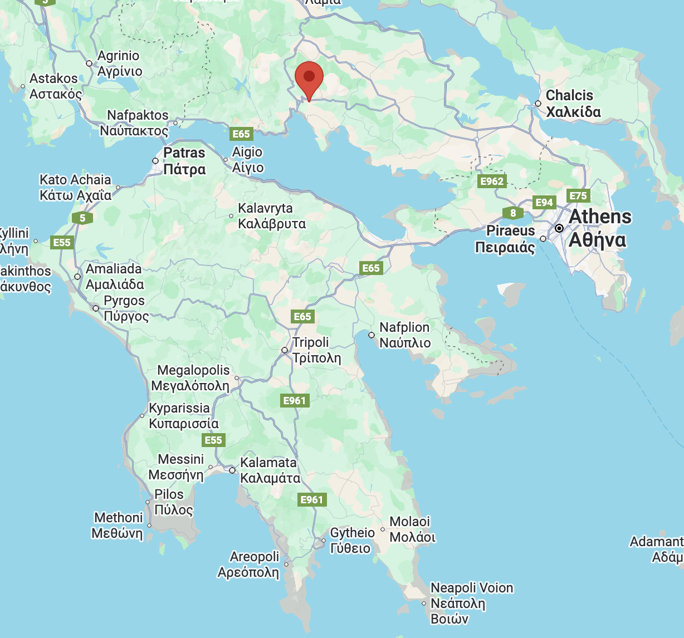
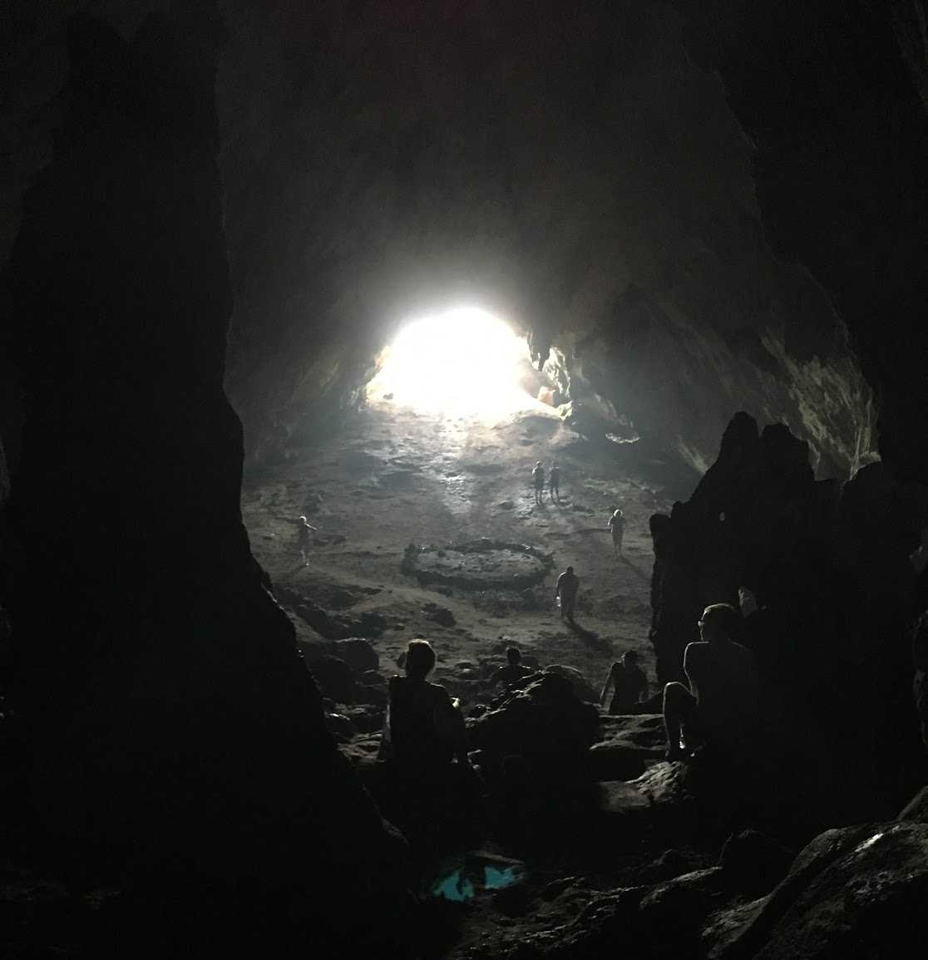
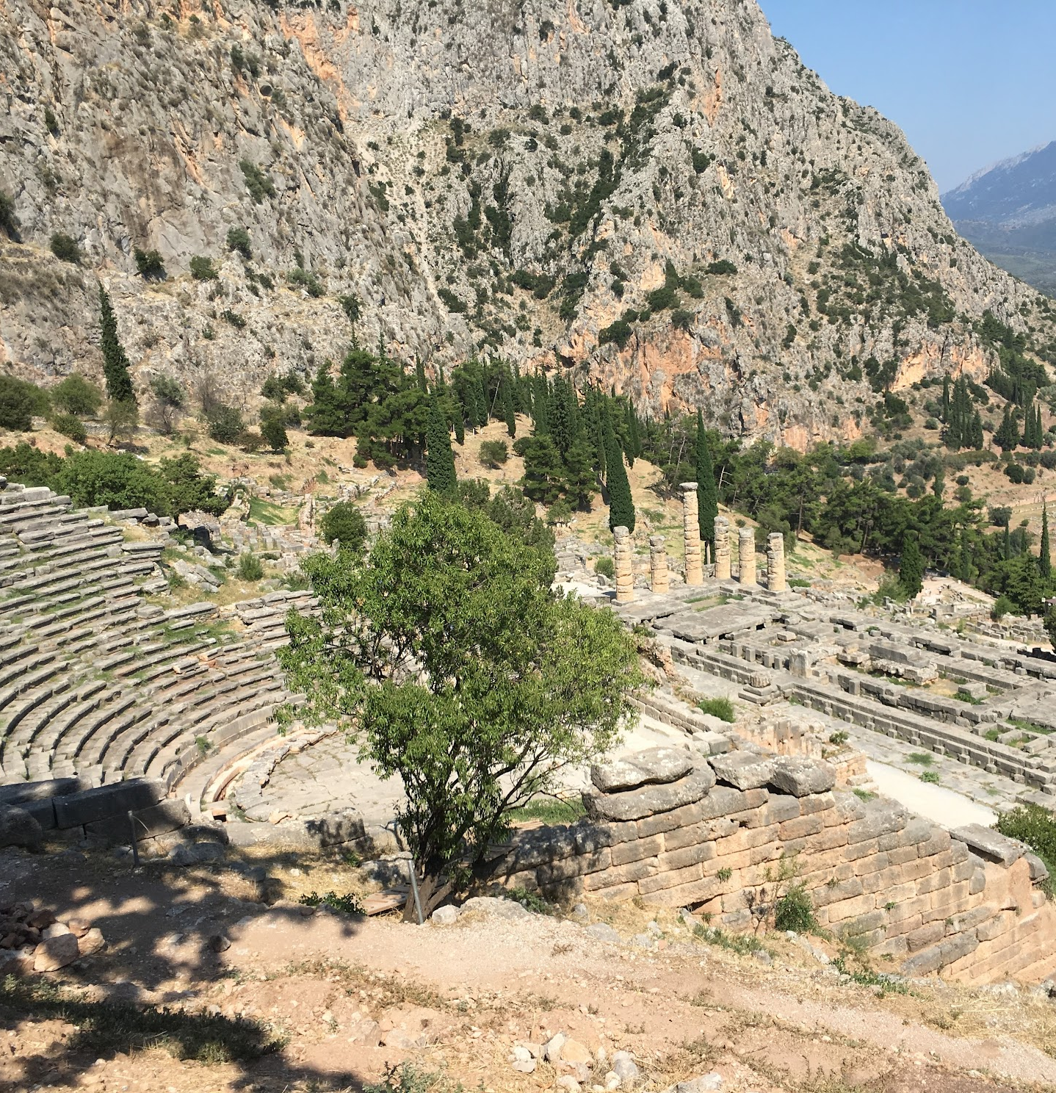
May 31-June 2
Base: Delphi
Eleusis, Thebes, Delphi and the Korykian Cave

Slide 11
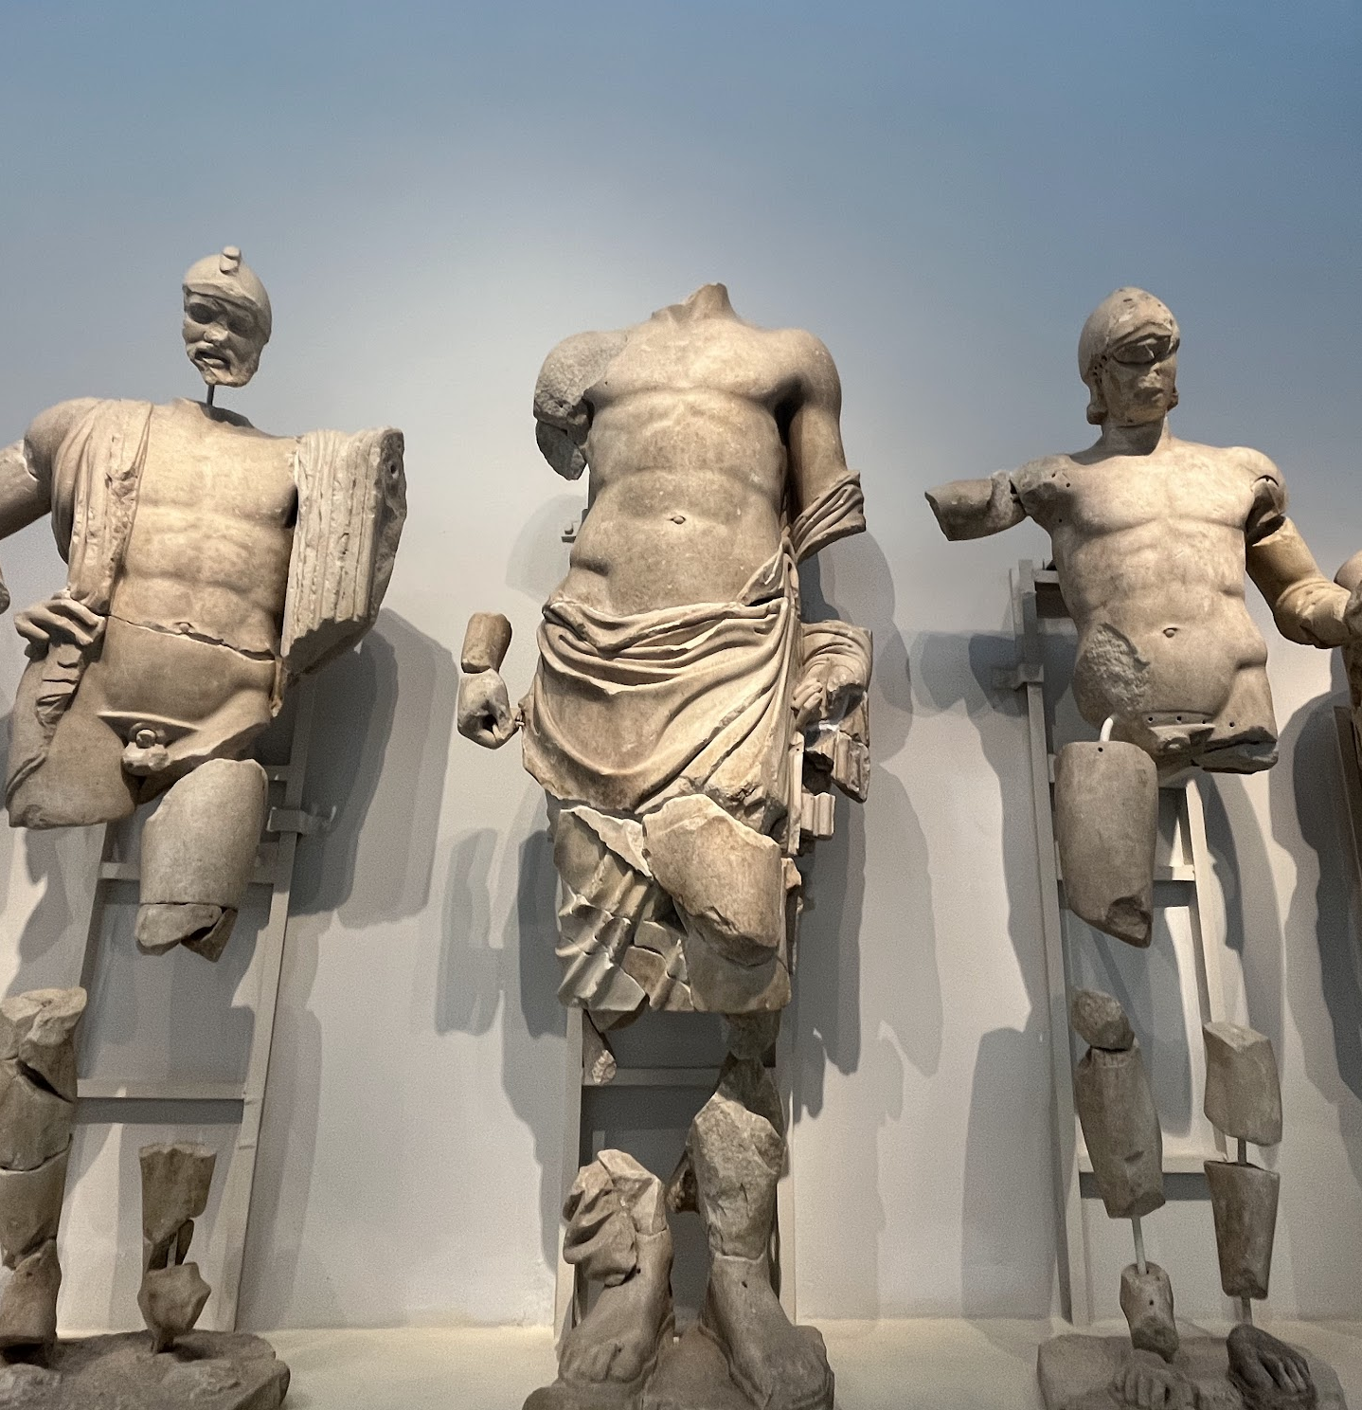
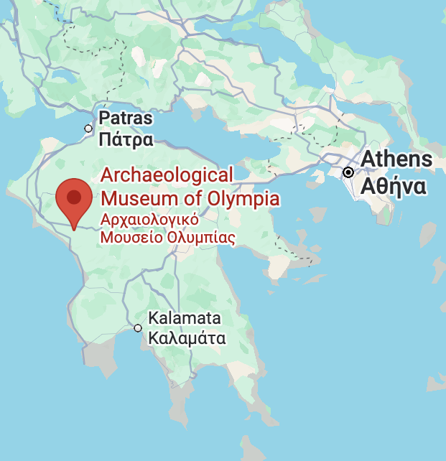
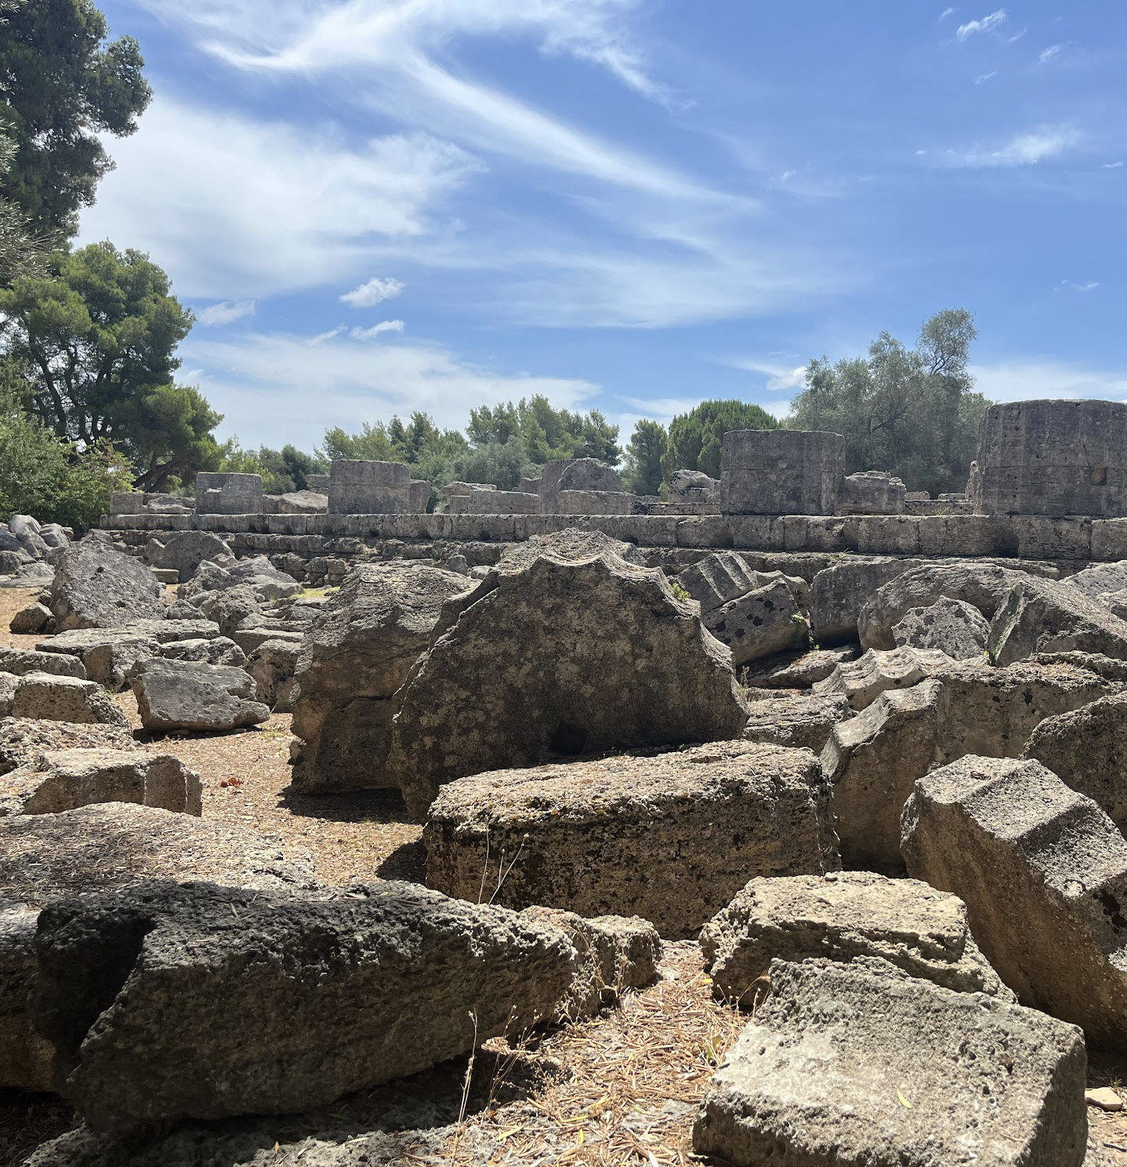
June 3
Base: Olympia

Slide 12
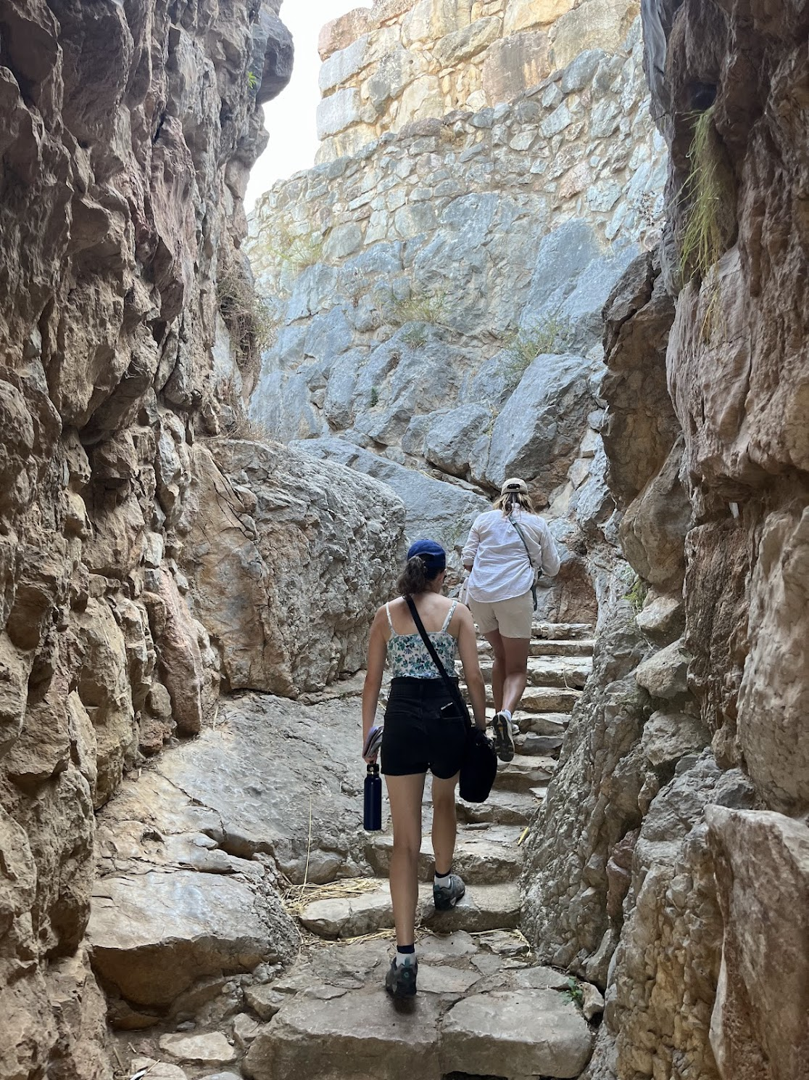
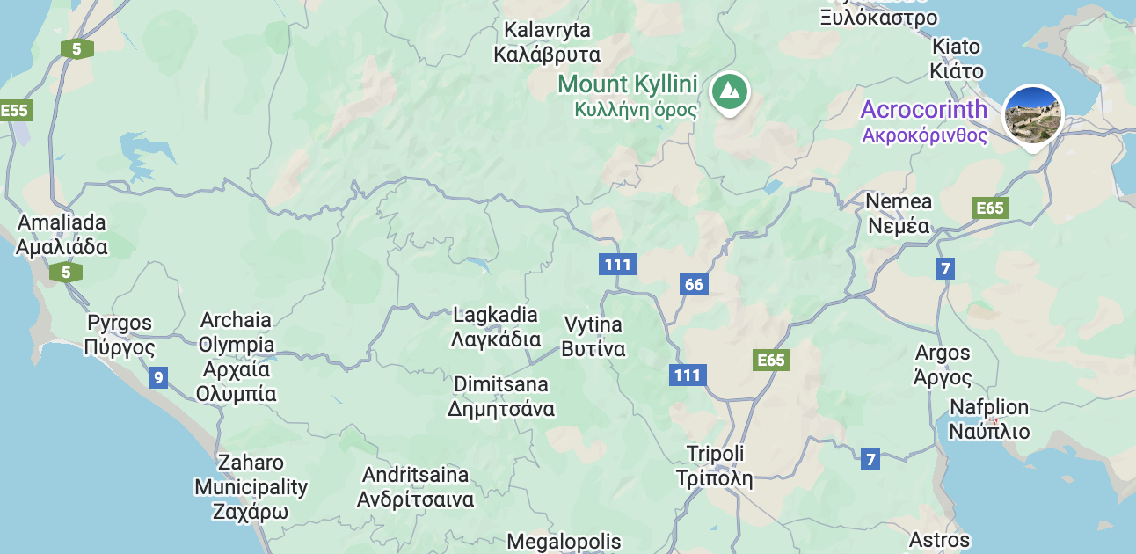
June 4-June7
Base: Naflpio
Nafplio Archaeological Museum
Epidauros
Tiryns
Franchthi Cave

Slide 13
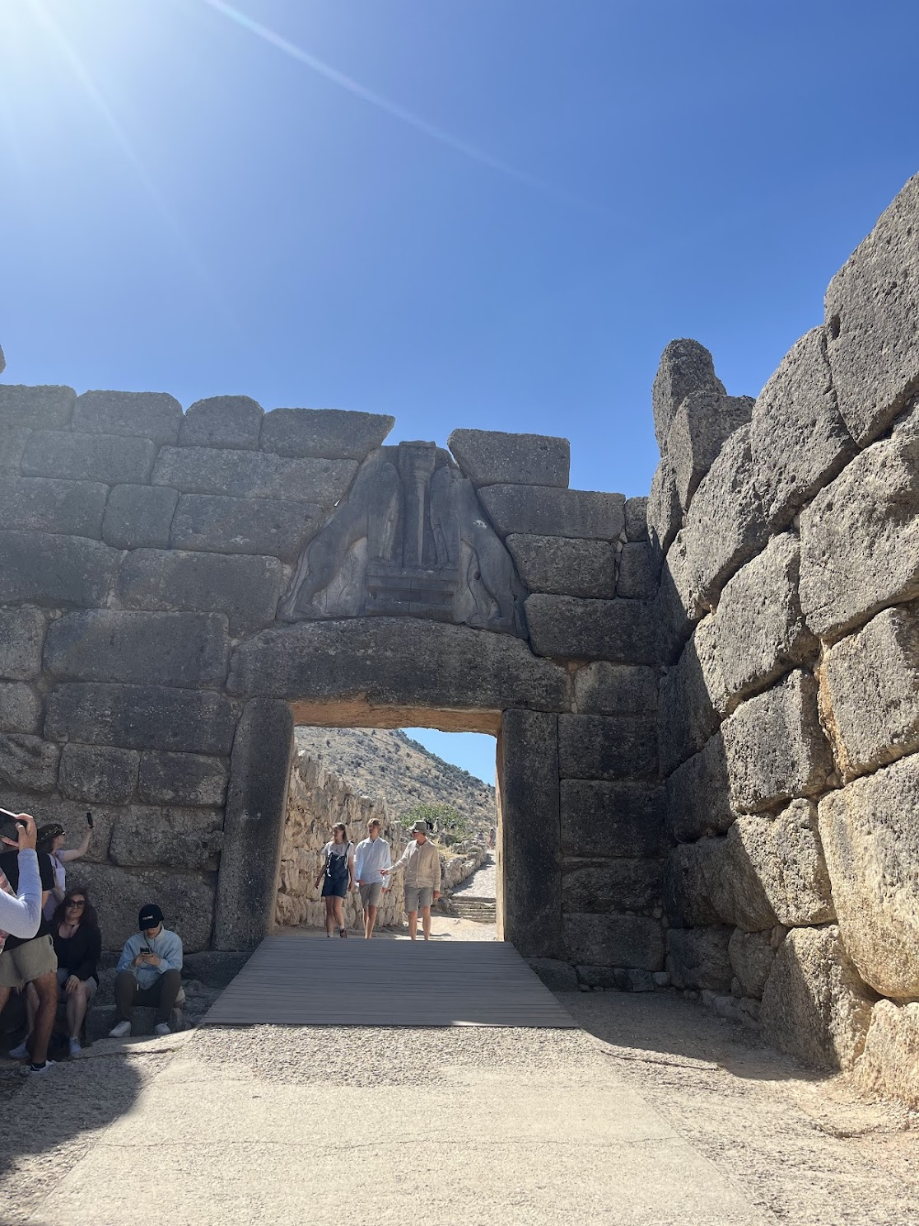
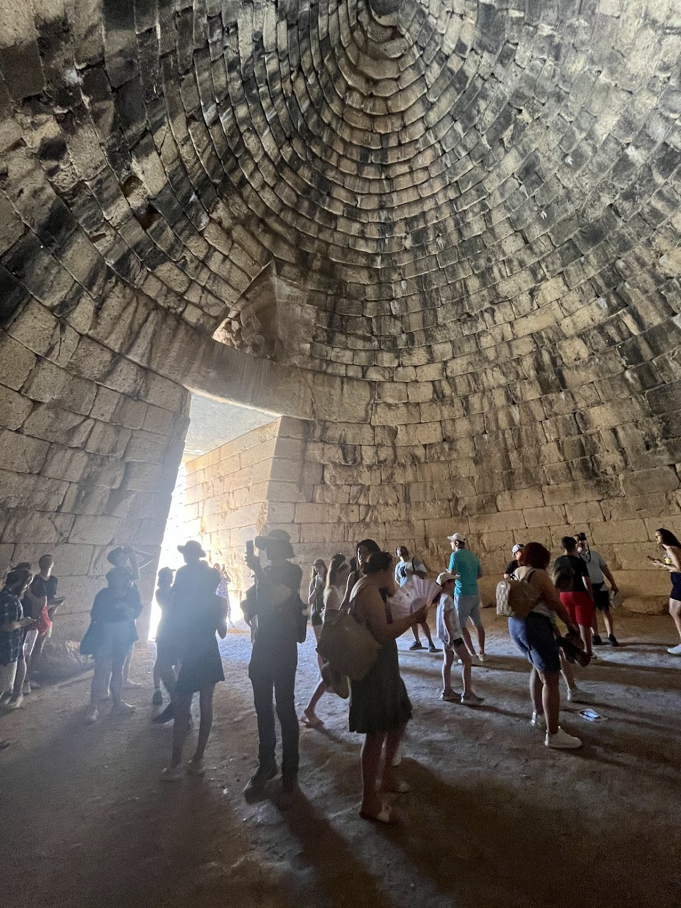
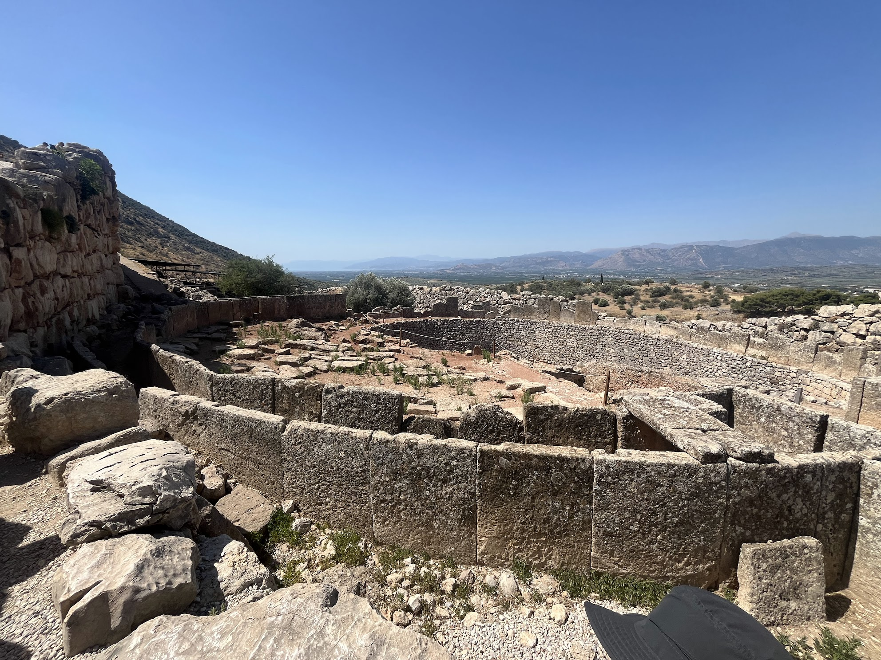
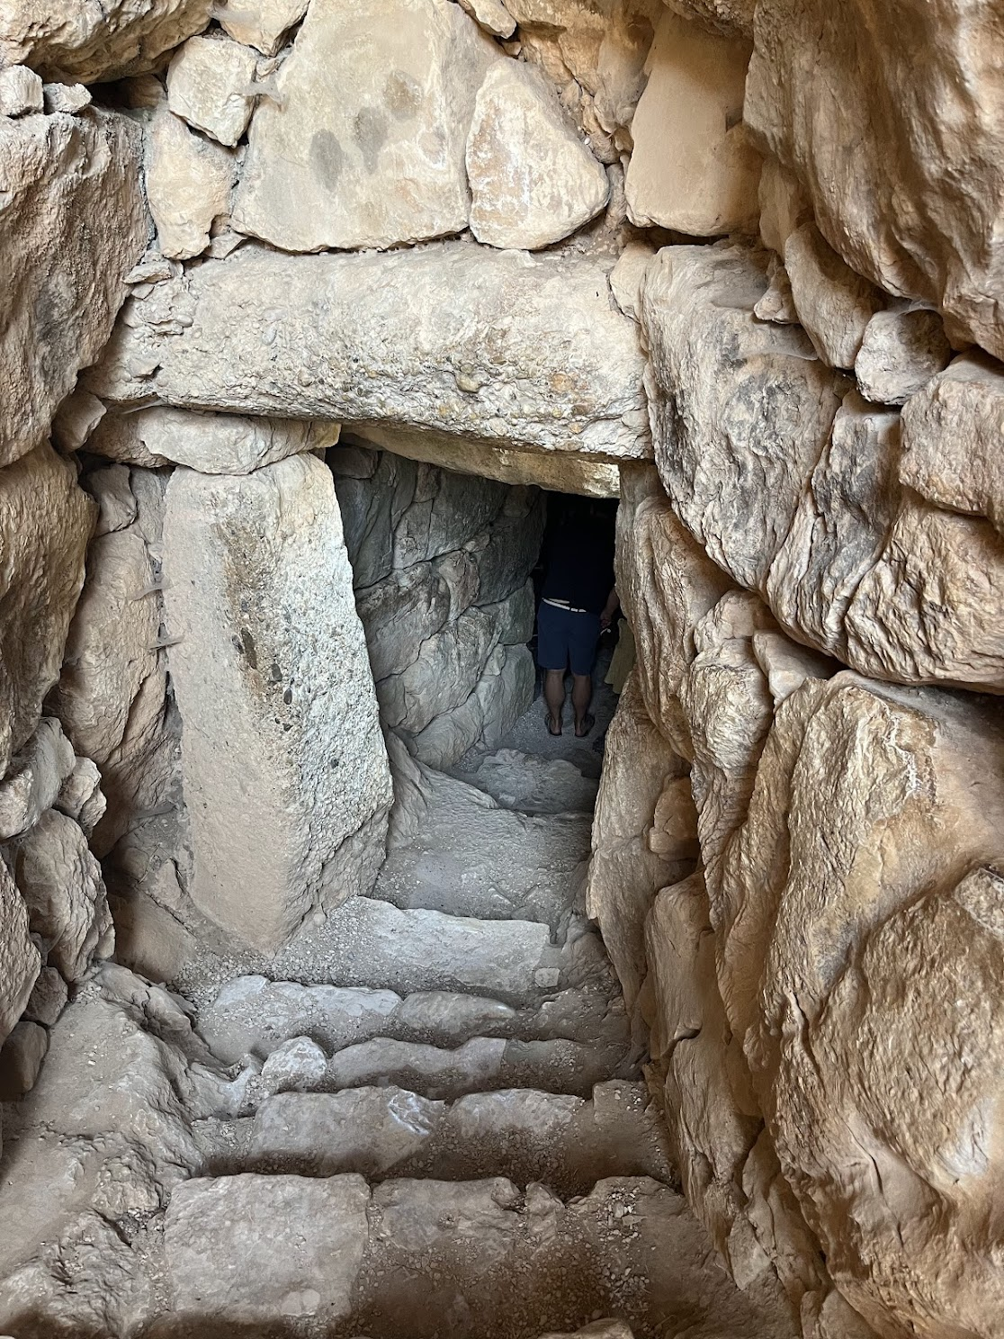
Treasury of Atreus
Mycenae

Slide 14
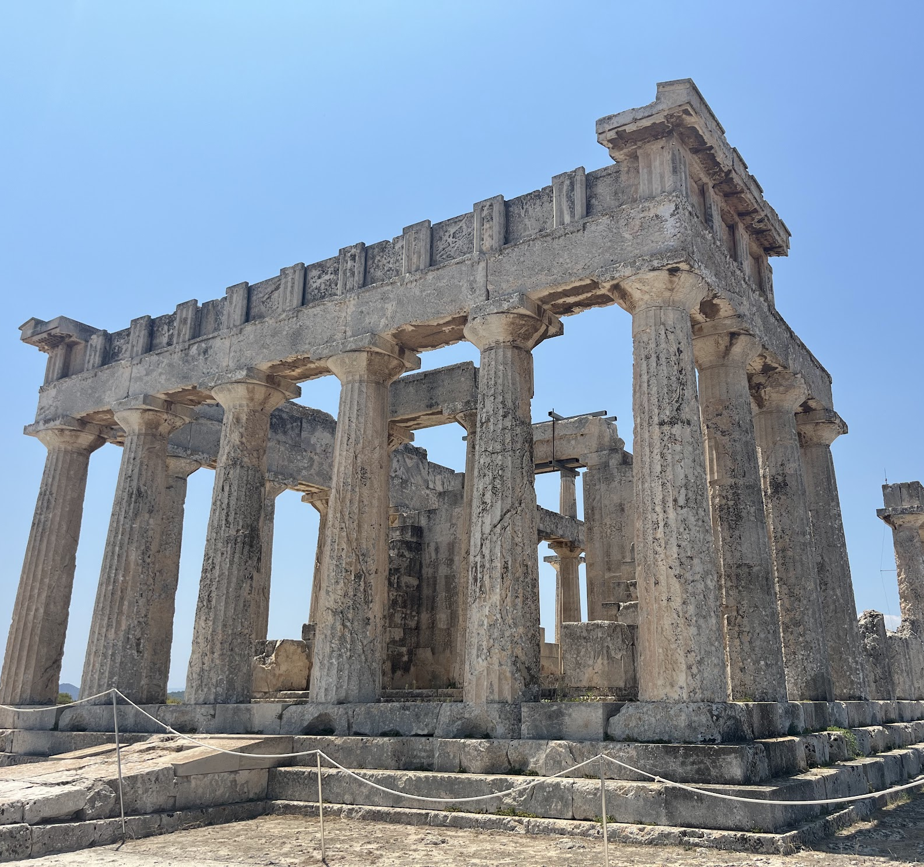
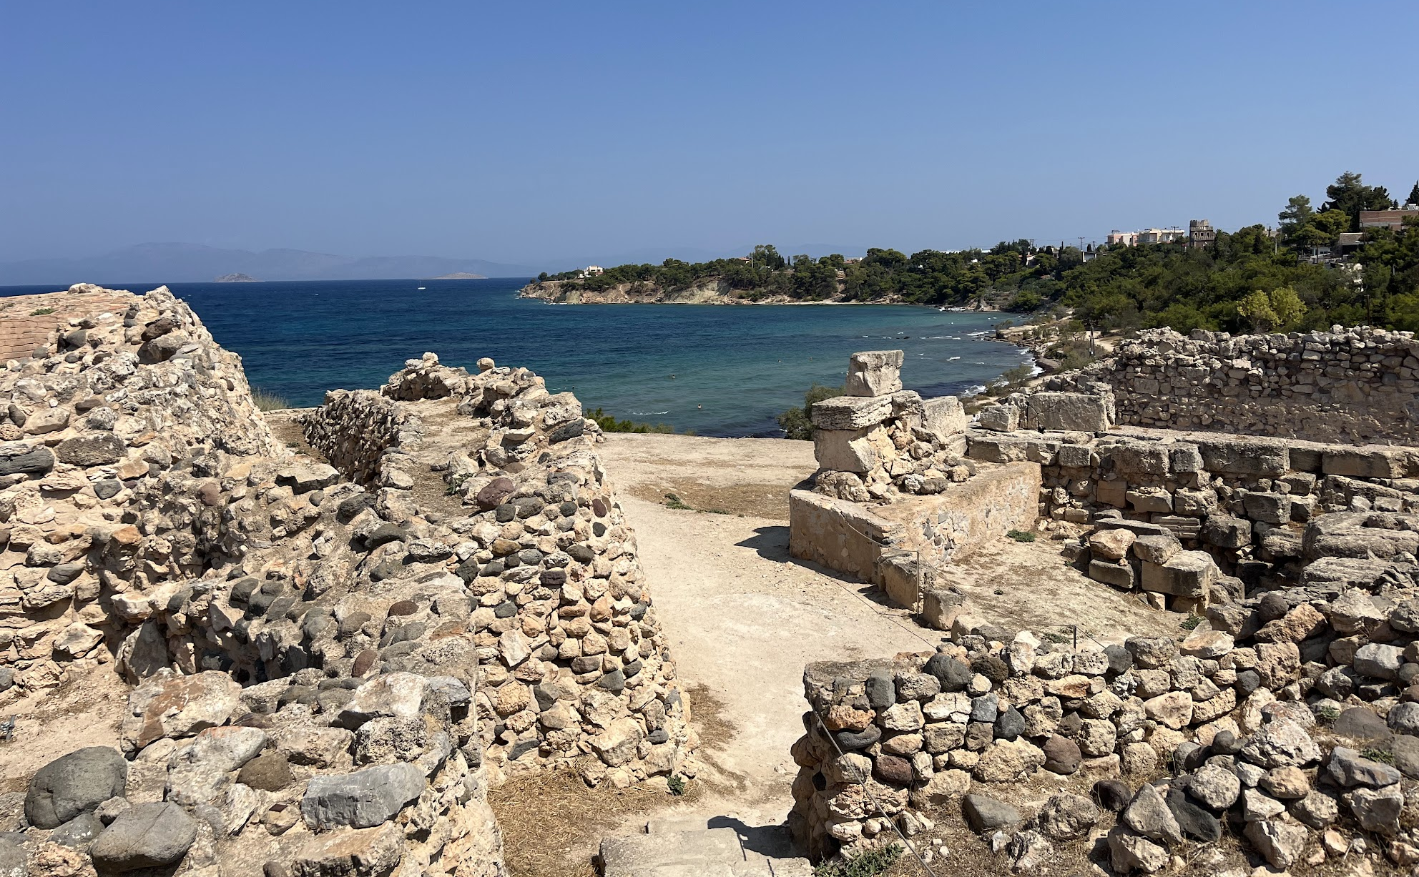
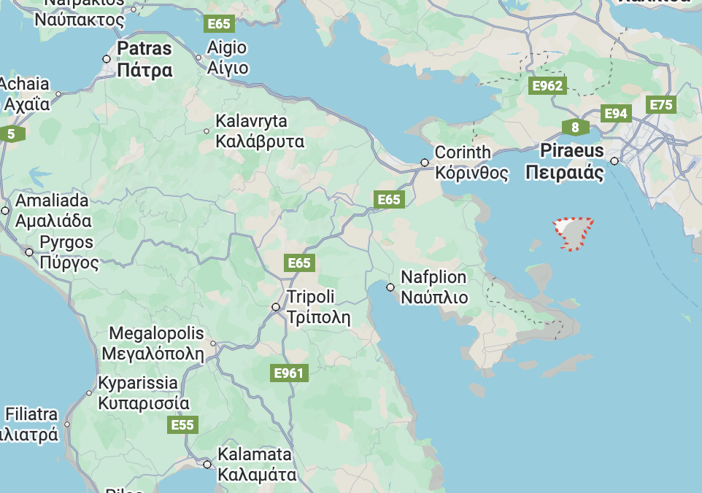
June 8-9
Base: Aegina
Temple of Afea
Aegina Archaeological Museum
Osios Nekatios
Moni Island

Slide 15
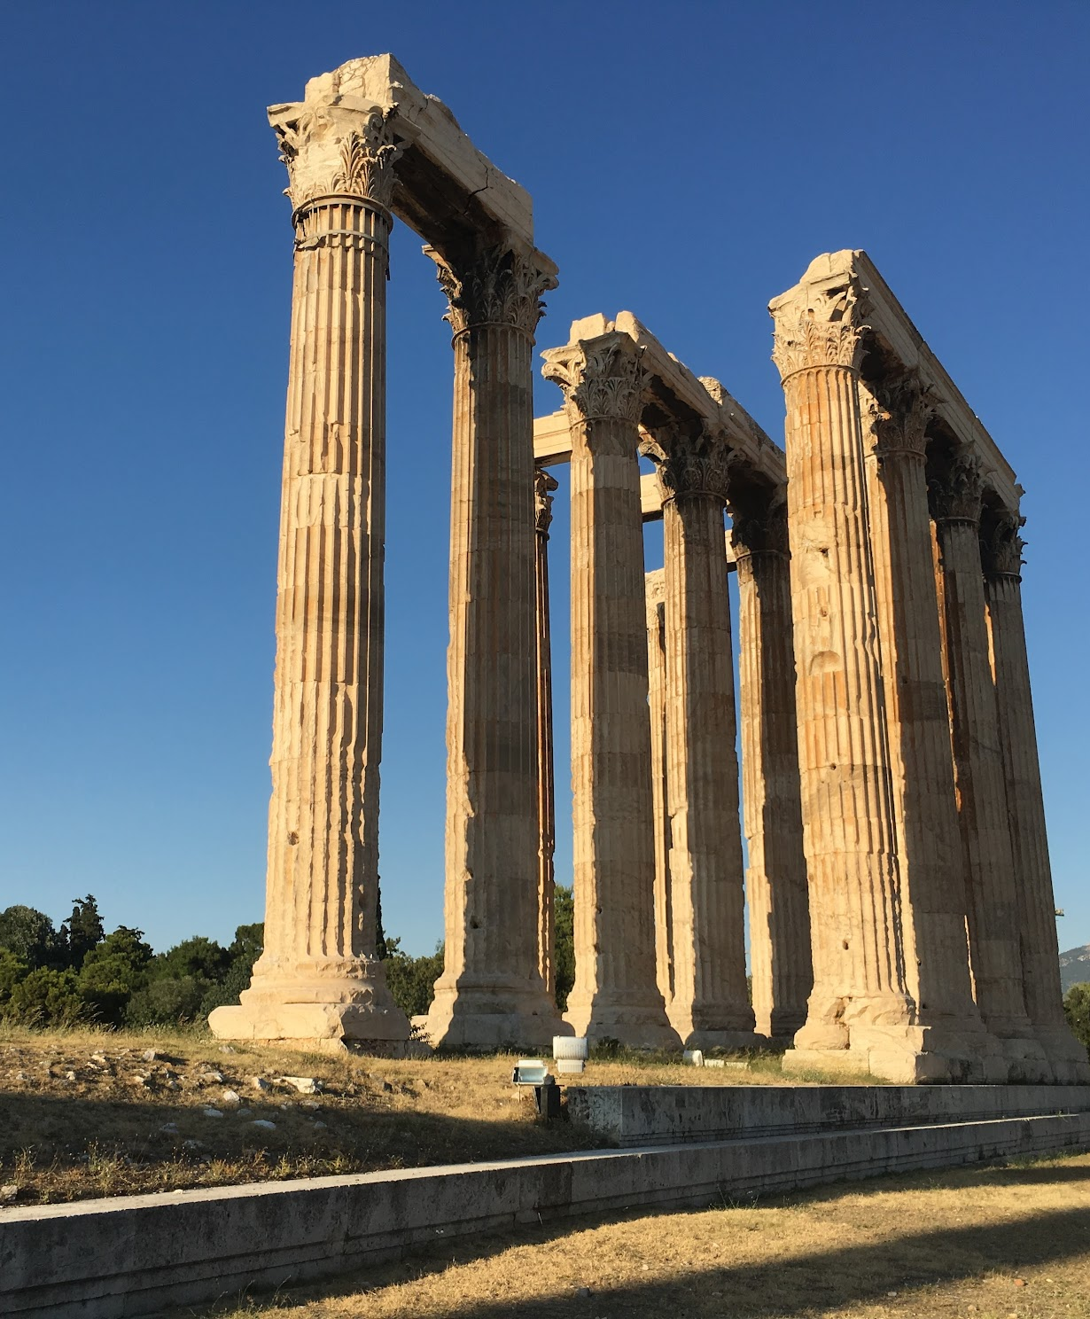
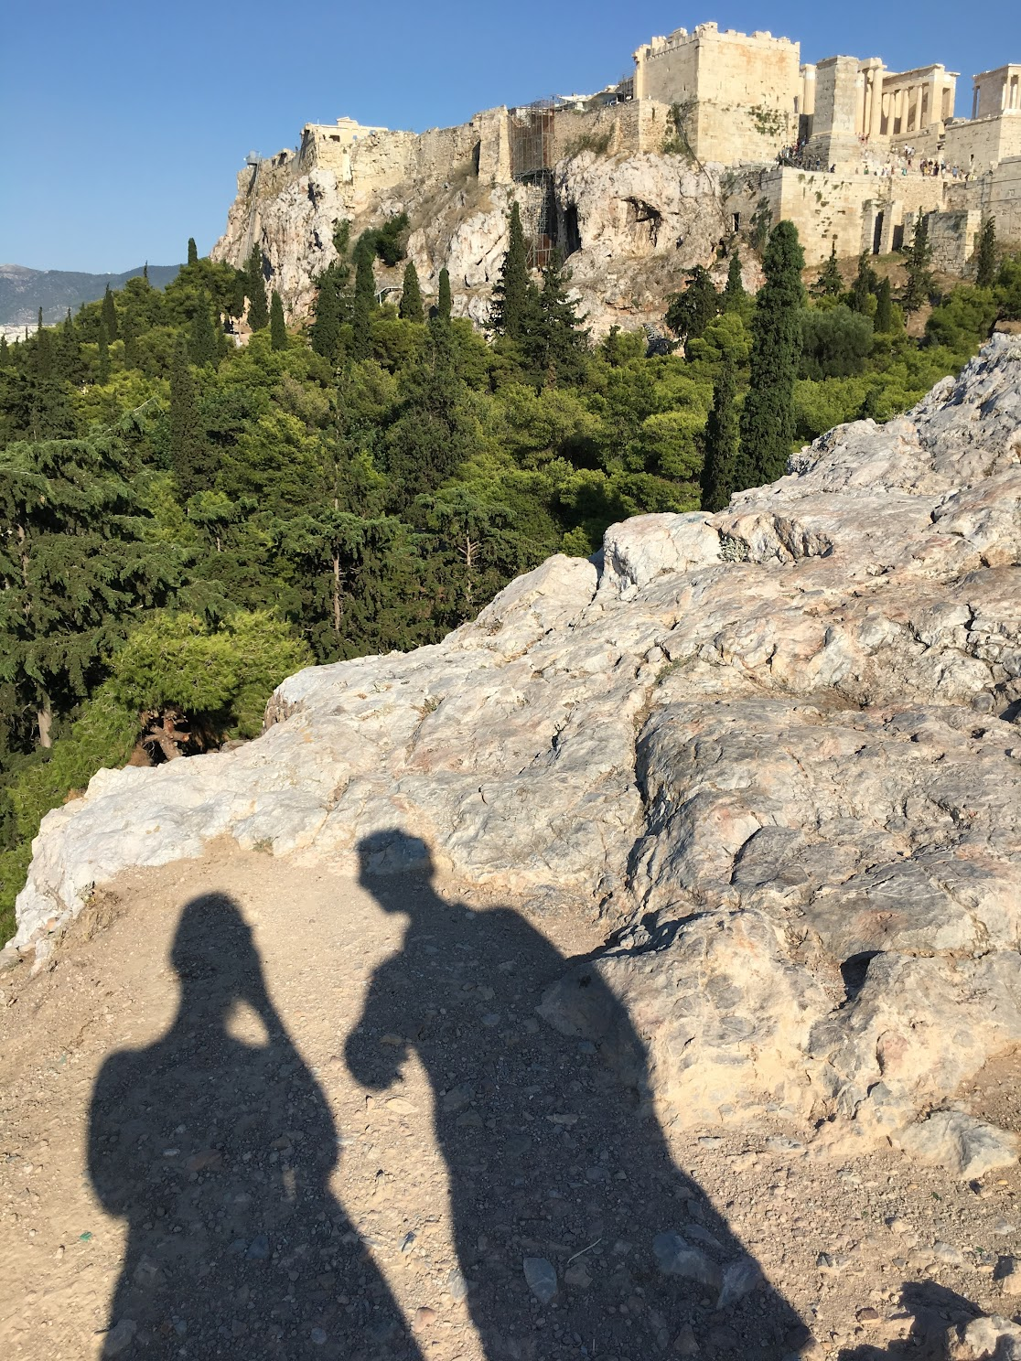
June 10-14
Base: Athens
National Archaeological Museum
Pnyx
Areopagus
Themistoclean Walls
Prison of Socrates
Roman Agora
Temple of Olympian Zeus
Hadrian's Arch
Hadrian's Library

Slide 16
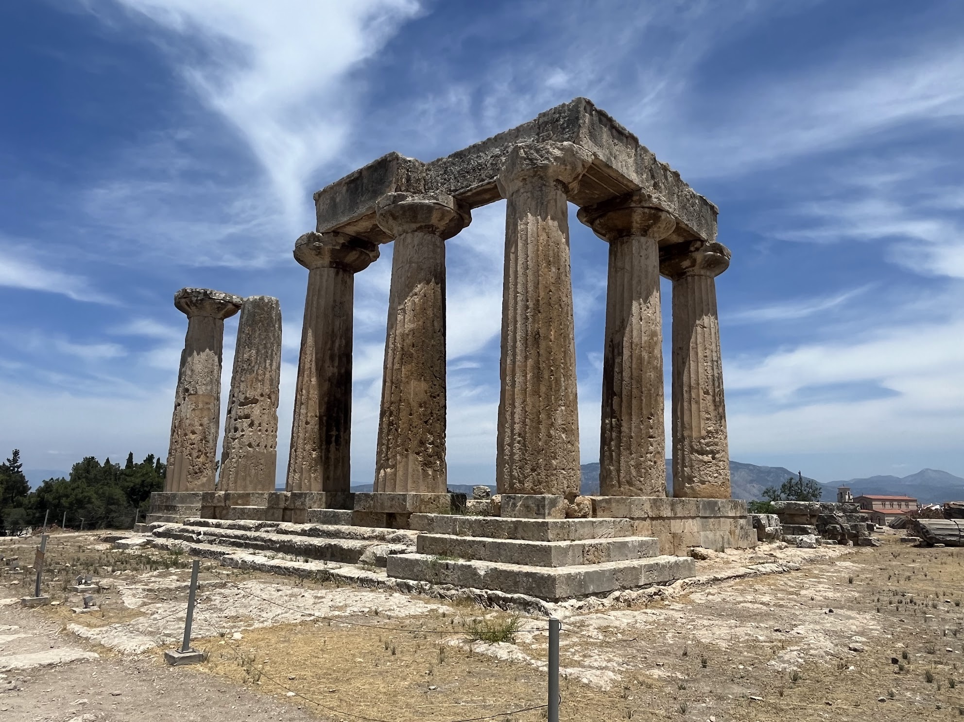
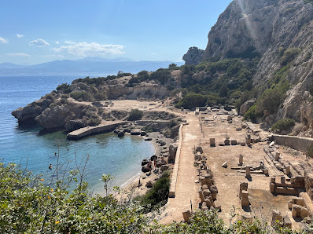
June 13
Corinth and Perachora

Slide 17
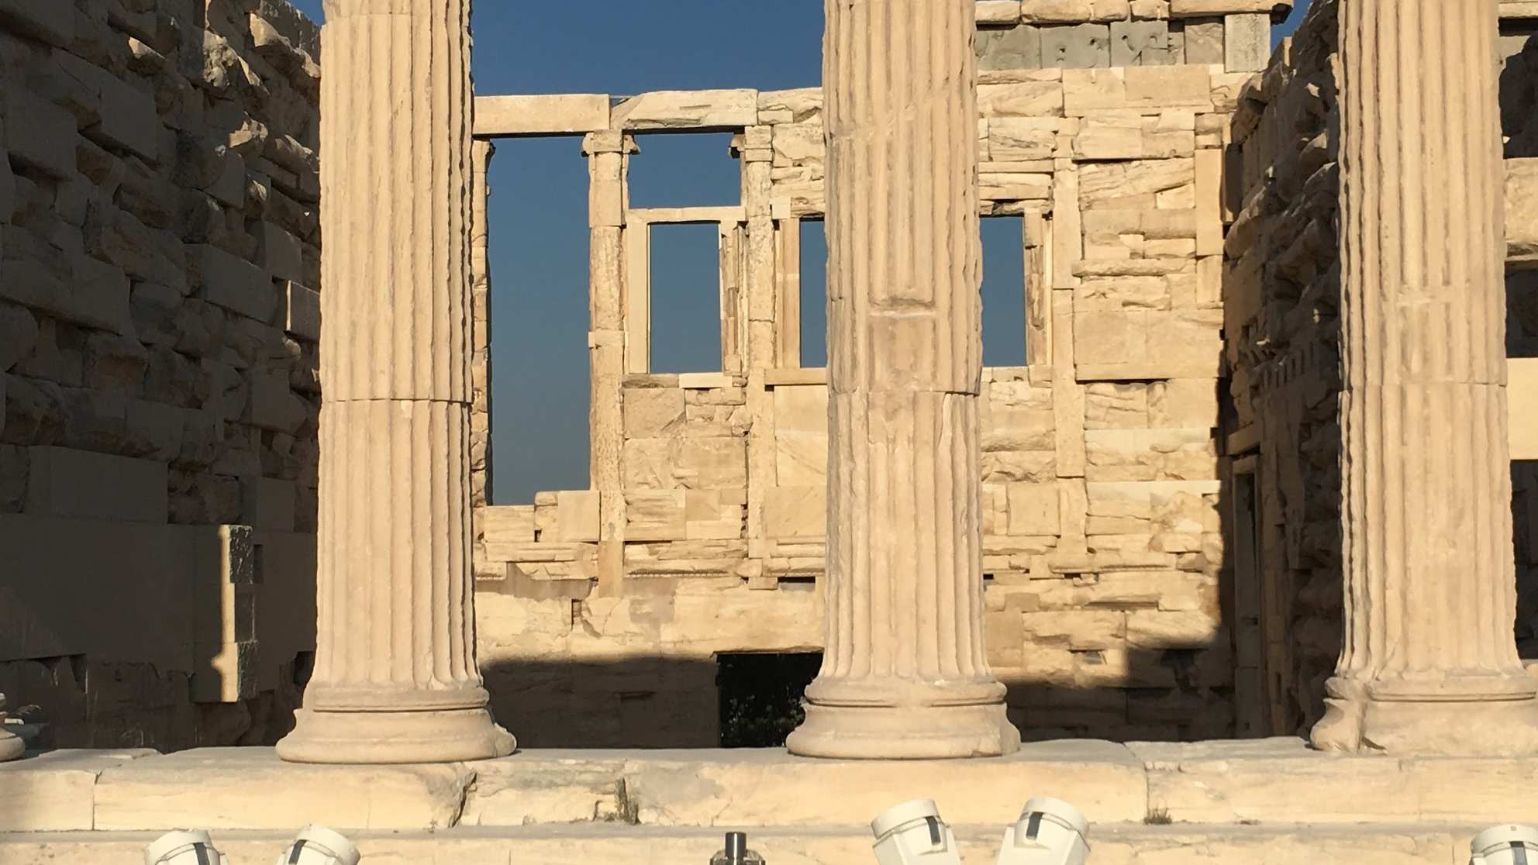
Interested in learning more?
Email Jessica Evans (penny), jaevans@uvm.edu

