Slide 1
Bodybuilding and Ancient Greek Culture
By Jackson Wolverton

Slide 2
Plato
Quote from Timaeus
From both these evils the one means of salvation is this—neither to exercise the soul without the body nor the body without the soul, so that they may be evenly matched and sound of health. Thus the student of mathematics, or of any other subject, who works very hard with his intellect must also provide his body with exercise by practising gymnastics; while he who is diligent in molding his body must, in turn, provide his soul with motion by cultivating music and philosophy in general, if either is to deserve to be called truly both fair and good.
http://www.perseus.tufts.edu/hopper/text?doc=Perseus%3Atext%3A1999.01.0180%3Atext%3DTim.%3Asection%3D88b
Plato was jacked

Slide 3
Pan metron ariston
Everything in Moderation – Kleovoulos of Lindios
https://www.digital-mr.com/blog/view/everything-moderation-even-moderation
Connection to proportions
To achieve the ideal male body, you want your flexed arms and calves to be 2.5 times larger than your non-dominant wrist, your shoulders to be 1.618 times larger than your waist, your chest to be 6.5 times larger than your wrist, and your upper leg to be 1.75 times larger than your knee
https://legionathletics.com/ideal-male-body/

Slide 4
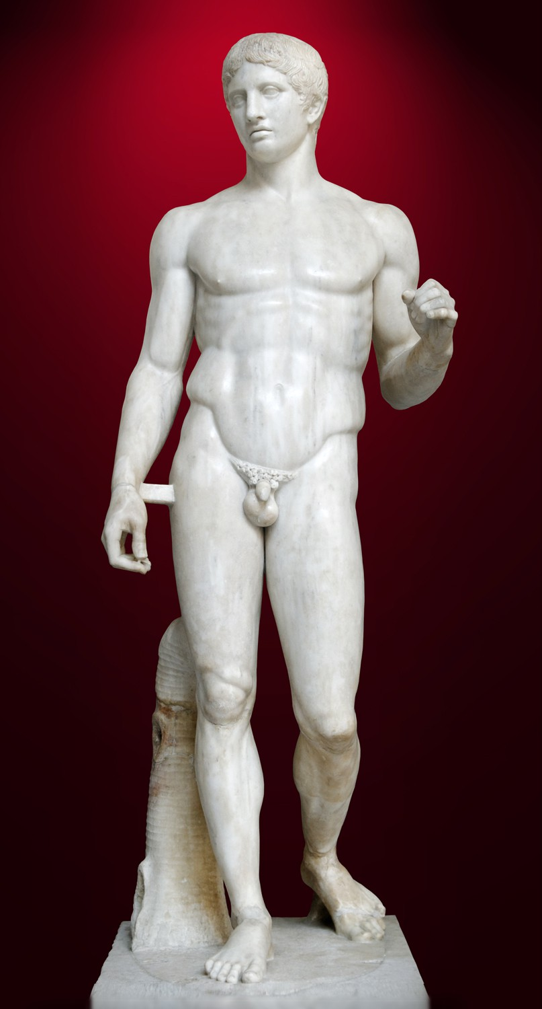
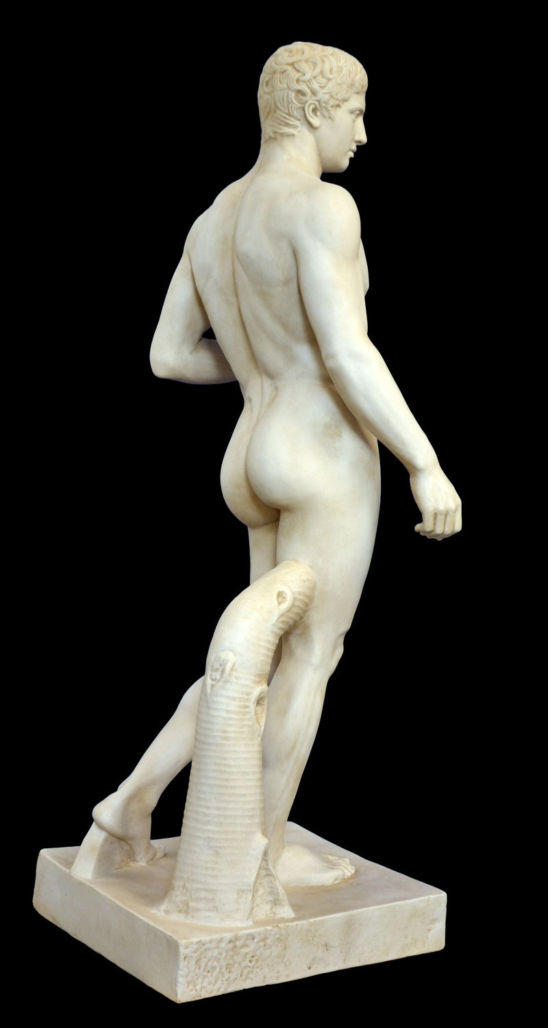
Doryphoros
Embodiment of proportions
Apollonian
Pure, order

Slide 5
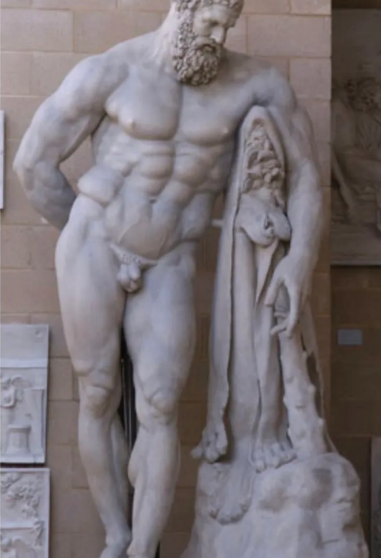
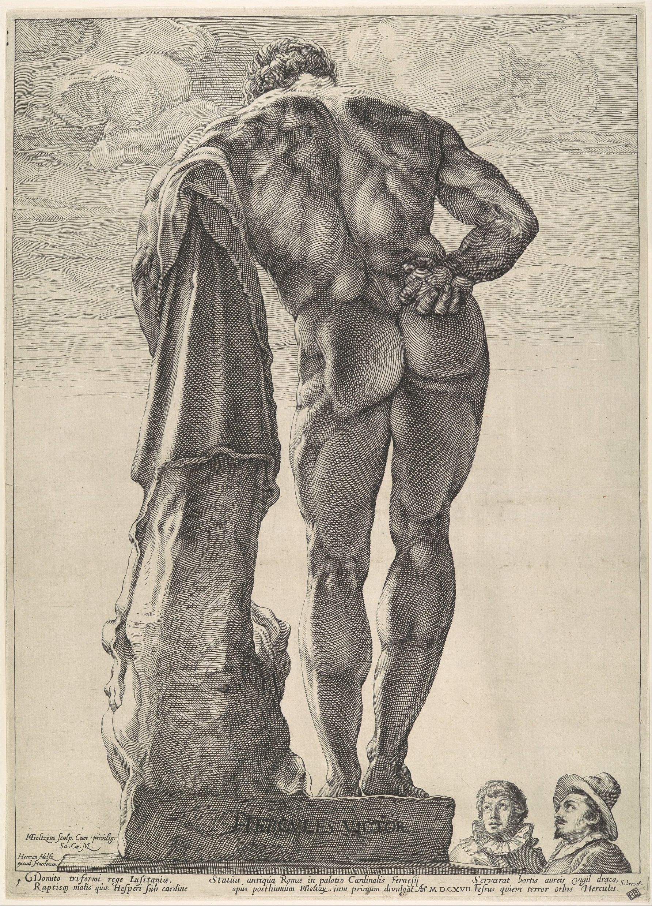
Farnese Hercules
Representation of the Greek spirit
Herculean/Dionysian
Passion, spirit

Slide 7
The Odyssey example
“Come, my friends, why don't we ask the stranger whether there's some contest he knows all about and understands. From the way his body looks he's no weakling—not in his thighs and calves, his thick neck and those two strong upper arms— lots of power there, no lack of youthful strength. He's just exhausted by his many troubles. The sea is bad at breaking a man down, no matter what his strength. From what I know, there's nothing worse.”
The Odyssey Book 8, 162-171

Slide 8
Questions?

