Slide 1
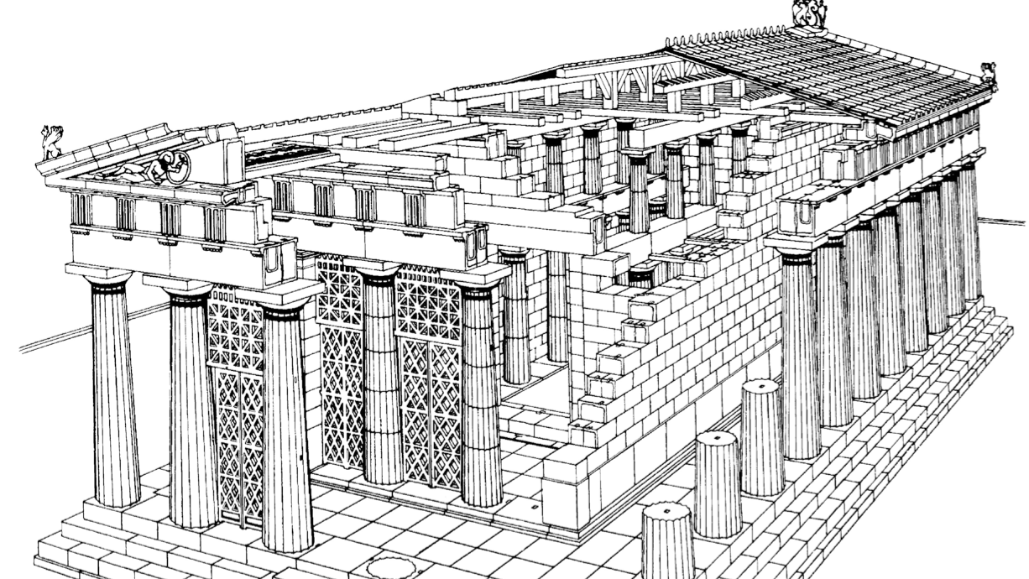
The Greek Heritage and Development of Architecture

Slide 2
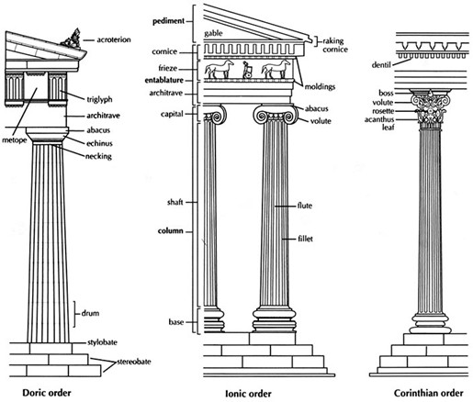
Historical Periods
Archaic (c.650-450 BCE): “Doric Order”
Classical (c.480-323 BCE): ”Ionic Order”
Hellenistic (C.323-27 BCE): “Corinthian Order”

Slide 3
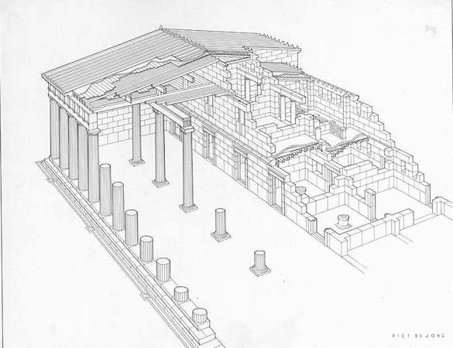
Construction in the Ancient Greece
First buildings was built with mud and wood, but then the material was changed to marble and brick
Triglyphs, which hold the roof, lean on columns which ae based on stone foundations

Slide 4
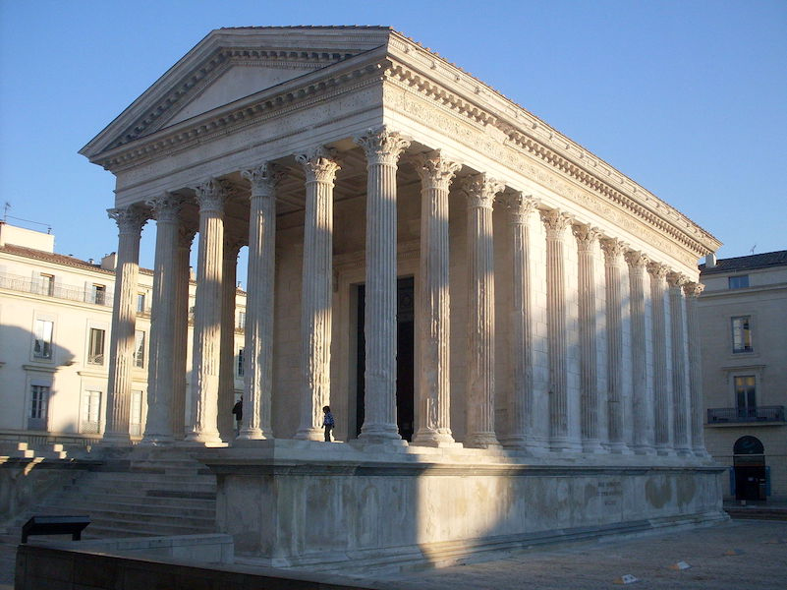
Roman Civilization
“All... must be built with due reference to durability, convenience, and beauty. ” Vitruvius, De Architectura Chapter III, Sec. 2
Maison carrée- Roman Temple

Slide 6
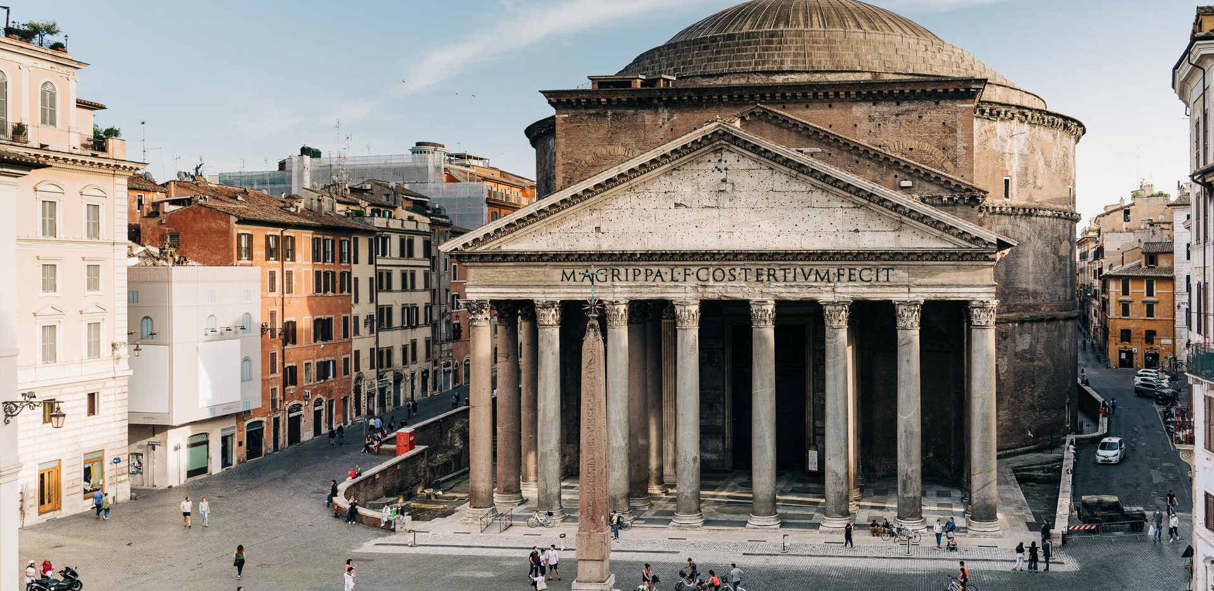
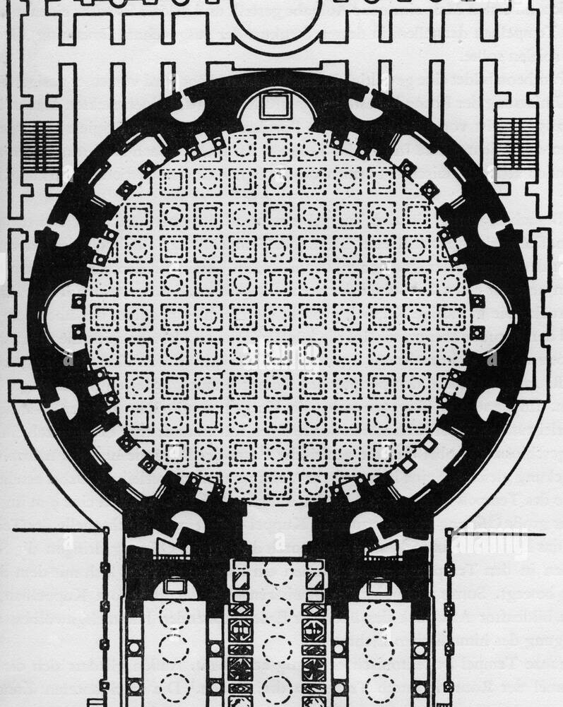
Pantheon in Rome

Slide 7
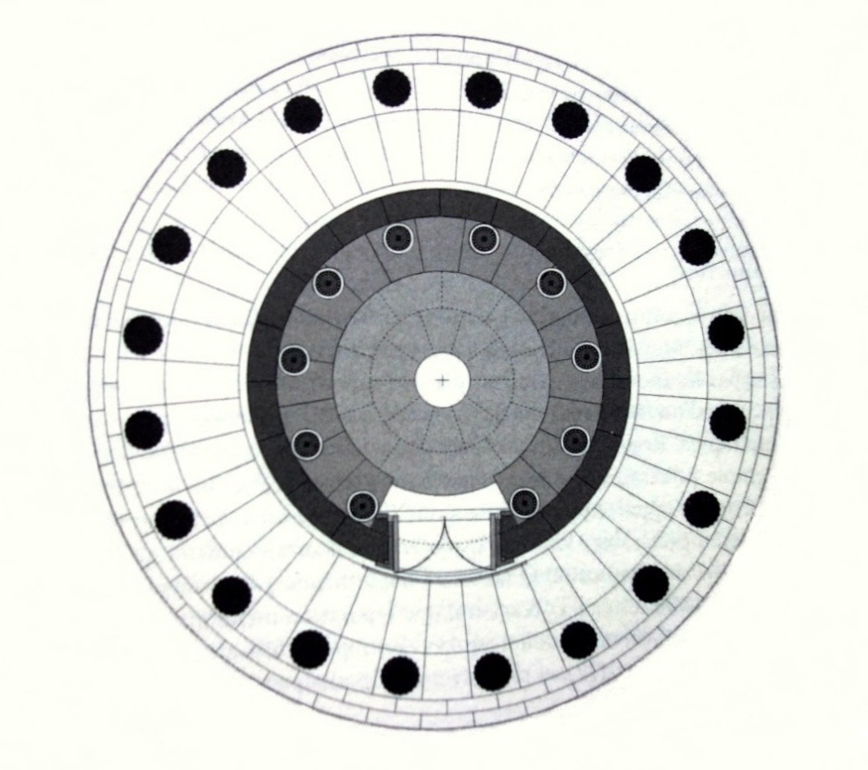
Tholos of Delphi

Slide 8
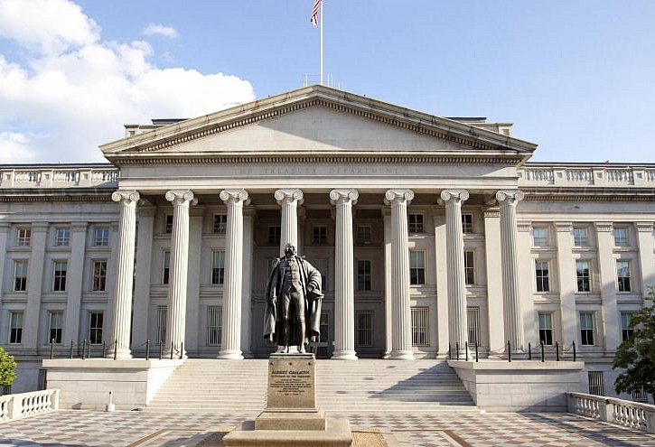
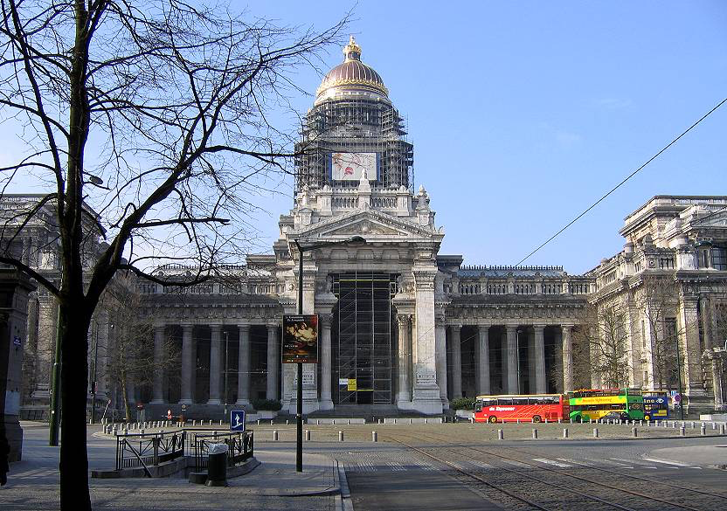
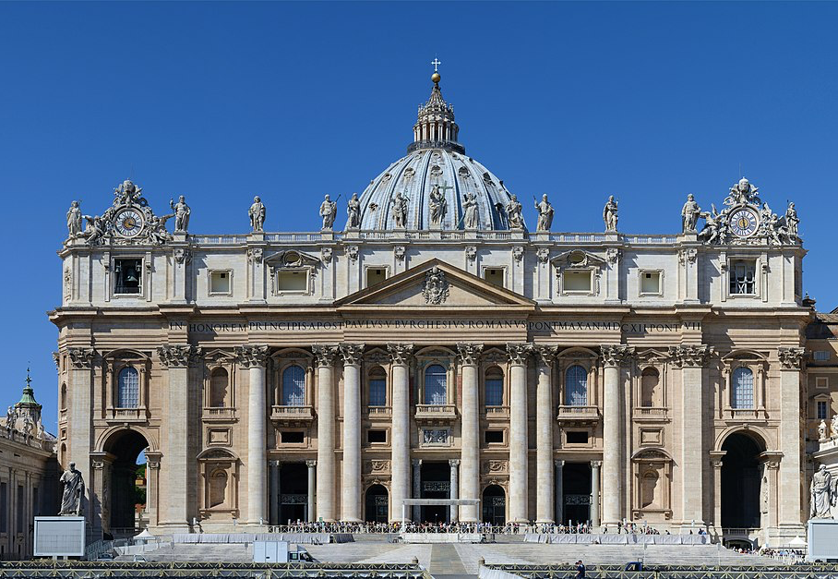
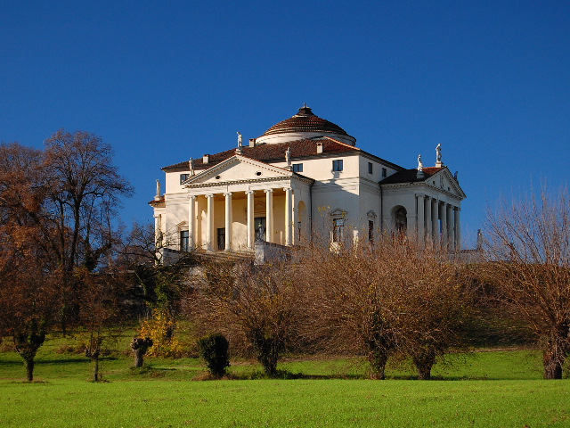
Renaissance & Enlightenment
Renaissance Architecture (14th and early 16th centuries) Revival and Development of Certain elements from Greek and Roman Architecture
-Enlightenment (17th-19th centuries) Neoclassical Architecture

Slide 9
Modern Times

