Slide 1
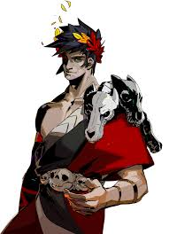
Greek Myth Today
Hades Video Game
Remy Blank

Slide 2
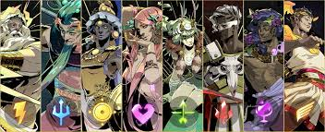
Greek Myth in Pop Culture
Greek mythology has evolved over time but remains influential in modern culture.
Stories have adapted to reflect contemporary society while retaining their core meanings.
Technology’s Role in Myth Retelling
Modern tech (movies, TV shows, video games) helps retell myths in engaging ways.
Video games, in particular, offer immersive storytelling experiences.
Video Games as Mythological Storytellers
Many games use Greek myth as a foundation or inspiration.
They allow players to engage with myths interactively.
Hades (2020) by Supergiant Games
A modern retelling rooted in Greek myth, centered around the Underworld.
Acts as both entertainment and an educational tool.
Encourages learning myth and storytelling through fun and repeatable gameplay loop.
Introduction

Slide 3
Mythography: Virtual Museum
Video games with historical settings let players explore and interact with historical places and artifacts. This applies to games based around Greek myth or era.
Historical game studies (HGS) looks into how games present history and how people learn through experience and immersion through gameplay.
A plethora of examples of Historical games considered “virtual museums.”
Assassin’s Creed: Origins is a game set in ancient Egypt and lets players explore like a museum.
Games like Valiant Hearts and Medal of Honor: Rising Sun let players explore and learn about World War I and II.
Myth-based video games are like mythography, a genre that organizes and records myths into collections, in that they collect, combine and retell myths in a more complete way.
These games take mythography and makes them fell modern and fun while also being education in an interactive way.

Slide 4
Neomythology: Breathing life into ancient myth
Neomythology is a modern reimagining of myth that goes beyond its original writing or boundaries and relates more to contemporary players.
Hades can relate more to modern players than ancient myth as its storytelling is more in line with society’s morals and ethics today
Hades is a story about a son trying to escape his abusive, cruel, and stern father to try and find his mother who already escaped. This is an example of familial problems that players could relate to on some level.
Myth based games hold player attention and create an imaginative learning experience while reshaping old stories into new life
Narrative-driven titles put players into the drivers seat allowing each individual to explore myth at their own pace.

Slide 5
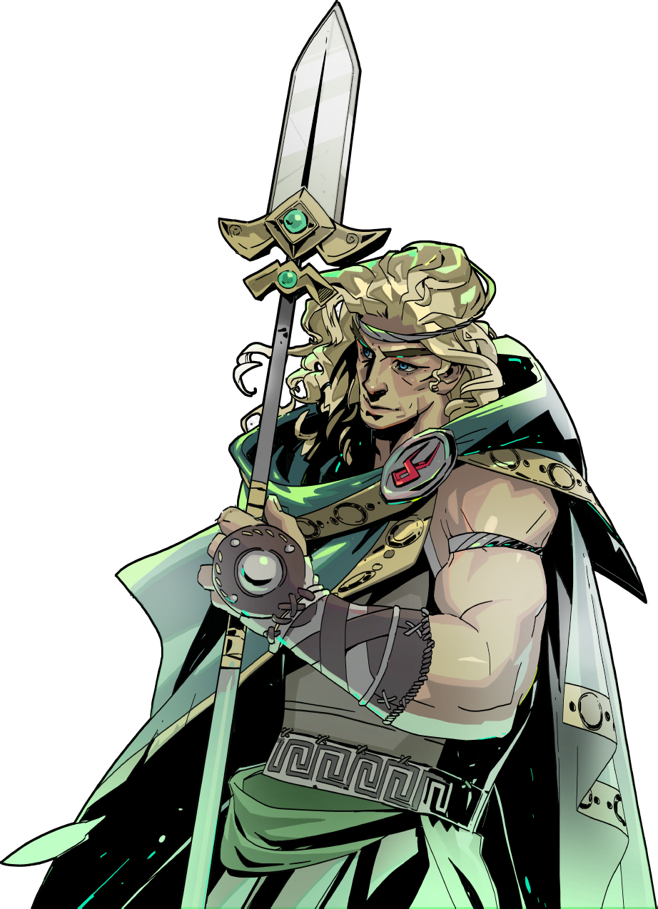
How does Hades fit as a neomyth and a mythography (virtual museum)?
A great example explaining this question is Achilles character portrayal in the game
Achilles is the protagonist, Zagreus, mentor and father figure. He helps Zagreus throughout the game and we learn Achilles taught him how to fight.
Zagreus says, “You’ve always been there for me, Achilles. Even when Father pushed me away. This is nothing. I don’t think I can ever repay you.
Achilles is a very different person from the Iliad than when we meet him in game. He is humble, respectful, loyal, and calm in the game and is a little embarrassed about his past.
“Lad, all this generosity, I… I’m just an old killer, yet you treat me like I’m the one who’s royalty around here.” Achilles speaks when gifted nectar.
We learn of Achilles past through furthering out relationship with him throughout the game. This is a great example of mythography.
“…I was a fool, you see. The gods promised me eternal glory beyond death. I could have stayed out of the war. Stayed home with Patroclus. I threw everything away. And sent so very many to this place.”

Slide 6
Achilles and Patroclus
Through furthering your relationship with Achilles, we not only learn more about his past but also can help him reunite with his dear friend Patroclus
Achilles questline sees the player, Zagreus, trying to reunite his mentor with Patroclus, who we meet out in Elysium.
This quest explains the relationship between these two warriors in the myth and even alludes to them being more than just friends in the game.
“We could have been no close. The ashes of our bodies yet mingle together somewhere on the surface there. What can I tell you lad? I loved him with all my heart. And he left me too soon.” Achilles states to Zagreus talking about Patroclus.

Slide 7
Works Cited…
Vandewalle, A. Video Games as Mythology Museums? Mythographical Story Collections in Games. Int class trad 31, 90–112 (2024). https://doi.org/10.1007/s12138-023-00646-w
Video Games and Classical Antiquity Author(s): PAUL CHRISTESEN and DOMINIC MACHADO Source: The Classical World, FALL 2010, Vol. 104, No. 1 (FALL 2010), pp. 107-110 Published by: The Johns Hopkins University Press on behalf of the Classical Association of the Atlantic States
Eckenfels, Hannah. “Https://Oaktrust.Library.Tamu.Edu/Server/Api/Core/...” Oaktrust, Texas A&M University, May 2023, oaktrust.library.tamu.edu/server/api/core/bitstreams/29961ccc-5742-4040-b3f2-a5fb7d3f52e8/content.
Wiki, Contributors to Hades. “Achilles.” Hades Wiki, Fandom, Inc., hades.fandom.com/wiki/Achilles. Accessed 21 Apr. 2025.
Wiki, Contributors to Hades. “Companion Antos.” Hades Wiki, Fandom, Inc., hades.fandom.com/wiki/Companion_Antos. Accessed 21 Apr. 2025.

Slide 8
Works Cited…
Wiki, Contributors to Hades. “Achilles.” Hades Wiki, Fandom, Inc., hades.fandom.com/wiki/Achilles. Accessed 21 Apr. 2025.
“Percy Jackson and the Olympians, Book One: Lightning Thief, the-Percy Jackson and the Olympians, Book One by Rick Riordan.” PenguinRandomhouse.Com, Disney Publishing Group, June 2005, www.penguinrandomhouse.com/books/730519/percy-jackson-and-the-olympians-book-one-lightning-thief-the-percy-jackson-and-the-olympians-book-one-by-rick-riordan/.
Parkin, Jeffrey. “Hades Guide: What Do Door Symbols Mean?” Polygon, Polygon, 22 Sept. 2020, www.polygon.com/hades-guide/21450696/door-symbols-meaning-artifacts-gods-boons-upgrades-heart-purple-gem-key-coin-hammer.
“Zagreus.” Hades Wiki, Fandom, Inc., hades.fandom.com/wiki/Zagreus. Accessed 21 Apr. 2025.

