Slide 1
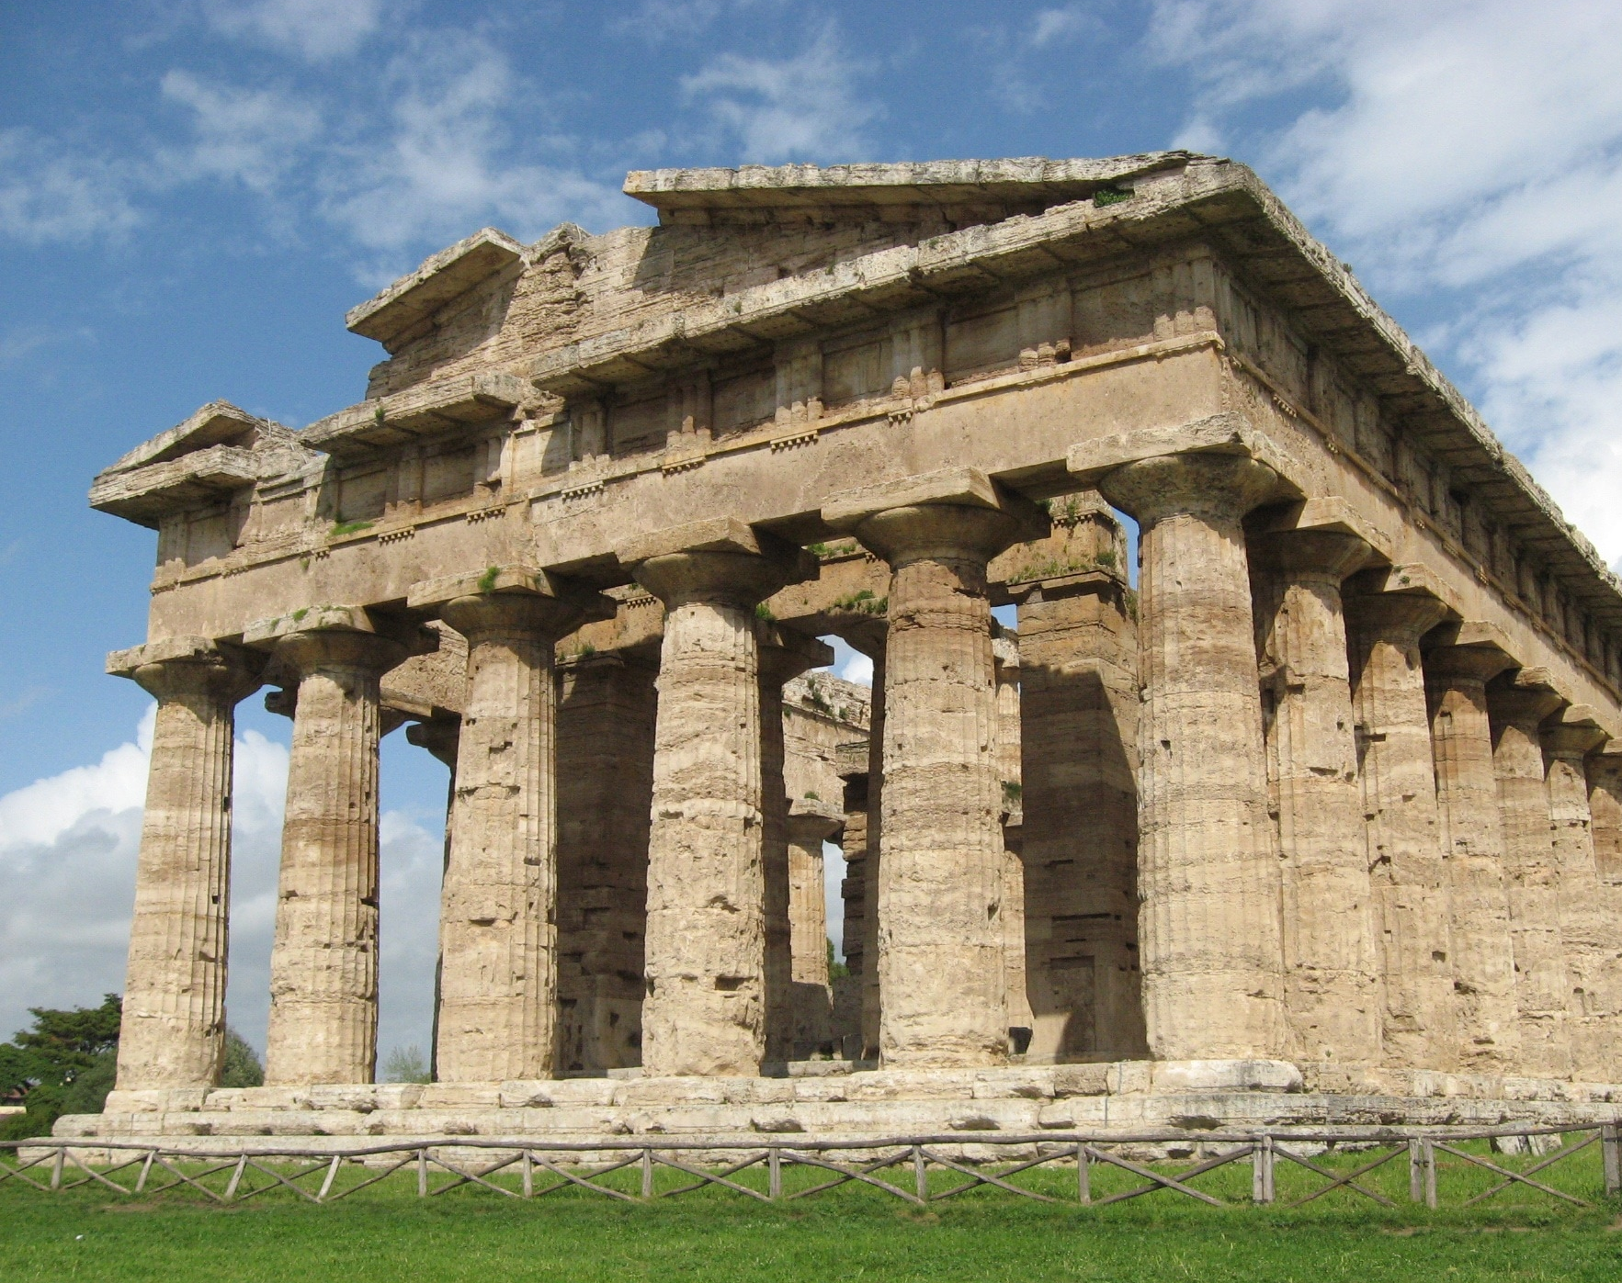
Gods and Men: In the Iliad and Odyssey
By: Nathan Sirovatka

Slide 2
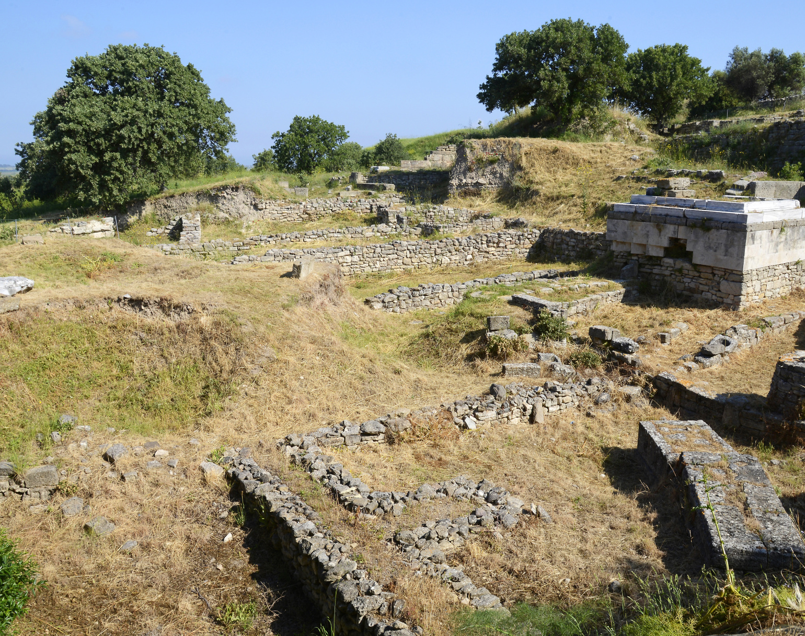
Two systems: Ethical vs. Pathetic
In the words of Aristotle, the Odyssey is ethical while The Iliad is pathetic
The Iliad proposes a system of interaction where the Gods represent the randomness and the harshness of fate
Conversely, The odyssey features a system that presents a “metaphysical foundation of the principle of justice” (Kullmann, 7)
This Photo by Unknown Author is licensed under CC BY-NC

Slide 3
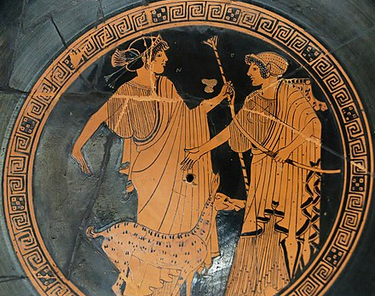
The Iliadic System: Pandarus’ Bow
Ex: Pandarus’ Bow: Athena deceives Pandarus into taking the shot, but Athena is not responsible for restarting the war, rather Pandarus is
Thus, the Gods drive action in the mortal world, but are not responsible for it, rather they represent the wheels of fate from afar, they also rarely act justly but for their own aims
This Photo by Unknown Author is licensed under CC BY-SA

Slide 4
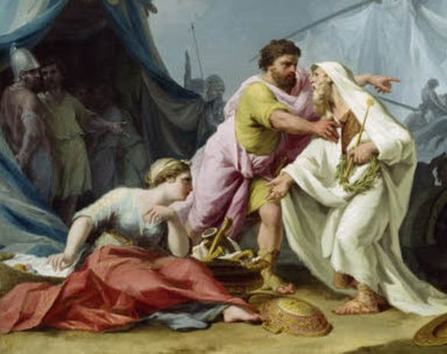
The Iliadic System: Chryses’ Prayer & Do ut des
Perhaps the most profound example of the interaction between Gods and man in the Iliad comes in the prayer of Chryses
Chryses has had his daughter taken by the Achaeans, but when he prays to Apollo he doesn’t invoke justice
Rather.. I’ve always sacrificed to you so please help me in this one instance
Clearly the situation seems like a violation of justice, but justice isn’t involved, rather some godly quid pro quo
NOT A MORAL SYSTEM

Slide 5
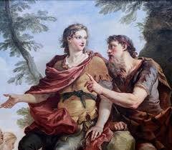
The Odyssey: Telemachus’ Prayer
The Odyssey conversely presents Godly interaction in a more Just light; Telemachus’ prayer is deeply indicative of this
Unlike Chryseis, Telemachus invokes justice in his prayer to Zeus
“But I will call upon the Gods that are forever, if haply Zeus may grant that deeps of requital may be wrought. Without atonement then you would die in my halls”
Here, Telemachus’ invocation doesn’t rely on quid pro quo, but an expectation that the Gods will adhere to a broader system of justice, a system outlined by Athena
“So, too, may any other also be destroyed who does such deeds”

Slide 6
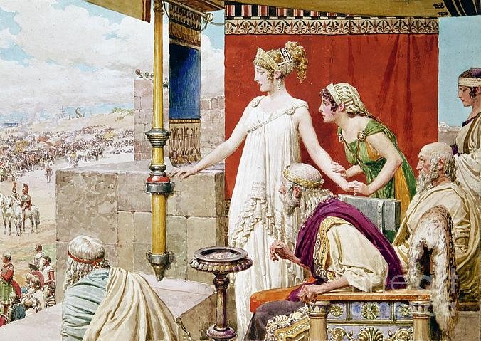
The Odyssey: The rejection of the goddess
Odysseus rejects the goddess Ino Leucothea
This degree of agency or refusal would not be possible in The Iliad
Stark contrast to a similar scene in the Iliad
Aphrodite essentially forces helen away from the walls of troy and into paris’ bed, she tries to refuse but cannot

Slide 7
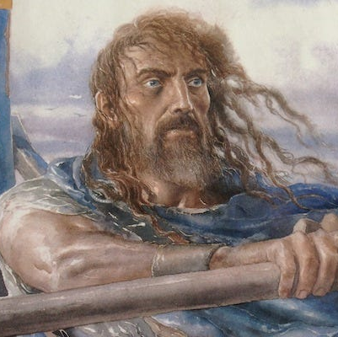
So What……
The two systems are in sharp contrast to one another
But the Homeric tradition is a shared one?
Two poets and two concurrent traditions
Or.. An organic development
Both theories have their merits
However, the two poets with concurrent traditions is very interesting to me

Slide 8
Reference Material
Kullmann, W. (1985). Gods and Men in the Iliad and the Odyssey. Harvard Studies in Classical Philology, 89, 1–23. https://doi.org/10.2307/311265

