Slide 1
Weapons and Armor of Homer
By: Evan

Slide 2
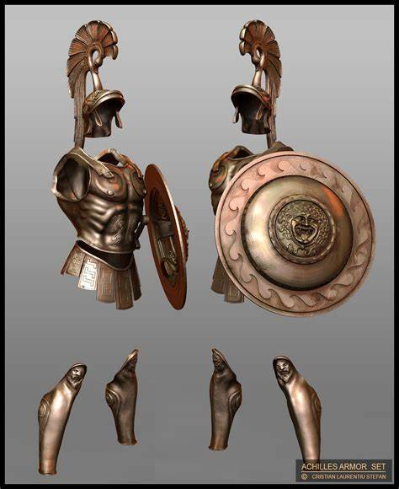
Symbolism in Armor
Armor in the Iliad and all other pieces from Homer is more than just a means to protect a warrior in battle
Armor is also a way of showing the honor that a certain soldier holds
For example Achilles armor is very unique and
decorated. This is symbolism that he is one of
the Greek’s greatest heroes.

Slide 3
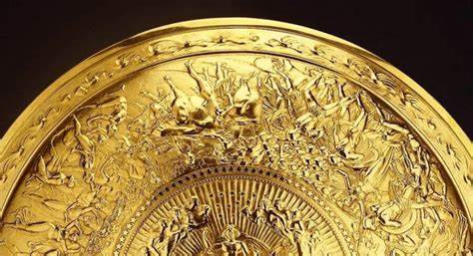
More Symbolism in Armor
Achilles armor was crafted by Hephaestus which symbolizes strength and the duality of the human experience
His shield is a good specific example of symbolism.
It represents his greatness and the warfare he’s seen. At the same time, it
connects to his normal life outside of his life on
the battlefield

Slide 4
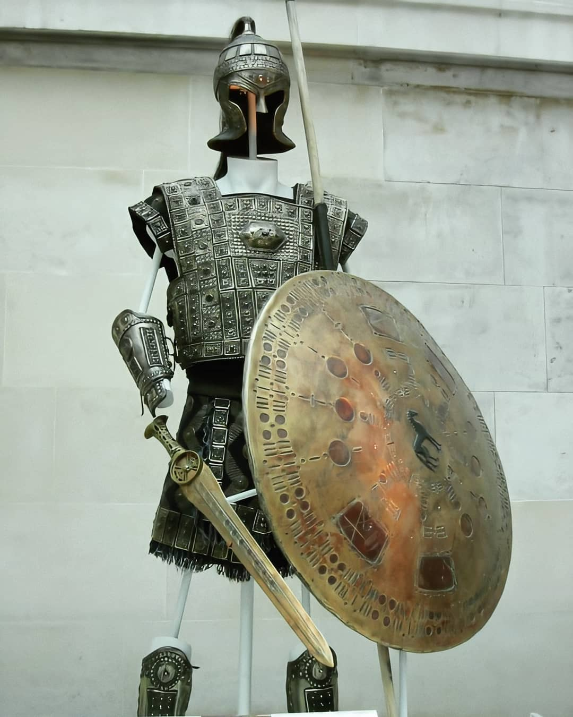
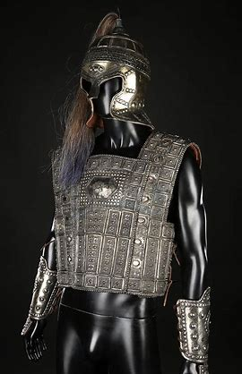
Hector’s Armor
Hector’s armor has a different symbolism from Achilles.
Hector is the protector of troy so his armor symbolizes his duty to protect his city and its people.
However, Hector’s armor is not made by any god which will become important in his battle against Achilles in the raid of Troy.

Slide 5
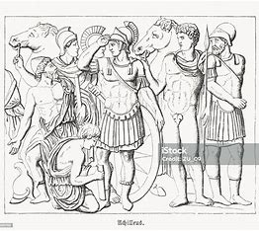
Arming scenes
Arming scenes in the Iliad are very important as they are used to show the power of a particular character. They can also be used to show the destinies of characters.
For example, when Achilles first puts on the armor forged by Hephaestus to finally rejoin the battle against the trojans after Patroclus is killed, it is obvious to the reader that Achilles is embracing his destiny to die a hero and not to live a long life

Slide 6
More Arming Scenes
Here is the quote talking about that arming scene
"Achilles dons armor made by Hephaestus, fully aware it will lead him to death. The act of arming becomes a moment of fate."
This is great symbolism for how Achilles chooses to die as a hero and be remembered forever instead of living a long life and being forgotten.

Slide 7
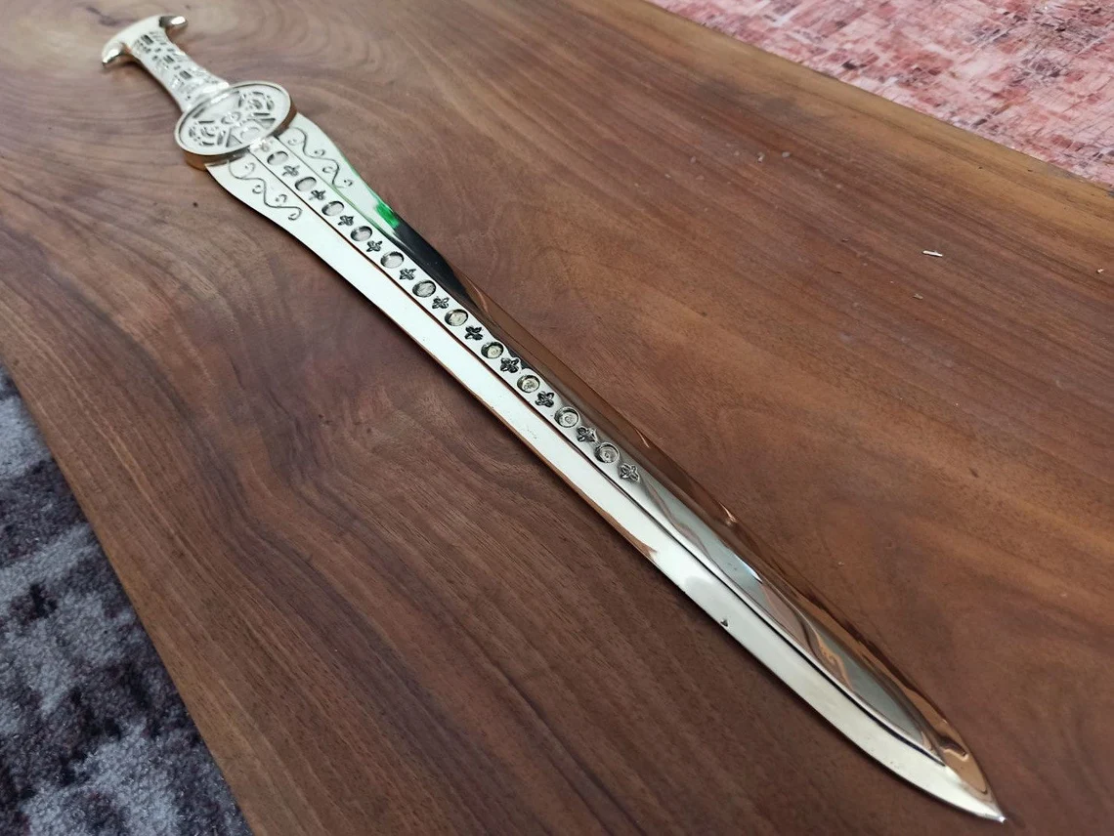
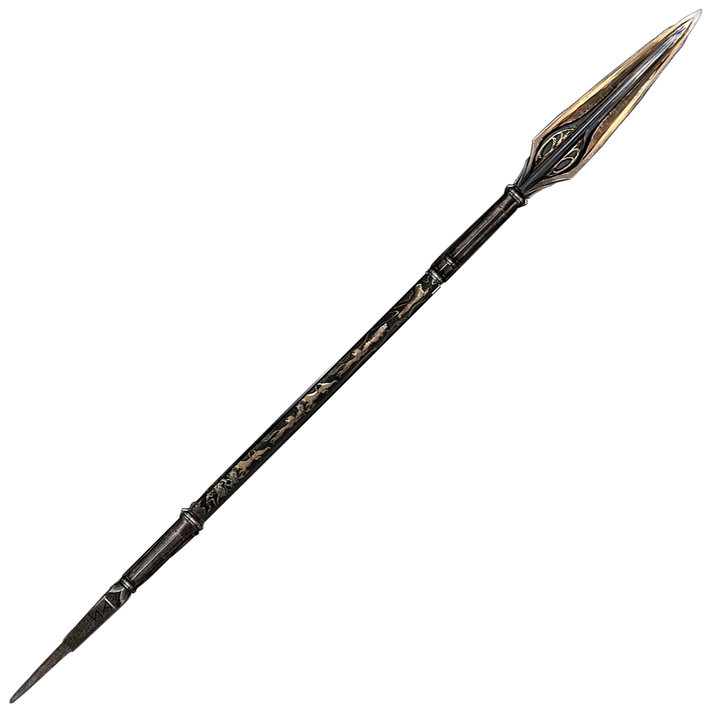
Weapon Symbolism
Many weapons of heroes are made by gods, tying them to the divine.
1 examples of this is achilles spear, forged by Hephaestus. In his battle with Hector, Hector brings out his sword which is not forged by a god which is symbolism for why he loses to Achilles spear
Hector’s sword being man made
ties him to his mortality in
this scene.

Slide 8
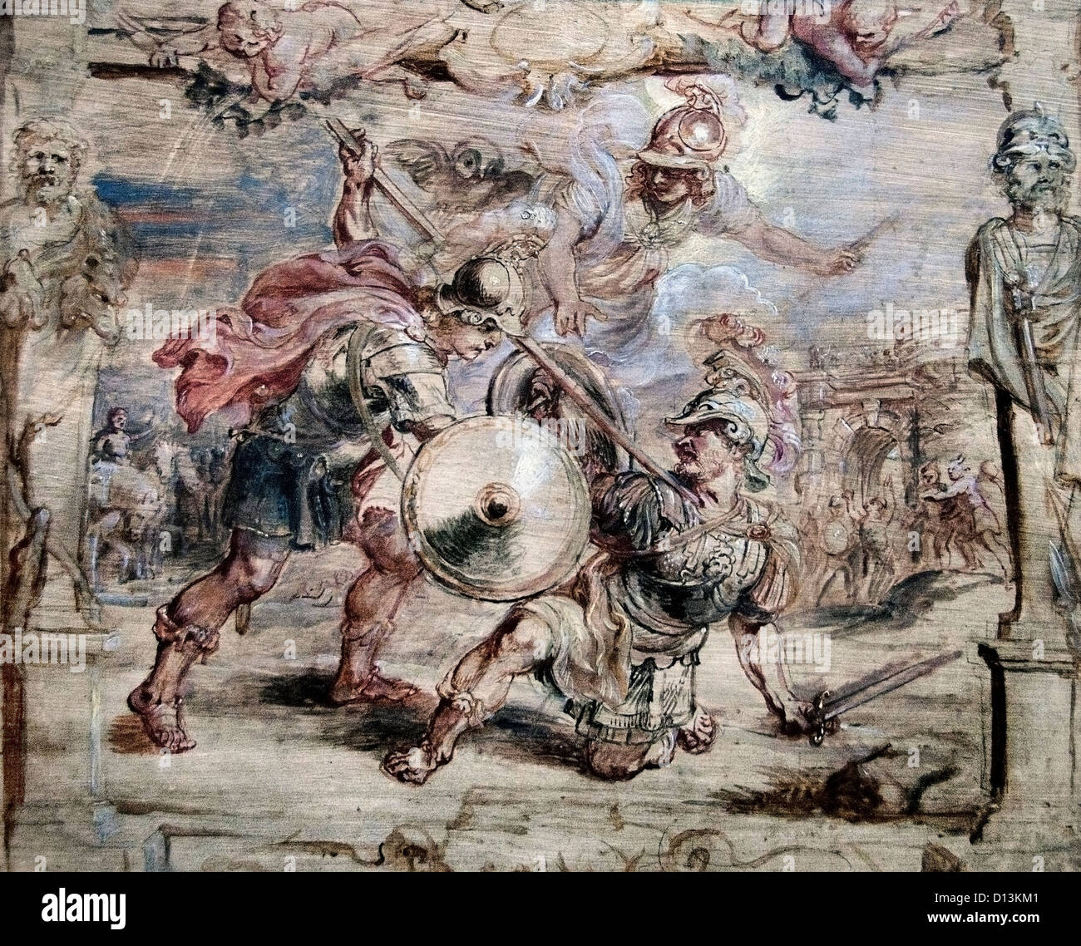
MORE Weapon Symbolism
Heroes keep track of who they kill with their weapons, depending on who they have killed, them and their weapons gain glory and build the hero’s legacy
An example of this is when Achilles kills hector with his spear, this moment is remembered forever through the Iliad and gives Achilles his eternal glory

Slide 9
The End

