Slide 1
Nostos - A Board Game
By Alex Agne

Slide 2
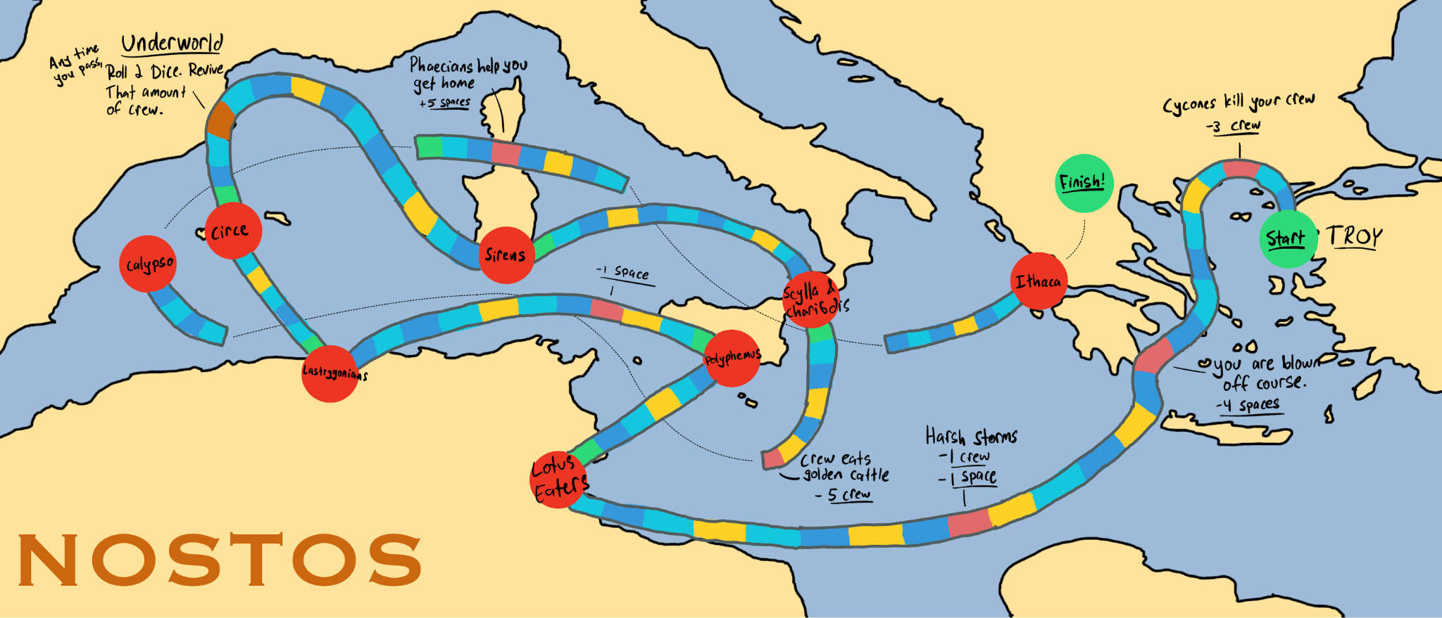
The Board

Slide 3
Instructions
Every turn, roll a standard 6 sided dice.
Each player starts with:
15/15 health points
0 skill points
12 crew members
If you run out of health points, you are revived with 10 health points and 5 skill points (same # crew). You must go back to the last trial you have completed and complete it again. You also lose every item you owned.
If you have 10+ crew, move an additional 2 spaces each turn.
If you have 6+ crew, move an additional space each turn.
If you have 2 or less crew, move one less space each turn.
Start at Troy. To win the game, be the first player to defeat the suitors and reach the end of the board.

Slide 4
Instructions
Standard space
Do action written on board
Spin the divinity wheel
Refresh Space. Roll a dice as soon as you reach this spot.
⚀ or ⚁ - Gain 2 health points
⚂ or ⚃- Gain 2 crew
⚄ or ⚅ - Gain 2 skill points
Trial

Slide 5
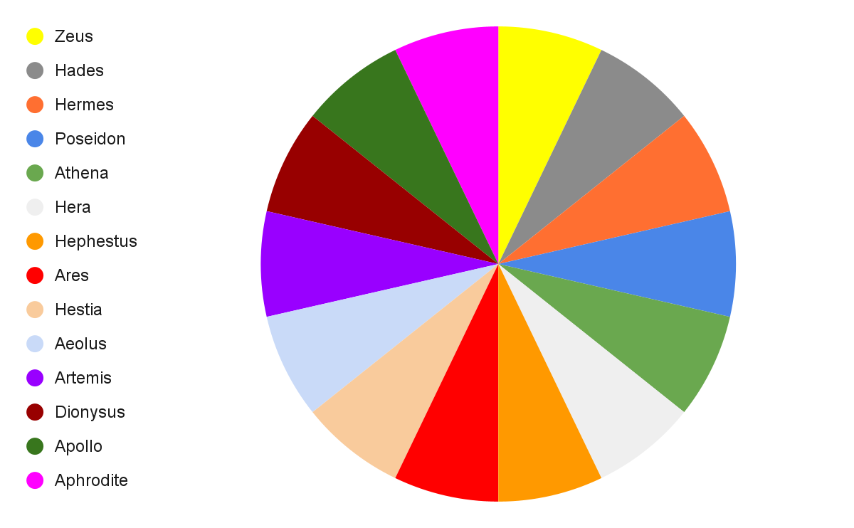
Divinity Wheel

Slide 6
Positive Divinities
Zeus - move forward 3 spaces and gain 1 skill point.
Hermes - roll again and advance twice the amount that you rolled. Gain 1 Magic Herb item.
Athena - Gain 6 skill points and 2 crew members.
Hephaestus - Gain 4 skill points
Hestia - Heal 4 health points. Health earned by Hestia can go over the 15 cap.
Artemis - Gain 3 skill points or 3 crew members (your choice)
Apollo - Gain 5 skill points and the Apollo’s Bow item.

Slide 7
Negative Divinities
Hades - every player loses 1 health point for each crew member they have less than 12.
Poseidon - move back 7 spaces, lose 3 health points and 3 crew members.
Hera - Lose 1 health point, 1 skill point, 1 crew, and one additional hp, sp, or crew, up to you.
Ares - lose 2 health points and 4 crew members
Aeolus - The crew found the jar of winds and opened it. Roll a dice and lose however many crew members appear on the dice.

Slide 8
Neutral Divinities
Aphrodite - Penelope is waiting patiently. move forward 10 spaces, but subtract 2 for each trial you have passed. If you have passed ogygia, you lose 2 crew and 2 health points as well.
Dionysus - If you have passed polyphemus, move forward 5 spaces and gain a crew member. If not, move backwards 5 spaces, lose 1 health point, gain 1 Bottle of wine item.

Slide 9
Item Exchange
At any point during the game, you may exchange items in the following way:
Magic Herb: +3 health points
Bottle of Wine: +3 health points, -1 skill point
Beeswax: +2 health points
Apollo’s Bow: +3 skill points

Slide 10
8 Trials
Lotus Eaters
Polyphemus
Laestrygonians
Circe
Sirens
Scylla & Charybdis
Calypso
The Suitors in Ithaca
As soon as a trial is completed, advance to the refresh space after it, roll for your reward, then end your turn.

Slide 11
Lotus Eaters
Call out a number on your dice and roll for that number.
If you are correct, you have passed the challenge. advance one spot, turn ends.
(You earn 2 skill points if you guess right on the first try)
If you are incorrect but your guess is on the bottom face of the dice, gain one skill point. Your turn ends.
If you are incorrect by rolling any other number, lose 1 health point or 1 skill point, up to you. Your turn ends.

Slide 12
Polyphemus
You must spend 8 skill points to defeat polyphemus. If you do not have enough skill points, you may pass your turn and gain 1 skill point.
You can also sacrifice members of your crew for 1 skill point each at any point during your turn.
For each turn you pass, you lose 1 health point.
If you pass, advance one space and your turn ends.
If you have a Bottle of Wine, you only need to spend 3 skill points to pass.

Slide 13
Laestrygonians
These giants devour members of your crew. They deal 15 damage to you minus each crew member and skill point you sacrifice.
You can choose to add 1 crew member at any point, but doing so immediately ends your turn.

Slide 14
Circe
Each turn you stay on circe’s island she takes 1 of your crew members. If you have no crew members, she deals 3 damage to you. You must wait on Circe’s island for 3 turns before moving on.
You can decrease the amount of turns you must wait for 2 skill points per turn.
If you have the Magic Herb, you must wait only 1 turn.
If you have sacrificed 3 crew members to circe, she gives you the Beeswax item.

Slide 15
Sirens
Roll 2 dice. The number you roll is the number of crew you lose. Also lose 4 health points.
If you have the Beeswax, you may only roll one dice and you do not lose any health points. Instead, gain 2 skill points.

Slide 16
Scylla & Charybdis
You may choose between Scylla and Charybdis:
Scylla: Lose 6 crew members. If you have less than 6 crew members you may not attempt to pass by scylla. If you do pass Scylla, gain 4 skill points.
Charybdis: Spend 6 skill points and lose 4 health points.
You may also choose to pass your turn to recover and gain 1 health point or 1 skill point.

Slide 17
Calypso
The first player to reach Calypso must wait 7 turns on Ogygia, just as Odysseus waited 7 years.
Every other player only needs to wait 3 turns, but can choose to stay for up to 7 turns.
For each turn you are on ogygia, choose 2 of the 3 options (no duplicates):
+1 health point
+1 skill point
+1 crew
Each time another player spins Zeus or Hermes, you may choose to subtract 2 years.

Slide 18
Ithaca
It is time to fend off the suitors. They deal 40 damage to you, but you may spend your skill points and sacrifice your crew for 1 less damage per skill point and crew.
If you own Apollo’s Bow, the suitors only deal 20 damage.
You may also choose to regroup before entering ithaca, gaining 1 crew, but your turn ends.

Slide 19
The End

