Slide 1
Sayables and Simple Propositions

Slide 2
Language is closely connected with Stoic logic and epistemology
Language is a key part of the process of assenting to impressions, so it has to fit in with the ideas of corporeality, reason, and truth
To sort out why language was so important, they had to first separate unimportant language from important, which they called signification
Notes:
In stoicism, language is closely connected with logic and epistemology, because language is what thoughts use to interpret impressions. First they separate out the important aspects of lanugage

Slide 3
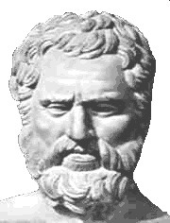
Voiced sound vs spoken speech
Any vocal sound is an utterance
Utterance that is articulated is speech
Speech that is a significant statement is language
-anything from animal noises to full sentences
-includes words, gibberish
-full phrases with a subject and predicate
33A

Slide 4
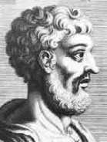
3 things linked
The signifier
the signification (sayable/λεκτον)
The name-bearer
The physical utterance
The meaning/state revealed by the utterance
The corporeal body spoken of
Notes:
-Of these, only the signification is incorporeal
-it is important to note that while the sayable is the summary of the thought, that same sayable wont’ bring about the same exact thought in different people, or even in the same person under different circumstances.

Slide 5
The significance isn’t inherent in speech, but a separate thing
Because…
Someone who doesn’t speak the language won’t receive the meaning
All minds are different, and the impressions created by a signification are different for everyone (B2)
So…
The significance is a logical conclusion or summary of the thought, which can be passed from person to person with language
Notes:
Significance or meaning can’t be part of the words, or part of the mind. (justified by ^^, diff language, and to them thoughts and the mind were physical bodies, and everyones thoughts are different) Instead it is a conclusion of the thoughts, which can be conveyed through words.
To me these seem like reasons that the significance is incorporeal, but not to Long and Sedly, so they provide two other plausible reasons

Slide 6
Incorporeality
Since language can be false, it can’t have a corporeal body “If Cato is not walking, the false statement that he is walking cannot have a corporeal entity, the non-walking Cato, as its meaning.”
Language distinguishes subjects and predicates, and this distinction is arbitrary/doesn’t exist in nature
-the Stoics don’t like incorporeality, so while they can’t say that these lekta exist, they place them into the ‘something’ class
Notes:
These are just proposed reasons by L&S

Slide 7
Impressions and the signification/sayable/λεκτον
When an impression arises from outside stimulus, the “commanding-faculty will be disposed in a certain way” (L&S 200) -the sayable is the correlate of that (corporeal) disposition
This sayable can be assented to or not (rationality)
This sayable is what we use to form speech to convey that thought
Notes:
This is the sayables part in the thought process. This is important because it is the Stoics solution to the problem of how two different people’s thoughts can be the same meaning. Made possible by the separation of the sayable from the rational impression

Slide 8
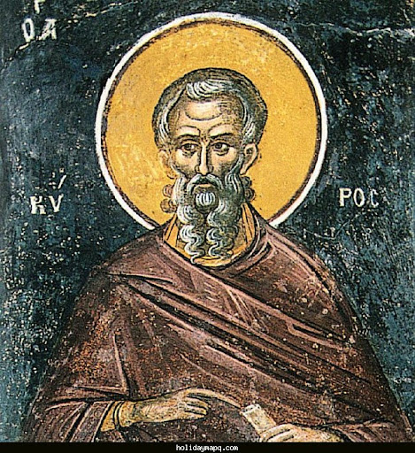
Complete vs Incomplete Sayables
A complete sayable needs:
A nominative (a subject) -The nominative case is the purest form which has ‘fallen upright’ directly from the thought (33K)
The signification of a characteristic, or a predicate, which the Stoics use to mean anything attached to that nominative (33G)
“Dion writes” “here is Dion” “Dion is skinny”
Proposition like this are the most important, but sayables also include questions, oaths, imperatives…
33K
Notes:
A complete sayable needs a nominative case, with a predicate attached.
The nominative case is a noun as a subject. It is considered the purest form, which falls directly from thought
The predicate is the characteristic of the nominative, and by itself a predicate is an incomplete sayable

Slide 9
Predicates
Incorporeal signification of a characteristic (of a body)
(28M) predicates aren’t something we can have, since they are just something a body is doing: ’Simon walks’ – nothing here besides Simon -while Simon is a thing, ‘walks’ doesn’t exist anywhere in nature ‘He acts prudently’ -we can have prudence, but we can’t have the ‘acting prudently’ (33J)
Notes:
Predicates are incorporeal, because they are not something that exists, but are a characteristic of a body
If you say ‘simon walks’ – simon exists in nature, but ‘walks’ is meaningless
In the same way, you can’t ‘have’ a predicate. You can have prudence, but acting prudently is only attachable to a nominative case

Slide 10
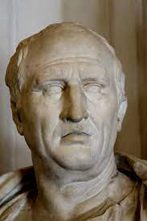
Simple Propositions
One species of the ‘complete sayable’, called ἀξίωμα, which Long and Sedly translate to proposition
A sayable that corresponds to the state of something in nature (34E)
Must be true or false (34A, B, C). A proposition either does or doesn’t correspond to the natural world
Propositions are not locked in time, and because of this they can change from true to untrue -”it is day” can be true at one time then untrue later, but it is the same axiom/proposition (34J, K)
Notes:
There are more species of sayable, including questions, oaths, imperatives, but were only concerned with truth statements, or propositions
…To them, propositions were not locked in time

Slide 11
3 types of simple affirmative propositions
Definite “this one is walking”
Indefinite “someone is walking”
Intermediate “a man is walking” “Socrates is walking”
33H
Notes:
Proper names are not definite to the Stoics, since they don’t necessarily refer to someone present

Slide 12
Contradictions
From Sextus Empiricus (34G) the contradictories are propositions one of which exceeds the other by a negative “It is day”, “Not: it is day”
The negative must precede the whole argument, so that it applies to each part
Notes:
Finally, for the Stoics, Contradictions fall under simple propositions. Contradiction involves adding a negative before a proposition, and for it to work logically the negative must precede entire argument, which applies it to each part.

Slide 13
In conclusion, impressions form on our mind from a stimulus. With the power of language, our thoughts extract sayables, or lekta from these impressions, which we can convey to others by voicing these sayables in speech. Regarding simple statements of truth these sayables are called propositions.

