Slide 1
HML as an implementation of the “standard”
Bob Milius, PhD
Bioinformatics Research
NMDP

Slide 2
How to implement the MIBBI?
The MIBBI is set of
  guiding principles &
  best practices
By itself,
  It is not a specification that a programmer can implement
  It does not ensure interoperability

Slide 3
Interoperability
  ability of a system to
  access and use
  the parts or equipment of another system
Syntactic
Interoperability
Semantic
Interoperability

Slide 4
HML
Histoimmunogenetics Markup Language
Supports
  reporting of paired genotype allele lists as determined from Primary DNA Results (SSO, SSP and SBT)
  reporting genetic typing results using WHO nomenclature
  describing the results of any/all tests performed to generate genetic typing results (raw data).
Current Version = 0.3.3
Maiers, M., Tissue Antigens 69:69-71, 2007
doi: 10.1111/j.1399-0039.2006.76061.x
http://bioinformatics.nmdp.org/HLA/HLA_Typing/HML/Histoimmunogenetics_Markup_Language_(HML).aspx

Slide 5
New Requirements
Enhancements needed for current typings
  Accept SBT and SSO typings for same locus
  Accept optional inclusion of locus
  Accept multiple GSSPs
NGS requirements from the “Draft Standard…”

Slide 7
changed
new
new
Notes:
Project-name attribute moved to root
Various test identifiers have been abstracted to test-id and test-id-source, where test-id is one of GTR, NMDP, probe-name, ref-id, etc
Added support for GL Strings and GL Resources (URIs and external xml for GL-resources)

Slide 8
DOCUMENT METADATA
AND
SAMPLE INFO
TYPING METHOD(S) &
RAW DATA
TYPING INTERPRETATION

Slide 9
DOCUMENT METADATA
AND
SAMPLE INFO

Slide 10
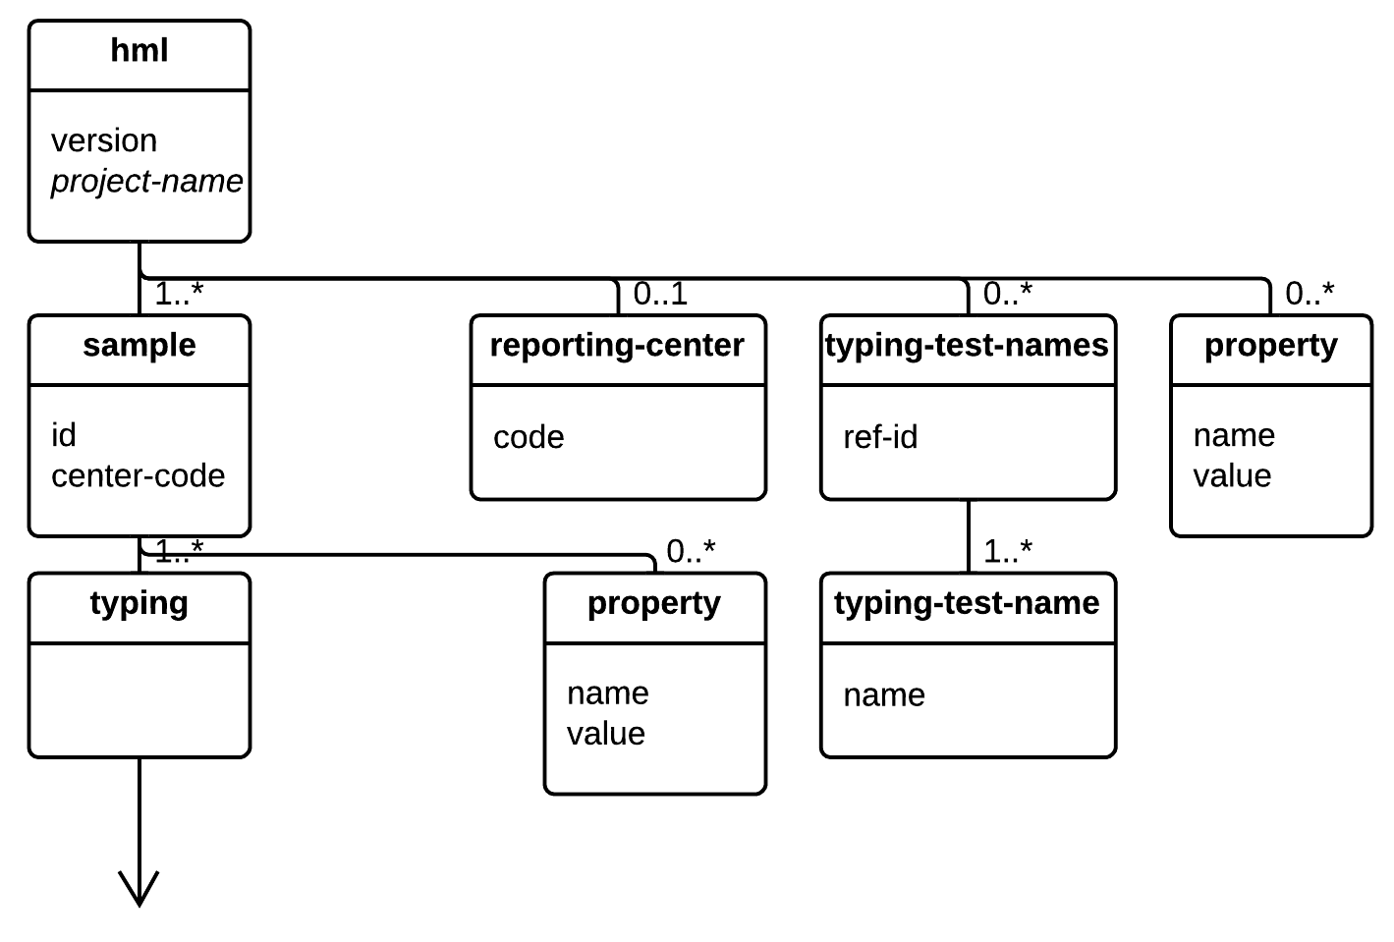
TO TYPING METHOD(S) & INTERPRETATION

Slide 11
TYPING METHOD(S)

Slide 13
TYPING RESULT/INTERPRETATION

Slide 14
genotype-list
is being deprecated
Notes:
GL Resource = Abstract class for all resources representable in GL String format.
Created to support the GL Service

Slide 15
 | Category Subject | HML 1.0 solution
1 | Sample annotation | <sample id="0101010101" center-code="099">
2 | Reference Context | <interpretation allele-db="IMGT/HLA" allele-version="3.14.0"/> <region-targeted ref-genome-db=“GRCh37”/>
3 | Genotype | <interpretation/>
4 | Consensus sequence | <ngs><consensus-sequence/></ngs>
5 | Novel polymorphisms | Can be represented as a GL String Nomenclature TBD by community
6 | Unreferenced seqs | TBD
7 | Sequence regions targeted | <ngs><region-targeted/></ngs>
8 | Read metadata | <ngs><raw-reads uri="http://uri.here" platform="myplatform"/></ngs>
9 | Primary data | <ngs><raw-reads uri="http://uri.here" platform="myplatform"/></ngs>
10 | Platform documentation | <ngs test-id="GTR000000000.0" test-id-source="GTR"
Notes:
Blue = attributes
Red = values

Slide 16
Category 1
Sample Annotation
<sample id="0101010101" center-code="999">

Slide 17
Category 2
Reference Context
<region-targeted
ref-genome-db="GRCh37.p13"/>

Slide 18
Category 2
Reference Context
<interpretation
allele-db="IMGT/HLA"
allele-version="3.14.0"/>

Slide 19
Category 3
Genotype
<glstring
uri="http://optional.uri.here">
KIR3DL2*008/KIR3DL2*038+KIR3DL2
*00701|KIR3DL2*027+KIR3DL2*01
</glstring>

Slide 20
Category 4
Consensus Sequence
<consensus-sequence
uri="http://optional.uri.here"
format="IUPAC"
informative-reads="77%"> GCTCCCACTCCATGAGGTATTTCTMCACWTCASACACAGATCTYCAAGACCAACACACAGACTKACCGATTCGS
</consensus-sequence>

Slide 21
Category 4
Consensus Sequence
<consensus-sequence
uri="http://optional.uri.here"
format="FASTA"
informative-reads="77%">
<![CDATA[>sample12345|allele_1|HLA-A|5’UTR|IMGT/HLA3.13.1|haploid|
CAGGAGCAGAGGGGTCAGGGCGAAGTCCCAGGGC]]>
</consensus-sequence>

Slide 22
Category 5
Novel Polymorphisms
We need a nomenclature for novel polymorphisms

Slide 23
Category 6
Unreferenced Sequences
We need to associate these

Slide 24
Category 7
Sequence Regions Targeted
<region-targeted format="BED">
<![CDATA[track name="HLA-DRB1" description="assessed DRB1 features"
Chr6 4009971 4010070 exon1 - 4009971 4010070 0,0,255]]>
</region-targeted>
<region-targeted format="exon">
HLA-B;exon2,exon3
</region-targeted>

Slide 25
Category 8
Read Metadata
<raw-reads
uri="http://required.uri.here"
platform="MiSeq"/>
Notes:
Primary data in SRA
SRA holds metadata

Slide 26
Category 9
Primary Data
<raw-reads
uri="http://required.uri.here"
platform="MiSeq"/>
Notes:
Primary data in SRA
SRA holds metadata

Slide 27
Category 10
Platform Documentation
<ngs test-id="GTR000000000.0" test-id-source="GTR">

Slide 28
Summary
Implementing principles of the MIBBI into a technical specification that supports interoperability is not trivial
We’ve got most of it worked out (v0.9)
We need community input for
  nomenclature for novel polymorphisms
  unreferenced sequences
We still need to be able to integrate into clinical reporting standards, e.g., HL7

Slide 29
Acknowledgements
NMDP
National Marrow Donor Program
  Martin Maiers
  Bob Milius
  Kathryn Doroschak
  Joel Schneider
  Michael Heuer
  Pradeep Bashyal
  Michael George
  Jane Pollack
CHORI
Children’s Hospital Oakland Research Institute, Oakland, USA
  Steven J. Mack
  Jill A. Hollenbach
LifeTechnologies
  Ben Gifford
Histogenetics

Slide 30
Thank you!
Questions?
See us at Exhibit Booth 410!

