Slide 1
Genomic Formats and the HLA Data Standard
Benjamin Gifford
Life Technologies R&D
Sunday, November 17, 2013

Slide 2
Existing Data Standards
The draft standard for HLA on Next-Gen Sequencing (NGS) uses existing data standards where it makes sense.
Some of the standards are common with the genomic sequencing community, others are HLA specific.

Slide 3
Existing Data Standards
The draft standard for HLA on Next-Gen Sequencing (NGS) uses existing data standards where it makes sense.
Some of the standards are common with the genomic sequencing community, others are HLA specific.
Don’t reinvent the wheel!

Slide 4
Genomic Formats Referenced in the MIBBI
Genome Reference Consortium
FASTA Format
FASTQ Format
Sequence Read Archive
Genetic Testing Registry
Variant Call Format
Genome List String

Slide 5
Genome Reference Consortium (GRC)
A single reference consensus sequence of a genome.
The current build for Homo sapiens is GRC37.
Most other genomic resources use this build as the basis of their genome, such as UCSC Genome Browser’s HG19.
The Genome Reference Consortium includes:

Slide 6
FASTA Format
>chr7
GGCAGATTCCCCCTAGACCCGCCCGCACCATGGTCAGGCATGCCCCTCCTCATCGCTGGGCACAGCCCAGAGGGTATAAACAGTGCTGGAGGCTGGCGGGGCAG
Consists of a header line, followed by lines of sequence.
Most common standard for reporting sequence, including the GRC.
As a single tiling, this format does not contain polymorphisms.

Slide 7
FASTQ Format
@EAS54_6_R1_2_1_443_348
GTTGCTTCTGGCGTGGGTGGGGGGG
+EAS54_6_R1_2_1_443_348
;;;;;;;;;;;9;7;;.7;393333
A data format that includes the FASTA sequence and data quality.
Most common standard for NGS data.
Developed by Wellcome Trust Sanger Institute.

Slide 8
NCBI Resources
Sequence Read Archive (SRA) is an archive created by NCBI to store NGS reads. SRA accepts FASTQ and other common NGS formats.
Genetic Testing Registry (GTR) An NCBI provided location where testing providers may submit test information.

Slide 9
Variant Call Format (VCF)
#fileformat=VCFv4.0
##FORMAT=<ID=GT,Number=1,Type=String,Description="Genotype">
##FORMAT=<ID=GQ,Number=1,Type=Integer,Description="Genotype Quality">
##FORMAT=<ID=DP,Number=1,Type=Integer,Description="Read Depth">
##FORMAT=<ID=HQ,Number=2,Type=Integer,Description="Haplotype Quality">
#CHROM POS ID REF ALT QUAL FILTER INFO FORMAT NA00001 NA00002 NA00003
20 14370 rs6054257 G A 29 PASS NS=3;DP=14;AF=0.5;DB;H2 GT:GQ:DP:HQ 0|0:48:1:51,51 1|0:48:8:51,51 1/1:43:5:.,.
17330 . T A 3 q10 NS=3;DP=11;AF=0.017 GT:GQ:DP:HQ 0|0:49:3:58,50 0|1:3:5:65,3 0/0:41:3
Store the sequence variation of an allele, compared to a reference sequence.
Can record SNPs, deletions, insertions, complex events of more than one base pair, and large structural variations.
Combined with a FASTA file, this format can address polymorphisms.
Developed by the 1000 genomes project.

Slide 10
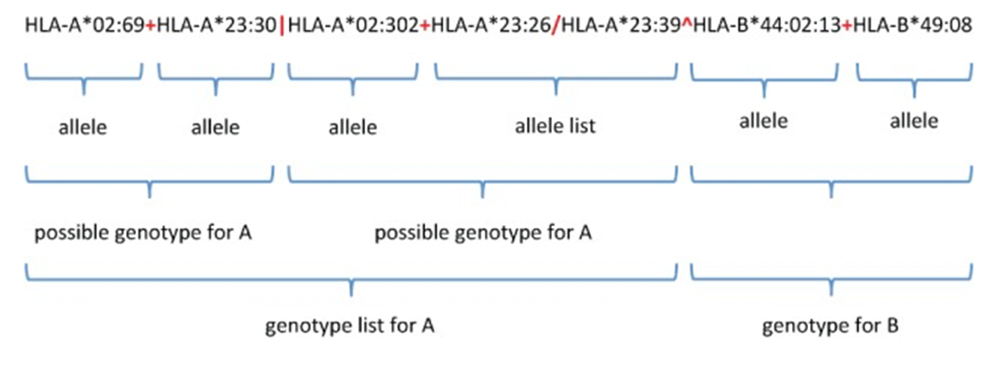
Genome List String (GLstring)
Encodes allele ambiguity of typing result, without losing information or adding additional ambiguity.
Available as a web service.

Slide 11
Health Level 7
Health Level 7 (HL7) is a frame work for healthcare informatics. Includes messaging standards that help electronic medical records systems communicate.

Slide 12
HLA “Island”
Genomic “Mainland”

Slide 13
HLA “Island”
Resources in dealing with highly polymorphic sequence.
Resources for dealing with repetitive sequence.
Clinical sequencing.
Genomic “Mainland”

Slide 14
HLA “Island”
Resources in dealing with highly polymorphic sequence.
Resources for dealing with repetitive sequence.
Clinical sequencing.
Genomic “Mainland”
More tools being developed for NGS sequencing.
Established solutions for Big Data.
Larger resource base.

Slide 15
Life Technologies
Established partner in HLA with SSP and SBT
A leading company in the genomic market
with the Ion PGM and Proton.

Slide 16
Acknowledgments
Life Technologies
Scott Conradson and the entire HLA R&D team
NMDP
Bob Milius, Martin Maier and Joel Schneider
CHORI
Steven J. Mack and Jill A. Hollenbach
Stanford
Marcelo Fernandez-Viña and Paul J. Norman
NIST
Marc Salit

