Slide 1
Next Generation Data Standards
Tuesday May 14th, 2013, 14:30 – 17:00 Location: Room 0.4/0.5 in MECC

Slide 2
Next Generation (of) Data Standards
Tuesday May 14th, 2013, 14:30 – 17:00 Location: Room 0.4/0.5 in MECC

Slide 3
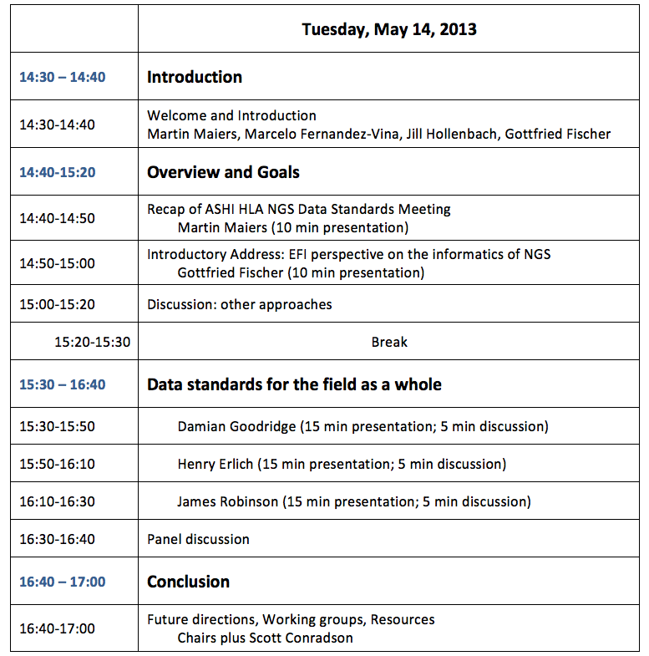

Slide 4
Goals
Strategic discussions about how using Next Generation Sequencing for HLA and KIR typing will change the fields of Histocompatibility and Immunogenetics.
To ensure NGS data is used most effectively data standards need to be established, and this meeting is to start this process.
Note: this meeting is not about methods, it is about data standards.

Slide 5
As a society we have much to be proud of
The thing we should be least proud of is our data management practices

Slide 6
Meaningful use
Machine-able
Complete
The Science and Medicine advances and improves at the rate that the data moves
“Fax me the lab report…”
“e-mail me the pdf of the lab report…”
“help me map the ; to a : on my keyboard so its easier to hand-enter HLA…”

Slide 7
Governance/Regulatory Trends (US)
Patient Protection and Affordable Care Act
Electronic Medical Records Mandate
Health Insurance Portability and Accountability Act
Food and Drug Administration
Licensure: Cord Blood (now), unrelated-PBSC (soon)

Slide 8
Nomenclature
Community Funded
Where would we be without it?
Only assign names to full alleles
Only type parts
If you do type the full allele it looks the same as if you only typed the parts

Slide 9
Closed World assumption
Continue typing until you have excluded all other possible genotypes (allele calls)
Reporting only most likely, most common
Proprietary reagents/methods

Slide 10
NGS
Opportunity to establish “meaningful use” data standards
Commoditization ➔ Open Standards
Liberation by Technology
Full genes
Complete, separated alleles

Slide 11
HLA NGS Data Consortium Meeting: Comments & Observations
From October 8, 2012
San Juan, Puerto Rico

Slide 12
Focus
On how data are “used” not how data are generated
Relevant metadata
Export formats

Slide 13
Syntactic interoperability
Definition of data exchange formats
Relatively trivial
Semantic annotation
Development of
Robust terminologies
Ontologies
Nomenclature
Important driver

Slide 14
Scope of Standardization
What data management and reporting standards are needed?
Metadata to record experimental details
NCBI GTR Genetic Testing Registry (ncbi.nlm.nih.gov/gtr)
Data processing and analysis pipelines
Software/version
Base calling parameters
Reporting sequence/genotype results
Consider existing formats (VCF, GVF)
Variant Call Format (1000genomes.org)
Genome Variation Format (www.sequenceontology.org)
Clinical results may require different format (HL7)

Slide 15
Scope of Standardization
Process for re-interpretation of data
Relies heavily on metadata and provenance standards for HLA
HLA nomenclature should be separate from core (static, primary) data, and only latter should be used for downstream analysis

Slide 16
Sequence data
What metadata is required?
Sample collection, processing, sequencing method, analysis parameters
Whatever is enough for reanalysis and reinterpretation
NCBI SRA & ASPERA
How much data should be stored?
Primary data is very large
Unmapped reads with quality scores (FASTQ) may be enough
Are quality scores cross-platform?
Does it matter?

Slide 17
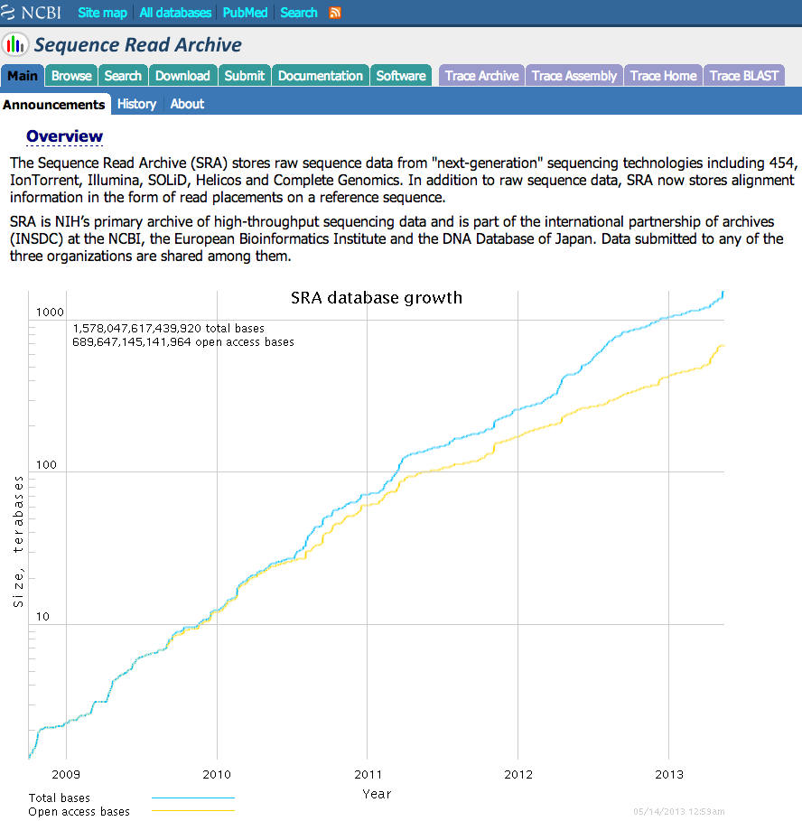

Slide 18
Data Analysis & Interpretation
What analysis process and methods should be used for HLA loci?
How should HLA genotype results be reported?
How should HLA alleles be named?
What capabilities are required to interpret HLA data over time?

Slide 19
“I learned very early the difference between knowing the name of something and knowing something.”
-Richard Feynman

Slide 20
HLA Nomenclature
Is the system intended for human readability or computability?
What assumptions can/should be made regarding unknown data
No way to name partial alleles, yet typing is partial
Names change based on biological knowledge
There is debate over whether a centralized naming process will scale over time

Slide 21
Next steps
1. Define the raw data format: unmapped reads
- FASTA with quality scores (FASTQ)
- SFF
- unmapped BAM
- put in SRA
- primers
2. Address issues with the alignment for the interpretation pipeline
3. Public documentation of NGS methods
GTR - put it in there

Slide 22
Meeting Objectives
• Gain agreement that a single standard is needed for NGS HLA data
• Assess current status of standards development and existing challenges
• Appoint sub‐committees to develop proposals for establishing a standard and addressing challenges
• Gain commitment from suppliers for sponsorship of a consortium website
• Subsequent meeting schedule and logistics

Slide 23
Questions for Speakers
Are allele‐calls alone sufficient to constitute an HLA typing result?
Should NGS software be required to identify/detect potential new alleles/novel sequences?
How should sequence data be formatted in order to represent coverage, primer regions, phasing across exons, etc. (e.g. via a format similar to the new IMGT/HLA database's XML)? Is there an existing format, or standard currently in place?
Should registration of the method in a publicly accessible database be mandatory for NGS technology and software elements (e.g. via a system like NCBI’s GTR)? This would allow reference to specific aspects of and updates to the wet and in silico aspects of the NGS method, as they are updated.

