Slide 1
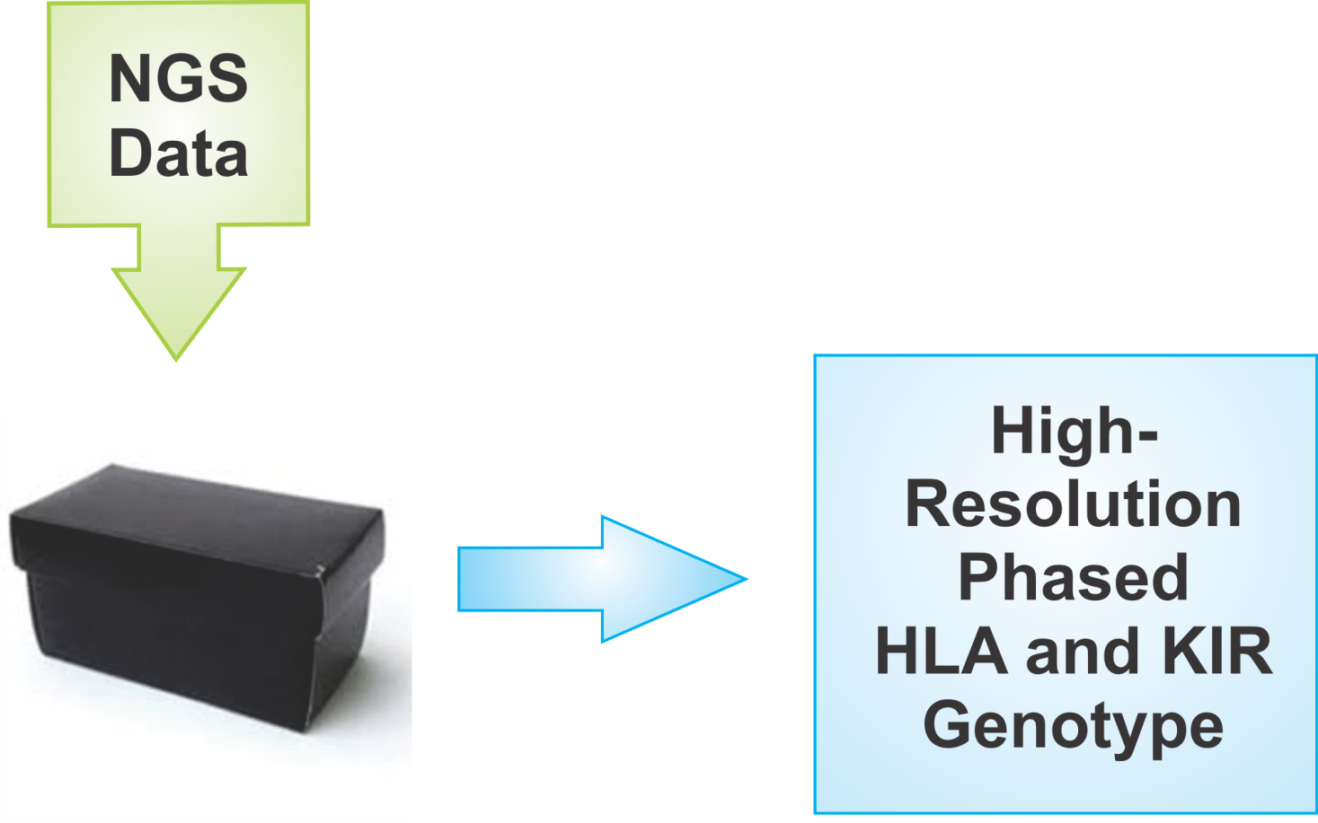
Genotyping HLA and KIR from NGS data
NGS Data Consortium Meeting: ASHI 2012

Slide 2
Main considerations per read
Quality
Specificity
Novel Mutation
Depth (post-filter)

Slide 3
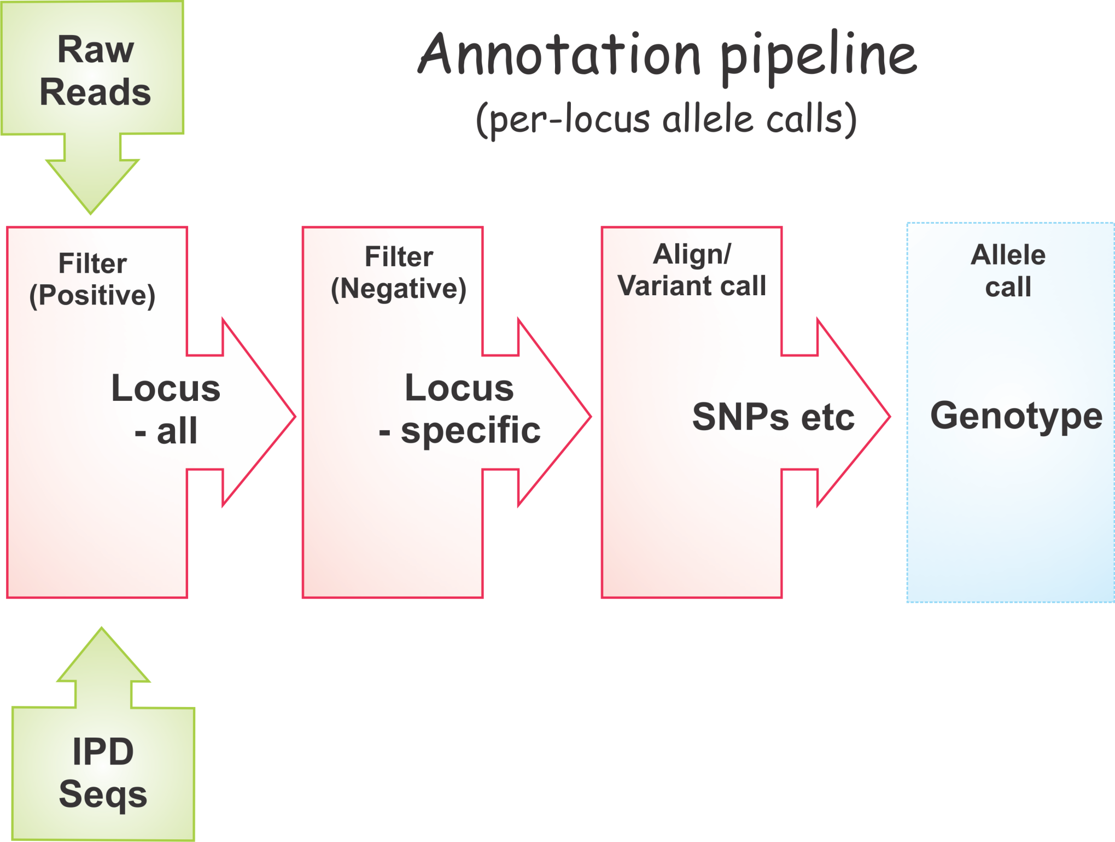

Slide 4
Quality
FASTQ sequence read format
Minimum Quality Requirement?
Per base ? per read ?
Vs read depth ?

Slide 5
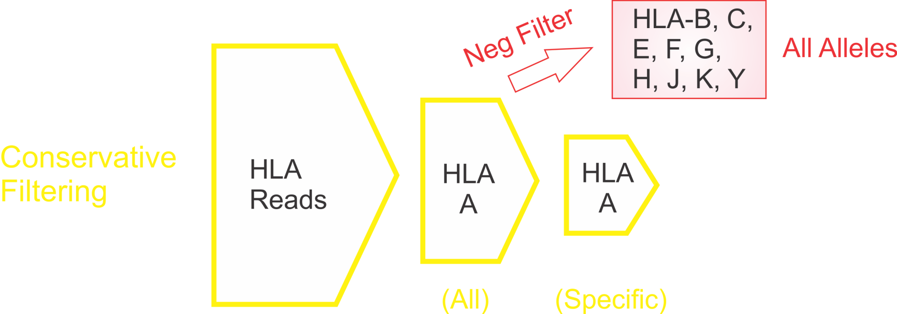
Specificity
Filtering Strategy (e.g. HLA-A)

Slide 6
Specificity
Filtering Strategy (e.g. HLA-A)

Slide 7
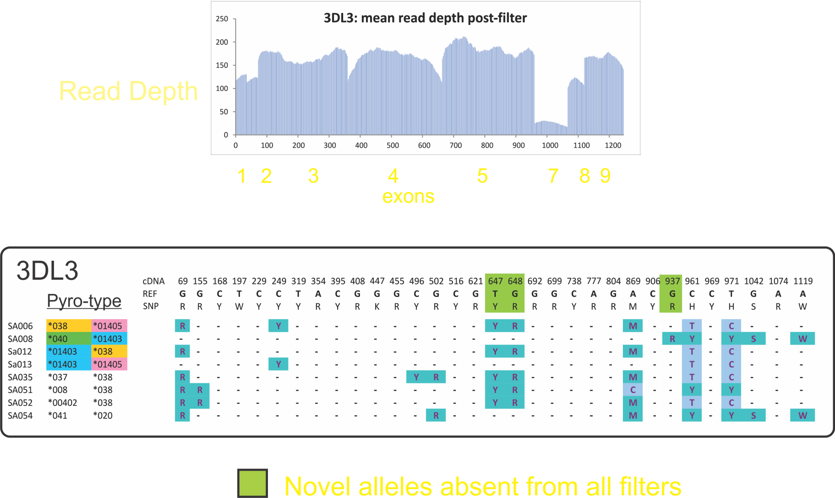
Specificity
Pipeline aligns and correctly identifies new alleles

Slide 8
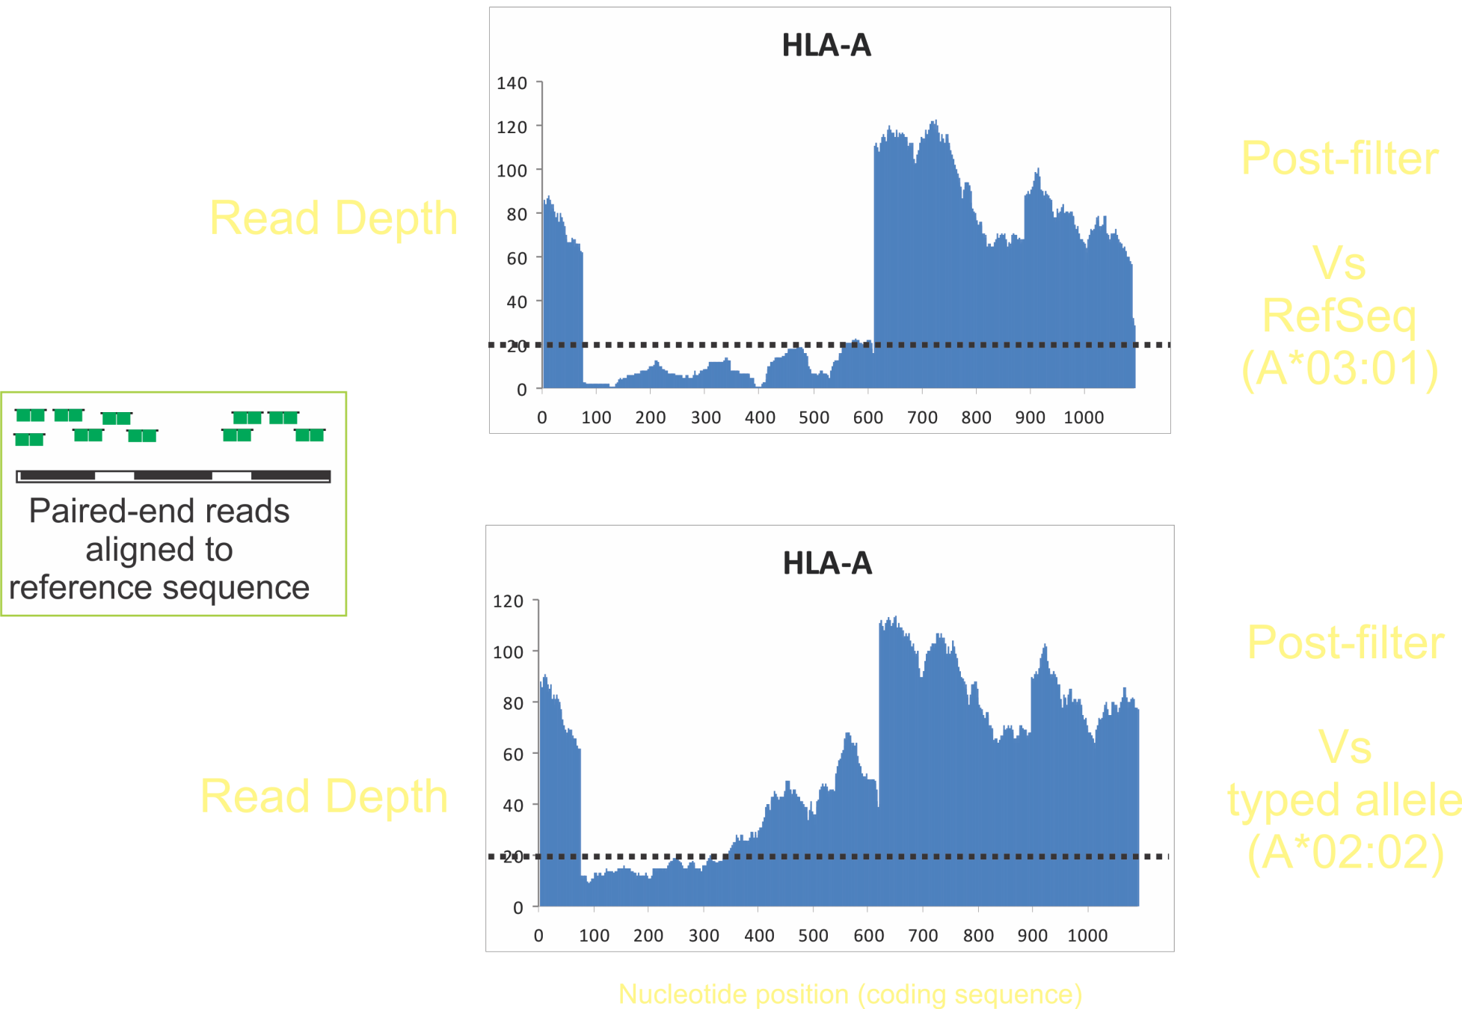
Depth
HLA: Alignment Reference Sequence Crucial

Slide 9
Read depth required for calling zygosity ?
WGS ~ 20x (with 99% accuracy)
Diagnostic HLA =?
Allele drop out ? (PCR & capture methods)

Slide 10
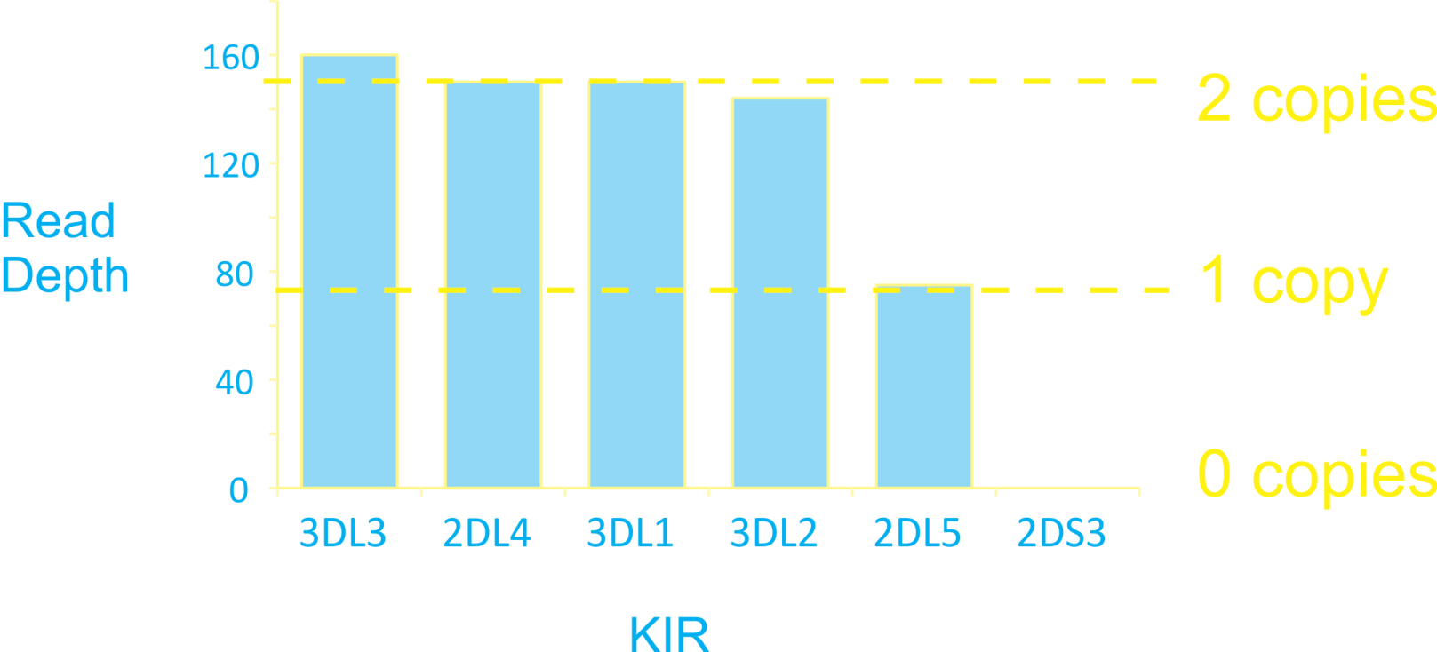
KIR gene-content by read depth
(WGS data))

Slide 11
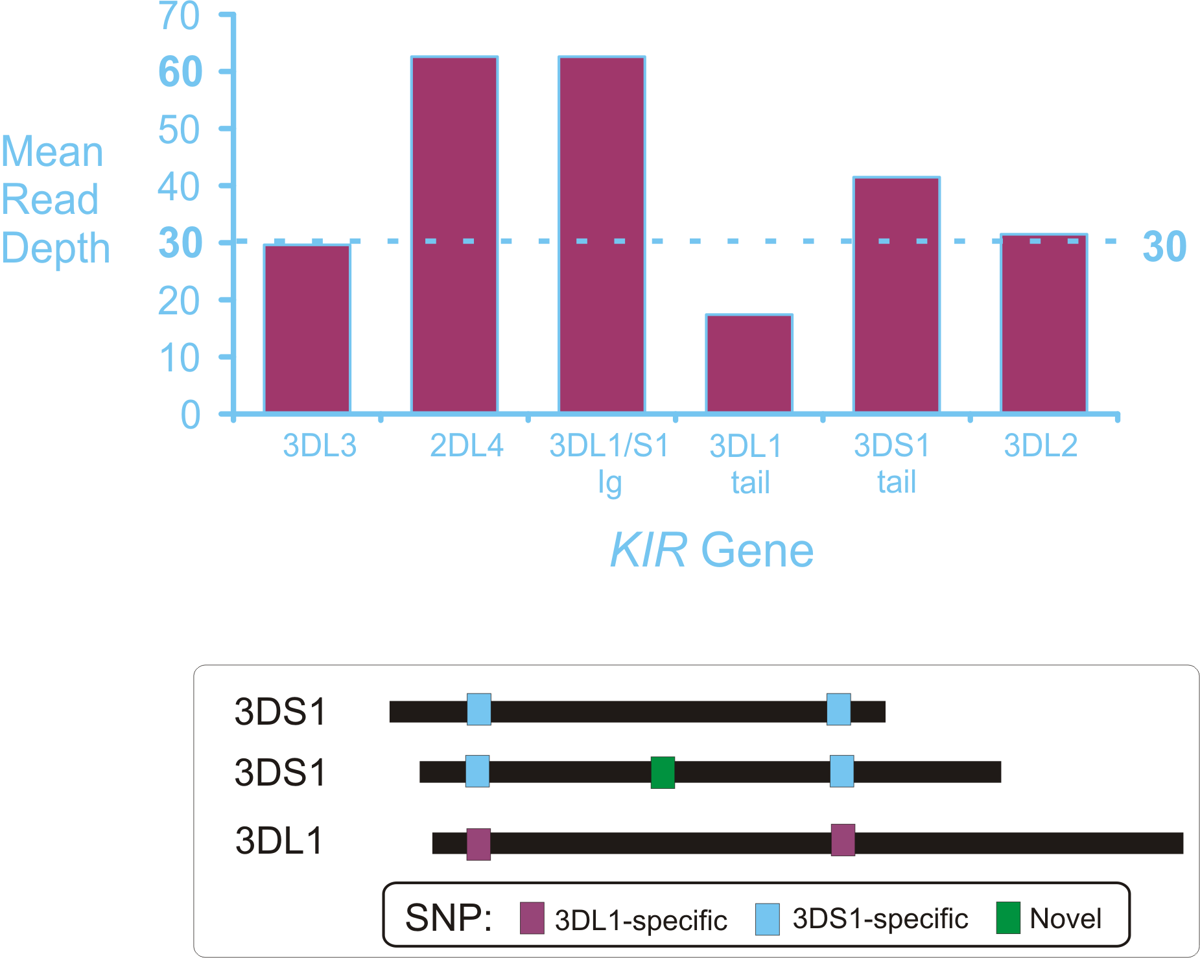
Denisovan had a KIR2DL4/3DS1-duplication haplotype

Slide 12
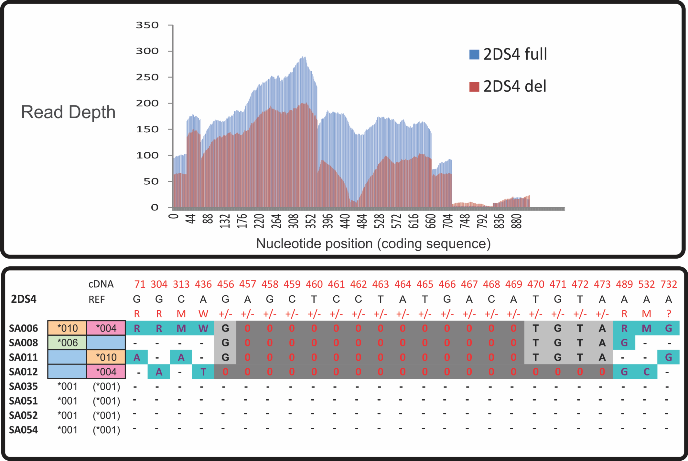
2DS4 in/del genotype based on read-depth

Slide 13
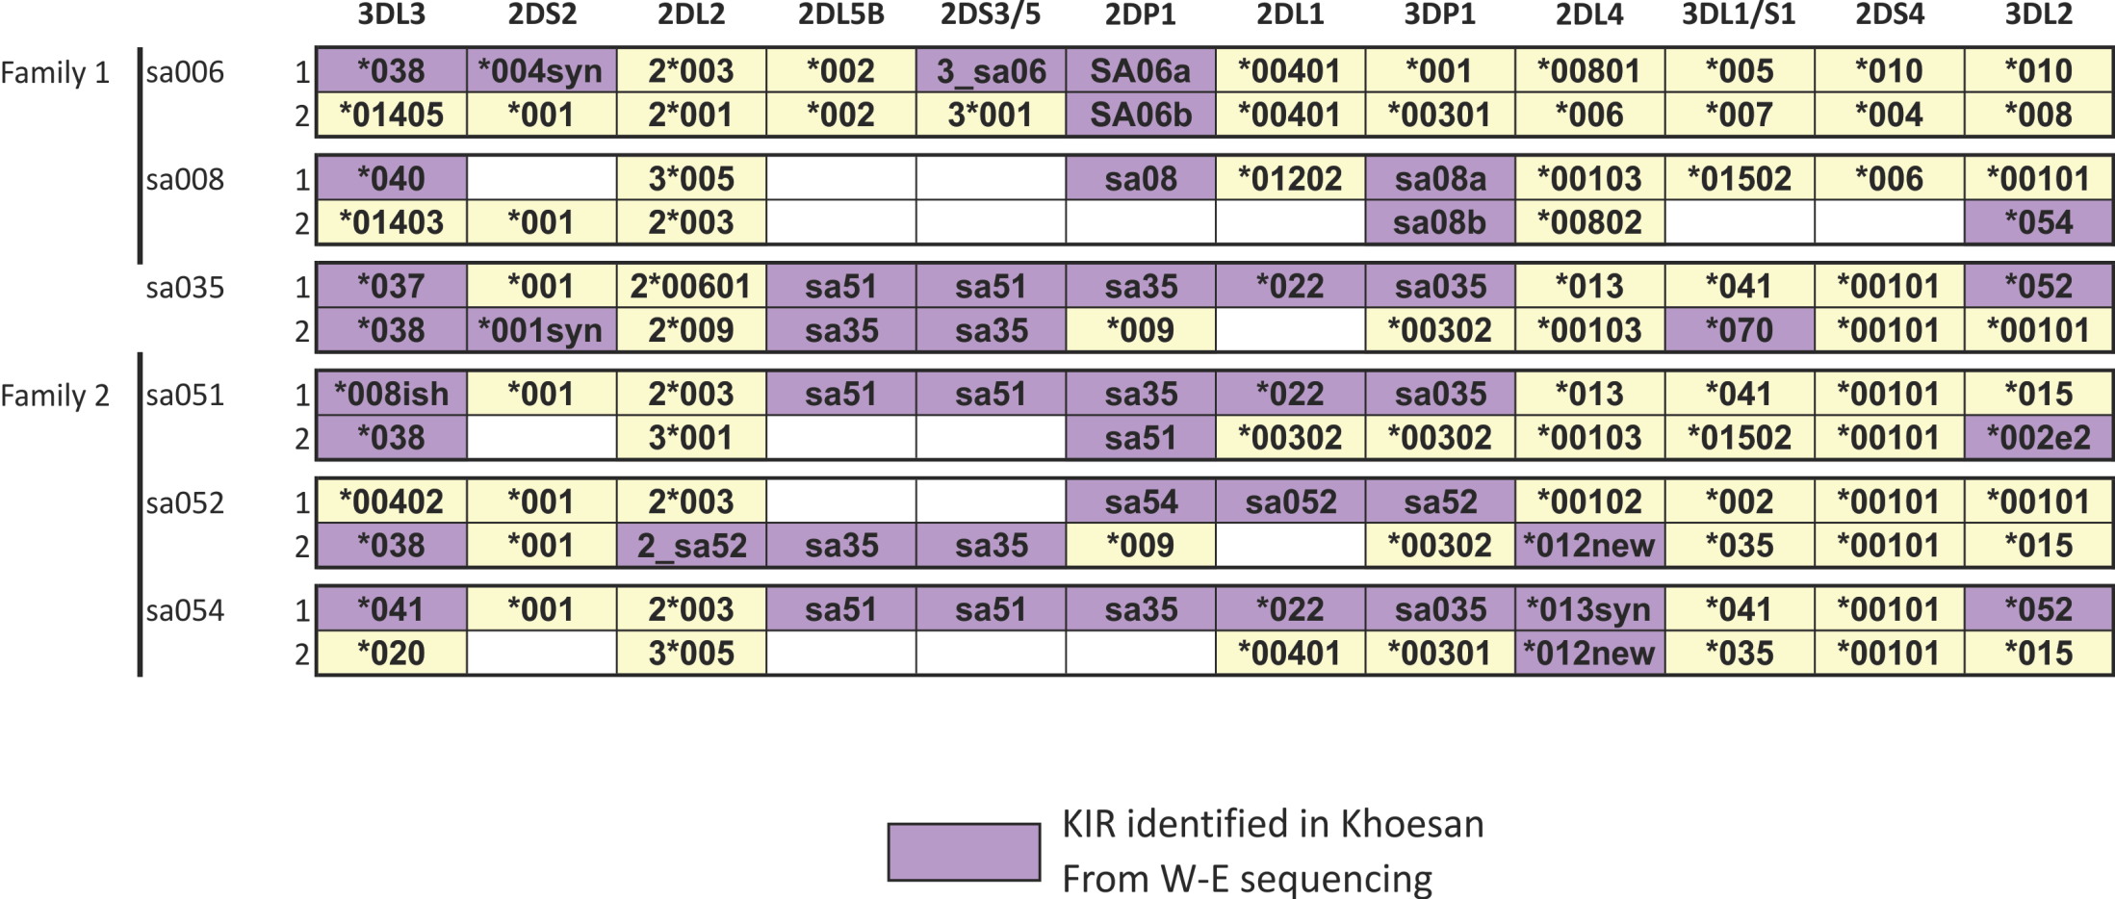
KIR: 21 New Alleles Discovered from 8 individuals

Slide 14
HLA haplotypes from 8 KhoeSan

Slide 15
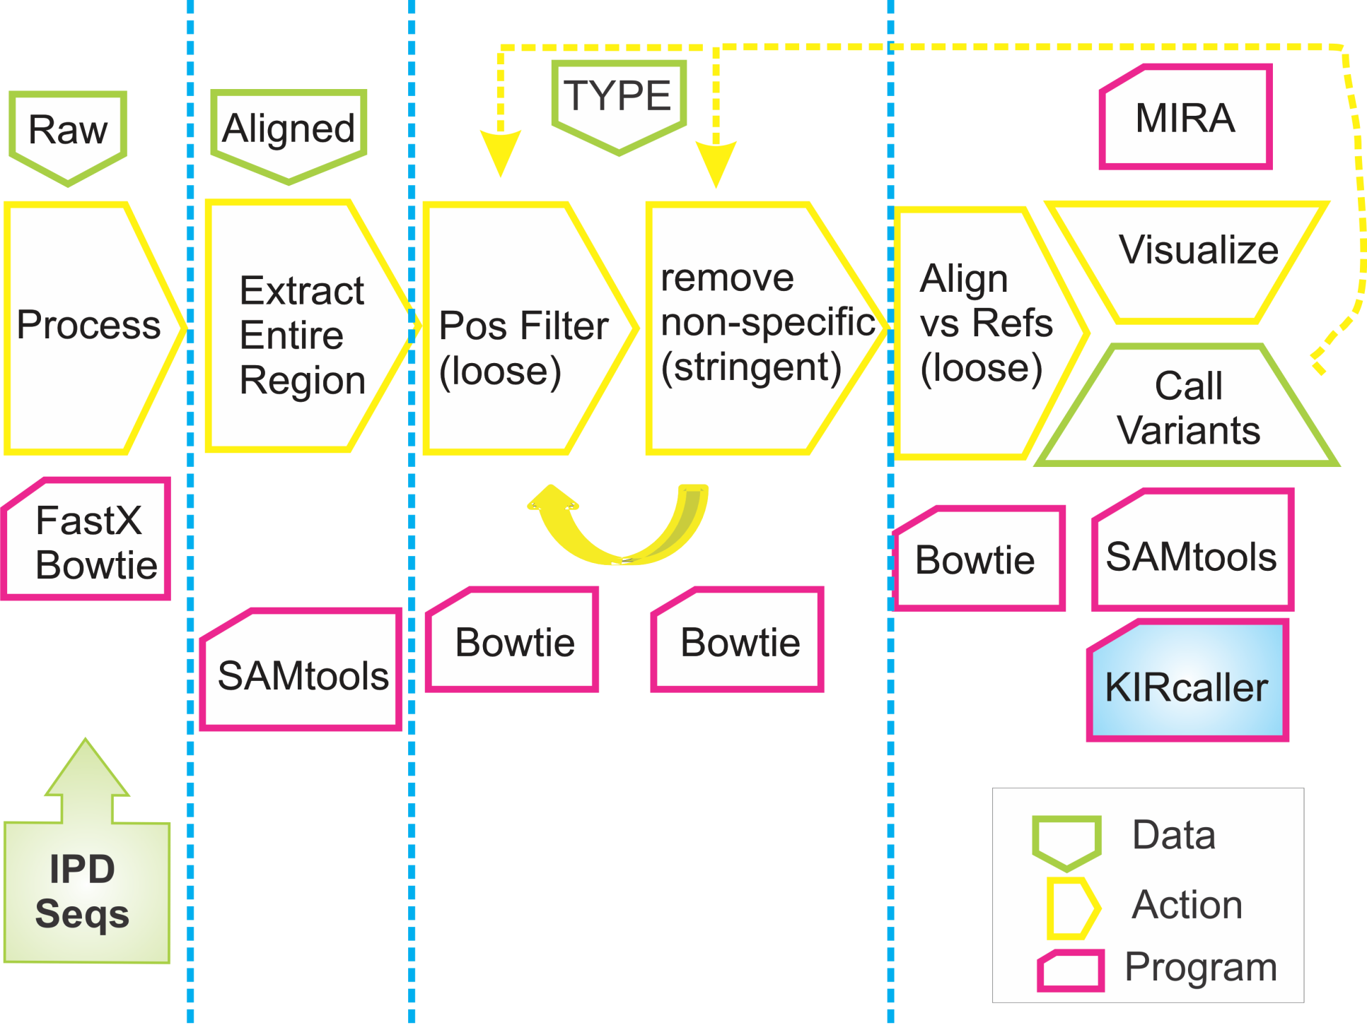
Summary
SOS ver. II

Slide 16
Acknowledgements
Peter Parham
DNA Samples
And Whole-Exome Data
Brenna Henn
Jeffrey Kidd
Jeff Wall
Carlos Bustamente
Arnav Moudgil
Neda Nemat-Gorgani
Laurent Abi-Rached
Meeting Organizers
Life Technologies

