Slide 1
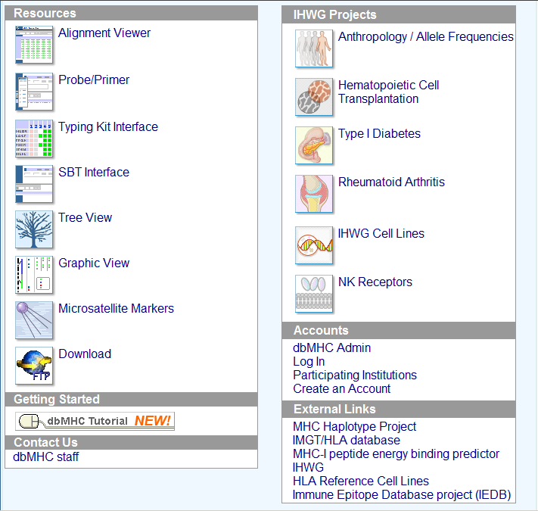
IHWG Workshop Data
Tools for HLA Sequence

Slide 2
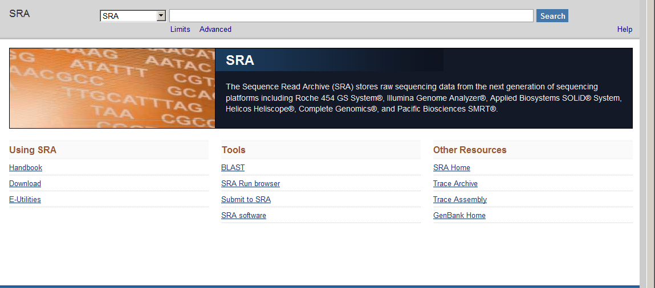
http://www.ncbi.nlm.nih.gov/sra

Slide 3
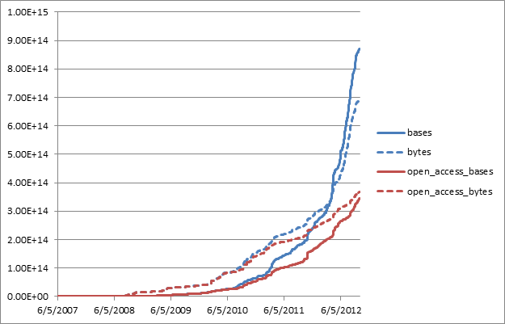
Growth

Slide 4
Scope
Repository of raw reads from next generation sequencing
Any Platform is in Scope
Align Sequences including BAM, SAM files
Worldwide shared content NCBI, EBI, DDBJ (www.insdc.org)
Minimally useful metadata, separable and indexed
Sample Attributes
Method details (library prep, etc.)
Capture method/reagents
Assembly used for alignments (BAMS and VCF files)

Slide 5
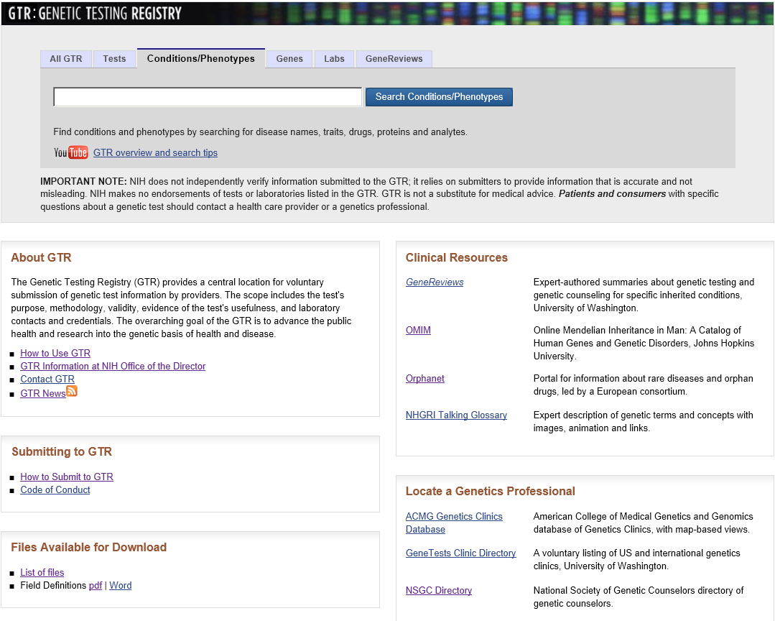

Slide 6
Purpose
Enable health care providers to find information about laboratories and genetic test that they do
Encourage providers to voluntarily share information about the availability and scientific basis of their tests
Facilitate research and new scientific discoveries
Each test assigned a unique accession/version number
Arose from the 2008 SACGHS recommendation to the Secretary of HHS to create a publicly available, Web-based registry to enhance the transparency of genetic testing and to assist efforts in reviewing the clinical validity of laboratory-developed tests.

Slide 7
Overview of Information
Laboratory
Contact information
Certification(s), license(s)
Test information
Intended use
Target population
Assay limitations
Methodology
Analytical validity
Clinical validity
Clinical utility
Ordering information
Test credentials (e.g., FDA, CAP, ASHI)
Additional resources
Other NLM resources and professional practice guidelines well integrated in the GTR

Slide 8
Scope and Content
Scope
Single-gene tests for heritable mutations
Molecular, cytogenetic and biochemical tests;
Multiplex panels and arrays → HLA tests are in scope for GTR
Pharmacogenetic tests
Content
82 labs registered in 24 countries with 608 registered tests 487 total conditions assessed by registered tests
588 genes measured by registered tests
GeneTests Laboratory Directory is reflected in GTR
Test results are not part of the GTR!

Slide 9
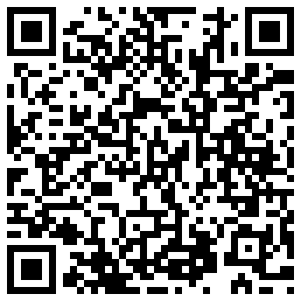
Role for GTR in HLA Testing?
Kit Manufacturer
Register kit methodology
Kit ID
Registry
Kit ID
Kit Methodology
Registers Use of Kit
Kit ID
GL Service
HLA Lab
GL String
URI
URI: QR Code
GL String
Lab Report
A …
B …
C …
DRB1 …
DQB1 …
URIs/IDs
Print
Scan
BMT Clinic

Slide 10
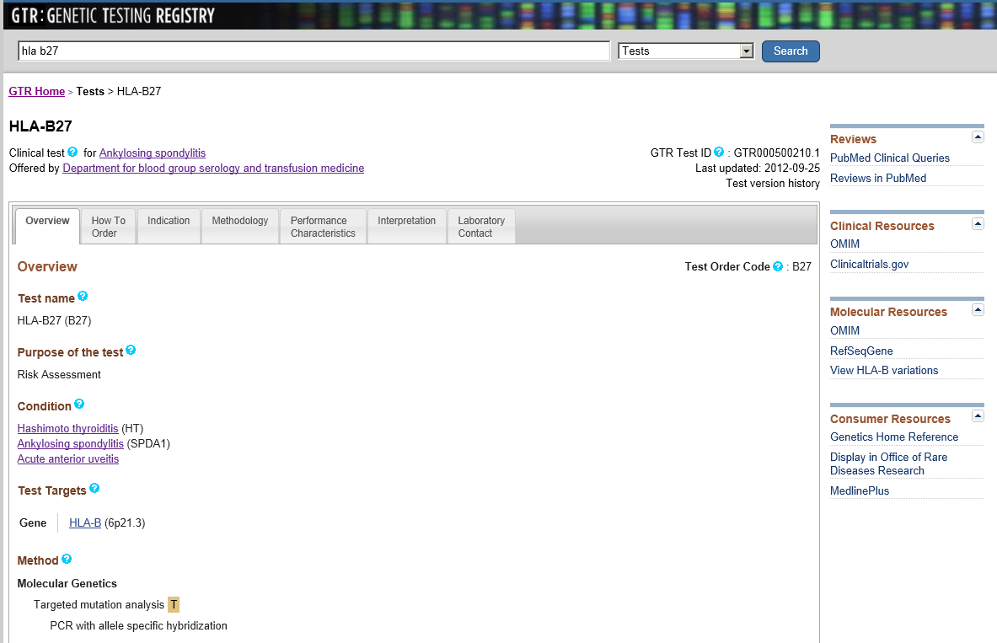

Slide 11
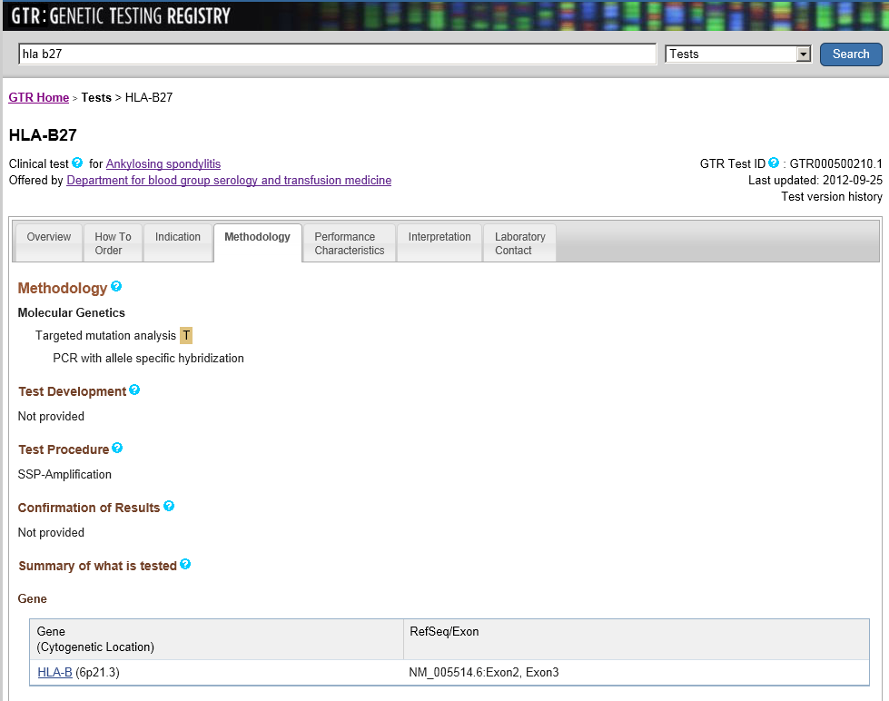

Slide 12
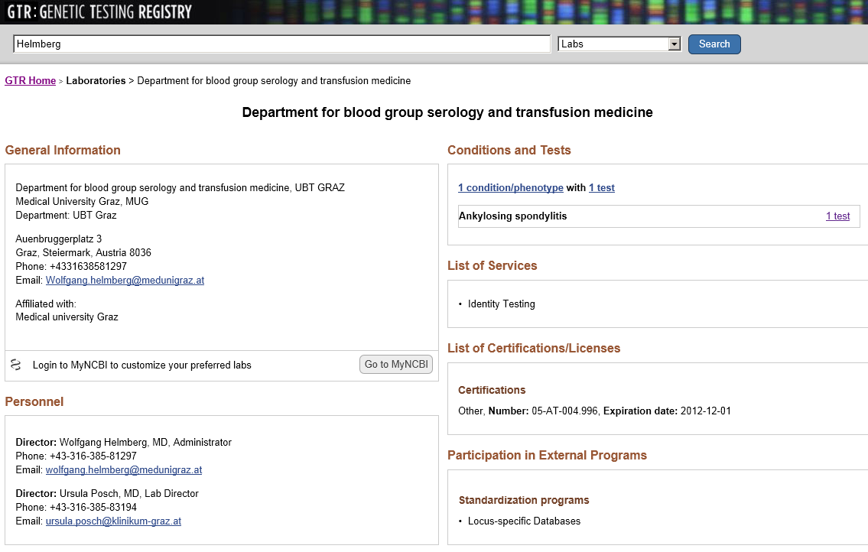

Slide 13
Discussion

