Slide 1
Progress towards high-throughput sequencing for clinical HLA genotyping
Matthew W. Anderson MD, PhD
Assistant Professor, Department of Pathology
Assistant Director, Stanford Histocompatibility, Immunogenetics, and Disease Profiling Laboratory (HIDPL)
Stanford University School of Medicine

Slide 2
Conflict-of-interest disclosure
Sponsored research:
Roche (454 study)
Life Technologies

Slide 3
Potential benefits of next-generation sequencing for clinical HLA genotyping
Clonal template amplification in vitro to eliminate problem of sequencing heterozygous DNA
Potential for one-step high resolution typing
Increased sequence coverage of HLA genes
Capability to multiplex specimens
Reduce turn-around-time

Slide 4
Outline
Roche multi-site trial
Ongoing development efforts
Sequencing workflow improvements
Amplicon genotyping
Shotgun sequencing

Slide 5
Roche 454 HLA study
Designed to evaluate feasibility/reproducibility
of using the Roche 454 sequencing platform to
perform HLA typing in the clinical laboratory
Two independent pilot studies had previously demonstrated the power of this approach
Eight participating laboratories
20 double-blinded samples with difficult SBT results (rare alleles, etc) submitted for analysis
Laboratories trained to perform experiment independently
Holcomb CL, et al., Tissue Antigens 2011, 77: 206-217.

Slide 6
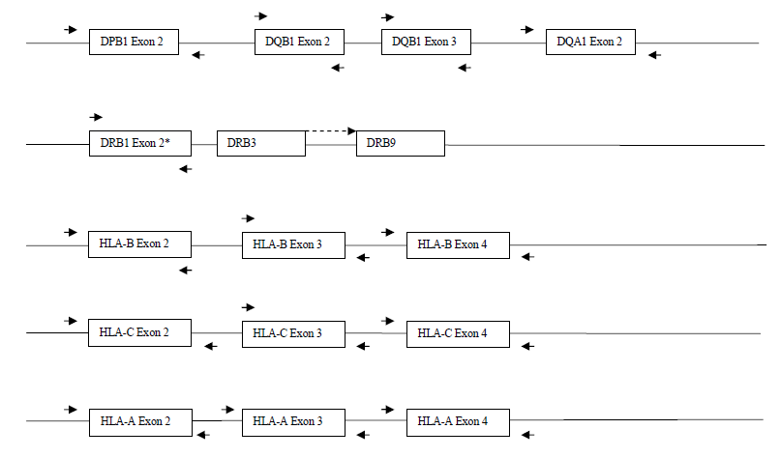

Slide 7
Results: study group
Raw data:
Average sequence read 250 bp
672 sequence reads per amplicon
Allele assignments were made in 95% of cases
Missed calls due to novel alleles or technical errors
Manual editing performed for only 3.7% of loci
57% of cases had residual ambiguity
Concordance between sites was high (95.3% - 99.4%)
Concordance with known alleles was 98.3%

Slide 8
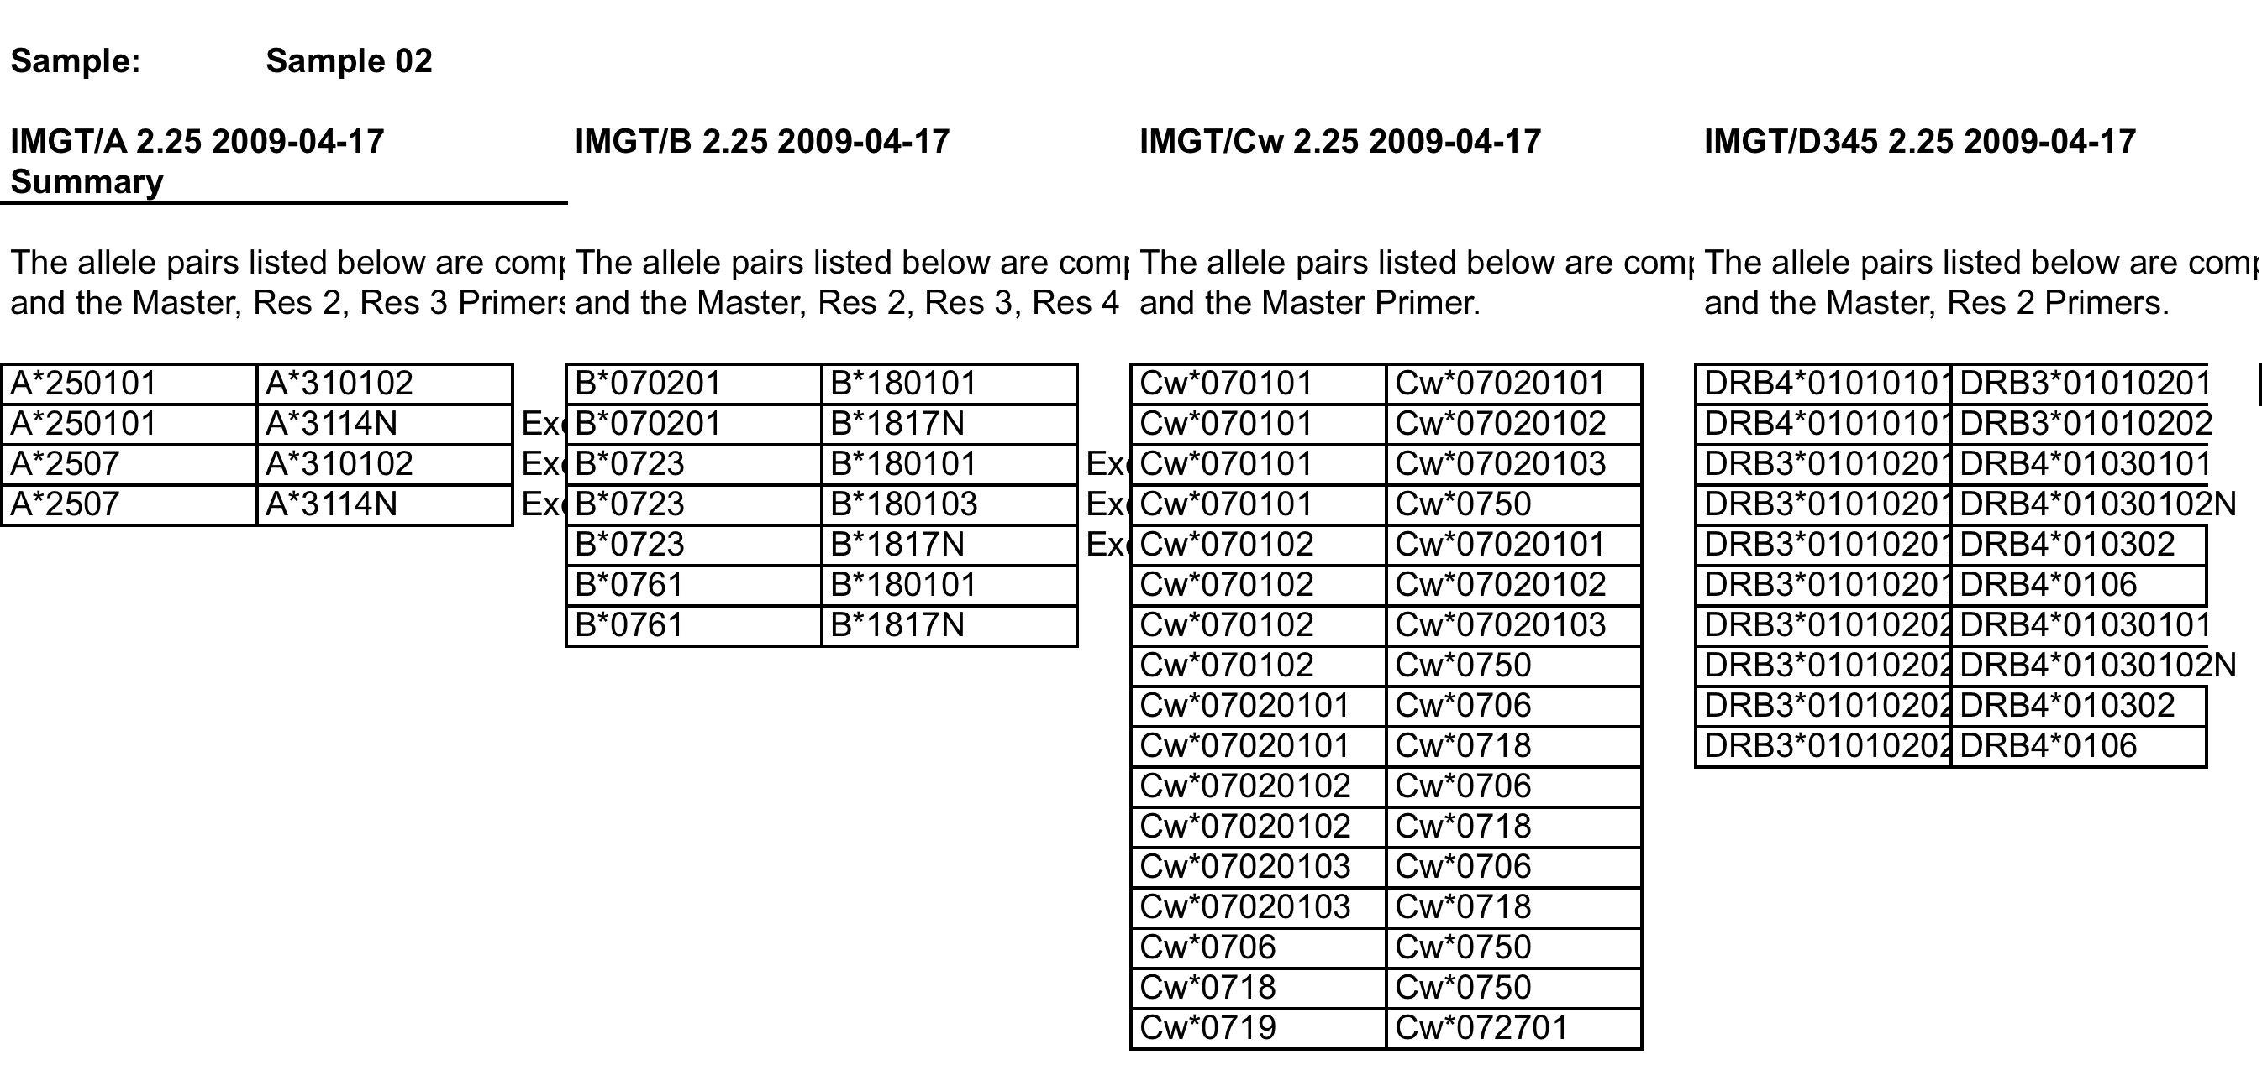
Result example

Slide 9
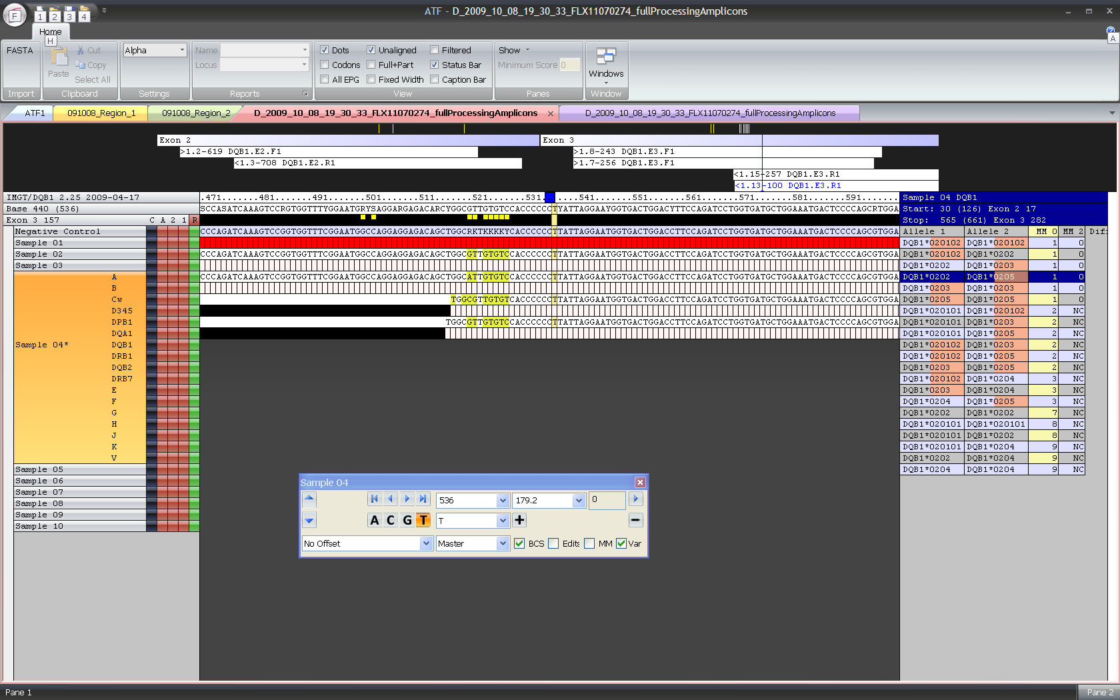

Slide 10
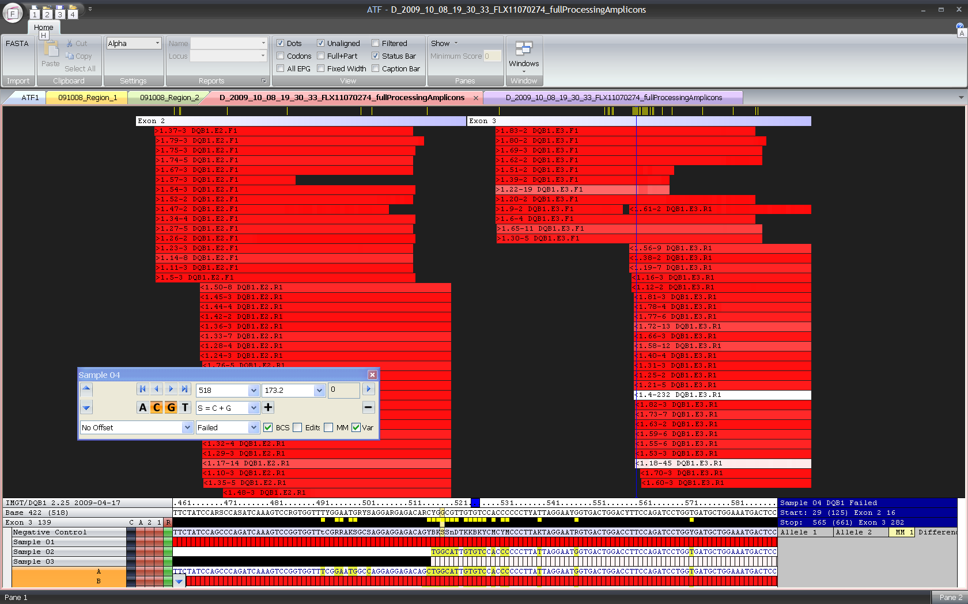
Novel allele (DQB1 exon 3 variant)

Slide 11
Amplicon genotyping workflow
Designed and validated primers for HLA Class I exons 1-7 and 2-3 for Class II exons
Adapted Access Array for multiplexed HLA amplicon library generation
Optimized library purification steps
Developed performance metrics to monitor all steps of sequencing process for Q/C
Sequence generated using a 454 GS Jr instrument
Collaborating with Conexio Genomics to develop custom bioinformatic pipeline

Slide 12
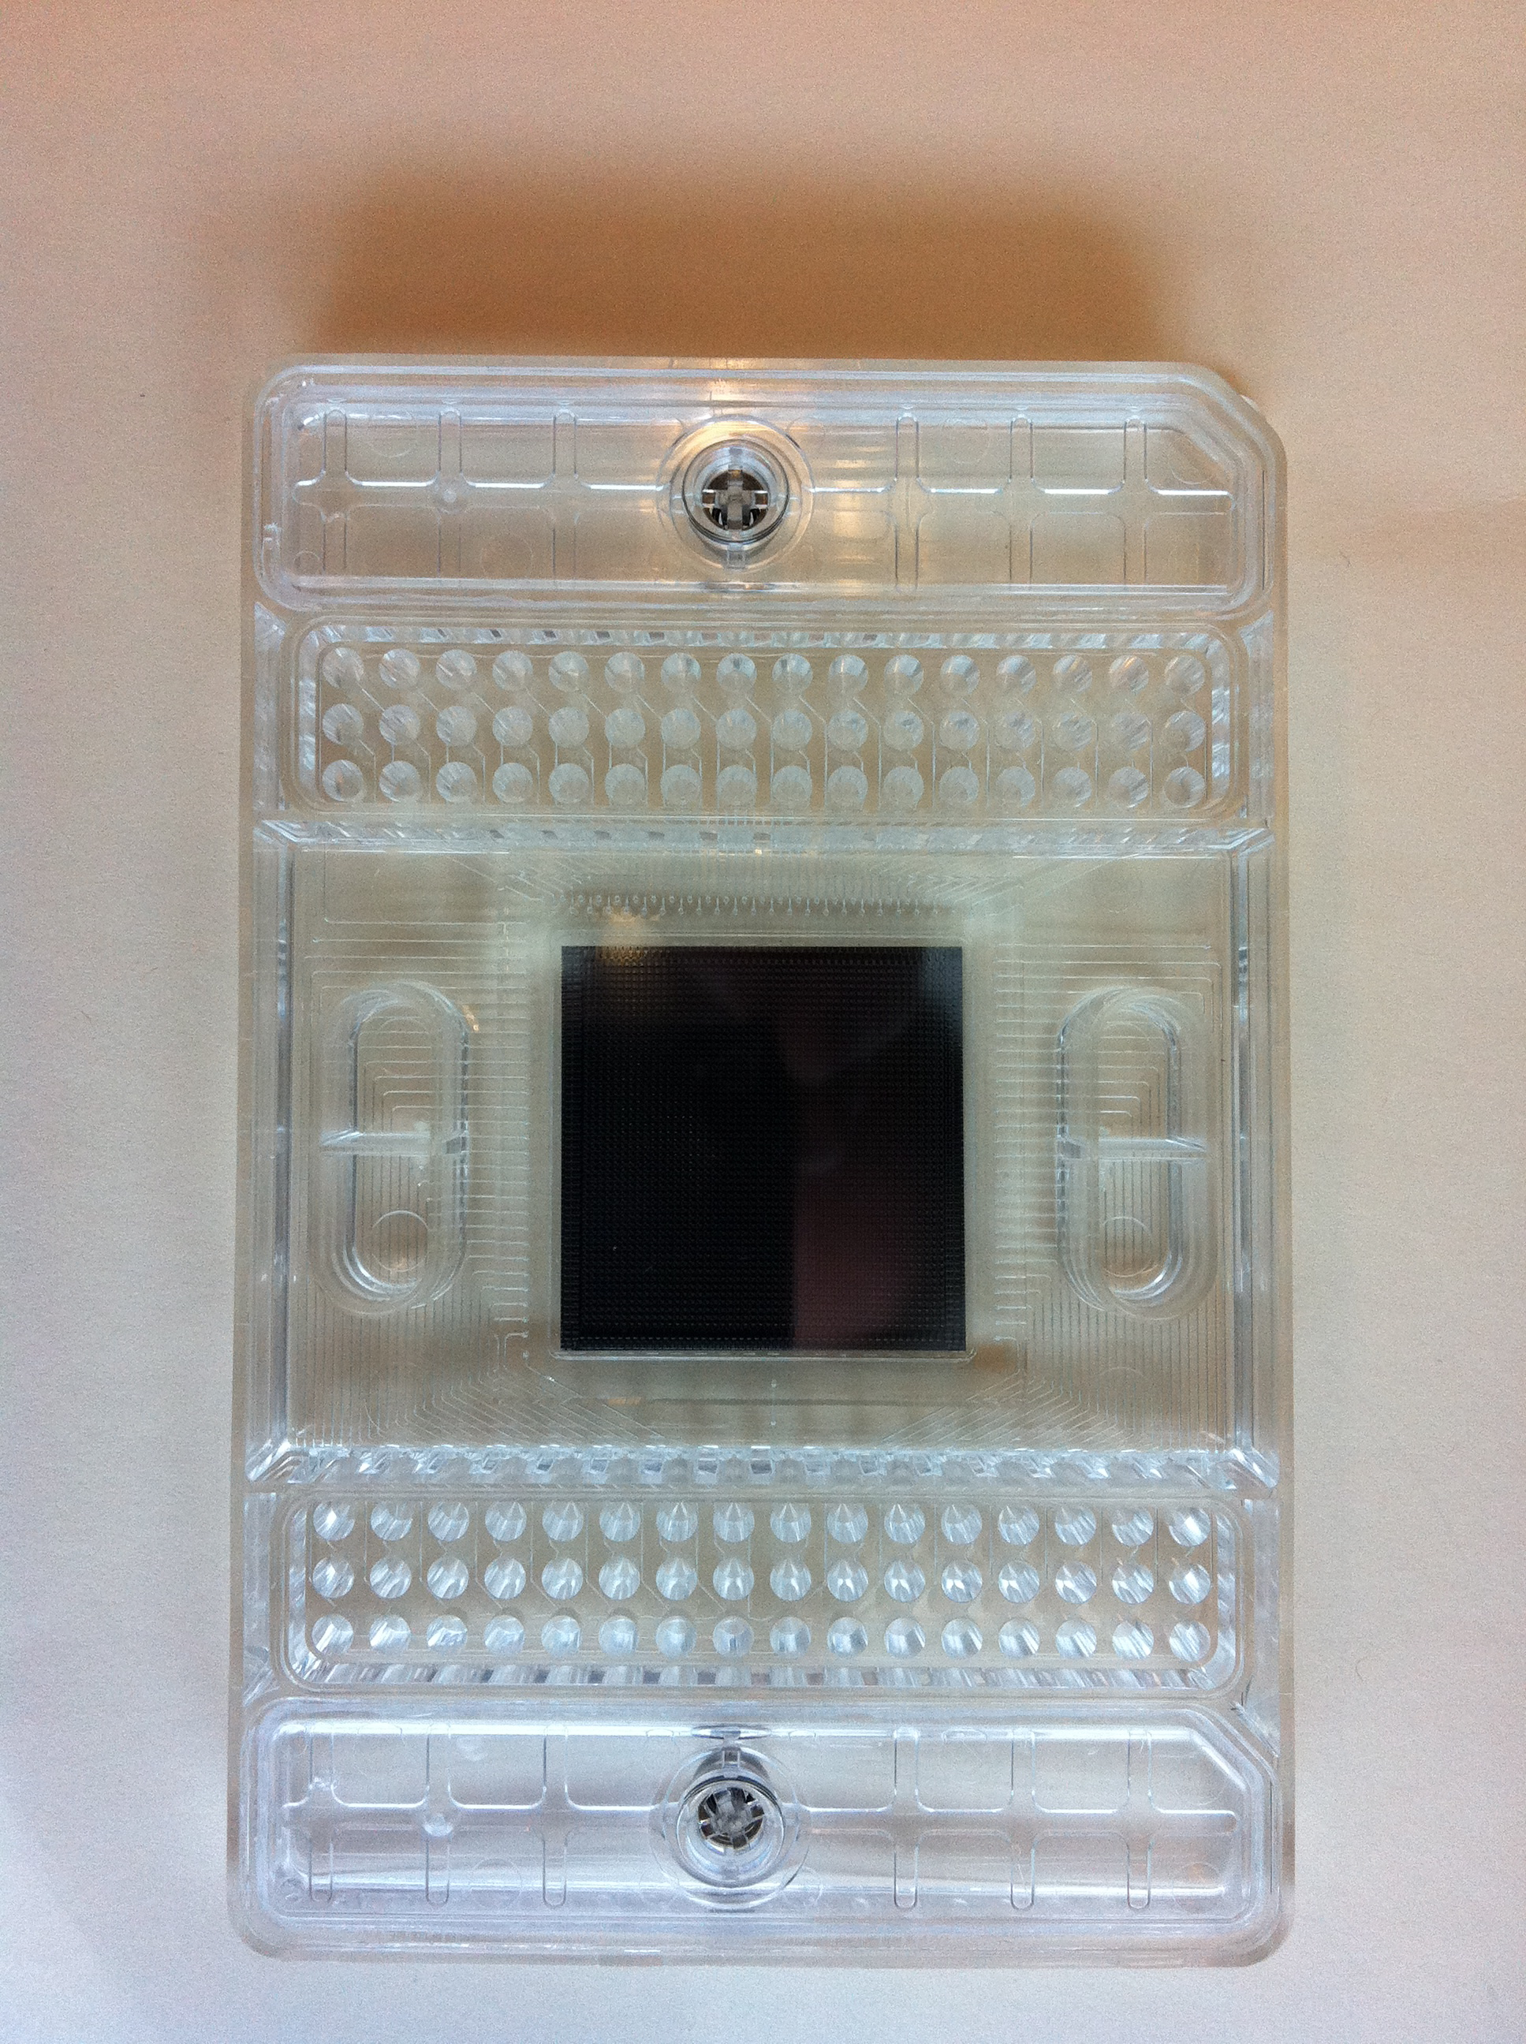
Automate using robotics and emulsion purification device
Barcode primers and up to 48 individual samples
Tagged sequence-specific primers (up to 48 individual targets)
Intron
Exon
Intron
Up to 48 barcoded amplicons from each sample (up to 2,304 amplicons)

Slide 13
Library prep with Access Array
Amplify 24 patients with 22 primer sets simultaneously
Allows for one-step barcoding of amplified products
Can “double-up” on reactions to increase total amount of product generated
Allows for easy recovery of amplified barcoded products
Can pool barcoded amplicons from different patients together without need for manual quantification and dilution of each individual amplicon

Slide 14
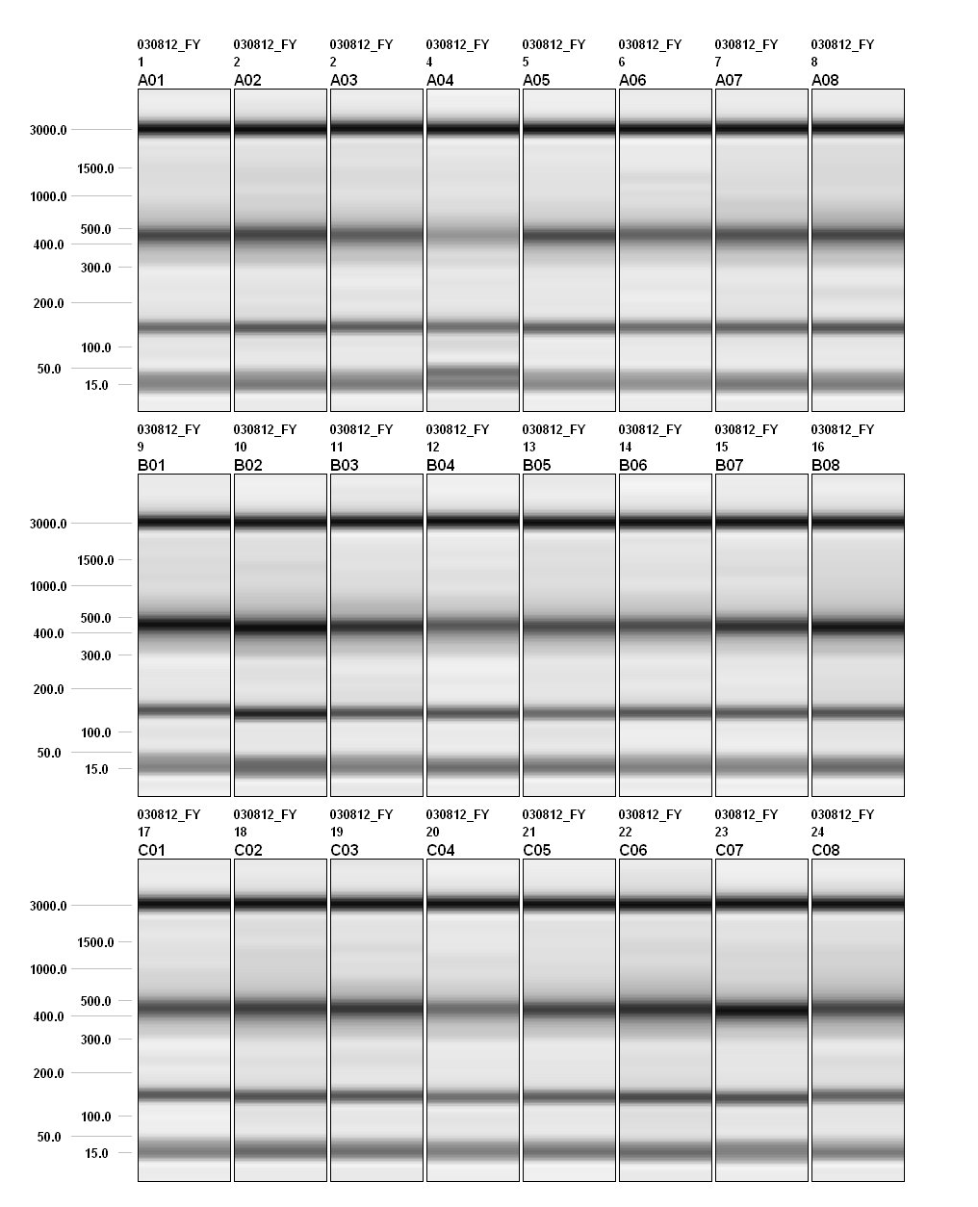
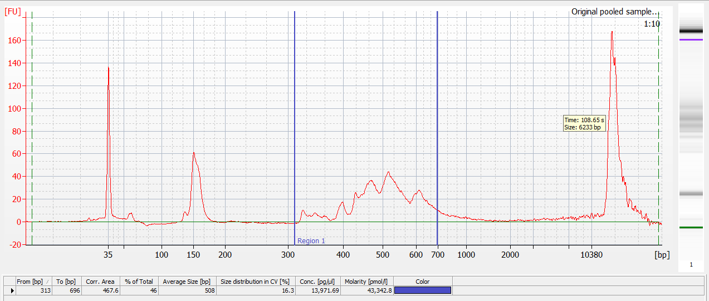
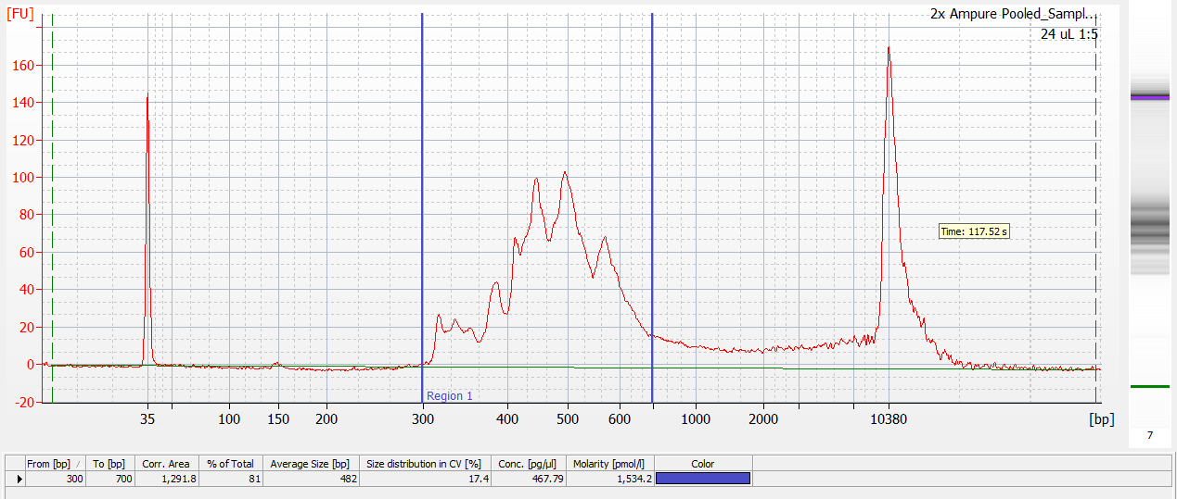

Slide 16
Shotgun sequencing workflow
Designed and validated long-range PCR primers to amplify DQA1 gene
Sequencing library prep using chemical cleavage and size selection
Data analyzed in collaboration with Chunlin Wang (Stanford Genome Center)
Collaborating on analysis with Conexio Genomics

Slide 17
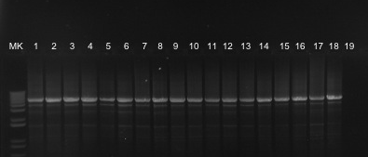
DQA1 LR-PCR results
*01
*02
*03
*04
*05
*06
NC

Slide 18
Sequencing workflow
Ex 1
Ex 2
Ex 3
Ex 4
Fragmentation
Ligate barcoded adaptors
Size select and purify 300-340 bp fragments

Slide 19
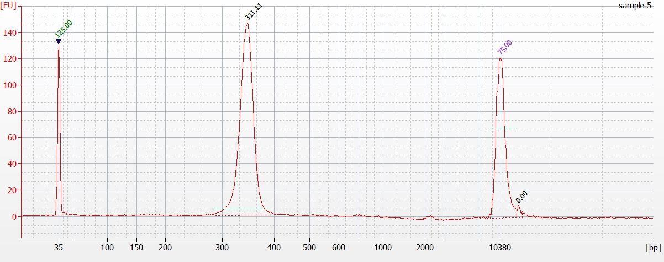
Sequencing library Q/C
Ex 1
Ex 2
Ex 3
Ex 4

Slide 22
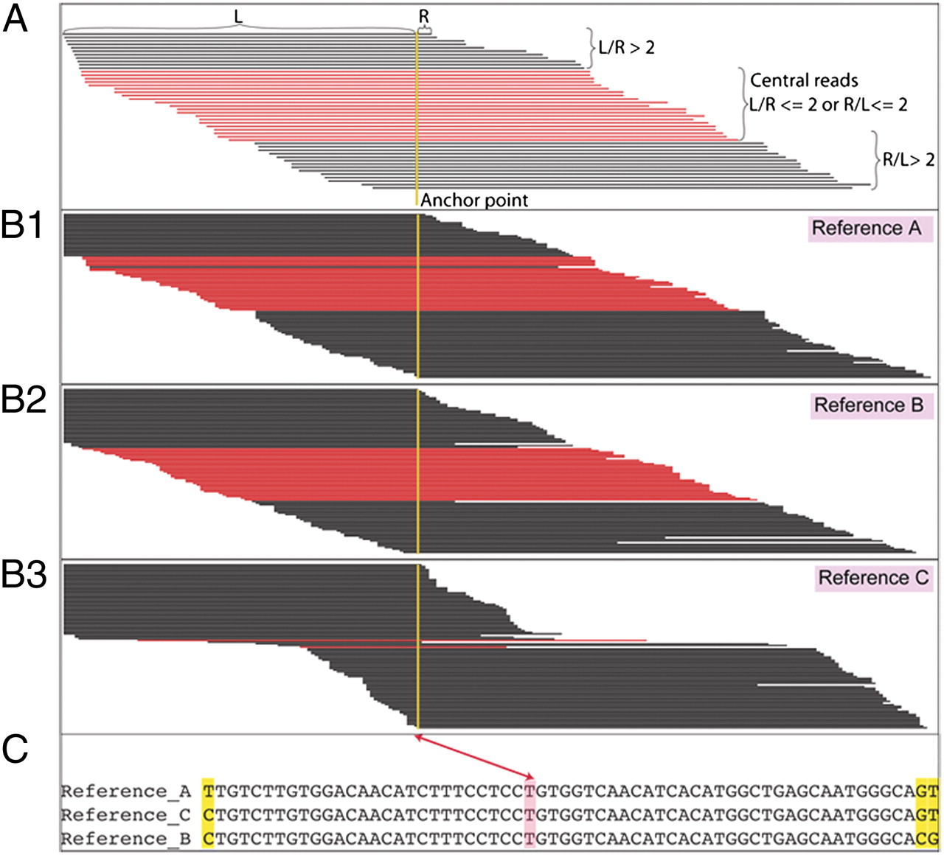
Wang, C. et al., PNAS 2012, 109 (22):8676.

Slide 23
Case # | Type 1 | Type 2 | PGM 1 | PGM 2
87050 | 01:02 | X | 01:02:01:01 | 01:02:01:01
78384 | 01:GN | X | 01:01:01 | 01:01:01
78412 | 01:GN | X | 01:01:01 | 01:01:02
87121 | 02:01 | X | 02:01 | X
81452 | 02:01 | X | 02:01 | X
84921 | 02:01 | X | 02:01 | X
79677 | 03:01 | 03:MN | 03:01:01 | 03:03:01
80593 | 03:MN | X | 03:01:01 | X
83796 | 03:MN | X | 03:01:01 | 03:03:01
84775 | 04:01 | X | 04:01:01 | X
77591 | 04:MS | X | 04:01:01 | X
84424 | 04:01 | X | 04:01:01 | X
80862 | 05:AXPF | X | 05:05:01:01 | X
82057 | 05:EF | X | 05:05:01:01 | X
83537 | 05:BFK | X | 05:05:01:01 | X
84514 | 06:01 | X | 06:01:01 | X
51387 | 06:01 | X | 06:01:01 | X

Slide 24
Case # | Type 1 | Type 2 | PGM 1 | PGM 2
76330 | 05:03 | 05:05 | 05:03 | 05:05:01:01
76390 | 03:MN | 04:MS | 03:01:01 | 04:01:01
79014 | 01:MV | 06:01 | 01:01:01 | 06:01:01
77524 | 02:01 | 05:EF | 02:01 | 05:05:01:01
82980 | 01:03 | 04:01 | 01:03:01:01 | 04:01:01
78084 | 01:GN | 02:01 | 01:01:02 | 02:01
77127 | 03:BC | 05:EF | 03:03:01 | 05:05:01:01
81871 | 01:MV | 05:01 | 01:04:01:01 | 05:01:01:01
03:MN=01/02/03 04:MS=01/02/04 01:MV=01/04/05 05:EF=05/09
01:GN=01/04/05/07 03:BC=02/03

Slide 25
Ongoing development efforts
Amplicon workflow:
Further optimizing Access Array and emulsion PCR conditions to ensure even coverage of all amplicons
Improving primer design to reduce pseudogene amplification
Collaborating with RMS on improved primer sets
Shotgun workflow:
Experimenting with additional primer sets
Expand sample size
Working with multiple informatics platforms
Planning to extend approach to other loci

Slide 26
Acknowledgements
Stanford Histocompatibility, Immunogenetics, and Disease Profiling Laboratory
Heidi Farina
Fiona Yamamoto
Dolly Tyan
Marcelo Fernandez-Vina
Stanford Genome Center
Chunlin Wang
Sujatha Krishnakumar
Michael Mindrinos
Life Technologies
David Dinauer
Carolyn Bialozynski
Steve Berosik
Roche Molecular Systems
Henry Erlich
Cherie Holcomb
Bryan Hoglund
Conexio Genomics – Damian Goodridge

