Slide 1
The Art of Fashion: Visualizing Jane Austen and Her Characters
Hope Greenberg
Notes:
The artist painting portraits is at liberty to alter the clothing worn by the sitter to support artistic aims (or the demands of the person who commissioned the portrait). But one thing that is lost is knowledge of what that clothing actually was—the fabric, the construction, the details. Filmmakers also have a complicated task as they must recreate historic clothing made with modern textiles that will actually be worn on real bodies—and they, too, have to concede to demands to make the actors and actresses “look good” to a modern audience. As many have said, it’s not the job of artists to give us a detailed history lesson on clothing.
As clothing historians we can also examine actual garments, though the percentage of garments available to the number of garments that were in existence guarantees that we cannot make too many sweeping generalizations. Recreating and wearing that clothing provides additional insight. For example, stays or corsets or other supporting garments.
For writers, the choice must be whether to write about clothing at all, and if so, how to speak of it. Describe it in detail? Use it to further delineate characters?

Slide 2
Interwoven Threads
Novels:
  Described
  Betrayed
Austen Era Changes:
Perceptions
(R)evolutionary
Letters:
Practical
Character sketch
Notes:
Jane Austen provides a wonderful opportunity to apply multiple lenses to the clothing of her time. First, her lifetime spans one of the most tumultuous and rapid evolutions of fashion in Europe and the US. As a witness, she wrote about fashion details in her letters. As an author, her references to fashion were brief but pointed.

Slide 3
Perceptions
Notes:
Perceptions: How did Austen visualize her characters?

Slide 4
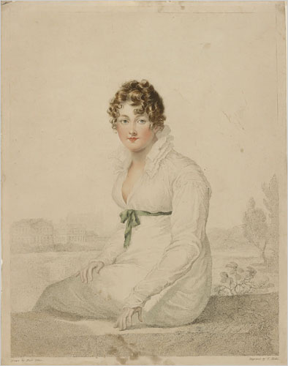
“Henry and I went to the Exhibition in Spring Gardens. ..I was very well pleased…with a small portrait of Mrs. Bingley (Jane Bennet), excessively like her…
Mrs. Bingley’s is exactly herself — size, shaped face, features, and sweetness; there never was a greater likeness. She is dressed in a white gown, with green ornaments, which convinces me of what I had always supposed, that green was a favourite colour with her.” 24 May 1813
William Blake, Harriet Quentin, based on portrait by Villiers (d. 1813).
Notes:
Stipple engraving by William Blake, with etching and mezzotint – printed in colours and coloured by hand.
Mrs.Q is probably the best known decorative print executed by William Blake, primarily due to the large number of facsimile reproduction impressions which were printed of this image in 1806. William Blake’s engraving is based upon a portrait by Francois Huet Villiers (d. 1813). The subject of Mrs.Q is Harriet Quentin, the wife of colonel Quentin and mistress to George IV when Prince Regent. The view in the background is thought to be the Thames at Eton, with the college chapel beyond. The miniature portraitist Villiers had died in 1813, thus this portrait must have had been drawn or painted at least seven years prior to the publication of this plate.
“Henry and I went to the exhibition in Spring Gardens. It is not thought a good collection, but I was very well pleased, particularly (pray tell Fanny) with a small portrait of Mrs. Bingley, excessively like her. “

Slide 5
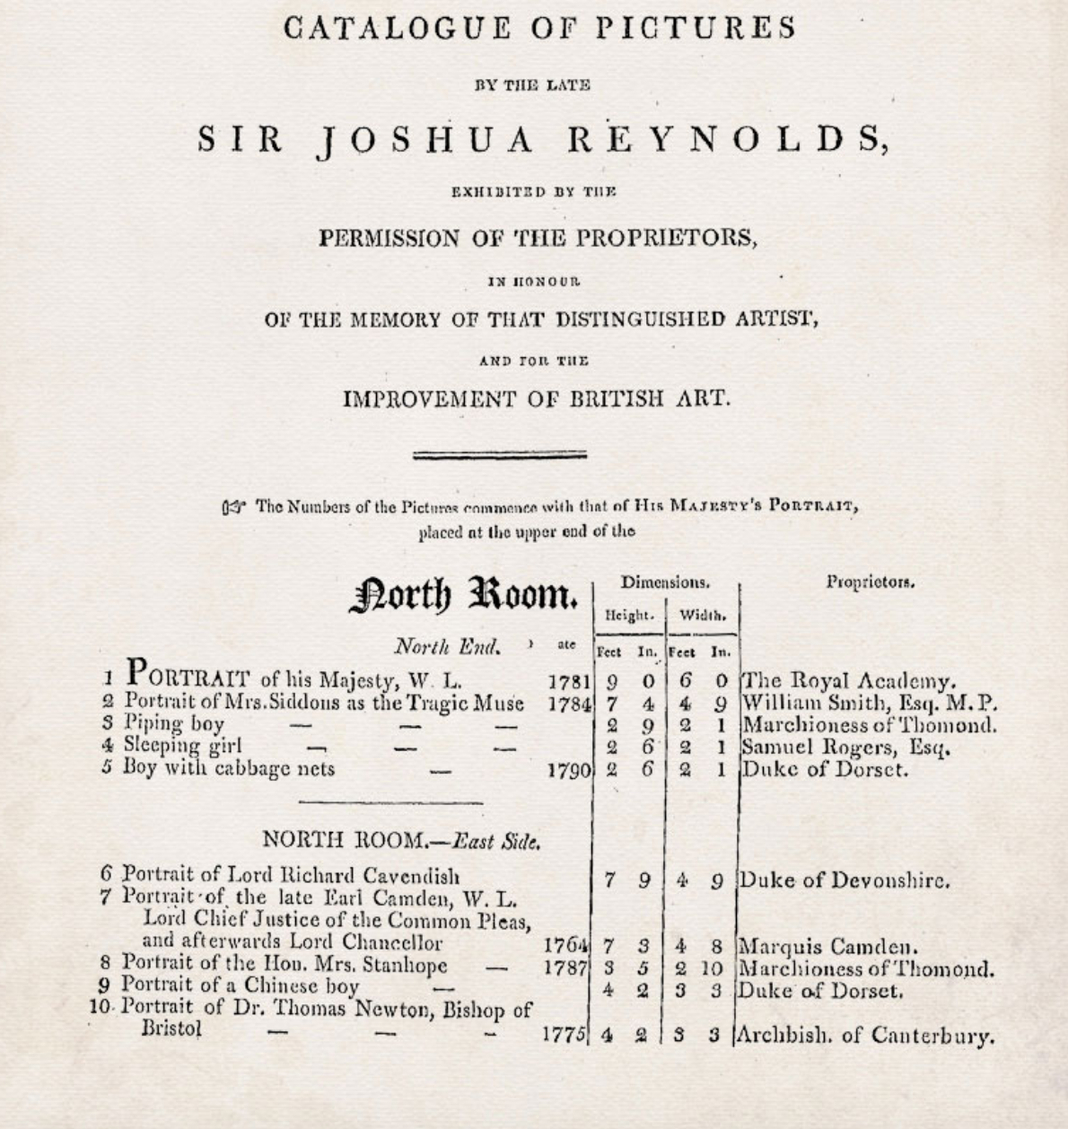
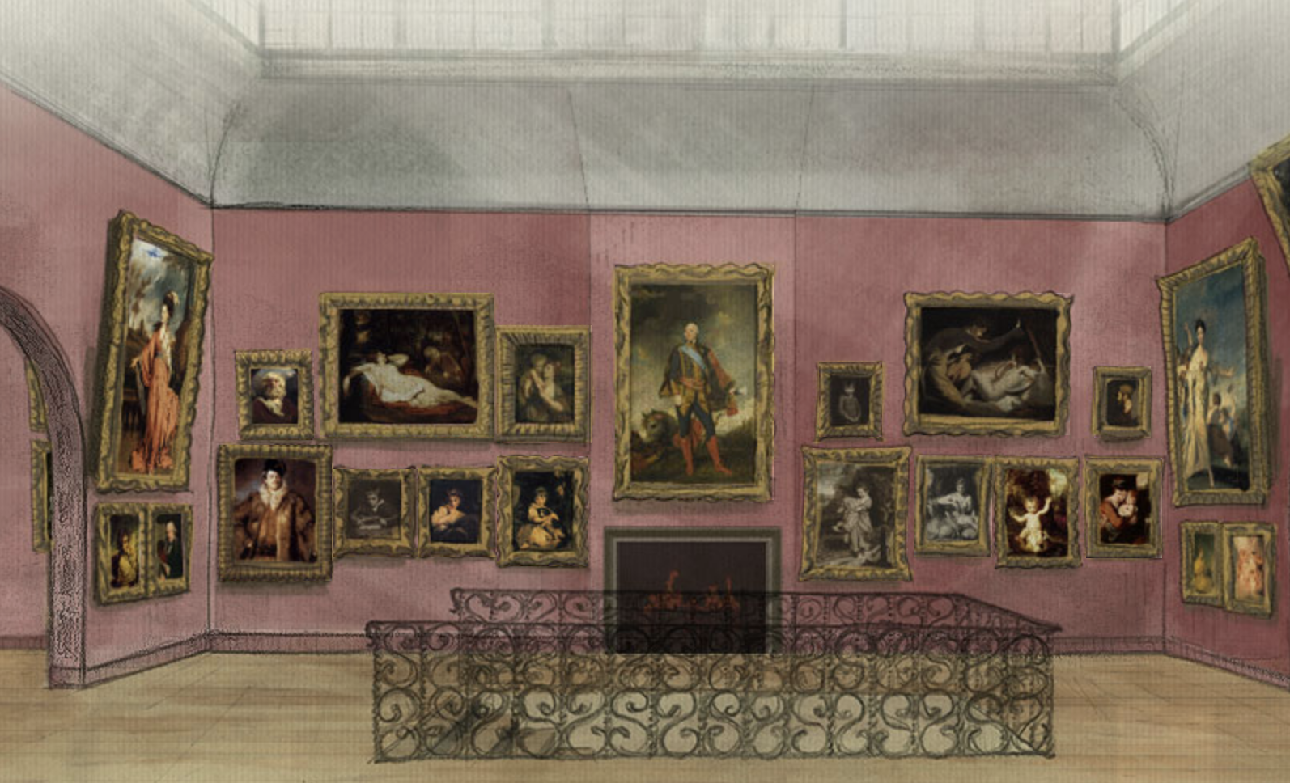
“I went in hopes of seeing one of her sister, but there was no Mrs. Darcy…I have no chance of her in the collection of Sir Joshua Reynolds’s paintings, which is now showing in Pall Mall, and which we are also to visit.” 24 May 1813
Images from Janine Barchas’ whatjanesaw.org

Slide 6
The Novels
1795-1799 writing
“Elinor and Marianne”(Sense and Sensibility)
“First Impressions” (Pride and Prejudice)
“Susan/Catherine” (Northanger Abbey)
1811-1816 writing, revising, publishing
Pride and Prejudice
Mansfield Park
Emma
Persuasion, Northanger Abbey published 1817
Notes:
But how does she shape our perceptions of her characters?
We tend to think of this entire period as that of “high waists” but the details of fashions actually changed quite a bit. While writing her early works, Austen would have dressed differently than she would have while writing later works, and would have envisioned her characters differently as well.

Slide 7
“Few words, tellingly applied.” James Thompson
“the little bit (two Inches wide) of Ivory on which I work with so fine a Brush” 17 December 1816
Notes:
One of the most fascinating aspects of Austen’s writing is how economical she can be with her language. When it comes to fashion, she does not give us long descriptive passages. But we can put most of her novel’s fashion speech into two categories. The narrator, when describing a character through clothing, is especially brief. But her characters that speak about clothing usually reveal their faults.

Slide 8
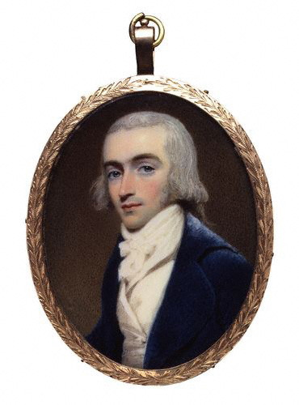
Mr. Bingley
“good-looking and gentlemanlike; he had a pleasant countenance, and easy, unaffected manners.”
(Pride and Prejudice)
Notes:
1800 Robert Fellows, philanthropist, by Edridge
Hair powder
But the fact that he is looking for a house suggests a family background in trade

Slide 9
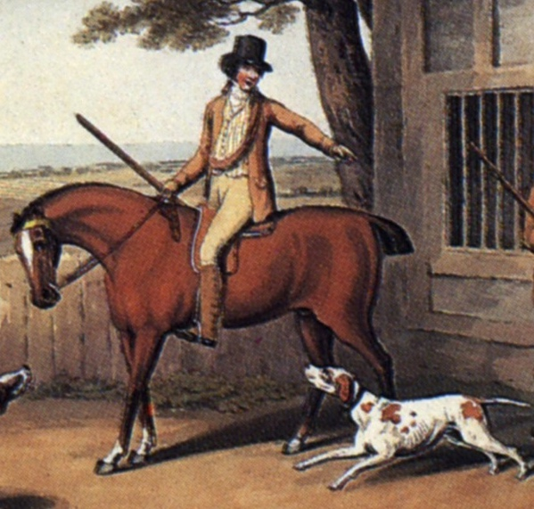
“His name was good, his residence was in their favourite village, and she soon found out that of all manly dresses a shooting jacket was the most becoming. Her imagination was busy…”
Notes:
Awareness of shooting jacket—the country life attire influence. This picture is a bit deceptive as regards the quote. The rider would have walked to go shooting with the object to bring back birds. If hunting (hunting=fox hunting), they would have been riding. If they were hunting on foot, and it was not their property or they did not have permission of the property owner, they might have been arrested for poaching.

Slide 10
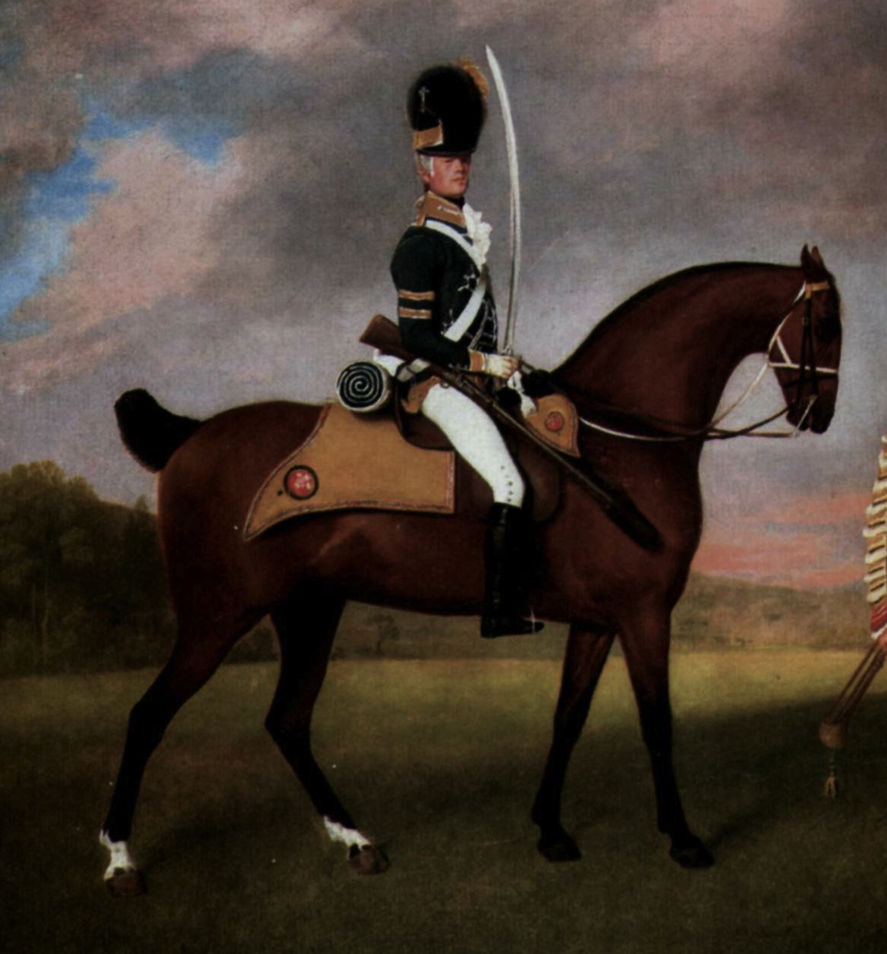
Wickham “wanted only regimentals to make him completely charming” (Pride and Prejudice)

Slide 11
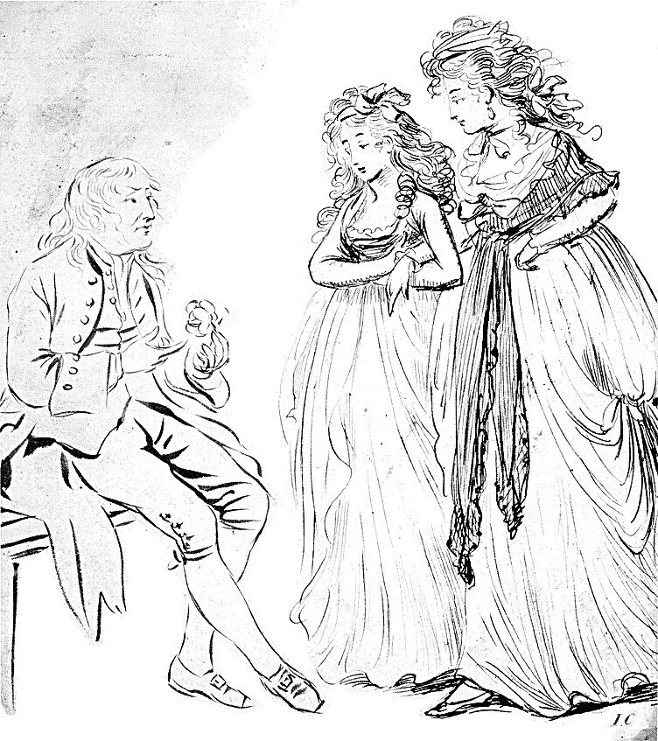
Young men and women driving about the country in open carriages!...Do not you think these kind of projects objectionable?”
“Yes, very much so indeed…A clean gown is not five minutes’ wear in them. They are splashed getting in and getting out...”
Mrs. Allen, Northanger Abbey

Slide 12
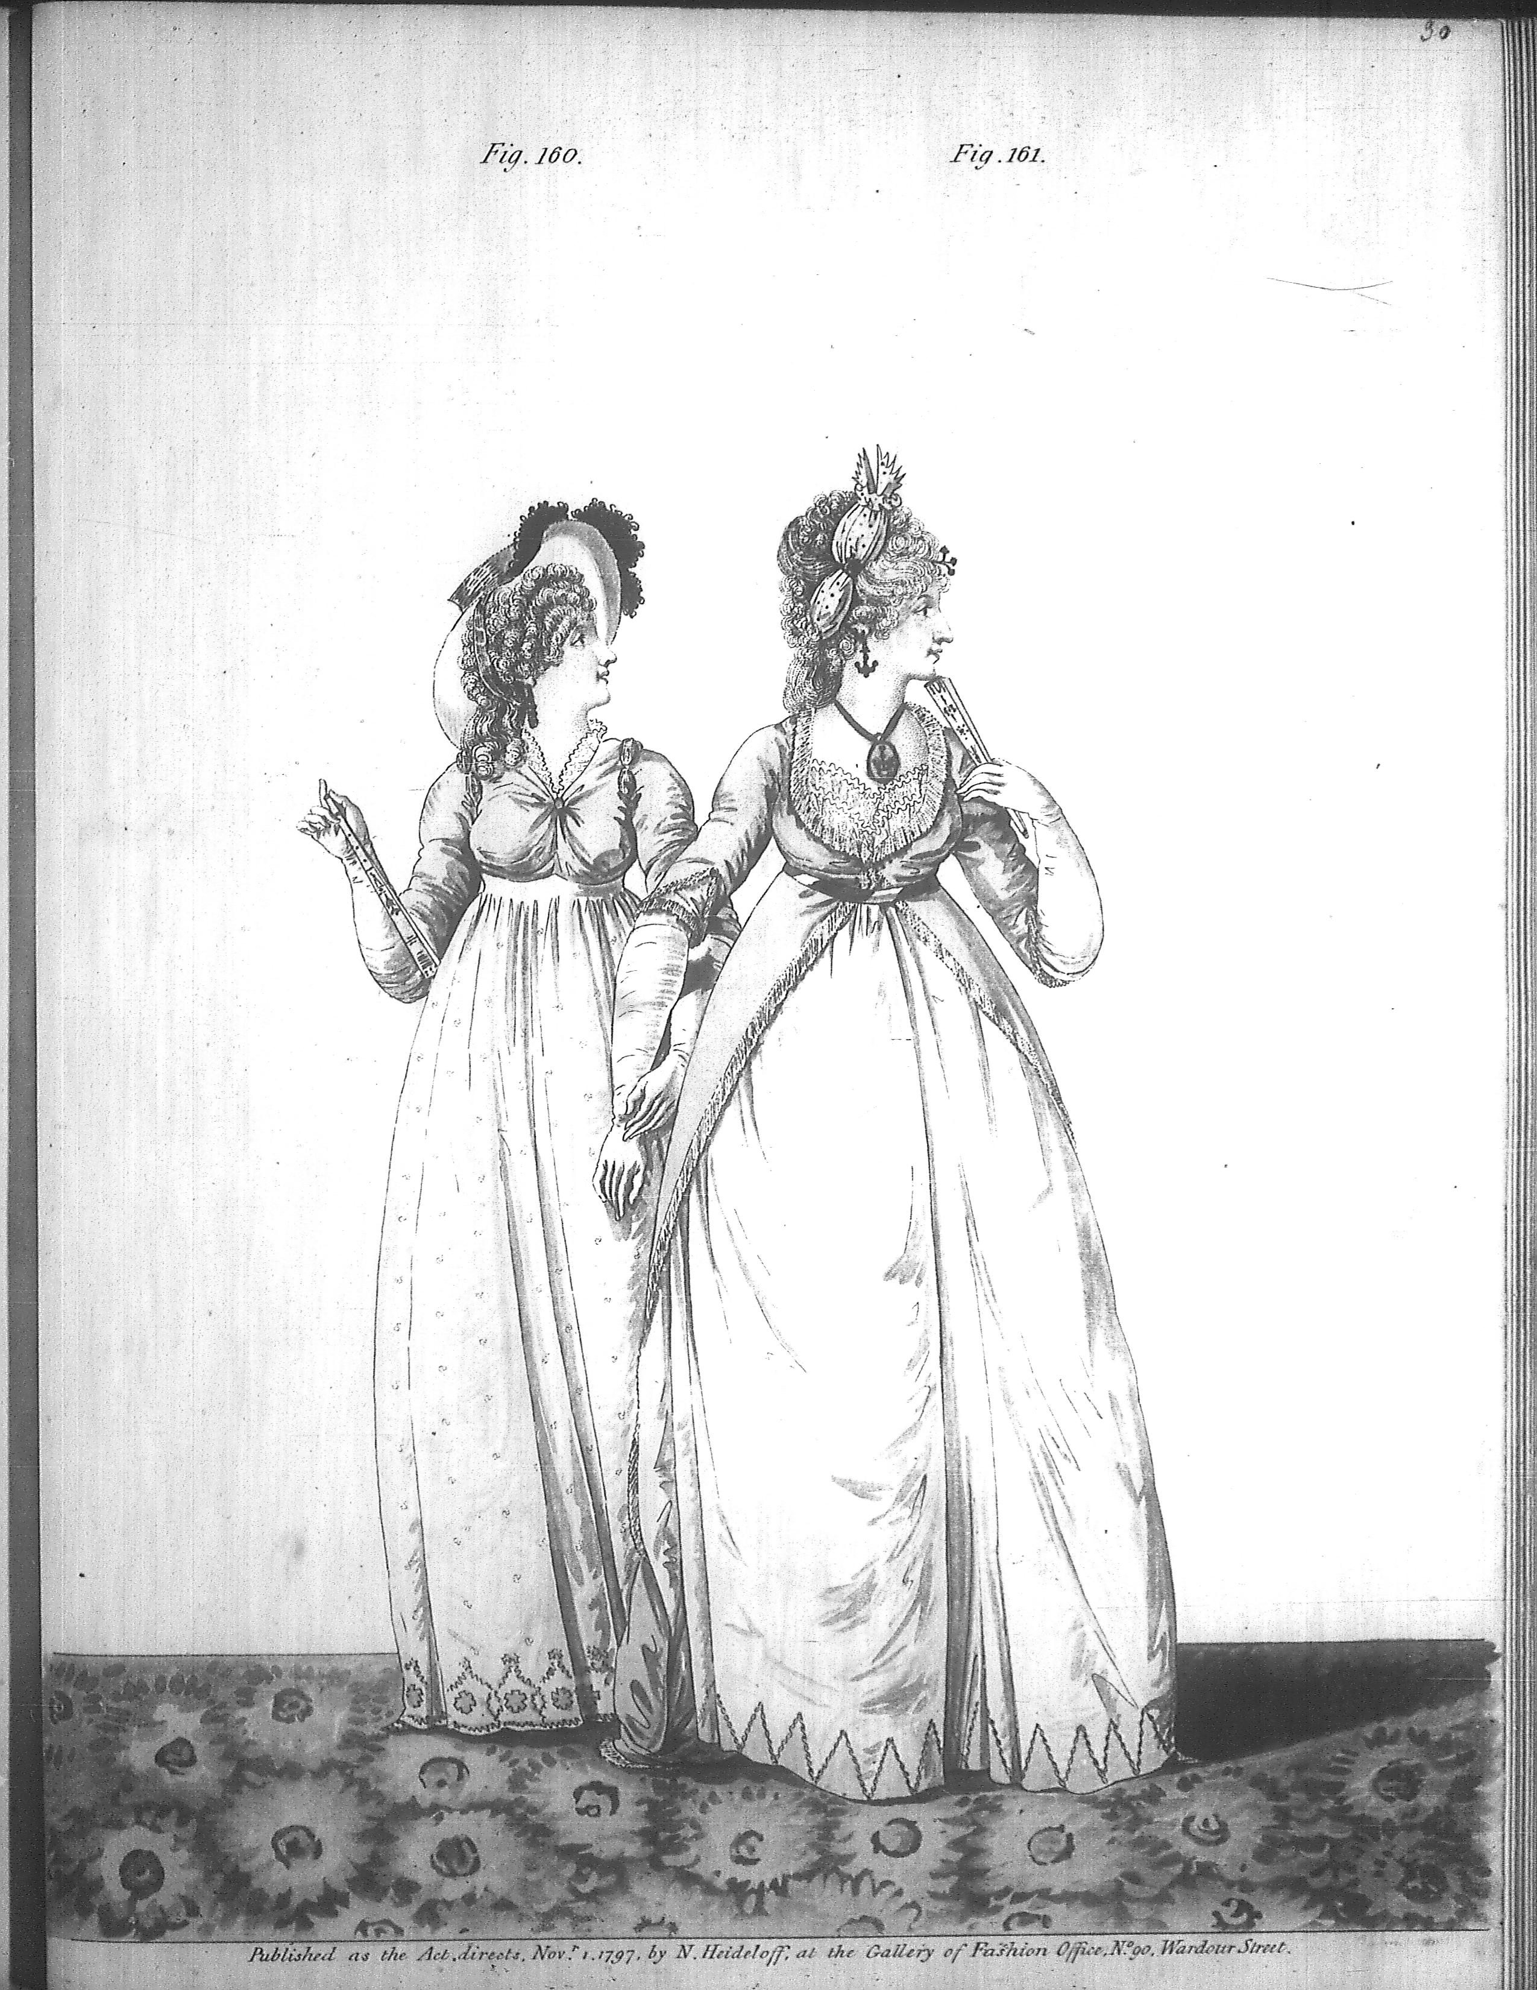
“Their appearance was by no means ungenteel or unfashionable; their dress was very smart, their manners very civil.”
The Steele sisters,
Sense and Sensibility
Notes:
Smart elegant: compare to Northanger Abbey where Eleanor is described as “elegant”

Slide 13
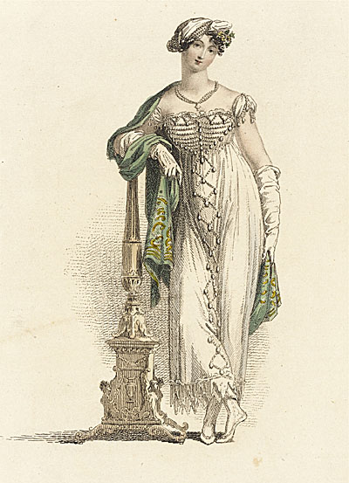
Said of her: “as elegant as lace and pearls could make her”
Said by her: “Very little white satin, very few lace veils; a most pitiful business!”
Ackermann, June 1813
Notes:
“

Slide 14
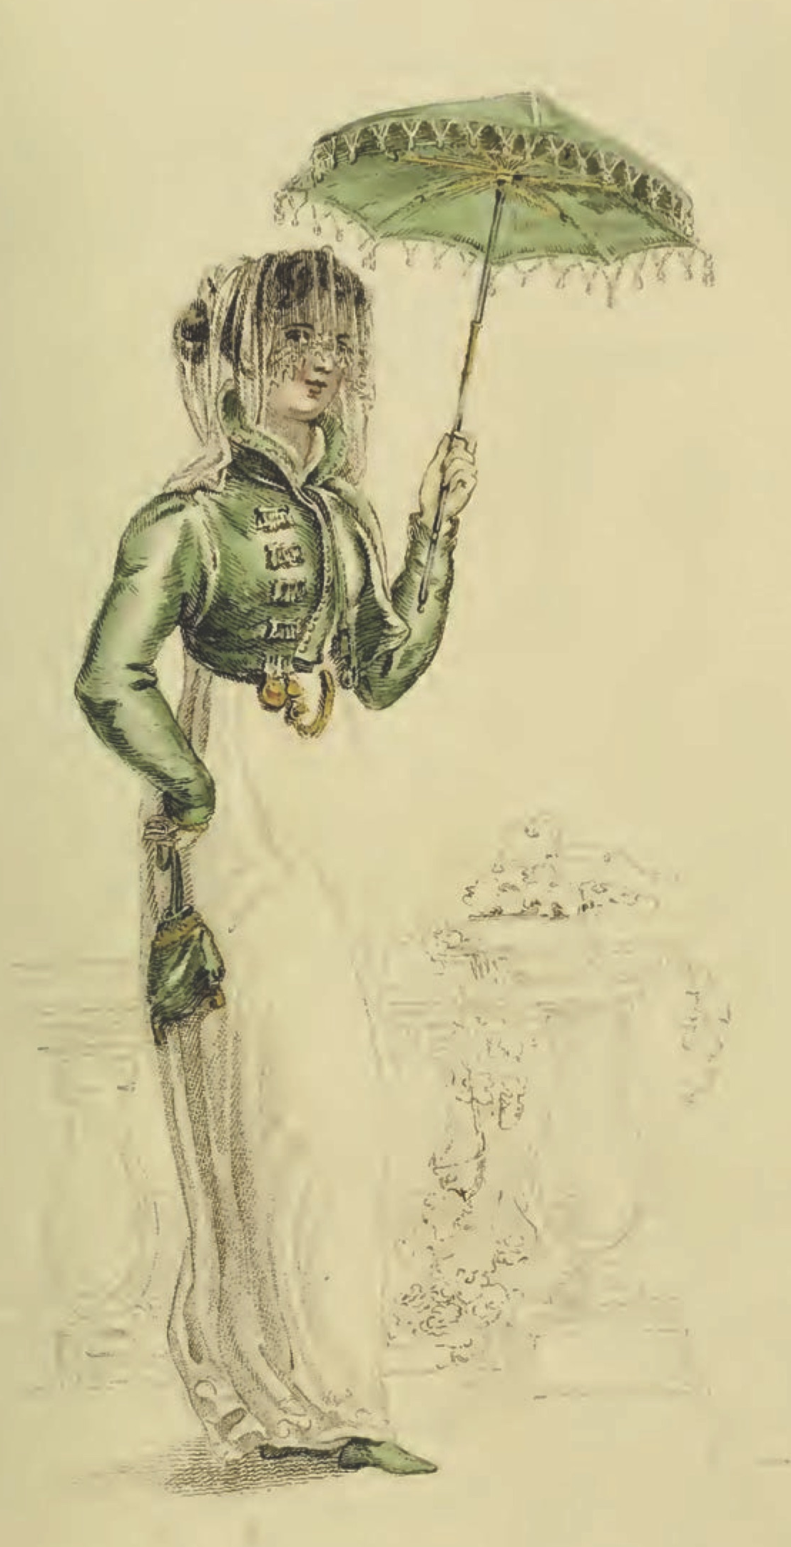
“I wish you would tell Sally to mend a great slit in my worked muslin gown before they are packed ...”
Ackermann, July 1811

Slide 15
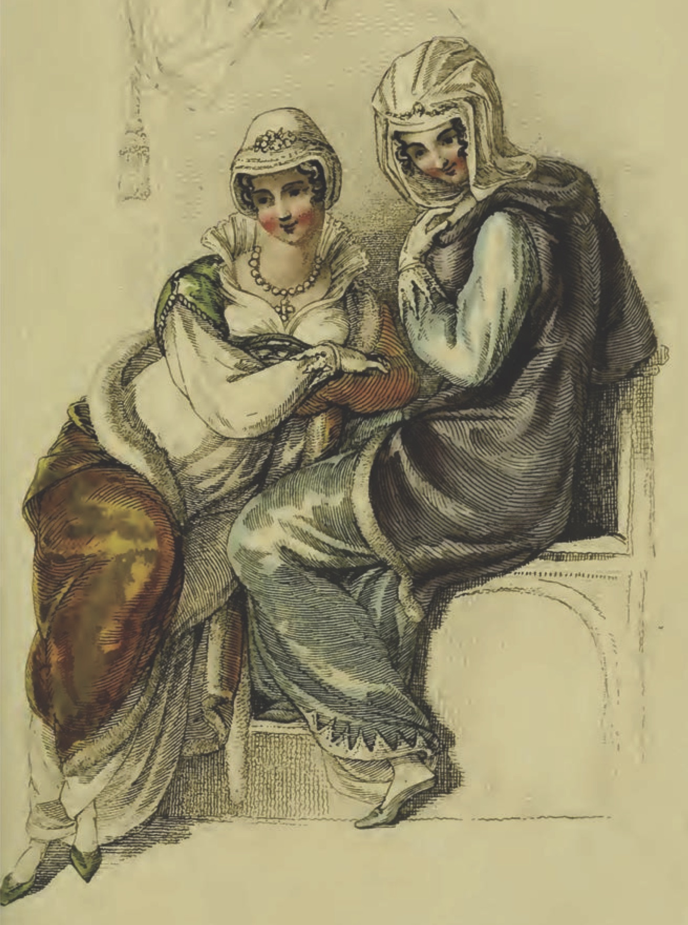
“I am very glad to hear what you tell us, of long sleeves.”
Ackermann, February, 1811
Notes:
However, using long sleeves is a safe bet because it was a fashion that came and went with regularity.

Slide 16
“One could not hope to conduct himself or herself properly on entering a room without immediately assigning a rank to every person.”
Richard Bushman
Notes:
In a society based on rank, clothes as an indicator of rank have to shift subtly. You keep up with the latest fashions, the latest dances, and the latest news, not just to be trendy or edgy but to ensure that your rank is recognized. Your deportment, manners and speech all mark you as acceptable into society.

Slide 17
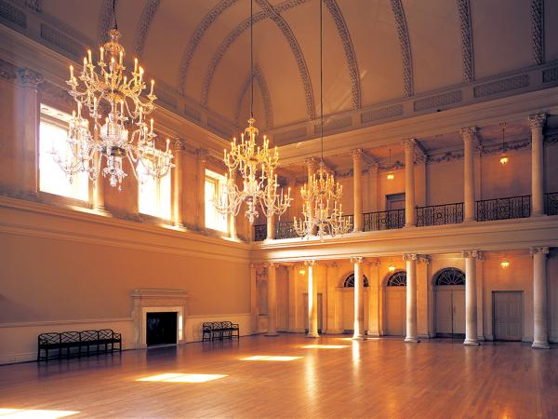
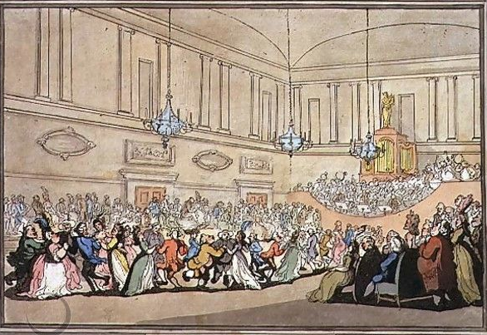
Notes:
The Assembly Rooms, Northanger Abbey
Pierce Egan, Walks Through Bath, 1819
Here, salutary rules exclude all those Whom no one hears of,
and whom no one knows;
That no plebian breathings may infect An atmosphere at all times so select;
No bankers’ clerks these splendid realms invade;
No FOLKS who carry on a retail trade;
No actors by profession must appear To act their parts, or speak their speeches here;
Yet even here, amid the crowds you view,
’Tis sometimes difficult to tell WHO’S WHO.”

Slide 18
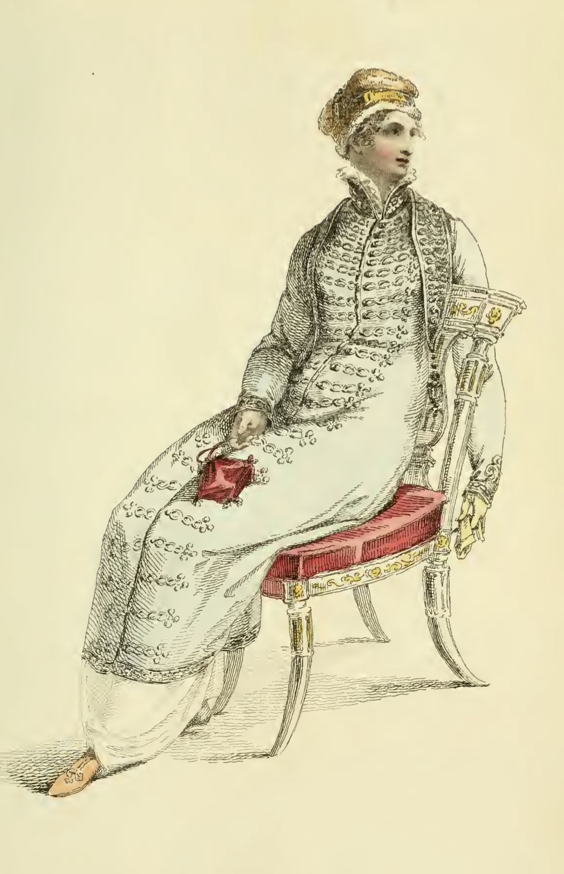
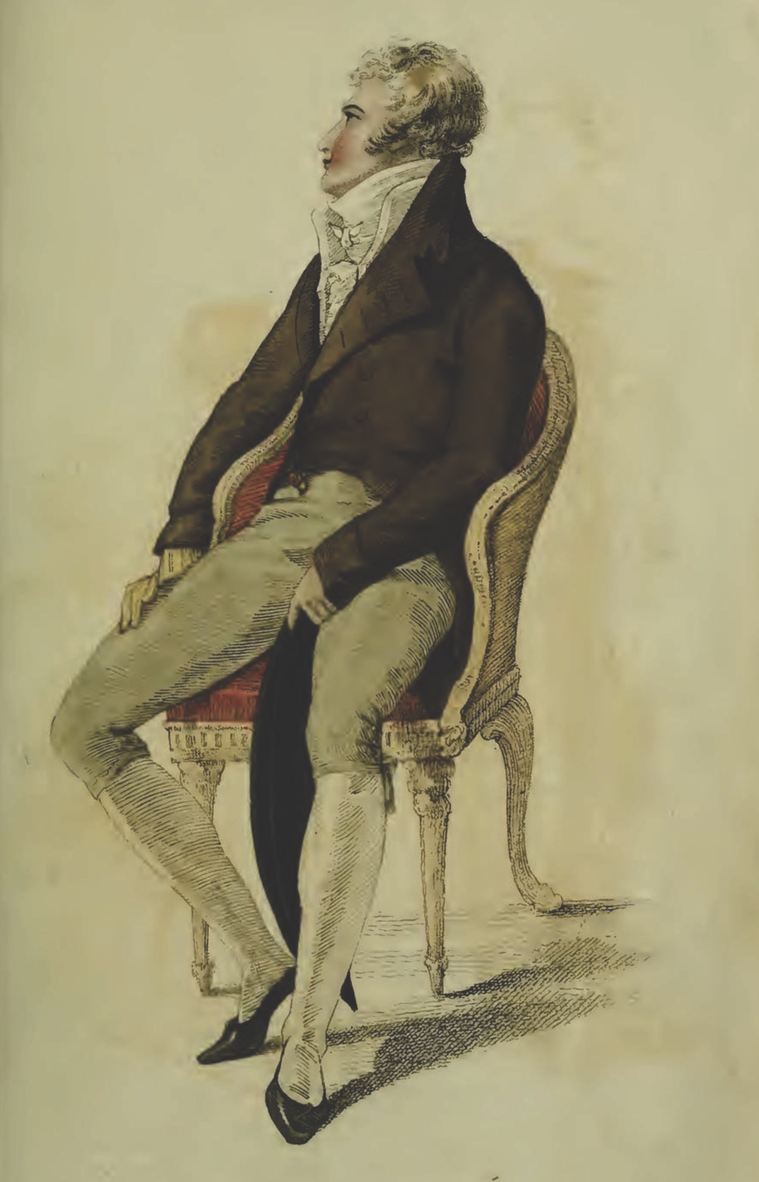
Ackermann, April 1810
Elizabeth Elliot of Lady Russel: “Something so formal and arrangé in her air! And she sits so upright!” (Persuasion)
Notes:
The cues for the initiated were many: fashion certainly, but also specific manners, knowledgeable, or at least interesting, conversation, and grace in movement.
That elegance, that air was being redefined as something more “natural” in the years after the turn of the century as Elizabeth Elliot notes.
But it continued to be cultivated in years of dance lessons, or acquired more quickly once a fortune in textile manufacturing was made.

Slide 19
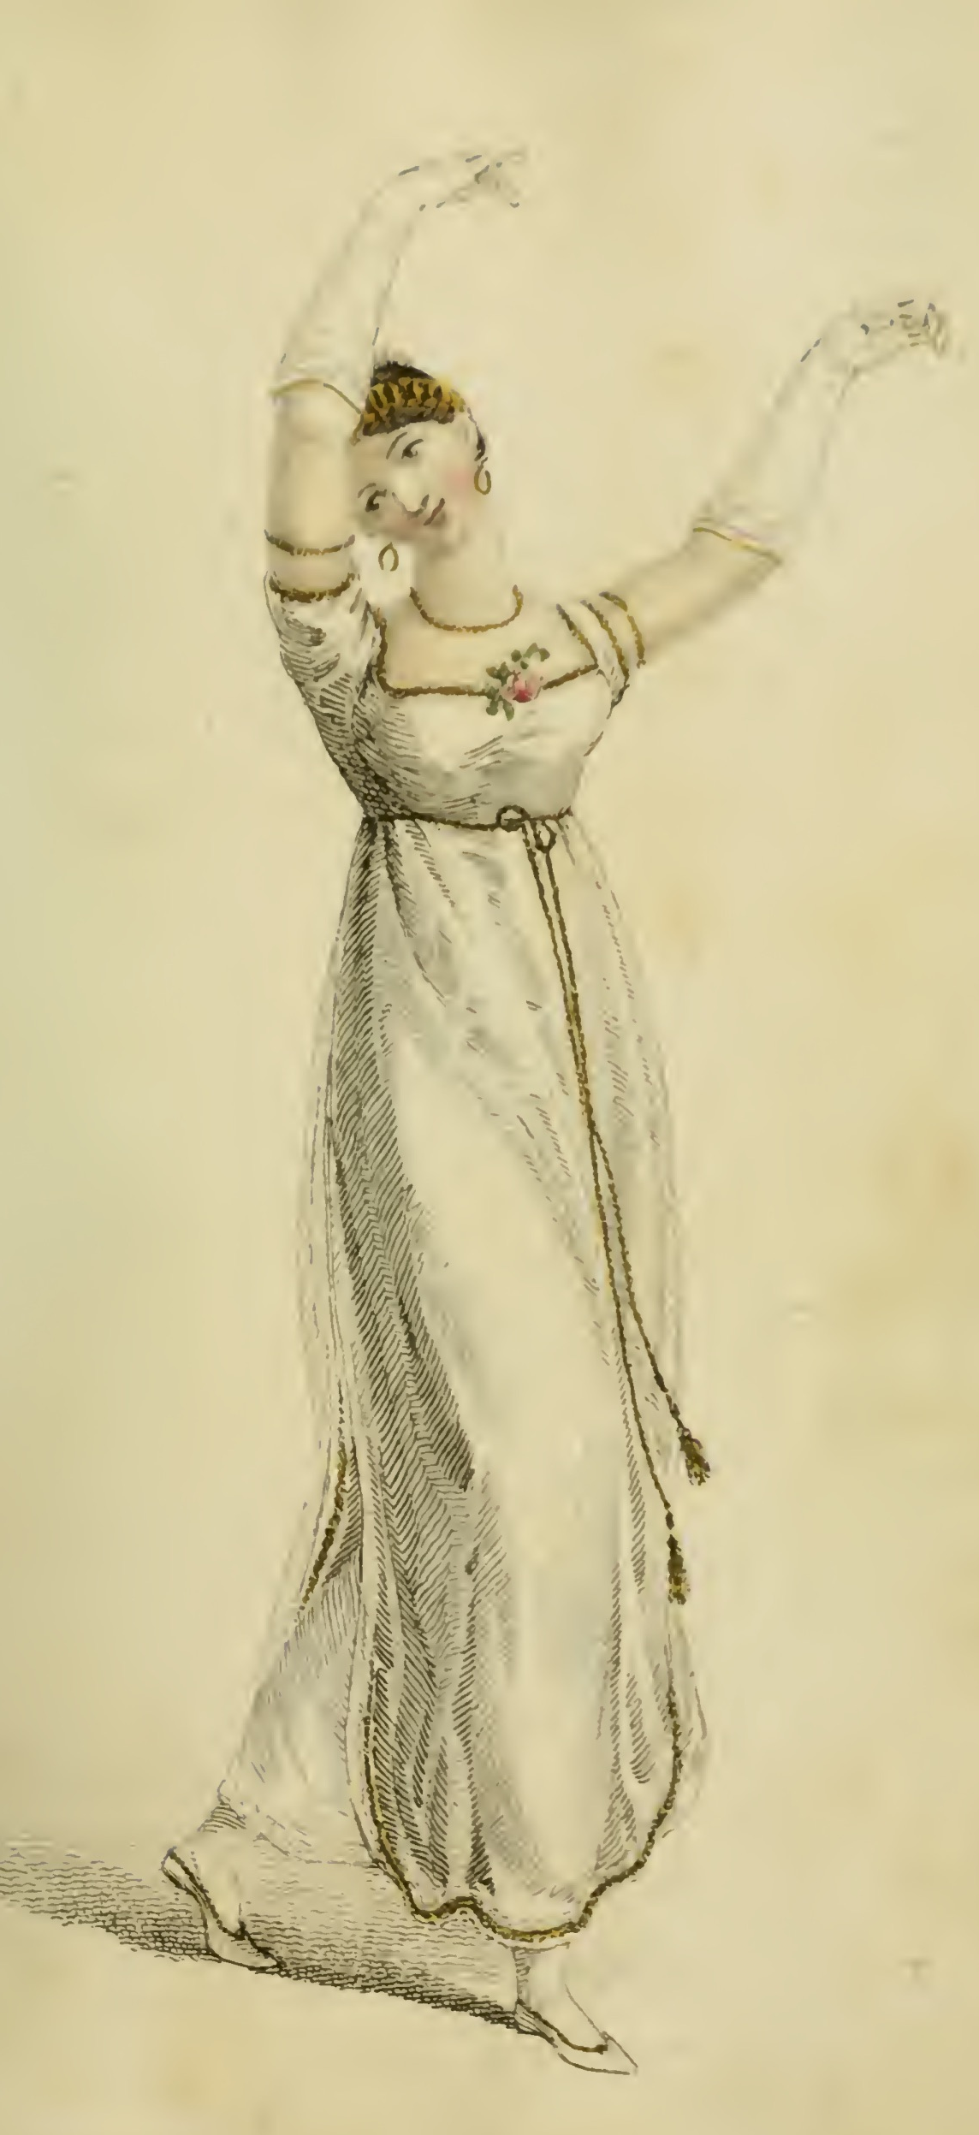
“…besides all this, she must possess a certain something in her air and manner of walking...”
Caroline Bingley, Pride and Prejudice
Ackermann, February1809
Notes:
As Caroline Bingley says, when attempting to describe the perfectly accomplished woman and hoping that Mr. Darcy will believe her description fits she herself, a true lady must have “a certain something in her air.” That grace of movement was cultivated in years of dance lessons (a required part of an upper class education), or acquired more quickly once a fortune in textile manufacturing was made.

Slide 20
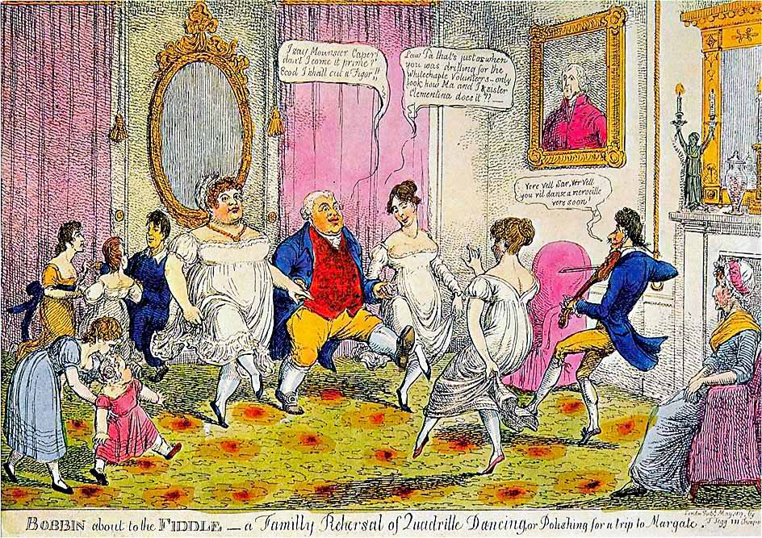
Notes:
Bobbin about the Fiddle – A Family Rehearsal of Quadrille Dancing, or Polishing for a trip to Margate.
“I say Monsouer Caper don’t I come it prime? Ecod I shall cut a figor!”
“Law Pa that’s just as when you was drilling for the Whitechapel Volunteers. Only look at how Ma and I and sister Clementina does it.”
“Ver vel sir, vere vel. You vil danse a merveileux ver soon.”
“The Season at Margate, for example, commenced on the King’s birthday, formally celebrated in June, and ended in late October, whereas Bath commanded the more fashionable months of October through May. The hours and pricing of the summer balls were usually different from those of the winter. ”
. “

Slide 21
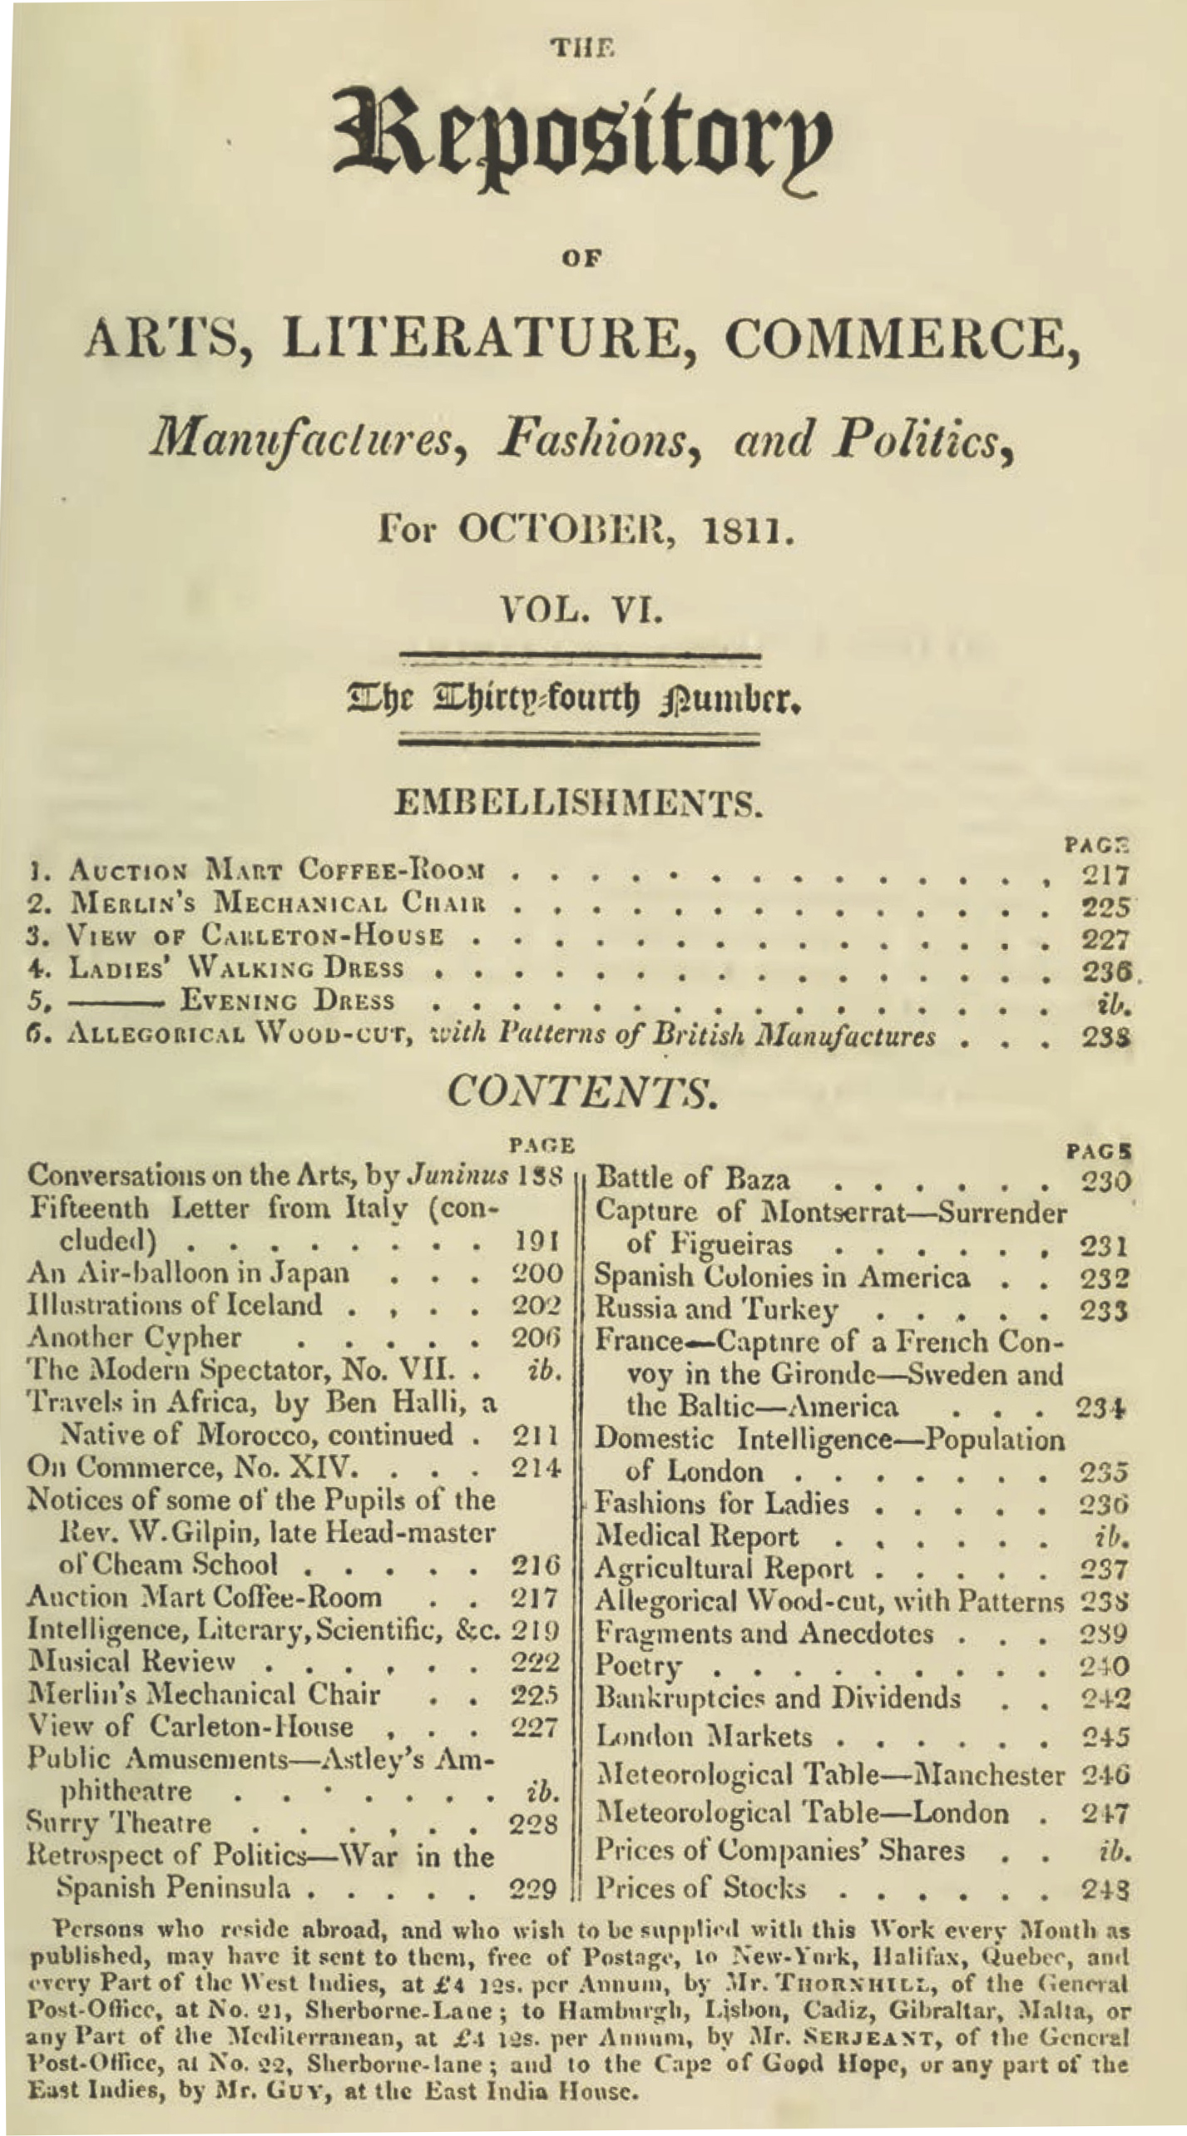
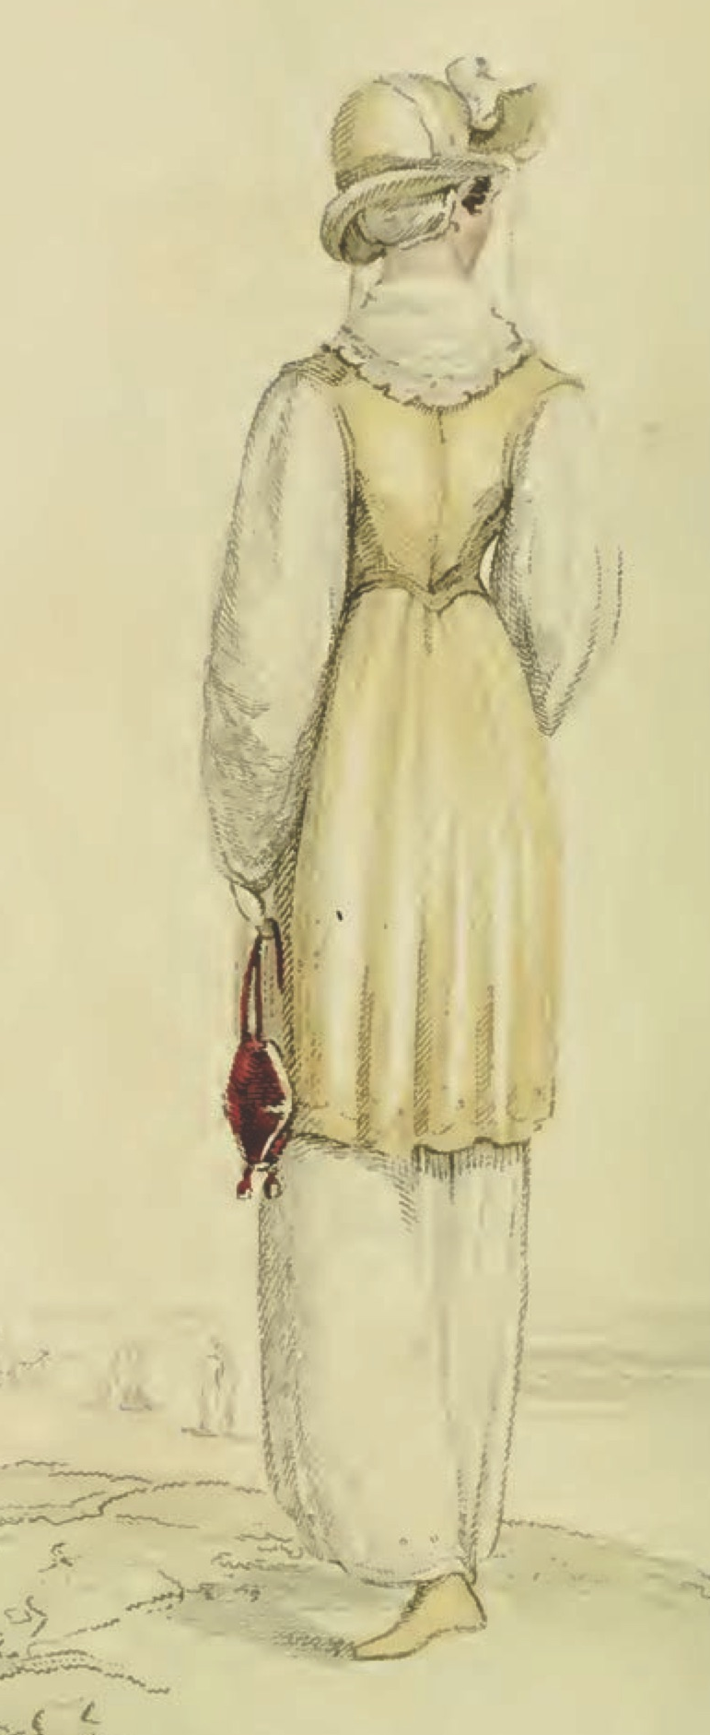
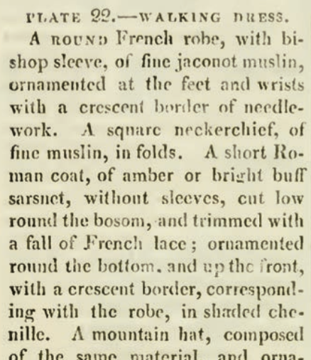
Ackermann’s Repository of the Arts. October 1811
Notes:
Keeping up with the subtle changes in the latest fashions was one way to indicate that you were among the genteel. As important, perhaps more important, was the ability to converse intelligently on a variety of topics. Both aspirations were served by magazines like Ackerman’s, or to give it its full name “The Repository of Arts, Literature, Commerce, Manufactures, Fashions, and Politics” (it also included reviews of music and examples of furniture, interior design, and public buildings or businesses) provided aquatint fashion plates with specific descriptions, and general descriptions of fashion trends. Jaconet: smooth cotton

Slide 22
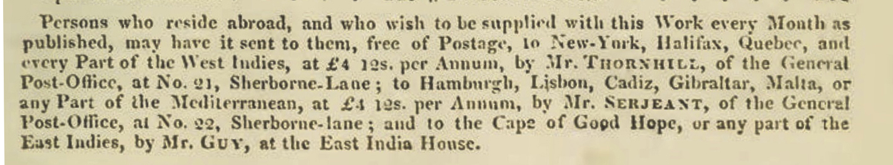
Ackermann’s Repository of the Arts. October 1811
Notes:
And could be sent all over the world

Slide 23
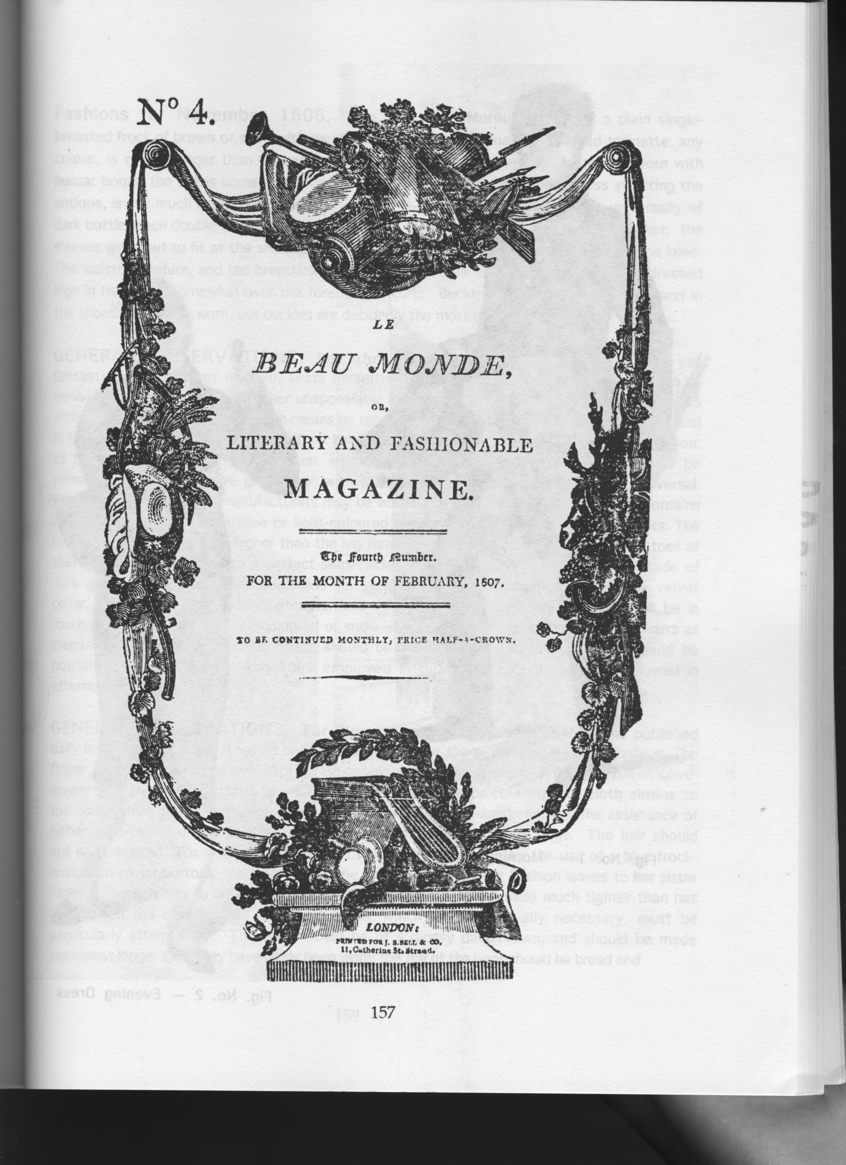

Slide 24
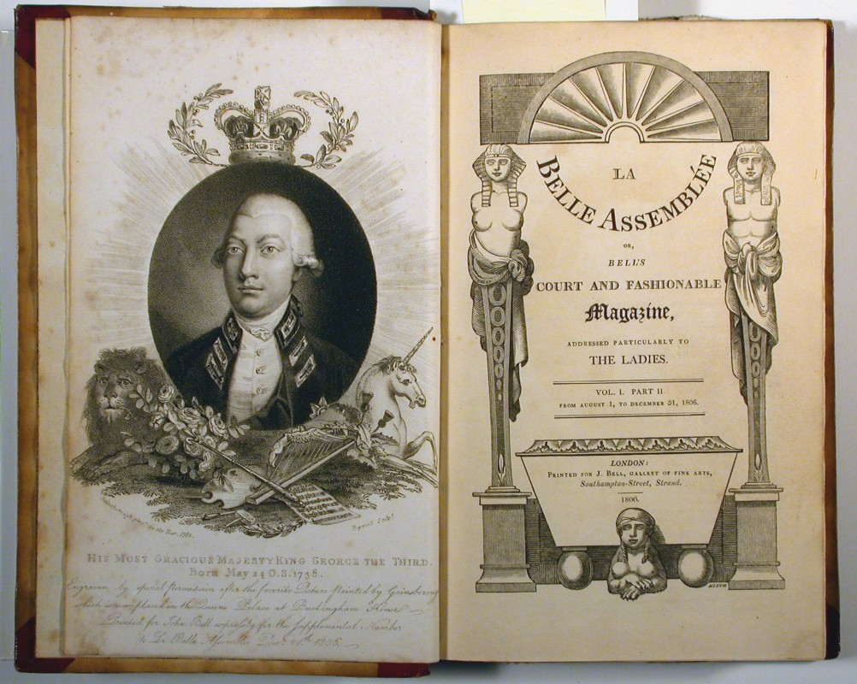
Notes:
La Belle Assemblée (which we know Fanny Knight received – at least, there is one issue of 1814 known to be hers),

Slide 25
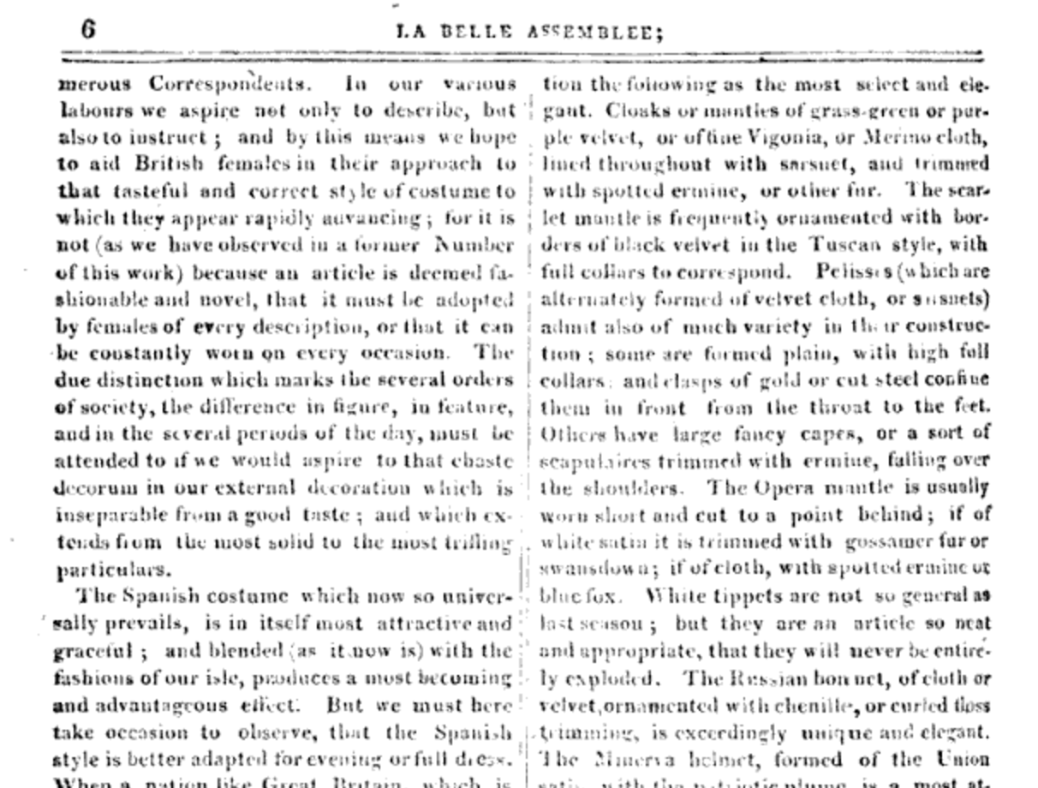
13 October 1808
“We must turn our black pelisses into new, for Velvet is to be very much worn this winter.”
“Pelisses, which are alternately formed of velvet or sarsnet, admit also of much variety in the constructions.”
La Belle Assemblée, October, 1808
Notes:
Austen frequently shows evidence, in her letters, that she was aware of, and assiduously adopting, the most recent fashion changes. When she suggested that her velvet pelisse would remain fashionable with just a bit of alteration she would have been happy to have that confirmed in La Belle Assemblée in October 1808.

Slide 26
“Scissor edited” from October 1808 La Belle Assemblée
The Morning Chronicle (London, England), Tuesday, November 1, 1808
The Leeds Mercury (Leeds, England), Saturday, November 5, 1808
Jackson's Oxford Journal (Oxford, England), Saturday, November 5, 1808
The Examiner (London, England), Sunday, November 6, 1808
Trewman's Exeter Flying Post or Plymouth and Cornish Advertiser (Exeter, England), Thursday, November 10, 1808; Issue 2322
The Derby Mercury (Derby, England), Thursday, November 10, 1808; Issue 3990
Notes:
And even if she did not have access to that issue of the magazine, so-called “scissor editors” were happy to clip that description and include it in their weekly newspapers shortly thereafter. You can find the exact same description for the fashions in at least these six. Nor was this information limited to England. Ackermann’s could be subscribed to from cities around the world.

Slide 27
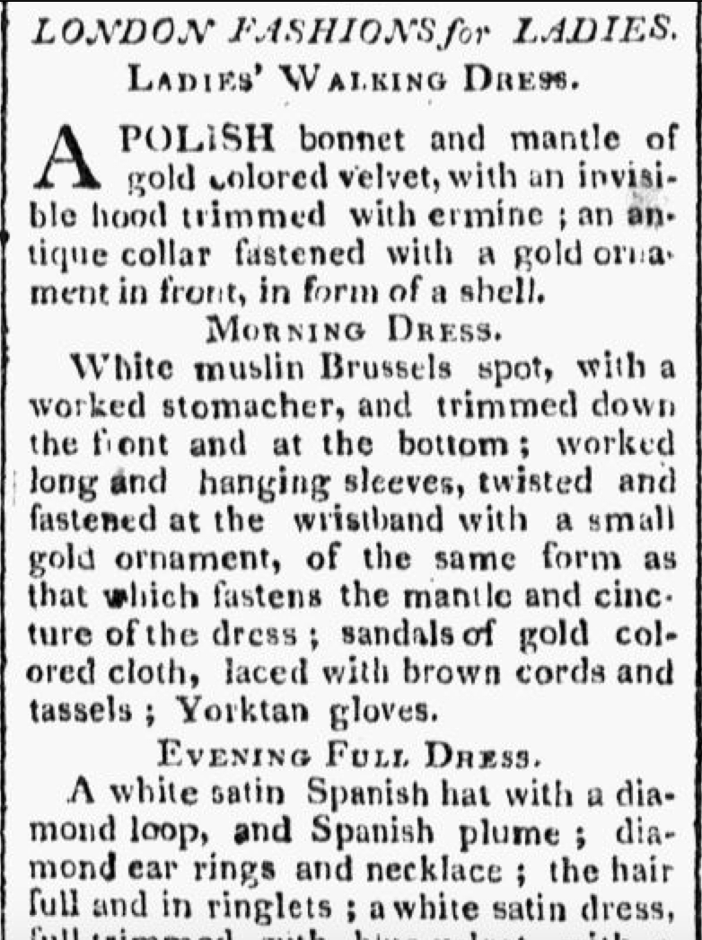
Worcester Gazette. (Worcester, MA) •
07 June1809
Notes:
How up on the latest fashion were American women

Slide 28
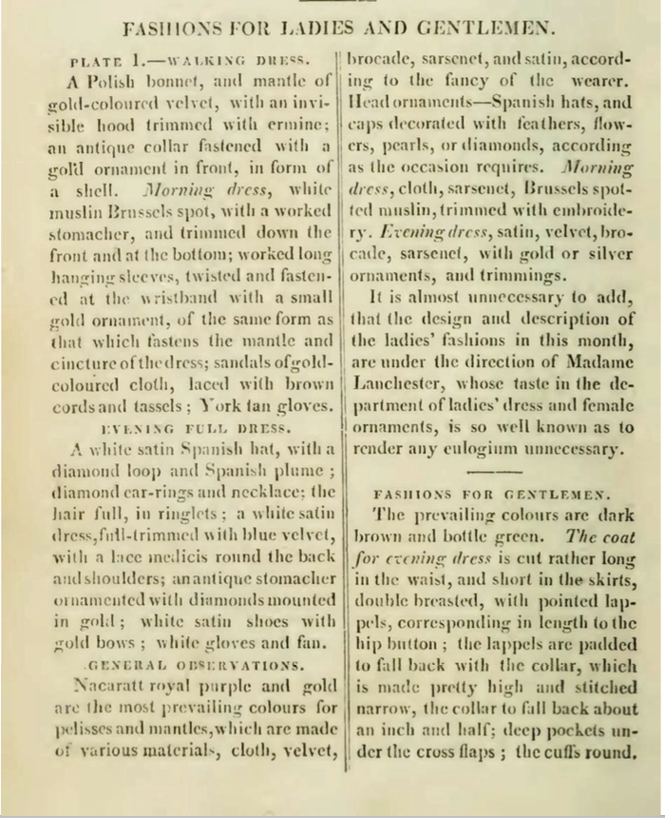
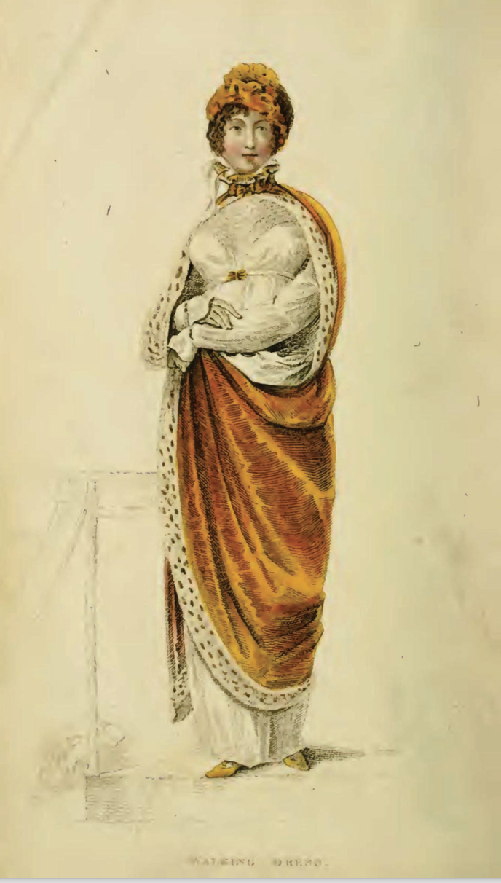
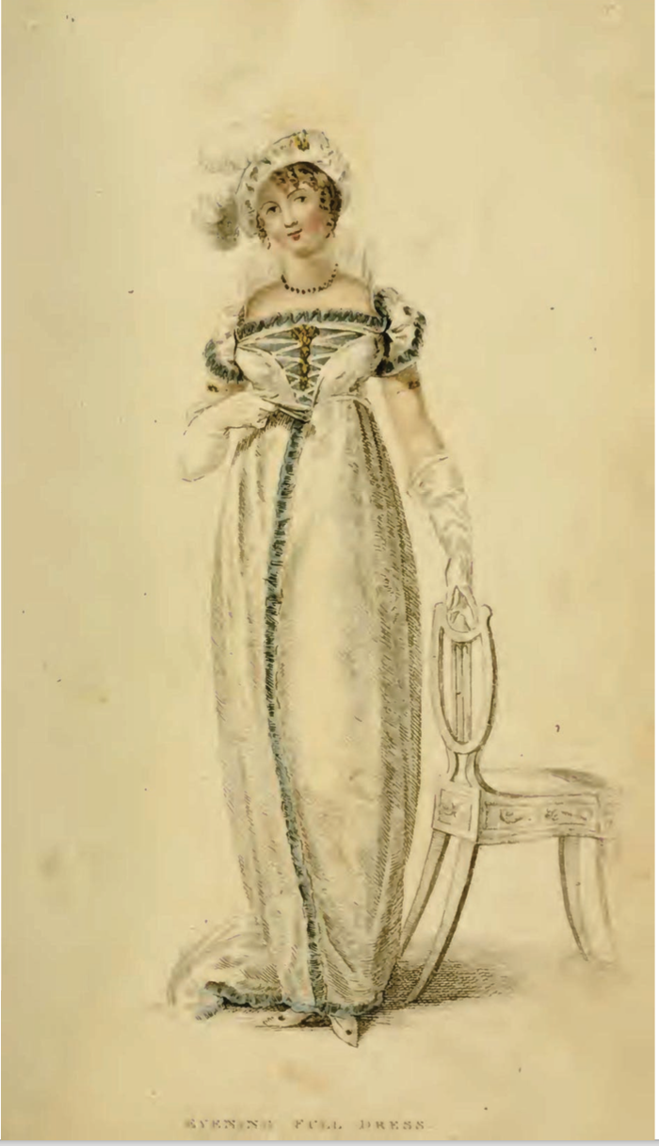
Ackermann’s Repository of the Arts. January 1809
Notes:
And looking for Plattsburgh NY Republican, May 28, 1814 which republished article from both Ackermann’s and La Belle Assemblee

Slide 29
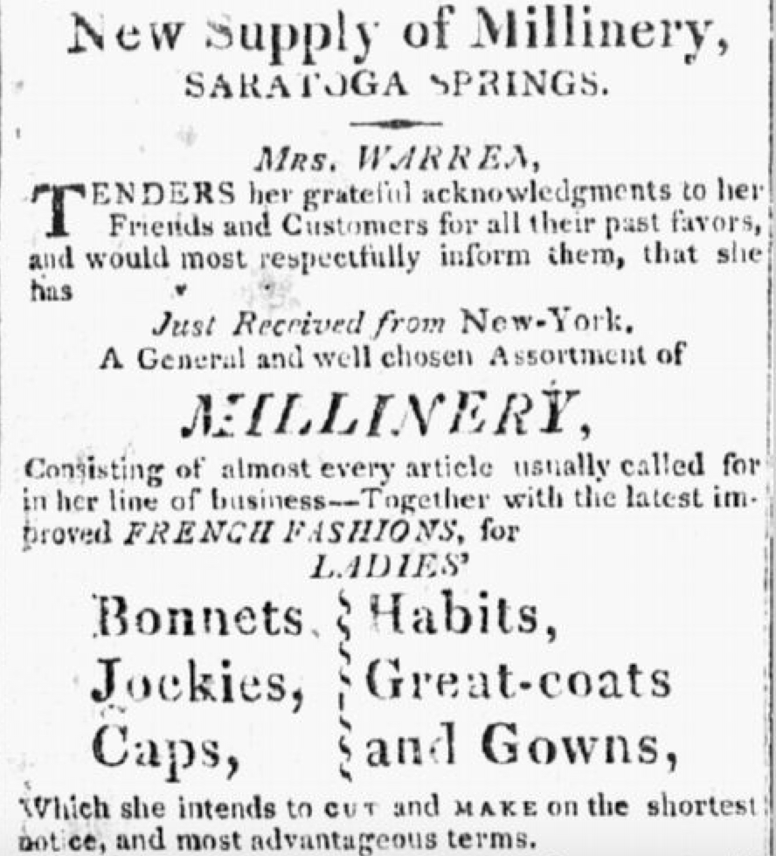
Independent American (Ballston Spa, New York) • 5 Oct 1814
Notes:
Even in the wilds – there are some from Ohio – but this one will serve as an example. And looking for Plattsburgh NY Republican, May 28, 1814 which republished article from both Ackermann’s and La Belle Assemblee

Slide 30
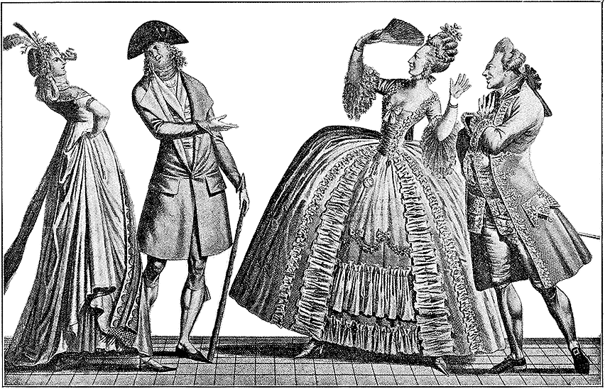
Notes:
Our perception of this period may be that women threw off their heavy petticoats and corsets, raised the waist of their gowns, called it classical and that was that for 40 years.

Slide 31
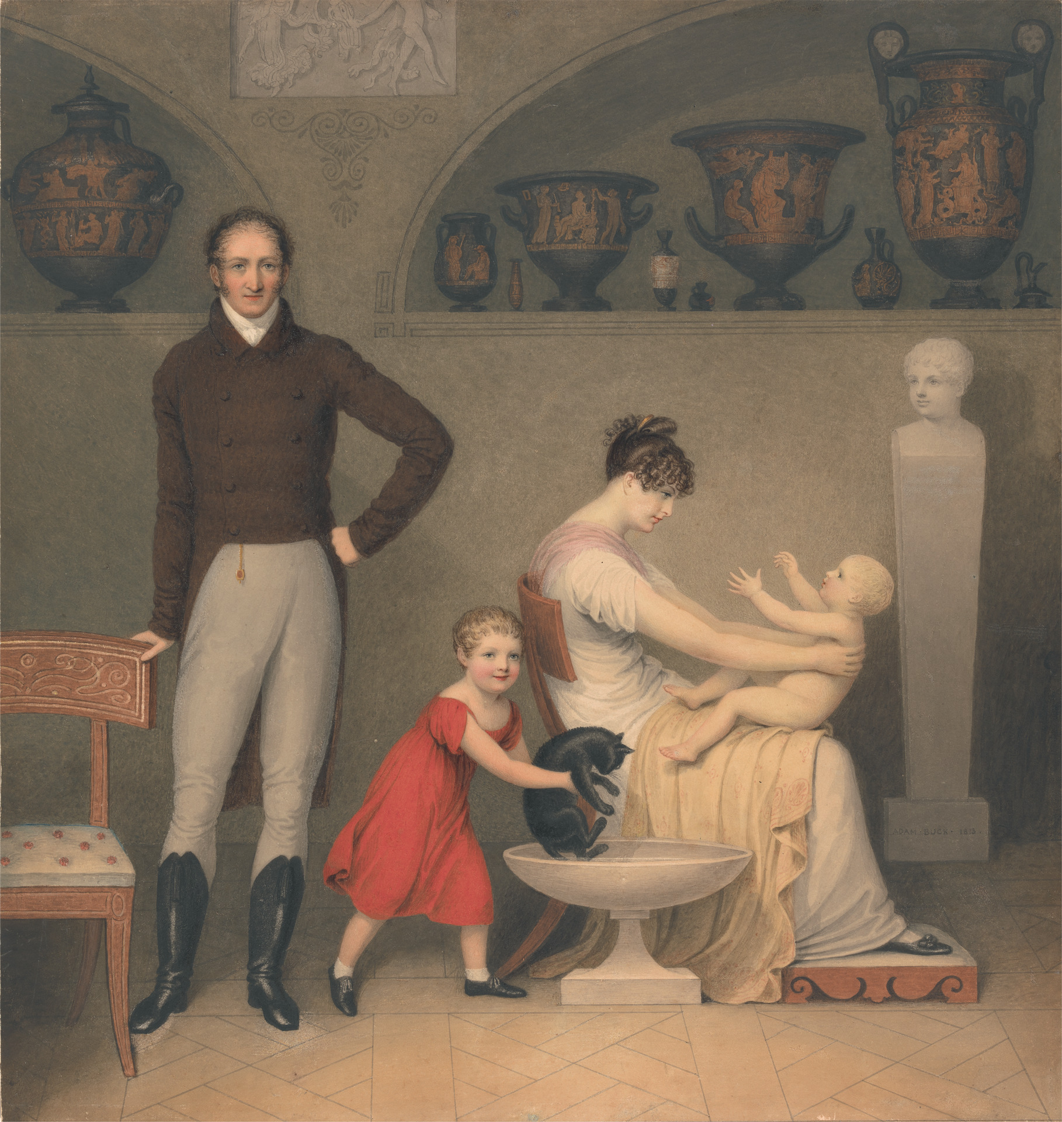
Adam Buck (1759–1833)
Self-Portrait with Wife
and Children, 1813
Notes:
But how did Austen and her contemporaries perceive the change. New natural, ease,
Adam Buck (1759–1833) Self-Portrait with Wife and Children, 1813 (probably Francis in red 1809-1817, and Alfred the baby 1813-1891

Slide 32
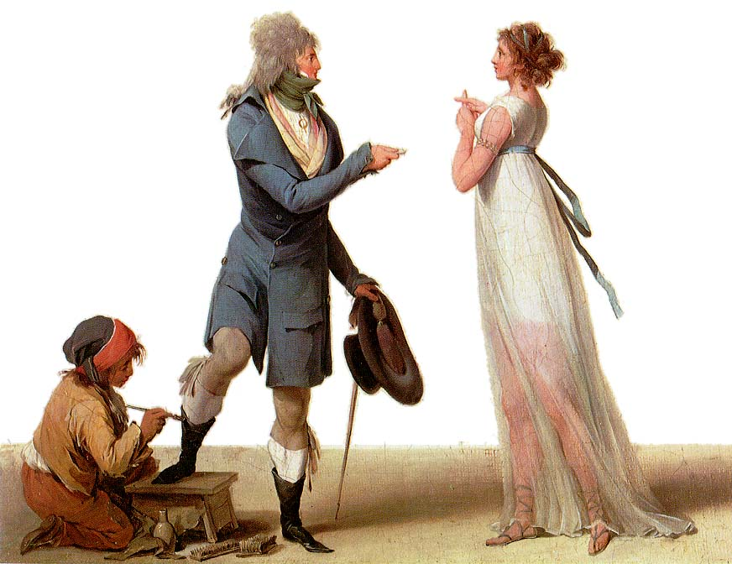
Notes:
Further complicating the reality of the neoclassicist clothing are cartoons and satirical works
Boilly Les Incroyables
A cartoon, not a realistic depiction

Slide 33
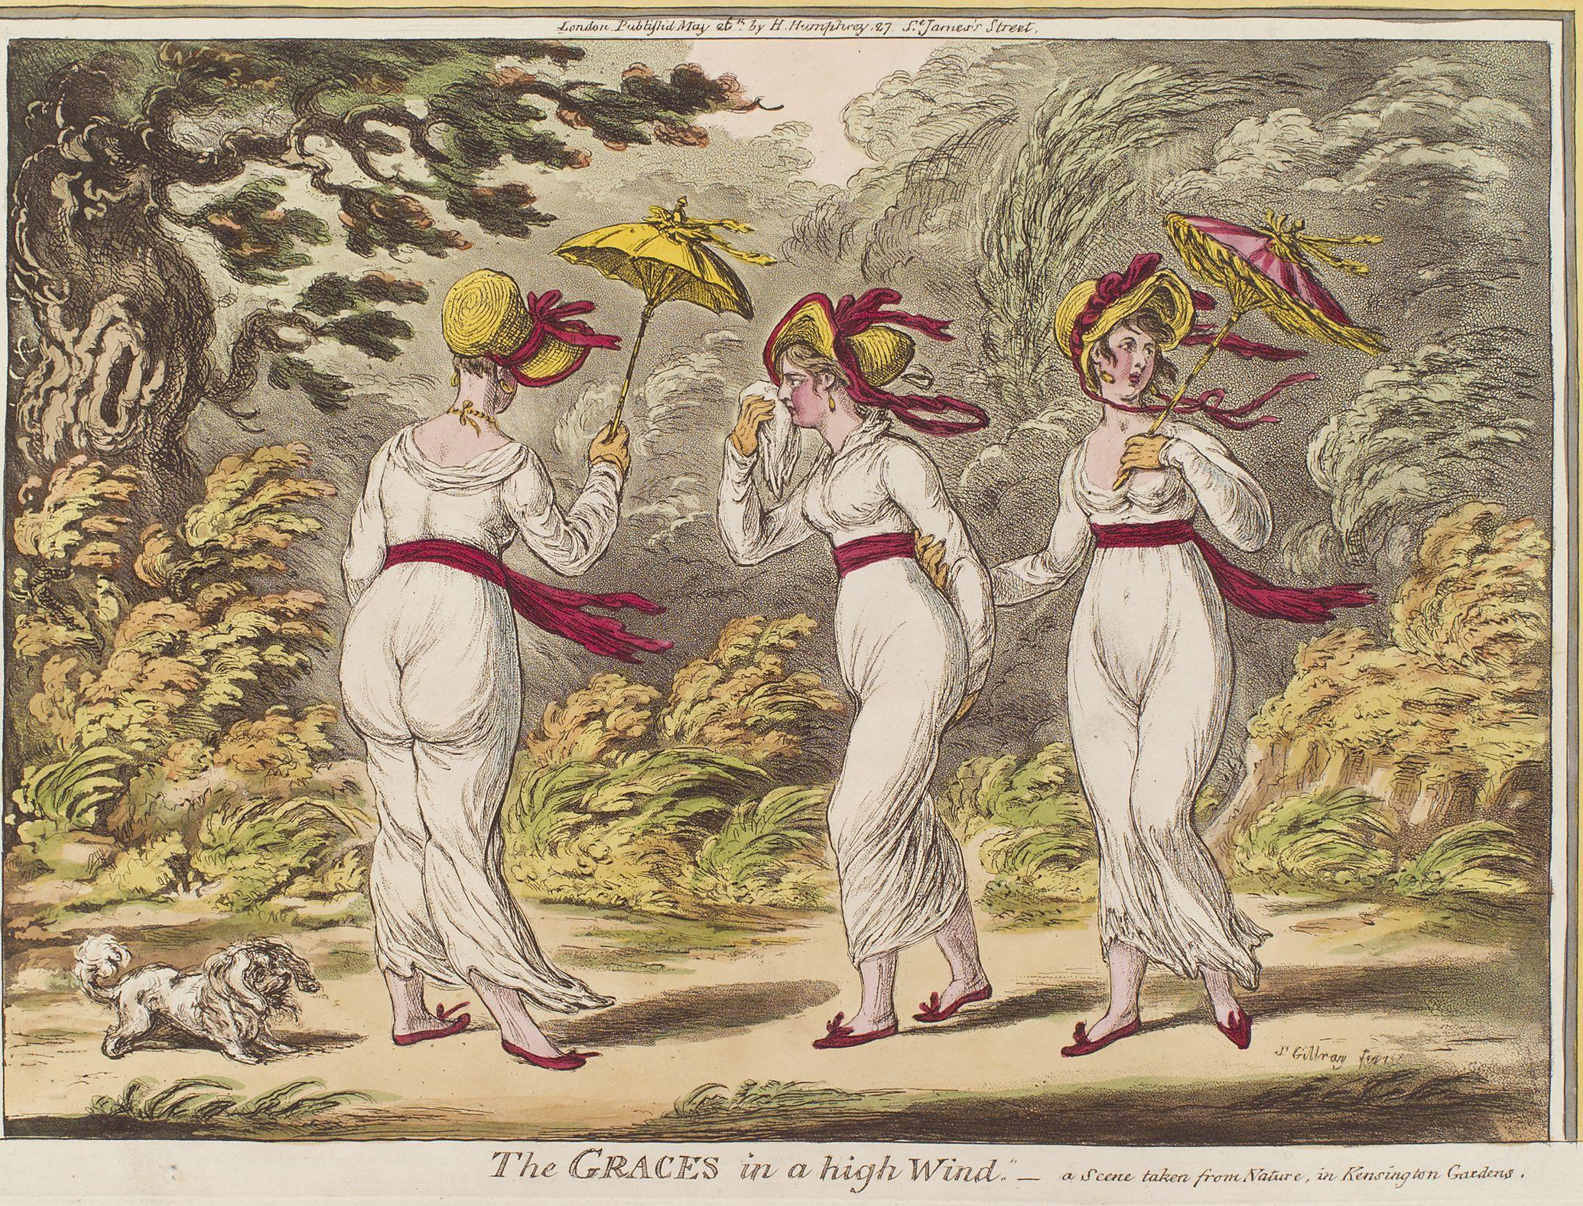
8 January 1801
Mrs. Powlett was at once expensively & nakedly dressed.”
Notes:
1810 “A scene taken from nature in Kensington Gardens” Gillray commenting on lightweight cotton and flimsy petticoats.

Slide 34
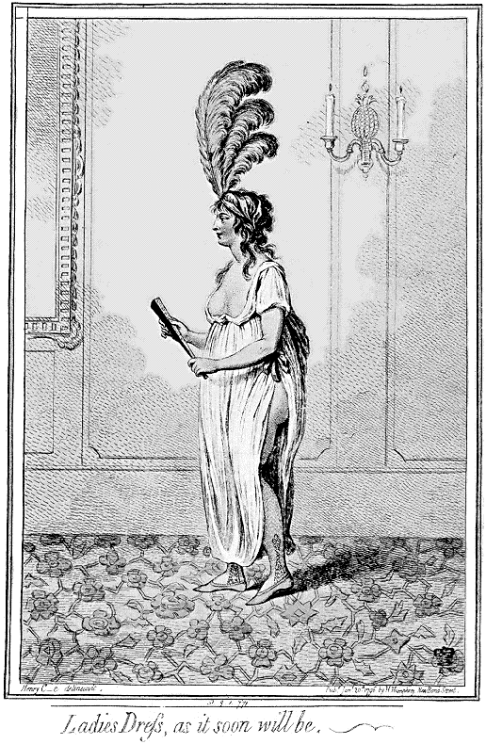
Gillray: “Ladies dress as it soon will be.”
Notes:
James Gillray (1757-1815)

Slide 35
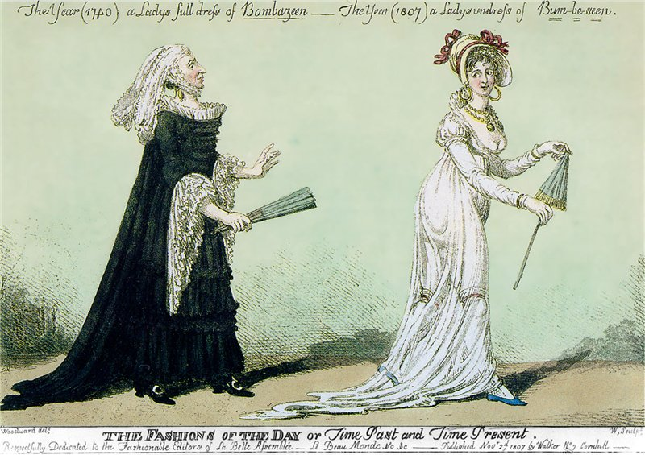
The year 1740, a Lady’s full dress of Bombazeen.
The year 1807, a Lady’s undress of “Bum-Be-Seen.”
Notes:
The year 1740 a Lady’s Full Dress of Bombazeen. The year 1807 a Lady’s Undress of Bum-be-seen (Full dress refers to formal dress, undress refers to daytime clothes but here it refers to rather more…or less as the case may be.

Slide 36
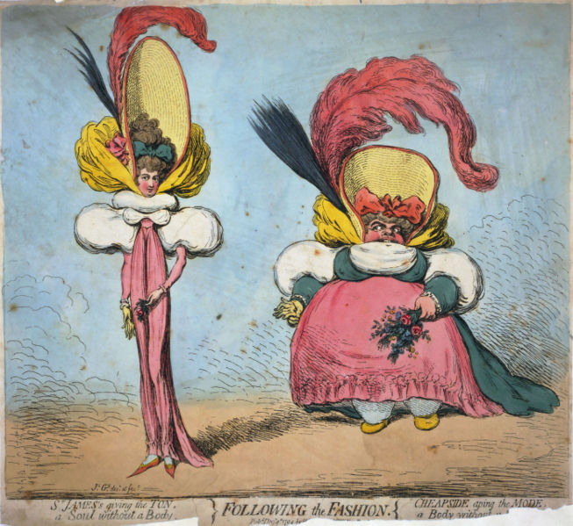
Gillray, 1796
Notes:
But of course the cynical were quite happy to point out that the new fashion did not flatter all body types.

Slide 37
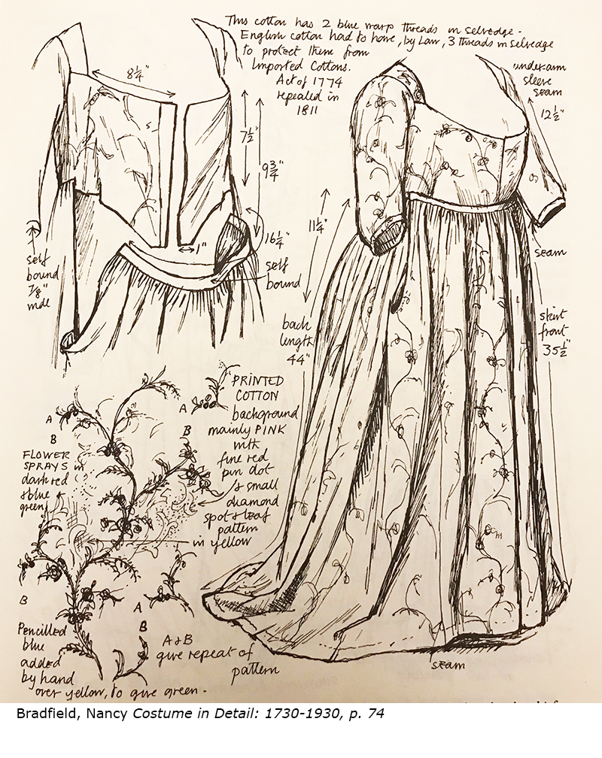
Notes:
So we are not surprised to find that some women did not fully commit: in this case a woman has removed the skirt from her robe a l’anglaise, reattached it a few inches higher, but left the bodice unaltered so she can lower it again if necessary. This is probably an appropriate time to mention a general rule about clothing of this time: fabric is expensive, labor is cheap. So gowns were altered or cut up to be reworked.

Slide 38
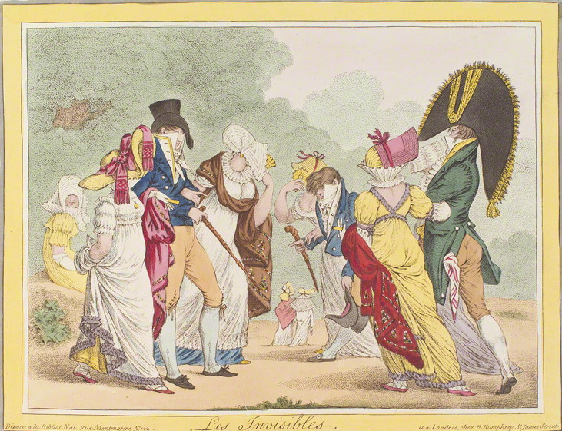
James Gillray, Les Invisibles, 1810

Slide 39
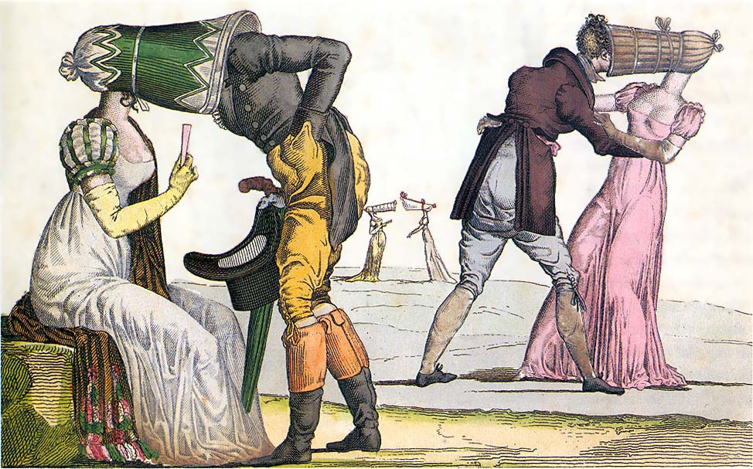

Slide 40
Influences

Slide 41
Why?
Was it the “Turkish/Oriental”?
Was it the Greek statues?
Was it Marie Antoinette?
Was it war?
Was it new technology?
Was it politics and globalization?
Was it the price of muslin?
Notes:
But as Jane Ashelford reminds us, the narrative of French women throwing off their clothes and wearing undergarments inspired by neoclassicism is appealing but simplistic. England – wool, Greek drapery, American egalitarianism, French freedom and egalite, West Indies – slave cotton and indigo, East Indies – true Indian muslins (Bangladesh suppression), better thread, better weaving, better quality, cheaper to produce.

Slide 42
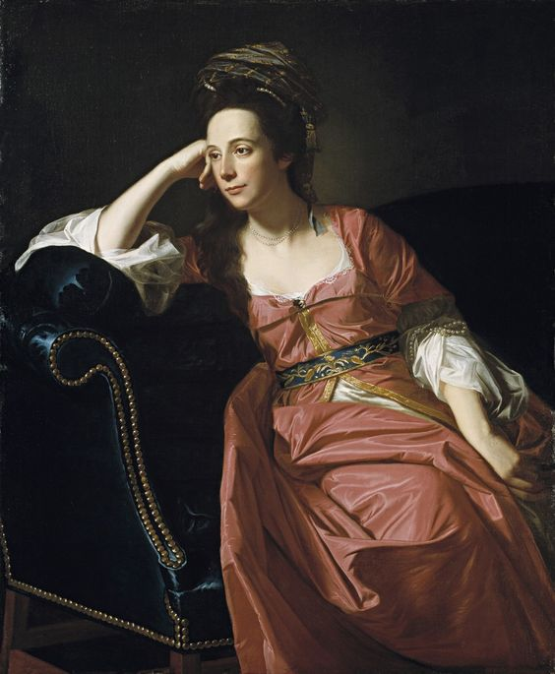
John Singleton Copley. Portrait of Margaret Kemble Gage (circa 1771) Timkin Gallery of Art
Notes:
Global travel already being felt in 18th century

Slide 43
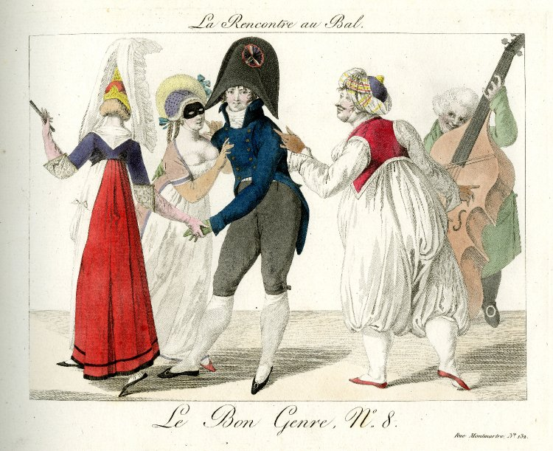
Pierre La Mésangère, 1801-1802
Notes:
Masquerade as a place to experiment

Slide 44
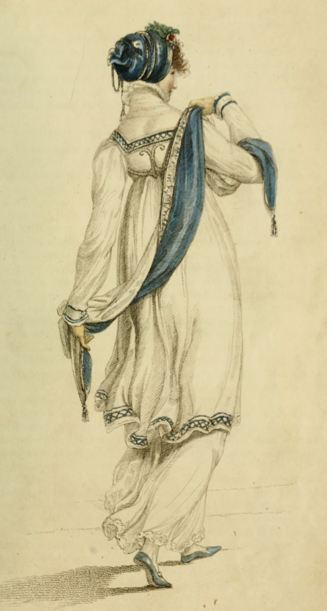
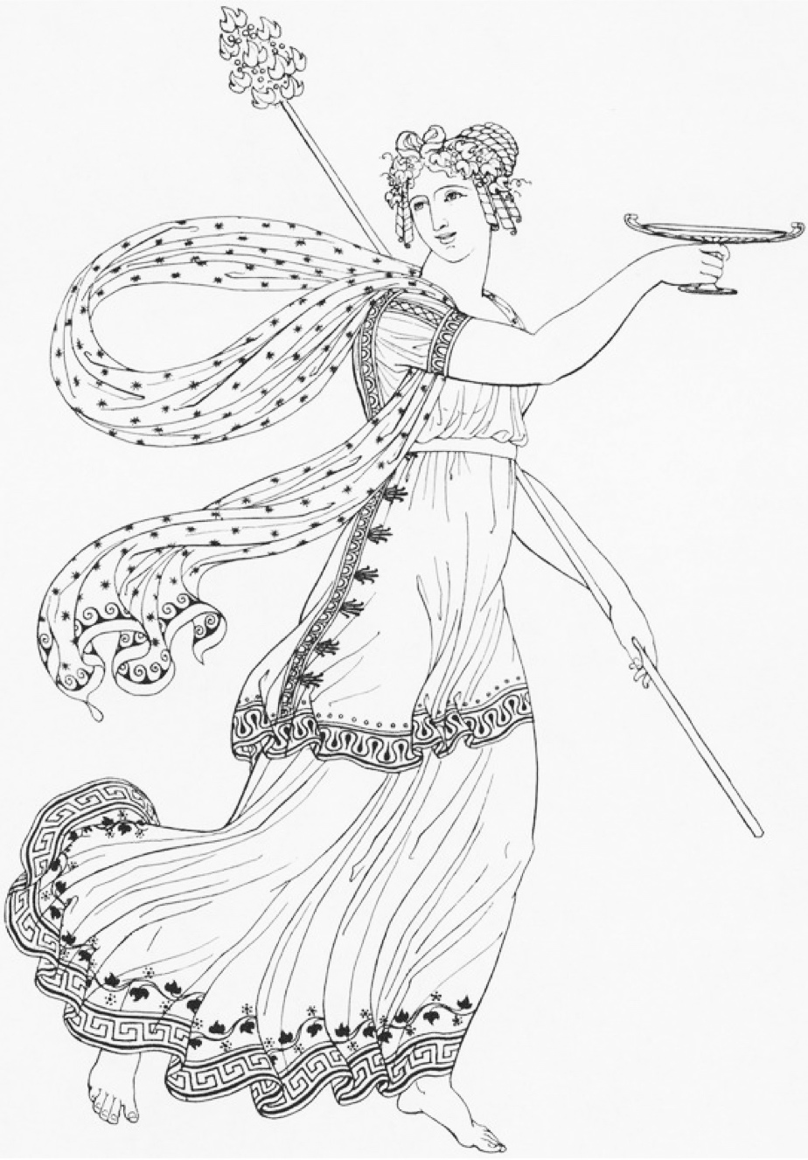
Ackermann, Walking Dress, April 1809
Thomas Hope, Ancient Costumes, 1809
Notes:
“first book in England which dealt with classical dress and one which the artist admitted was no scholarly; it was a work, stated Hope, that aimed not to advance erudition but only to promote taste. Intended for artists, theatre designers, and for members of the general public

Slide 45
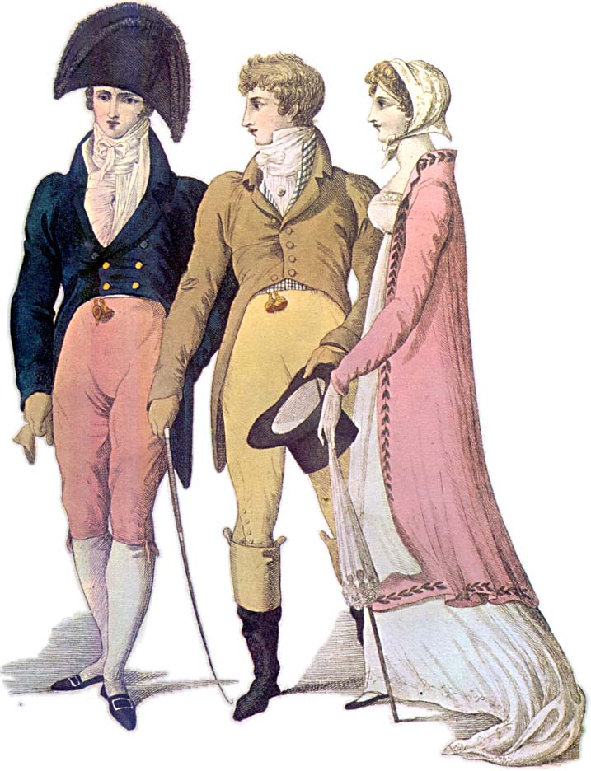
Notes:
1809 – cutaway, swallow-tail, classical statues – the nude male vs. the draped female

Slide 46
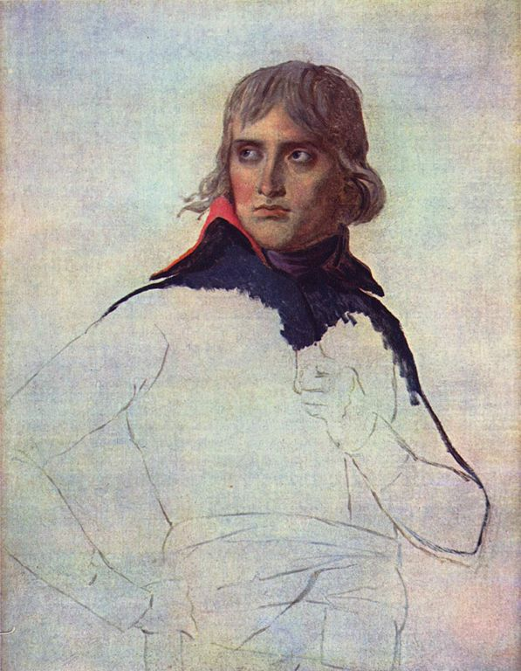
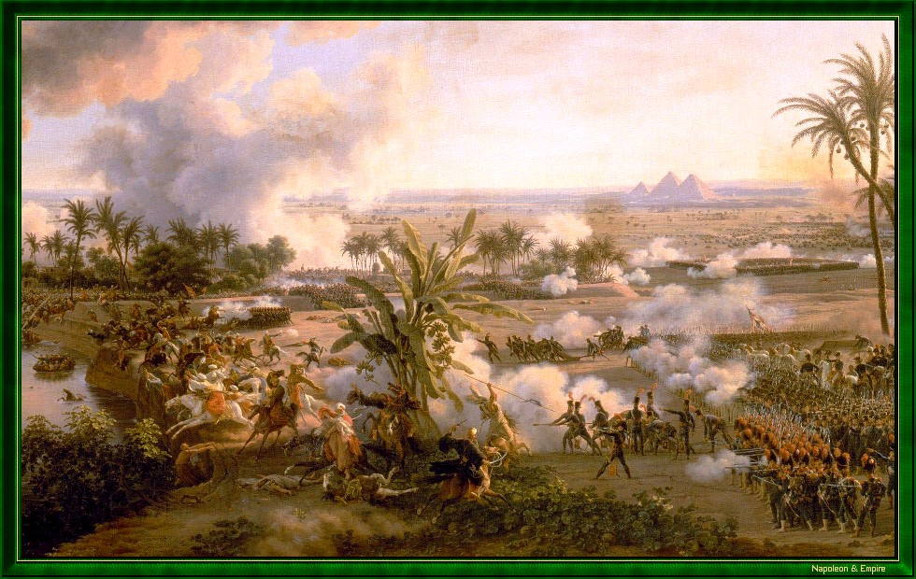
Battle of the Pyramids (Embabeh), July 21,1798

Slide 47
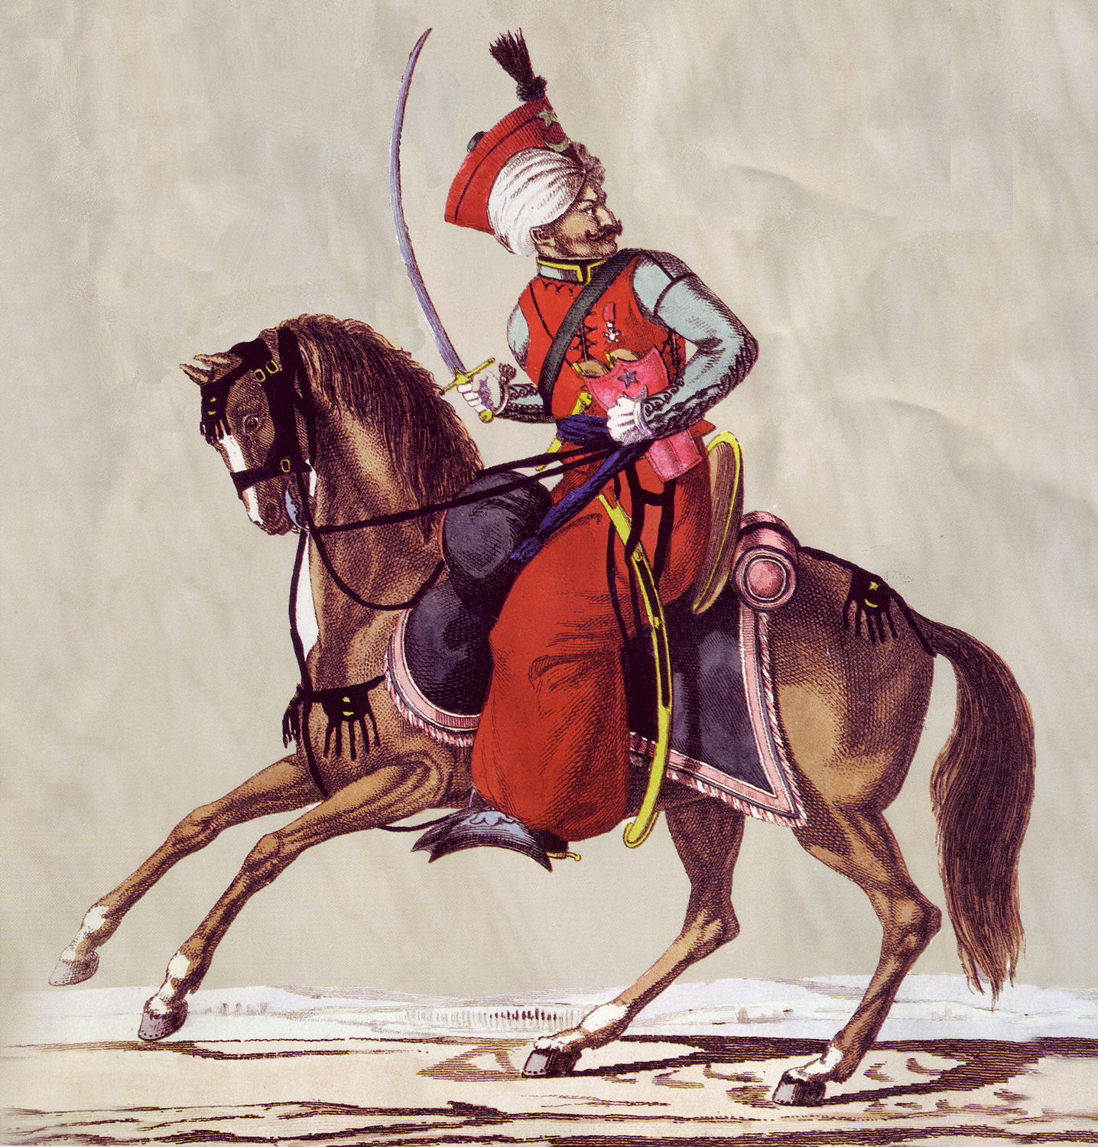
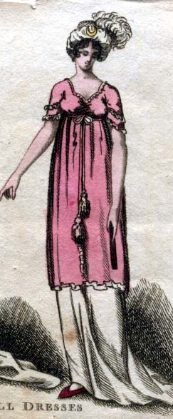
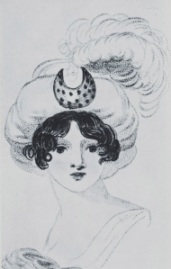
8 January 1799:
“I am not to wear my white satin cap to-night, after all; I am to wear a mamalone [mameluke] cap instead…It is all the fashion now; worn at the opera, and by Lady Mildmays at Hackwood balls.”
Notes:
Warrior caste in Egypt defeated by Napoleon at the Battle of the Pyramids, 1798 “On July 1, 1798, Napoleon landed in Egypt with 400 ships and 54,000 men and proceeded to invade the country, as he had recently invaded Italy. But this Egyptian invasion was to be different. For, in addition to soldiers and sailors, Napoleon brought along 150 savants — scientists, engineers and scholars whose responsibility was to capture, not Egyptian soil, but Egyptian culture and history.” The ladies picked up the turban almost immediately.
In former ages it seemed requisite that every lady should cut out her garments by a certain erect standard. ..But in our days, an English woman has the extensive privilege of arraying herself in whatever garb may best suit her figure or her fancy. The fashions of every nation and of every era are open to her choice. One day she may appear as the Egyptian Cleopatra, then a Grecian Helen; next morning the Roman Cornelia; or, if these styles be too august for her taste, there are Sylphs, Goddesses, Nymphs of every region, in earth or air, ready to lend her their wardrobe.
Mirror of Graces, 1811 (p. 52)

Slide 48
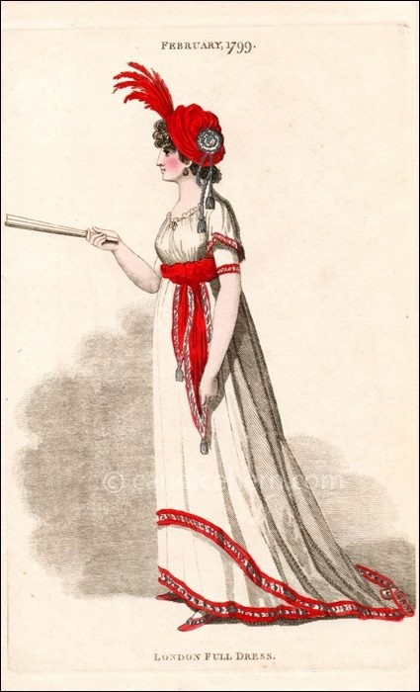
“Egyptian” gown with coquelicott trim,
February 1799
(From Candace Hern’s collection)
Notes:
Mirror of Graces, 1811 (p. 52)

Slide 49

Ackermann, March 1809
Ladies Walking Dress:
Polish cap, pelisse of silver grey cloth…
Notes:
In former ages it seemed requisite that every lady should cut out her garments by a certain erect standard. ..But in our days, an English woman has the extensive privilege of arraying herself in whatever garb may best suit her figure or her fancy. The fashions of every nation and of every era are open to her choice. One day she may appear as the Egyptian Cleopatra, then a Grecian Helen; next morning the Roman Cornelia; or, if these styles be too august for her taste, there are Sylphs, Goddesses, Nymphs of every region, in earth or air, ready to lend her their wardrobe.

Slide 50

Ackermann, March 1809
Opera Dress:
“Henry VIII hat of purple velvet trimmed with pearls…dress of the same…white satin Spanish mantle…”

Slide 51

Ackermann, July 1809
Promenade Dress:
“A round high frock of fine French cambric…
trimmed with a fine Vandyke lace…
Tyrolese cloak…
Venetian binding…
hair dressed in Grecian style…
veil à la Maltese…
parasol with white Chinese awning (fringe)
Gloves, Limerick or York tan.”

Slide 52

Ackermann, 1809
French
Roman
Venetian
Tyrolese
Andalusian
Spanish
Chinese
à la Maltese
Henry VIII
Vandyke
Polish
Brussels/Mecklin
Egyptian
Russian
Indian muslin
à l’antique
à la militaire
Turkish
Danish
India muslin
à la Hussar

Slide 53


William Dawe, Princess Charlotte, 1817 (wearing a sarafan)
Notes:
June 1814 “take care of yourself and do not be trampled to death in running after the emperor [Tsar Alexander I]

Slide 54


Edridge, Captain Hoste, 1811
1807
Notes:
And she had brothers in the Navy
Captain Hoste 1811 by Edridge. Sailor’s trousers
People in park, 1807. The young man shows nautical influence - adopts the Navy uniform look.

Slide 55


Edridge, Sir William Harbord, 1810
Notes:
Remember: England was at war for almost all of Austen’s life.
Sir William Harbord, 1810 by Edridge, The other major influence on men’s fashion: military pantaloons – wool knit to cling and stretch.

Slide 56

The Prince of Wales’ Own Uniform
Notes:
Brummel – Prince Regent’s regiment – consulted on uniform: The 10th Royal Hussars (Prince of Wales's Own) was a cavalry regiment of the British Army from 1715 to 1969.

Slide 57


Slide 58


Notes:
1805 Dighton caricature – blue superfine (wool) coat, pantaloons,

Slide 59

“…a true India muslin...”

Slide 60

James Crompton, Spinning mule, 1770s
Claude Berthollet, liquid bleach, 1780s
Charles Taylor, 1788 “calico…bleached white, printed in permanent colours, having undergone all these operations in less than 48 hours

Slide 61


Agostino Brunias, c. 1780 “Linen Day, Roseau, Dominica”
Marie Antoinette’s “chemise dress” Portrait by Elisabeth Louise Vigée-LeBrun, 1783, dress by Rose Bertin
Notes:
Globalization of textile manufacture: raw cotton from the Americas, muslin/mull from India dyed white with indigo from the West Indies, then turned into a gown by Marie Antoinette’s dressmaker Rose Bertin, adopted shortly thereafter by Georgiana, Duchess of Devonshire (1784). The impact of Georgiana's revolutionary trip to the concert and the association of the chemise with Marie Antoinette and the West Indies complicate less nuanced accounts.

Slide 62
Practical Matters
Notes:
What did they actually wear – what did it look like – how did it evolve?

Slide 63

9 January 1796
“You say nothing of the silk stockings; I flatter myself, therefore, that Charles has not purchased any, as I cannot very well afford to pay for them…”
14 January 1796
“What a good-for-nothing-fellow Charles is to bespeak the stockings—I hope he will be too hot all the rest of his life for it.”

Slide 64

25 November 1798
“The Overton Scotchman [a peddler carrying fabric for sale door to door] has been kind enough to rid me of some of my money, in exchange for six shifts and four pair of stockings. The Irish [linen] is not so fine as I would like it; ... It cost me 3s. 6d. per yard. It is rather finer, however, than our last, and not so harsh a cloth.”
Notes:
“six shifts” i.e. enough fabric to make them, not ready made.
21 shillings for Emma = about $95 in 2011 so 3s 6d is about $14/yd.
20 shillings in a pound, 12 pence in a shilling
Dr. Eric Nye - http://uwacadweb.uwyo.edu/numimage/currency%20conversion.htm “A Method for Determining Historical Monetary Values”
La Belle Assemblée, Feb 1806, p. 15:
The Ladies Toilette, or Encyclopedia of Beauty
Of cleanliness--…A careful attention to the person, frequent ablutions, linen always white, which never betrays the inevitable effect of perspiration and of dust; a skin always smooth and brilliant, garments not soiled by any stain, and which might be taken for the garments of a nymph; a shoe which seems never to have touched the ground; this it is what constitutes cleanliness. To this might likewise be added a scrupulous care to avoid every thing that can indicate functions which undeceive the imagination.

Slide 65

Austen, Thursday, 1 September 1796:
“We are very busy making Edward’s shirts, and I am proud to say that I am the neatest worker of the party.”
Notes:
While many people had their clothing made by tailors (men’s clothing but also women’s riding habits) or modistes/dressmakers, people often made or at least trimmed and finished, their own. But shirts and shifts were usually made by the women in the family. The cut was simple and extremely economical, using all the width of the linen. The “workbasket” was always to hand with shirts/shifts to be sewn. And when staying with friends one could always bring a work-bag for smaller needlework projects.

Slide 66

Notes:
Or for a slightly more interesting view of a well made shirt…

Slide 67


Notes:
Rowlandson, 1800, “Exhibition Stair Case” at Somerset House leading to the gallery of the Royal Academy of Art (pres. Sir Joshua Reynolds)

Slide 68


Early 1790s
Notes:
1790

Slide 69

Notes:
Corset and stockings, two layers of linen, channels of baleen or cord, single spiral laced, busk (thin wooden stick about 1-2”wide – great for posture)

Slide 70

F.P. Gérard, Madame Recamier, 1805
Notes:
Shows some sign of support

Slide 71

Notes:
1818 Cruickshank
“Dammit I really believe I must take off my cravat or I shall never get my trwosers on…”
“Pon honour Tom, you are a charming figure! You’ll captivate the girsl to a nicety!!”
“Do you think so Charles? I shall look more the thing when I get my other calf on.”
“Dear me, this is hardley stiff enough. I wish I had another sheet of foolscap.”
“You’ll find some to spare in my breeches.”

Slide 72


“six inches deep in mud”
Notes:
Unlike the ornate petticoats of the earlier 18th cent, turn of- and early 19th century petticoats were sometimes meant to be seen, sometimes not. Portrait-1804?

Slide 73

Rolinda Sharples “The Cloak Room at the Assembly Rooms at Clifton”1818
Notes:
Rolinda Sharples “The Cloak Room at the Assembly Rooms at Clifton”1818: Sharples shows examples of all mens options. The older gentleman on the left wears grey/light silk breeches, the army men are in their uniforms with pantaloons, the thirty-something husband in the middle wears black breeches while the young flirt wears trousers. Also note the impossibly tiny bodices on the women’s gowns. For more on Clifton Assembly see http://www.thespasdirectory.com/profilego.asp?ref=2841393B

Slide 74
1774-1817
A fashion timeline
1775-1790: Formal, stiff, wide, natural waist
1789-1799: High waists and muslins, light but very full
1800-1808: Greek and Roman, narrowing, vertical
1809-1814: vertical continues with defined line, “Gothic,” “Spanish,” “Polish,” “Russian” “Tudor/Elizabethan”
1815-1818: More trim top and bottom, wider hem
1820s: Waistlines drop, shoulders and skirts go wide
After 1828: vertical no more!
Notes:
covered one of the most tumultuous in fashion history.
Talk about volume – where’s the bulge – fashion silhouettes morph from vertical to horizontal to vertical and back, with an occasional foray into bustles.

Slide 75
Fashion detectives
Slow Seeing
Notes:
Norah Waugh: The Cut of Women’s Clothes. Also “Corsets and Crinolines”
Janet Arnold
Nancy Bradfield: Costume in Detail
The Dress Detective: A Practical Guide to Object-Based Research in Fashion
Nov 19, 2015 by Ingrid Mida and Alexandra Kim

Slide 76
Hat
Shape, Proportion, Decoration
Neckline
“V” or Closed, Rounded, Square, Filled in
Elbow/Sleeve
Short/Elbow/Long, Straight/Puffed, Gloves
Hemline
Train, Narrow, Wider, Plain/Trimmed
Accessories
Shawl, Cloak, Muff

Slide 77

1790s: Soft round hats, big hair, big feathers
Notes:
When Austen was writing her early novels this is what she was seeing and wearing.
And note: when Henry Tilney imaginary journal article: “wore my sprigged muslin robe with blue trimmings—plain black shoes—appeared to much advantage”

Slide 78



2 June 1799
“My cloak is come home & here follows the pattern of its lace.”

Slide 79

1800: big feather but small hair, narrower silhouette
Austen, Wednesday, 18 December 1798:
“I believe I shall make my new gown like my robe, but the back of the latter is all in a piece with the tail, and will seven yards enable me to copy it in that respect?”

Slide 80


1800-1808: tall and narrow, less fabric, trains
Notes:
Still lots of fabric gathered at waist but the silhouette is definitely vertical, the greek column ideal
1) 1800-artstor-AMICO_CLARK_103902762
1) 1800-artstor-pinkback-AMICO_CLARK_103902764

Slide 81


Notes:
Fashion plates emphasize the vertical by making women into giantesses.

Slide 82


1809-10: Trains hang on in evening dress
Evening Full Dress, Ackermann, January 1809
Notes:
Ackermann, Jan. 1809: White satin Spanish hat, diamond loop, Spanish plume, diamond ear-rings and necklace…lace medicis around the back, antique stomacher ornamented with diamons mounted in gold
La Belle Assemblée, Dec. 1810

Slide 83

Ackermann, March 1809, Harding , Howell, & Co., 89 Pall Mall
24 May 1813
I went the day before (Friday) to Layton's as I proposed, and got my mother's gown, — seven yards at 6s. 6d.

Slide 84


1812: Emphasis shifting to bodice
Ackermann, April, 1812
Ackermann, December, 1812
Notes:
By 1813 the emphasis is shifting to the bodice. The vertical line disappears from the skirt and the bodice gets the eye-catching trim
1) Ackermann, April, 1812
2) Ackermann, Dec. 1812

Slide 85

13 September 1813
I learnt from Mrs. Tickars's young lady, to my high amusement, that the stays now are not made to force the bosom up at all; that was a very unbecoming, unnatural fashion. I was really glad to hear that they are not to be so much off the shoulders as they were.
Ackermann, September 1813

Slide 86

Wednesday, 9 March 1814
I wear my gauze gown to-day, long sleeves and all. I shall see how they succeed, but as yet I have no reason to suppose long sleeves are allowable.
Ackermann, April 1814

Slide 87
2 September 1814
I am amused by the present style of female dress;—the coloured petticoats with braces over the white Spencers & enormous Bonnets upon the full stretch, are quite entertaining. It seems to me a more marked change than one has seen lately…Petticoats short, & generally, tho’ not always, flounced.
(sending news of the London fashions to Martha Lloyd in Bath)

Slide 88


Ackermann, August 1814
Ackermann, October 1814
Notes:
2 September 1814
I am amused by the present style of female dress;—the coloured petticoats with braces over the white Spencers & enormous Bonnets upon the full stretch, are quite entertaining. It seems to me a more marked change than one has seen lately…Petticoats short, & generally, tho’ not always, flounced.

Slide 89

Austen’s actual pelisse? 1812-1814
18 April 1811:
“Our pelisses are 17s. each; she charges only 8s. for the making, but the buttons seem expensive, — are expensive, I might have said, for the fact is plain enough.”
Notes:
Ackermann, March 1809

Slide 90


“A woman can never be too fine when she is all in white.”
Edmund to Fanny, Mansfield Park
1815
1815
Notes:
1815-1820 – the move to decorated bodice and hem
1) Ackermann, July 1815
2) Ackermann, June 1815

Slide 91


Ackermann, November 1817
Met Museum, c. 1820, American

Slide 92

29 May 1817 (To Frances Tilson)
“You will find Captain —— a very respectable, well-meaning man, without much manner, his wife and sister all good humour and obligingness, and I hope (since the fashion allows it) with rather longer petticoats than last year.”
Notes:
of silk, showing the richness of detail that became the hallmark of pelisses at this time.

Slide 93

Notes:
1830s – super horizontal, bodice and skirt. Even the hair is horizontal. This shape will be toned down in the 1840s with sleeves narrowing but once the crinoline comes into fashion skirts will attain crazy widths but retain the 1830s bell shape

Slide 94




Austen, Thursday, 20 November 1800:
“Miss Debary, Susan, and Sally, all in black, but without any statues, made their appearance…”
Notes:
1819, 1810, 1816. Women in mourning were typically depicted draped over urns, statues, tombstones…The broach is a piece of hair jewelry – the weeping willow is made of hair. There were several royal deaths in the years after Austen’s death so fashion magazines provided suitable clothing.

Slide 95

Court Dress (After 1821)
The former Regent, now George IV, mercifully lifted the requirements enforced by his mother Queen Charlotte who had decreed that hoops must be worn at court appearances regardless of the fashion for high-waisted gowns.
Notes:
Court dress – specific rules about number of feathers, decoration, etc. Extremely expensive.

Slide 96


Court Dress: 1800-1821
This is the style Sir William Lucas would have seen at court.
Notes:
Court dress: Unfortunately the rules about hoop width did not change before waists went up!

Slide 97




1790s
Early 1800s
1815
Notes:
Norah Waugh: The Cut of Women’s Clothes. Also “Corsets and Crinolines”
Janet Arnold
Nancy Bradfield: Costume in Detail
The Dress Detective: A Practical Guide to Object-Based Research in Fashion
Nov 19, 2015 by Ingrid Mida and Alexandra Kim

Slide 98



1790s
Early 1800s
1815

Slide 99




1790s
Early 1800s
1815

Slide 100



1790s
Early 1800s
1815

Slide 101


Slide 102






c.1800-03
1770s
1796
1797
1811
1813
1815
1817
Notes:
The gowns her parents generation would have worn
The gowns she would have worn at 20, and that the characters in her early novels would have worn when she first created them.
The gowns she would have worn and seen when living at Bath,
The gowns she would have seen around 1810, then 1812-13.
The pelisse style she might have worn in 1815.
The gowns that women would have been wearing at the time of her death.

Slide 103



1796
1809
1815
Notes:
Her visit was November 13, 1815

