Slide 1
Edward, Lord Brabourne, ed. Letters of Jane Austen. 1884
“…I might very well have left out all those parts of her letters which refer to the details of dress and the descriptions of her gowns and other raiment…I am, however, of a contrary opinion; …to alter or omit the apparently insignificant parts of a large picture may have a prejudicial effect upon the whole. Besides, it is something in the nature of a comfort to ordinary persons to find that so superior a being as Jane Austen concerned herself about such trifles as the fit of a gown or the colour of a stocking, and I am glad to be in a position to afford the slightest comfort to anybody.”
Notes:
In a society based on rank, clothes as an indicator of rank have to shift subtly. You keep up with the latest fashions, the latest dances, and the latest news, not just to be trendy or edgy but to ensure that your rank is recognized. Your deportment, manners and speech all mark you as acceptable into society.

Slide 2
Envisioning:
Jane Austen and Fashion
Hope Greenberg

Slide 3
The Novels
Characters who talk about fashion.
Characters who are described by their fashion.
Fascinating anomalies.
Notes:
How do we see the novels? How did Austen see her characters? How did her readers see them?
one area where Austin’s economy of language is so visible is in talking of fashion.
What kinds of characters talk about fashion?
Who is described in terms of their clothing?
And when is this not so?

Slide 4
Jane Austen
How did she use fashion in her novels?
How fashion conscious was she, personally?
What did men and women (“of good society”) wear during Austen’s lifetime?
How did fashion change over the course of her life?
Notes:
There are a number of questions we can consider when looking at clothing in Jane Austen’s time.
Personally: in her letters
Of course – how did it change – her life aligns with one of the most revolutionary periods in fashion history.

Slide 5
But first…
Notes:
Clothing and fashion are mentioned rarely but when they are it is “never irrelevantly” Thompson
So let’s try a little test.
Can you identify the character from either these descriptions or this speech.

Slide 6
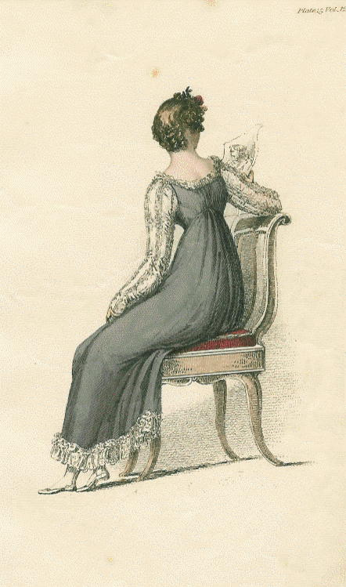
“long sleeves” (for evening wear)
Notes:
1814

Slide 7
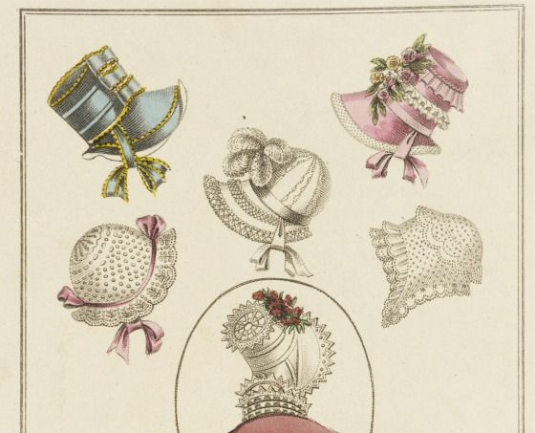
“’There now, you are going to laugh at me too. But why should not I wear pink ribands ? I do not care if it is the Doctor's favourite colour…My cousins have been so plaguing me!’' She had wandered away to a subject on which ______ had nothing to say, ...”
Notes:
1804: Promenade in Kensington Gardens

Slide 8
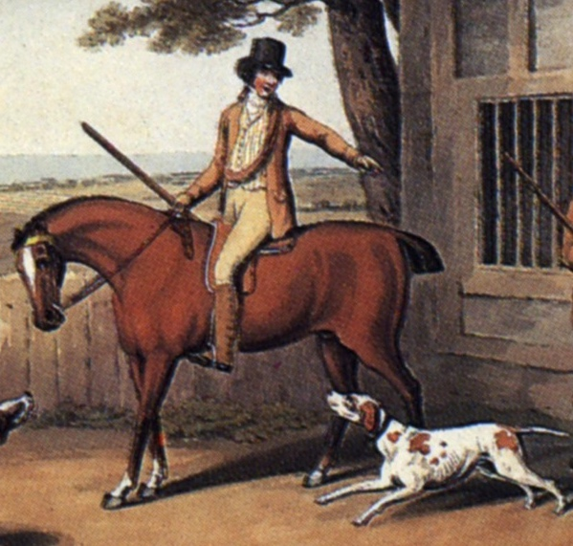
“His name was good, his residence was in their favourite village, and she soon found out that of all manly dresses a shooting jacket was the most becoming. Her imagination was busy…”
Notes:
Awareness of shooting jacket—the country life attire influence. This picture is a bit deceptive as regards the quote. The rider would have walked to go shooting with the object to bring back birds. If hunting (hunting=fox hunting), they would have been riding. If they were hunting on foot, and it was not their property or they did not have permission of the property owner, they might have been arrested for poaching.

Slide 9
“I wish you would tell Sally to mend a great slit in my worked muslin gown before they are packed ...”

Slide 10
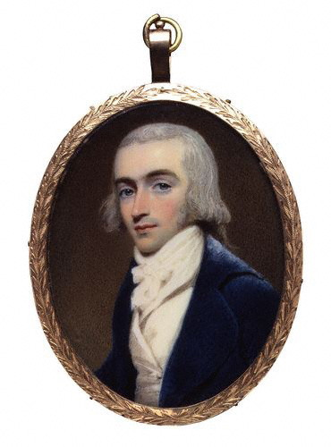
“good-looking and gentlemanlike; he had a pleasant countenance, and easy, unaffected manners.”
Notes:
1800 Robert Fellows, philanthropist, by Edridge

Slide 11
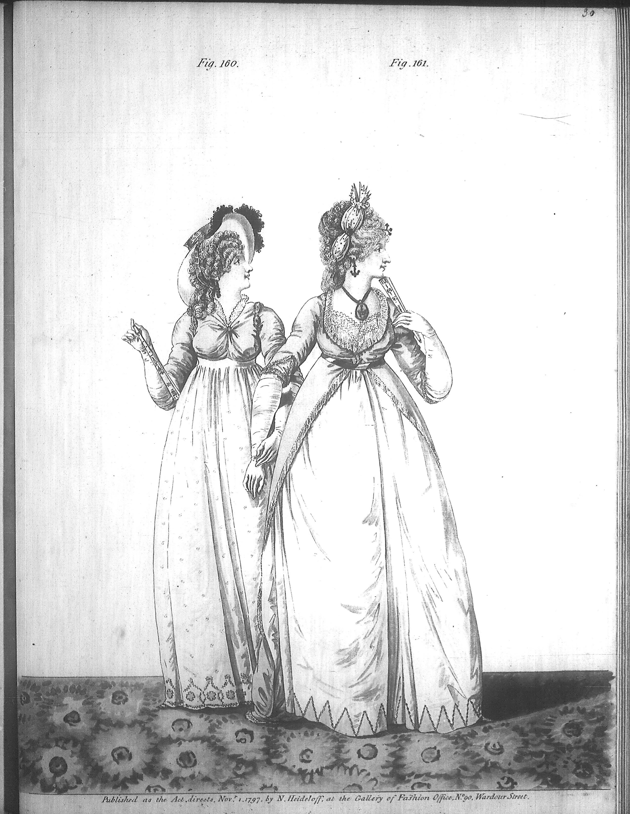
“Their appearance was by no means ungenteel or unfashionable; their dress was very smart, their manners very civil.”
Notes:
Smart elegant: compare to Northanger Abbey where Eleanor is described as “elegant”

Slide 12
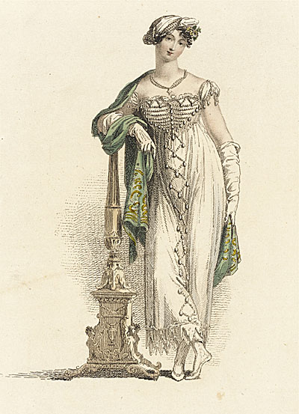
“as elegant as lace and pearls could make her”
Notes:
“

Slide 13
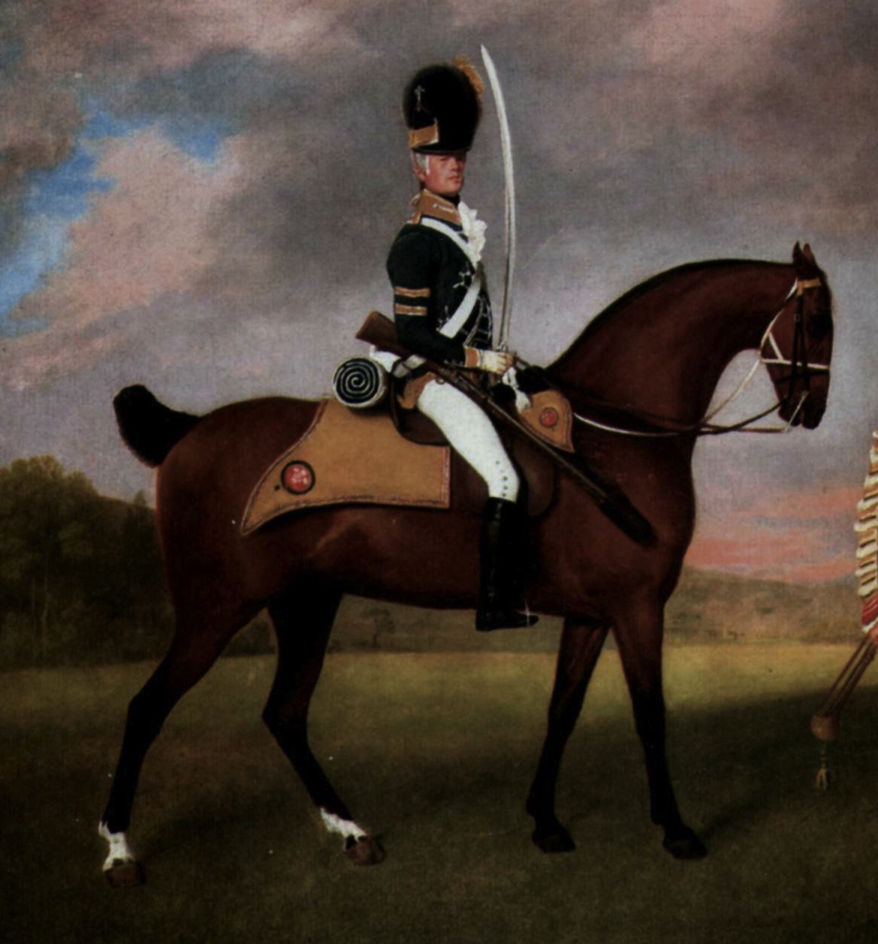
“wanted only regimentals to make him completely charming”

Slide 14
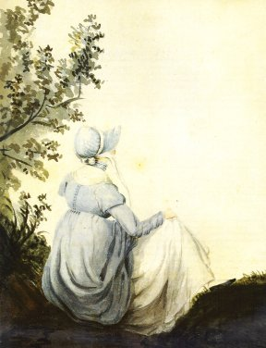
I hope you saw her petticoat, six inches deep in mud, I am absolutely certain; and the gown which had been let down to hide it not doing its office."

Slide 15
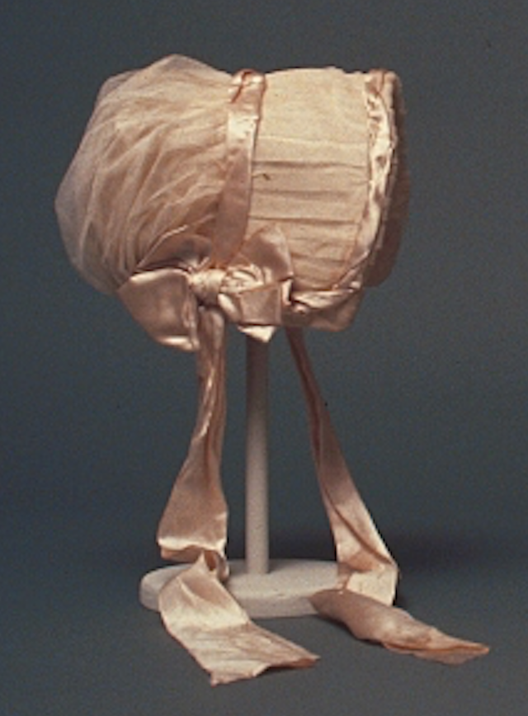
Is she out?
Notes:
A girl not out, has always the same sort of dress : a close bonnet, for instance ; looks very demure, and never says a word. You may smile, but it is so,

Slide 16
“One could not hope to conduct himself or herself properly on entering a room without immediately assigning a rank to every person.”
Richard Bushman
Notes:
In a society based on rank, clothes as an indicator of rank have to shift subtly. You keep up with the latest fashions, the latest dances, and the latest news, not just to be trendy or edgy but to ensure that your rank is recognized. Your deportment, manners and speech all mark you as acceptable into society.

Slide 17
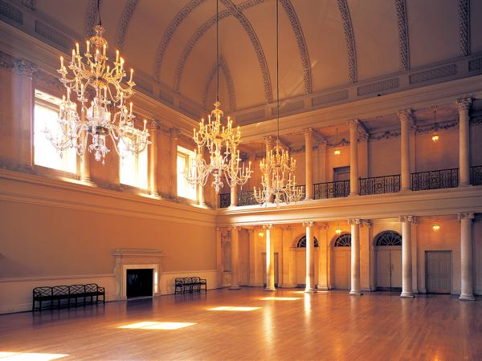
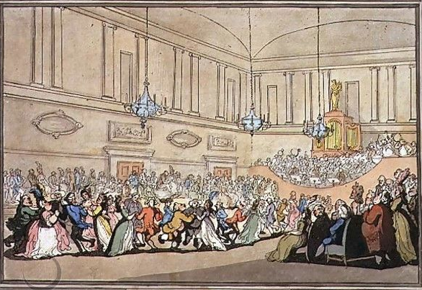
Notes:
The Assembly Rooms, Northanger Abbey

Slide 18
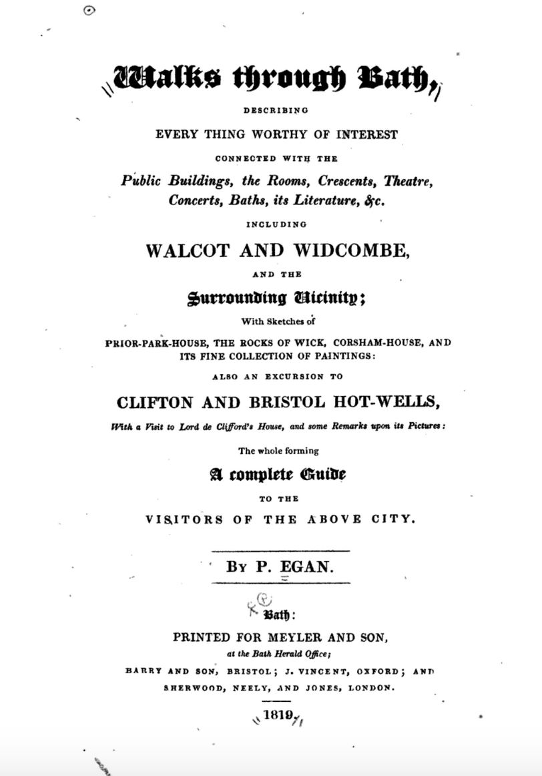
Notes:
Pierce Egan, Walks Through Bath, 1819
Here, salutary rules exclude all those Whom no one hears of,
and whom no one knows;
That no plebian breathings may infect An atmosphere at all times so select;
No bankers’ clerks these splendid realms invade;
No FOLKS who carry on a retail trade;
No actors by profession must appear To act their parts, or speak their speeches here;
Yet even here, amid the crowds you view,
’Tis sometimes difficult to tell WHO’S WHO.”

Slide 19
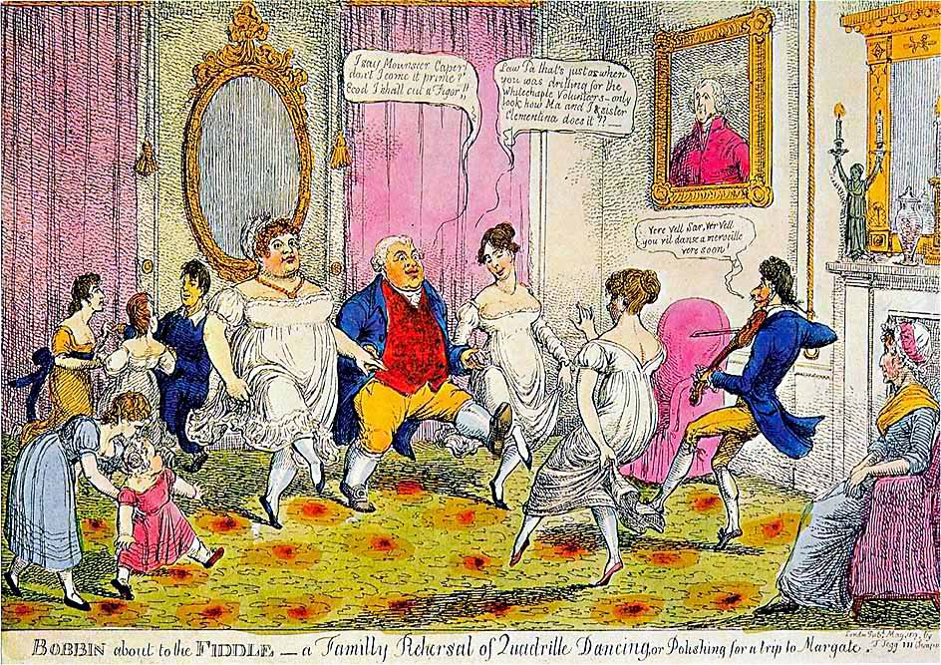
Notes:
“I say Monsouer Caper don’t I come it prime? Ecod I shall cut a figor!”
Law Pa that’s just as when you was drilling for the Whitechapel Volunteers. Only look at how Ma and I and sister Clementina does it.”
Ver vel sir, vere vel. You vil danse a merveileux ver soon.”
“The Season at Margate, for example, commenced on the King’s birthday, formally celebrated in June, and ended in late October, whereas Bath commanded the more fashionable months of October through May. The hours and pricing of the summer balls were usually different from those of the winter. ”
. “

Slide 20
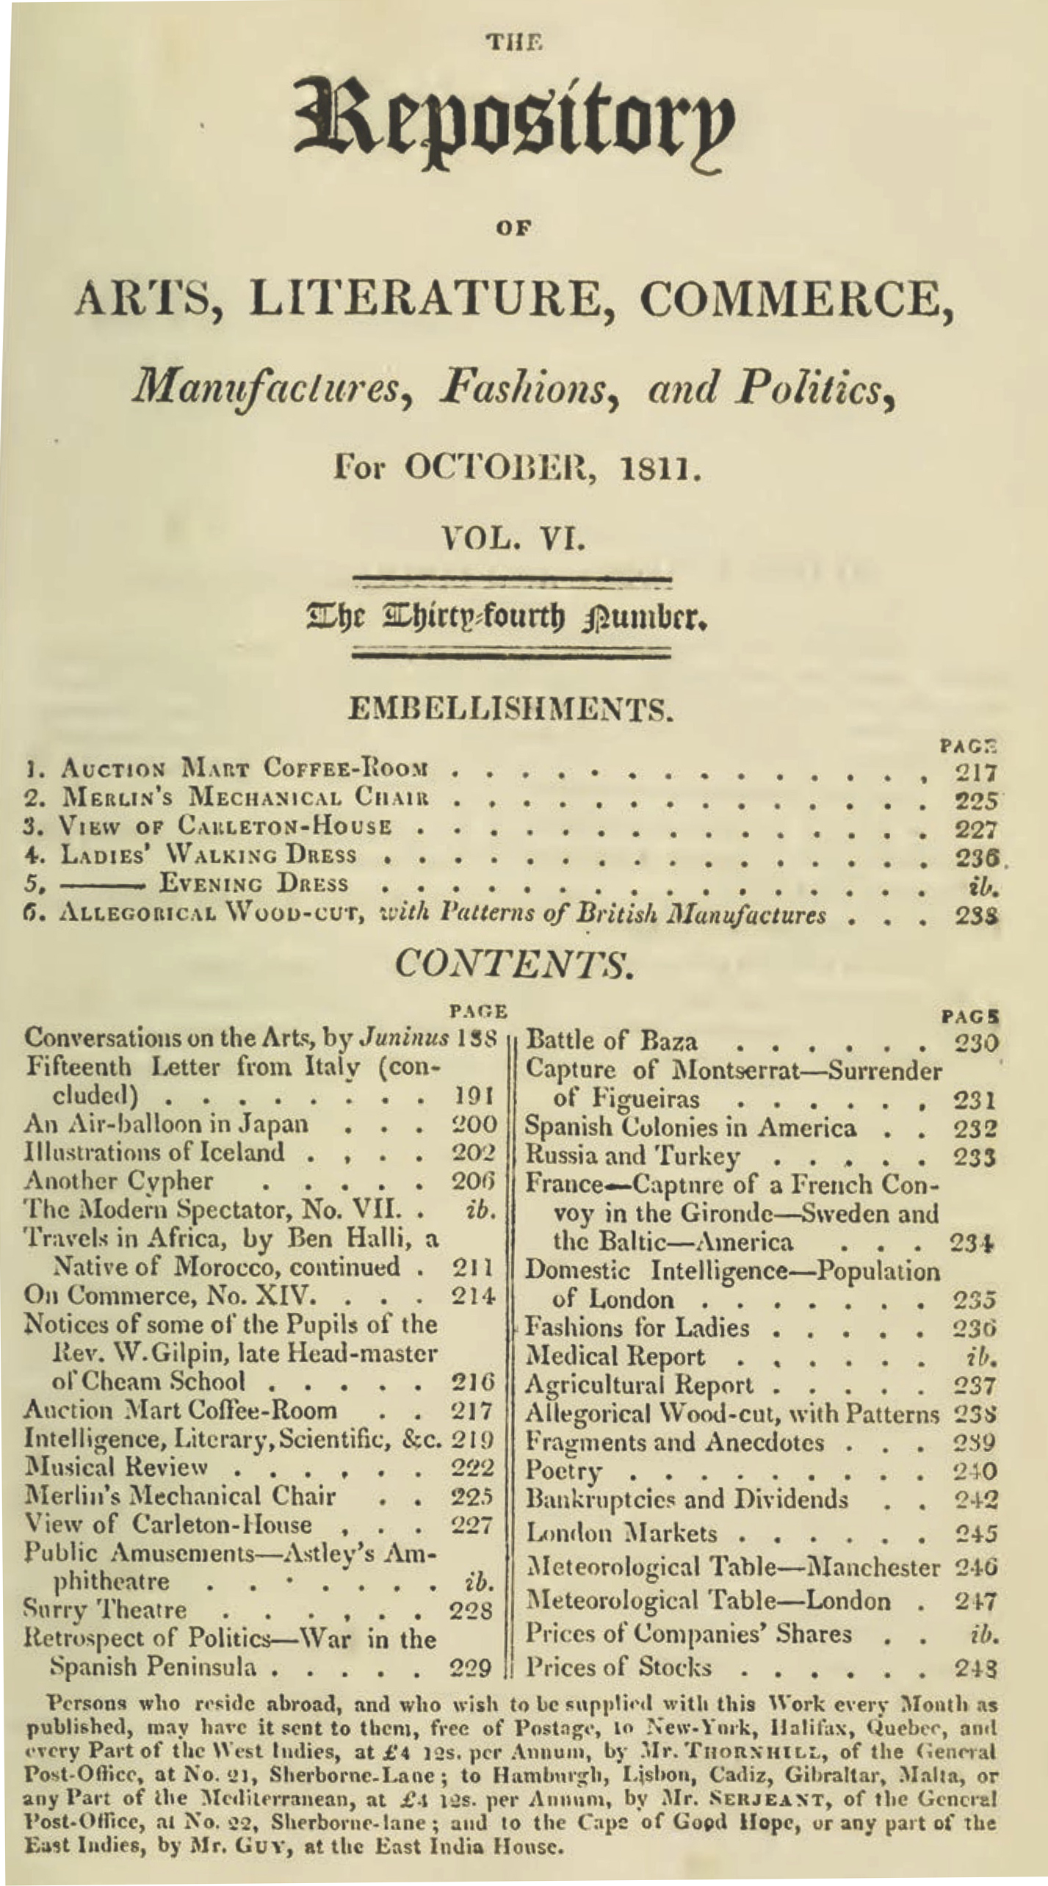
Ackermann’s Repository of the Arts. October 1811
Notes:
January 1809
to converse intelligently on a number of interesting topics. Ackermann’s included politics, music reviews, stock prices, lists of who had gone bankrupt, travel information, biographical information, poetry, images of furniture, obituaries of royalty and it even contained actual fabric samples pasted into every issue so you could see and touch before ordering.

Slide 21
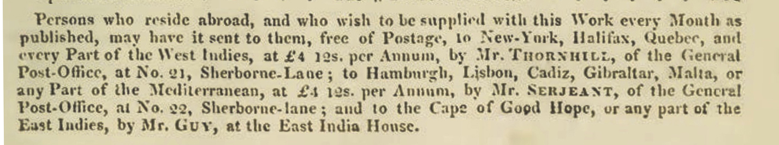
Ackermann’s Repository of the Arts. October 1811
Notes:
January 1809
to converse intelligently on a number of interesting topics. Ackermann’s included politics, music reviews, stock prices, lists of who had gone bankrupt, travel information, biographical information, poetry, images of furniture, obituaries of royalty and it even contained actual fabric samples pasted into every issue so you could see and touch before ordering.

Slide 22
The Novels
1795-1799 writing
“Elinor and Marianne”(Sense and Sensibility).
“First Impressions” (Pride and Prejudice).
“Susan/Catherine” (Northanger Abbey).
1811-1816 writing, revising, publishing
Pride and Prejudice.
Mansfield Park
Emma.
Persuasion, Northanger Abbey published 1817.
Notes:
We tend to think of this entire period as that of “high waists” but the details of fashions actually changed quite a bit. While writing her early works, Austen would have dressed differently than she would have while writing later works, and would have envisioned her characters differenty as well.

Slide 23
What did men wear?
Men’s basics from the outside in,
or, undressing Mr. Crawford.

Slide 24
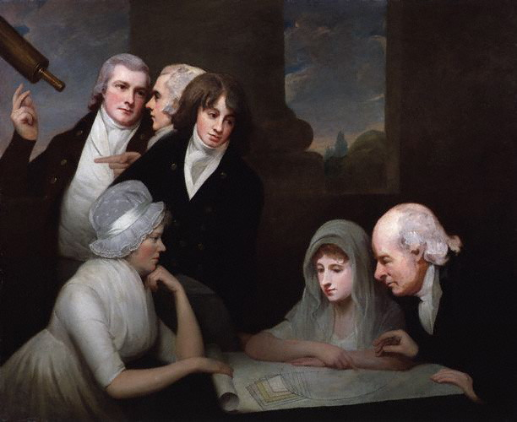
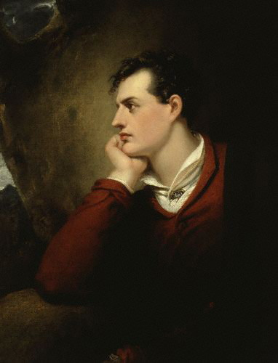
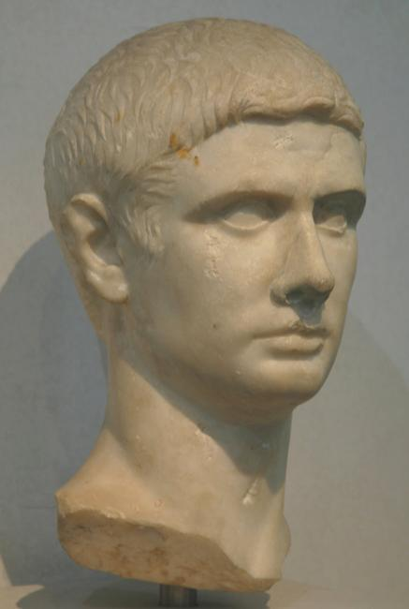
Hair
Notes:
1796 or so, after Pitt’s hairpowder tax of 1795, statue of Titus, Lord Byron. Style names “The Brutus” “The Windswept” “The Stanhope Crop”

Slide 25
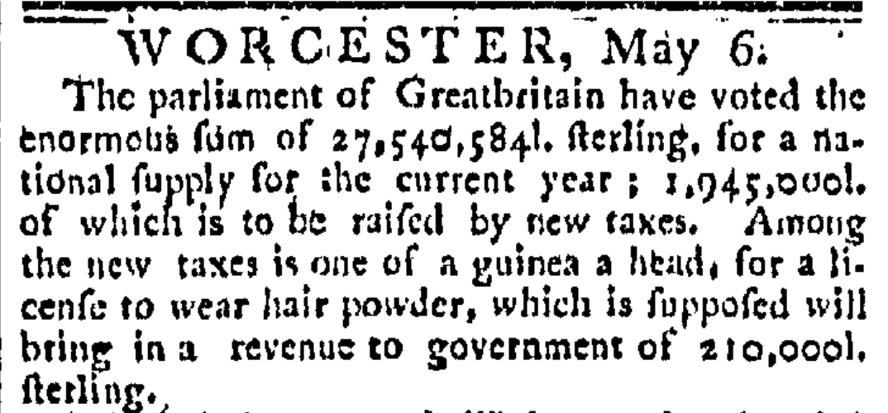
The Worcester GAZETTE. (Worcester, Massachusetts) • 05-06-1795
Notes:
News travels fast
The use of hair powder had been declining and the tax hastened its near death. In 1812 46,684 people still paid the tax, in 1855 only 997 did, and almost all of these were servants. By the time it was repealed in 1869 it yielded an annual revenue of £1000

Slide 26
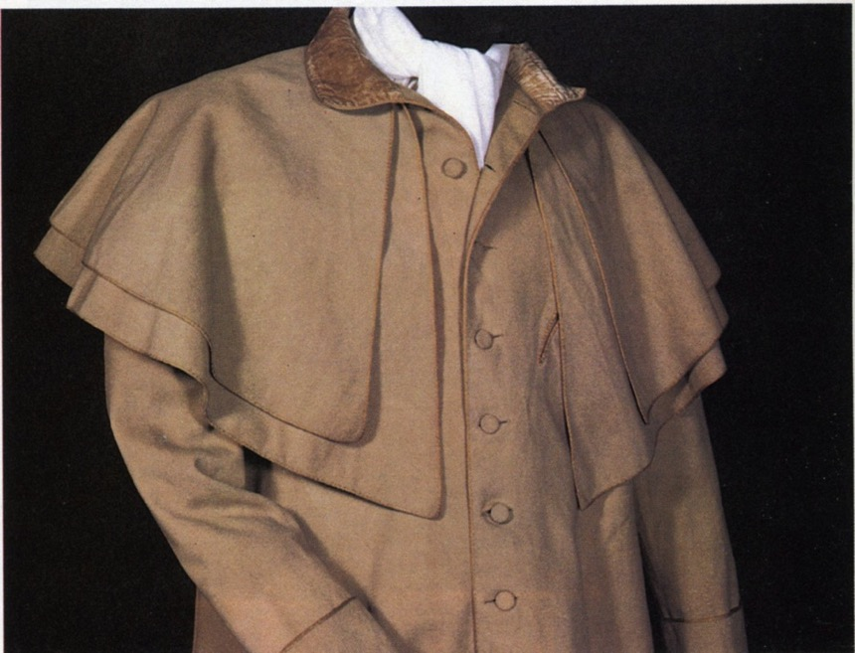
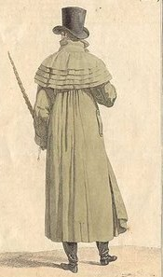
Catherine Morland of Henry Tilney: “His hat sat so well, and the innumerable capes of his great-coat looked so becomingly important. To be driven by him, next to being dancing with him, was certainly the greatest happiness in the world!”
Notes:
Henry can speak of fashion with impunity
A greatcoat was made of “cloth” which was a synonym for wool. The capes were originally designed to keep off rain but they quickly became a fashion statement as well, as Catherine notes with admiration.

Slide 27
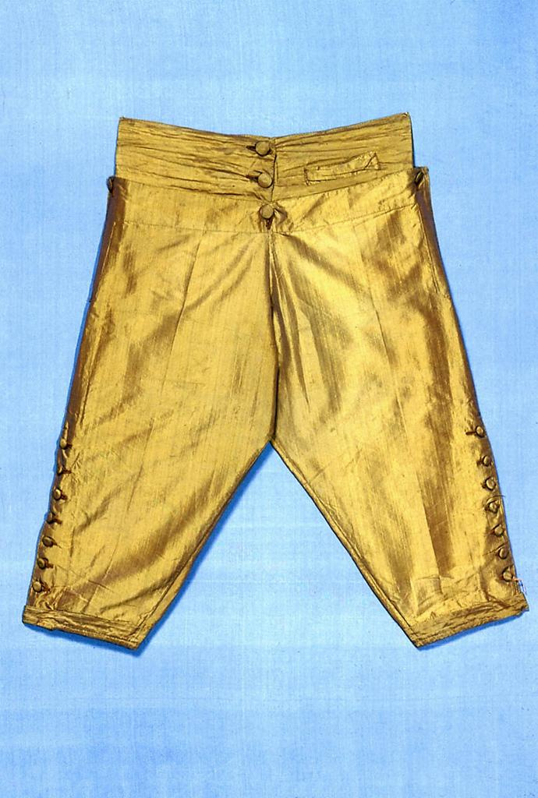
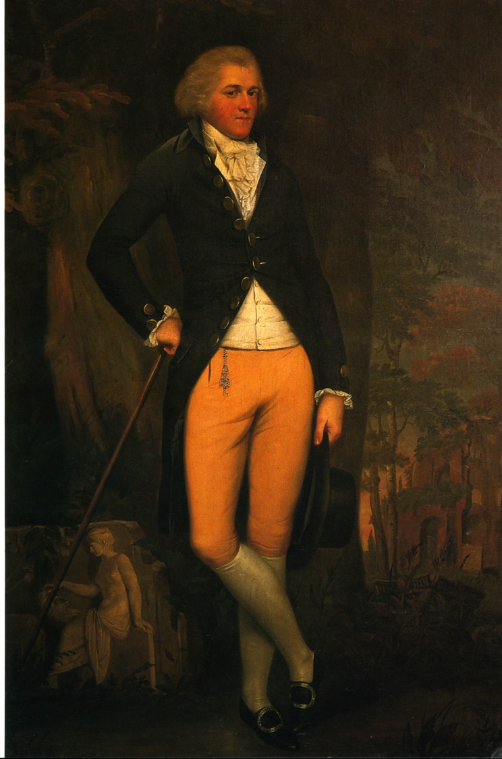
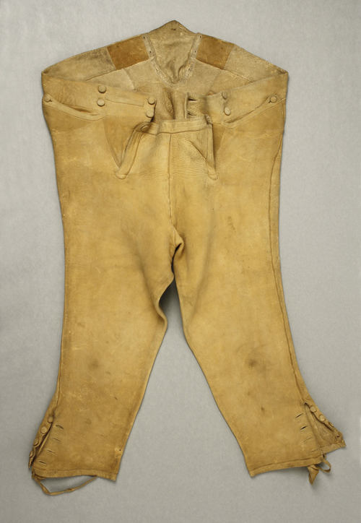
Notes:
Edward Austen Knight, grand tour, 1800. Breeches continued in popularity throughout Austen’s lifetime. By the 180ss they were beginning to be nudged out by pantaloons and trousers but hung on in the country or for formal wear. And they were never allowed into Almack’s in anything but knee breeches. There is a story, unconfirmed, that even the Duke of Wellington was turned away when he arrived in trousers. Another version has him turned away because he arrived after the official time allowed, midnight.

Slide 28
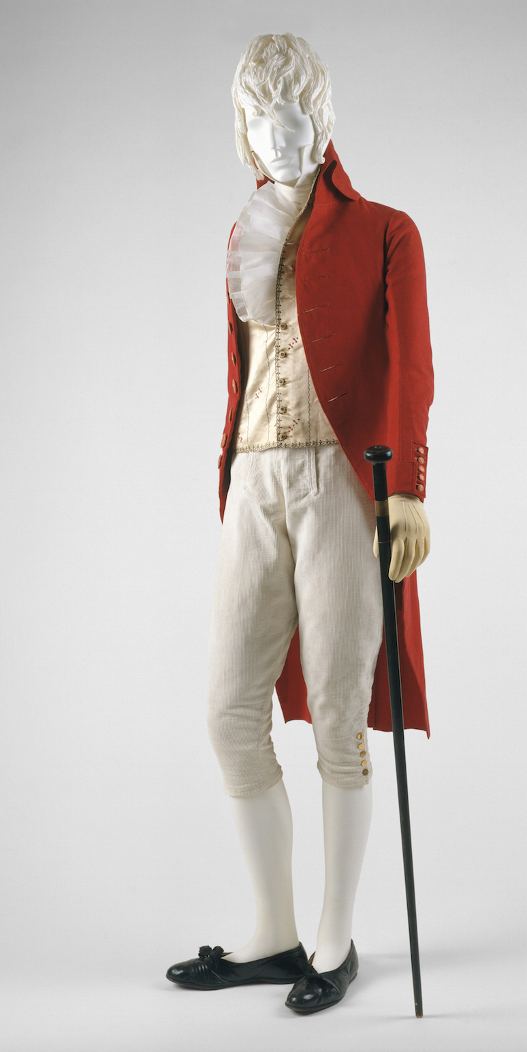
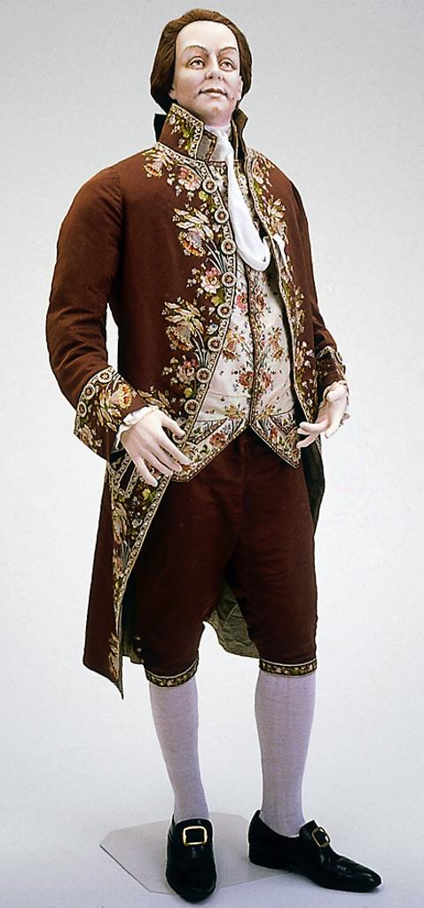
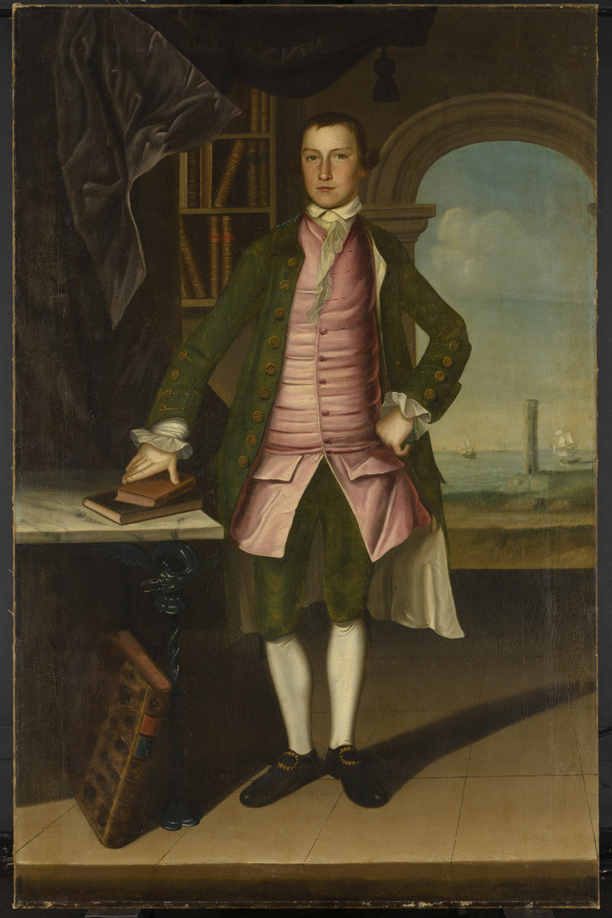
What did men wear?
1790s
1780s
1760s
.
Notes:
Those changed in shape and volume throughout the period. a waistcoat that would act as a body-shaping or posture garment he was considering the earlier example. When he talks about a new freedom of movement and ease at the end of the century it is more like the latter.

Slide 29
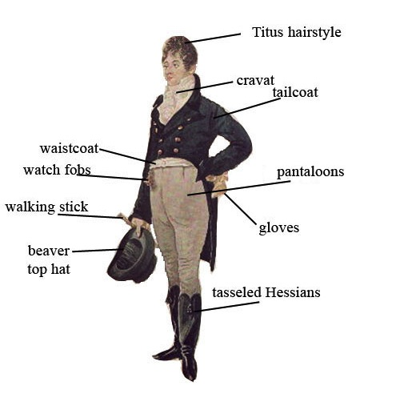
Notes:
1805 Dighton caricature – blue superfine (wool) coat, pantaloons,

Slide 30
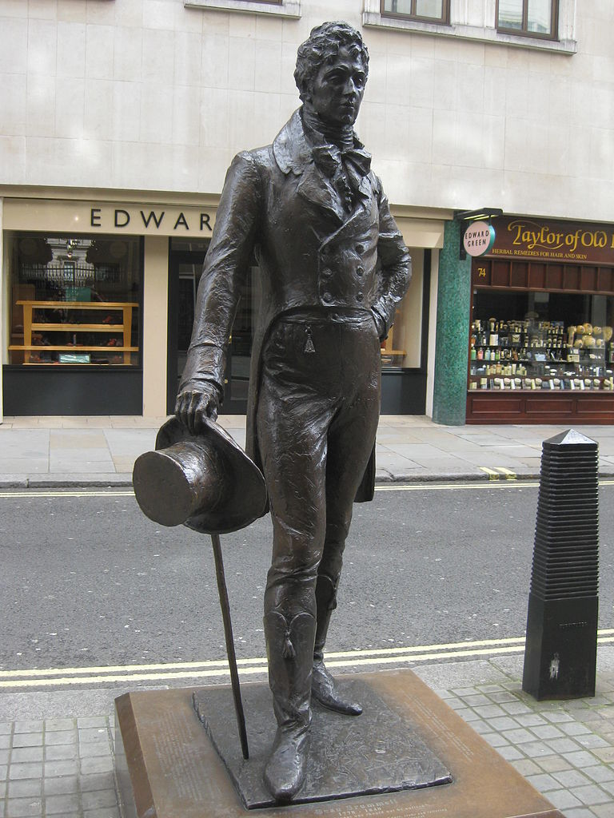
George Bryan “Beau” Brummel
Notes:
George Bryan “Beau” Brummell who almost singlehandedly changed fashion. Friend of the Prince Regent, made simple yet exquisitely tailored clothing the mode to be followed, notorious for demanding a full tub bath every day, and a perfectionist when it came to his cravats. see next slide
“If John Bull turns round to look at you, you are not well-dressed, but either too stiff, too tight, or too fashionable.” Letter to Hariette Wilson, quoted in “The Beaux of the Regency” Melville Lewis 1908.

Slide 31
Notes:
1809 – cutaway, swallow-tail, classical statues – the nude male vs. the draped female

Slide 32
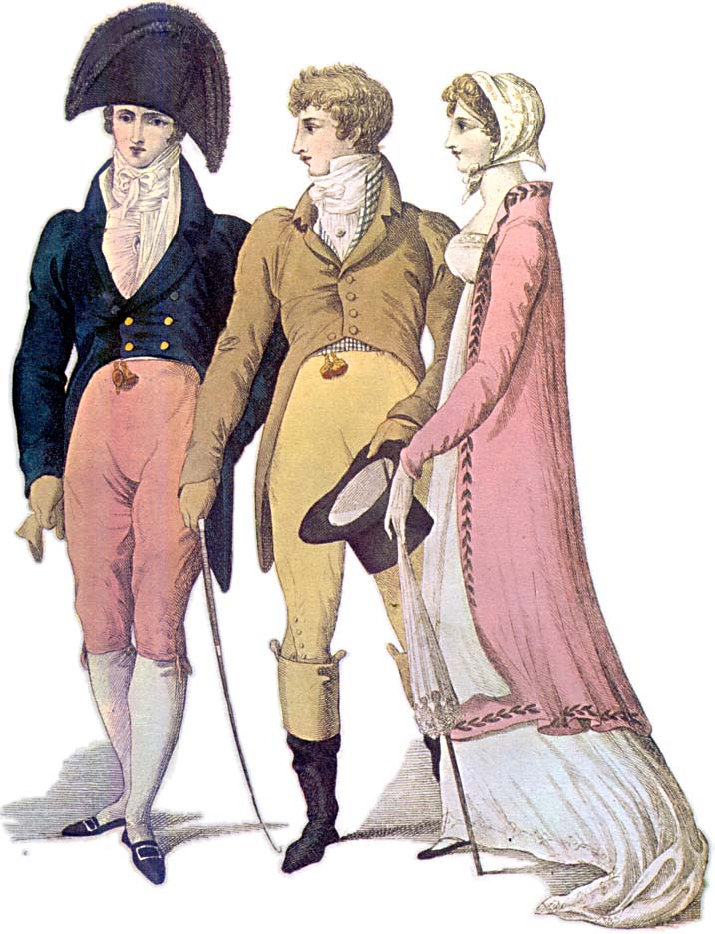
Notes:
1809 – cutaway, swallow-tail, classical statues – the nude male vs. the draped female

Slide 33
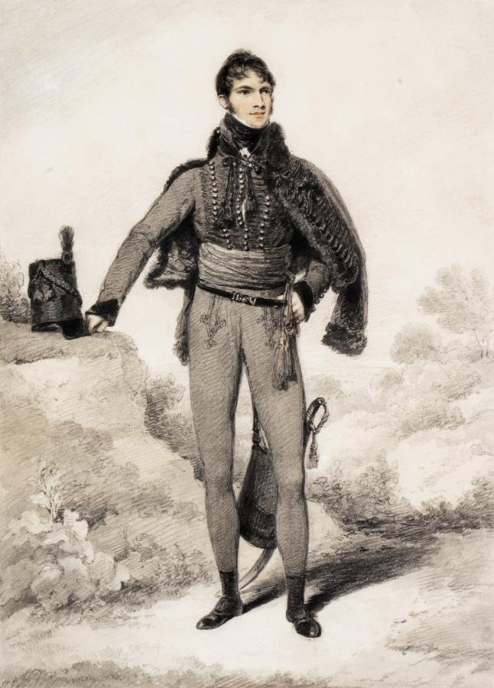
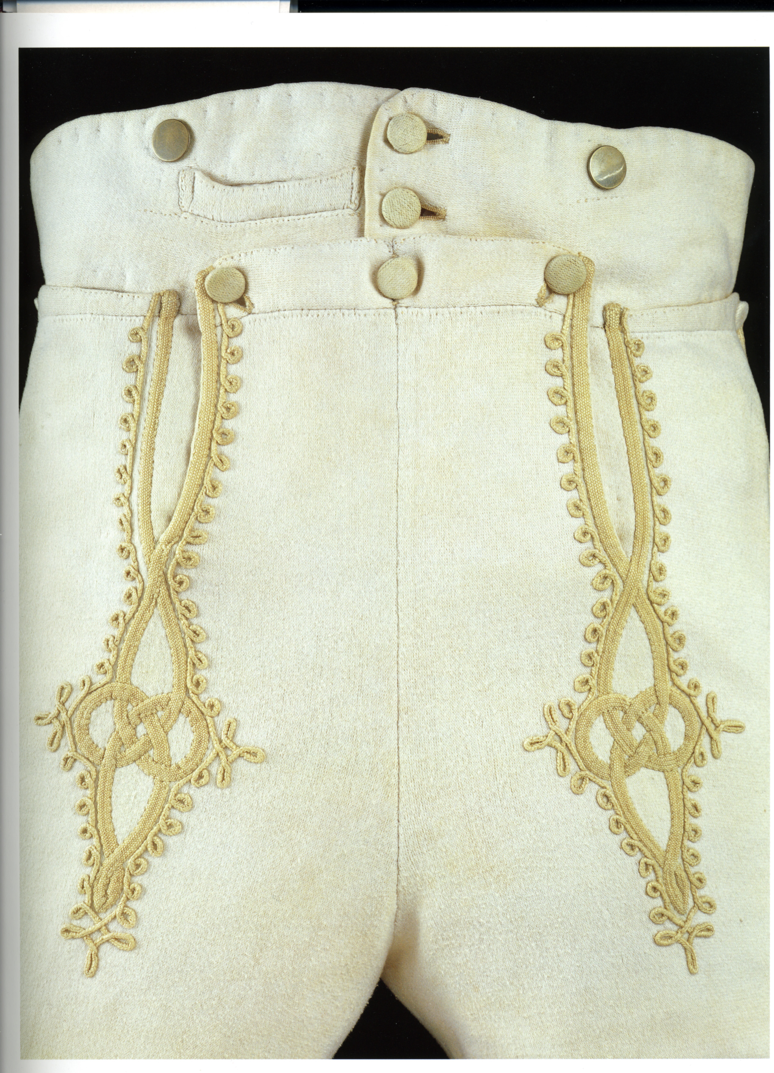
Notes:
Sir William Harbord, 1810 by Edridge, The other major influence on men’s fashion: military pantaloons – wool knit to cling and stretch.
Brummel – Prince Regent’s regiment – consulted on uniform: The 10th Royal Hussars (Prince of Wales's Own) was a cavalry regiment of the British Army from 1715 to 1969.

Slide 34
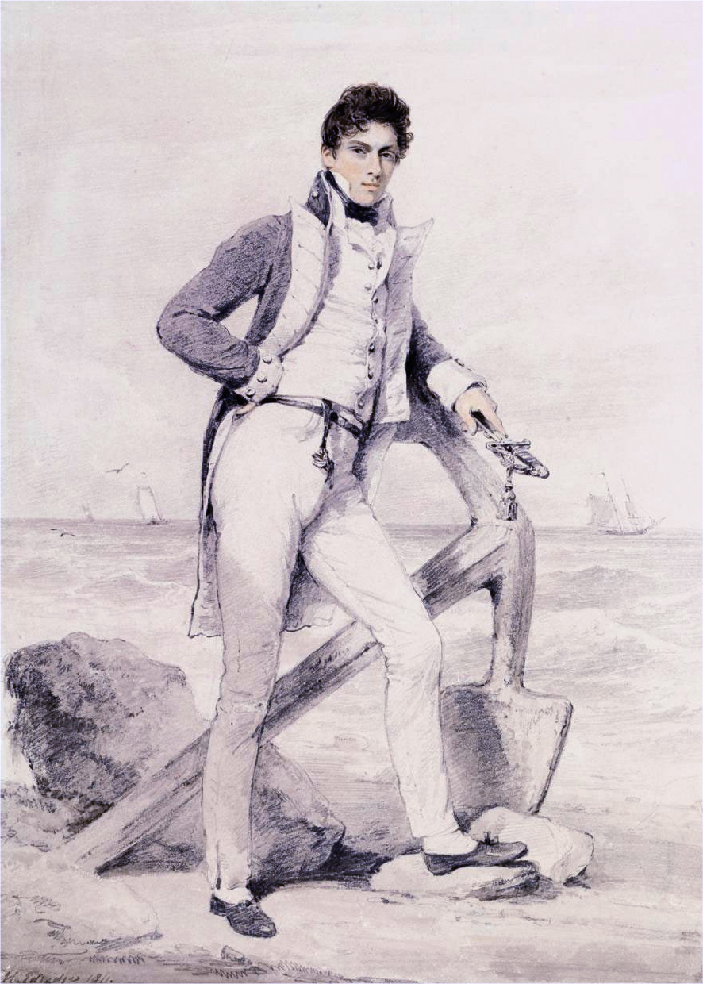
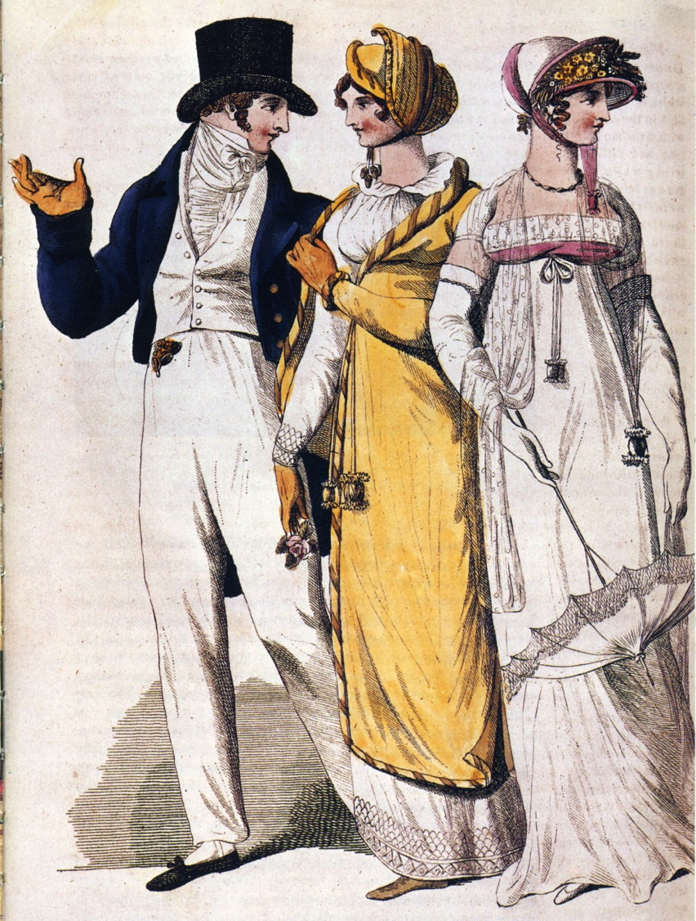
Notes:
Captain Hoste 1811 by Edridge. Sailor’s trousers
People in park, 1807. The young man adopts the Navy uniform look.

Slide 35
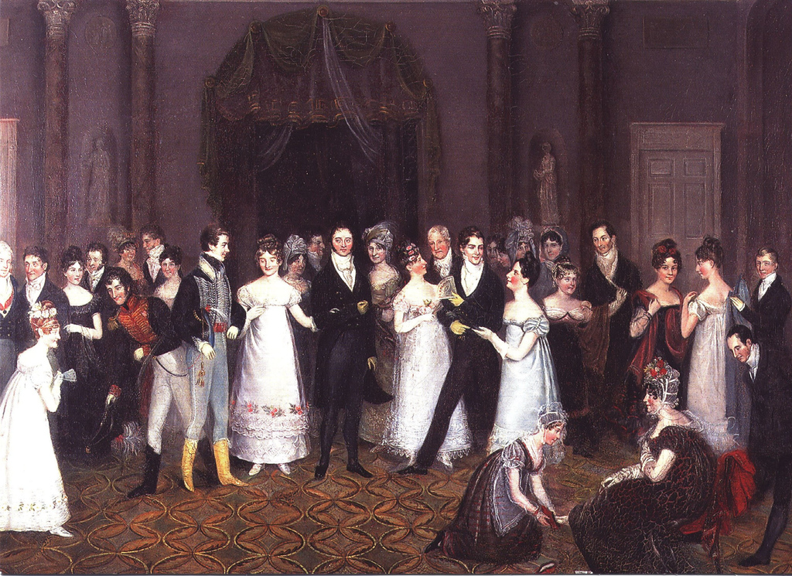
Notes:
Rolinda Sharples “The Cloak Room at the Assembly Rooms at Clifton”1818: Yolanda Shows examples of all mens options. The older gentleman on the left wears grey/light silk breeches, the armu men are in their uniforms with panataloons, the thirty-something husband in the middle wears black breeches while the young flirt wears trousers. Also note the impossibly tiny bodices on the women’s gowns. For more on Clifton Assembly see http://www.thespasdirectory.com/profilego.asp?ref=2841393B

Slide 36
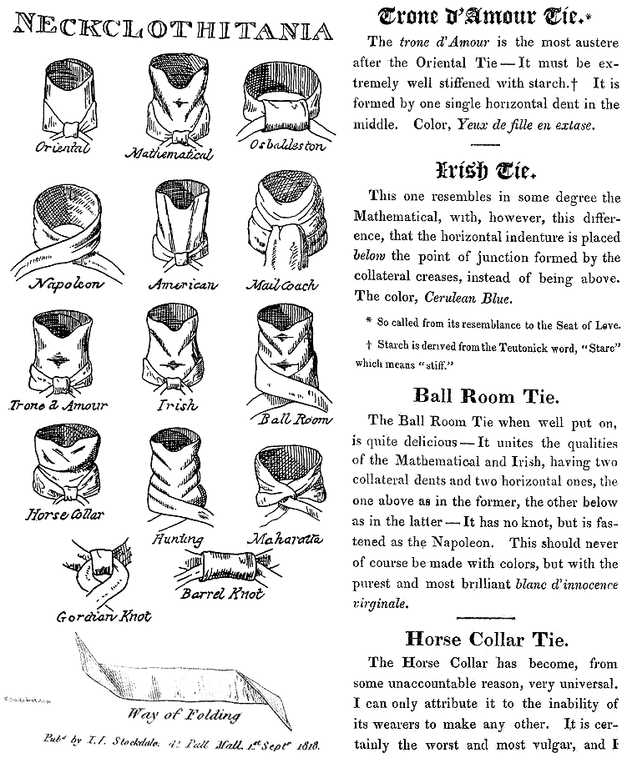
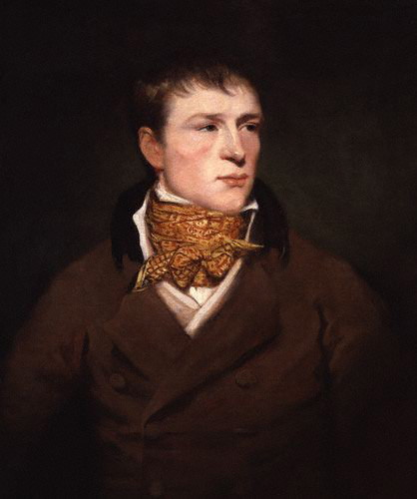
Jem Belcher:
Celebrated Boxer with his trademark spotted neckcloth
Notes:
Some neckcloth styles with fanciful names. The boxing star Jem Belcher with his trademark spotted neckcloth.

Slide 37
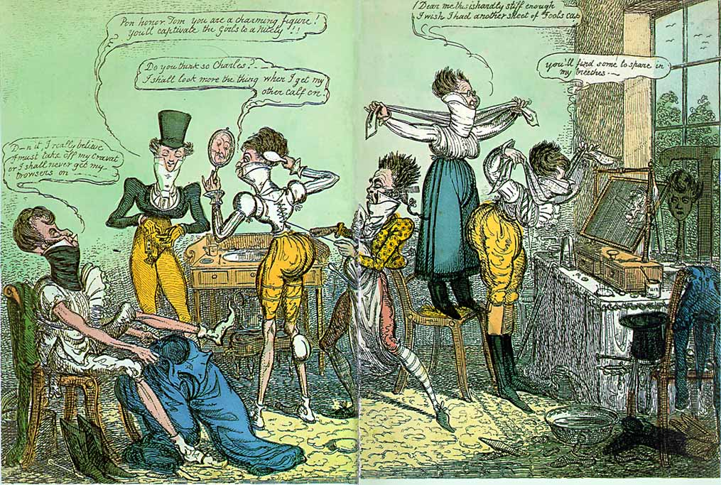
Notes:
1818 Cruickshank

Slide 38
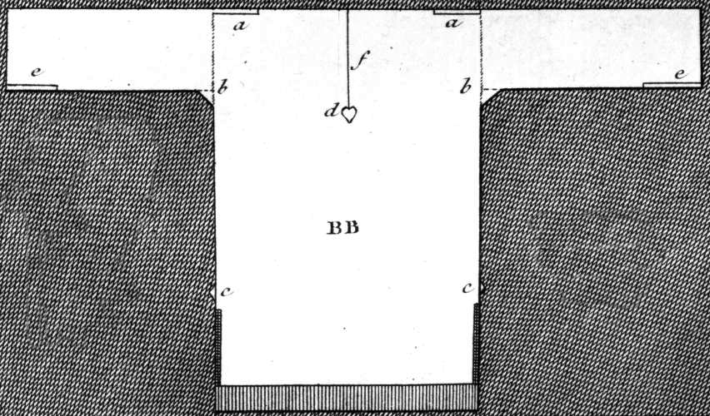
Austen, Thursday, 1 September 1796:
“We are very busy making Edward’s shirts, and I am proud to say that I am the neatest worker of the party.”
Notes:
While many people had their clothing made by tailors (men’s clothing but also women’s riding habits) or modistes/dressmakers, people often made or at least trimmed and finished, their own. But shirts and shifts were usually made by the women in the family. The cut was simple and extremely economical, using all the width of the linen. The “workbasket” was always to hand with shirts/shifts to be sewn.

Slide 39
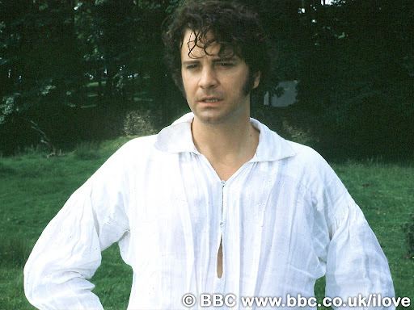
Notes:
Or for a slightly more interesting view of a well made shirt…

Slide 40
Dressing a Lady

Slide 41
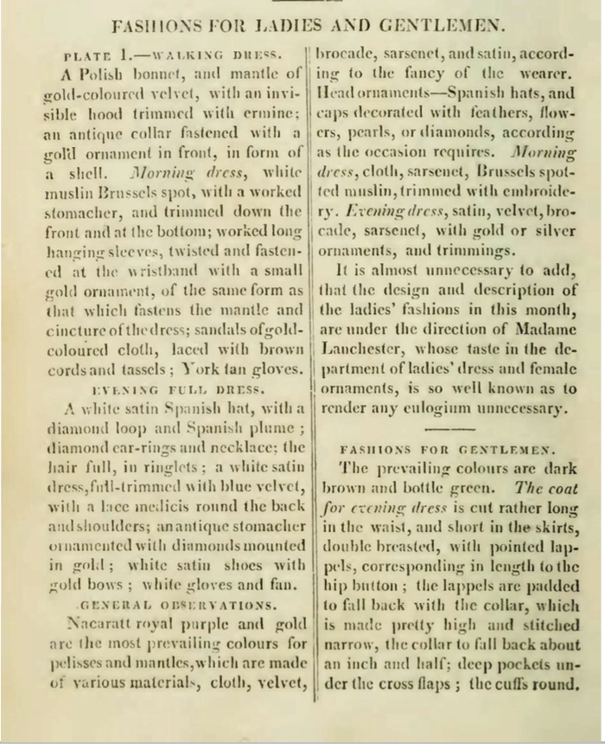
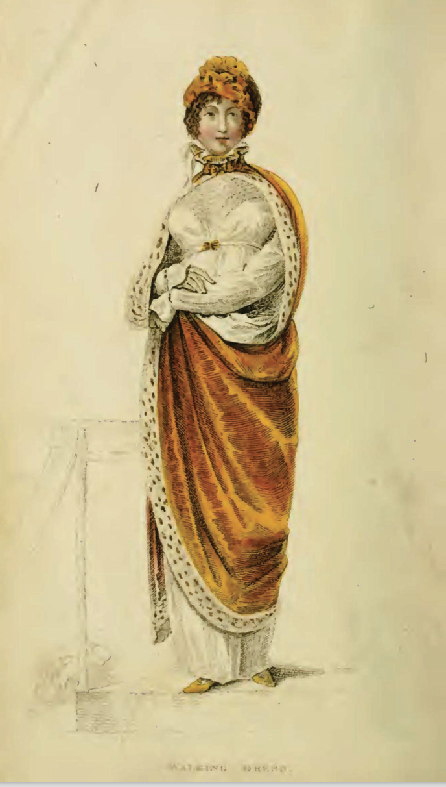
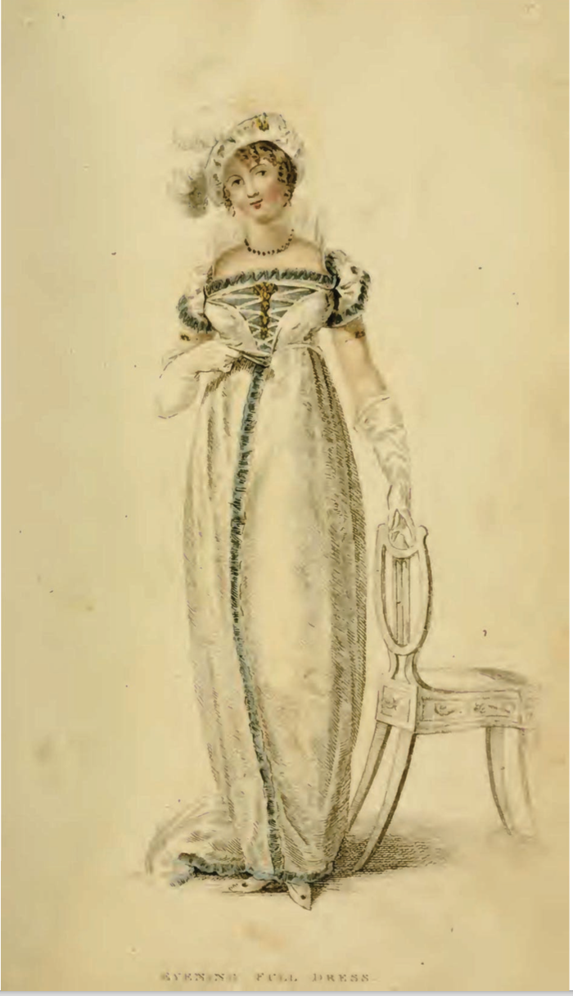
Ackermann’s Repository of the Arts. January 1809
Notes:
January 1809
EXPLAIN morning dress, afternoon or promenade, evening/full/ball dress “look”

Slide 42
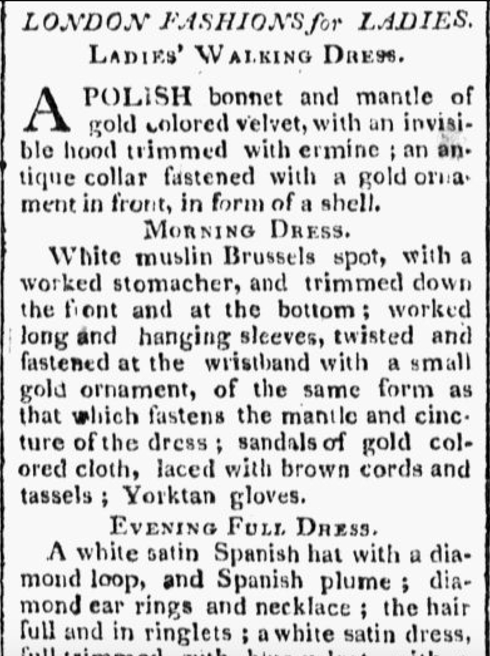
Worcester Gazette. (Worcester, MA)
June-1809
Notes:
How up on the latest fashion were American women
Before extensive copyright laws scissors editing was the accepted practice

Slide 43
Sunday, 25 November 1798:
“The Overton Scotchman [a peddler carrying fabric for sale door to door] has been kind enough to rid me of some of my money, in exchange for six shifts and four pair of stockings. The Irish [linen] is not so fine as I would like it; ... It cost me 3s. 6d. per yard. It is rather finer, however, than our last, and not so harsh a cloth.”
Notes:
21 shillings for Emma = about $95 in 2011 so 3s 6d is about $14/yd.
20 shillings in a pound, 12 pence in a shilling
Dr. Eric Nye - http://uwacadweb.uwyo.edu/numimage/currency%20conversion.htm “A Method for Determining Historical Monetary Values”

Slide 44
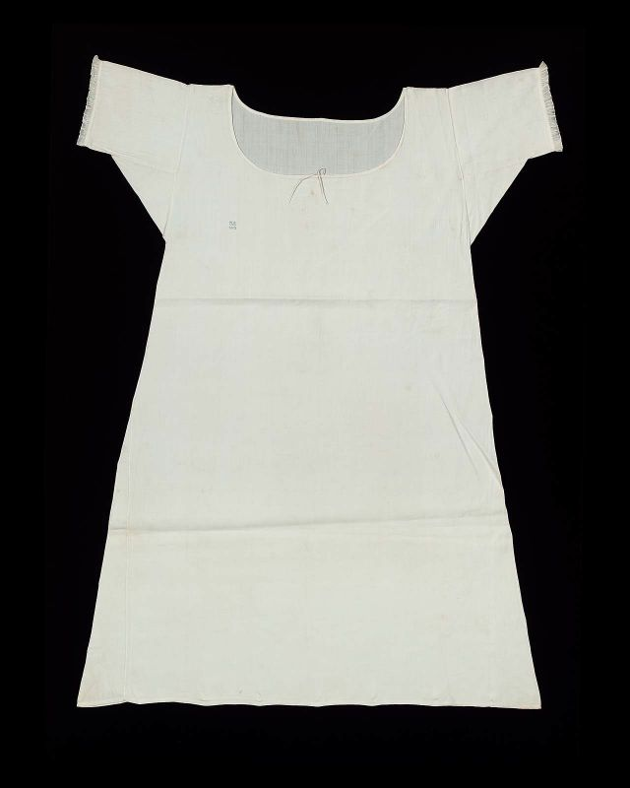
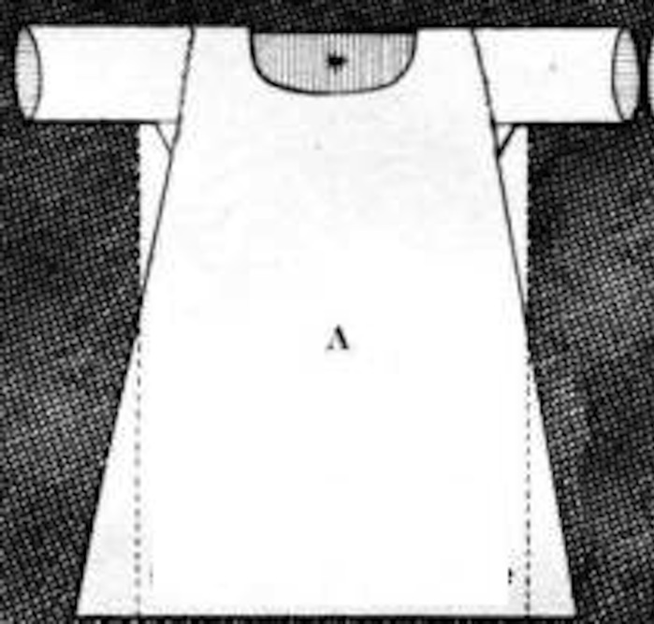
Shift/chemise
Notes:
Wpmens’ shifts were cut similar to men’s shirts but by the 19th century were more a-line.

Slide 45
Cleanliness
La Belle Assemblée, Feb 1806, p. 15:
The Ladies Toilette, or Encyclopedia of Beauty
Of cleanliness--…A careful attention to the person, frequent ablutions, linen always white, which never betrays the inevitable effect of perspiration and of dust; a skin always smooth and brilliant, garments not soiled by any stain, and which might be taken for the garments of a nymph; a shoe which seems never to have touched the ground; this it is what constitutes cleanliness. To this might likewise be added a scrupulous care to avoid every thing that can indicate functions which undeceive the imagination.

Slide 46
The frequent use of tepid baths is not more grateful to the senses than it is salutary to the health and to beauty…By such means do women of the East render their skins softer than that of the tenderest babes in this climate…
This delightful and delicate oriental fashion is now, I am happy to say, embraced almost all over the continent…The generality of English ladies seem to be ignorant of the use of any bath larger than a wash-hand basin.
Mirror of Graces, 1811, p. 32

Slide 47
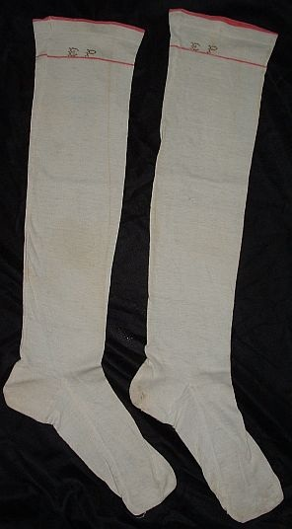
Silk or cotton stockings tied above or below the knee with a silk garter/ ribbon.

Slide 48
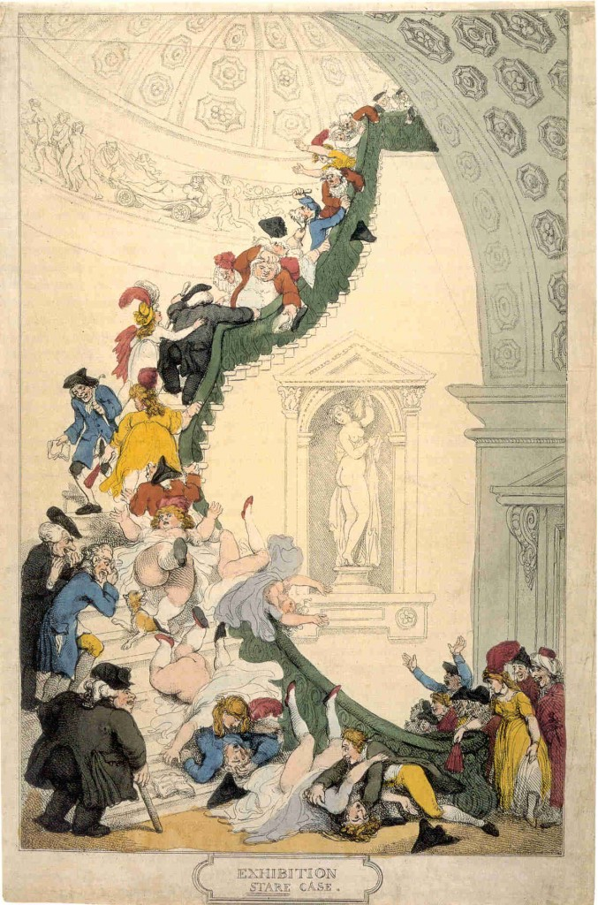
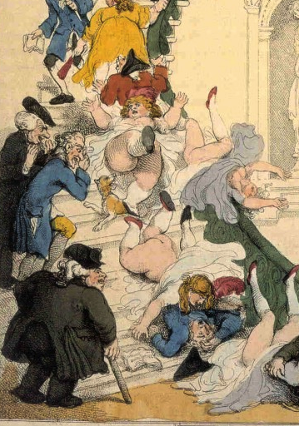
Notes:
Rowlandson, 1800, “Exhibition Stair Case” at Somerset House leading to the gallery of the Royal Academy of Art (pres. Sir Joshua Reynolds)

Slide 49
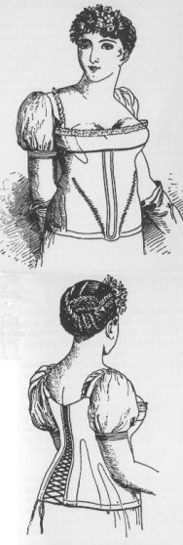

Notes:
So what do you wear under those lightweight narrow gowns? What is the ideal and how do you achieve it: columns
This corset is missing it’s busk and boning but you can see that it has few bone channels and a gathered bodice like the gowns under which it would have been worn.

Slide 50


Notes:
Unlike the ornate petticoats of the earlier 18th cent, turn of- and early 19th century petticoats were sometimes meant to be seen, sometimes not.

Slide 51


Caps: to keep your hair clean, to wear under bonnets or for at home.
Notes:
Caps for sleeping, caps for morning wear, caps to wear under bonnets, even evening at homes. Morning wear caps could be quite ornate with embroidery, lace, ribbons, and flowers.

Slide 52


Chemisette
Notes:
A fine cotton lawn (rarely ever linen) garment meant to fill in the neckline. Usually worn for day dress.

Slide 53


Slide 54



Spencer
Notes:
Afternoon Dress – Walking Dress – Promenade - Carriage Dress: Spencers, named after Lord Spencer, were short jackets, often military-inspired. In recent movies there seems to be a trend to make them shorter in the back than the gown they are being worn with, i.e. hem is above the waistline of dress. I’ve never seen any pictured this way so it looks odd to me.

Slide 55


Pelisse
Notes:
These examples are post-1815, of silk, showing the richness of detail that became the hallmark of pelisses at this time.

Slide 56


Riding
Notes:
Riding Habits, often (usually?) made by tailors instead of dressmakers.

Slide 57




Austen, Thursday, 20 November 1800:
“Miss Debary, Susan, and Sally, all in black [mourning], but without any statues, made their appearance…”
Notes:
1819, 1810, 1816. Women in mourning were typically depicted draped over urns, statues, tombstones…The broach is a piece of hair jewelry – the weeping willow is made of hair. There were several royal deaths in the years after Austen’s death so fashion magazines provided suitable clothing.

Slide 58

Court Dress (After 1821)
Notes:
Court dress – specific rules about number of feathers, decoration, etc. Extremely expensive.

Slide 59


Court Dress: 1800-1821
Notes:
Court dress: Unfortunately the rules about hoop width did not change before waists went up!

Slide 60




Reticules

Slide 61



Sunday, 2 June 1799:
“I am not fond of ordering shoes;
and, at any rate,
they shall all
have flat heels.”
Notes:
Earliest had small heels, these have flat heels and pointed toes. Later shoes would have rounded, then squared toes (Victorian)

Slide 62

Sunday, 2 June 1799:
“Flowers are very much worn, and fruit is still more the thing. Elizabeth has a bunch of strawberries, and I have seen grapes, cherries, plums, and apricots.”
Tuesday, 11 June 1799:
“I cannot decide on the fruit till I hear from you again. Besides, I cannot help thinking that it is more natural to have flowers grow out of the head than fruit. What do you think on that subject?

Slide 63


1808-1810: Accommodating Grecian hair
Notes:
Bonnet: Metropolitan Museum of Art

Slide 64


Slide 65


Notes:
Ackermann, Dec. 1814 bonnets and hats

Slide 66
1775-1830
A fashion timeline
1775-1790: Formal, wide, natural waist
1789-1799: High waists and muslins, full
1800-1810: Greek and Roman, narrowing, vertical
1811-1814: Gothic moves in, decorative trim
1815-1817: Shrinking bodice, more trim
1817-1820: More trim, wider hem with deeper trim
1820s: Waistlines drop, shoulders and skirts go wide
Notes:
covered one of the most tumultuous in fashion history.
Talk about volume – where’s the bulge – fashion silhouettes morph from vertical to horizontal to vertical and back, with an occasional foray into bustles.

Slide 67
In Fashion Terms…
1775-1790 Youth – “horizontal” silhouette, natural waist, wide skirts, highly structured (but not for children)
1795-1800 First novels – waists move up, fabrics get more lightweight, moving to vertical but still very full
1801-1806 Bath years – extremely narrow, “Greek columns”
1807-1811 More fitted, the vertical line craze
1811-1817 Emphasis moves to bodice and hem, more decoration, skirts widen at hem
After 1817 even more width at hem, waist starts to drop
Notes:
We tend to think of this entire period as that of “high waists” but the details of fashions actually changed quite a bit. While writing her early works, Austen would have dressed differently than she would have while writing later works, and would have envisioned her characters differently as well.

Slide 68

Notes:
A generational reaction of horror! In one generation we went from wide and heavy to narrow and light in an exceedingly short amount of time. But it didn’t stop there.

Slide 69


Stays, hoop, shift (Kyoto Costume Museum)
Stays (Fleming Museum)
Notes:
Stays, Hoops and shift – Kyoto Museum. Additional stays, Fleming Museum. Though the cut and boning layout evolved to be quite efficient by centurr’s end, the 18th century corset in general had “wall-to-wall” boning and was designed to create a barrel shape with rounded neckline. It was not about nipping in the waist, although from the front your waist might look smaller (from the side it would look larger).

Slide 70

Robe a l’anglaise: 1770s and 1780s
Notes:
A little trip back in time: draping, fitting, shaping. With fitting: 14th cent. Fitted, 15th - vertical, 16th - horizontal, vertical, horizontal. Since the 16th century women have been using stays or corsets for both support and for shaping. The shape and design of the stays or corsets provides the foundation for the shape of the clothing.

Slide 71


Robe a la francaise: 1770s and 1780s
Notes:
A little trip back in time: draping, fitting, shaping. With fitting: 14th cent. Fitted, 15th - vertical, 16th - horizontal, vertical, horizontal. Since the 16th century women have been using stays or corsets for both support and for shaping. The shape and design of the stays or corsets provides the foundation for the shape of the clothing.

Slide 72


1790s
Notes:
1790

Slide 73



1780s
Chemise
Dress
Notes:
Marie Antoinette’s “chemise dress” Portrait by Elisabeth Louise Vigée-LeBrun,(Veejee lebron) 1783, dress by Rose Bertin
August 1784: Georgiana, Duchess of Devonshire, wears a chemise a la reine to a concert
Comtesse DuBarry
Jacques Louis David (1748-1825) “Antoine-Laurent Lavoisier (1743–1794) and His Wife (Marie-Anne-Pierrette Paulze, 1758–1836)
Date: 1788

Slide 74
In Fashion Terms…
1775-1790 Youth – “horizontal” silhouette, natural waist, wide skirts, highly structured (but not for children)
1795-1800 First novels – waists move up, fabrics get more lightweight, moving to vertical but still very full
1801-1806 Bath years – extremely narrow, “Greek columns”
1807-1811 more fitted, the vertical line craze
1811-1817 emphasis moves to bodice and hem, more decoration, skirts widen at hem
After 1817 even more width at hem, waist starts to drop
Notes:
HAND OUT CARDS - explain

Slide 75
Why?
Was it the Greek statues?
Was it the French revolution?
Was it the Indies (East and West)?
Was it new technology?
Was it politics?
Was it the price of muslin?
Notes:
But the greatest change to note was that to muslin – not American – this is mull
England – wool, Greek drapery, American egalitarianism, French freedom and egalite, West Indies – slave cotton, East Indies – true Indian muslins (Bangladesh suppression), better thread, better weaving, better quality, cheaper to produce.

Slide 76
Slow Seeing
Hat/Head
Shape, Proportion, Decoration
Neckline
“V” or Closed, Rounded, Square, Filled in
Elbow/Sleeve
Short/Elbow/Long, Straight/Puffed, Gloves
Hemline
Train, Narrow, Wider, Plain/Trimmed
Accessories
Shawl, Cloak, Muff
Notes:
Norah Waugh: The Cut of Women’s Clothes. Also “Corsets and Crinolines”
Janet Arnold
Nancy Bradfield: Costume in Detail
The Dress Detective: A Practical Guide to Object-Based Research in Fashion
Nov 19, 2015 by Ingrid Mida and Alexandra Kim

Slide 77


Notes:
Open robe 1790, still fairly structured, higher waist, full petticoat, corset to suit, with ‘tail’ to hold skirt out at back.

Slide 78


Notes:
Even in America the trend towards a higher waist was followed, though in this case the construction of the back of the gown remained the same.

Slide 79


1794
Notes:
Watch the sleeves – they are still elbow length. That will change, of course.

Slide 80


Notes:
As the 1790s progress we move into a transition gown. It is high waisted but still very full. The fabric is lightweight cotton or muslin and hair is big!

Slide 81


1790s: Big hats, big hair, big feathers
Notes:
When Austen was writing her early novels this is what she was seeing and wearing.

Slide 82

Notes:
The brown embroidered and sequined silk dress is a round gown – i.e. the dress is closed all the way around without a front opening.

Slide 83

1800: big feather but small hair, narrower silhouette
Austen, Wednesday, 18 December 1798:
“I believe I shall make my new gown like my robe, but the back of the latter is all in a piece with the tail, and will seven yards enable me to copy it in that respect?”

Slide 84


Round Gowns, c. 1800 (Colonial Williamsburg): trains, gathers to make shape, elbow-length sleeves
Notes:
Note transitions style – high waist, gathered front cut all of a piece

Slide 85

“Both well-dressed with veils and parasols like other girls.”
Notes:
1804: Promenade in Kensington Gardens

Slide 86


1800-1808: tall and narrow, less fabric, trains
Notes:
Still lots of fabric gathered at waist but the silhouette is definitely vertical, the greek column ideal
1) 1800-artstor-AMICO_CLARK_103902762
1) 1800-artstor-pinkback-AMICO_CLARK_103902764

Slide 87

In Fashion Terms…
1775-1790 Youth – “horizontal” silhouette, natural waist, wide skirts, highly structured (but not for children)
1795-1800 First novels – waists move up, fabrics get more lightweight, moving to vertical but still very full
1801-1806 Bath years – extremely narrow,
“Greek columns”
1807-1811 more fitted, the vertical line craze
1811-1817 emphasis moves to bodice and hem, more decoration, skirts widen at hem
After 1817 even more width at hem, waist starts to drop
Notes:
It’s all about the column and the ionic column is mimicked by the way corsets are designed to ‘lift and separate.’

Slide 88


Notes:
Fashion plates emphasize the vertical by making women into giantesses.

Slide 89



Austen, Tuesday, 8 January 1799:
“I am not to wear my white satin cap to-night, after all; I am to wear a mamalone [mameluke] cap instead…It is all the fashion now; worn at the opera, and by Lady Mildmays at Hackwood balls.”
Notes:
Warrior caste in Egypt defeated by Napoleon at the Battle of the Pyramids, 1798 “On July 1, 1798, Napoleon landed in Egypt with 400 ships and 54,000 men and proceeded to invade the country, as he had recently invaded Italy. But this Egyptian invasion was to be different. For, in addition to soldiers and sailors, Napoleon brought along 150 savants — scientists, engineers and scholars whose responsibility was to capture, not Egyptian soil, but Egyptian culture and history.” The ladies picked up the turban almost immediately.
In former ages it seemed requisite that every lady should cut out her garments by a certain erect standard. ..But in our days, an English woman has the extensive privilege of arraying herself in whatever garb may best suit her figure or her fancy. The fashions of every nation and of every era are open to her choice. One day she may appear as the Egyptian Cleopatra, then a Grecian Helen; next morning the Roman Cornelia; or, if these styles be too august for her taste, there are Sylphs, Goddesses, Nymphs of every region, in earth or air, ready to lend her their wardrobe.
Mirror of Graces, 1811 (p. 52)

Slide 90



“She [Madame Bonaparte] has made a great noise here, and mobs of boys have crowded round her splendid equipage to see what I hope will not often be seen in this country, an almost naked woman.”
Rosalie Calvert, Baltimore
Notes:
So, gowns are becoming narrow and lightweight, thin cotton
1803 married
Dress from 1804

Slide 91

Notes:
1797-boilly-incroyables-merveilleuses

Slide 92

Notes:
1810 “A scene taken from nature in Kensington Gardens” Gillray commenting on lightweight cotton and flimsy petticoats.

Slide 93

Notes:
James Gillray (1757-1815)

Slide 94

The year 1740, a Lady’s full dress of Bombazeen. The year 1807, a Lady’s undress of “Bum-Be-Seen.”
Notes:
The year 1740 a Lady’s Full Dress of Bombazeen. The year 1807 a Lady’s Undress of Bum-be-seen (Full dress refers to formal dress, undress refers to daytime clothes but her it refers to rather more…or less as the case may be.

Slide 95
In Fashion Terms…
1775-1790 Youth – “horizontal” silhouette, natural waist, wide skirts, highly structured (but not for children)
1795-1800 First novels – waists move up, fabrics get more lightweight, moving to vertical but still very full
1801-1806 Bath years – extremely narrow, “Greek columns”
1807-1811 more fitted, the vertical line craze
1811-1817 emphasis moves to bodice and hem, more decoration, skirts widen at hem
After 1817 even more width at hem, waist starts to drop

Slide 96

Notes:
Corset and stockings, two layers of linen, channels of baleen or cord, single spiral laced, busk (thin wooden stick about 1-2”wide – great for posture)

Slide 97

Thursday, 18 April 1811:
“Our pelisses are 17s. each; she charges only 8s. for the making, but the buttons seem expensive, — are expensive, I might have said, for the fact is plain enough.”
Notes:
Ackermann, March 1815

Slide 98


1809
Notes:
Ackermann, May 1809

Slide 99


1810: Trains hang on in evening dress
Notes:
Ackermann, Jan. 1809
La Belle Assemblée, Dec. 1810

Slide 100
In Fashion Terms…
1775-1790 Youth – “horizontal” silhouette, natural waist, wide skirts, highly structured (but not for children)
1795-1800 First novels – waists move up, fabrics get more lightweight, moving to vertical but still very full
1801-1806 Bath years – extremely narrow, “Greek columns”
1807-1811 more fitted, the vertical line craze
1811-1817 emphasis moves to bodice and hem, more decoration, skirts widen at hem
After 1817 even more width at hem, waist starts to drop

Slide 101



Morning Dress
Notes:
But which gown? This is the period where upper class women dressed according to the time of day: Morning dress (anytime before dinner around 1:00, or 2, 3, 4…) If you were at home to visitors you would wear these. Even if paying calls, although for those you might have preferred afternoon, carriage, or promenade dress.

Slide 102


1812-13: Emphasis shifting to bodice
Notes:
By 1813 the emphasis is shifting to the bodice. The vertical line disappears from the skirt and the bodice gets the eye-catching trim
1) Ackermann, April, 1812
2) Ackermann, Dec. 1812
Lady Russell: “You may as well take back that tiresome book she would lend me, and pretend I have read it through. I really cannot be plaguing myself forever with all the new poems and states of the nation that come out. Lady Russel quite bores one with her new publications. You need not tell her so, but I thought her dress hideous the other night. I used to think she had some taste in dress, but I was ashamed of her at the concert. Something so formal and arrangé in her air! And she sits so upright! My best love of course.

Slide 103


Canada (McCord Museum)
Notes:
McCord Museum, 1819. Accession number M982.20.1

Slide 104


Notes:
Museum of London.

Slide 105



Notes:
Corsets continue to evolve, longer to create a smooth columnar line, busk still there to provide support and posture, and bustline very high
1) Late 18-teens, early 1820s corset. Kyoto Costume Institute
2) A very original corset – original, a recreation? Fleming Museum – do not duplicate or repost.
3) c. 1820 Connecticut Historical Society

Slide 106


1814
Notes:
Or full dress- evening dress – opera dress – dinner dress
1) Ackermann, March 1814

Slide 107


1815
“A woman can never be too fine when she is all in white.”
Notes:
1815-1820 – the move to decorated bodice and hem
1) Ackermann, July 1815
2) Ackermann, June 1815

Slide 108
In Fashion Terms…
1775-1790 Youth – “horizontal” silhouette, natural waist, wide skirts, highly structured (but not for children)
1795-1800 First novels – waists move up, fabrics get more lightweight, moving to vertical but still very full
1801-1806 Bath years – extremely narrow, “Greek columns”
1807-1811 more fitted, the vertical line craze
1811-1817 emphasis moves to bodice and hem, more decoration, skirts widen at hem
After 1817 even more width at hem, waist starts to drop

Slide 109


Notes:
Small bodice, sleeves fall at waistline

Slide 110


Notes:
Skirt hem even wider, waist begins to drop. Corset shows how this narrowed waist is achieved.

Slide 111


Notes:
Sturbridge – early 1820s
Col Will

Slide 112



Slide 113

Notes:
1830s – super horizontal, bodice and skirt. Even the hair is horizontal. This shape will be toned down in the 1840s with sleeves narrowing but once the crinoline comes into fashion skirts will attain crazy widths but retain the 1830s bell shape

Slide 114







Slide 115
Fashion detectives
Slow Seeing
Notes:
Norah Waugh: The Cut of Women’s Clothes. Also “Corsets and Crinolines”
Janet Arnold
Nancy Bradfield: Costume in Detail
The Dress Detective: A Practical Guide to Object-Based Research in Fashion
Nov 19, 2015 by Ingrid Mida and Alexandra Kim

Slide 116
Hat
Shape, Proportion, Decoration
Neckline
“V” or Closed, Rounded, Square, Filled in
Elbow/Sleeve
Short/Elbow/Long, Straight/Puffed, Gloves
Hemline
Train, Narrow, Wider, Plain/Trimmed
Accessories
Shawl, Cloak, Muff

Slide 117



1790s
Early 1800s
1815
Notes:
Norah Waugh: The Cut of Women’s Clothes. Also “Corsets and Crinolines”
Janet Arnold
Nancy Bradfield: Costume in Detail
The Dress Detective: A Practical Guide to Object-Based Research in Fashion
Nov 19, 2015 by Ingrid Mida and Alexandra Kim

Slide 118



1790s
Early 1800s
1815

Slide 119



1790s
Early 1800s
1815

Slide 120



1790s
Early 1800s
1815

Slide 121


