Slide 1
The Fashionable Miss Austen
Hope Greenberg

Slide 2
Jane Austen
What did men and women (“of good society”) wear during Austen’s lifetime?
How fashion conscious was she, personally? (in her letters)
How did she use fashion in her novels?
Notes:
There are a number of questions we can consider when looking at clothing in Jane Austen’s time.

Slide 3
The Novels
1775 Born Dec. 16
1795 “Elinor and Marianne”(Sense and Sensibility) written
1796-1797 “First Impressions” (Pride and Prejudice) written.
1798-1799 “Susan” (Northanger Abbey) written.
1801-1806 Bath years, Chawton move
1811 Mansfield Park begun. Pride and Prejudice revised.
1813 Pride and Prejudice published.
1814 Mansfield Park published.
1815 Emma completed and published (1816 on title page).
1816 Persuasion completed. Northanger Abbey revised.
Notes:
We tend to think of this entire period as that of “high waists” but the details of fashions actually changed quite a bit. While writing her early works, Austen would have dressed differently than she would have while writing later works, and would have envisioned her characters differently as well.

Slide 4
“One could not hope to conduct himself or herself properly on entering a room without immediately assigning a rank to every person.”
(Bushman)
Notes:
In a society based on rank, clothes as an indicator of rank have to shift subtly. You keep up with the latest fashions, the latest dances, and the latest news, not just to be trendy or edgy but to ensure that your rank is recognized. Your deportment, manners and speech all mark you as acceptable into society. “A parvenu could hire a tailor to dress his body and a dancing master to teach physical deportment...{but] conversation was...the culminating genteel art.”

Slide 5
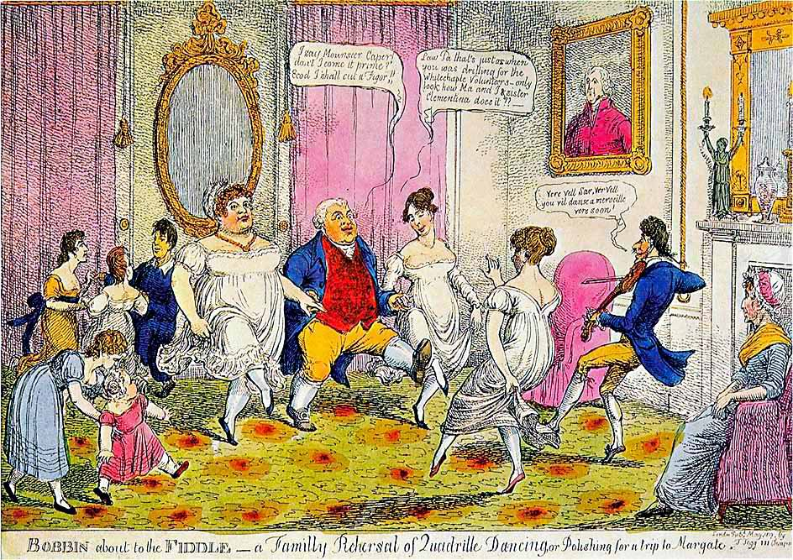
Notes:
“I say Monsouer Caper don’t I come it prime? Ecod I shall cut a figor!”
Law Pa that’s just as when you was drilling for the Whitechapel Volunteers. Only look at how Ma and I and sister Clementina does it.”
Ver vel sir, vere vel. You vil danse a merveileux ver soon.”
“The Season at Margate, for example, commenced on the King’s birthday, formally celebrated in June, and ended in late October, whereas Bath commanded the more fashionable months of October through May. The hours and pricing of the summer balls were usually different from those of the winter. ”

Slide 6
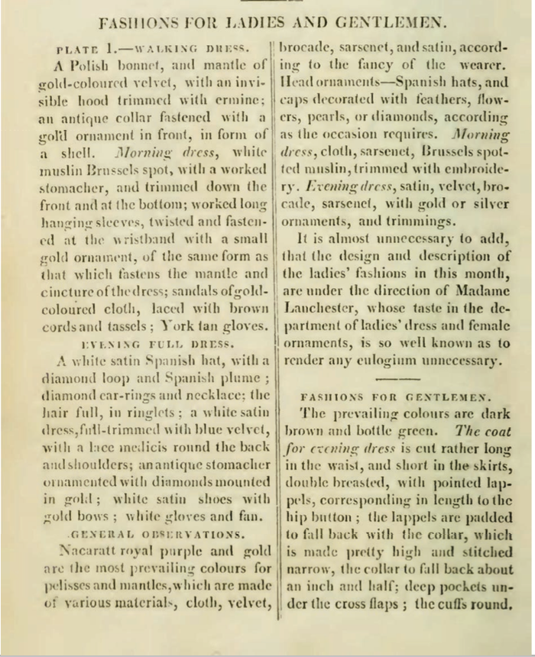
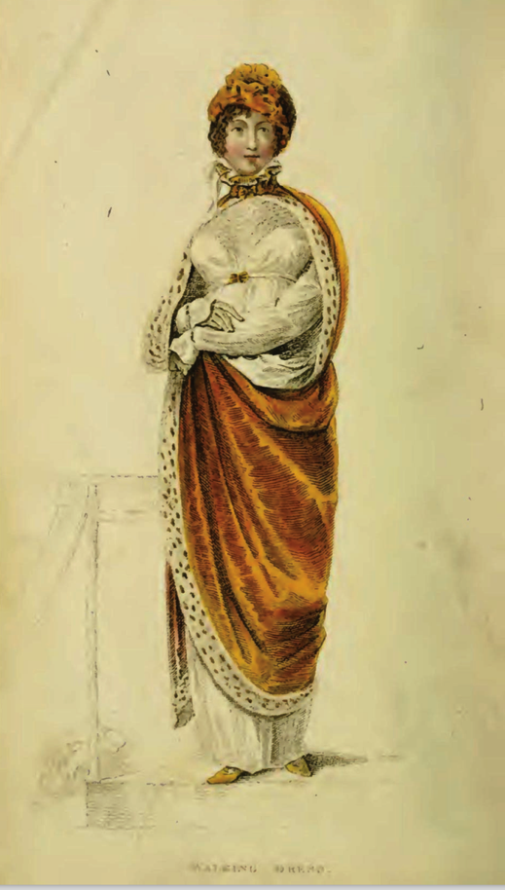
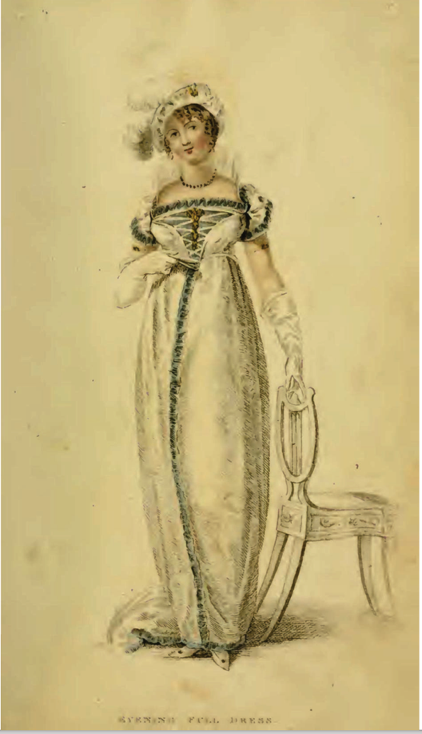
Ackermann’s Repository of the Arts. January 1809
Notes:
January 1809
Bushman mentions the importance of being able to converse intelligently on a number of interesting topics. Ackermann’s included politics, music reviews, stock prices, lists of who had gone bankrupt, travel information, biographical information, poetry, images of furniture, obituaries of royalty and it even contained actual fabric samples pasted into every issue so you could see and touch before ordering.

Slide 7
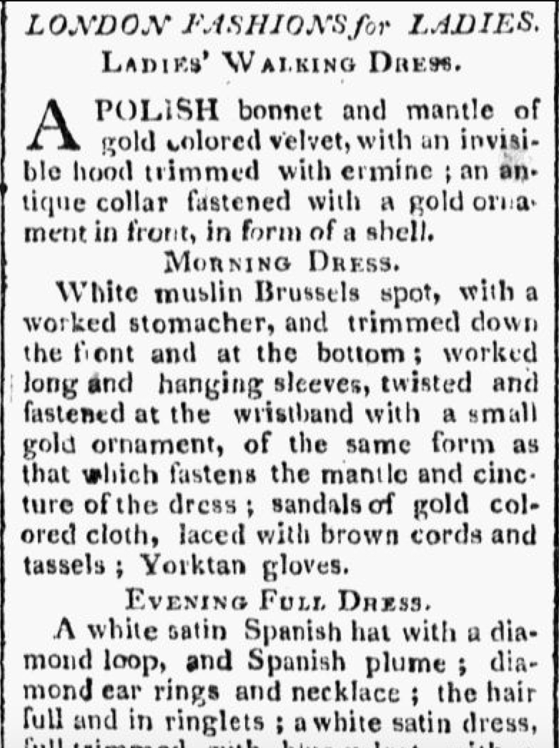
Worcester Gazette. (Worcester, MA) • 06-07-1809
Notes:
Fashion traveled quickly. This is the text of the previous example “scissor edited” (i.e. copied and reprinted) from the magazine into a local paper. Copyright? No such thing.

Slide 8
What did men wear?
Men’s basics from the outside in,
or, undressing Mr. Darcy.

Slide 9
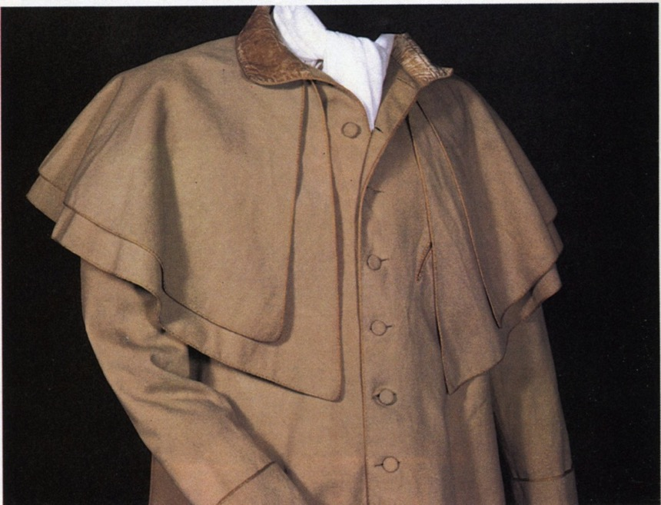
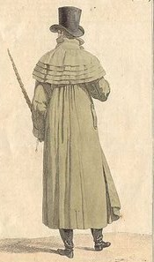
Catherine Morland of Henry Tilney: “His hat sat so well, and the innumerable capes of his great-coat looked so becomingly important. To be driven by him, next to being dancing with him, was certainly the greatest happiness in the world!”
Notes:
Henry can speak of fashion with impunity
A greatcoat was made of “cloth” which was a synonym for wool. The capes were originally designed to keep off rain but they quickly became a fashion statement as well, as Catherine notes with admiration.

Slide 10
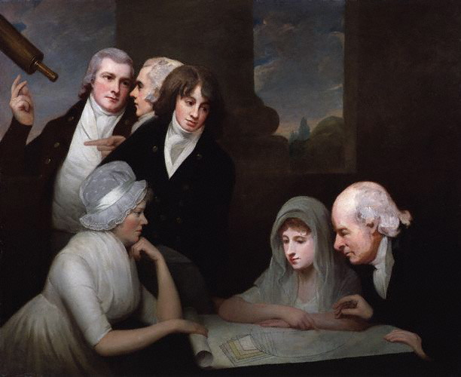
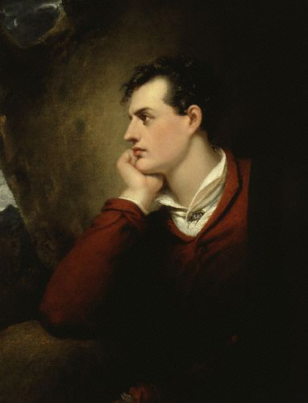
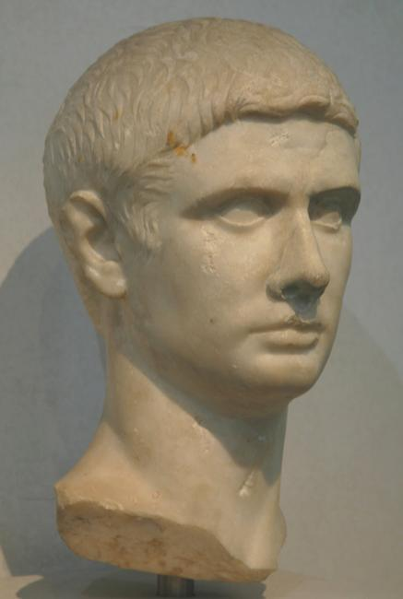
Hair
Notes:
1796 or so, after Pitt’s hairpowder tax of 1795, statue of Titus, Lord Byron. Style names “The Brutus” “The Windswept” “The Stanhope Crop”

Slide 11
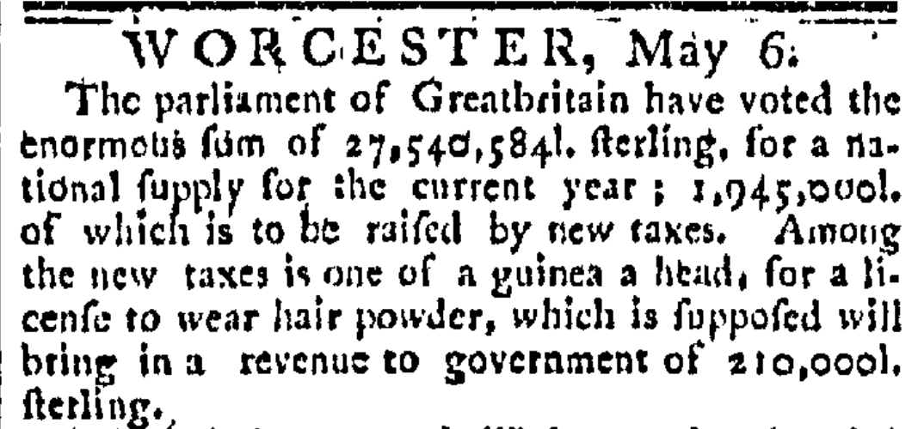
The Worcester GAZETTE. (Worcester, Massachusetts) 05-06-1795
Notes:
News travels fast
The use of hair powder had been declining and the tax hastened its near death. In 1812 46,684 people still paid the tax, in 1855 only 997 did, and almost all of these were for servants wearing livery. By the time it was repealed in 1869 it yielded an annual revenue of £1000

Slide 12
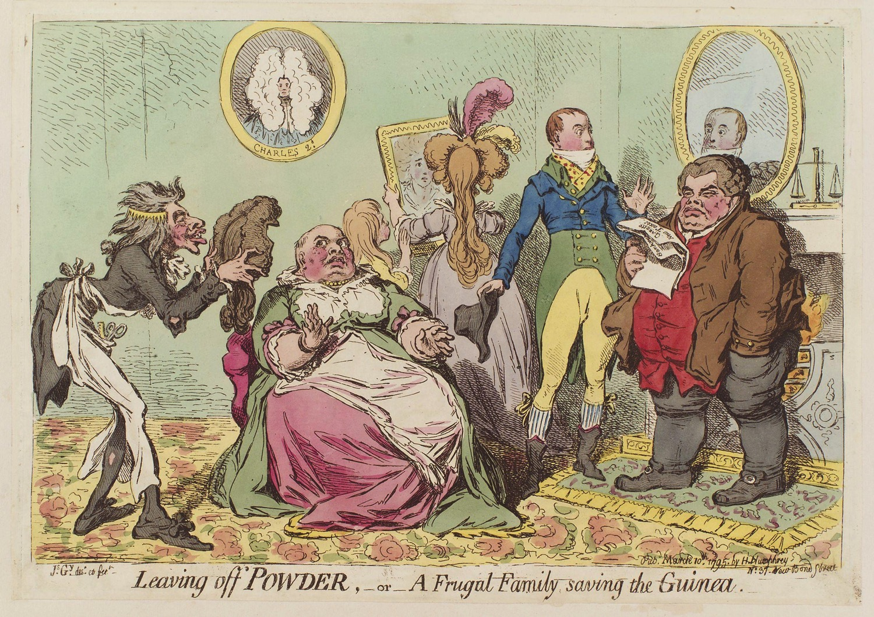
Notes:
John Bull is happy to save the money, his family less happy to do without their fashionable powder.

Slide 13
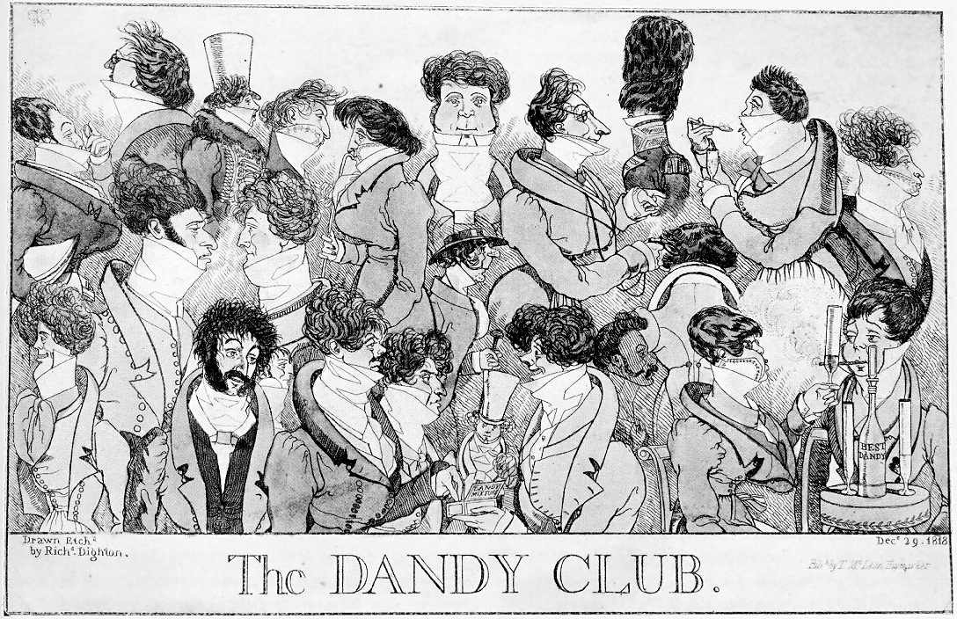
Notes:
1818 – Brummell would not have approved these extremes

Slide 14
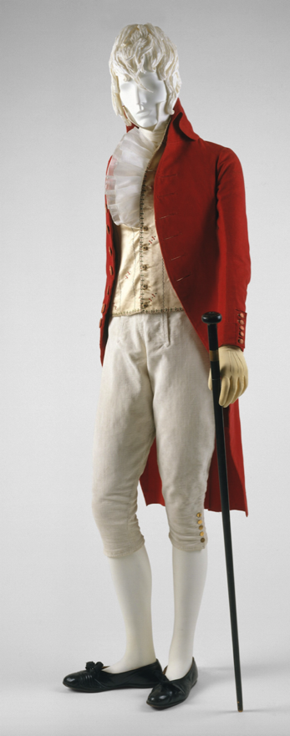
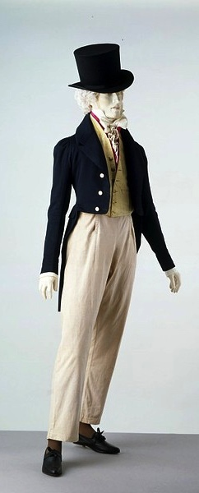
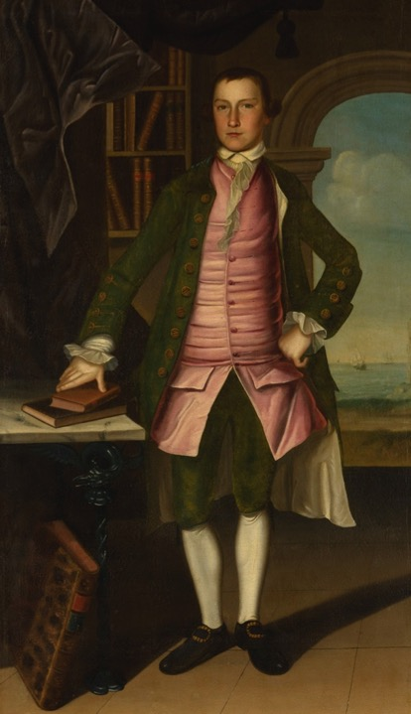
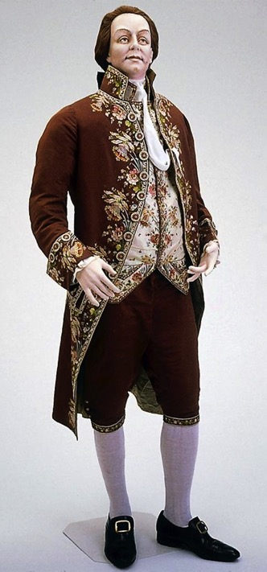
What did men wear?
1760s
1800
1815-20
1780s
.
Notes:
Those changed in shape and volume throughout the period. When Bushman mentions a waistcoat that would act as a body-shaping or posture garment he was considering the earlier example. When he talks about a new freedom of movement and ease at the end of the century it is more like the latter.

Slide 15
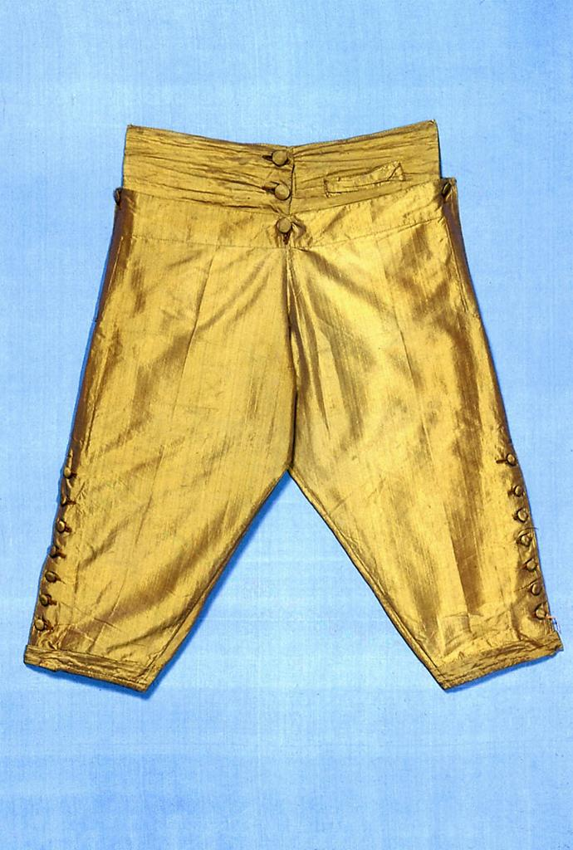
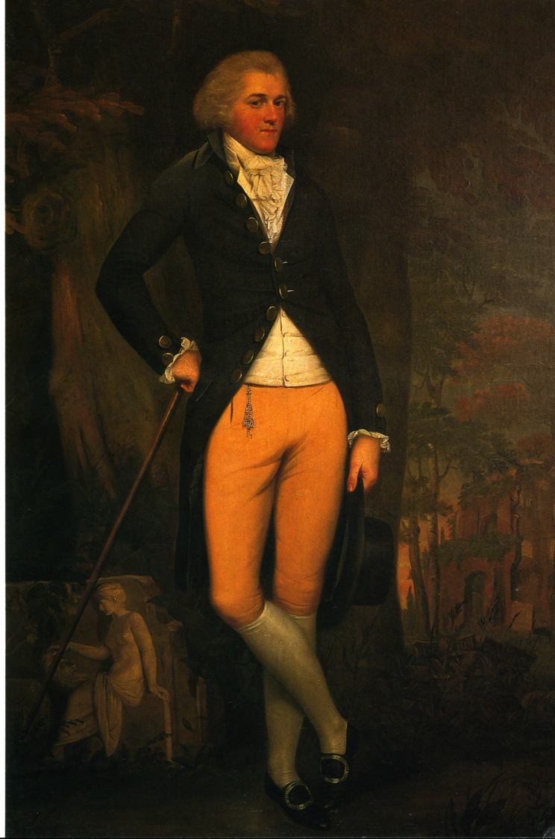
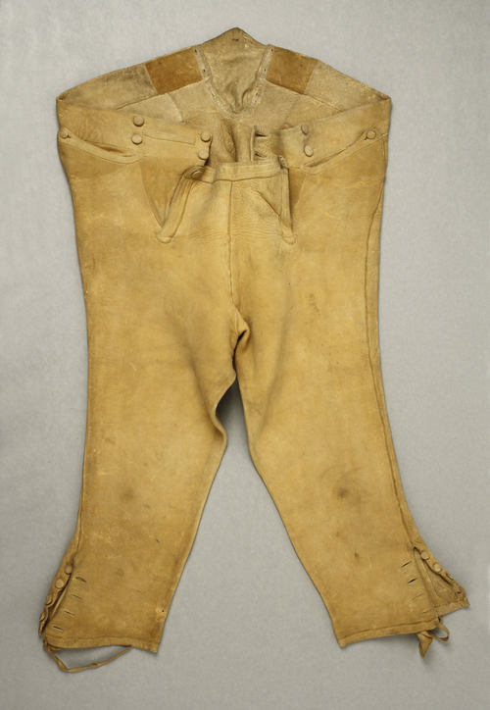
Notes:
Edward Austen Knight, grand tour, 1800. Breeches continued in popularity throughout Austen’s lifetime. By the 180ss they were beginning to be nudged out by pantaloons and trousers but hung on in the country or for formal wear. And they were never allowed into Almack’s in anything but knee breeches. There is a story, unconfirmed, that even the Duke of Wellington was turned away when he arrived in trousers. Another version has him turned away because he arrived after the official time allowed, midnight.

Slide 16
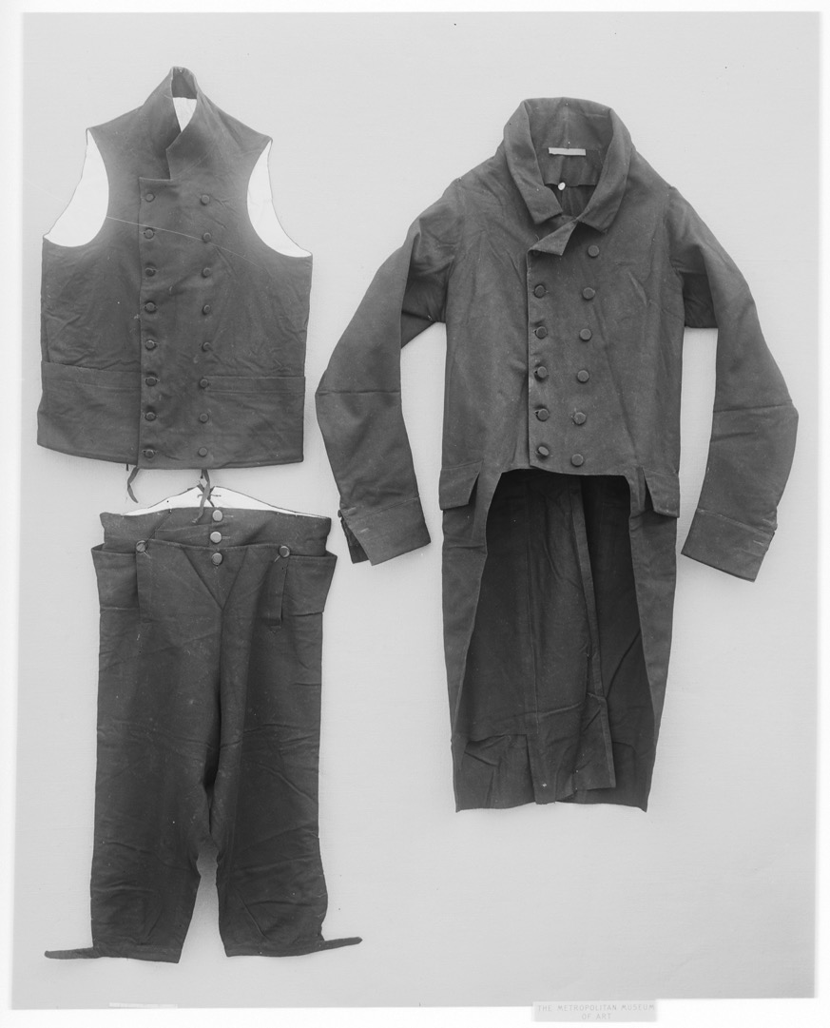
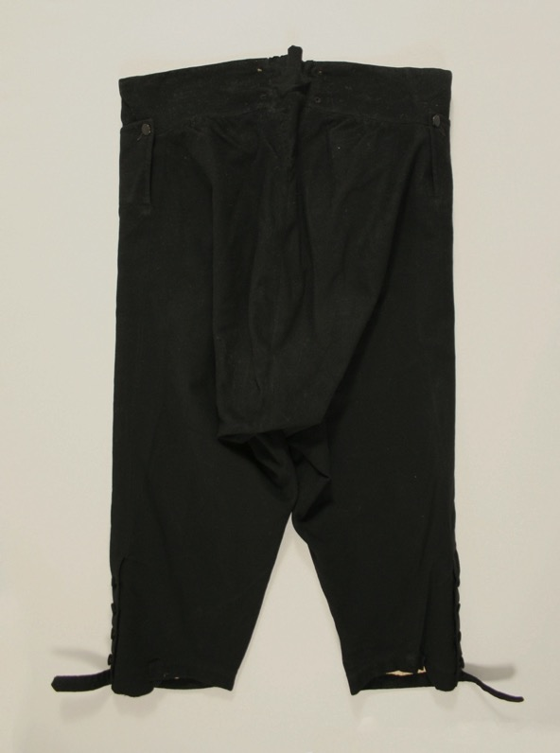
Waistcoat, coat, breeches
Metropolitan Museum, 1810-1820, 08.187.3
Notes:
In general, for the entire period we are looking at, men wore a coat (we’d say “suit jacket”, a waistcoat (vest), breeches. Note the baggy bottom on the breeches – room was needed to tuck the shirt between the legs - no underwear/drawers.

Slide 17
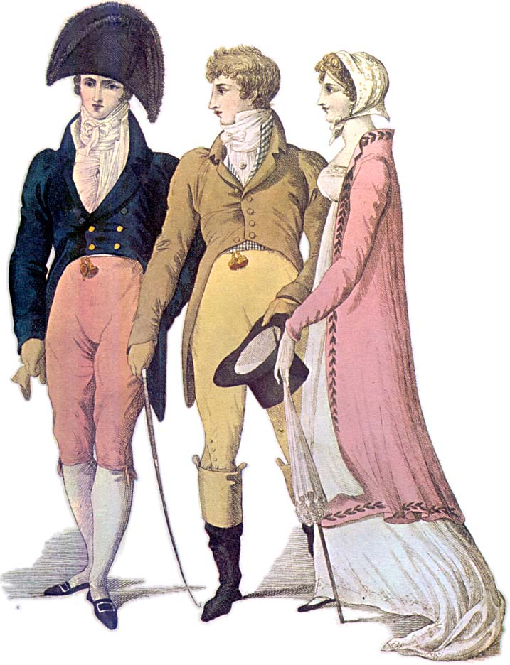
Notes:
1809 – emulating classical nude statues – cutaway coat to show maximum leg, swallow-tail – the nude male and the draped female

Slide 18
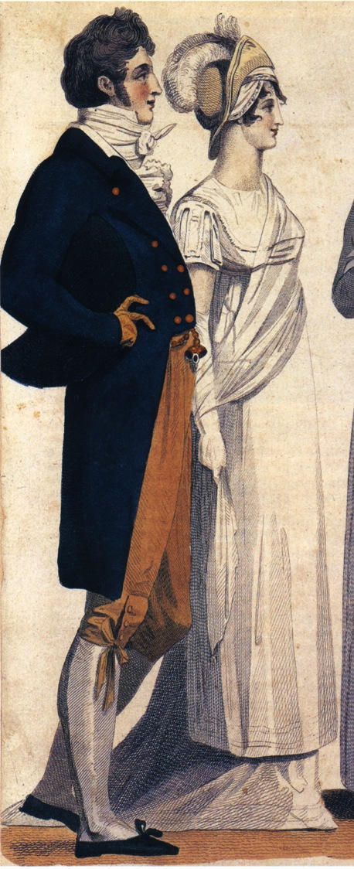
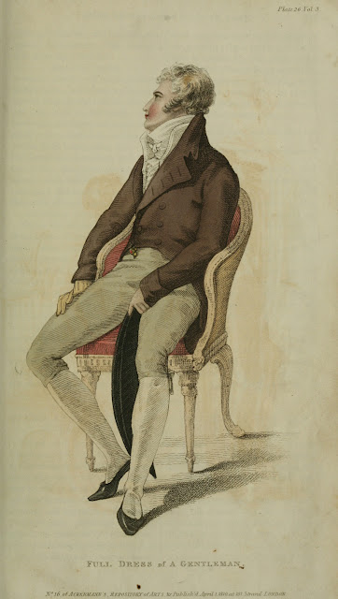
Notes:
1807, 1810, subtle differences in cut of breeches and coat but essentially the same overall design

Slide 19
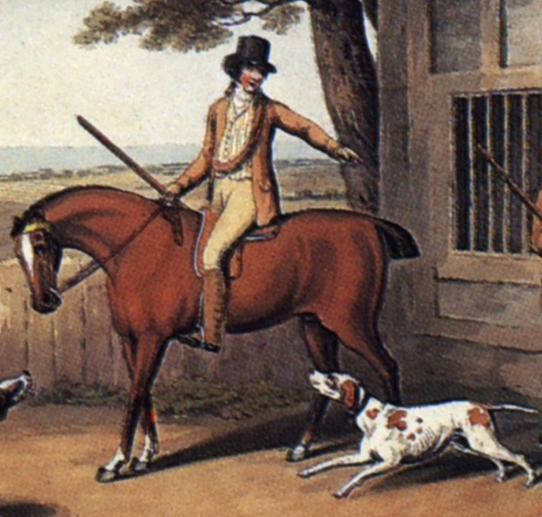
Thursday, 15 September 1796
“Edward and Fly went out yesterday very early in a couple of shooting jackets and came home like a couple of bad shots, for they killed nothing at all.”
Sense and Sensibility “His name was good, his residence was in their favourite village, and and she soon found out that of all manly dresses a shooting jacket was the most becoming. Her imagination was busy…”
Notes:
Awareness of shooting jacket—the country life attire influence. This picture is a bit deceptive as regards the quote. Edward and Fly would have walked to go shooting with the object to bring back birds. If hunting (hunting=fox hunting), they would have been riding. If they were hunting on foot, and it was not their property or they did not have permission of the property owner, they might have been arrested for poaching.

Slide 20
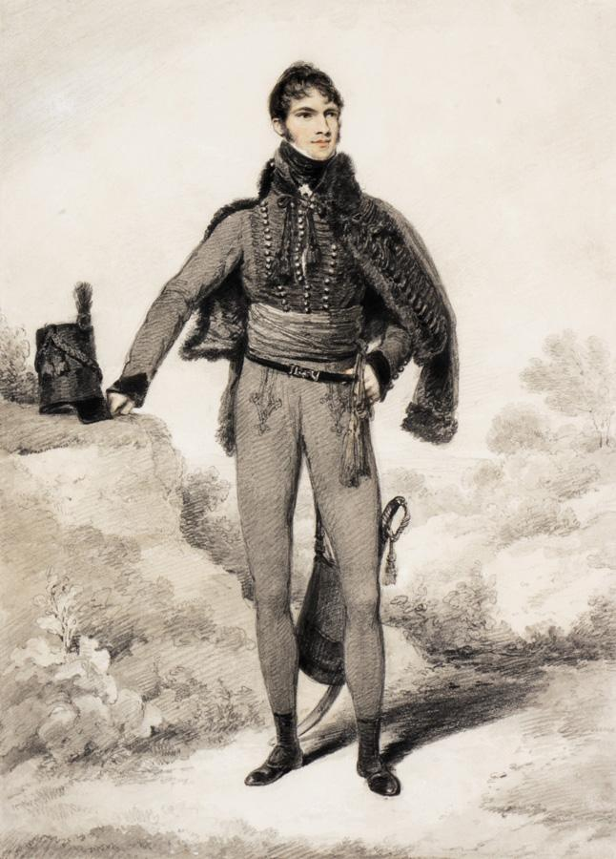
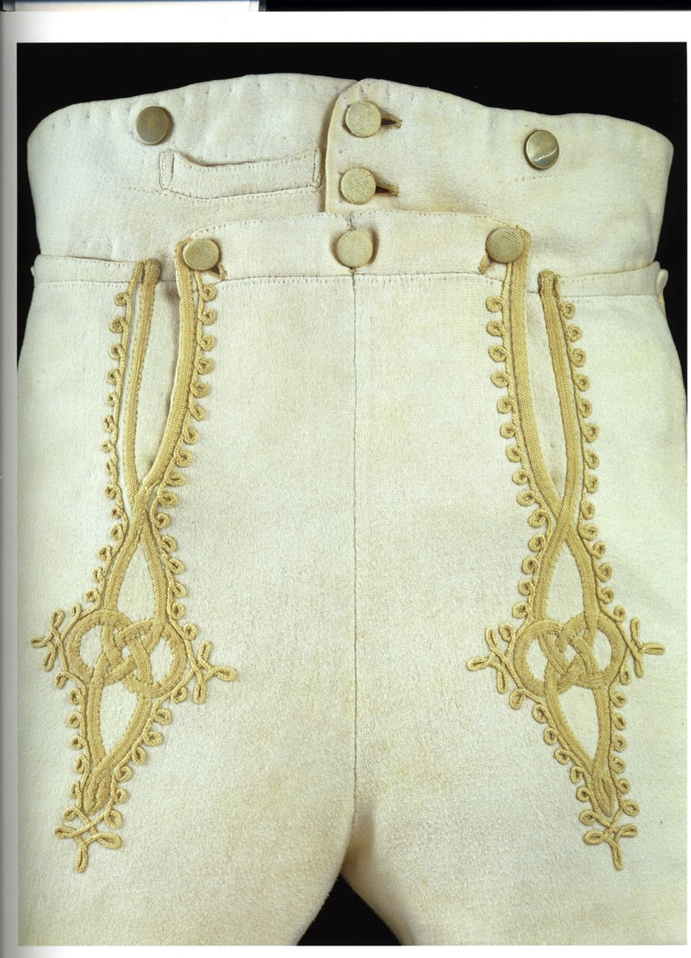
Notes:
Sir William Harbord, 1810 by Edridge, The other major influence on men’s fashion: military pantaloons – wool knit to cling and stretch.

Slide 21
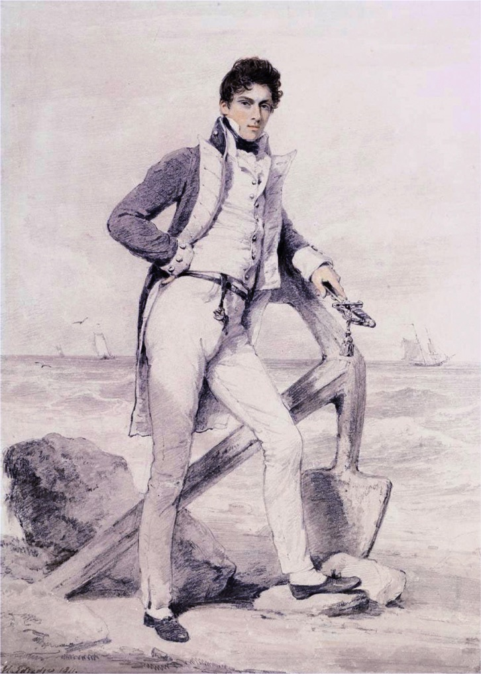
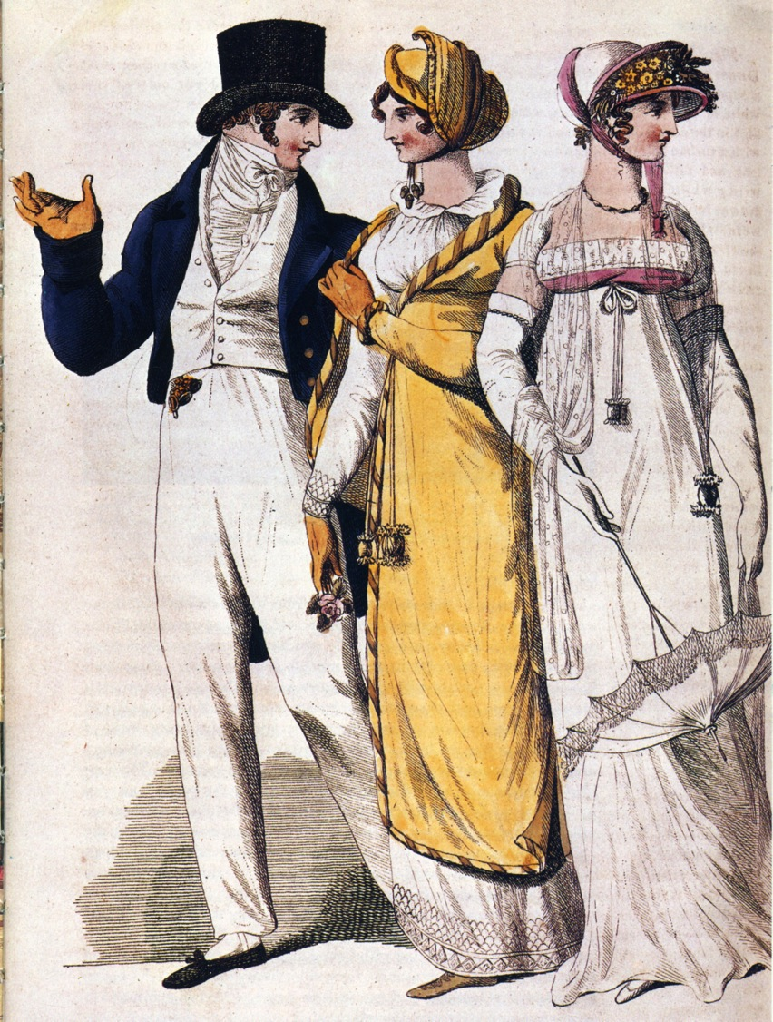
Notes:
Captain Hoste 1811 by Edridge. Sailor’s trousers
People in park, 1807. The young man adopts the Navy trouser look.

Slide 22
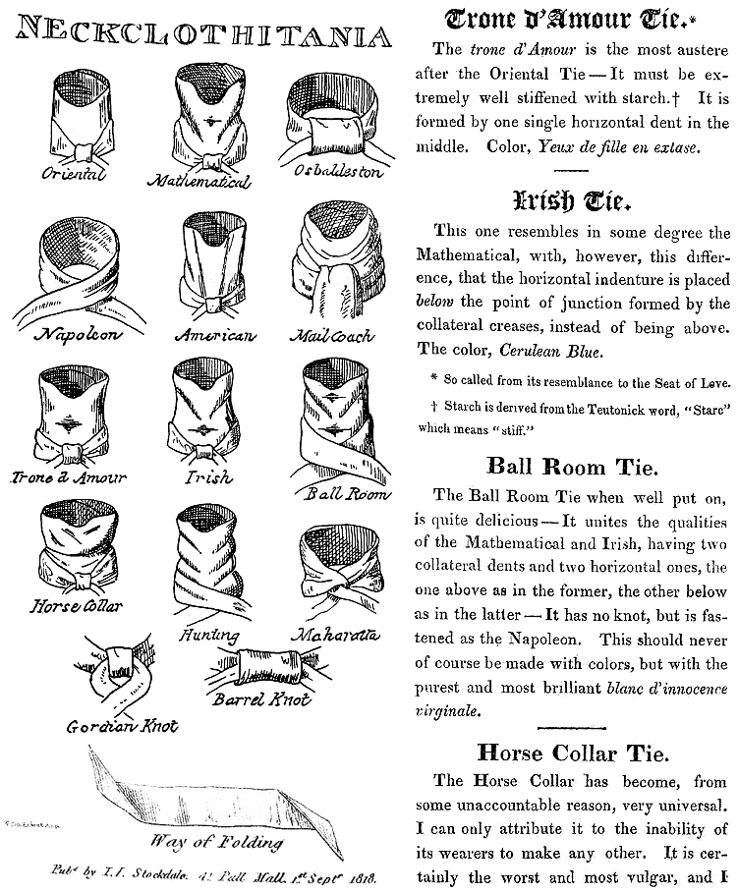
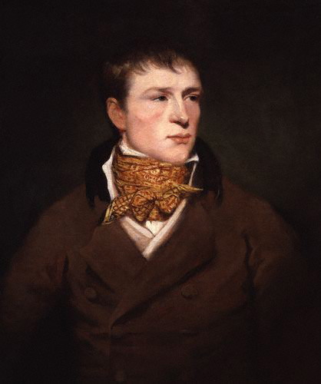
Jem Belcher:
Celebrated Boxer with his trademark spotted neckcloth
Notes:
Some neckcloth styles with fanciful names. Neckcloths were wide strips of linen, wrapped around the neck, tied and then carefully creased or indented by lowering the chin. The boxing star Jem Belcher with his trademark spotted neckcloth.

Slide 23
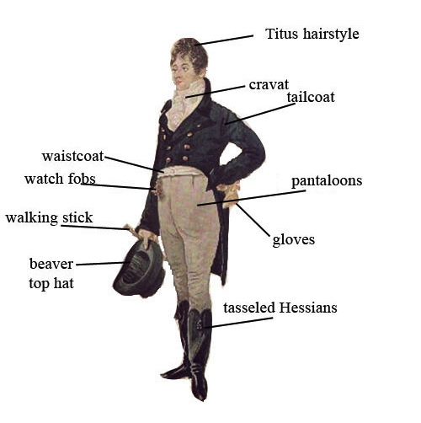
George “Beau” Brummel
Notes:
1805 Dighton caricature – blue superfine (wool) coat, pantaloons,

Slide 24
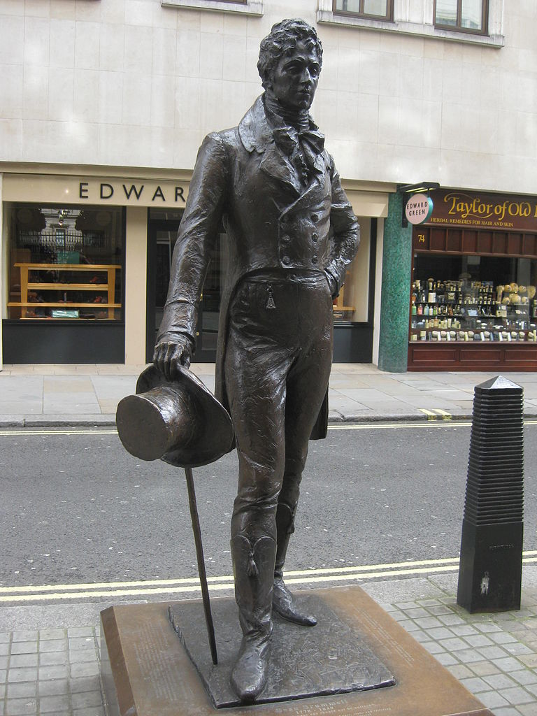
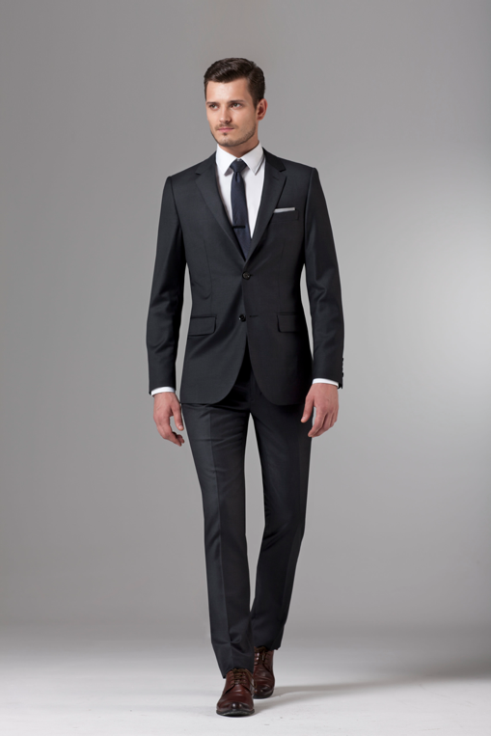
George Bryan “Beau” Brummel
The reason we wear this:
Notes:
George Bryan “Beau” Brummell who almost singlehandedly changed fashion. Friend of the Price Regent, made simple yet exquisitely tailored clothing the mode to be followed, notorious for demanding a full tub bath every day, and a perfectionist when it came to his cravats.

Slide 25
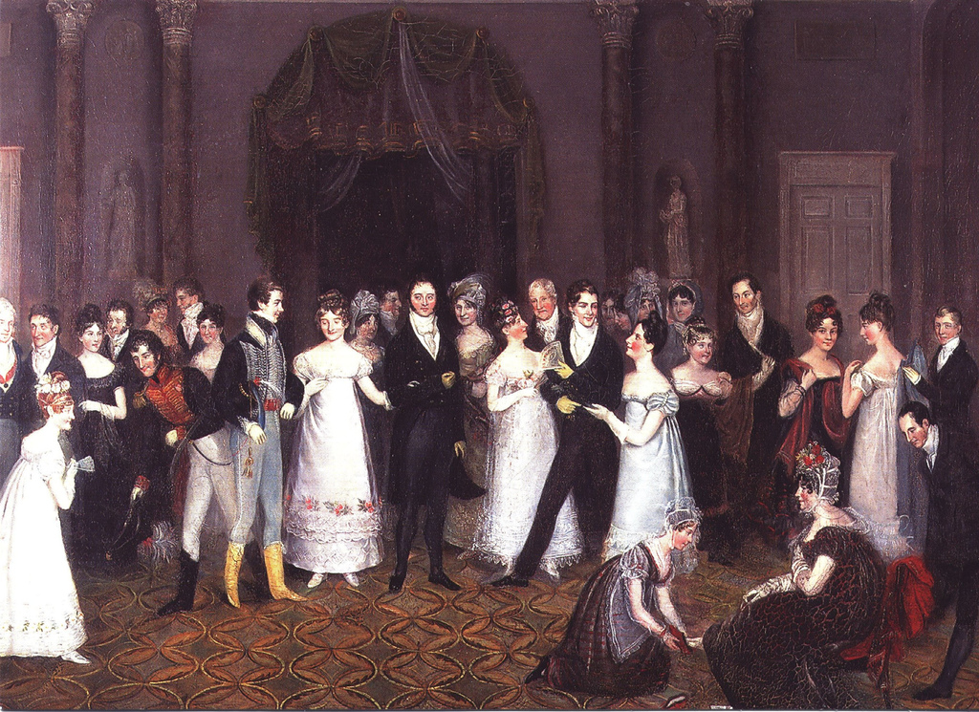
Notes:
Rolinda Sharples “The Cloak Room at the Assembly Rooms at Clifton”1818: Sharples shows examples of all men’s options. The older gentleman on the left wears grey/light silk breeches, the army men are in their uniforms with pantaloons, the thirty-something husband in the middle wears black breeches while the young flirt wears trousers. Also note the impossibly tiny bodices on the women’s gowns. For more on Clifton Assembly see http://www.thespasdirectory.com/profilego.asp?ref=2841393B

Slide 26
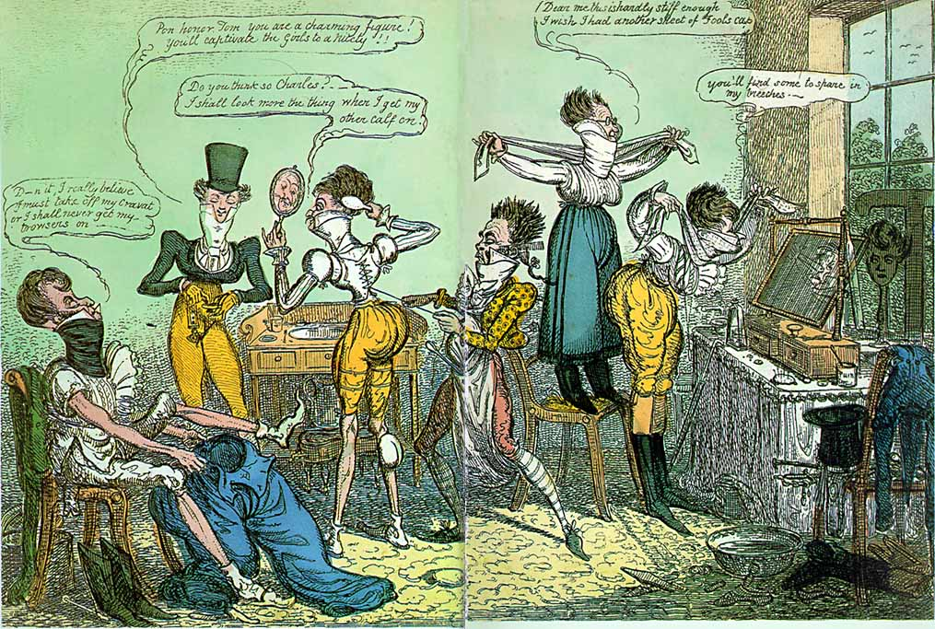
Notes:
1818 Cruickshank: sawdust padded calves, nip-waisted coats, pleated trousers, high starched neckcloths/shirt collars, corsets.

Slide 27
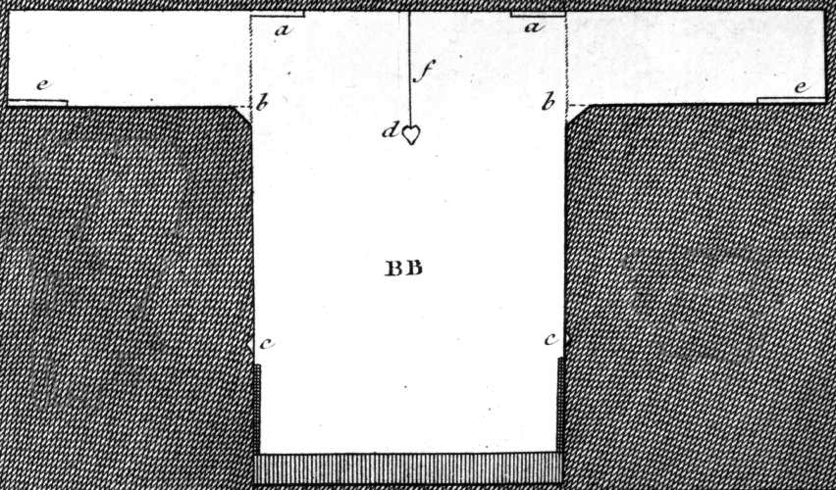
Thursday, 1 September 1796:
“We are very busy making Edward’s shirts, and I am proud to say that I am the neatest worker of the party.”
Notes:
While many people had their clothing made by tailors (men’s clothing but also women’s riding habits) or modistes/dressmakers, people often made or at least trimmed and finished, their own. But shirts and shifts were usually made by the women in the family. The cut was simple and extremely economical, using all the width of the linen. The “workbasket” was always to hand with shirts/shifts to be sewn.

Slide 28
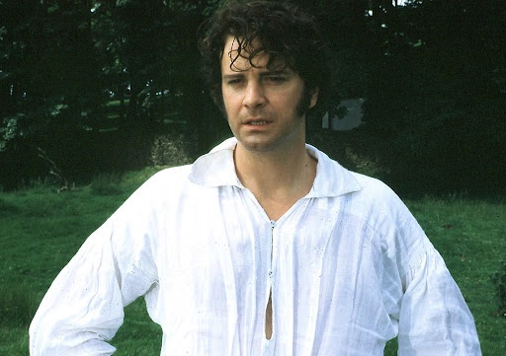
Notes:
Obligatory Firth/Darcy wet shirt image

Slide 29
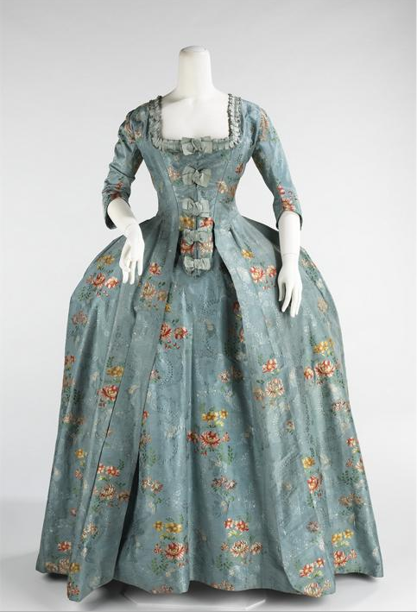
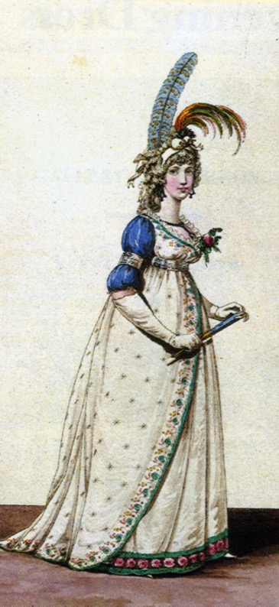
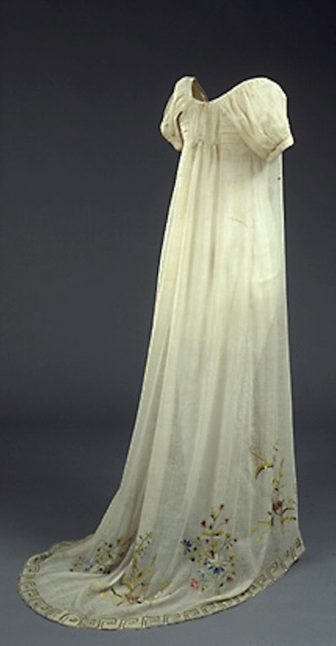
What did women wear?
1770s-80s
1790s
1800s
Notes:
Wide heavy silk needs the support of a corset and panniers/hoops – weight is carried by hips instead of shoulders. 1790s have a riding waistline but still lots of fabric – very full. 1800s begins with gowns made with fabric that runs uncut from neck to hem and is gathered around the waist, but soon evolves into a bodice and skirt cut separately then sewn together. This allows for a narrower, less bunchy look.

Slide 30
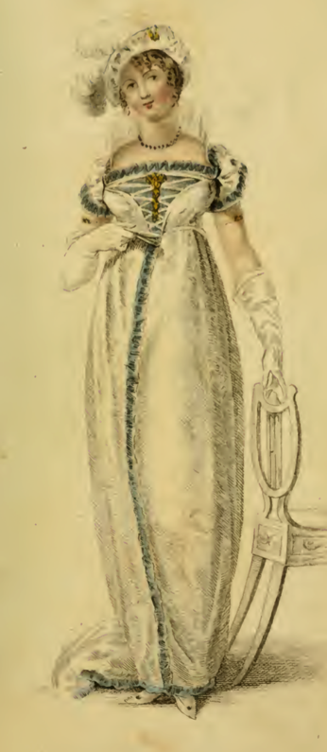
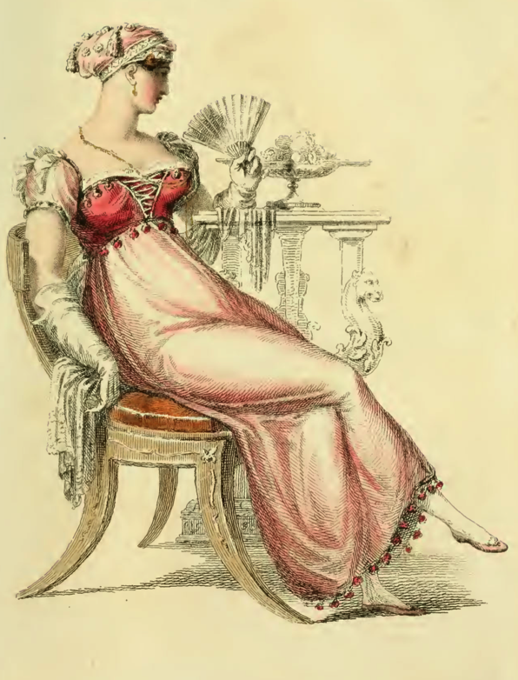
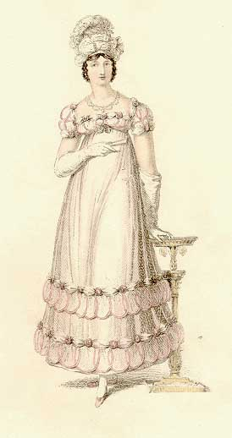
What did women wear?
1810
1813
1817
Notes:
1810s – look for the vertical central line – it’s everywhere!
1813 – emphasis shifting to the bodice, skirt still simple
1817 – lots of trim on bodice, lots of trim at skirt, skirt moving towards an a-line shape (6 panel skirt instead of 4 panels)

Slide 31
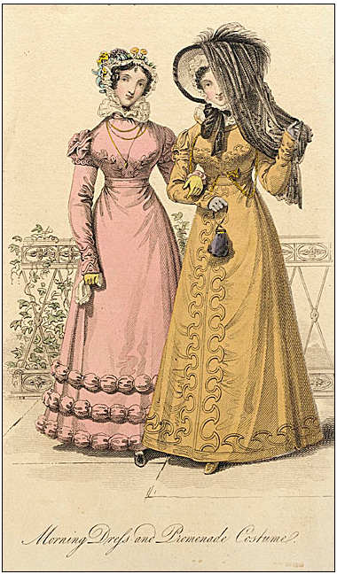
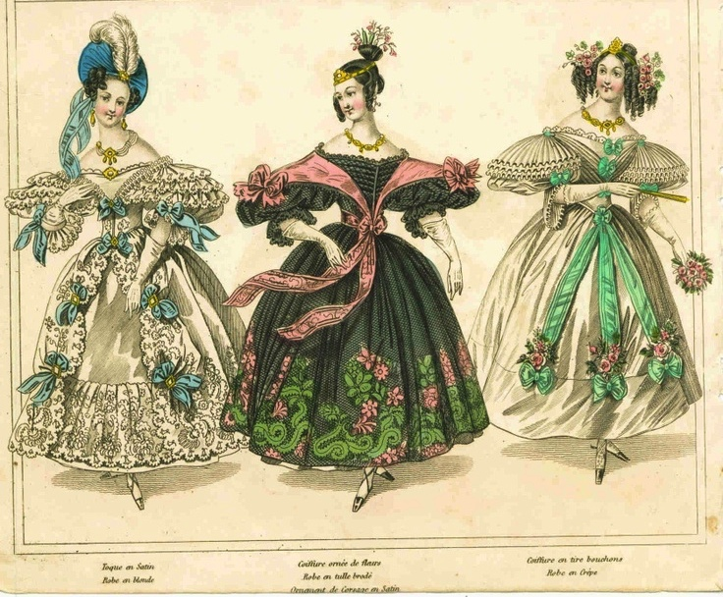
What did women wear?
1822
1830s
Notes:
1820s - Waist starting to drop, more coverage in smooth lines, wider skirt
1839s, horizontal here we come!

Slide 32
The Evolution of Fashion in Austen’s Lifetime

Slide 33
Jane Austen 1774-1817
A fashion timeline
1774-1790: Formal, wide, natural waist
1789-1799: High waists and muslins, full
1800-1810: Greek and Roman, narrowing
1811-1814: Gothic moves in, decorative trim
1815-1817: Shrinking bodice, more trim
1817… The return of volume
Notes:
If we look at clothing during her lifetime we see that her life covered one of the most tumultuous in fashion history.
Talk about volume – where’s the bulge – fashion silhouettes morph from vertical to horizontal to vertical and back, with an occasional foray into bustles. At this point western Europe had had 200 years of horizontal – time for a change even if it didn’t last long.

Slide 34
In Fashion Terms…
1775-1790 Youth – “horizontal” silhouette, natural waist, wide skirts, highly structured (but not for children)
1795-1800 First novels – waists move up, fabrics get more lightweight, moving to vertical but still very full
1801-1806 Bath years – extremely narrow, “Greek columns”
1807-1811 more fitted, the vertical line craze
1811-1817 emphasis moves to bodice and hem, more decoration, skirts widen at hem
After 1817 even more width at hem, waist starts to drop
Notes:
We tend to think of this entire period as that of “high waists” but the details of fashions actually changed quite a bit. While writing her early works, Austen would have dressed differently than she would have while writing later works, and would have envisioned her characters differently as well.

Slide 35
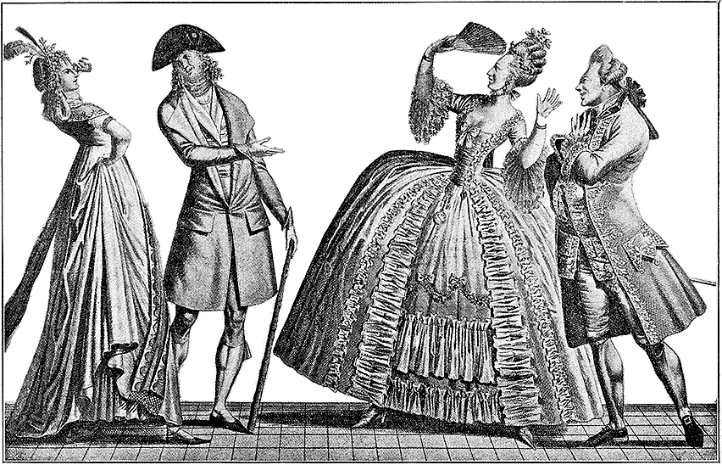
Notes:
A generational reaction of ‘quelle horreur!’ The fashion extremist man and woman were called “incroyables” and “merveilleuses”

Slide 36
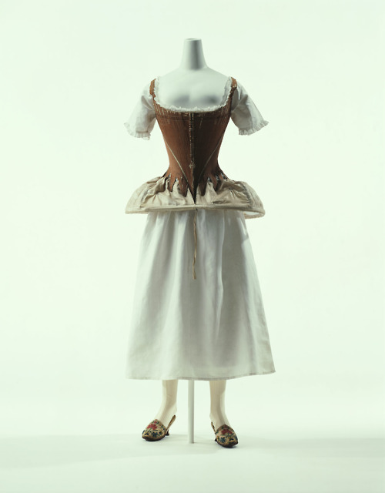
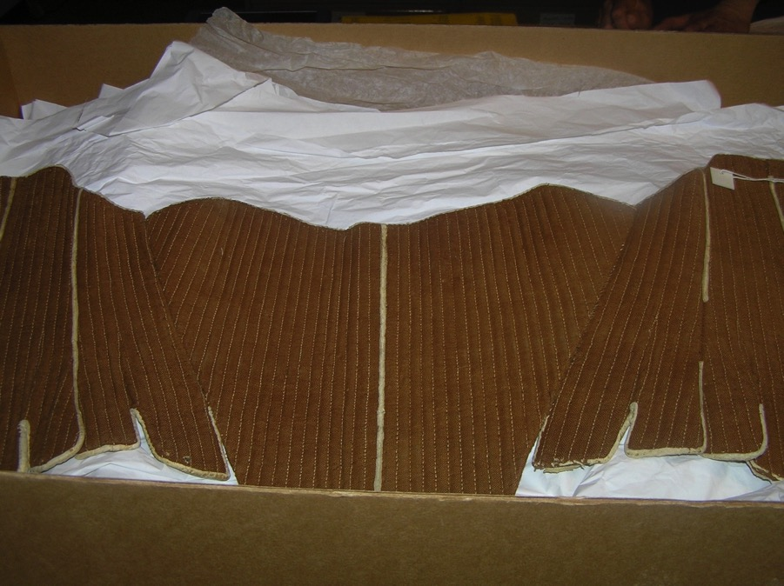
Stays, hoop, shift (Kyoto Costume Museum)
Stays (Fleming Museum)
Notes:
Stays, Hoops and shift – Kyoto Museum. Additional stays, Fleming Museum. Though the cut and boning layout evolved to be quite efficient by century’s end, the 18th century corset in general had “wall-to-wall” boning and was designed to create a barrel shape with rounded neckline. It was not about nipping in the waist, although from the front your waist might look smaller (from the side it would look larger).

Slide 37
Robe a l’anglaise: 1770s and 1780s
Notes:
A little trip back in time: draping, fitting, shaping. With fitting: 14th cent. Fitted, 15th - vertical, 16th - horizontal, vertical, horizontal. Since the 16th century women have been using stays or corsets for both support and for shaping. The shape and design of the stays or corsets provides the foundation for the shape of the clothing.

Slide 38
Robe a la francaise: 1770s and 1780s
Notes:
A little trip back in time: draping, fitting, shaping. With fitting: 14th cent. Fitted, 15th - vertical, 16th - horizontal, vertical, horizontal. Since the 16th century women have been using stays or corsets for both support and for shaping. The shape and design of the stays or corsets provides the foundation for the shape of the clothing.

Slide 39
Notes:
Later 18th (1770s) with petticoat and stomacher matching gown.

Slide 40
1790s
Notes:
1790s – same general barrel/cone shape but new lighter weight silk for gowns – a minimized/minamalist version of previous fashion

Slide 41
1780s
Chemise
Dress
Notes:
Marie Antoinette’s “chemise dress” Portrait by Elisabeth Louise Vigée-LeBrun,(Veejee lebron) dress by Rose Bertin
August 1784: Georgiana, Duchess of Devonshire, wears a chemise a la reine to a concert
Comtesse DuBarry
Jacques Louis David (1748-1825) “Antoine-Laurent Lavoisier (1743–1794) and His Wife (Marie-Anne-Pierrette Paulze, 1758–1836)
Date: 1788 She wears a normal corset under this new style gown.

Slide 42
In Fashion Terms…
1775-1790 Youth – “horizontal” silhouette, natural waist, wide skirts, highly structured (but not for children)
1795-1800 First novels – waists move up, fabrics get more lightweight, moving to vertical but still very full
1801-1806 Bath years – extremely narrow, “Greek columns”
1807-1811 more fitted, the vertical line craze
1811-1817 emphasis moves to bodice and hem, more decoration, skirts widen at hem
After 1817 even more width at hem, waist starts to drop

Slide 43
Why?
Was it the Greek statues?
Was it the French revolution?
Was it the Indies (East and West)?
Was it new technology?
Was it politics?
Was it the price of muslin?
Notes:
But the greatest change to note was that from silk to muslin as a fashionable formal fabric– not American craft muslin – this is mull – an Indian contain that would be almost transparent.
England – wool, Greek drapery, American egalitarianism, French freedom and egalite, West Indies – slave cotton, East Indies – true Indian muslins (Bangladesh suppression by British of Banglasdesh textile factories and workers to cut production and make room in the market for muslin made in England). Machines to make better thread, better weaving, better quality, cheaper to produce.

Slide 44
Notes:
Open robe 1790, still fairly structured, higher waist, full petticoat, corset to suit, with ‘tail’ to hold skirt out at back.

Slide 45
1790s: Big hats, big hair, big feathers
Notes:
The brown embroidered and sequined silk dress is a round gown – i.e. the dress is closed all the way around without a front opening.

Slide 47
1794
Notes:
Watch the sleeves – they are still elbow length. That will change, of course.

Slide 48
Wednesday, 18 December 1798:
“I believe I shall make my new gown like my robe, but the back of the latter is all in a piece with the tail, and will seven yards enable me to copy it in that respect?”

Slide 49
Tuesday, 8 January 1799:
“I am not to wear my white satin cap to-night, after all; I am to wear a mamalone [mameluk] cap instead…It is all the fashion now; worn at the opera, and by Lady Mildmays at Hackwood balls.”
Notes:
Warrior caste in Egypt defeated by Napoleon at the Battle of the Pyramids, 1798 “On July 1, 1798, Napoleon landed in Egypt with 400 ships and 54,000 men and proceeded to invade the country, as he had recently invaded Italy. But this Egyptian invasion was to be different. For, in addition to soldiers and sailors, Napoleon brought along 150 savants — scientists, engineers and scholars whose responsibility was to capture, not Egyptian soil, but Egyptian culture and history.” The ladies picked up the turban almost immediately.

Slide 50
In Fashion Terms…
1775-1790 Youth – “horizontal” silhouette, natural waist, wide skirts, highly structured (but not for children)
1795-1800 First novels – waists move up, fabrics get more lightweight, moving to vertical but still very full
1801-1806 Bath years – extremely narrow, “Greek columns”
1807-1811 more fitted, the vertical line craze
1811-1817 emphasis moves to bodice and hem, more decoration, skirts widen at hem
After 1817 even more width at hem, waist starts to drop
Notes:
It’s all about the column and the ionic column is mimicked by the way corsets are designed to ‘lift and separate.’

Slide 51
1800-1808: tall and narrow, less fabric, trains
Notes:
Still lots of fabric gathered at waist but the silhouette is definitely vertical, the greek column ideal
1) 1800-artstor-AMICO_CLARK_103902762
1) 1800-artstor-pinkback-AMICO_CLARK_103902764

Slide 52
Notes:
Fashion plates emphasize the vertical by making women into giantesses. These women are the same “size” but depicted as much taller.

Slide 53
Notes:
1810 “A scene taken from nature in Kensington Gardens” Gillray commenting on lightweight cotton and flimsy petticoats. Naked did not mean see through, it meant ‘see shape.’

Slide 54
Notes:
James Gillray (1757-1815)

Slide 55
The year 1740, a Lady’s full dress of Bombazeen. The year 1807, a Lady’s undress of Bum-Be-Seen.
Notes:
The year 1740 a Lady’s Full Dress of Bombazeen. The year 1807 a Lady’s Undress of Bum-be-seen (Full dress refers to formal evening dress, undress usually refers to daytime clothes but here it refers to rather more…or less as the case may be.)

Slide 56
In Fashion Terms…
1775-1790 Youth – “horizontal” silhouette, natural waist, wide skirts, highly structured (but not for children)
1795-1800 First novels – waists move up, fabrics get more lightweight, moving to vertical but still very full
1801-1806 Bath years – extremely narrow, “Greek columns”
1807-1811 more fitted, the vertical line craze
1811-1817 emphasis moves to bodice and hem, more decoration, skirts widen at hem
After 1817 even more width at hem, waist starts to drop

Slide 57
Notes:
This corset is missing it’s busk and boning but you can see that it has few bone channels and a gathered shelf-like bodice like the gowns under which it would have been worn.

Slide 58
Notes:
As we move towards 1810 the vertical emphasis appears in the decoration as well as the construction. Trains continue to be seen in evening dress though they are disappearing from day dress.
1804: Museum of Modern Art
1805-1810, Museum of Fine Arts, mull (muslin) with red crewel embroidery, Accession number: 22.665

Slide 59
Notes:
Ackermann, May 1809
MMA 1810

Slide 60
1810: Trains hang on in evening dress
Notes:
Ackermann, Jan. 1809 Note also the gothic or Spanish influence in the bodice
La Belle Assemblée, Dec. 1810

Slide 61
In Fashion Terms…
1775-1790 Youth – “horizontal” silhouette, natural waist, wide skirts, highly structured (but not for children)
1795-1800 First novels – waists move up, fabrics get more lightweight, moving to vertical but still very full
1801-1806 Bath years – extremely narrow, “Greek columns”
1807-1811 more fitted, the vertical line craze
1811-1817 emphasis moves to bodice and hem, more decoration, skirts widen at hem
After 1817 even more width at hem, waist starts to drop

Slide 62
1813: Emphasis shifting to bodice
Notes:
By 1813 the emphasis is shifting to the bodice. The vertical line disappears from the skirt and the bodice gets the eye-catching trim
1) Ackermann, April, 1812
2) Ackermann, Dec. 1812

Slide 63
McCord Museum, Montreal, 1810s
Notes:
McCord Museum, 1810s. Accession number M982.20.1

Slide 64
Notes:
Corsets continue to evolve, longer to create a smooth columnar line, busk still there to provide support and posture, and bustline very high
1) Late 18-teens, early 1820s corset. Kyoto Costume Institute
2) A very original corset – original, a recreation? Fleming Museum – do not duplicate or repost.
3) c. 1820 Connecticut Historical Society

Slide 65
Notes:
Museum of London. Spencer and gown with distinctive “divorcer’ cut

Slide 66
Notes:
Ackermann, Jan 1815

Slide 67
1815
Notes:
1815-1820 – the move to decorated bodice and hem
1) Ackermann, July 1815
2) Ackermann, June 1815

Slide 68
In Fashion Terms…
1775-1790 Youth – “horizontal” silhouette, natural waist, wide skirts, highly structured (but not for children)
1795-1800 First novels – waists move up, fabrics get more lightweight, moving to vertical but still very full
1801-1806 Bath years – extremely narrow, “Greek columns”
1807-1811 more fitted, the vertical line craze
1811-1817 emphasis moves to bodice and hem, more decoration, skirts widen at hem
After 1817 even more width at hem, waist starts to drop

Slide 69
Notes:
Small bodice, sleeves fall at waistline

Slide 70
Notes:
Skirt hem even wider, waist begins to drop. Corset shows how this narrowed waist is achieved.

Slide 71
Notes:
1) Sturbridge – early 1820s – the gown looks pink but it is actually brown and white striped (I made it in deep blue)
2) Colonial Williamsburg. That ruched bodice shows up frequently in the early 20s
Both have the 6 panel skirt.

Slide 72
What did women wear?
Women’s basics from the inside out,
or, dressing Mrs. Darcy.

Slide 73
Shift/chemise
Notes:
Wpmens’ shifts were cut similar to men’s shirts but by the 19th century were more a-line.

Slide 74
Saturday, 9 January 1796:
“You say nothing of the silk stockings; I flatter myself, therefore, that Charles has not purchased any, as I cannot very well to pay them...”
Notes:
Thursday Sept 16: What a good for nothing fellow Charles is to bespeak the stockings. I hope he will be too hot all the rest of his life for it.

Slide 75
Notes:
Rowlandson, 1800, “Exhibition Stair Case” at Somerset House leading to the gallery of the Royal Academy of Art (pres. Sir Joshua Reynolds)

Slide 76
Notes:
Corset: two layers of linen, channels of baleen or cord, single spiral laced, busk (thin wooden stick about 1-2”wide – great for posture)

Slide 77
1790s
Notes:
Petticoats can be seen or unseen, an underlayer or not.

Slide 78
Notes:
Unlike the ornate petticoats of the earlier 18th cent, turn of- and early 19th century petticoats were sometimes meant to be seen, sometimes not. On the right is Cassandra’s water-colour of Jane with her overgown tucked up.

Slide 79
Chemisette
Notes:
A fine cotton lawn (rarely ever linen) garment meant to fill in the neckline. Usually worn for day dress.

Slide 80
Notes:
Caps for sleeping, caps for morning wear, caps to wear under bonnets, even evening at homes. Morning wear caps could be quite ornate with embroidery, lace, ribbons, and flowers. Caps are useful for keeping your hair clean and out of the way.

Slide 81
Sunday, 2 June 1799:
“Flowers are very much worn, and fruit is still more the thing. Elizabeth has a bunch of strawberries, and I have seen grapes, cherries, plums, and apricots.”
Tuesday, 11 June 1799:
“I cannot decide on the fruit till I hear from you again. Besides, I cannot help thinking that it is more natural to have flowers grow out of the head than fruit. What do you think on that subject?”
Notes:
1800 Heideloff – smaller than earlier 1790s hats, rounded shape for short curly hair.

Slide 82
1800-06 Hair and hats round and close to head
1808-1810: Accommodating Greek hair
Notes:
Rounded hats (hats=no ties; bonnets=ties)
Bonnet: Metropolitan Museum of Art

Slide 84
Notes:
Ackermann, Dec. 1814 bonnets and hats. Shaped to accommodate hairstyles. Crown moves from fullness in back (Greek) to room at the top (Roman).

Slide 85
Reticules
Notes:
Also spelled ridicule

Slide 86
Wednesday, 9 January 1799:
“I wore my green shoes last night…”
Sunday, 2 June 1799:
“I am not fond of ordering shoes;
and, at any rate,
they shall all
have flat heels.”
Notes:
Earliest had small heels, these have flat heels and pointed toes. Later shoes would have rounded toes, then evolve to squared toes (Victorian)

Slide 87
Morning: Before Dinner
Early: write, play piano, meet with housekeeper, sew (work), read novels(!)
Breakfast: 10:00-11:00
Mid-day: pay or receive morning calls
Notes:
Elizabeth walks to Netherfield after breakfast – the Netherfield people, being Londoners who retain their city hours in the country, are just sitting down to breakfast as she arrives.

Slide 88
Morning Dress
Notes:
But which gown? This is the period where upper class women dressed according to the time of day: Morning dress (anytime before dinner around 1:00, or 2, 3, 4…) If you were at home to visitors you would wear these. For paying calls you might have preferred afternoon, carriage, or promenade dress.

Slide 89
Afternoon, Walking, Promenade, Carriage Dress
Notes:
Ackermanns 1810, 1814, 1820

Slide 90
Cloaks: 1794-1797
Notes:
Cloaks, hats, hair, fine spotted or sprigged muslin (Indian cotton) gowns

Slide 91
Spencer
Notes:
Afternoon Dress – Walking Dress – Promenade - Carriage Dress: Spencers, named after Lord Spencer, were short jackets, often military-inspired. In recent movies there seems to be a trend to make them shorter in the back than the gown they are being worn with, i.e. hem is above the waistline of dress. I’ve never seen any pictured this way so it looks odd to me.

Slide 93
Thursday, 18 April 1811:
“Our pelisses are 17s. each; she charges only 8s. for the making, but the buttons seem expensive, — are expensive, I might have said, for the fact is plain enough.”
Notes:
Jane Austen’s pelisse - http://www3.hants.gov.uk/austen/austen-pelisse.htm
Ackermann, March 1815

Slide 94
Notes:
These examples are post-1815, of silk, showing the richness of detail that became the hallmark of pelisses at this time.

Slide 95
Notes:
3 piece Spencer dress. It would never have been worn without the jacket but may have been worn open at the throat to show the military braiding on the bodice.

Slide 96
Notes:
Even ladies got to wear caped greatcoats!

Slide 97
Notes:
Gloves, shawls, half-boots. And a ruff and spencer that look quite like the one made for “Bright Star”
1815-1818
Printed in La Mode Illustre? See also a copy in Ackermann, Dec. 1815

Slide 98
Notes:
Shopping at Wedgewood showroom.

Slide 99
Notes:
Linen-draper Harding Howell & Co at Pall Mall, 1809

Slide 100
Notes:
Scarborough Circulating Library

Slide 102
Evening
Dinner: 5:00, no 6, no 7, how about 8?
Tea
Cards and conversation
Rout
Ball
Opera
Notes:
Dinner keeps moving to be later and later so “morning” (for morning calls, etc.) now extends from about 11:00 to 5:00. Once it becomes well-established as a later meal the Duchess of Bedford ‘invents’ afternoon tea to fill in the gap (1840s)

Slide 103
Notes:
Or full dress- evening dress – opera dress – dinner dress
1) Ackermann, March 1814
Opera dress is usually the most formal/decorated, with hats. Evening and dinner dress are also dressy, with hats. The new fashion for long sleeves in evening wear is remarked upon by Mrs. Bennet.

Slide 104
Notes:
Ackermann, Jan. 1813 (‘Russian’ gown) Russian becomes even more popular after the state visit Csar Alexander and other Allied Sovereigns in June 1814. Princess Charlotte is painted in a Russian gown by Dawe in 1817. The painting and actual gown are described here: https://janeaustensworld.wordpress.com/2012/04/22/princess-charlottes-blu-gown/
Metropolitan Museum of Art

Slide 105
Notes:
Ball dress, Ackermanns, Feb. 1814. Note the shorter hemline for dancing. Although the woman wears a veil the norm would be to wear no hat – hair would be intricately configured with flowers or other decoration instead.
Peach-colored dress: McCord Museum,

Slide 106
Notes:
The Assembly Rooms at Bath:
“Here, salutary rules exclude all those
Whom no one hears of, and whom no one knows;
That no plebian breathings may infect
An atmosphere at all times so select;
No bankers’ clerks these splendid realms invade;
No FOLKS who carry on a retail trade;
No actors by profession must appear
To act their parts, or speak their speeches here;
Yet even here, amid the crowds you view,
’Tis sometimes difficult to tell WHO’S WHO.”
Pierce Egan, Walks Through Bath, 1819

Slide 107
Notes:
Only to be obtained from one of the seven lady patronesses. Usually exclude new money people but sometimes could even exclude landed gentry who had misbehaved. Ball on Wednesday nights during the Season (spring – starts after Parliament returns from the winter hunting season) from 11:00-3:00. Best place to catch a husband, no one allowed in after midnight, refreshments minimal – lemonade, watered wine, pound cake and bread/butter. Lady Jersey (Sally Fane) (not to be confused with her mother the POW’s mistress), Emily Cowper, Countess Lieven (Dorothea Benckendorff), Mrs. Drummond-Burrell, Lady Castlereagh, Lady Sefton, Princess Esterhazy

Slide 108
Specialty Dress:
Mourning
Riding
Court

Slide 109
Saturday, 15 October 1808:
On the death of her sister-in-law Mrs. Edward Austen:
“I am to be in bombazeen and crape, according to what we are told is universal here, and which agrees with Martha’s previous observation. My mourning, however, will not impoverish me, for by having my velvet pelisse fresh lined and made up, I am sure I shall have no occasion this winter for anything new of that sort.”
Notes:
On the death of Mrs. Edward Austen
Specialty Dress: Mourning. Bombazeen (bombazin) was particularly popular for mourning because it was a twill silk with a dull, not shiny, surface.

Slide 110
Thursday, 20 November 1800:
“Miss Debary, Susan, and Sally, all in black, but without any statues, made their appearance…”
Notes:
1819, 1810, 1816. Women in mourning were typically depicted draped over urns, statues, tombstones…The broach is a piece of hair jewelry – the weeping willow is made of hair. There were several royal deaths in the years after Austen’s death so fashion magazines provided suitable clothing.

Slide 111
Notes:
Riding Habits, often (usually) made by tailors instead of dressmakers.

Slide 112
Notes:
Court dress – specific rules about number of feathers, decoration, etc. Extremely expensive. This is the post 1820 version after the POW changed the rules.

Slide 113
Notes:
Court dress: Unfortunately the rules about hoop width did not change before waists went up!

Slide 114
Austen, Fashion, Novels

Slide 115
Notes:
S&S Miss Steele, stockings 1804: Promenade in Kensington Gardens. Smart vs. elegant. The Steeles were described as “by no means ungenteel or unfashionable; their dress was very smart”
Compare to Miss Tilney: had a good figure, a pretty face, and a very agreeable countenance; and her air, though it had not all the decided pretension, the resolute stylishness of Miss Thorpe's, had more ‘real elegance.’

Slide 116
Notes:
1800 Robert Fellows, philanthropist, by Edridge Blue coat: Tory
Mr. Bingley was good-looking and gentlemanlike; he had a pleasant countenance, and easy, unaffected manners. His sisters were fine women, with an air of decided fashion. His brother-in-law, Mr. Hurst, merely looked the gentleman; but his friend Mr. Darcy soon drew the attention of the room by his fine, tall person, handsome features, noble mien, and the report which was in general circulation within five minutes after his entrance, of his having ten thousand a year. The gentlemen pronounced him to be a fine figure of a man, the ladies declared he was much handsomer than Mr. Bingley, and he was looked at with great admiration for about half the evening, till his manners gave a disgust which turned the tide of his popularity; for he was discovered to be proud; to be above his company, and above being pleased; and not all his large estate in Derbyshire could then save him from having a most forbidding, disagreeable countenance, and being unworthy to be compared with his friend.
Mr. Bingley had soon made himself acquainted with all the principal people in the room; he was lively and unreserved, danced every dance, was angry that the ball closed so early, and talked of giving one himself at Netherfield. Such amiable qualities must speak for themselves.

Slide 117
Notes:
1815-blake-engraving: “Henry and I went to the exhibition in Spring Gardens. It is not thought a good collection, but I was very well pleased, particularly (pray tell Fanny) with a small portrait of Mrs. Bingley, excessively like her. “

Slide 118
Notes:
P&P Elizabeth as seen by the Bingley sisters: “Hem 6 inches deep in mud, I am absolutely certain, and the gown which had been let down to hide it not doing its office.”

Slide 119
Notes:
Wickham: “Wanted only regimentals to make him charming” i.e. he is trying to ‘change his coat’ thus hide his reputation.

Slide 120
Notes:
1814Mrs. B. rhapsodizing over long sleeves and boring Mr. B with talk of lace. Long sleeves. And Lydia - listen to how she talks about clothes – Andher letter to Kitty “I shall send for my clothes when I get to Longbourn; but I wish you would tell Sally to mend a great slit in my worked muslin gown before they are packed up.” Yes, that was deliberate: Jane Austen is no prude.
Ackermann, Sept. 1814

Slide 121
Mrs. Elton:
“as elegant as lace and pearls could make her”
Notes:
Emma/Mrs. Elton: as elegant as lace and pearls could make her”
Ackermann, June 1813

Slide 122
Questions?
References?
Want to see more images?
hope.greenberg@uvm.edu

