Slide 1
The Fashionable Miss Austen
Hope Greenberg

Slide 2
Jane Austen
What did men and women (“of good society”) wear during Austen’s lifetime?
How did fashion change over the course of her life?
How fashion conscious was she, personally? (in her letters)
How did she use fashion in her novels?
Notes:
There are a number of questions we can consider when looking at clothing in Jane Austen’s time.

Slide 3
The Novels
1795 “Elinor and Marianne”(Sense and Sensibility) written
1796-1797 “First Impressions” (Pride and Prejudice) written.
1798-1799 “Susan/Catherine” (Northanger Abbey) written.
1811 Mansfield Park begun. Pride and Prejudice revised.
1813 Pride and Prejudice published.
1814 Mansfield Park published.
1815 Emma completed and published (1816 on title page).
1816 Persuasion completed. “Susan” revised as “Catherine.”
Notes:
We tend to think of this entire period as that of “high waists” but the details of fashions actually changed quite a bit. While writing her early works, Austen would have dressed differently than she would have while writing later works, and would have envisioned her characters differetnly as well.

Slide 4
What did men wear?
Men’s basics from the outside in,
or, undressing Mr. Darcy.

Slide 5
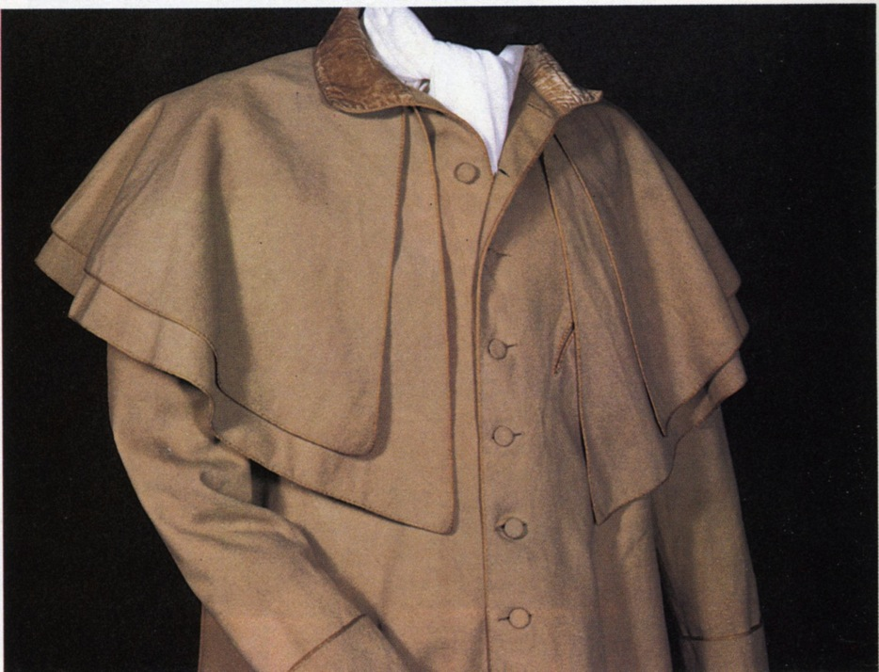
Greatcoat, overcoat
Catherine Morland of Henry Tilney: “His hat sat so well, and the innumerable capes of his great-coat looked so becomingly important. To be driven by him, next to being dancing with him, was certainly the greatest happiness in the world!”
Notes:
Henry can speak of fashion with impunity
A greatcoat was made of “cloth” which was a synonym for wool. The capes were originally designed to keep off rain but they quickly became a fashion statement as well, as Catherine notes with admiration.

Slide 6
Thursday, 15 September 1796
“Edward and Fly went out yesterday very early in a couple of shooting jackets and came home like a couple of bad shots, for they killed nothing at all.”
Notes:
Awareness of shooting jacket—the country life attire influence. This picture is a bit deceptive as regards the quote. Edward and Fly would have walked to go shooting with the object to bring back birds. If they hunting they would have been riding. If they were hunting on foot, and it was not their property or they did not have permission of the property owner, they might have been arrested for poaching.

Slide 7
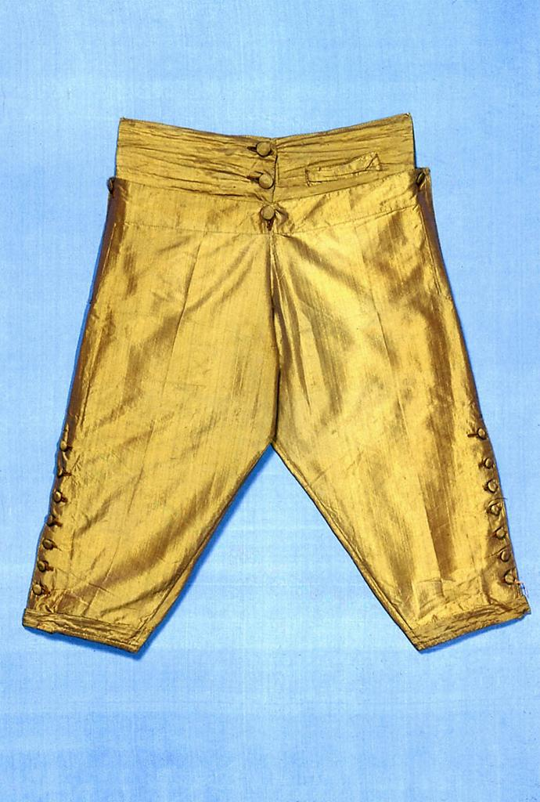
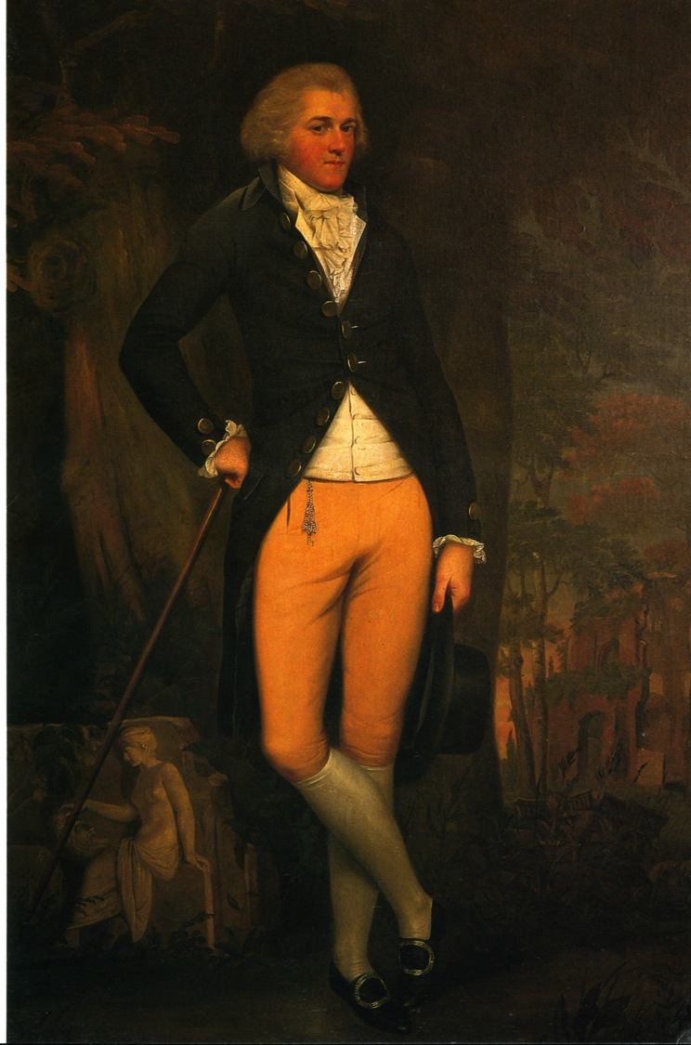
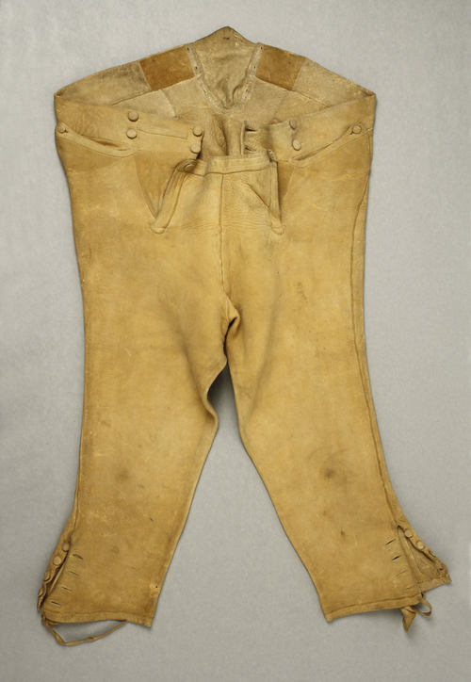
Notes:
Edward Austen Knight, grand tour, 1800. Breeches continued in popularity throughout Austen’s lifetime. By the 180ss they were beginning to be nudged out by pantaloons and trousers but hung on in the country or for formal wear. And they were never allowed into Almack’s in anything but knee breeches. There is a story, unconfirmed, that even the Duke of Wellington was turned away when he arrived in trousers. Another version has him turned away because he arrived after the official time allowed, midnight.

Slide 8
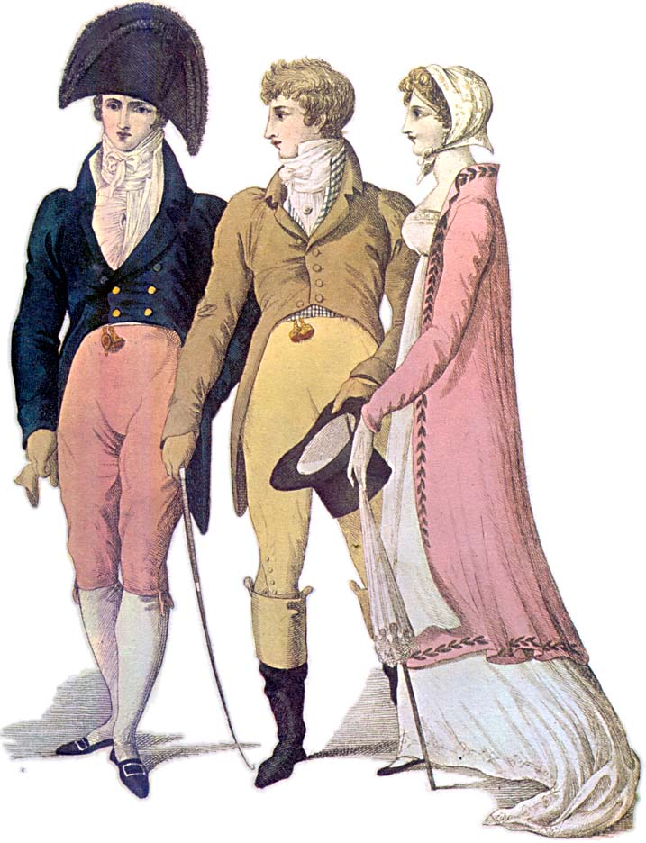
Notes:
1809 – cutaway, swallow-tail, classical statues – the nude male vs. the draped female

Slide 9
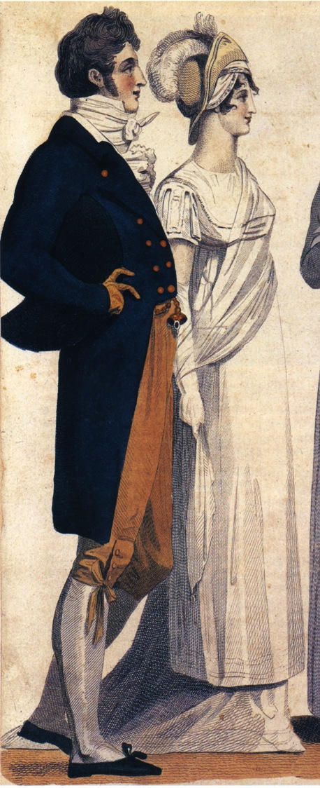
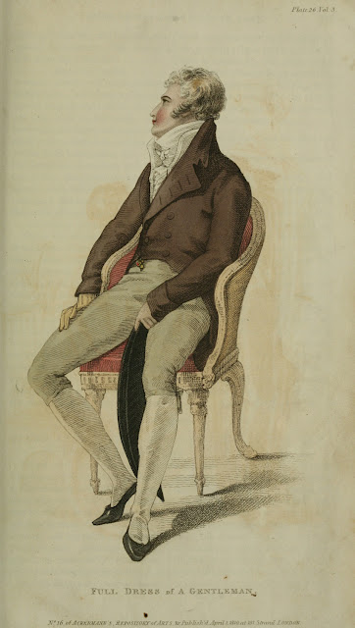
Notes:
1807, 1810, subtle differences in cut of breeches and coat

Slide 10
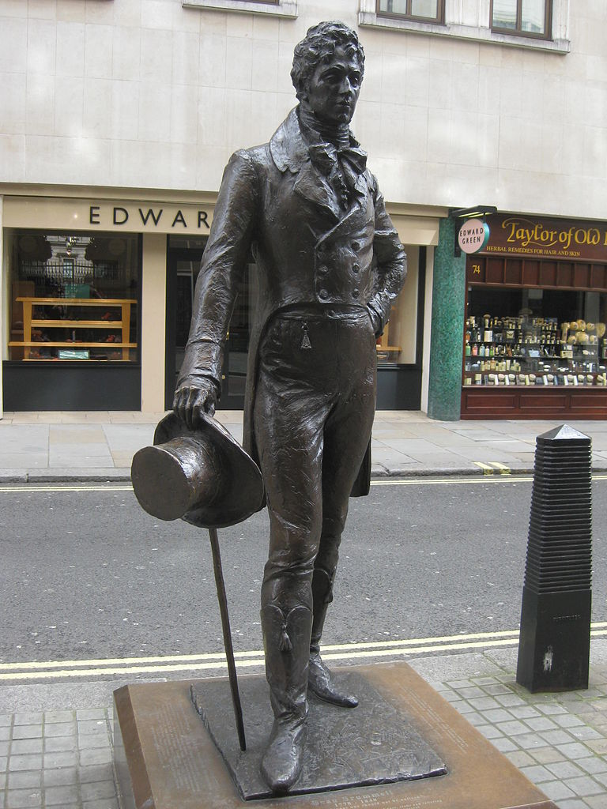
George Bryan “Beau” Brummel
Notes:
George Bryan “Beau” Brummell who almost singlehandedly changed fashion. Friend of the Price Regent, made simple yet exquisitely tailored clothing the mode to be followed, notorious for demanding a full tub bath every day, and a perfectionist when it came to his cravats. see next slide

Slide 11
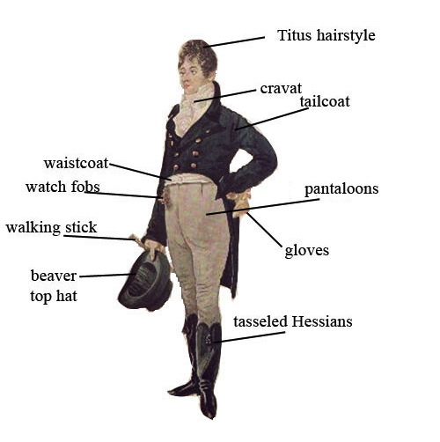
George “Beau” Brummel
Notes:
1805 Dighton caricature – blue superfine (wool) coat, pantaloons,

Slide 12
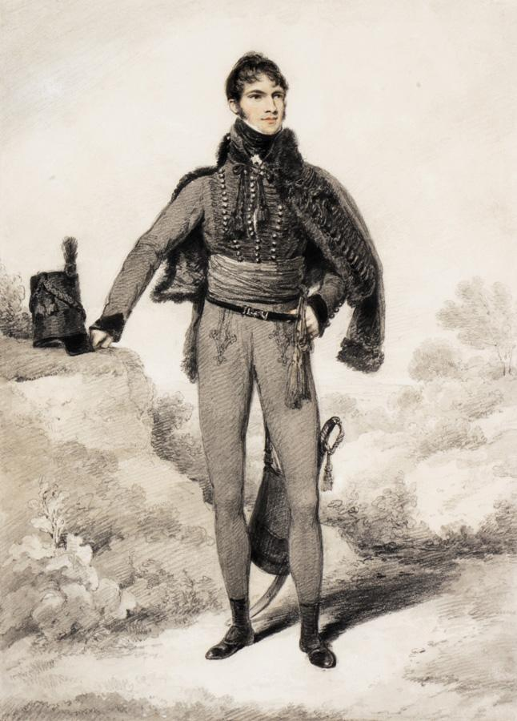
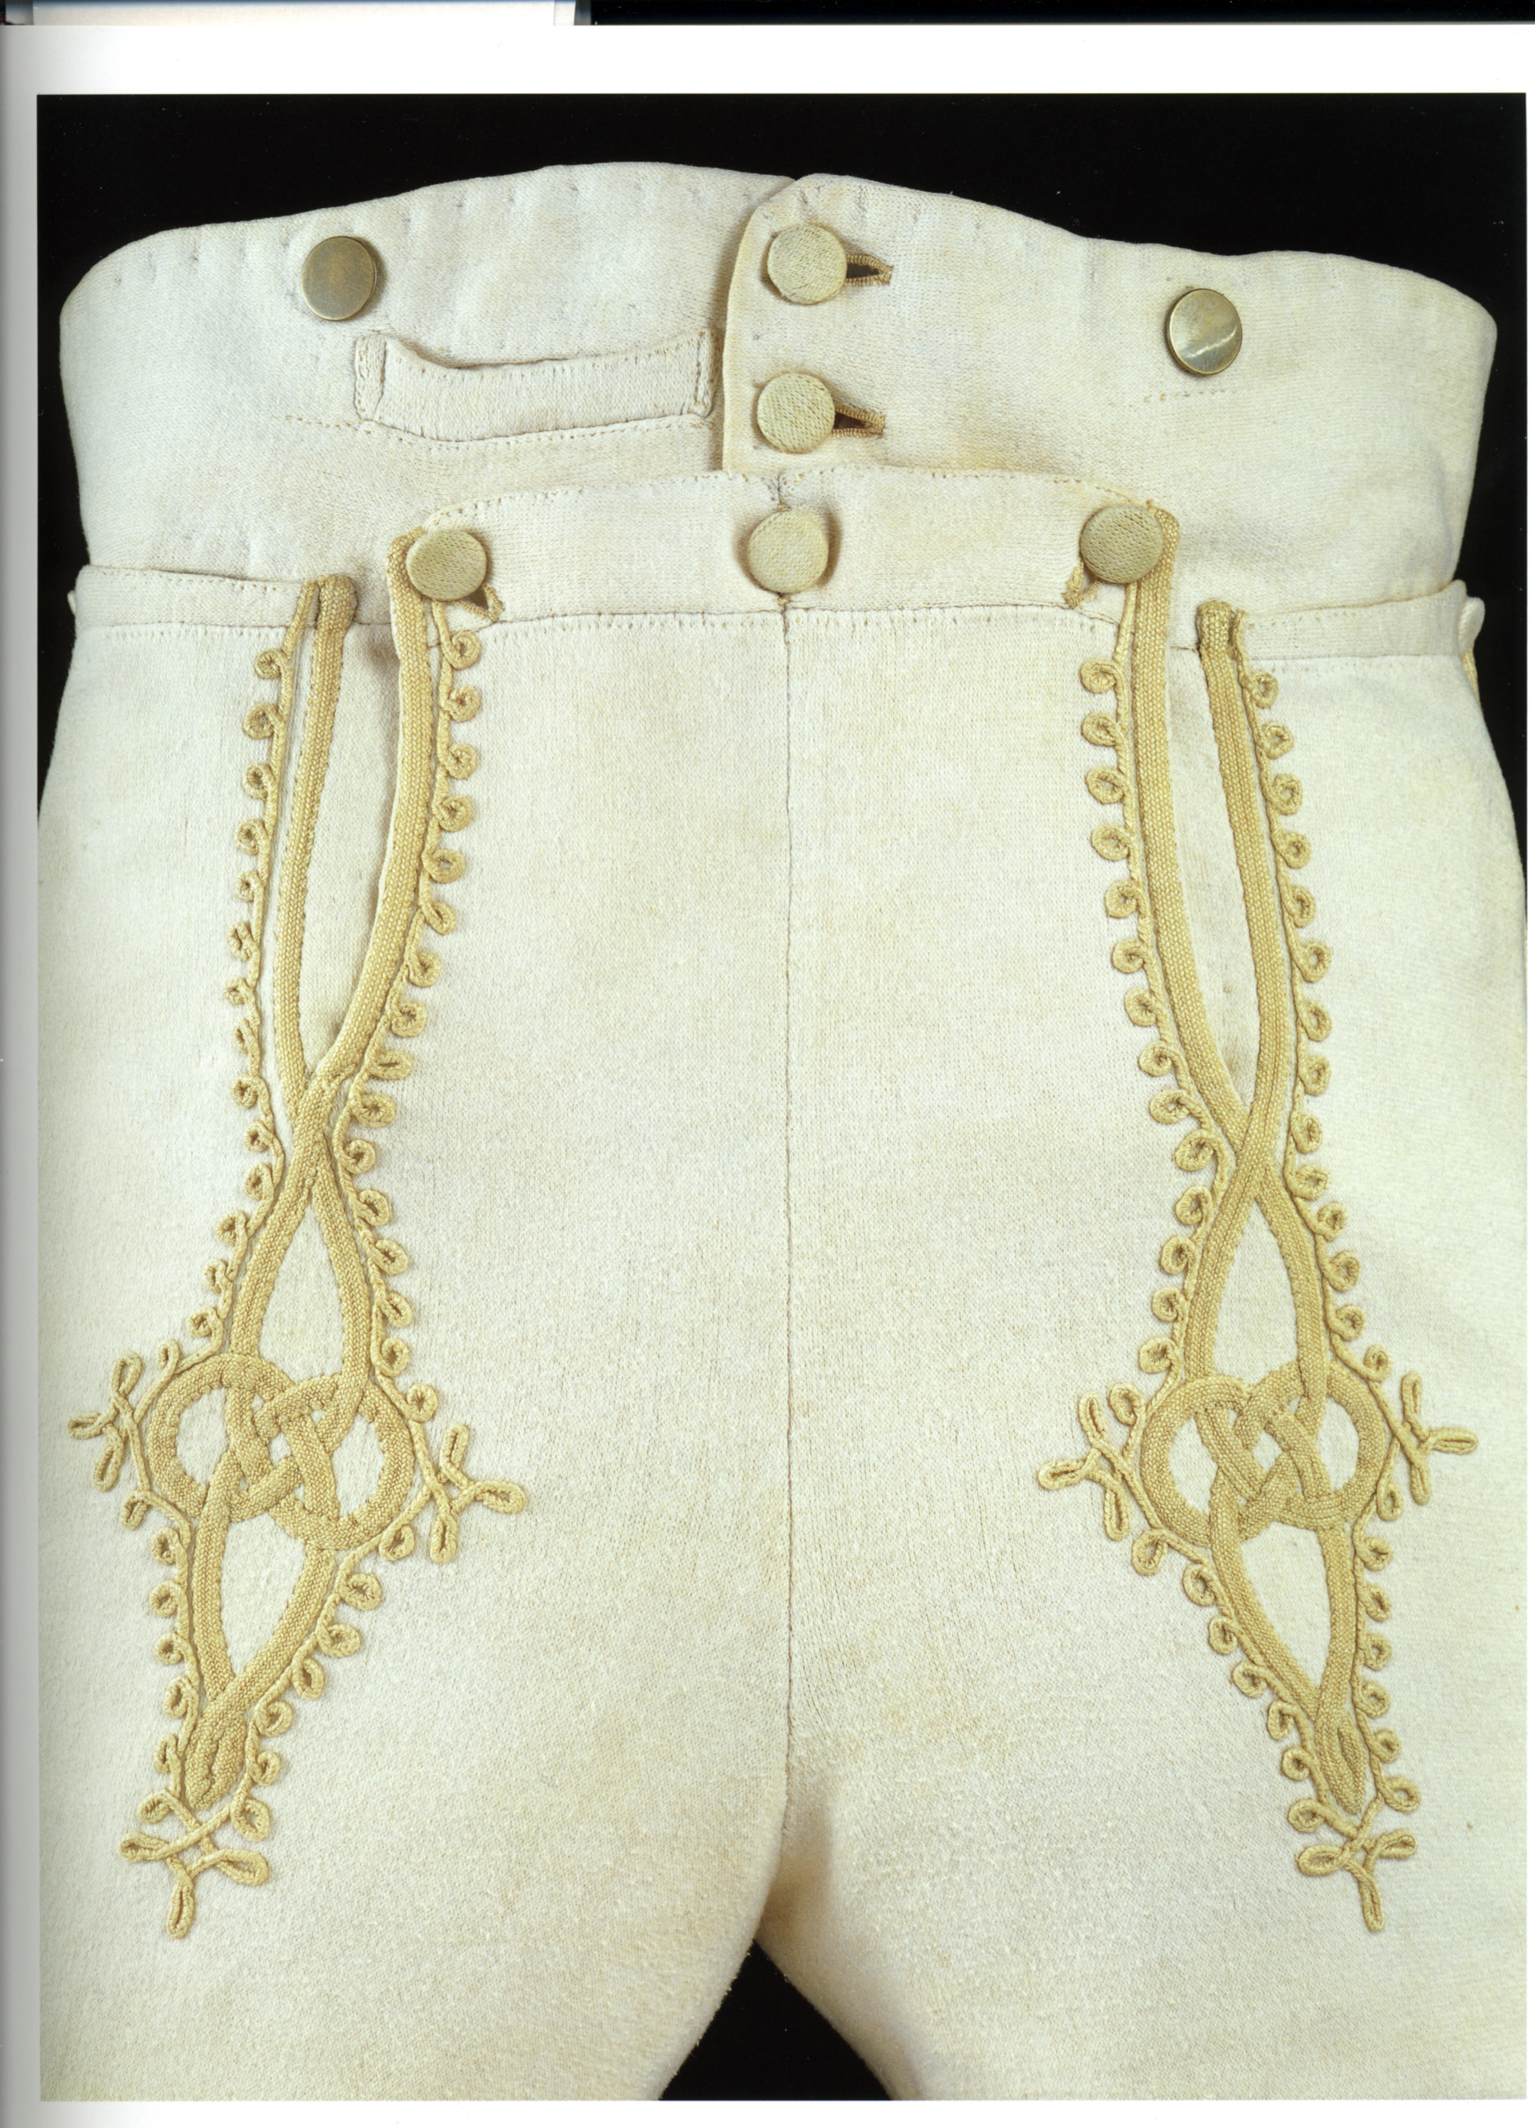
Notes:
Sir William Harbord, 1810 by Edridge, The other major influence on men’s fashion: military pantaloons – wool knit to cling and stretch.

Slide 13
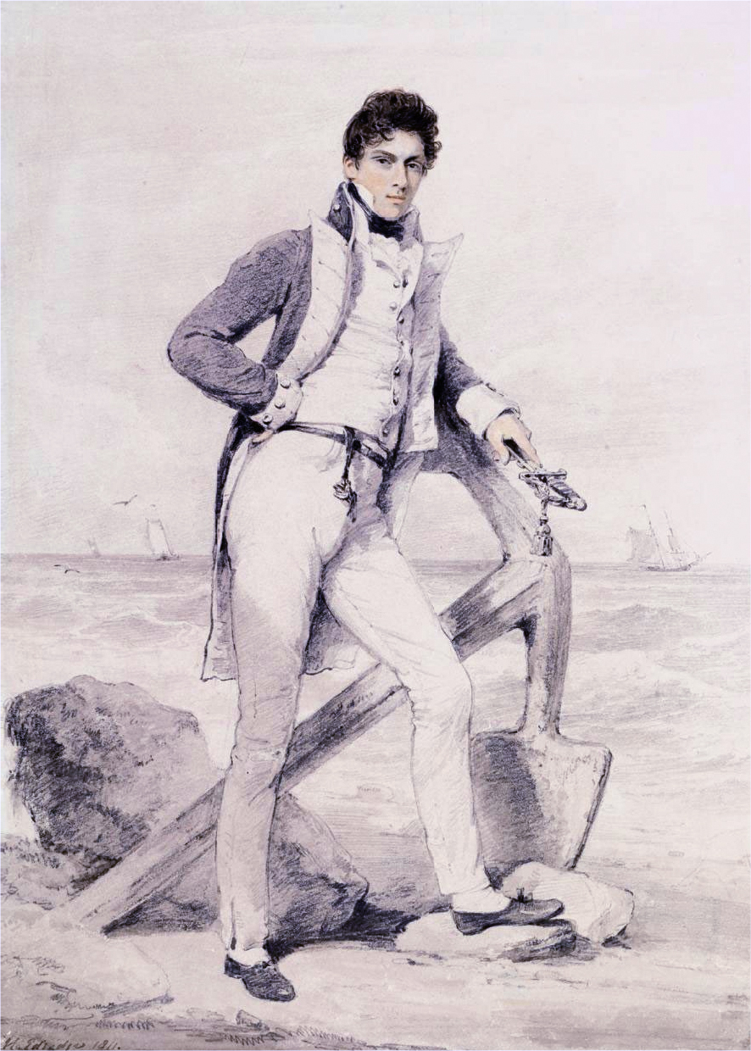
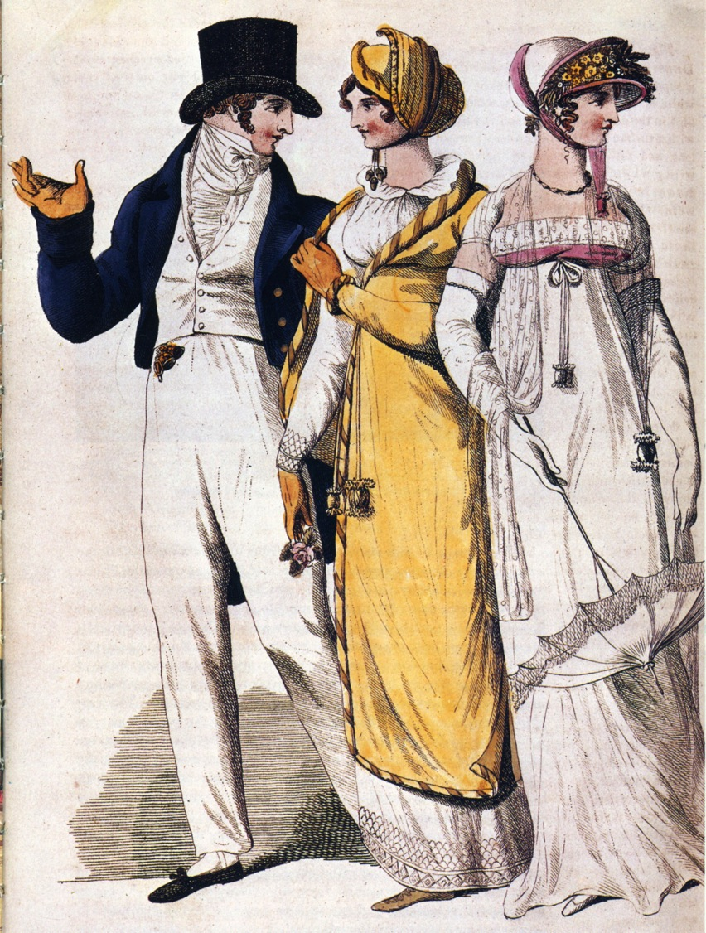
Notes:
Captain Hoste 1811 by Edridge. Sailor’s trousers
People in park, 1807. The young man adopts the Navy uniform look.

Slide 14
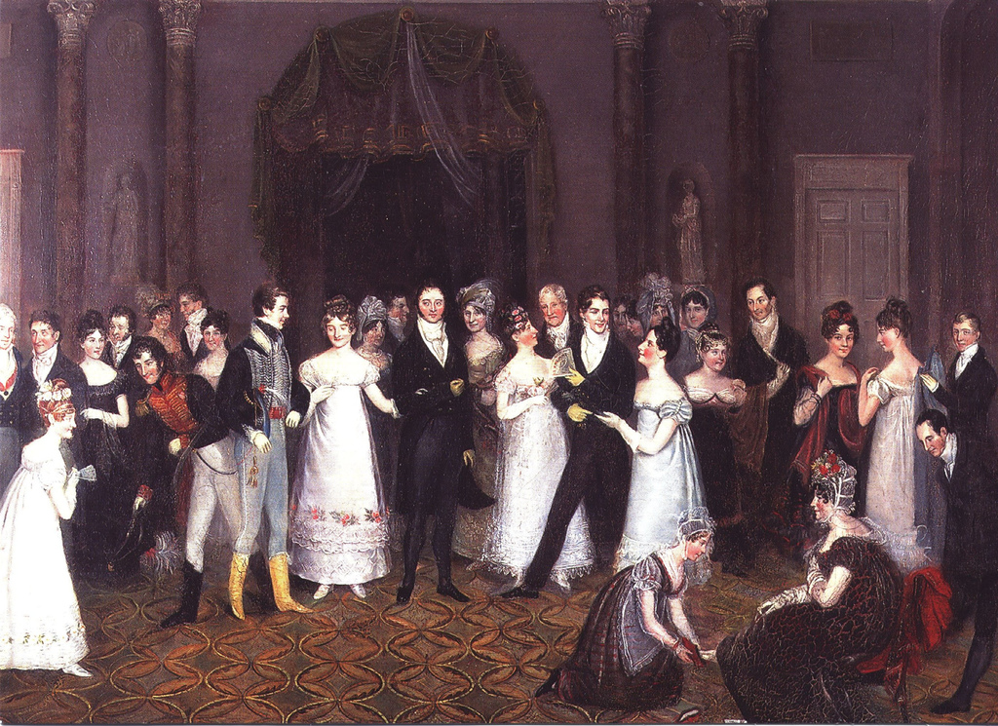
Notes:
Rolinda Sharples “The CloakRoom at the Assembly Rooms at Clifton”1818: Yolanda Shows examples of all mens options. The older gentleman on the left wears grey/light silk breeches, the armu men are in their uniforms with panataloons, the thirty-something husband in the middle wears black breeches while the young flirt wears trousers. Also note the impossibly tiny bodices on the women’s gowns. For more on Clifton Assembly see http://www.thespasdirectory.com/profilego.asp?ref=2841393B

Slide 15
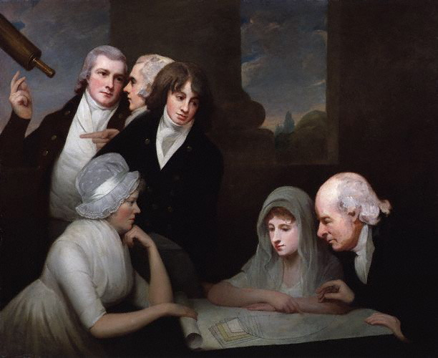
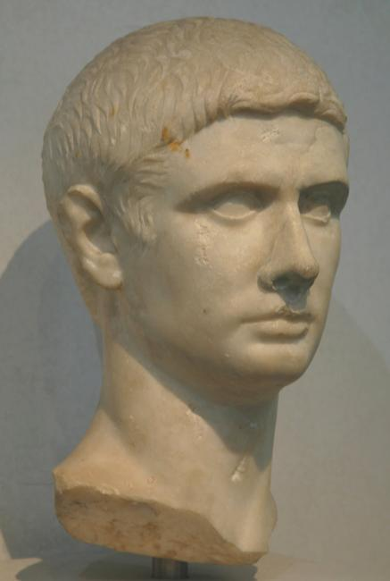
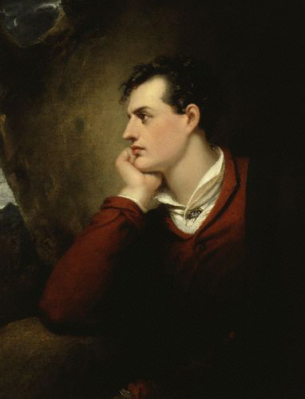
Hair
Notes:
1796 or so, after Pitt’s hairpowder tax of 1795, statue of Titus, Lord Byron. Style names “The Brutus” “The Windswept” “The Stanhope Crop”

Slide 16
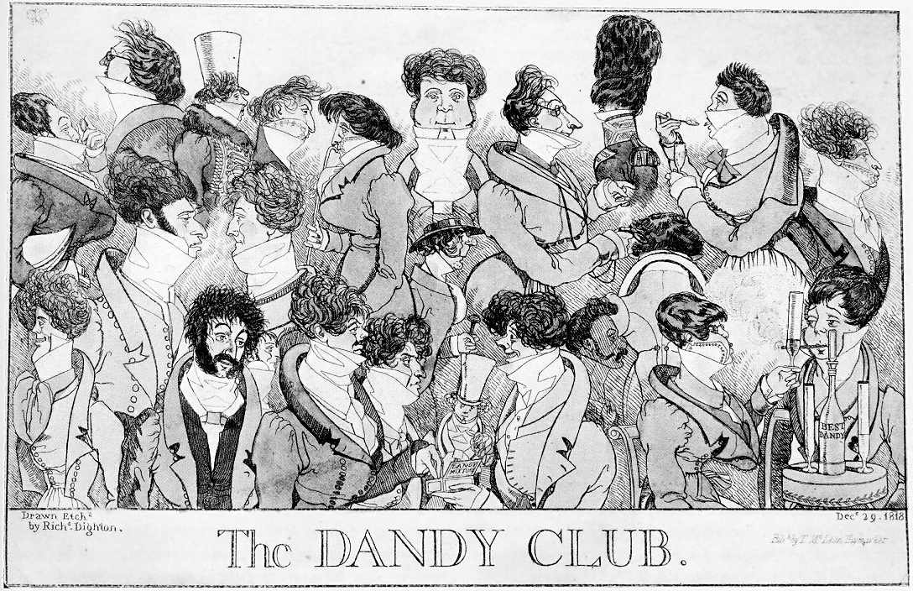
Notes:
1818 – Brummell would not have approved these extremes

Slide 17
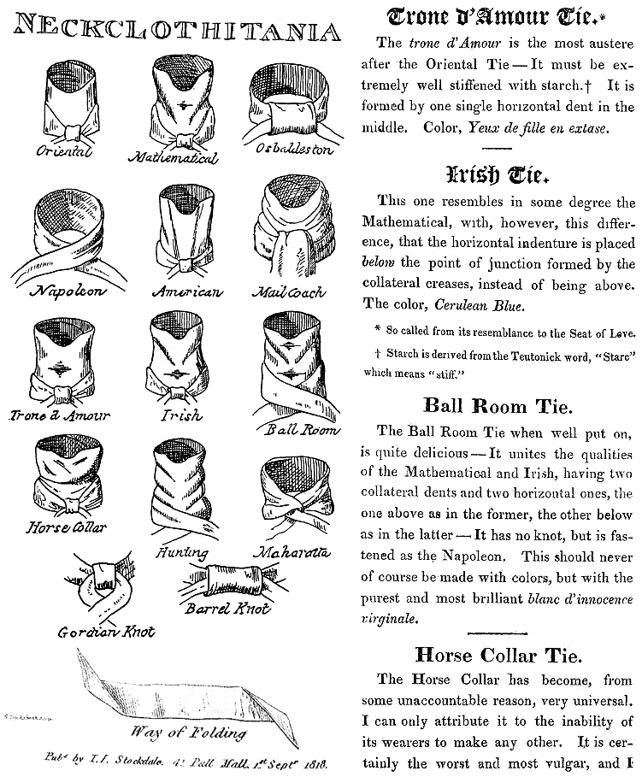
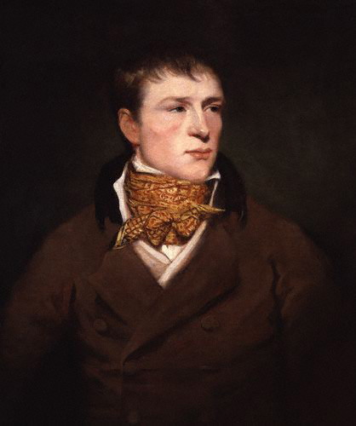
Notes:
Some neckcloth styles with fanciful names. The boxing star Jem Belcher with his trademark spotted neckcloth.

Slide 18
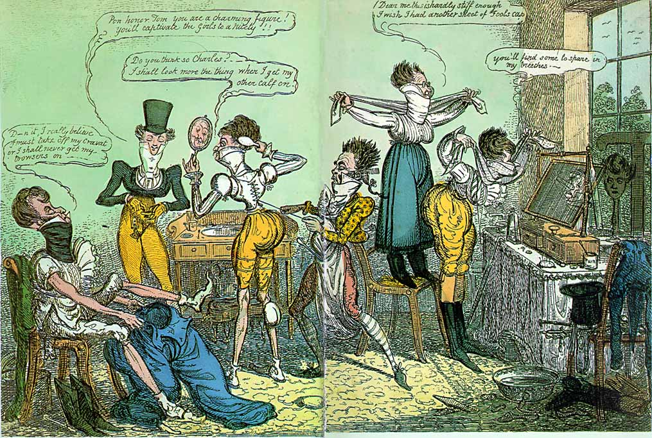
Notes:
1818 Cruickshank

Slide 19
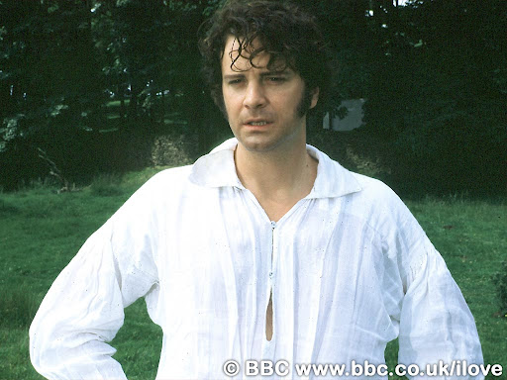

Slide 20
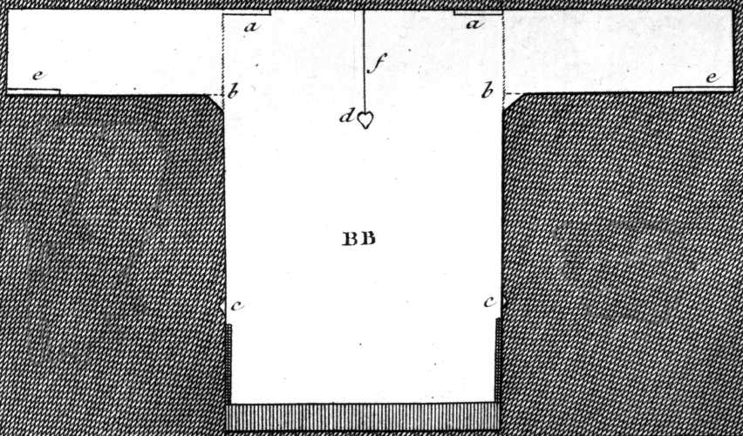
Thursday, 1 September 1796:
“We are very busy making Edward’s shirts, and I am proud to say that I am the neatest worker of the party.”
Notes:
While many people had their clothing made by tailors (men’s clothing but also women’s riding habits) or modistes/dressmakers, people often made or at least trimmed and finished, their own. But shirts and shifts were usually made by the women in the family. The cut was simple and extremely economical, using all the width of the linen. The “workbasket” was always to hand with shirts/shifts to be sewn.

Slide 21
What did women wear?
Women’s basics from the inside out,
or, dressing Mrs. Darcy.

Slide 22
Sunday, 25 November 1798:
“The Overton Scotchman [a peddler carrying fabric for sale door to door] has been kind enough to rid me of some of my money, in exchange for six shifts and four pair of stockings. The Irish [linen] is not so fine as I would like it; ... It cost me 3s. 6d. per yard. It is rather finer, however, than our last, and not so harsh a cloth.”
Notes:
21 shillings for Emma = about $95 in 2011 so 3s 6d is about $14/yd.
20 shillings in a pound, 12 pence in a shilling
Dr. Eric Nye - http://uwacadweb.uwyo.edu/numimage/currency%20conversion.htm “A Method for Determining Historical Monetary Values”

Slide 23
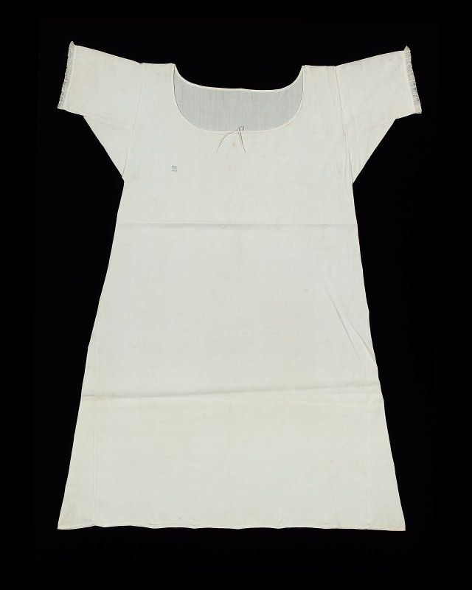
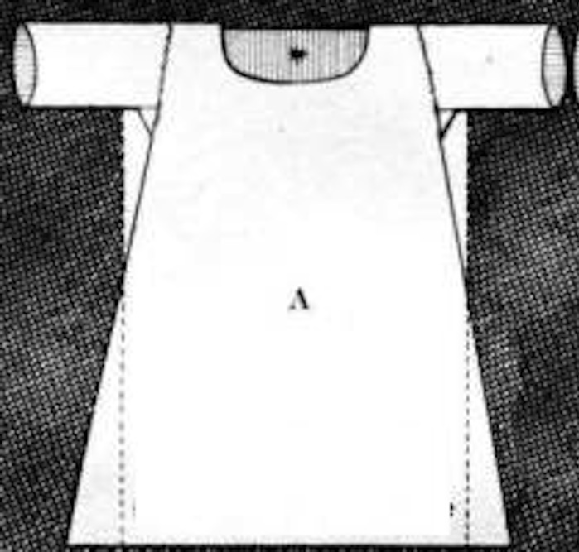
Shift/chemise
Notes:
Wpmens’ shifts were cut similar to men’s shirts but by the 19th century were more a-line.

Slide 24
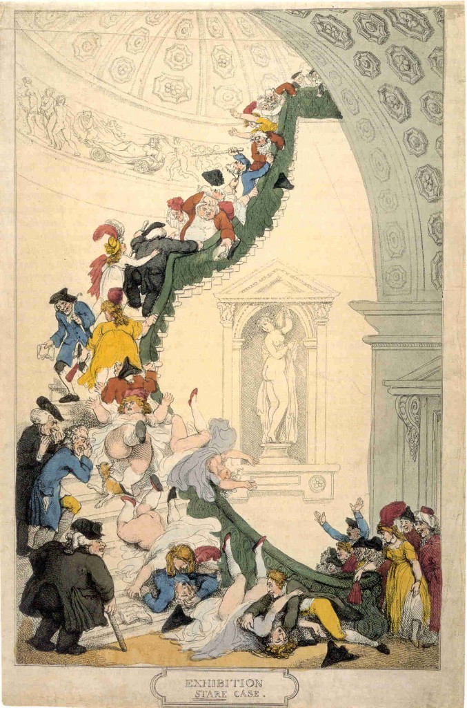
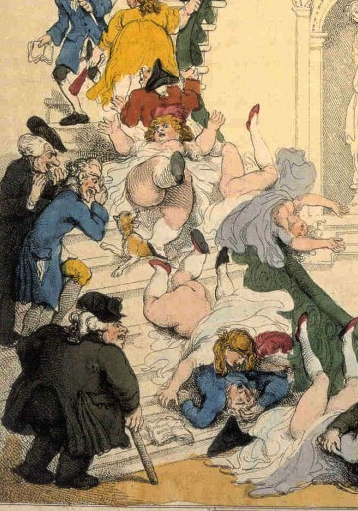
Notes:
Rowlandson, 1800, “Exhibition Stair Case” at Somerset House leading to the gallery of the Royal Academy of Art (pres. Sir Joshua Reynolds)

Slide 25
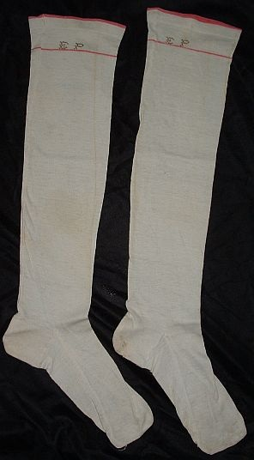
Saturday, 9 January 1796:
“You say nothing of the silk stockings; I flatter myself, therefore, that Charles has not purchased any, as I cannot very well to pay them...”
Notes:
Thursday Sept 16: What a good for nothing fellow Charles is to bespeak the stockings. I hope he will be too hot all the rest of his life for it.

Slide 26
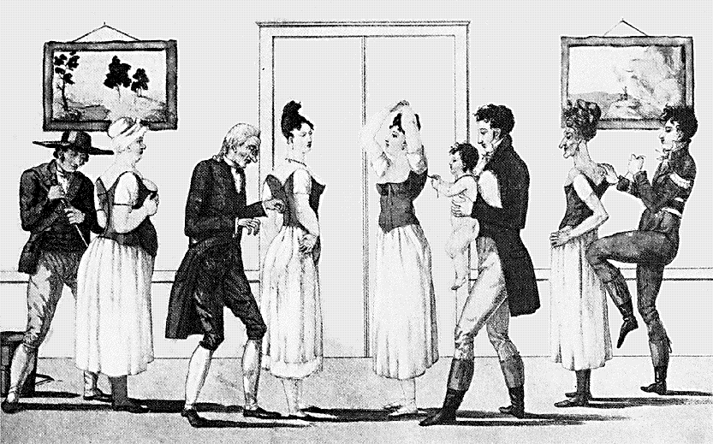
Notes:
Corset and stockings, two layers of linen, channels of baleen or cord, single spiral laced, busk (thin wooden stick about 1-2”wide – great for posture)

Slide 27
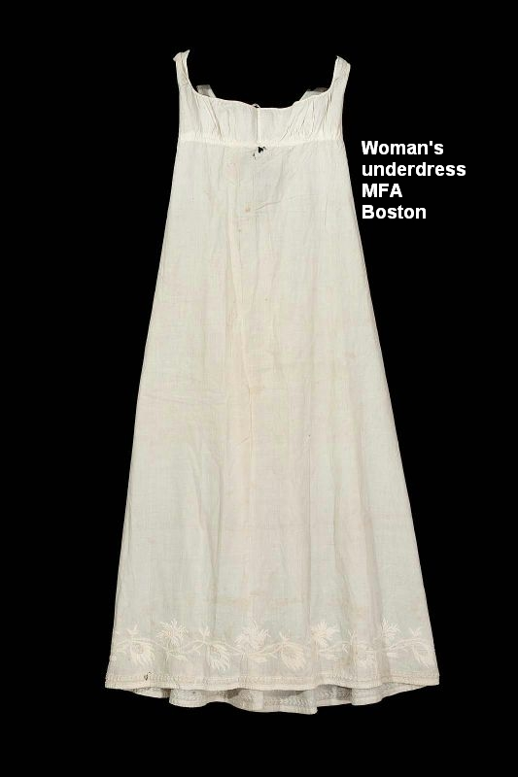
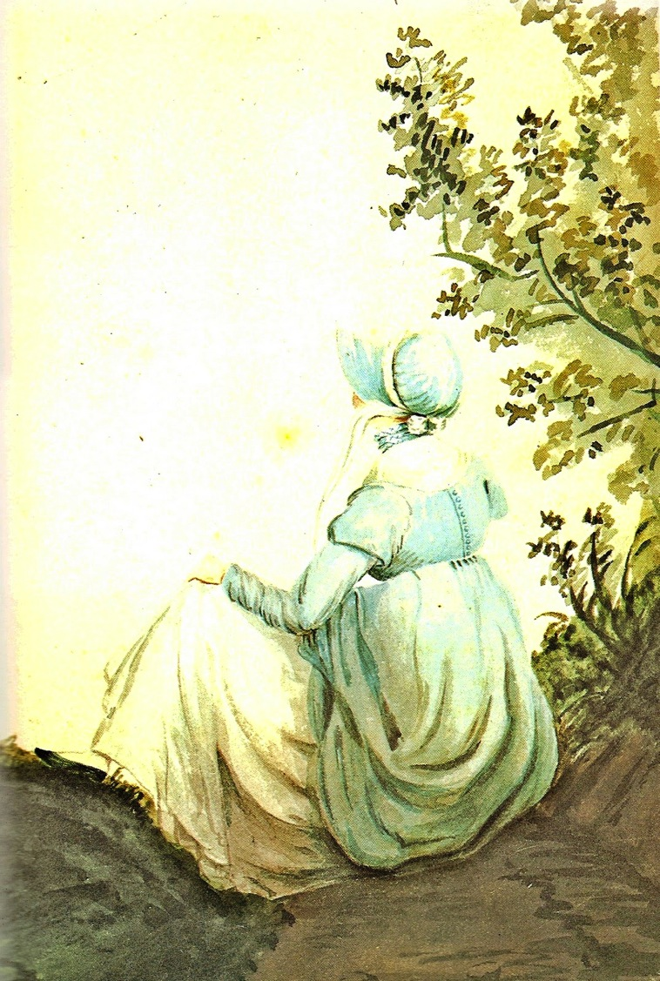
Notes:
Unlike the ornate petticoats of the earlier 18th cent, turn of- and early 19th century petticoats were sometimes meant to be seen, sometimes not.

Slide 28
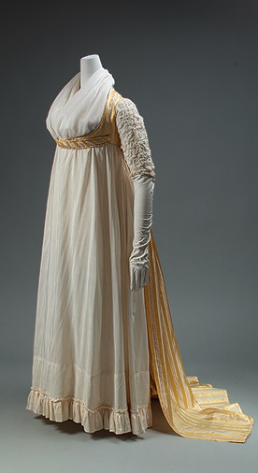
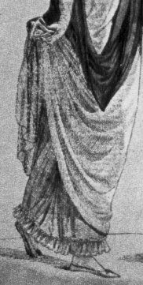

Slide 29
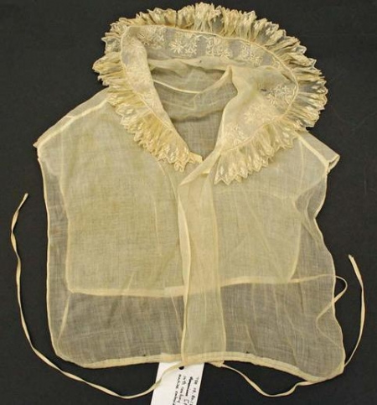
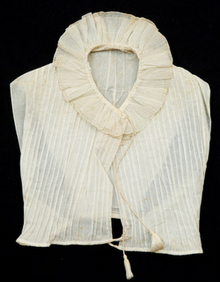
Chemisette
Notes:
A fine cotton lawn (rarely ever linen) garment meant to fill in the neckline. Usually worn for day dress.

Slide 30
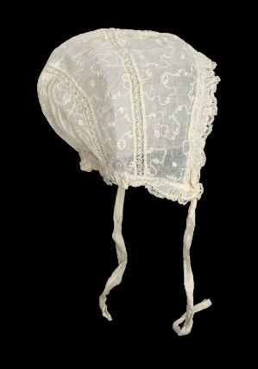
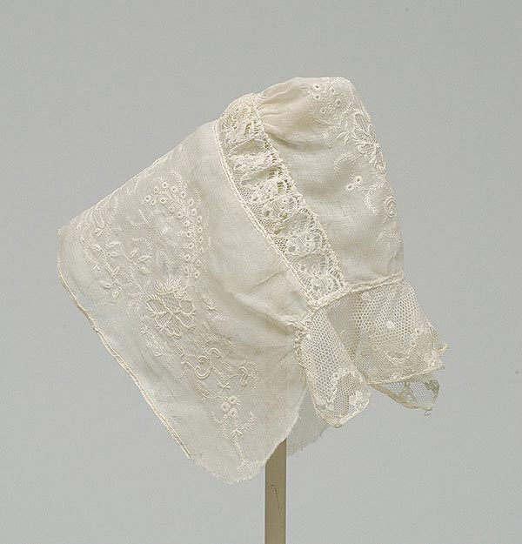
Notes:
Caps for sleeping, caps for morning wear, caps to wear under bonnets, even evening at homes. Morning wear caps could be quite ornate with embroidery, lace, ribbons, and flowers.

Slide 31
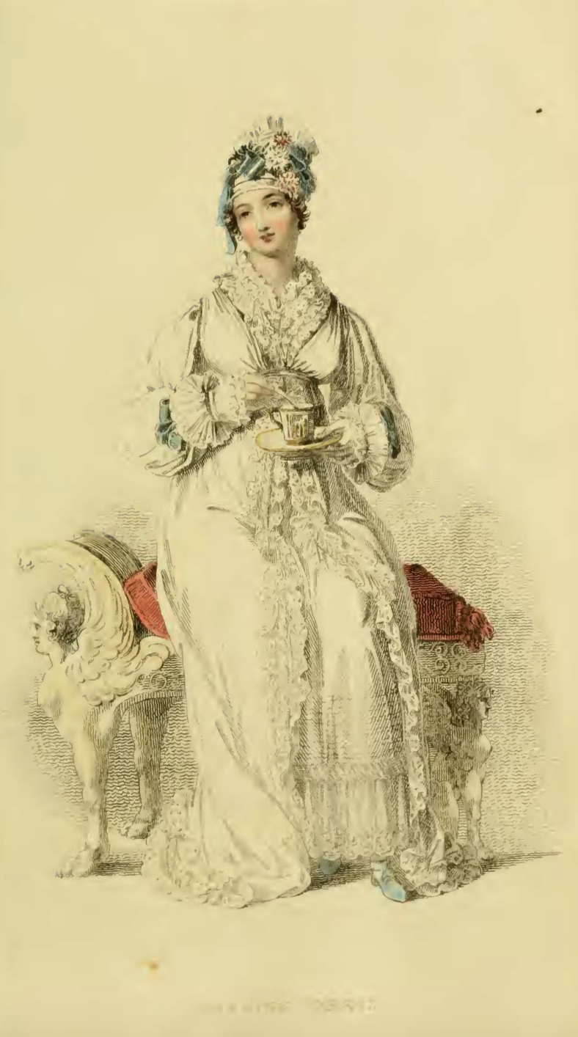
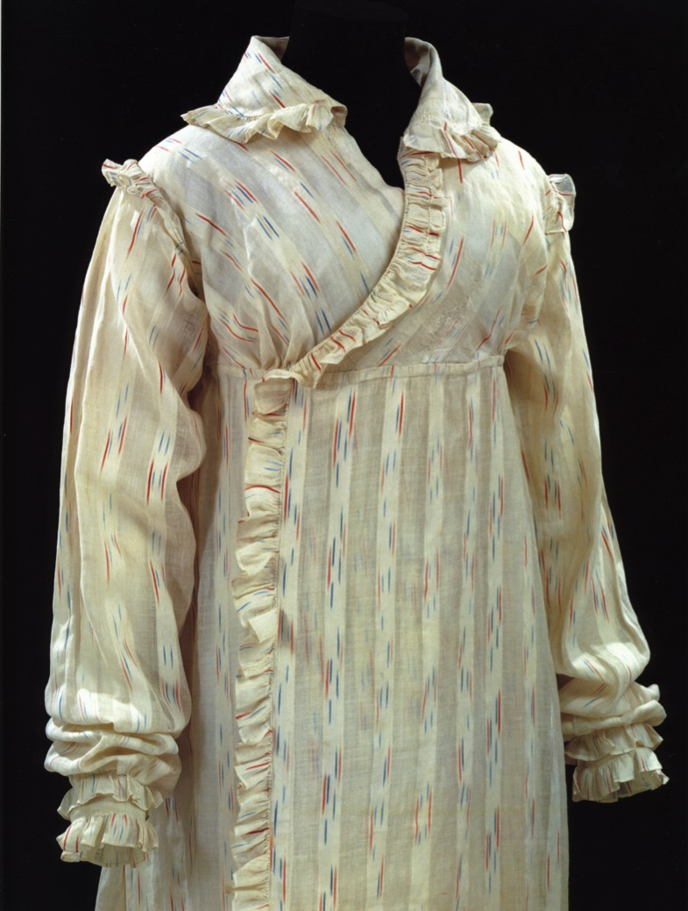
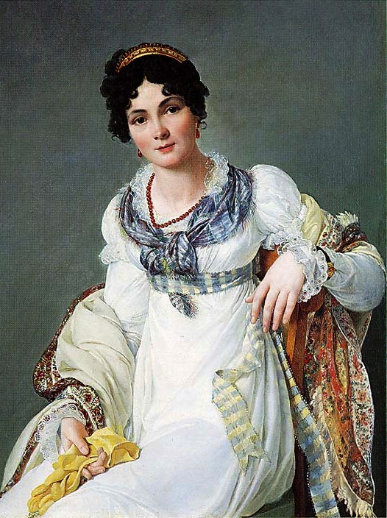
Morning Dress
Notes:
But which gown? This is the period where upper class women dressed according to the time of day: Morning dress (anytime before dinner around 1:00, or 2, 3, 4…) If you were at home to visitors you would wear these. Even if paying calls, although for those you might have preferred afternoon, carriage, or promenade dress.

Slide 32
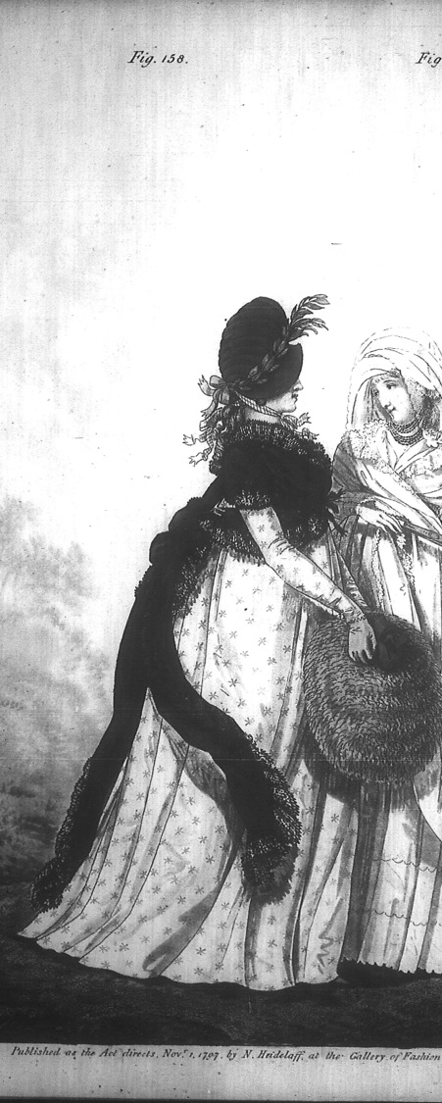
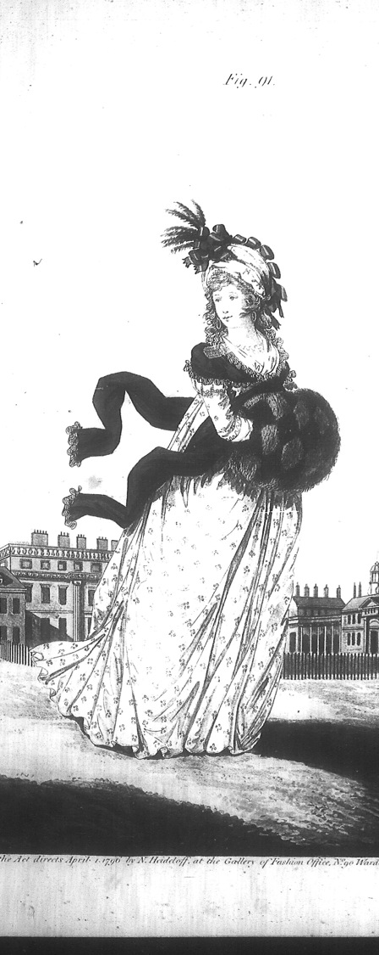
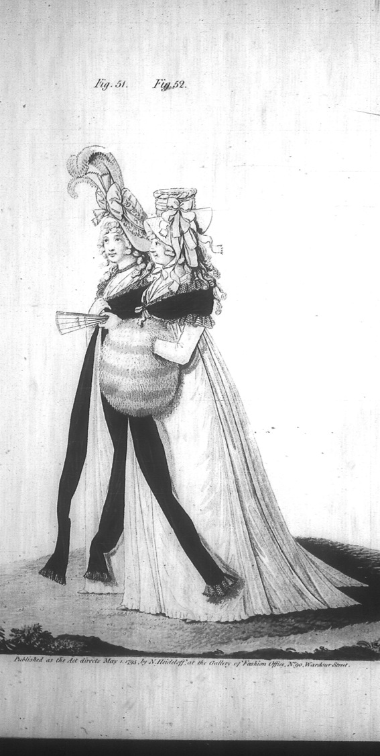
Cloaks: 1794-1797
Notes:
Cloaks, hats, hair, fine spotted or sprigged muslin (Indian cotton) gowns

Slide 33
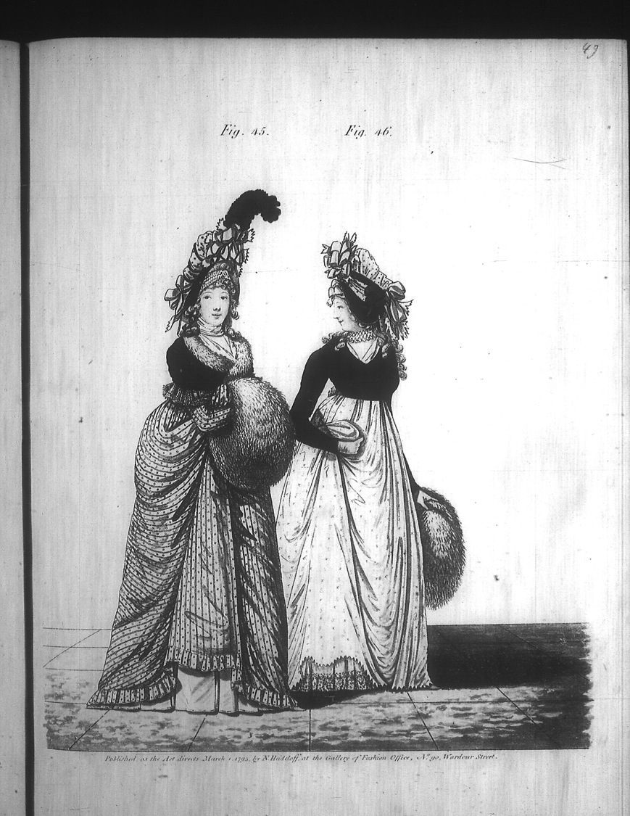
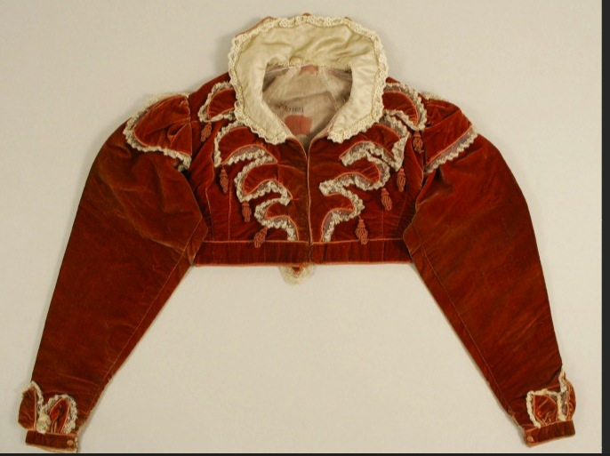
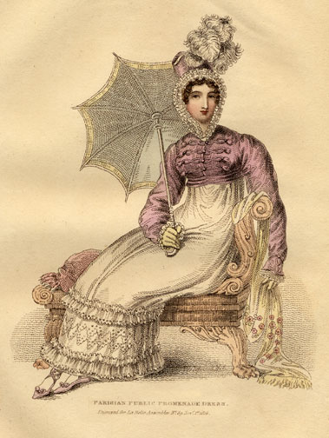
Spencer
Notes:
Afternoon Dress – Walking Dress – Promenade - Carriage Dress: Spencers, named after Lord Spencer, were short jackets, often military-inspired. In recent movies there seems to be a trend to make them shorter in the back than the gown they are being worn with, i.e. hem is above the waistline of dress. I’ve never seen any pictured this way so it looks odd to me.

Slide 34
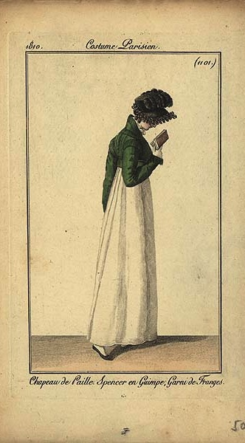
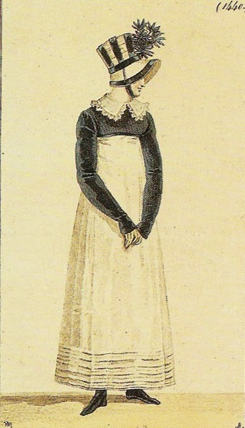
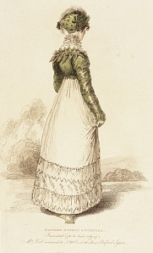

Slide 35
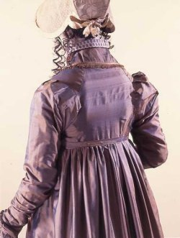
Pelisse

Slide 36
Thursday, 18 April 1811:
“Our pelisses are 17s. each; she charges only 8s. for the making, but the buttons seem expensive, — are expensive, I might have said, for the fact is plain enough.”
Notes:
Ackermann, March 1815

Slide 37
Notes:
These examples are post-1815, of silk, showing the richness of detail that became the hallmark of pelisses at this time.

Slide 38
Notes:
Spencers usually did not match the dress, but in some cases, as here, they were meant to be worn together. In this case, since the dress will not be worn alone, the sleeves have been made of net to make the outfit lighter and more fitted.

Slide 39
Notes:
Spencer dress

Slide 40
Notes:
Even ladies got to wear caped greatcoats!

Slide 41
Notes:
Gloves, shawls, half-boots. And a ruff and spencer that look quite like the one made for “Bright Star”
1815-1818
Printed in La Mode Illustre? See also a copy in Ackermann, Dec. 1815

Slide 42
Notes:
1799-1804 smaller, 1814 stovepipe, shako and other extreme bonnets

Slide 43
Sunday, 2 June 1799:
“Flowers are very much worn, and fruit is still more the thing. Elizabeth has a bunch of strawberries, and I have seen grapes, cherries, plums, and apricots.”
Tuesday, 11 June 1799:
“I cannot decide on the fruit till I hear from you again. Besides, I cannot help thinking that it is more natural to have flowers grow out of the head than fruit. What do you think on that subject?”

Slide 44
Notes:
Ackermann, Dec. 1814 bonnets and hats

Slide 45
Reticules

Slide 46
Wednesday, 9 January 1799:
“I wore my green shoes last night…”
Sunday, 2 June 1799:
“I am not fond of ordering shoes;
and, at any rate,
they shall all
have flat heels.”
Notes:
Earliest had small heels, these have flat heels and pointed toes. Later shoes would have rounded, then squared toes (Victorian)

Slide 47
Notes:
Or full dress- evening dress – opera dress – dinner dress
1) Ackermann, March 1814

Slide 48
Notes:
Ackermann, Jan. 1813
Metropolitan Museum of Art

Slide 49
Notes:
Ball dress, Ackermanns, Feb. 1814.
Peach-colored dress: McCord Museum,

Slide 50
Saturday, 15 October 1808:
“I am to be in bombazeen and crape, according to what we are told is universal here, and which agrees with Martha’s previous observation. My mourning, however, will not impoverish me, for by having my velvet pelisse fresh lined and made up, I am sure I shall have no occasion this winter for anything new of that sort.”
Notes:
On the death of Mrs. Edward Austen
Specialty Dress: Mourning. Bombazeen (bombazin) was particularly popular for mourning because it was a twill silk with a dull, not shiny, surface.

Slide 51
Thursday, 20 November 1800:
“Miss Debary, Susan, and Sally, all in black, but without any statues, made their appearance…”
Notes:
1819, 1810, 1816. Women in mourning were typically depicted draped over urns, statues, tombstones…The broach is a piece of hair jewelry – the weeping willow is made of hair. There were several royal deaths in the years after Austen’s death so fashion magazines provided suitable clothing.

Slide 52
Notes:
Riding Habits, often (usually?) made by tailors instead of dressmakers.

Slide 53
Notes:
Court dress – specific rules about number of feathers, decoration, etc. Extremely expensive.

Slide 54
Notes:
Court dress: Unfortunately the rules about hoop width did not change before waists went up!

Slide 55
The Evolution of Fashion in Austen’s Lifetime

Slide 56
…But first, a fashion mystery.
Notes:
I’m going to ask you, at the end of the talk to solve a mystery. Here’s the story.

Slide 57
Notes:
James Stanier Clarke, librarian to Prince Regent, first met Austen at Carlton House in 1815 to discuss The Prince Regent’s invitation to her to dedicate her next novel to him. Clarke was impressed by Austen, writing to her several times afterwards. In one letter he suggested she make a character for her next novel that was obviously himself. He also had kept a sketch book for many years. Richard Wheeler, Austen scholar, found and bought this sketchbook in 1998. Though this sketch was not labeled he determined it must be Austen and wrote his reasoning. Unfortunately, the outfit worn by this woman is more likely that of about 1797-99. So either he sketched Austen in a completely out of date outfit, or she far behind the fashion times in what she wore (not likely!) or this is someone else entirely.

Slide 58
Jane Austen 1774-1817
A fashion timeline
1774-1790: Formal, wide, natural waist
1789-1799: High waists and muslins, full
1800-1810: Greek and Roman, narrowing
1811-1814: Gothic moves in, decorative trim
1815-1817: Shrinking bodice, more trim
1817… The return of volume
Notes:
If we look at clothing during her lifetime we see that her life covered one of the most tumultuous in fashion history.
Talk about volume – where’s the bulge – fashion silhouettes morph from vertical to horizontal to vertical and back, with an occasional foray into bustles.

Slide 59
Notes:
A generational reaction of horror!

Slide 60
1770s and 1780s
Notes:
A little trip back in time: draping, fitting, shaping. With fitting: 14th cent. Fitted, 15th - vertical, 16th - horizontal, vertical, horizontal. Since the 16th century women have been using stays or corsets for both support and for shaping. The shape and design of the stays or corsets provides the foundation for the shape of the clothing.

Slide 61
Notes:
Stays, Hoops and shift – Kyoto Museum. Additional stays, Fleming Museum. Though the cut and boning layout evolved to be quite efficient by centurr’s end, the 18th century corset in general had “wall-to-wall” boning and was designed to create a barrel shape with rounded neckline. It was not about nipping in the waist, although from the front your waist might look smaller (from the side it would look larger).

Slide 62
Notes:
Later 18th (1770s) with petticoat and stomacher matching gown.

Slide 64
Cousin Eliza de Feuillide
Notes:
1790 – the narrowing begins but waist is still in question – will it stay down? Feuillide was Austen’s cousin. Her husband was a Frenchmen who literally lost his head in the terror. Her life is interesting in its own right (Google her). She married Austen’s brother Henry. She died in 1814.

Slide 65
1780s
Chemise
Dress
Notes:
Marie Antoineet’s “chemise dress” Portrait by Elisabeth Louise Vigée-LeBrun,(Veejee lebron) dress by Rose Bertin
?
Jacques Louis David (1748-1825) “Antoine-Laurent Lavoisier (1743–1794) and His Wife (Marie-Anne-Pierrette Paulze, 1758–1836)
Date: 1788

Slide 66
Notes:
Open robe 1790, still fairly structured, higher waist, full petticoat, corset to suit, with ‘tail’ to hold skirt out at back.

Slide 67
Notes:
Even in America the trend towards a higher waist was followed, though in this case the construction of the back of the gown remained the same.

Slide 68
Notes:
As the 1790s progress we move into a transition gown. It is high waisted but still very full. The fabric is lightweight cotton or muslin and hair is big!

Slide 69
Notes:
The brown embroidered and sequined silk dress is a round gown – i.e. the dress is closed all the way around without a front opening.

Slide 70
1790s: Big hats, big hair, big feathers
Notes:
When Austen was writing her early novels this is what she was seeing and wearing.

Slide 72
1795
Notes:
Experiments with fitting using pleats
Johnston, Lucy “Nineteenth Century Fashion in Detail” dress at Victoria and Albert

Slide 73
1794
Notes:
Watch the sleeves – they are still elbow length. That will change, of course.

Slide 74
Wednesday, 18 December 1798:
“I believe I shall make my new gown like my robe, but the back of the latter is all in a piece with the tail, and will seven yards enable me to copy it in that respect?”

Slide 75
Tuesday, 8 January 1799:
“I am not to wear my white satin cap to-night, after all; I am to wear a mamalone [mameluk] cap instead…It is all the fashion now; worn at the opera, and by Lady Mildmays at Hackwood balls.”
Notes:
Warrior caste in Egypt defeated by Napoleon at the Battle of the Pyramids, 1798 “On July 1, 1798, Napoleon landed in Egypt with 400 ships and 54,000 men and proceeded to invade the country, as he had recently invaded Italy. But this Egyptian invasion was to be different. For, in addition to soldiers and sailors, Napoleon brought along 150 savants — scientists, engineers and scholars whose responsibility was to capture, not Egyptian soil, but Egyptian culture and history.” The ladies picked up the turban almost immediately.

Slide 76
1800-1808: tall and narrow, less fabric, trains
Notes:
Still lots of fabric gathered at waist but the silhouette is definitely vertical, the greek column ideal
1) 1800-artstor-AMICO_CLARK_103902762
1) 1800-artstor-pinkback-AMICO_CLARK_103902764

Slide 77
Notes:
Fashion plates emphasize the vertical by making women into giantesses.

Slide 78
Notes:
1810 “A scene taken from nature in Kensington Gardens” Gillray commenting on lightweight cotton and flimsy petticoats.

Slide 79
Notes:
James Gillray (1757-1815)

Slide 80
The year 1740, a Lady’s full dress of Bombazeen. The year 1807, a Lady’s undress of Bum-Be-Seen.
Notes:
The year 1740 a Lady’s Full Dress of Bombazeen. The year 1807 a Lady’s Undress of Bum-be-seen (Full dress refers to formal dress, undress refers to daytime clothes but her it refers to rather more…or less as the case may be.

Slide 81
Notes:
This corset is missing it’s busk and boning but you can see that it has few bone channels and a gathered bodice like the gowns under which it would have been worn.

Slide 82
Notes:
As we move towards 1810 the vertical emphasis appears in the decoration as well as the construction. Trains continue to be seen in evening dress though they are disappearing from day dress.
1804: Museum of Modern Art
1805-1810, Museum of Fine Arts, mull (muslin) with red crewel embroidery, Accession number: 22.665

Slide 83
Notes:
Ackermann, May 1809

Slide 84
Notes:
Around 1810 construction techniques are developed to make less fullness at the front. This apron dress is a lightweight muslin with wool crewel embroidery.
1) Johnston, Lucy. Nineteenth Century Fashion in Detail
2) Ackermann, Feb. 1809

Slide 85
1810: Trains hang on in evening dress
Notes:
Ackermann, Jan. 1809
La Belle Assemblée, Dec. 1810

Slide 86
Notes:
This beautiful example from the V&A shows crewel embroidery on a silk net gown.
1810, Victoria and Albert Museum, Accession number T.194-1958

Slide 87
1808-1810: Accommodating Grecian hair
Notes:
Bonnet: Metropolitan Museum of Art

Slide 89
1813: Emphasis shifting to bodice
Notes:
By 1813 the emphasis is shifting to the bodice. The vertical line disappears from the skirt and the bodice gets the eye-catching trim
1) Ackermann, April, 1812
2) Ackermann, Dec. 1812

Slide 90
Notes:
McCord Museum, 1819. Accession number M982.20.1

Slide 91
Notes:
Blue silk apron/stomacher gown
1813-1815 National Museum of Australia, Accession number 2005.0005.0141

Slide 92
Notes:
Museum of London.

Slide 93
Notes:
M
Ackermann, Jan 1815

Slide 94
1815
Notes:
1815-1820 – the move to decorated bodice and hem
1) Ackermann, July 1815
2) Ackermann, June 1815

Slide 95
Notes:
By the year of Austen’s death the bodice is high, the hemline is decorated, skirts are beginning to attain a more aline shape

Slide 96
Notes:
Corsets continue to evolve, longer to create a smooth columnar line, busk still there to provide support and posture, and bustline very high
1) Late 18-teens, early 1820s corset. Kyoto Costume Institute
2) A very original corset – original, a recreation? Fleming Museum – do not duplicate or repost.
3) c. 1820 Connecticut Historical Society

Slide 97
Notes:
Small bodice, sleeves fall at waistline

Slide 98
Notes:
Skirt hem even wider, waist begins to drop. Corset shows how this narrowed waist is achieved.

Slide 99
Notes:
1830s – super horizontal, bodice and skirt. Even the hair is horizontal. This shape will be toned down in the 1840s with sleeves narrowing but once the crinoline comes into fashion skirts will attain crazy widths but retain the 1830s bell shape

Slide 100
Austen, Fashion, Novels

Slide 101
Notes:
S&S Miss Steele, stockings 1804: Promenade in Kensington Gardens: But first “by no means ungenteel or unfashionable; their dress was very smart”
Compare to Miss Tilney: had a good figure, a pretty face, and a very agreeable countenance; and her air, though it had not all the decided pretension, the resolute stylishness of Miss Thorpe's, had more real elegance.

Slide 102
Mrs. Elton:
“as elegant as lace and pearls could make her”
Notes:
Emma/Mrs. Elton: as elegant as lace and pearls could make her”
Ackermann, June 1813

Slide 103
1797:
writing “Pride and Prejudice”
Notes:
1797

Slide 104
Notes:
1800 Robert Fellows, philanthropist, by Edridge Blue coat: Tory
Mr. Bingley was good-looking and gentlemanlike; he had a pleasant countenance, and easy, unaffected manners. His sisters were fine women, with an air of decided fashion. His brother-in-law, Mr. Hurst, merely looked the gentleman; but his friend Mr. Darcy soon drew the attention of the room by his fine, tall person, handsome features, noble mien, and the report which was in general circulation within five minutes after his entrance, of his having ten thousand a year. The gentlemen pronounced him to be a fine figure of a man, the ladies declared he was much handsomer than Mr. Bingley, and he was looked at with great admiration for about half the evening, till his manners gave a disgust which turned the tide of his popularity; for he was discovered to be proud; to be above his company, and above being pleased; and not all his large estate in Derbyshire could then save him from having a most forbidding, disagreeable countenance, and being unworthy to be compared with his friend.
Mr. Bingley had soon made himself acquainted with all the principal people in the room; he was lively and unreserved, danced every dance, was angry that the ball closed so early, and talked of giving one himself at Netherfield. Such amiable qualities must speak for themselves.

Slide 105
Notes:
1815-blake-engraving: “Henry and I went to the exhibition in Spring Gardens. It is not thought a good collection, but I was very well pleased, particularly (pray tell Fanny) with a small portrait of Mrs. Bingley,1 excessively like her. “

Slide 106
Notes:
Hem 6 inches deep in mud, I am absolutely certain, and the gown which had been let down to hide it not doing its office.”

Slide 107
Notes:
Wanted only regimentals to make him charming – changing his coat.

Slide 108
Notes:
1814Mrs. B. rhapsodizing over long sleeves and boring Mr. B with talk of lace. long sleeves. And Lydia - someone tell me how she talks about clothes – And “I shall send for my clothes when I get to Longbourn; but I wish you would tell Sally to mend a great slit in my worked muslin gown before they are packed up. “
Ackermann, Sept. 1814

Slide 109
Notes:
James Stanier Clarke, librarian to Prince Regent, met at Carlton House in 1815. Richard Wheeler, 1998.

Slide 110
1799
1807
1815

