Slide 1
Jane Austen and Fashion:
Did she wear what she saw; did she write what she wore?
Hope Greenberg
JASNA-VT
Notes:
You have probably seen austen-era fashion talks or articles that described the types of clothing she would wear. And you may recall certain passages or descriptions where her characters talk about fashion. But how much attention did she pay to clothing, and more so to fashion in her life? And how did that translate into her writing?

Slide 2
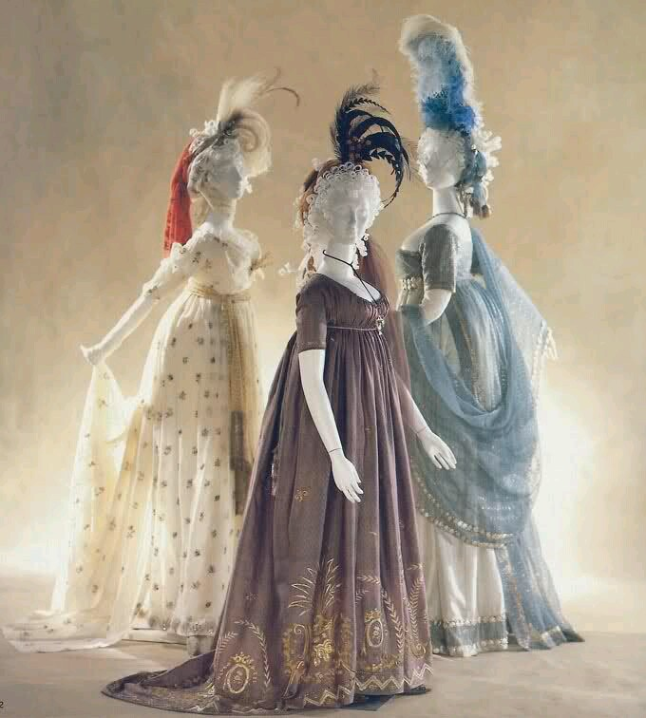
The Novels
1795-1799 writing
“Elinor and Marianne”(Sense and Sensibility)
“First Impressions” (Pride and Prejudice)
“Susan/Catherine” (Northanger Abbey)
1801-1809 writing, revising
The Watsons (begun), S&S, P&P, NA, MP (revising)
1811-1817 writing, revising, publishing
Sense and Sensibility (1811)
Pride and Prejudice (1813)
Mansfield Park (1814)
Emma (1815)
Persuasion, Northanger Abbey (1817).
Notes:
First let’s her novel. We tend to think of this entire period as that of “high waists” but the details of fashions actually changed quite a bit. There is also the question of when the novels were set. For example, though published in 1813, it has been argued by Austen scholar Dierdre LeFaye based on when the militia was to have ben set in 1795. So, the way Austen envisioned the characters would have changed.

Slide 3
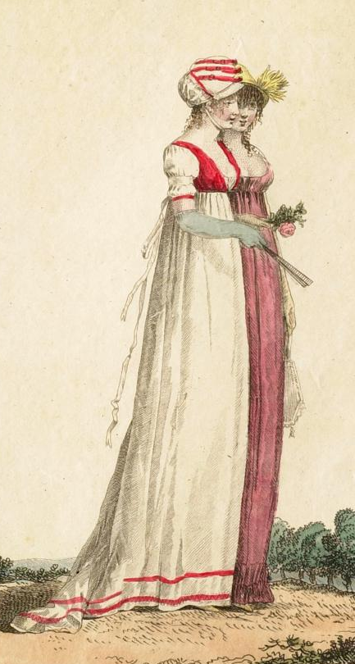
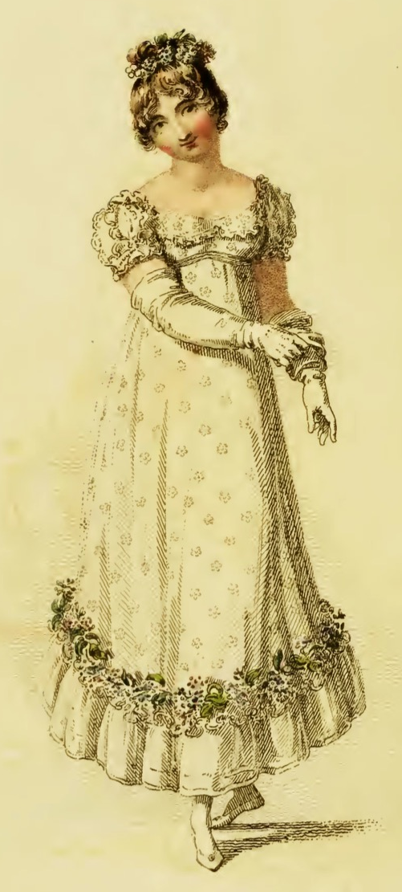
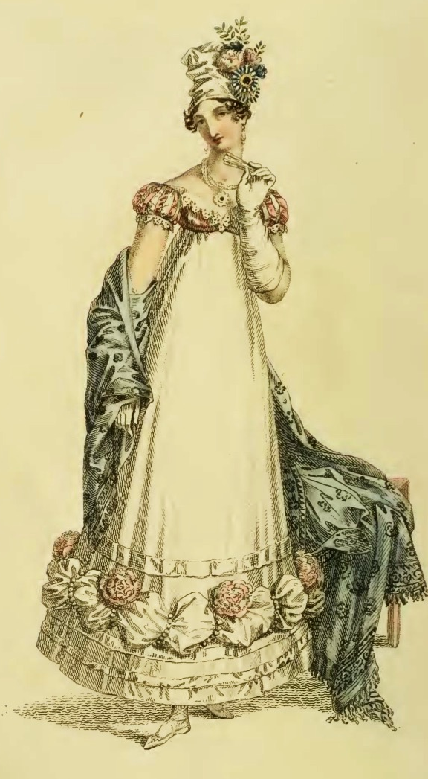
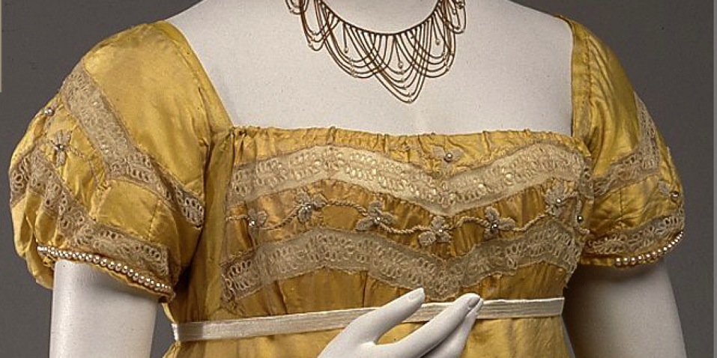
1794
1800
1809
Letters
1796-1798-1799-1800-1801
1804-1805-1807-1808-1809
1811-1812-1813
1814-1815-1816-1817
1815
1818
1812-1813
Notes:
Almost every one of her extant letters contain fashion references. Here is an overall view of the major changes. Our questions are did she keep current with trends and how did she use fashion in her novels?

Slide 4
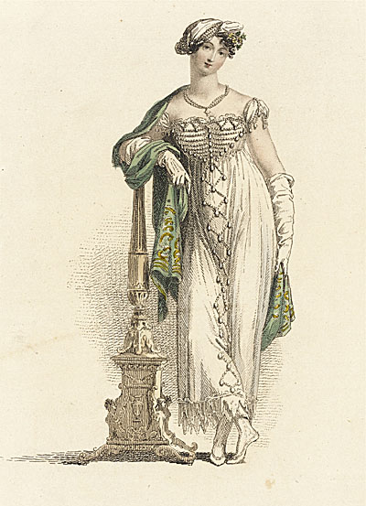
17 December 1816
“…the little bit (two inches wide) of Ivory on which I work with so fine a Brush.”
“Few words, tellingly applied.”
James Thompson
“…as elegant as lace and pearls could make her.”
Describing Mrs. Elton, Emma
Ackermann Ball Dress June 1813
Notes:
One of the most fascinating aspects of Austen’s writing is how economical she can be with her language. As James Thomson puts it… And as Austen said herself…

Slide 5
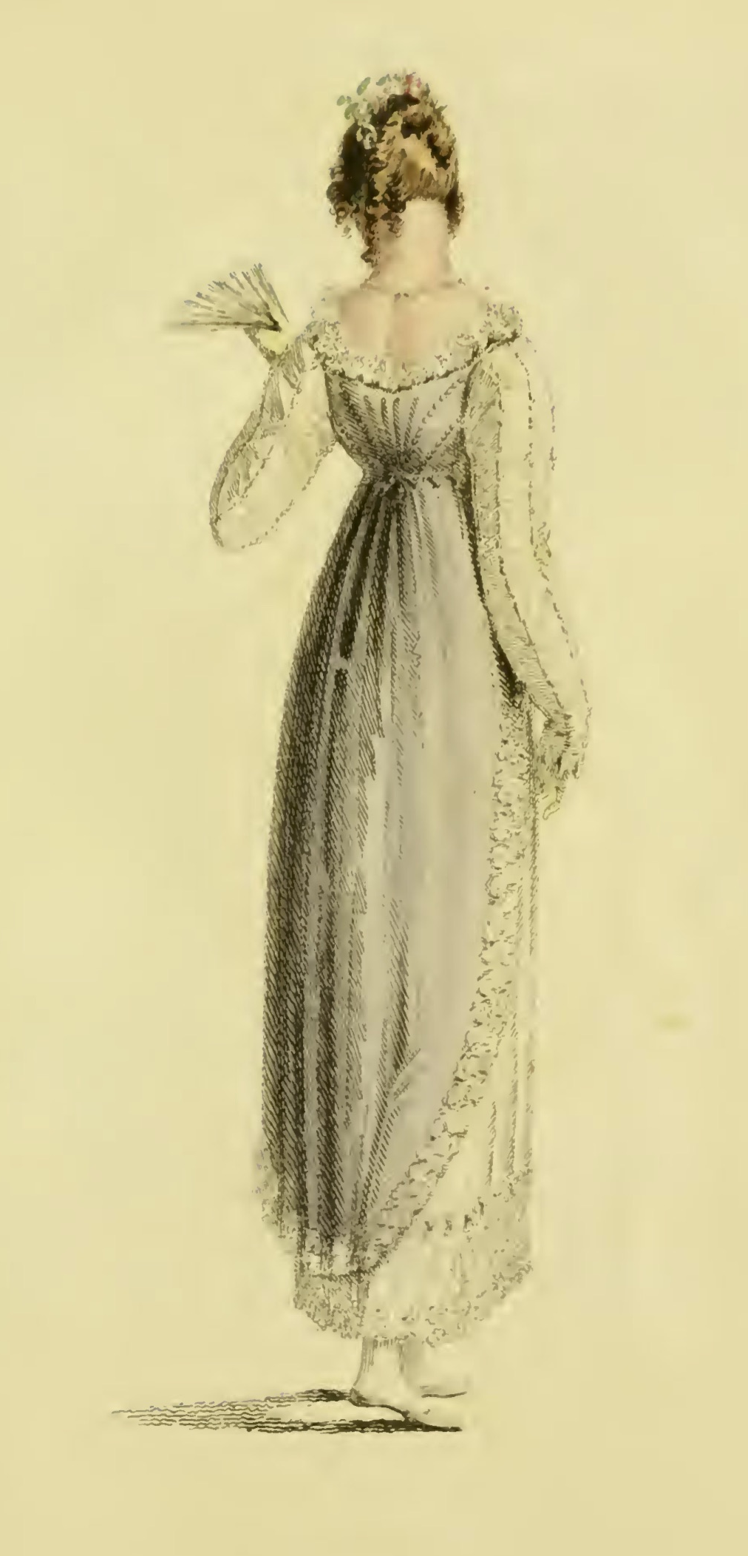
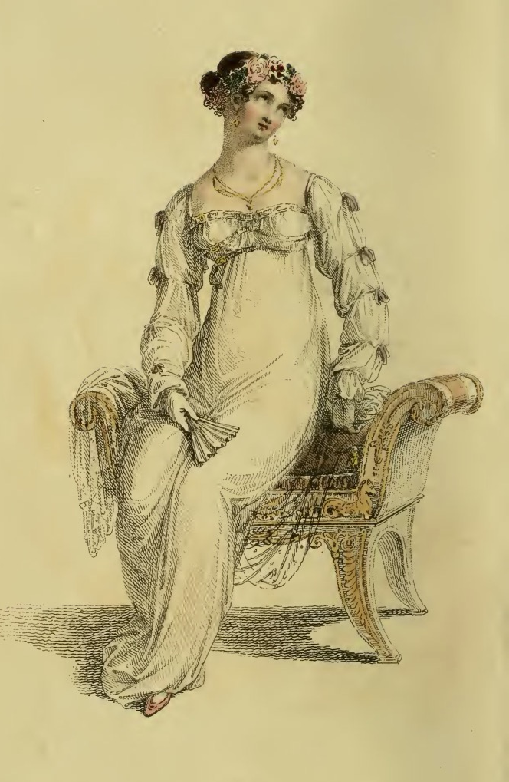
9 March 1814
“I wear my gauze gown to-day, long sleeves and all. I shall see how they succeed, but as yet I have no reason to suppose long sleeves are allowable.”
“I am very glad to hear what you tell us, of long sleeves.”
Mrs. Bennet, P&P
Ackermann April 1814
Ackermann September 1812
Notes:
Let’s compare that to her characters. Who talks of fashion and how do they? This does not sound objectionable but the context? Mrs. Bennet at the worst moment for her family…And Jane is clever. Long sleeves are safe to discuss—they came and went with the styles.

Slide 6
“One could not hope to conduct himself or herself properly on entering a room without immediately assigning a rank to every person.”
Richard Bushman, The Refinement of America
Notes:
But first, why talk about fashion at all. Modern: partly cultural and partly an expression of individualism. Austen’s time? Most importantly, an indicator of rank. Keeping up with the latest fashions, the latest dances, and the latest news, not just to be trendy or edgy but to ensure that your rank is recognized. Your deportment, manners and speech all mark you as acceptable into society. Knowing who is who and following proper deference to those above you in the hierarchy, is key. For example, you do not introduce yourself to a high-ranking gentleman simply because his aunt is your next-door neighbor.

Slide 7
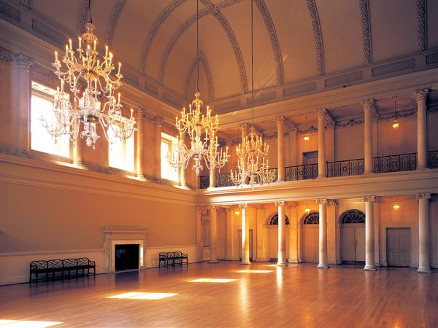
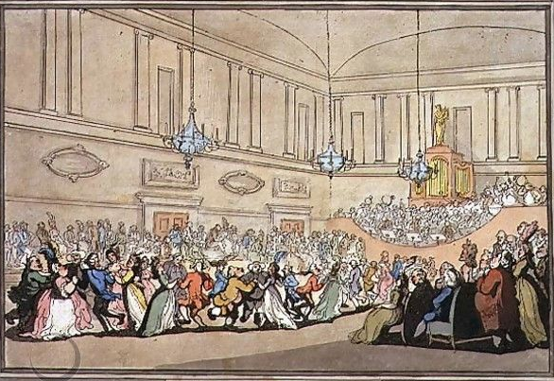
“Yet even here, amid the crowds you view,
’Tis sometimes difficult to tell WHO’S WHO.”
Pierce Egan, Walks Through Bath, 1819
The Assembly Rooms, Bath
Notes:
In a crowded Assembly, like this in Bath, that may be difficult.
Here, salutary rules exclude all those
Whom no one hears of, and whom no one knows;
That no plebian breathings may infect
An atmosphere at all times so select;
;…
And concludes
Yet even here, amid the crowds you view,
’Tis sometimes difficult to tell WHO’S WHO.”
Pierce Egan, Walks Through Bath, 181

Slide 8
“In former ages it seemed requisite that every lady should cut out her garments by a certain erect standard.”
Mirror of Graces, 1811
Notes:
Two key words
The first is lady—and as you have probably guessed, we are going to be focusing on the gentry here—those who would have the means to be fashionable.
miserable. The second keyword phrase is “erect standard.”

Slide 9
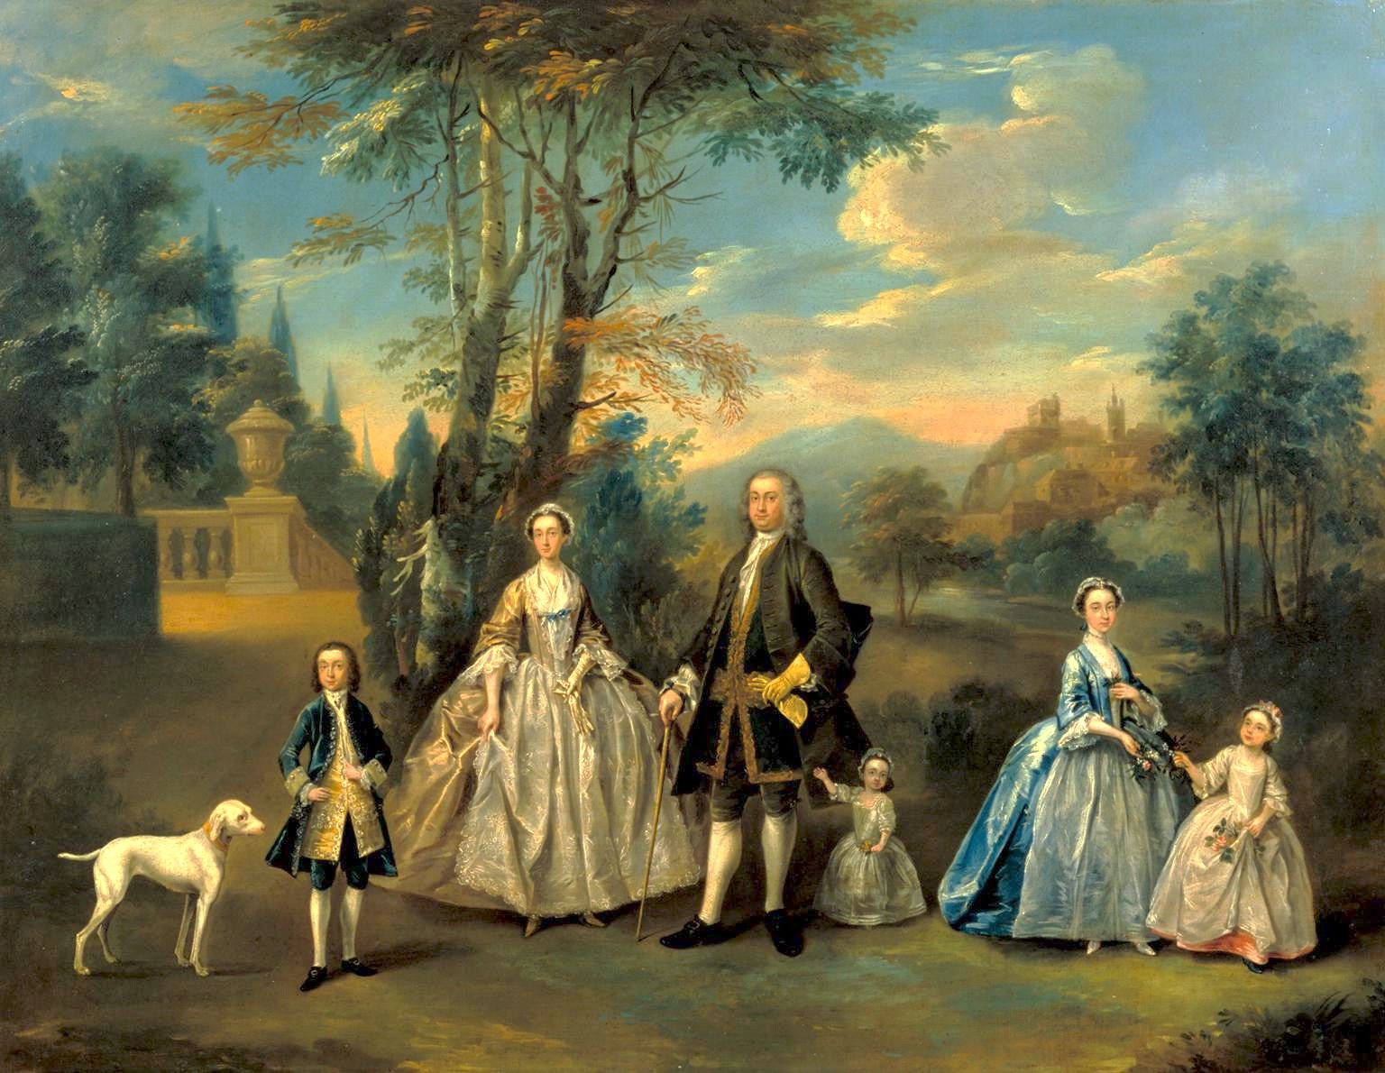
c. 1750, Artist and Subjects Unknown (Tate)
Notes:
The period that spans the changes in fashion also demonstrates
posture, stance, and movement. The 18th century all the members of this family, youngest--even the dog.
“a good leg”—

Slide 10
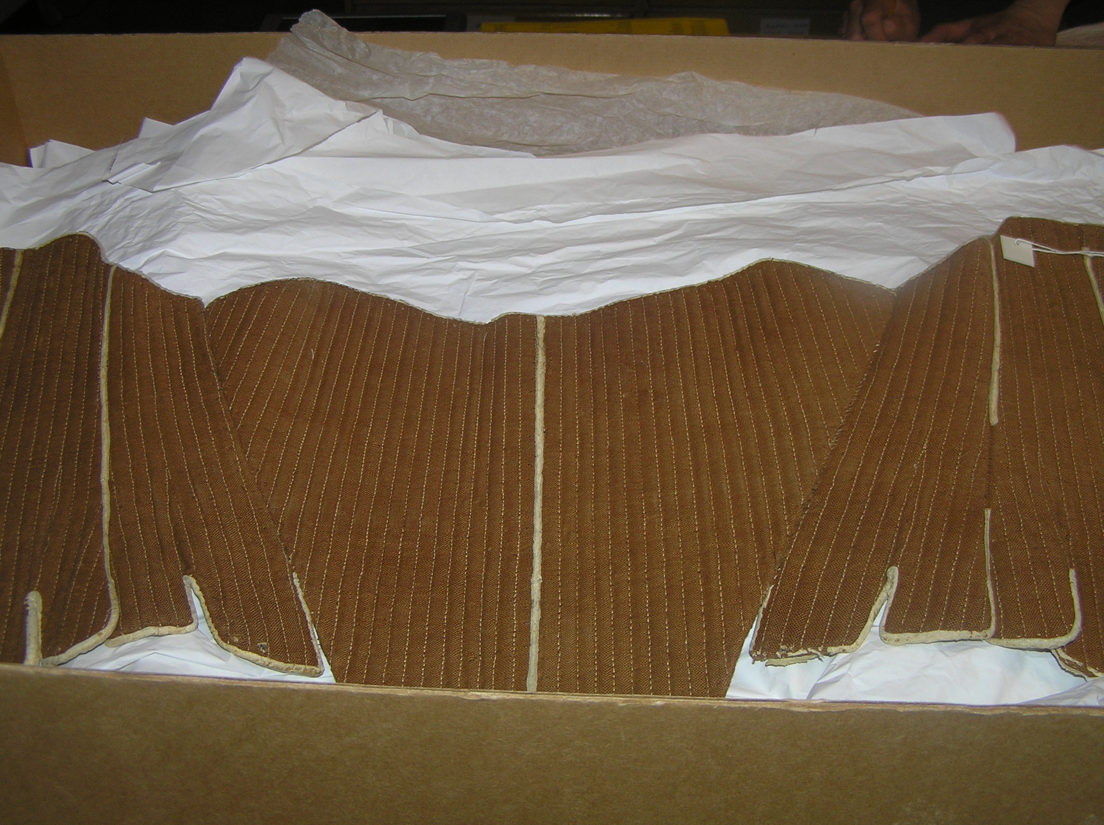
Stays: Fleming Museum, University of Vermont
Stays, hoop, shift: Kyoto Costume Museum
Notes:
We could talk about draping vs. fitting to shapes women’s bodies starting the the 1300s.
Since the 16th century women have been using boning or other stiffening
cut and boning technical and efficient
“wall-to-wall” boning
barrel shape, no waist nipping, rounded neckline

Slide 11
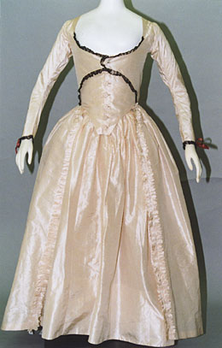
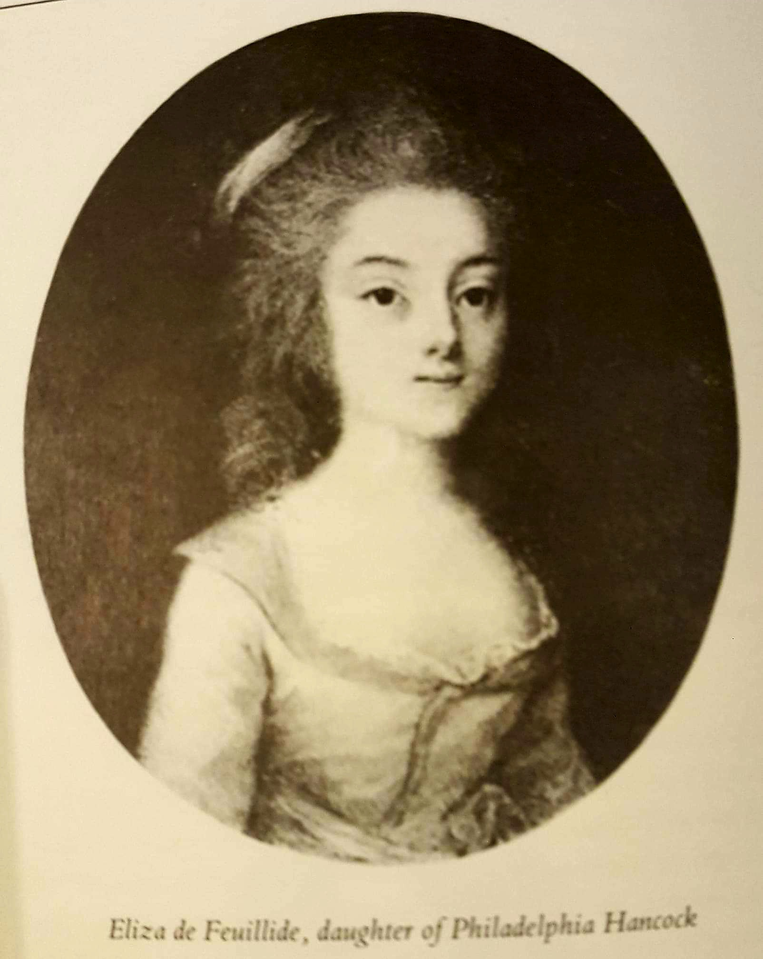
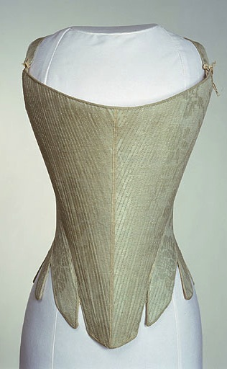
Late 1780s/Early1790s
Eliza (Hancock) de Feuillide
Mrs. Henry Austen (1797)
Dec. 1761-April 1813
Kyoto Costume Museum
Notes:
George’s sister Philadelphia married Hancock in India. Back to England and met Austens in 1786 – Jane 11 yrs old. Married Henry in 1797, died April 25 1813. Jane writes (letter 86, July 5-6 1813 that they are still in mourning

Slide 12
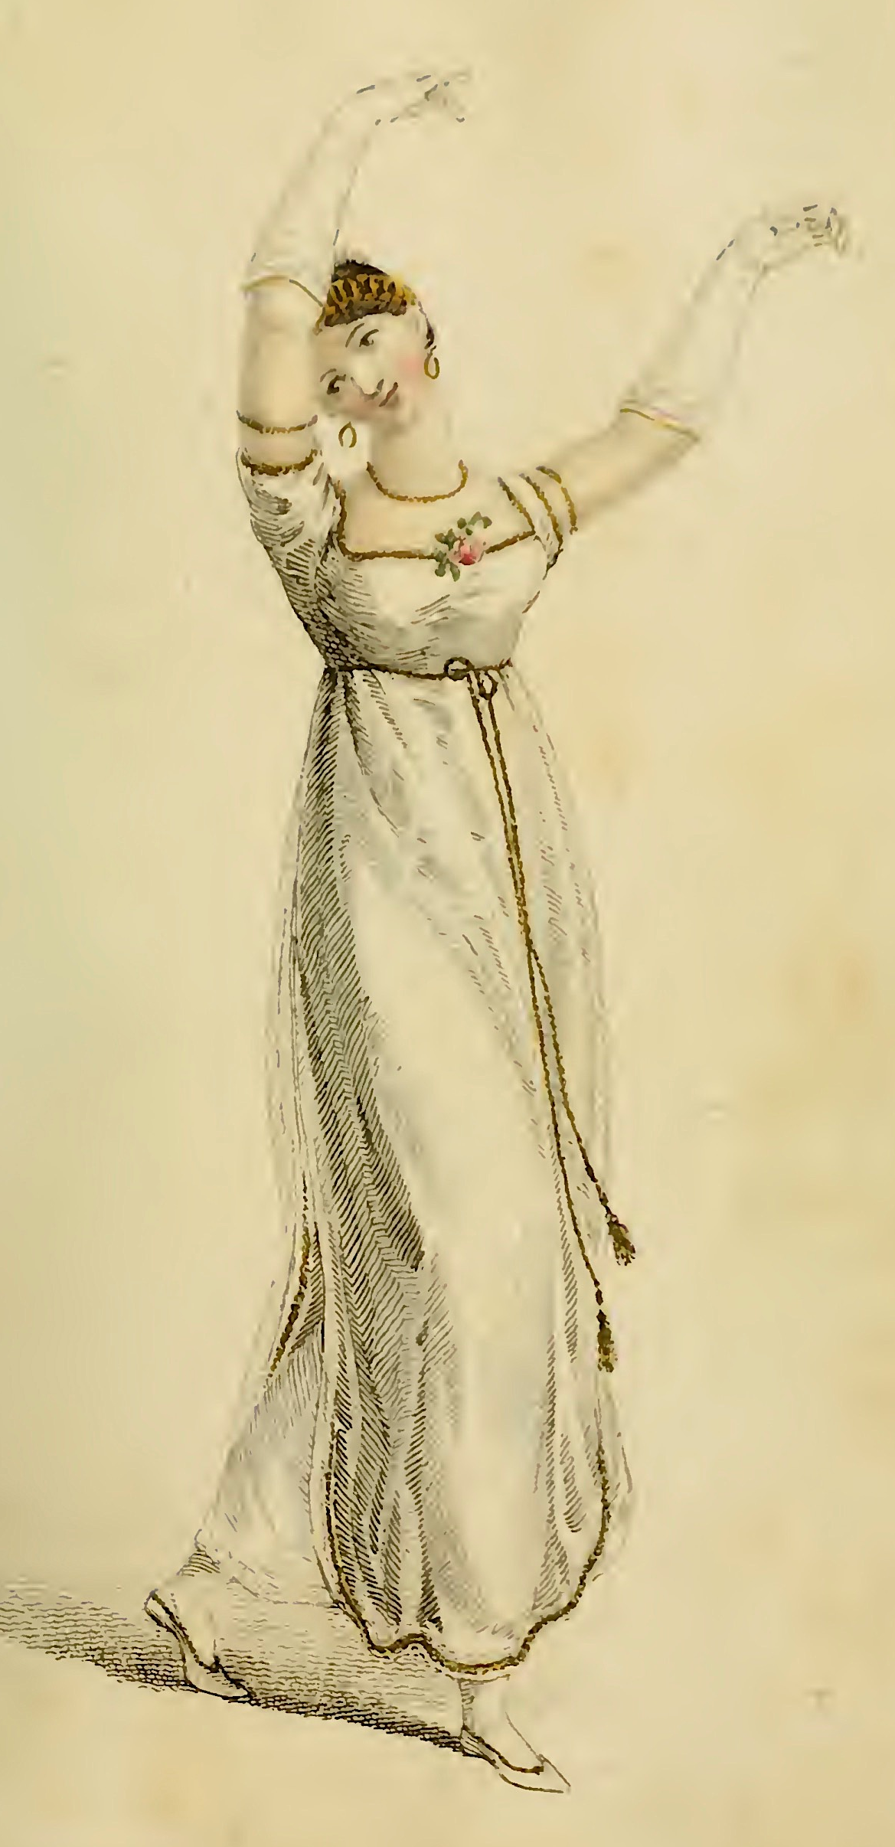
“…besides all this, she must possess a certain something in her air and manner of walking...”
Caroline Bingley, P&P
Ackermann, ‘Ball Dress’ February 1809
Notes:
Grace of movement in dance lessons, a required part of an upper-class education.
Also note: Emma – in Mrs. Goddard’s school school in Emma, Harriet Smith has not learned to draw or play an instrument but she has learned to dance.

Slide 13
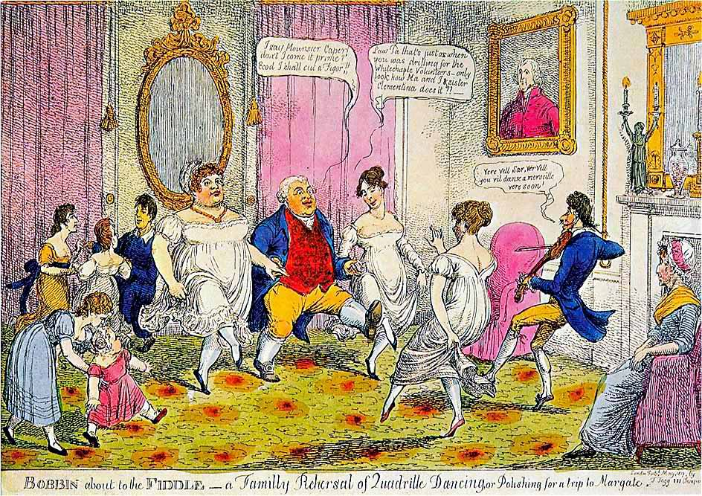
Notes:
As this cartoon shows: Bobbin (reference to retail trade) Fiddle (trying to con or sham—either the family to con their way into high society, or the fiddler himself, pretending to be a French dance master)
“I say Monsouer Caper don’t I come it prime? Ecod I shall cut a figor!”
Law Pa that’s just as when you was drilling for the Whitechapel Volunteers. Only look at how Ma and I and sister Clementina does it.”
Ver vel sir, vere vel. You vil danse a merveileux ver soon.”
“The Season at Margate, for example, commenced on the King’s birthday, formally celebrated in June, and ended in late October, whereas Bath commanded the more fashionable months of October through May. The hours and pricing of the summer balls were usually different from those of the winter. ”

Slide 14
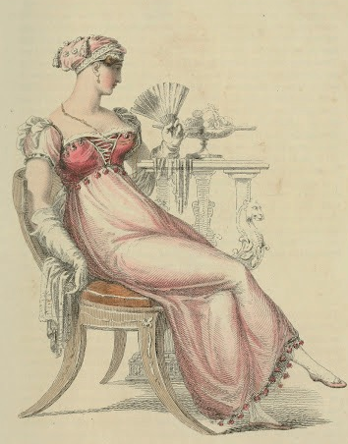
Ackermann April 1812
Ackermann April 1810
“I thought her dress hideous the other night. I used to think she had some taste in dress, but I was ashamed of her at the concert. Something so formal and arrangé in her air! and she sits so upright! My best love, of course.”
Elizabeth Elliot, Persuasion
Notes:
So the cues to show…gentry: fashion, manners, knowledgeable, conversation, grace: “a studied ease”
“mean girl” “Something so formal and arrangé in her air! And she sits so upright!”
Not wearing old clothes but still upright

Slide 15
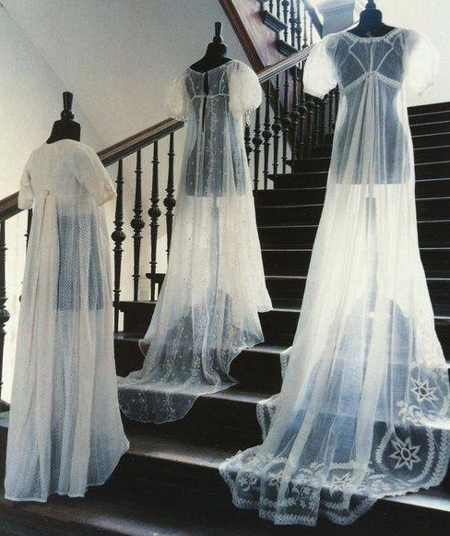
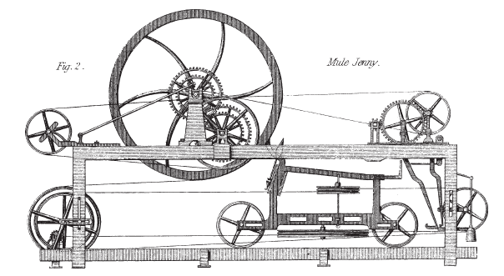
Samuel Crompton, spinning mule, 1779
Claude Berthollet, liquid bleach, 1780s
“I do not think it will wash well.”
Henry Tilney, Northanger Abbey
Notes:
The aim was always to get a muslin as fine and transparent as that made in India, but make it in England for a much lower price.

Slide 16
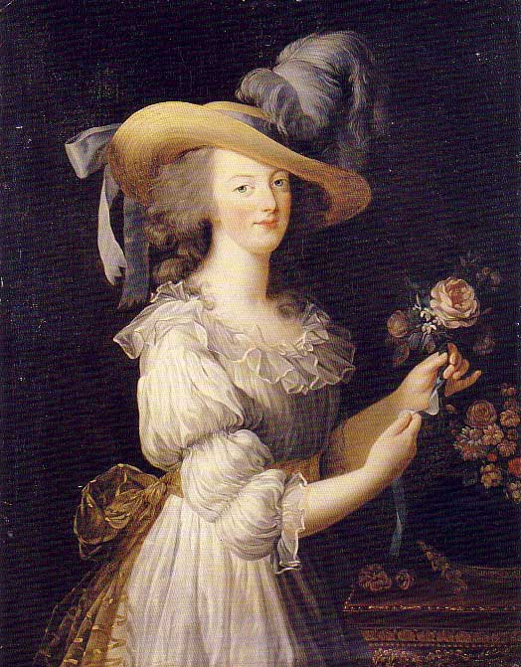
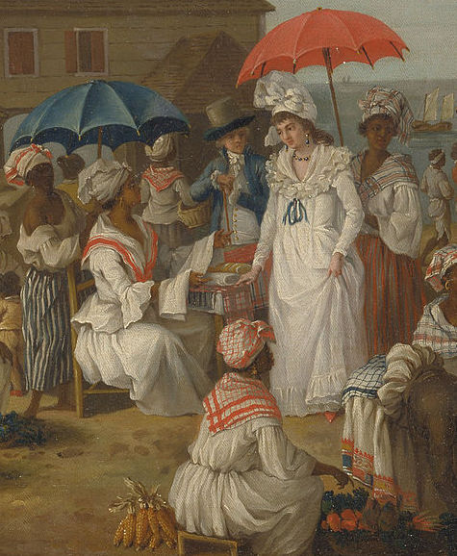
Agostino Brunias, c. 1780 “Linen Day, Roseau, Dominica”
Marie Antoinette’s “chemise dress”
Notes:
That air and grace now took on a more natural form, helped by the clothing. The globalization of textile manufacture: raw cotton from the Americas dyed white with indigo from the West Indies and woven into fine muslin/mull in India,
Rose Bertin. Poor Marie Antoinette.
muslin, a textile that was imported from Britain and its colonies.
chemise—underwear---Georgiana Duchess of Devonshire 1784

Slide 17
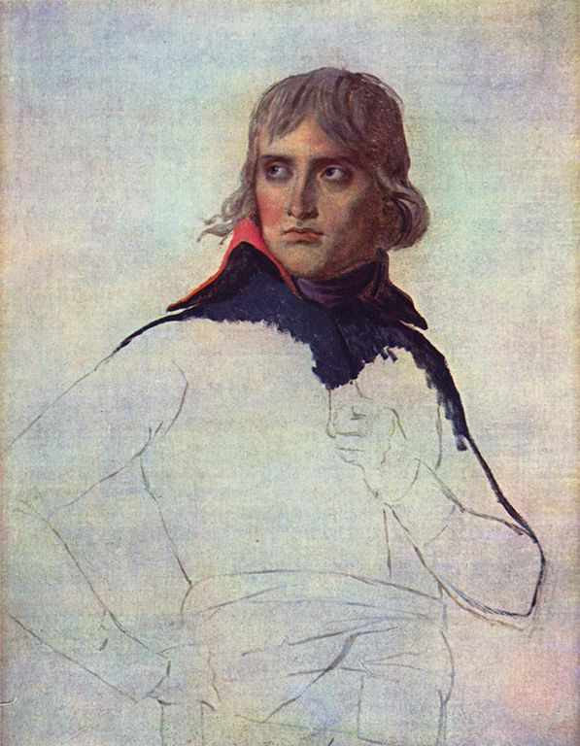
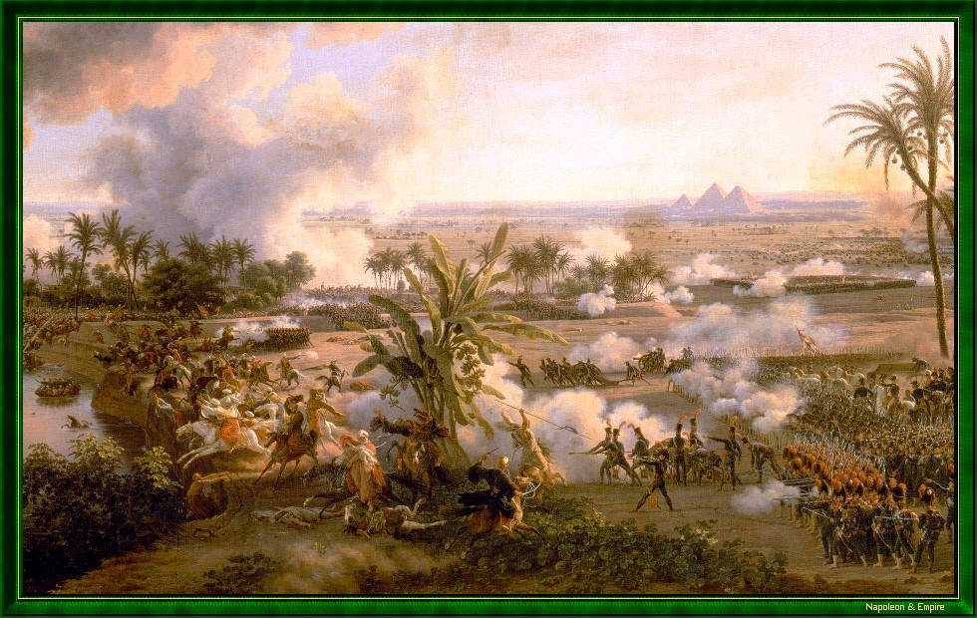
Battle of the Pyramids, July 21, 1798
(Note the date)
Notes:
So, we have the impetus to wear looser clothing, the technology to make the appropriate textile. Now we need the inspiration. Warrior caste in Egypt defeated by Napoleon at the Battle of the Pyramids, 1798 “On July 1, 1798, Napoleon landed in Egypt with 400 ships and 54,000 men and proceeded to invade the country, as he had recently invaded Italy. But this Egyptian invasion was to be different. For, in addition to soldiers and sailors, Napoleon brought along 150 savants — scientists, engineers and scholars whose responsibility was to capture, not Egyptian soil, but Egyptian culture and history.”

Slide 18
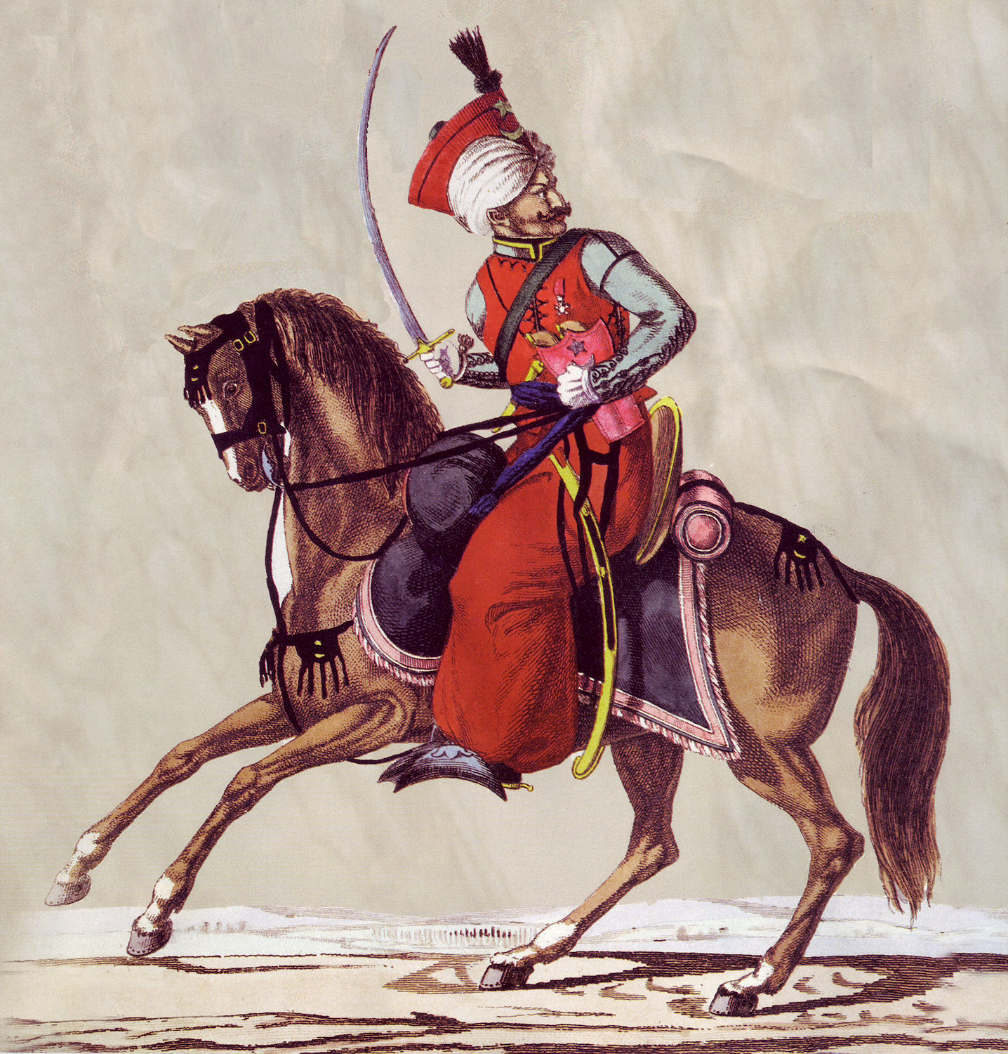
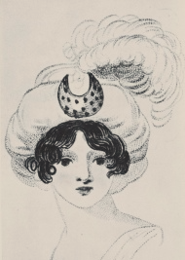
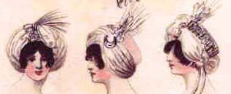
8 January 1799:
“I am not to wear my white satin cap to-night, after all; I am to wear a mamalone [mameluke] cap instead…It is all the fashion now; worn at the opera, and by Lady Mildmays at Hackwood balls.”
Notes:
Letter is one of the earliest we have. The ladies back home picked up the turban almost immediately. Remember July 1 1798 was the battle.
Mirror of Graces, 1811 (p. 52)

Slide 19
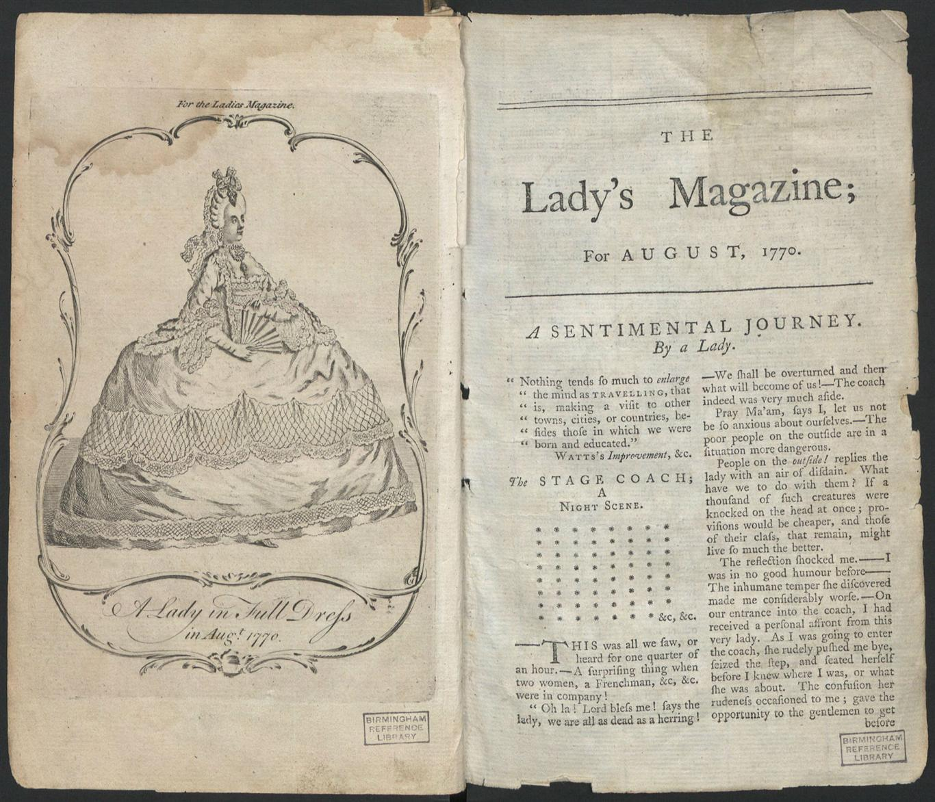
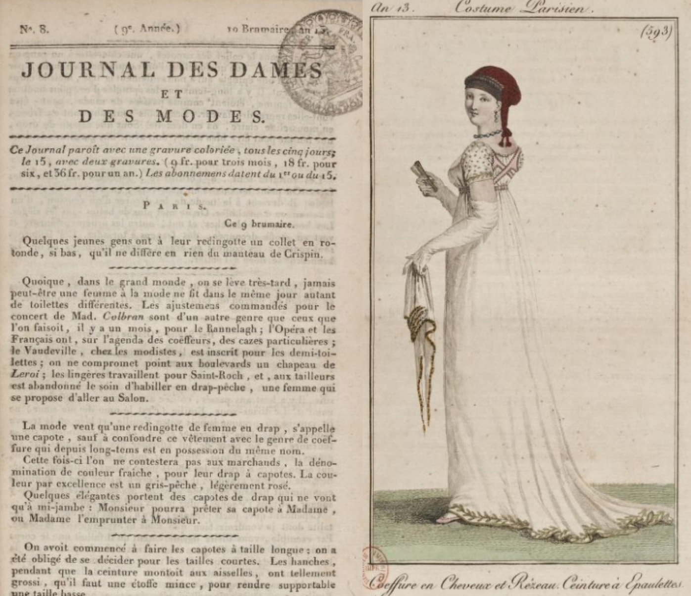
Published 1770-1832
Published 1797-1839
Notes:
How keep up? From your dressmaker, friends, magazines. The rise in print publications of all kinds included the Ladies Magazine (1770-1832)--recognised as the first created specifically for women.

Slide 20
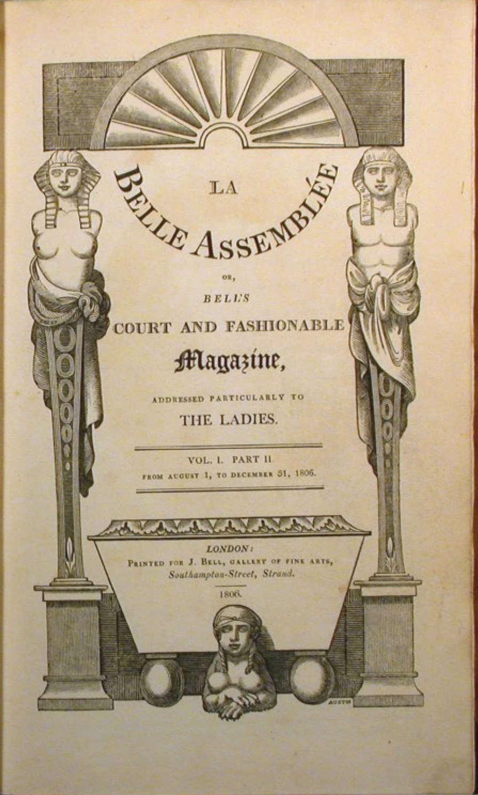
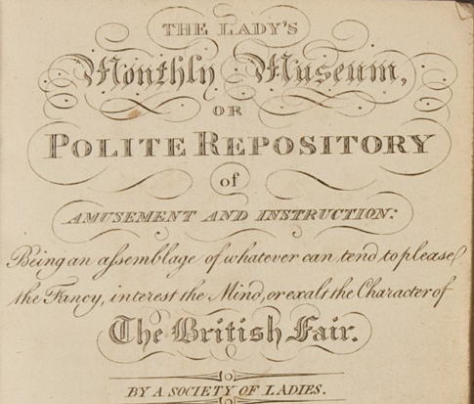
Published by Vernon and Hood 1798-1832
Published by John Bell 1806-1837
Monthly for 2s/6d (half a crown) with B&W engravings
Or 3s/6d for hand watercoloured
Notes:
3s/6d is also what Austen paid for shift linen

Slide 21
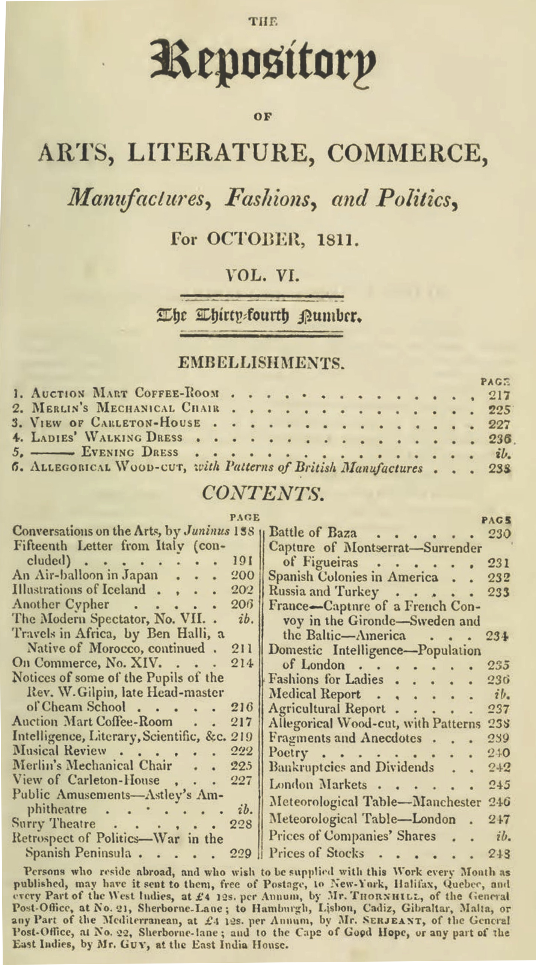
Ackermann, October 1811
Notes:
Rudolph Ackermann

Slide 22
Ackermann’s sent around the world for £4 12s per annum
Notes:
Nor was this information limited to England. Ackermann’s could be subscribed to from cities around the world

Slide 23
“Scissor edited” from La Belle Assemblée
The Morning Chronicle (London, England), Tuesday, November 1, 1808
The Leeds Mercury (Leeds, England), Saturday, November 5, 1808
Jackson's Oxford Journal (Oxford, England), Saturday, November 5, 1808
The Examiner (London, England), Sunday, November 6, 1808
Trewman's Exeter Flying Post (Exeter, England), Thursday, November 10, 1808; Issue 2322
The Derby Mercury (Derby, England), Thursday, November 10, 1808; Issue 3990

Slide 24
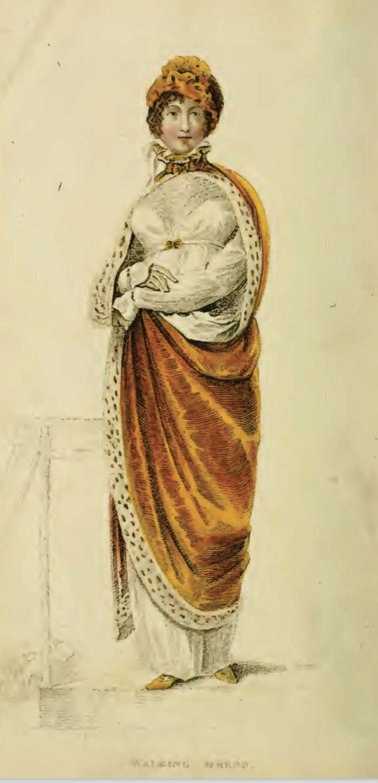
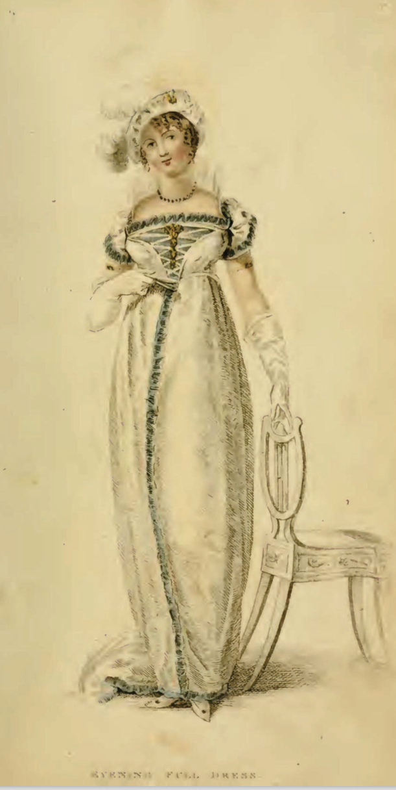
Ackermann January 1809

Slide 25
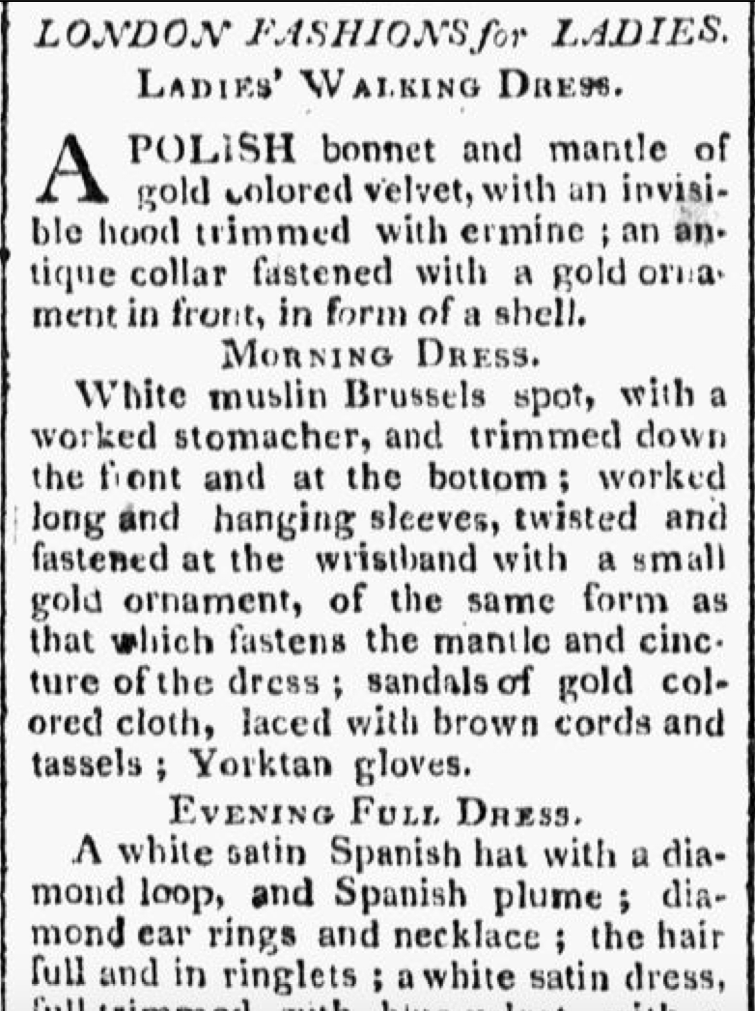
Worcester Gazette (Worcester, MA) 07 June 1809
Notes:
And also copied all around the world. Here is the same description, copied word for word in Massachusetts by June of the same year.

Slide 26
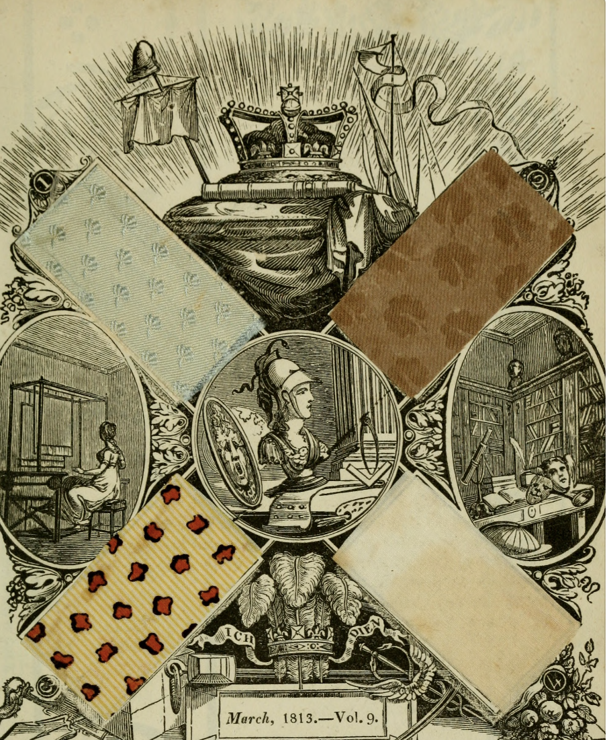
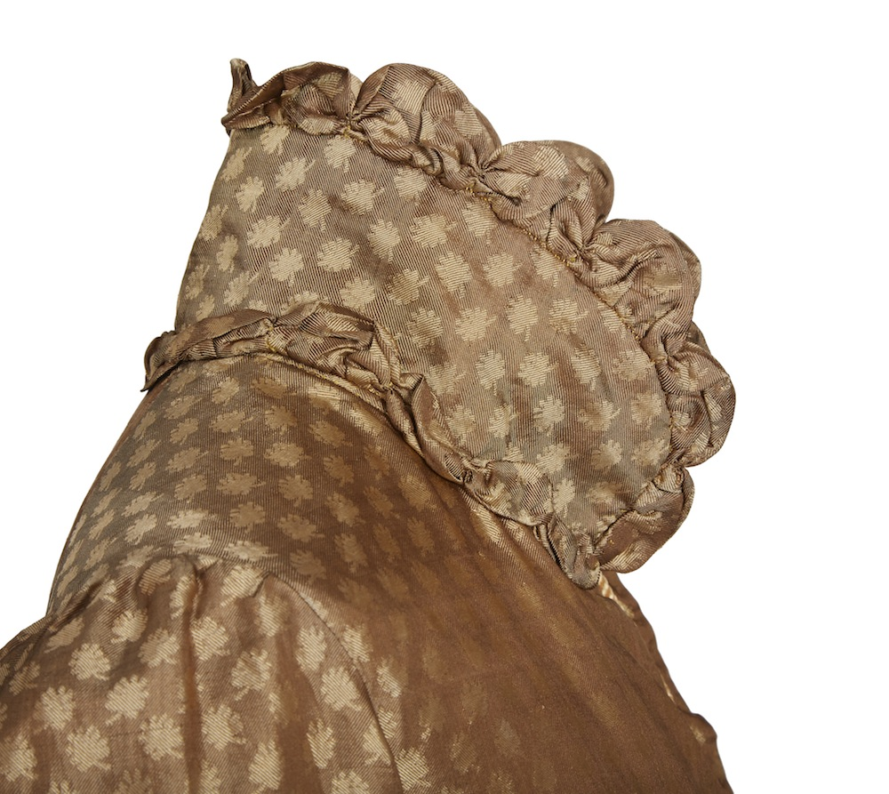
Austen’s pelisse
Ackermann March 1813
Notes:
Having access to Ackermann’s was also useful because, for many years, it included actual fabric swatches provided by London warehouses, like this one, Layton’s. Subscribers could then tell their family and friends in London which fabric to buy—Pattern #4 is shirting—linen—advertised as “as good as 4s/yd and only costs 2s

Slide 27
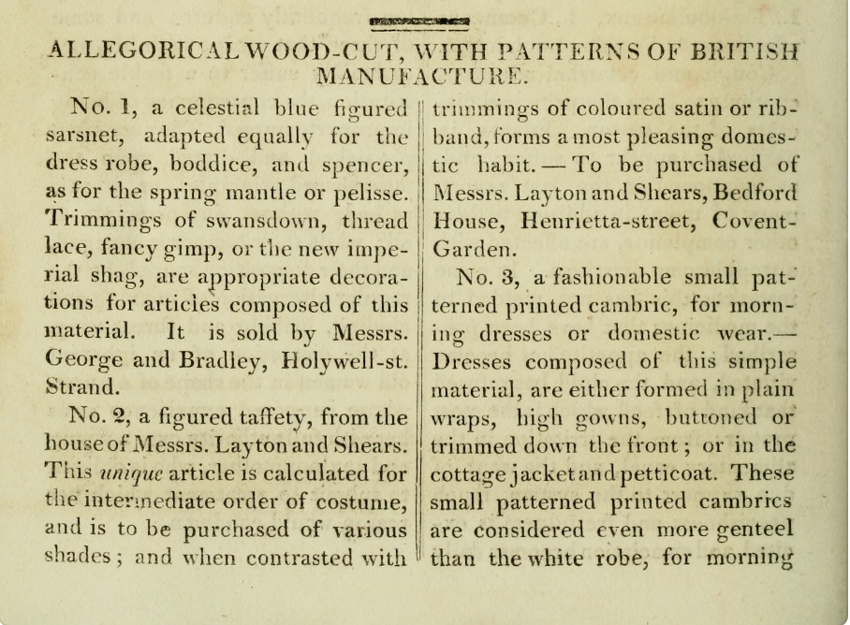
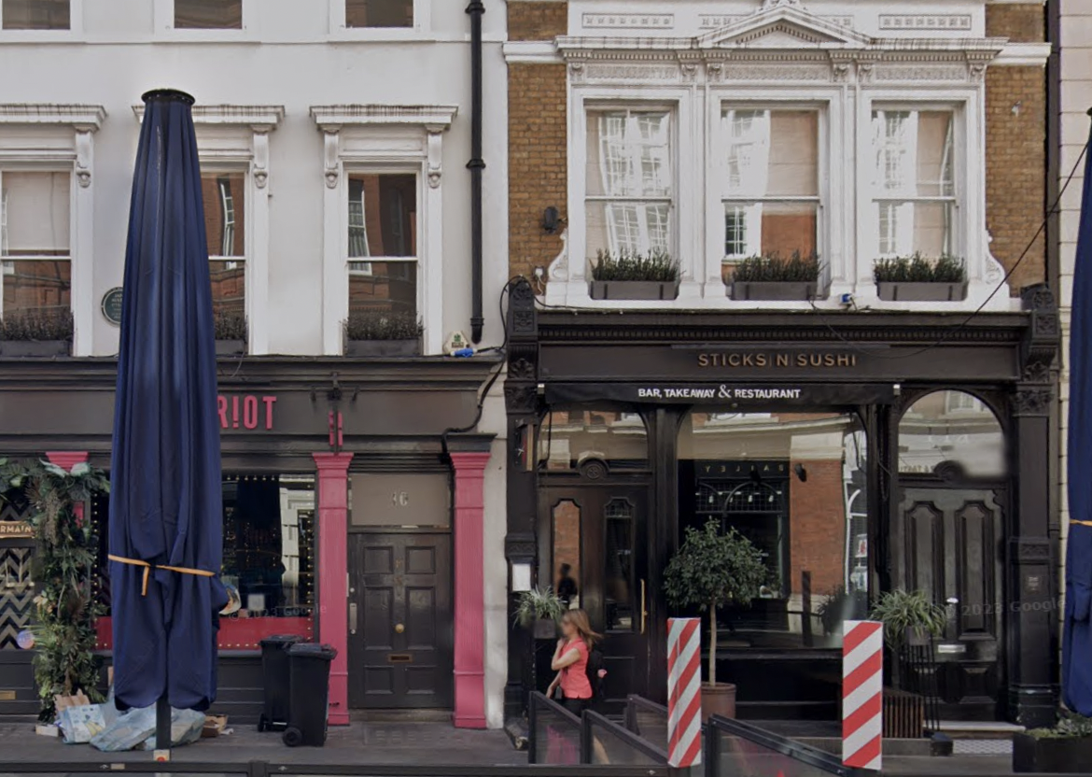
24 May 1813
“I went to Laytons…and got my mother’s [black sarsnet] gown, 7 yards at 6s/6d.”
Notes:
Having access to Ackermann’s was also useful because, for many years, it included actual fabric swatches provided by London warehouses, like this one, Layton’s. Subscribers could then tell their family and friends in London which fabric to buy—Pattern #4 is shirting—linen—advertised as “as good as 4s/yd and only costs 2s

Slide 28
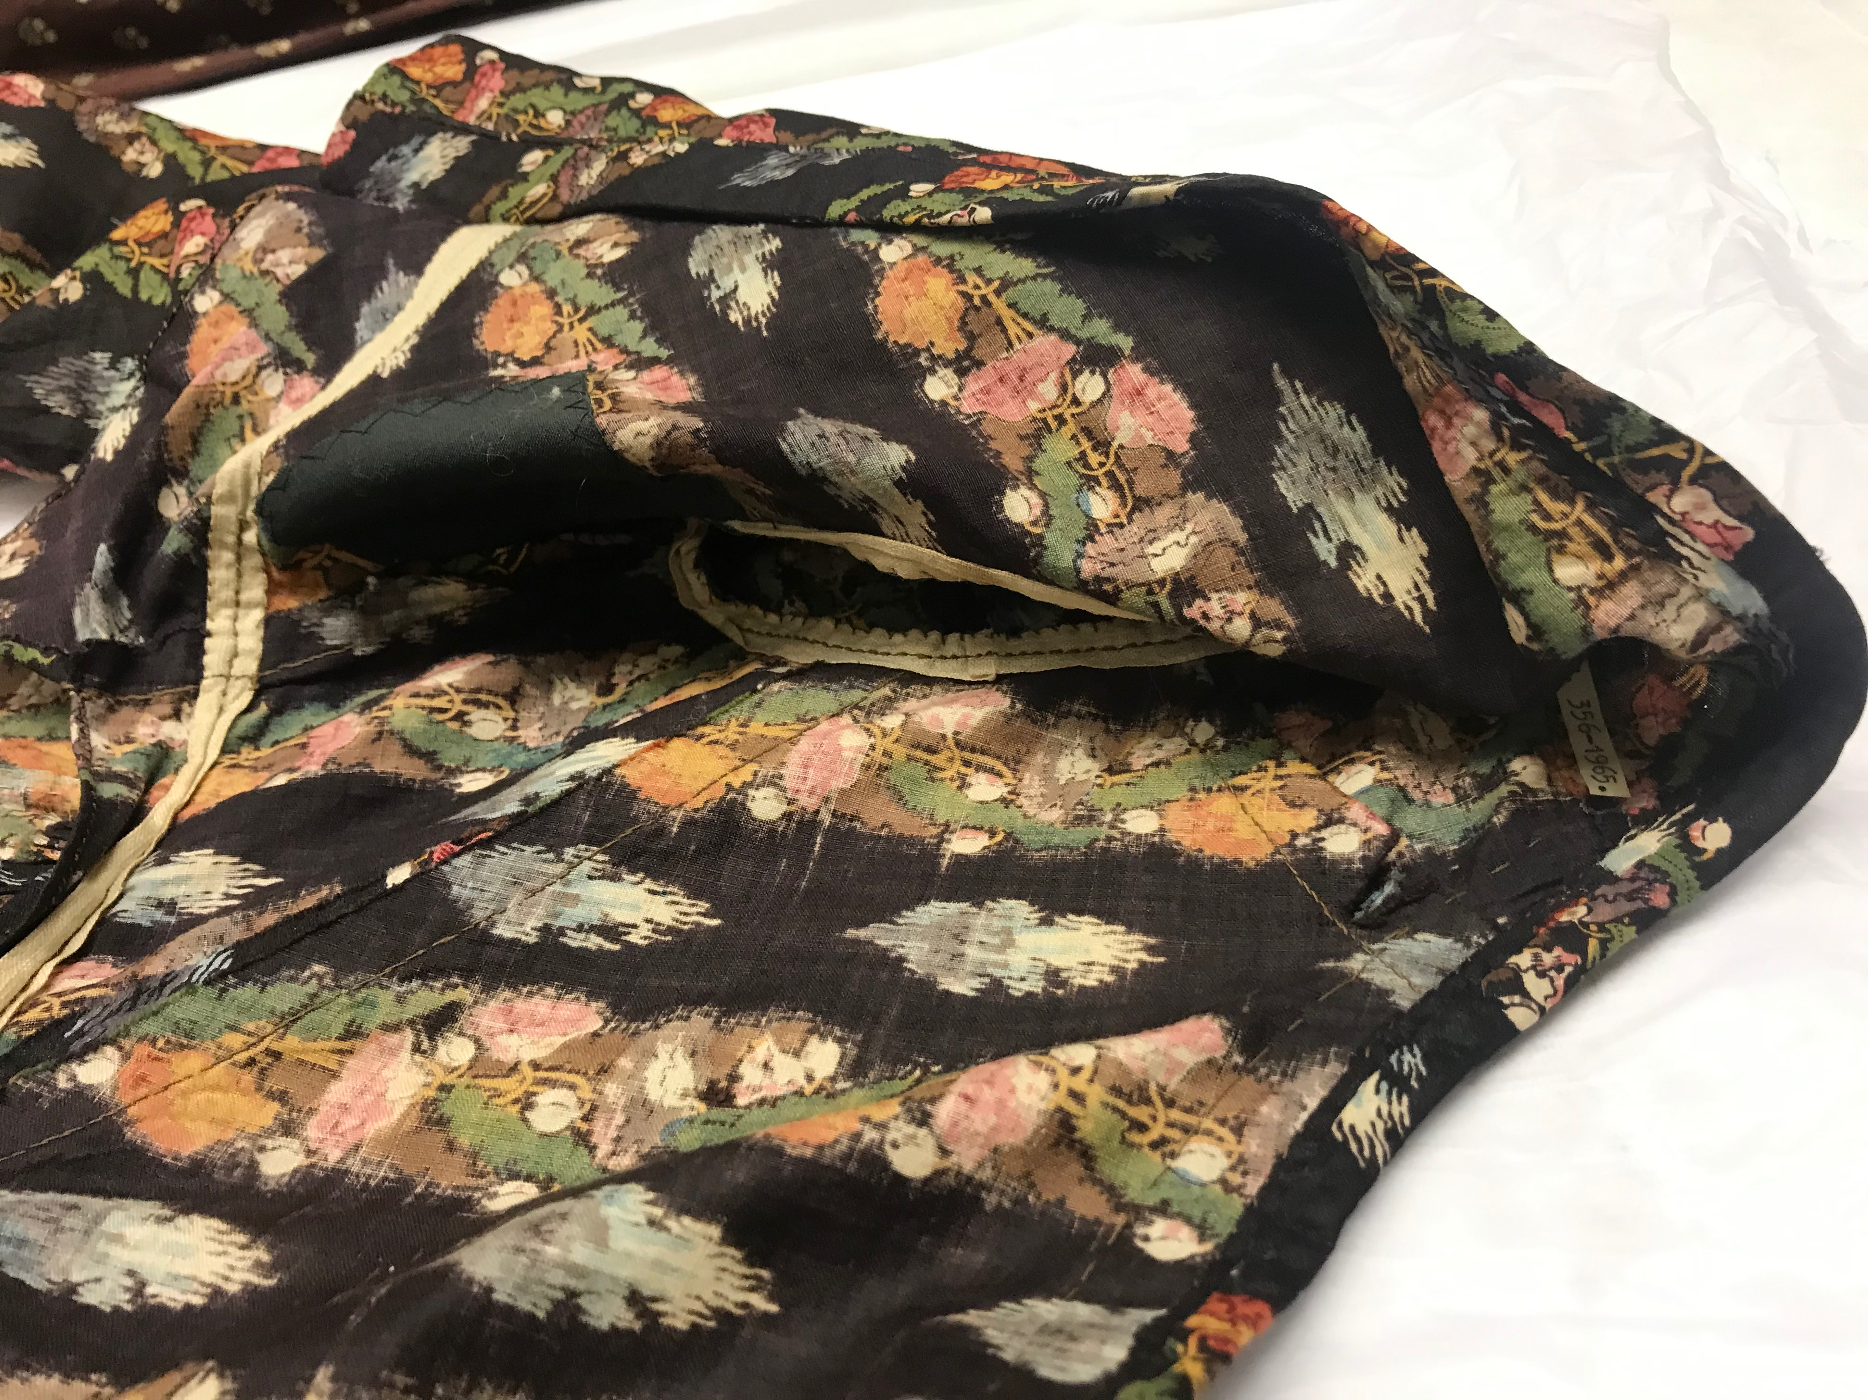
“Only, my pattern gown is at Hartfield. No, you shall send it to… But then, Mrs. Goddard will want to see it…”
Harriet Smith, Emma
V & A, T.356-1965
Victoria and Albert Museum
Notes:
““Should I send it to Mrs. Goddard’s, ma’am?” asked Mrs. Ford.—“Yes—no—yes, to Mrs. Goddard’s. Only my pattern gown is at Hartfield. No, you shall send it to Hartfield, if you please. But then, Mrs. Goddard will want to see it.—And I could take the pattern gown home any day. But I shall want the ribbon directly—so it had better go to Hartfield—at least the ribbon. You could make it into two parcels, Mrs. Ford, could not you?””

Slide 29
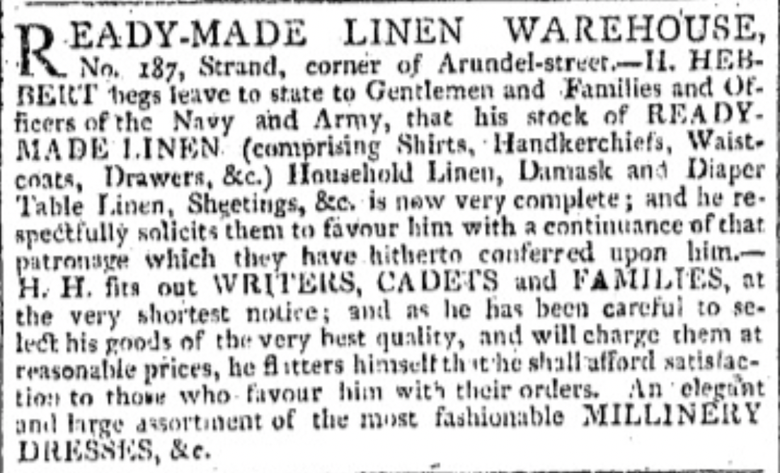
24 December 1798
“I cannot determine what to do about my new gown; I wish such things were to be bought ready made.”
1 November 1800
“I have heard from Charles [awaiting orders on the Endymion] and am to send his shirts by half dozens as they are finished;--one set will go next week.”
9 March 1814, Morning Chronicle
Notes:
Work, but by 1814 they could be bought ready made

Slide 30
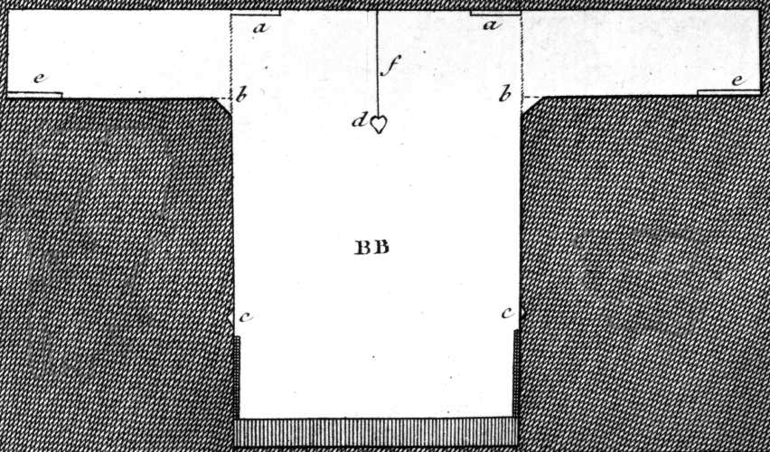
1 September 1796
“We are very busy making Edward’s shirts, and I am proud to say that I am the neatest worker of the party.”

Slide 31
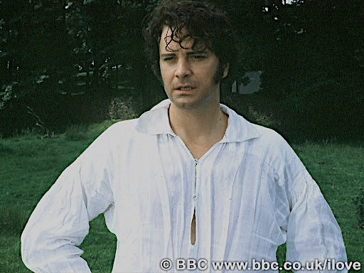

Slide 32
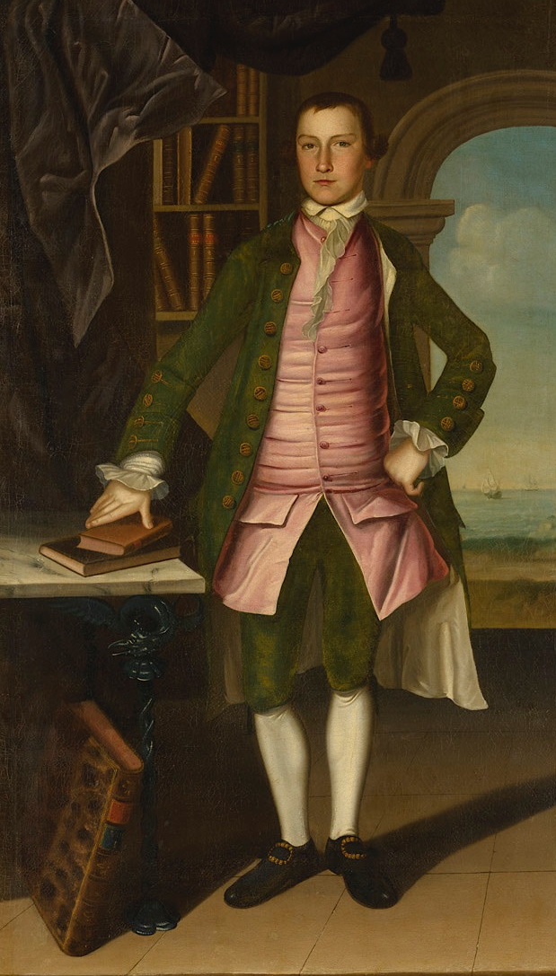
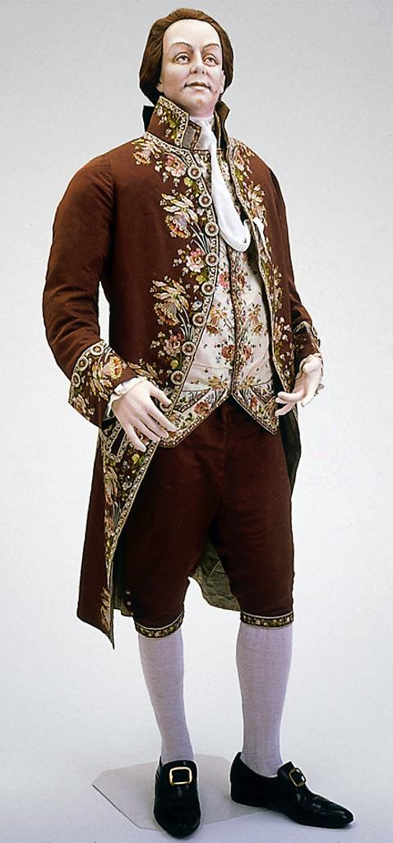
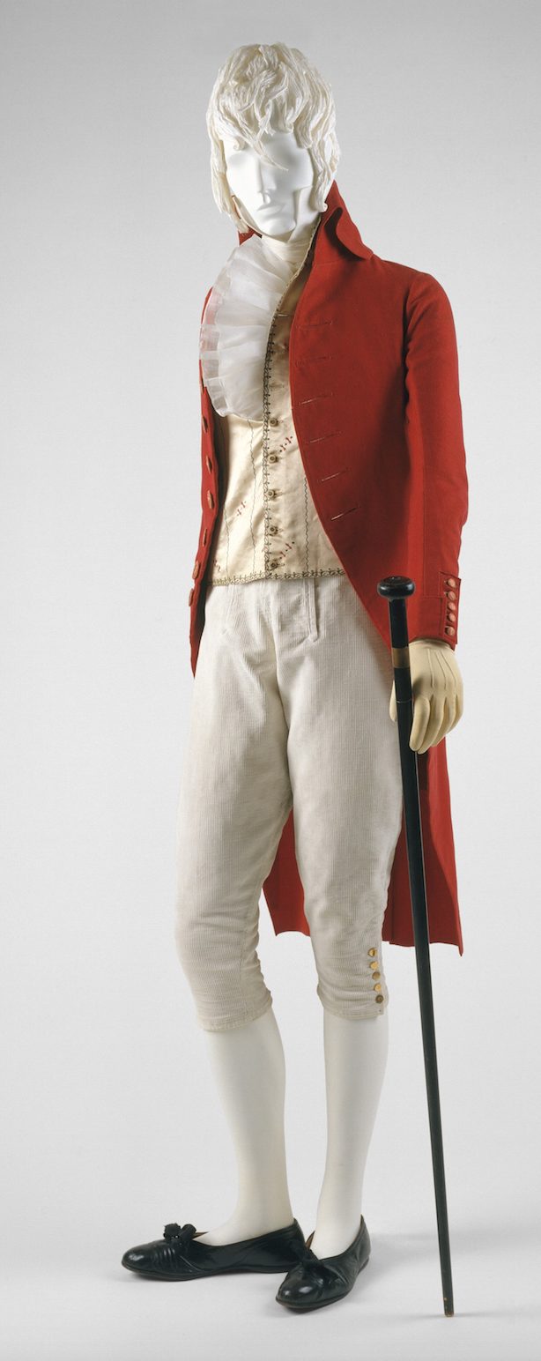
1760s
1780s
1790s
.
Notes:
body-shaping or posture garment
studied ease

Slide 33
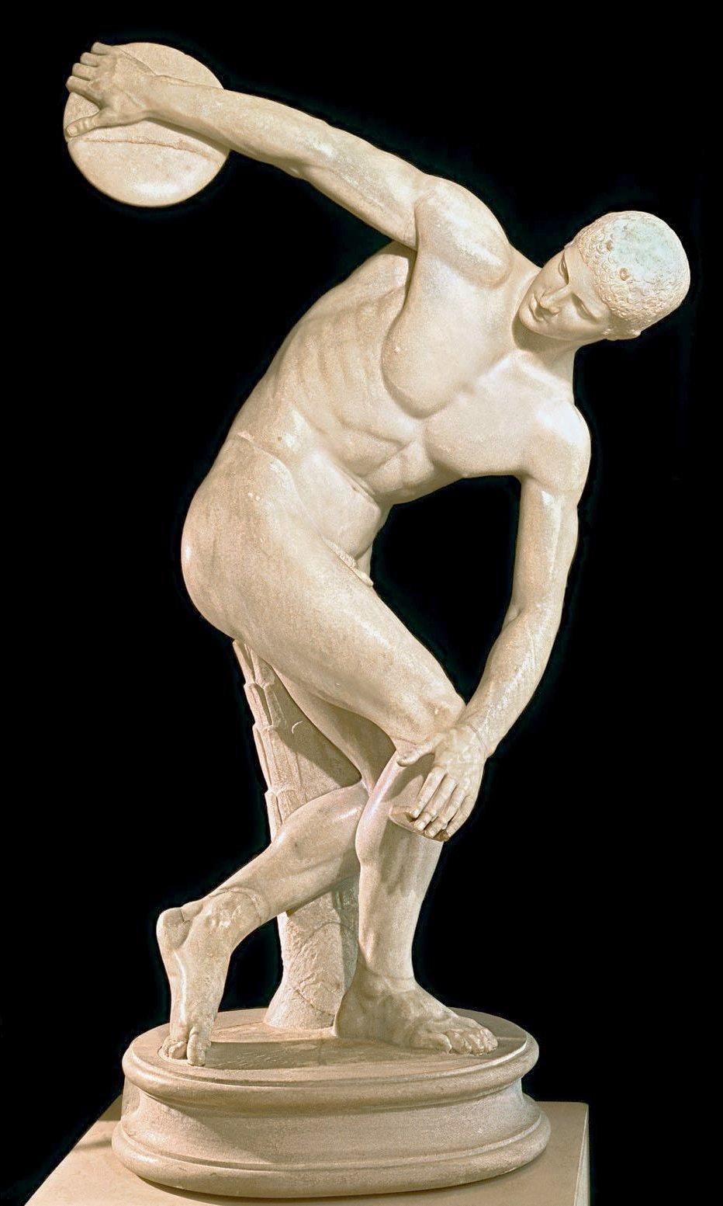
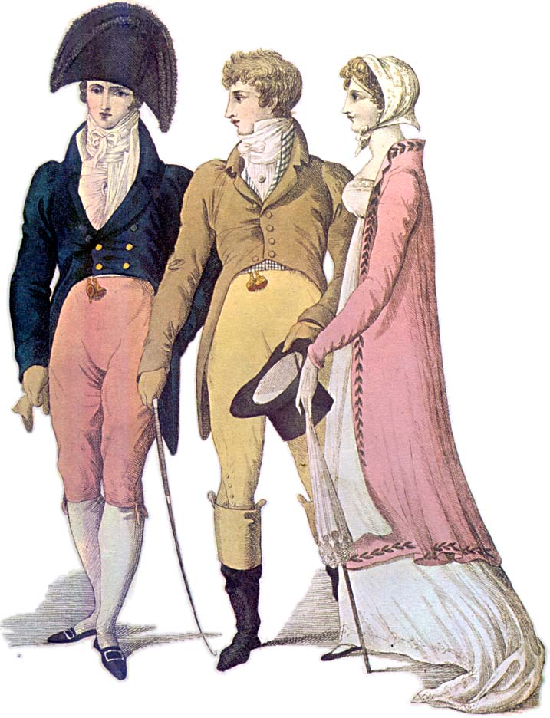
April 1808
From Le Beau Monde
Notes:
classical male nude

Slide 34
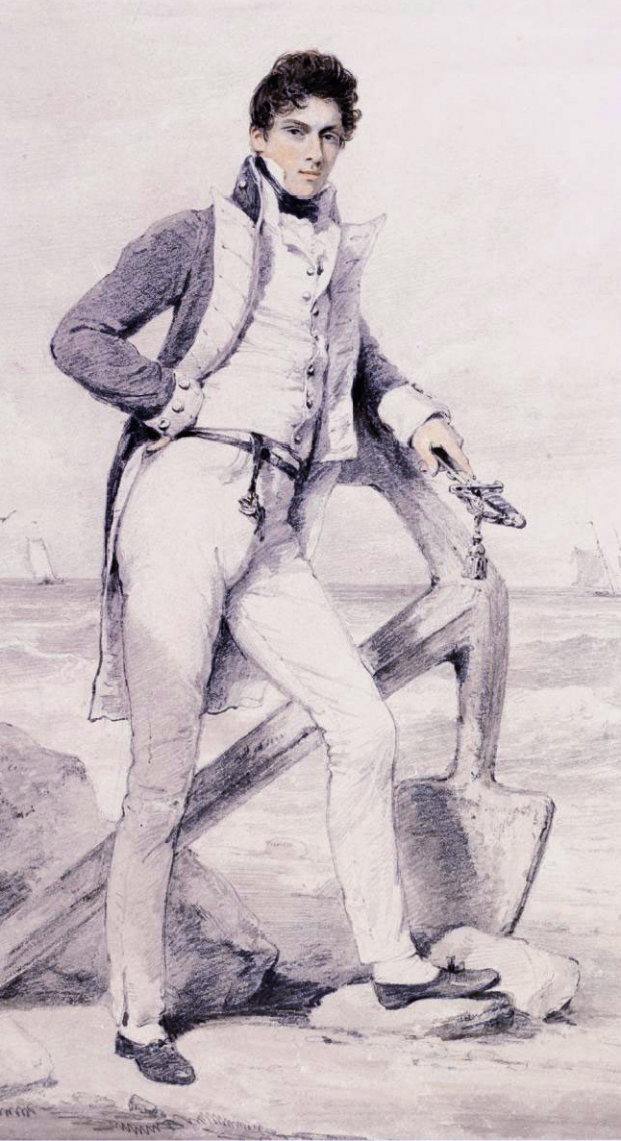
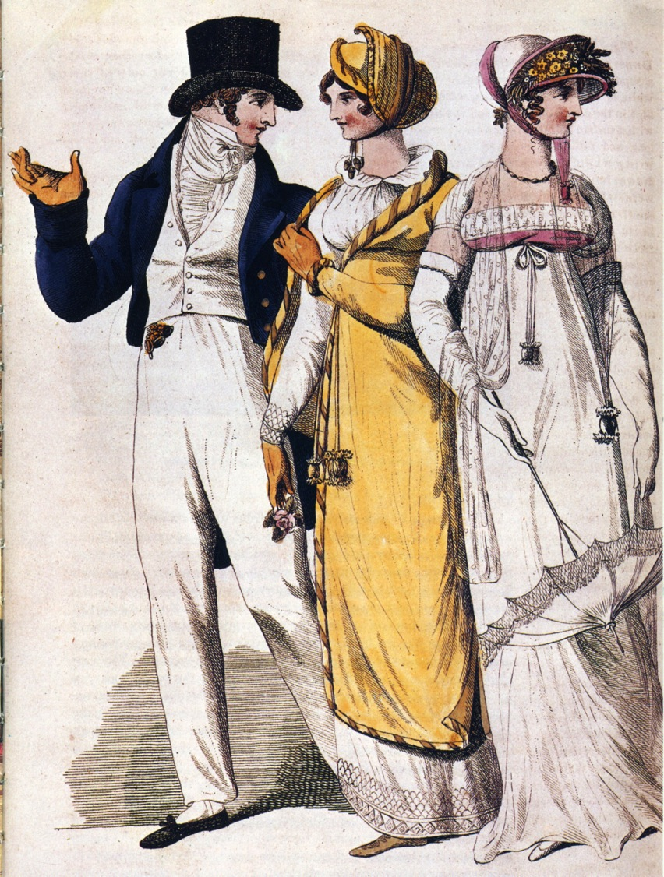
“…he would have been delighted to shew his uniform there too, had not cruel custom prohibited its appearance except on duty.”
William Price, Mansfield Park
1807
Captain Hoste 1811 by Edridge

Slide 35
Sir William Harbord, 1810 by Edridge

Slide 36
He “wanted only regimentals to make him completely charming.”
George Wickham, P&P

Slide 37
Notes:
shaped piece under the arm
wool can be shaped when heated.

Slide 38
10th Regiment of Dragoons, aka “The Prince of Wales's Own Royal Regiment of Light Dragoons” or “The China 10th”
George, Prince of Wales by Sir William Beechey c. 1798
Notes:
Here we see an amazing example of skilled tailoring in a uniform coat made for the Prince of Wales August 1762-June 1830) August 1762 He is in his late 30s here but was already growing stout. The coat, however is designed to fit him like a glove. By the way, the 10th was designed to be a “show” regiment, not designed for battle. Hence the moniker China—fragile and breakable, to be handled with care. As such it attracted young men of wealth and birth, including…

Slide 39
George Bryan “Beau” Brummel
1805 by Dighton
Notes:
From hair to toe, the perfect gentleman

Slide 40
Rolinda Sharples, The Cloak Room at the Assembly Rooms at Clifton, 1818
Notes:
Pants
bodices
Don’t forget to mention dancing pumps.

Slide 41
Hair
21 January 1799
“[Charles] appears to far more advantage here than he did at Godmersham with powder in his hair.”
Notes:
“The Brutus” “The Windswept” “The Stanhope Crop.” Charles wearing powder in 1799 (made Lieutenant, December 1797)

Slide 42
James Gillray, 10 March 1795
Notes:
What do you do when hair powder is taxed? Gillray was prompt to point out the inevitable outcome.

Slide 43
“…good-looking and gentlemanlike; he had a pleasant countenance, and easy, unaffected manners.”
Charles Bingley, P&P
21 January 1799
[Charles Austen] “He appears to far more advantage here than he did at Godmersham, not…oppressed by powder in his hair.”
Robert Fellows, by Edridge 1800
Notes:
1800 Robert Fellows, philanthropist, by Edridge
But the fact that he is looking for a house suggests a family background in trade

Slide 44
“His hat sat so well, and the innumerable capes of his great-coat looked so becomingly important. To be driven by him, next to being dancing with him, was certainly the greatest happiness in the world!”
Catherine Morland about Henry Tilney,
Northanger Abbey
Notes:
Henry can speak of fashion with impunity
A greatcoat was made of “cloth” which was a synonym for wool. The capes were originally designed to keep off rain but they quickly became a fashion statement as well, as Catherine notes with admiration.

Slide 45
“His name was good, his residence was in their favourite village, and she soon found out that of all manly dresses a shooting jacket was the most becoming. Her imagination was busy…”
Marianne Dashwood when considering Mr. Willoughby, S&S
Notes:
Awareness of shooting jacket—the country life attire influence. This picture is a bit deceptive as regards the quote. The rider would have walked to go shooting with the object to bring back birds. If hunting (hunting=fox hunting), they would have been riding. If they were hunting on foot, and it was not their property or they did not have permission of the property owner, they might have been arrested for poaching.

Slide 46
14 September 1804
“Like other young ladies Miss Armstrong is considerably genteeler than her parents. Mrs. Armstrong sat darning a pair of stockings the whole of my visit.”
Notes:
Both men and women wore stockings

Slide 47
25 November 1798
“The Overton Scotchman [pedlar] has been kind enough to rid me of some of my money, in exchange for six shifts and four pair of stockings. The Irish is not so fine as I would like it…It cost me 3s. 6d. per yard.”
23 January 1817
“Nothing offends me so much as the absurdity of not being able to pronounce the word Shift. I could forgive her any follies in English, rather than the Mock Modesty of that French word.” *
(Letter to niece Caroline Austen re: the heroine in her attempted novel who calls a shift a chemise.)
Notes:
Womens’ shifts were cut similar to men’s shirts but by the 19th century were more a-line.
But the question remains: did women wear drawers?
3s/6d

Slide 48
Rowlandson, “Exhibition ‘Stare’ case, Somerset House 1800
Notes:
Rowlandson, 1800, “Exhibition Stair Case” at Somerset House leading to the gallery of the Royal Academy of Art (pres. Sir Joshua Reynolds)

Slide 49
Charles Williams?
1805-1810
1801

Slide 50
Autumn de Wilde, Emma, 2020

Slide 51
Notes:
Corset and stockings, two layers of linen, channels of baleen or cord, single spiral laced, busk (thin wooden stick about 1-2” wide – great for posture)

Slide 52
Notes:
No busk, boning, gathered top

Slide 53
“I hope you saw her petticoat, six inches deep in mud, I am absolutely certain; and the gown which had been let down to hide it not doing its office.”
Louisa (Bingley) Hurst, P&P
Notes:
We learn that Louisa is catty, jealous, and that Elizabeth is forthright

Slide 54
23 January 1817
“Sally has got a new red cloak, which adds much to her happiness.”
Diana Sperling as printed in Mrs. Hurst Dancing

Slide 55
1810, Costume Parisien
Spencers
May 1797, Heideloff, Gallery of Fashion
1819-1822, Metropolitan Museum
Notes:
Spencer-corset

Slide 56
Ackermann December 1813
Gown and matching Spencer of kerseymere
(…a sort of day to evening outfit!)
30 June 1808
“What cold, disagreeable weather, ever since Sunday!—I dare say you have fires every day. My kerseymere Spencer is quite the comfort of our evening walks.”

Slide 57
18 April 1811
“Our Pelisses are 17s 6d each—she charges only 8s for the making, but the buttons seem expensive;—are expensive, I might have said—for the fact is plain enough.”
Sept. 1812 La Belle Assemblée

Slide 58
1817-1820 Victoria and Albert Museum

Slide 59
16 September 1813
“My [evening] cap is come home & I like it very much.
Fanny’s cap “is of sarsnet and lace, of a different shape from mine, more fit for morning carriage wear.”
L to R: Metropolitan Museum of Art; Susan Greene Collection at Genesee Country Museum; Ackermann April 1813; Ackermann March 1813

Slide 60
1790s Big Hats/Big Hair/
Big Feathers
1808-1810: Accommodating
Grecian hairstyles
Les journals des dames et des mode
21 December 1802

Slide 61
A girl not out, has always the same sort of dress: a close bonnet, for instance, looks very demure…
Mary Crawford, Mansfield Park
James Gillray, Les Invisibles, 1810

Slide 62
1810s: Accommodating…other activities.

Slide 63
Les journals des dames et des modes 1814
“Look here, I have bought this bonnet. I do not think it is very pretty; but I thought I might as well buy it as not. I shall pull it to pieces as soon as I get home and see if I can make it up any better.”
Lydia Bennet, P&P
Ackermann 1817
Notes:
French bonnets all the rage. The most famous bonnet in Austen

Slide 64
Saturday, 15 October 1808:
On the death of her sister-in-law Mrs. Edward Austen:
“I am to be in bombazeen and crape, according to what we are told is universal here…My mourning, however, will not impoverish me, for by having my velvet pelisse fresh lined and made up, I am sure I shall have no occasion this winter for anything new of that sort.”

Slide 65
1818
1810
1816
20 November 1800
“Miss Debary, Susan, and Sally, all in black, but without any statues, made their appearance…”
Gown of silk bombasine
Notes:
followed the styles of the day,
but certain textiles
Bombazine,. Silk crepe
broach
royal deaths: Princess Charlotte (George IV’s daughter) 6 November 1817 Queen Charlotte (George III wife), 17 November 1818 Edward, Duke of Kent (son of George III, father of Queen Victoria) 23 January 1820 George III, (coronation 19 July 1821) 29 January 1820 Princess Frederica Charlotte of Prussia (wife of Frederick, Duke of York, second son of George III) 6 August 1820 Caroline of Brunswick, (George IV wife) 7 August 1821

Slide 66
Notes:
Chariciturists not above using mourning clothes to poke fun

Slide 67
1794
1800
1809
Letters
1796-1798-1799-1800-1801
1804-1805-1807-1808-1809
1811-1812-1813
1814-1815-1816-1817
1815
1818
1812-1813
Notes:
While writing her early works, Austen would have dressed differently than she would have while writing later works and would have envisioned her characters differently as well. Almost every one of her extant letters contain fashion references but here is an overall view of the major changes….briefly describe…but did she keep current with trends? For example…Napoleon

Slide 68
18 December 1798
“I believe I shall make my new gown like my robe, but the back of the latter is all in a piece with the tail, and will seven yards enable me to copy it in that respect?”
Victoria and Albert Museum

Slide 69
Notes:
While women of means were anxious to stay in fashion, not all were willing to commit. After all, fabric was expensive and labor was cheap. Rather than picking the entire gown apart to remake it, this woman hedged her bets by raising the skirt to the new higher waist, but leaving the bodice intact just in case the waistlines came down again.

Slide 70
James Gillray
20 January 1796
“Ladies Dress as it soon will be”
Notes:
Well, Gillray was already forecasting that current those trends would lead to certain outcomes.

Slide 71
8 January 1801
“Mrs. Powlett was at once expensively & nakedly dressed.”

Slide 72
Ackermann, 1809
French
Roman
Venetian
Tyrolese
Andalusian
Spanish
Chinese
à la Maltese
Henry VIII
Brussels/Mecklin
Egyptian
Russian
Indian muslin
à l’antique
à la militaire
Turkish
Danish
India muslin
à la Hussar
Van Dyke
Polish
July 1809, Ackermann, Promenade Dress
Notes:
But so many other influences. Ackerman fashion descriptions in 1809 contain all these.

Slide 73
Ackermann July 1813
“A round robe of pale jonquil or canary-coloured crape, worn over a white satin slip; short sleeves composed of the shell-scalloped lace and satin…a broad scalloped lace finishes the robe at the feet, above which is placed a double row of plaited ribband, and a diamond clasp confines the waist in front.”
15 September 1813
“My gown is to be trimmed everywhere with white ribbon plaited on somehow or other. She says it will look well. I am not sanguine. They trim with white very much.”

Slide 74
14 June 1814
“…do not be trampled to death in running after the Emperor.” [Tsar Alexander I]
Princess Charlotte, Russian sarafan
Notes:
June 1814 when Tsar Alexander I and other European leaders came to London to celebrate what they thought was the defeat of Napoleon, Prices Charlotte wore the sarafan, russian style. And Jane Austen warned Cassandra, who was in London at the time, to “take care of yourself and do not be trampled to death in running after the emperor” [Tsar Alexander I].

Slide 75
Ackermann July 1814
Morning Dress
30 November 1814
”Her purple pelisse rather surprised me…it looked very well.”
Ackermann December 1814
Walking Dress
Notes:
A Lady of means would change several times during the day.
Morning wear—
pay calls or receive callers in morning dress.
Afternoon dress, or walking dress,.

Slide 76
A lilac sarsenet petticoat, full flounce round the bottom, confined by plaits or tufts of riband of corresponding color, and headed with a border of the same; high plain body of white jaconet muslin; braces tied behind.
Ackermann August 1814
2 September 1814
“I am amused by the present style of female dress;—the coloured petticoats with braces over the white Spencer…”

Slide 77
Giles Foster, Northanger Abbey, 1986
“…pinned up each other's train for the dance and were not to be divided in the set.”
Catherine Morland/Isabella Thorpe, Northanger Abbey

Slide 78
13 October 1808
“We must turn our black pelisses into new, for Velvet is to be very much worn this winter.”
“Pelisses, which are alternately formed of velvet or sarsnet, admit also of much variety in the constructions.”
La Belle Assemblée, October 1808

Slide 79
Drawing Room,
St. James’s Palace
Ackermann’s Microcosm of London (1808-10)
“…looked forward to her introduction at Rosings with as much apprehension as her father had done to his presentation at St. James’s.”
Maria Lucas, P&P
Notes:
But let’s look at another item at the very top of the fashion ladder: the court

Slide 80
Court Dress
Between
1800 and 1821
Notes:
can see why women, though sorry that the Queen had died, were overjoyed with the new rules. silk sellers

Slide 81
Court Dress (After 1820)
Notes:
Queen Charlotte (George III’s wife) set specific rules about court dress died 1818, George 3 died 1820
most irksome must wear hoops of specific dimension,
Consider the high-waisted style. Now consider wearing that with hoops.

Slide 82
29 May 1817 (To Frances Tilson)
“You will find Captain —— a very respectable, well-meaning man, without much manner, his wife and sister all good humour and obligingness, and I hope (since the fashion allows it) with rather longer petticoats than last year.”
March 1817 La Belle Assemblée
Notes:
To come back to Austen: how shall we rate her fashion consciousness?

Slide 83
The End
hope.greenberg@uvm.edu

