Slide 1
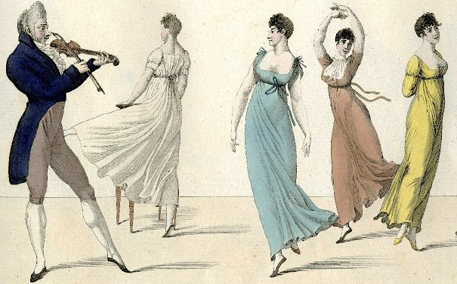
Fashion in Jane Austen’s England
Hope Greenberg
Notes:
Title slide: Thank the organizers.
whirlwind tour of fashion 1775-1820
Jane Austen’s lifetime
Austen Era” instead of “Regency Era.” 1811-1820
Jane Austen was a close observer of fashion

Slide 2
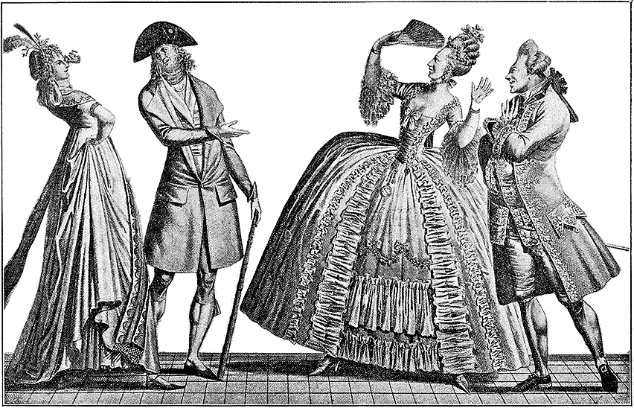
Notes:
One hundred years of stiff and formal clothing, then BAM! fashion leaders tore up the rules. The traditional narrative is that women took one look at classical statues, got inspired, shouted liberte, egalite, fraternite, threw off their corsets, and hiked up their waistlines. “Expensively and nakedly dressed” women appeared in diaphanous gowns that, oh horrors!, showed their shape while men adopted skin tight stretch pants and cutaway jackets that left little to the imagination. And all of them tried to stay one step ahead of a growing middle-class eager to be fashionable, too.

Slide 3
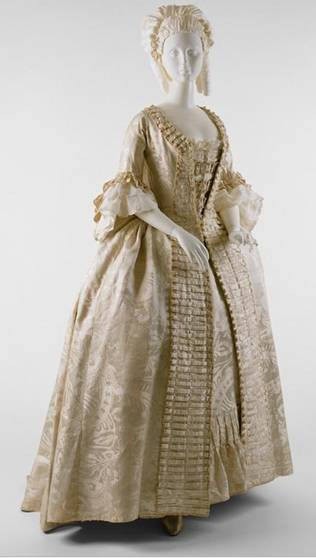
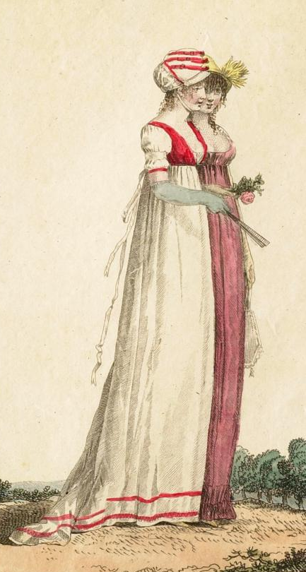
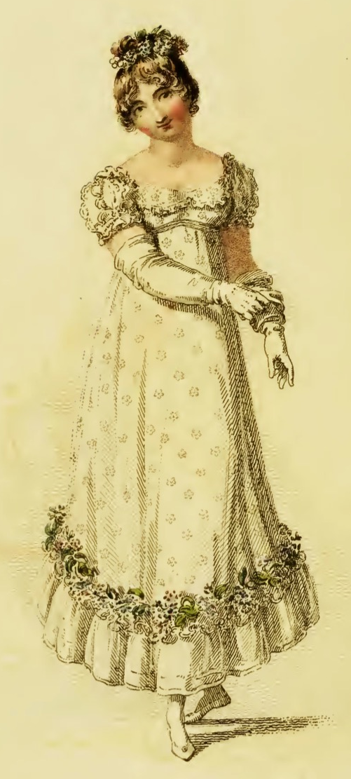
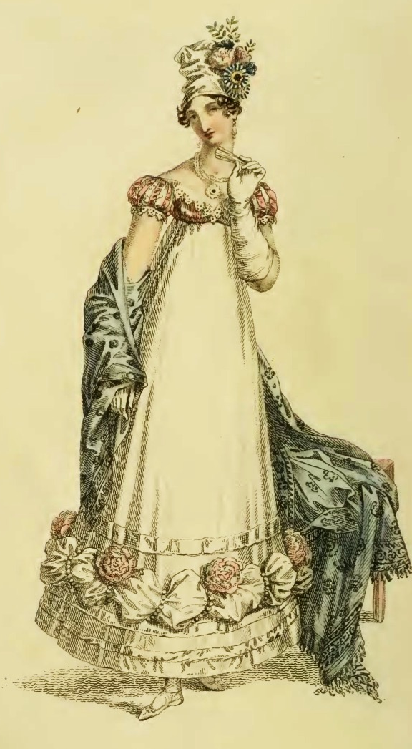
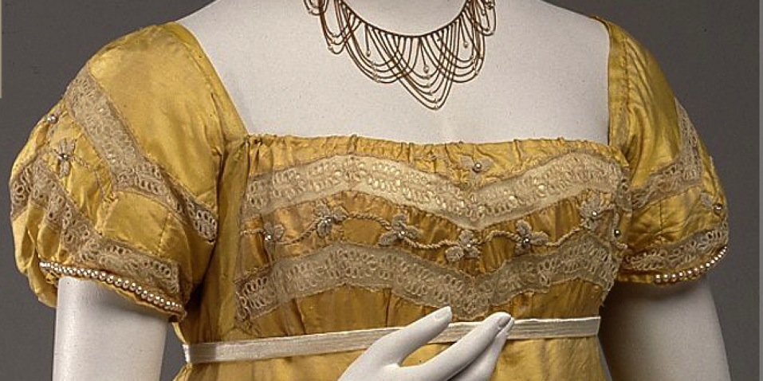
1794
1800
1809
1815
1818
1812-1813

Slide 4
Were Statues and Revolution Enough?
Notes:
So we’ve seen this incredible evolution in a few short years from stiff, formal, erect posture and clothing to diaphanous, light, flowing and graceful clothing that is, in turn heading back wide, horizontal look. The question remains why? How did this happen. Impossible to answer fully but we can look at some of the influencers.
Was it the Greek statues?
Was it the French revolution?
Was it the “Turkish/Oriental”?
Was it the Indies (East and West)?
Was it new technology?
Was it politics and globalization?
Was it the price of muslin?

Slide 5
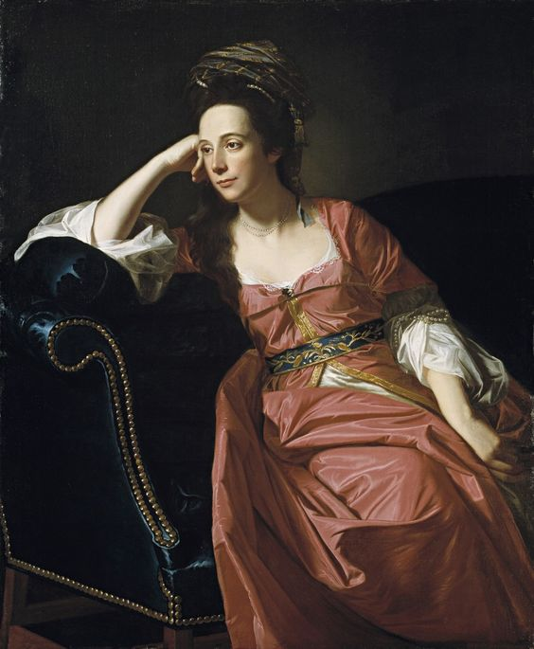
John Singleton Copley, Margaret Kemble Gage (circa 1771)
Notes:
Global travel already being felt in 18th century

Slide 6
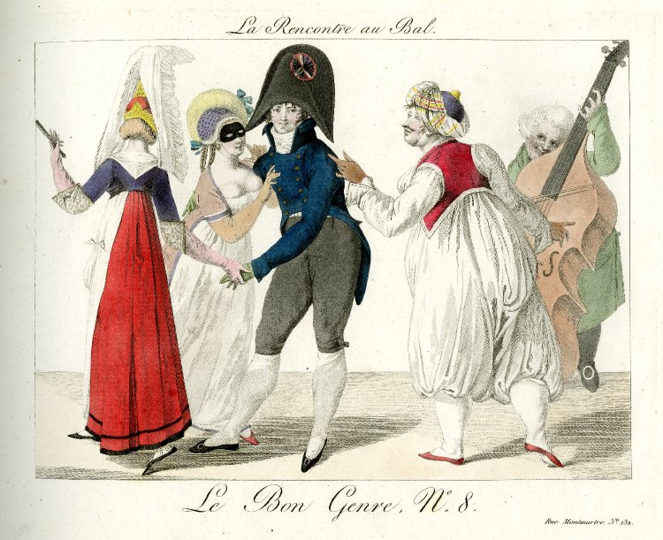
Pierre de la Mésangère, Le Bon Genre, 1801 (Staatliche Muzeen zu Berlin)
Notes:
Pierre de la Mésangère, Le Bon Genre, 1801 (Staatliche Muzeen zu Berlin) https://www.europeana.eu/portal/en/record/2048202/DE_MUS_018313_1939309.html

Slide 7
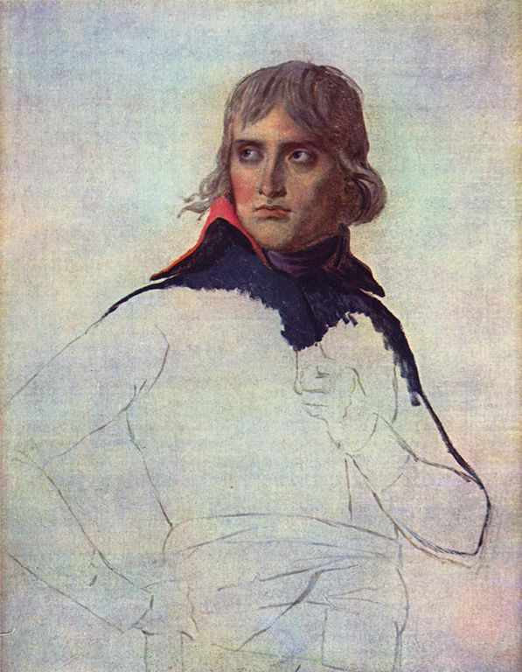
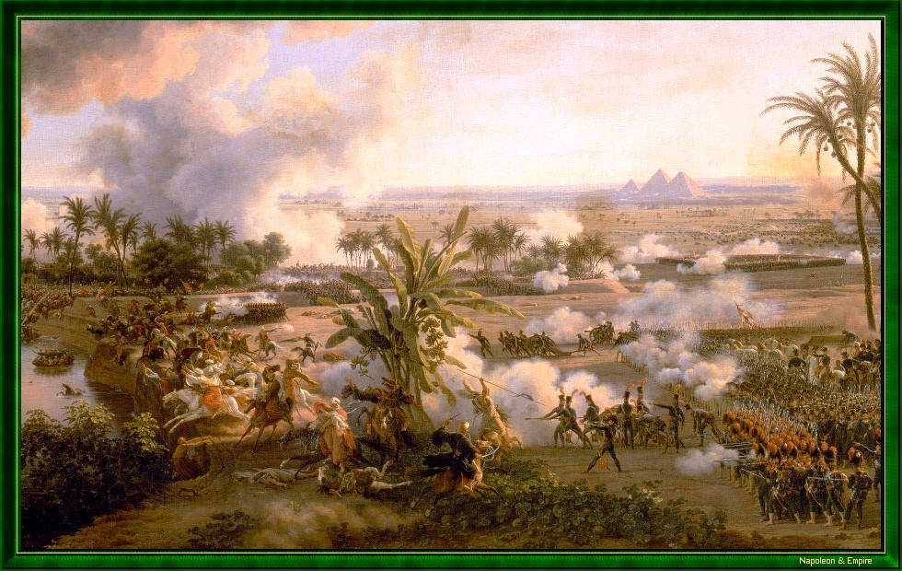
Battle of the Pyramids, July 21, 1798

Slide 8
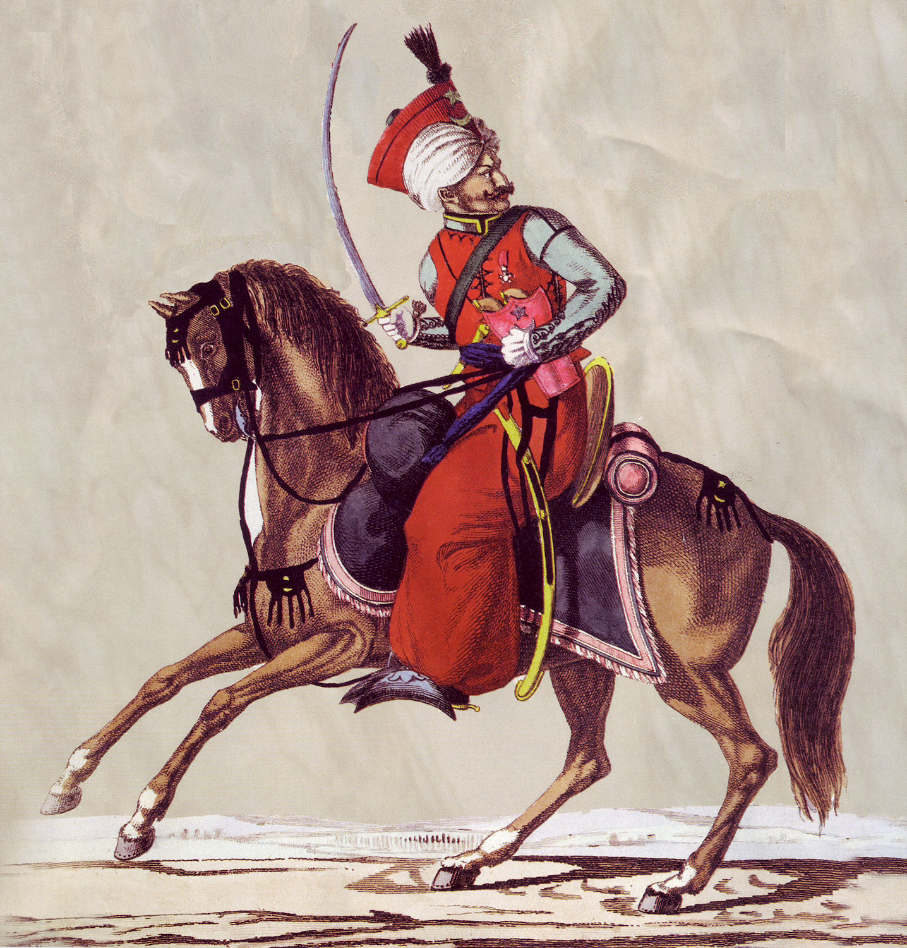
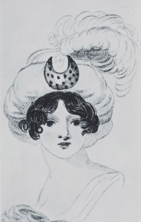
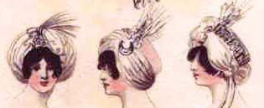
Austen, Tuesday, 8 January 1799:
“I am not to wear my white satin cap to-night, after all; I am to wear a mamalone [mameluke] cap instead…It is all the fashion now; worn at the opera, and by Lady Mildmays at Hackwood balls.”
Notes:
Warrior caste in Egypt defeated by Napoleon at the Battle of the Pyramids, 1798 “On July 1, 1798, Napoleon landed in Egypt with 400 ships and 54,000 men and proceeded to invade the country, as he had recently invaded Italy. But this Egyptian invasion was to be different. For, in addition to soldiers and sailors, Napoleon brought along 150 savants — scientists, engineers and scholars whose responsibility was to capture, not Egyptian soil, but Egyptian culture and history.” The ladies picked up the turban almost immediately.
In former ages it seemed requisite that every lady should cut out her garments by a certain erect standard. ..But in our days, an English woman has the extensive privilege of arraying herself in whatever garb may best suit her figure or her fancy. The fashions of every nation and of every era are open to her choice. One day she may appear as the Egyptian Cleopatra, then a Grecian Helen; next morning the Roman Cornelia; or, if these styles be too august for her taste, there are Sylphs, Goddesses, Nymphs of every region, in earth or air, ready to lend her their wardrobe.
Mirror of Graces, 1811 (p. 52)

Slide 9
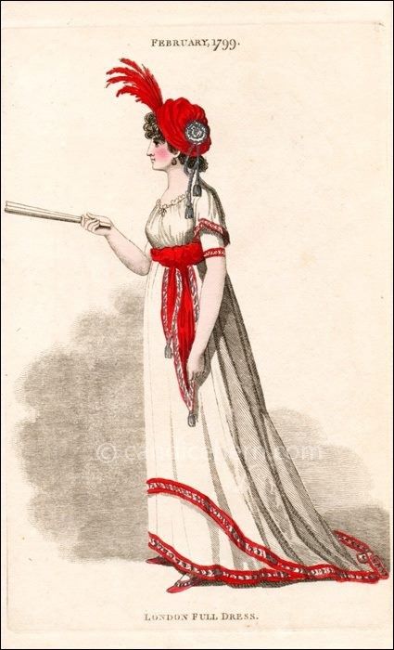
“Egyptian” gown with coquelicott trim, London Full Dress,
February 1799
Notes:
(From Candace Hern’s collection)

Slide 10
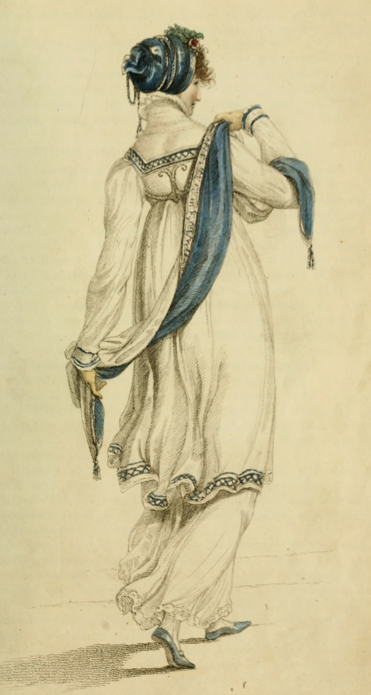
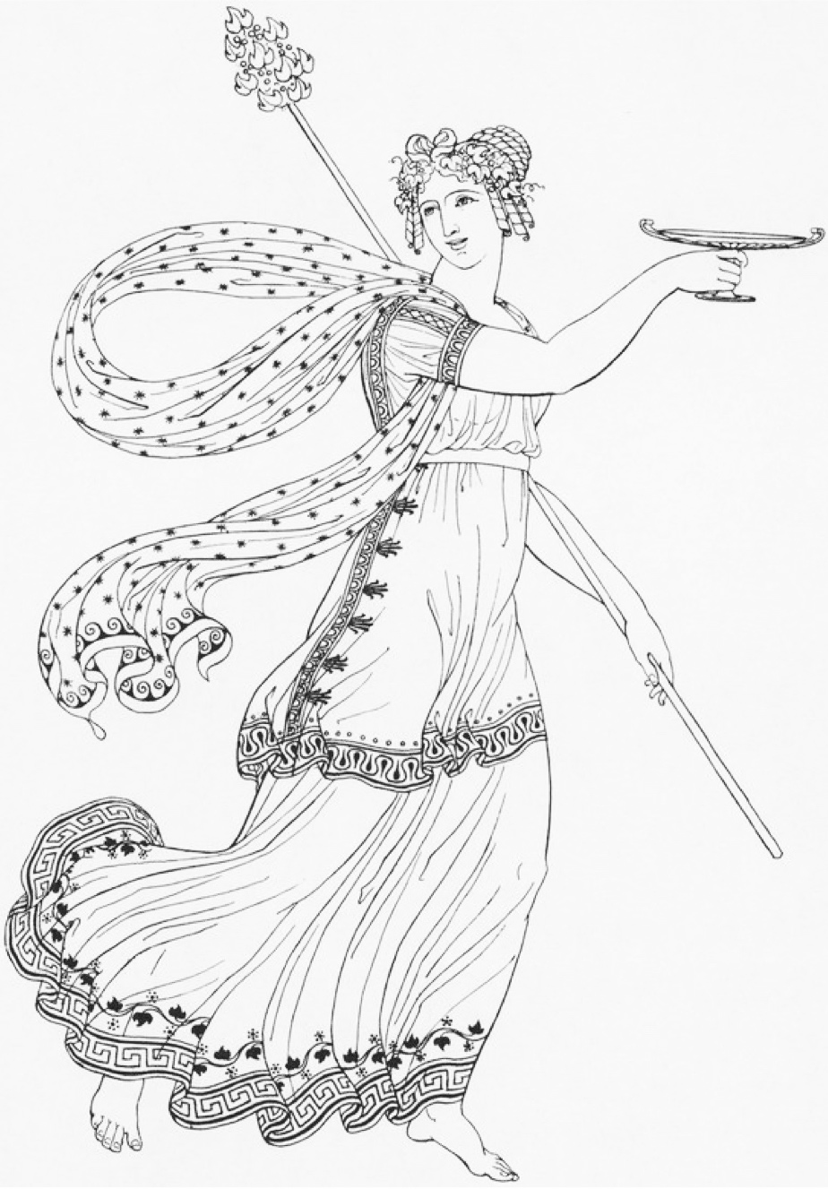
Ackermann, Walking Dress, June 1809
Thomas Hope, Ancient Costumes, 1809
Notes:
Thomas Hope publishes “Ancient Costumes” with drawings of garments taken from actual friezes and sculptures, which fashionable women then copy.

Slide 11
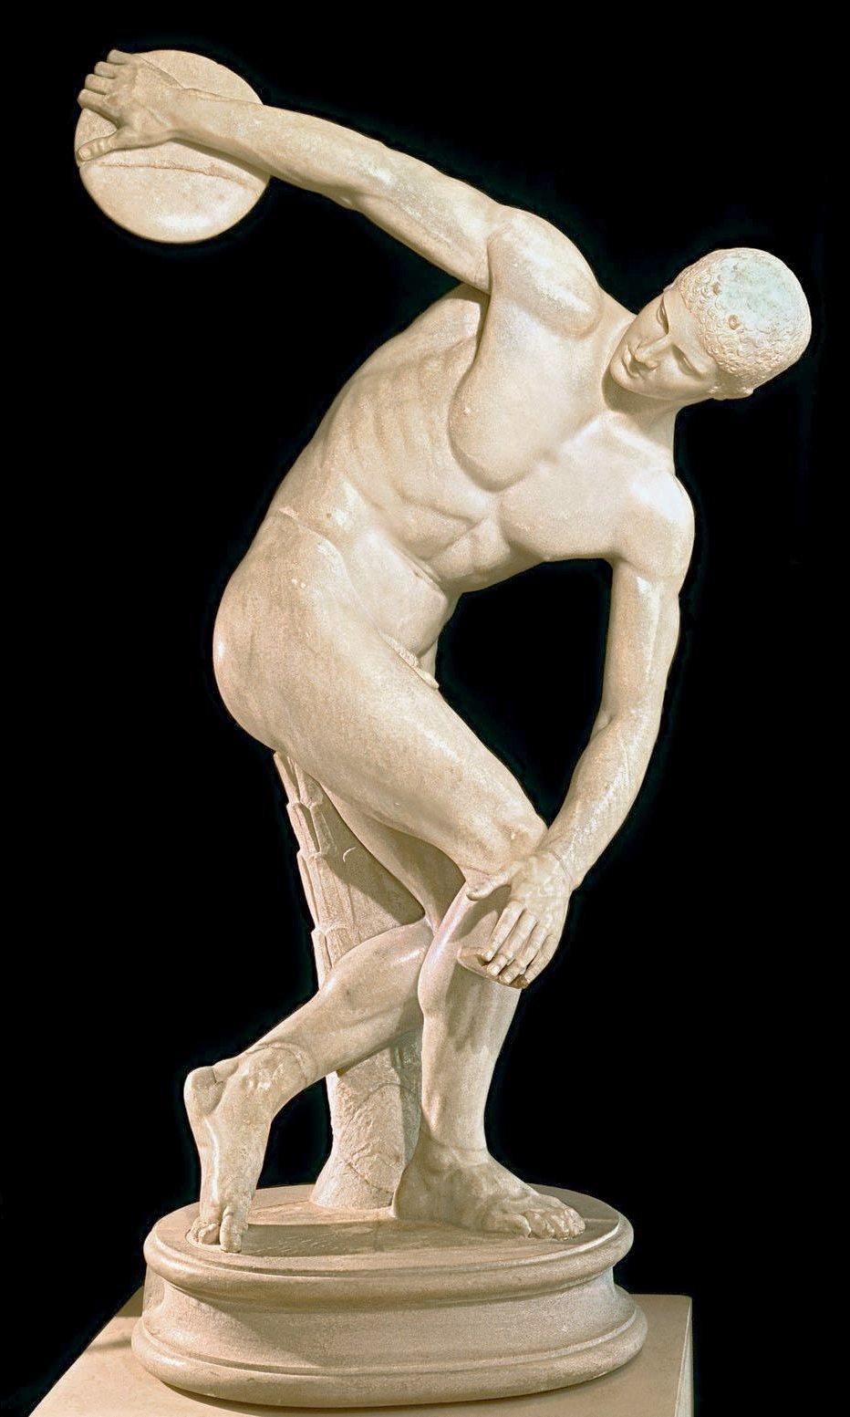
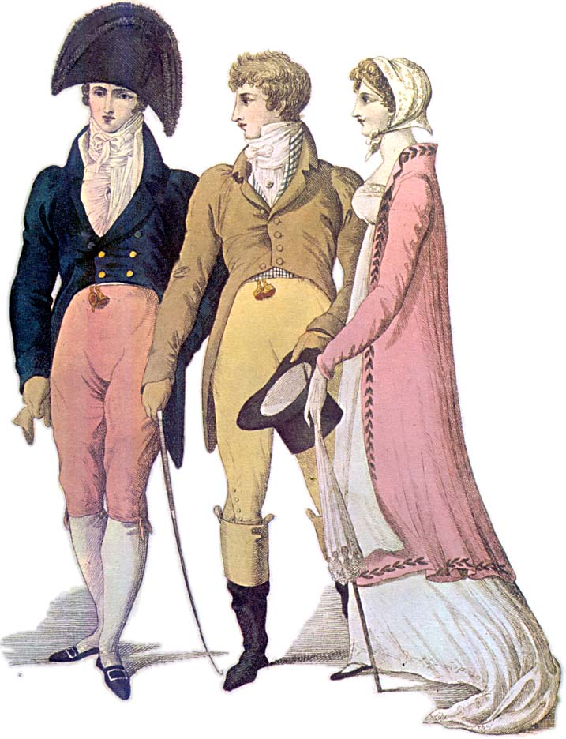
1809
Notes:
classical male nude

Slide 12
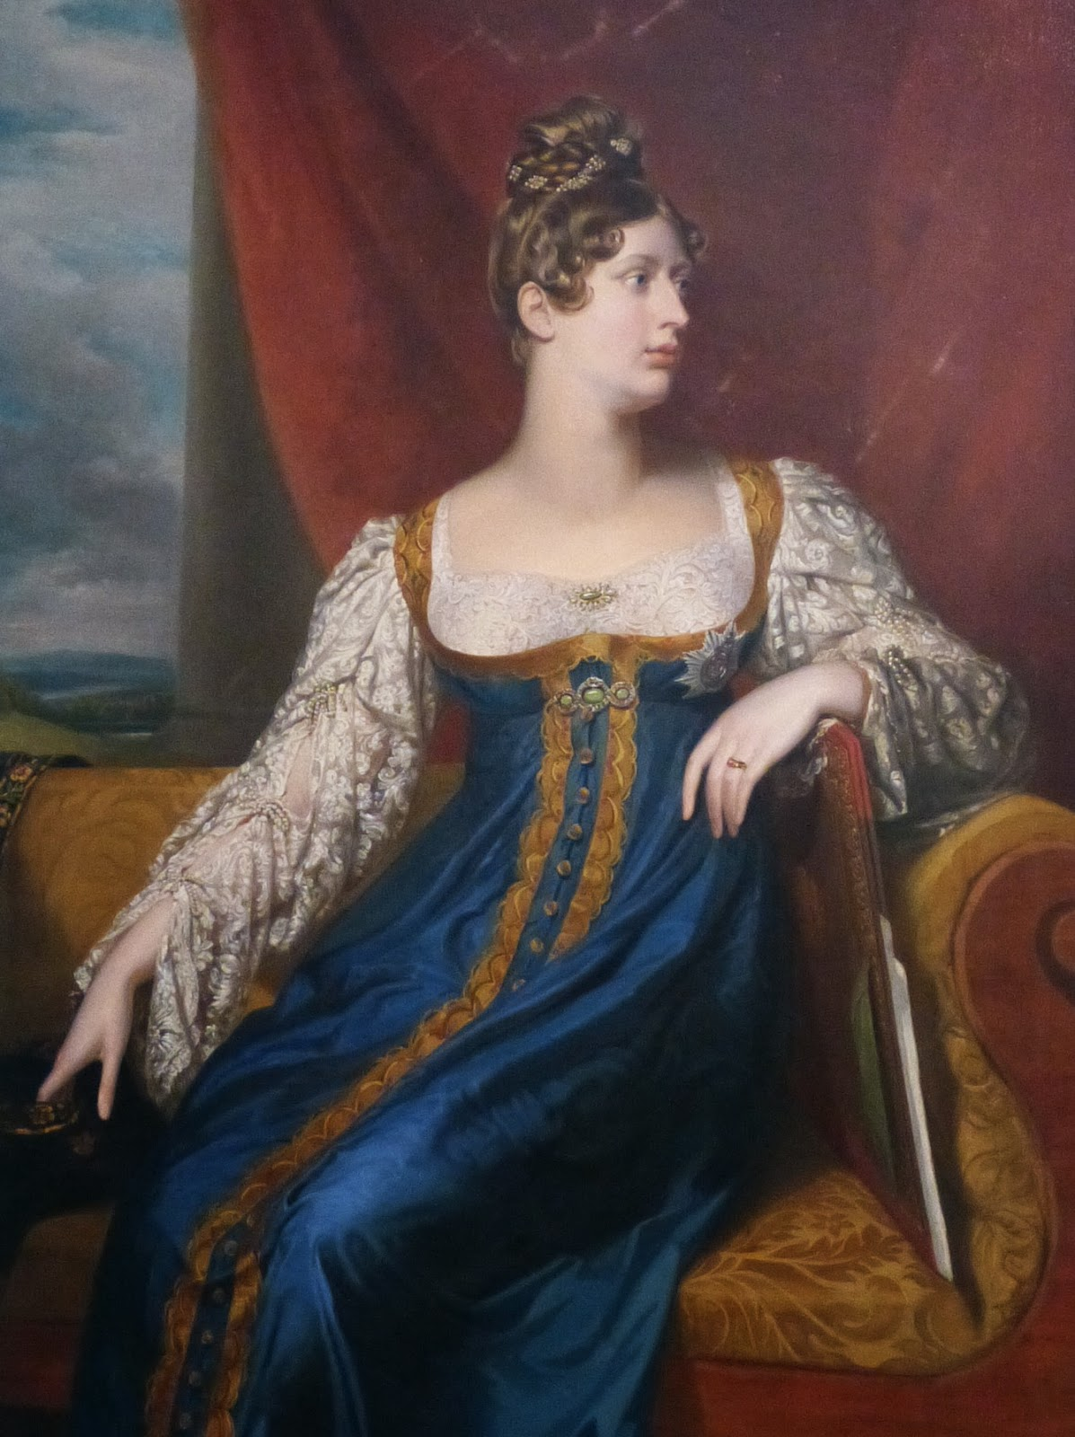
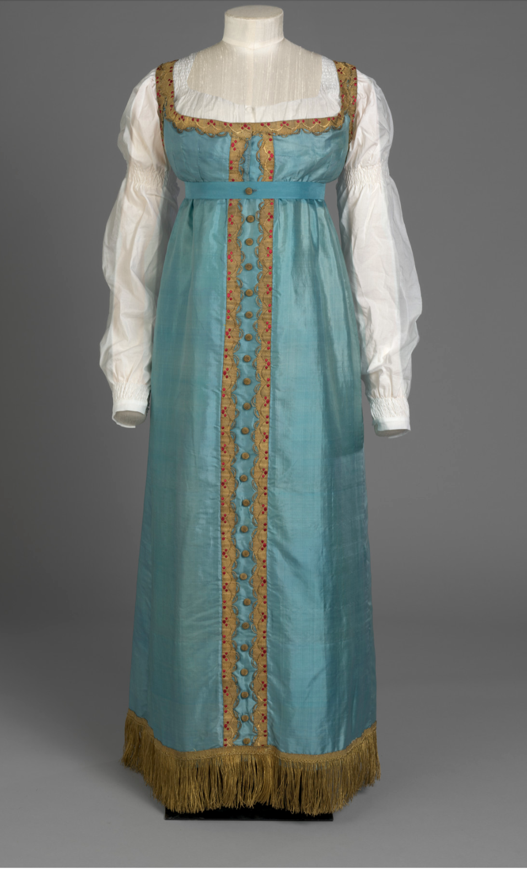
William Dawe, Princess Charlotte, 1817 (wearing a sarafan)
The actual gown still exists
Notes:
June 1814 when Tsar Alexander I and other European leaders came to London to celebrate what they thought was the defeat of Napoleon, Prices Charlotte wore the sarafan, russian style. And Jane Austen warned Cassandra, who was in London at the time, to “take care of yourself and do not be trampled to death in running after the emperor” [Tsar Alexander I].

Slide 13
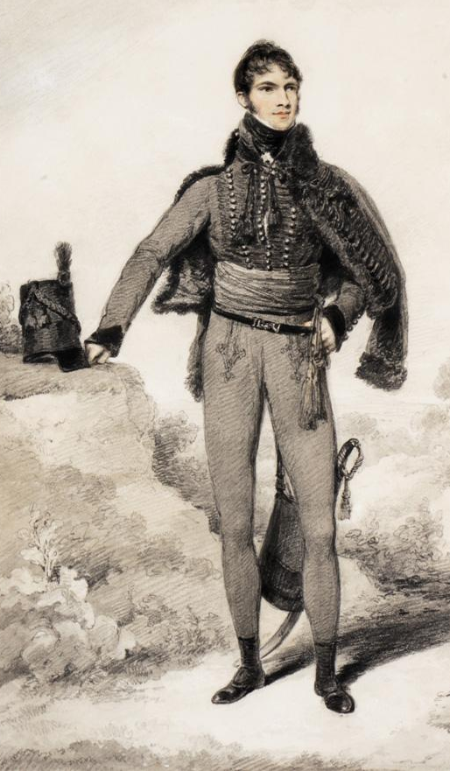
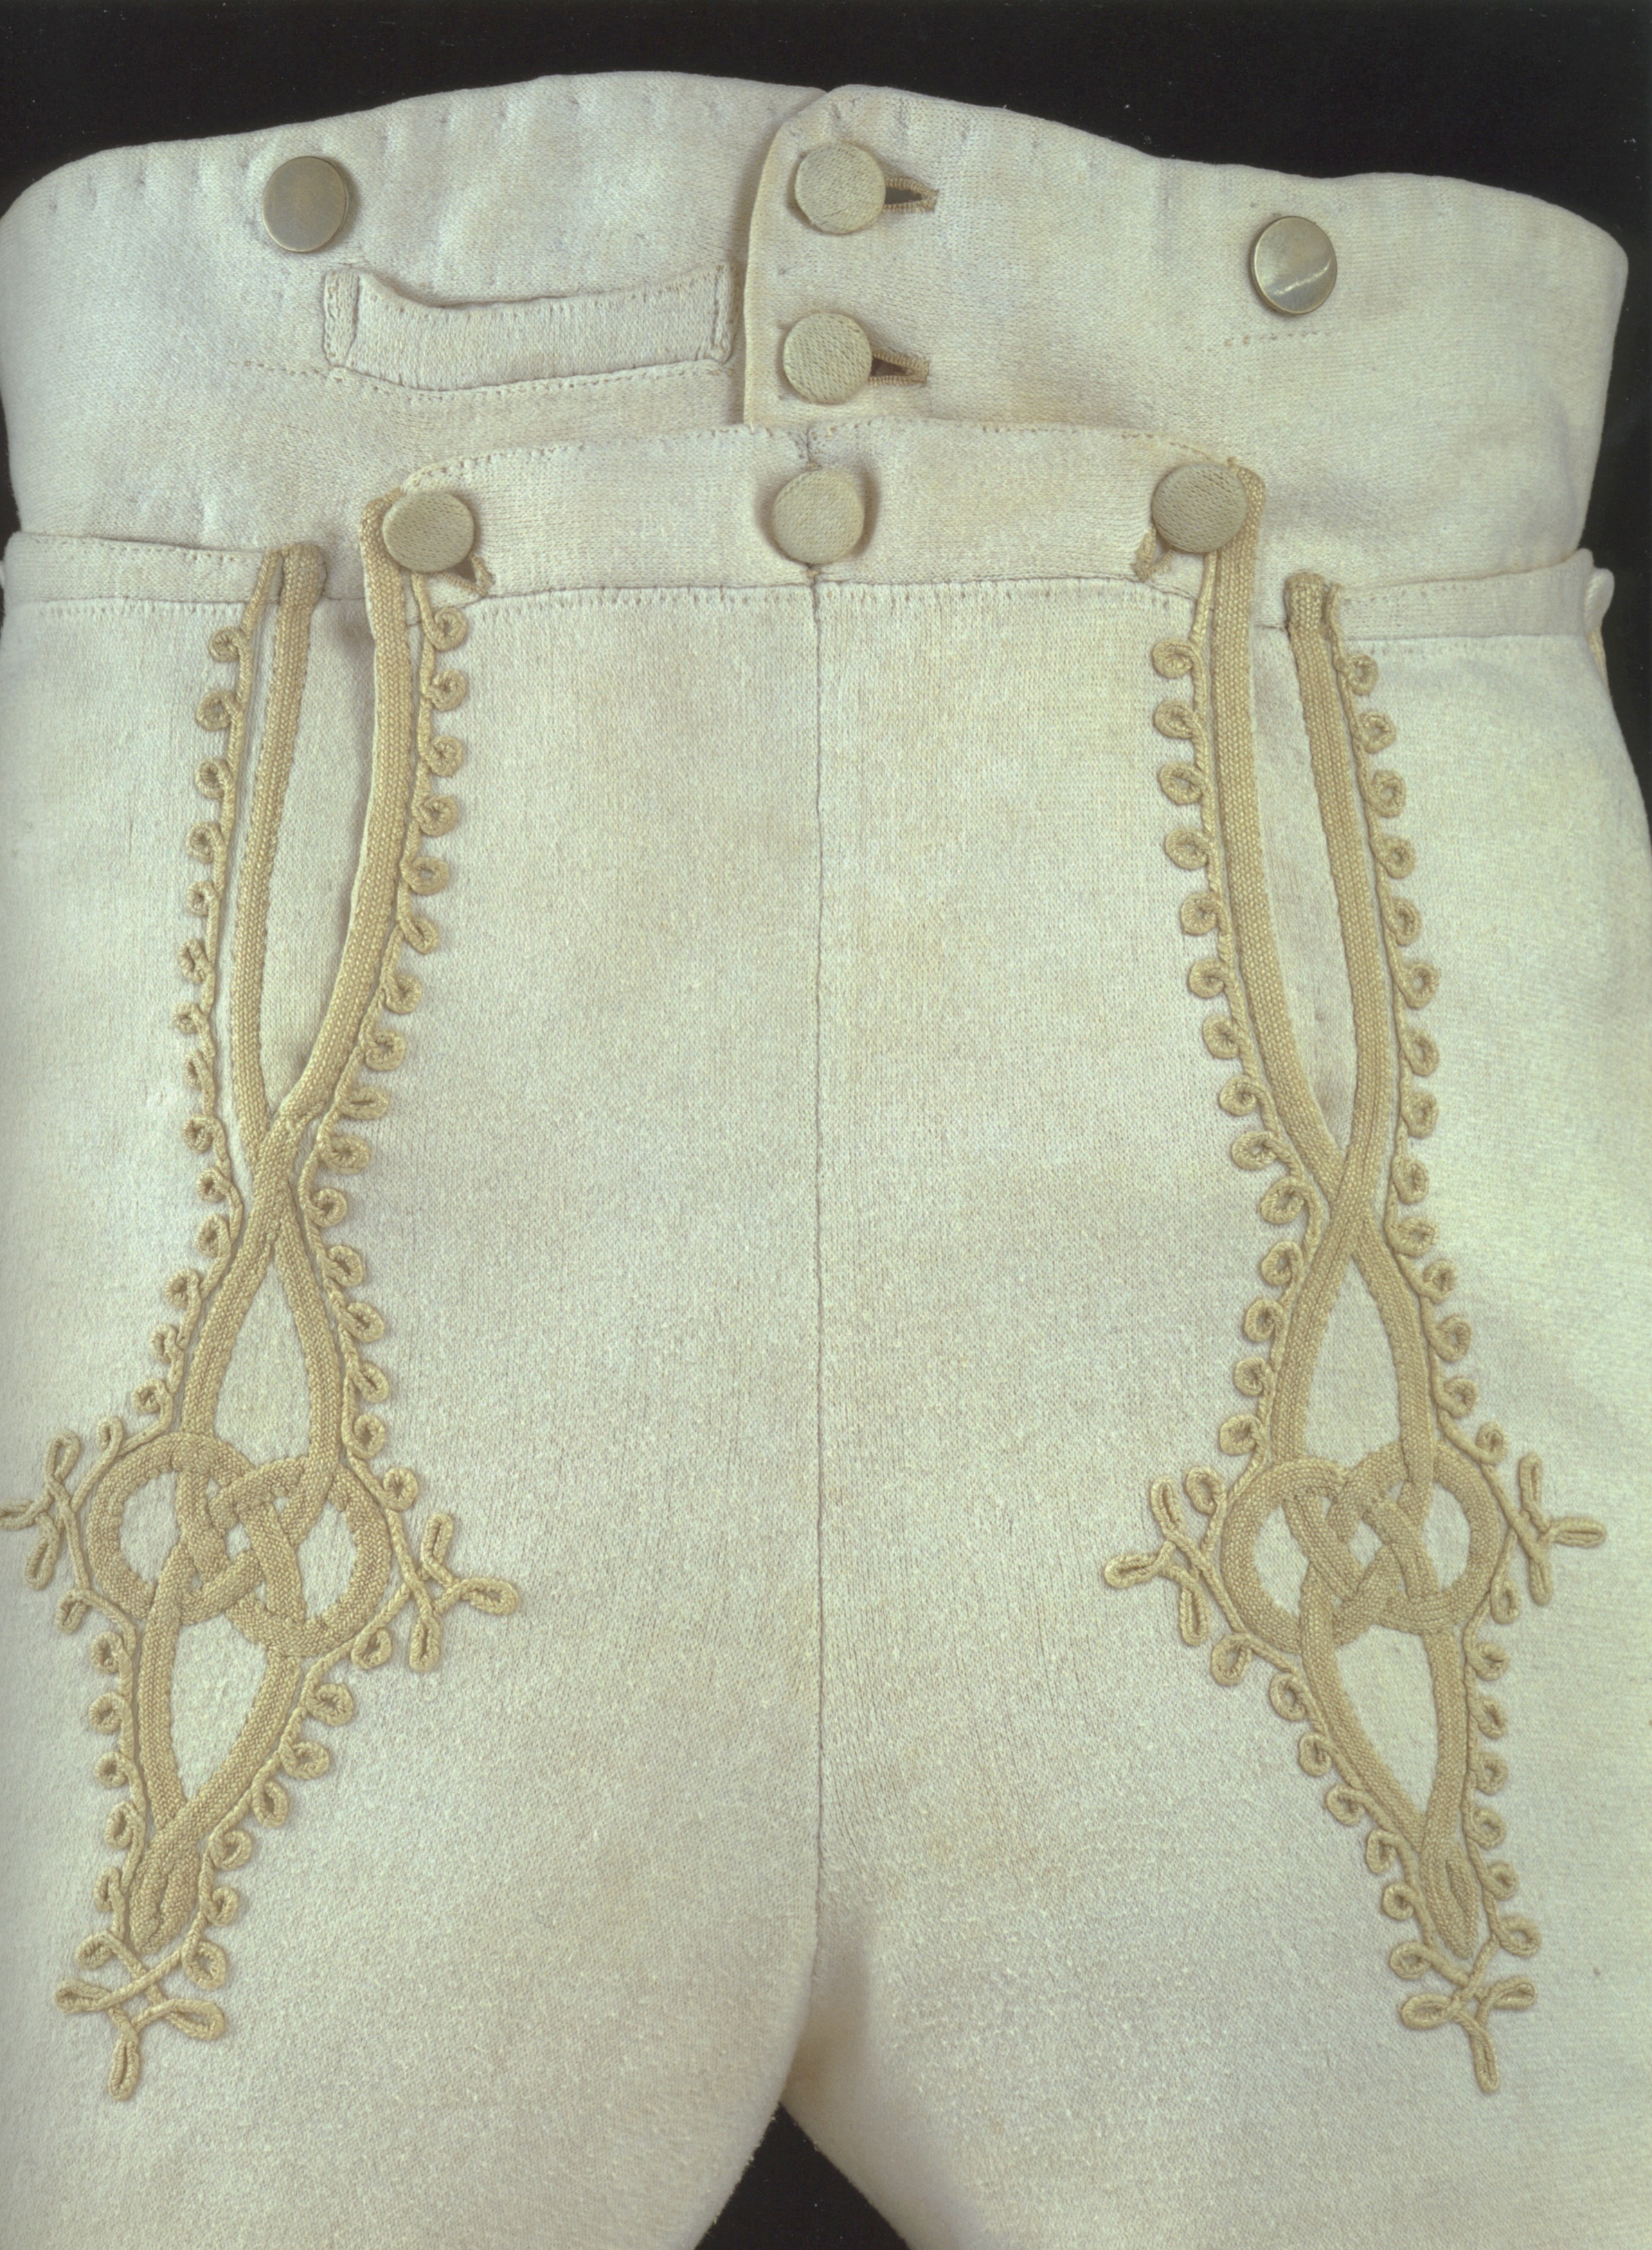
Sir William Harbord, 1810 by Edridge

Slide 14
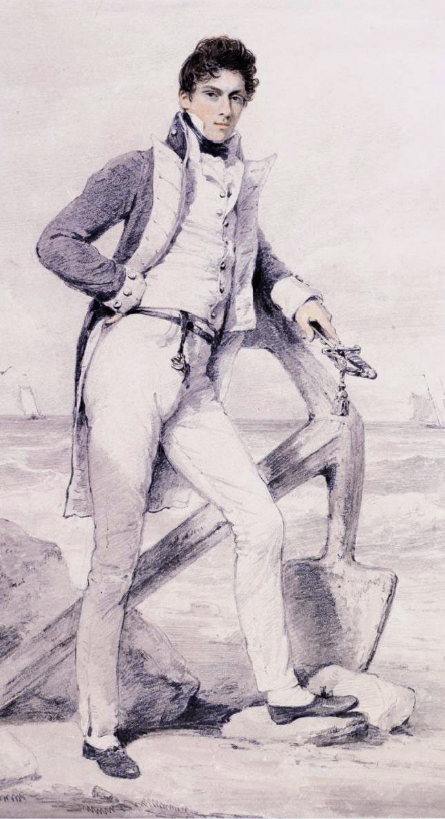
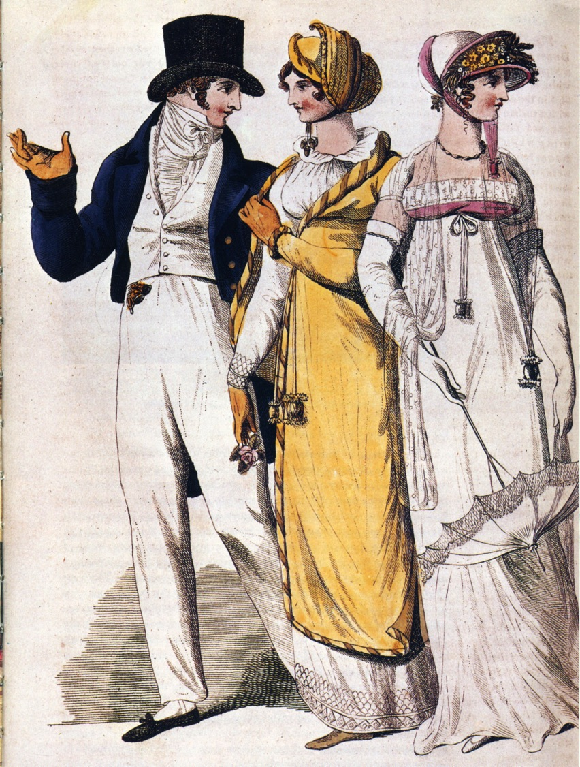
1807
Captain Hoste 1811 by Edridge

Slide 15
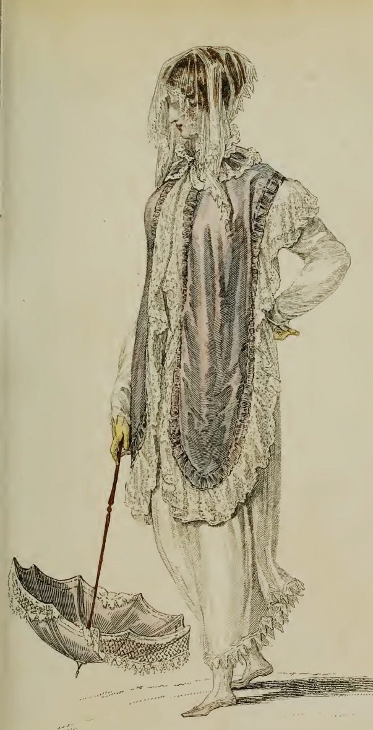
Ackermann, 1809
French
Roman
Venetian
Tyrolese
Andalusian
Spanish
Chinese
à la Maltese
Henry VIII
Brussels/Mecklin
Egyptian
Russian
Indian muslin
à l’antique
à la militaire
Turkish
Danish
India muslin
à la Hussar
Van Dyke
Polish
July 1809, Ackermann, Promenade Dress
Notes:
But so many other influences. Ackerman fashion descriptions in 1809 contain all these.

Slide 16
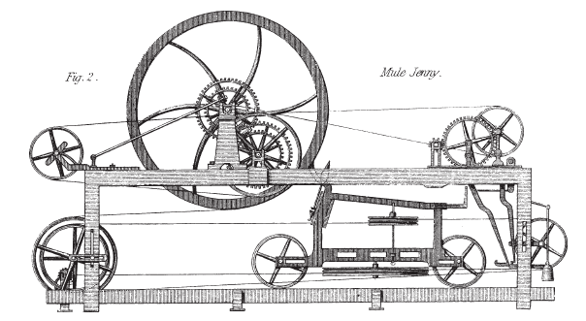
Samuel Crompton, spinning mule, 1779
Claude Berthollet, liquid bleach, 1780s
Charles Taylor, 1788 “calico…bleached white, printed in permanent colours, having undergone all these operations in less than 48 hours
Notes:
But it wasn’t just the visual influences.
Samuel Crompton invented the spinning mule in 1779, so called because it is a hybrid of Arkwright's water frame and James Hargreaves' spinning jenny in the same way that mule is the product of crossbreeding a female horse with a male donkey (a female donkey is called a jenny).

Slide 17
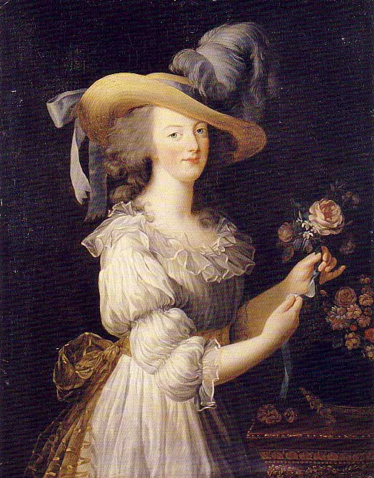
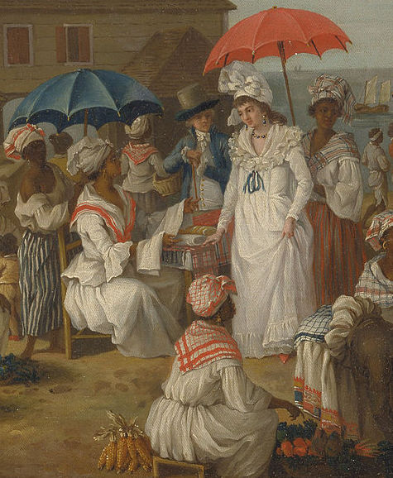
Agostino Brunias, c. 1780 “Linen Day, Roseau, Dominica”
Marie Antoinette’s “chemise dress”
Notes:
The globalization of textile manufacture: raw cotton from the Americas dyed white with indigo from the West Indies and woven into fine muslin/mull in India,
Rose Bertin. Poor Marie Antoinette.
muslin, a textile that was imported from Britain and its colonies.
chemise—underwear---

Slide 18
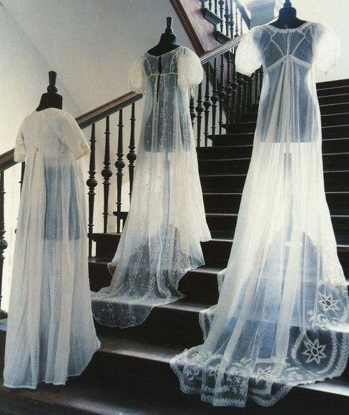
“…a true India muslin...”
Henry Tilney
Northanger Abbey
Notes:
The aim was always to get a muslin as fine and transparent as that made in India, but make it in England for a much lower price.

Slide 19
Undressing a Gentleman
Notes:
So we’ve seen this incredible evolution in a few short years from stiff, formal, erect posture and clothing to diaphanous, light, flowing and graceful clothing that is, in turn heading back wide, horizontal look. The question remains why? How did this happen. Impossible to answer fully but we can look at some of the influencers.
Was it the Greek statues?
Was it the French revolution?
Was it the “Turkish/Oriental”?
Was it the Indies (East and West)?
Was it new technology?
Was it politics and globalization?
Was it the price of muslin?

Slide 20
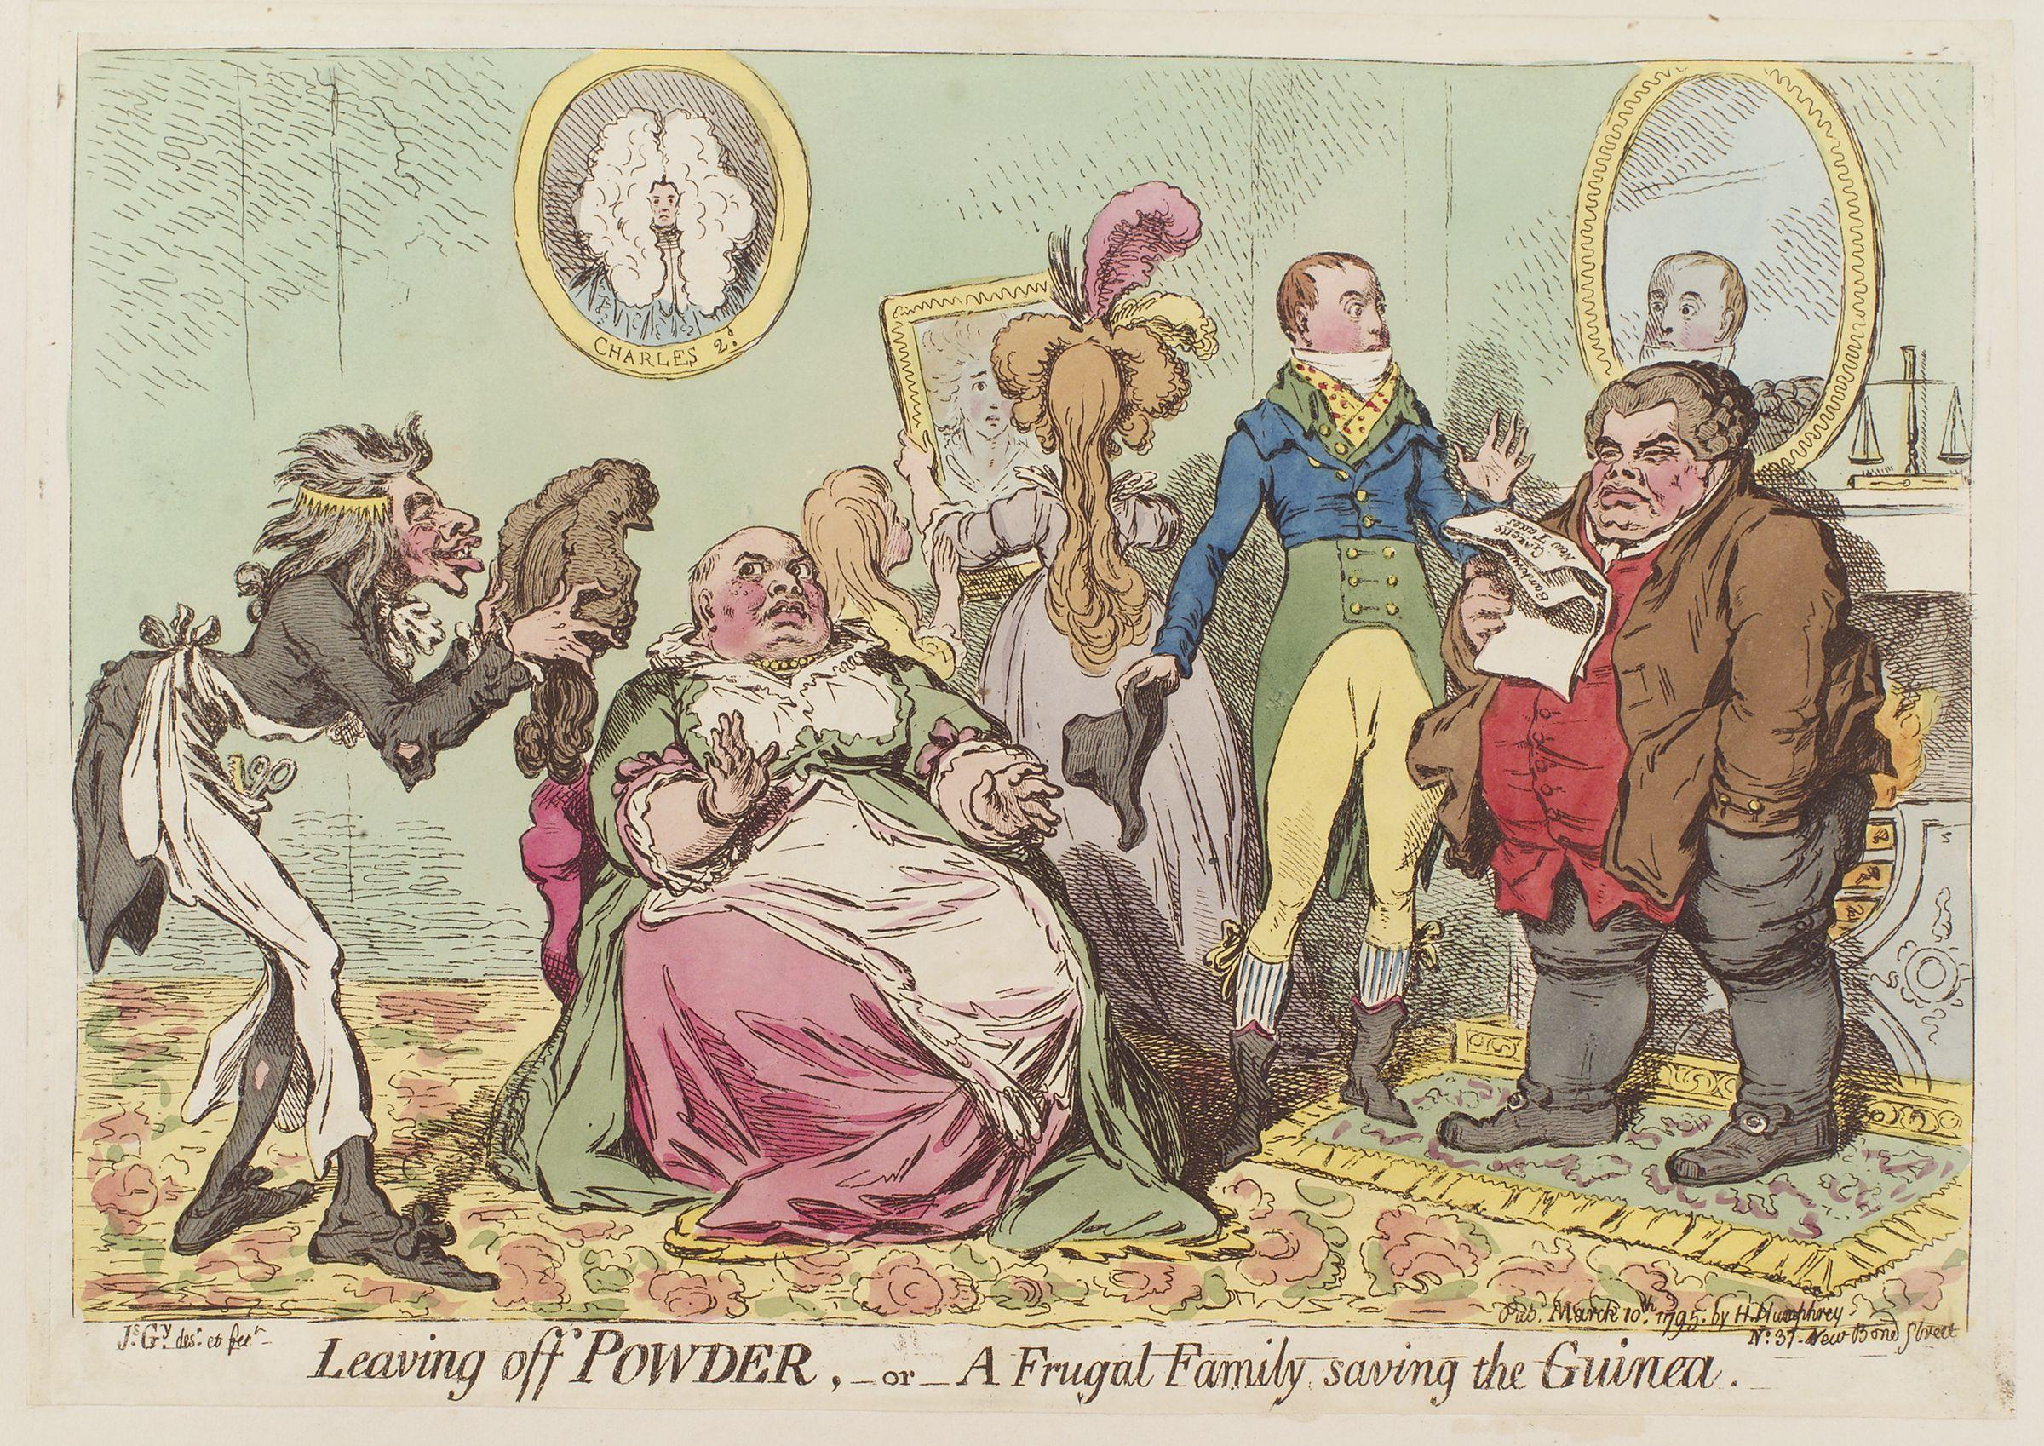
James Gillray, 10 March 1795
Notes:
What do you do when hair powder is taxed? Gillray was prompt to point out the inevitable outcome.

Slide 21
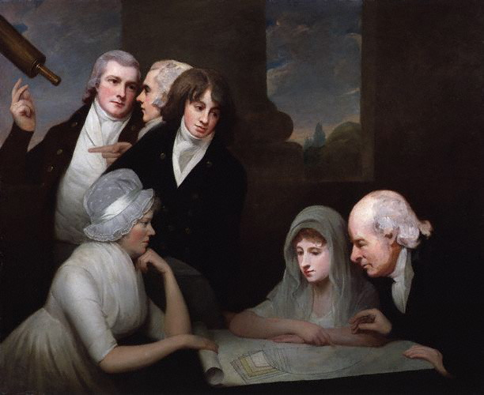
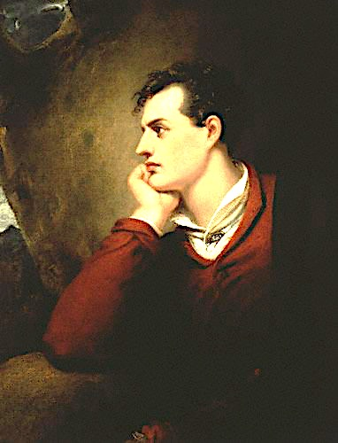
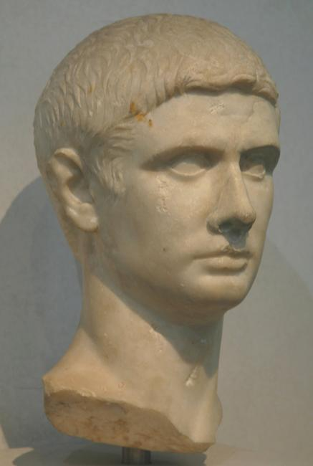
Hair
Notes:
“The Brutus” “The Windswept” “The Stanhope Crop.”

Slide 22
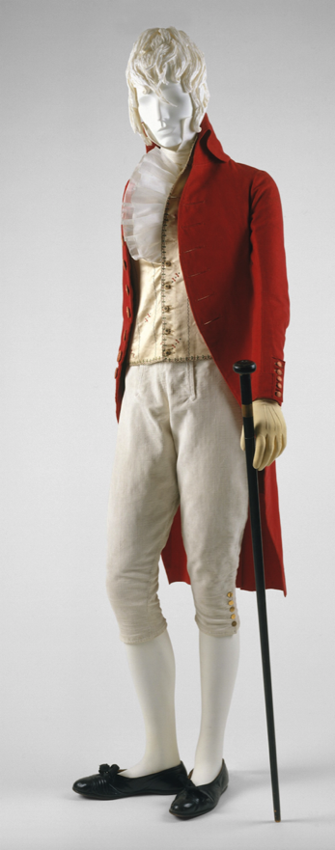
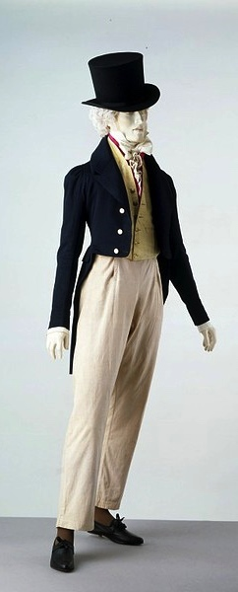
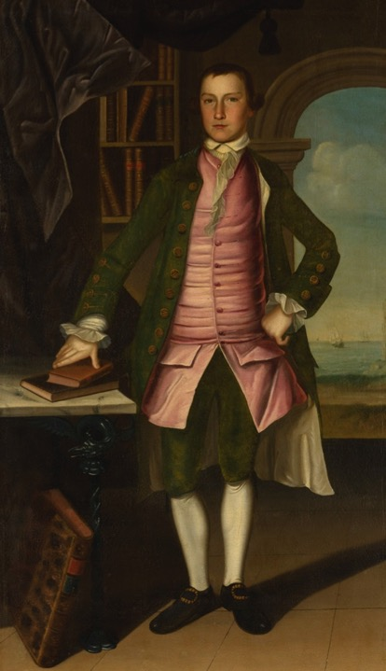
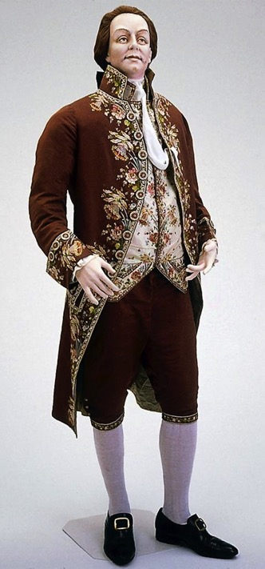
What did men wear?
1760s
1780s
1800
1815-20
.
Notes:
Those changed in shape and volume throughout the period. When Bushman mentions a waistcoat that would act as a body-shaping or posture garment he was considering the earlier example. When he talks about a new freedom of movement and ease at the end of the century it is more like the latter.

Slide 23
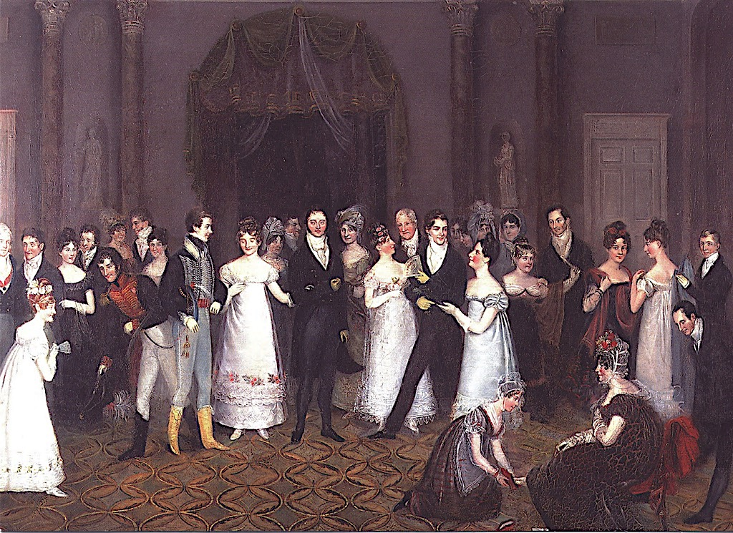
Rolinda Sharples, The Cloak Room at the Assembly Rooms at Clifton, 1818
Notes:
Pants
bodices
Don’t forget to mention dancing pumps.

Slide 24
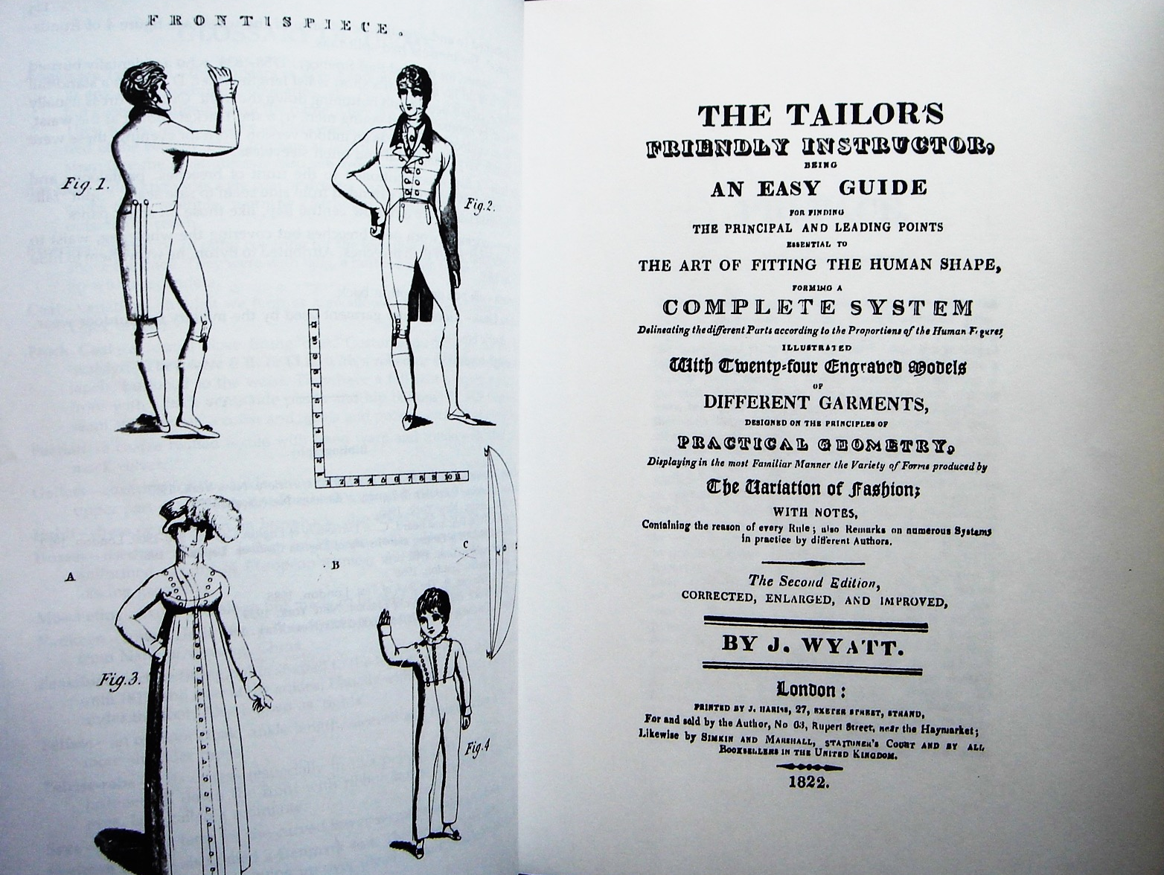
Notes:
shaped piece under the arm
wool can be shaped when heated.

Slide 25
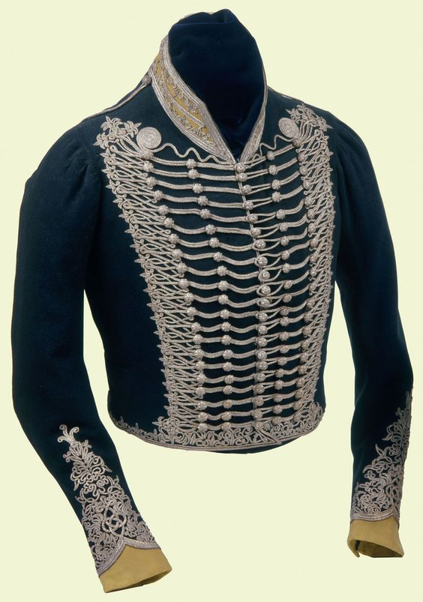
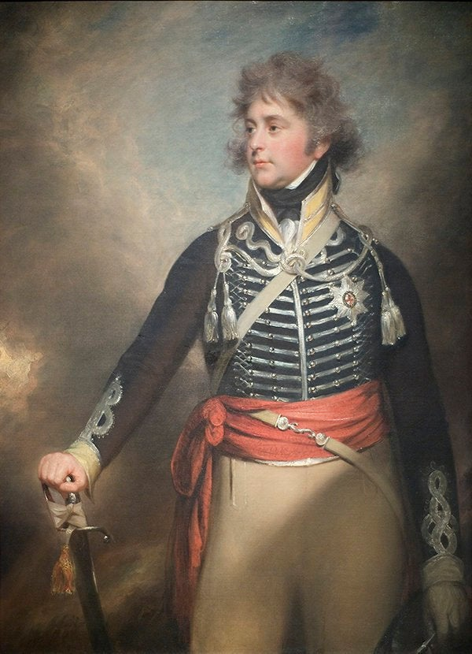
10th Regiment of Dragoons, aka “The Prince of Wales's Own Royal Regiment of Light Dragoons” or “The China 10th”
George, Prince of Wales by Sir William Beechey c. 1798
Notes:
Here we see an amazing example of skilled tailoring in a uniform coat made for the Prince of Wales August 1762-June 1830) He is shown wearing it in the portrait by Sir William Beechey. He is in his late 30s here but was already growing stout. The coat, however is designed to fit him like a glove. By the way, the 10th was designed to be a “show” regiment, not designed for battle. Hence the moniker China—fragile and breakable, to be handled with care. As such it attracted young men of wealth and birth, including…

Slide 26
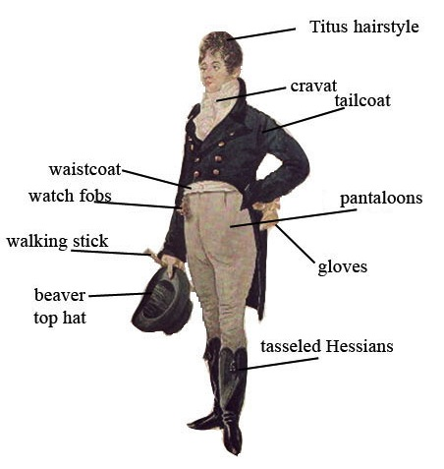
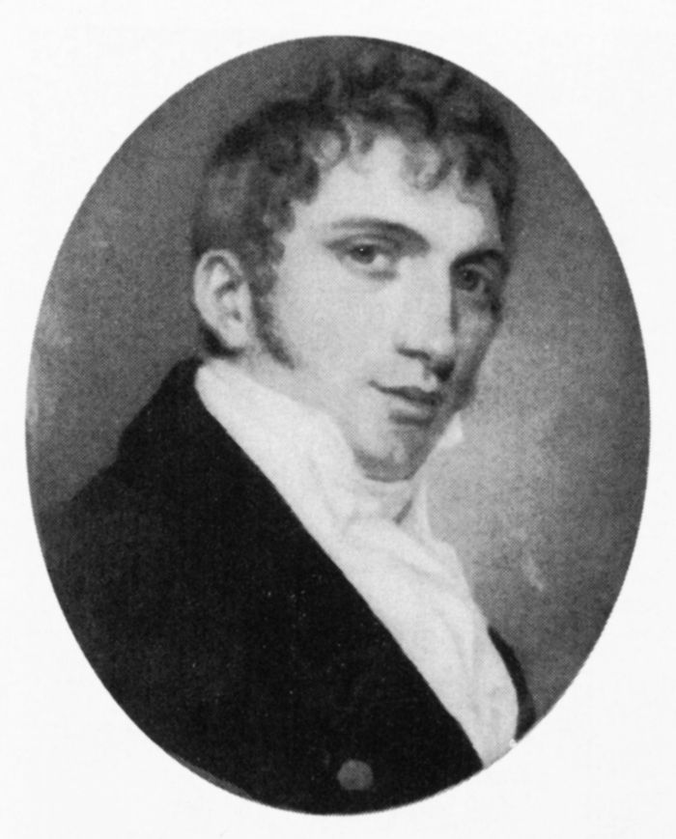
George Bryan “Beau” Brummel
Notes:
sartorial advisor,
left the 10th (legend Manchester
understated yet exquisitely tailored clothing
greatest accomplishment dark coats over light colored trousers
did not invent trousers he certainly re-popularized them,
notorious for demanding a full tub bath every day,
perfectionist when it came to his cravats.

Slide 27
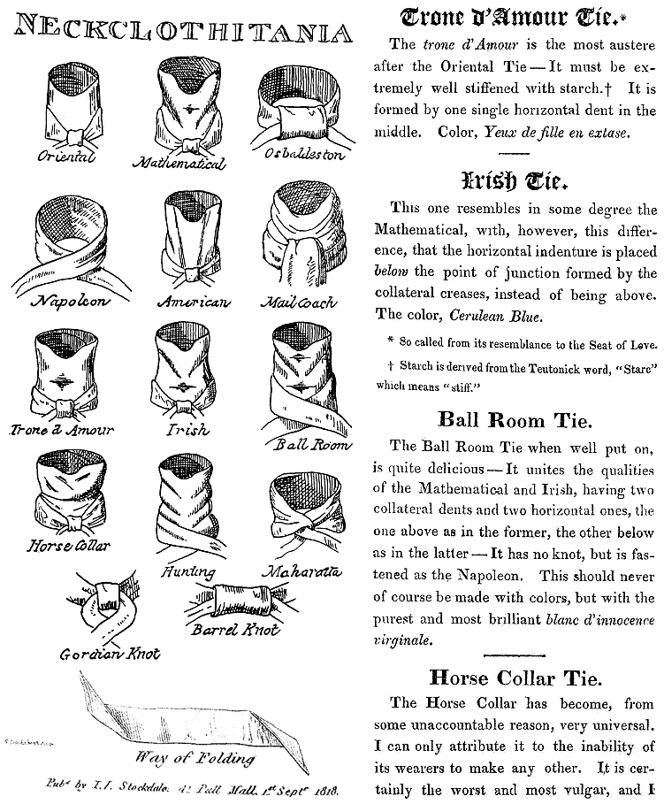
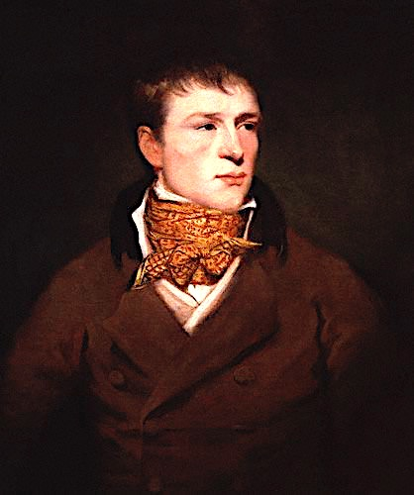
Jem Belcher:
Celebrated boxer with his trademark spotted neckcloth
Notes:
it’s the folds that determine the names!

Slide 28
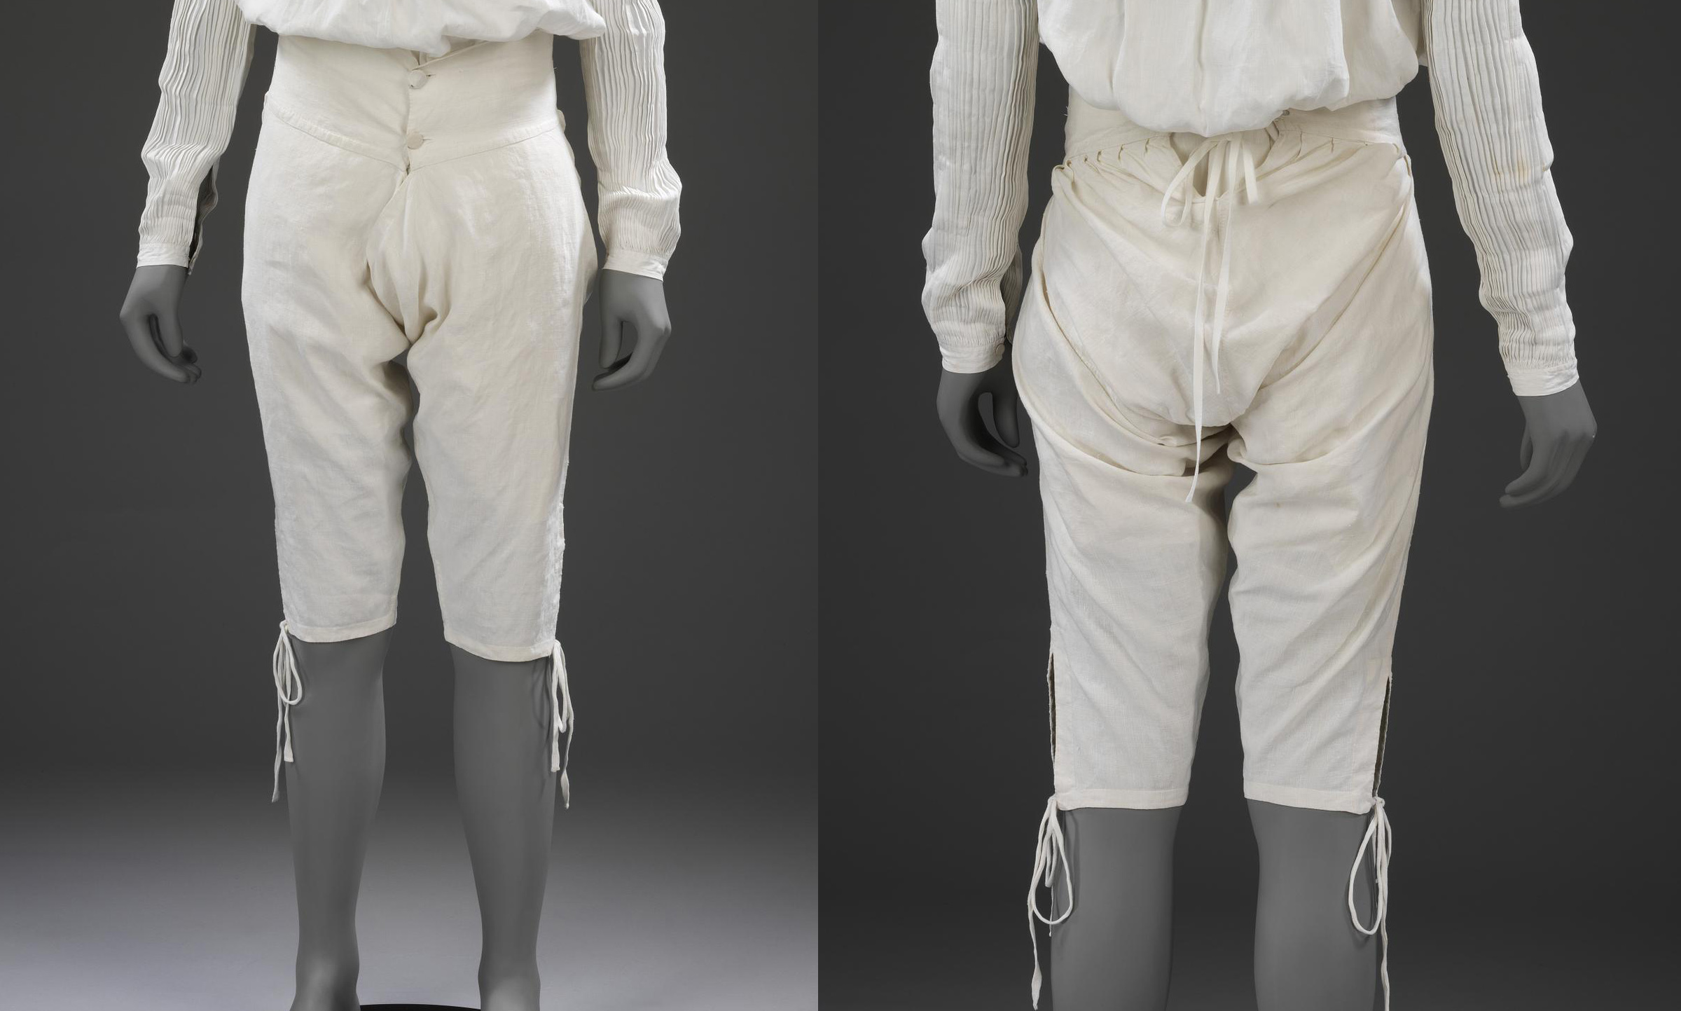
1775-1800, Linen drawers, Victoria and Albert Museum

Slide 29
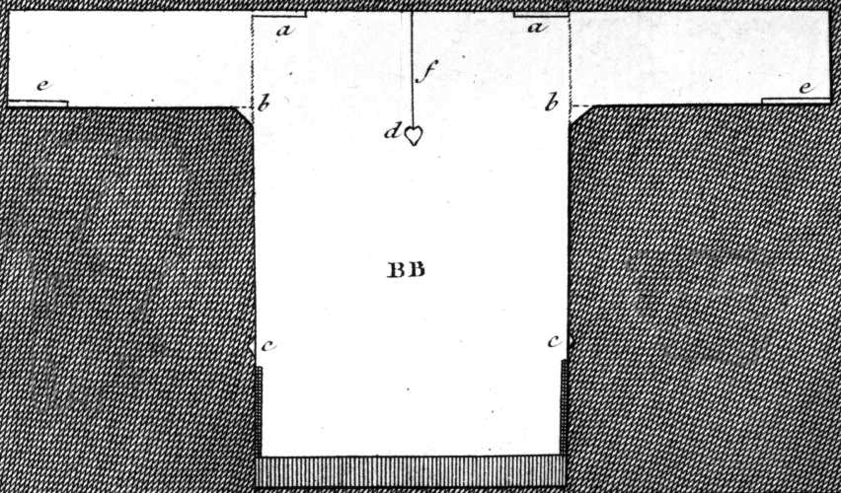
Austen, Thursday, 1 September 1796:
“We are very busy making Edward’s shirts, and I am proud to say that I am the neatest worker of the party.”

Slide 30
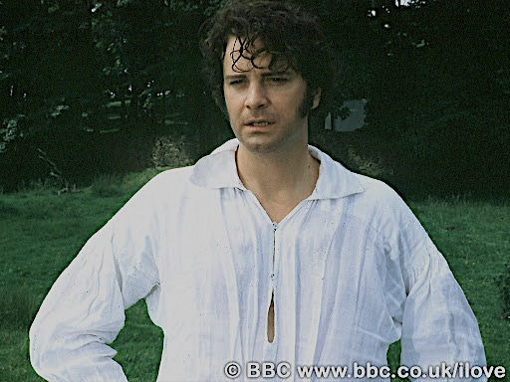

Slide 31
The World (newspaper), November 29, 1788
Notes:
wear the prevailing, body hugging, styles with panache.
Where nature did not cooperate, ingenuity served.
A very technical

Slide 32
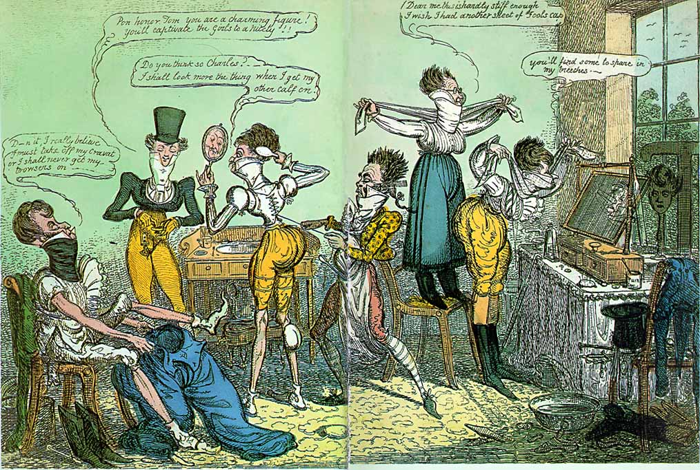
Cruikshank
1818
Notes:
Other strategies were lampooned by caricaturists like Cruikshank:
1818 “Dammit I really believe I must take off my cravat or I shall never get my trowsers on.
“Pon honour Tom you are a charming figure – you’ll captivate the girls to a nicety.”
“Do you think so Charles? I shall look more the thing when I get my other calf on.”
“Dear me this is hardly stiff enough. I wish I had another sheet of foolscap.”
“You’ll find some to spare in my breeches.”

Slide 33
Dressing a Lady
Notes:
So we’ve seen this incredible evolution in a few short years from stiff, formal, erect posture and clothing to diaphanous, light, flowing and graceful clothing that is, in turn heading back wide, horizontal look. The question remains why? How did this happen. Impossible to answer fully but we can look at some of the influencers.
Was it the Greek statues?
Was it the French revolution?
Was it the “Turkish/Oriental”?
Was it the Indies (East and West)?
Was it new technology?
Was it politics and globalization?
Was it the price of muslin?

Slide 34
Stockings and Shifts
Notes:
Womens’ shifts were cut similar to men’s shirts but by the 19th century were more a-line.
But the question remains: did women wear drawers?

Slide 35
Rowlandson, “Exhibition” Staircase, 1800
Notes:
Rowlandson, 1800, “Exhibition Stair Case” at Somerset House, Royal Academy

Slide 36
James Gillray
20 January 1796
“Ladies Dress as it soon will be”
Notes:
Well, Gillray was already forecasting that current those trends would lead to certain outcomes.

Slide 37
Notes:
Corset and stockings, two layers of linen, channels of baleen or cord, single spiral laced, busk (thin wooden stick about 1-2” wide – great for posture)

Slide 38
Notes:
confusion when reading historic descriptions of clothing.

Slide 39
Cap
Chemisette

Slide 40
Sunday, 2 June 1799:
“I am not fond of ordering shoes;
and, at any rate,
they shall all
have flat heels.”

Slide 41
Reticules
Workbags
Purses

Slide 42
1808-1810: Accommodating Grecian hair

Slide 43
1810s: Accommodating…other things.

Slide 44
Costume Parisian 1814
Ackermann 1817
Notes:
French bonnets all the rage

Slide 45
Morning Dress
Notes:
But which gown? This is the period where upper class women dressed according to the time of day: Morning dress (anytime before dinner around 1:00, or 2, 3, 4…) If you were at home to visitors you would wear these. For paying calls you might have preferred afternoon, carriage, or promenade dress.

Slide 46
Afternoon, Walking, Promenade, Carriage Dress
Notes:
Ackermanns 1810, 1814, 1820

Slide 47
1814 Ackermann
Evening Dress,
Ball Dress

Slide 48
May 1797, Heideloff, Gallery of Fashion
1810, Costume Parisien
Spencers
1819-1822, Metropolitan Museum

Slide 49
Victoria and Albert Museum

Slide 50
1809 Ackermann
Pelisse
1817 Journal des dames et des modes
Caped Greatcoat/
Garrick

Slide 51
Austen, Thursday, 20 November 1800:
“Miss Debary, Susan, and Sally, all in black, but without any statues, made their appearance…”
1818
1816
1810
Gown of silk bombasine
Notes:
followed the styles of the day,
but certain textiles
Bombazine,. Silk crepe
broach
royal deaths: Princess Charlotte (George IV’s daughter) 6 November 1817 Queen Charlotte (George III wife), 17 November 1818 Edward, Duke of Kent (son of George III, father of Queen Victoria) 23 January 1820 George III, (coronation 19 July 1821) 29 January 1820 Princess Frederica Charlotte of Prussia (wife of Frederick, Duke of York, second son of George III) 6 August 1820 Caroline of Brunswick, (George IV wife) 7 August 1821

Slide 52
1818 Ackermanns, Riding Habit
Riding Habit
Court Dress
(after 1821)
Notes:
Queen Charlotte (George III’s wife) set specific rules about court dress
most irksome must wear hoops of specific dimension,
Consider the high-waisted style. Now consider wearing that with hoops.

Slide 53
Court Dress
Between
1800 and 1821
Notes:
can see why women, though sorry that the Queen had died, were overjoyed with the new rules. silk sellers. It is my fervent hope that a bold filmmaker and costume designer will create a scene where one of these gowns is worn.

Slide 54
“One could not hope to conduct himself or herself properly on entering a room without immediately assigning a rank to every person.”
Richard Bushman, The Refinement of America
Notes:
clothes as an indicator of that rank stay ahead of the social climbers. “the mushrooms”,
keep up with the latest fashions, the latest dances, and the latest news, not just to be trendy or edgy but to ensure that your rank is recognized. Your deportment, manners and speech all mark you as acceptable into society. Knowing who is who, and following proper deference to those above you in the hierarchy, is key.

Slide 55
The Assembly Rooms, Bath
“Yet even here, amid the crowds you view,
’Tis sometimes difficult to tell WHO’S WHO.”
Pierce Egan, Walks Through Bath, 1819
Notes:
Here, salutary rules exclude all those
Whom no one hears of, and whom no one knows;
That no plebian breathings may infect
An atmosphere at all times so select;
;…
And concludes
Yet even here, amid the crowds you view,
’Tis sometimes difficult to tell WHO’S WHO.”
Pierce Egan, Walks Through Bath, 181

Slide 56
Notes:
As this cartoon shows: Bobbin (reference to retail trade) Fiddle (trying to con or sham—either the family to con their way into high society, or the fiddler himself, pretending to be a French dance master)
“I say Monsouer Caper don’t I come it prime? Ecod I shall cut a figor!”
Law Pa that’s just as when you was drilling for the Whitechapel Volunteers. Only look at how Ma and I and sister Clementina does it.”
Ver vel sir, vere vel. You vil danse a merveileux ver soon.”
“The Season at Margate, for example, commenced on the King’s birthday, formally celebrated in June, and ended in late October, whereas Bath commanded the more fashionable months of October through May. The hours and pricing of the summer balls were usually different from those of the winter. ”

Slide 57
Published 1770-1832
Notes:
How keep up? From your dressmaker, friends, magazines. The rise in print publications of all kinds included the Ladies Magazine (1770-1832)--recognised as the first created specifically for women.

Slide 58
Published 1770-1832 by Pierre Antoine Leboux de La Mésangère
and
Jean-Baptiste Sellèque

Slide 59
Heideloff’s Gallery of Fashion, Published 1794-1804
Le Beau Monde, Published 1806-1810

Slide 60
Published by Vernon and Hood 1798-1832
Published by John Bell 1806-1837

Slide 61
Rudolph Ackermann’s
Repository of the Arts. 1809-1828
Notes:
ability to converse intelligently on a variety of topics.
aquatint
specific descriptions

Slide 62
Actual fabric swatches in the January 1811 edition of Ackermann’s. Fabrics suitable for “light” or “half” mourning.

Slide 63
“Scissor edited” from October 1808 La Belle Assemblée
The Morning Chronicle (London, England), Tuesday, November 1, 1808
The Leeds Mercury (Leeds, England), Saturday, November 5, 1808
Jackson's Oxford Journal (Oxford, England), Saturday, November 5, 1808
The Examiner (London, England), Sunday, November 6, 1808
Trewman's Exeter Flying Post (Exeter, England), Thursday, November 10, 1808; Issue 2322
The Derby Mercury (Derby, England), Thursday, November 10, 1808; Issue 3990

Slide 64
Ackermann’s Repository of the Arts.
January 1809
Notes:
Nor was this information limited to England. Ackermann’s could be subscribed to from cities around the world

Slide 65
Worcester Gazette (Worcester, MA) 06-07-1809
Notes:
And also copied all around the world. Here is the same description, copied word for word in Massachusetts by June of the same year.

Slide 66
A lilac sarsnet petticoat, full flounce round the bottom, confined by plaits or tufts of riband of corresponding color, and headed with a border of the same; high plain body of white jaconet muslin; braces tied behind.
Ackermann’s, August 1814
“I am amused by the present style of female dress;—the colored petticoats with braces over the white Spencer…”
Jane Austen, 2 September 1814
Notes:
And once someone has seen the fashion plate, or even the gown being described, one can pass that information to others quite quickly, as Jane did in her letter

Slide 67
13 October 1808
“We must turn our black pelisses into new, for Velvet is to be very much worn this winter.”
“Pelisses, which are alternately formed of velvet or sarsnet, admit also of much variety in the constructions.”
La Belle Assemblée, October, 1808
Notes:
Austen frequently shows evidence, in her letters, that she was aware of, and assiduously adopting, the most recent fashion changes. When she suggested that her velvet pelisse would remain fashionable with just a bit of alteration she would have been happy to have that confirmed in La Belle Assemblée in October 1808.

Slide 68
9 March 1814
I have lowered the bosom, especially at the corners, and plaited black satin ribbon round the top.
Ackermann, March 1814
1814
Notes:
evening dress Ackermann, March 1814

Slide 69
Notes:
While women of means were anxious to stay in fashion, not all were willing to commit. After all, fabric was expensive and labor was cheap. This woman hedged her bets by raising the skirt to the new higher waist, but leaving the bodice intact just in case the waistlines came down again.

Slide 70
“In former ages it seemed requisite that every lady should cut out her garments by a certain erect standard.”
Mirror of Graces, 1811
Notes:
But lets look at the clothes. two key words
The first is lady.
miserable. Poverty, war, slavery, disease, oppression
very small slice of the population who had very specific ideas about their culture and the hierarchies
We will be focused on the gentry.
second keyword phrase is erect standard.

Slide 71
c. 1750, Artist and Subjects Unknown (Tate)
Notes:
The period that spans the changes in fashion also demonstrates
posture, stance, and movement. The 18th century all the members of this family, youngest--even the dog.
“a good leg”—

Slide 72
Stays (Fleming Museum, University of Vermont)
Stays, hoop, shift (Kyoto Costume Museum)
Notes:
The stays include wall-to-wall boning and hoops to hold out the skirt
These aren’t actually the same stays – one is from the Kyoto Costume Museum, the other, slightly earlier, is from the Fleming Museum at the U of vermont

Slide 73
Late 1780s/Early1790s
Kyoto Costume Museum
Notes:
By the late 80s and early 90s , corset makers created increasingly complex boning patterns, custom made to fit the wearer, to achieve the desired shape. In this case, the shape is still conical, with that supports and contains the bust.

Slide 74
Ouch!
Notes:
Not this painful and disfiguring garment.

Slide 75
Ackermann, April 1812
Notes:
So the cues to show…gentry: fashion, manners, knowledgeable, conversation, grace
“mean girl” “You need not tell her so, but I thought her dress hideous the other night. I used to think she had some taste in dress, but I was ashamed of her at the concert. Something so formal and arrange in her air! And she sits so upright! My best love of course.
Not wearing old clothes but still upright

Slide 76
The Novels
1795-1799 writing
“Elinor and Marianne”(Sense and Sensibility)
“First Impressions” (Pride and Prejudice)
“Susan/Catherine” (Northanger Abbey)
1811-1816 writing, revising, publishing
Sense and Sensibility
Pride and Prejudice
Mansfield Park
Emma
Persuasion, Northanger Abbey published 1817.
Notes:
So let us return to Austen, Thompson, weaponizing

Slide 77
The Characters
Thompson: “few words, tellingly applied”
Condemned out of their own mouths
Meow! Weaponizing.
Notes:
So let us return to Austen, Thompson, weaponizing

Slide 78
Catherine Morland of Henry Tilney: “His hat sat so well, and the innumerable capes of his great-coat looked so becomingly important. To be driven by him, next to being dancing with him, was certainly the greatest happiness in the world!”
Notes:
Henry can speak of fashion with impunity
A greatcoat was made of “cloth” which was a synonym for wool. The capes were originally designed to keep off rain but they quickly became a fashion statement as well, as Catherine notes with admiration.

Slide 79
“…her air...had more real elegance.”
“Go, by all means, my dear; only put on a white gown.
Miss Tilney always wears white.”
c. 1800
Notes:
Smart elegant: compare to Northanger Abbey where Eleanor is described as “elegant” 1800

Slide 80
“A woman can never be too fine when she is all in white.”
Edmund to Fanny
Mansfield Park
Ackermann, 1815
Ackermann, 1815

Slide 81
“good-looking and gentlemanlike; he had a pleasant countenance, and easy, unaffected manners.”
Edridge, Robert Fellows, 1800
Notes:
1800 Robert Fellows, philanthropist, by Edridge. The fact that he is looking for a house suggests a , possibly a grand father who was in trade.

Slide 82
“His name was good, his residence was in their favourite village, and she soon found out that of all manly dresses a shooting jacket was the most becoming. Her imagination was busy…”
Marianne contemplating Willoughby, Sense and Sensibility
Notes:
Awareness of shooting jacket—the country life attire influence. This picture is a bit deceptive as regards the quote. The rider would have walked to go shooting with the object to bring back birds. If hunting (hunting=fox hunting), they would have been riding. If they were hunting on foot, and it was not their property or they did not have permission of the property owner, they might have been arrested for poaching.

Slide 83
“wanted only regimentals to make him completely charming”
Narrator on Wickham, Pride and Prejudice

Slide 84
“as elegant as lace and pearls could make her”
Ackermann, June 1813
Notes:
“

Slide 85
The Misses Steeles’ “appearance was by no means ungenteel or unfashionable; their dress was very smart, their manners very civil.”
Miss (Nancy) Steele was “never easy till she knew the price of every part of Marianne’s dress”
Sense and Sensibility
Heideloff, Nov. 1797
Notes:
Smart elegant: compare to Northanger Abbey where Eleanor is described as “elegant”

Slide 86
Isabella and her sisters are “smart-looking” but her friendship with Catherine quickly evolves to the point where they walked arm in arm and “pinned up each other's train for the dance.”
Giles Foster, Northanger Abbey, 1986

Slide 87
“…besides all this, she must possess a certain something in her air and manner of walking...”
Caroline Bingley, Pride and Prejudice
Ackermann, February 1809
Notes:
grace of movement in dance lessons, a required part of an upper-class education,
Or mushrooms

Slide 88
“I hope you saw her petticoat, six inches deep in mud, I am absolutely certain; and the gown which had been let down to hide it not doing its office.”
Caroline Bingley on Elizabeth Bennet
Pride and Prejudice

Slide 89
“Young men and women driving about the country in open carriages!...Do not you think these kind of projects objectionable?”
“Yes, very much so indeed…A clean gown is not five minutes’ wear in them. They are splashed getting in and getting out...”
Mr. and Mrs. Allen regarding Catherine
Northanger Abbey

Slide 90
“I am very glad to hear what you tell us, of long sleeves.”
Mrs. Bennet
Pride and Prejudice
Ackermann
September 1812
Ackermann, April 1814
Notes:
(Note: From the letters: Wednesday, 9 March 1814: I wear my gauze gown to-day, long sleeves and all. I shall see how they succeed, but as yet I have no reason to suppose long sleeves are allowable.) She is reassured that they are, and a couple weeks later that decision is confirmed in Ackermanns.
However, using long sleeves is a safe bet because it was a fashion that came and went with regularity.

Slide 91
“I wish you would tell Sally to mend a great slit in my worked muslin gown before they are packed ...”
Letter from Lydia to Kitty
Pride and Prejudice
Ackermann, July 1811

Slide 92
“A girl not out has always the same sort of dress: a close bonnet, for instance; looks very demure, and never says a word. You may smile but it is so.”
Mary Crawford (not?) identifying Fanny,
Mansfield Park

Slide 93
The Steele sisters “taking patterns of some elegant new dress” of Mrs. Middleton’s.
Sense and Sensibility
Harriet Smith: “Only, my pattern gown is at Hartfield. No, you shall send it to Hartfield, if you please. But then, Mrs. Goddard will want to see it…”
Emma
V & A, T.356-1965
Notes:
How keep up? From your dressmaker, friends, magazines. The rise in print publications of all kinds included the Ladies Magazine (1770-1832)--recognised as the first created specifically for women.

Slide 94
1798 Heideloff
“I had no more discoveries to make than you would have as to the fashion and strength of any old pelisse, which you had seen lent about among half your acquaintance…”
Captain Wentworth about the ‘Asp’, Persuasion
1801
Notes:
But by the end of the century a new look was taking over.

Slide 95
29 May 1817 (To Frances Tilson)
“You will find Captain —— a very respectable, well-meaning man, without much manner, his wife and sister all good humour and obligingness, and I hope (since the fashion allows it) with rather longer petticoats than last year.”
Notes:
of silk, showing the richness of detail that became the hallmark of pelisses at this time.

Slide 96
The End
hope.greenberg@uvm.edu

