Slide 1
Jane Austen: Fashionista or Frump?
Hope Greenberg
Notes:
Miniature, thompson, talking about fashion: all the time means foolish/bad, doing needlework/good, being described by fashion/mixed, clues to her own character in her letters (in terms of being a fashionable woman)
Bring back bathing, Mirror of Graces,
Shopping
Art galleries
Dancing
Conversation
Lydia tears up a bonnet, Jane steals her sister’s,
Print the quotes, call them up in extra window?

Slide 2
Jane Austen
Novels: Used How?
Letters: Practical and “Catty.” Fashion conscious?
Culturally: What did men and women (“of good society”) wear during her lifetime?
Evolutionary: How did fashion change over the course of her life?
Notes:
There are a number of questions we can consider when looking at clothing in Jane Austen’s time.
Personally: in her letters
Of course – how did it change – her life aligns with one of the most revolutionary periods in fashion history.

Slide 3
The Novels
People engaged in sewing.
Characters who are described by their fashion.
Characters who talk about fashion.
Fascinating anomalies.
Her references to fashion are “brief but never irrelevant and always tellingly applied.” (Thompson)
Notes:
How do we see the novels? How did Austen see her characters? How did her readers see them?
one area where Austin’s economy of language is so visible is in talking of fashion.
What kinds of characters talk about fashion?
Who is described in terms of their clothing?
And when is this not so?

Slide 4
“I meant,” said Elinor, taking up some of her work from the table, “to inquire after Mrs. Edward Ferrars.”
Elizabeth took up some needlework…
Elizabeth, at work in the opposite corner…
Elizabeth…sat down again to her work…
[Lady Catherine] examined their employments, looked at their work, and …
Notes:
One of the things that make it easy to miss Words, especially fashion-related words, have different meanings

Slide 5
“I meant,” said Elinor, taking up some of her work from the table, “to inquire after Mrs. Edward Ferrars.”
Elizabeth took up some needlework…
Elizabeth, at work in the opposite corner…
Elizabeth…sat down again to her work…
[Lady Catherine] examined their employments, looked at their work, and …
advised them to do it differently
Notes:
One of the things that make it easy to miss Words, especially fashion-related words, have different meanings

Slide 6
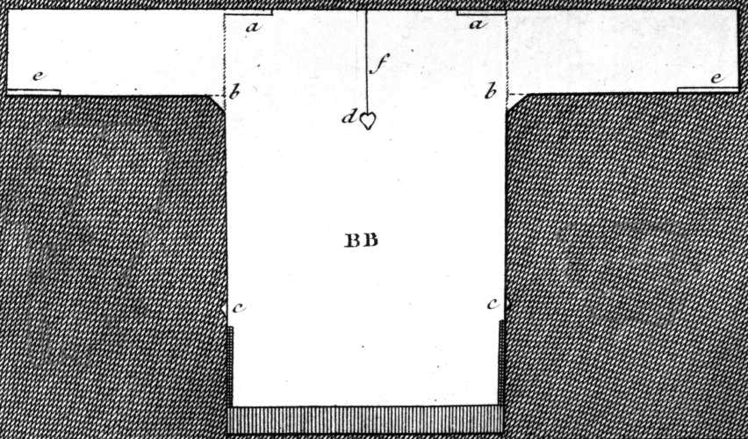
Austen, Thursday, 1 September 1796:
“We are very busy making Edward’s shirts, and I am proud to say that I am the neatest worker of the party.”
Notes:
While many people had their clothing made by tailors (men’s clothing but also women’s riding habits) or modistes/dressmakers, people often made or at least trimmed and finished, their own. But shirts and shifts were usually made by the women in the family. The cut was simple and extremely economical, using all the width of the linen. The “workbasket” was always to hand with shirts/shifts to be sewn. And when staying with friends one could always bring a work-bag for smaller needlework projects.

Slide 7
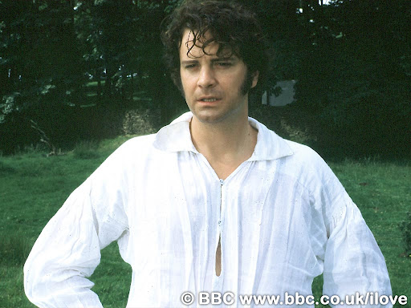
Notes:
Or for a slightly more interesting view of a well made shirt…

Slide 8
Fashion detectives
Notes:
Norah Waugh: The Cut of Women’s Clothes. Also “Corsets and Crinolines”
Janet Arnold
Nancy Bradfield: Costume in Detail
The Dress Detective: A Practical Guide to Object-Based Research in Fashion
Nov 19, 2015 by Ingrid Mida and Alexandra Kim

Slide 9
Hat
Shape, Proportion, Decoration
Neckline
“V” or Closed, Rounded, Square, Filled in
Elbow/Sleeve
Short/Elbow/Long, Straight/Puffed, Gloves
Hemline
Train, Narrow, Wider, Plain/Trimmed
Accessories
Shawl, Cloak, Muff

Slide 10
The Novels
1795-1799 writing
“Elinor and Marianne”(Sense and Sensibility)
“First Impressions” (Pride and Prejudice)
“Susan/Catherine” (Northanger Abbey)
1811-1816 writing, revising, publishing
Sense and Sensibility
Pride and Prejudice
Mansfield Park
Emma
Persuasion, Northanger Abbey published 1817.
Notes:
We tend to think of this entire period as that of “high waists” but the details of fashions actually changed quite a bit. While writing her early works, Austen would have dressed differently than she would have while writing later works, and would have envisioned her characters differently as well.

Slide 11
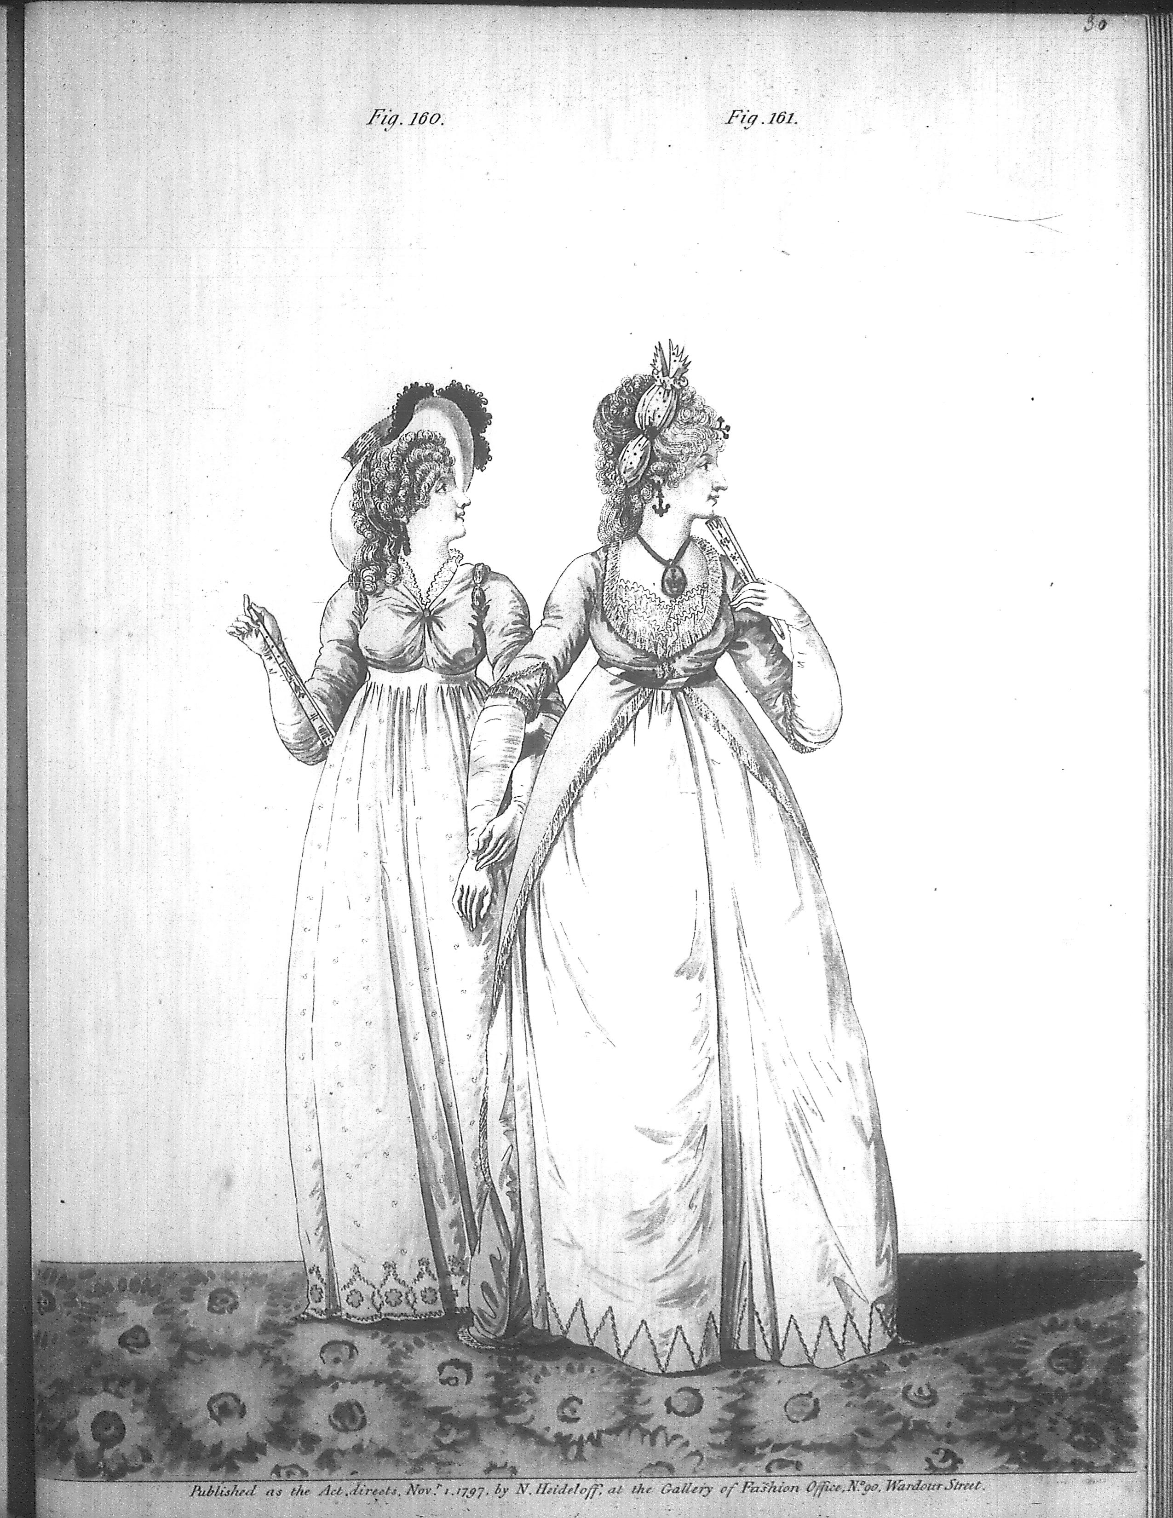
“Their appearance was by no means ungenteel or unfashionable; their dress was very smart, their manners very civil.”
Heideloff, Nov. 1797
Notes:
Smart elegant: compare to Northanger Abbey where Eleanor is described as “elegant”

Slide 12
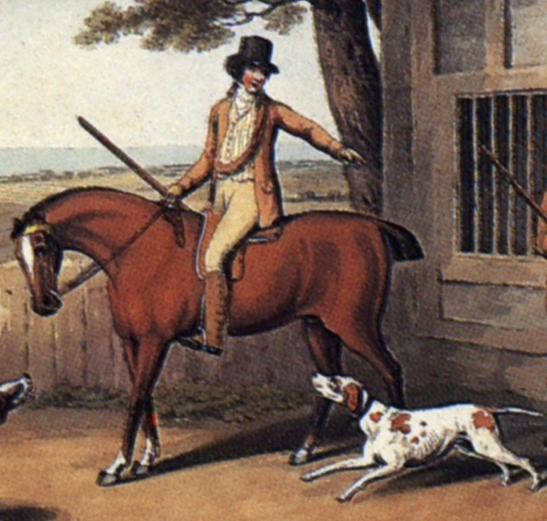
“His name was good, his residence was in their favourite village, and she soon found out that of all manly dresses a shooting jacket was the most becoming. Her imagination was busy…”
Notes:
Awareness of shooting jacket—the country life attire influence. This picture is a bit deceptive as regards the quote. The rider would have walked to go shooting with the object to bring back birds. If hunting (hunting=fox hunting), they would have been riding. If they were hunting on foot, and it was not their property or they did not have permission of the property owner, they might have been arrested for poaching.

Slide 13
“’There now, you are going to laugh at me too. But why should not I wear pink ribands ? I do not care if it is the Doctor's favourite colour…My cousins have been so plaguing me!’' She had wandered away to a subject on which Elinor had nothing to say, ...”
Notes:
1

Slide 14
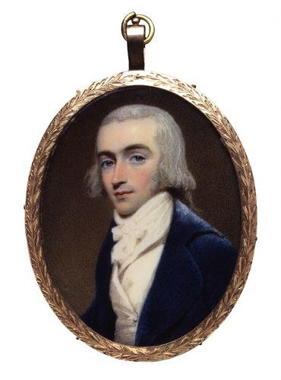
“good-looking and gentlemanlike; he had a pleasant countenance, and easy, unaffected manners.”
Edridge, Robert Fellows, 1800
Notes:
1800 Robert Fellows, philanthropist, by Edridge
But the fact that he is looking for a house suggests a family background in trade

Slide 15
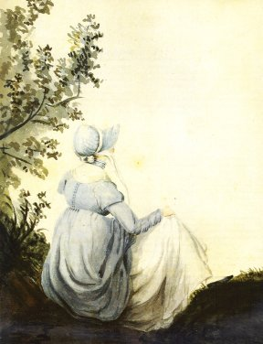
“I hope you saw her petticoat, six inches deep in mud, I am absolutely certain; and the gown which had been let down to hide it not doing its office.”

Slide 16
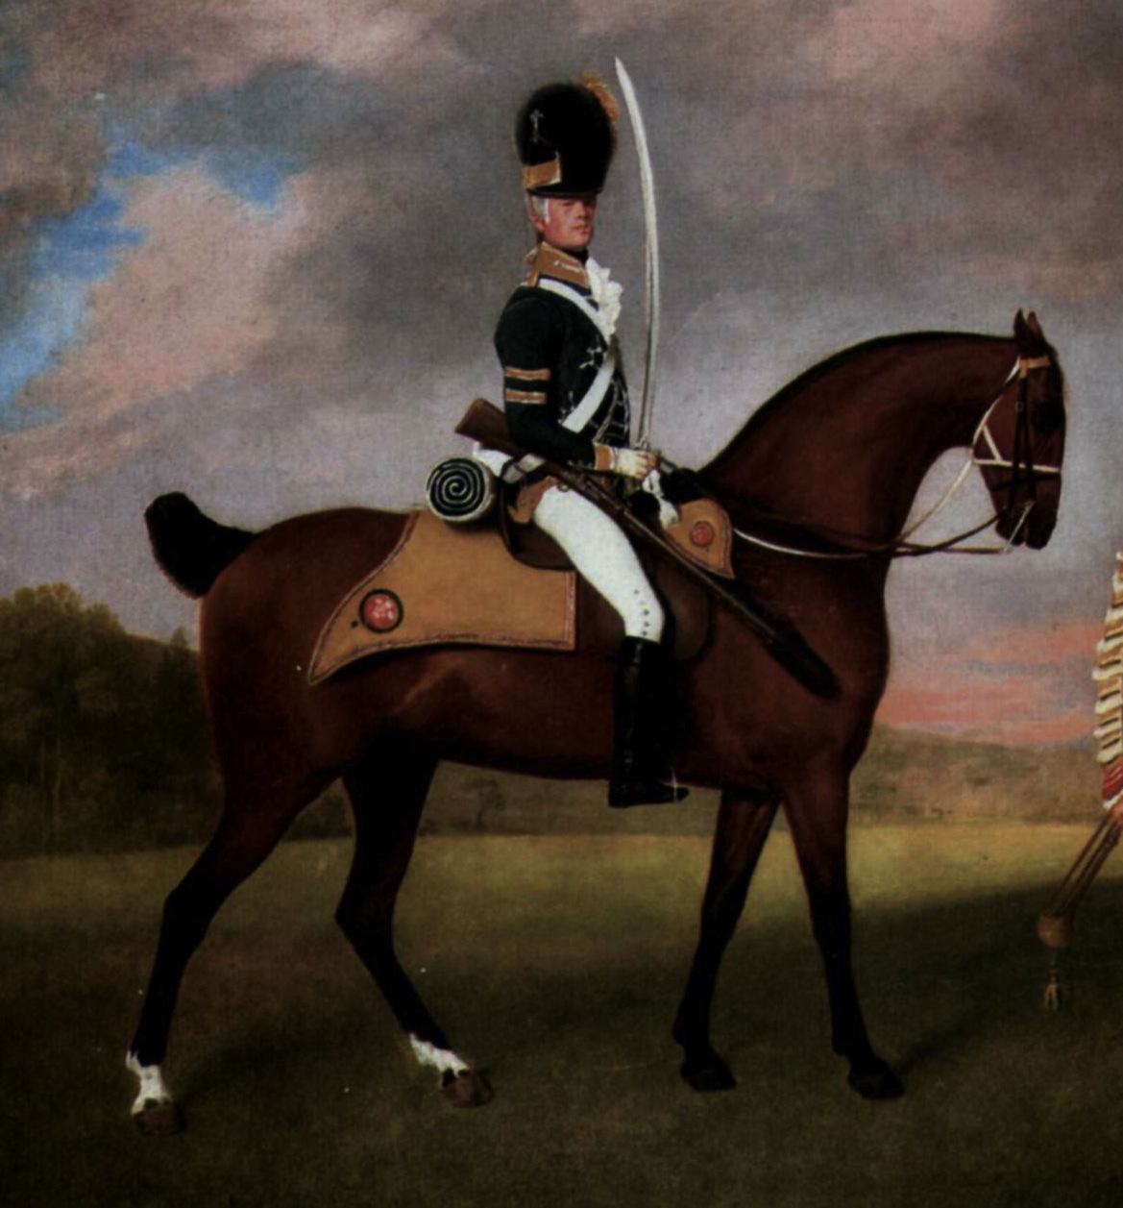
“wanted only regimentals to make him completely charming”

Slide 17
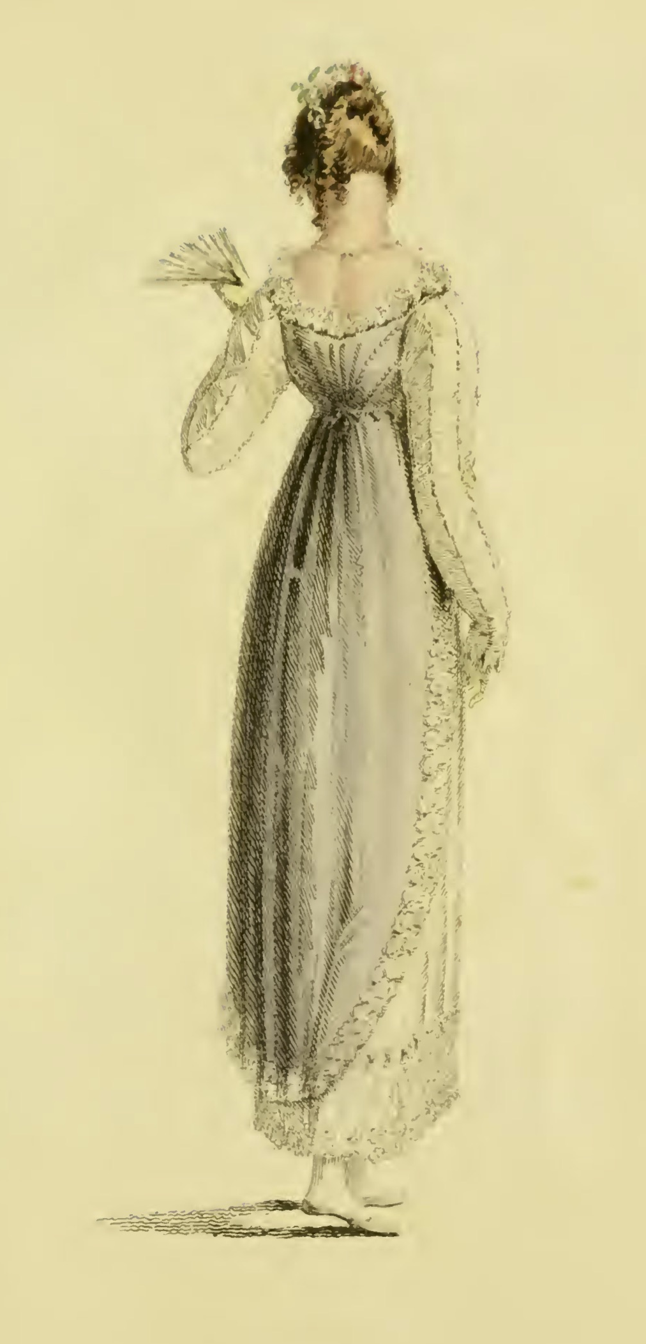
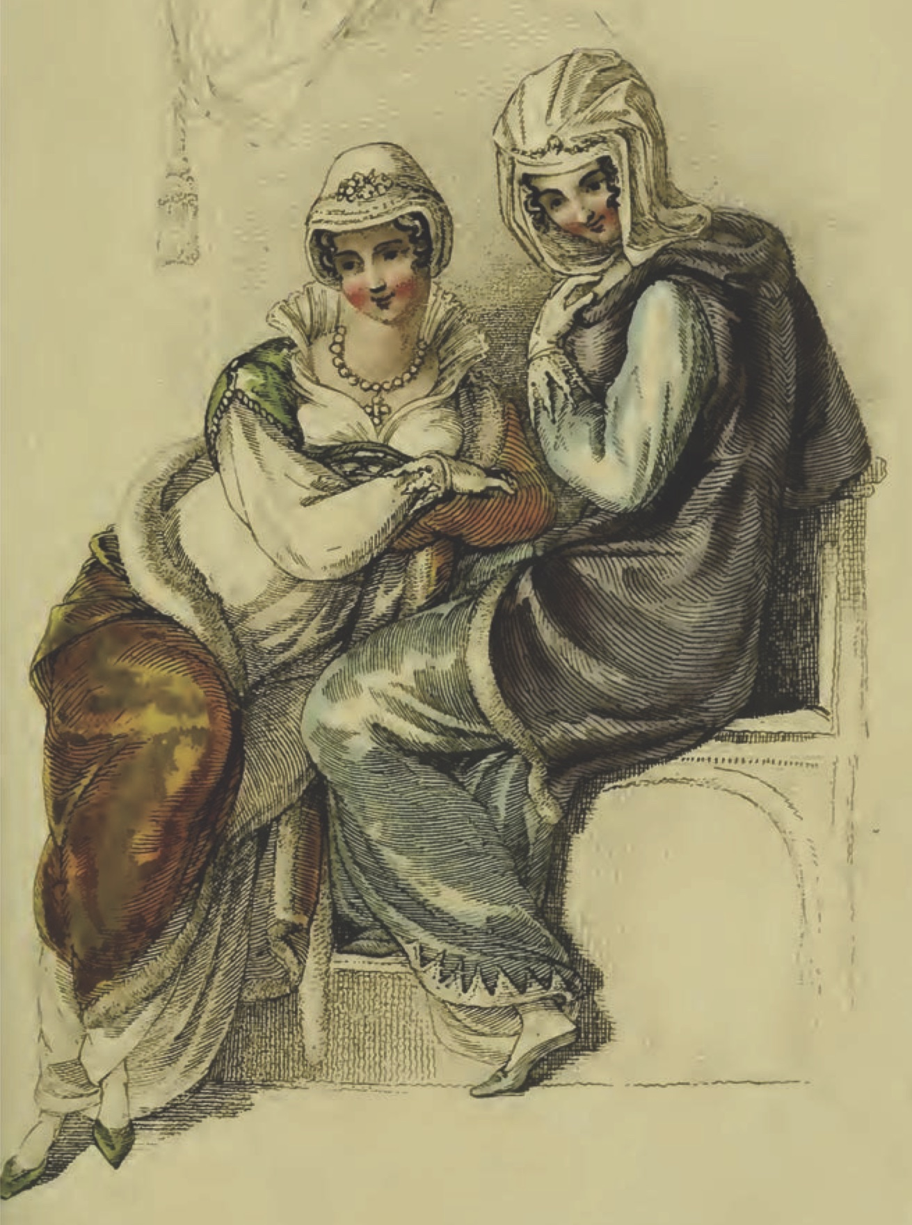
“I am very glad to hear what you tell us, of long sleeves.”
Ackermann, April 1814
Ackermann, February, 1811
Notes:
(Note: From the letters: Wednesday, 9 March 1814: I wear my gauze gown to-day, long sleeves and all. I shall see how they succeed, but as yet I have no reason to suppose long sleeves are allowable.)
However, using long sleeves is a safe bet because it was a fashion that came and went with regularity.

Slide 18
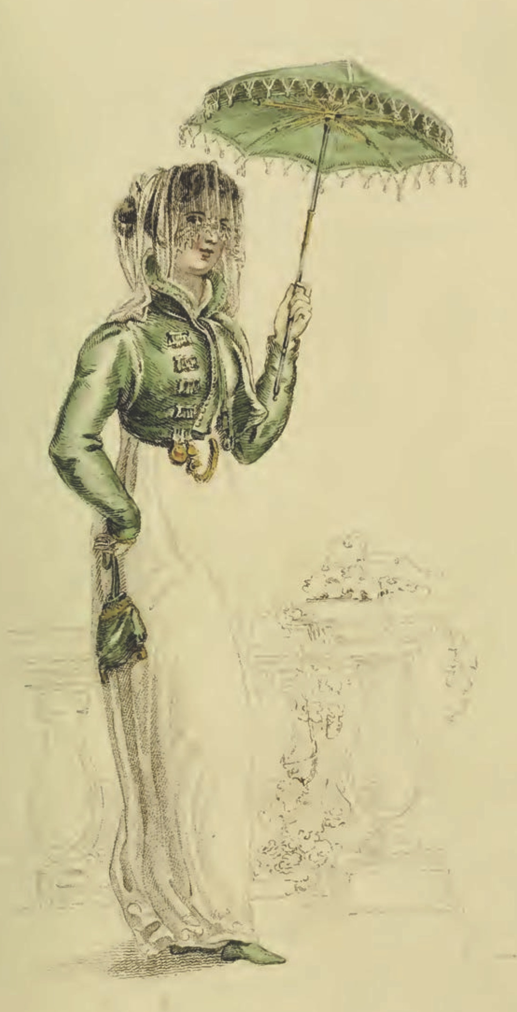
“I wish you would tell Sally to mend a great slit in my worked muslin gown before they are packed ...”
Ackermann, July 1811

Slide 19
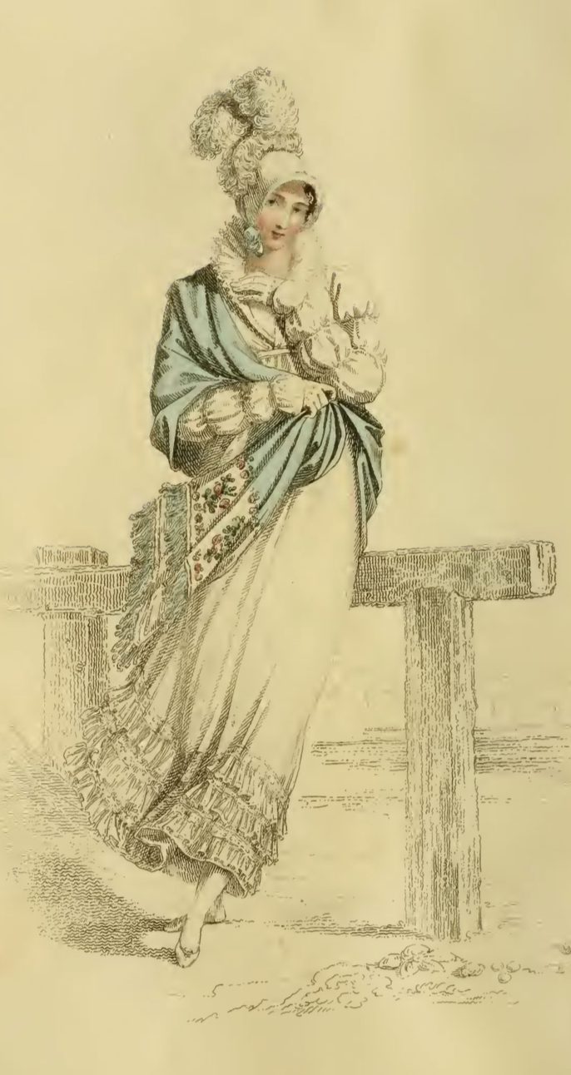
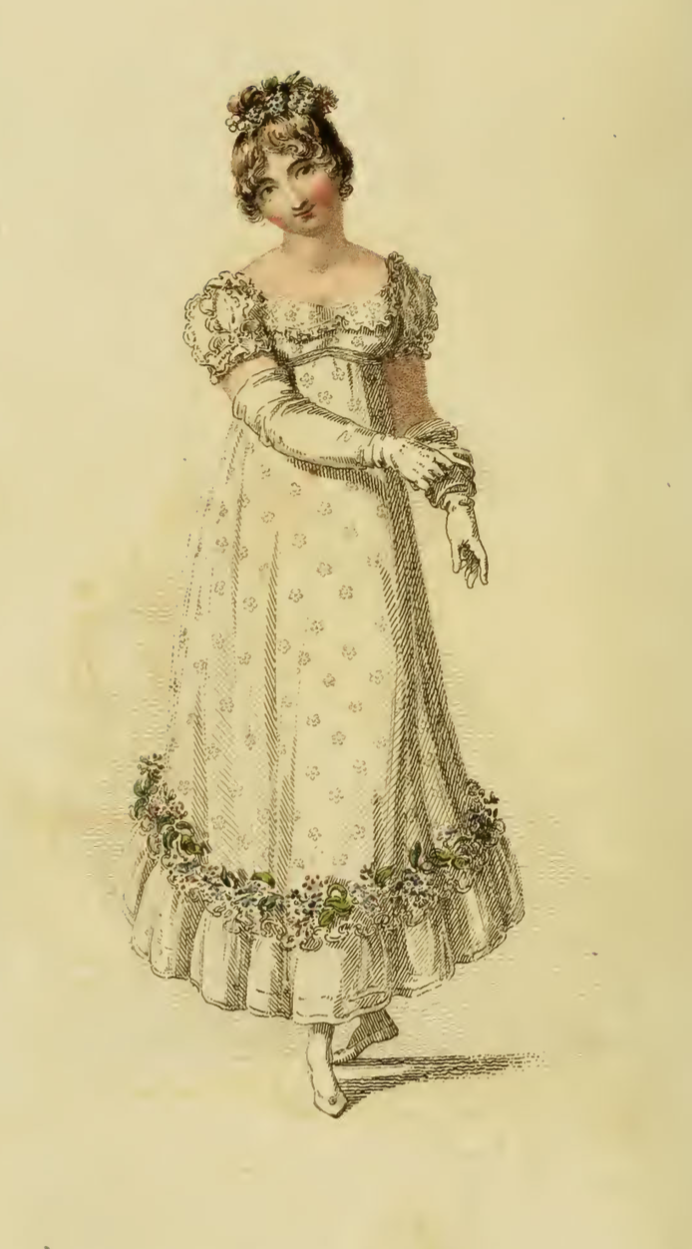
“A woman can never be too fine when she is all in white.”
Edmund to Fanny, Mansfield Park
1815
1815
Notes:
1815-1820 – the move to decorated bodice and hem
1) Ackermann, July 1815
2) Ackermann, June 1815

Slide 20
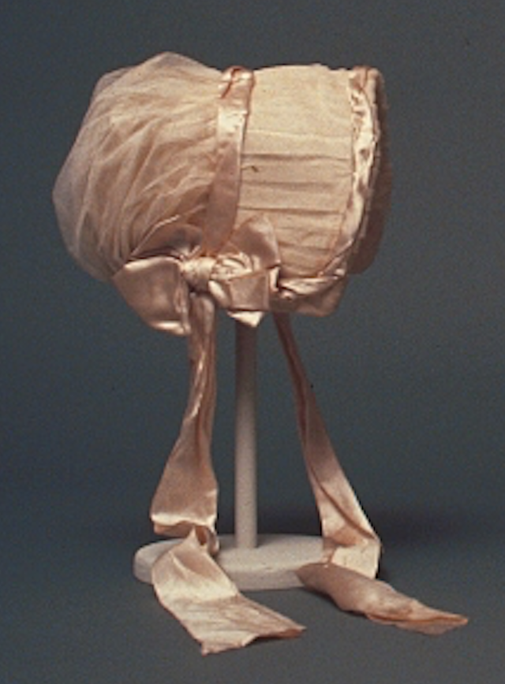
“A girl not out has always the same sort of dress: a close bonnet, for instance; looks very demure, and never says a word. You may smile but it is so.”

Slide 21
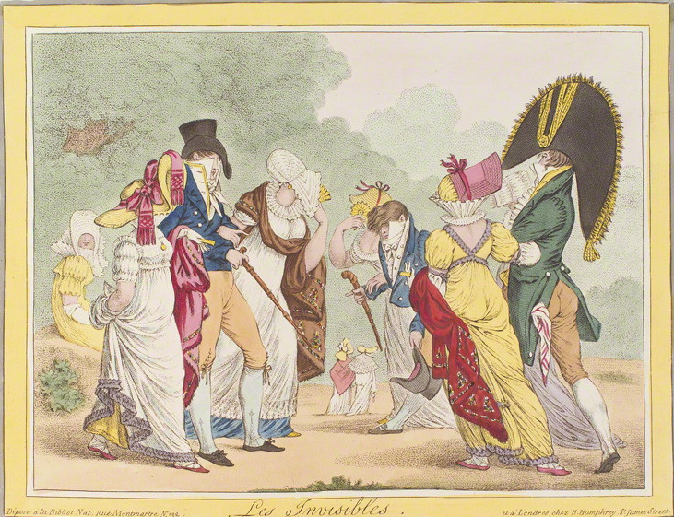
James Gillray, Les Invisibles, 1810

Slide 22
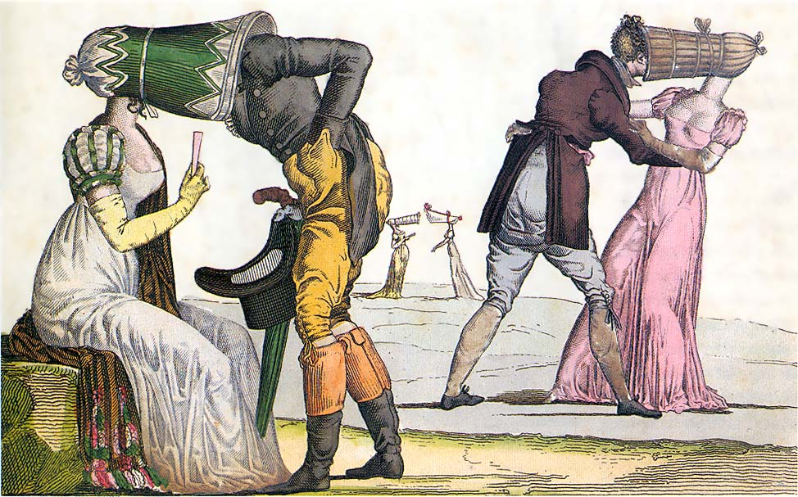

Slide 23
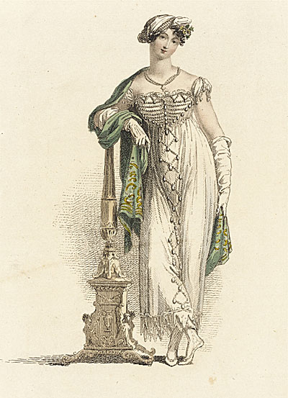
“as elegant as lace and pearls could make her”
Mrs. Elton, Emma
Ackermann, June 1813
Notes:
“

Slide 24
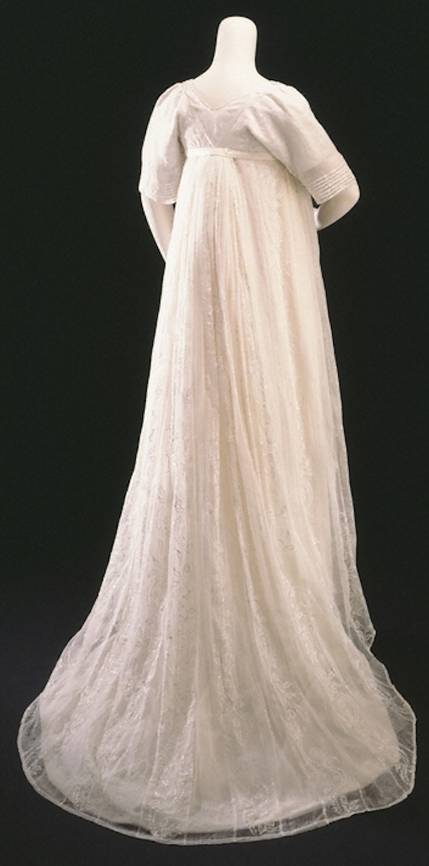
“…her air...had more real elegance.”
“Go, by all means, my dear; only put on a white gown.
Miss Tilney always wears white.”
c. 1800
Notes:
Smart elegant: compare to Northanger Abbey where Eleanor is described as “elegant” 1800

Slide 25
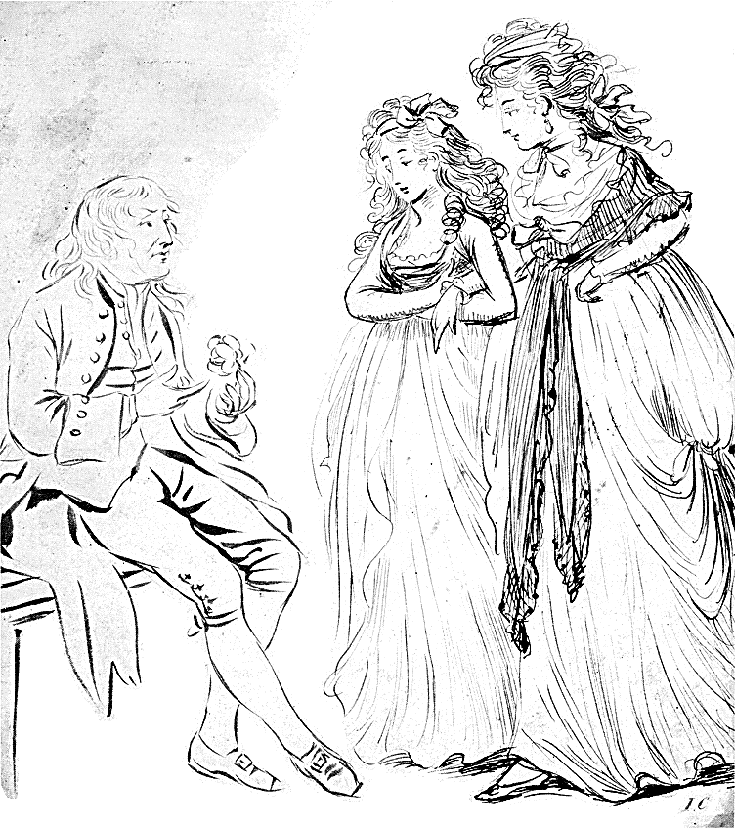
Young men and women driving about the country in open carriages!...Do not you think these kind of projects objectionable?”
“Yes, very much so indeed…A clean gown is not five minutes’ wear in them. They are splashed getting in and getting out...”

Slide 26
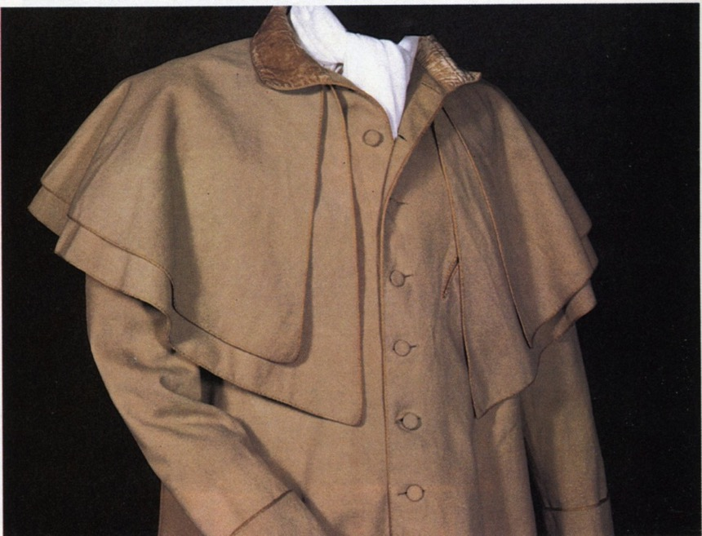
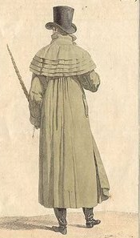
Catherine Morland of Henry Tilney: “His hat sat so well, and the innumerable capes of his great-coat looked so becomingly important. To be driven by him, next to being dancing with him, was certainly the greatest happiness in the world!”
Notes:
Henry can speak of fashion with impunity
A greatcoat was made of “cloth” which was a synonym for wool. The capes were originally designed to keep off rain but they quickly became a fashion statement as well, as Catherine notes with admiration.

Slide 27
“I do not think it will wash well.”

Slide 28
“One could not hope to conduct himself or herself properly on entering a room without immediately assigning a rank to every person.”
Richard Bushman
Notes:
In a society based on rank, clothes as an indicator of rank have to shift subtly. You keep up with the latest fashions, the latest dances, and the latest news, not just to be trendy or edgy but to ensure that your rank is recognized. Your deportment, manners and speech all mark you as acceptable into society.

Slide 29
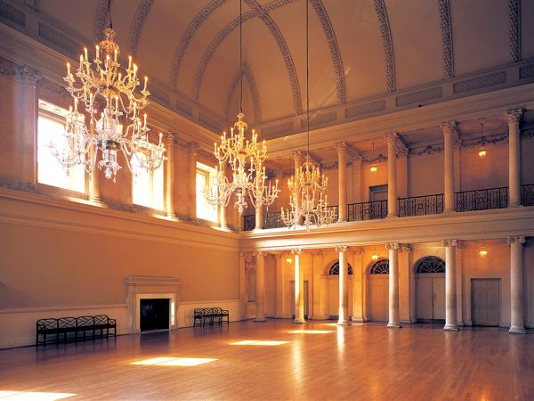
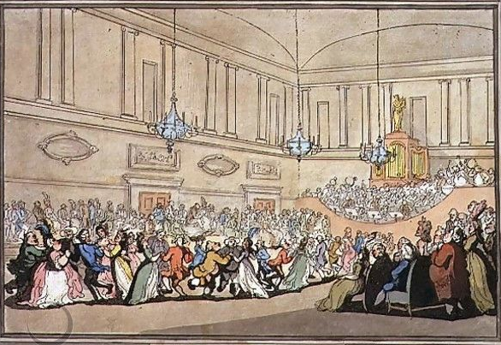
Notes:
The Assembly Rooms, Northanger Abbey
Pierce Egan, Walks Through Bath, 1819
Here, salutary rules exclude all those Whom no one hears of,
and whom no one knows;
That no plebian breathings may infect An atmosphere at all times so select;
No bankers’ clerks these splendid realms invade;
No FOLKS who carry on a retail trade;
No actors by profession must appear To act their parts, or speak their speeches here;
Yet even here, amid the crowds you view,
’Tis sometimes difficult to tell WHO’S WHO.”

Slide 30
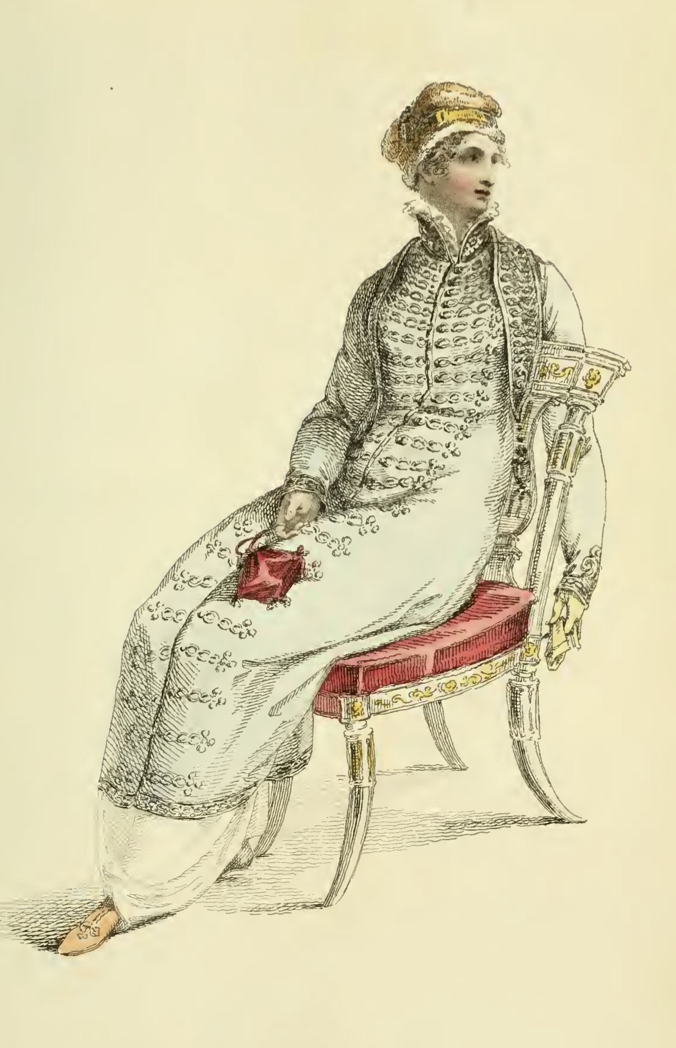
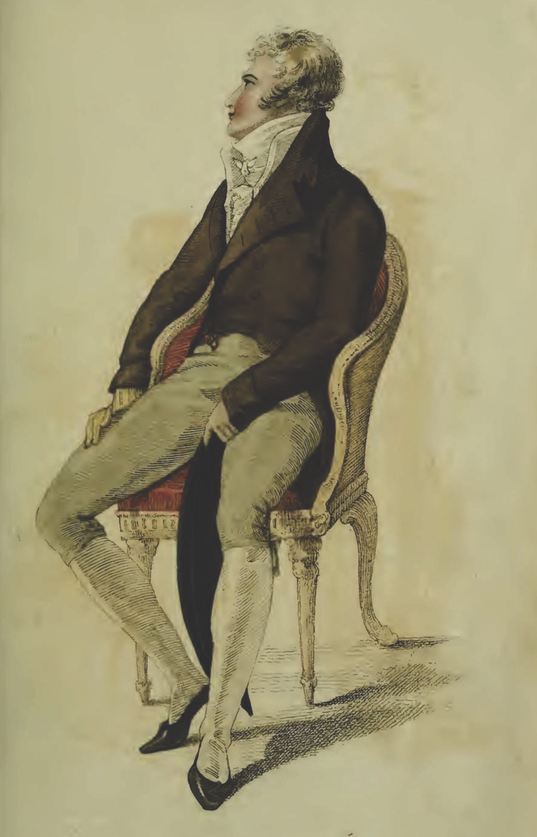
Ackermann, April 1810
Elizabeth Elliot of Lady Russel: “Something so formal and arrangé in her air! And she sits so upright!”
Notes:
The cues for the initiated were many: fashion certainly, but also specific manners, knowledgeable, or at least interesting, conversation, and grace in movement.
That elegance, that air was being redefined as something more “natural” in the years after the turn of the century as Elizabeth Elliot notes.
But it continued to be cultivated in years of dance lessons, or acquired more quickly once a fortune in textile manufacturing was made.

Slide 31
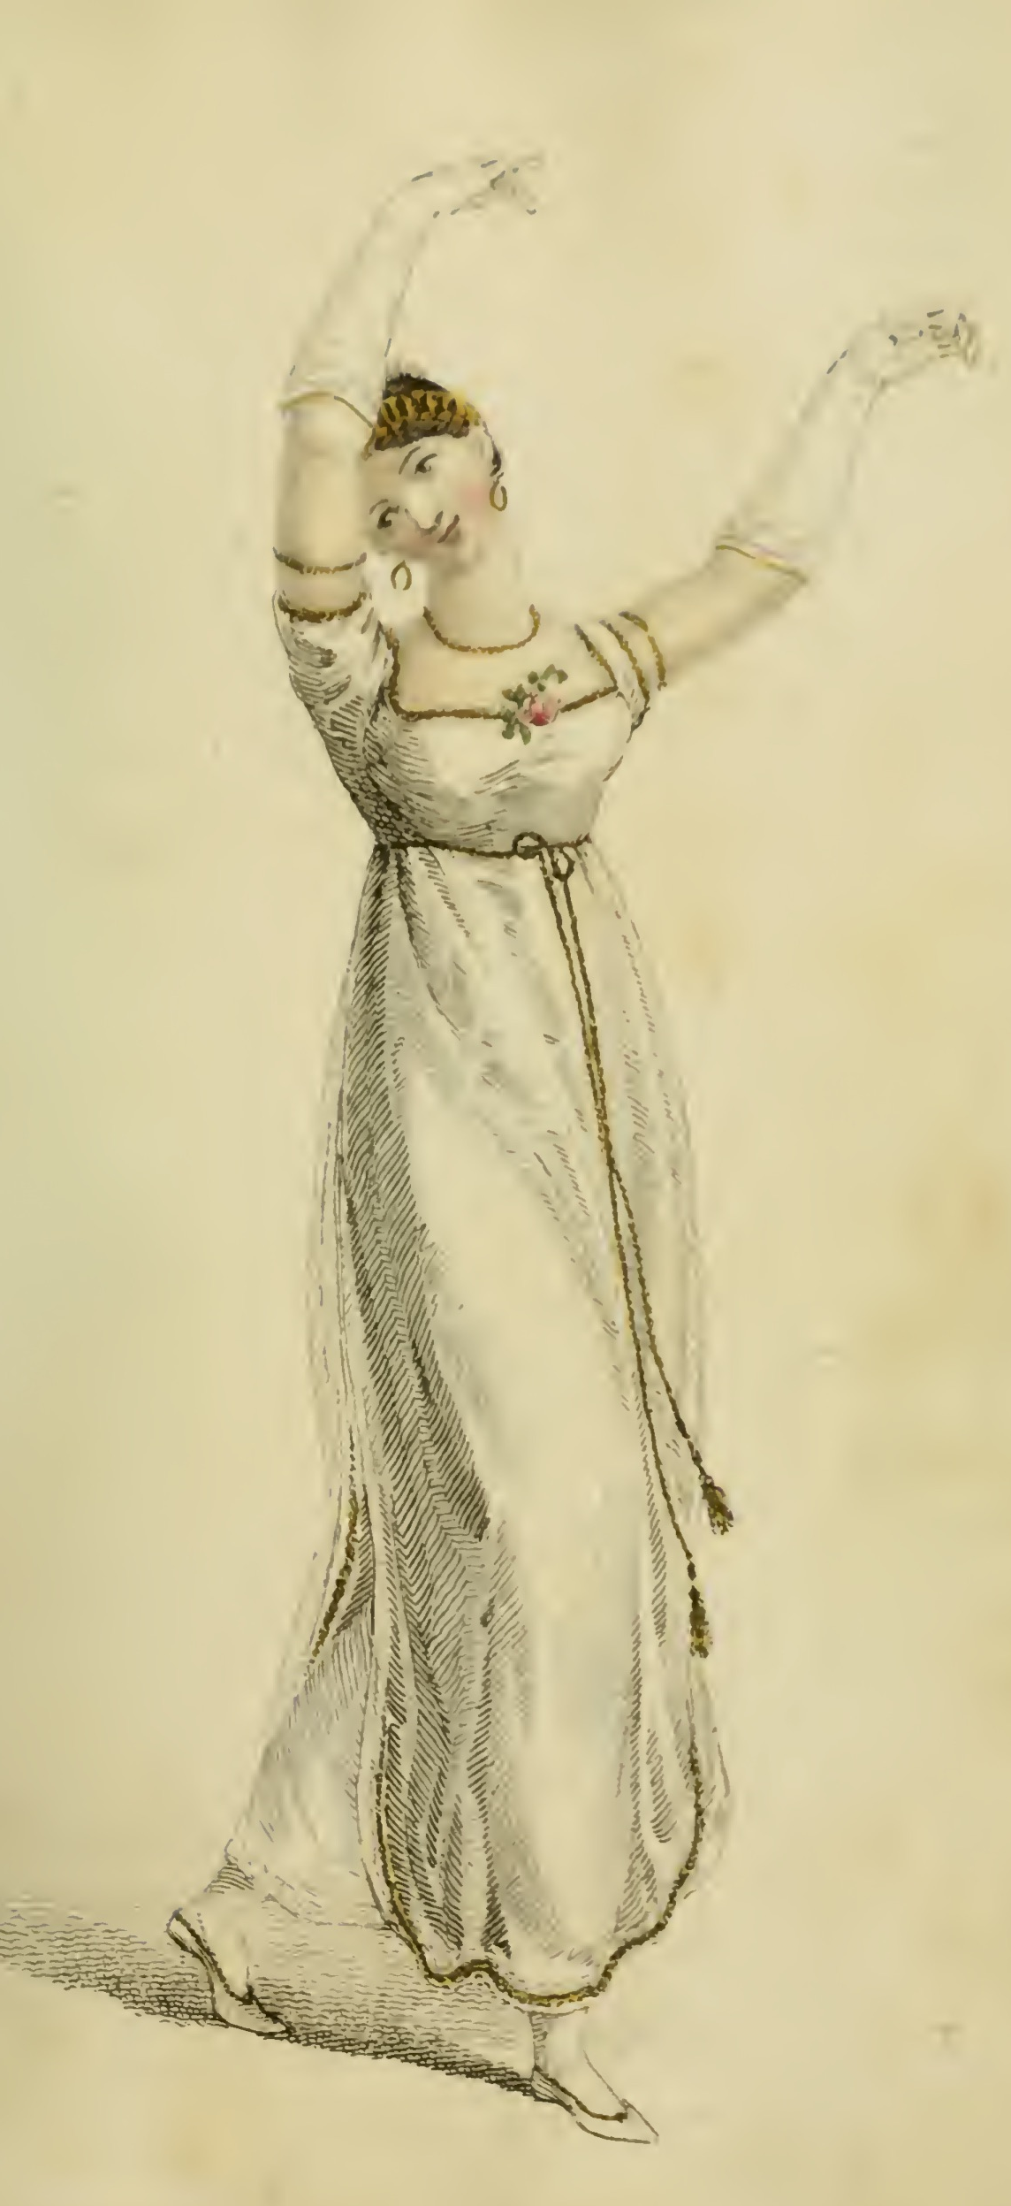
“…besides all this, she must possess a certain something in her air and manner of walking...”
Caroline Bingley, Pride and Prejudice
Ackermann, February1809
Notes:
As Caroline Bingley says, a true lady must have “a certain something in her air.” That grace of movement was cultivated in years of dance lessons (a requiredpart of an upper class education), or acquired more quickly once a fortune in textile manufacturing was made.

Slide 32
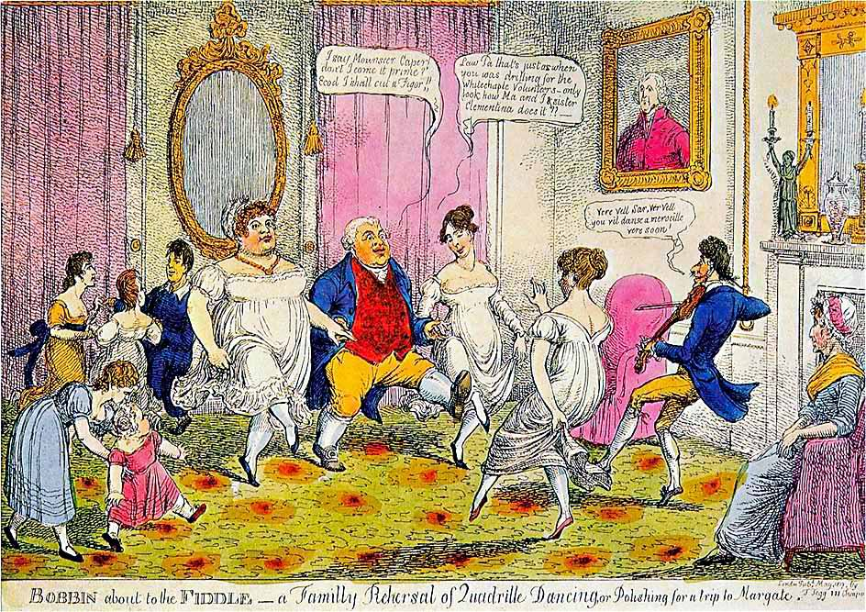
Notes:
Bobbin about the Fiddle – A Family Rehearsal of Quadrille Dancing, or Polishing for a trip to Margate.
“I say Monsouer Caper don’t I come it prime? Ecod I shall cut a figor!”
“Law Pa that’s just as when you was drilling for the Whitechapel Volunteers. Only look at how Ma and I and sister Clementina does it.”
“Ver vel sir, vere vel. You vil danse a merveileux ver soon.”
“The Season at Margate, for example, commenced on the King’s birthday, formally celebrated in June, and ended in late October, whereas Bath commanded the more fashionable months of October through May. The hours and pricing of the summer balls were usually different from those of the winter. ”
. “

Slide 33
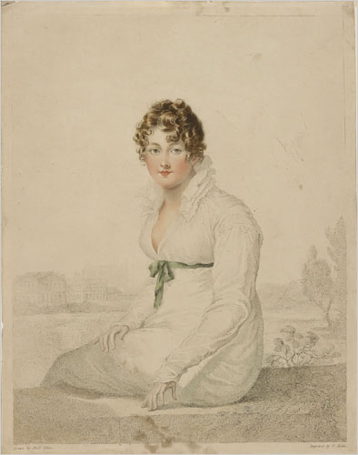
“Henry and I went to the Exhibition in Spring Gardens. ..I was very well pleased…with a small portrait of Mrs. Bingley (Jane Bennet), excessively like her…
Mrs. Bingley’s is exactly herself — size, shaped face, features, and sweetness; there never was a greater likeness. She is dressed in a white gown, with green ornaments, which convinces me of what I had always supposed, that green was a favourite colour with her.” 24 May 1813
William Blake, Harriet Quentin, based on portrait by Villiers (d. 1813).
Notes:
Stipple engraving by William Blake, with etching and mezzotint – printed in colours and coloured by hand.
Mrs.Q is probably the best known decorative print executed by William Blake, primarily due to the large number of facsimile reproduction impressions which were printed of this image in 1806. William Blake’s engraving is based upon a portrait by Francois Huet Villiers (d. 1813). The subject of Mrs.Q is Harriet Quentin, the wife of colonel Quentin and mistress to George IV when Prince Regent. The view in the background is thought to be the Thames at Eton, with the college chapel beyond. The miniature portraitist Villiers had died in 1813, thus this portrait must have had been drawn or painted at least seven years prior to the publication of this plate.
“Henry and I went to the exhibition in Spring Gardens. It is not thought a good collection, but I was very well pleased, particularly (pray tell Fanny) with a small portrait of Mrs. Bingley, excessively like her. “

Slide 34
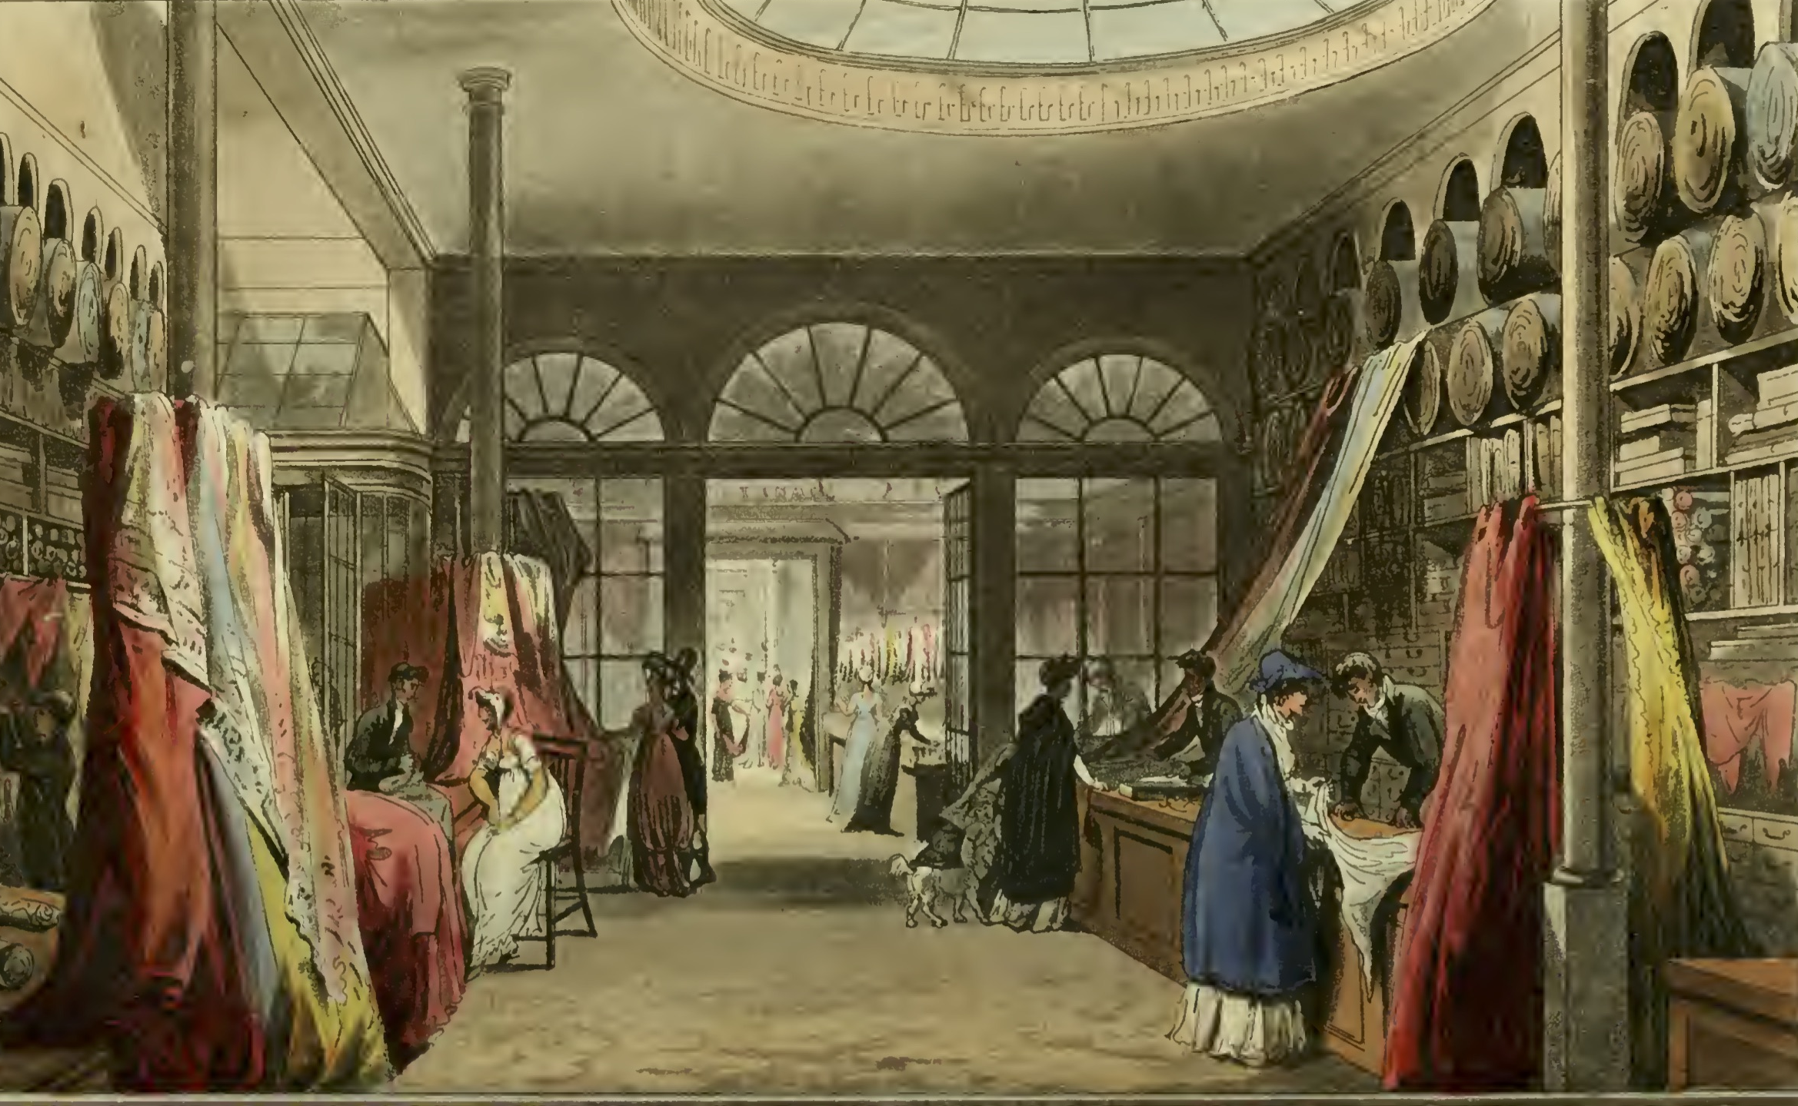
Ackermann, March 1809, Harding , Howell, & Co., 89 Pall Mall
24 May 1813
I went the day before (Friday) to Layton's as I proposed, and got my mother's gown, — seven yards at 6s. 6d.

Slide 35
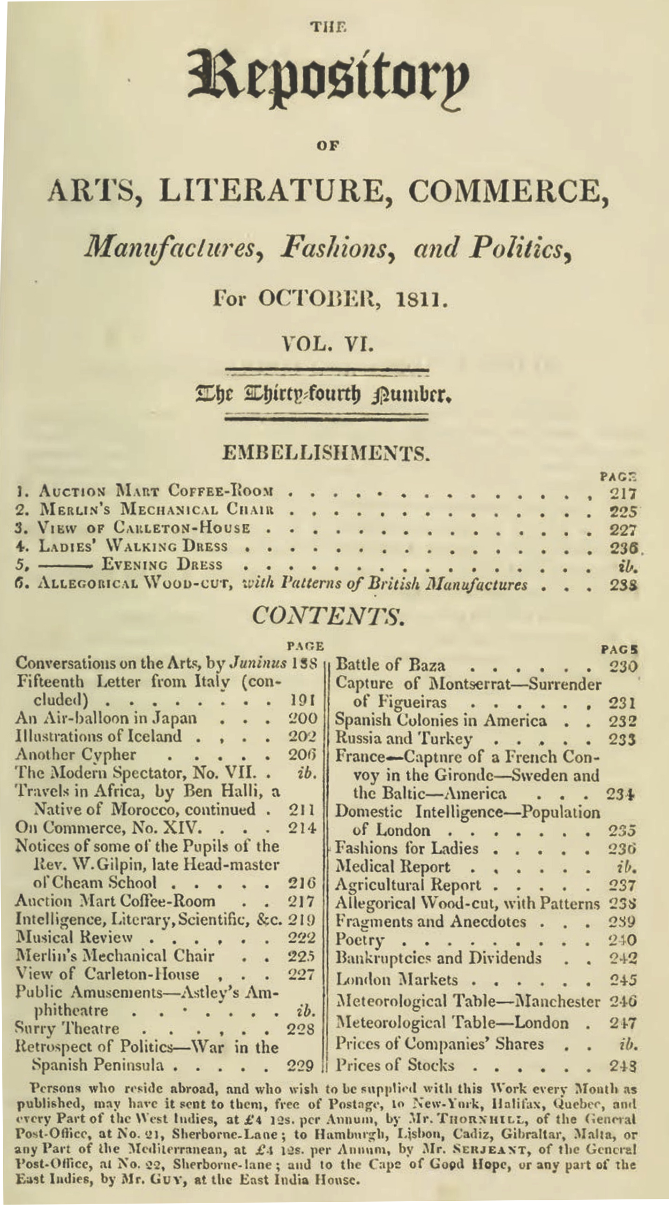
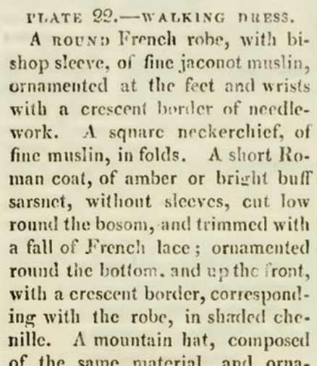
Ackermann’s Repository of the Arts. October 1811
Notes:
Keeping up with the subtle changes in the latest fashions was one way to indicate that you were among the genteel. As important, perhaps more important, was the ability to converse intelligently on a variety of topics. Both aspirations were served by magazines like
Ackerman’s, or to give it its full name “The Repository of Arts, Literature, Commerce, Manufactures, Fashions, and Politics” (it also included reviews of music and examples of furniture, interior design, and public buildings or businesses) provided hand-watercoloured fashion plates with specific descriptions, and general descriptions of fashion trends.

Slide 36
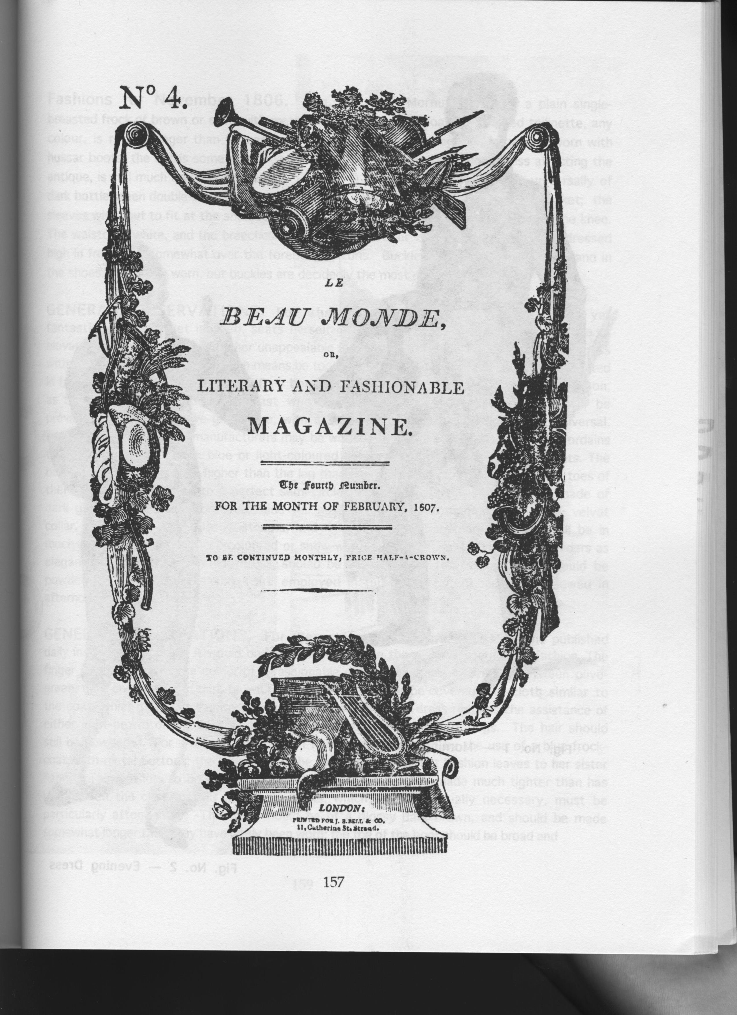

Slide 37
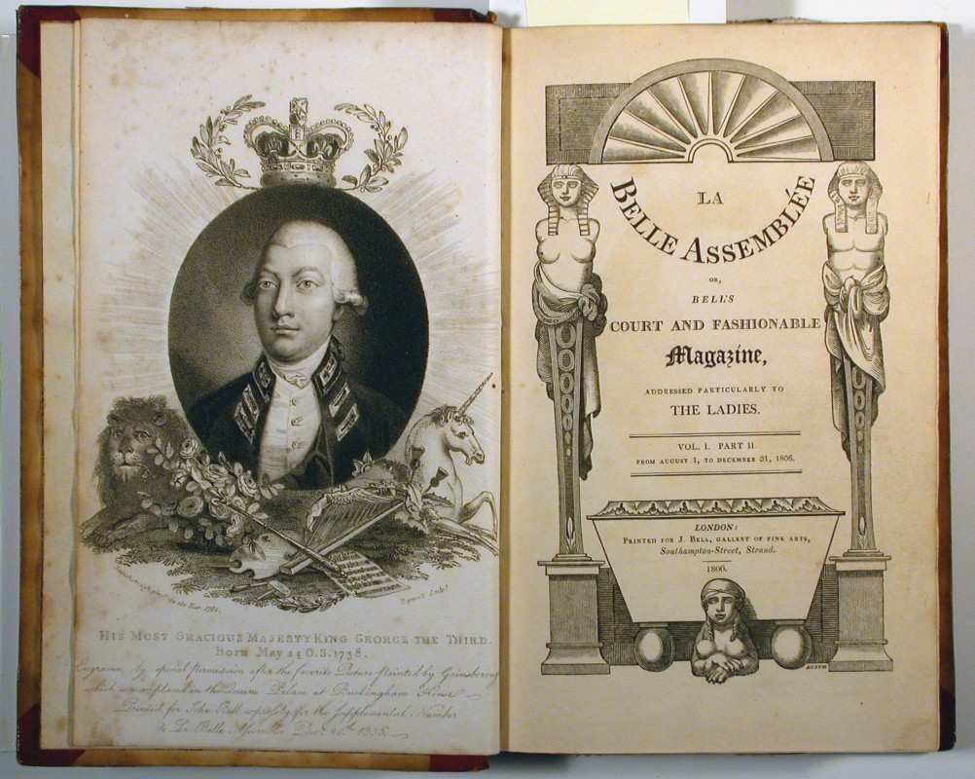
Notes:
La Belle Assemblée (which we know Austen’s niece Fanny Knight received – at least, there is one issue of 1814 known to be hers),

Slide 38
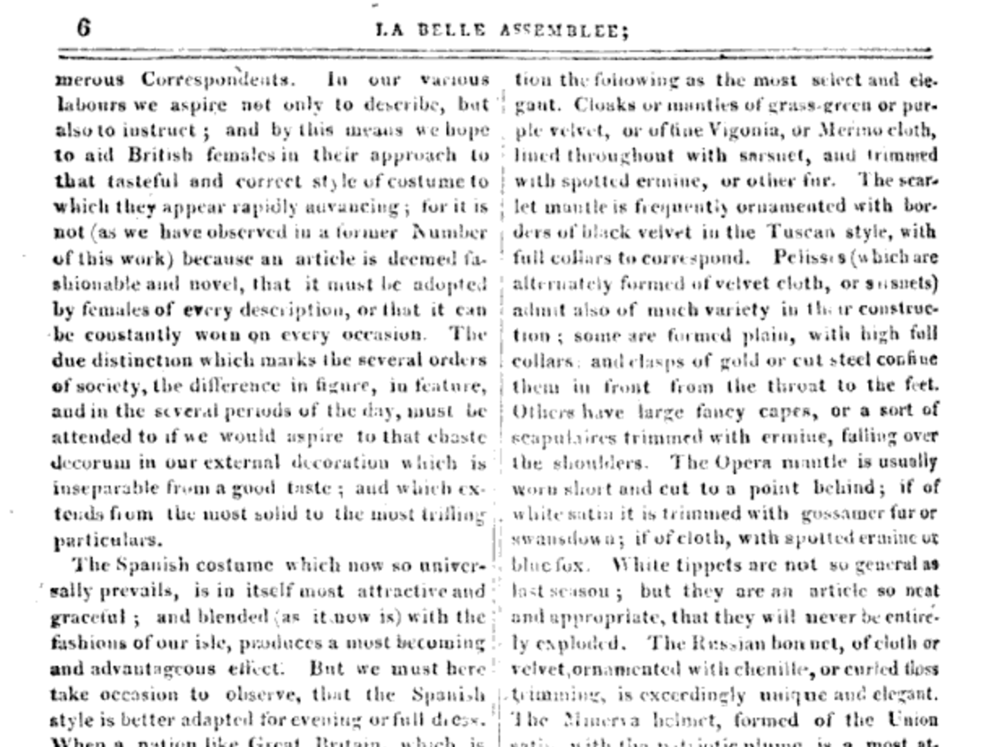
13 October 1808
“We must turn our black pelisses into new, for Velvet is to be very much worn this winter.”
“Pelisses, which are alternately formed of velvet or sarsnet, admit also of much variety in the constructions.”
La Belle Assemblée, October, 1808
Notes:
Austen frequently shows evidence, in her letters, that she was aware of, and assiduously adopting, the most recent fashion changes. When she suggested that her velvet pelisse would remain fashionable with just a bit of alteration she would have been happy to have that confirmed in La Belle Assemblée in October 1808.

Slide 39
“Scissor edited” from October 1808 La Belle Assemblée
The Morning Chronicle (London, England), Tuesday, November 1, 1808
The Leeds Mercury (Leeds, England), Saturday, November 5, 1808
Jackson's Oxford Journal (Oxford, England), Saturday, November 5, 1808
The Examiner (London, England), Sunday, November 6, 1808
Trewman's Exeter Flying Post or Plymouth and Cornish Advertiser (Exeter, England), Thursday, November 10, 1808; Issue 2322
The Derby Mercury (Derby, England), Thursday, November 10, 1808; Issue 3990
Notes:
And even if she did not have access to that issue of the magazine, so-called “scissor editors” were happy to clip that description and include it in their weekly newspapers shortly thereafter. You can find the exact same description for the fashions in at least these six. Nor was this information limited to England. Ackermann’s could be subscribed to from cities around the world.

Slide 40
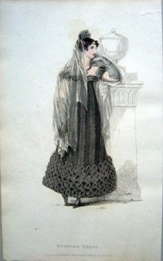
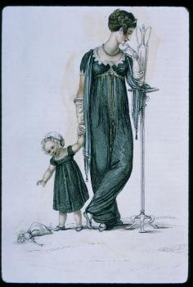
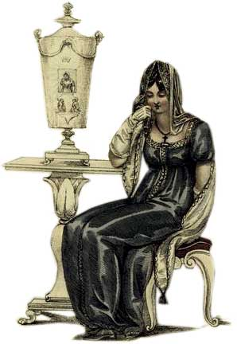
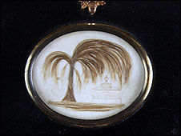
Austen, Thursday, 20 November 1800:
“Miss Debary, Susan, and Sally, all in black, but without any statues, made their appearance…”
Notes:
1819, 1810, 1816. Women in mourning were typically depicted draped over urns, statues, tombstones…The broach is a piece of hair jewelry – the weeping willow is made of hair. There were several royal deaths in the years after Austen’s death so fashion magazines provided suitable clothing.

Slide 41
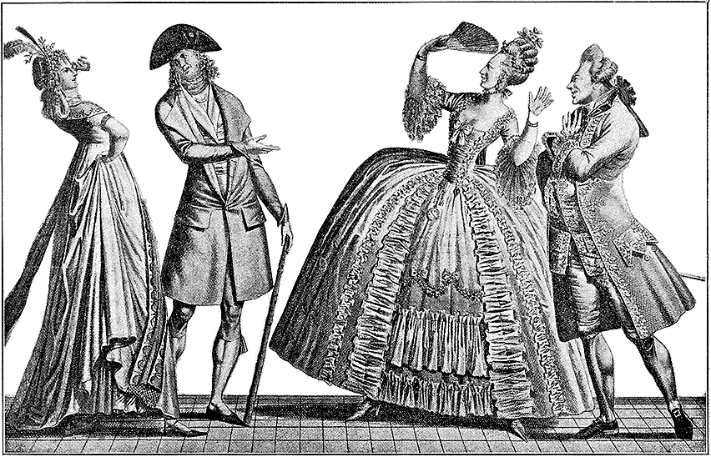
Notes:
A generational reaction of horror! In one generation we went from wide and heavy to narrow and light in an exceedingly short amount of time. But it didn’t stop there.

Slide 42
Influences
Was it the “Turkish/Oriental”?
Was it the Greek statues?
Was it Marie Antoinette?
Was it war?
Was it new technology?
Was it politics and globalization?
Was it the price of muslin?
Notes:
But as Jane Ashelford reminds us, the narrative of French women throwing off their clothes and wearing undergarments inspired by neoclassicism is appealing but simplistic. England – wool, Greek drapery, American egalitarianism, French freedom and egalite, West Indies – slave cotton and indigo, East Indies – true Indian muslins (Bangladesh suppression), better thread, better weaving, better quality, cheaper to produce.

Slide 43
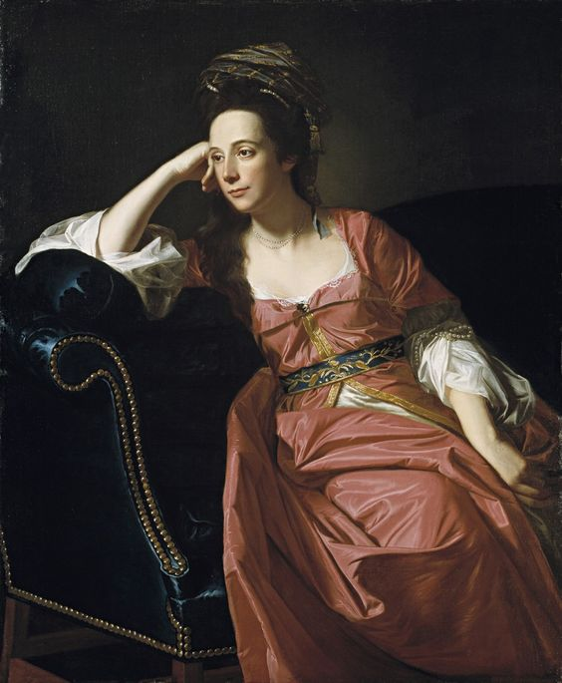
John Singleton Copley. Portrait of Margaret Kemble Gage (circa 1771) Timkin Gallery of Art
Notes:
Global travel already being felt in 18th century

Slide 44
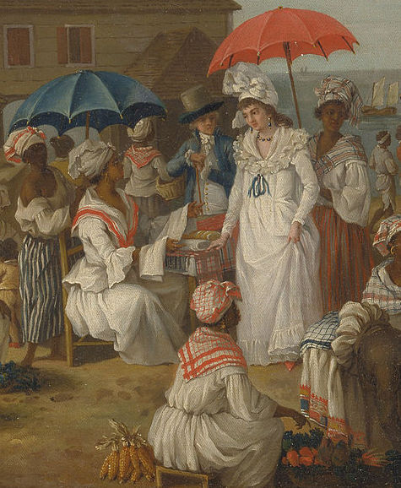
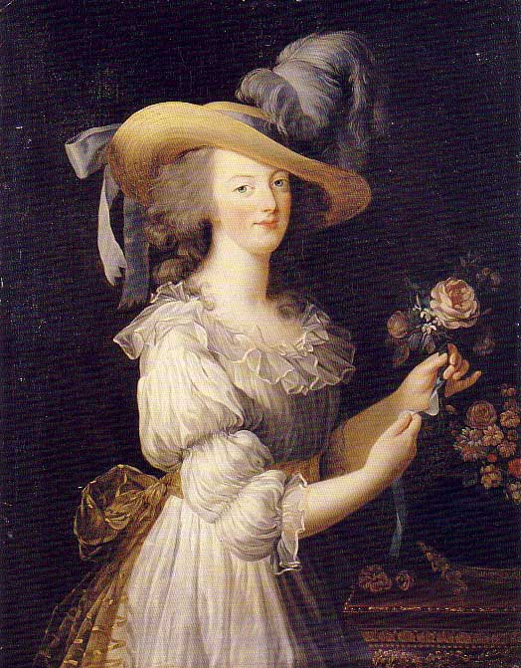
Agostino Brunias, c. 1780 “Linen Day, Roseau, Dominica”
Marie Antoinette’s “chemise dress” Portrait by Elisabeth Louise Vigée-LeBrun, 1783, dress by Rose Bertin
Notes:
Globalization of textile manufacture: raw cotton from the Americas, muslin/mull from India dyed white with indigo from the West Indies, then turned into a gown by Marie Antoinette’s dressmaker Rose Bertin, adopted shortly thereafter by Georgiana, Duchess of Devonshire (1784). The impact of Georgiana's revolutionary trip to the concert and the association of the chemise with Marie Antoinette and the West Indies complicate less nuanced accounts.

Slide 45
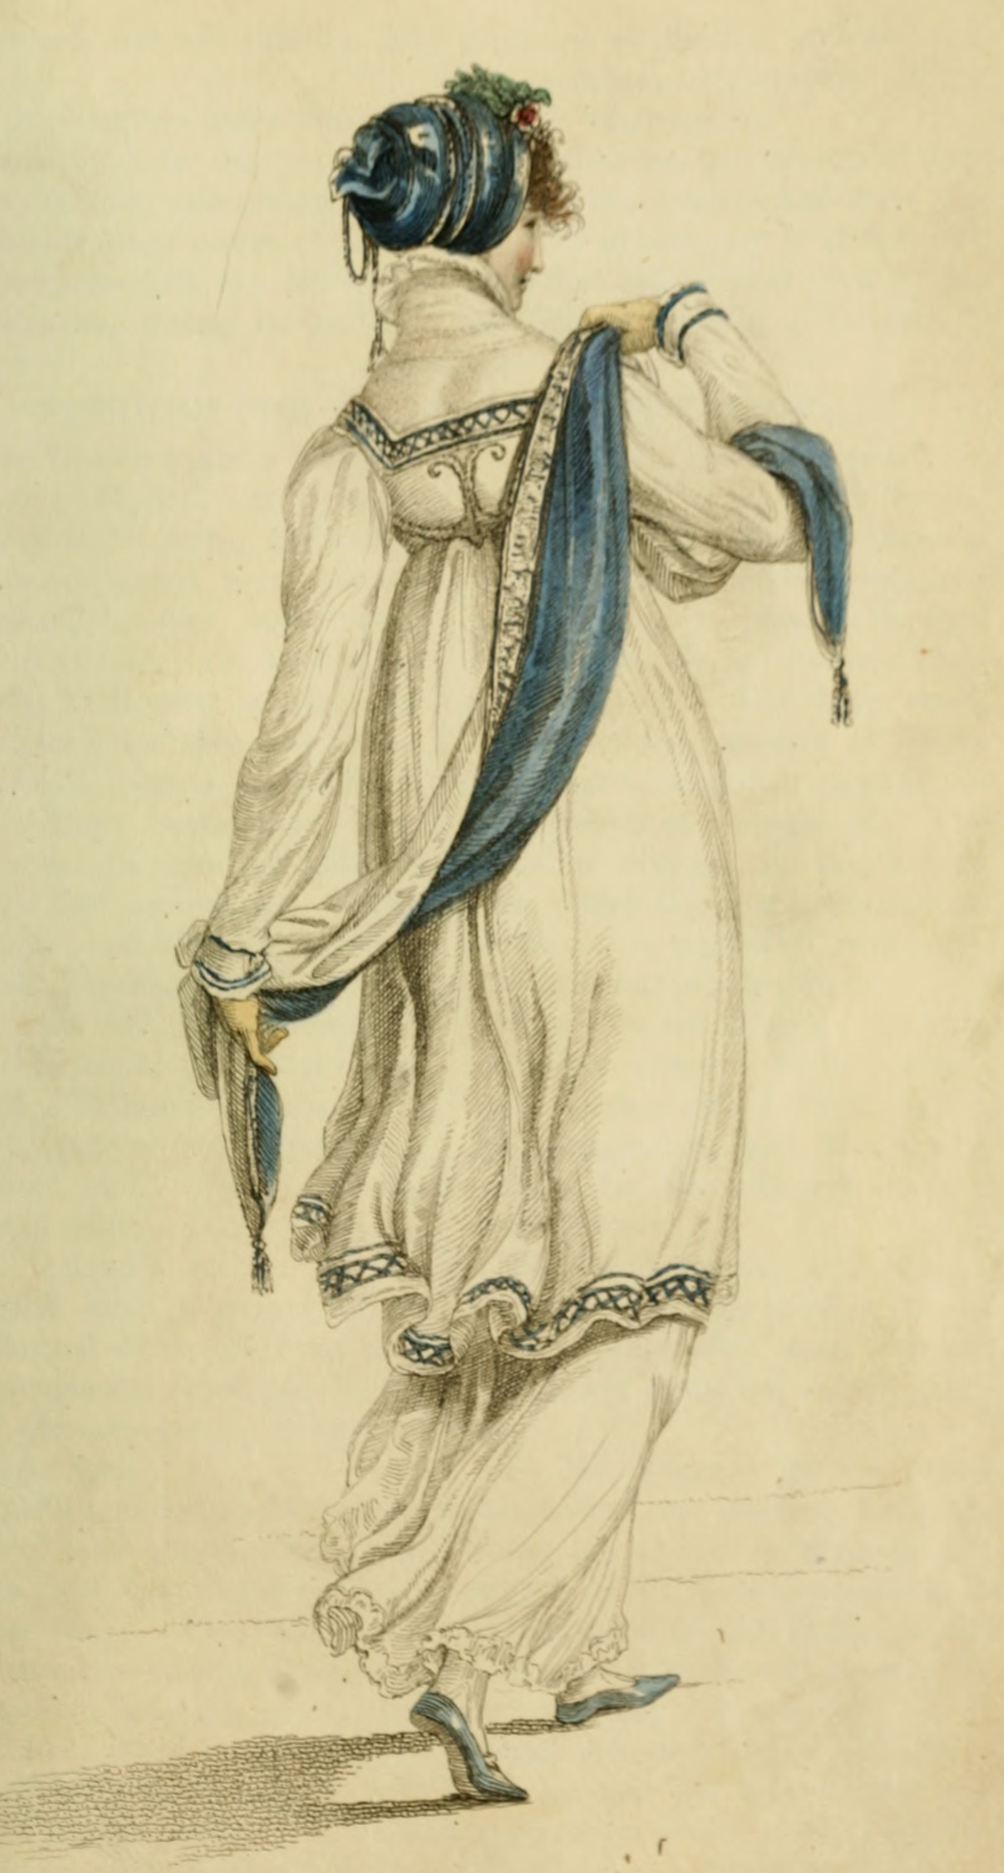
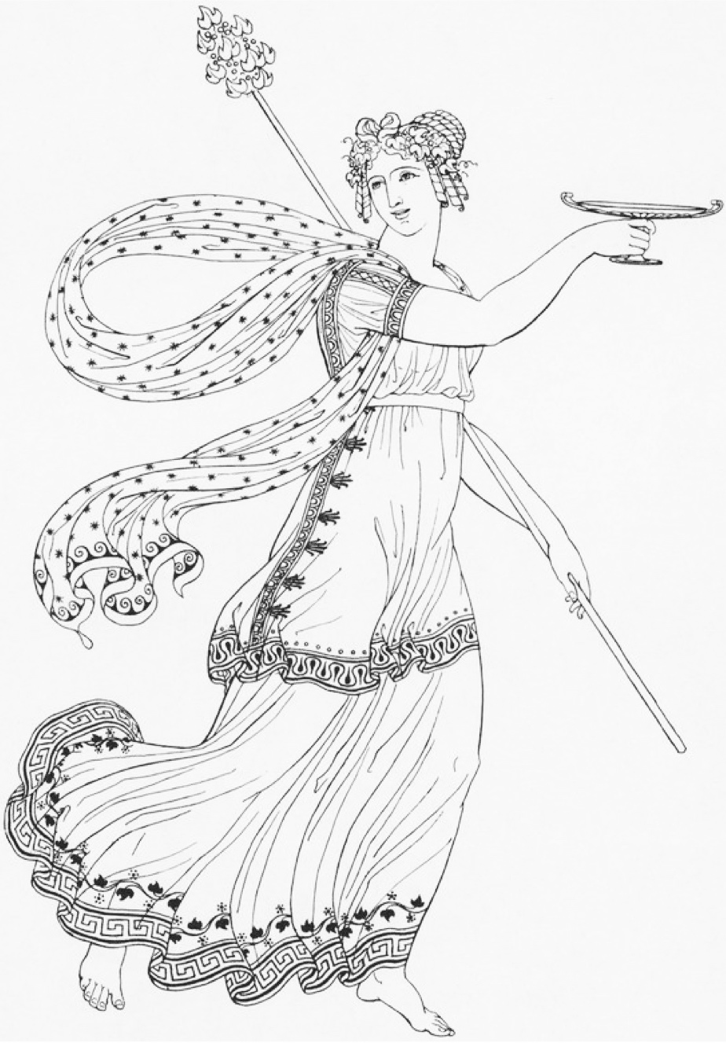
Ackermann, Walking Dress, April 1809
Thomas Hope, Ancient Costumes, 1809
Notes:
“first book in England which dealt with classical dress and one which the artist admitted was no scholarly; it was a work, stated Hope, that aimed not to advance erudition but only to promote taste. Intended for artists, theatre designers, and for members of the general public

Slide 46
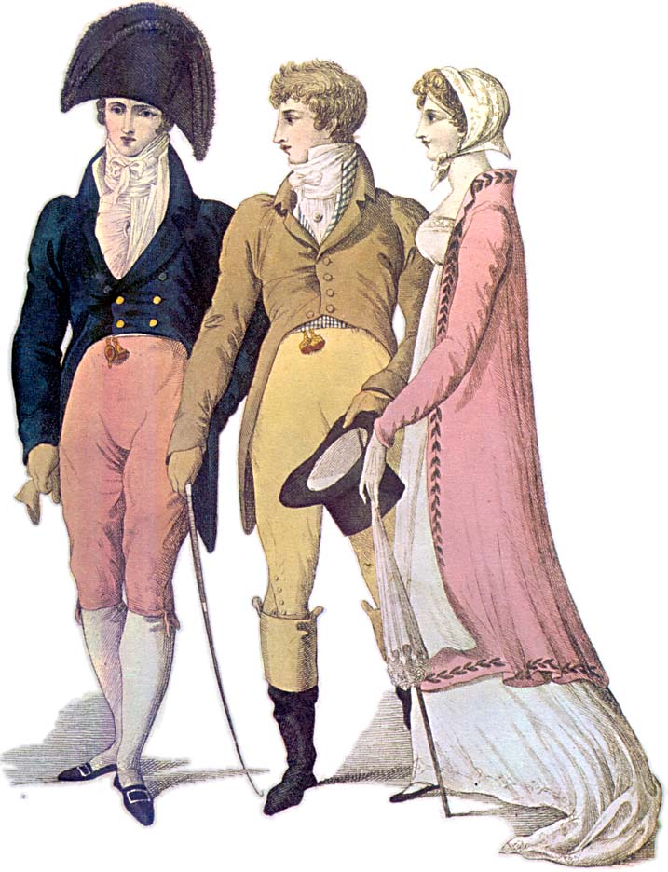
Notes:
1809 – cutaway, swallow-tail, classical statues – the nude male vs. the draped female

Slide 47
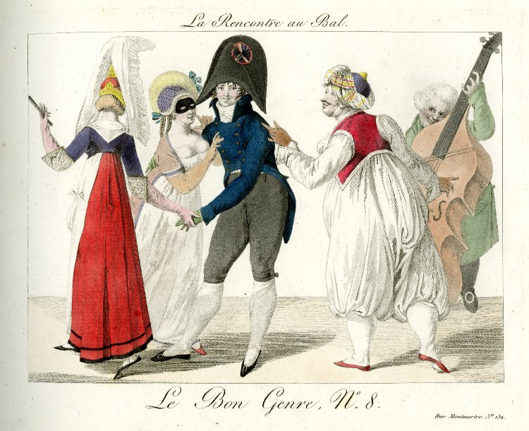
Pierre La Mésangère, 1801-1802
Notes:
Masquerade as a place to experiment

Slide 48
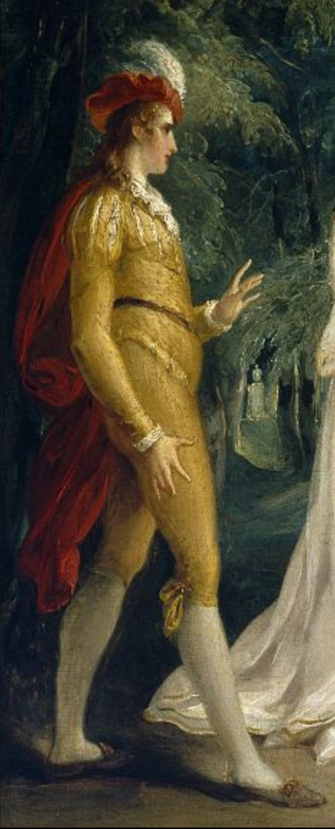
“It is to be Lovers’ Vows; and I am to be Count Cassel, and am to come in first with a blue dress and a pink satin cloak, and afterwards am to have another fine fancy suit, by way of a shooting-dress. I do not know how I shall like it.”
Mr. Rushworth, Mansfield Park
Notes:
Act IV, Scene 3 of William Shakespeare's Twelfth Night, Cesario, 1796

Slide 49
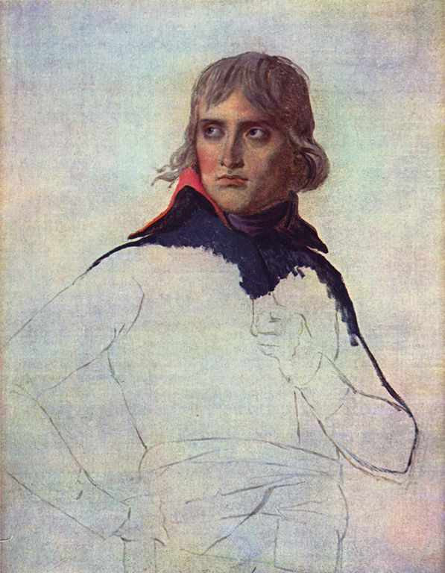
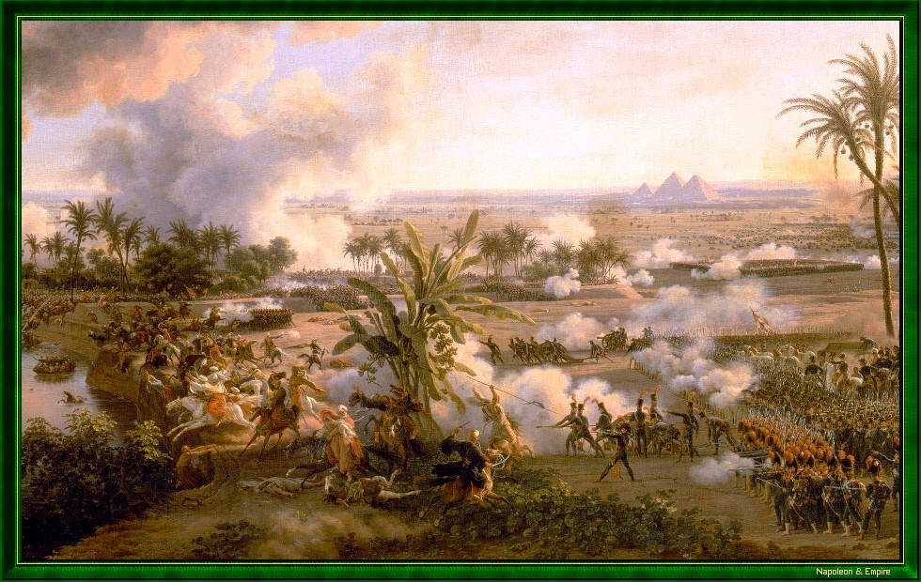
Battle of the Pyramids (Embabeh), July 21,1798

Slide 50
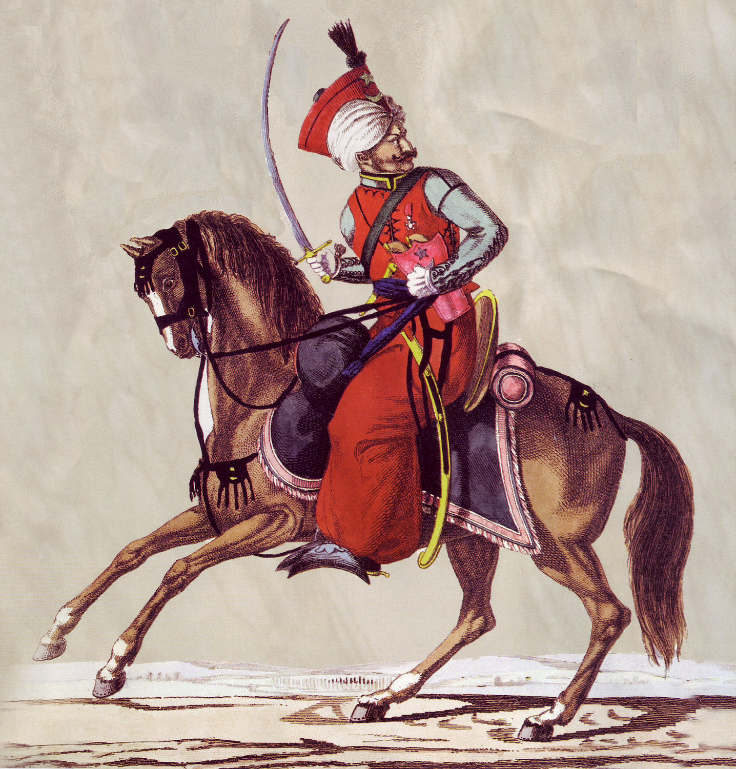
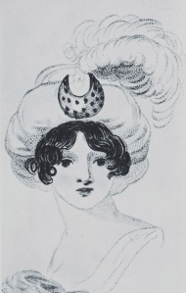
8 January 1799:
“I am not to wear my white satin cap to-night, after all; I am to wear a mamalone [mameluke] cap instead…It is all the fashion now; worn at the opera, and by Lady Mildmays at Hackwood balls.”
Notes:
Warrior caste in Egypt defeated by Napoleon at the Battle of the Pyramids, 1798 “On July 1, 1798, Napoleon landed in Egypt with 400 ships and 54,000 men and proceeded to invade the country, as he had recently invaded Italy. But this Egyptian invasion was to be different. For, in addition to soldiers and sailors, Napoleon brought along 150 savants — scientists, engineers and scholars whose responsibility was to capture, not Egyptian soil, but Egyptian culture and history.” The ladies picked up the turban almost immediately.
In former ages it seemed requisite that every lady should cut out her garments by a certain erect standard. ..But in our days, an English woman has the extensive privilege of arraying herself in whatever garb may best suit her figure or her fancy. The fashions of every nation and of every era are open to her choice. One day she may appear as the Egyptian Cleopatra, then a Grecian Helen; next morning the Roman Cornelia; or, if these styles be too august for her taste, there are Sylphs, Goddesses, Nymphs of every region, in earth or air, ready to lend her their wardrobe.
Mirror of Graces, 1811 (p. 52)

Slide 51
“Egyptian” gown with coquelicott trim,
February 1799
(From Candace Hern’s collection)
Notes:
Mirror of Graces, 1811 (p. 52)

Slide 52
Ackermann, March 1809
Opera Dress:
“Henry VIII hat of purple velvet trimmed with pearls…dress of the same…white satin Spanish mantle…”

Slide 53
Ackermann, July 1809
Promenade Dress:
“A round high frock of fine French cambric…
trimmed with a fine Vandyke lace…
Tyrolese cloak…
Venetian binding…
hair dressed in Grecian style…
veil à la Maltese…
parasol with white Chinese awning (fringe)
Gloves, Limerick or York tan.”

Slide 54
Ackermann, 1809
French
Roman
Venetian
Tyrolese
Andalusian
Spanish
Chinese
à la Maltese
Henry VIII
Vandyke
Polish
Brussels/Mecklin
Egyptian
Russian
Indian muslin
à l’antique
à la militaire
Turkish
Danish
India muslin
à la Hussar

Slide 55
William Dawe, Princess Charlotte, 1817 (wearing a sarafan)
Notes:
June 1814 “take care of yourself and do not be trampled to death in running after the emperor [Tsar Alexander I]

Slide 56
James Crompton, Spinning mule, 1770s
Claude Berthollet, liquid bleach, 1780s
Charles Taylor, 1788 “calico…bleached white, printed in permanent colours, having undergone all these operations in less than 48 hours

Slide 57
Notes:
1805 Dighton caricature – blue superfine (wool) coat, pantaloons,

Slide 58
Edridge, Captain Hoste, 1811
1807
Notes:
And she had brothers in the Navy
Captain Hoste 1811 by Edridge. Sailor’s trousers
People in park, 1807. The young man shows nautical influence - adopts the Navy uniform look.

Slide 59
Edridge, Sir William Harbord, 1810
Notes:
Remember: England was at war for almost all of Austen’s life.
Sir William Harbord, 1810 by Edridge, The other major influence on men’s fashion: military pantaloons – wool knit to cling and stretch.

Slide 60
The Prince of Wales’ Own Uniform
Notes:
Brummel – Prince Regent’s regiment – consulted on uniform: The 10th Royal Hussars (Prince of Wales's Own) was a cavalry regiment of the British Army from 1715 to 1969.

Slide 62
Notes:
Rolinda Sharples “The Cloak Room at the Assembly Rooms at Clifton”1818: Sharples shows examples of all mens options. The older gentleman on the left wears grey/light silk breeches, the army men are in their uniforms with pantaloons, the thirty-something husband in the middle wears black breeches while the young flirt wears trousers. Also note the impossibly tiny bodices on the women’s gowns. For more on Clifton Assembly see http://www.thespasdirectory.com/profilego.asp?ref=2841393B

Slide 63
Notes:
1818 Cruickshank
“Dammit I really believe I must take off my cravat or I shall never get my trwosers on…”
“Pon honour Tom, you are a charming figure! You’ll captivate the girsl to a nicety!!”
“Do you think so Charles? I shall look more the thing when I get my other calf on.”
“Dear me, this is hardley stiff enough. I wish I had another sheet of foolscap.”
“You’ll find some to spare in my breeches.”

Slide 64
“…a true India muslin...”

Slide 65
8 January 1801
Mrs. Powlett was at once expensively & nakedly dressed.”
Notes:
1810 “A scene taken from nature in Kensington Gardens” Gillray commenting on lightweight cotton and flimsy petticoats.

Slide 66
Notes:
James Gillray (1757-1815)

Slide 67
The year 1740, a Lady’s full dress of Bombazeen.
The year 1807, a Lady’s undress of “Bum-Be-Seen.”
Notes:
The year 1740 a Lady’s Full Dress of Bombazeen. The year 1807 a Lady’s Undress of Bum-be-seen (Full dress refers to formal dress, undress refers to daytime clothes but her it refers to rather more…or less as the case may be.

Slide 68
9 January 1796
“You say nothing of the silk stockings; I flatter myself, therefore, that Charles has not purchased any, as I cannot very well afford to pay for them…”
14 January 1796
“What a good-for-nothing-fellow Charles is to bespeak the stockings—I hope he will be too hot all the rest of his life for it.”

Slide 69
25 November 1798
“The Overton Scotchman [a peddler carrying fabric for sale door to door] has been kind enough to rid me of some of my money, in exchange for six shifts and four pair of stockings. The Irish [linen] is not so fine as I would like it; ... It cost me 3s. 6d. per yard. It is rather finer, however, than our last, and not so harsh a cloth.”
Notes:
“six shifts” i.e. enough fabric to make them, not ready made.
21 shillings for Emma = about $95 in 2011 so 3s 6d is about $14/yd.
20 shillings in a pound, 12 pence in a shilling
Dr. Eric Nye - http://uwacadweb.uwyo.edu/numimage/currency%20conversion.htm “A Method for Determining Historical Monetary Values”
La Belle Assemblée, Feb 1806, p. 15:
The Ladies Toilette, or Encyclopedia of Beauty
Of cleanliness--…A careful attention to the person, frequent ablutions, linen always white, which never betrays the inevitable effect of perspiration and of dust; a skin always smooth and brilliant, garments not soiled by any stain, and which might be taken for the garments of a nymph; a shoe which seems never to have touched the ground; this it is what constitutes cleanliness. To this might likewise be added a scrupulous care to avoid every thing that can indicate functions which undeceive the imagination.

Slide 70
Notes:
Corset and stockings, two layers of linen, channels of baleen or cord, single spiral laced, busk (thin wooden stick about 1-2”wide – great for posture)

Slide 71
Notes:
Corsets continue to evolve, longer to create a smooth columnar line, busk still there to provide support and posture, and bustline very high
1) Late 18-teens, early 1820s corset. Kyoto Costume Institute
2) A very original corset – original, a recreation? Fleming Museum – do not duplicate or repost.
3) c. 1820 Connecticut Historical Society

Slide 72
F.P. Gérard, Madame Recamier, 1805
Notes:
Shows some sign of support

Slide 73
Notes:
Unlike the ornate petticoats of the earlier 18th cent, turn of- and early 19th century petticoats were sometimes meant to be seen, sometimes not.

Slide 74
Chemisette
Notes:
A fine cotton lawn (rarely ever linen) garment meant to fill in the neckline. Usually worn for day dress.

Slide 75
Caps: to keep your hair clean, to wear under bonnets or for at home.
Notes:
Caps for sleeping, caps for morning wear, caps to wear under bonnets, even evening at homes. Morning wear caps could be quite ornate with embroidery, lace, ribbons, and flowers.

Slide 77
Early 1790s
Notes:
1790

Slide 78
2 June 1799
“My cloak is come home & here follows the pattern of its lace.”

Slide 79
1790s: Big hats, big hair, big feathers
Notes:
When Austen was writing her early novels this is what she was seeing and wearing.

Slide 80
Notes:
The brown embroidered and sequined silk dress is a round gown – i.e. the dress is closed all the way around without a front opening.

Slide 81
1794
Notes:
Watch the sleeves – they are still elbow length. That will change, of course.

Slide 82
1800: big feather but small hair, narrower silhouette
Austen, Wednesday, 18 December 1798:
“I believe I shall make my new gown like my robe, but the back of the latter is all in a piece with the tail, and will seven yards enable me to copy it in that respect?”

Slide 83
1800-1808: tall and narrow, less fabric, trains
Notes:
Still lots of fabric gathered at waist but the silhouette is definitely vertical, the greek column ideal
1) 1800-artstor-AMICO_CLARK_103902762
1) 1800-artstor-pinkback-AMICO_CLARK_103902764

Slide 84
30 June 1808
“What cold disagreeable walks…My kerseymere Spencer is quite the comfort of our Evening walks.
Notes:
Afternoon Dress – Walking Dress – Promenade - Carriage Dress: Spencers, named after Lord Spencer, were short jackets, often military-inspired. In recent movies there seems to be a trend to make them shorter in the back than the gown they are being worn with, i.e. hem is above the waistline of dress. I’ve never seen any pictured this way so it looks odd to me.

Slide 85
1804
“Both well-dressed with veils and parasols like other girls.”
Notes:
1804: Promenade in Kensington Gardens

Slide 86
1809
Notes:
Ackermann, May 1809

Slide 87
Morning Dress
Notes:
But which gown? This is the period where upper class women dressed according to the time of day: Morning dress (anytime before dinner around 1:00, or 2, 3, 4…) If you were at home to visitors you would wear these. Even if paying calls, although for those you might have preferred afternoon, carriage, or promenade dress.

Slide 88
18 April 1811:
“Our pelisses are 17s. each; she charges only 8s. for the making, but the buttons seem expensive, — are expensive, I might have said, for the fact is plain enough.”
Notes:
Ackermann, March 1809

Slide 89
13 September 1813
I learnt from Mrs. Tickars's young lady, to my high amusement, that the stays now are not made to force the bosom up at all; that was a very unbecoming, unnatural fashion. I was really glad to hear that they are not to be so much off the shoulders as they were.
Ackermann, January 1813

Slide 90
1812-13: Emphasis shifting to bodice
Notes:
By 1813 the emphasis is shifting to the bodice. The vertical line disappears from the skirt and the bodice gets the eye-catching trim
1) Ackermann, April, 1812
2) Ackermann, Dec. 1812
Lady Russell: “You may as well take back that tiresome book she would lend me, and pretend I have read it through. I really cannot be plaguing myself forever with all the new poems and states of the nation that come out. Lady Russel quite bores one with her new publications. You need not tell her so, but I thought her dress hideous the other night. I used to think she had some taste in dress, but I was ashamed of her at the concert. Something so formal and arrangé in her air! And she sits so upright! My best love of course.

Slide 91
Canada (McCord Museum)
Notes:
McCord Museum, 1819. Accession number M982.20.1

Slide 92
9 March 1814
I have lowered the bosom, especially at the corners, and plaited black satin ribbon round the top.
Ackermann, March 1814
1814
Notes:
evening dress Ackermann, March 1814

Slide 93
2 September 1814
I am amused by the present style of female dress;—the coloured petticoats with braces over the white Spencers & enormous Bonnets upon the full stretch, are quite entertaining. It seems to me a more marked change than one has seen lately…Petticoats short, & generally, tho’ not always, flounced.
(sending news of the London fashions to Martha Lloyd in Bath)

Slide 94
Ackermann, August 1814
Ackermann, October 1814
Notes:
2 September 1814
I am amused by the present style of female dress;—the coloured petticoats with braces over the white Spencers & enormous Bonnets upon the full stretch, are quite entertaining. It seems to me a more marked change than one has seen lately…Petticoats short, & generally, tho’ not always, flounced.

Slide 95
1815
“A woman can never be too fine when she is all in white.”
Notes:
1815-1820 – the move to decorated bodice and hem
1) Ackermann, July 1815
2) Ackermann, June 1815

Slide 96
Notes:
Small bodice, sleeves fall at waistline

Slide 97
29 May 1817 (To Frances Tilson)
“You will find Captain —— a very respectable, well-meaning man, without much manner, his wife and sister all good humour and obligingness, and I hope (since the fashion allows it) with rather longer petticoats than last year.”
Notes:
of silk, showing the richness of detail that became the hallmark of pelisses at this time.

Slide 98
Notes:
Skirt hem even wider, waist begins to drop. Corset shows how this narrowed waist is achieved.

Slide 99
Notes:
Sturbridge – early 1820s
Col Will

Slide 101
Notes:
1830s – super horizontal, bodice and skirt. Even the hair is horizontal. This shape will be toned down in the 1840s with sleeves narrowing but once the crinoline comes into fashion skirts will attain crazy widths but retain the 1830s bell shape

Slide 102
1790s
Early 1800s
1815
Notes:
Norah Waugh: The Cut of Women’s Clothes. Also “Corsets and Crinolines”
Janet Arnold
Nancy Bradfield: Costume in Detail
The Dress Detective: A Practical Guide to Object-Based Research in Fashion
Nov 19, 2015 by Ingrid Mida and Alexandra Kim

Slide 103
1790s
Early 1800s
1815

Slide 104
1790s
Early 1800s
1815

Slide 105
1790s
Early 1800s
1815

