Slide 1
Jane Austen and the Art of Fashion
Hope Greenberg

Slide 2
Jane Austen: Fashionista or Frump?
Hope Greenberg

Slide 3
Edward, Lord Brabourne, ed. Letters of Jane Austen. 1884
“…it is something in the nature of a comfort to ordinary persons to find that so superior a being as Jane Austen concerned herself about such trifles as the fit of a gown or the colour of a stocking…”
Notes:
In 1884, Edward, Lord Brabourne, assured the readers of his publication of Austen's edited letters that he had not removed her many references to fashion despite critics' advice to do so. Though he called them "apparently insignificant" he suggested it was "a comfort to ordinary persons to find that so superior a being as Jane Austen concerned herself about such trifles." The phrases Brabourne called apparently insignificant, we, like James Thompson, call “brief but never irrelevant” and “always tellingly applied.” And what he calls trifles we can call true artistry of language.

Slide 4
“One could not hope to conduct himself or herself properly on entering a room without immediately assigning a rank to every person.”
Richard Bushman
Notes:
In a society based on rank, clothes as an indicator of rank have to shift subtly. You keep up with the latest fashions, the latest dances, and the latest news, not just to be trendy or edgy but to ensure that your rank is recognized. Your deportment, manners and speech all mark you as acceptable into society.

Slide 5
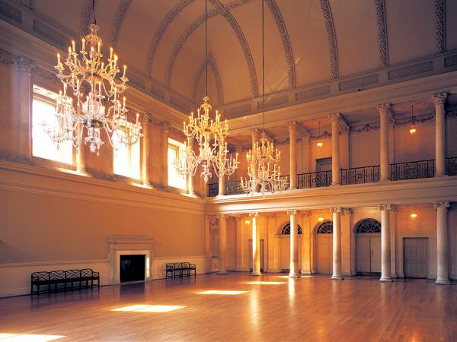
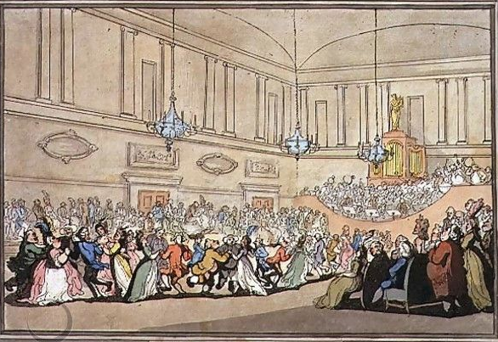
Notes:
The Assembly Rooms, Northanger Abbey
Pierce Egan, Walks Through Bath, 1819
Here, salutary rules exclude all those Whom no one hears of,
and whom no one knows;
That no plebian breathings may infect An atmosphere at all times so select;
No bankers’ clerks these splendid realms invade;
No FOLKS who carry on a retail trade;
No actors by profession must appear To act their parts, or speak their speeches here;
Yet even here, amid the crowds you view,
’Tis sometimes difficult to tell WHO’S WHO.”

Slide 6
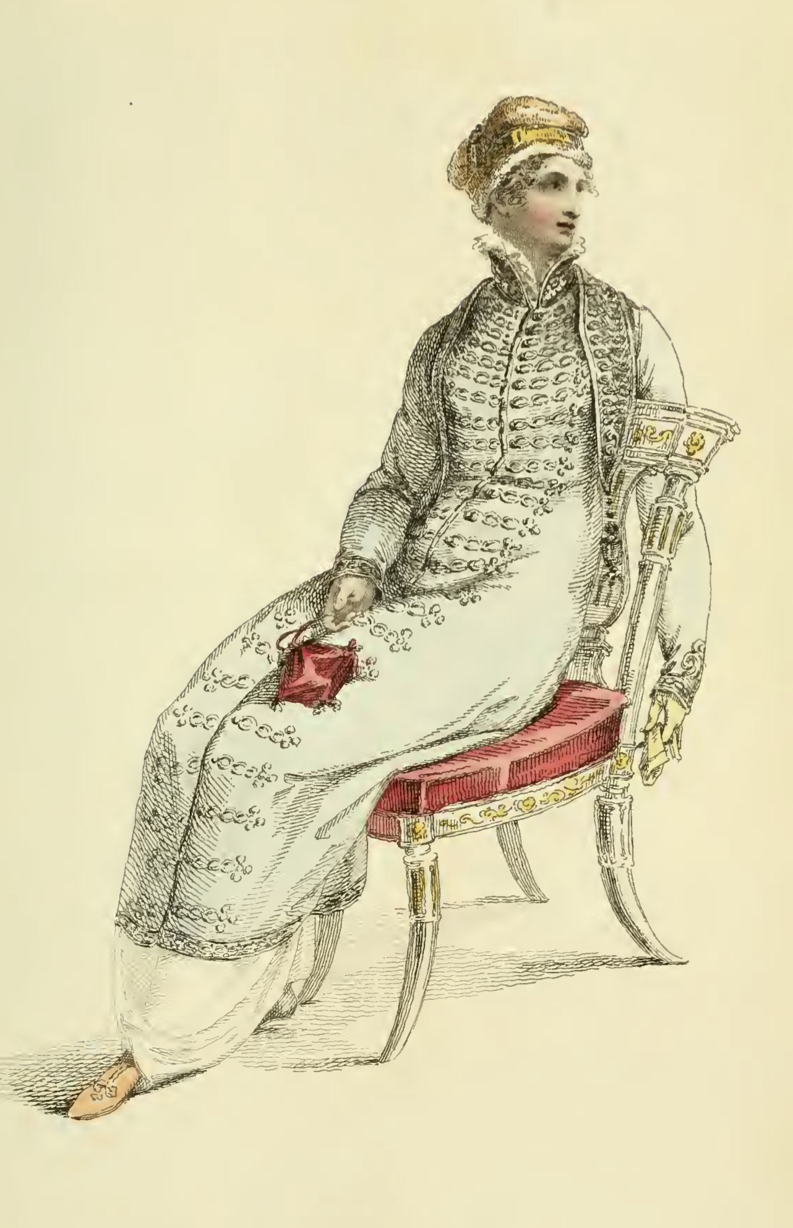
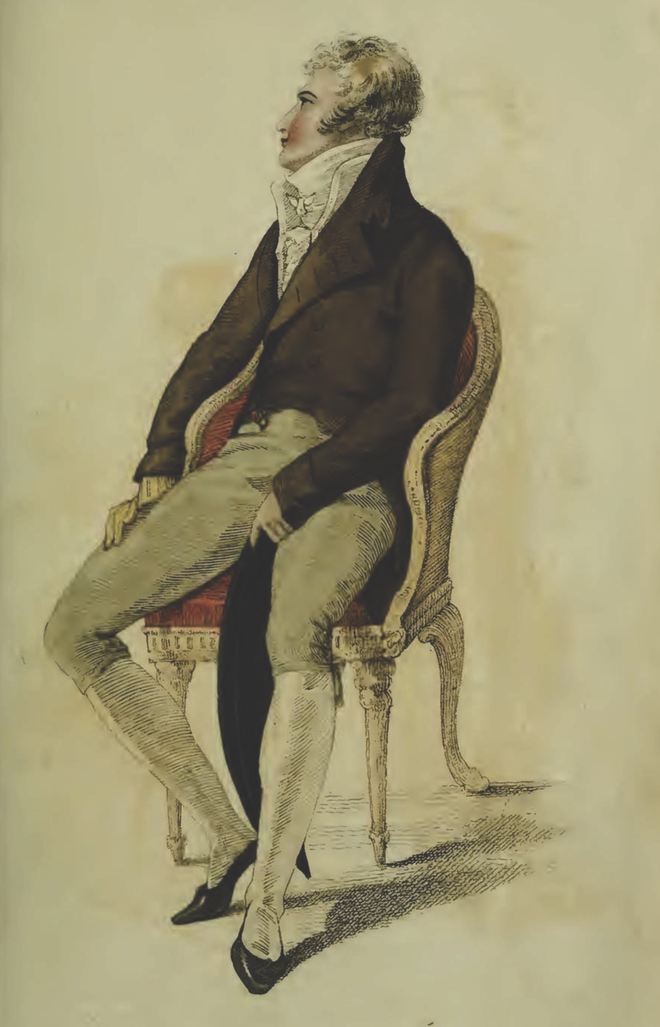
Ackermann, April 1810
Elizabeth Elliot of Lady Russel: “Something so formal and arrangé in her air! And she sits so upright!”
Notes:
The cues for the initiated were many: fashion certainly, but also specific manners, knowledgeable, or at least interesting, conversation, and grace in movement.
That elegance, that air was being redefined as something more “natural” in the years after the turn of the century as Elizabeth Elliot notes.
But it continued to be cultivated in years of dance lessons, or acquired more quickly once a fortune in textile manufacturing was made.

Slide 7
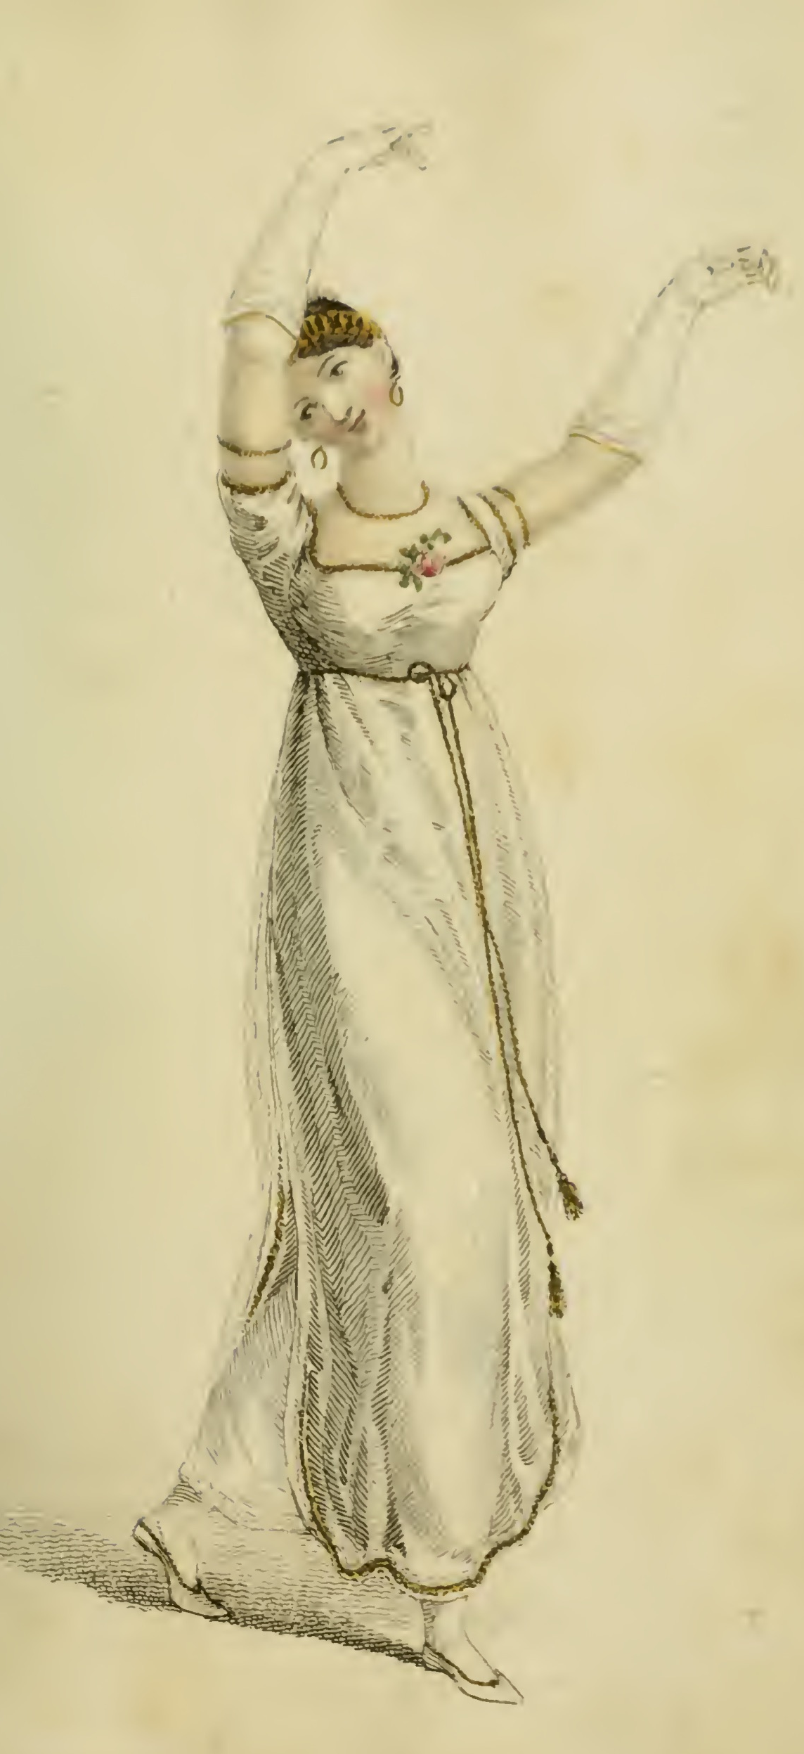
“…besides all this, she must possess a certain something in her air and manner of walking...”
Caroline Bingley, Pride and Prejudice
Ackermann, February1809
Notes:
As Caroline Bingley says, a true lady must have “a certain something in her air.” That grace of movement was cultivated in years of dance lessons (a requiredpart of an upper class education), or acquired more quickly once a fortune in textile manufacturing was made.

Slide 8
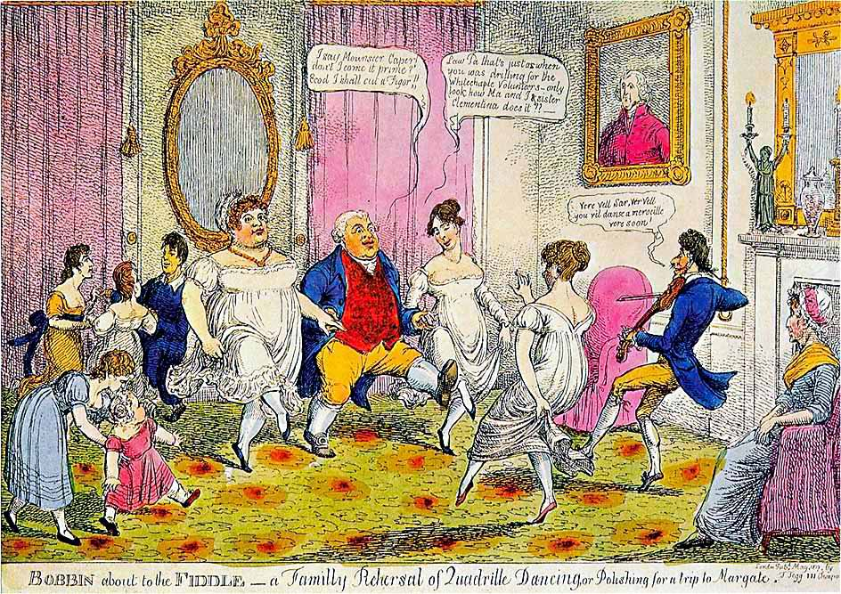
Notes:
Bobbin about the Fiddle – A Family Rehearsal of Quadrille Dancing, or Polishing for a trip to Margate.
“I say Monsouer Caper don’t I come it prime? Ecod I shall cut a figor!”
“Law Pa that’s just as when you was drilling for the Whitechapel Volunteers. Only look at how Ma and I and sister Clementina does it.”
“Ver vel sir, vere vel. You vil danse a merveileux ver soon.”
“The Season at Margate, for example, commenced on the King’s birthday, formally celebrated in June, and ended in late October, whereas Bath commanded the more fashionable months of October through May. The hours and pricing of the summer balls were usually different from those of the winter. ”
. “

Slide 9
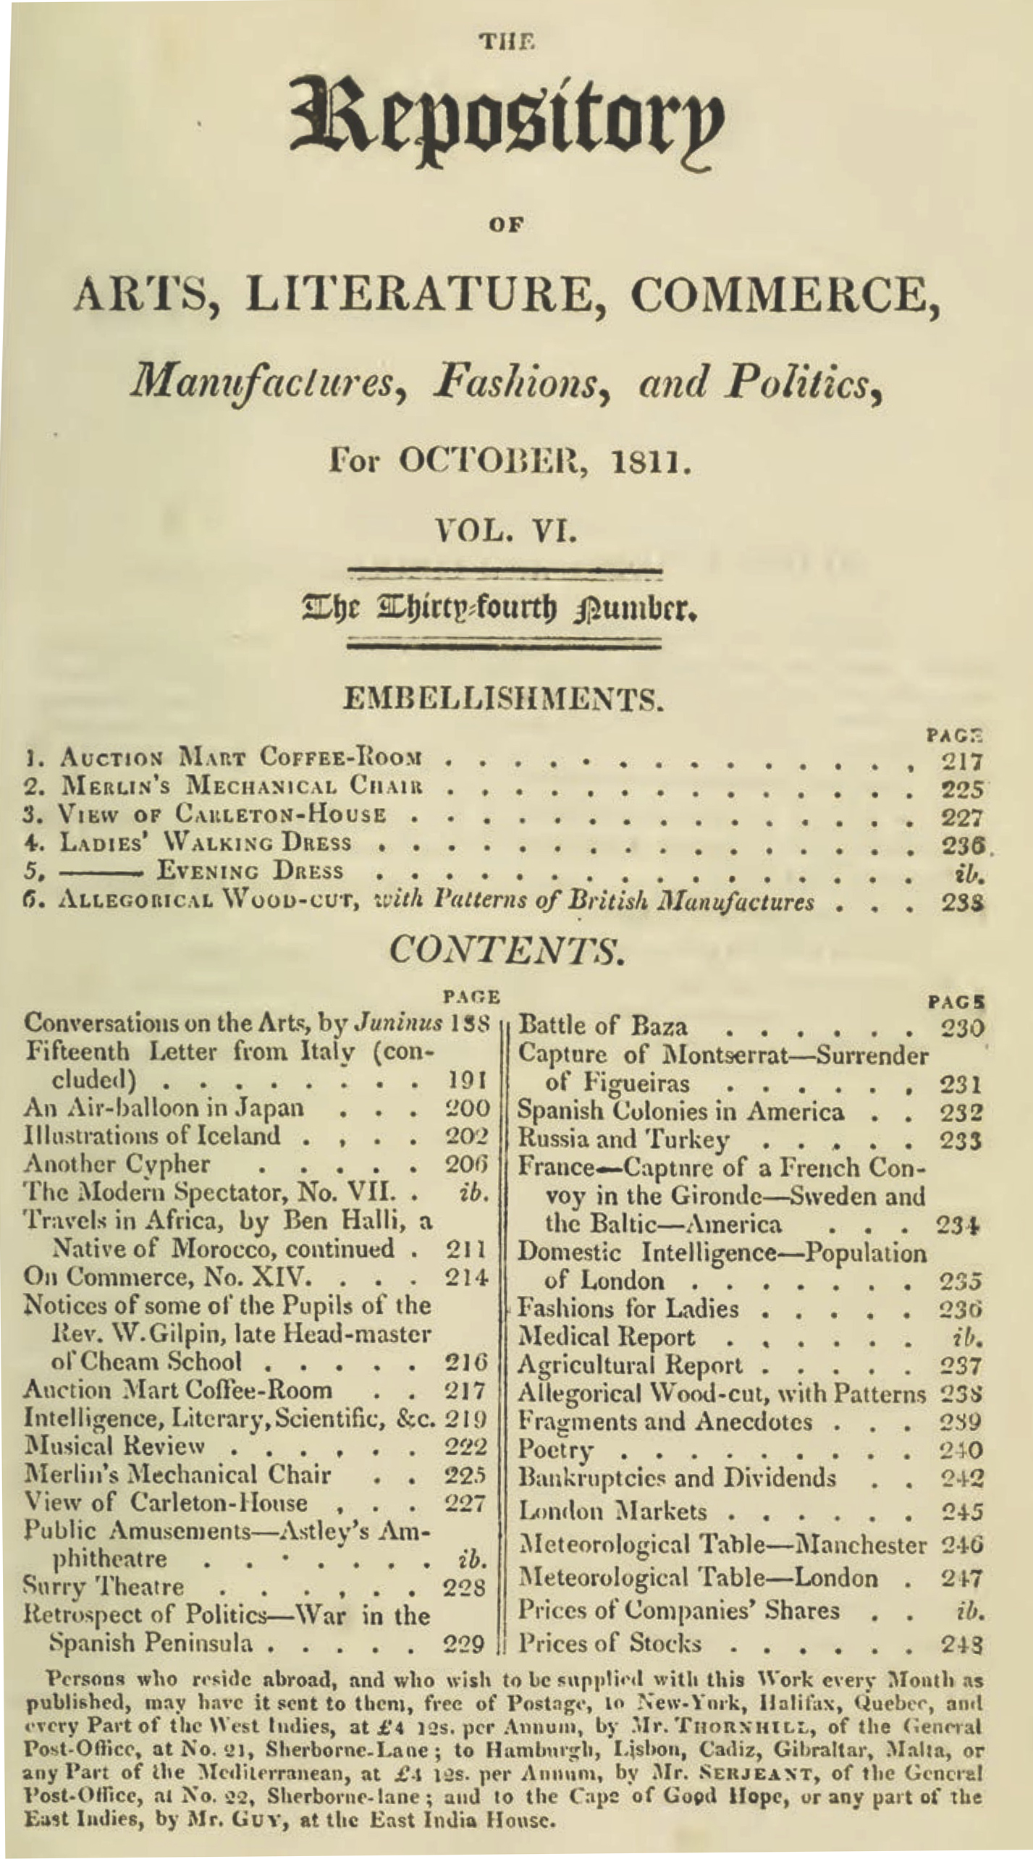
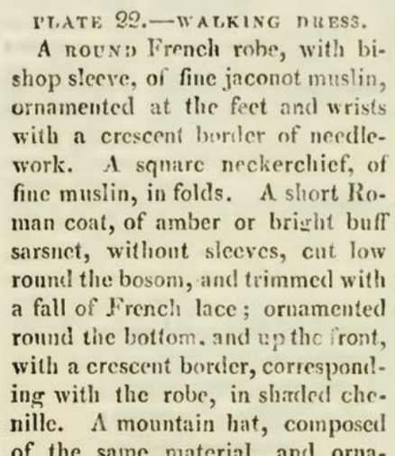
Ackermann’s Repository of the Arts. October 1811
Notes:
Keeping up with the subtle changes in the latest fashions was one way to indicate that you were among the genteel. As important, perhaps more important, was the ability to converse intelligently on a variety of topics. Both aspirations were served by magazines like
Ackerman’s, or to give it its full name “The Repository of Arts, Literature, Commerce, Manufactures, Fashions, and Politics” (it also included reviews of music and examples of furniture, interior design, and public buildings or businesses) provided hand-watercoloured fashion plates with specific descriptions, and general descriptions of fashion trends.

Slide 10
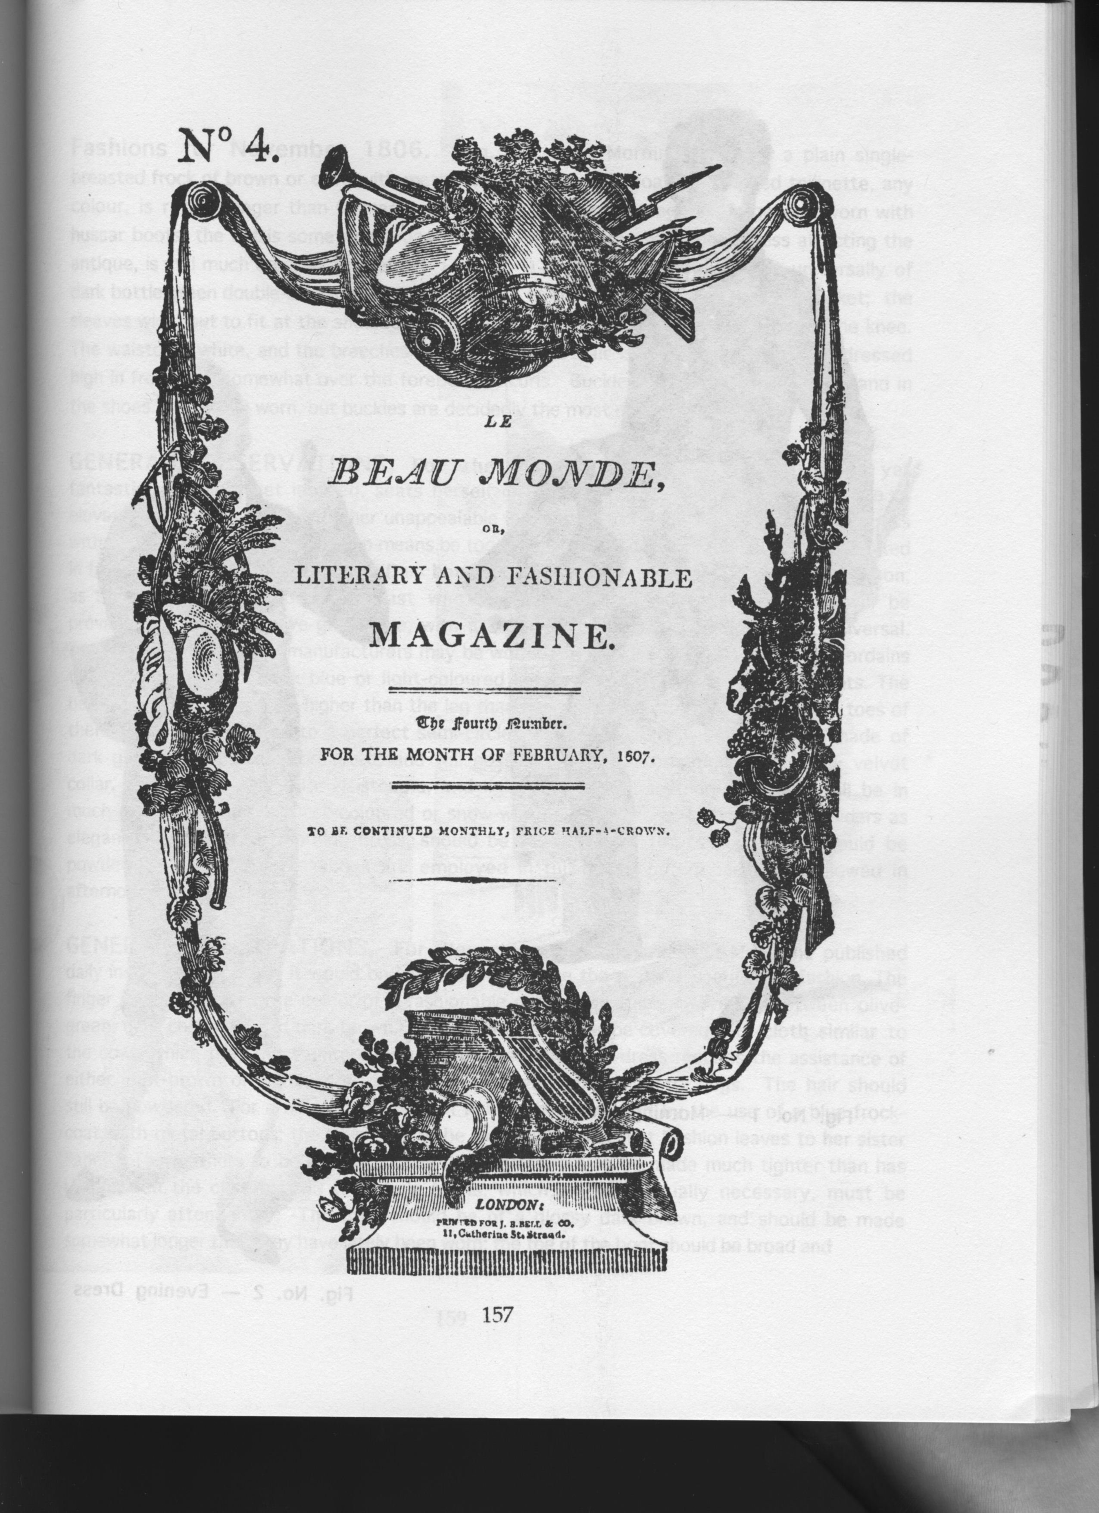

Slide 11
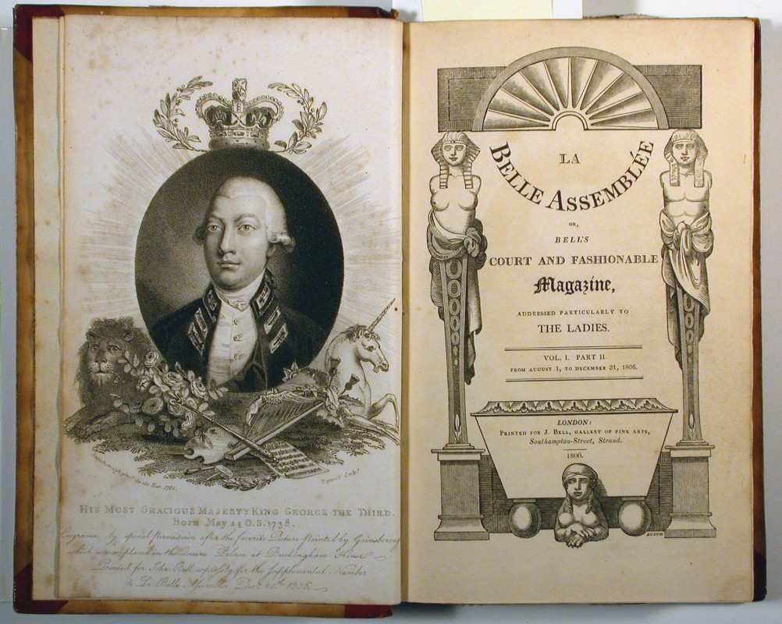
Notes:
La Belle Assemblée (which we know Fanny Knight received – at least, there is one issue of 1814 known to be hers),

Slide 12
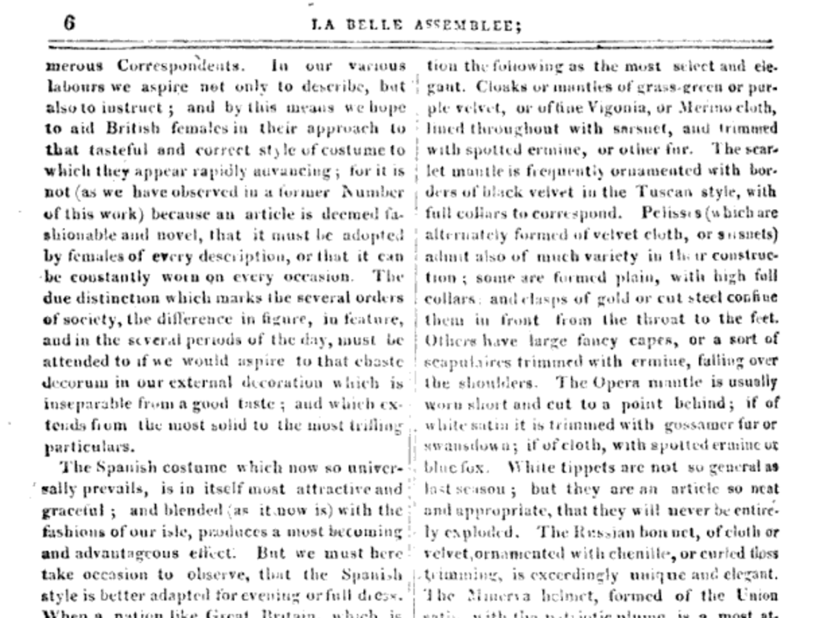
13 October 1808
“We must turn our black pelisses into new, for Velvet is to be very much worn this winter.”
“Pelisses, which are alternately formed of velvet or sarsnet, admit also of much variety in the constructions.”
La Belle Assemblée, October, 1808
Notes:
Austen frequently shows evidence, in her letters, that she was aware of, and assiduously adopting, the most recent fashion changes. When shesuggested that her velvet pelisse would remain fashionable with just a bit of alteration she would have been happy to have that confirmed in La Belle Assemblée in October 1808.

Slide 13
“Scissor edited” from October 1808 La Belle Assemblée
The Morning Chronicle (London, England), Tuesday, November 1, 1808
The Leeds Mercury (Leeds, England), Saturday, November 5, 1808
Jackson's Oxford Journal (Oxford, England), Saturday, November 5, 1808
The Examiner (London, England), Sunday, November 6, 1808
Trewman's Exeter Flying Post or Plymouth and Cornish Advertiser (Exeter, England), Thursday, November 10, 1808; Issue 2322
The Derby Mercury (Derby, England), Thursday, November 10, 1808; Issue 3990
Notes:
And even if she did not have access to that issue of the magazine, so-called “scissor editors” were happy to clip that description and include it in their weekly newspapers shortly thereafter. You can find the exact same description for the fashions in at least these six. Nor was this information limited to England. Ackermann’s could be subscribed to from cities around the world.

Slide 14
Interwoven Threads
Austen Era Changes:
(R)evolutionary
Terms and definitions
Letters:
Practical
Character sketch
Novels:
Described
Betrayed
Notes:
As we look at what we might call the interwoven threads of the Austen/fashion question there are several barriers to understanding that must be addressed. Her lifetime align with one of the most revolutionary period in fashion change.

Slide 15
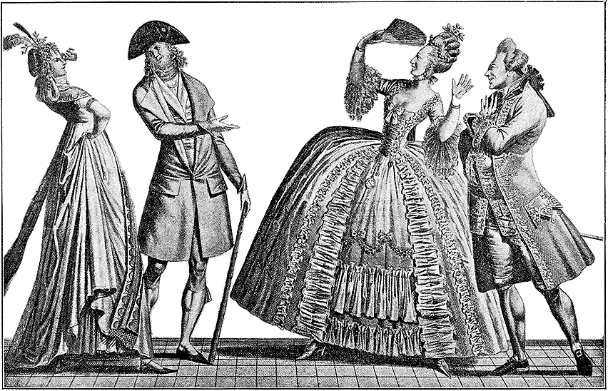
Notes:
A generational reaction of horror! In one generation we went from wide and heavy to narrow and light in an exceedingly short amount of time. But it didn’t stop there.

Slide 16
1775-1817
A fashion timeline
1775-1790: Formal, wide, natural waist
1789-1799: High waists and muslins, full
1800-1805: Greek and Roman, narrowing, vertical
1811-1814: “Gothic,” “Spanish,” “Polish,” “Russian” “Mary Queen of Scotts,” “Tudor/Elizabethan”
1815-1817: More trim top and bottom, wider hem
1820s: Waistlines drop, shoulders and skirts go wide
Notes:
covered one of the most tumultuous in fashion history.
Talk about volume – where’s the bulge – fashion silhouettes morph from vertical to horizontal to vertical and back, with an occasional foray into bustles.

Slide 17
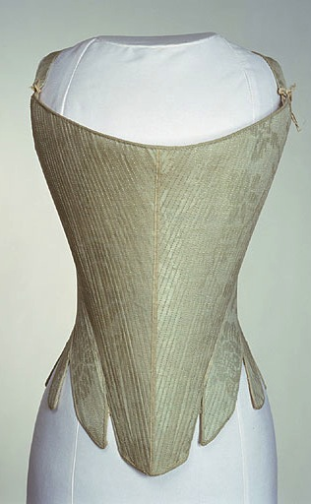
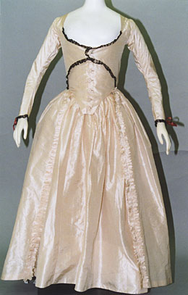
Early 1790s
Notes:
1790

Slide 18
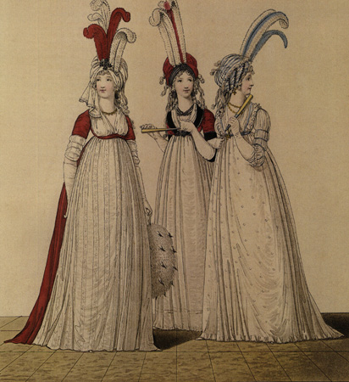
1790s: Big hats, big hair, big feathers
Notes:
When Austen was writing her early novels this is what she was seeing and wearing.
And note: when Henry Tilney imaginary journal article: “wore my sprigged muslin robe with blue trimmings—plain black shoes—appeared to much advantage”

Slide 19
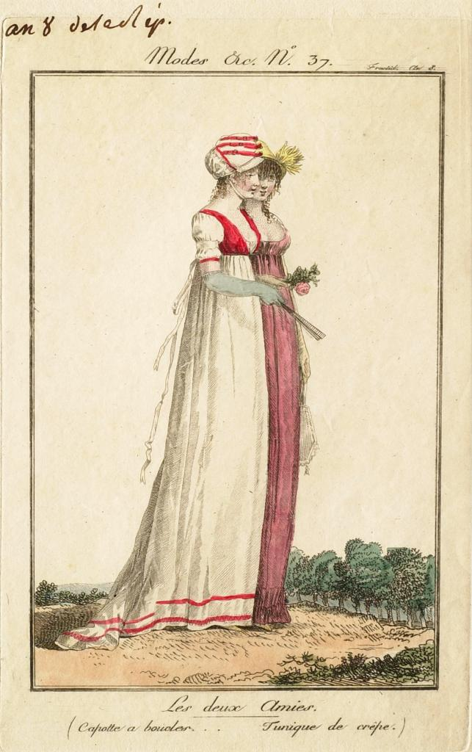
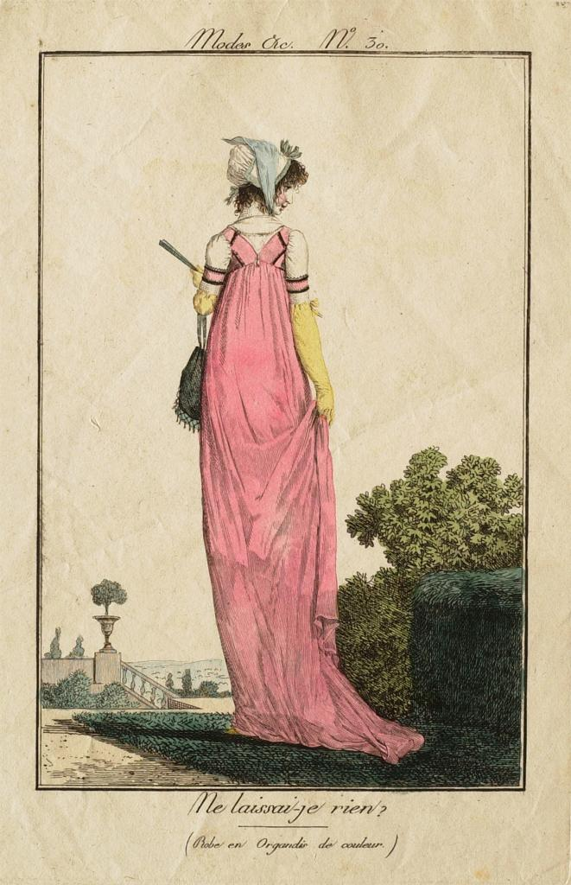
1800-1808: tall and narrow, less fabric, trains
Notes:
Still lots of fabric gathered at waist but the silhouette is definitely vertical, the greek column ideal
1) 1800-artstor-AMICO_CLARK_103902762
1) 1800-artstor-pinkback-AMICO_CLARK_103902764

Slide 20
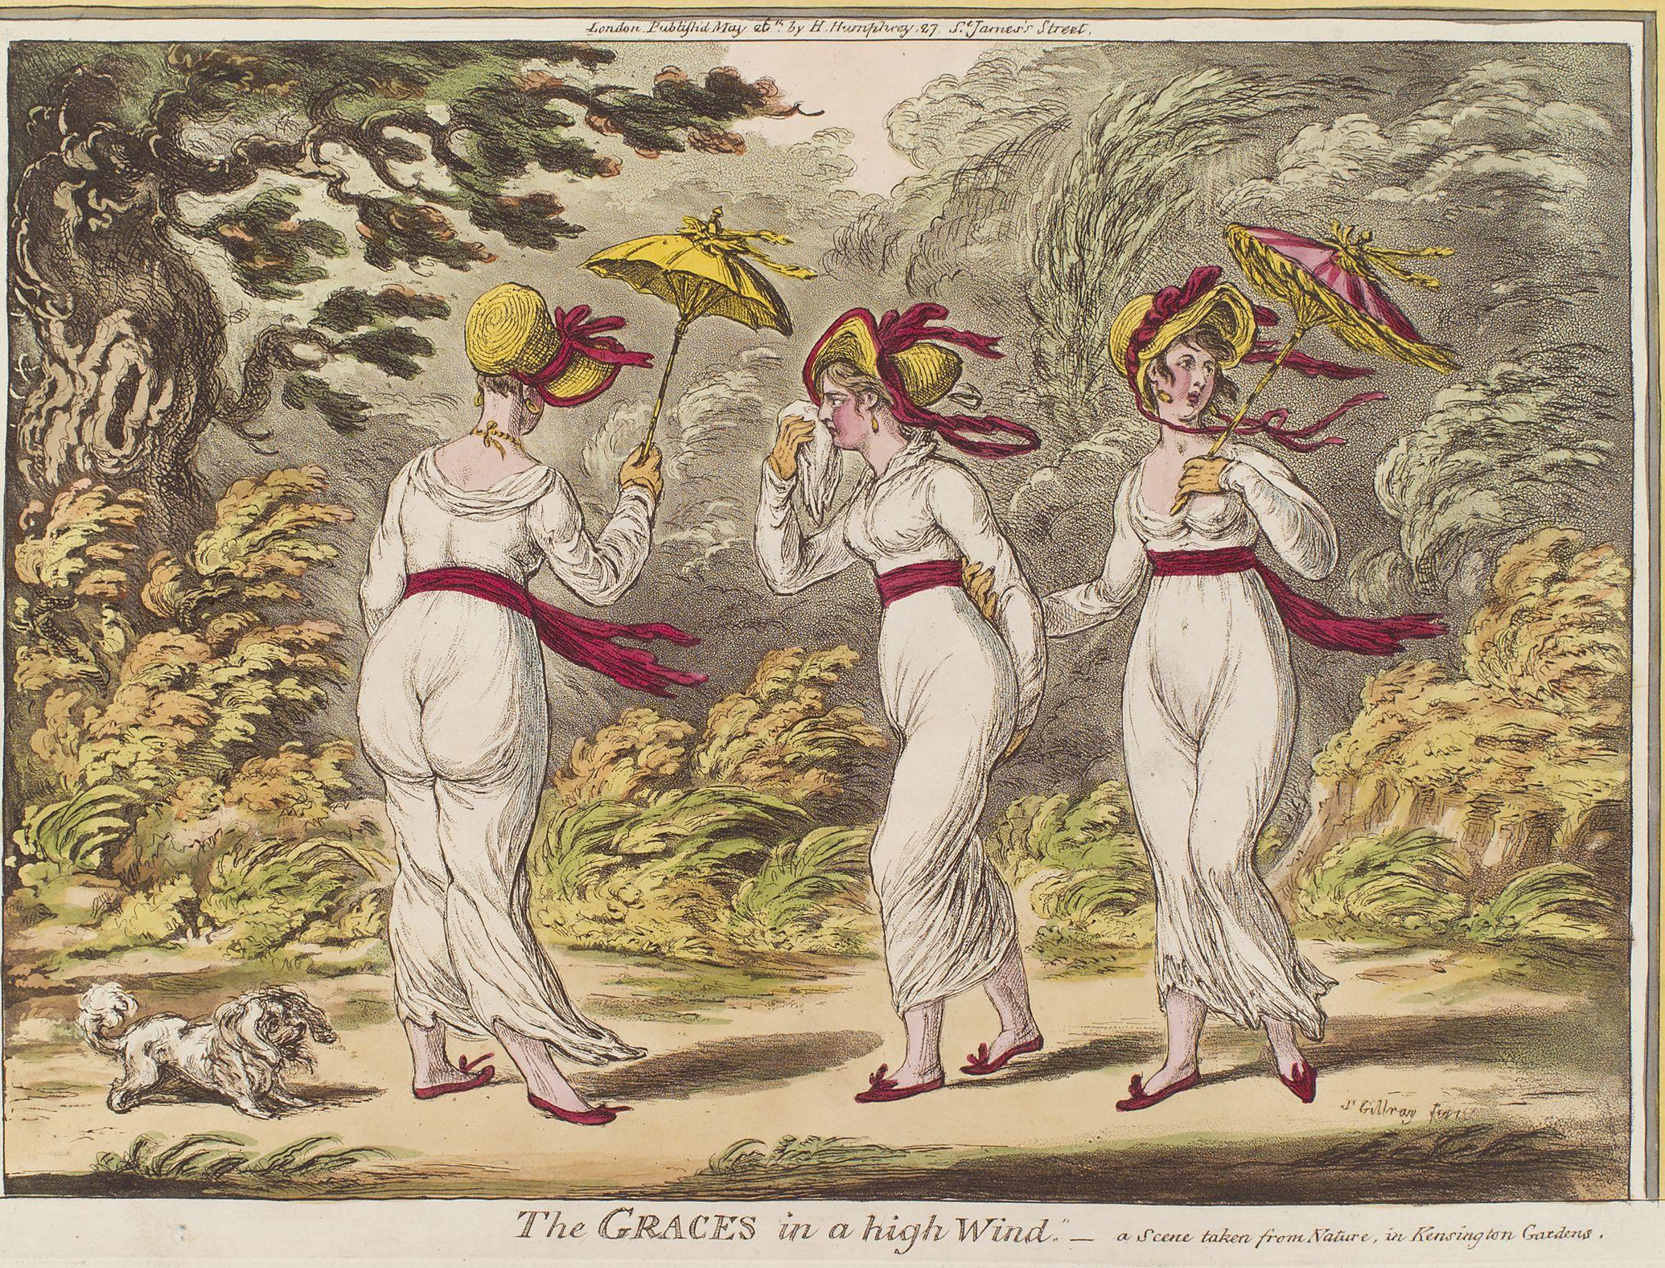
8 January 1801
Mrs. Powlett was at once expensively & nakedly dressed.”
Notes:
1810 “A scene taken from nature in Kensington Gardens” Gillray commenting on lightweight cotton and flimsy petticoats.

Slide 21
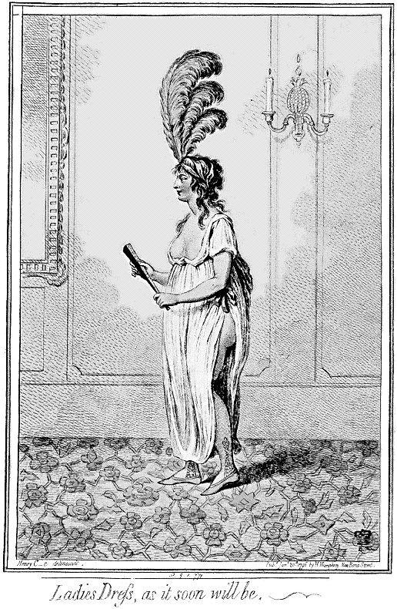
Notes:
James Gillray (1757-1815)

Slide 22
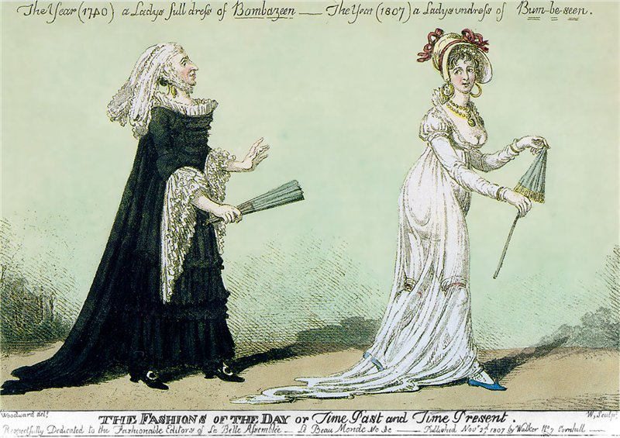
The year 1740, a Lady’s full dress of Bombazeen.
The year 1807, a Lady’s undress of “Bum-Be-Seen.”
Notes:
The year 1740 a Lady’s Full Dress of Bombazeen. The year 1807 a Lady’s Undress of Bum-be-seen (Full dress refers to formal dress, undress refers to daytime clothes but her it refers to rather more…or less as the case may be.

Slide 23
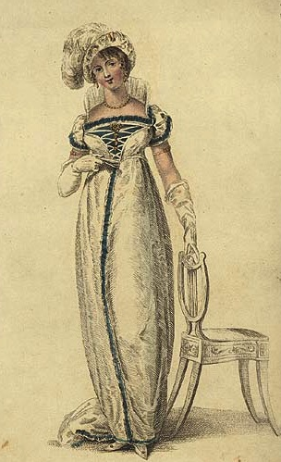
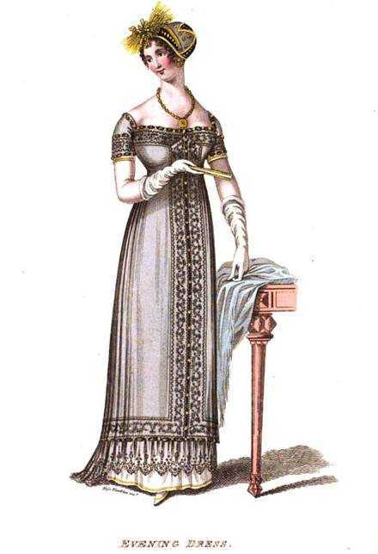
1809-10: Trains hang on in evening dress
Evening Full Dress, Ackermann, January 1809
Notes:
Ackermann, Jan. 1809: White satin Spanish hat, diamond loop, Spanish plume, diamond ear-rings and necklace…lace medicis around the back, antique stomacher ornamented with diamons mounted in gold
La Belle Assemblée, Dec. 1810

Slide 24
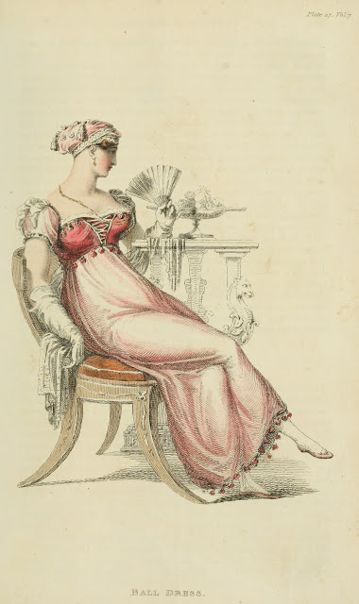
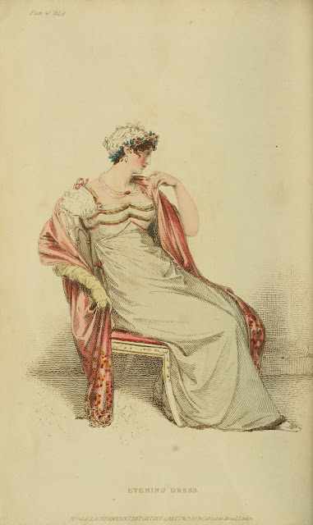
1813: Emphasis shifting to bodice
Notes:
By 1813 the emphasis is shifting to the bodice. The vertical line disappears from the skirt and the bodice gets the eye-catching trim
1) Ackermann, April, 1812
2) Ackermann, Dec. 1812

Slide 25
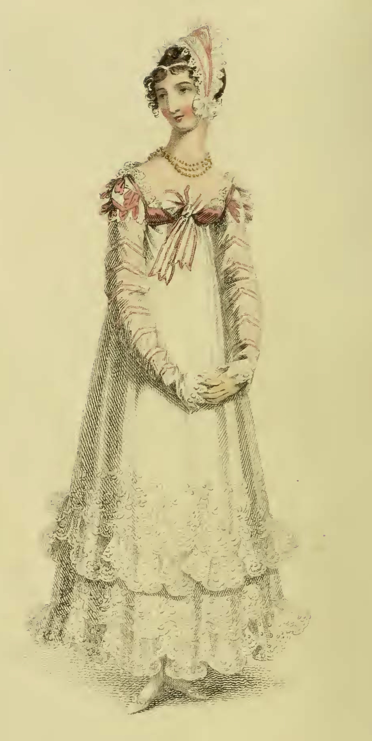
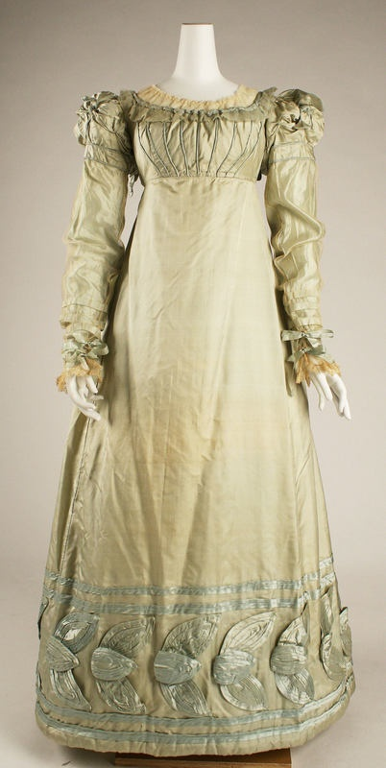
Ackermann, November 1817
Met Museum, c. 1820, American

Slide 26
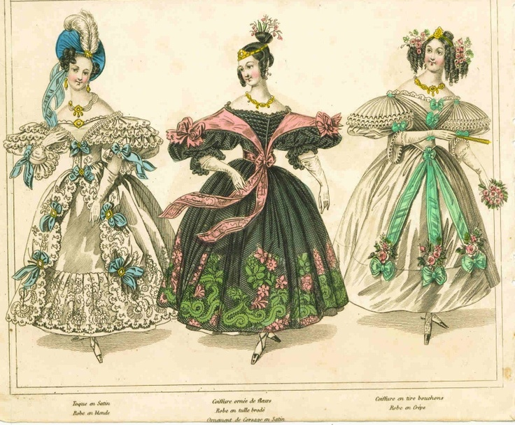
Notes:
1830s – super horizontal, bodice and skirt. Even the hair is horizontal. This shape will be toned down in the 1840s with sleeves narrowing but once the crinoline comes into fashion skirts will attain crazy widths but retain the 1830s bell shape

Slide 27
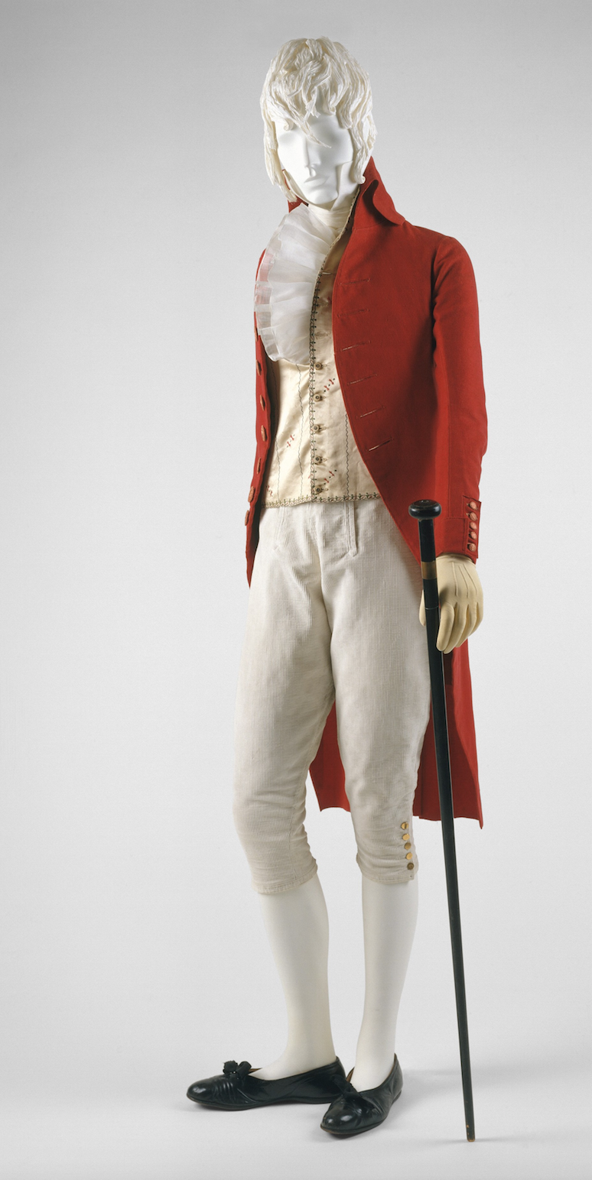
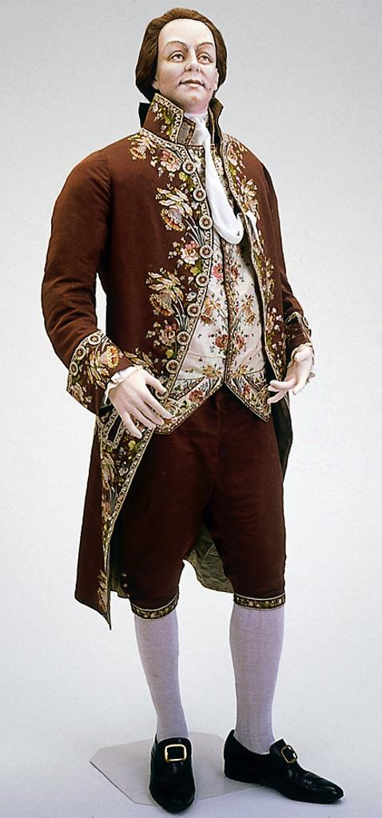
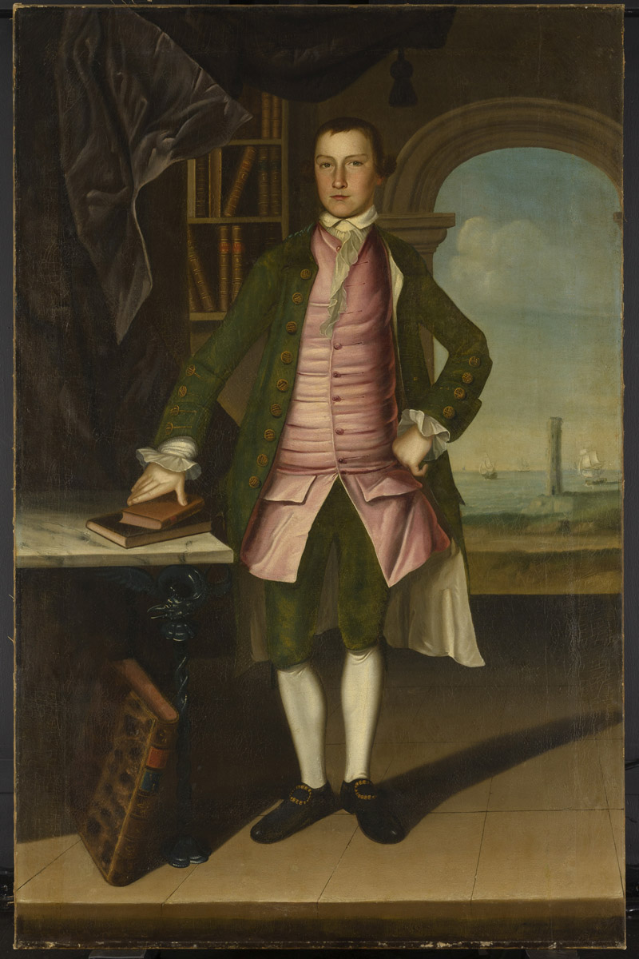
What did men wear?
1790s
1780s
1760s
.
Notes:
Anglomania: the simple, restrained, tailored cut. Those changed in shape and volume throughout the period. a waistcoat that would act as a body-shaping or posture garment he was considering the earlier example. When he talks about a new freedom of movement and ease at the end of the century it is more like the latter.

Slide 28
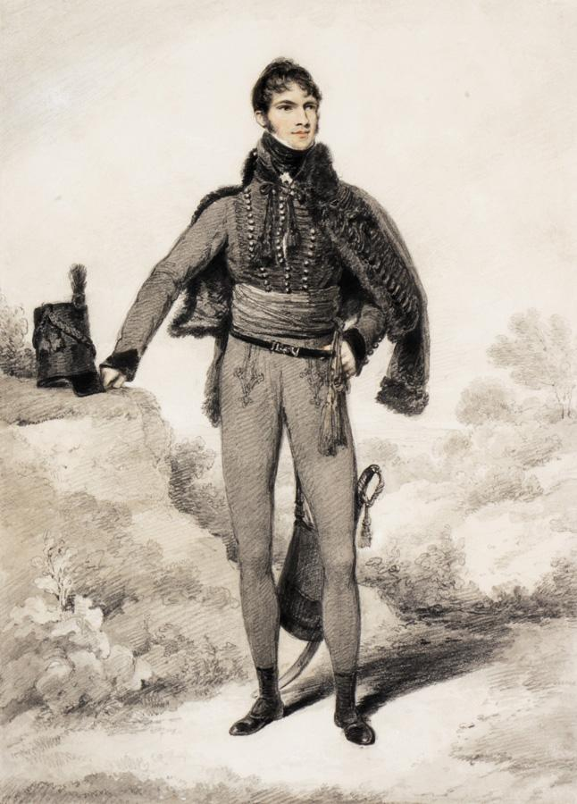
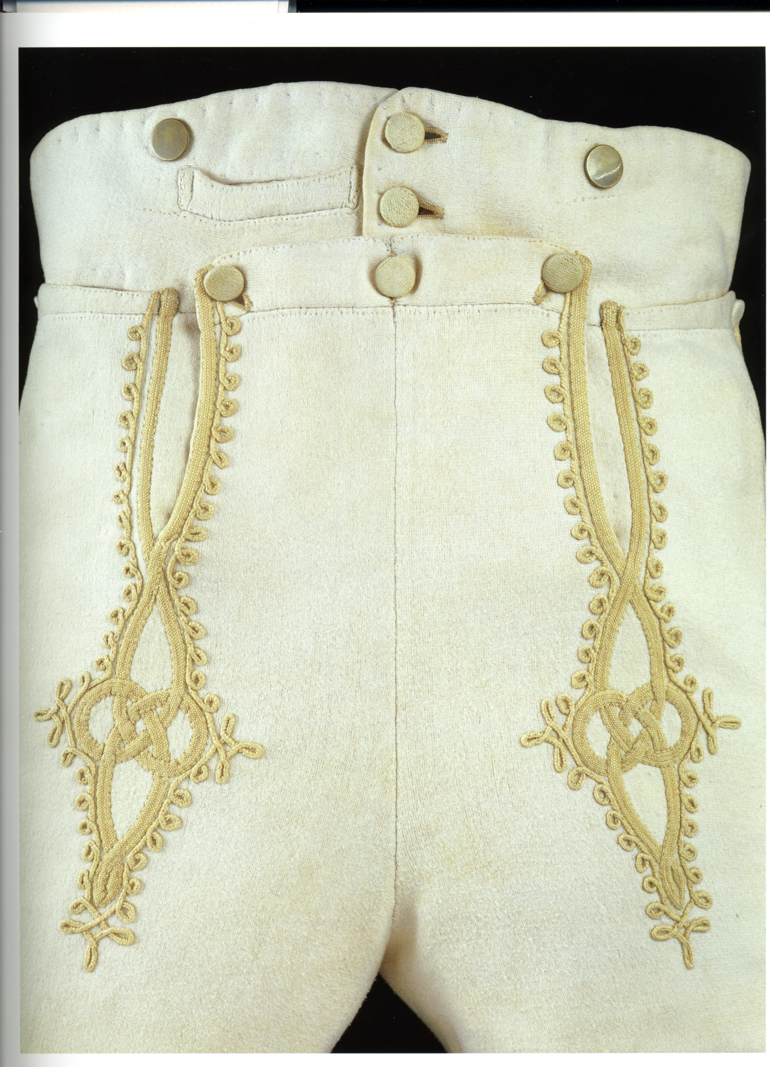
Notes:
Remember: England was at war for almost all of Austen’s life.
Sir William Harbord, 1810 by Edridge, The other major influence on men’s fashion: military pantaloons – wool knit to cling and stretch.
Brummel – Prince Regent’s regiment – consulted on uniform: The 10th Royal Hussars (Prince of Wales's Own) was a cavalry regiment of the British Army from 1715 to 1969.

Slide 29
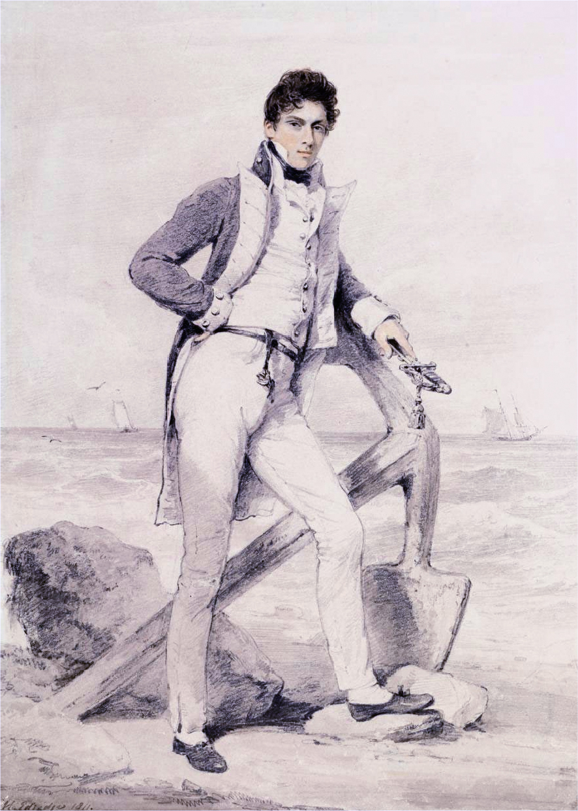
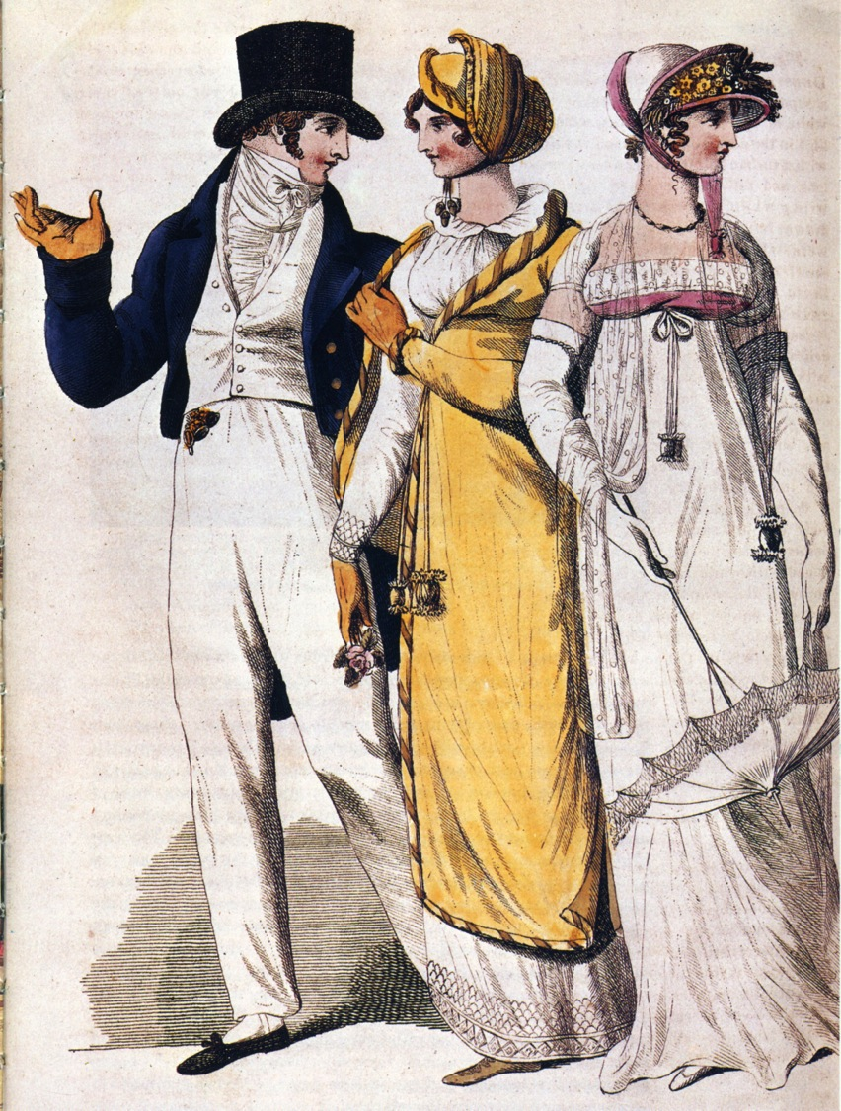
Notes:
And she had brothers in the Navy
Captain Hoste 1811 by Edridge. Sailor’s trousers
People in park, 1807. The young man shows nautical influence - adopts the Navy uniform look.

Slide 30
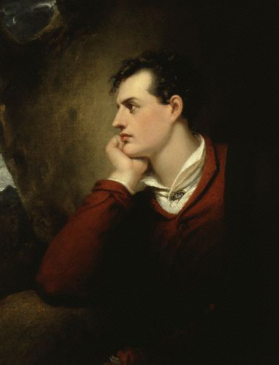
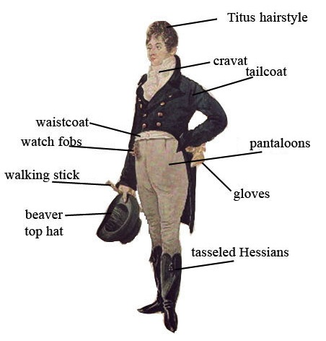
Notes:
1805 Dighton caricature – blue superfine (wool) coat, pantaloons,

Slide 31
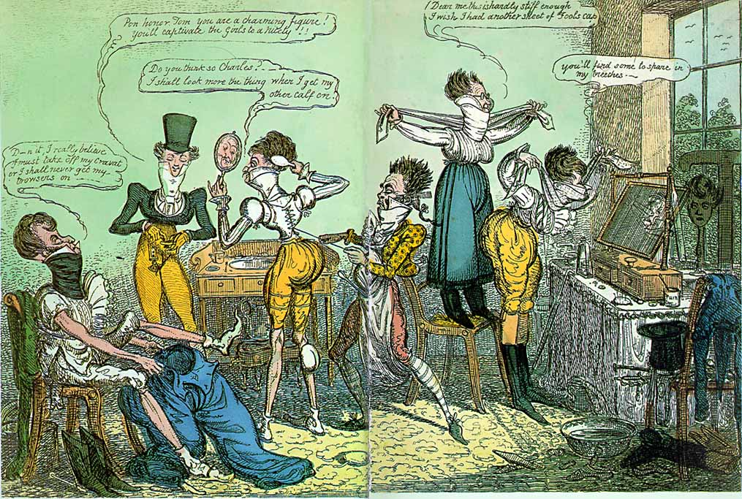
Notes:
1818 Cruickshank
“Dammit I really believe I must take off my cravat or I shall never get my trwosers on…”
“Pon honour Tom, you are a charming figure! You’ll captivate the girsl to a nicety!!”
“Do you think so Charles? I shall look more the thing when I get my other calf on.”
“Dear me, this is hardley stiff enough. I wish I had another sheet of foolscap.”
“You’ll find some to spare in my breeches.”

Slide 32
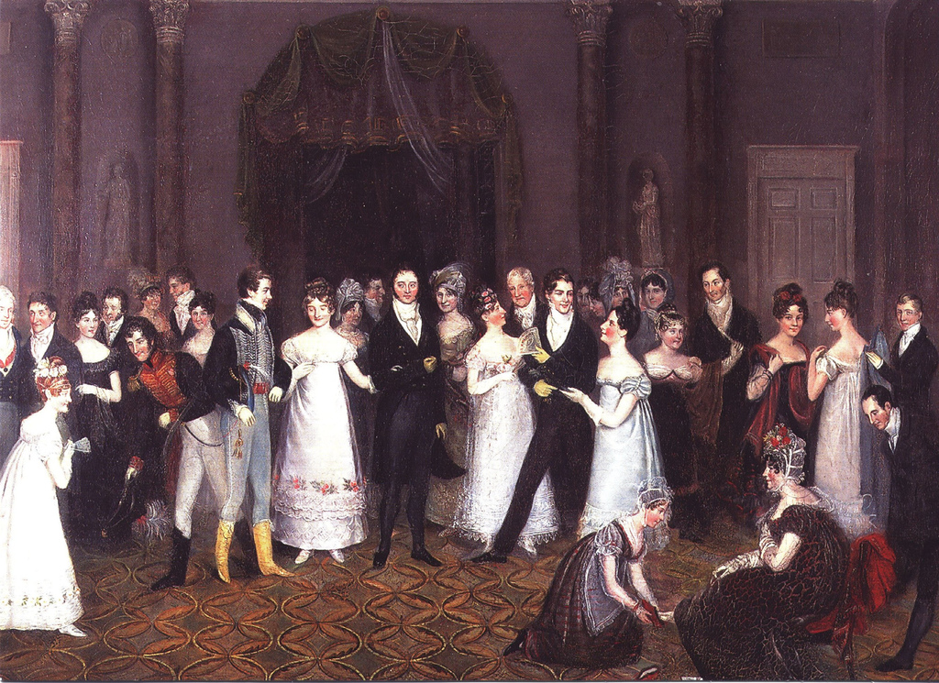
Notes:
Rolinda Sharples “The Cloak Room at the Assembly Rooms at Clifton”1818: Sharples shows examples of all mens options. The older gentleman on the left wears grey/light silk breeches, the army men are in their uniforms with pantaloons, the thirty-something husband in the middle wears black breeches while the young flirt wears trousers. Also note the impossibly tiny bodices on the women’s gowns. For more on Clifton Assembly see http://www.thespasdirectory.com/profilego.asp?ref=2841393B

Slide 33
Why?
Was it the Greek statues?
Was it Marie Antoinette?
Was it the French revolution?
Was it the Indies (East and West)?
Was it new technology?
Was it politics and globalization?
Was it the price of muslin?
Notes:
But the greatest change to note was that to muslin – not American – this is mull
England – wool, Greek drapery, American egalitarianism, French freedom and egalite, West Indies – slave cotton and indigo, East Indies – true Indian muslins (Bangladesh suppression), better thread, better weaving, better quality, cheaper to produce.

Slide 34
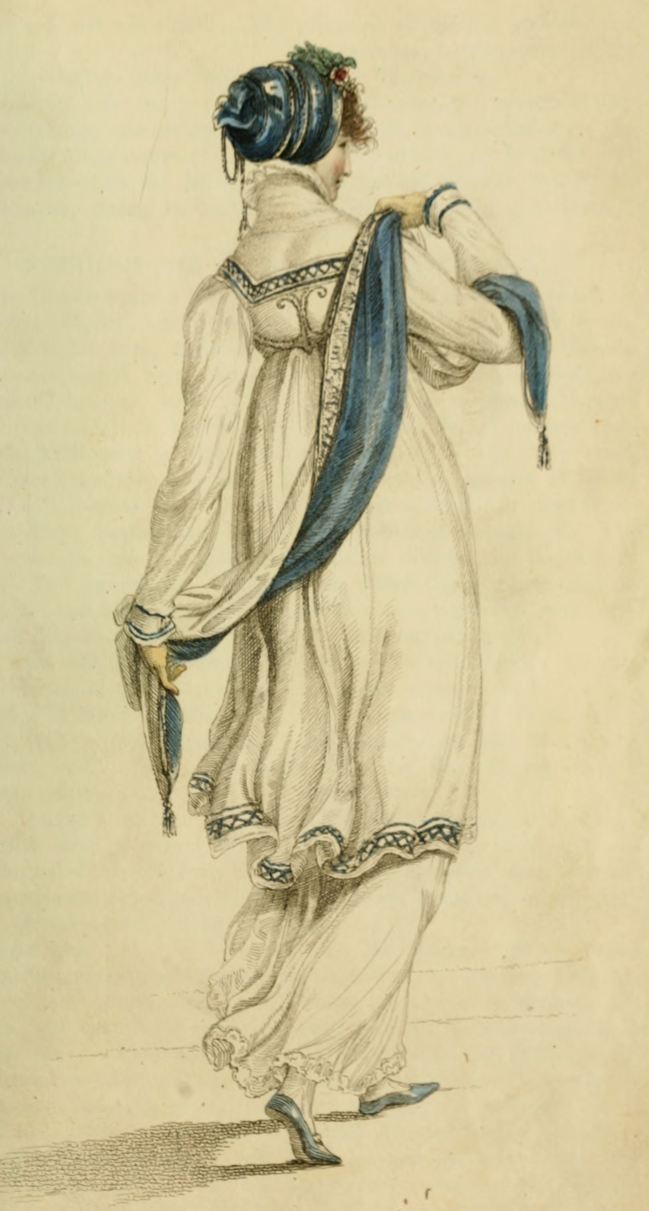
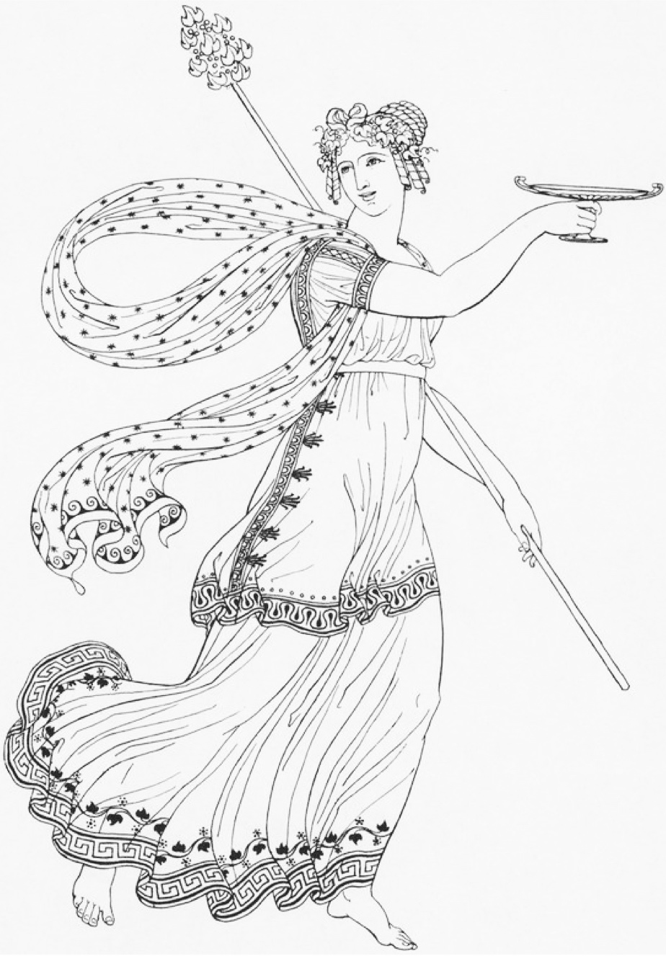
Ackermann, Walking Dress, April 1809
Thomas Hope, Ancient Costumes, 1809

Slide 35
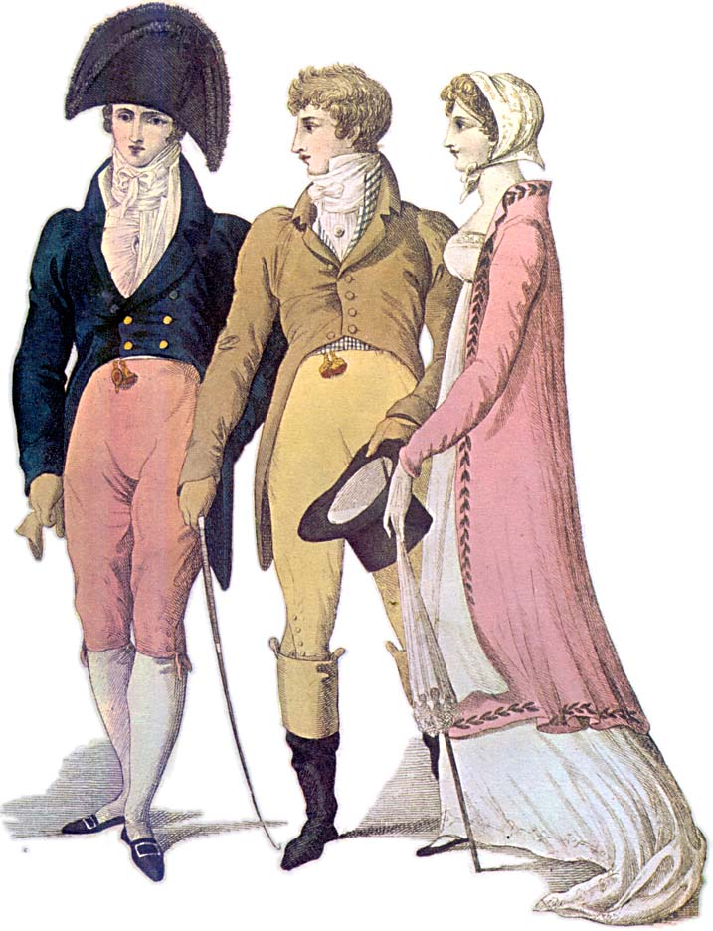
Notes:
1809 – cutaway, swallow-tail, classical statues – the nude male vs. the draped female

Slide 36
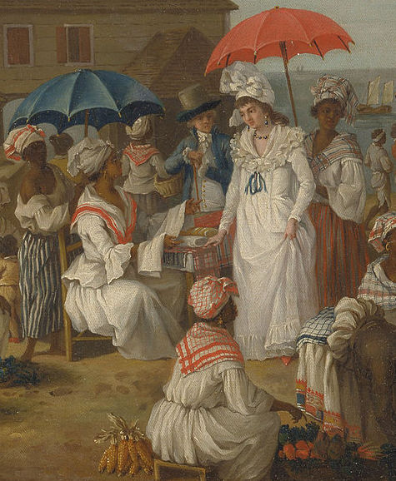
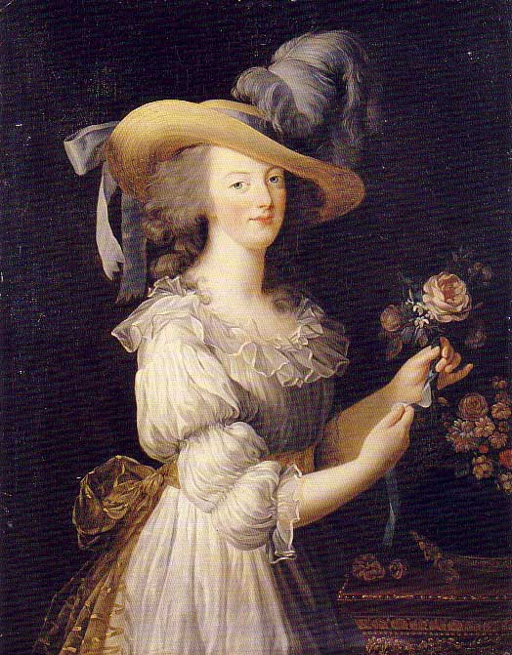
Agostino Brunias, c. 1780 “Linen Day, Roseau, Dominica”
Marie Antoinette’s “chemise dress” Portrait by Elisabeth Louise Vigée-LeBrun, 1783, dress by Rose Bertin
Notes:
Globalization of textile manufacture: raw cotton from the Americas, muslin/mull from India dyed white with indigo from the West Indies, then turned into a gown by Marie Antoinette’s dressmaker Rose Bertin, adopted shortly thereafter by Georgina, Duchess of Devonshire (1784). But as Jane Ashelford reminds us, the narrative of French women throwing off their clothes and wearing undergarments inspired by neoclassicism is appealing but simplistic. The impact of Georgiana's revolutionary trip to the concert and the association of the chemise with Marie Antoinette and the West Indies complicate less nuanced accounts.

Slide 37
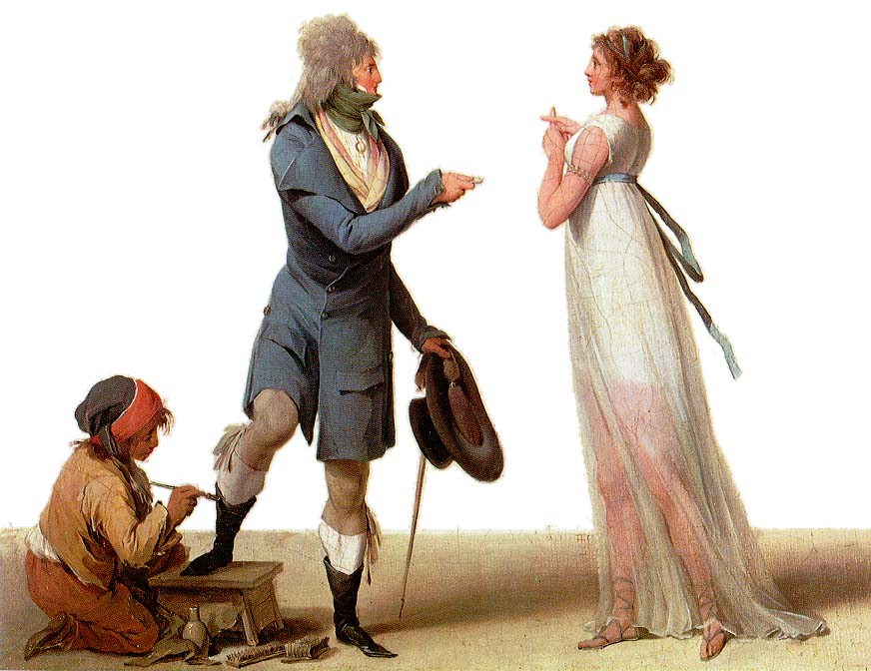
Notes:
Boilly Les Incroyables
A cartoon, not a realistic depiction

Slide 38
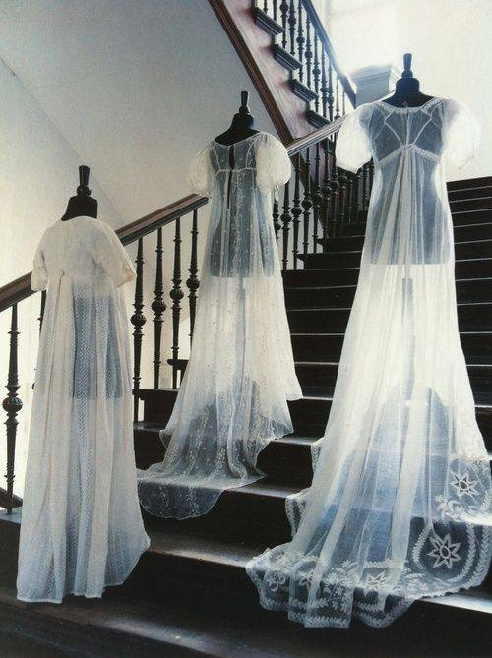
“…a true India muslin...”

Slide 39
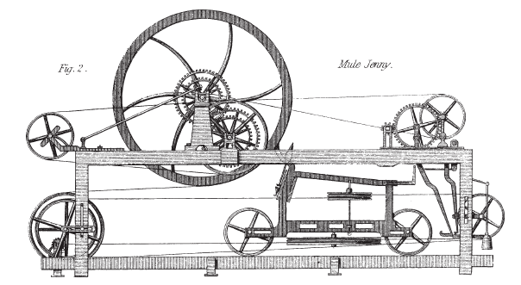
James Crompton, Spinning mule, 1770s
Claude Berthollet, liquid bleach, 1780s
Charles Taylor, 1788 “calico…bleached white, printed in permanent colours, having undergone all these operations in less than 48 hours
Notes:
The only sensible answer is “all of the above”

Slide 40
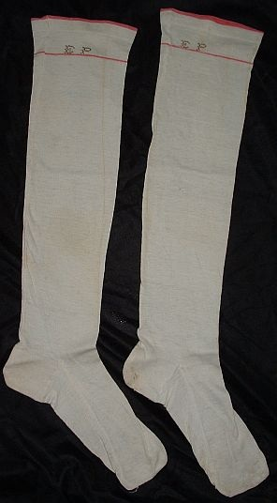
9 January 1796
“You say nothing of the silk stockings; I flatter myself, therefore, that Charles has not purchased any, as I cannot very well afford to pay for them…”
14 January 1796
“What a good-for-nothing-fellow Charles is to bespeak the stockings—I hope he will be too hot all the rest of his life for it.”

Slide 41
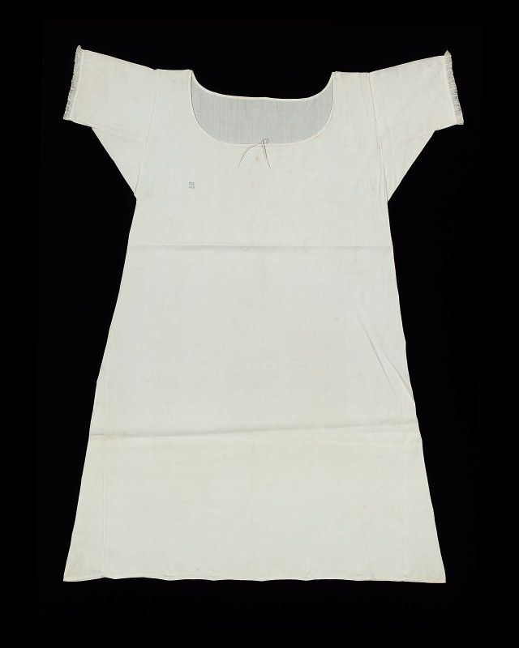
25 November 1798
“The Overton Scotchman [a peddler carrying fabric for sale door to door] has been kind enough to rid me of some of my money, in exchange for six shifts and four pair of stockings. The Irish [linen] is not so fine as I would like it; ... It cost me 3s. 6d. per yard. It is rather finer, however, than our last, and not so harsh a cloth.”
Notes:
“six shifts” i.e. enough fabric to make them, not ready made.
21 shillings for Emma = about $95 in 2011 so 3s 6d is about $14/yd.
20 shillings in a pound, 12 pence in a shilling
Dr. Eric Nye - http://uwacadweb.uwyo.edu/numimage/currency%20conversion.htm “A Method for Determining Historical Monetary Values”
La Belle Assemblée, Feb 1806, p. 15:
The Ladies Toilette, or Encyclopedia of Beauty
Of cleanliness--…A careful attention to the person, frequent ablutions, linen always white, which never betrays the inevitable effect of perspiration and of dust; a skin always smooth and brilliant, garments not soiled by any stain, and which might be taken for the garments of a nymph; a shoe which seems never to have touched the ground; this it is what constitutes cleanliness. To this might likewise be added a scrupulous care to avoid every thing that can indicate functions which undeceive the imagination.

Slide 42
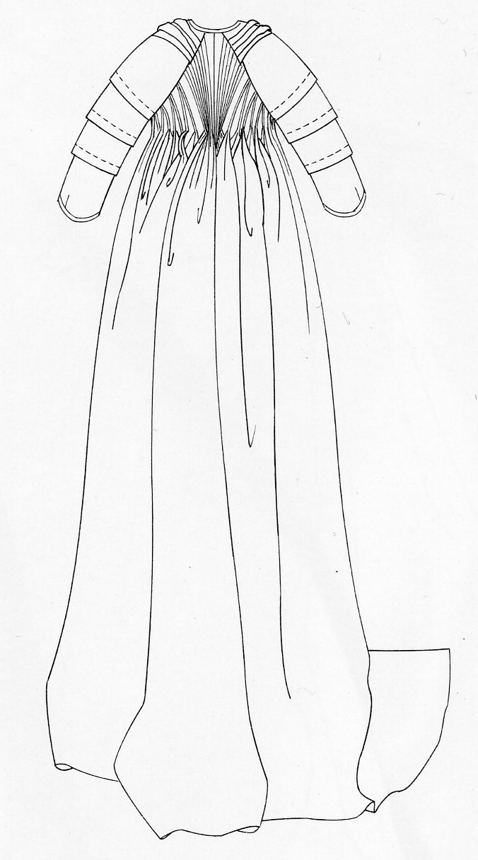
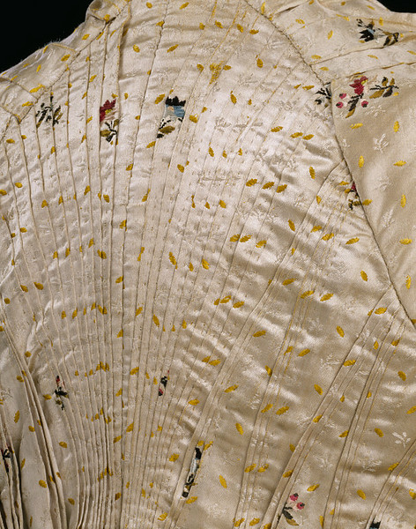
18 December 1798
“I believe I shall make my new gown like my robe, but the back of the latter is all in a piece with the tail, and will seven yards enable me to copy it in that respect?”

Slide 43
30 June 1808
“What cold disagreeable walks…My kerseymere Spencer is quite the comfort of our Evening walks.
Notes:
Afternoon Dress – Walking Dress – Promenade - Carriage Dress: Spencers, named after Lord Spencer, were short jackets, often military-inspired. In recent movies there seems to be a trend to make them shorter in the back than the gown they are being worn with, i.e. hem is above the waistline of dress. I’ve never seen any pictured this way so it looks odd to me.

Slide 44
18 April 1811:
“Our pelisses are 17s. each; she charges only 8s. for the making, but the buttons seem expensive, — are expensive, I might have said, for the fact is plain enough.”
Notes:
Ackermann, March 1809

Slide 45
8 January 1799:
“I am not to wear my white satin cap to-night, after all; I am to wear a mamalone [mameluke] cap instead…It is all the fashion now; worn at the opera, and by Lady Mildmays at Hackwood balls.”
(After Napoleon defeated the Mamelukes at the Battle of the Pyramids, July 1798.)
Notes:
Warrior caste in Egypt defeated by Napoleon at the Battle of the Pyramids, 1798 “On July 1, 1798, Napoleon landed in Egypt with 400 ships and 54,000 men and proceeded to invade the country, as he had recently invaded Italy. But this Egyptian invasion was to be different. For, in addition to soldiers and sailors, Napoleon brought along 150 savants — scientists, engineers and scholars whose responsibility was to capture, not Egyptian soil, but Egyptian culture and history.” The ladies picked up the turban almost immediately.
In former ages it seemed requisite that every lady should cut out her garments by a certain erect standard. ..But in our days, an English woman has the extensive privilege of arraying herself in whatever garb may best suit her figure or her fancy. The fashions of every nation and of every era are open to her choice. One day she may appear as the Egyptian Cleopatra, then a Grecian Helen; next morning the Roman Cornelia; or, if these styles be too august for her taste, there are Sylphs, Goddesses, Nymphs of every region, in earth or air, ready to lend her their wardrobe.
Mirror of Graces, 1811 (p. 52)

Slide 46
13 September 1813
I learnt from Mrs. Tickars's young lady, to my high amusement, that the stays now are not made to force the bosom up at all; that was a very unbecoming, unnatural fashion. I was really glad to hear that they are not to be so much off the shoulders as they were.
Ackermann, January 1813

Slide 47
Notes:
Corset and stockings, two layers of linen, channels of baleen or cord, single spiral laced, busk (thin wooden stick about 1-2”wide – great for posture)

Slide 48
Austen, Thursday, 20 November 1800:
“Miss Debary, Susan, and Sally, all in black, but without any statues, made their appearance…”
Notes:
1819, 1810, 1816. Women in mourning were typically depicted draped over urns, statues, tombstones…The broach is a piece of hair jewelry – the weeping willow is made of hair. There were several royal deaths in the years after Austen’s death so fashion magazines provided suitable clothing.

Slide 49
2 June 1799
“My cloak is come home & here follows the pattern of its lace.”

Slide 50
Ackermann, March 1809, Harding , Howell, & Co., 89 Pall Mall
24 May 1813
I went the day before (Friday) to Layton's as I proposed, and got my mother's gown, — seven yards at 6s. 6d.

Slide 51
2 September 1814
I am amused by the present style of female dress;—the coloured petticoats with braces over the white Spencers & enormous Bonnets upon the full stretch, are quite entertaining. It seems to me a more marked change than one has seen lately…Petticoats short, & generally, tho’ not always, flounced.
(sending news of the London fashions to Martha Lloyd in Bath)

Slide 52
Ackermann, August 1814
Ackermann, October 1814
Notes:
2 September 1814
I am amused by the present style of female dress;—the coloured petticoats with braces over the white Spencers & enormous Bonnets upon the full stretch, are quite entertaining. It seems to me a more marked change than one has seen lately…Petticoats short, & generally, tho’ not always, flounced.

Slide 53
“six inches deep in mud”
Notes:
Unlike the ornate petticoats of the earlier 18th cent, turn of- and early 19th century petticoats were sometimes meant to be seen, sometimes not. Portrait-1804?

Slide 54
Austen, Thursday, 1 September 1796:
“We are very busy making Edward’s shirts, and I am proud to say that I am the neatest worker of the party.”
Notes:
While many people had their clothing made by tailors (men’s clothing but also women’s riding habits) or modistes/dressmakers, people often made or at least trimmed and finished, their own. But shirts and shifts were usually made by the women in the family. The cut was simple and extremely economical, using all the width of the linen. The “workbasket” was always to hand with shirts/shifts to be sewn. And when staying with friends one could always bring a work-bag for smaller needlework projects.

Slide 55
A Brief Diversion: Work
[Lady Middleton] saw their sashes untied, their hair pulled about their ears, their work-bags searched,…and scissors stolen away…
“I meant,” said Elinor, taking up some of her work from the table, “to inquire after Mrs. Edward Ferrars.”…His words were echoed with unspeakable astonishment by all but Elinor, who sat, her head leaning over her work, in a state of such agitation as made her hardly know where she was.

Slide 56
Elizabeth took up some needlework…
Elizabeth, at work in the opposite corner…
Elizabeth…sat down again to her work…
[Lady Catherine] examined their employments, looked at their work, and advised them to do it differently…
In a few minutes he approached the table where she was sitting with Kitty, and, while pretending to admire her work, said in a whisper, “Go to your father; he wants you in the library.”

Slide 57
“good-looking and gentlemanlike; he had a pleasant countenance, and easy, unaffected manners.”
Notes:
1800 Robert Fellows, philanthropist, by Edridge
But the fact that he is looking for a house suggests a family background in trade

Slide 58
“His name was good, his residence was in their favourite village, and she soon found out that of all manly dresses a shooting jacket was the most becoming. Her imagination was busy…”
Notes:
Awareness of shooting jacket—the country life attire influence. This picture is a bit deceptive as regards the quote. The rider would have walked to go shooting with the object to bring back birds. If hunting (hunting=fox hunting), they would have been riding. If they were hunting on foot, and it was not their property or they did not have permission of the property owner, they might have been arrested for poaching.

Slide 59
“wanted only regimentals to make him completely charming”

Slide 60
“Their appearance was by no means ungenteel or unfashionable; their dress was very smart, their manners very civil.”
Notes:
Smart elegant: compare to Northanger Abbey where Eleanor is described as “elegant”

Slide 61
“…her air...had more real elegance.”
“Go, by all means, my dear; only put on a white gown.
Miss _____ always wears white.”
Notes:
Smart elegant: compare to Northanger Abbey where Eleanor is described as “elegant” 1800

Slide 62
“A woman can never be too fine when she is all in white.”
Edmund to Fanny, Mansfield Park
1815
1815
Notes:
1815-1820 – the move to decorated bodice and hem
1) Ackermann, July 1815
2) Ackermann, June 1815

Slide 63
Court Dress (After 1821)
The former Regent, now George IV, mercifully lifted the requirements enforced by his mother Queen Charlotte who had decreed that hoops must be worn at court appearances regardless of the fashion for high-waisted gowns.
Notes:
Court dress – specific rules about number of feathers, decoration, etc. Extremely expensive.

Slide 64
Court Dress: 1800-1821
This is the style Sir William Lucas would have seen at court.
Notes:
Court dress: Unfortunately the rules about hoop width did not change before waists went up!

Slide 65
“We have got a play,” said [Rushworth]. “It is to be Lovers’ Vows; and I am to be Count Cassel, and am to come in first with a blue dress and a pink satin cloak, and afterwards am to have another fine fancy suit, by way of a shooting-dress. I do not know how I shall like it.”
Notes:
Act IV, Scene 3 of William Shakespeare's Twelfth Night, Cesario, 1796

Slide 66
Young men and women driving about the country in open carriages!...Do not you think these kind of projects objectionable?”
“Yes, very much so indeed…A clean gown is not five minutes’ wear in them. They are splashed getting in and getting out...”

Slide 67
Said of her: “as elegant as lace and pearls could make her”
Said by her: “Very little white satin, very few lace veils; a most pitiful business!”
Ackermann, June 1813
Notes:
“

Slide 68
“I am very glad to hear what you tell us, of long sleeves.”
Ackermann, April 1814
Ackermann, February, 1811
Notes:
(Note: From the letters: Wednesday, 9 March 1814: I wear my gauze gown to-day, long sleeves and all. I shall see how they succeed, but as yet I have no reason to suppose long sleeves are allowable.)
However, using long sleeves is a safe bet because it was a fashion that came and went with regularity.

Slide 69
“I wish you would tell Sally to mend a great slit in my worked muslin gown before they are packed ...”
Ackermann, July 1811

Slide 70
“A girl not out has always the same sort of dress: a close bonnet, for instance; looks very demure, and never says a word. You may smile but it is so.”

Slide 71
James Gillray, Les Invisibles, 1810

Slide 73
“I do not think it will wash well.”

Slide 74
29 May 1817 (To Frances Tilson)
“You will find Captain —— a very respectable, well-meaning man, without much manner, his wife and sister all good humour and obligingness, and I hope (since the fashion allows it) with rather longer petticoats than last year.”
Notes:
of silk, showing the richness of detail that became the hallmark of pelisses at this time.

Slide 75
Notes:
The gowns her parents generation would have worn
The gowns she would have worn at 20, and that the characters in her early novels would have worn when she first created them.
The gowns she would have worn and seen when living at Bath,
The gowns she would have seen around 1810, then 1812-13.
The pelisse style she might have worn in 1815.
The gowns that women would have been wearing at the time of her death.

Slide 76
1799
1807
1815

