Slide 1
Jane Austen: War and Fashion
Hope Greenberg
hope.greenberg@uvm.edu

Slide 2
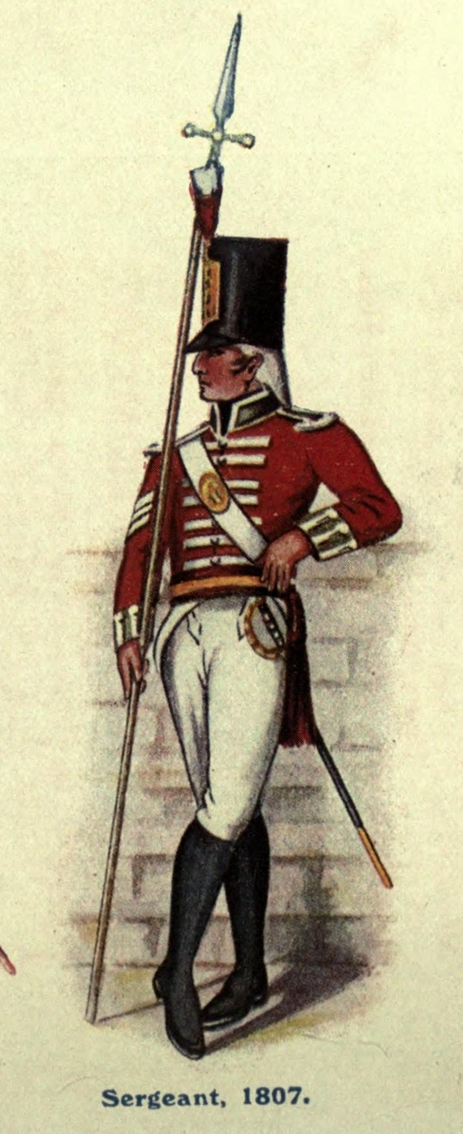
“We have now little French milliners in every part of town.”
Notes:
A Serjeant of the South Gloucester Regiment of Militia, while, it is said, pursuing his road across a garden to the west of town, to the dwelling of a Cyprian… was discovered by the gardener, whose name was Botring, and who ultimately discharged a blunderbuss at him, and lodged about twenty small slugs in his body. The man is yet lying in a dangerous state at the Military Hospital.

Slide 3
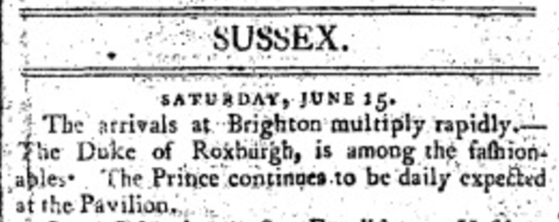
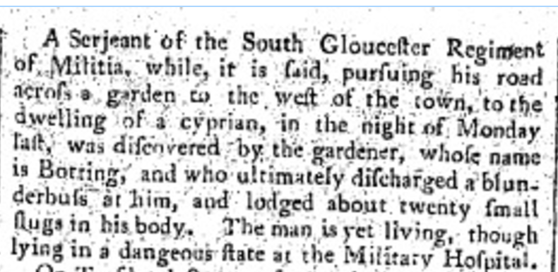

Slide 4
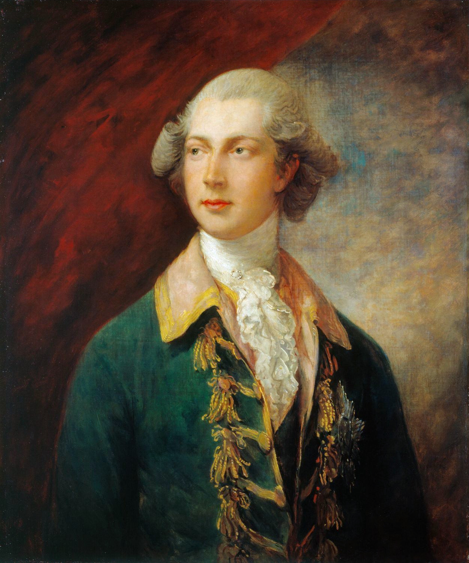
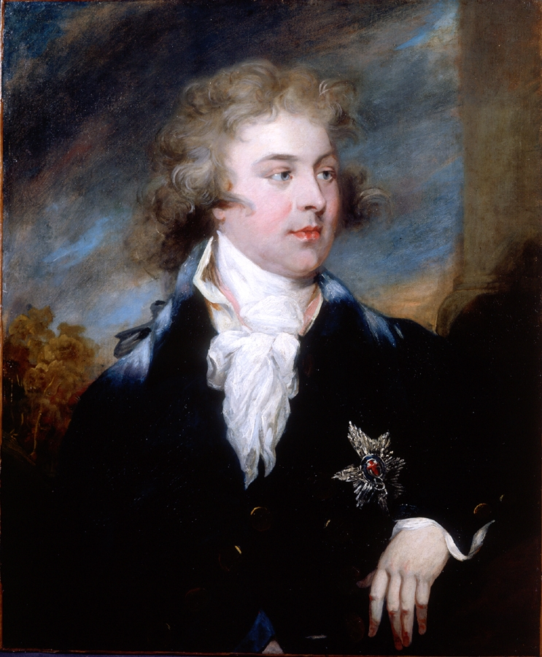
Notes:
regiments moving,
1793 Brummell (16 yr/Oxford)
China 10th
entree into society

Slide 5
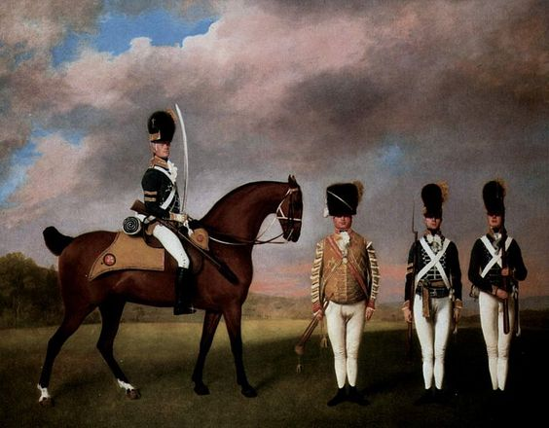
10th (or the Prince of Wales's Own Royal) Regiment of (Light) Dragoons, by George Stubbs
Notes:
purchase 735

Slide 6
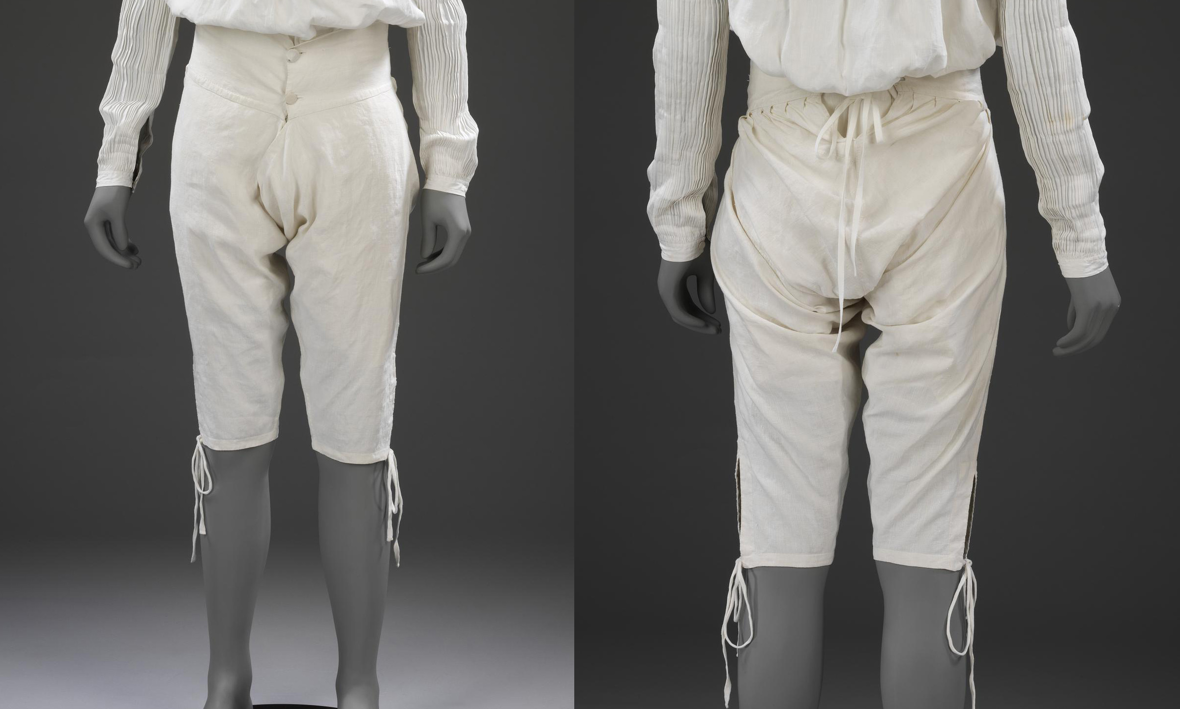
1775-1800, Linen drawers, Victoria and Albert Museum

Slide 7
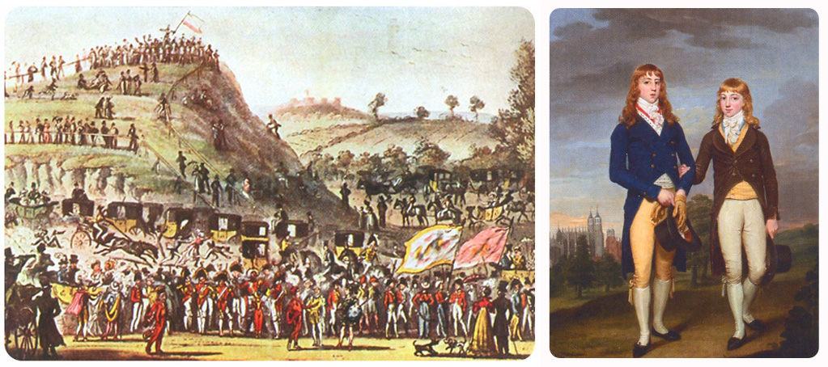
William and George Brummell as Montem Polemen (from Ian Kelley, Beau Brummell )

Slide 8
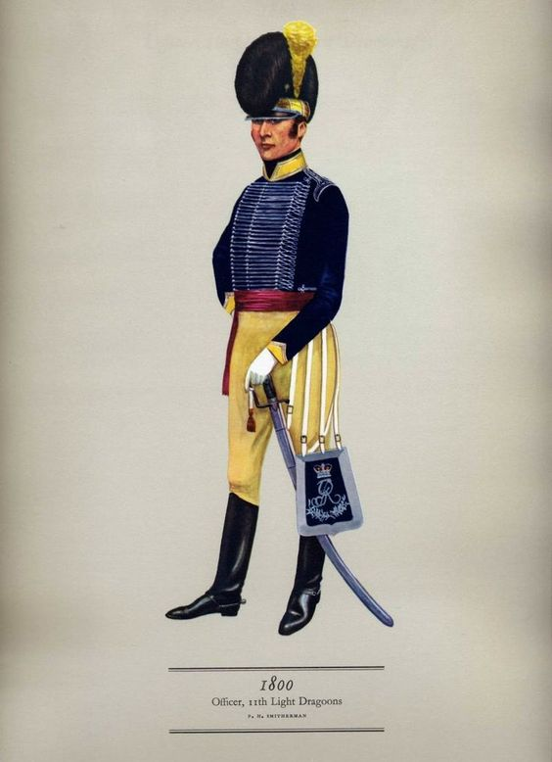

Slide 9
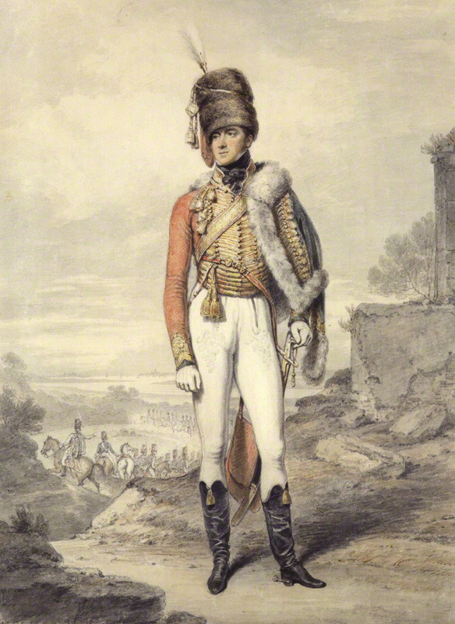
Henry William Paget, Marquess of Anglesy
(by Edridge)

Slide 10
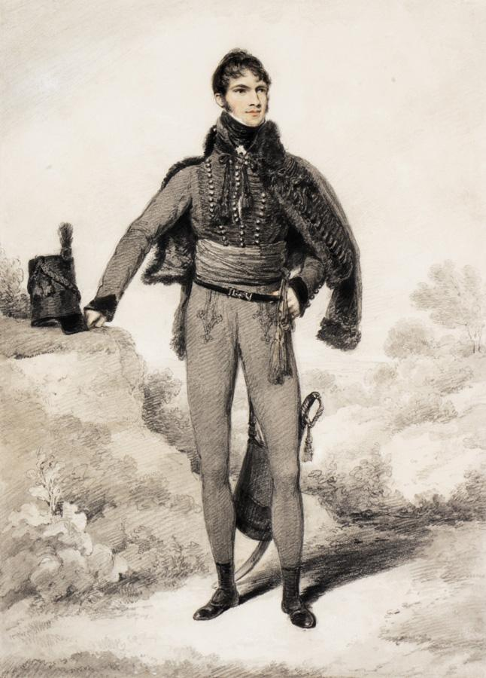
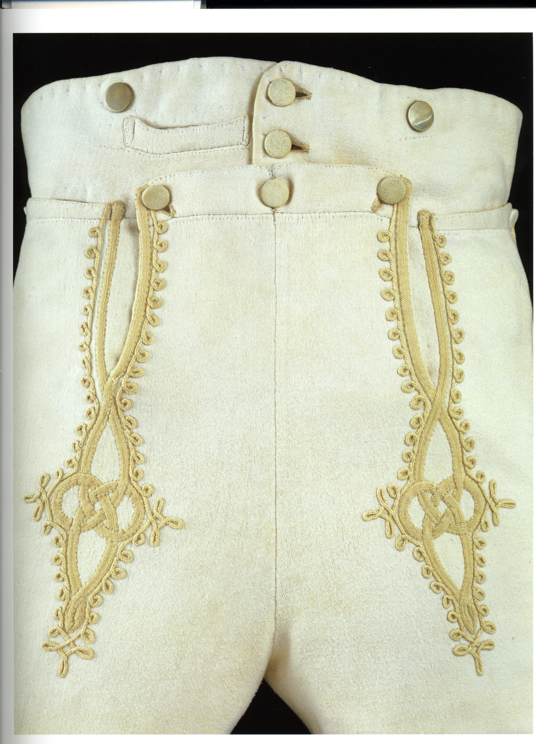
Sir William Harbord, 1810 by Edridge
Notes:
Sir William Harbord, 1810 by Edridge, The other major influence on men’s fashion: military pantaloons – cotton or wool knit to cling and stretch.

Slide 11
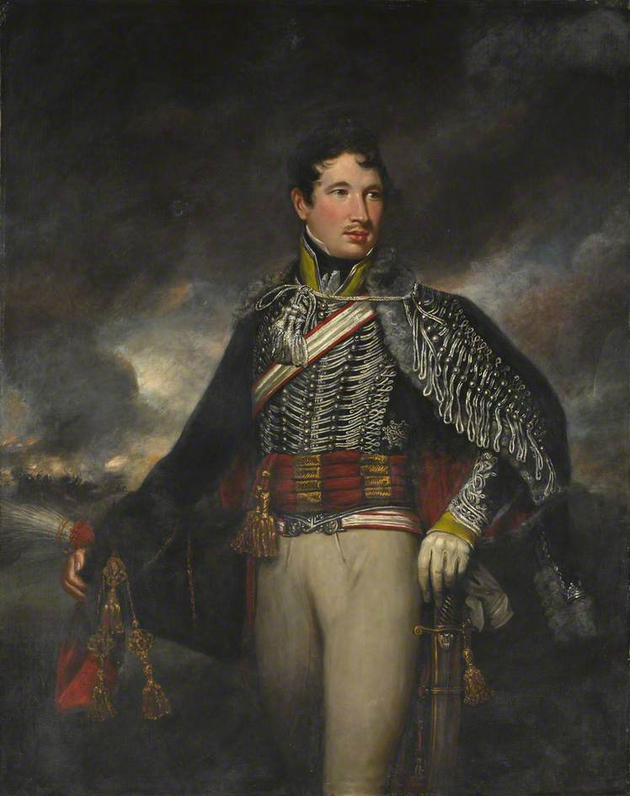
Lt. Andrew Finucane
10th Light Dragoons (Hussars)
By James Northcote
(after 1806)

Slide 12
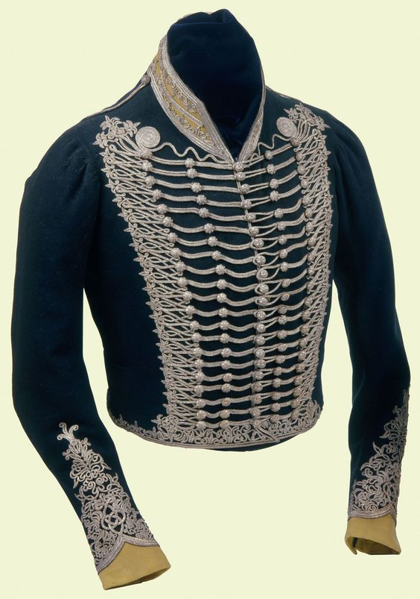
The Prince of Wales’ Own Uniform

Slide 13
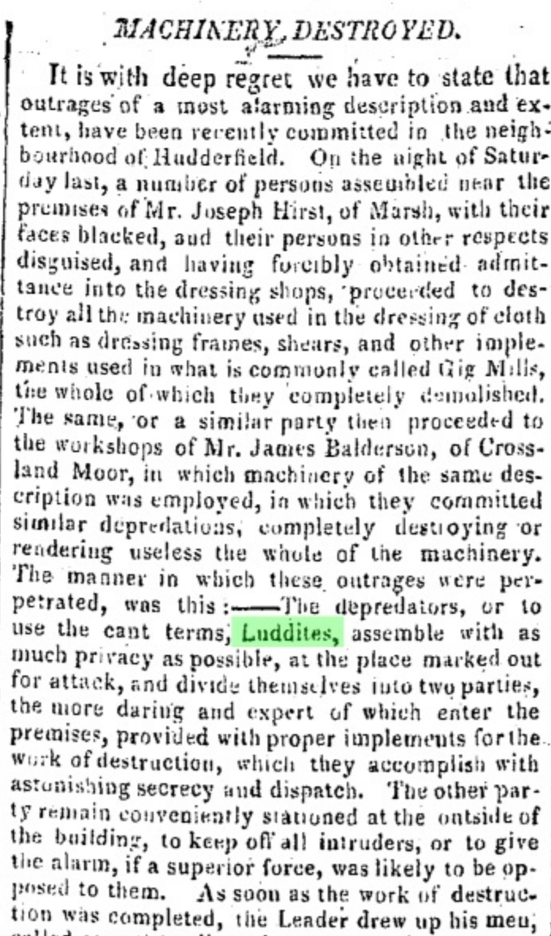
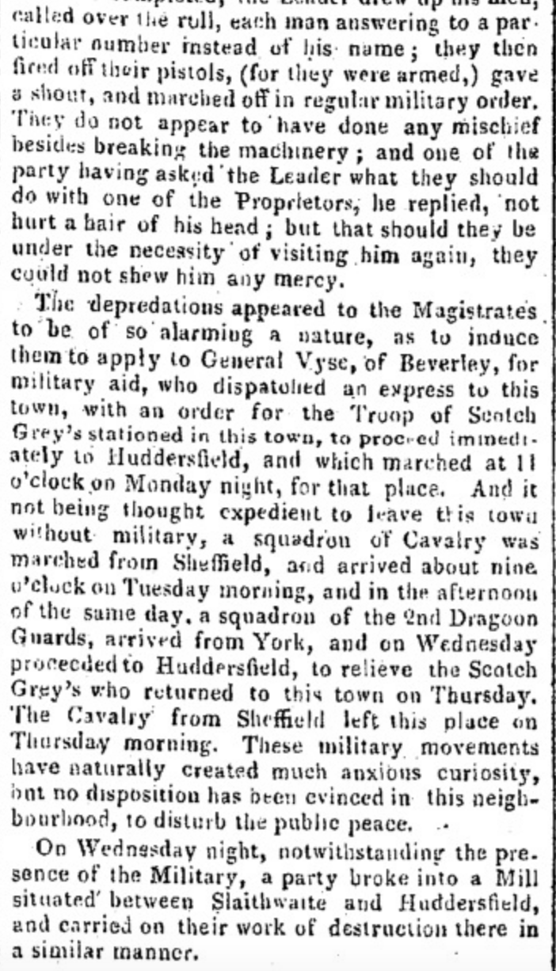
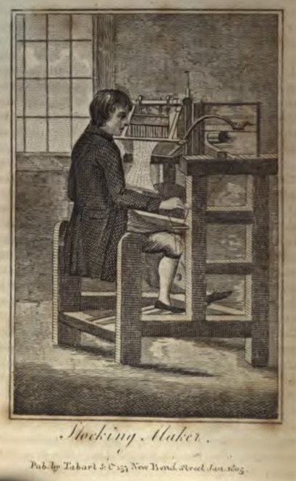
Notes:
Then exports of Midland cotton goods fell in early 1811 and a failed harvest drove up food prices (fortunate workers earned 78 shillings/week but bread prices rose to 1shilling/loaf) Nottingham Felony Bill (Byron spoke against it) was passed making it a capital offense (it had been 14 years transportation (and remember this is only 20 years after The Terror)

Slide 14
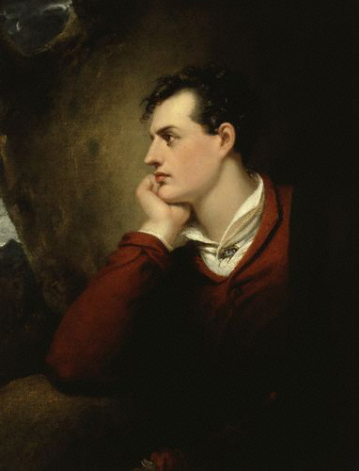
March 2, 1812, Morning Chronicle

Slide 15
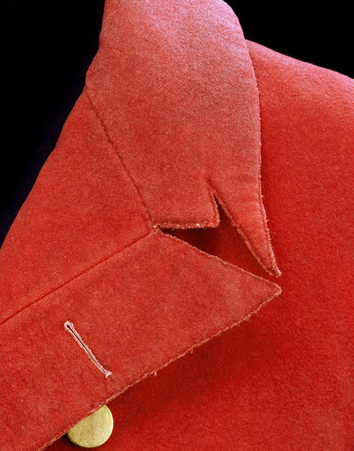
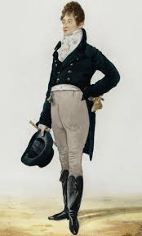
Notes:
1805 Dighton caricature – sent to Manchester, north like Wickham

Slide 16
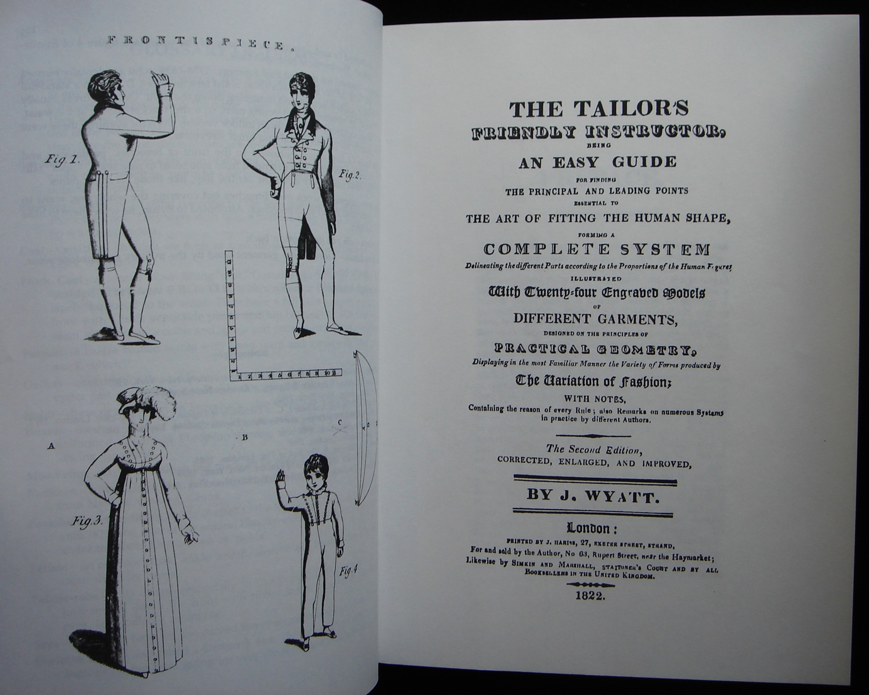

Slide 17
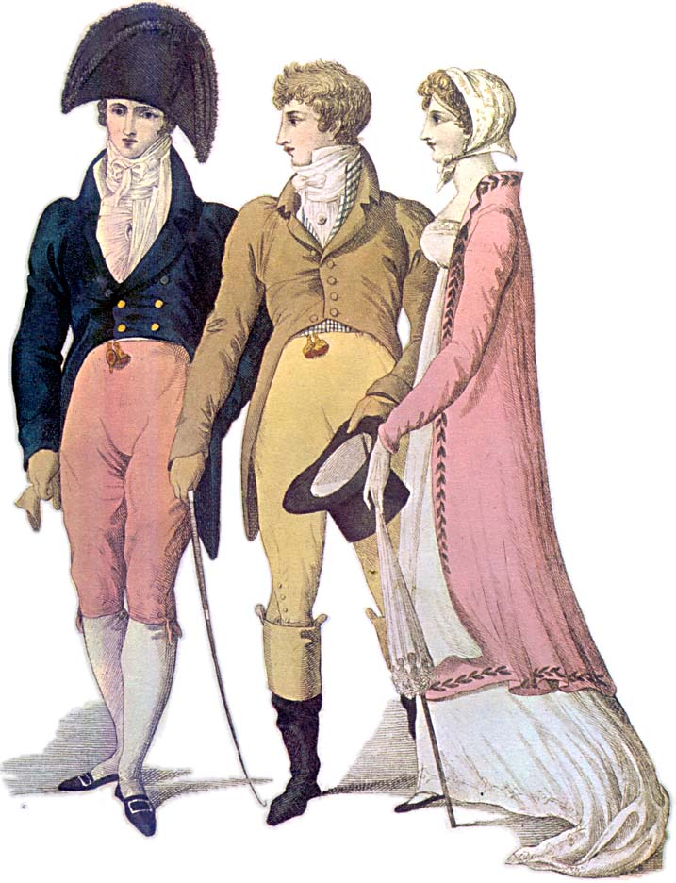
1809
Notes:
1809 – cutaway, swallow-tail, classical statues – the nude male and the draped female

Slide 18
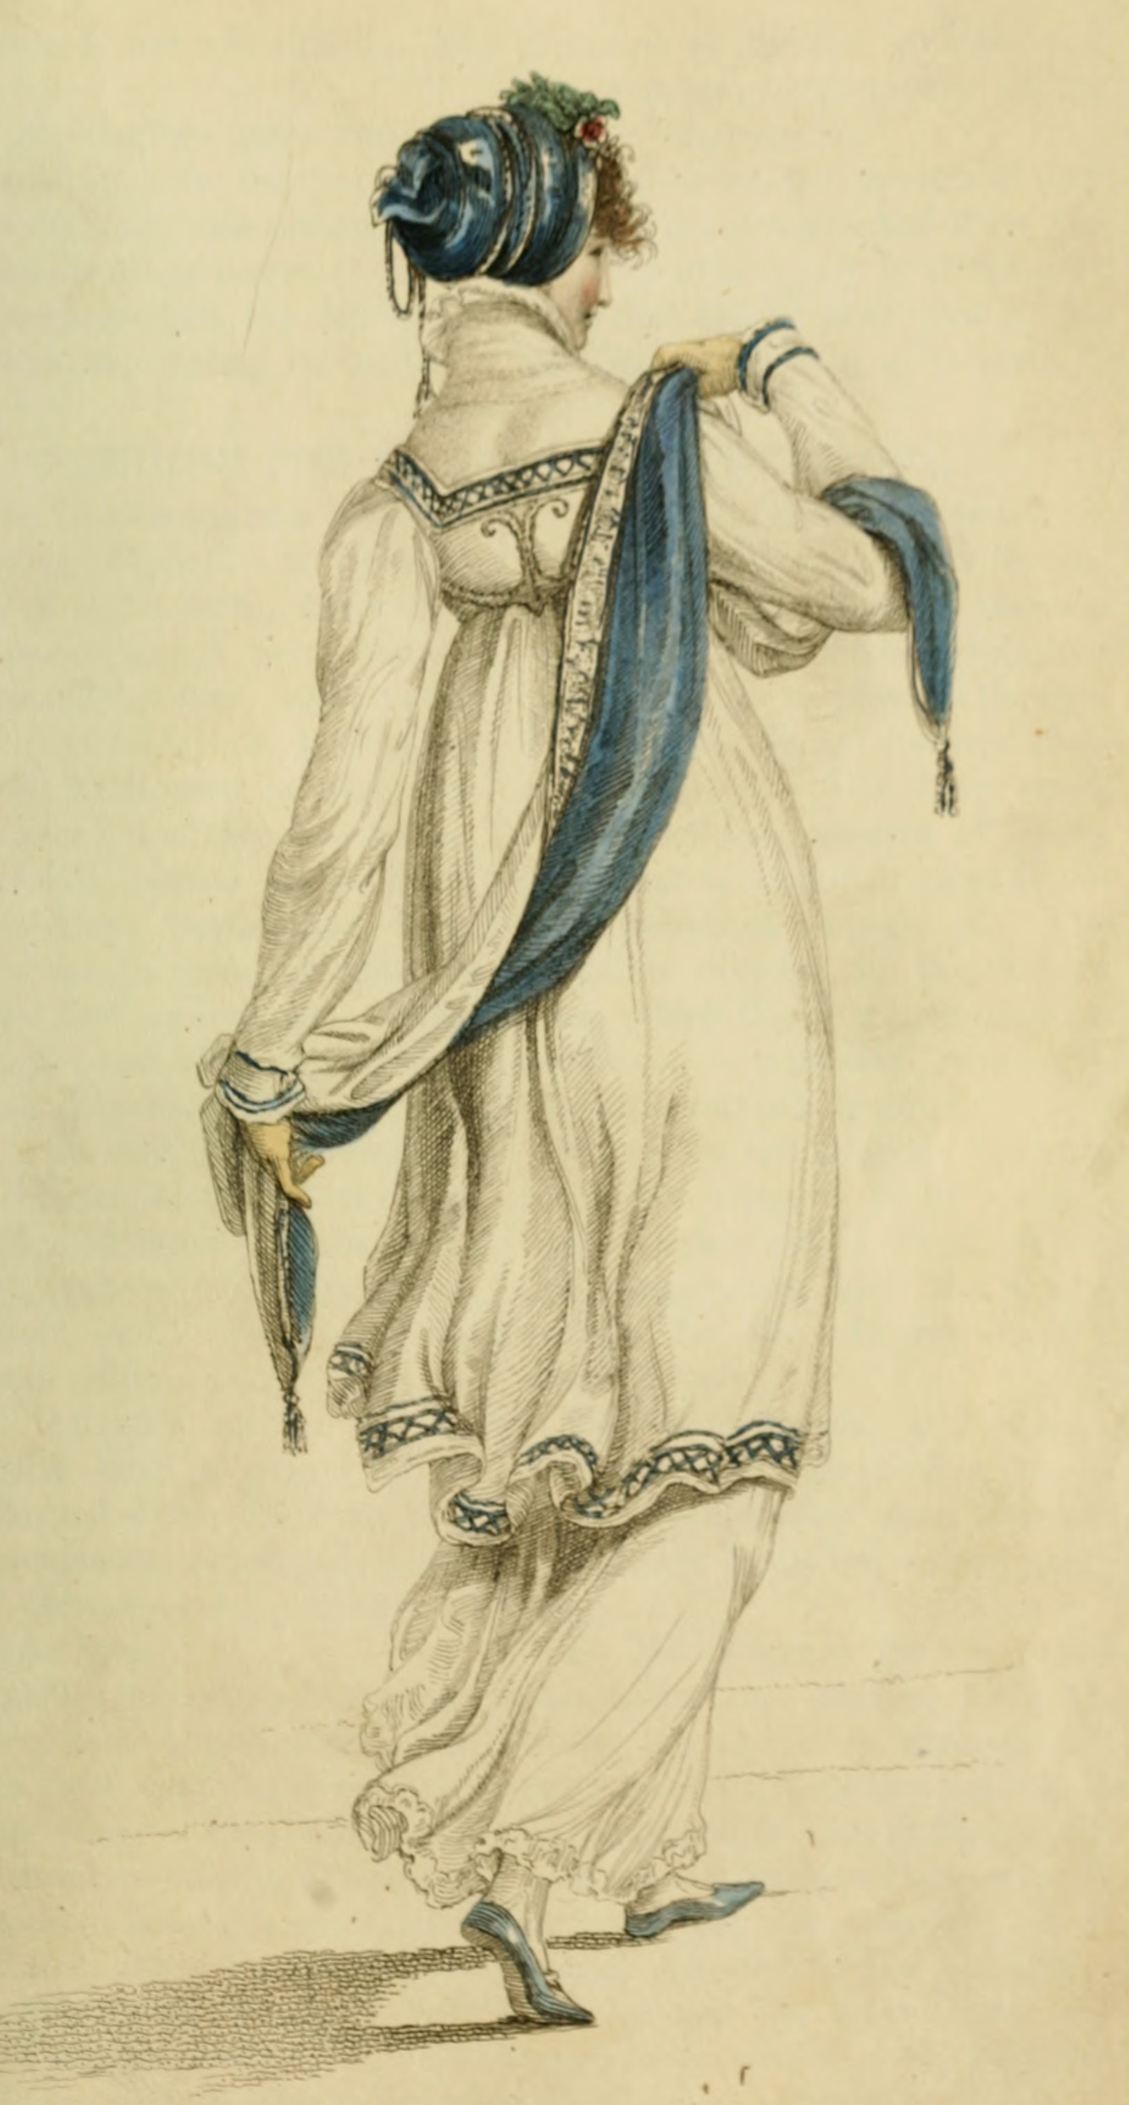
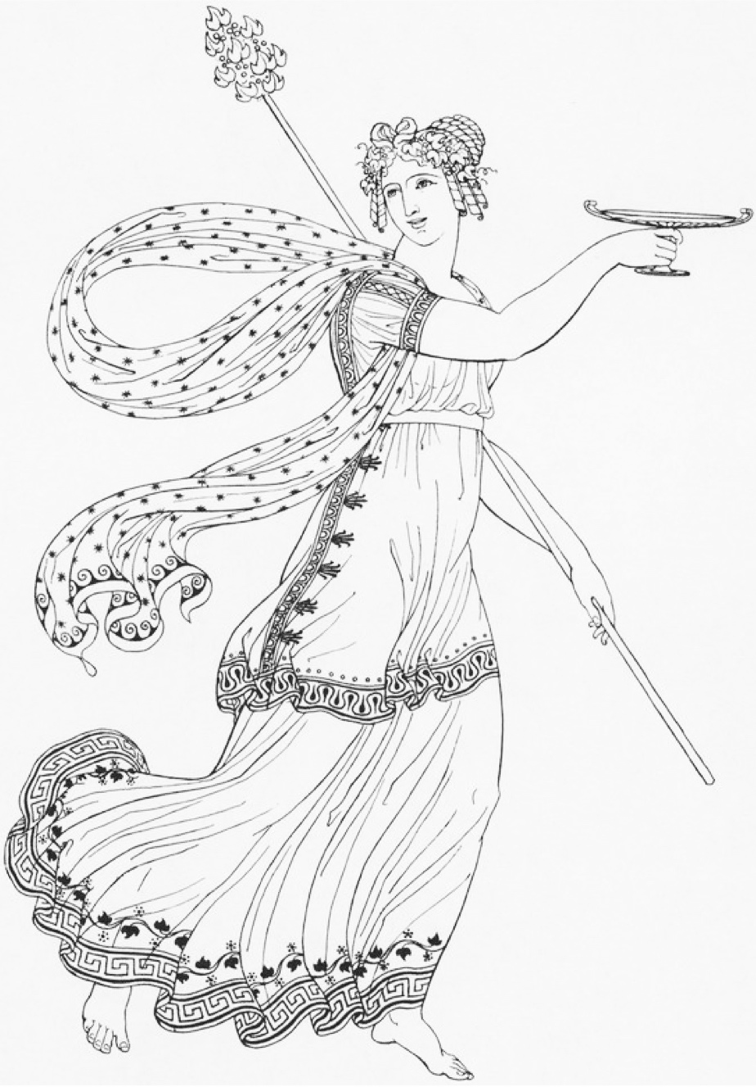
Ackermann, Walking Dress, June 1809
Thomas Hope, Ancient Costumes, 1809

Slide 19
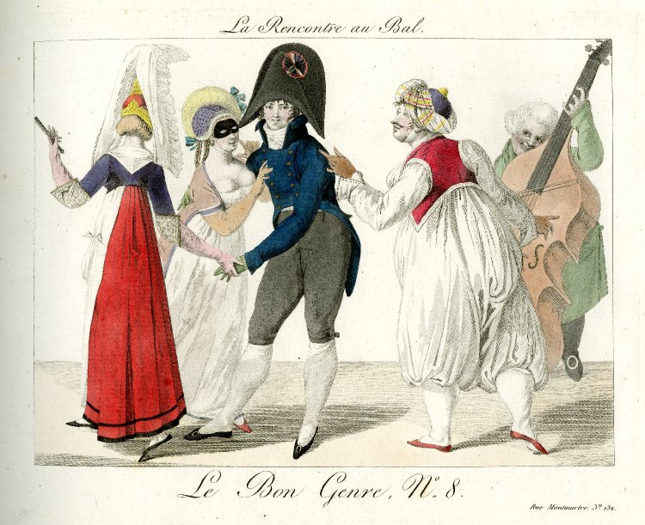

Slide 20
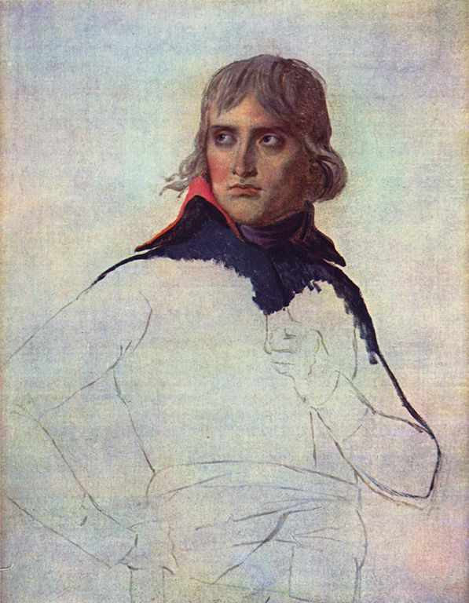
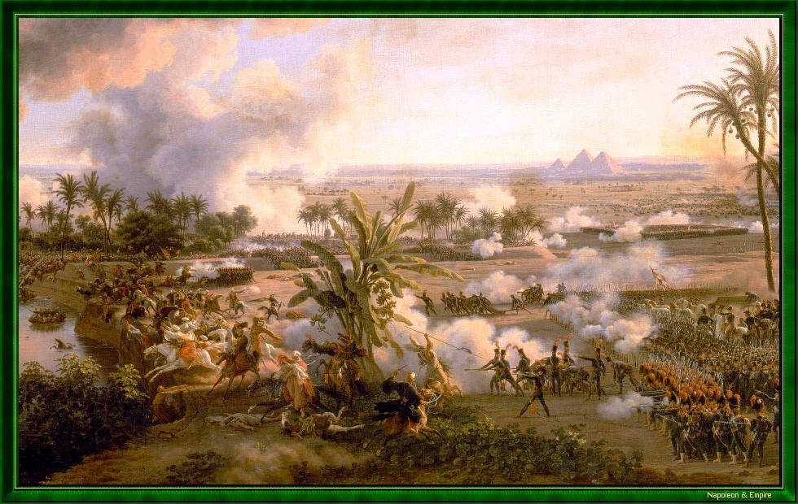
Battle of the Pyramids (Embabeh), July 21,1798

Slide 21
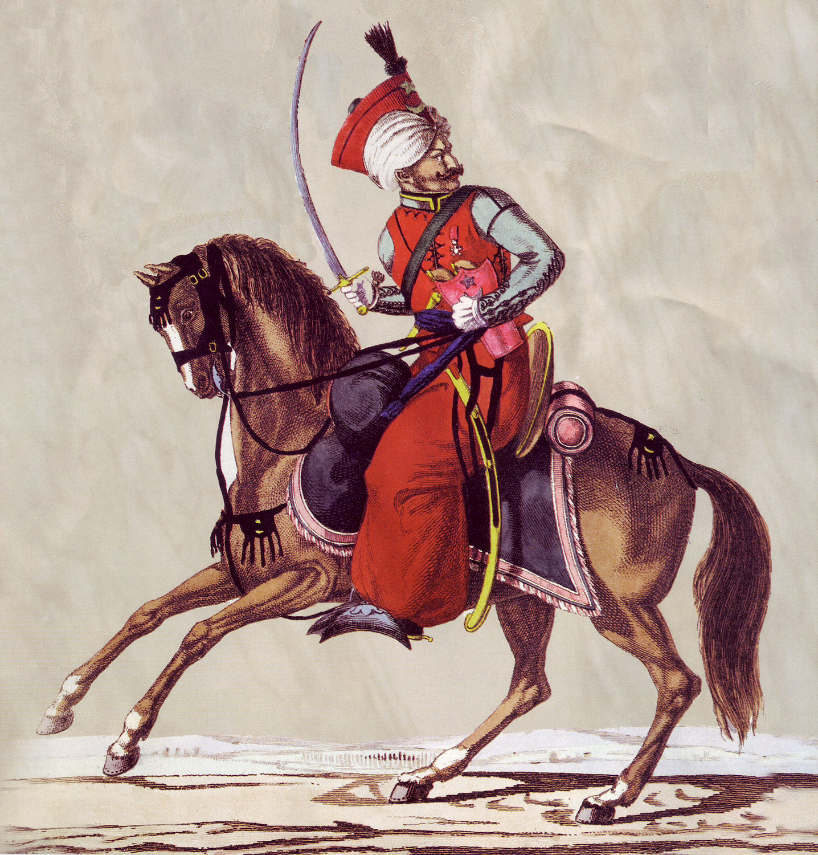
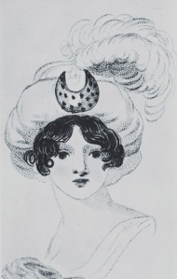
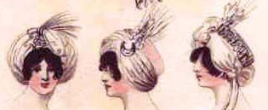
Austen, Tuesday, 8 January 1799:
“I am not to wear my white satin cap to-night, after all; I am to wear a mamalone [mameluke] cap instead…It is all the fashion now; worn at the opera, and by Lady Mildmays at Hackwood balls.”
Notes:
Warrior caste in Egypt defeated by Napoleon at the Battle of the Pyramids, 1798 “On July 1, 1798, Napoleon landed in Egypt with 400 ships and 54,000 men and proceeded to invade the country, as he had recently invaded Italy. But this Egyptian invasion was to be different. For, in addition to soldiers and sailors, Napoleon brought along 150 savants — scientists, engineers and scholars whose responsibility was to capture, not Egyptian soil, but Egyptian culture and history.” The ladies picked up the turban almost immediately.
In former ages it seemed requisite that every lady should cut out her garments by a certain erect standard. ..But in our days, an English woman has the extensive privilege of arraying herself in whatever garb may best suit her figure or her fancy. The fashions of every nation and of every era are open to her choice. One day she may appear as the Egyptian Cleopatra, then a Grecian Helen; next morning the Roman Cornelia; or, if these styles be too august for her taste, there are Sylphs, Goddesses, Nymphs of every region, in earth or air, ready to lend her their wardrobe.
Mirror of Graces, 1811 (p. 52)

Slide 22
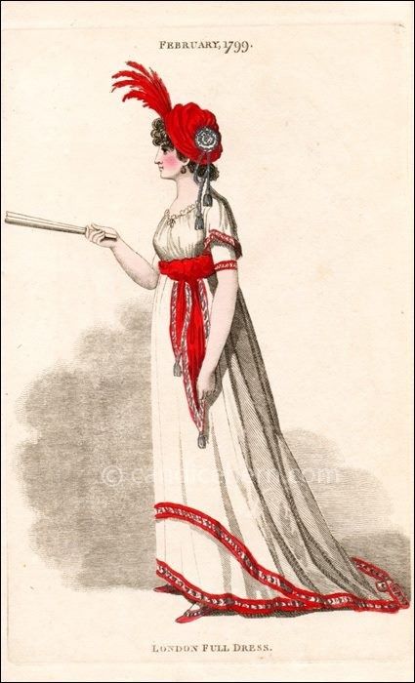
“Egyptian” gown with coquelicott trim,
February 1799
(From Candace Hern’s collection)

Slide 23
“In former ages it seemed requisite that every lady should cut out her garments by a certain erect standard. ..But in our days, an English woman has the extensive privilege of arraying herself in whatever garb may best suit her figure or her fancy. The fashions of every nation and of every era are open to her choice. One day she may appear as the Egyptian Cleopatra, then a Grecian Helen; next morning the Roman Cornelia; or, if these styles be too august for her taste, there are Sylphs, Goddesses, Nymphs of every region, in earth or air, ready to lend her their wardrobe.”
Mirror of Graces, 1811
Notes:
In former ages it seemed requisite that every lady should cut out her garments by a certain erect standard. ..But in our days, an English woman has the extensive privilege of arraying herself in whatever garb may best suit her figure or her fancy. The fashions of every nation and of every era are open to her choice. One day she may appear as the Egyptian Cleopatra, then a Grecian Helen; next morning the Roman Cornelia; or, if these styles be too august for her taste, there are Sylphs, Goddesses, Nymphs of every region, in earth or air, ready to lend her their wardrobe.
Mirror of Graces, 1811 (p. 52)

Slide 24
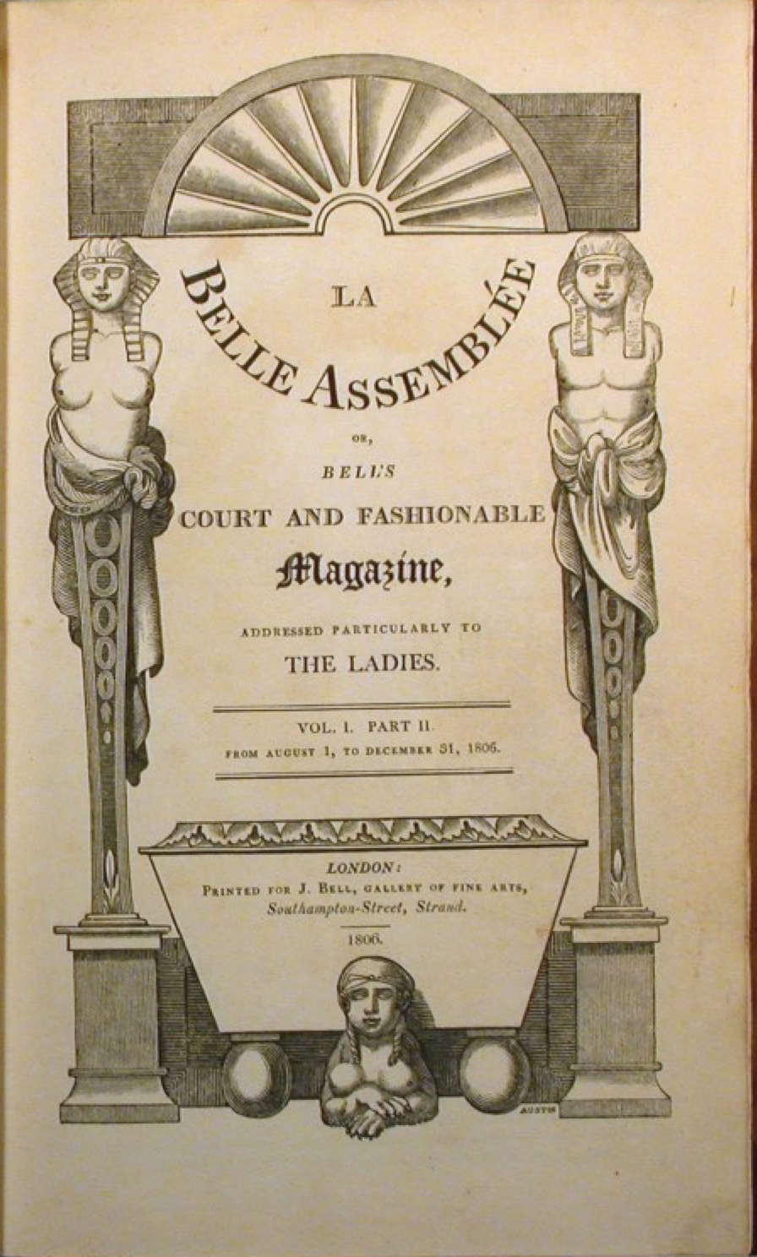
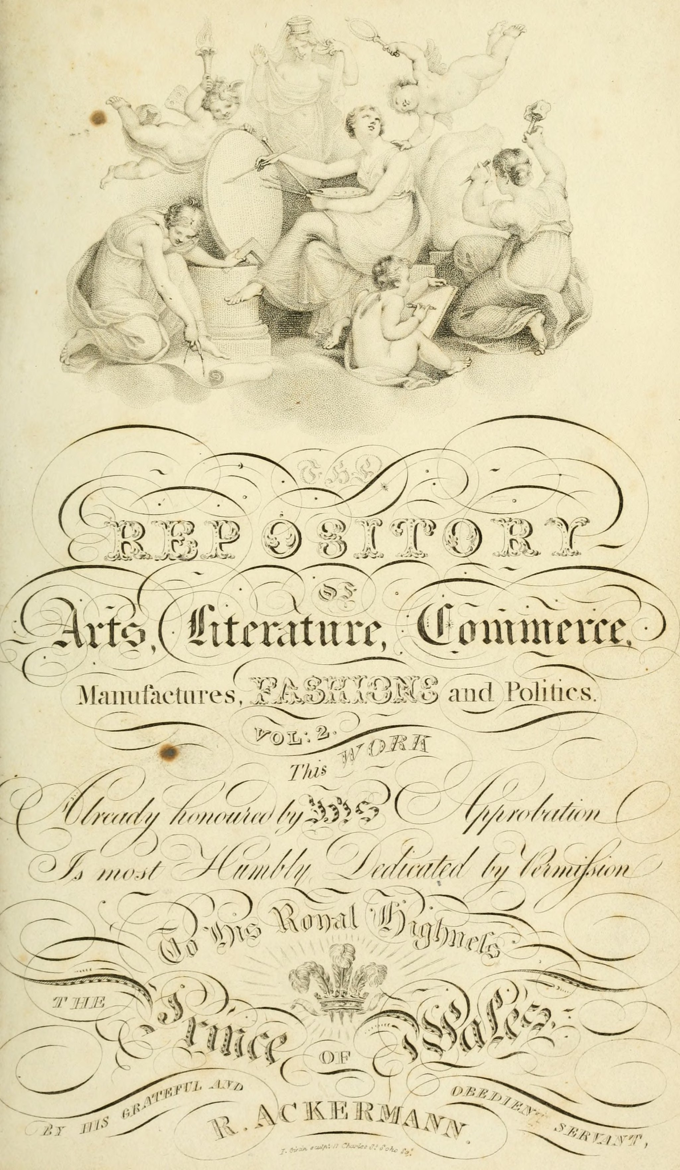
Notes:
Find another LBA famous man pic

Slide 25
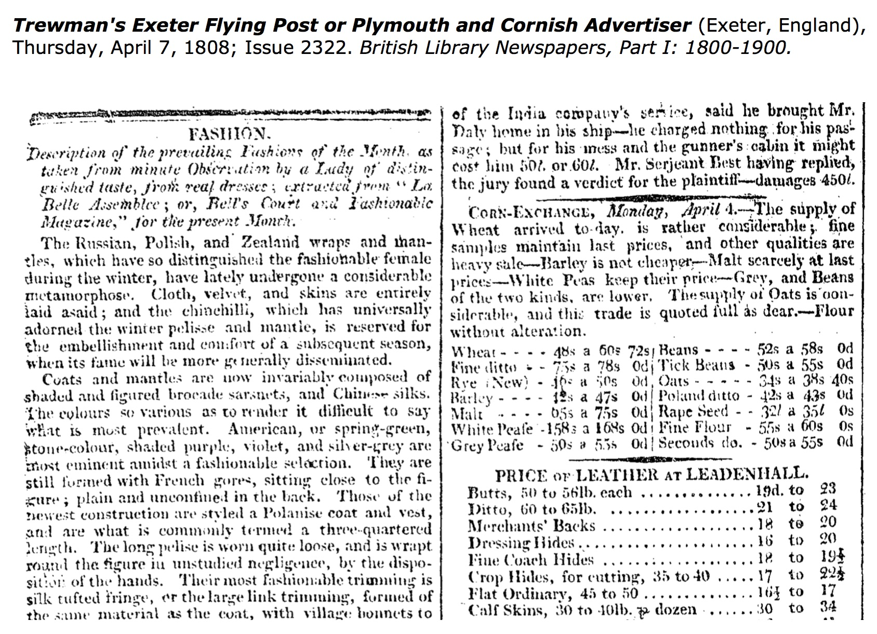
Notes:
Find another LBA famous man pic

Slide 26
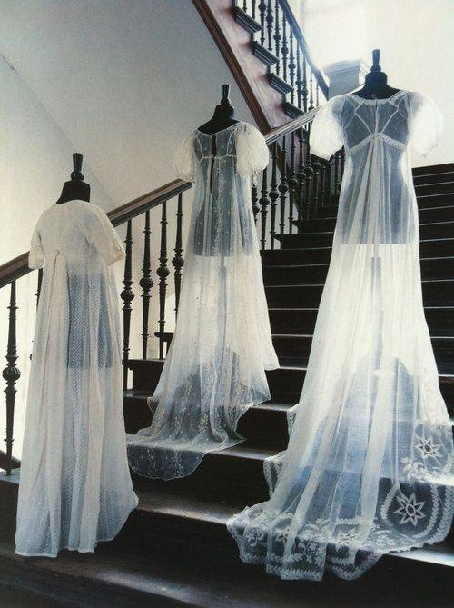
“…a true India muslin...”

Slide 27
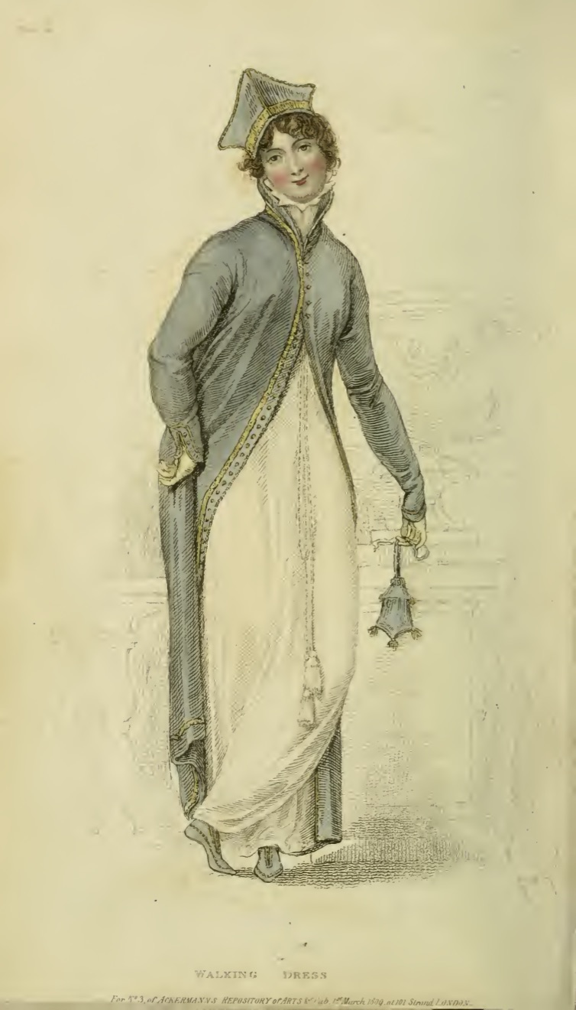
Ackermann, March 1809
Ladies Walking Dress:
Polish cap, pelisse of silver grey cloth…
Notes:
Use the lady for military, the gent for men’s fashion

Slide 28
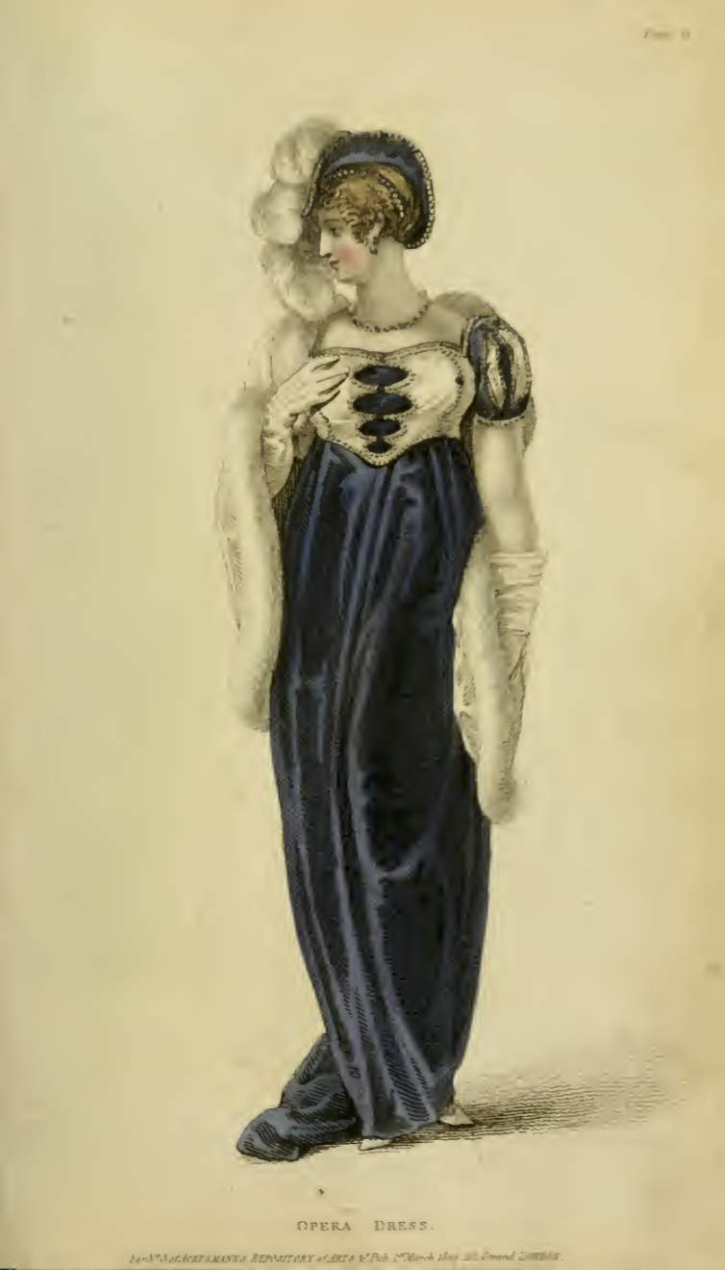
Ackermann, March 1809
Opera Dress:
“Henry VIII hat of purple velvet trimmed with pearls…dress of the same…white satin Spanish mantle…”
Notes:
Use the lady for military, the gent for men’s fashion

Slide 29
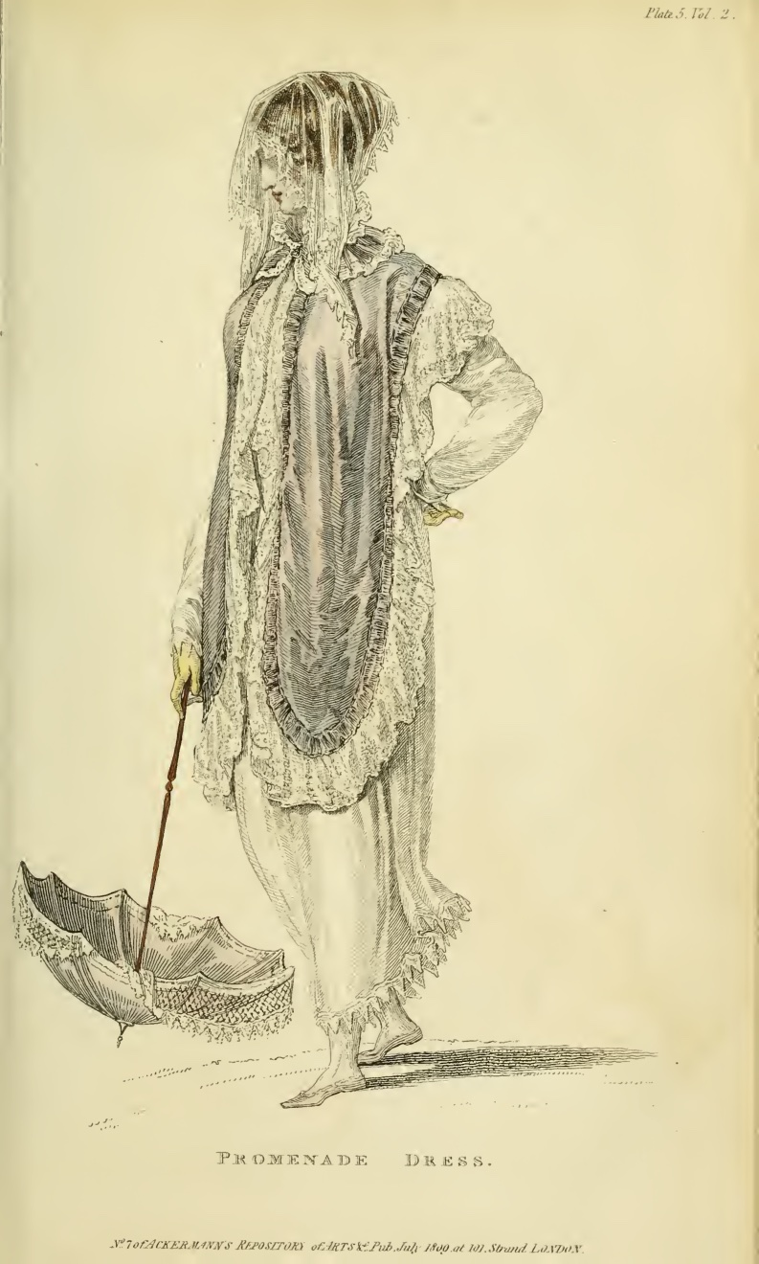
Ackermann, July 1809
Promenade Dress:
“A round high frock of fine French cambric…
trimmed with a fine Vandyke lace…
Tyrolese cloak…
Venetian binding…
hair dressed in Grecian style…
veil à la Maltese…
parasol with white Chinese awning (fringe)
Gloves, Limerick or York tan.”
Notes:
Use the lady for military, the gent for men’s fashion

Slide 30
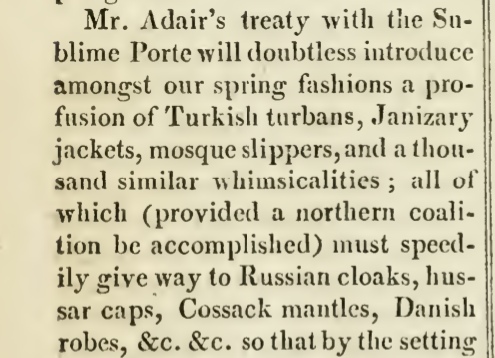
Ackermann, 1809
French
Roman
Venetian
Tyrolese
Andalusian
Spanish
Chinese
à la Maltese
Henry VIII
Vandyke
Polish
Brussels/Mecklin
Egyptian
Russian
Indian muslin
à l’antique
à la militaire
Turkish
Danish
India muslin
à la Hussar

Slide 31
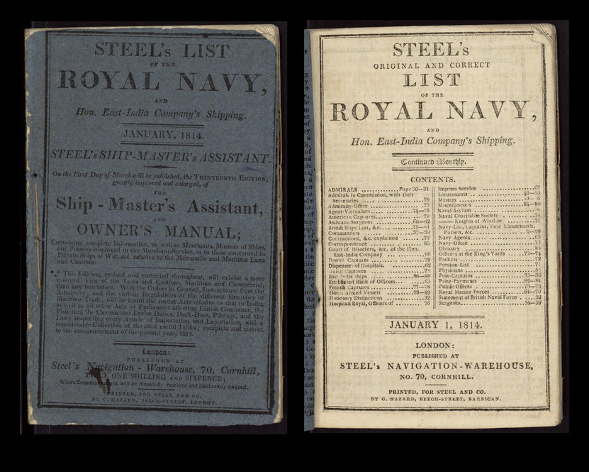

Slide 32
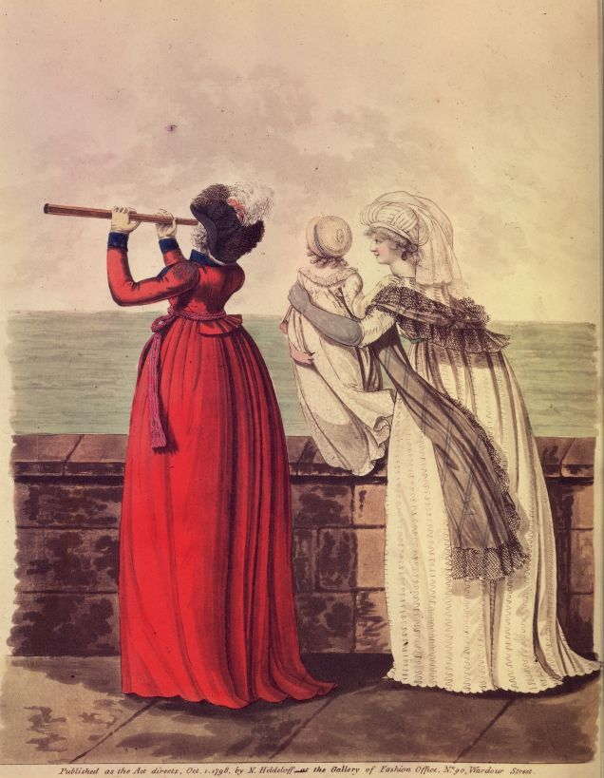
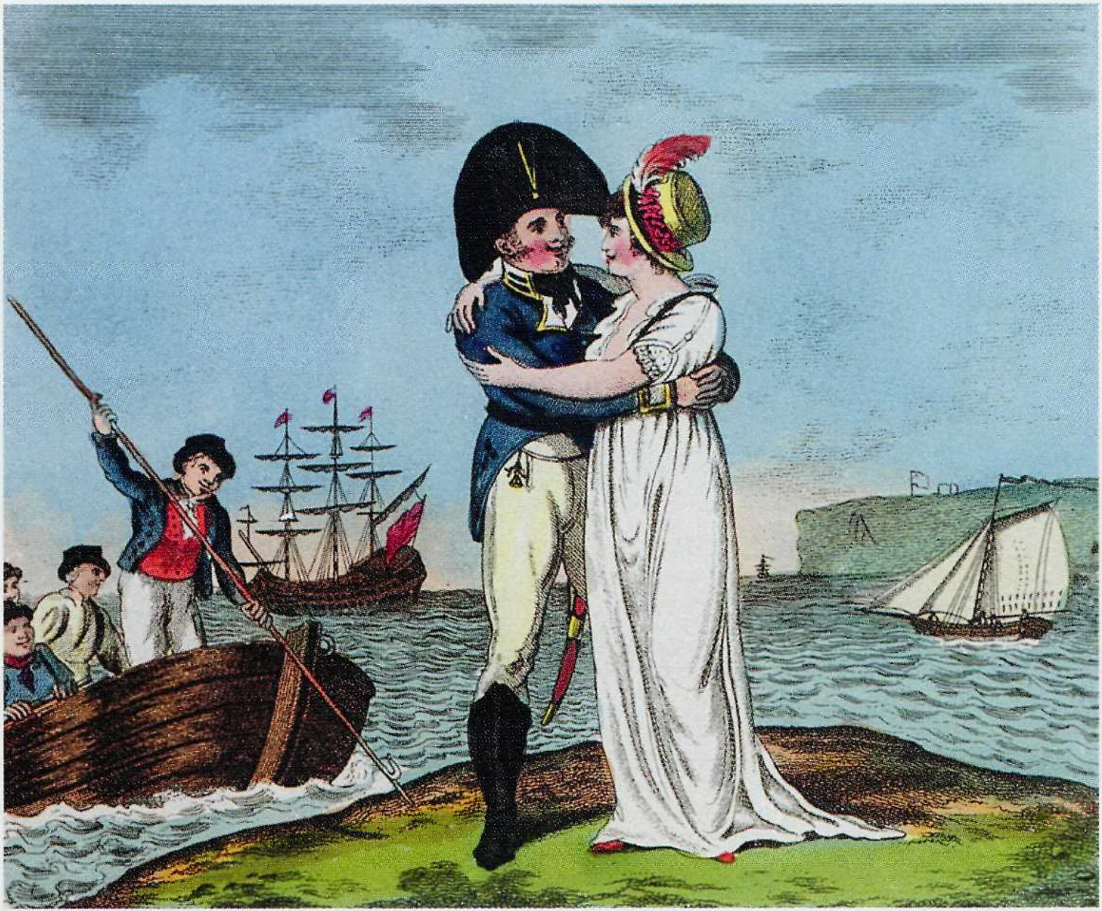
1798, Heideloff

Slide 33
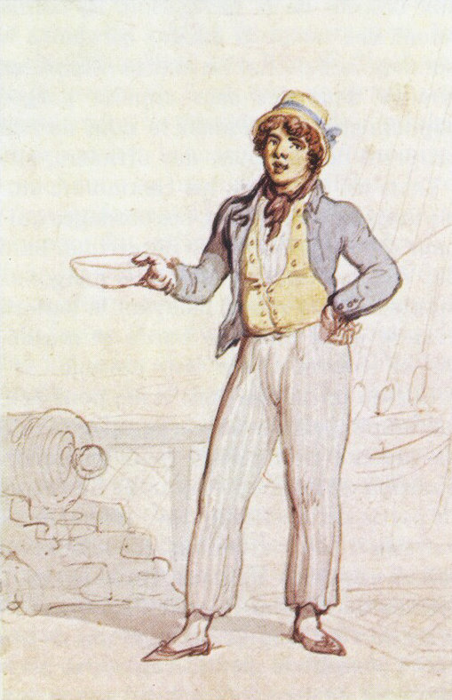
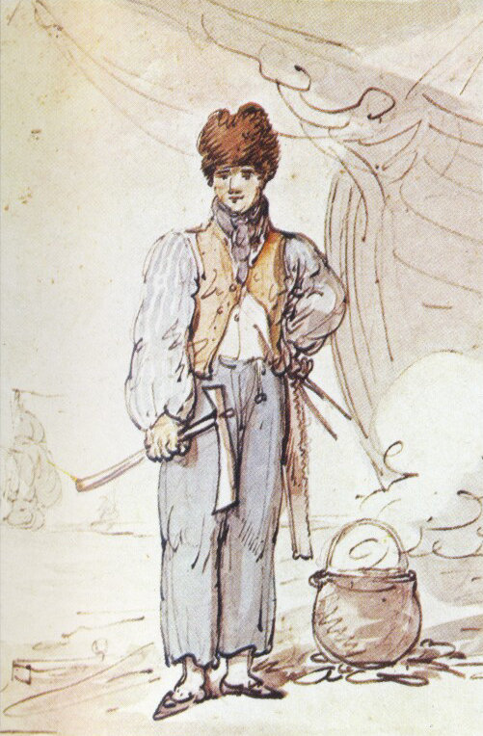
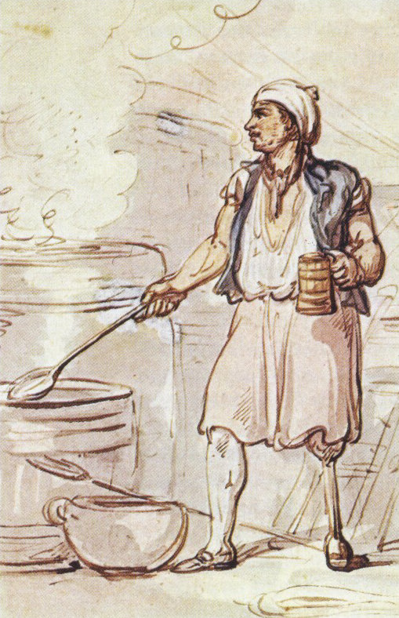
Thomas Rowlandson, Navy series, 1799
Carpenter
Seaman
Cook

Slide 34
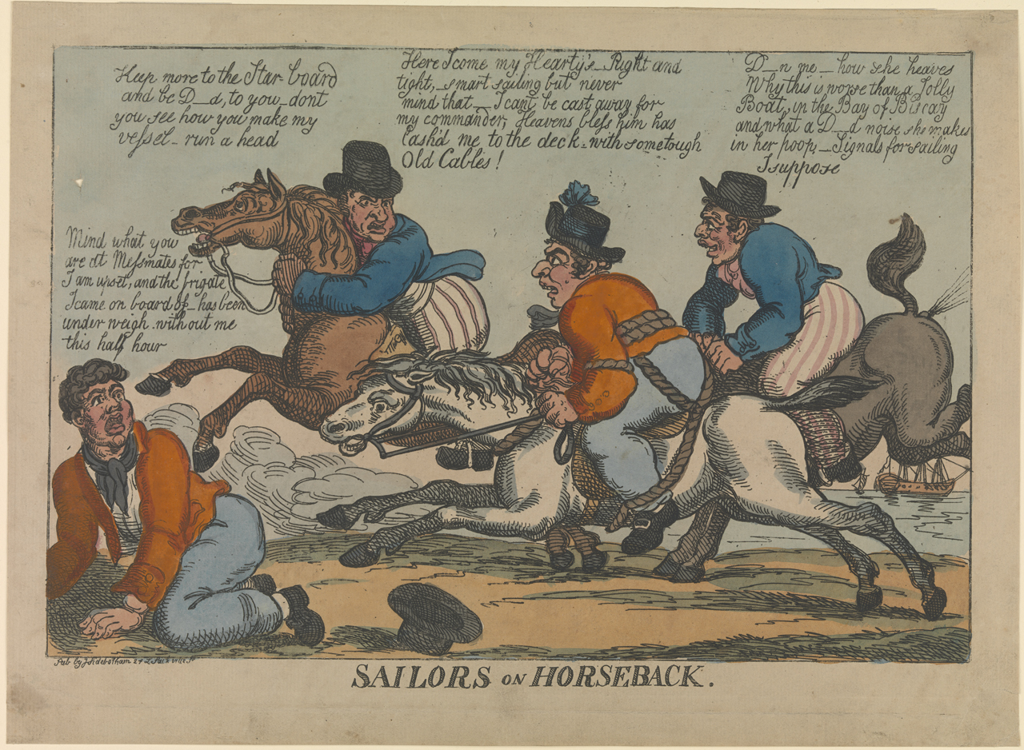

Slide 35
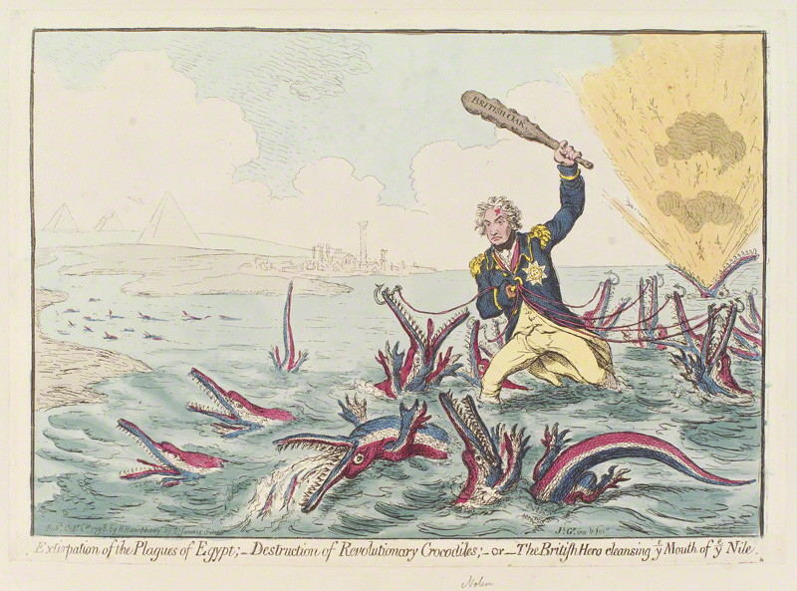
(Battle of the Nile was in August 1798)
Notes:
Extirpation of the Plagues of Egypt. Destruction of the Revolutionary Crocodiles or The British Hero cleansing the Mouth of the Nile.

Slide 36
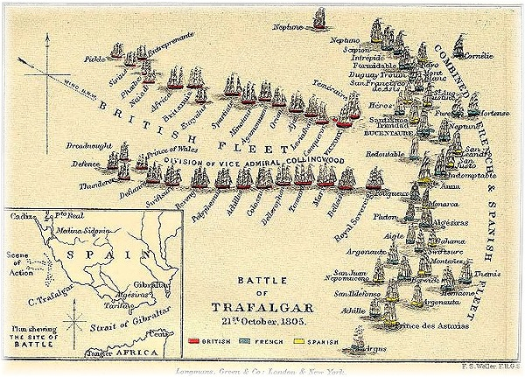

Slide 38
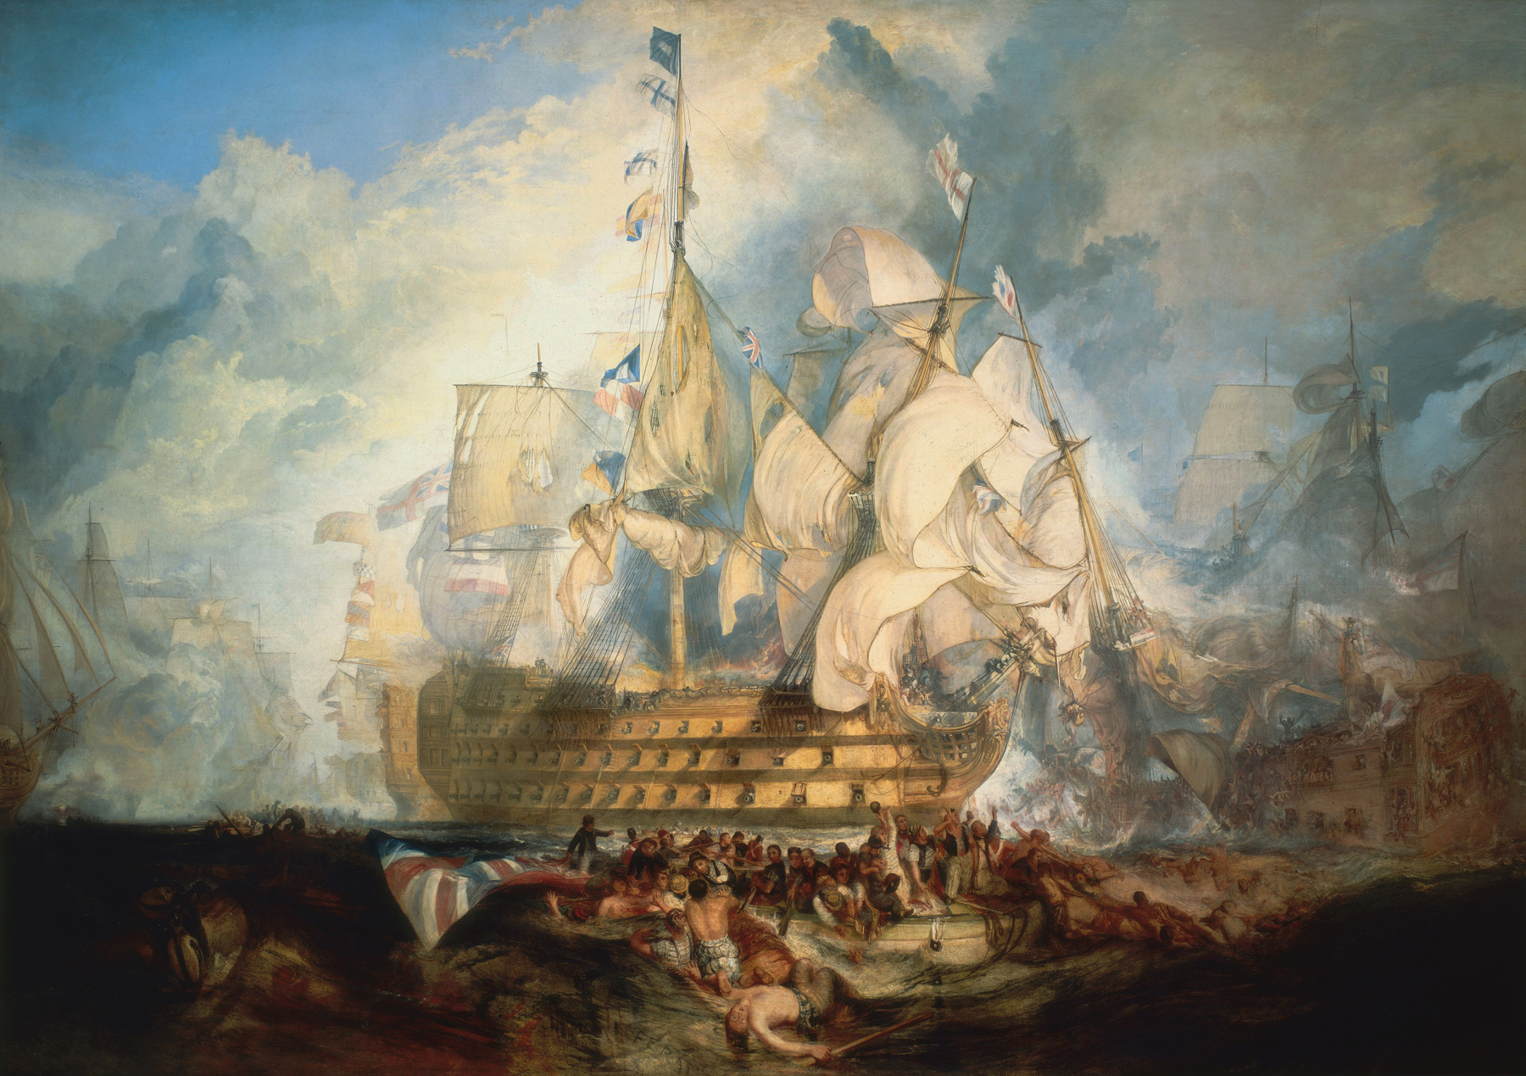
J.M.W. Turner, The Battle of Trafalgar
Notes:
Painted in 1822

Slide 39
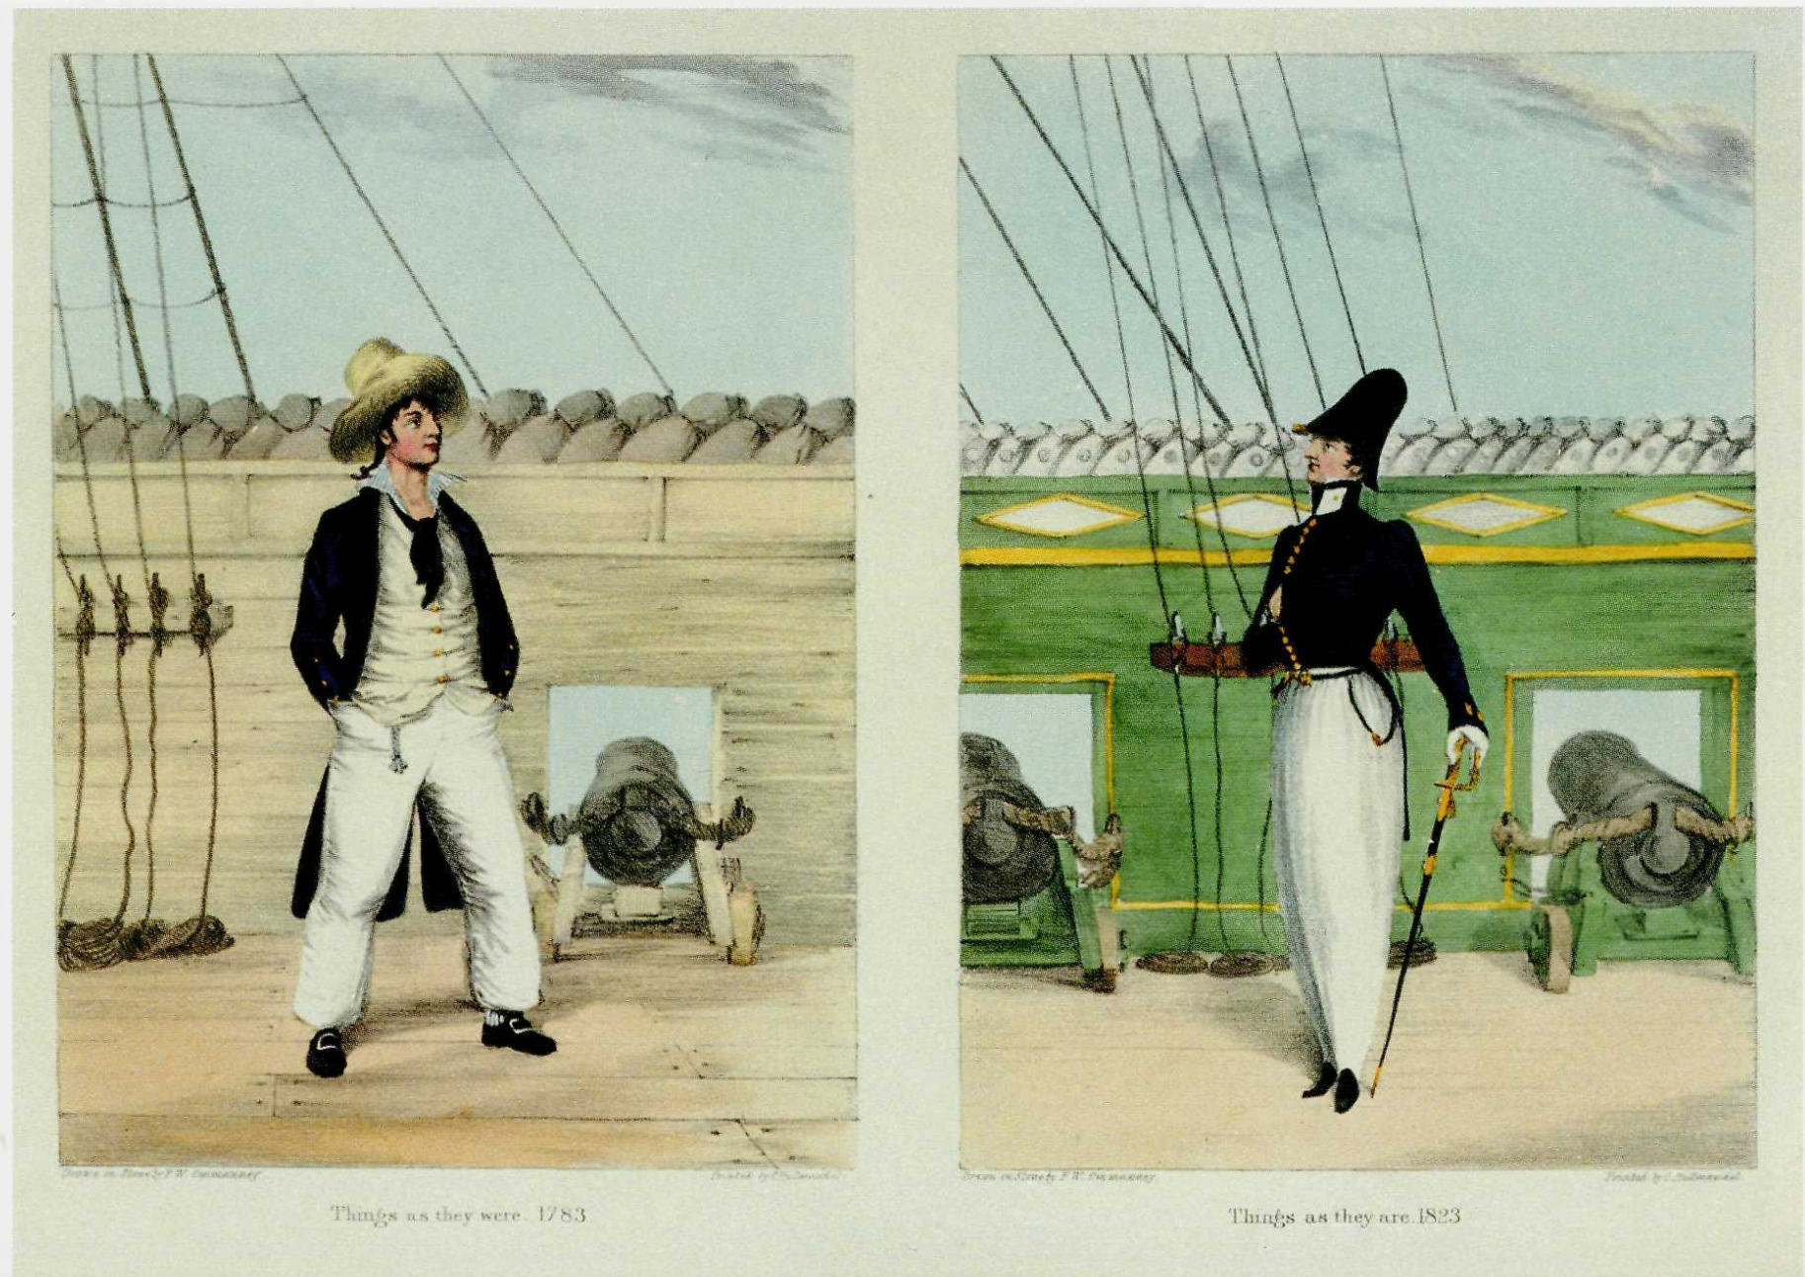

Slide 40
Thomas Rowlandson, Navy series, 1799

Slide 41
Lord Cochrane, (“the sea wolf”), by Stroehling, 1807
Notes:
Spoken of highly by Frank Austen

Slide 43
Coat of Lieutenant William Hicks

Slide 45
Amy Miller, Dressed to Kill

Slide 50
Agostino Brunias, c. 1780 “Linen Day, Roseau, Dominica”
Marie Antoinette’s “chemise dress” Portrait by Elisabeth Louise Vigée-LeBrun, 1783, dress by Rose Bertin
Notes:
Globalization of textile manufacture: raw cotton from the Americas, muslin/mull from India dyed white with indigo from the West Indies, then turned into a gown by Marie Antoinette’s dressmaker Rose Bertin, adopted shortly thereafter by Georgina, Duchess of Devonshire (1784). But as Jane Ashelford reminds us, the narrative of French women throwing off their clothes and wearing undergarments inspired by neoclassicism is appealing but simplistic. The impact of Georgiana's revolutionary trip to the concert and the association of the chemise with Marie Antoinette and the West Indies complicate less nuanced accounts.

Slide 52
Calico – Calicut, Chintz, Madras (India)
Muslin – Mosul (Iran, woven and dyed in India)
Nankeen-Nanking (China)
Percale (Persia)

Slide 53
Notes:
Reviving the silk industry. Started in 1799, changed again in 1805, and again in 1812.

Slide 54
Notes:
Don’t forget Hortense and muslin

Slide 55
“Thus I naturalized in France the manufacture of cotton, which includes
1st: Spun-cotton – We did not previously spin it ourselves; the English supplied us with it as a sort of favor.
2nd: The fabric – we did not yet make it; it came to us from abroad.
3rd: The printing – this is the only part of the manufacture the we performed ourselves.”
Bonaparte

Slide 56
Napoleonic Wars
3rd: (1803-1806) Austria, Holy Roman Empire, Russia, Britain. Holy Roman Emperor Francis II abdicates, becomes Francis I of Austria, German buffer states set up (Confederation of the Rhine).
4th: 1806-1807 Prussia, Russia, Saxony, Sweden, and Great Britain. Prussia joins in 9 October 1806, overrun and defeated 14 October 1806. Russia signs Treaties of Tilsit July 1807 to become part of continental system. Prussia loses extensively (Jerome Bonaparte, Kingdom of Westphalia) Britain remains at war with France.
1807: France comes to Spain to “support” them. June 1808, Joseph Bonaparte is placed on the throne in 1808. Franco-Spanish force invades Portugal. Peninsular War begins
5th: 1809 – Austria and Britain
1809, January: Portugal Battle of Corunna – Britain withdraws
14 October 1809 Austria defeated (Napoleon marries Marie Louise, daughter of Francis) 20% of their population has died
1811: A few British/Allied victories after May: Almeida, Albuera, Usagre, Arroy dos Molinos, Ciudad Rodrigo (hue-dad Roderigo), Badajoz (bah-da-ho). Finally Salamanca – 22 July 1812 – decisive, liberation of Madrid 12 Aug 1812, Vitoria 21 June 1813 decisive, Pyranees 25 July 1813, there are more but Joseph B abdicates 11 Dec 1813, 10 April 1814 Battle of Toulouse. Wellesley gets word that Napoleon has abdicated in France.
6th: 1813-1814 Napoleon invades Russia in 1812. 650,000 (1/2 French), loses 370,000 casualties, 200,000 captured, comes back with 27,000 fit men. Everyone else (Austria, Prussia, Russia, the United Kingdom, Portugal, Sweden, Spain and a number of German states) join together to drive Napoleon out of Germany and then invade France. 6 April 1814 Napoleon defeated.

Slide 57
Napoleonic Wars
3rd: (1803-1806) Austria, Holy Roman Empire, Russia, Britain. Holy Roman Emperor Francis II abdicates, becomes Francis I of Austria, German buffer states set up (Confederation of the Rhine).
4th: 1806-1807 Prussia, Russia, Saxony, Sweden, and Great Britain. Prussia joins in 9 October 1806, overrun and defeated 14 October 1806. Russia signs Treaties of Tilsit July 1807 to become part of continental system. Prussia loses extensively (Jerome Bonaparte, Kingdom of Westphalia) Britain remains at war with France.
1807: France comes to Spain to “support” them. June 1808, Joseph Bonaparte is placed on the throne in 1808. Franco-Spanish force invades Portugal. Peninsular War begins
5th: 1809 – Austria and Britain
1809, January: Portugal Battle of Corunna – Britain withdraws
14 October 1809 Austria defeated (Napoleon marries Marie Louise, daughter of Francis) 20% of their population has died
1811: A few British/Allied victories after May: Almeida, Albuera, Usagre, Arroy dos Molinos, Ciudad Rodrigo (hue-dad Roderigo), Badajoz (bah-da-ho). Finally Salamanca – 22 July 1812 – decisive, liberation of Madrid 12 Aug 1812, Vitoria 21 June 1813 decisive, Pyranees 25 July 1813, there are more but Joseph B abdicates 11 Dec 1813, 10 April 1814 Battle of Toulouse. Wellesley gets word that Napoleon has abdicated in France.
6th: 1813-1814 Napoleon invades Russia in 1812. 650,000 (1/2 French), loses 370,000 casualties, 200,000 captured, comes back with 27,000 fit men. Everyone else (Austria, Prussia, Russia, the United Kingdom, Portugal, Sweden, Spain and a number of German states) join together to drive Napoleon out of Germany and then invade France. 6 April 1814 Napoleon defeated.

Slide 64
Notes:
1819, 1810, 1816. Women in mourning were typically depicted draped over urns, statues, tombstones…The broach is a piece of hair jewelry – the weeping willow is made of hair. There were several royal deaths in the years after Austen’s death so fashion magazines provided suitable clothing.

Slide 65
Walking Dress, Sept. 1809

Slide 66
Dec. 1817
Mourning for Princess Charlotte

Slide 68
To Martha Lloyd, 2 Sept 1814 – coloured petticoats with braces over white spencers and enormous bonnets upon the full stretch are quite entertaining. It seems to me a more marked change that one has lately seen…waists short…bosoms covered… petticoats short & generally, tho’ not always, flounced…
August 1814, Walking Dress

Slide 72
Sept. 1812,
Walking Dress,
Wellington Hat

Slide 73
Political news, fashion news, and clothing named for battles.

Slide 74
Jan. 1812, Carriage Dress

Slide 75
Nov. 1812
Parisian Opera Dress, Imperial Helmet

Slide 76
Feb. 1813
Morning Dress
Prussian Hussar Cloak, Moorish Turban

Slide 77
June 1813,
Evening Ball Dress
Grecian Round Robe,
Beads and Pearls à la militaire
Indian Turban

Slide 78
1812

Slide 79
1815

Slide 80
1816

Slide 81
Oct. 1816
Spencer

Slide 82
April 1817
Walking Dress
Military Collar and Frogs

Slide 83
May 1817
(A headdress style favoured by Princess Charlotte)

Slide 84
June 1817,
Evening Dress

Slide 85
Sept. 1817
Glengary Habit

Slide 86
Oct. 1817
Promenade Dress
Charlotte Spencer

Slide 87
Sept. 1817
Brighton Walking Dress
French Bonnet

Slide 88
Questions?
hope.greenberg@uvm.edu

