Slide 1
Federal/Empire/Regency Fashion
Hope Greenberg
Notes:
We’ll extend it a bit to 1775-1830. Why these names? The Atlantic basin and expanding British empire.

Slide 2
“One could not hope to conduct himself or herself properly on entering a room without immediately assigning a rank to every person.”
(Bushman)
Notes:
In a society based on rank, clothes as an indicator of rank have to shift subtly. You keep up with the latest fashions, the latest dances, and the latest news, not just to be trendy or edgy but to ensure that your rank is recognized. Your deportment, manners and speech all mark you as acceptable into society.

Slide 3
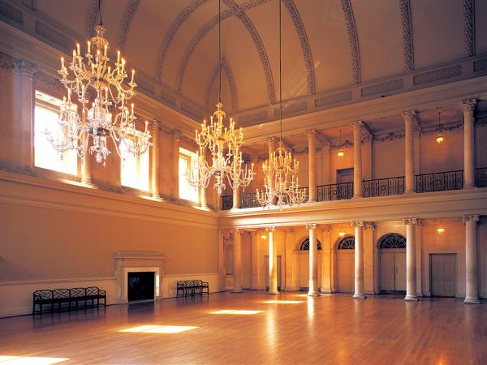
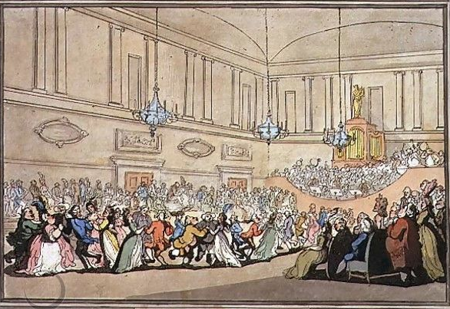
Notes:
Here, salutary rules exclude all those
Whom no one hears of, and whom no one knows;
That no plebian breathings may infect
An atmosphere at all times so select;
No bankers’ clerks these splendid realms invade;
No FOLKS who carry on a retail trade;
No actors by profession must appear
To act their parts, or speak their speeches here;
Yet even here, amid the crowds you view,
’Tis sometimes difficult to tell WHO’S WHO.”
Pierce Egan, Walks Through Bath, 181

Slide 4
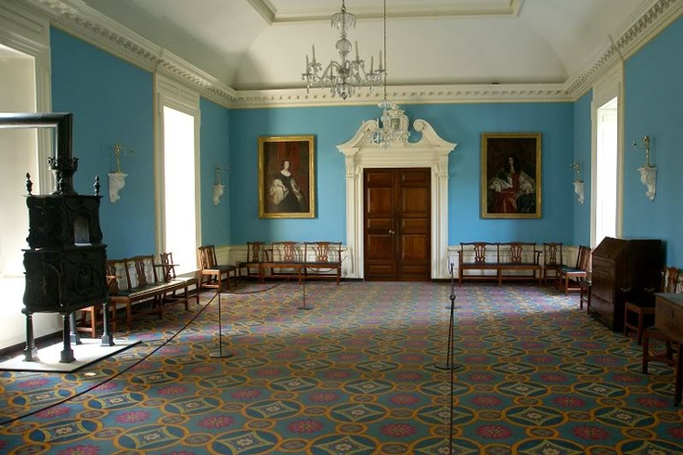
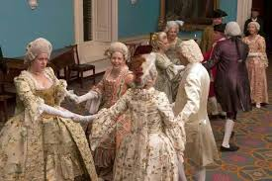
Governor’s House, Colonial Williamsburg, ball room

Slide 5
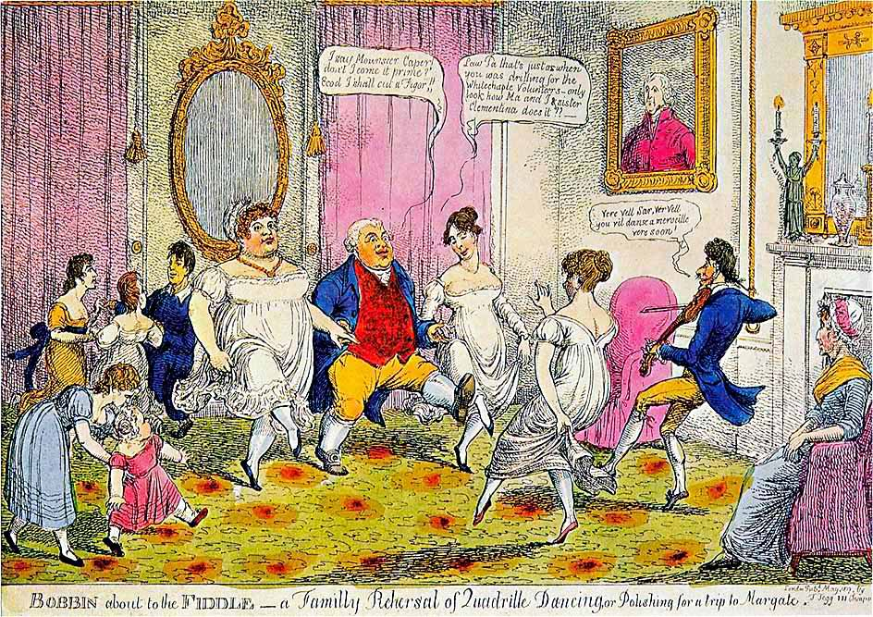
Notes:
“I say Monsouer Caper don’t I come it prime? Ecod I shall cut a figor!”
Law Pa that’s just as when you was drilling for the Whitechapel Volunteers. Only look at how Ma and I and sister Clementina does it.”
Ver vel sir, vere vel. You vil danse a merveileux ver soon.”
“The Season at Margate, for example, commenced on the King’s birthday, formally celebrated in June, and ended in late October, whereas Bath commanded the more fashionable months of October through May. The hours and pricing of the summer balls were usually different from those of the winter. ”
. “

Slide 6
Undressing a Gentleman

Slide 7
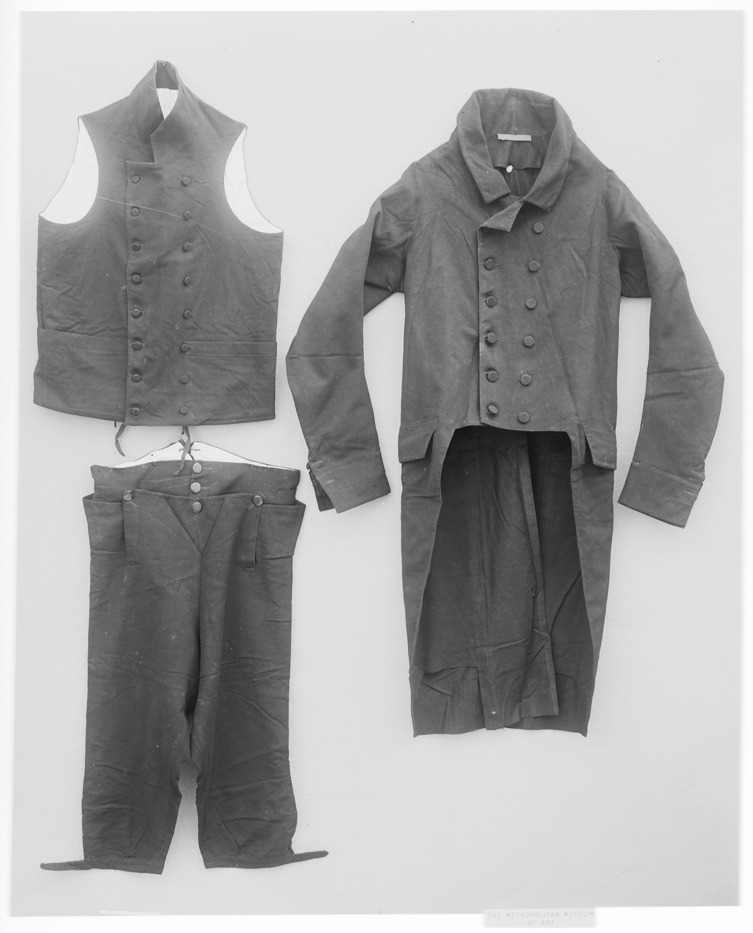
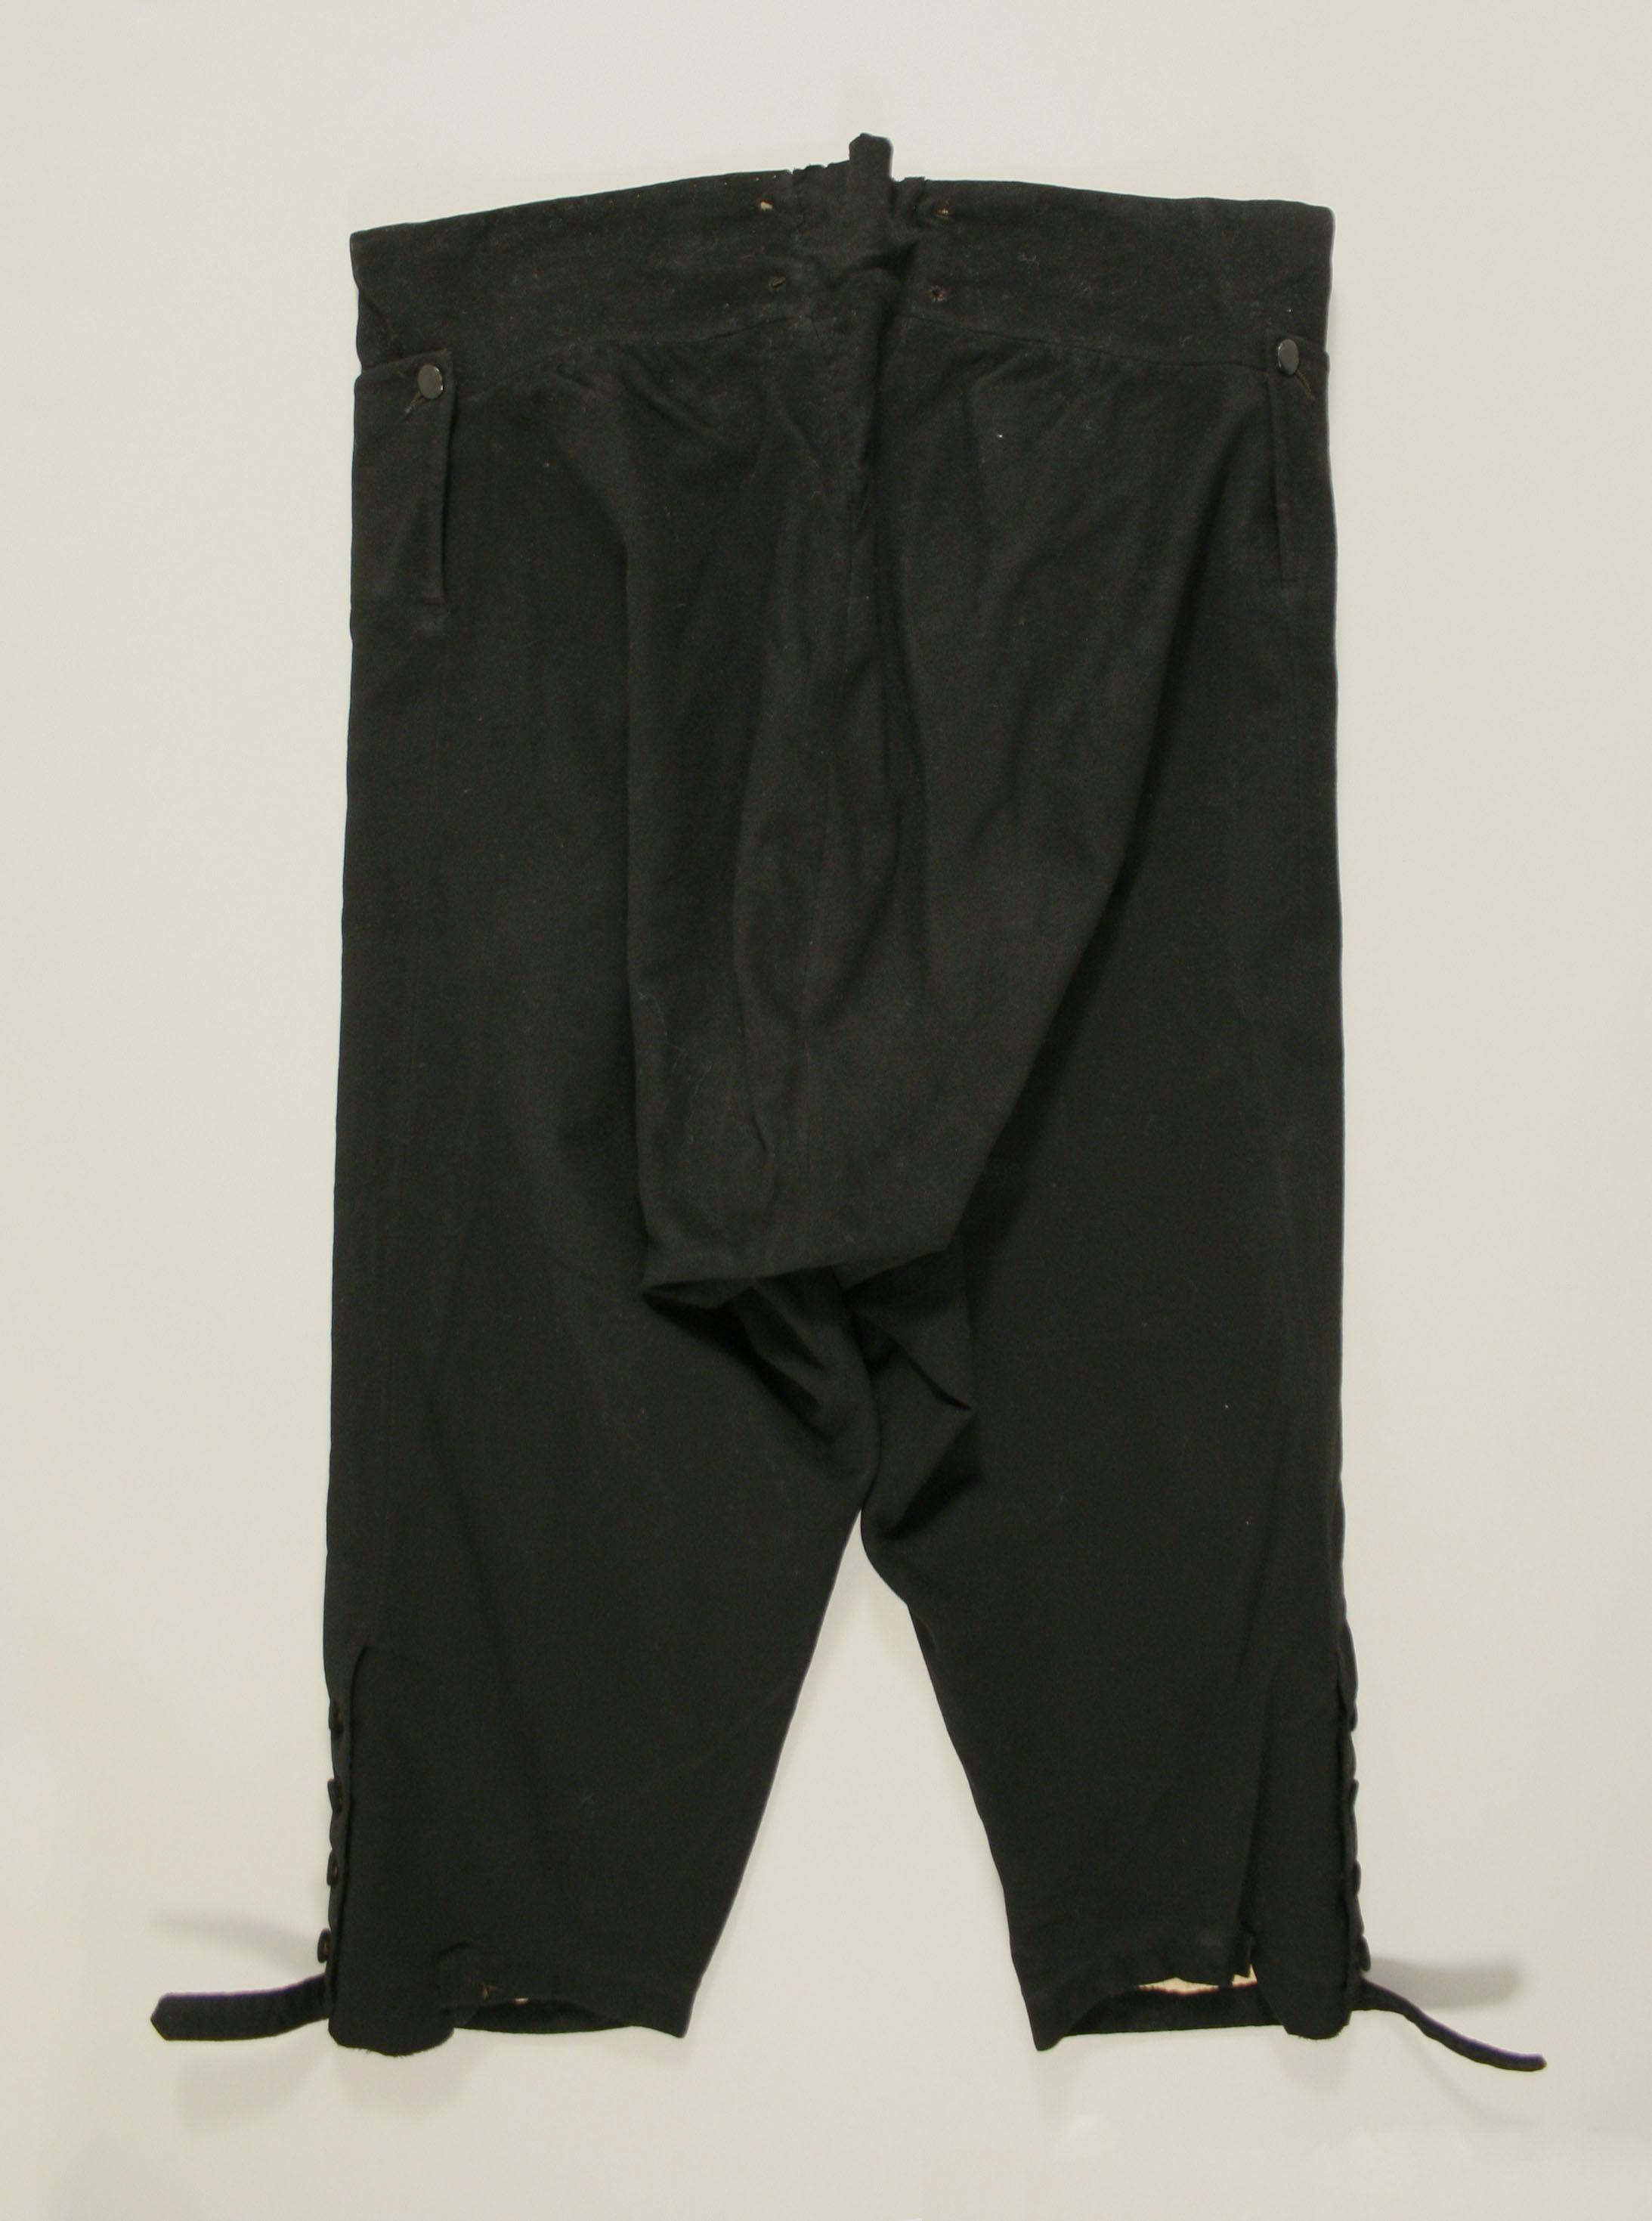
Waistcoat, coat, breeches
Metropolitan Museum, 1810-1820, 08.187.3
Notes:
In general, for the entire period we are looking at, men wore a coat (we’d say “suit jacket”, a waistcoat (vest), breeches

Slide 8
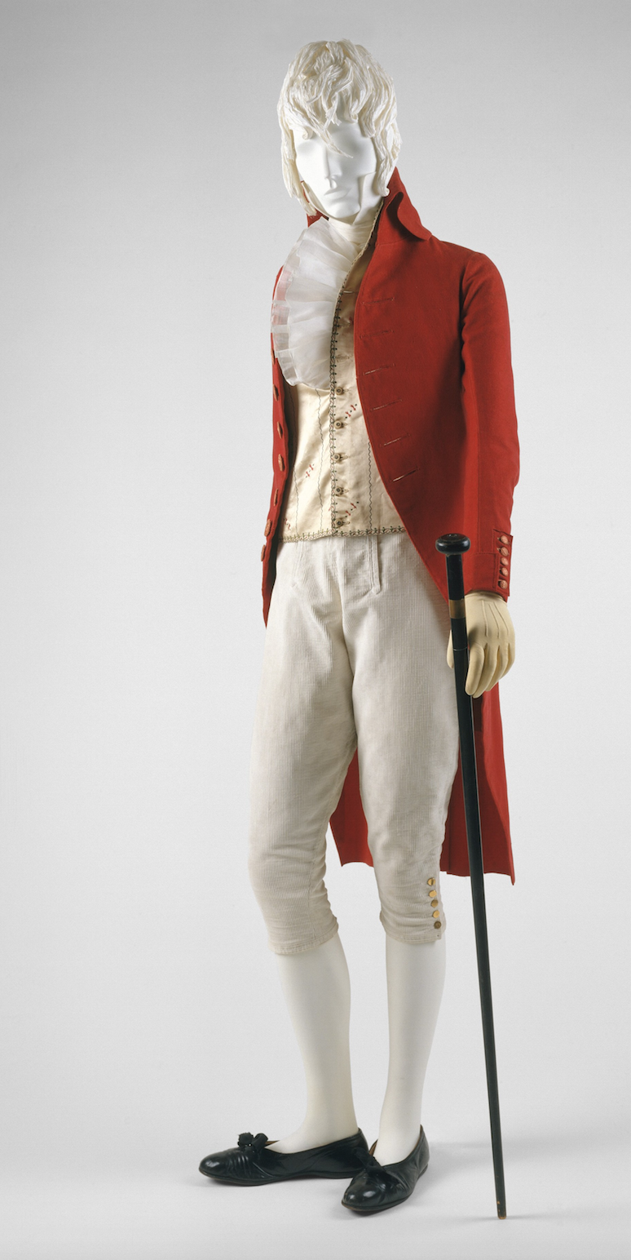
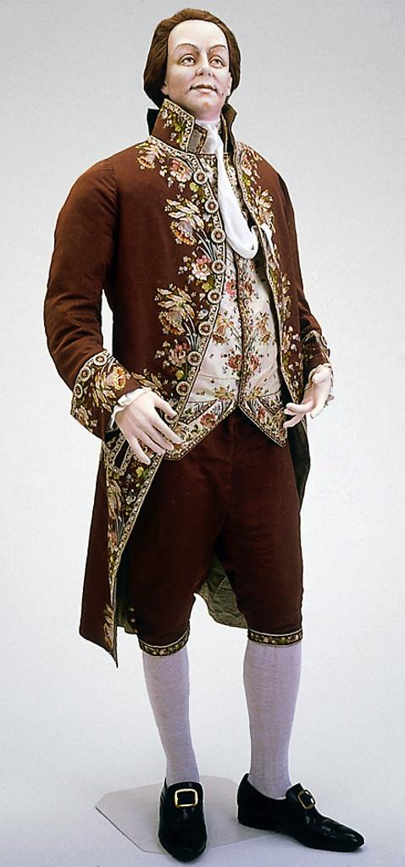
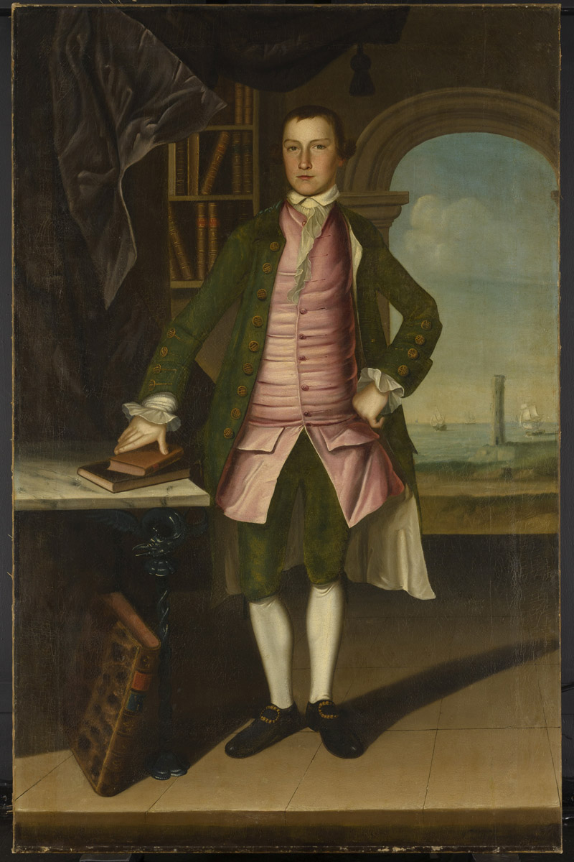
What did men wear?
1790s
1780s
1760s
.
Notes:
Those changed in shape and volume throughout the period. When Bushman mentions a waistcoat that would act as a body-shaping or posture garment he was considering the earlier example. When he talks about a new freedome of movement and ease at the end of the century it is more like the latter.

Slide 9
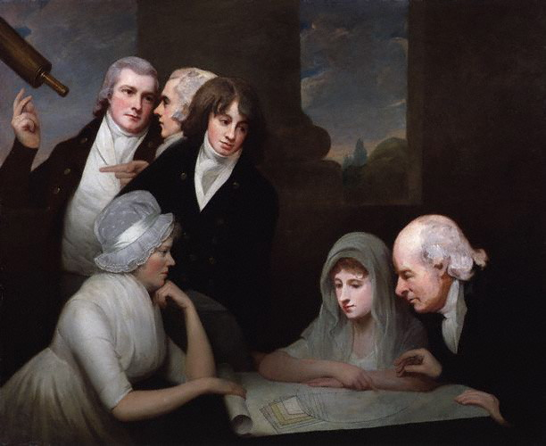
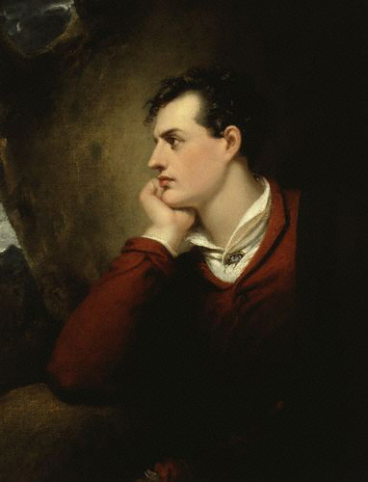
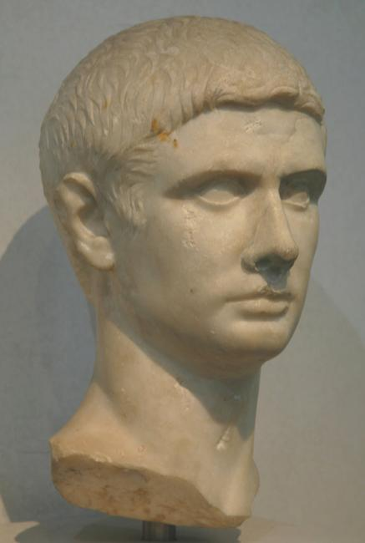
Hair
Notes:
1796 or so, after Pitt’s hairpowder tax of 1795, statue of Titus, Lord Byron. Style names “The Brutus” “The Windswept” “The Stanhope Crop”

Slide 10
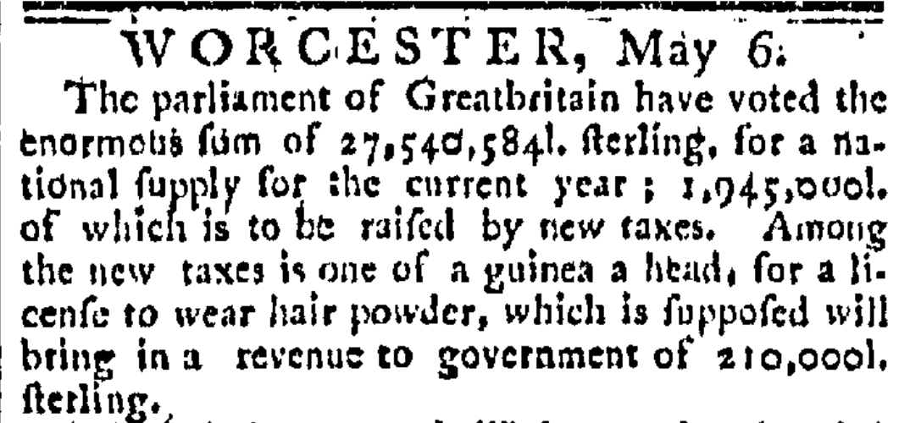
The Worcester GAZETTE. (Worcester, Massachusetts) • 05-06-1795
Notes:
News travels fast
The use of hair powder had been declining and the tax hastened its near death. In 1812 46,684 people still paid the tax, in 1855 only 997 did, and almost all of these were servants. By the time it was repealed in 1869 it yielded an annual revenue of £1000

Slide 11
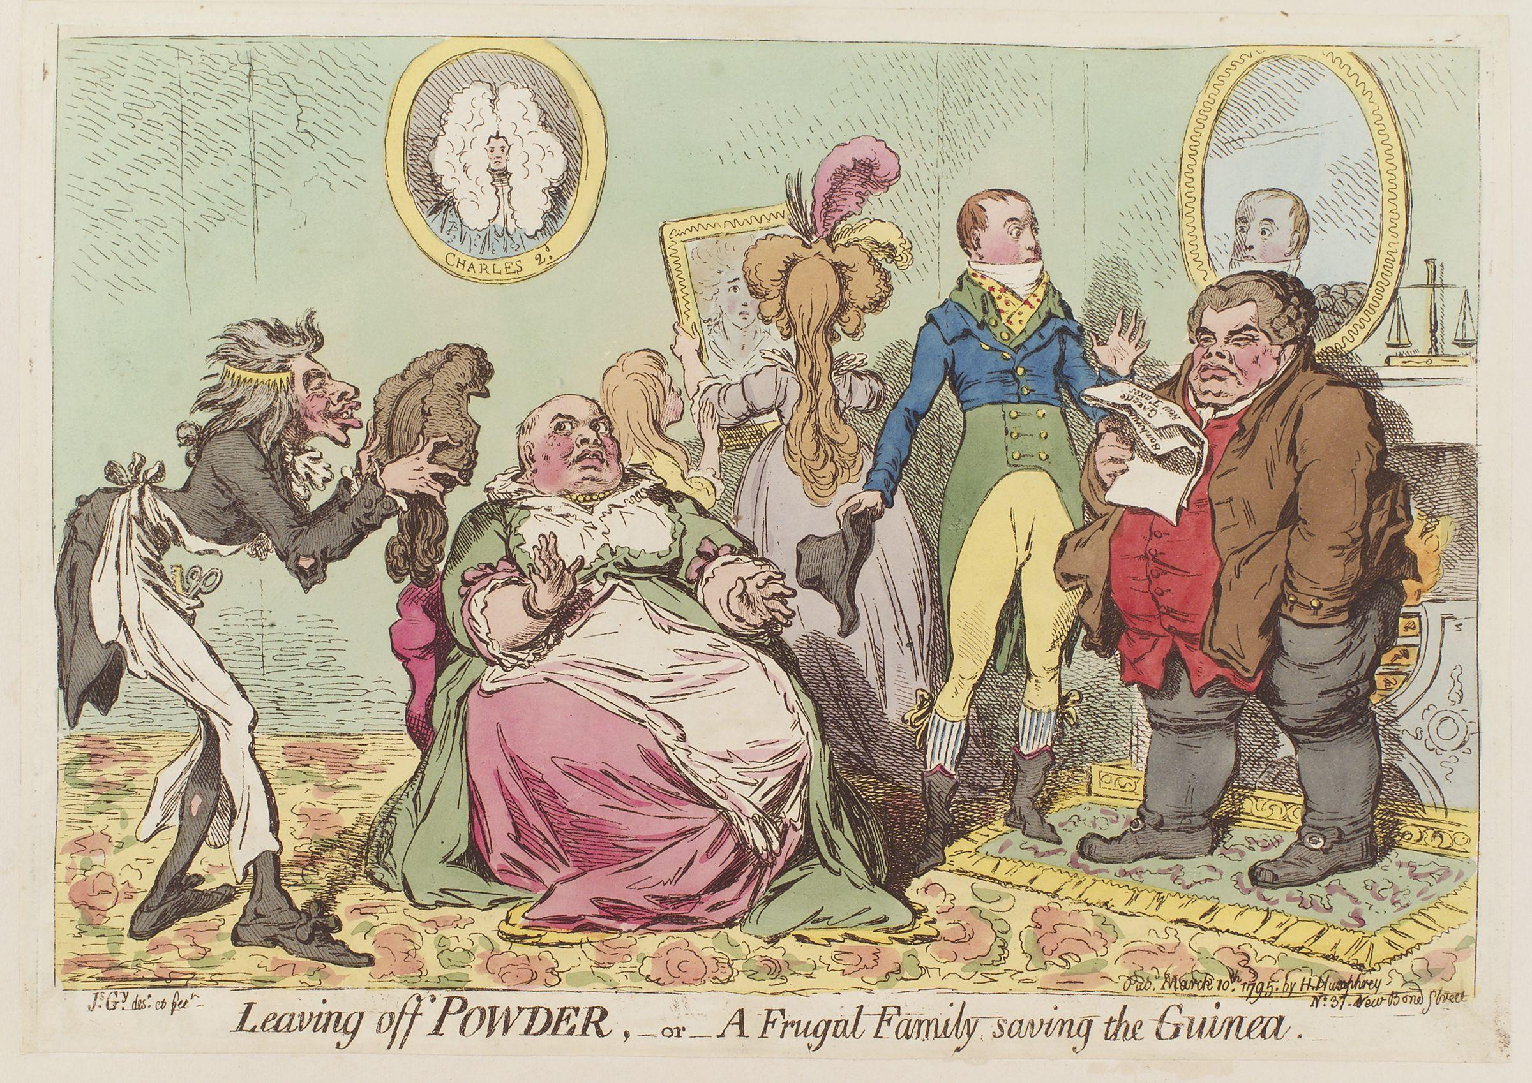

Slide 12
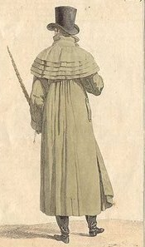
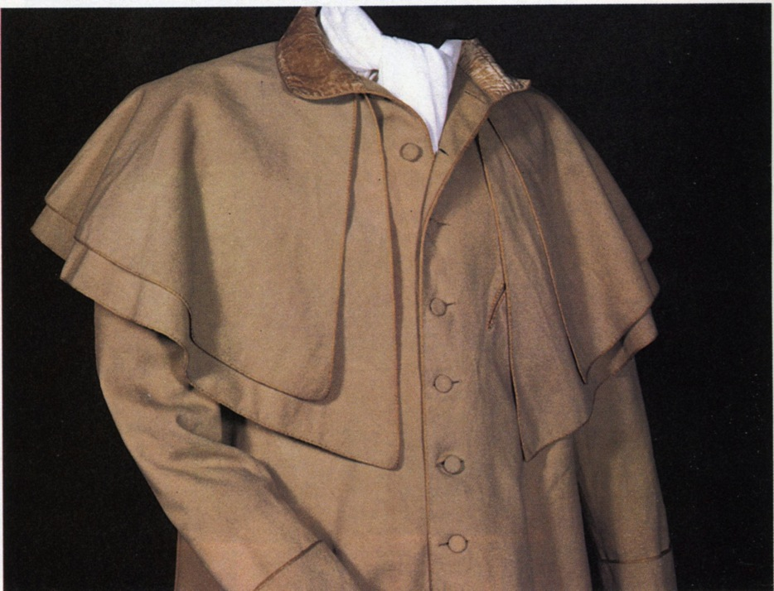
Greatcoat, overcoat
Notes:
Henry can speak of fashion with impunity
A greatcoat was made of “cloth” which was a synonym for wool. The capes were originally designed to keep off rain but they quickly became a fashion statement as well, as Catherine notes with admiration.

Slide 13
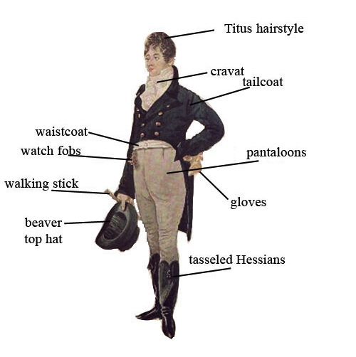
Notes:
1805 Dighton caricature – blue superfine (wool) coat, pantaloons,

Slide 14
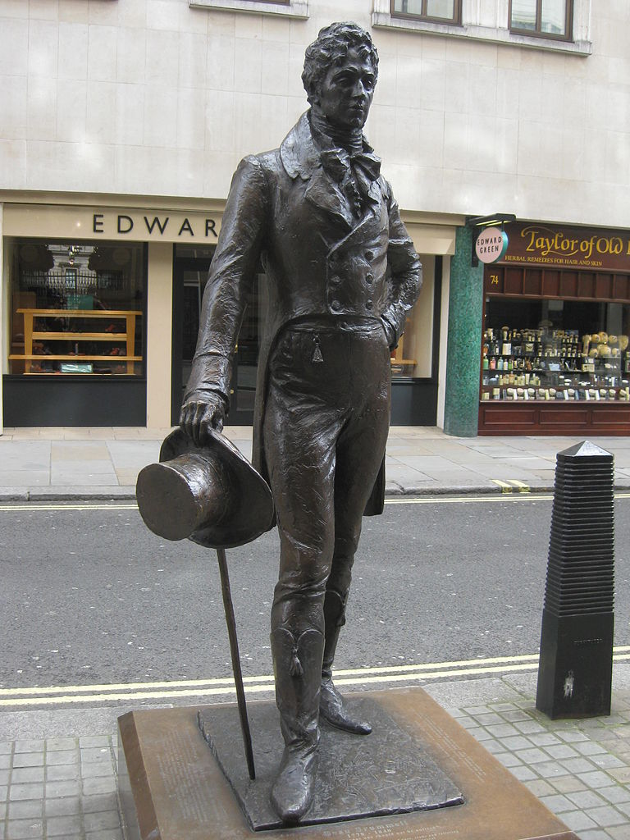
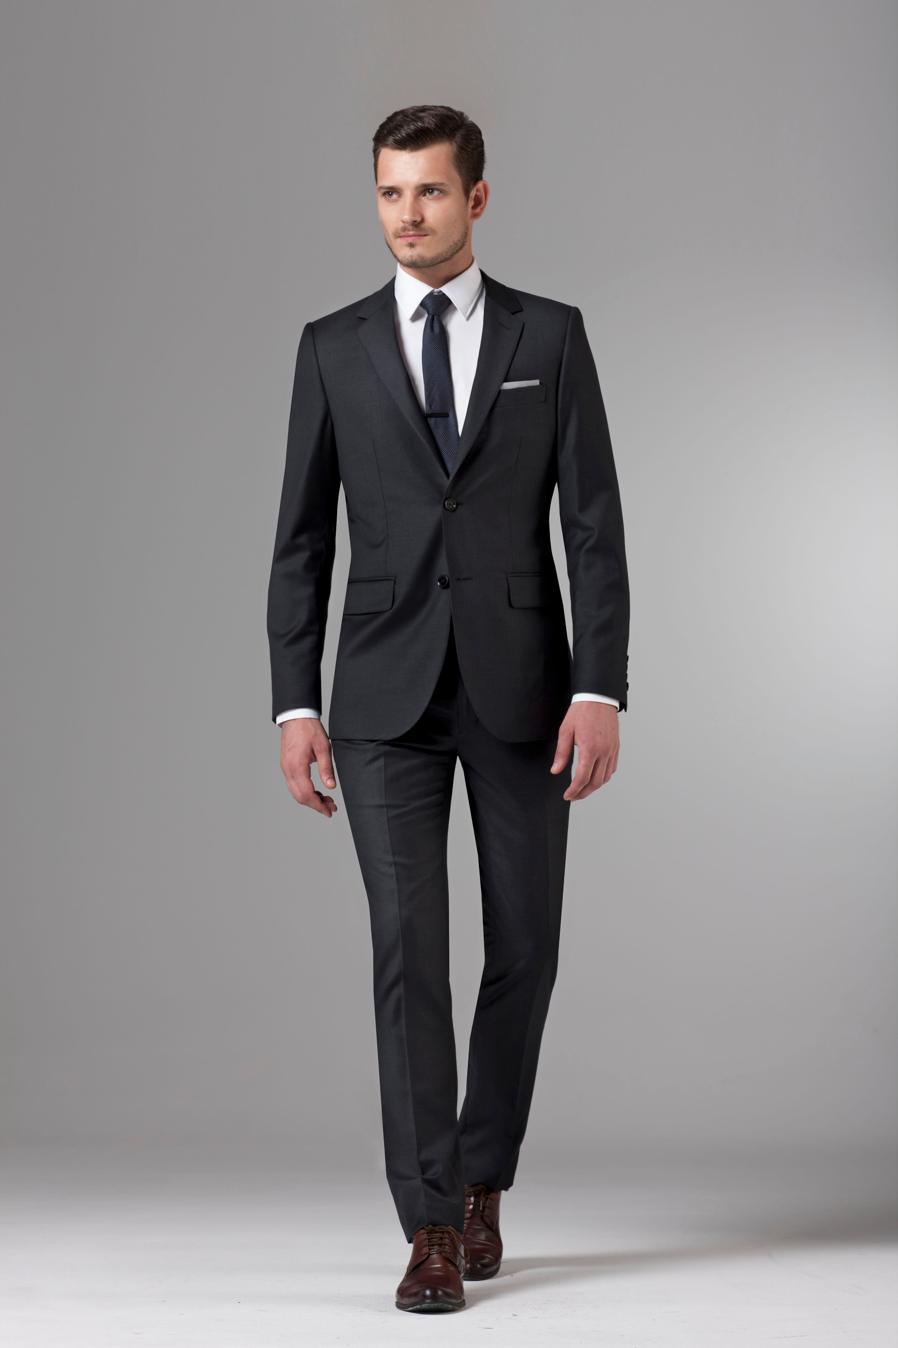
George Bryan “Beau” Brummel
The reason we wear this:
Notes:
George Bryan “Beau” Brummell who almost singlehandedly changed fashion. Friend of the Price Regent, made simple yet exquisitely tailored clothing the mode to be followed, notorious for demanding a full tub bath every day, and a perfectionist when it came to his cravats. see next slide

Slide 15
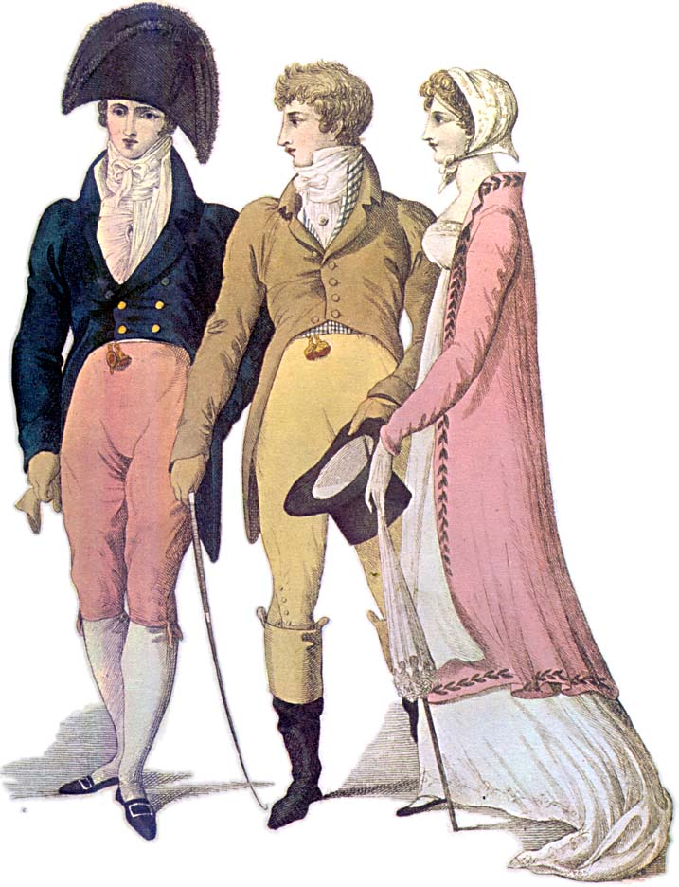
Notes:
1809 – cutaway, swallow-tail, classical statues – the nude male vs. the draped female

Slide 16
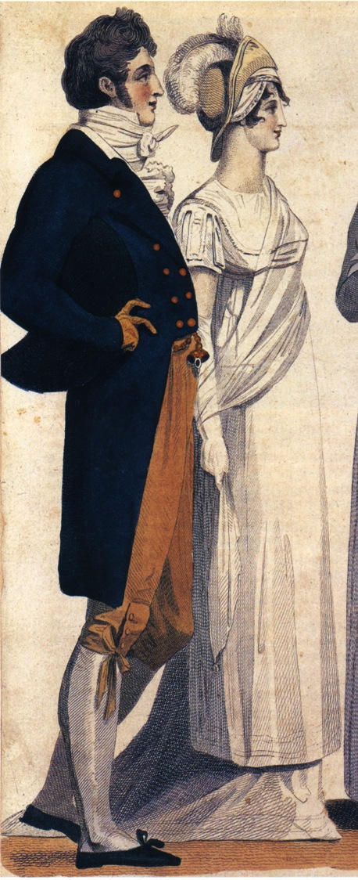
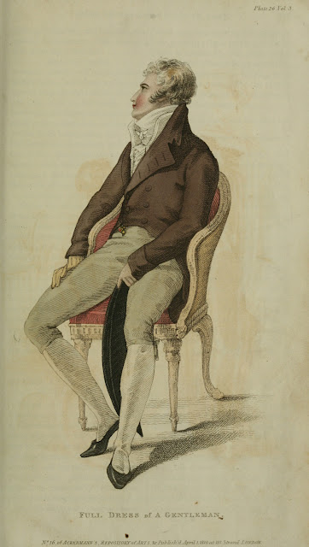
Notes:
1807, 1810, subtle differences in cut of breeches and coat

Slide 17
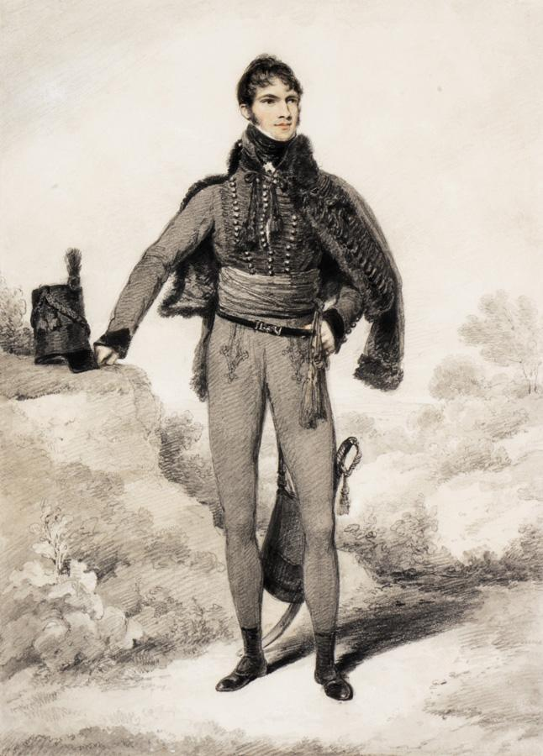
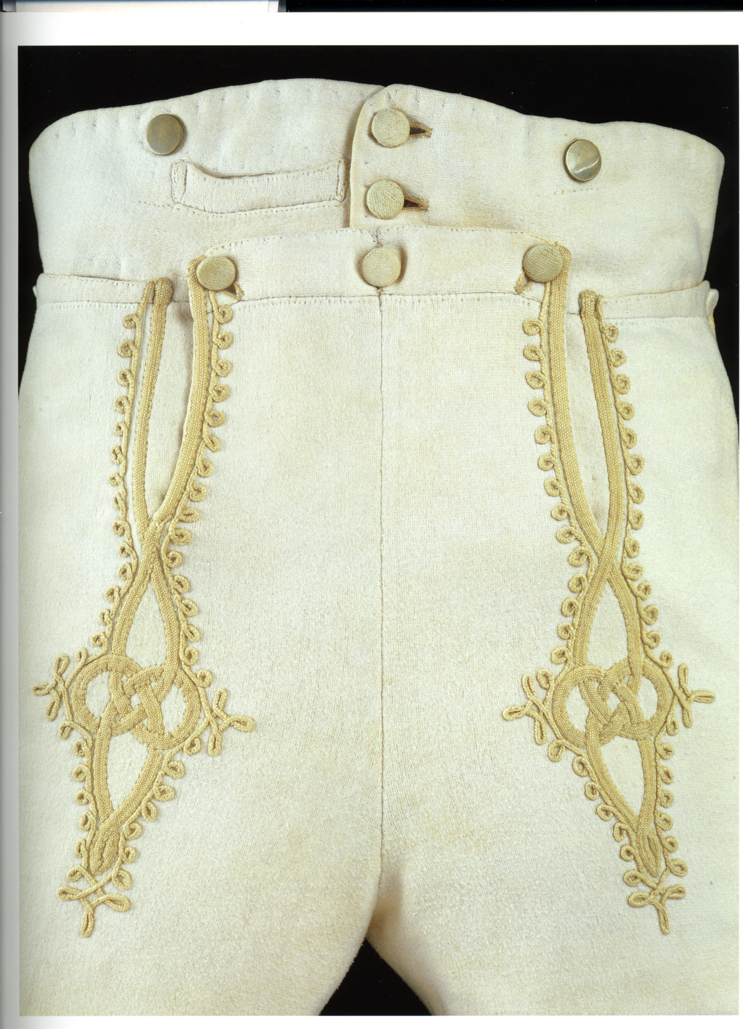
Notes:
Sir William Harbord, 1810 by Edridge, The other major influence on men’s fashion: military pantaloons – wool knit to cling and stretch.

Slide 18
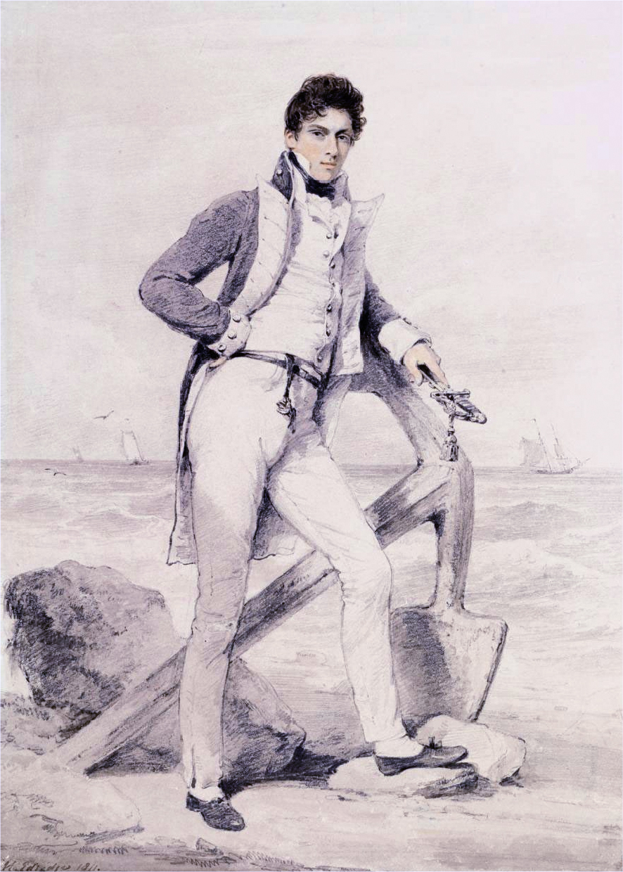
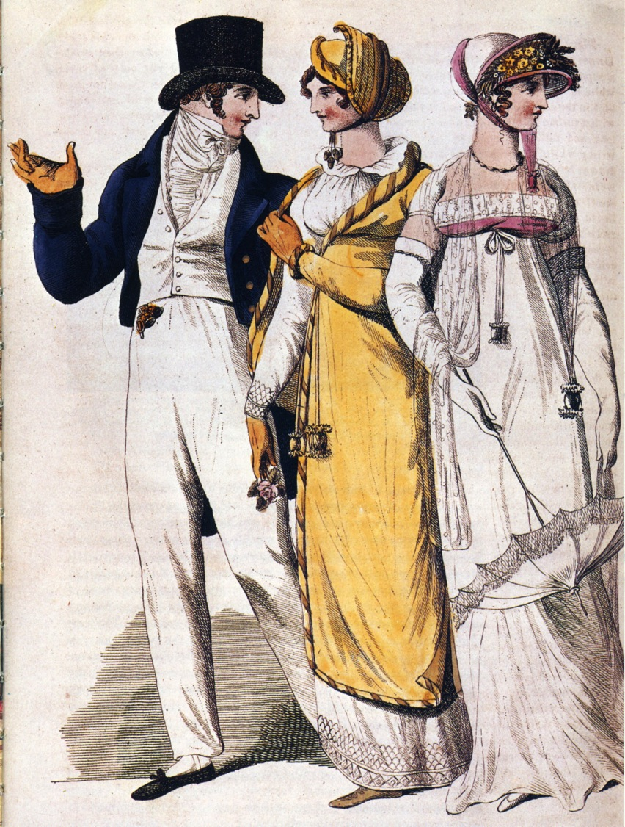
Notes:
Captain Hoste 1811 by Edridge. Sailor’s trousers
People in park, 1807. The young man adopts the Navy uniform look.

Slide 19
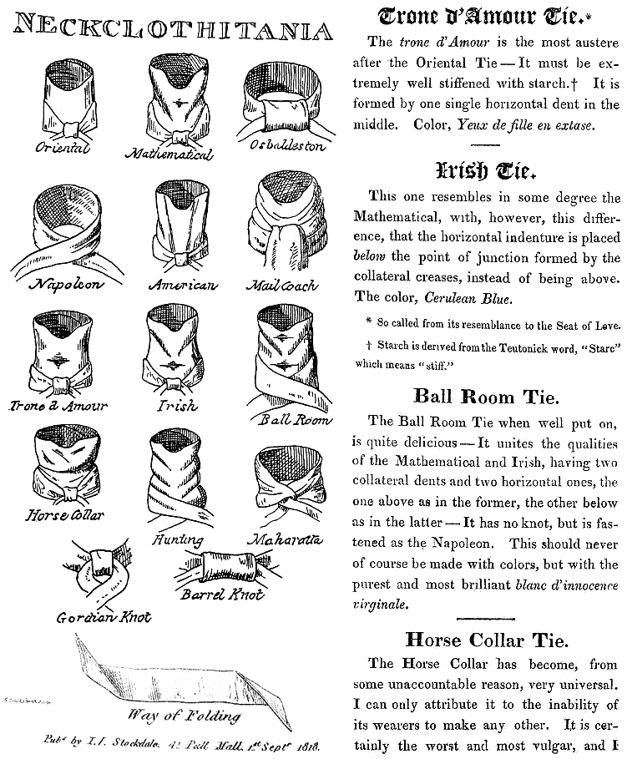
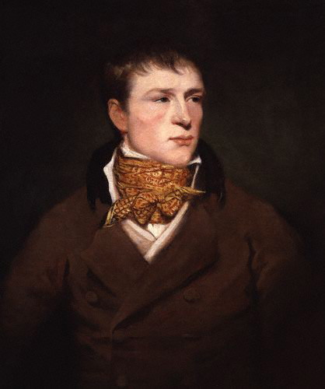
Jem Belcher:
Celebrated Boxer with his trademark spotted neckcloth
Notes:
Some neckcloth styles with fanciful names. The boxing star Jem Belcher with his trademark spotted neckcloth.

Slide 20
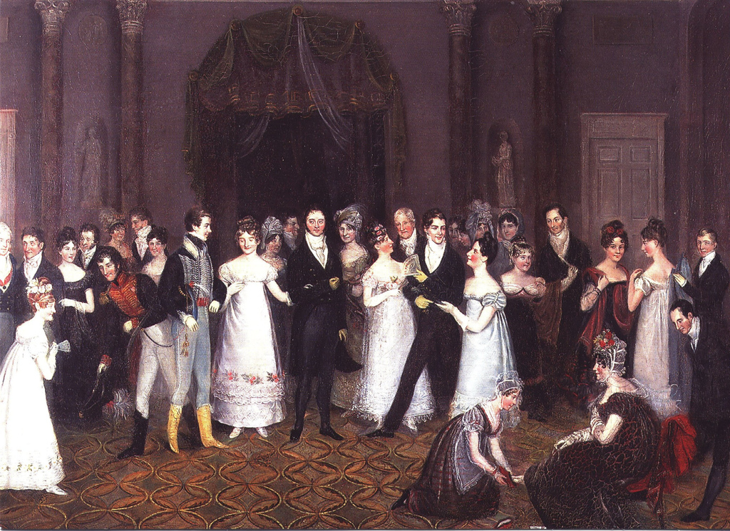
Notes:
Rolinda Sharples “The CloakRoom at the Assembly Rooms at Clifton”1818: Yolanda Shows examples of all mens options. The older gentleman on the left wears grey/light silk breeches, the armu men are in their uniforms with panataloons, the thirty-something husband in the middle wears black breeches while the young flirt wears trousers. Also note the impossibly tiny bodices on the women’s gowns. For more on Clifton Assembly see http://www.thespasdirectory.com/profilego.asp?ref=2841393B

Slide 21
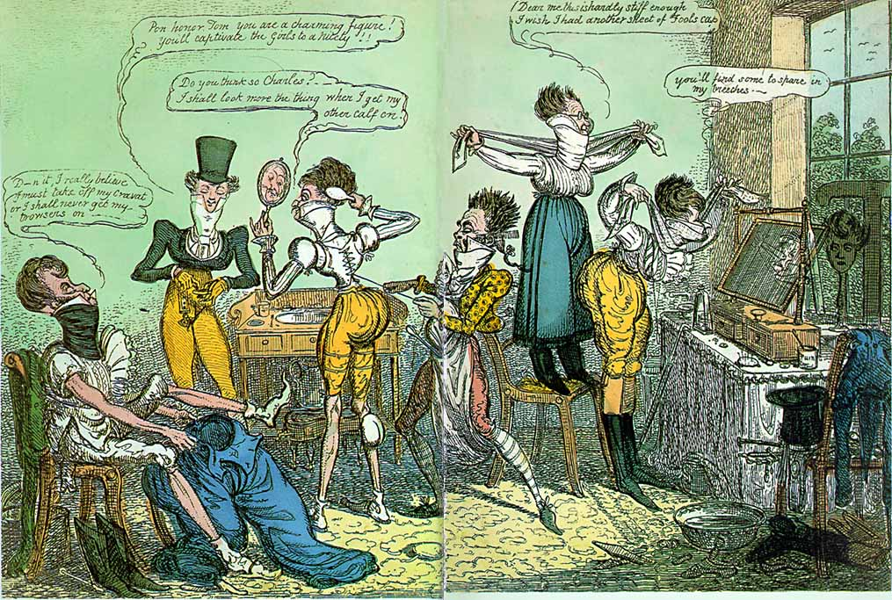
Notes:
1818 Cruickshank

Slide 22
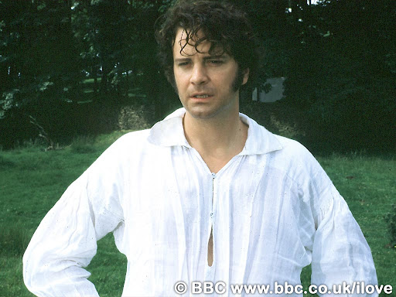

Slide 23
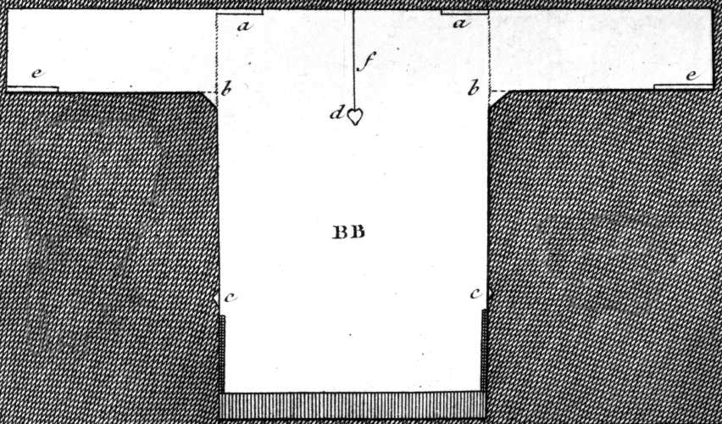
Austen, Thursday, 1 September 1796:
“We are very busy making Edward’s shirts, and I am proud to say that I am the neatest worker of the party.”
Notes:
While many people had their clothing made by tailors (men’s clothing but also women’s riding habits) or modistes/dressmakers, people often made or at least trimmed and finished, their own. But shirts and shifts were usually made by the women in the family. The cut was simple and extremely economical, using all the width of the linen. The “workbasket” was always to hand with shirts/shifts to be sewn.

Slide 24
Dressing a Lady

Slide 25
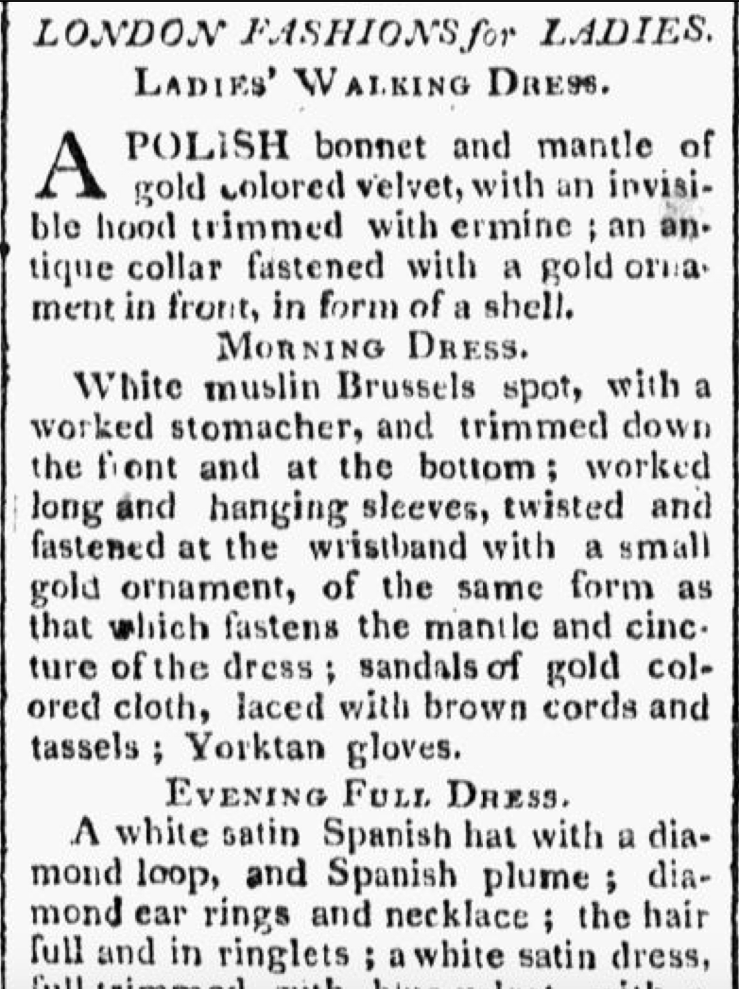
Worcester Gazette. (Worcester, MA) • 06-07-1809
Notes:
How up on the latest fashion were American women

Slide 26
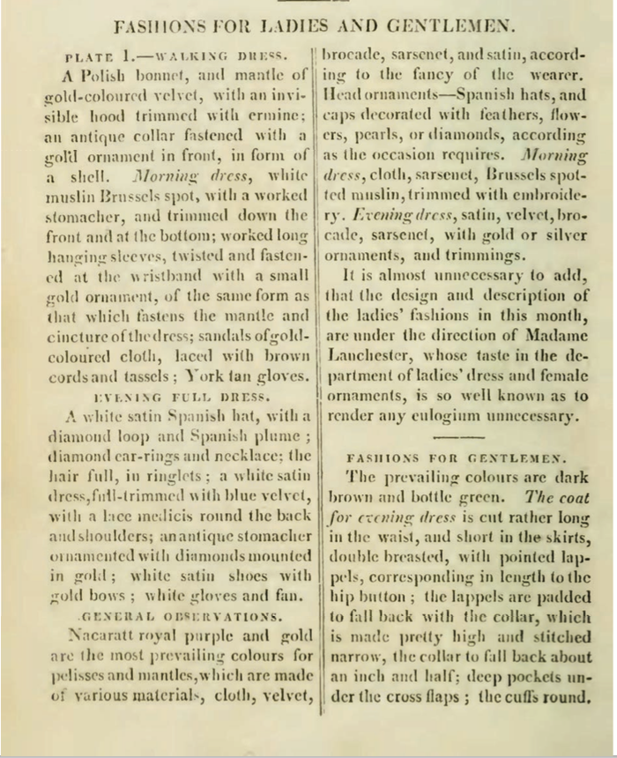
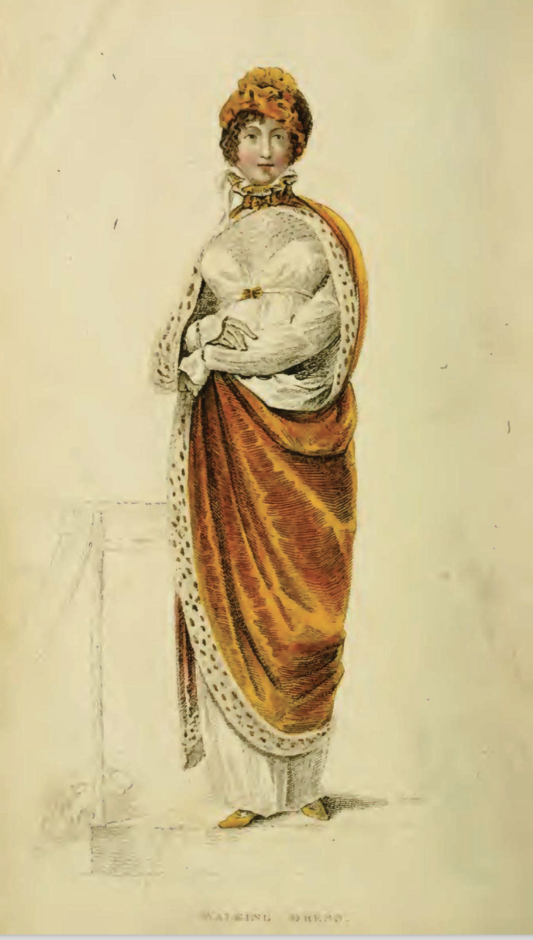
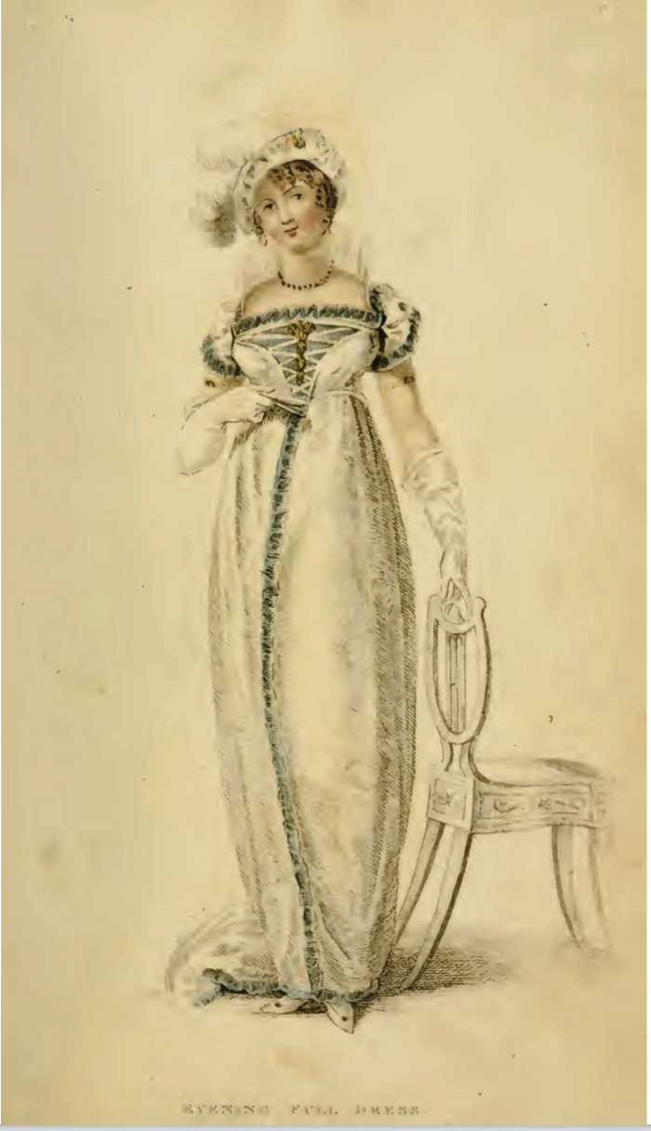
Ackermann’s Repository of the Arts. January 1809
Notes:
January 1809
Show Ackermanns and title: Bushman mentions the importance of being able to converse intelligently on a number of interesting topics
EXPLAIN morning dress, afternoon or promenade, evening/full/ball dress “look”

Slide 27
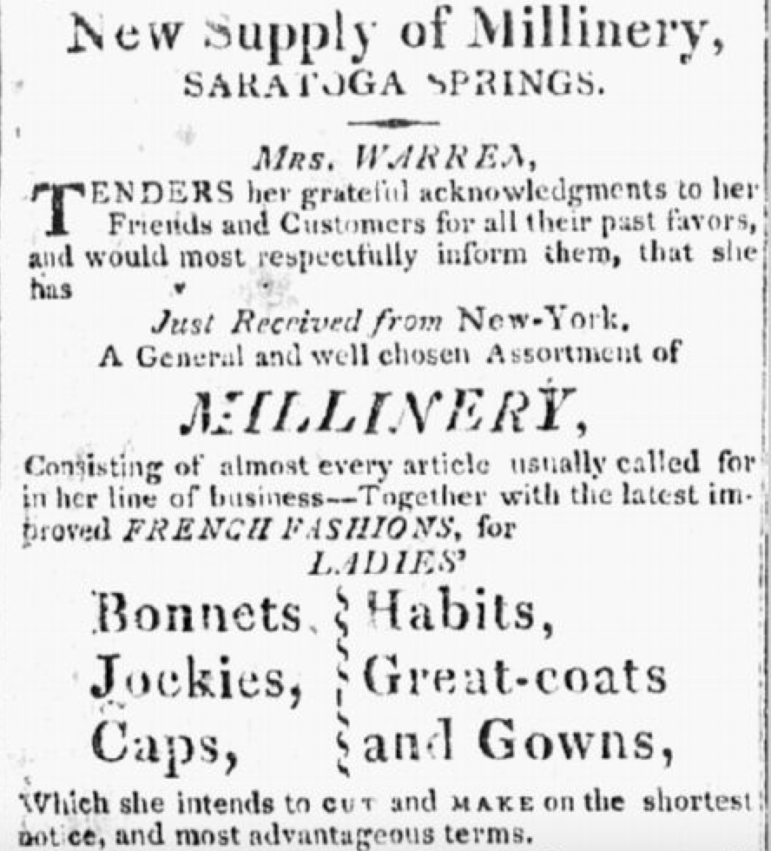
Independent American (Ballston Spa, New York) • 10-05-1814
Notes:
Even in the wilds – there are some from Ohio – but this one will serve as an example

Slide 28
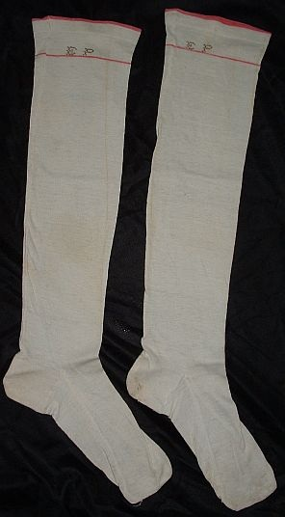
Silk or cotton stockings tied above or below the knee with a silk garter/ribbon.

Slide 29
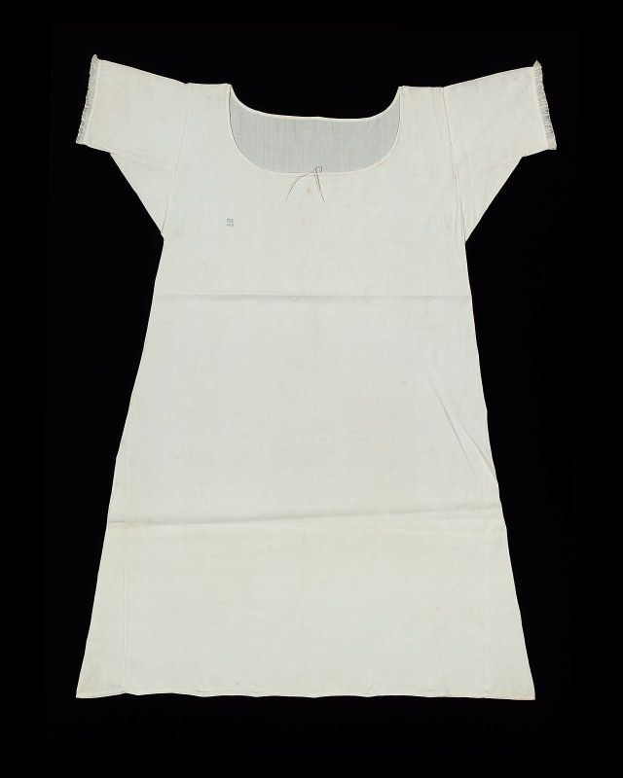
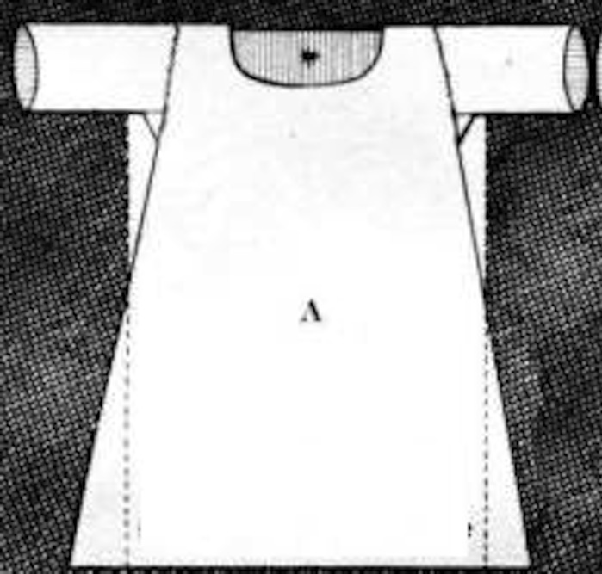
Shift/chemise
Notes:
Wpmens’ shifts were cut similar to men’s shirts but by the 19th century were more a-line.

Slide 30
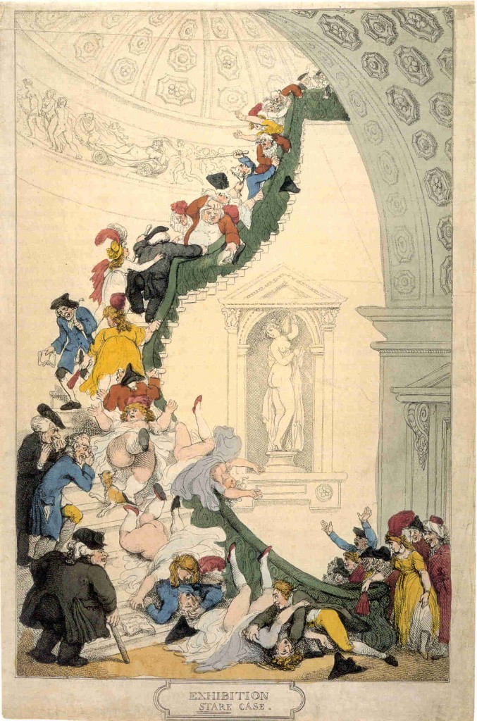
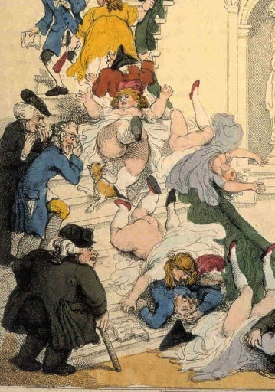
Notes:
Rowlandson, 1800, “Exhibition Stair Case” at Somerset House leading to the gallery of the Royal Academy of Art (pres. Sir Joshua Reynolds)

Slide 31
Cleanliness
La Belle Assemblée, Feb 1806, p. 15:
The Ladies Toilette, or Encyclopedia of Beauty
Of cleanliness--…A careful attention to the person, frequent ablutions, linen always white, which never betrays the inevitable effect of perspiration and of dust; a skin always smooth and brilliant, garments not soiled by any stain, and which might be taken for the garments of a nymph; a shoe which seems never to have touched the ground; this it is what constitutes cleanliness. To this might likewise be added a scrupulous care to avoid every thing that can indicate functions which undeceive the imagination.

Slide 32
The frequent use of tepid baths is not more grateful to the senses than it is salutary to the health and to beauty…By such means do women of the East render their skins softer than that of the tenderest babes in this climate…
This delightful and delicate oriental fashion is now, I am happy to say, embraced almost all over the continent…The generality of English ladies seem to be ignorant of the use of any bath larger than a wash-hand basin.
Mirror of Graces, 1811, p. 32

Slide 33
1775-1830
A fashion timeline
1775-1790: Formal, wide, natural waist
1789-1799: High waists and muslins, full
1800-1810: Greek and Roman, narrowing, vertical
1811-1814: Gothic moves in, decorative trim
1815-1817: Shrinking bodice, more trim
1817-1820: More trim, wider hem with deeper trim
1820s: Waistlines drop, shoulders and skirts go wide
Notes:
covered one of the most tumultuous in fashion history.
Talk about volume – where’s the bulge – fashion silhouettes morph from vertical to horizontal to vertical and back, with an occasional foray into bustles.

Slide 34
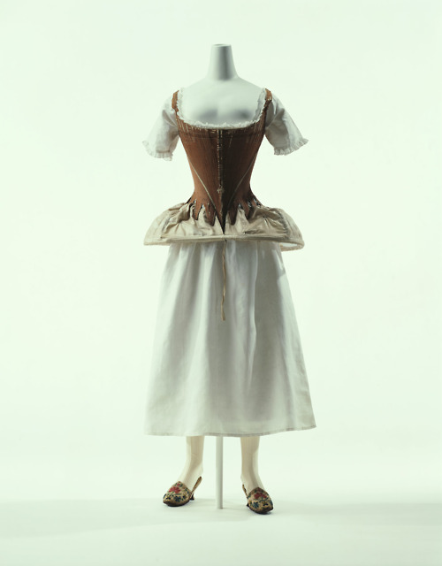
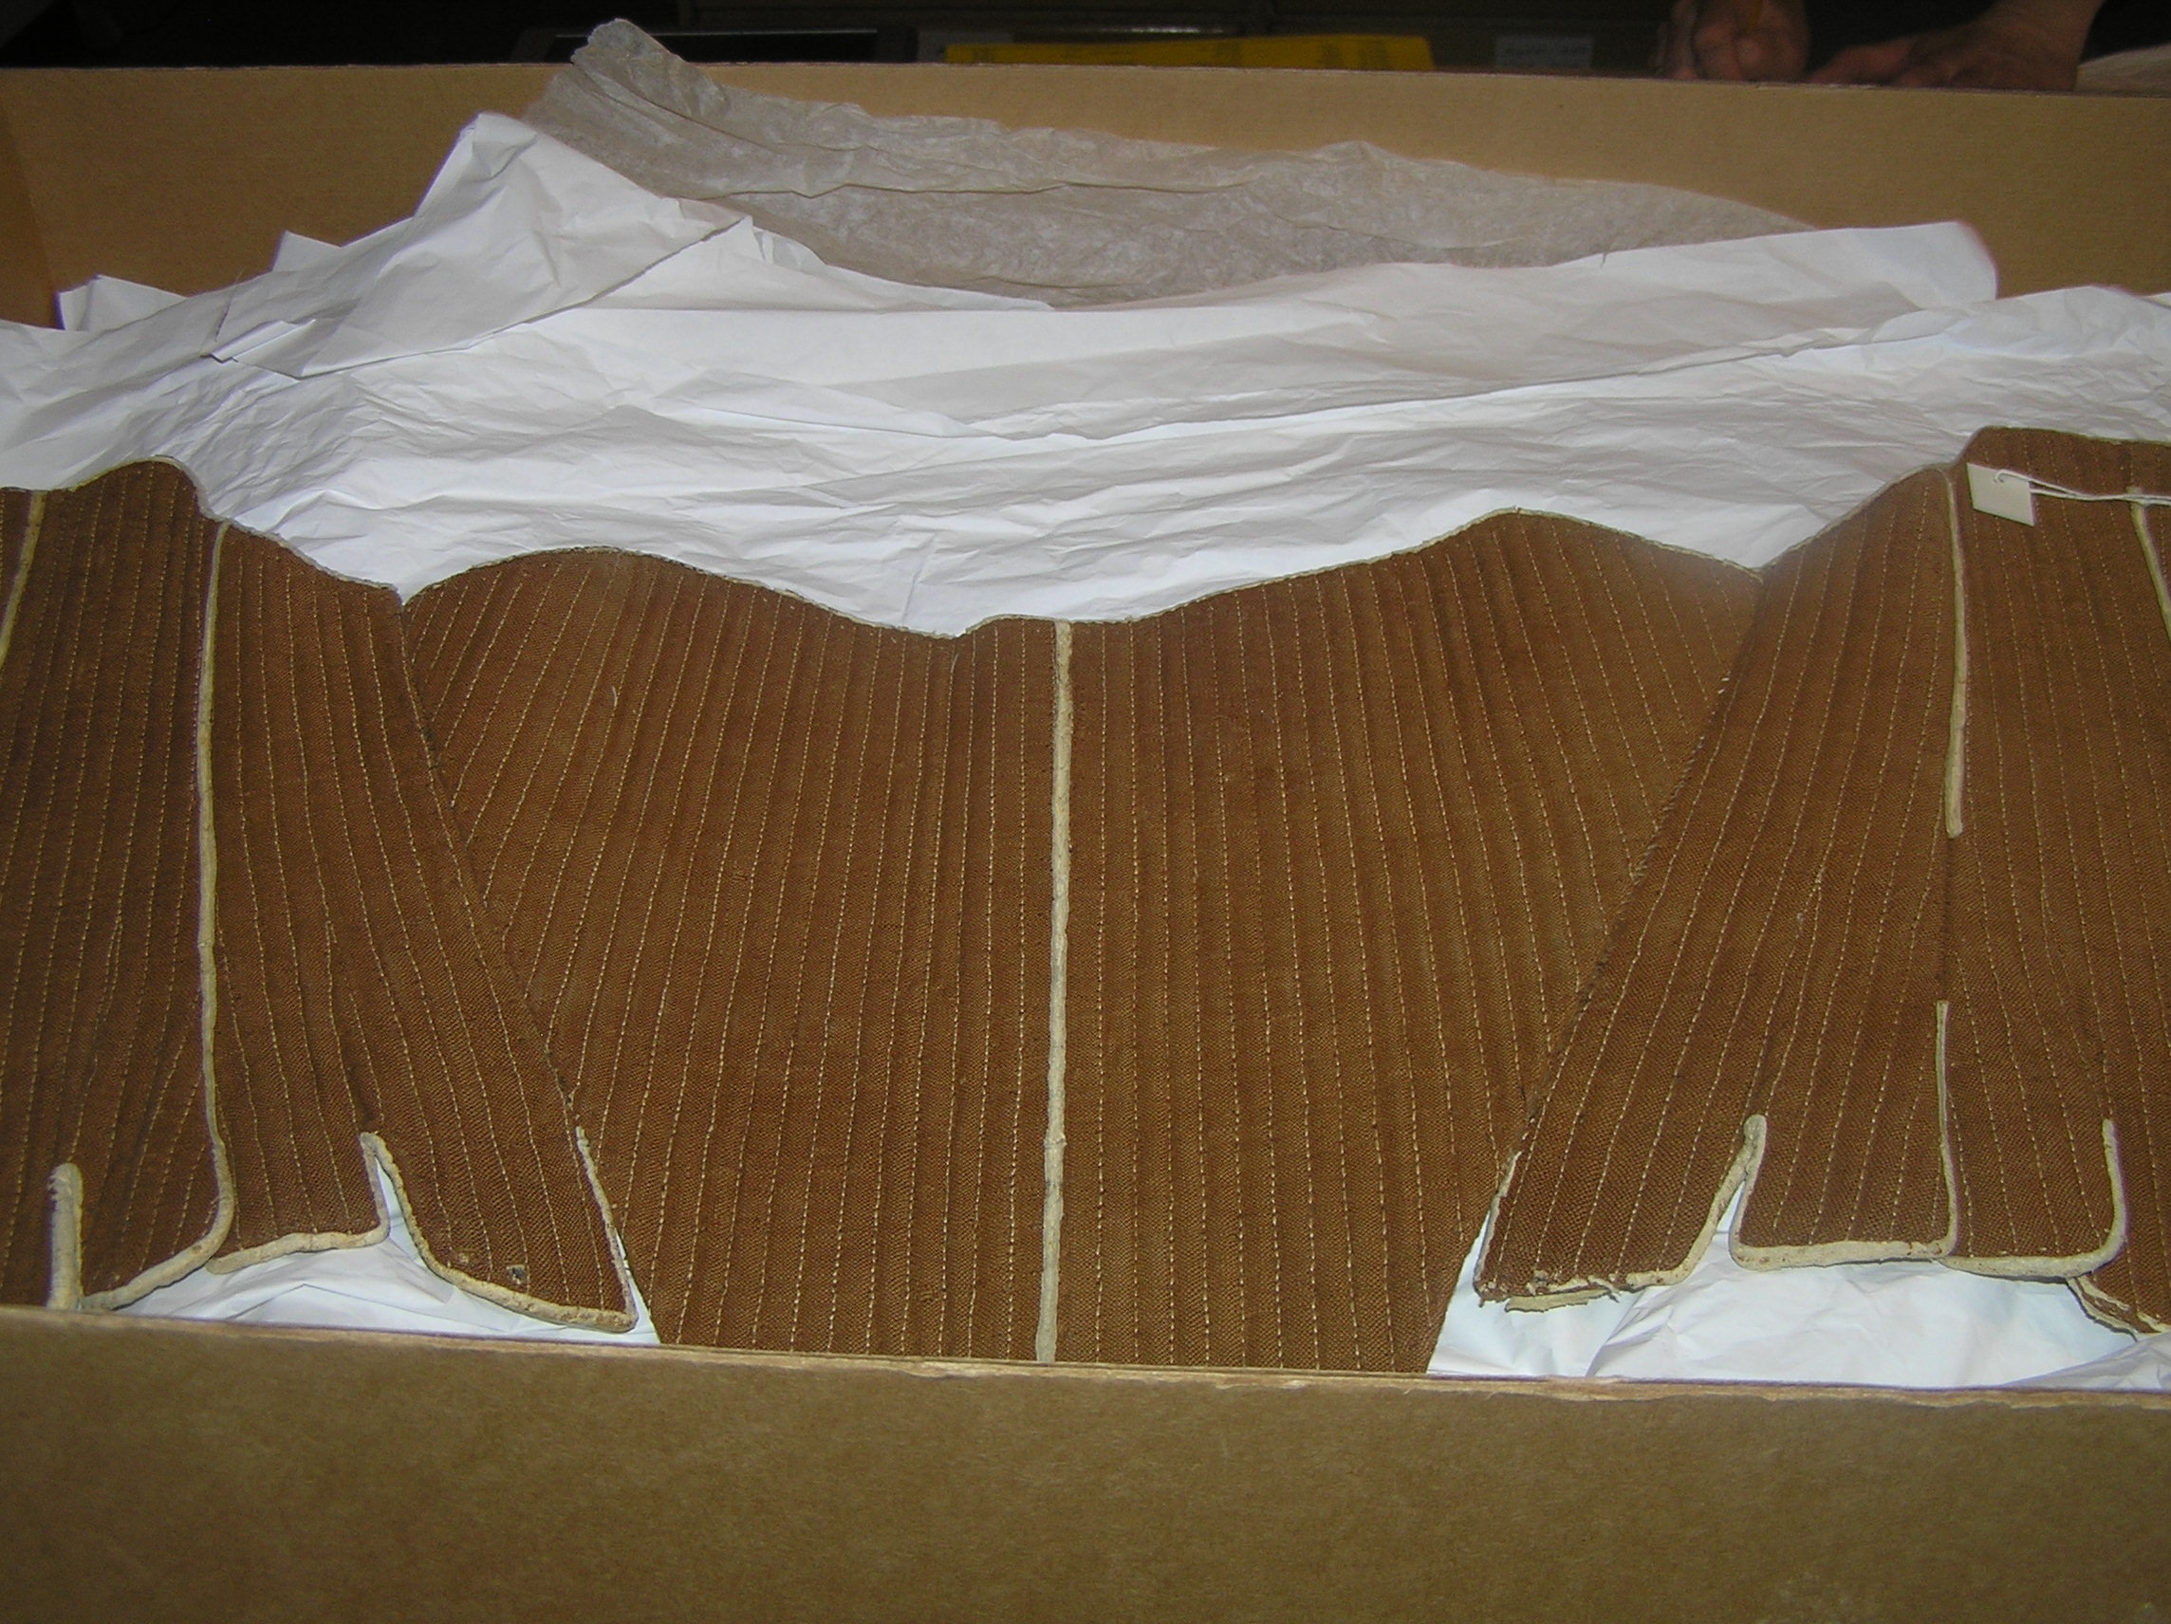
Stays, hoop, shift (Kyoto Costume Museum)
Stays (Fleming Museum)
Notes:
Stays, Hoops and shift – Kyoto Museum. Additional stays, Fleming Museum. Though the cut and boning layout evolved to be quite efficient by centurr’s end, the 18th century corset in general had “wall-to-wall” boning and was designed to create a barrel shape with rounded neckline. It was not about nipping in the waist, although from the front your waist might look smaller (from the side it would look larger).

Slide 35
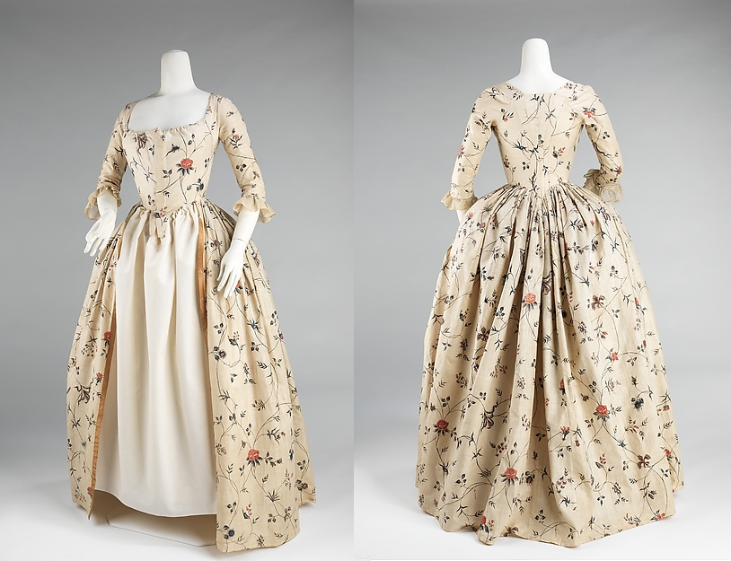
Robe a l’anglaise: 1770s and 1780s
Notes:
A little trip back in time: draping, fitting, shaping. With fitting: 14th cent. Fitted, 15th - vertical, 16th - horizontal, vertical, horizontal. Since the 16th century women have been using stays or corsets for both support and for shaping. The shape and design of the stays or corsets provides the foundation for the shape of the clothing.

Slide 36
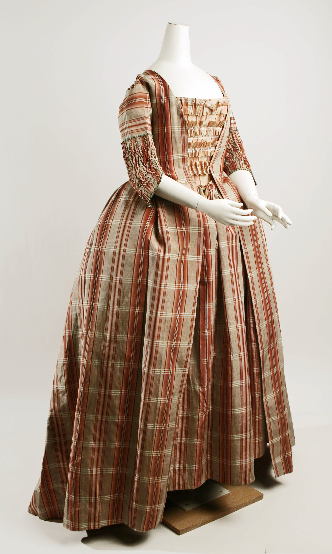
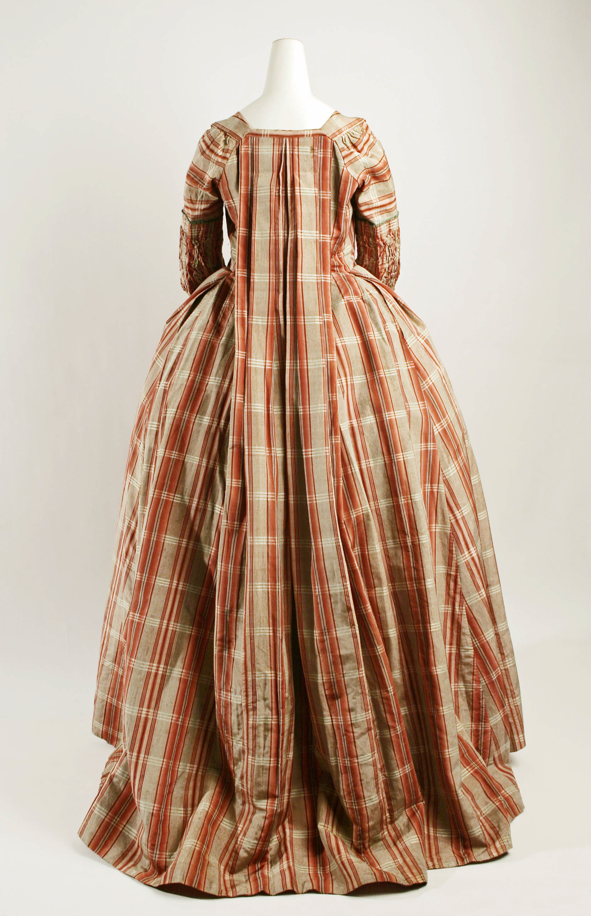
Robe a la francaise: 1770s and 1780s
Notes:
A little trip back in time: draping, fitting, shaping. With fitting: 14th cent. Fitted, 15th - vertical, 16th - horizontal, vertical, horizontal. Since the 16th century women have been using stays or corsets for both support and for shaping. The shape and design of the stays or corsets provides the foundation for the shape of the clothing.

Slide 37
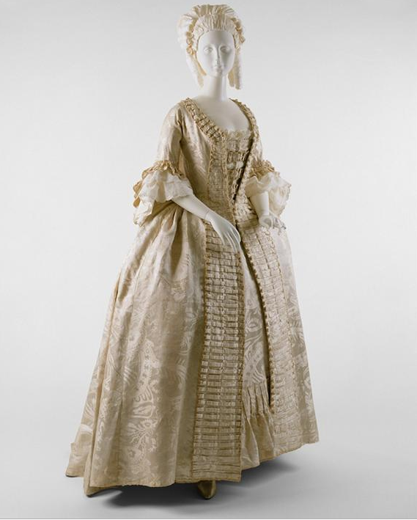
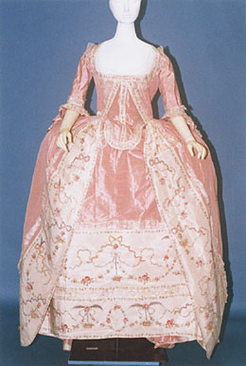
Notes:
Later 18th (1770s) with petticoat and stomacher matching gown.

Slide 38
1790s
Notes:
1790

Slide 39
1780s
Chemise
Dress
Notes:
Marie Antoinette’s “chemise dress” Portrait by Elisabeth Louise Vigée-LeBrun,(Veejee lebron) dress by Rose Bertin
August 1784: Georgiana, Duchess of Devonshire, wears a chemise a la reine to a concert
Comtesse DuBarry
Jacques Louis David (1748-1825) “Antoine-Laurent Lavoisier (1743–1794) and His Wife (Marie-Anne-Pierrette Paulze, 1758–1836)
Date: 1788

Slide 40
Notes:
Open robe 1790, still fairly structured, higher waist, full petticoat, corset to suit, with ‘tail’ to hold skirt out at back.

Slide 41
1794
Notes:
Watch the sleeves – they are still elbow length. That will change, of course.

Slide 42
Notes:
Even in America the trend towards a higher waist was followed, though in this case the construction of the back of the gown remained the same.

Slide 43
Notes:
As the 1790s progress we move into a transition gown. It is high waisted but still very full. The fabric is lightweight cotton or muslin and hair is big!

Slide 44
1790s: Big hats, big hair, big feathers
Notes:
When Austen was writing her early novels this is what she was seeing and wearing.

Slide 45
Notes:
The brown embroidered and sequined silk dress is a round gown – i.e. the dress is closed all the way around without a front opening.

Slide 47
1800: big feather but small hair, narrower silhouette
Austen, Wednesday, 18 December 1798:
“I believe I shall make my new gown like my robe, but the back of the latter is all in a piece with the tail, and will seven yards enable me to copy it in that respect?”

Slide 48
Round Gowns, c. 1800 (Colonial Williamsburg): trains, gathers to make shape, elbow-length sleeves
Notes:
Note transitions style – high waist, gathered front cut all of a piece

Slide 49
c. 1795-1800 American (Fleming Museum)

Slide 50
Notes:
A generational reaction of horror! In one generation we went from wide and heavy to narrow and light in an exceedingly short amount of time. But it didn’t stop there.

Slide 51
Notes:
1797-boilly-incroyables-merveilleuses

Slide 52
Why?
Was it the Greek statues?
Was it the French revolution?
Was it the Indies (East and West)?
Was it new technology?
Was it politics?
Was it the price of muslin?
Notes:
But the greatest change to note was that to muslin – not American – this is mull
England – wool, Greek drapery, American egalitarianism, French freedom and egalite, West Indies – slave cotton, East Indies – true Indian muslins (Bangladesh suppression), better thread, better weaving, better quality, cheaper to produce.

Slide 53
Notes:
Fashion plates emphasize the vertical by making women into giantesses.

Slide 54
1800-1808: tall and narrow, less fabric, trains
Notes:
Still lots of fabric gathered at waist but the silhouette is definitely vertical, the greek column ideal
1) 1800-artstor-AMICO_CLARK_103902762
1) 1800-artstor-pinkback-AMICO_CLARK_103902764

Slide 55
Austen, Tuesday, 8 January 1799:
“I am not to wear my white satin cap to-night, after all; I am to wear a mamalone [mameluke] cap instead…It is all the fashion now; worn at the opera, and by Lady Mildmays at Hackwood balls.”
(…and yes, they do turn up in the fashion news in America!)
Notes:
Warrior caste in Egypt defeated by Napoleon at the Battle of the Pyramids, 1798 “On July 1, 1798, Napoleon landed in Egypt with 400 ships and 54,000 men and proceeded to invade the country, as he had recently invaded Italy. But this Egyptian invasion was to be different. For, in addition to soldiers and sailors, Napoleon brought along 150 savants — scientists, engineers and scholars whose responsibility was to capture, not Egyptian soil, but Egyptian culture and history.” The ladies picked up the turban almost immediately.
In former ages it seemed requisite that every lady should cut out her garments by a certain erect standard. ..But in our days, an English woman has the extensive privilege of arraying herself in whatever garb may best suit her figure or her fancy. The fashions of every nation and of every era are open to her choice. One day she may appear as the Egyptian Cleopatra, then a Grecian Helen; next morning the Roman Cornelia; or, if these styles be too august for her taste, there are Sylphs, Goddesses, Nymphs of every region, in earth or air, ready to lend her their wardrobe.
Mirror of Graces, 1811 (p. 52)

Slide 56
“She [Madame Bonaparte] has made a great noise here, and mobs of boys have crowded round her splendid equipage to see what I hope will not often be seen in this country, an almost naked woman.”
Rosalie Calvert, Baltimore
Notes:
So, gowns are becoming narrow and lightweight, thin cotton
1803 married
Dress from 1804

Slide 57
Notes:
1810 “A scene taken from nature in Kensington Gardens” Gillray commenting on lightweight cotton and flimsy petticoats.

Slide 58
Notes:
James Gillray (1757-1815)

Slide 59
The year 1740, a Lady’s full dress of Bombazeen. The year 1807, a Lady’s undress of “Bum-Be-Seen.”
Notes:
The year 1740 a Lady’s Full Dress of Bombazeen. The year 1807 a Lady’s Undress of Bum-be-seen (Full dress refers to formal dress, undress refers to daytime clothes but her it refers to rather more…or less as the case may be.

Slide 60
Notes:
Corset and stockings, two layers of linen, channels of baleen or cord, single spiral laced, busk (thin wooden stick about 1-2”wide – great for posture)

Slide 61
Notes:
So what do you wear under those lightweight narrow gowns? What is the ideal and how do you achieve it: columns
This corset is missing it’s busk and boning but you can see that it has few bone channels and a gathered bodice like the gowns under which it would have been worn.

Slide 62
Notes:
Unlike the ornate petticoats of the earlier 18th cent, turn of- and early 19th century petticoats were sometimes meant to be seen, sometimes not.

Slide 63
Gowns? In a minute.
First, some accessories and outerwear:
Caps
Chemisettes
Bonnets
Reticules
Shoes
Spencers, Pelisses, Greatcoats

Slide 64
Caps: to keep your hair clean, to wear under bonnets or for at home.
Notes:
Caps for sleeping, caps for morning wear, caps to wear under bonnets, even evening at homes. Morning wear caps could be quite ornate with embroidery, lace, ribbons, and flowers.

Slide 65
Chemisette
Notes:
A fine cotton lawn (rarely ever linen) garment meant to fill in the neckline. Usually worn for day dress.

Slide 66
Sunday, 2 June 1799:
“Flowers are very much worn, and fruit is still more the thing. Elizabeth has a bunch of strawberries, and I have seen grapes, cherries, plums, and apricots.”
Tuesday, 11 June 1799:
“I cannot decide on the fruit till I hear from you again. Besides, I cannot help thinking that it is more natural to have flowers grow out of the head than fruit. What do you think on that subject?

Slide 67
1808-1810: Accommodating Grecian hair
Notes:
Bonnet: Metropolitan Museum of Art

Slide 69
Notes:
Ackermann, Dec. 1814 bonnets and hats

Slide 70
Reticules

Slide 71
Sunday, 2 June 1799:
“I am not fond of ordering shoes;
and, at any rate,
they shall all
have flat heels.”
Notes:
Earliest had small heels, these have flat heels and pointed toes. Later shoes would have rounded, then squared toes (Victorian)

Slide 72
Spencer
Notes:
Afternoon Dress – Walking Dress – Promenade - Carriage Dress: Spencers, named after Lord Spencer, were short jackets, often military-inspired. In recent movies there seems to be a trend to make them shorter in the back than the gown they are being worn with, i.e. hem is above the waistline of dress. I’ve never seen any pictured this way so it looks odd to me.

Slide 73
Thursday, 18 April 1811:
“Our pelisses are 17s. each; she charges only 8s. for the making, but the buttons seem expensive, — are expensive, I might have said, for the fact is plain enough.”
Notes:
Ackermann, March 1815

Slide 74
Notes:
These examples are post-1815, of silk, showing the richness of detail that became the hallmark of pelisses at this time.

Slide 75
Notes:
Even ladies got to wear caped greatcoats!

Slide 76
…And now back to gowns, or, seeing the subtle (?) changes of 1809-1830.

Slide 77
1809
Notes:
Ackermann, May 1809

Slide 78
1810: Trains hang on in evening dress
Notes:
Ackermann, Jan. 1809
La Belle Assemblée, Dec. 1810

Slide 79
Notes:
Around 1810 construction techniques are developed to make less fullness at the front. This apron dress is a lightweight muslin with wool crewel embroidery.
1) Johnston, Lucy. Nineteenth Century Fashion in Detail
2) Ackermann, Feb. 1809

Slide 80
Notes:
This beautiful example from the V&A shows crewel embroidery on a silk net gown.
1810, Victoria and Albert Museum, Accession number T.194-1958

Slide 81
Notes:
Spencers usually did not match the dress, but in some cases, as here, they were meant to be worn together. In this case, since the dress will not be worn alone, the sleeves have been made of net to make the outfit lighter and more fitted.

Slide 82
Day Dress, Sturbridge Village, c. 1805-10

Slide 83
Morning Dress
Notes:
But which gown? This is the period where upper class women dressed according to the time of day: Morning dress (anytime before dinner around 1:00, or 2, 3, 4…) If you were at home to visitors you would wear these. Even if paying calls, although for those you might have preferred afternoon, carriage, or promenade dress.

Slide 84
Riding
Notes:
Riding Habits, often (usually?) made by tailors instead of dressmakers.

Slide 85
1812-13: Emphasis shifting to bodice
Notes:
By 1813 the emphasis is shifting to the bodice. The vertical line disappears from the skirt and the bodice gets the eye-catching trim
1) Ackermann, April, 1812
2) Ackermann, Dec. 1812

Slide 86
Canada (McCord Museum)
Notes:
McCord Museum, 1819. Accession number M982.20.1

Slide 87
Notes:
Museum of London.

Slide 88
Notes:
Corsets continue to evolve, longer to create a smooth columnar line, busk still there to provide support and posture, and bustline very high
1) Late 18-teens, early 1820s corset. Kyoto Costume Institute
2) A very original corset – original, a recreation? Fleming Museum – do not duplicate or repost.
3) c. 1820 Connecticut Historical Society

Slide 89
1814
Notes:
Or full dress- evening dress – opera dress – dinner dress
1) Ackermann, March 1814

Slide 90
Notes:
Spencer dress

Slide 91
1815
Notes:
1815-1820 – the move to decorated bodice and hem
1) Ackermann, July 1815
2) Ackermann, June 1815

Slide 92
Austen, Thursday, 20 November 1800:
“Miss Debary, Susan, and Sally, all in black [mourning], but without any statues, made their appearance…”
Notes:
1819, 1810, 1816. Women in mourning were typically depicted draped over urns, statues, tombstones…The broach is a piece of hair jewelry – the weeping willow is made of hair. There were several royal deaths in the years after Austen’s death so fashion magazines provided suitable clothing.

Slide 93
Notes:
Small bodice, sleeves fall at waistline

Slide 94
Court Dress (After 1821)
Notes:
Court dress – specific rules about number of feathers, decoration, etc. Extremely expensive.

Slide 95
Court Dress: 1800-1821
Notes:
Court dress: Unfortunately the rules about hoop width did not change before waists went up!

Slide 96
Notes:
Skirt hem even wider, waist begins to drop. Corset shows how this narrowed waist is achieved.

Slide 97
Notes:
Sturbridge – early 1820s
Col Will

Slide 99
…and just 2-3 years later?

Slide 100
Notes:
1830s – super horizontal, bodice and skirt. Even the hair is horizontal. This shape will be toned down in the 1840s with sleeves narrowing but once the crinoline comes into fashion skirts will attain crazy widths but retain the 1830s bell shape

Slide 101
A volunteer?

