Slide 1
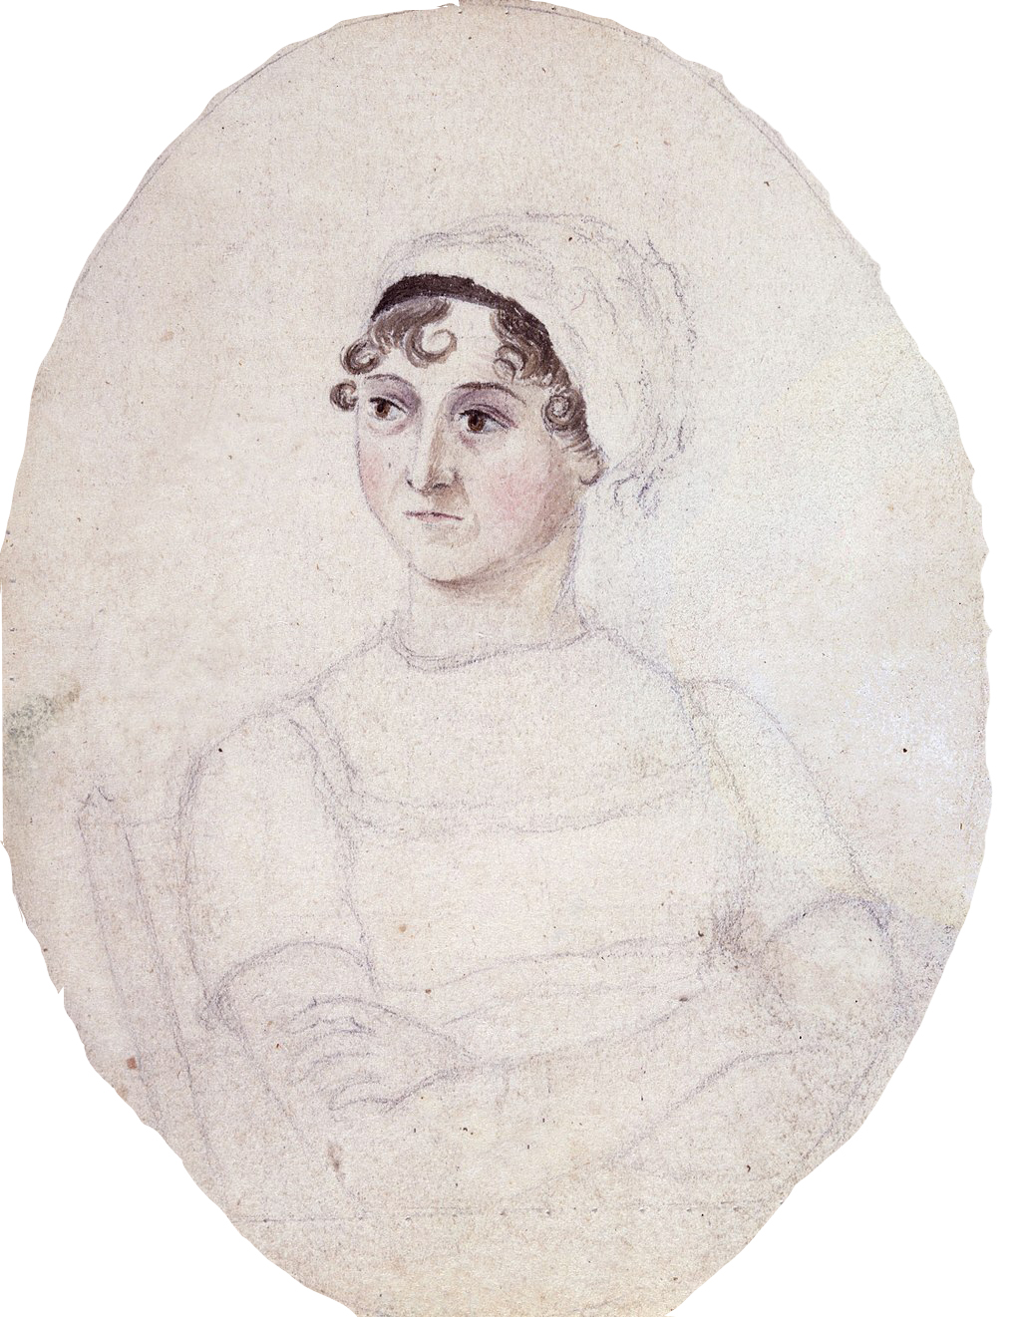
How well do you know Persuasion (and a few others)?

Slide 2
How old is Anne Elliot at the beginning of the novel?
34
27
25
38

Slide 3
How old is Anne Elliot at the beginning of the novel?
b. 27
“…but Anne, at seven-and-twenty, thought very differently from what she had been made to think at nineteen.”

Slide 4
Roughly, how much is Captain Wentworth worth?
£10000
£15000
£25000
£30000

Slide 5
Roughly, how much is Captain Wentworth worth?
c. £25000
“Captain Wentworth, with five-and-twenty thousand pounds, and as high in his profession as merit and activity could place him, was no longer nobody.”

Slide 6
What is Lady Russel’s favorite recreation?
Knitting
Dancing
Reading
Matchmaking

Slide 7
What is Lady Russel’s favorite recreation?
Reading
"I am sure Lady Russell would like him. He is just Lady Russell's sort. Give him a book, and he will read all day long."

Slide 8
Why should Sir Walter be, as he says ‘distressed for money’?
Traveling
Living in London
Servants
Horses
All of the above

Slide 9
Why should Sir Walter be, as he says ‘distressed for money’?
Traveling
Living in London
Servants
Horses
All of the above!!

Slide 10
What caused the years’ long rupture between the Dalrymples and the Elliots?
Sir Walter once gave the Viscountess the cut direct
Elizabeth neglected to invite them to a ball
Sir Walter did not send his condolences on the death of the Viscount
Lady Dalrymple could not stand Sir Walter’s vanity

Slide 11
What caused the years’ long rupture between the Dalrymples and the Elliots?
Sir Walter did not send his condolences on the death of the Viscount
“…ever since the death of that said late viscount, when, in consequence of a dangerous illness of Sir Walter's at the same time, there had been an unlucky omission at Kellynch. No letter of condolence had been sent to Ireland.”

Slide 12
What is the ostensible subject of a letter Captain Wentworth writes during the visit to the Musgroves in Bath?
He is writing to secure tickets to the opera
He is writing of his undying love for Anne
He is writing to his London tailor to bespeak a new greatcoat
He is writing to get a miniature of
Benwick reframed

Slide 13
What is the ostensible subject of a letter Captain Wentworth writes during the visit to the Musgroves in Bath?
He is writing to get a miniature of
Benwick reframed

Slide 14
What is the “domestic hurricane” in the Musgrove household?
Charles and Mary fight constantly
Louisa is prone to the vapors
The children are home for the holidays
Mrs. Musgrove berates the cook

Slide 15
What is the “domestic hurricane” in the Musgrove household?
The children are home for the holidays
“The Musgroves came back to receive their happy boys and girls from school…chattering girls…riotous boys…roaring Christmas fire…clamour of the children... Anne, judging from her own temperament, would have deemed such a domestic hurricane a bad restorative of the nerves…but Mrs Musgrove, [observed] …that nothing was so likely to do her good as a little quiet cheerfulness at home.”

Slide 16
What is one change the Crofts make to Kellynch Hall?
They redecorate the master bedroom
They remove mirrors
They install a new water closet
They build a hothouse
Bonus: What else do they do?

Slide 17
What is one change the Crofts make to Kellynch Hall?
They remove mirrors
“I have done very little besides sending away some of the large looking-glasses from my dressing-room.”

Slide 18
Which person known to Anne has a “squareness, uprightness, and vigour of form, which gave importance to [his/her] person?”
Mrs. Smith
Captain Harville
Mrs. Croft
Sir Walter

Slide 19
Which person known to Anne has a “squareness, uprightness, and vigour of form, which gave importance to [his/her] person?”
Mrs. Croft
She also: “had bright dark eyes, good teeth, and altogether an agreeable face; though her reddened and weather-beaten complexion… made her seem to have lived some years longer in the world than her real eight-and-thirty. Her manners were open, easy, and decided…”

Slide 20
What is the name of the horse Willoughby intends to give Marianne?
Queen Mab
Bessy
Midnight Storm
Salamanca

Slide 21
What is the name of the horse Willoughby intends to give Marianne?
Queen Mab

Slide 22
If Capt. Wentworth were to write a match.com wishlist of characteristics in a future wife which would he NOT include?
Pays compliments to the Navy
Strong-minded
Sweetness of character
Between fifteen and thirty
Willing to sail with him

Slide 23
If Capt. Wentworth were to write a match.com wishlist of characteristics in a future wife which would he NOT include?
Willing to sail with him
“Anybody between fifteen and thirty…A little beauty, and a few smiles, and a few compliments to the navy…A strong mind, with sweetness of manner…”
“I hate to hear of women on board, or to see them on board; and no ship under my command shall ever convey a family of ladies anywhere, if I can help it."

Slide 24
How many people named Charles are mentioned in Persuasion?
3
4
5
6

Slide 25
How many people named Charles are mentioned in Persuasion?
6
Charles Musgrove, esq.
Charles Musgrove
Little Charles Musgrove
Charles Hayter
Charles Smith
“and dignity of baronet, in the first year of Charles II”

Slide 26
Which of the following vehicles is not mentioned in Persuasion?
Phaeton
Curricle
Gig
Dung-cart
Barouche

Slide 27
Which of the following vehicles is not mentioned in Persuasion?
Phaeton
Charles Musgrove and Mr. Elliot drive curricles.
Admiral Croft drives (and often turns over) a gig.
Lady Dalrymple is driven in a barouche (of course!).
And the driver of the dung-cart is unspecified.
But no phaetons!

Slide 28
According to Mrs. Croft, she was never in what place?
Bermuda
West Indies
Cord
Lisbon
Gibralter

Slide 29
According to Mrs. Croft, she was never in what place?
West Indies
“…have been once to the East Indies, and back again, and only once; besides being in different places about home: Cork, and Lisbon, and Gibraltar. But I never went beyond the Streights, and never was in the West Indies. We do not call Bermuda or Bahama, you know, the West Indies."

Slide 30
OK, one literature geek question: Captain Benick would probably prefer not to read which of the following poems?
Childe Harold’s Pilgrimage
The Corsair
The Lady of the Lake
Marmion
The Castaway

Slide 31
Captain Benick would probably prefer not to read which of the following poems?
Childe Harold’s Pilgrimage (Byron)
The Corsair (Byron)
The Lady of the Lake (Scott)
Marmion (Scott)
The Castaway (Cowper)

Slide 32
In Persuasion, whose heart has been pierced? ?
Captain Hayter
Captain Benick
Captain Wentworth
Elizabeth Elliot
Mrs. Smith

Slide 33
In Persuasion, whose heart has been pierced?
Captain Benick
“…with a heart pierced, almost broken! Fanny Harville was a very superior creature, and his attachment to her was indeed attachment. A man does not recover from such a devotion of the heart to such a woman. He ought not; he does not."
Captain Wentworth had a pierced SOUL.

Slide 34
“It was misery to think of ________’s attentions. Their evil was incalculable.”
Mr. Collins
Mr. Elliot
Henry Crawford
Mr. Elton
Wickham

Slide 35
“It was misery to think of ________’s attentions. Their evil was incalculable.”
Mr. Elliot
Quite honestly the attentions of any of them would be misery in the long run, but since this is a direct quote the correct answer is Mr. Elliot.

Slide 36
Mr. Bingley danced the first set of two dances with Miss Lucas and the second set with Jane. With whom did he dance the two sixth?
Miss King
Lizzy
Maria Lucas
Jane again
Bonus: With whom did he dance
the Boulanger?

Slide 37
Mr. Bingley danced the first set of two dances with Miss Lucas and the second set with Jane. With whom did he dance the two sixth?
Lizzy
“Then the two third he danced with Miss King, and the two fourth with Maria Lucas, and the two fifth with Jane again, and the two sixth with Lizzy.

Slide 38
As to the Bonus question, we will never know because Mr. Bennet interrupts her:
“If he had had any compassion for me,” cried her husband impatiently, “he would not have danced half so much! For God's sake, say no more of his partners. Oh that he had sprained his ankle in the first dance!”

