Slide 1
The Fashionable Miss Austen
Hope Greenberg

Slide 2
“One could not hope to conduct himself or herself properly on entering a room without immediately assigning a rank to every person.”
Richard Bushman, The Refinement of America
Notes:
In a society based on rank, clothes as an indicator of rank have to shift subtly. You keep up with the latest fashions, the latest dances, and the latest news, not just to be trendy or edgy but to ensure that your rank is recognized. Your deportment, manners and speech all mark you as acceptable into society.

Slide 3
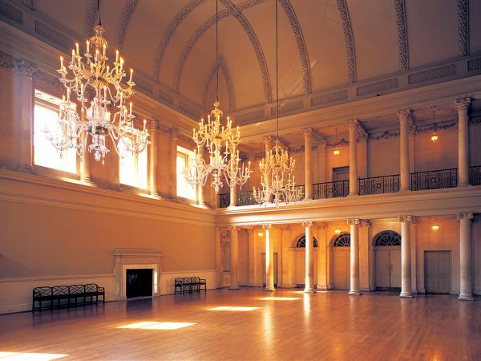
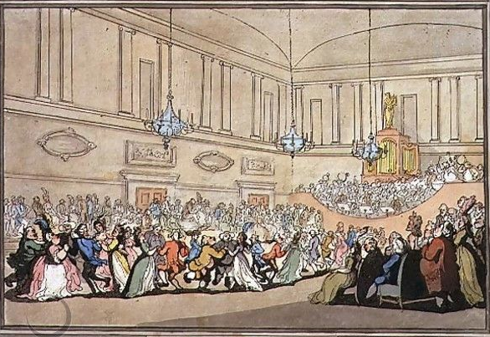
Notes:
The Assembly Rooms, Northanger Abbey

Slide 4
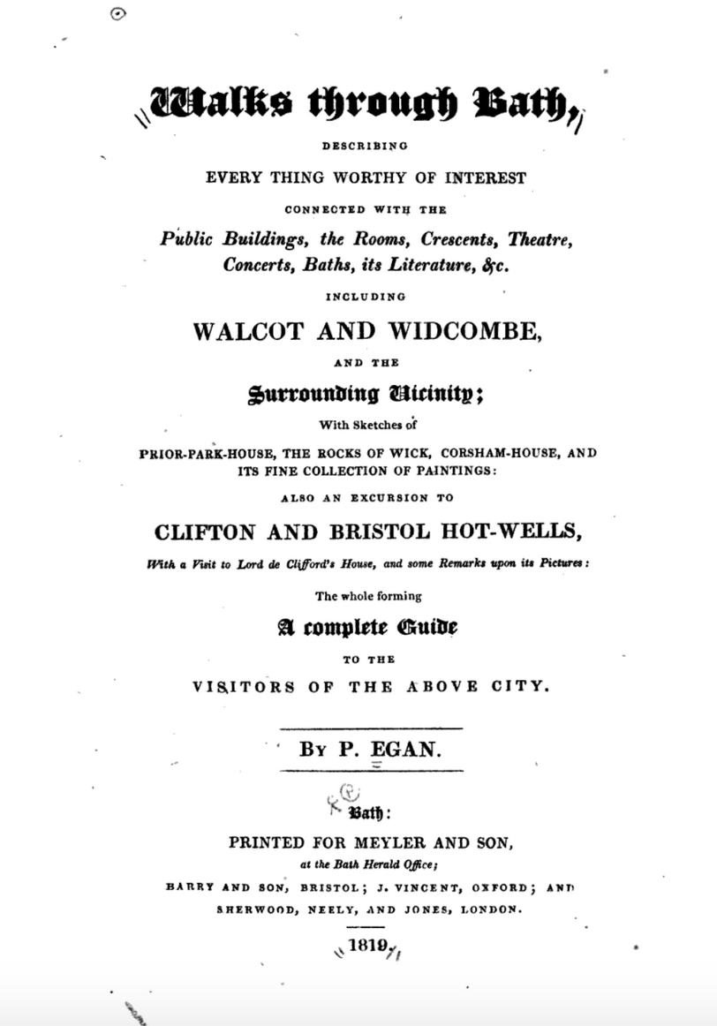
Notes:
Pierce Egan, Walks Through Bath, 1819
Here, salutary rules exclude all those Whom no one hears of,
and whom no one knows;
That no plebian breathings may infect An atmosphere at all times so select;
No bankers’ clerks these splendid realms invade;
No FOLKS who carry on a retail trade;
No actors by profession must appear To act their parts, or speak their speeches here;
Yet even here, amid the crowds you view,
’Tis sometimes difficult to tell WHO’S WHO.”

Slide 5
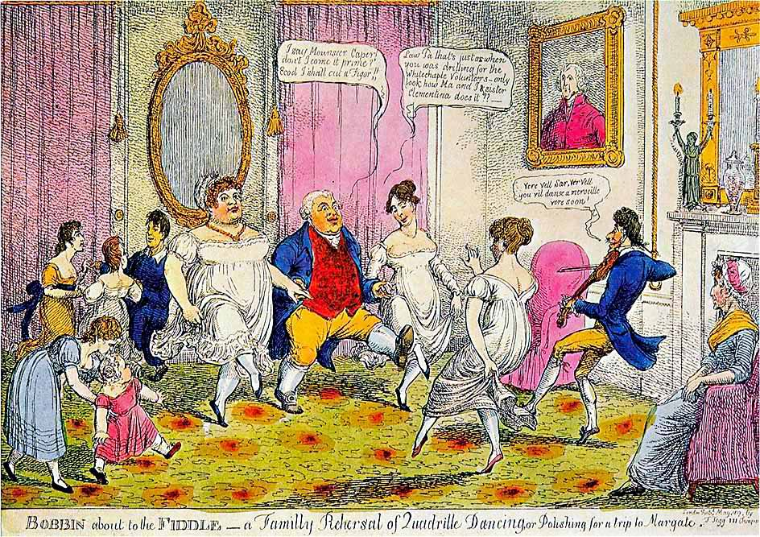
Notes:
“I say Monsouer Caper don’t I come it prime? Ecod I shall cut a figor!”
Law Pa that’s just as when you was drilling for the Whitechapel Volunteers. Only look at how Ma and I and sister Clementina does it.”
Ver vel sir, vere vel. You vil danse a merveileux ver soon.”
“The Season at Margate, for example, commenced on the King’s birthday, formally celebrated in June, and ended in late October, whereas Bath commanded the more fashionable months of October through May. The hours and pricing of the summer balls were usually different from those of the winter. ”
. “

Slide 6
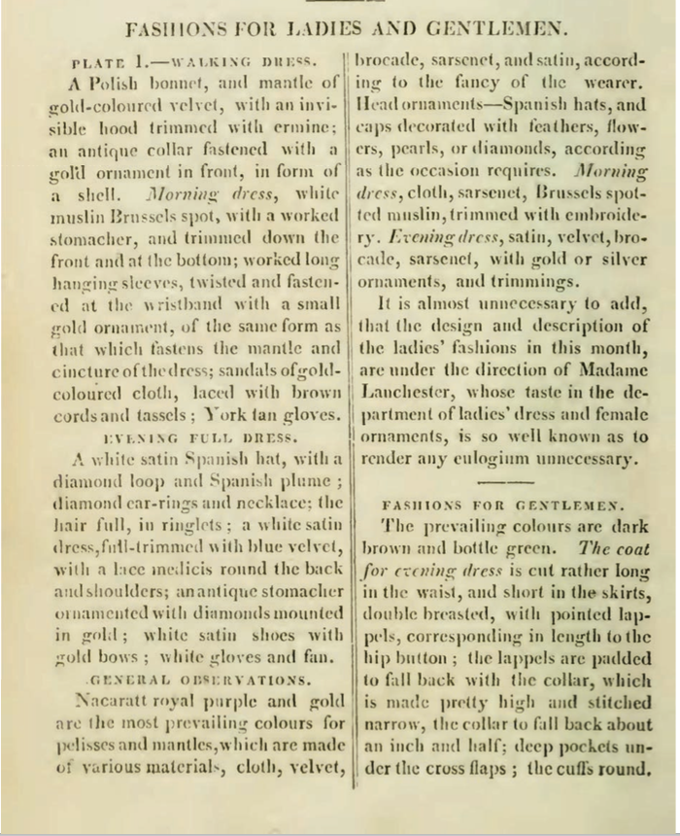
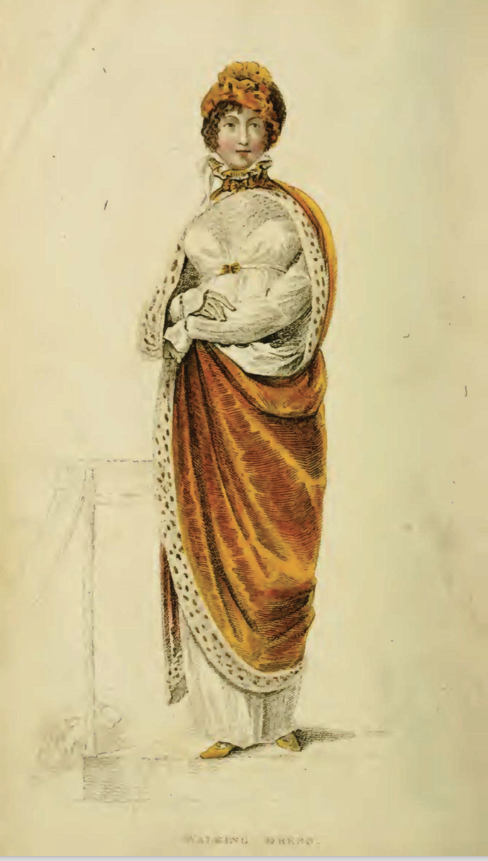
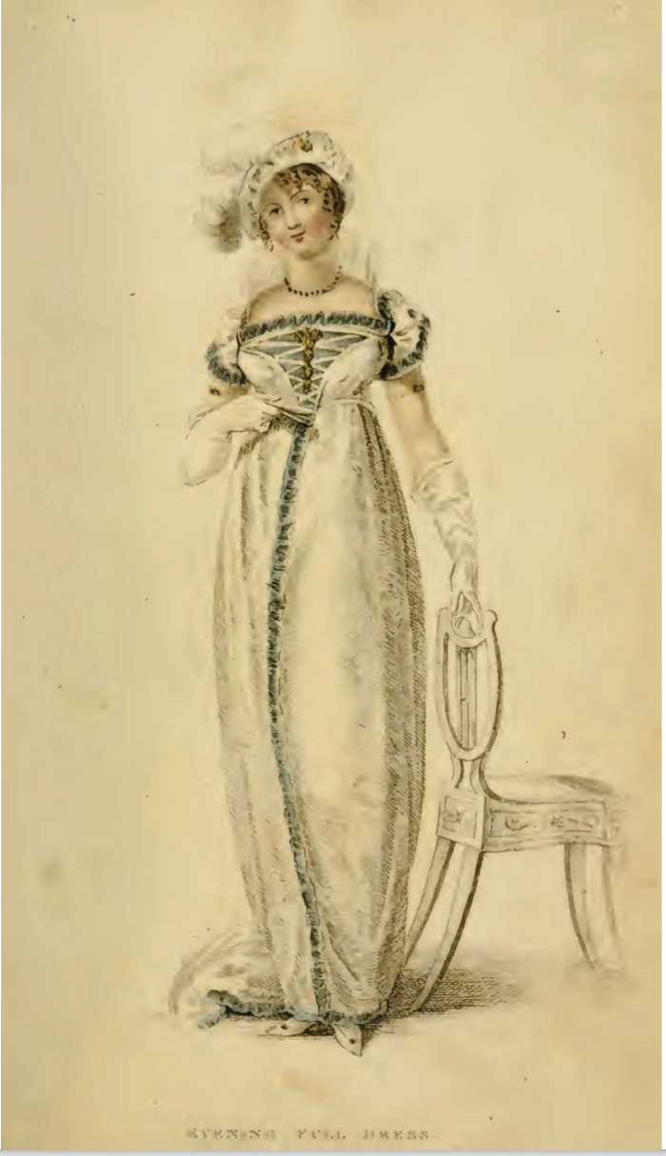
Ackermann’s Repository of the Arts. January 1809
Notes:
January 1809
Bushman mentions the importance of being able to converse intelligently on a number of interesting topics. Ackermann’s included politics, music reviews, stock prices, lists of who had gone bankrupt, travel information, biographical information, poetry, images of furniture, obituaries of royalty and it even contained actual fabric samples pasted into every issue so you could see and touch before ordering.

Slide 7
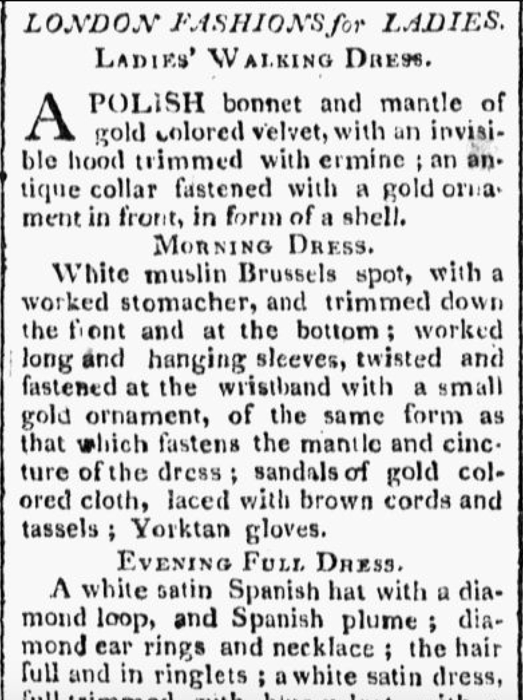
Worcester Gazette. (Worcester, MA) • 06-07-1809
Notes:
Fashion traveled quickly. This is the text of the previous example “scissor edited” (i.e. copied and reprinted) from the magazine into a local paper. Copyright? No such thing.

Slide 8
Austen, Fashion, Novels

Slide 9
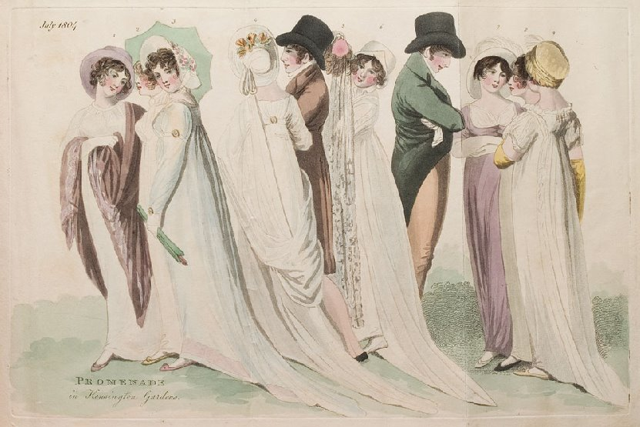
Notes:
S&S Miss Steele, stockings 1804: Promenade in Kensington Gardens. Smart vs. elegant. The Steeles were described as “by no means ungenteel or unfashionable; their dress was very smart”
Compare to Miss Tilney: had a good figure, a pretty face, and a very agreeable countenance; and her air, though it had not all the decided pretension, the resolute stylishness of Miss Thorpe's, had more ‘real elegance.’

Slide 10
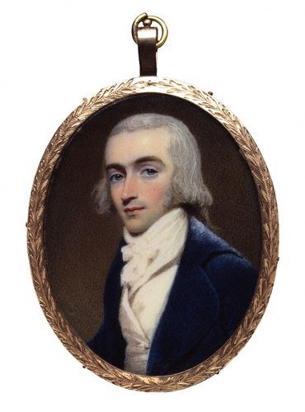
Notes:
1800 Robert Fellows, philanthropist, by Edridge Blue coat: Tory
Mr. Bingley was good-looking and gentlemanlike; he had a pleasant countenance, and easy, unaffected manners. His sisters were fine women, with an air of decided fashion. His brother-in-law, Mr. Hurst, merely looked the gentleman; but his friend Mr. Darcy soon drew the attention of the room by his fine, tall person, handsome features, noble mien, and the report which was in general circulation within five minutes after his entrance, of his having ten thousand a year. The gentlemen pronounced him to be a fine figure of a man, the ladies declared he was much handsomer than Mr. Bingley, and he was looked at with great admiration for about half the evening, till his manners gave a disgust which turned the tide of his popularity; for he was discovered to be proud; to be above his company, and above being pleased; and not all his large estate in Derbyshire could then save him from having a most forbidding, disagreeable countenance, and being unworthy to be compared with his friend.
Mr. Bingley had soon made himself acquainted with all the principal people in the room; he was lively and unreserved, danced every dance, was angry that the ball closed so early, and talked of giving one himself at Netherfield. Such amiable qualities must speak for themselves.

Slide 11
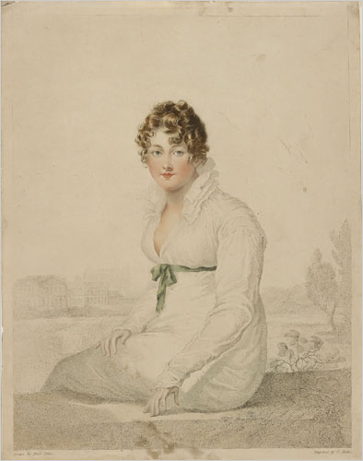
Notes:
1815-blake-engraving: “Henry and I went to the exhibition in Spring Gardens. It is not thought a good collection, but I was very well pleased, particularly (pray tell Fanny) with a small portrait of Mrs. Bingley, excessively like her. “

Slide 12
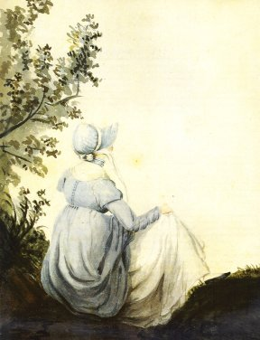
Notes:
P&P Elizabeth as seen by the Bingley sisters: “Hem 6 inches deep in mud, I am absolutely certain, and the gown which had been let down to hide it not doing its office.”

Slide 13
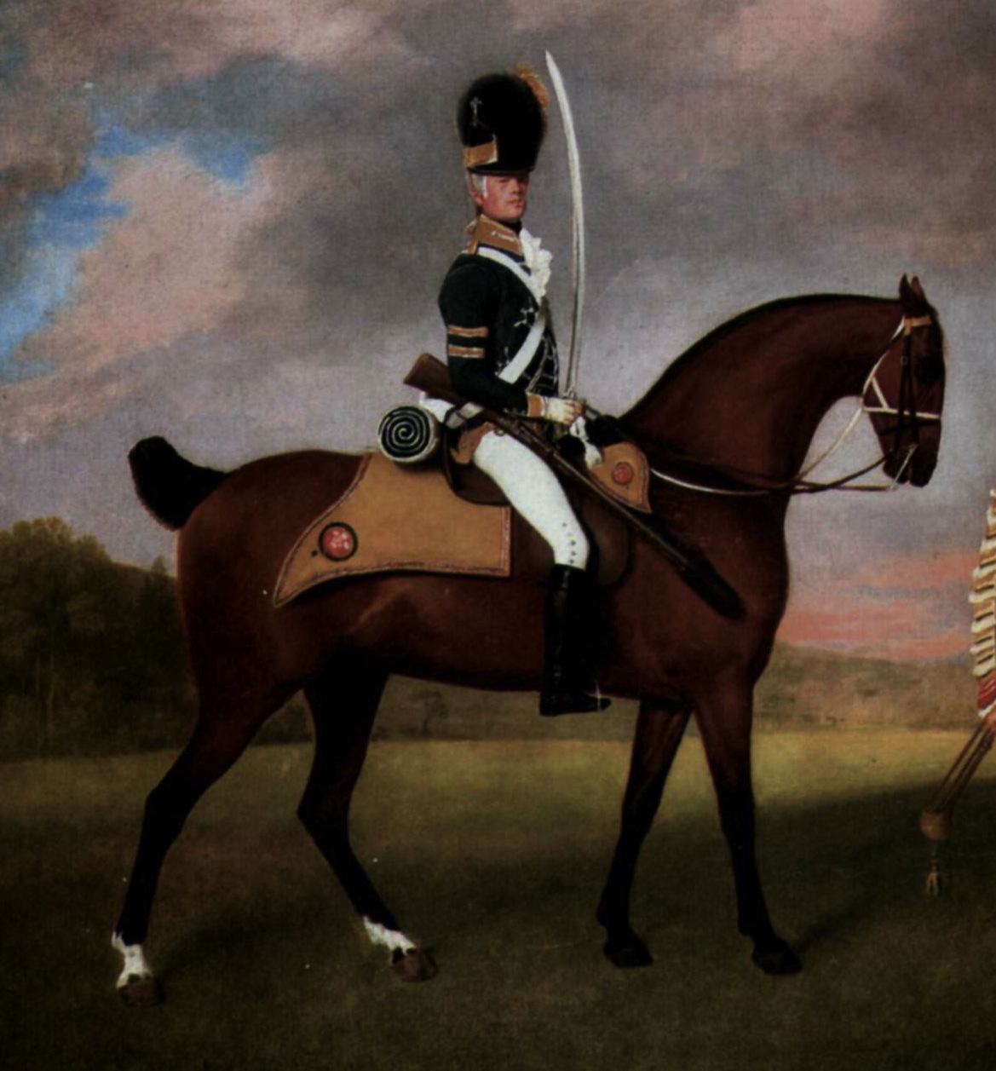
Notes:
Wickham: “Wanted only regimentals to make him charming” i.e. he is trying to ‘change his coat’ thus hide his reputation.

Slide 14
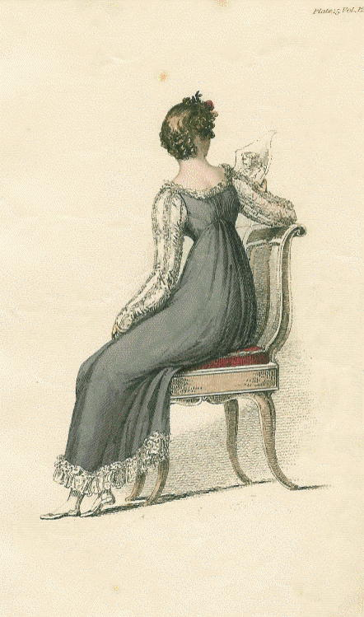
Notes:
1814Mrs. B. rhapsodizing over long sleeves and boring Mr. B with talk of lace. Long sleeves. And Lydia - listen to how she talks about clothes – Andher letter to Kitty “I shall send for my clothes when I get to Longbourn; but I wish you would tell Sally to mend a great slit in my worked muslin gown before they are packed up.” Yes, that was deliberate: Jane Austen is no prude.
Ackermann, Sept. 1814

Slide 15
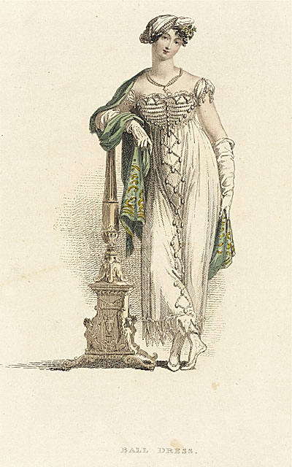
Mrs. Elton:
“as elegant as lace and pearls could make her”
Notes:
Emma/Mrs. Elton: as elegant as lace and pearls could make her”
Ackermann, June 1813

Slide 16
What did men wear?
Men’s basics from the outside in,
or, undressing Mr. Darcy.

Slide 17
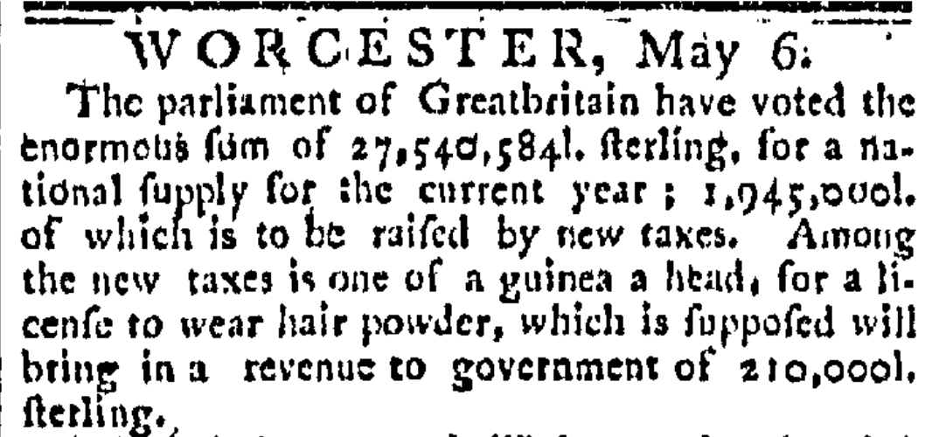
The Worcester GAZETTE. (Worcester, Massachusetts) • 05-06-1795
Notes:
News travels fast
The use of hair powder had been declining and the tax hastened its near death. In 1812 46,684 people still paid the tax, in 1855 only 997 did, and almost all of these were servants. By the time it was repealed in 1869 it yielded an annual revenue of £1000

Slide 18
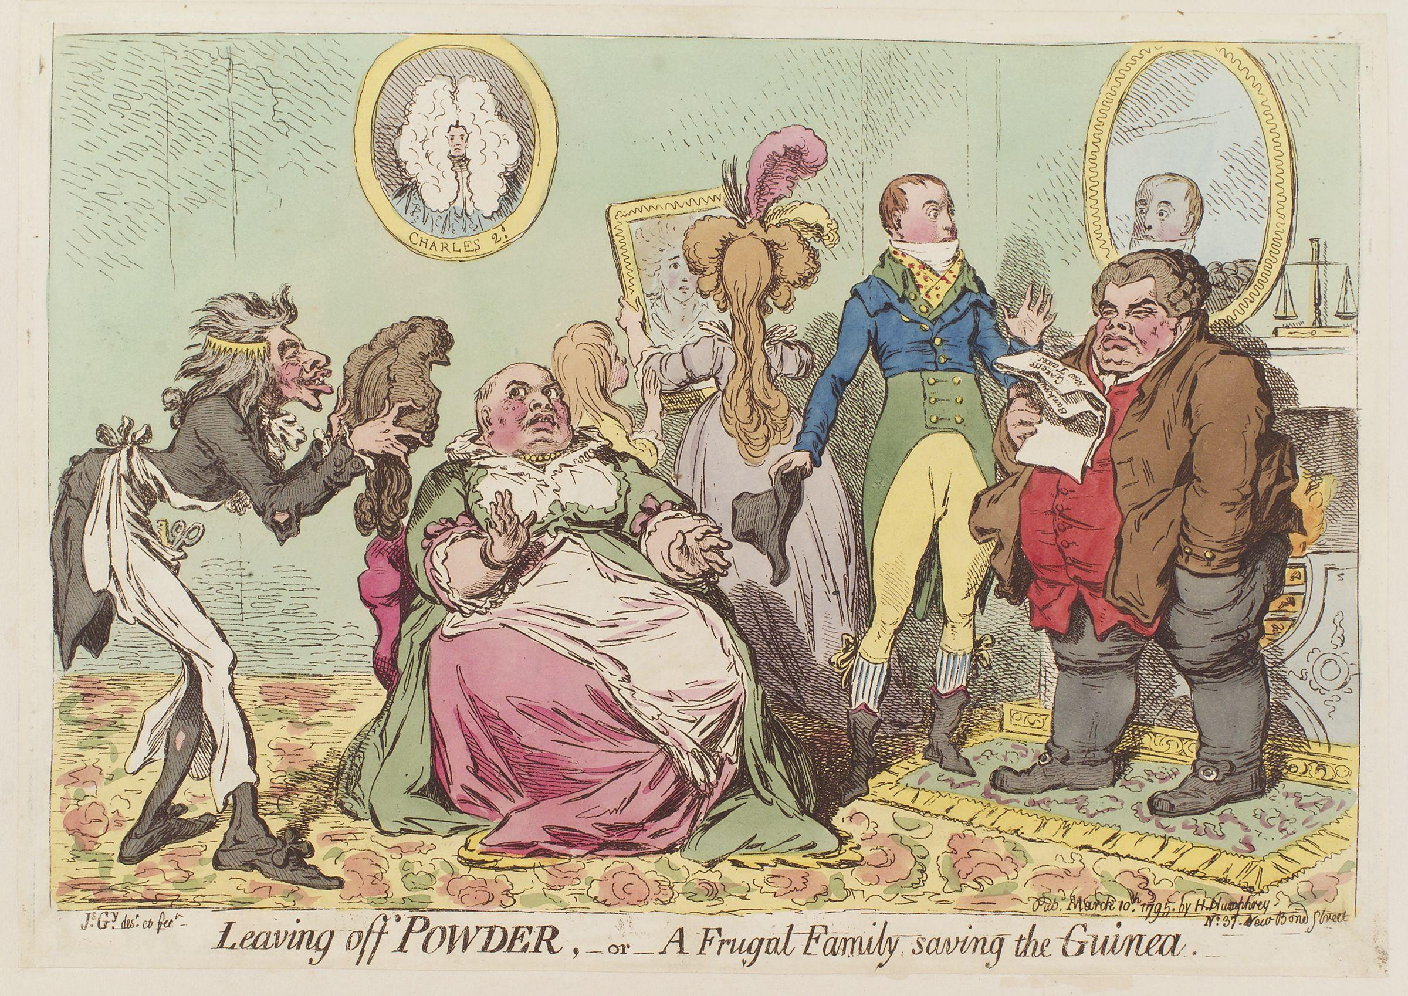

Slide 19
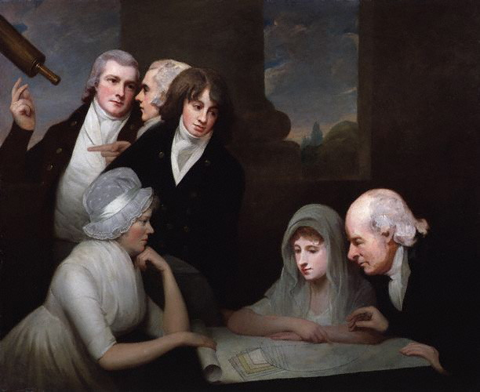
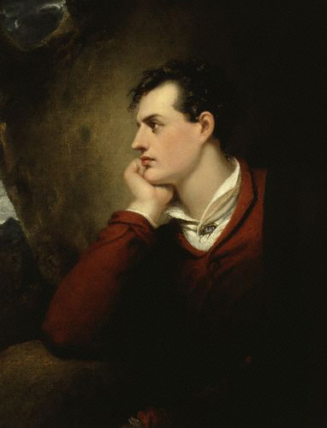
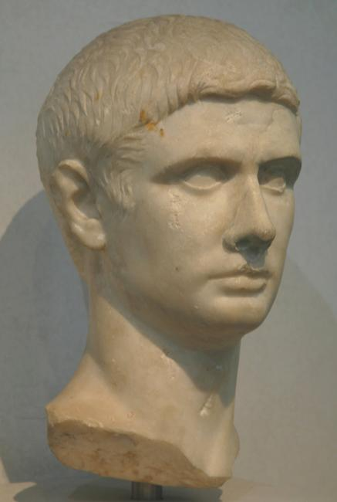
Hair
Notes:
1796 or so, after Pitt’s hairpowder tax of 1795, statue of Titus, Lord Byron. Style names “The Brutus” “The Windswept” “The Stanhope Crop”

Slide 20
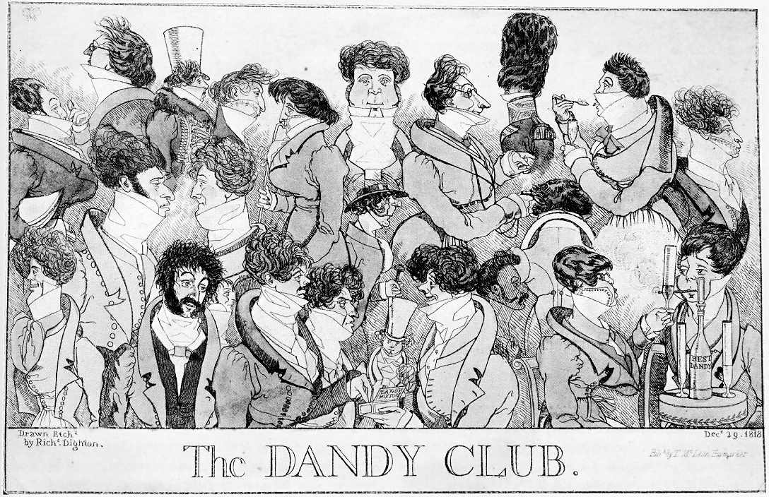
Notes:
1818 – Brummell would not have approved these extremes

Slide 21
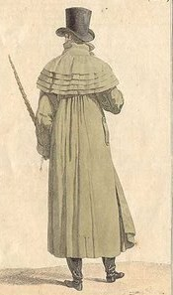
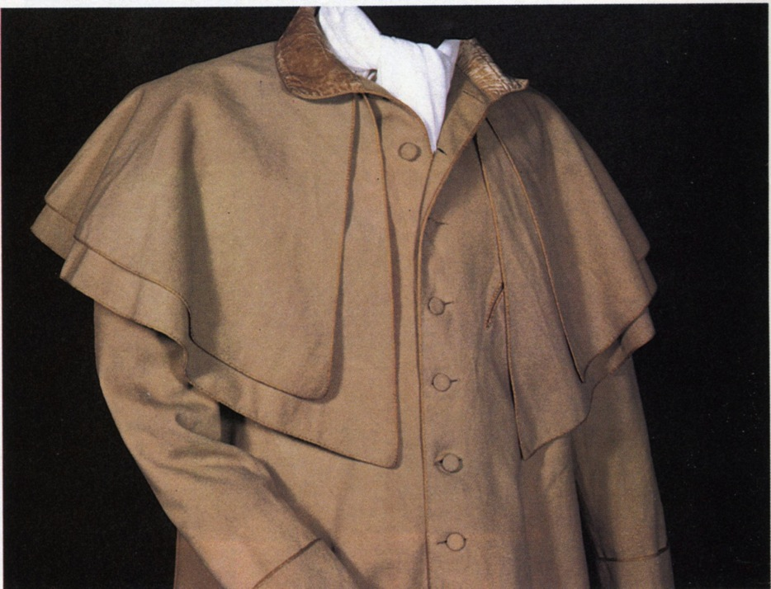
Greatcoat, overcoat
Notes:
A greatcoat was made of “cloth” which was a synonym for wool. The capes were originally designed to keep off rain but they quickly became a fashion statement as well, as Catherine notes with admiration.:
“…his hat sat so well, and the innumerable capes of his great-coat looked so becomingly important! To be driven by him, next to being dancing with him, was certainly the greatest happiness in the world.”

Slide 22
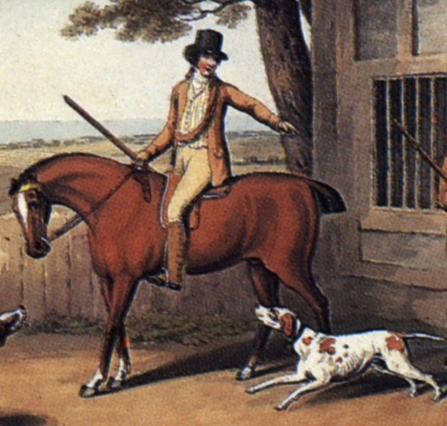
Thursday, 15 September 1796
“Edward and Fly went out yesterday very early in a couple of shooting jackets and came home like a couple of bad shots, for they killed nothing at all.”
Sense and Sensibility “His name was good, his residence was in their favourite village, and and she soon found out that of all manly dresses a shooting jacket was the most becoming. Her imagination was busy…”
Notes:
Awareness of shooting jacket—the country life attire influence. This picture is a bit deceptive as regards the quote. Edward and Fly would have walked to go shooting with the object to bring back birds. If hunting (hunting=fox hunting), they would have been riding. If they were hunting on foot, and it was not their property or they did not have permission of the property owner, they might have been arrested for poaching.

Slide 23
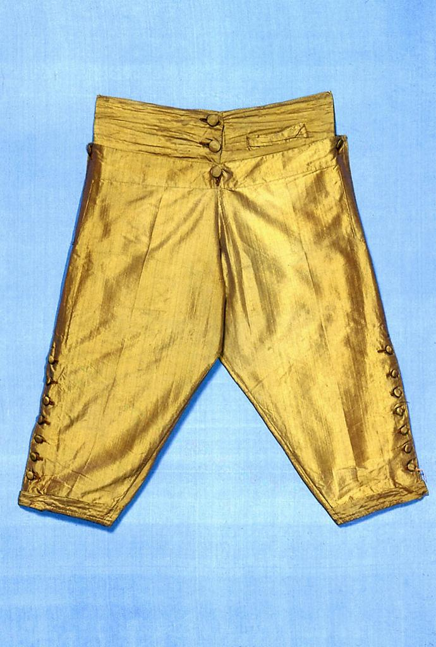
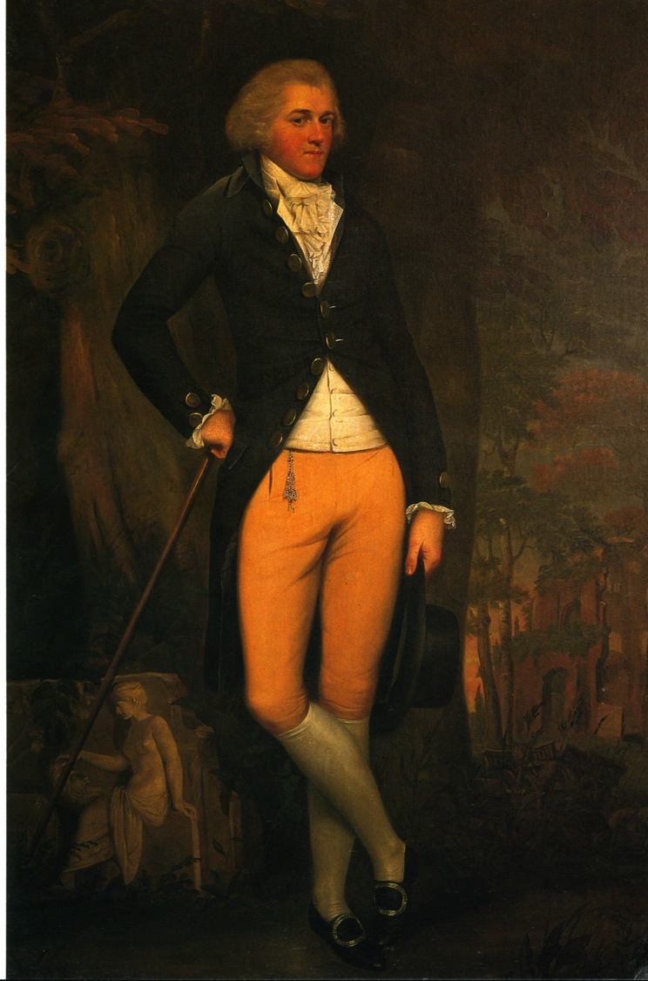
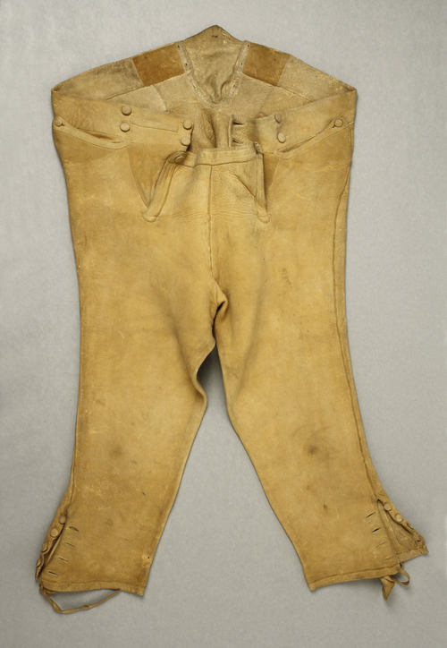
Notes:
Edward Austen Knight, grand tour, 1800. Breeches continued in popularity throughout Austen’s lifetime. By the 180ss they were beginning to be nudged out by pantaloons and trousers but hung on in the country or for formal wear. And they were never allowed into Almack’s in anything but knee breeches. There is a story, unconfirmed, that even the Duke of Wellington was turned away when he arrived in trousers. Another version has him turned away because he arrived after the official time allowed, midnight.

Slide 24
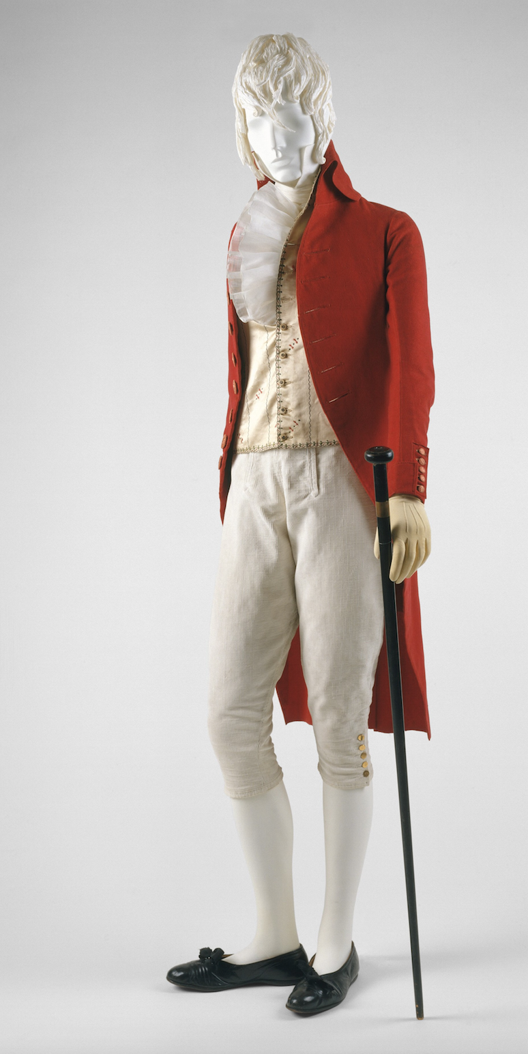
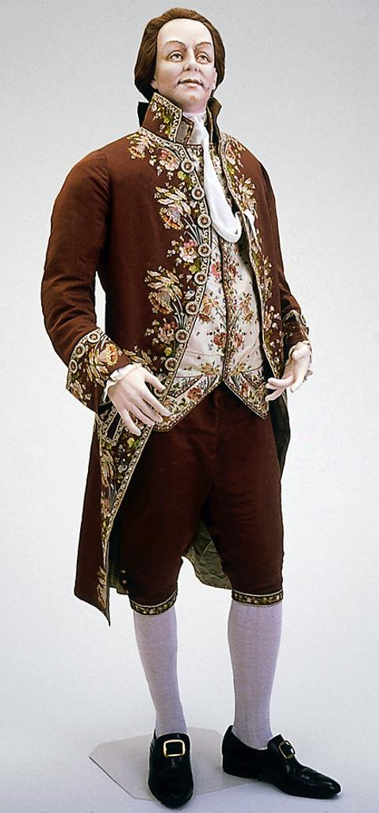
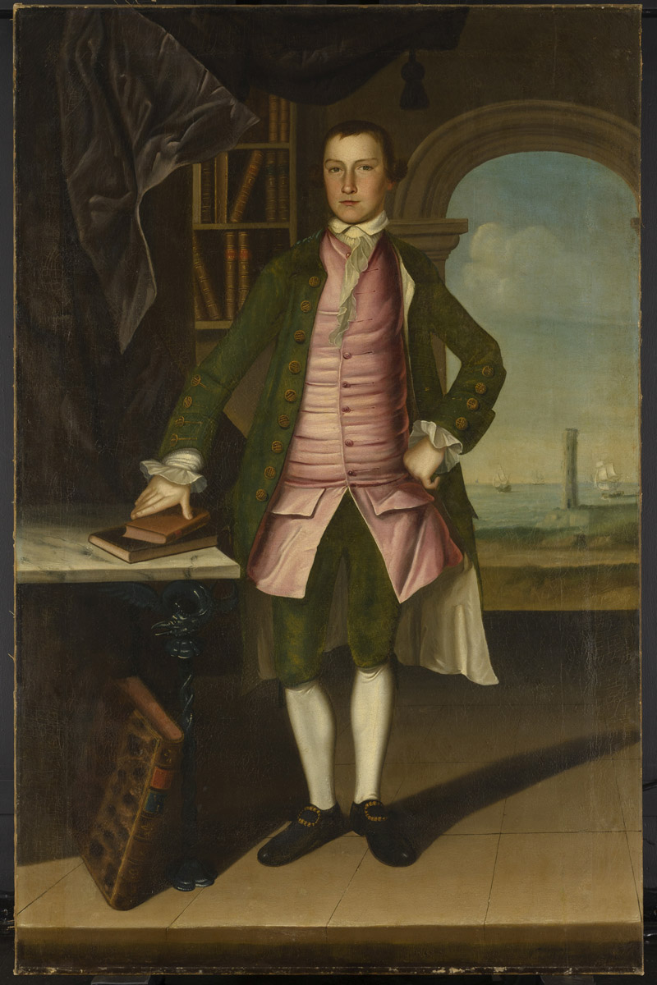
What did men wear?
1790s
1780s
1760s
.
Notes:
Those changed in shape and volume throughout the period. When Bushman mentions a waistcoat that would act as a body-shaping or posture garment he was considering the earlier example. When he talks about a new freedome of movement and ease at the end of the century it is more like the latter.

Slide 25
Notes:
1809 – cutaway, swallow-tail, classical statues – the nude male vs. the draped female

Slide 26
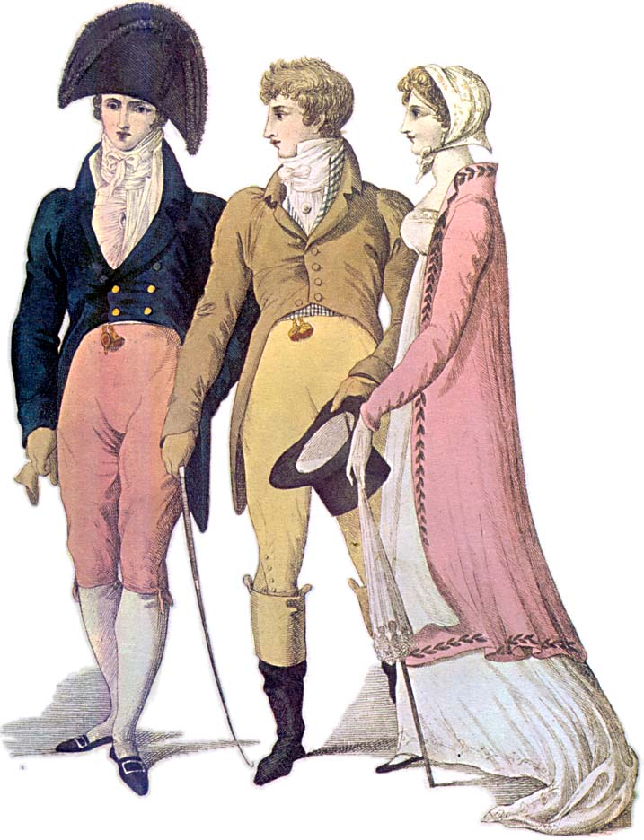
Notes:
1809 – cutaway, swallow-tail, classical statues – the nude male vs. the draped female

Slide 27
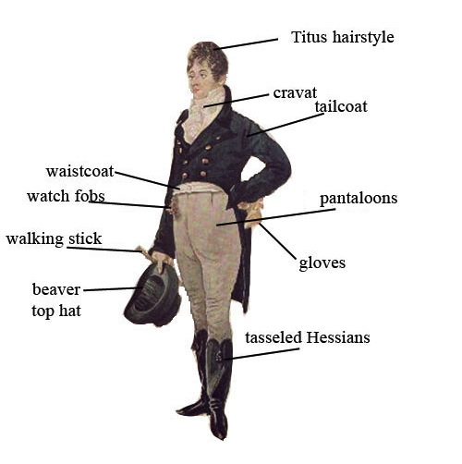
Notes:
1805 Dighton caricature – blue superfine (wool) coat, pantaloons,
“If John Bull turns round to look at you, you are not well-dressed, but either too stiff, too tight, or too fashionable.” Letter to Hariette Wilson, quoted in “The Beaux of the Regency” Melville Lewis 1908.

Slide 28
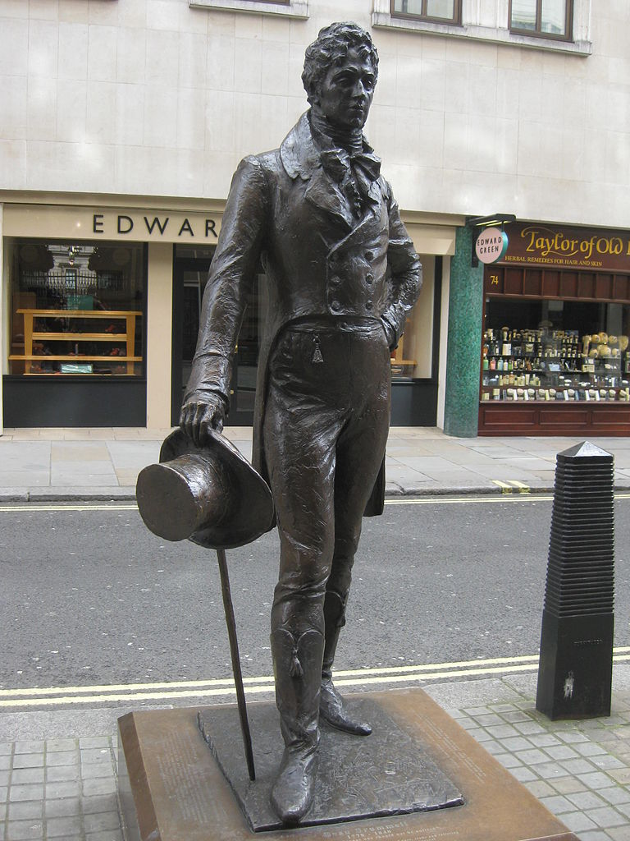
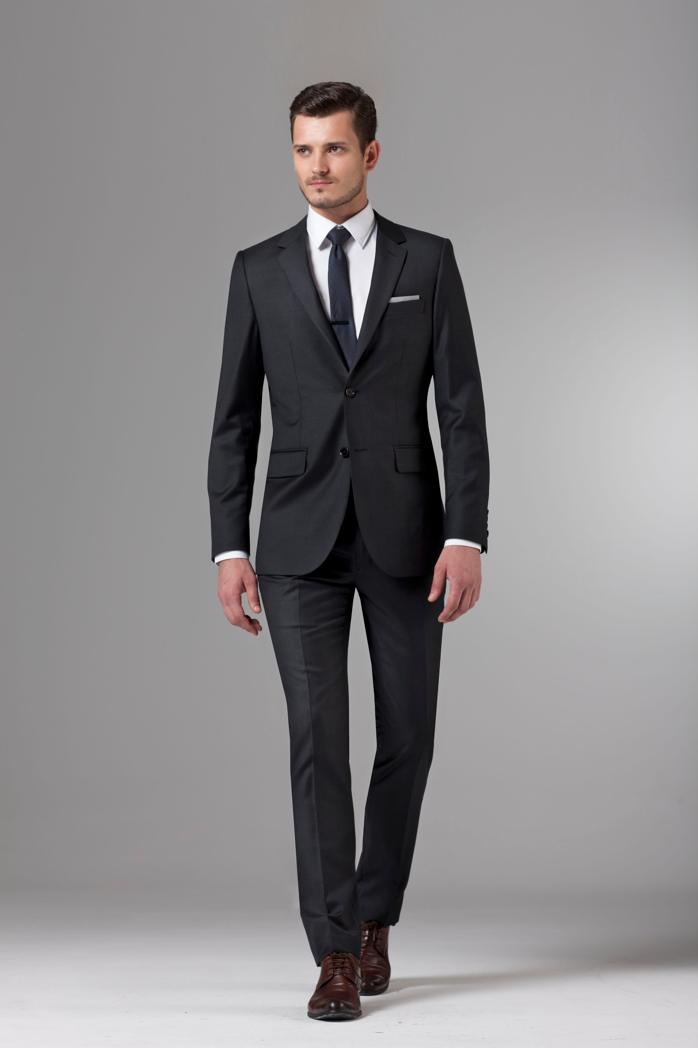
George Bryan “Beau” Brummel
The reason we wear this:
Notes:
George Bryan “Beau” Brummell who almost singlehandedly changed fashion. Friend of the Price Regent, made simple yet exquisitely tailored clothing the mode to be followed, notorious for demanding a full tub bath every day, and a perfectionist when it came to his cravats. see next slide

Slide 29
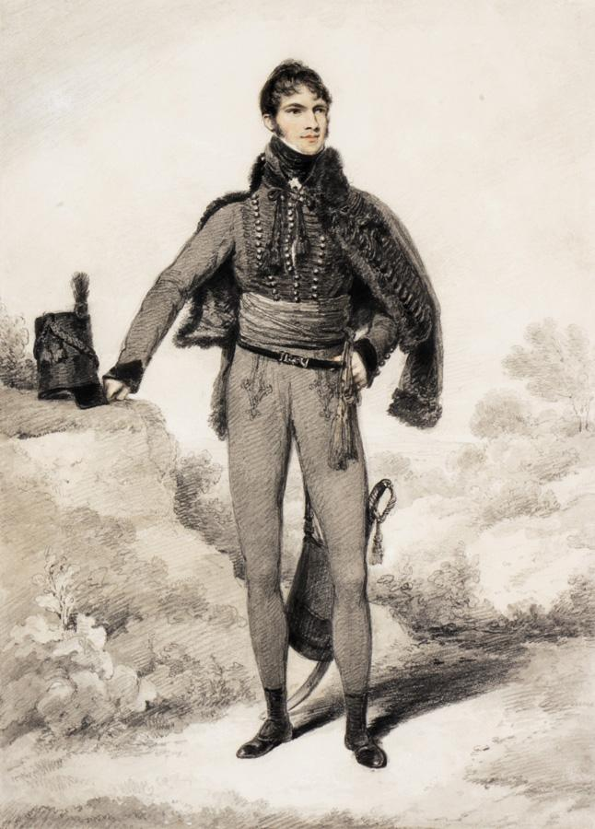
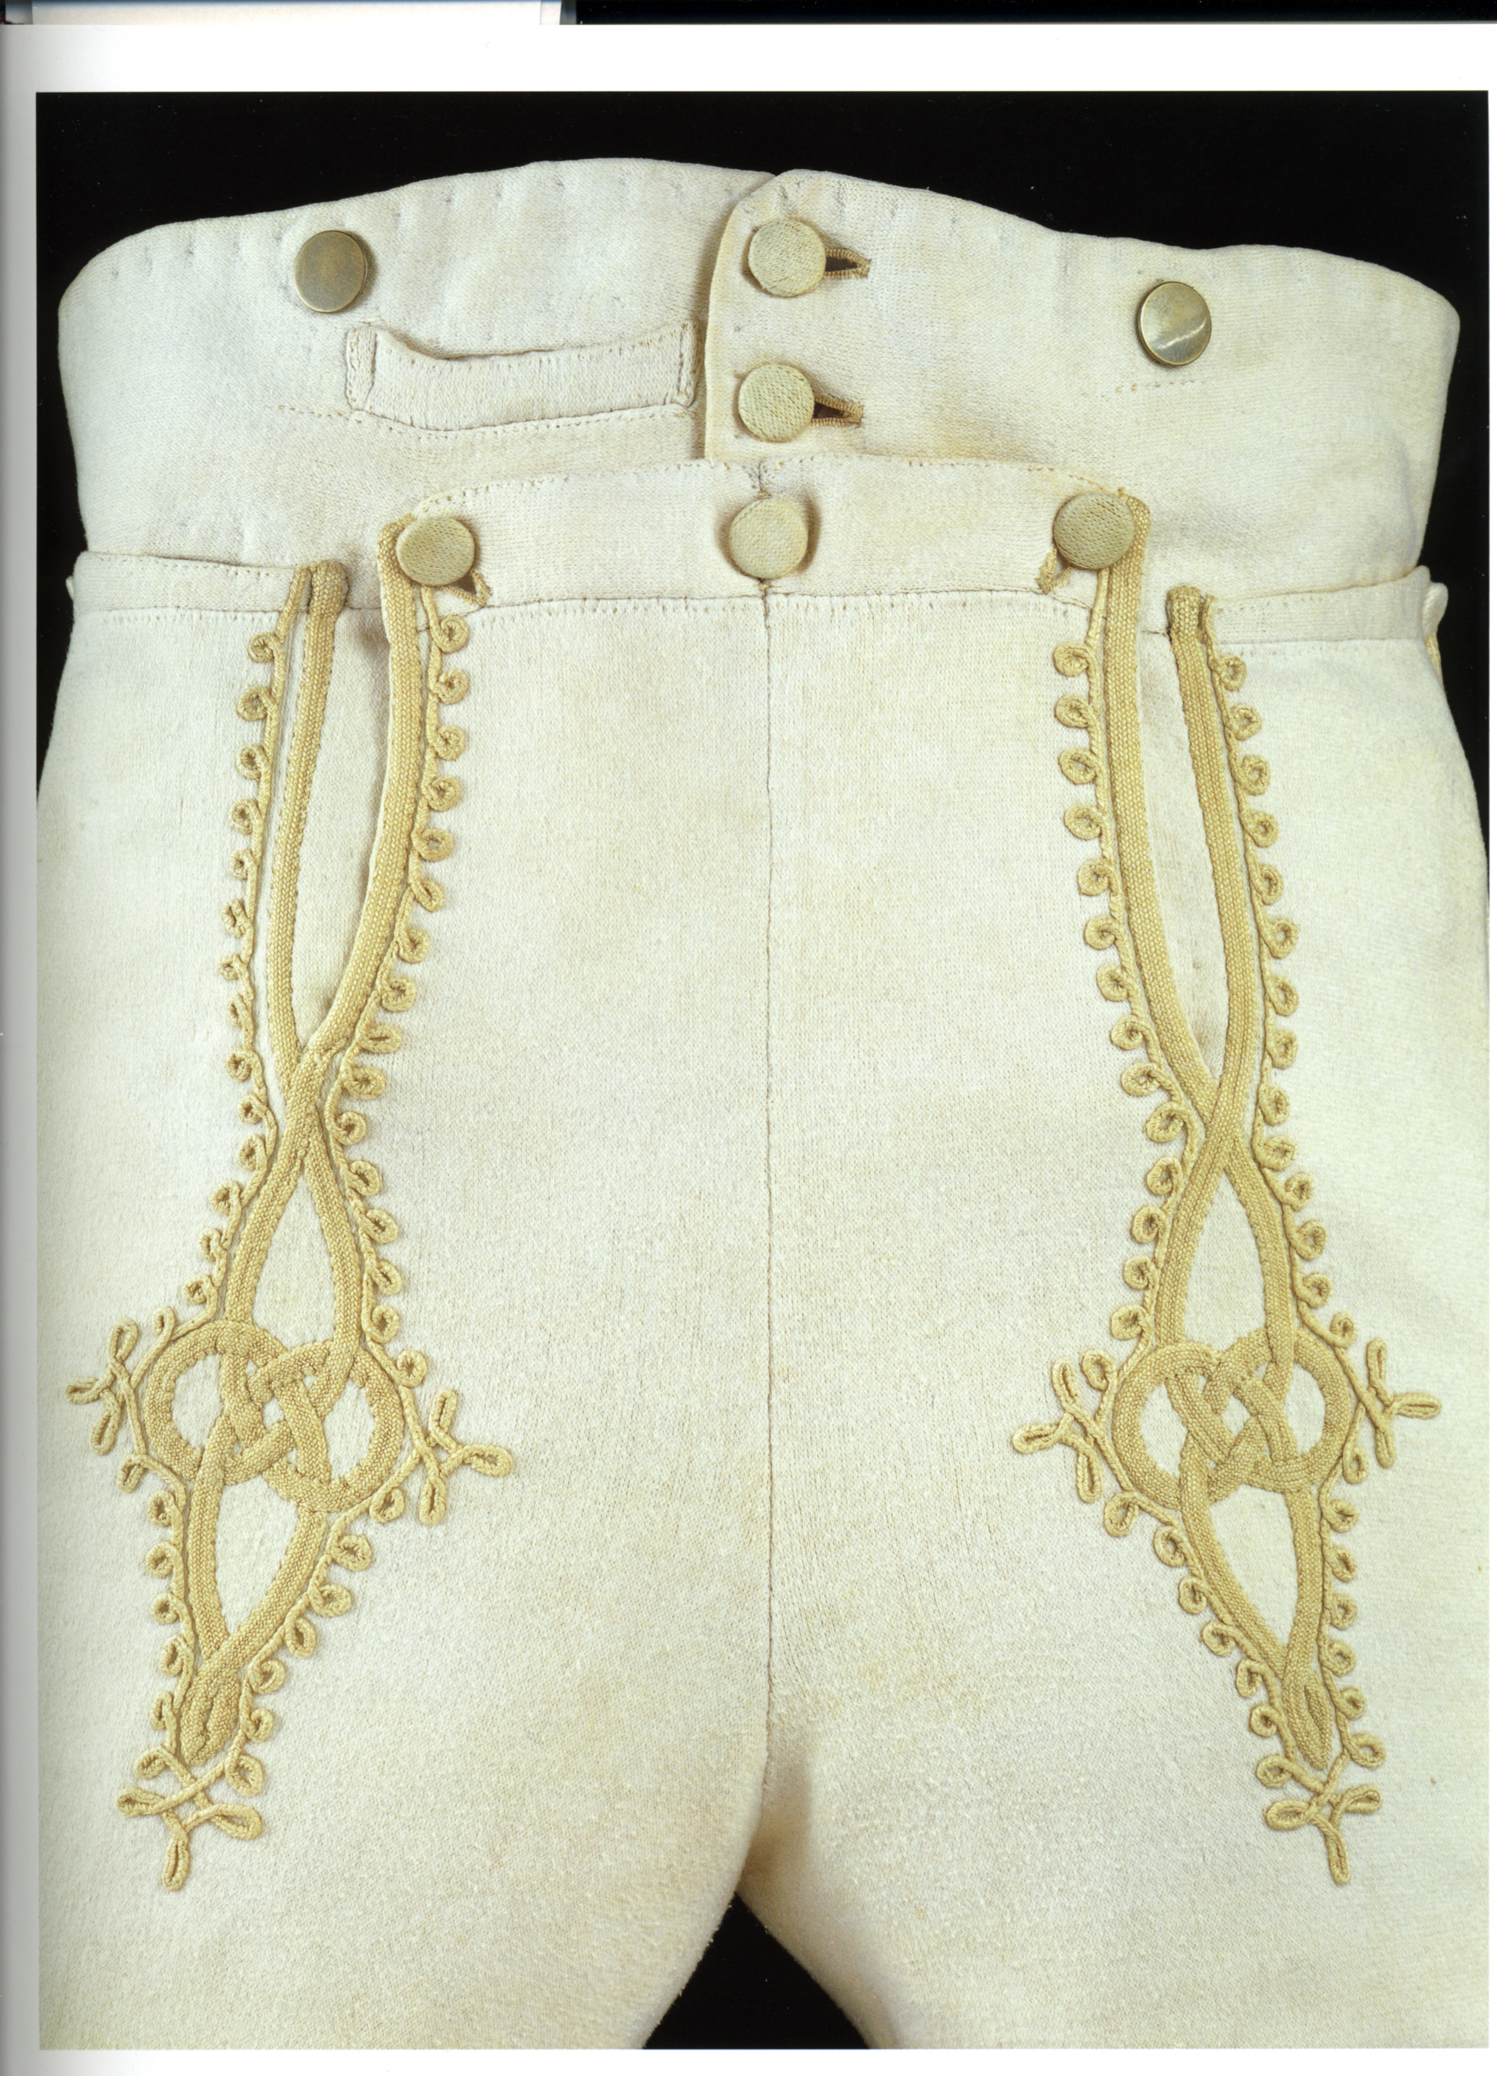
Notes:
Sir William Harbord, 1810 by Edridge, The other major influence on men’s fashion: military pantaloons – wool knit to cling and stretch.

Slide 30
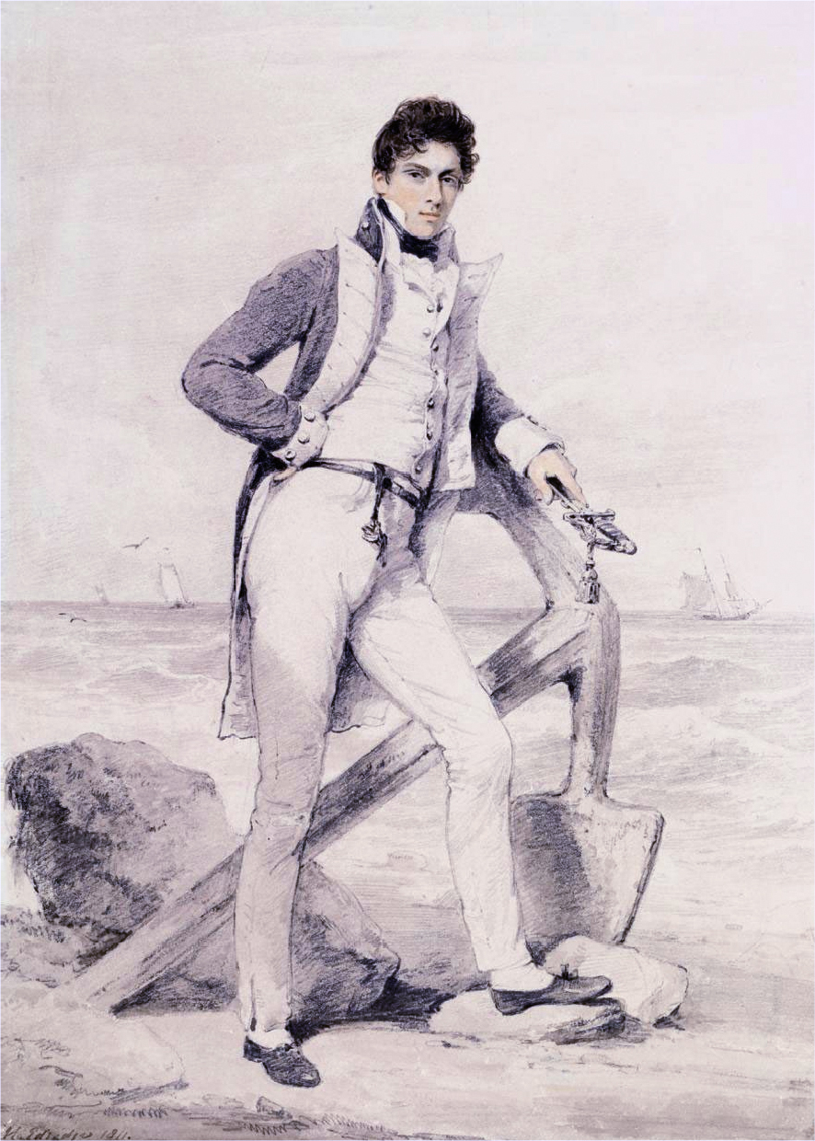
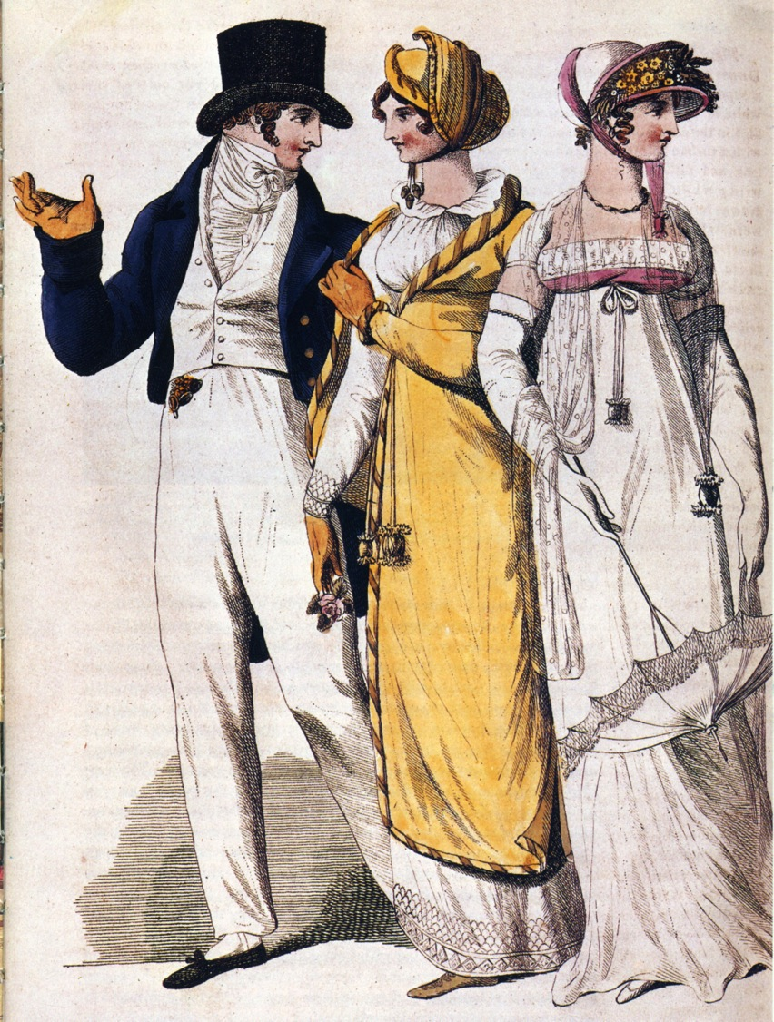
Notes:
Captain Hoste 1811 by Edridge. Sailor’s trousers
People in park, 1807. The young man adopts the Navy uniform look.

Slide 31
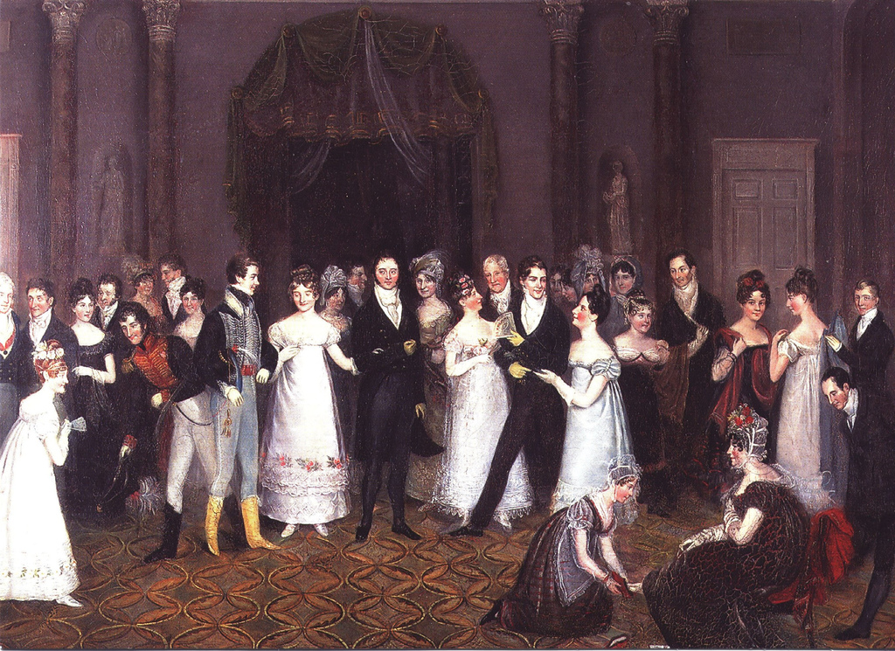
Notes:
Rolinda Sharples “The Cloak Room at the Assembly Rooms at Clifton”1818: Yolanda Shows examples of all mens options. The older gentleman on the left wears grey/light silk breeches, the armu men are in their uniforms with panataloons, the thirty-something husband in the middle wears black breeches while the young flirt wears trousers. Also note the impossibly tiny bodices on the women’s gowns. For more on Clifton Assembly see http://www.thespasdirectory.com/profilego.asp?ref=2841393B

Slide 32
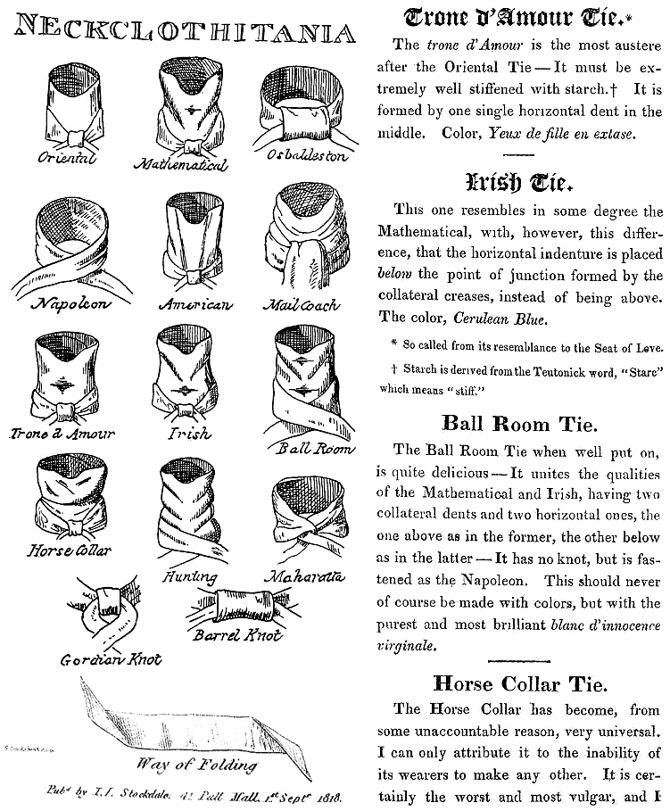
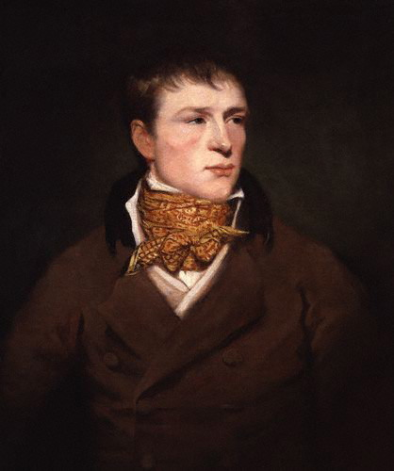
Jem Belcher:
Celebrated Boxer with his trademark spotted neckcloth
Notes:
Some neckcloth styles with fanciful names. The boxing star Jem Belcher with his trademark spotted neckcloth.
“Things, you know, whisker'd, great coated, and lac'd, Like an hour-glass, exceedingly small in the waist; Quite a new sort of creatures, unknown yet to scholars. With heads so immoveably stuck in shirt collars, § That seats like our music-stools, soon must be found 'em, To twirl, whenthecreatures may wish to look round'em “ (From Neckclothitania

Slide 33
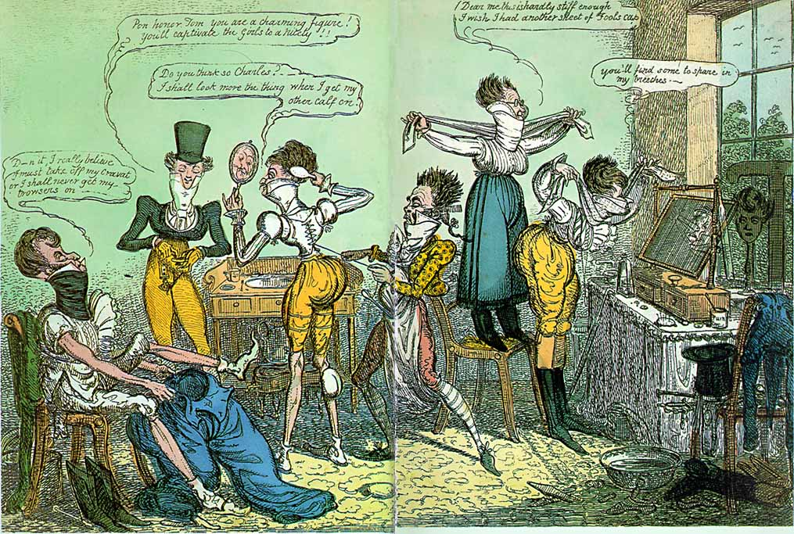
Notes:
1818 Cruickshank
Dammit I believe I must take off my cravat or I shall never get my trousers on
Pon honour Tom you are a charming figure. You’ll captivate the grils to a nicety.
Do you think so Charles? I shall look more the thing when I get my other calf on.
Dear me this is hardly stiff enough. I wish I had another sheet of foolscap.
You’ll find some in my breeches.

Slide 34
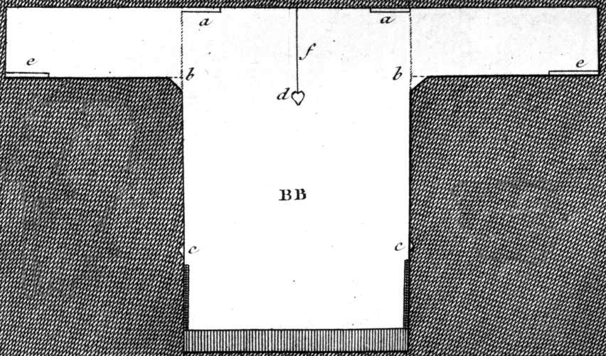
Austen, Thursday, 1 September 1796:
“We are very busy making Edward’s shirts, and I am proud to say that I am the neatest worker of the party.”
Notes:
While many people had their clothing made by tailors (men’s clothing but also women’s riding habits) or modistes/dressmakers, people often made or at least trimmed and finished, their own. But shirts and shifts were usually made by the women in the family. The cut was simple and extremely economical, using all the width of the linen. The “workbasket” was always to hand with shirts/shifts to be sewn.

Slide 35
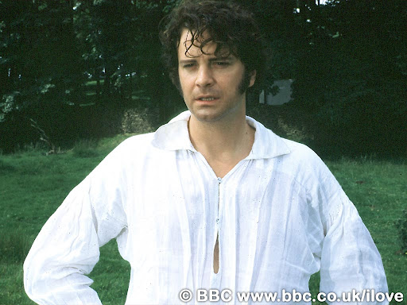
Notes:
Or for a slightly more interesting view of a well made shirt…

Slide 36
Cleanliness
La Belle Assemblée, Feb 1806, p. 15:
The Ladies Toilette, or Encyclopedia of Beauty
Of cleanliness--…A careful attention to the person, frequent ablutions, linen always white, which never betrays the inevitable effect of perspiration and of dust; a skin always smooth and brilliant, garments not soiled by any stain, and which might be taken for the garments of a nymph; a shoe which seems never to have touched the ground; this it is what constitutes cleanliness. To this might likewise be added a scrupulous care to avoid every thing that can indicate functions which undeceive the imagination.

Slide 37
The frequent use of tepid baths is not more grateful to the senses than it is salutary to the health and to beauty…By such means do women of the East render their skins softer than that of the tenderest babes in this climate…
This delightful and delicate oriental fashion is now, I am happy to say, embraced almost all over the continent…The generality of English ladies seem to be ignorant of the use of any bath larger than a wash-hand basin.
Mirror of Graces, 1811, p. 32

Slide 38
What did women wear?
Women’s basics from the outside in,
or, dressing Mrs. Darcy.

Slide 39
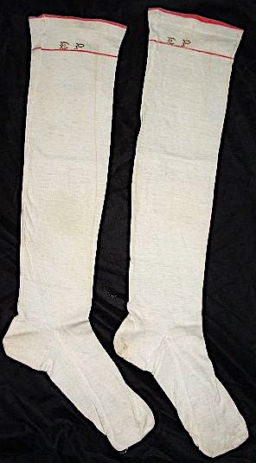
Silk or cotton stockings tied above or below the knee with a silk garter/ ribbon.
Notes:
1/9/1796 “"You say nothing of the silk stockings ; I flatter myself, therefore, that Charles has not purchased any, as I cannot very well afford to pay for them; all my money is spent in buying white gloves and pink persian." “

Slide 40
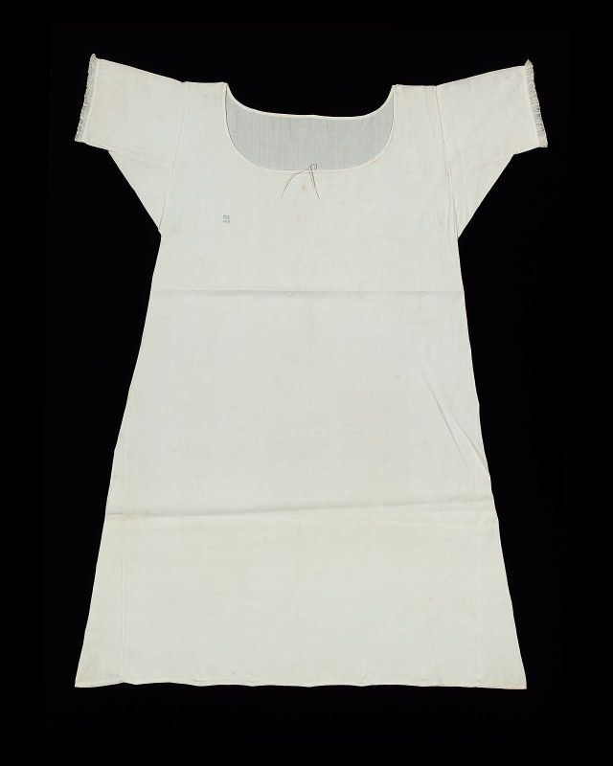
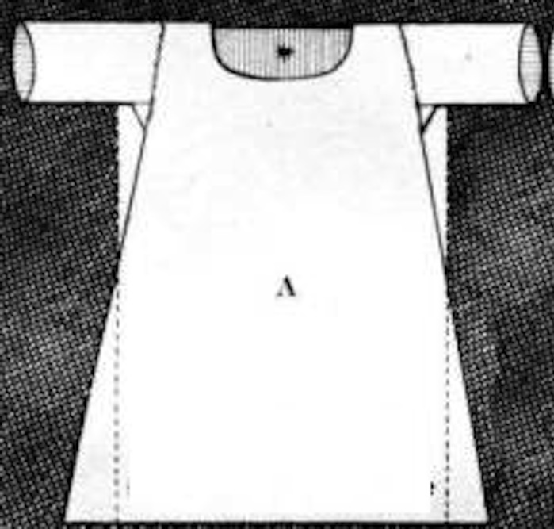
Shift/chemise
Notes:
Womens’ shifts were cut similar to men’s shirts but by the 19th century were more a-line.

Slide 41
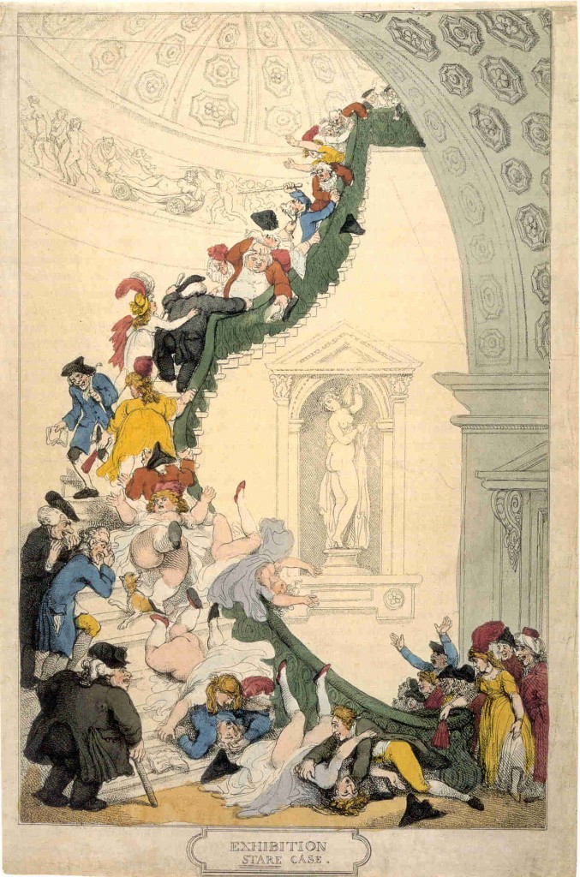
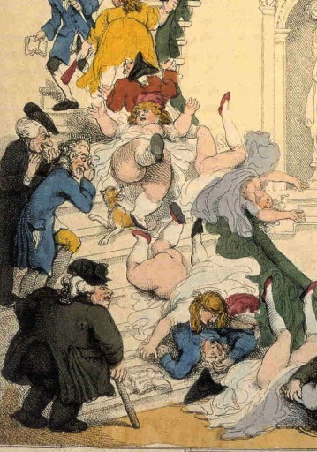
Notes:
Rowlandson, 1800, “Exhibition Stair Case” at Somerset House leading to the gallery of the Royal Academy of Art (pres. Sir Joshua Reynolds)

Slide 42
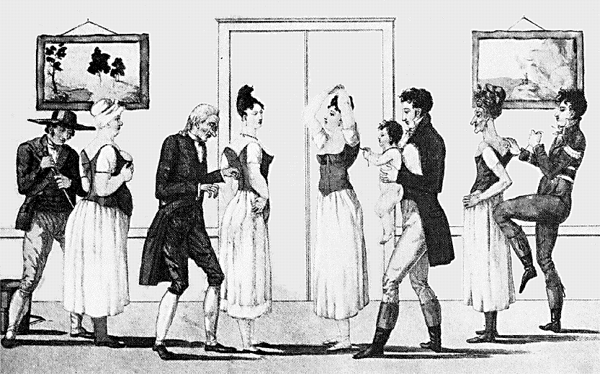
Notes:
Corset and stockings, two layers of linen, channels of baleen or cord, single spiral laced, busk (thin wooden stick about 1-2”wide – great for posture)

Slide 43
Fashion during Austen’s life
1775-1790: Youth – “horizontal” structured silhouette, natural waist, wide skirts
1795-1800: 1st novels – waists move up, lightweight fabrics (muslin), more vertical but full
1801-1806: Bath years – “Greek columns”
1807-1811: more fitted, the center line craze
1811-1817: emphasis on bodice, more decoration, skirts widen at hem
After 1817: more width at hem, waist starts to drop
Notes:
We tend to think of this entire period as that of “high waists” but the details of fashions actually changed quite a bit. While writing her early works, Austen would have dressed differently than she would have while writing later works, and would have envisioned her characters differently as well.

Slide 44
Notes:
A generational reaction of horror! In one generation we went from wide and heavy to narrow and light in an exceedingly short amount of time. But it didn’t stop there.

Slide 45
Stays, hoop, shift (Kyoto Costume Museum)
Stays (Fleming Museum)
Notes:
Stays, Hoops and shift – Kyoto Museum. Additional stays, Fleming Museum. Though the cut and boning layout evolved to be quite efficient by centurr’s end, the 18th century corset in general had “wall-to-wall” boning and was designed to create a barrel shape with rounded neckline. It was not about nipping in the waist, although from the front your waist might look smaller (from the side it would look larger).

Slide 46
Robe a l’anglaise: 1770s and 1780s
Notes:
A little trip back in time: draping, fitting, shaping. With fitting: 14th cent. Fitted, 15th - vertical, 16th - horizontal, vertical, horizontal. Since the 16th century women have been using stays or corsets for both support and for shaping. The shape and design of the stays or corsets provides the foundation for the shape of the clothing.

Slide 47
Robe a la francaise: 1770s and 1780s
Notes:
A little trip back in time: draping, fitting, shaping. With fitting: 14th cent. Fitted, 15th - vertical, 16th - horizontal, vertical, horizontal. Since the 16th century women have been using stays or corsets for both support and for shaping. The shape and design of the stays or corsets provides the foundation for the shape of the clothing.

Slide 48
1780s
Chemise
Dress
Notes:
Marie Antoinette’s “chemise dress” Portrait by Elisabeth Louise Vigée-LeBrun,(Veejee lebron) dress by Rose Bertin – scandal because too plain
August 1784: Georgiana, Duchess of Devonshire, wears a chemise a la reine to a concert
Comtesse DuBarry
Jacques Louis David (1748-1825) “Antoine-Laurent Lavoisier (1743–1794) and His Wife (Marie-Anne-Pierrette Paulze, 1758–1836)
Date: 1788

Slide 49
1790s
Notes:
1790

Slide 50
Notes:
Open robe 1790, still fairly structured, higher waist, full petticoat, corset to suit, with ‘tail’ to hold skirt out at back.

Slide 51
1794
Notes:
Watch the sleeves – they are still elbow length. That will change, of course.

Slide 52
Notes:
Even in America the trend towards a higher waist was followed, though in this case the construction of the back of the gown remained the same.

Slide 53
Fashion during Austen’s life
1775-1790: Youth – “horizontal” structured silhouette, natural waist, wide skirts
1795-1800: 1st novels – waists move up, lightweight fabrics (muslin), more vertical but full
1801-1806: Bath years – “Greek columns”
1807-1811: more fitted, the center line craze
1811-1817: emphasis on bodice, more decoration, skirts widen at hem
After 1817: more width at hem, waist starts to drop
Notes:
We tend to think of this entire period as that of “high waists” but the details of fashions actually changed quite a bit. While writing her early works, Austen would have dressed differently than she would have while writing later works, and would have envisioned her characters differently as well.

Slide 54
Notes:
As the 1790s progress we move into a transition gown. It is high waisted but still very full. The fabric is lightweight cotton or muslin and hair is big!

Slide 55
1790s: Big hats, big hair, big feathers
Notes:
When Austen was writing her early novels this is what she was seeing and wearing.

Slide 56
Notes:
The brown embroidered and sequined silk dress is a round gown – i.e. the dress is closed all the way around without a front opening.
Northanger Abbey: pinning up each other’s trains

Slide 58
1800: big feather but small hair, narrower silhouette
Austen, Wednesday, 18 December 1798:
“I believe I shall make my new gown like my robe, but the back of the latter is all in a piece with the tail, and will seven yards enable me to copy it in that respect?”

Slide 59
Round Gowns, c. 1800 (Colonial Williamsburg): trains, gathers to make shape, elbow-length sleeves
Notes:
Note transitions style – high waist, gathered front cut all of a piece – elbow sleeves

Slide 60
Why?
Was it the Greek statues?
Was it the French revolution?
Was it the Indies (East and West)?
Was it new technology?
Was it politics?
Was it the price of muslin?
Notes:
But the greatest change to note was that to muslin – not American – this is mull
England – wool, Greek drapery, American egalitarianism, French freedom and egalite, West Indies – slave cotton, East Indies – true Indian muslins (Bangladesh suppression), better thread, better weaving, better quality, cheaper to produce.

Slide 61
Notes:
So what do you wear under those lightweight narrow gowns? What is the ideal and how do you achieve it: columns
This corset is missing it’s busk and boning but you can see that it has few bone channels and a gathered bodice like the gowns under which it would have been worn.

Slide 62
Fashion during Austen’s life
1775-1790: Youth – “horizontal” structured silhouette, natural waist, wide skirts
1795-1800: 1st novels – waists move up, lightweight fabrics (muslin), more vertical but full
1801-1806: Bath years – “Greek columns”
1807-1811: more fitted, the center line craze
1811-1817: emphasis on bodice, more decoration, skirts widen at hem
After 1817: more width at hem, waist starts to drop
Notes:
We tend to think of this entire period as that of “high waists” but the details of fashions actually changed quite a bit. While writing her early works, Austen would have dressed differently than she would have while writing later works, and would have envisioned her characters differently as well.

Slide 63
1800-1808: tall and narrow, less fabric, trains
Notes:
Still lots of fabric gathered at waist but the silhouette is definitely vertical, the greek column ideal
1) 1800-artstor-AMICO_CLARK_103902762
1) 1800-artstor-pinkback-AMICO_CLARK_103902764

Slide 64
Notes:
Fashion plates emphasize the vertical by making women into giantesses.

Slide 65
Austen, Tuesday, 8 January 1799:
“I am not to wear my white satin cap to-night, after all; I am to wear a mamalone [mameluke] cap instead…
It is all the fashion now; worn at the opera, and by Lady Mildmays at Hackwood balls.”
Notes:
Warrior caste in Egypt defeated by Napoleon at the Battle of the Pyramids, 1798 “On July 1, 1798, Napoleon landed in Egypt with 400 ships and 54,000 men and proceeded to invade the country, as he had recently invaded Italy. But this Egyptian invasion was to be different. For, in addition to soldiers and sailors, Napoleon brought along 150 savants — scientists, engineers and scholars whose responsibility was to capture, not Egyptian soil, but Egyptian culture and history.” The ladies picked up the turban almost immediately.
In former ages it seemed requisite that every lady should cut out her garments by a certain erect standard. ..But in our days, an English woman has the extensive privilege of arraying herself in whatever garb may best suit her figure or her fancy. The fashions of every nation and of every era are open to her choice. One day she may appear as the Egyptian Cleopatra, then a Grecian Helen; next morning the Roman Cornelia; or, if these styles be too august for her taste, there are Sylphs, Goddesses, Nymphs of every region, in earth or air, ready to lend her their wardrobe.
Mirror of Graces, 1811 (p. 52)

Slide 66
“She [Madame Bonaparte] has made a great noise here, and mobs of boys have crowded round her splendid equipage to see what I hope will not often be seen in this country, an almost naked woman.” (Rosalie Calvert, Baltimore)
Notes:
So, gowns are becoming narrow and lightweight, thin cotton
1803 married
Dress from 1804

Slide 67
Notes:
1810 “A scene taken from nature in Kensington Gardens” Gillray commenting on lightweight cotton and flimsy petticoats.

Slide 68
Notes:
James Gillray (1757-1815)

Slide 69
The year 1740, a Lady’s full dress of Bombazeen. The year 1807, a Lady’s undress of “Bum-Be-Seen.”
Notes:
The year 1740 a Lady’s Full Dress of Bombazeen. The year 1807 a Lady’s Undress of Bum-be-seen (Full dress refers to formal dress, undress refers to daytime clothes but her it refers to rather more…or less as the case may be.

Slide 70
Fashion during Austen’s life
1775-1790: Youth – “horizontal” structured silhouette, natural waist, wide skirts
1795-1800: 1st novels – waists move up, lightweight fabrics (muslin), more vertical but full
1801-1806: Bath years – “Greek columns”
1807-1811: more fitted, the center line craze
1811-1817: emphasis on bodice, more decoration, skirts widen at hem
After 1817: more width at hem, waist starts to drop
Notes:
As we move into the years when Austen wrote the most we start to see what we consider the Regency look.

Slide 71
1809
Notes:
Ackermann, May 1809

Slide 72
1810: Trains hang on in evening dress
Notes:
Ackermann, Jan. 1809
La Belle Assemblée, Dec. 1810

Slide 73
Notes:
Around 1810 construction techniques are developed to make less fullness at the front. This apron dress is a lightweight muslin with wool crewel embroidery.
1) Johnston, Lucy. Nineteenth Century Fashion in Detail
2) Ackermann, Feb. 1809

Slide 74
Notes:
This beautiful example from the V&A shows crewel embroidery on a silk net gown.
1810, Victoria and Albert Museum, Accession number T.194-1958

Slide 75
Fashion during Austen’s life
1775-1790: Youth – “horizontal” structured silhouette, natural waist, wide skirts
1795-1800: 1st novels – waists move up, lightweight fabrics (muslin), more vertical but full
1801-1806: Bath years – “Greek columns”
1807-1811: more fitted, the center line craze
1811-1817: emphasis on bodice, more decoration, skirts widen at hem
After 1817: more width at hem, waist starts to drop
Notes:
We tend to think of this entire period as that of “high waists” but the details of fashions actually changed quite a bit. While writing her early works, Austen would have dressed differently than she would have while writing later works, and would have envisioned her characters differently as well.

Slide 76
Notes:
Corsets continue to evolve, longer to create a smooth columnar line, busk still there to provide support and posture, and bustline very high
1) Late 18-teens, early 1820s corset. Kyoto Costume Institute
2) A very original corset – original, a recreation? Fleming Museum – do not duplicate or repost.
3) c. 1820 Connecticut Historical Society

Slide 77
1812-13: Emphasis shifting to bodice
Notes:
By 1813 the emphasis is shifting to the bodice. The vertical line disappears from the skirt and the bodice gets the eye-catching trim
1) Ackermann, April, 1812
2) Ackermann, Dec. 1812

Slide 78
Canada (McCord Museum)
Notes:
McCord Museum, 1813. Accession number M982.20.1

Slide 79
Notes:
Museum of London.

Slide 80
1814
Notes:
Or full dress- evening dress – opera dress – dinner dress
1) Ackermann, March 1814 with contrasting body

Slide 81
Fashion during Austen’s life
1775-1790: Youth – “horizontal” structured silhouette, natural waist, wide skirts
1795-1800: 1st novels – waists move up, lightweight fabrics (muslin), more vertical but full
1801-1806: Bath years – “Greek columns”
1807-1811: more fitted, the center line craze
1811-1817: emphasis on bodice, more decoration, skirts widen at hem
After 1817: more width at hem, waist starts to drop
Notes:
We tend to think of this entire period as that of “high waists” but the details of fashions actually changed quite a bit. While writing her early works, Austen would have dressed differently than she would have while writing later works, and would have envisioned her characters differently as well.

Slide 82
Notes:
Small bodice, sleeves fall at waistline

Slide 83
Notes:
Skirt hem even wider, waist begins to drop. Corset shows how this narrowed waist is achieved.

Slide 84
Notes:
Sturbridge – early 1820s
Col Will

Slide 86
…and just 2-3 years later?

Slide 87
Notes:
1830s – super horizontal, bodice and skirt. Even the hair is horizontal. This shape will be toned down in the 1840s with sleeves narrowing but once the crinoline comes into fashion skirts will attain crazy widths but retain the 1830s bell shape

Slide 88
Morning: Before Dinner
Early: write, play piano, meet with housekeeper, sew (work), read novels(!)
Breakfast: 10:00-11:00
Mid-day: pay or receive morning calls
Notes:
Elizabeth walks to Netherfield after breakfast – the Netherfield people, being Londoners who retain their city hours in the country, are just sitting down to breakfast as she arrives.

Slide 89
Morning Dress
Notes:
But which gown? This is the period where upper class women dressed according to the time of day: Morning dress (anytime before dinner around 1:00, or 2, 3, 4…) If you were at home to visitors you would wear these. For paying calls you might have preferred afternoon, carriage, or promenade dress.

Slide 90
Caps: to keep your hair clean, to wear under bonnets or for at home.
Notes:
Caps for sleeping, caps for morning wear, caps to wear under bonnets, even evening at homes. Morning wear caps could be quite ornate with embroidery, lace, ribbons, and flowers.

Slide 91
Afternoon, Walking, Promenade, Carriage Dress
Notes:
Ackermanns 1810, 1814, 1820

Slide 92
Chemisette
Notes:
A fine cotton lawn (rarely ever linen) garment meant to fill in the neckline. Usually worn for day dress.

Slide 93
Cloaks: 1794-1797
Notes:
Cloaks, hats, hair, fine spotted or sprigged muslin (Indian cotton) gowns

Slide 95
Thursday, 18 April 1811:
“Our pelisses are 17s. each; she charges only 8s. for the making, but the buttons seem expensive, — are expensive, I might have said, for the fact is plain enough.”
Notes:
Jane Austen’s pelisse - http://www3.hants.gov.uk/austen/austen-pelisse.htm
Ackermann, March 1815

Slide 96
Notes:
These examples are post-1815, of silk, showing the richness of detail that became the hallmark of pelisses at this time.

Slide 97
Reticules

Slide 98
Sunday, 2 June 1799:
“Flowers are very much worn, and fruit is still more the thing. Elizabeth has a bunch of strawberries, and I have seen grapes, cherries, plums, and apricots.”
Tuesday, 11 June 1799:
“I cannot decide on the fruit till I hear from you again. Besides, I cannot help thinking that it is more natural to have flowers grow out of the head than fruit. What do you think on that subject?

Slide 99
1808-1810: Accommodating Grecian hair
Notes:
Bonnet: Metropolitan Museum of Art
Mary Crawford – close bonnet – is she out?

Slide 101
Notes:
Ackermann, Dec. 1814 bonnets and hats

Slide 102
Notes:
Shopping at Wedgewood showroom.

Slide 103
Notes:
Linen-draper Harding Howell & Co at Pall Mall, 1809

Slide 104
Notes:
Scarborough Circulating Library

Slide 106
Notes:
Even ladies got to wear caped greatcoats!

Slide 107
Sunday, 2 June 1799:
“I am not fond of ordering shoes;
and, at any rate,
they shall all
have flat heels.”
Notes:
Earliest had small heels, these have flat heels and pointed toes. Later shoes would have rounded, then squared toes (Victorian)

Slide 108
Evening
Dinner: 5:00, no 6, no 7, how about 8?
Tea
Cards and conversation
Rout
Ball
Opera
Notes:
Dinner keeps moving to be later and later so “morning” (for morning calls, etc.) now extends from about 11:00 to 5:00. Once it becomes well-established as a later meal the Duchess of Bedford ‘invents’ afternoon tea to fill in the gap (1840s)

Slide 109
Notes:
Only to be obtained from one of the seven lady patronesses. Usually exclude new money people but sometimes could even exclude landed gentry who had misbehaved. Ball on Wednesday nights during the Season (spring – starts after Parliament returns from the winter hunting season) from 11:00-3:00. Best place to catch a husband, no one allowed in after midnight, refreshments minimal – lemonade, watered wine, pound cake and bread/butter. Lady Jersey (Sally Fane) (not to be confused with her mother the POW’s mistress), Emily Cowper, Countess Lieven (Dorothea Benckendorff), Mrs. Drummond-Burrell, Lady Castlereagh, Lady Sefton, Princess Esterhazy

Slide 110
Riding
Notes:
Riding Habits, often (usually?) made by tailors instead of dressmakers.

Slide 111
Saturday, 15 October 1808:
On the death of her sister-in-law Mrs. Edward Austen:
“I am to be in bombazeen and crape, according to what we are told is universal here, and which agrees with Martha’s previous observation. My mourning, however, will not impoverish me, for by having my velvet pelisse fresh lined and made up, I am sure I shall have no occasion this winter for anything new of that sort.”
Notes:
On the death of Mrs. Edward Austen
Specialty Dress: Mourning. Bombazeen (bombazin) was particularly popular for mourning because it was a twill silk with a dull, not shiny, surface.

Slide 112
Austen, Thursday, 20 November 1800:
“Miss Debary, Susan, and Sally, all in black [mourning], but without any statues, made their appearance…”
Notes:
1819, 1810, 1816. Women in mourning were typically depicted draped over urns, statues, tombstones…The broach is a piece of hair jewelry – the weeping willow is made of hair. There were several royal deaths in the years after Austen’s death so fashion magazines provided suitable clothing.

Slide 113
Court Dress (After 1821)
Notes:
Court dress – specific rules about number of feathers, decoration, etc. Extremely expensive.

Slide 114
Court Dress: 1800-1821
Notes:
Court dress: Unfortunately the rules about hoop width did not change before waists went up!

Slide 115
A volunteer?

