Slide 1
The Fashionable Miss Austen
Hope Greenberg

Slide 2
Jane Austen
What did men and women (“of good society”) wear during Austen’s lifetime?
How did fashion change over the course of her life?
How fashion conscious was she, personally? (in her letters)
How did she use fashion in her novels?
Notes:
There are a number of questions we can consider when looking at clothing in Jane Austen’s time.

Slide 3
The Novels
Which characters talk about fashion?
How?
When?

Slide 4
Notes:
Sense and Sensibility: Marianne, Willoughby

Slide 5
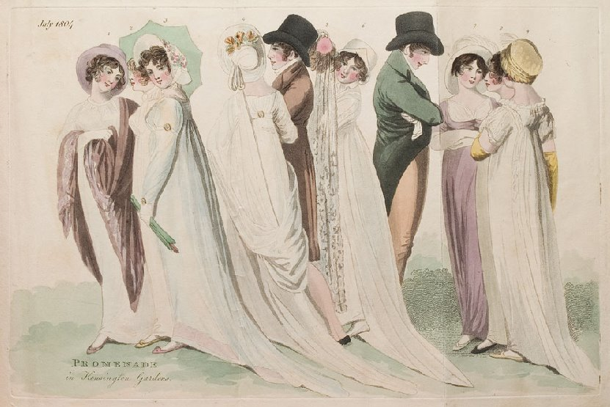
Notes:
S&S Miss Steele, stockings 1804: Promenade in Kensington Gardens: But first “by no means ungenteel or unfashionable; their dress was very smart”

Slide 6
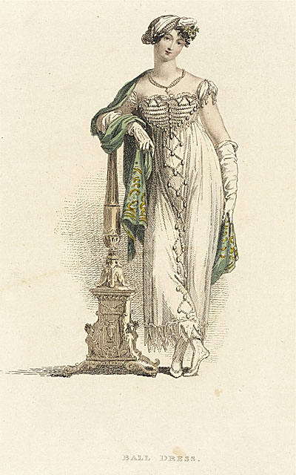
Mrs. Elton:
“as elegant as lace and pearls could make her”
Notes:
Emma/Mrs. Elton: as elegant as lace and pearls could make her”

Slide 7
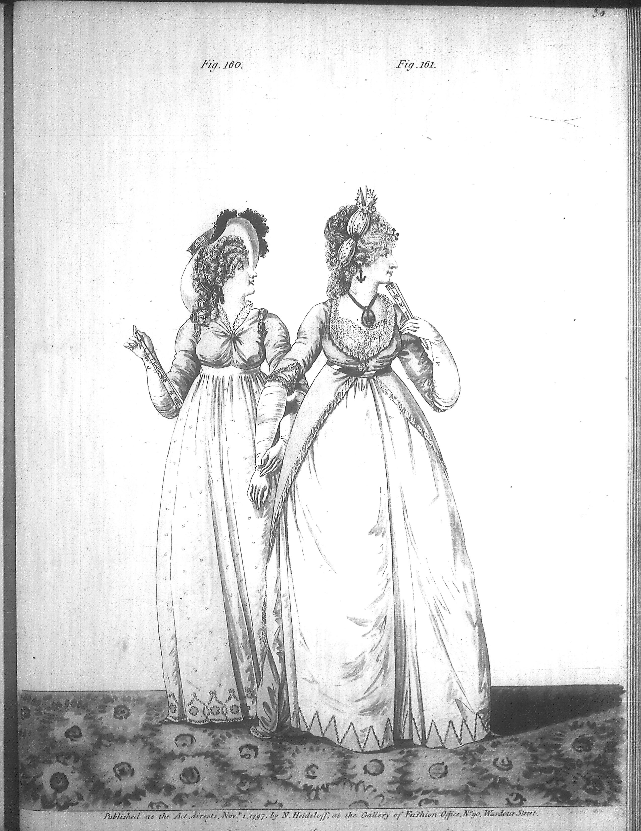
1797:
writing “Pride and Prejudice”
Notes:
1797

Slide 8
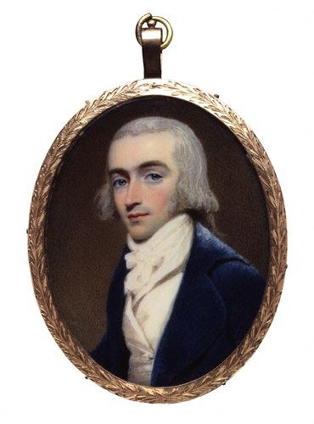
Notes:
1800 Robert Fellows, philanthropist, by Edridge Blue coat: Tory

Slide 9
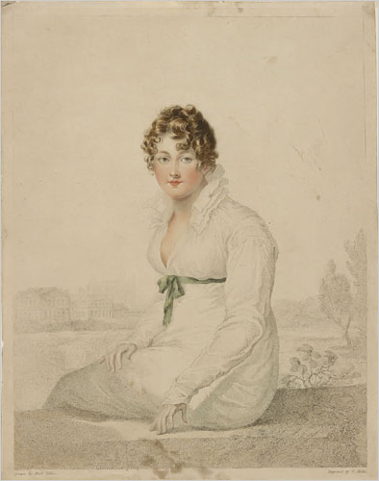
Notes:
1815-blake-engraving

Slide 10
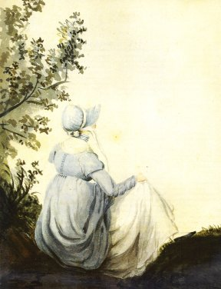
Notes:
Hem 6 inches deep in mud, I am absolutely certain, and the gown which had been let down to hide it not doing its office.”

Slide 11
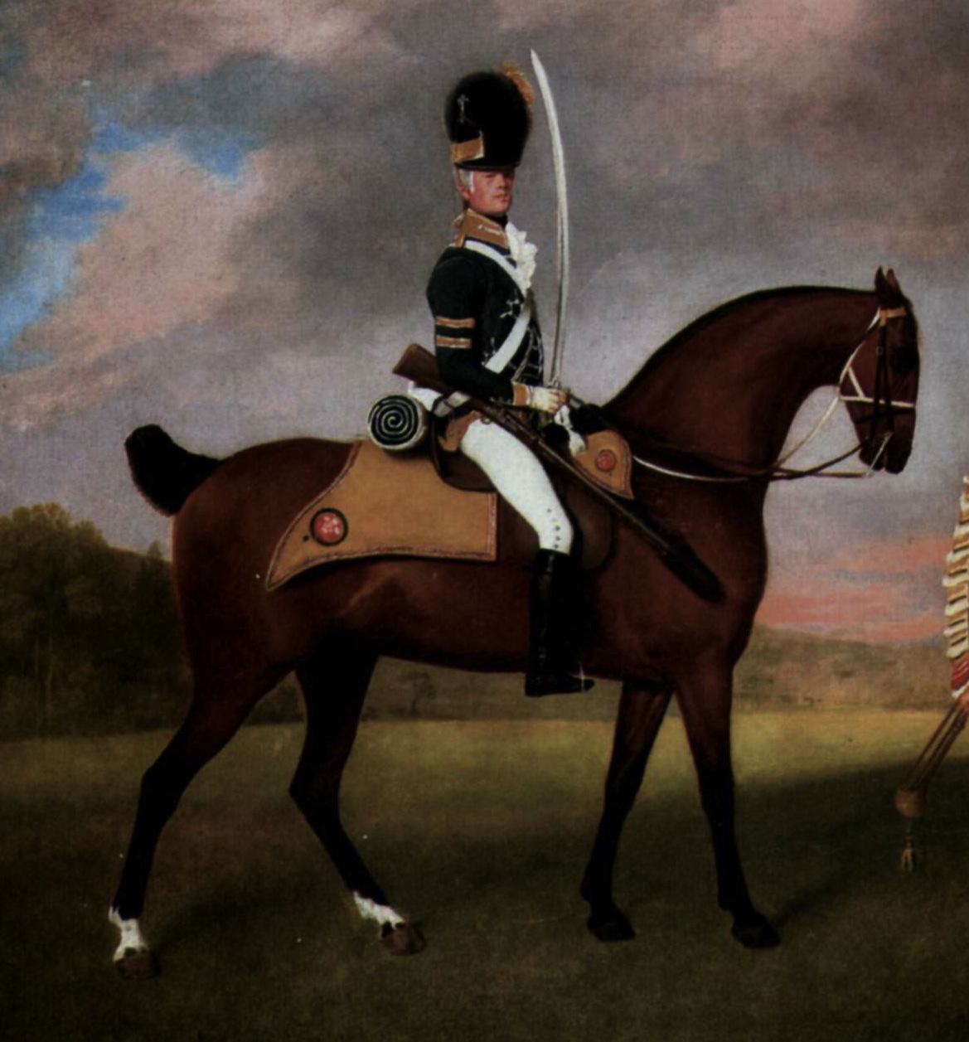
Notes:
Wanted only regimentals to make him charming – changing his coat.

Slide 12
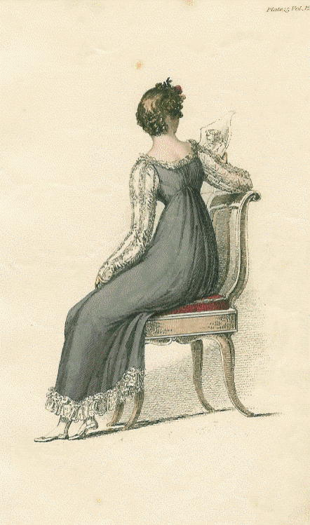
Notes:
1814Mrs. B. rhapsodizing over long sleeves and boring Mr. B with talk of lace. long sleeves. And Lydia - someone tell me how she talks about clothers – And “I shall send for my clothes when I get to Longbourn; but I wish you would tell Sally to mend a great slit in my worked muslin gown before they are packed up. “

Slide 13
What did men wear?
Men’s basics from the outside in,
or, undressing Mr. Darcy.

Slide 14
Thursday, 15 September 1796
“Edward and Fly went out yesterday very early in a couple of shooting jackets and came home like a couple of bad shots, for they killed nothing at all.”
Notes:
Awareness of shooting jacket—the country life attire influences city life

Slide 15
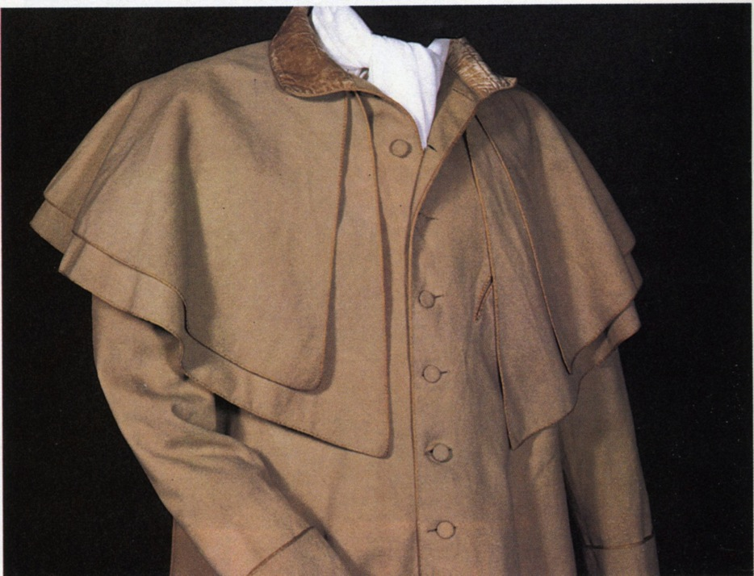
Greatcoat, overcoat
Catherine Morland of Henry Tilney: “His hat sat so well, and the innumerable capes of his great-coat looked so becomingly important. To be driven by him, next to being dancing with him, was certainly the greatest happiness in the world!”
Notes:
Henry can speak of fashion with impunity

Slide 16
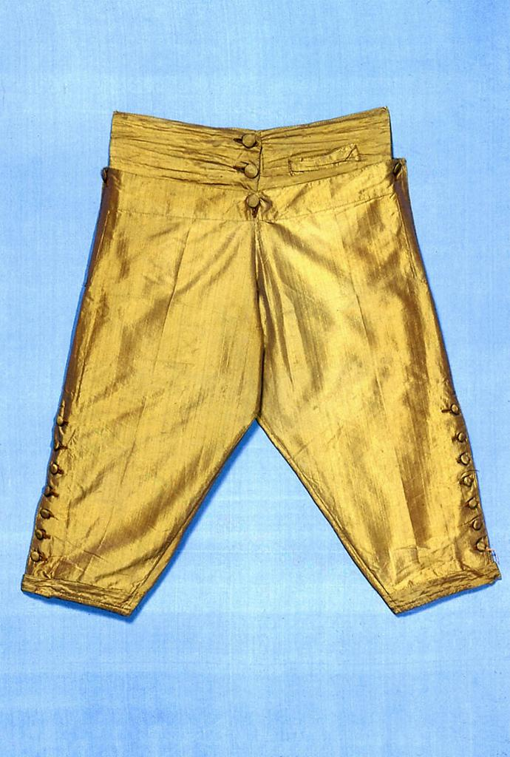
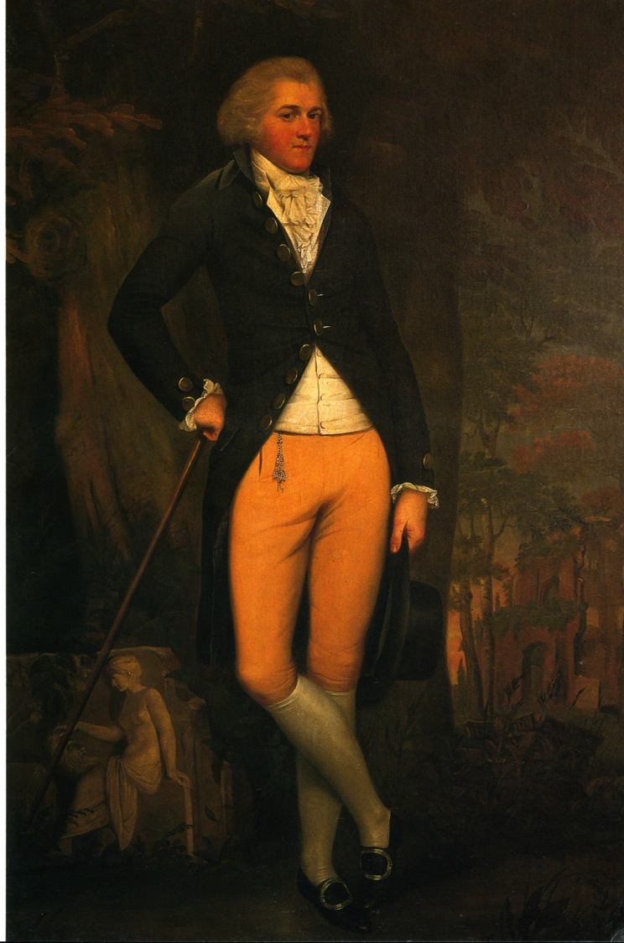
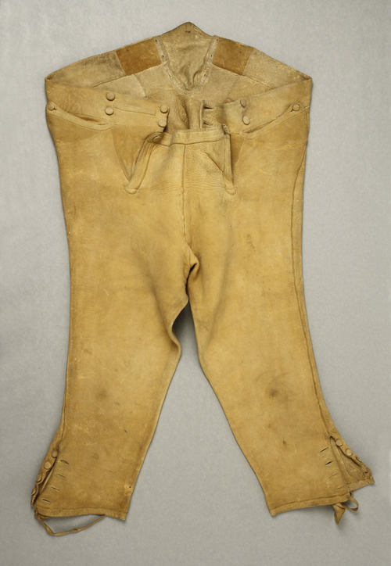
Notes:
Edward Austen Knight, grand tour, 1800

Slide 17
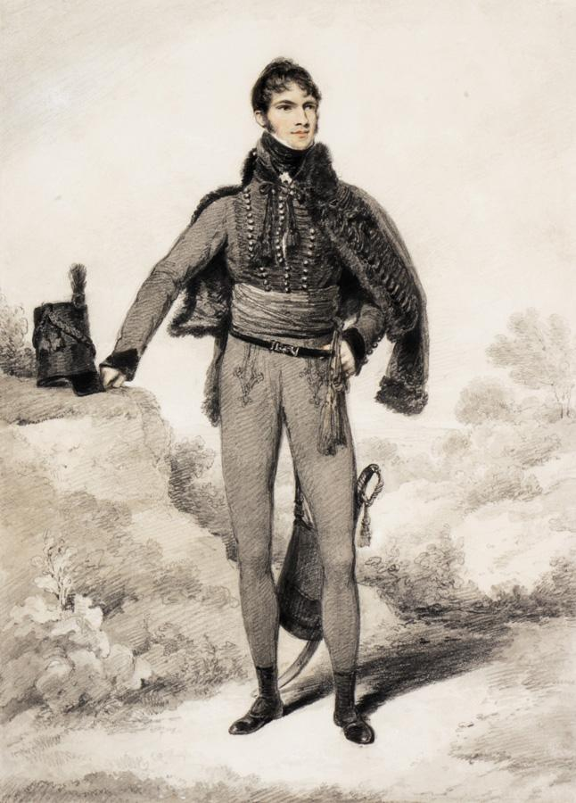
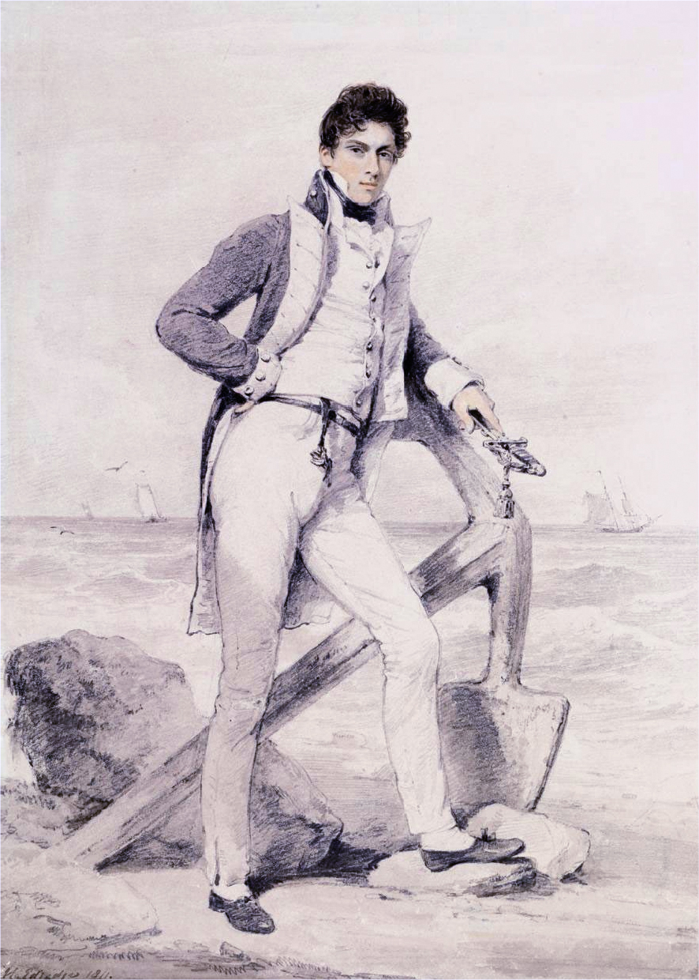
Notes:
Sir William Harbord, 1810 by Edridge, Captain Hoste 1811 by Edridge
The other major influence on men’s fashion: military pantaloons and navy trousers

Slide 18
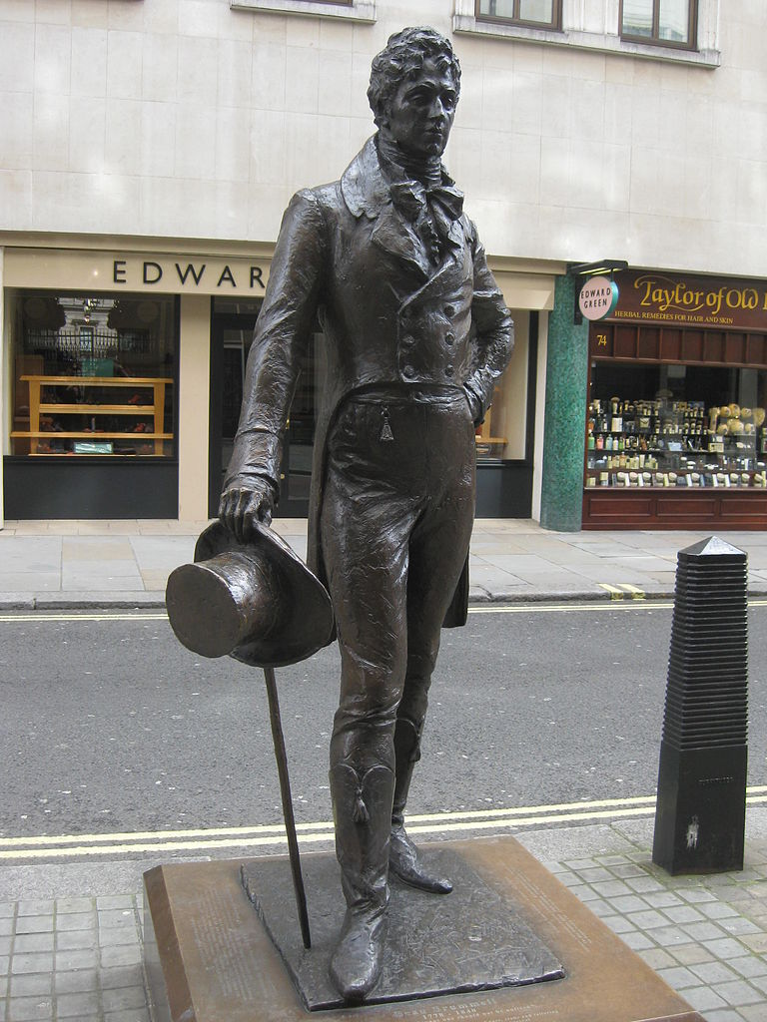
George Bryan “Beau” Brummel
Notes:
George Bryan “Beau” Brummell who almost singlehandedly changed fashion: see next slide

Slide 19
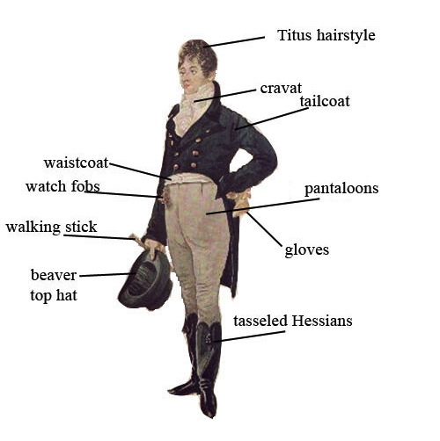
George “Beau” Brummel
Notes:
1805 Dighton caricature – blue superfine, pantaloons,

Slide 20
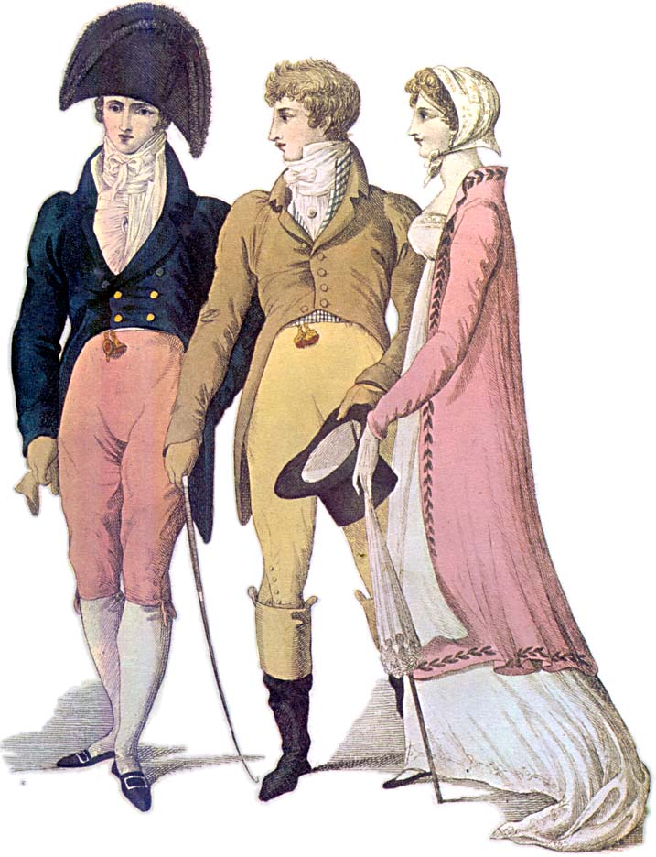
Notes:
1809 – cutaway, swallow-tail, classical statues – the nude male vs. the draped female

Slide 21
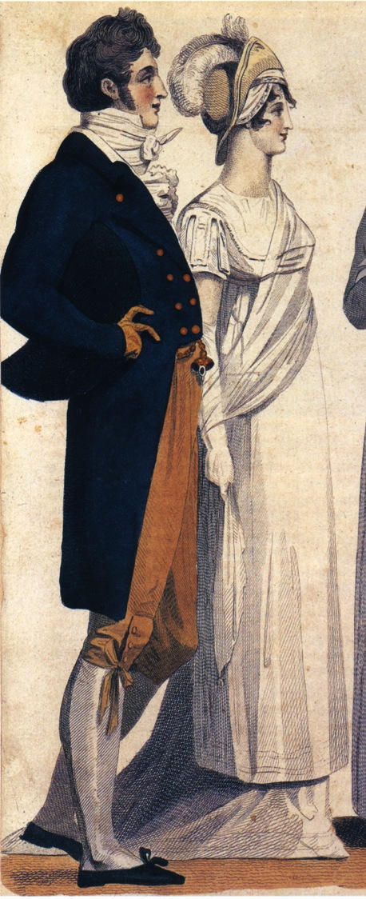
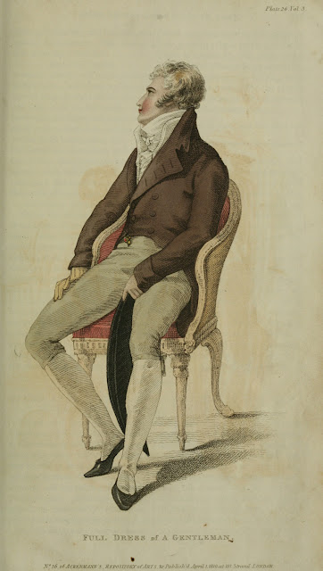
Notes:
1807, 1810, subtle differences in cut of breeches and coat

Slide 22
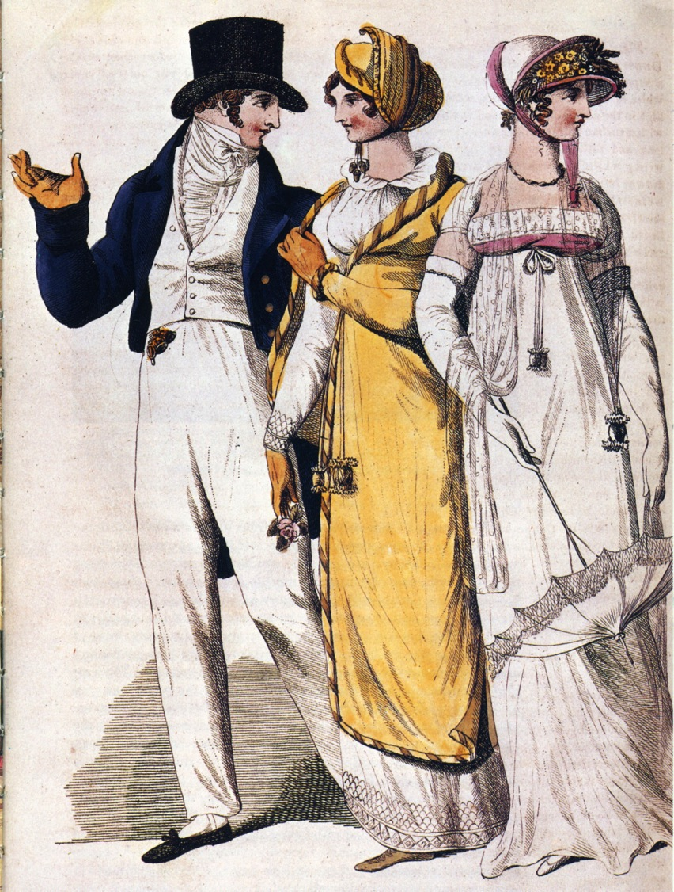
Notes:
1807

Slide 23
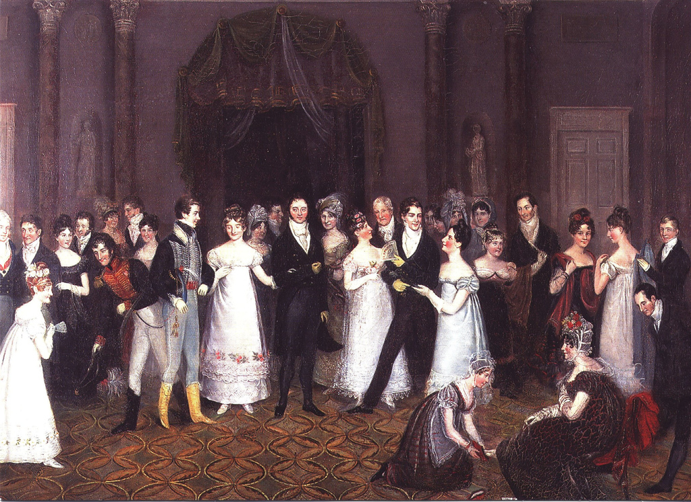
Notes:
1818

Slide 24
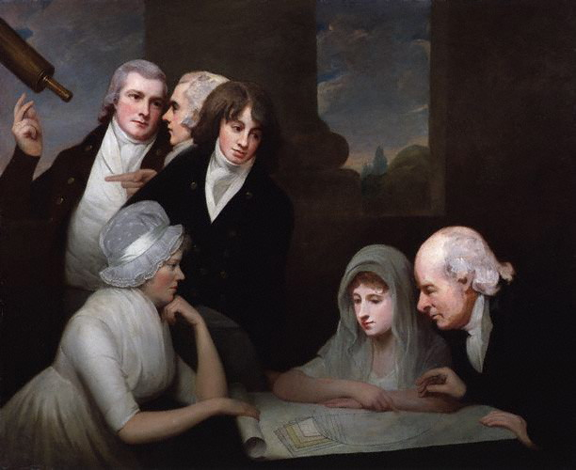
Hair
Notes:
1796 or so, after Pitt’s hairpowder tax of 1795

Slide 25
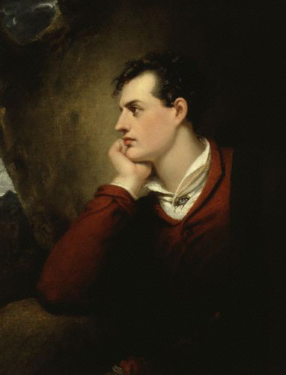
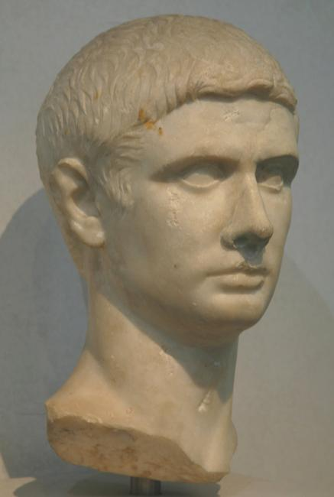
Notes:
Titus, Brutus, Caesar, the romantics

Slide 26
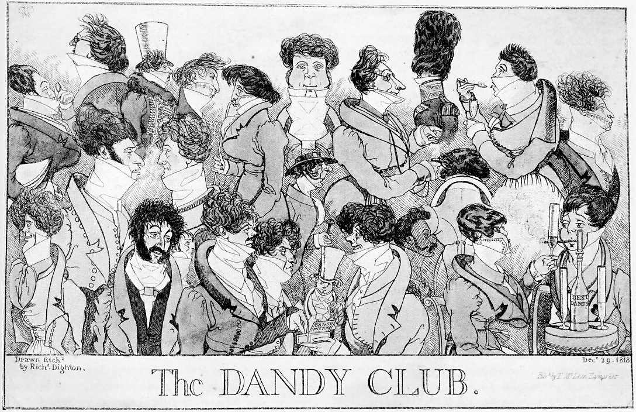
Notes:
1818 – Brummell would not have approved

Slide 27
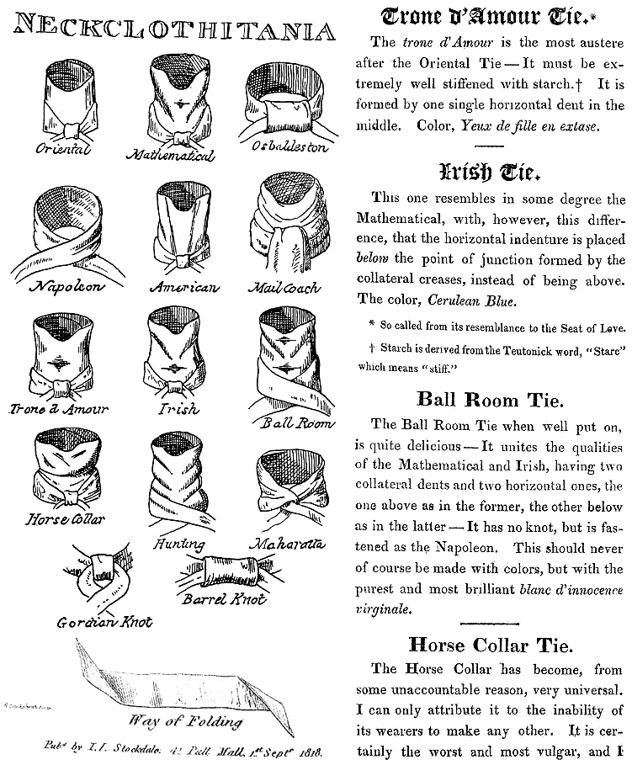
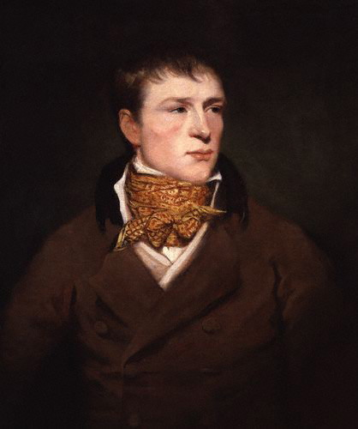

Slide 28
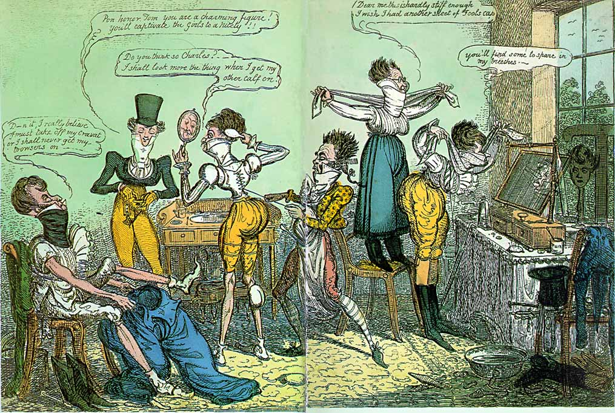
Notes:
1818 Cruickshank

Slide 29
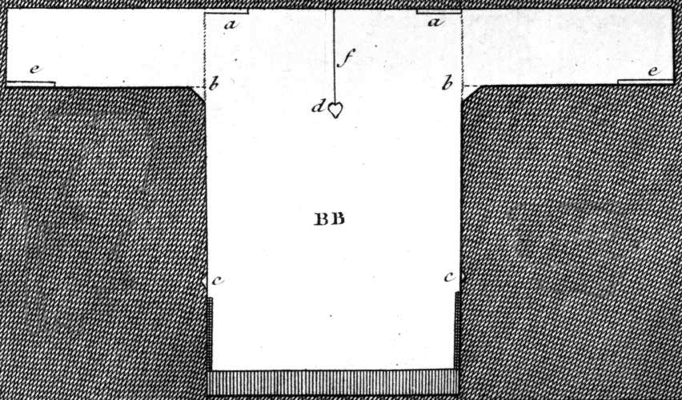
Thursday, 1 September 1796:
“We are very busy making Edward’s shirts, and I am proud to say that I am the neatest worker of the party.”

Slide 30
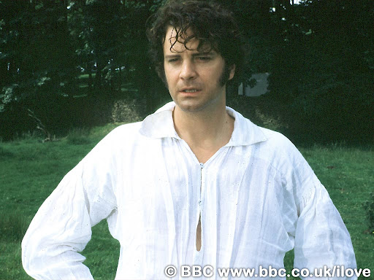

Slide 31
What did women wear?
Women’s basics from the inside out,
or, dressing Mrs. Darcy.

Slide 32
Sunday, 25 November 1798:
“The Overton Scotchman [a peddler carrying fabric for sale door to door] has been kind enough to rid me of some of my money, in exchange for six shifts and four pair of stockings. The Irish [linen] is not so fine as I would like it; but as I gave as much money for it as I intended I have no reason to complain. It cost me 3s. 6d. per yard. It is rather finer, however, than our last, and not so harsh a cloth.”
Notes:
21 shillings for Emma = about $95 in 2011 so 3s 6d is about $14/yd.
20 shillings in a pound, 12 pence in a shilling
Dr. Eric Nye - http://uwacadweb.uwyo.edu/numimage/currency%20conversion.htm “A Method for Determining Historical Monetary Values”

Slide 33
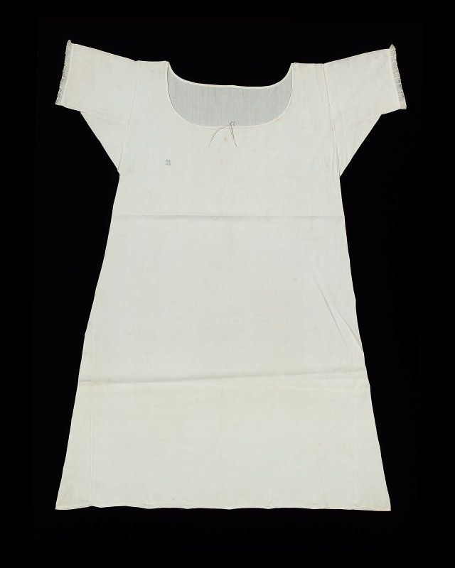
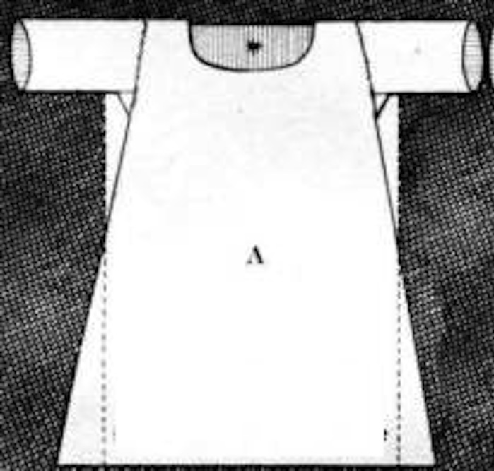
Shift/chemise

Slide 34
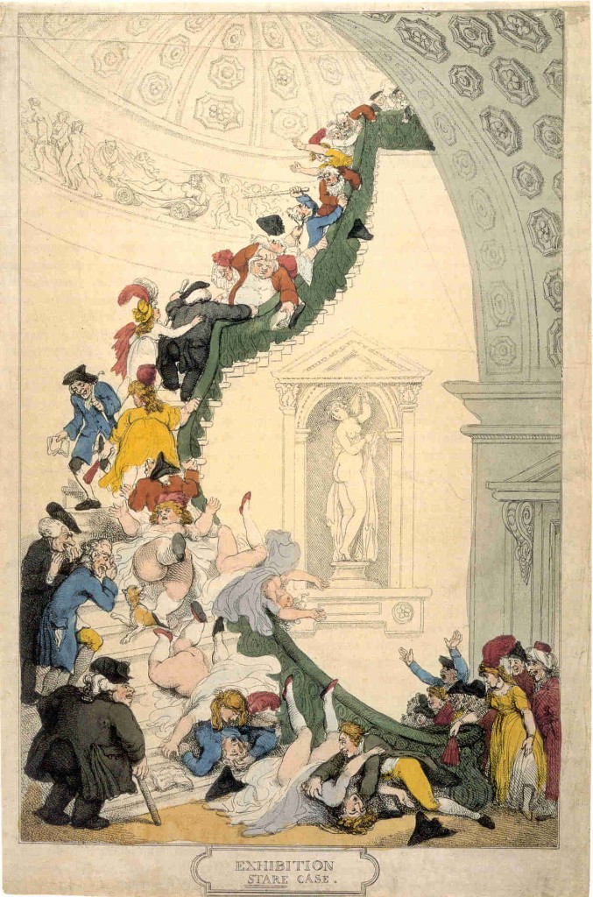
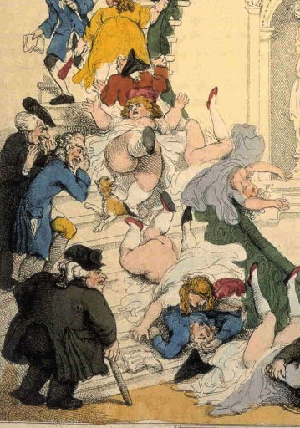

Slide 35
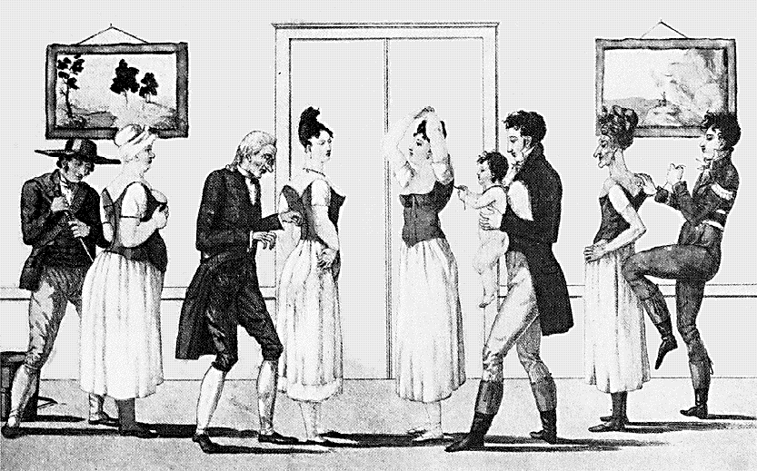
Notes:
Corset and stockings, two layers of linen, channels of baleen or cord, single spiral laced, busk (more later)

Slide 36
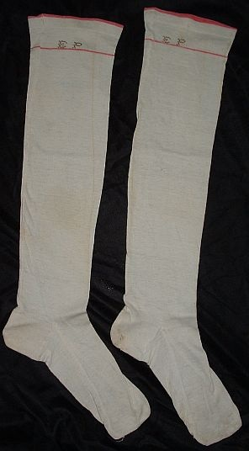
Saturday, 9 January 1796:
“You say nothing of the silk stockings; I flatter myself, therefore, that Charles has not purchased any, as I cannot very well to pay them; all my money is spent buying white gloves and pink persian.”
Notes:
Thursday Sept 16: What a good for nothing fellow Charles is to bespeak the stockings. I hope he will be too hot all the rest of his life for it.

Slide 37
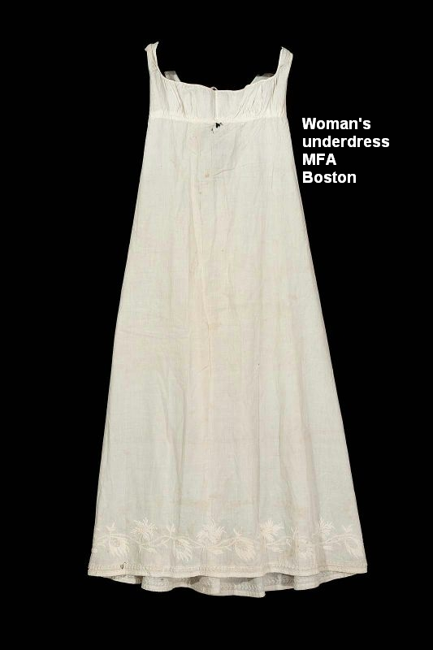
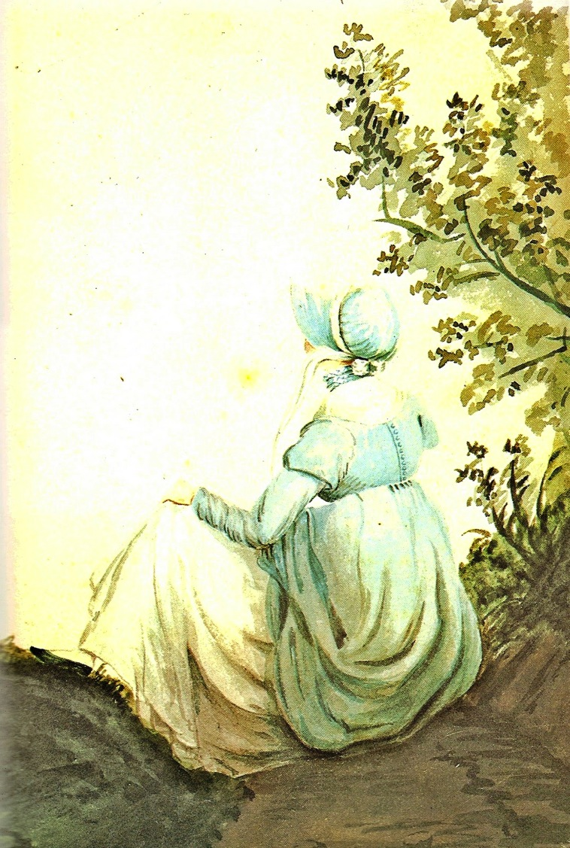

Slide 38
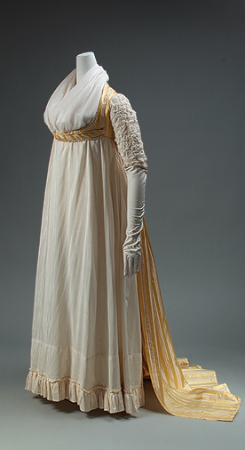
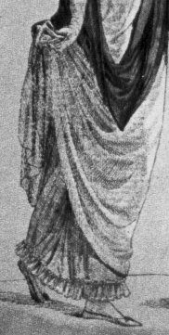

Slide 39
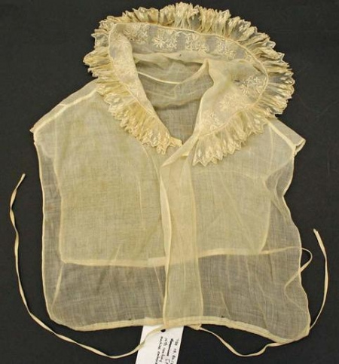
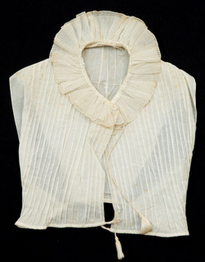
Chemisette

Slide 40
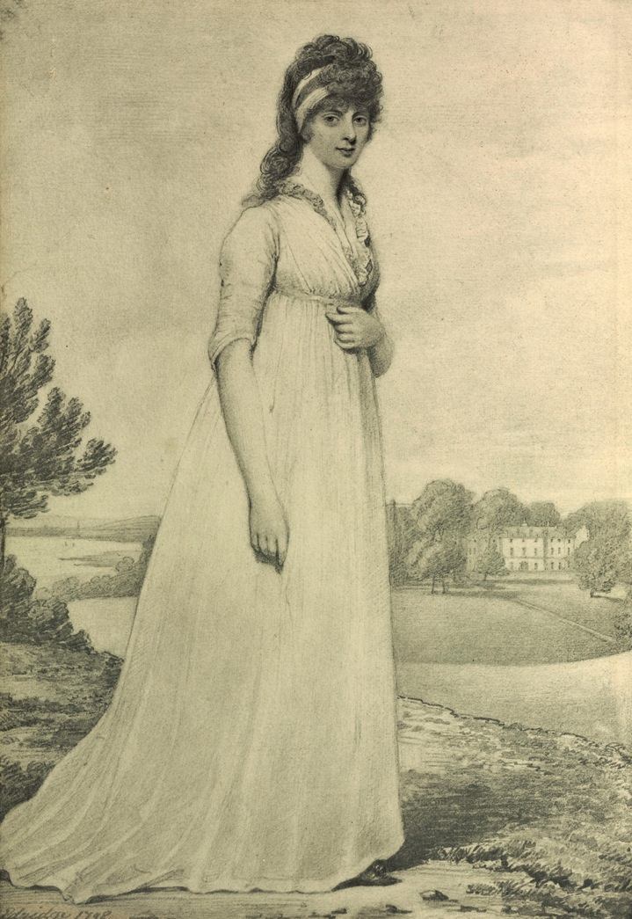
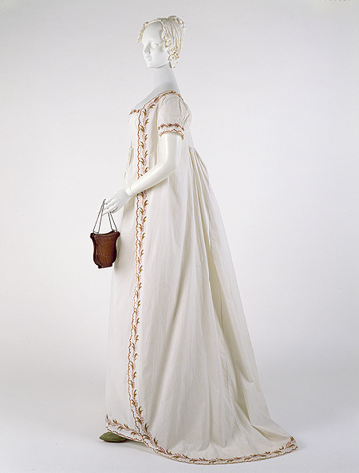
Notes:
1798, Theresa Parker by Edridge

Slide 41
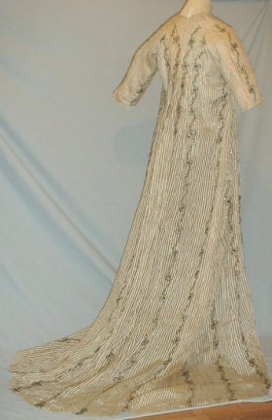
Wednesday, 18 December 1798:
“I believe I shall make my new gown like my robe, but the back of the latter is all in a piece with the tail, and will seven yards enable me to copy it in that respect?”

Slide 42
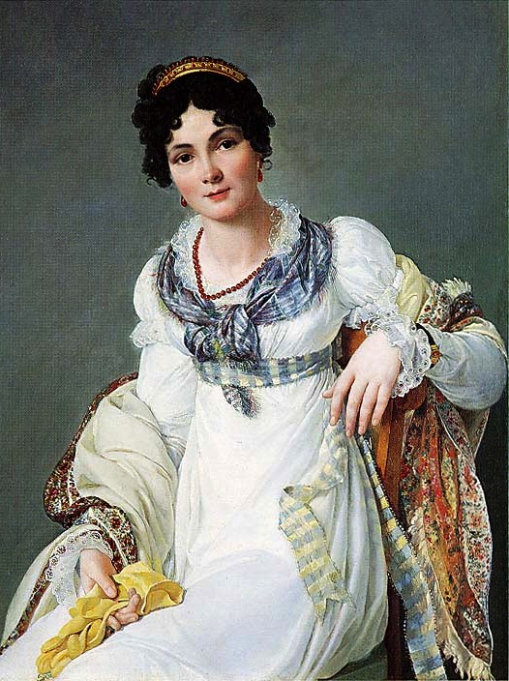
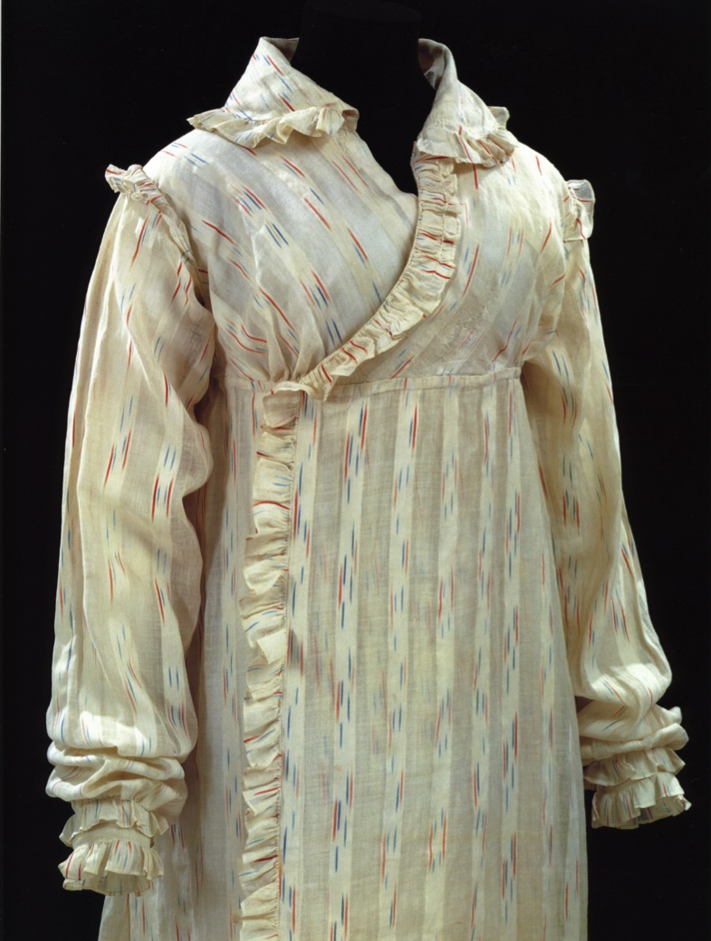
Notes:
But which gown? This is the period where upper class women dressed according to the time of day: Morning dress (anytime before dinner around 1:00, or 2, 3, 4…)

Slide 43
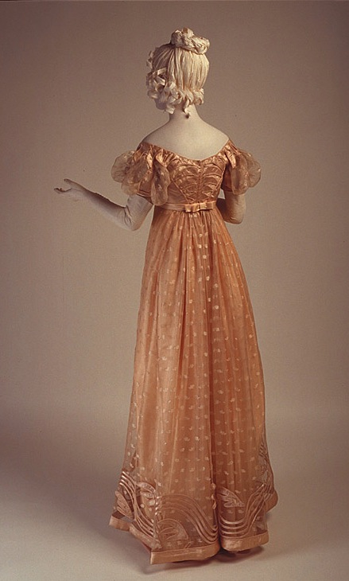
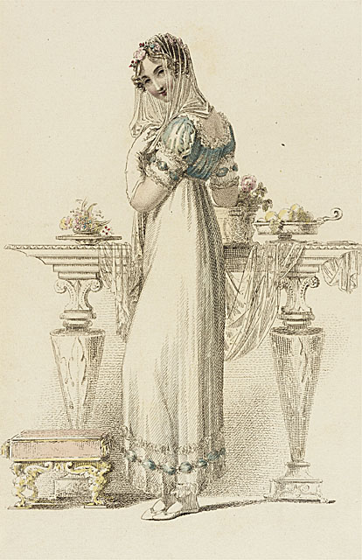

Slide 44
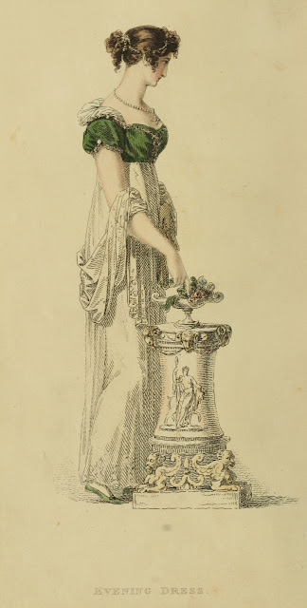
Notes:
Or full dress

Slide 46
Cloaks
Notes:
Cloaks, hats, hair

Slide 47
Notes:
1809, York St., St. James Square

Slide 48
Spencer

Slide 53
Thursday, 18 April 1811:
“Our pelisses are 17s. each; she charges only 8s. for the making, but the buttons seem expensive, — are expensive, I might have said, for the fact is plain enough.”
Tuesday, 22 April 1811:
“I do not mean to provide another trimming for my pelisse, for I am determined to spend no more money; so I shall wear it as it is, longer than I ought, and then — I do not know…”

Slide 56
Notes:
Pelisse…redingote

Slide 58
Notes:
1821 Royal Academy originally in Somerset House, President Sir Joshua Reynolds

Slide 60
Notes:
1790s – large and round, 1799-1804 smalled

Slide 61
Sunday, 2 June 1799:
“Flowers are very much worn, and fruit is still more the thing. Elizabeth has a bunch of strawberries, and I have seen grapes, cherries, plums, and apricots. There are likewise almonds and raisins, French plums, and tamarinds at the grocers’,
but I have never seen any of
them in hats.”
Tuesday, 11 June 1799:
“I cannot decide on the fruit till I hear from you again. Besides, I cannot help thinking that it is more natural to have flowers grow out of the head than fruit. What do you think on that subject?”

Slide 63
Reticules

Slide 64
Wednesday, 9 January 1799:
“I wore my green shoes last night…”
Sunday, 2 June 1799:
“I am not fond of ordering shoes;
and, at any rate,
they shall all
have flat heels.”

Slide 65
Notes:
Gloves, shawls,

Slide 68
Saturday, 15 October 1808:
“I am to be in bombazeen and crape, according to what we are told is universal here, and which agrees with Martha’s previous observation. My mourning, however, will not impoverish me, for by having my velvet pelisse fresh lined and made up, I am sure I shall have no occasion this winter for anything new of that sort. I take my cloak for lining, and shall send yours on the chance of its doing something of the same for you, though I believe your pelisse is in better repair than mine. One Miss Baker makes my gown and the other my bonnet, which is to be silk covered with crape.”
Notes:
On the death of Mrs. Edward Austen

Slide 69
Thursday, 20 November 1800:
“Miss Debary, Susan, and Sally, all in black, but without any statues, made their appearance…”
Notes:
1819, 1810, 1816

Slide 70
Notes:
1799,

Slide 72
Jane Austen 1774-1817
A fashion timeline
1774-1790: Formal, wide, natural waist
1789-1799: High waists and muslins, full
1800-1810: Greek and Roman, narrowing
1811-1814: Gothic moves in, decorative trim
1815-1817: Shrinking bodice, more trim
1817… The return of volume
Notes:
If we look at clothing during her lifetime we see that her life covered one of the most tumultuous in fashion history.
Talk about volume.

Slide 74
1770s and 1780s

Slide 77
Cousin Eliza de Feuillide
Notes:
1790 – the narrowing begins but waist is still in question

Slide 79
1780s
Chemise
Dress

Slide 80
Notes:
Open robe 1790, still fairly structured, higher waist, full petticoat

Slide 82
Notes:
Even in America the trend towards a higher waist was followed, though in this case the construction of the back of the gown remained the same.

Slide 83
Notes:
As the 1790s progress we move into a transition gown. It is high waisted but still very full. The fabric is lightweight cotton or muslin and hair is big!

Slide 85
1795

Slide 86
1794
Notes:
Watch the sleeves

Slide 87
1790s: Big hats, big hair, big feathers

Slide 89
Notes:
When Austen was writing her early novels this is what she was seeing and wearing. Ladies in a high-perch Phaeton.

Slide 90
Notes:
Greek and roman

Slide 91
Notes:
At end of century hair is smaller, dresses are narrower

Slide 92
Tuesday, 8 January 1799:
“I am not to wear my white satin cap to-night, after all; I am to wear a mamalone [mameluke] cap instead, which Charles Fowle sent to Mary, and which she lends me. It is all the fashion now; worn at the opera, and by Lady Mildmays at Hackwood balls.”

Slide 94
Notes:
1797 Boilly Incroyable and Marveilleuse

Slide 95
Notes:
1796 Gillray

Slide 97
Notes:
1810 “A scene taken from nature in Kensington Gardens”

Slide 98
1800-1808: tall and narrow, less fabric, trains
Notes:
Still lots of fabric gathered at waist but the silhouette is definitely vertical, the greek column ideal

Slide 100
Note gathering at waist

Slide 103
Thursday, 18 April 1811:
“I am sorry to tell you that I am getting very extravagant, and spending all my money, and, what is worse for you, I have been spending yours too; for in a linendraper's shop to which I went for checked muslin, and for which I was obliged to give seven shillings a yard, I was tempted by a pretty-colored muslin, and bought ten yards of it on the chance of your liking it; but at the same time, if it should not suit you, you must not think yourself at all obliged to take it; it is only 3s. 6d. per yard, and I should not in the least mind keeping the whole. In texture it is just what we prefer, but its resemblance to green crewels, I must own, is not great, for the pattern is a small red spot.”

Slide 104
Tuesday, 8 January 1799:
“My gown is made very much like my blue one, which you always told me sat very well, with only these variations: the sleeves are short, the wrap fuller, the apron comes over it, and a band of the same completes the whole.”
Notes:
Not quite the same – this is a bit later but show the apron dress

Slide 106
Notes:
As we move towards 1810 the vertical emphasis appears in the decoration as well as the construction

Slide 107
Notes:
Around 1810 construction techniques are developed to make less fullness at the front

Slide 109
1810: Trains hang on in evening dress

Slide 110
1808-1810: Accommodating Grecian hair

Slide 113
1813: Emphasis shifting to bodice
Notes:
By 1813 the emphasis is shifting to the bodice. The vertical line disappears from the skirt and the bodice gets the eye-catching trim

Slide 115
Wednesday, 13 September 1813:
“I learnt from Mrs. Tickars's young lady, to my high amusement, that the stays now are not made to force the bosom up at all; that was a very unbecoming, unnatural fashion. I was really glad to hear that they are not to be so much off the shoulders as they were.”

Slide 116
Notes:
Corsets continue to evolve, longer to create a smooth columnar line, busk still there to provide support and posture, and bustline very high

Slide 118
Notes:
By the year of Austen’s death the bodice is high, the hemline is decorated, skirts are beginning to attain a more aline shape

Slide 120
Notes:
Small bodice, sleeves fall at waistline

Slide 122
Sarah Villiers, Countess of Jersey, aka Sally Fane, aka Lady Jersey, aka “Silence”
Notes:
By Alfred Edward Chalon

Slide 124
Jane Austen 1774-1817
A fashion timeline
1774-1790: Formal, wide, natural waist
1789-1799: High waists and muslins, full
1800-1810: Greek and Roman, narrowing
1811-1814: Gothic moves in, decorative trim
1815-1817: Shrinking bodice, more trim
1817… The return of volume
Notes:
If we look at clothing during her lifetime we see that her life covered one of the most tumultuous in fashion history.
Talk about volume.

Slide 125
…and now to solve a fashion mystery.

Slide 127
1799
1807
1815

