Slide 1
Fashion in Jane Austen’s Time
Hope Greenberg

Slide 2
or

Slide 3
Dressing the Knightleys

Slide 4
How did we get there:
500 years of fashion evolution
Notes:
The most well-known thing about the fashions of Jane Austen’s time is that they changed tremendously. But what came before?

Slide 5
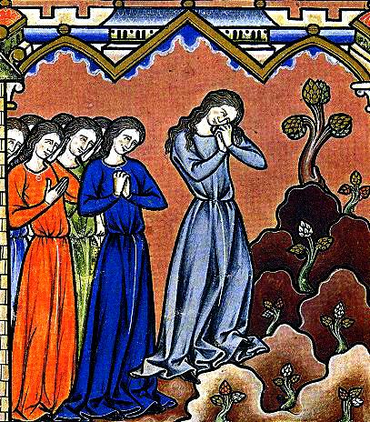
1300s
Notes:
We’ll begin with the 1300s. Don’t worry – this will be the ultra condensed version of fashion history. I begin here because this is the point where people begin to consider how to make clothes fit the body Construction – rectangles, also conspicuous consumption

Slide 6
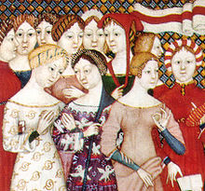
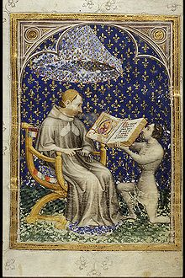
1400s
Notes:
by the 1400s people hd become quite skilled at making clothes fit smoothly and had begun to consider how fabric can also mold body shape

Slide 7
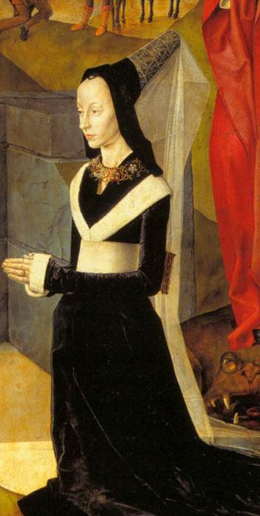
Late 1400s
Notes:
By the late 1400s fashions were following the vertical shape also seen in architecture, gothic cathedrals, flying buttresses

Slide 8
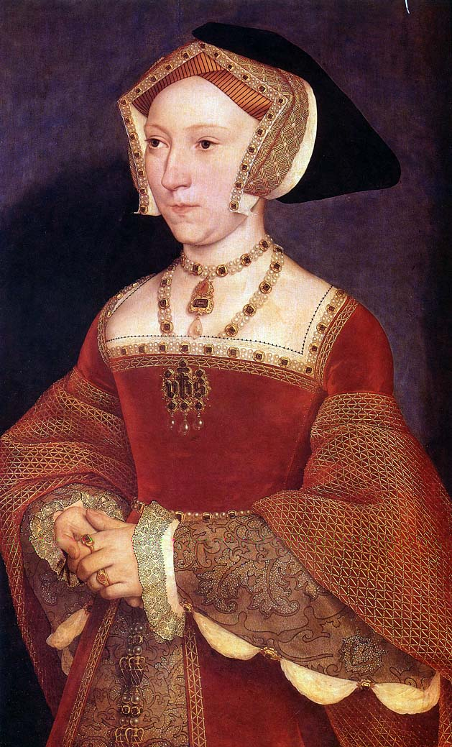
1530
Notes:
By 1530 fashion had moved into a horizontal phase setting up a pattern of change from vertical to horizontal that continues even until today. 1950s, 60/70s 80 shoulders

Slide 9
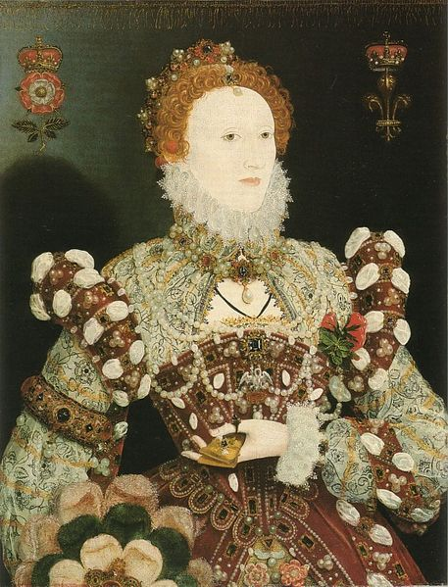
Late 1500s
Notes:
Also, body shaping through corsetry

Slide 10
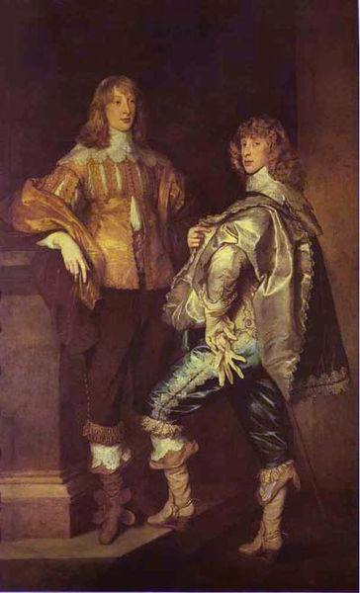
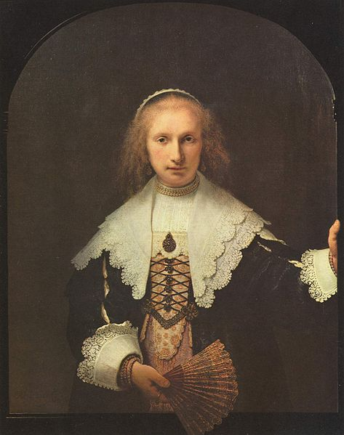
1600s

Slide 11
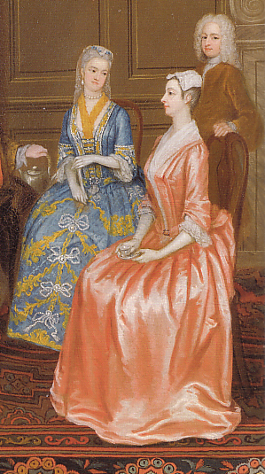
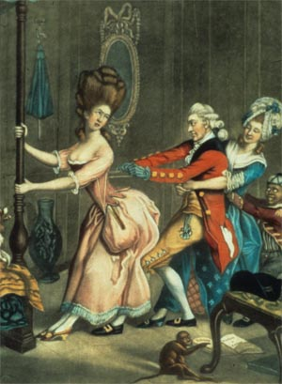
1700s

Slide 12
1776-1792
Jane Born: 16 December 1775
1770s: continuation of previous styles
1780s: Marie Antoinette and the chemise gown
1790s: the big change!

Slide 13
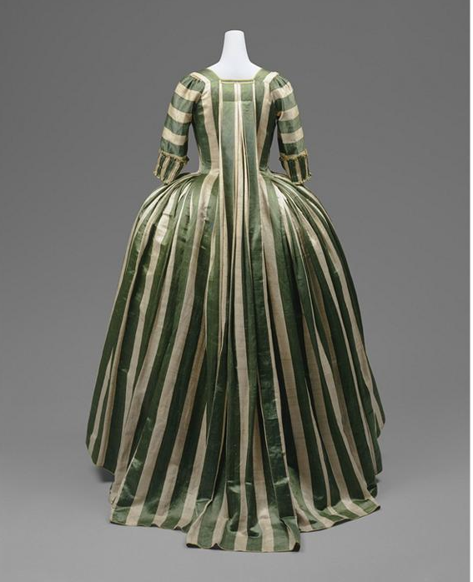
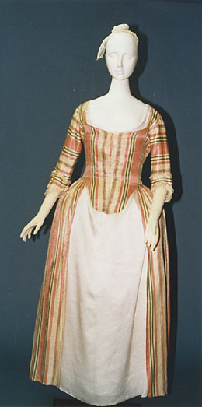
1785 Dress a Francaise
1780s Dress a l’Anglaise

Slide 14
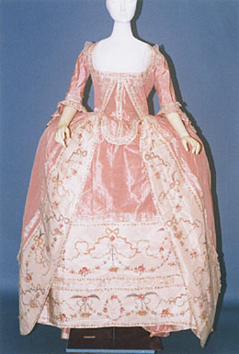
1780

Slide 15
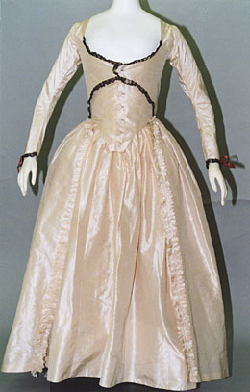
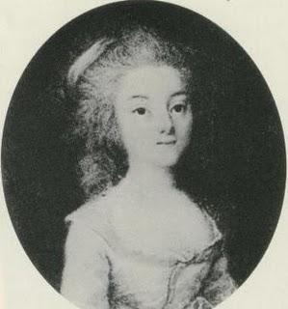
1790

Slide 16
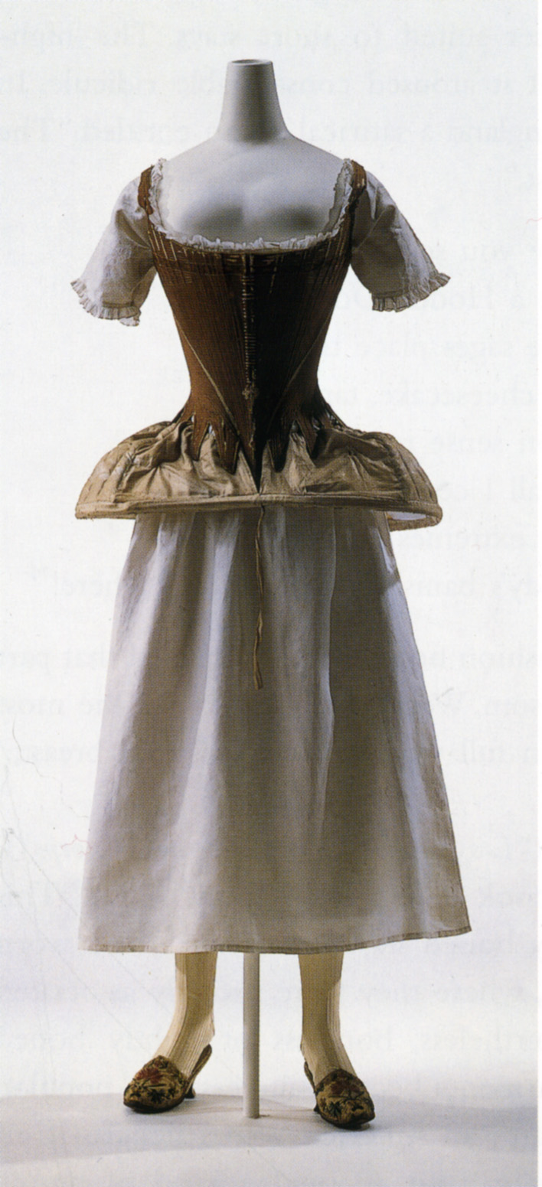

Slide 17
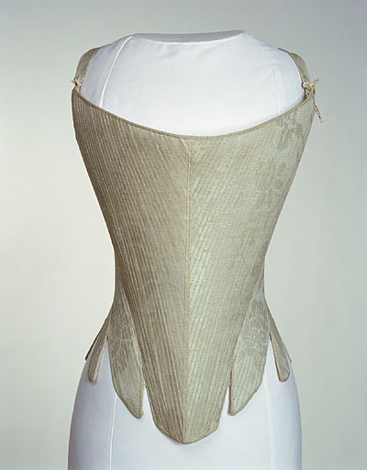
1775-1790 corset

Slide 18
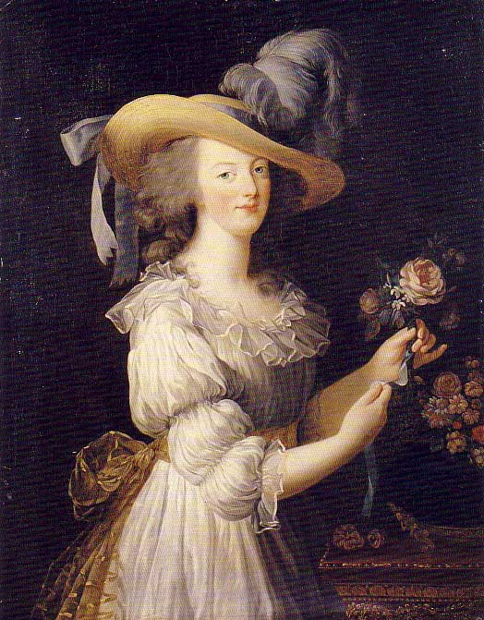
1780s Marie Antoinette, Chemise Gown

Slide 19
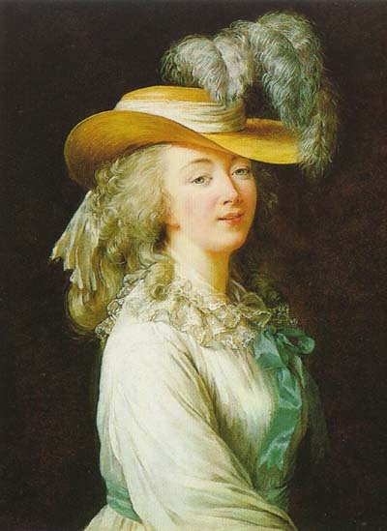
1780s M. du Barry, Chemise Gown

Slide 20
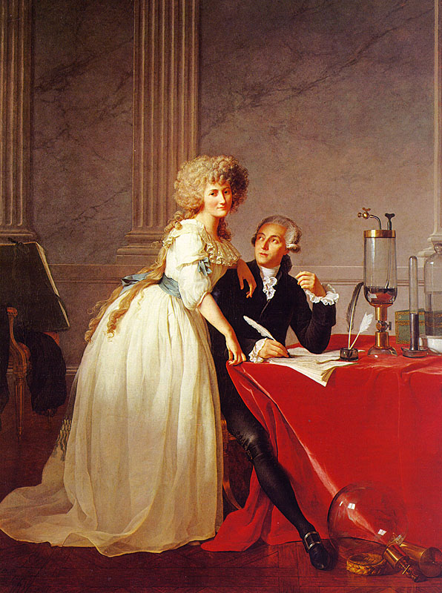
1780s, chemise gown

Slide 21
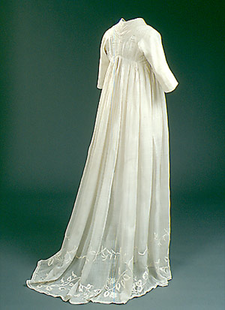

Slide 22
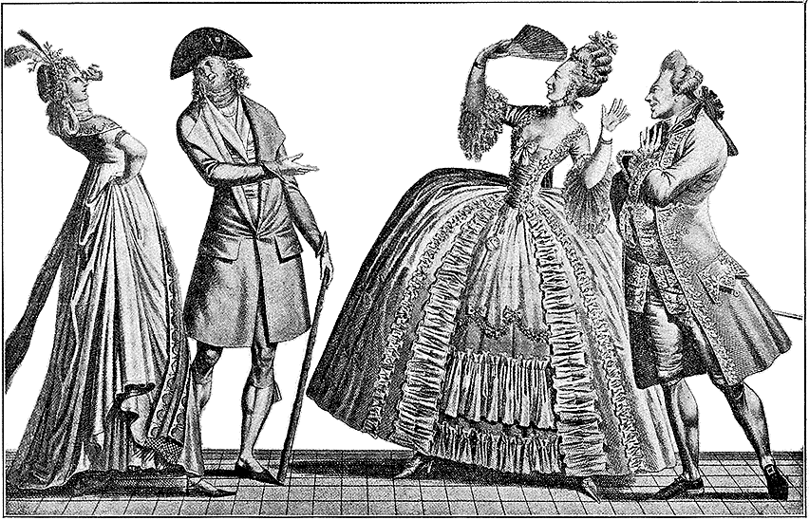

Slide 23
1793-1804
Jane is 18-28, young, dancing, marriageable
Writing Sense and Sensibility, First Impressions (P&P), Northanger Abbey, and The Watsons
1803: Move to Bath
Napoleon crowned Emperor, 2 Dec. 1804

Slide 24
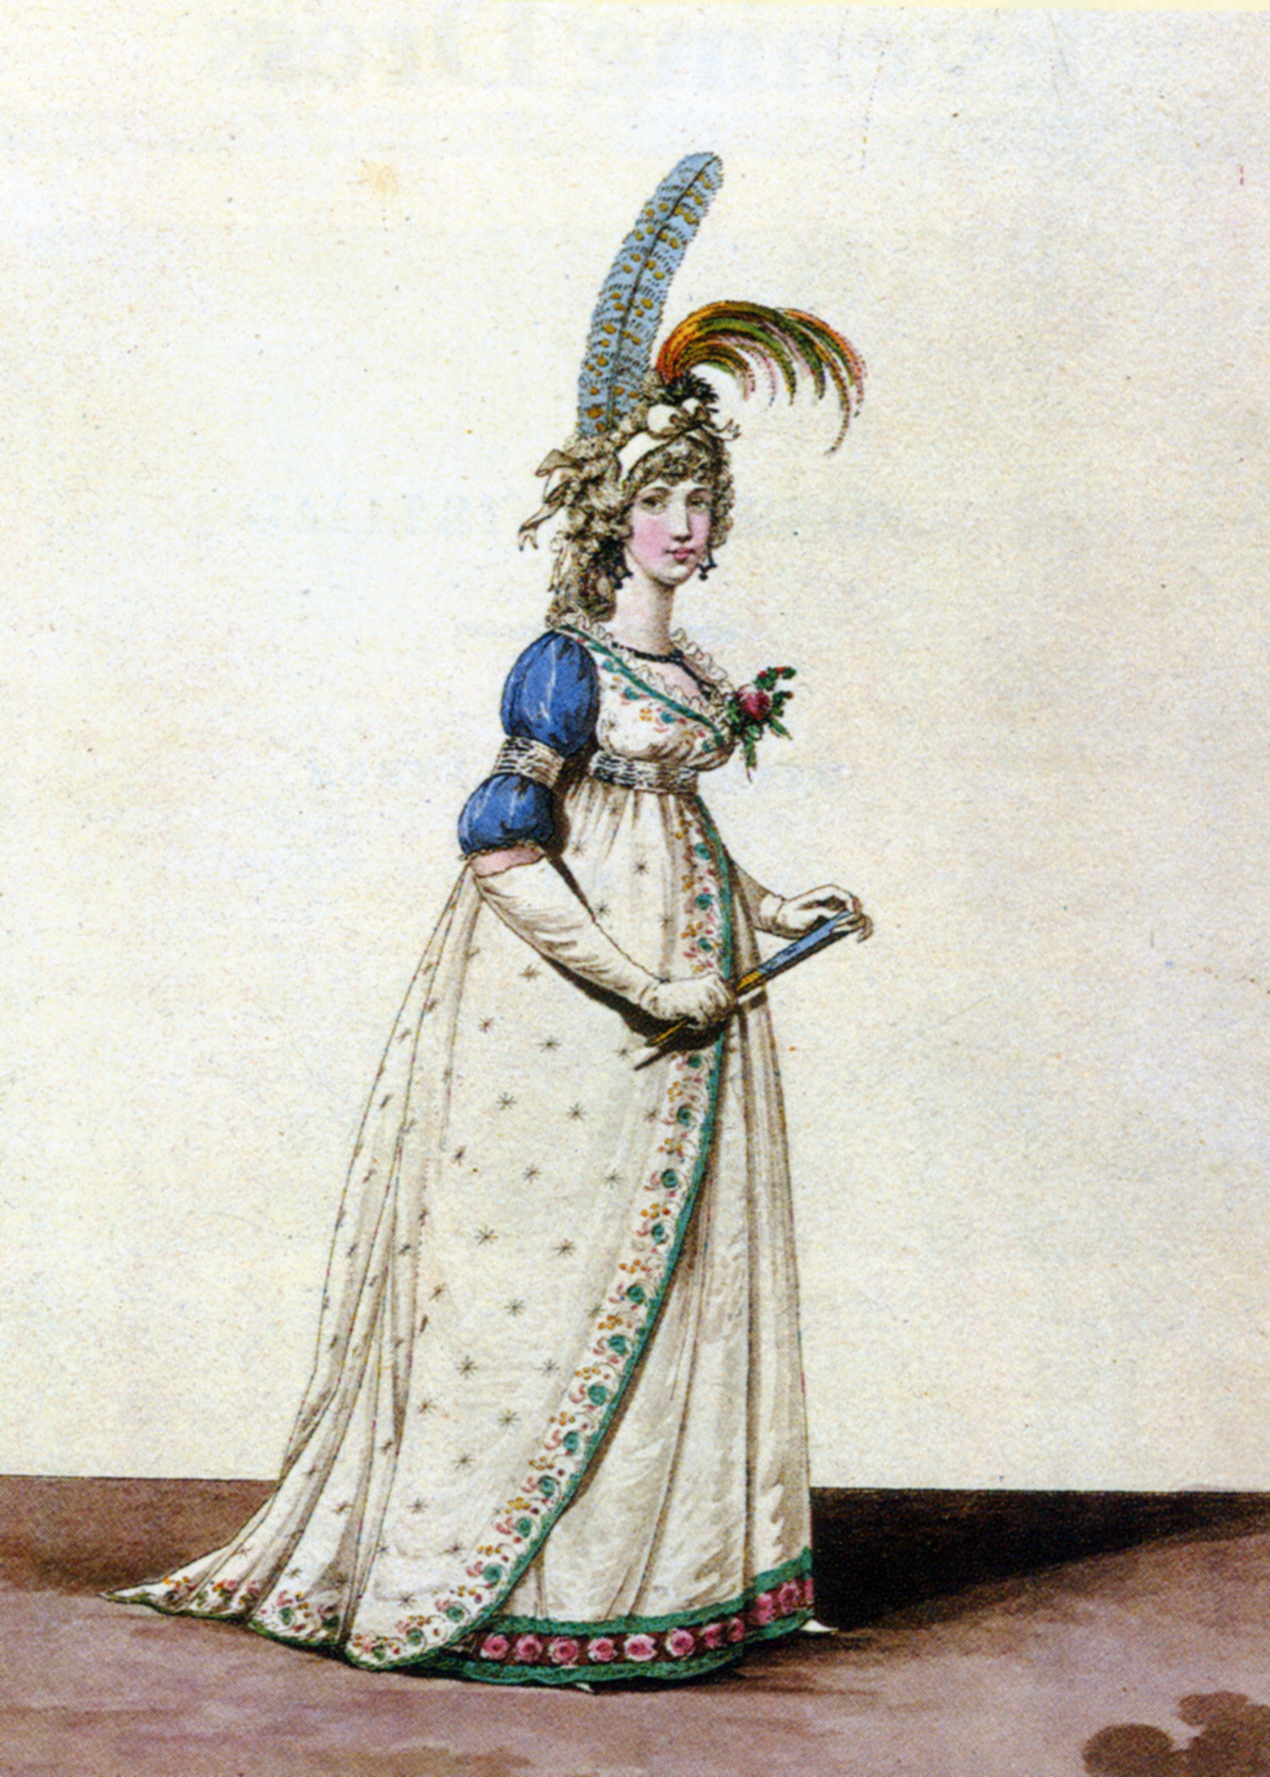
1790s

Slide 25
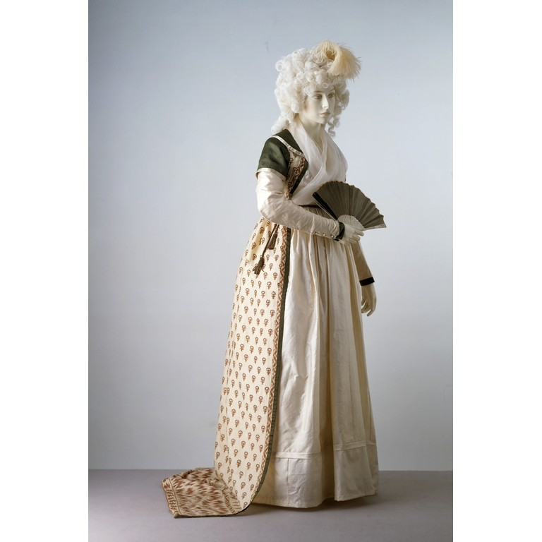

Slide 26
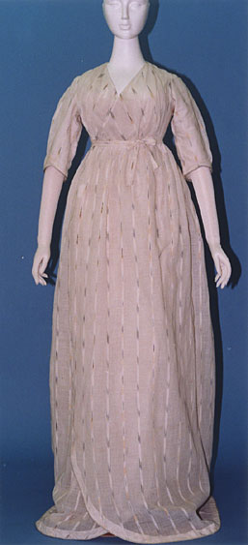

Slide 27
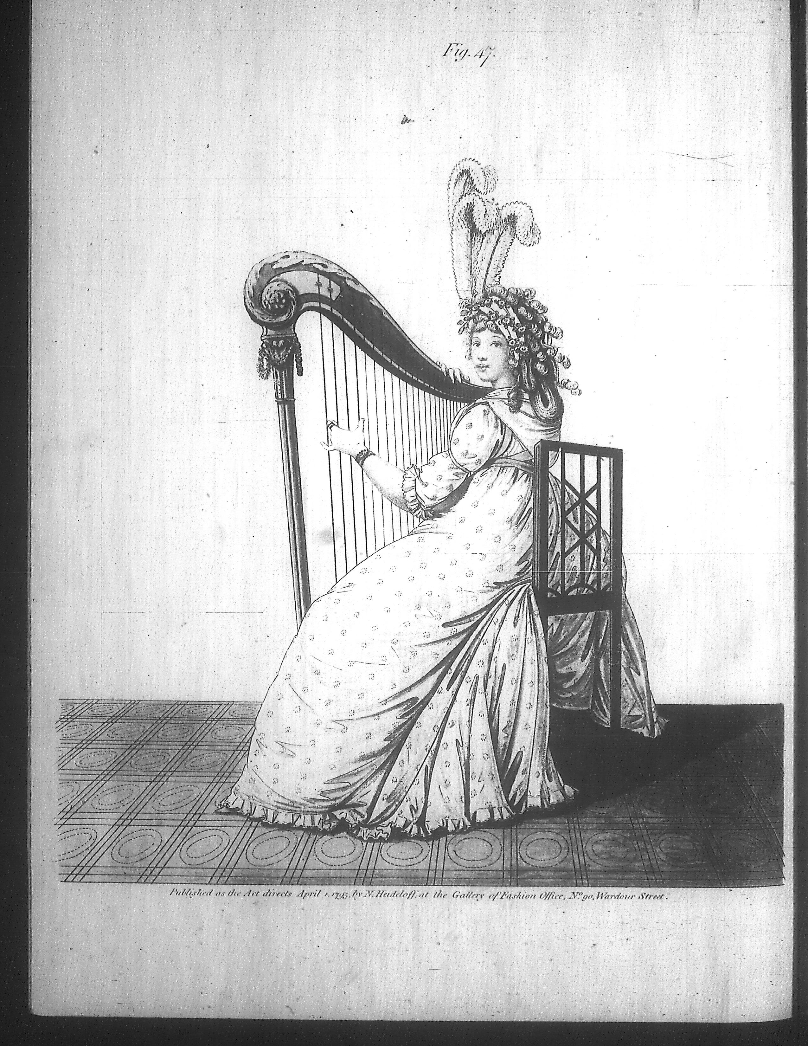

Slide 28
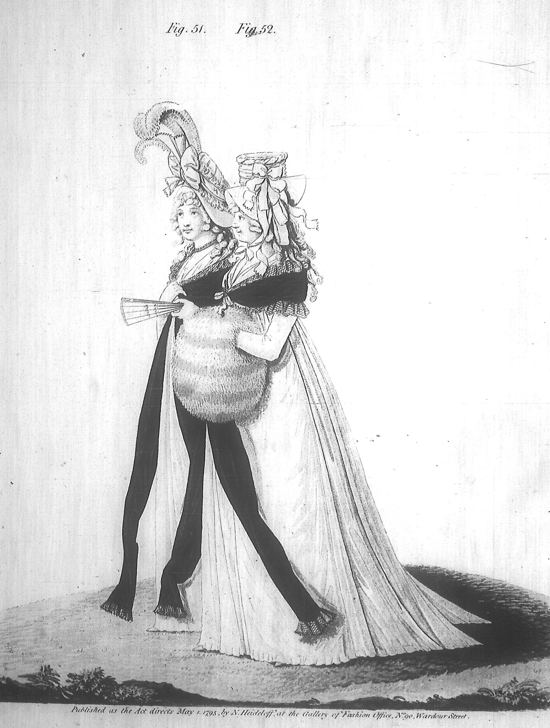

Slide 29
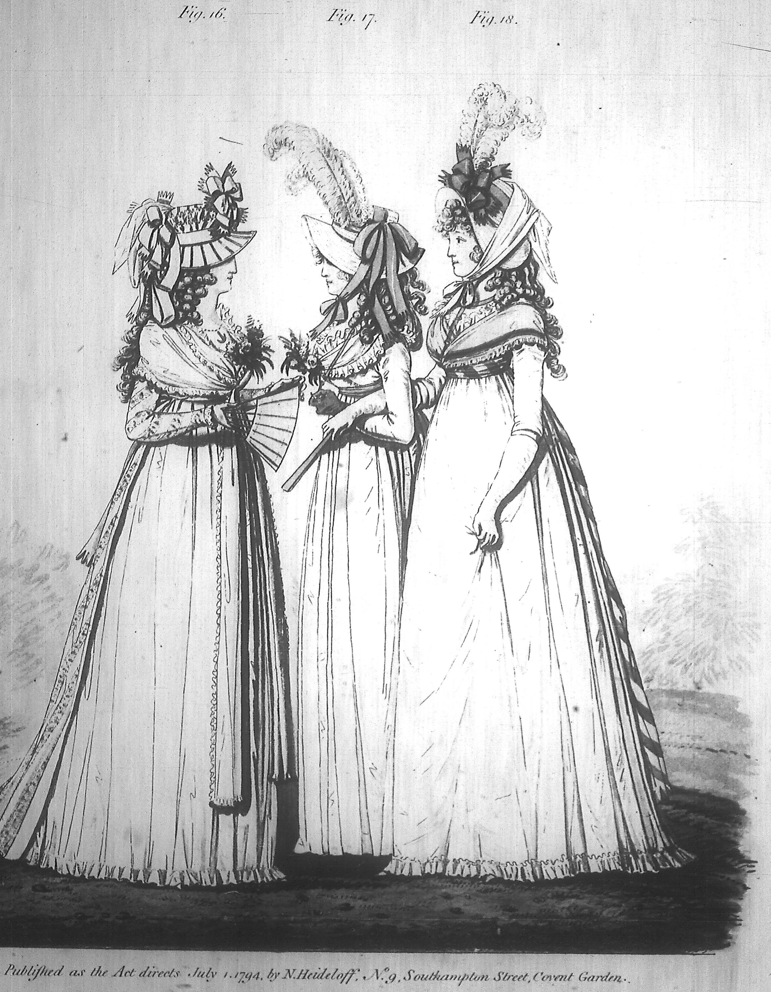

Slide 30
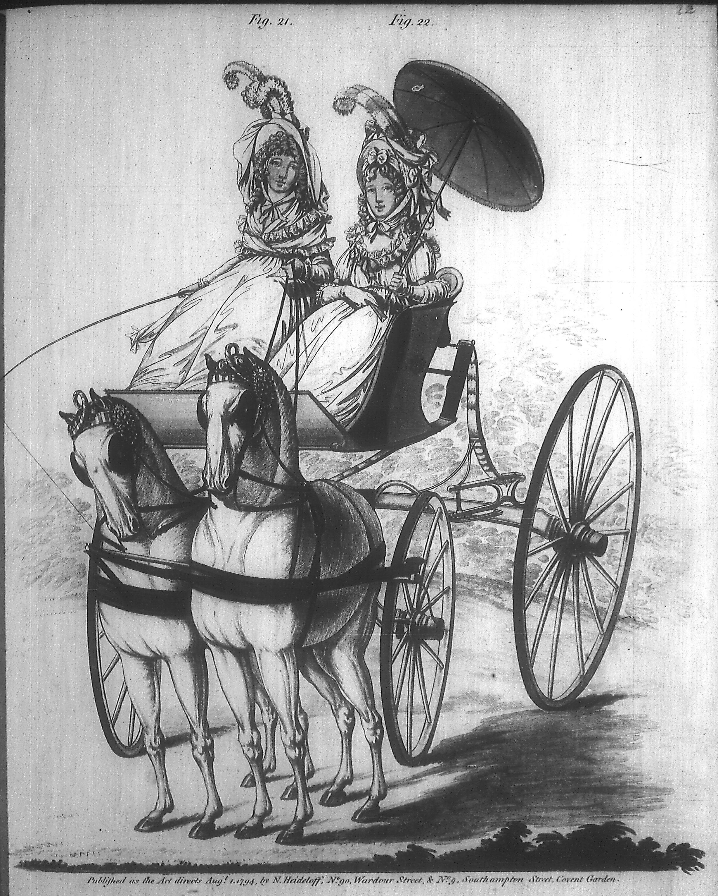

Slide 31
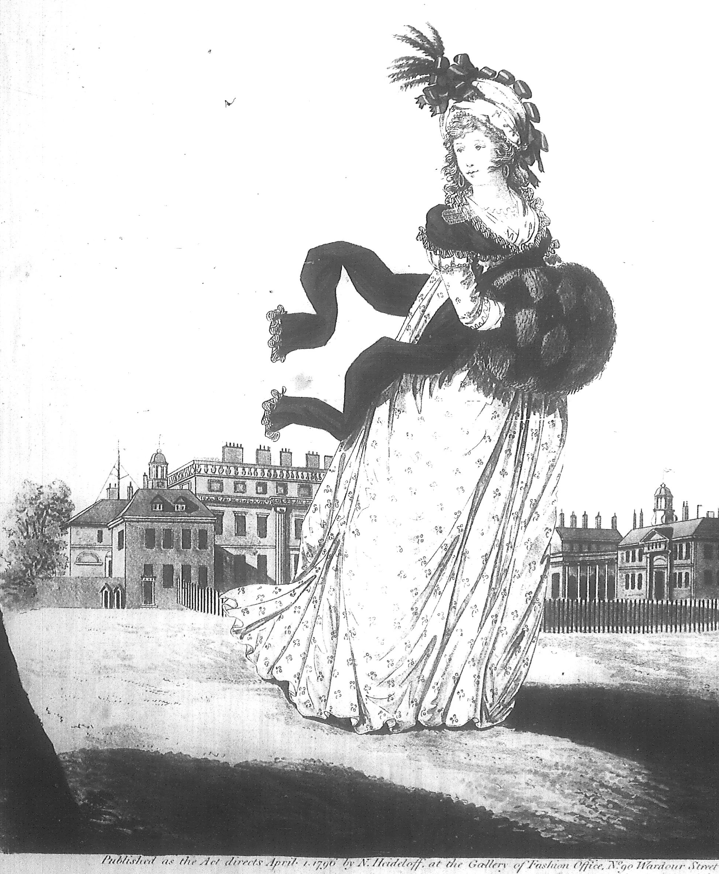

Slide 32
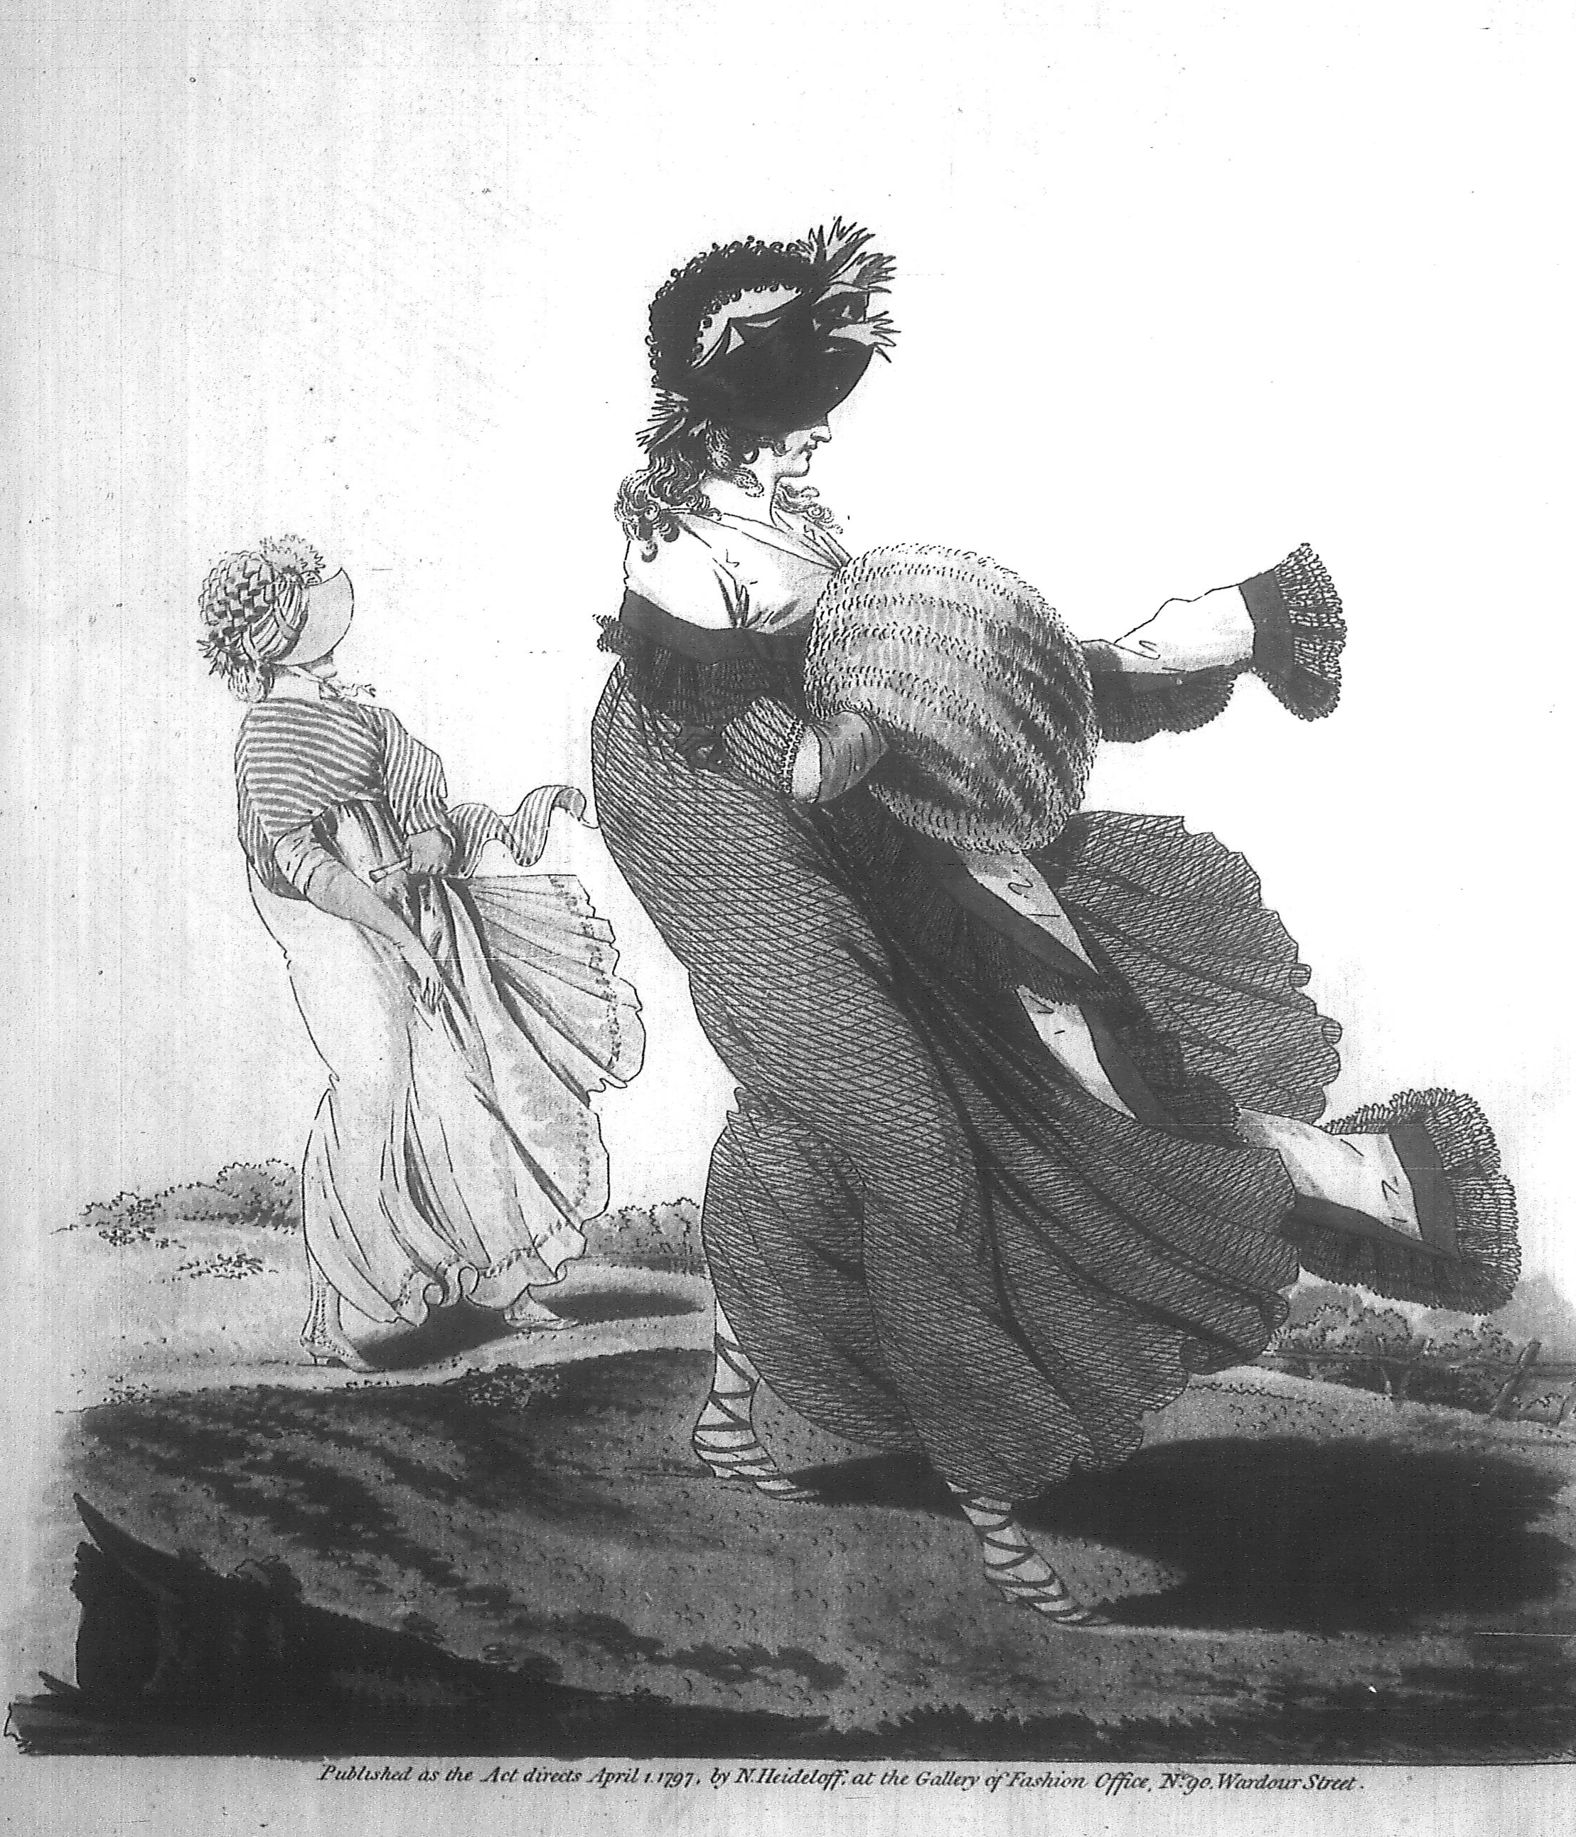

Slide 33
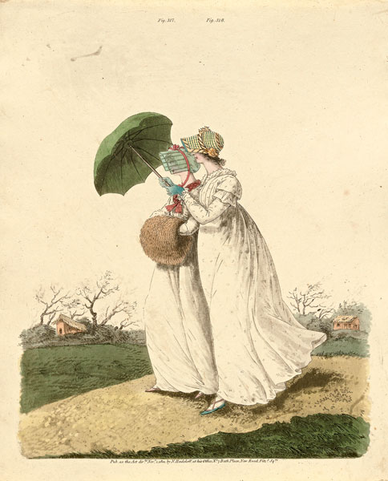

Slide 34
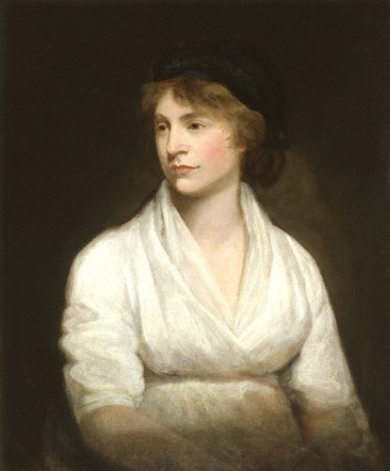

Slide 35
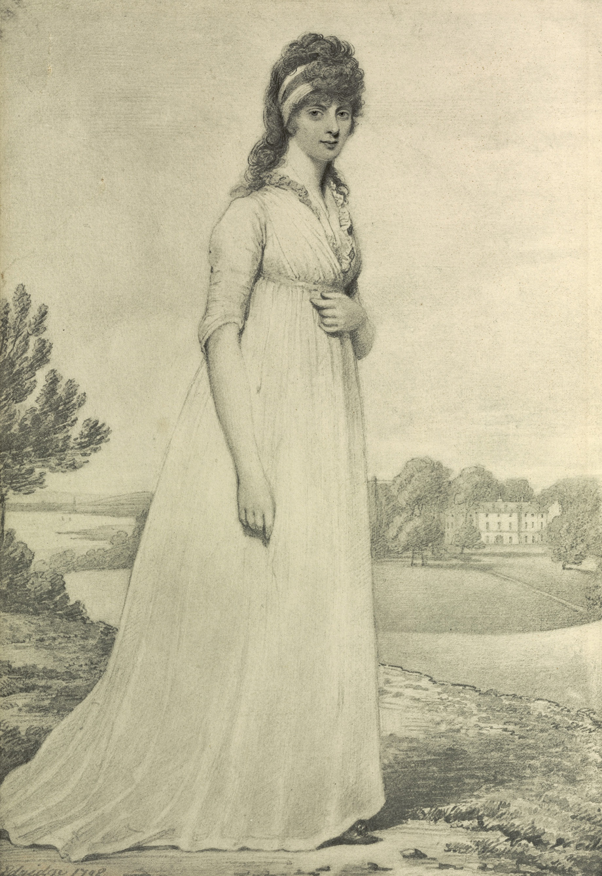
1798

Slide 36
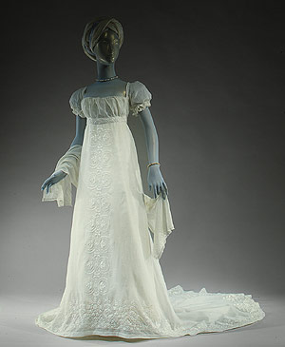
Notes:
Elbows uncovered, men’s neckcloth, men’s calves

Slide 37
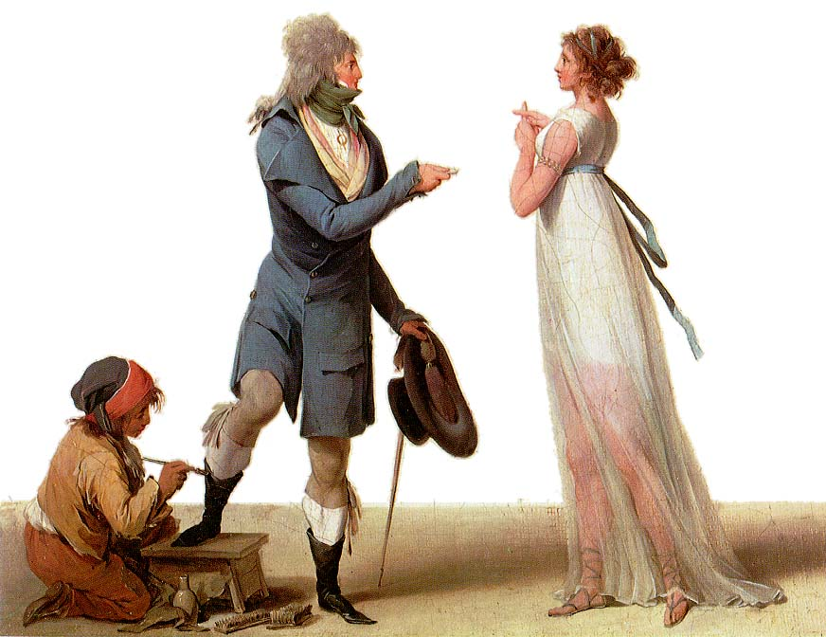

Slide 38
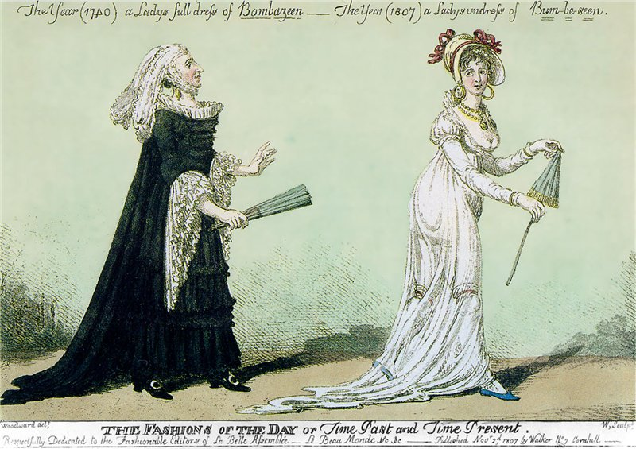

Slide 39
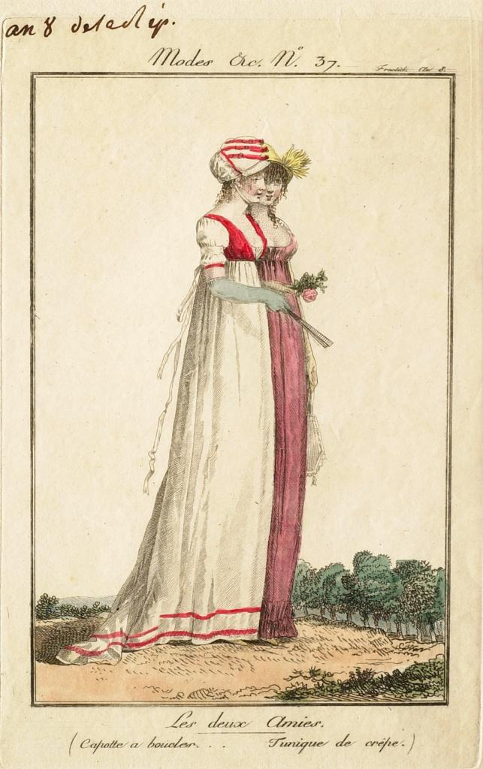
1800

Slide 40
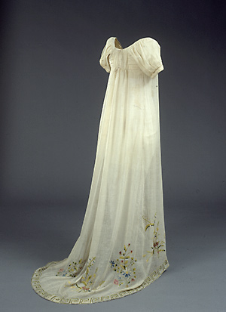
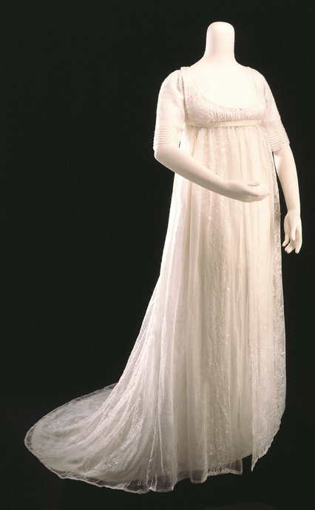

Slide 41
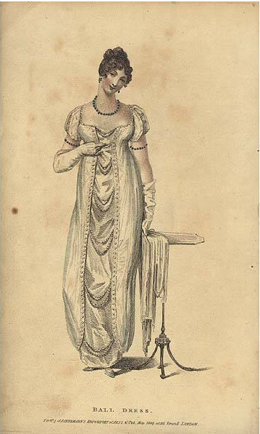
1809

Slide 42
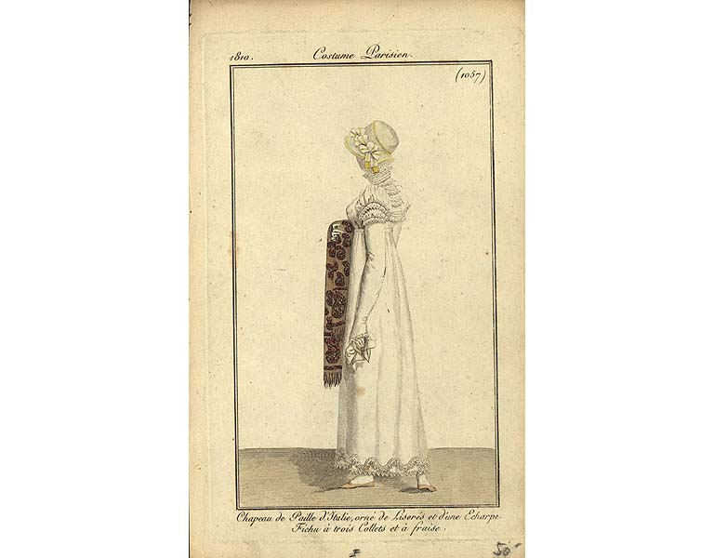

Slide 43
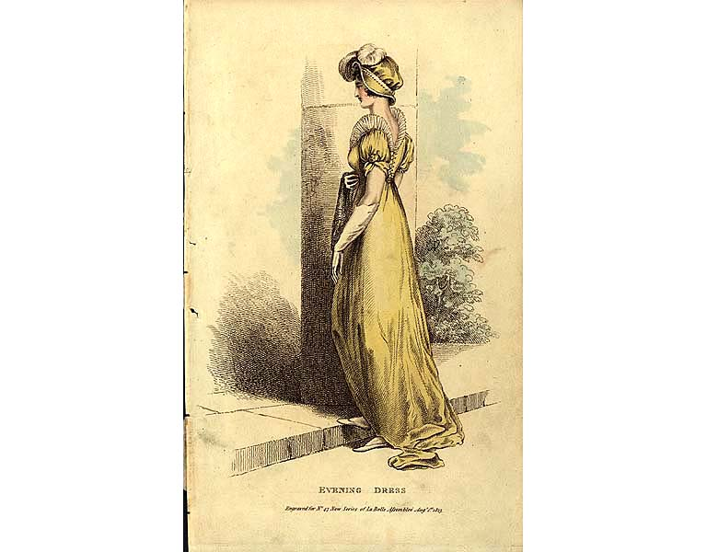

Slide 44
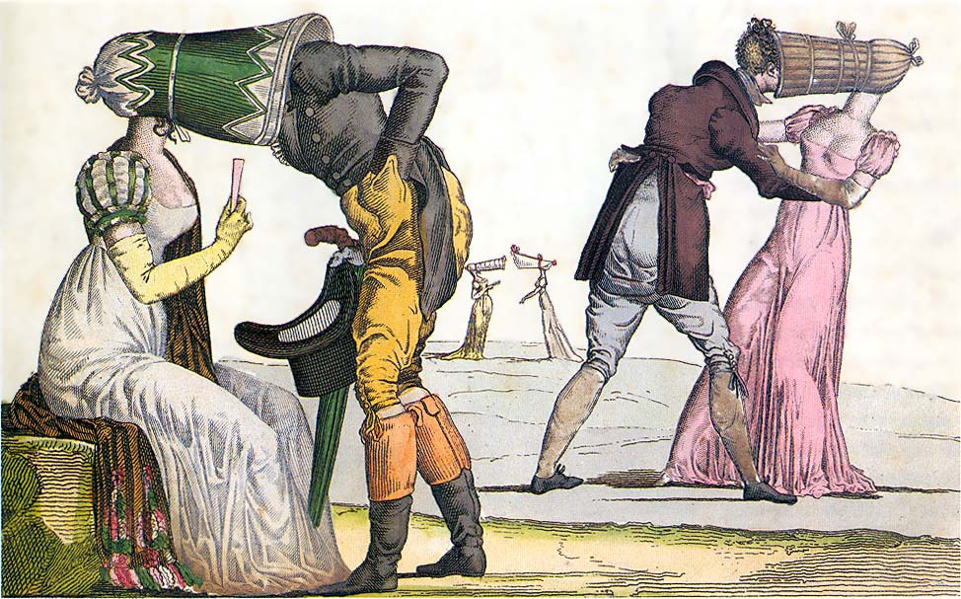

Slide 45
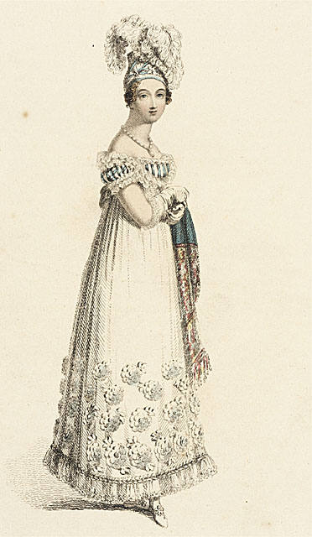
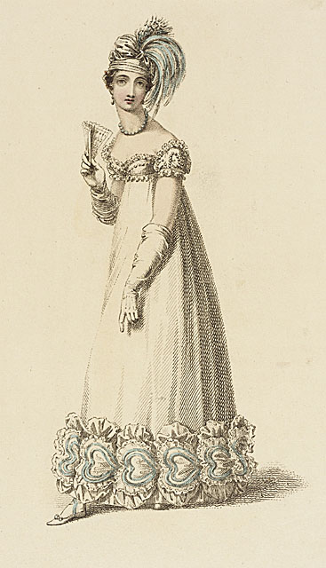

Slide 46
