Slide 1
Fashion in Jane Austen’s Time
Hope Greenberg

Slide 2
or

Slide 3
Undressing Mr. Darcy/ Dressing Miss Elizabeth Bennett

Slide 4
Mr. Darcy (P&P, 1995)
http://www.youtube.com/watch?v=zrE8wXj3Mnw
Mr. Darcy (Lost in Austen, 2008) 1:10
http://www.youtube.com/watch?v=7WOCU7eHzeI

Slide 5
Men’s clothes

Slide 6
Women’s Clothes

Slide 7
How did we get there: 500 years of fashion evolution

Slide 8
1300s

Slide 9
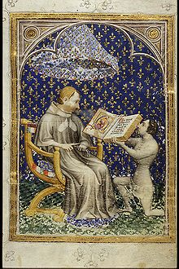
1400s

Slide 10
Late 1400s

Slide 11
1530

Slide 12
Late 1500s

Slide 13
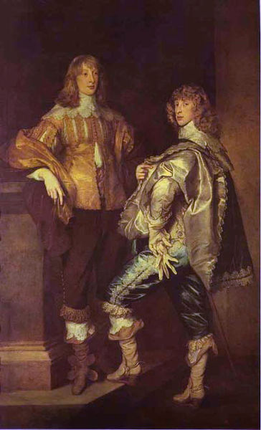
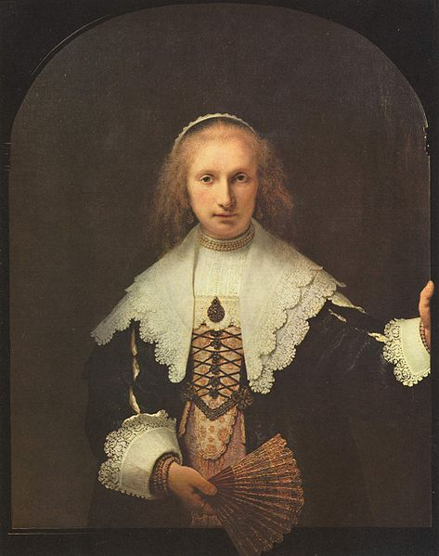
1600s

Slide 14
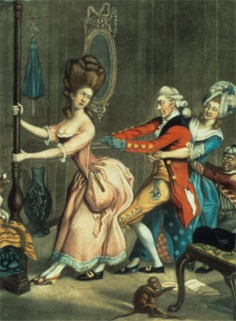
1700s

Slide 15
1776-1792
Born: 16 December 1775
1770s: continuation of previous styles
1780s: Marie Antoinette and the chemise gown
1790s: the big change!

Slide 16
1785 Dress a Francaise
1780s Dress a l’Anglaise

Slide 17
1780

Slide 18
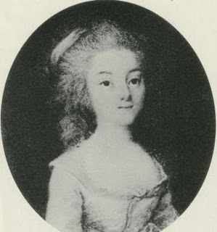
1790

Slide 19
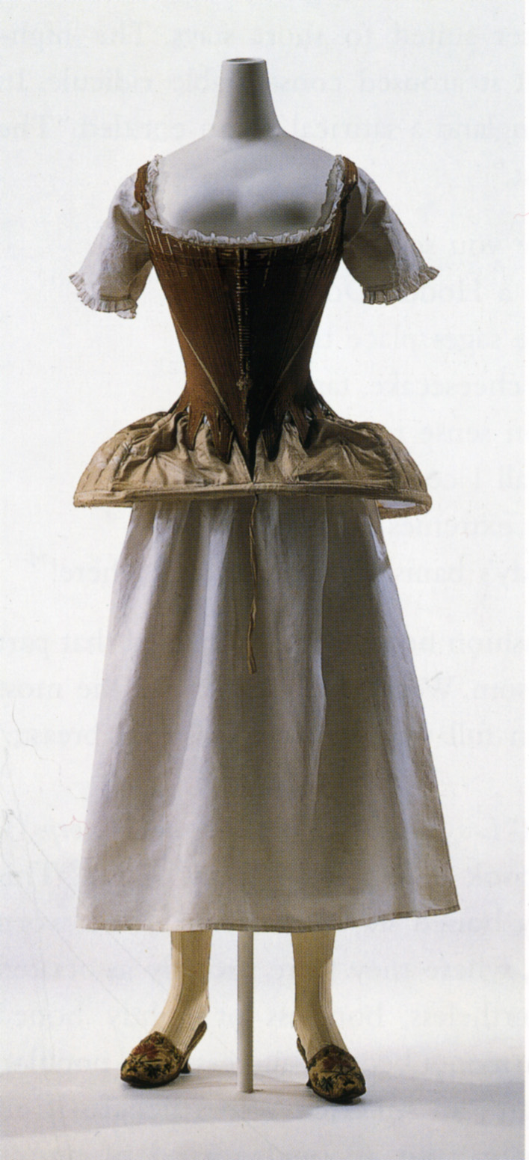

Slide 20
1775-1790 corset

Slide 21
1780s Marie Antoinette, Chemise Gown

Slide 22
1780s M. du Barry, Chemise Gown

Slide 23
1780s, chemise gown

Slide 26
1793-1804
Jane is 18-28, young, dancing, marriageable
Writing Sense and Sensibility, First Impressions (P&P), Northanger Abbey, and The Watsons
1803: Move to Bath
Napoleon crowned Emperor, 2 Dec. 1804

Slide 27
1790s

Slide 28
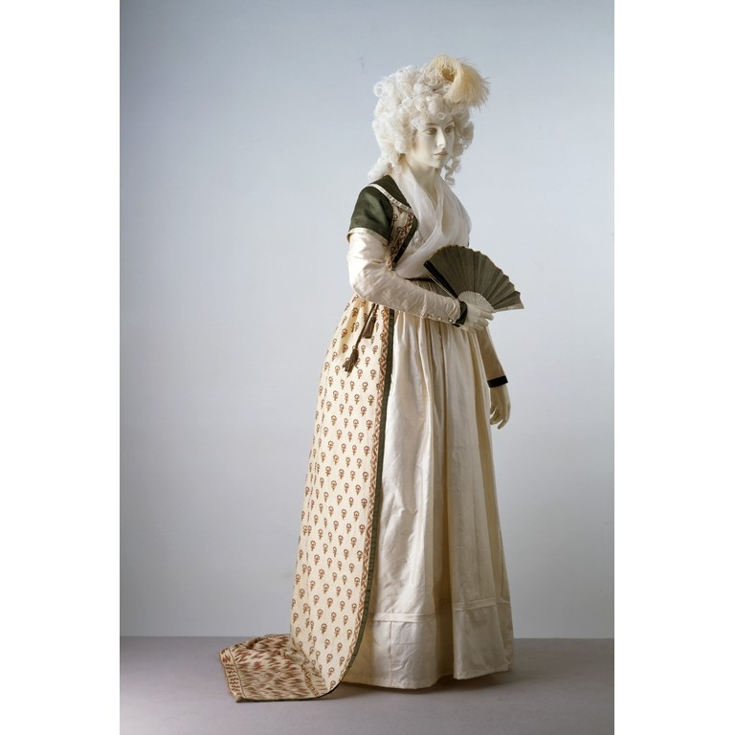

Slide 29
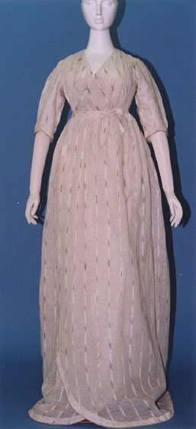

Slide 36
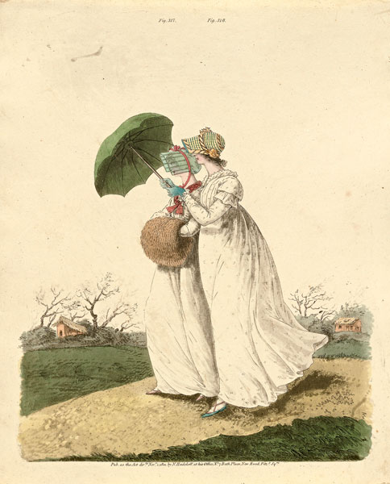

Slide 38
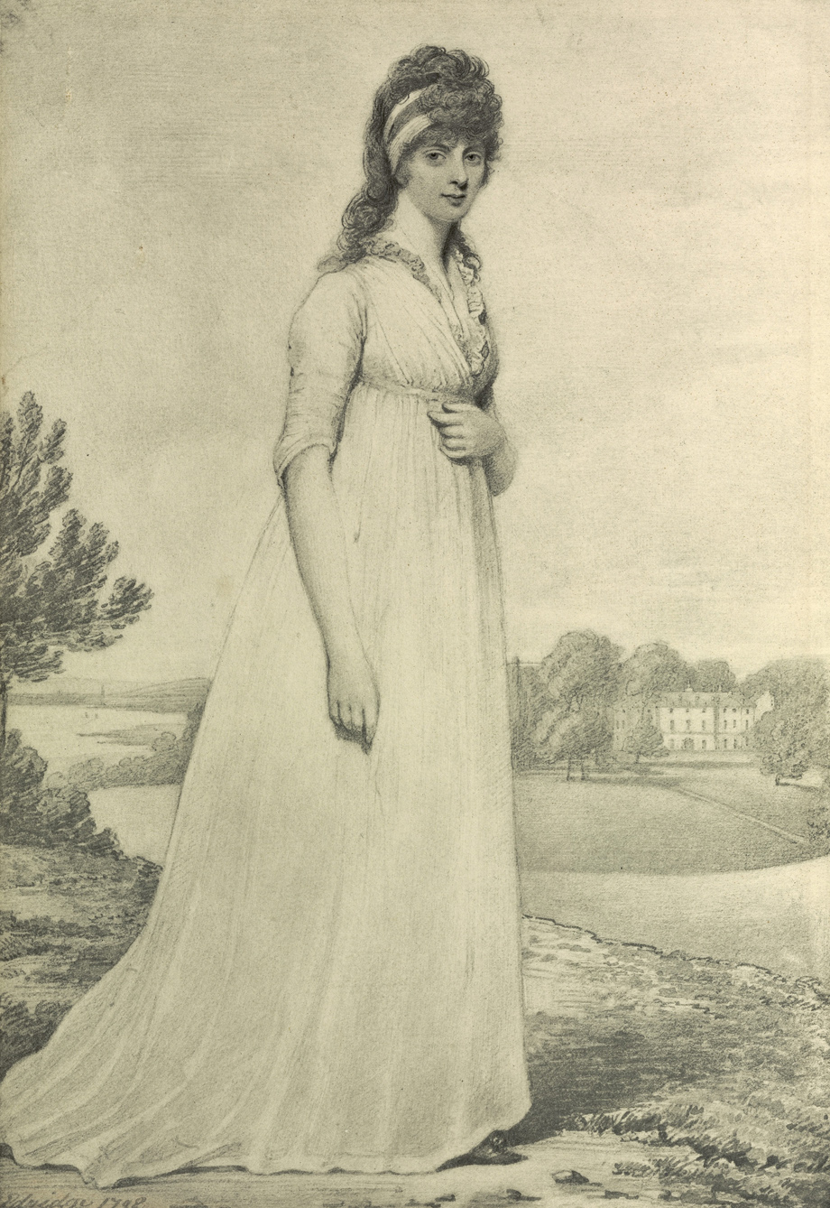
1798

Slide 39
Notes:
Elbows uncovered, men’s neckcloth, men’s calves

Slide 42
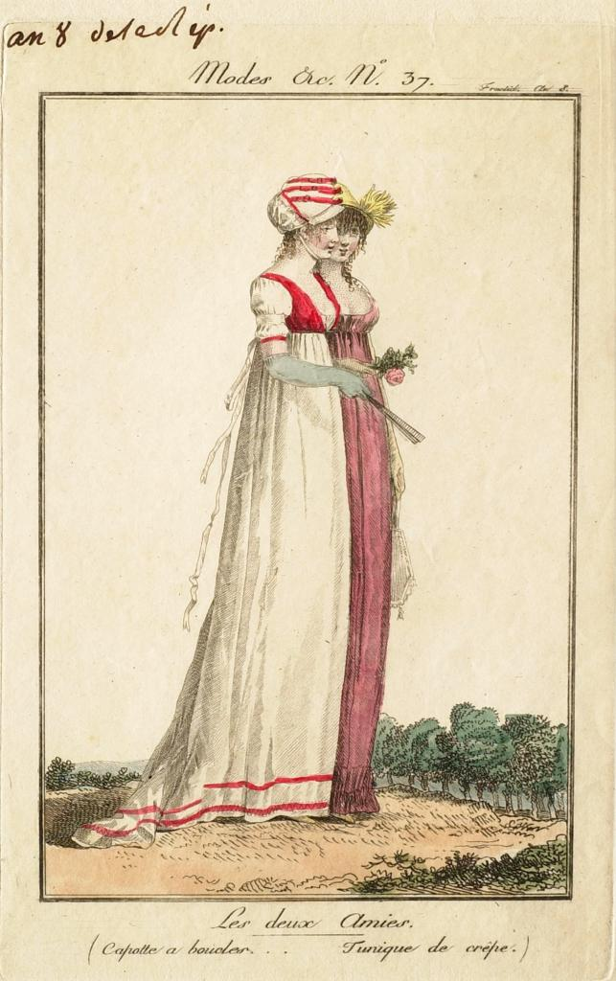
1800

Slide 44
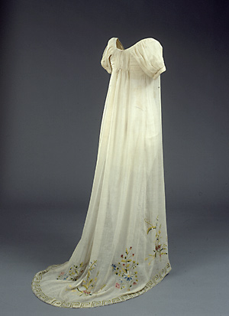
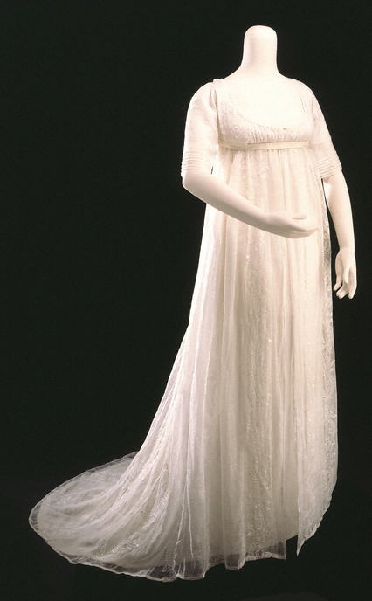

Slide 45
1809

Slide 46
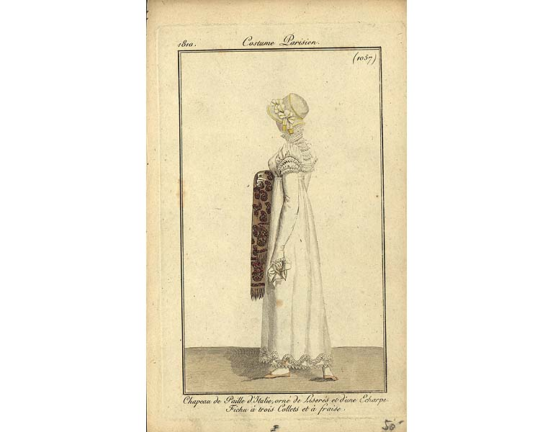

Slide 47
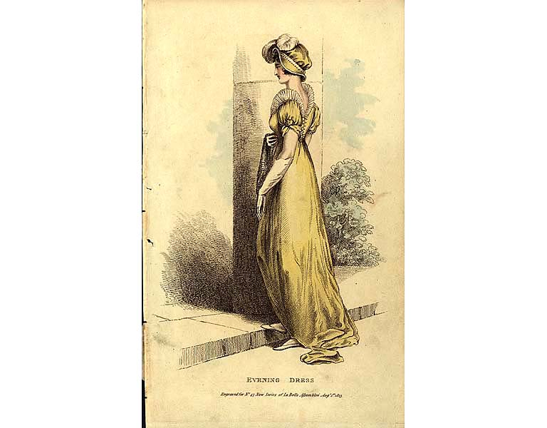

Slide 49
1814

Slide 50
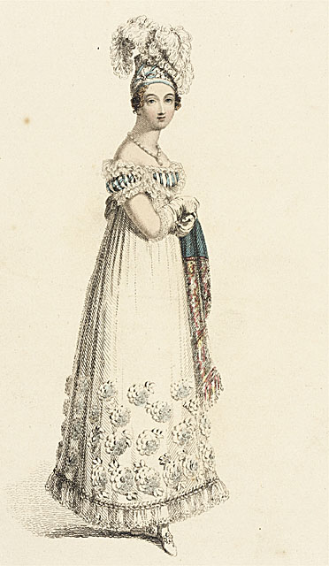
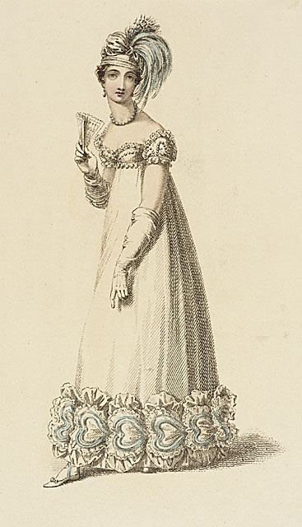

Slide 51
