Slide 1
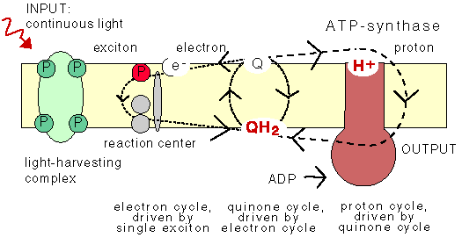
Q cycle
Ubiquinone (Q) pool is critical to H⁺ shuttling to maintain the pmf and drive phosphorylation to produce ATP
Quinone (Q) is reduced with an electron through cytochrome bc1 to form hydroquinone (QH₂) – QH₂ is then oxidized by another site on cytochrome bc1 back to Q – this shuttles H⁺ across the membrane, the H⁺ goes through ATPase back into the cell, generating ATP

Slide 2
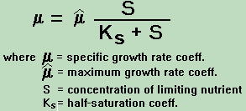
Growth
Monod equation – accounts for substrate availability and idea that organism can only eat so fast… (saturation of transporters)
Michaelis-Menton equation, derived from enzyme activities, also accounts for substrate availability and idea that specific number of enzymes can only work so fast…

Slide 3
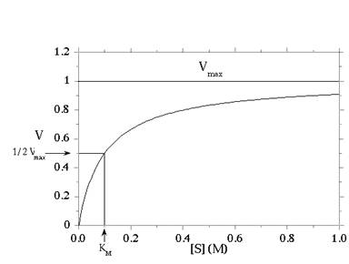
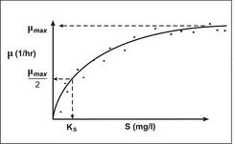
Specific growth rate, μ, (time⁻¹)
Specific metabolic rate, V, (mmol cell⁻¹ h⁻¹)
Notes:
Michaelis-menton has always been a term I think of as more specifically meaningul as a cell-normalized rate – BUT – how to get these rates is an interesting question...

Slide 4
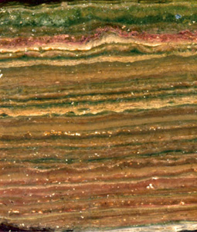
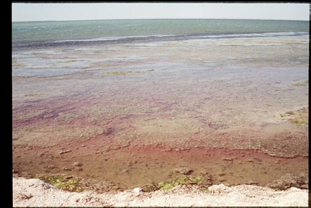
Microbial Communities

Slide 5
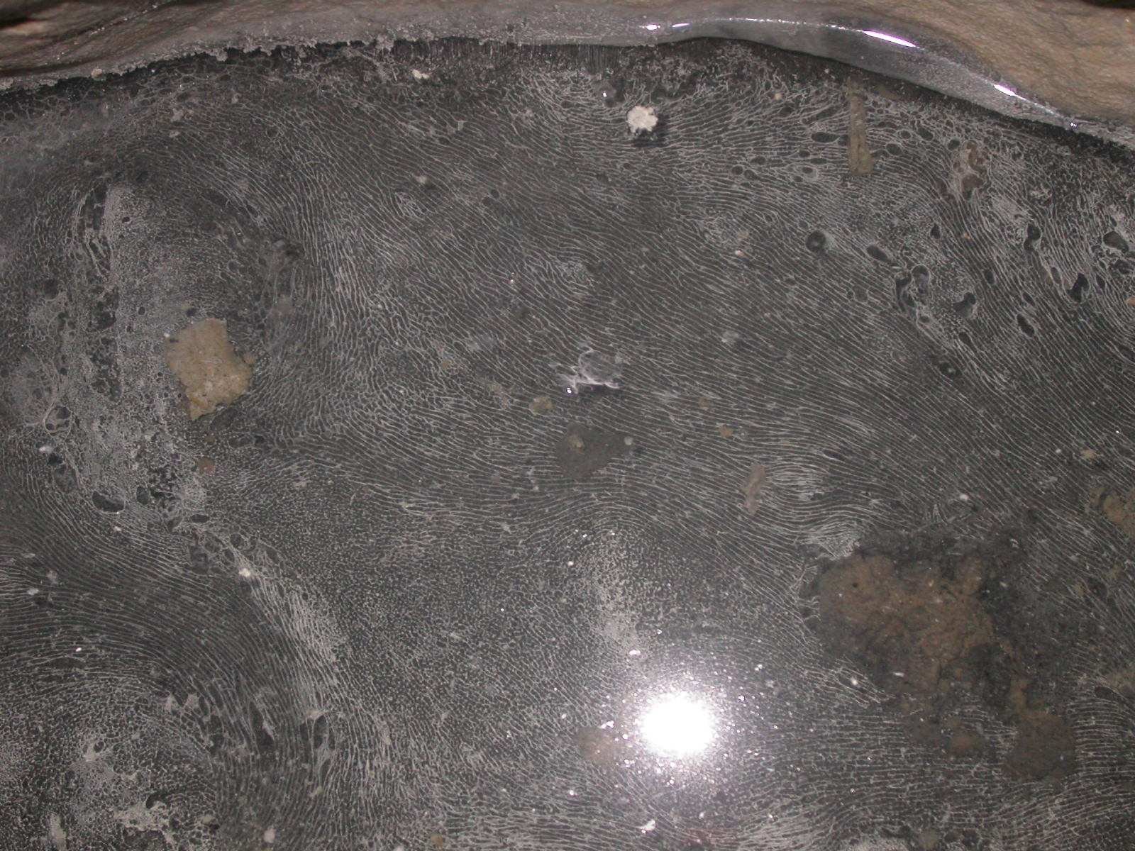
0.5 m
‘thiovulum’ mats, Pozzo di Cristale, Frassassi caves

Slide 6
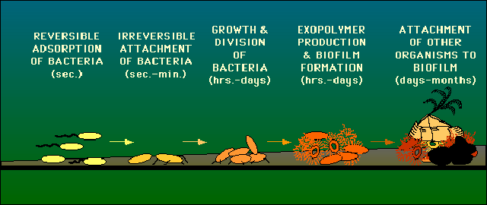
Biofilm formation

Slide 7
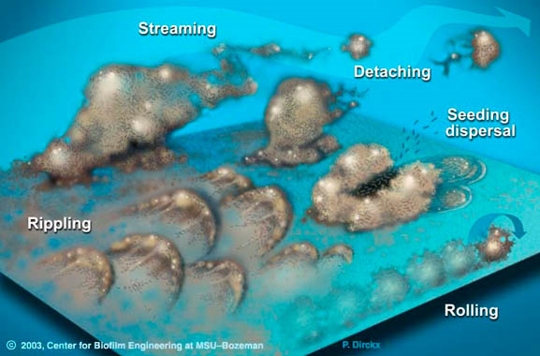
Biofilm characteristics: dynamic, complex structures

Slide 8
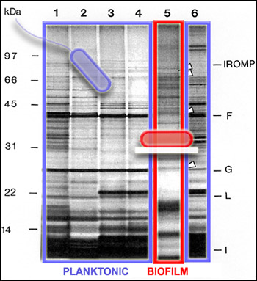
Biofilms’ genetic expression different
When in a biofilm the same organism express different proteins
Functions become specialized

Slide 9
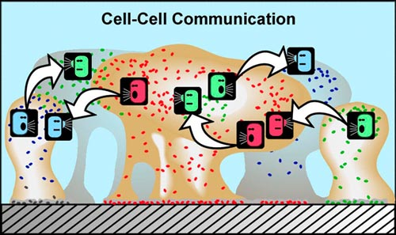
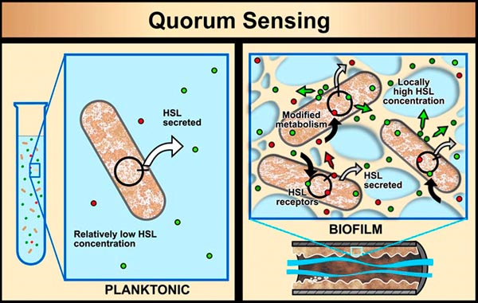
Different cells communicate to coordinate behaviors/genetic expression in a biofilm
Cells can sense when there is a sufficient density of cells and the conditions to create a biofilm – quorum sensing

Slide 10
Capabilities of the group
Biofilms are ore resistant to attack than planktonic expressions of the same organisms (attack = antimicrobial agents, viruses, physicochemical changes)

Slide 11
