Slide 1
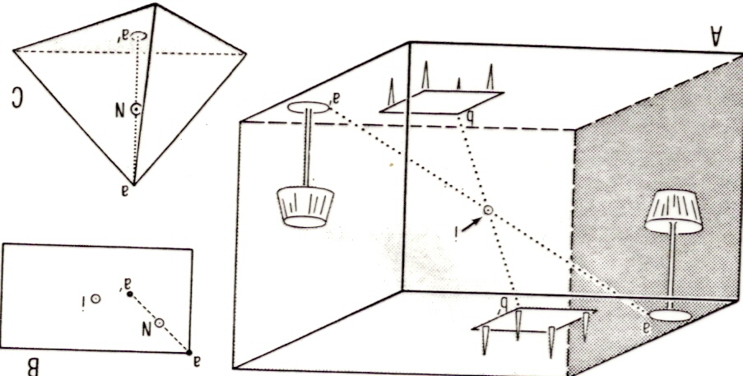

Slide 2
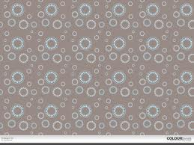

Slide 3
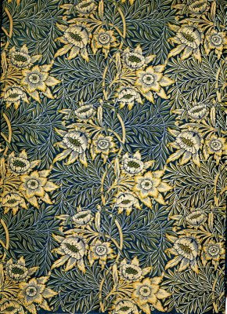

Slide 5
t1
t2

Slide 6
t1
t2

Slide 8
t1
t2

Slide 9
t1
t2

Slide 10
t1
t2

Slide 11
t2
t1

Slide 12
t1
t2

Slide 13
Triclinic:
Primitive (P)
Monoclinic:
Primitive (P)
End-centered (A, B, C)

Slide 14
Orthorhombic:
Primitive (P)
End-centered (A, B, C)
Body-Centered (I)
Face-Centered (F)

Slide 15
Tetragonal:
Primitive (P)
Body-Centered (I)
Rhombohedral:
Rhombohedral (R)

Slide 16
Hexagonal:
Primitive (P)

Slide 17
Isometric:
Primitive (P)
Body-Centered (I)
Face-Centered (F)

Slide 18
Crystal Systems
(Describe size and shape of unit cell)
Point Groups
(Symmetry about a point, line, or plane)
Bravais Lattices
(P, A,B,C,I,F)
Screw Axes, Glide Planes
SPACE GROUPS

Slide 19
b
b
2
2₁

Slide 20
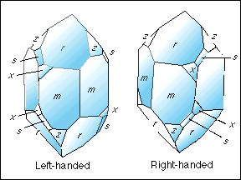

Slide 21
a
m
a
a-glide

Slide 22
Crystal Systems
(Describe size and shape of unit cell)
Point Groups
(Symmetry about a point, line, or plane)
Bravais Lattices
(P, A,B,C,I,F)
Screw Axes, Glide Planes
SPACE GROUPS

