Slide 1
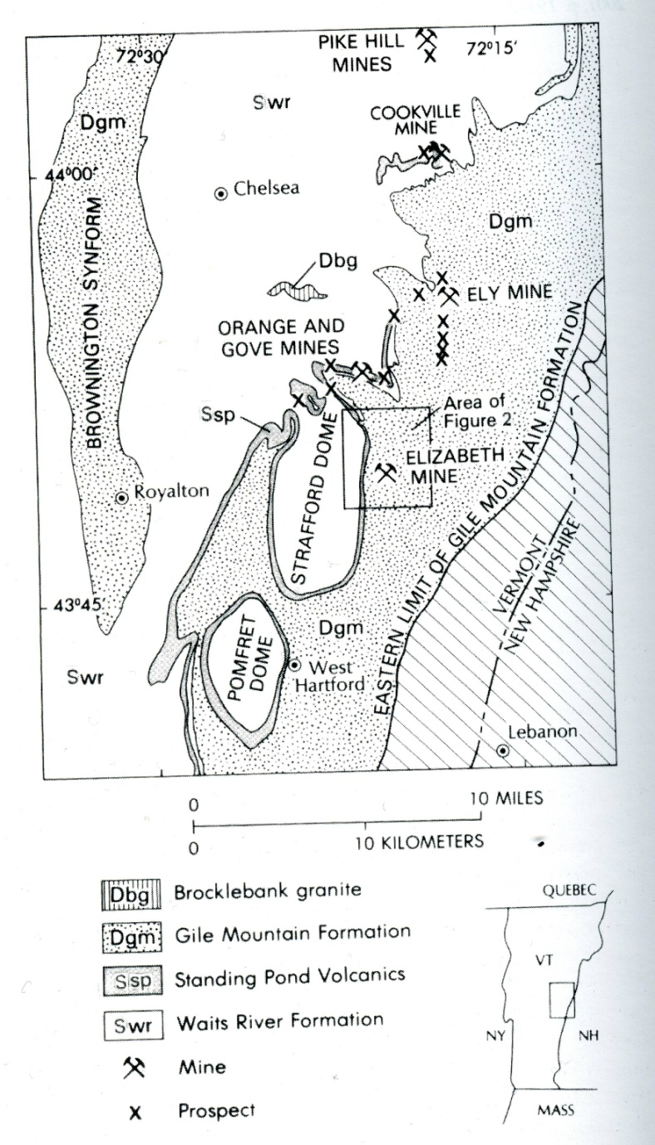
Vermont Copperbelt
Besshi-type massive sulfide deposits
Key Units:
Giles Mountain formation – More siliciclastic, including graphitic pelite, quartoze granofels (metamorphosed greywacke), hornblende schist, amphibolite
Standing Pond Volcanics – mostly a fine grained hormblende-plagioclase amphibolite, likely formed from extrusive basaltic rocks (local evidence of pillow structures in St. Johnsbury). Felsic dike near Springfield VT yielded a U-Pb age of 423± 4 Ma.
Waits River formation – Calcareous pelite (metamorphosed mudstone), metalimestone, metadolostone, quartzite.

Slide 2
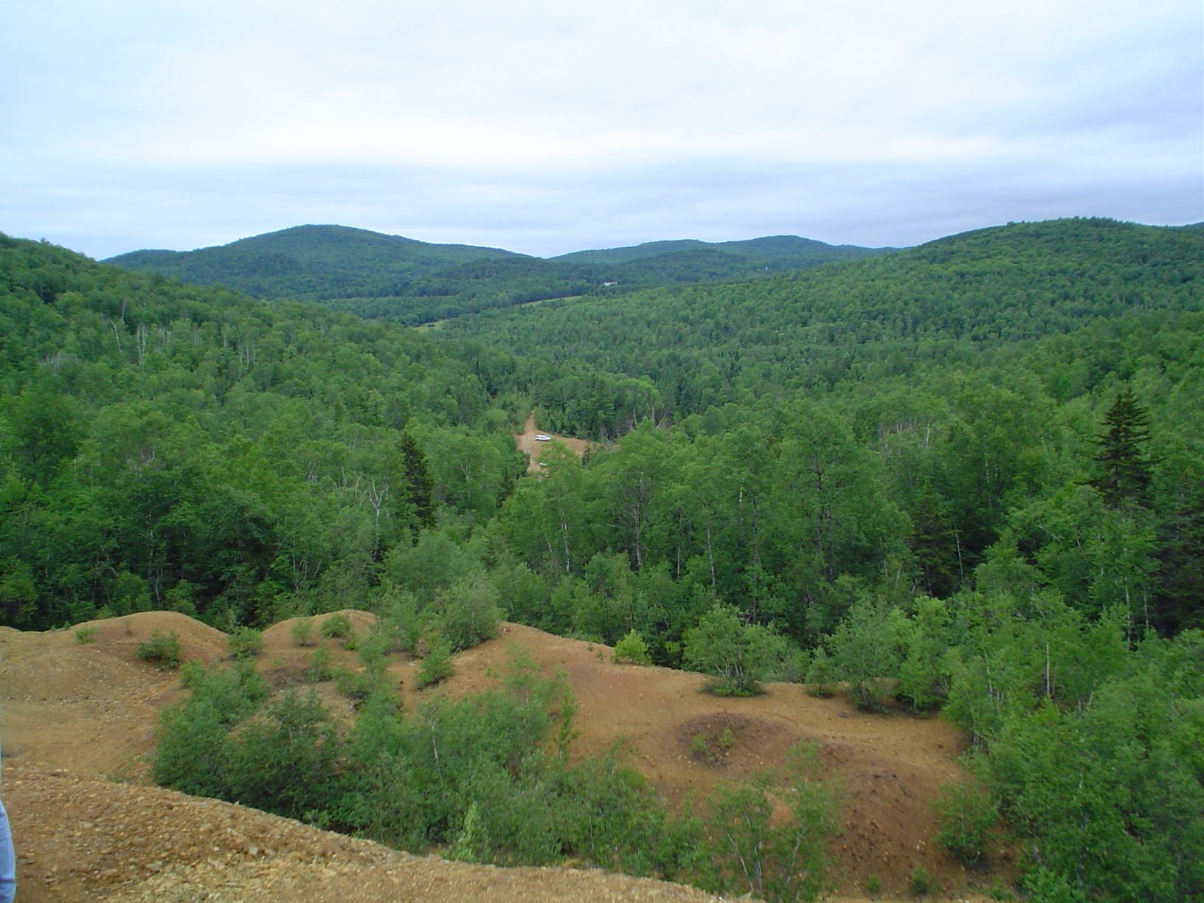
Ely Mine

Slide 3
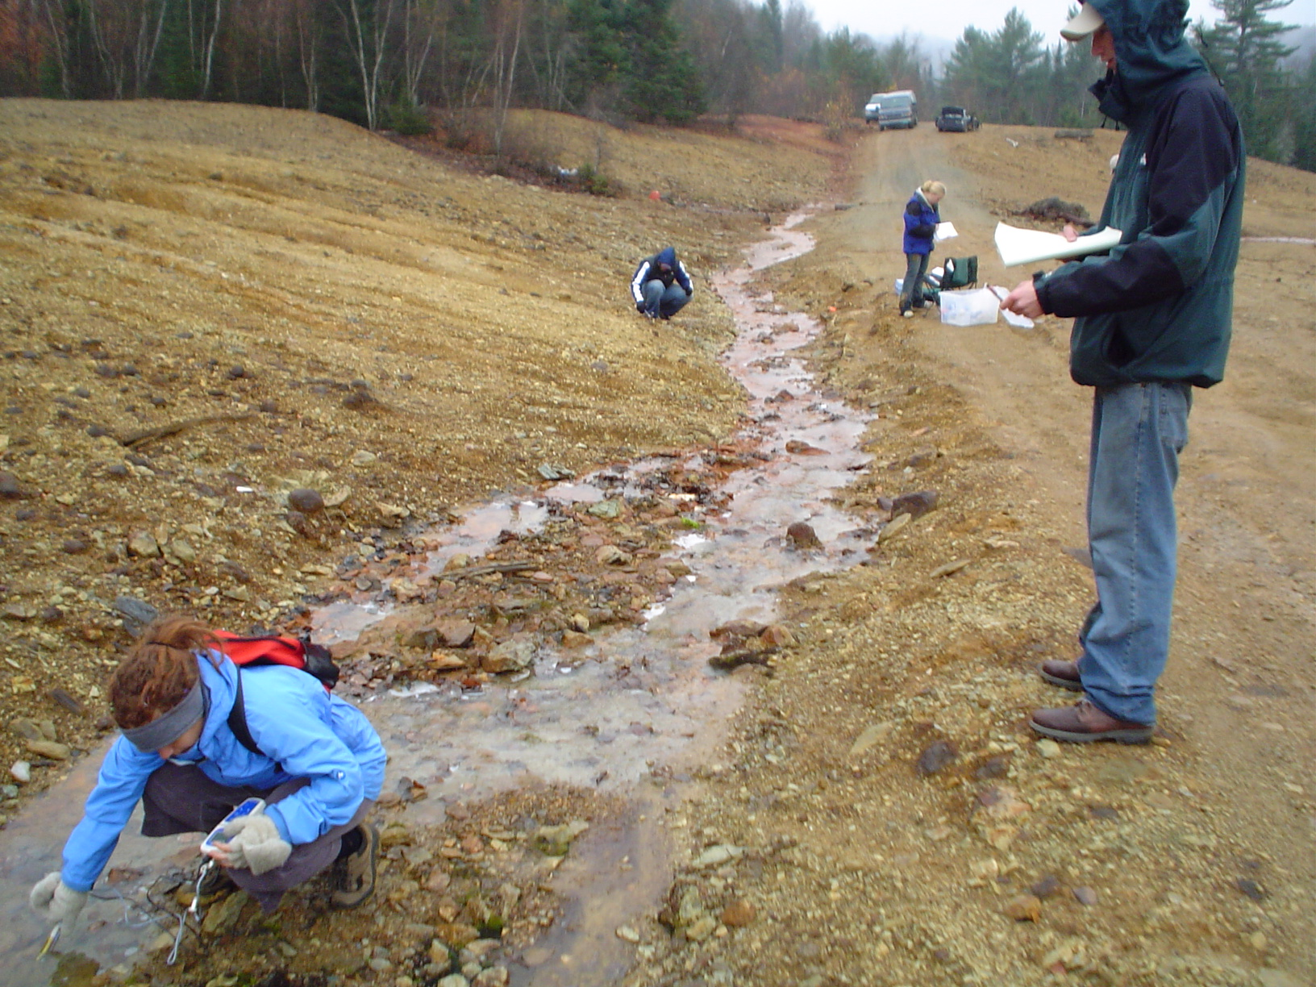

Slide 4
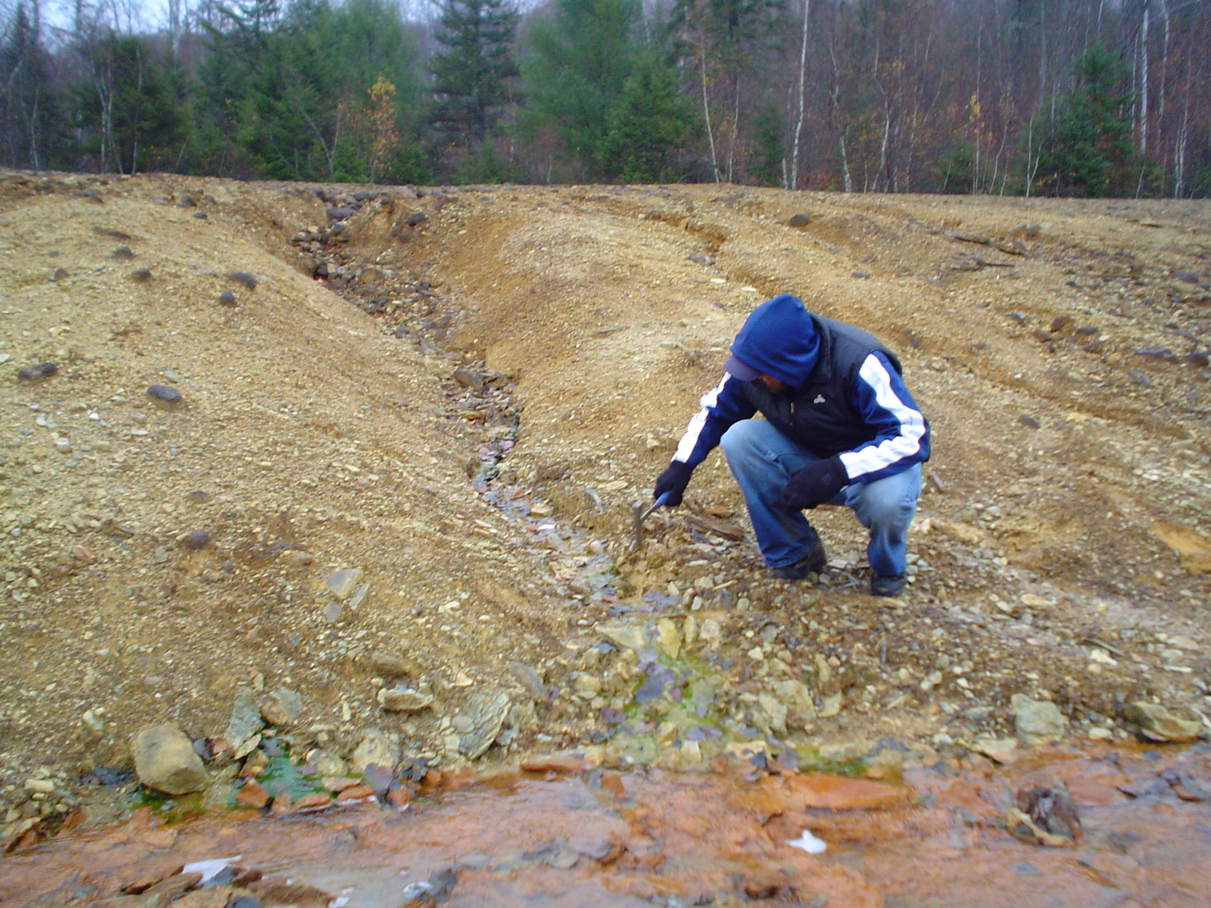

Slide 5
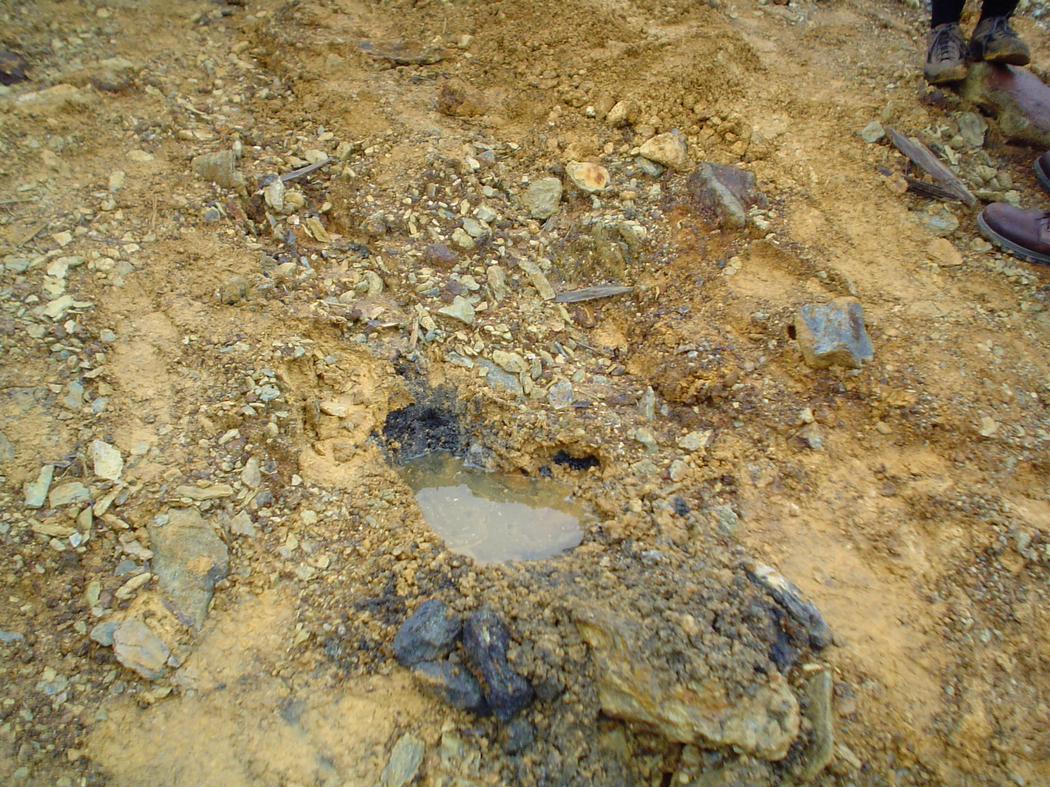

Slide 6
Acid Mine Drainage
Notes:
Thank you for coming
Today I would like to present the results of a part of my doctoral thesis at the University of Wisconsin on the oxidation kinetics of intermediate sulfur species as it relates to pyrite oxidation and the problem of acid mine drainage at an abandoned mine, then progress to a discussion on the sequential precipitation of metal sulfides associated with sulfate reducing bacterial activity in more circumneutral pH solutions.

Slide 7
Oxidizing Pyrite
FeS₂ + 3.5 O₂ + H₂O → Fe²⁺ + 2 SO₄²⁻ + 2 H⁺
FeS₂ + 14 Fe³⁺ + 8 H₂O → 15 Fe²⁺ + 2 SO₄²⁻ + 16 H⁺
The oxidation of FeS₂ transfers 14 electrons from S₂²⁻ to 2 SO₄²⁻ !!
These reactions occur over many steps to develop pathways of oxidation
Notes:
Iron Mountain effluent so acidic due to pyrite oxidation
See actively oxidizing pyrite (point out SEM in background) and Fe2+ microbes all over…
General reaction of pyrite oxidation, with O2 as TEAP is:
The oxidation of pyrite with Fe3+ is faster, making re-oxidation of Fe2+ rate limiting, and the basis for the original idea that microbes must be very important in these environments
Why are we concerned with intermediate S-species? If an intermediate achieves a significant steady-state concentration, that may affect the local pH significantly

Slide 8
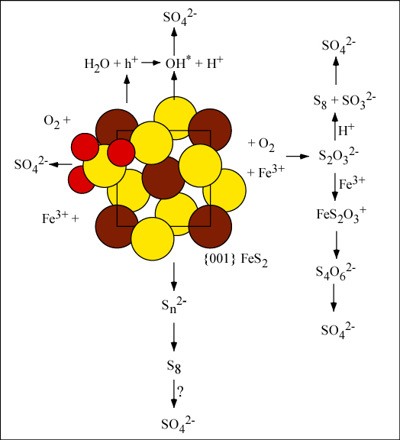
Notes:
Ths leads us to consideration of the ideas governing pyrite oxidation pathways
This diagram will serve as a sort of bookmark through the talk as we discuss different parts of this, the kinetics of selected intermediates along the way, and how they come together and how that may affect mcrobial ecology
We will begin with a detailed discussion of (point out)

Slide 9
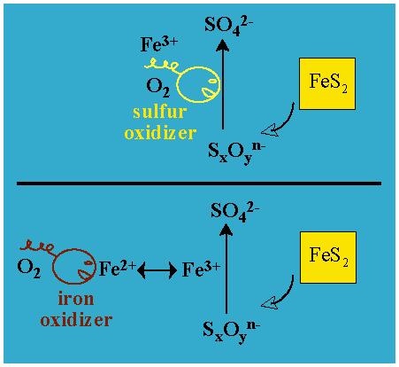
Oxidation Kinetics and Microbes
Do microbes couple sulfur oxidation to O₂/Fe³⁺ reduction or is Fe³⁺ oxidation of those species faster and microbes can only gain energy from Fe²⁺ oxidation?
Notes:
In this environment, the oxidation kinetics and different mechanisms are the key to understanding microbial ecology
If Fe3+ oxidizes intermediate sulfur species faster than a sulfur-oxidizing microbe can harness that energy, then Fe2+ is all that is left, and iron-oxidizers have the advantage.
On the other hand, if Fe3+ is not an efficient oxidant of an intermediate sulfur species, then that leaves the door open for a sulfur-oxidizing microbe to use that energy and sulfur oxidizers hav the advantage
Because FeS2 oxidation goes trough many steps, and as we shall see, through potentially different parallel pathways, these ideas will apply to each step along the way…

Slide 10
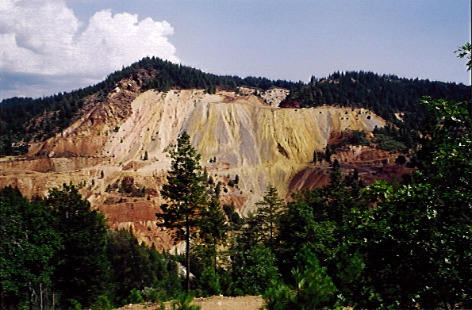
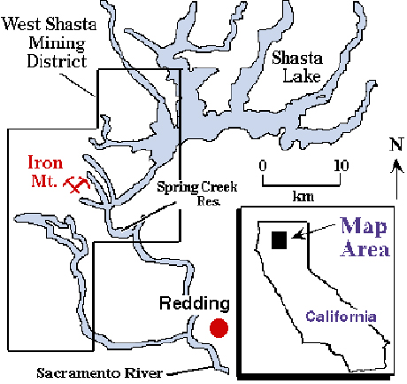
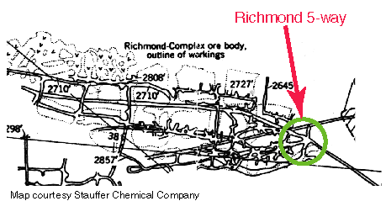
Field Site: Iron Mountain Northern CA
Iron Mountain = Opportunity to study FeS₂ oxidation inside a giant block of FeS₂!
Notes:
I will concentrate a great deal in this talk on the Iron Mountain field site in N CA, near Redding.
A number of people have done work in this field site at the 5-way in the Richmond Mine complex of Iron Mountain, point out location
They have looked at geochemistry, mineralogy, and a number of people I had the fortune of working with have been investigating the detailed microbiology at this site.
Made it a great setting to study oxidation mechanisms and the role of microbes in these environments

Slide 11
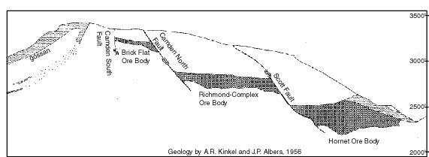
Iron Mountain Mine Complex
large complex of several mines operated intermittently between the 1860’s and 1962 for Au, Ag, Cu, and Zn
Became a superfund site in 1983 – millions spent on treatment of effluent
Site of lowest recorded ‘natural’ pH= -3.6 (Nordstrom et al., 2000)
Notes:
Description of IMM complex
-mined intermittently between 1860’s and 1962 for Au, Ag, Cu, and Zn
-after closure in 1962, mine floods were responsible for major fish kills and metal loading in S.F. bay
-became a superfulnd site in 1983, now all effluent is collected and limed before release
-Also site of lowest recorded natural pH = -3.6
-X-section, point out study site again

Slide 12
Richmond Portal Effluent Geochemistry
pH of majority of the flow 0.6-0.8
Fe_{T} is ~ 0.2 – 0.4 M, SO₄²⁻ is ~0.6 – 1.1 M
An average of 100,000 moles FeS₂/day is oxidized (range ~ 20,000-200,000 mol/day)
~2 m³ block weighing about a ton per day
Requires 350,000 mol O₂ = ~ 8,000 m³ O₂
FeS₂ oxidation requires: 30 g/l in water (O₂ saturation ~ 3 mg/l)
Water must be re-oxidized thousands of times before exiting, about once per 15-150 cm.
Notes:
Ellfuent discharges through the Richmond portal collection site at an average of ~60 gal/min
pH 0.6-0.8, FeT 0.2 – 0.4, SO4 0.6-1.1 M
This equates to a flux of ~100,000 mol FeS2/day
2x2x2 m block
Requires a lot of O2
Calculations indicate the water which flows through must be re-oxidized every 15-150 cm

Slide 13
Life at pH 0-1 and lower??
Significant communities of bacteria, archaea, fungi, and protists!!

Slide 14
Sulfoxyanions in experimental FeS₂ oxidation experiments – previous work
Several studies have found polythionates associated with experimental studies of pyrite oxidation – Goldhaber, 1983; Moses et al., 1987; Schippers et al., 1996, 1999

Slide 15
Iron Mountain Microbial Metabolisms
Organism | ## | Org C/ O₂ | Org C /Fe³⁺ | Fe²⁺/O₂ | S_{x}O_{y}^{n-}/O₂ | S_{x}O_{y}^{n-}/Fe³⁺
Ferromicrobium sp. Acidimicrobium sp. | Few |  | Yes | Yes | Yes | Yes
Sulfobacillus spp. | Few | Yes | Yes | Yes | Yes | Yes
Thermoplasma sp. | Few | Yes |  | No | No
Fungi, protists | Some | Yes | No | No | No | No
Ferroplasma acidarmanus | Lots | Yes | Yes | Yes | No | No
Leptospirillum spp. | Lots | No | No | Yes | No | No
Notes:
So, what is the microbial population at the study site
In low pH (pH 0.5-0.8), a majority of the microbes at the mine (determined through clone work and FISH studies) are the archeaon Ferroplasma acidarmanus and a Leptospirrillum group III. F acidarmanus is an iron oxidizer and has not been able to grow on any intermediate S species either aerobically or microaerophilically. Leptospirrllum is an organism which was first isolated at this site, and its metabolisms are not well known yet. Other Leptospirrilum are unable to oxidize intermedaite sulfur species aerobically…
Other microorganisms include Sulfobacillus and A. caldus which are able to oxidize intermediate S species including elemental sulfur
The microbial population in higher pH environment within the study site (these are pools with higher pH and Eh, lower metal concentrations) are different, and are the only environments which contain thiobacillus ferrooxidans.

Slide 16
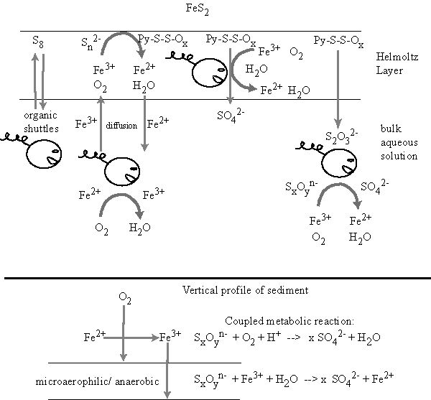
Microbes and FeS₂ oxidation
S
anaerobic
aerobic
S
S
Fe
Notes:
The mechanisms potentially active at low pH are represented here, and I want to start discussiong how this affects microbes.
Microbes can potentially interact with pyrite in one of 4 ways illustrated here:
S8 oxidation – question of electron shuttles/ solubillization
Fe2+ oxidation, and regeneration of that Fe2+ from oxidation of S at the surface
Oxidation of SxOy groups attached to the surface
Oxidation of SxOy compounds in the bulk
Additionally, O2 gradients and the great excess of iron at IMM and other sites may facilitate the generation of microaerophilic regions where microbial oxidation of sulfoxy species may be coupled to ferric iron reduction instead of oxygen.

Slide 17
Let’s take a closer look at this piece
Notes:
Based on results of Borda et al., which showed a similar plse of OH* and H2O2 as a result of wetting of a surface not cleaned to the standards of Moses et al., we investgated the reactivity of OH* and H2O2 with polythionates

Slide 18
FeS₂ Oxidation + Microbes at Iron Mountain
Predominance of a pathway in which pyritic sulfide is oxidized by Fe³⁺ at the surface of FeS₂ (without detachment) is consistent with microbial populations
Microaerophilic regions of active pyrite oxidation may facilitate microbial coupling of intermediate sulfur species to ferrous iron reduction for energy.
Small populations of Sulfobacillus spp. and Acidithiobacillus caldus may indicate formation of some elemental sulfur
Notes:
The study site is characterized by actively oxidizing pyrite and microbial populations dominated by iron-oxidizing microorganisms. This is consistent with a pyrite oxidation mechanism in which S is oxidized at the surface by ferric iron.
Microarephilic regions at the mine are unidentified as yet, but may be important particularly if Leptospirrilum ferrooxidans group III is shown capable of microaerophilic sulfur oxidation
Small communities of organisms which can utilize elemental sulfur may indicate a parallel pathway in which S8 is formed.

