Slide 1
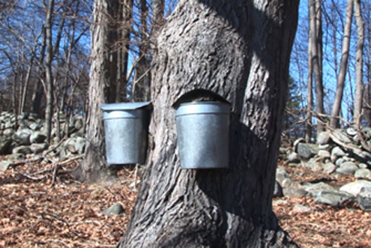
Review: Maple sugaring and the science of sap flow
Explain what it is about sugar maples – besides a high sugar content in the sap - that make them so good for syrup production.
Explain why it is that in other parts of the country where sugar maples grow (Georgia, for example), the trees aren’t tapped for syrup
Describe what happens inside a maple tree that allows sap to flow.
What is the springtime relationship between air temperature and pressure in the maple tree’s xylem?
How is vacuum on the syrup lines used to increase production in modern sugaring operations?
How is reverse osmosis used?
Describe the principal steps in syrup production.
On what qualities is maple syrup graded?
What is the concentration of sugar in xylem sap? In finished maple syrup?
Where is UVM’s Proctor Maple Research Center and what is its mission?

