Slide 1
What is a Plant?

Slide 2
Aristotle,
384-322 B.C.
Linnaeus,
1707-1778
plant
animal

Slide 3
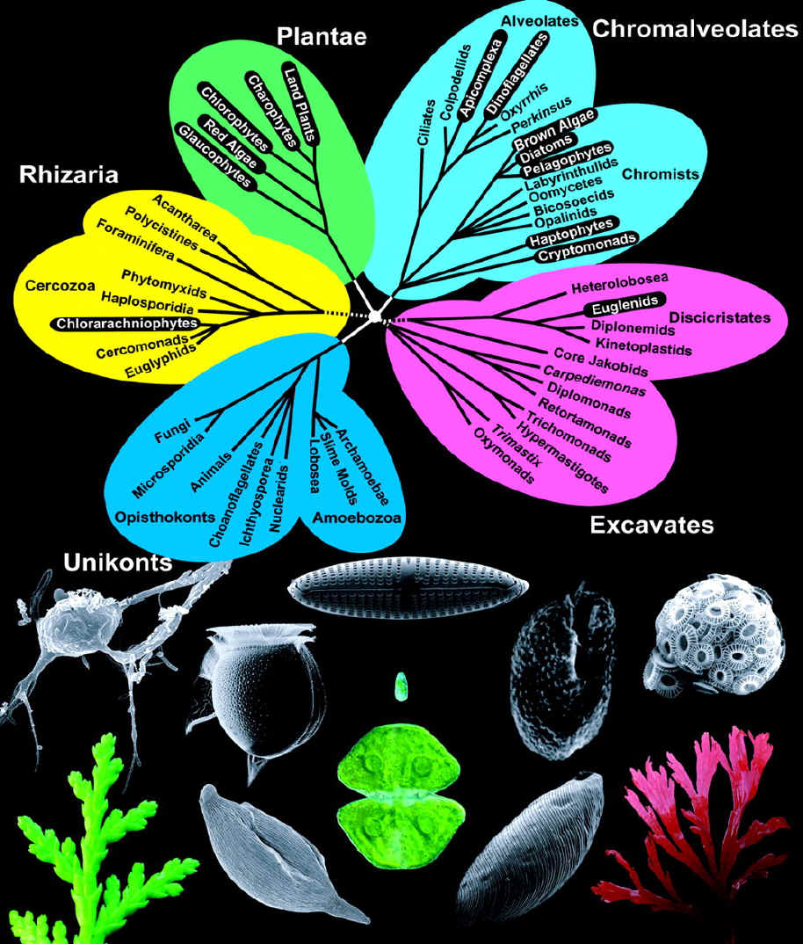

Slide 4
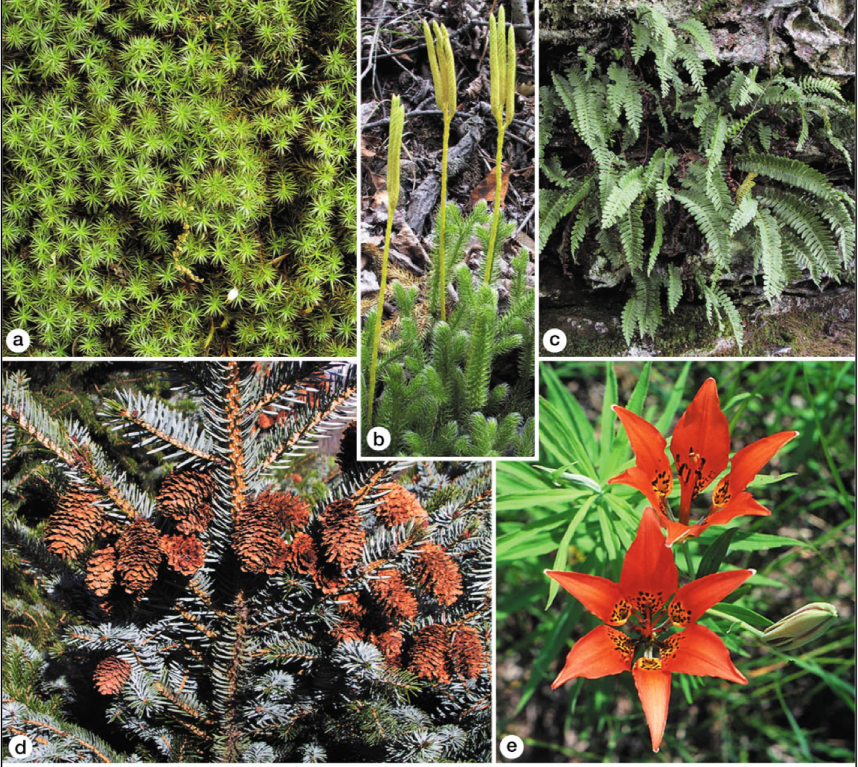
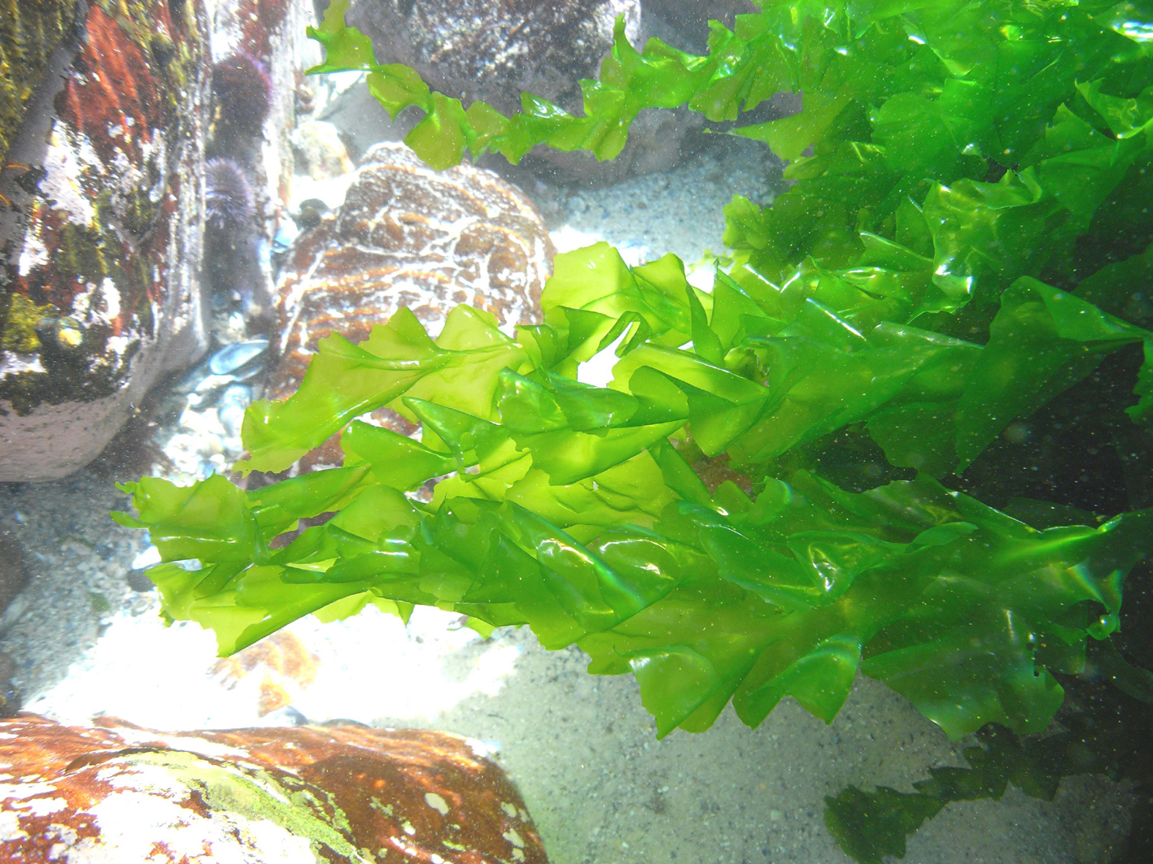

Slide 5
Viridiplantae – The Green Plants

Slide 6
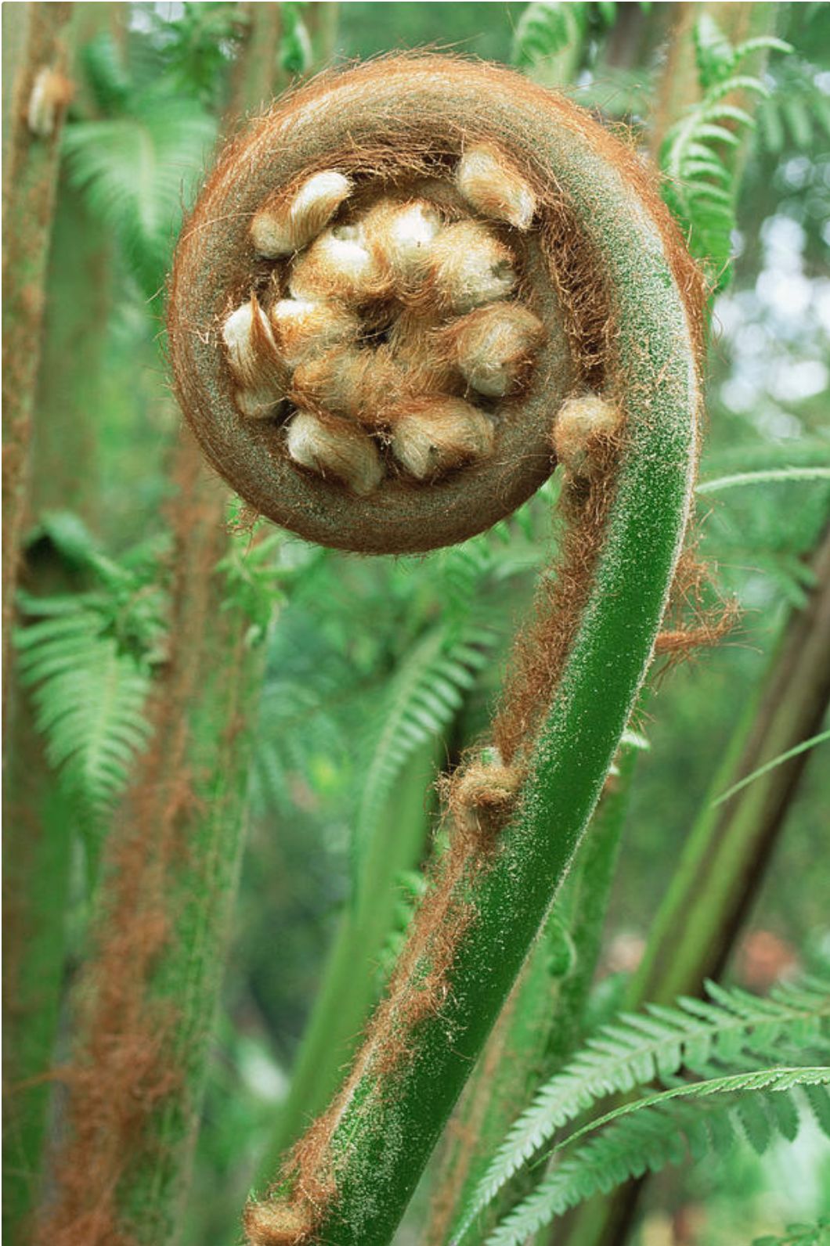
So what makes a plant a plant?
Photosynthetic
Sedentary
Cell walls made of cellulose
Eukaryotic
Multicellular

Slide 7
