Slide 1
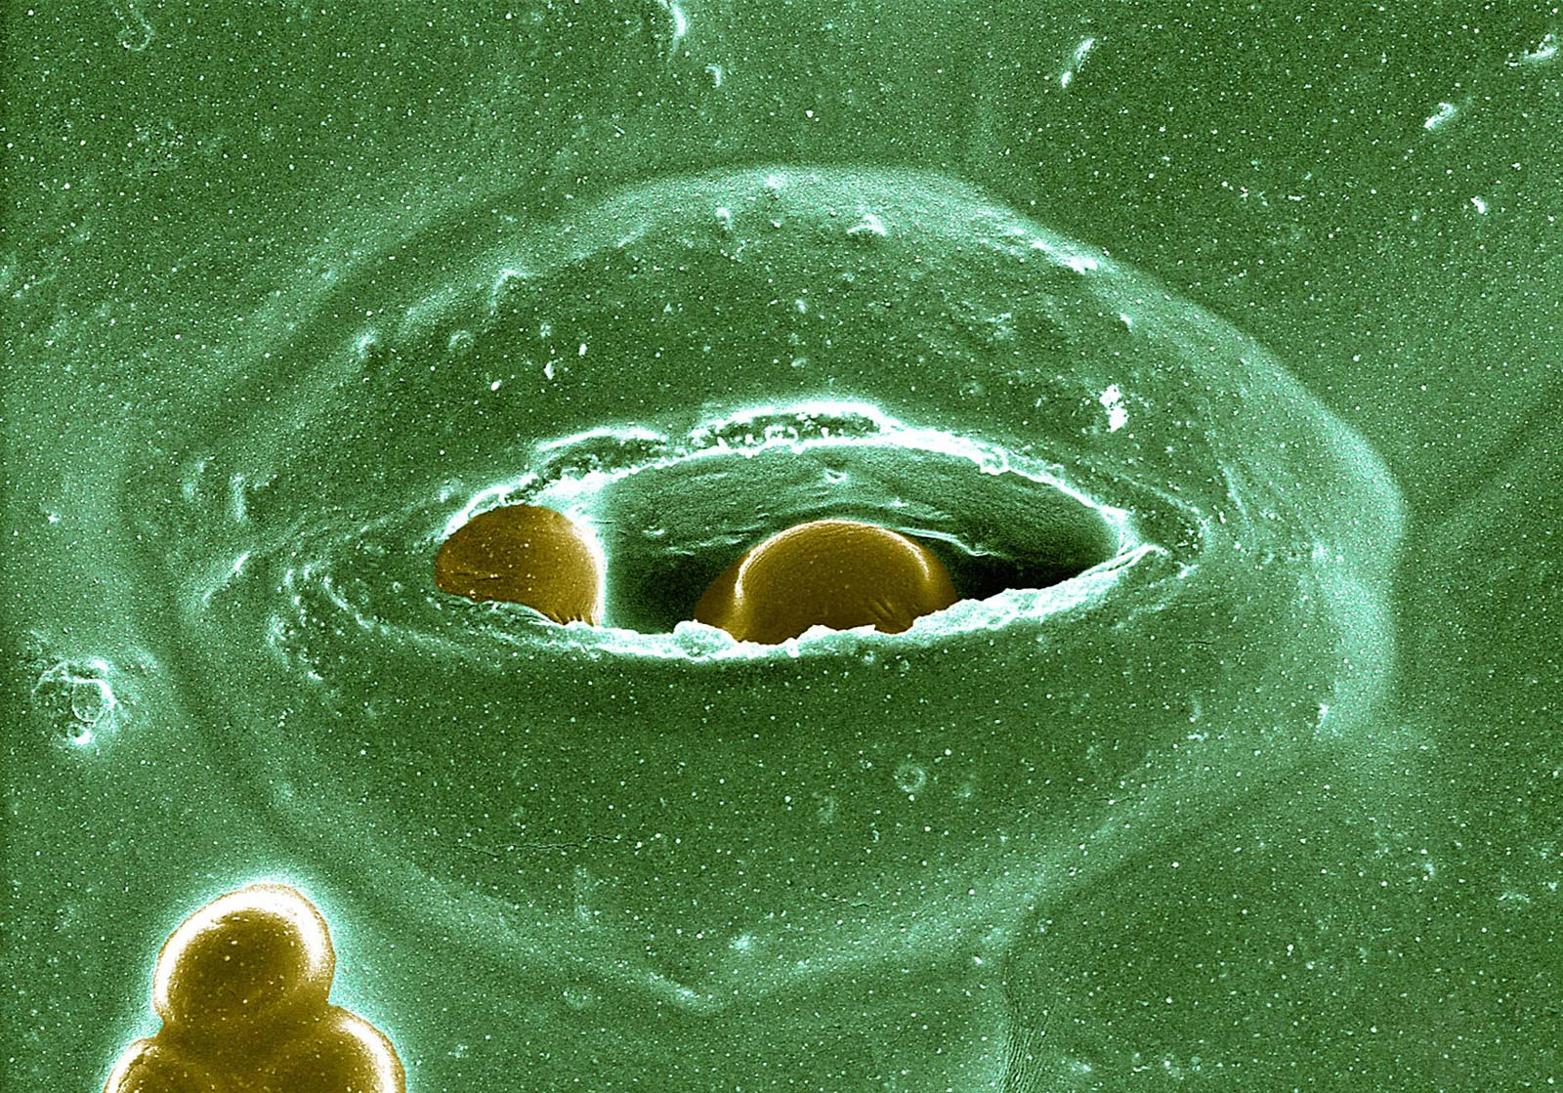
Plant Transport
Chapter 4,
pp. 48 - 52
Fall 2021

Slide 2
Vascular plants have long-distance transport systems
XYLEM
Water moves from the soil to the atmosphere through the hollow dead cells of the xylem
PHLOEM
Photosynthetically-produced sugars (and other molecules) move from their source to sinks (non-photosynthetic tissues) through the phloem

Slide 3
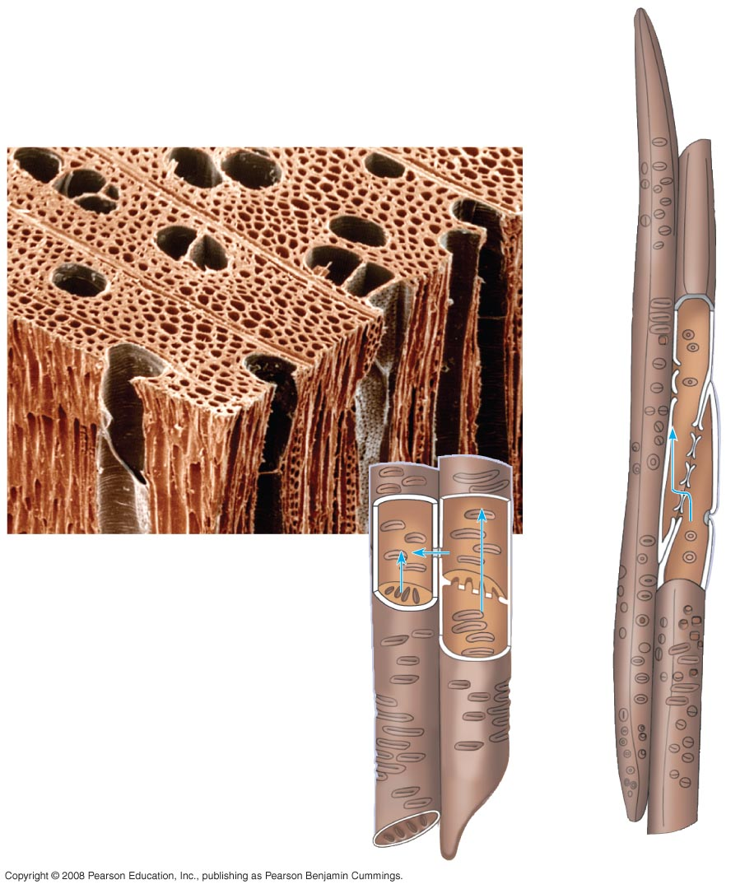
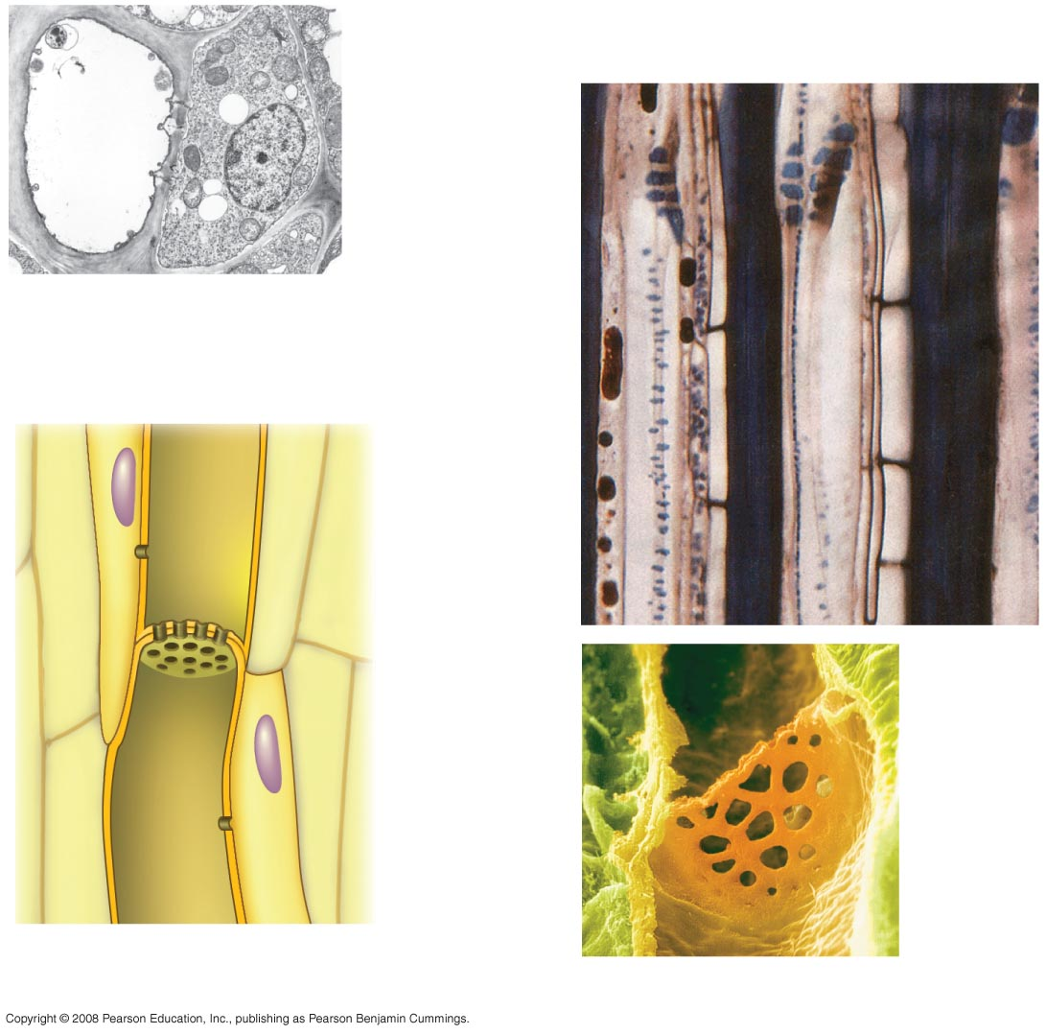
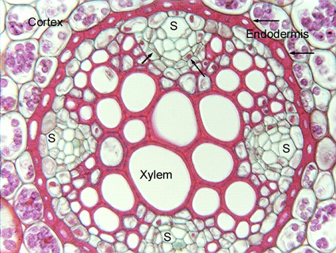
Specialized Transport Tissue: Xylem and Phloem
Phloem
Xylem
Vessel
Tracheids
100 µm
Sieve-tube element (left)
and companion cell:
cross section
Pits
Vessel
element
Sieve-tube elements:
longitudinal view
Tracheid
Sieve plate with pores
Tracheids

Slide 4
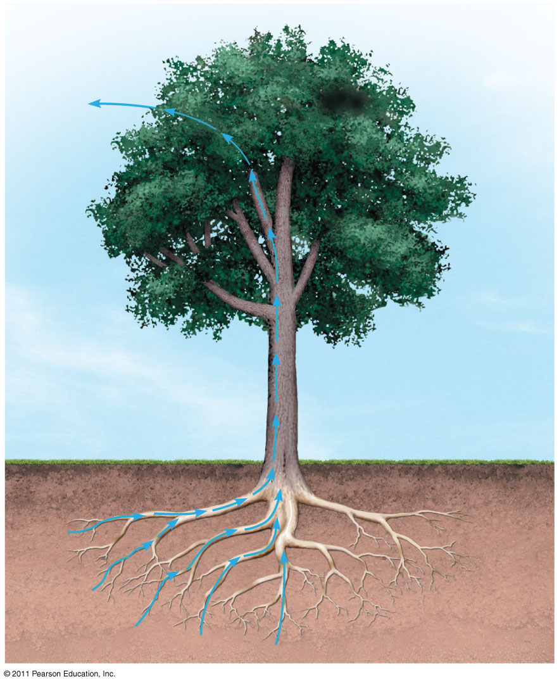
Movement of water in the xylem
H₂O
H₂O
Water movement in the xylem from root to leaf can take place over distances of 300 feet or more, without using any energy. How do plants do this?
H₂O and minerals

Slide 5
Water Movement in the Xylem: a Play in Three Acts
Act One: Transpiration, the evaporation of water from the stomates of the leaf
Act Two: Water movement into the root from the soil
Act Three: Conduction of water up the stem

Slide 6
Transpiration is the evaporative loss of water from the leaves of a plant.
H₂O
H₂O and minerals

Slide 7
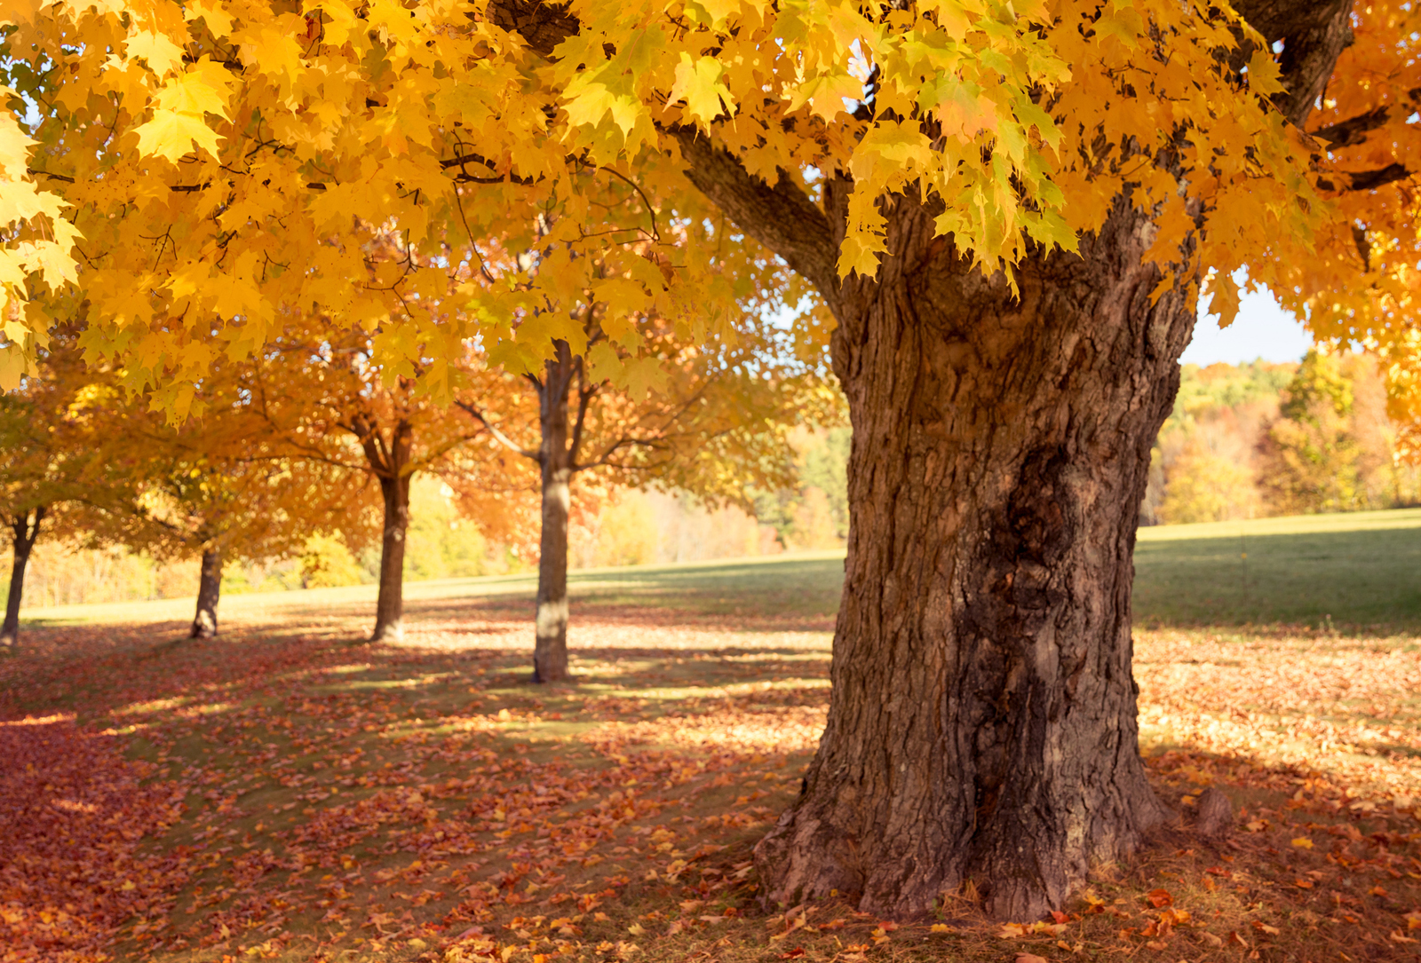
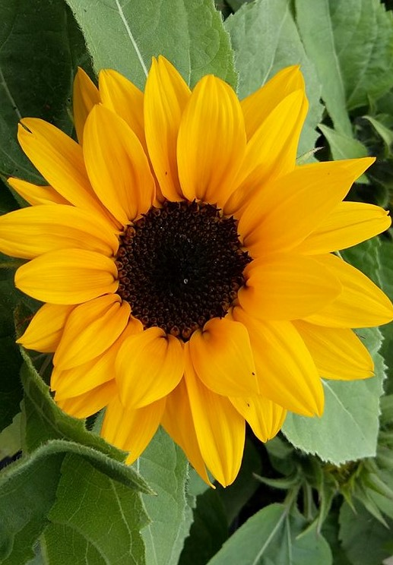
How much water evaporates
from the plant body in the course of a day?
Almost 1.5 gallons, in the case of a
sunflower…
… and more than 50 gallons per day for a full-grown maple!

Slide 8
90% of water lost through a plant’s leaves evaporates through the stomates.
Opening and closing of stomates is regulated by guard cells.

Slide 9
What drives transpiration?
Water is pulled through the hollow xylem by tension developed at evaporative sites in the leaves
In the leaf, water evaporates out of the xylem into the intracellular spaces, and then through the stomata into the atmosphere
Stomate
Water is moving from an area of higher concentration (inside the leaf)
to one of lower concentration (the atmosphere).

Slide 10
Water Movement in the Xylem: a Play in Three Acts
Act One: Transpiration, the evaporation of water from the stomates of the leaf
Act Two: Water movement into the root from the soil
Act Three: Conduction of water up the stem

Slide 11
Water uptake and movement in vascular plants
Endodermis
Water moves from the soil, into the outer layers of the root, then into the vascular cylinder and xylem
Vascular cylinder
Outer root layer

Slide 12
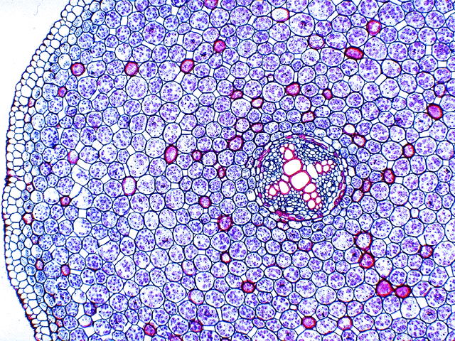
Water and minerals must travel from the soil through the epidermis and cortex into the vascular cylinder (xylem/phloem) of the root…
endodermis
cortex
vascular cylinder

Slide 13
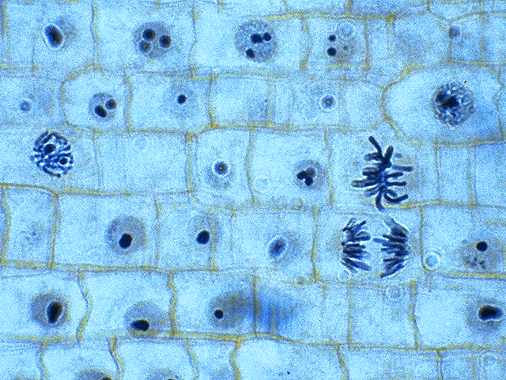
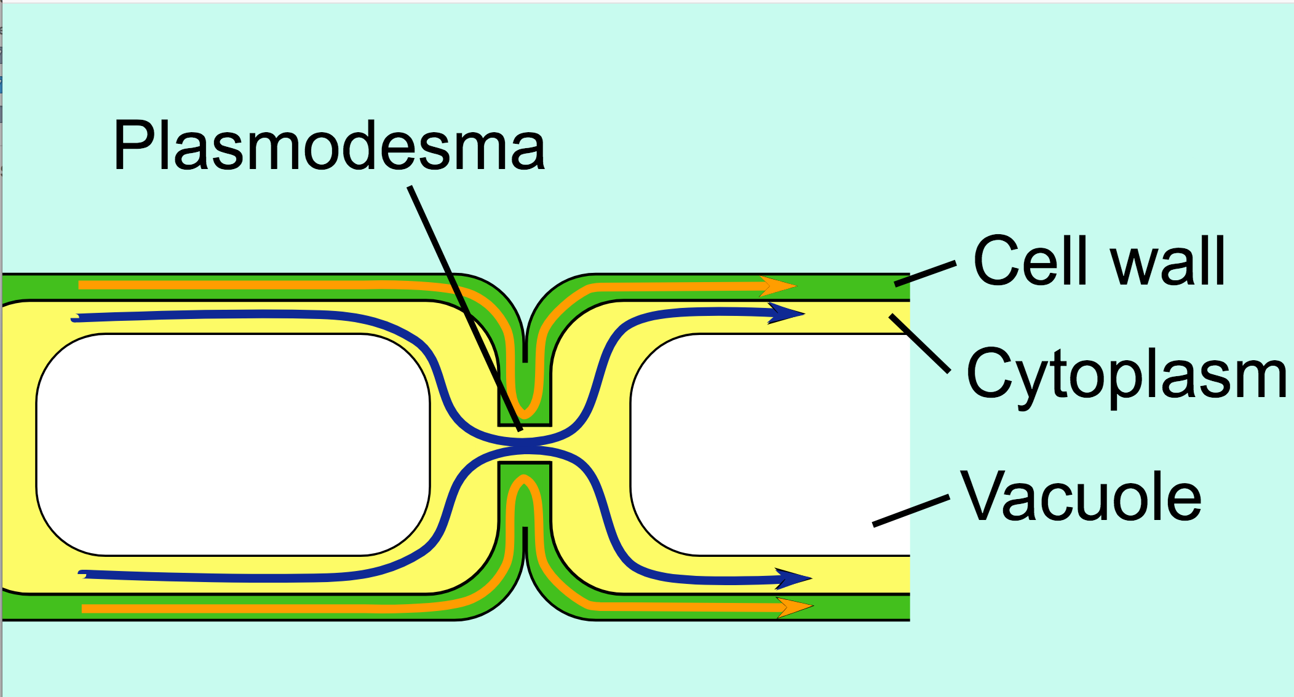
But first, something about plant cells that we haven’t mentioned yet …
Adjacent cells are intimately connected through
membranous tunnels called plasmodesmata

Slide 14
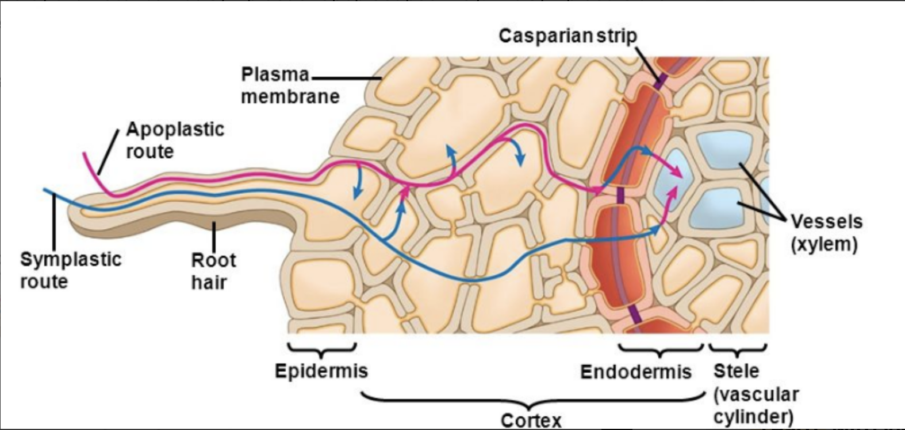
Water moving through the root can do so by either of two routes:
… the apoplastic route or the symplastic route

Slide 15
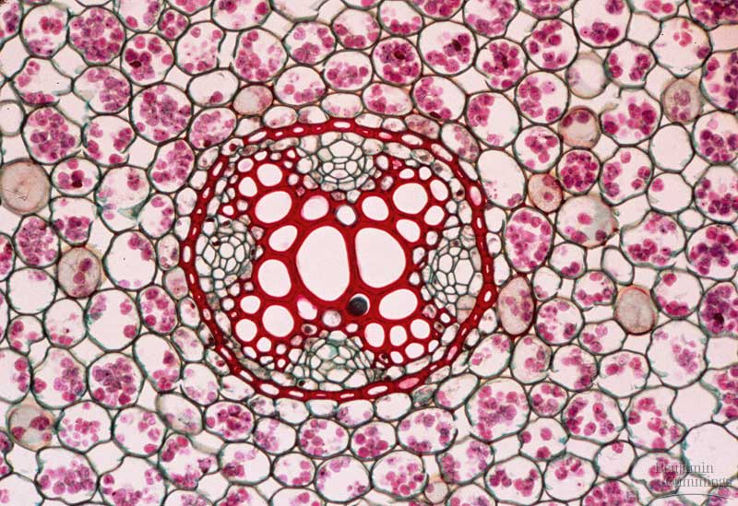
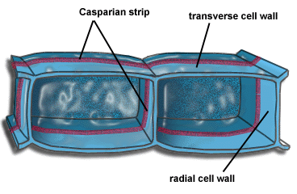
endodermis, with
Casparian strip
eudicot root, cross section

Slide 16
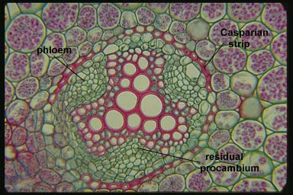
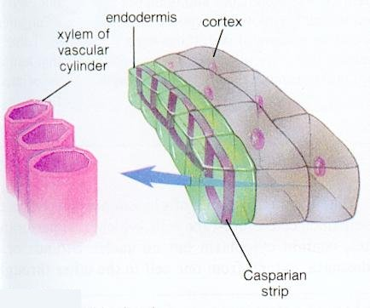
The Casparian strip
forces water to cross a living membrane in order to reach the xylem
endodermis

Slide 17
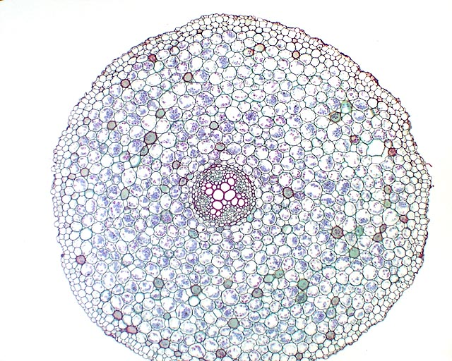
The root endodermis thus acts as a filter
Na⁺
Na⁺
Na⁺
Na⁺
The endodermis produces a water-impermeable layer, the Casparian strip, that provides selectivity
Na⁺
Na⁺
Na⁺
Photo credit Michael Clayton

Slide 18
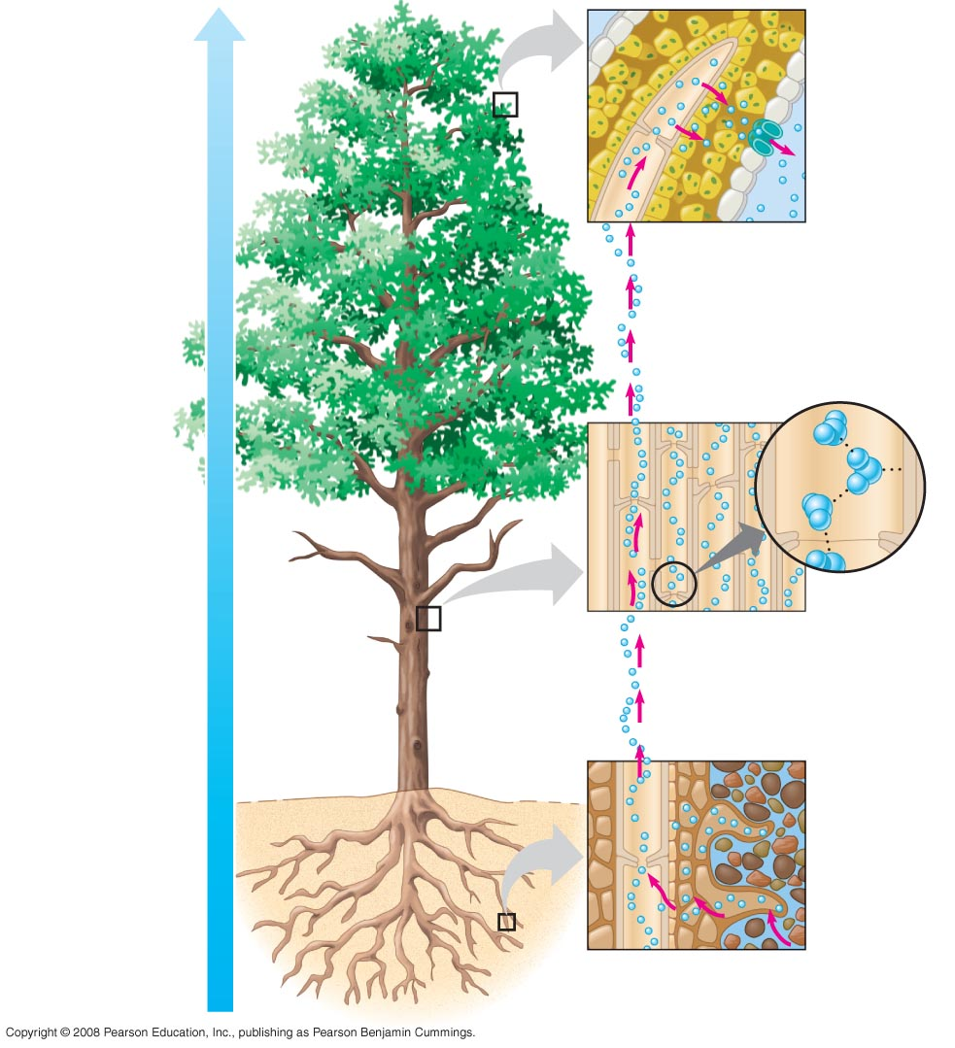
Xylem sap
B.
Stomata function in transpiration
Water molecule
Atmosphere
Adhesion by hydrogen bonding
So how does water
get from point A
(the root) to point
B (the leaf, stomate,
and atmosphere)?
Xylem cells
Cell wall
Water potential gradient
Cohesion by hydrogen bonding
Cohesion and adhesion in the xylem
Water molecule
Root hair
A.
Water uptake from soil
Soil particle
Water

Slide 19
Water Movement in the Xylem: a Play in Three Acts
Act One: Transpiration, the evaporation of water from the stomates of the leaf
Act Two: Water movement into the root from the soil
Act Three: Conduction of water up the stem

Slide 20
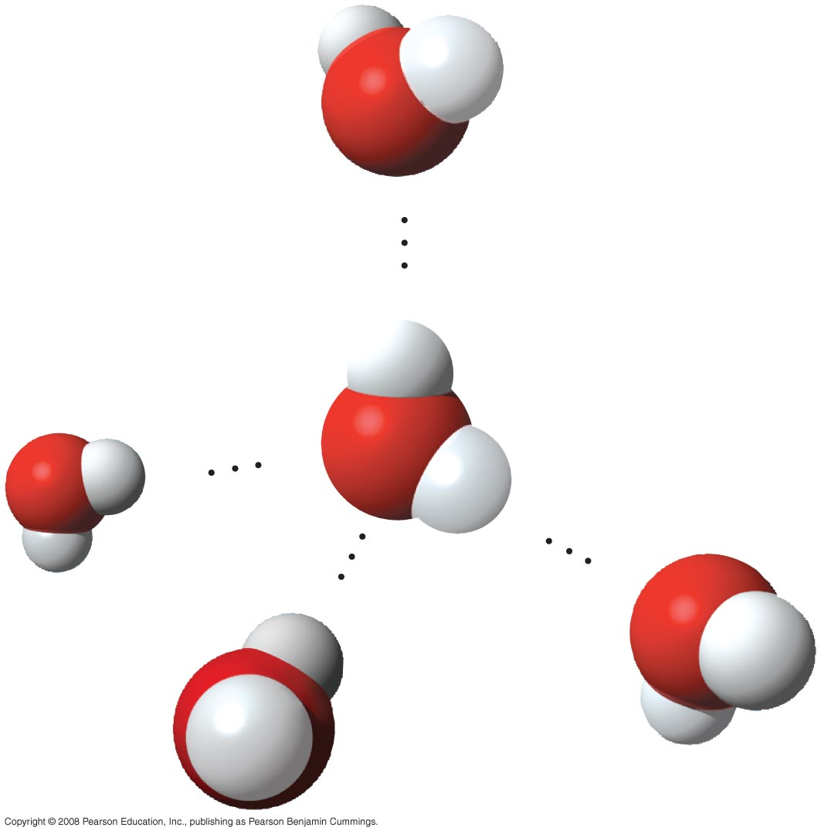
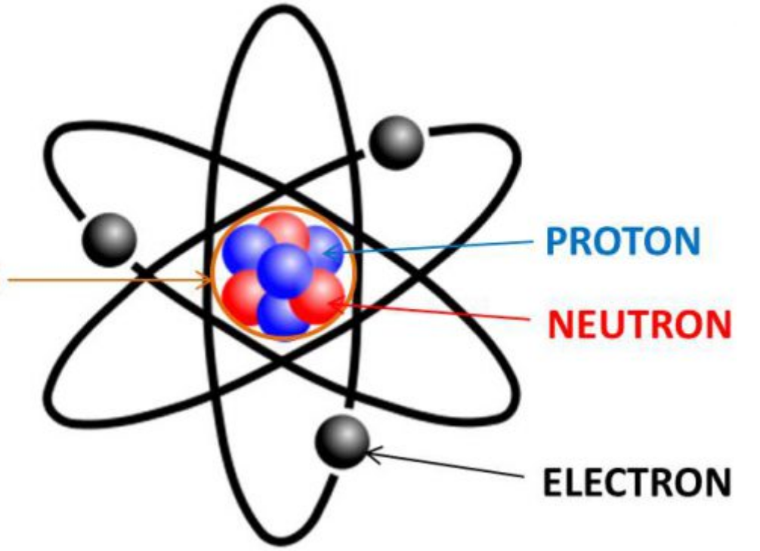
The ascent of xylem sap depends on hydrogen bonds between water molecules
The oxygen (O) is partially –
The hydrogen (H) is partially +
H
+
NUCLEUS
——
H₂O = water
O
–
——
+
H
–
+
–
+
-

Slide 21
The ascent of xylem sap (water and minerals)
Xylem sap
Mesophyll cells
Stoma
Stoma
Water molecule
Transpiration
Atmosphere
Adhesion by hydrogen bonding
Xylem cells
Cell wall
Water potential gradient
Cohesion and adhesion in the xylem
Cohesion by hydrogen bonding
Water molecule
Root hair
Soil particle
Water
Water uptake from soil

Slide 22
How much water evaporates
from the plant body in the course of a day?
Almost 1.5 gallons, in the case of a
sunflower…
Negative pressure created by the evaporation of water from the
leaf causes bulk flow of water in the stem, from the area of higher
pressure to the area of lower pressure.

Slide 23
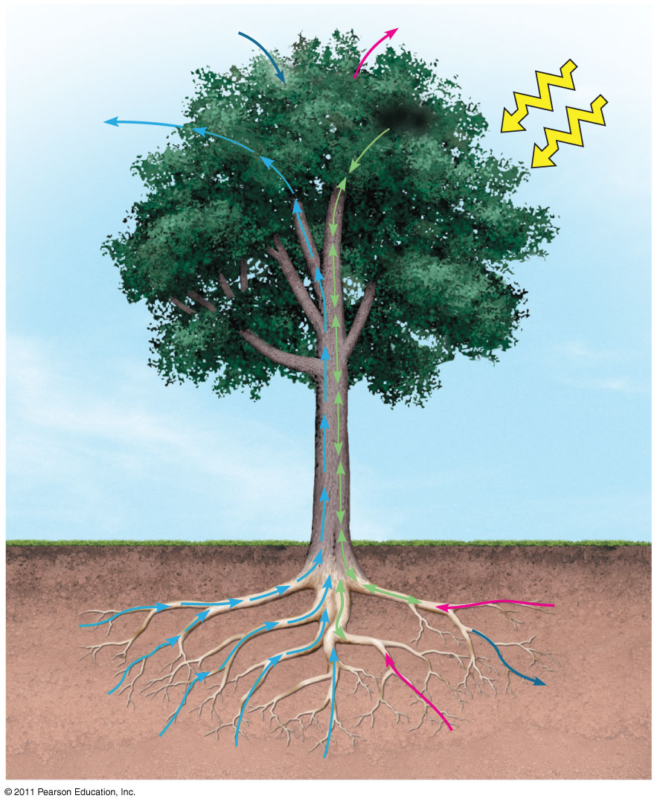
CO₂
O₂
Translocation:
Movement of
dissolved sugars in the
phloem
Light
Sugar

Slide 24
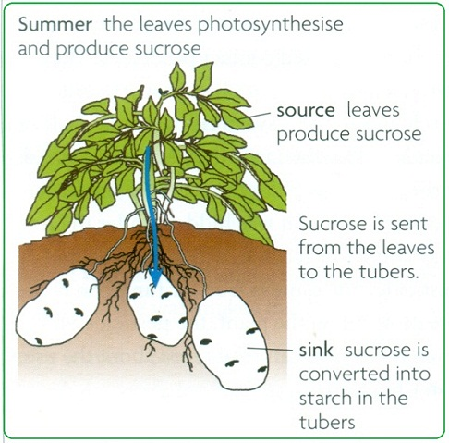
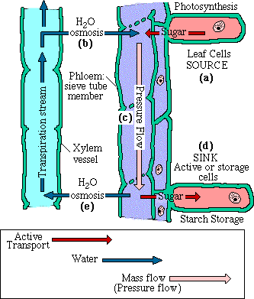
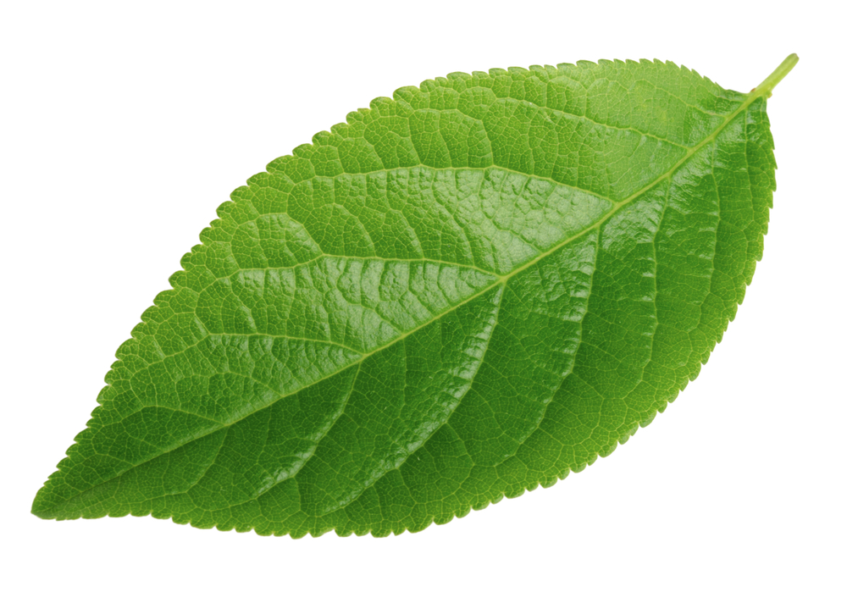
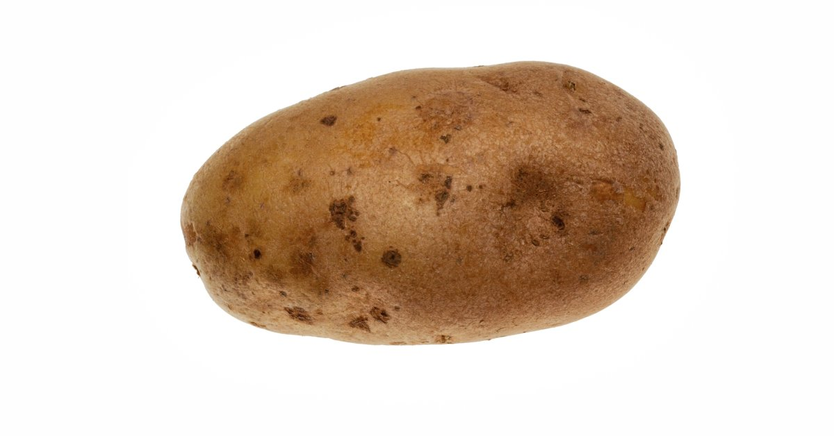
Source to Sink

Slide 25
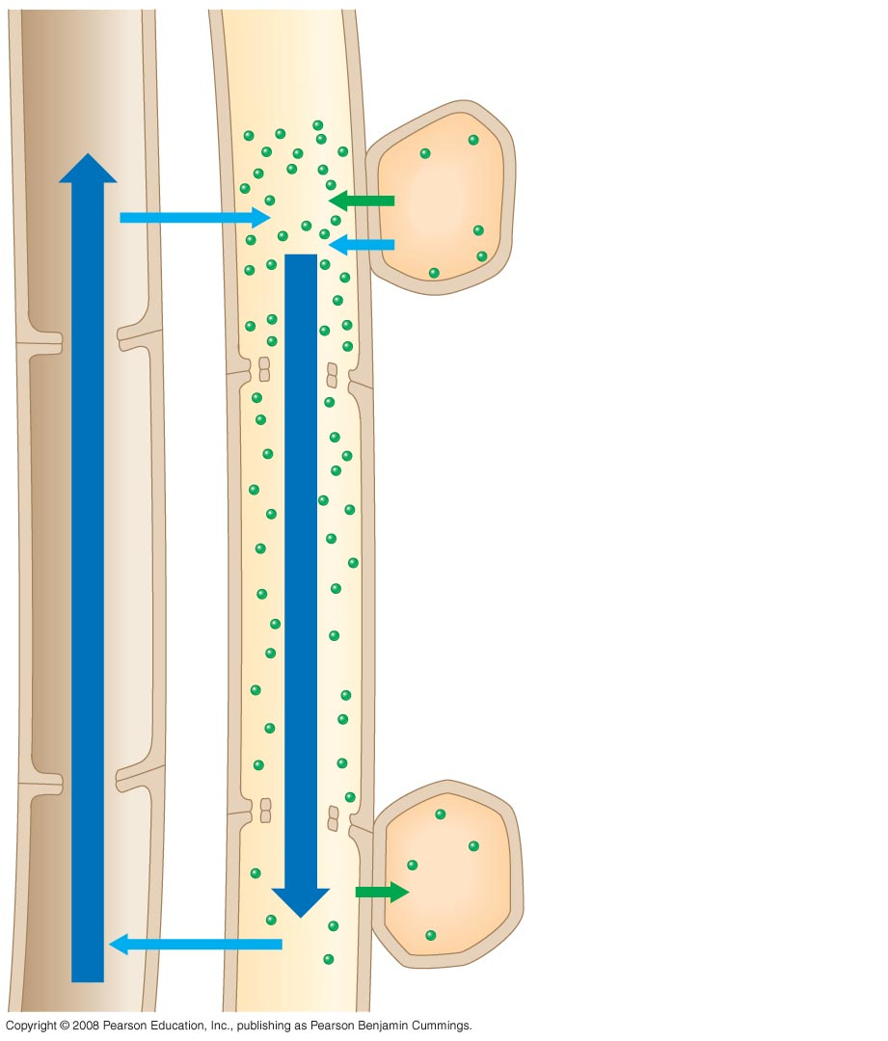
Fig. 36-20
Pressure-flow hypothesis
Vessel (xylem)
Sieve tube (phloem)
Source cell (leaf)
1
H₂O
Sugar
Load sugar into the phloem at the source (requires energy)
1
H₂O
2
2
Water from the xylem flows into the phloem (OSMOSIS)
Bulk flow
Bulk flow
Unload sugar at the sink (requires energy)
3
Sink cell (storage root)
Water from the phloem flows back into the xylem (OSMOSIS)
4
3
H₂O
Sugar

Slide 26
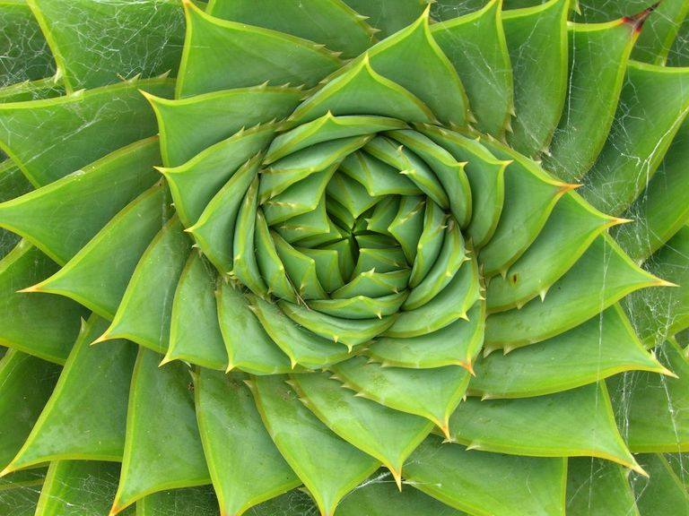

Slide 27
Lecture Review, Chap. 4, pp. 48-52
Relate structure to function in sieve-tube cells, vessel cells, and tracheid cells.
How are water and mineral nutrients from the soil transferred into the vascular cylinder of a root?
Define transpiration.
Describe the cohesion-tension mechanism and relate it to the function of the stomata and the properties of water.
Why do water molecules stick together? How does this relate to why plants can move water against the force of gravity without using any energy?
Trace the path of sugar in the phloem from source to sink. What is the name of the hypothesis to describe this flow?

