Slide 1
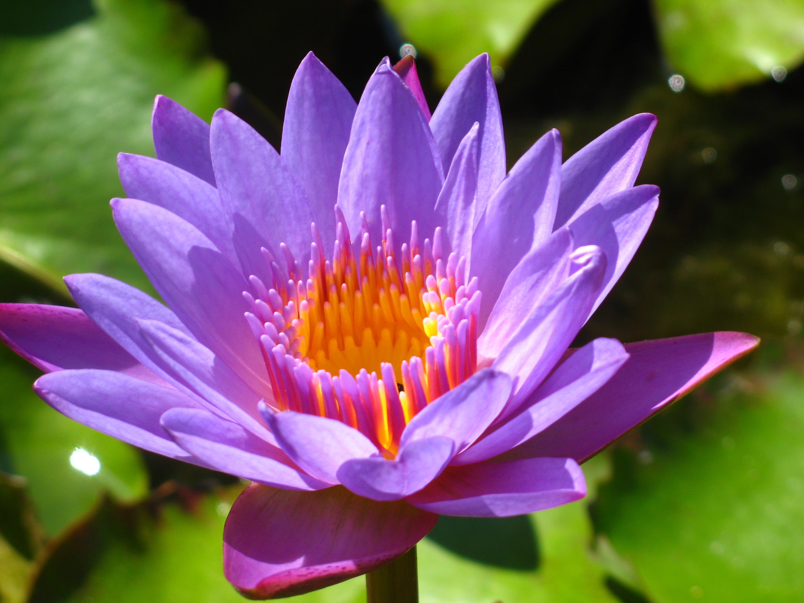
Plant Life Cycle: Flowers
Chapter 5
PBIO 006
Fall 2021

Slide 2
Outline
I. Introduction to the Angiosperms
II. Flower Structure
III. Flowering Plant Life Cycle
IV. Pollination
Polygaloides pauciflora, fringed polygala

Slide 3
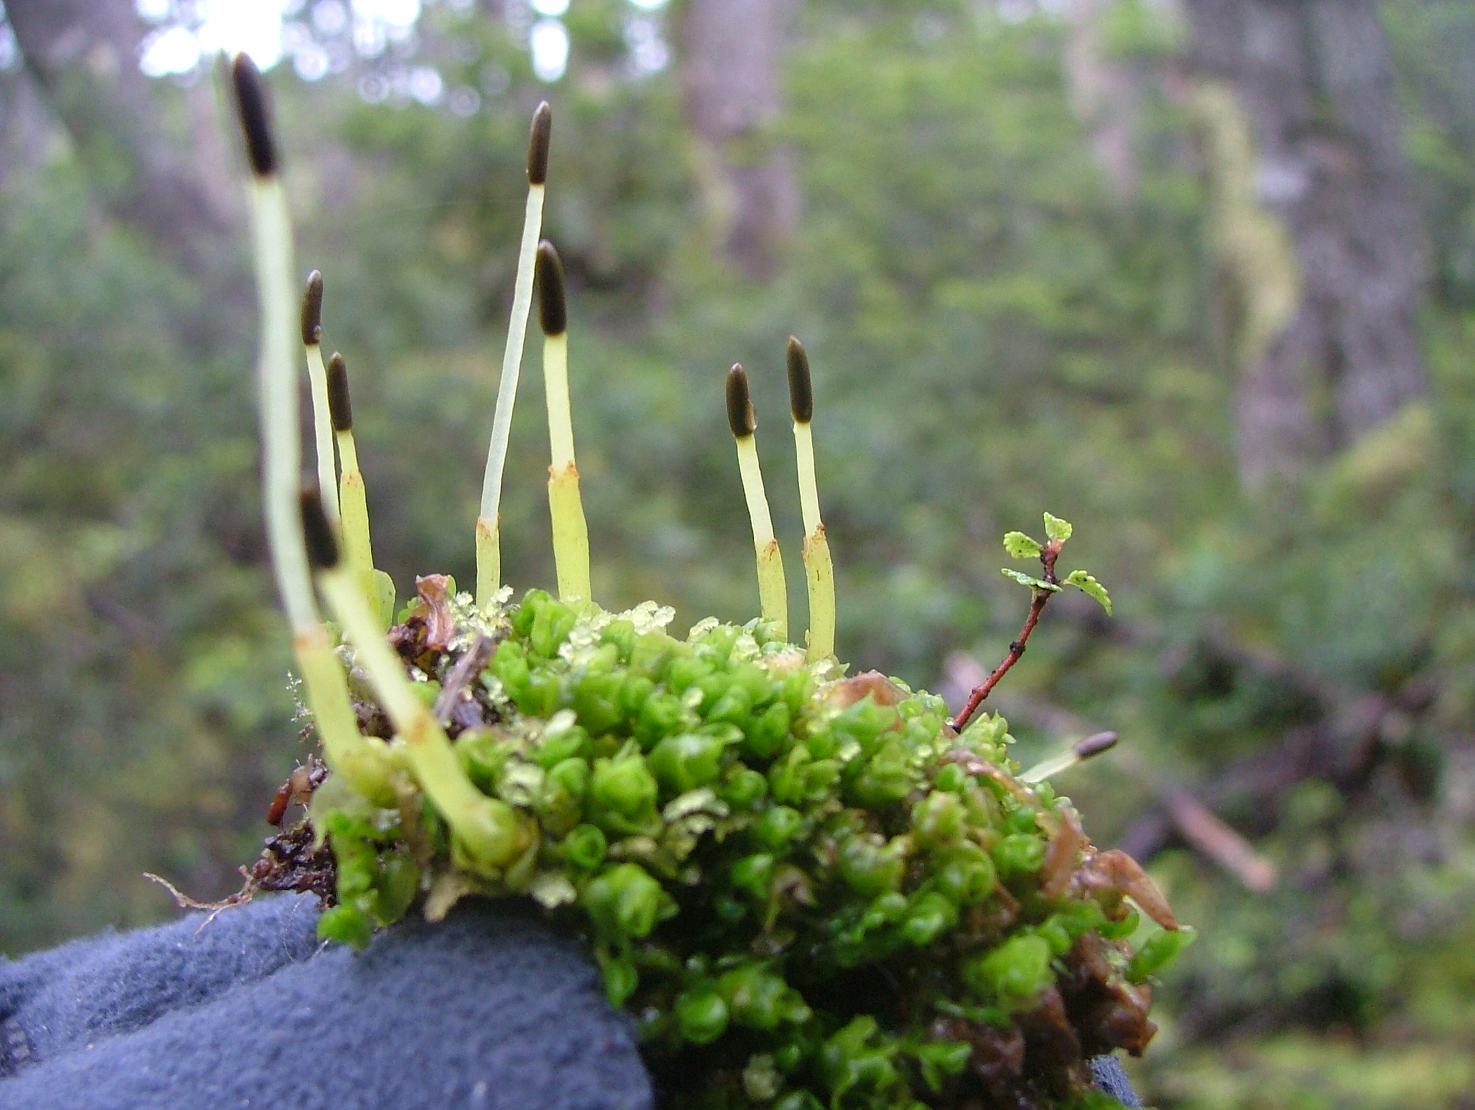
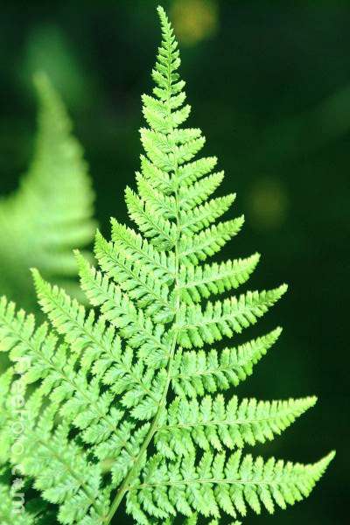
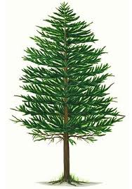
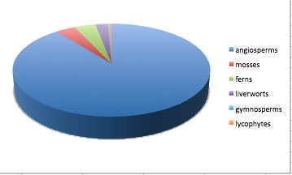
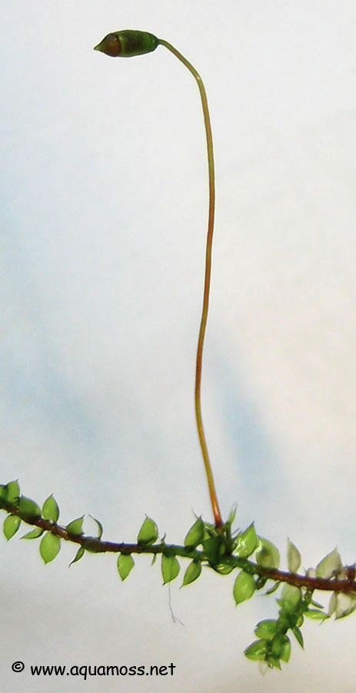
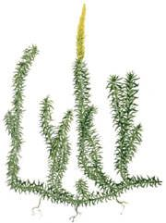
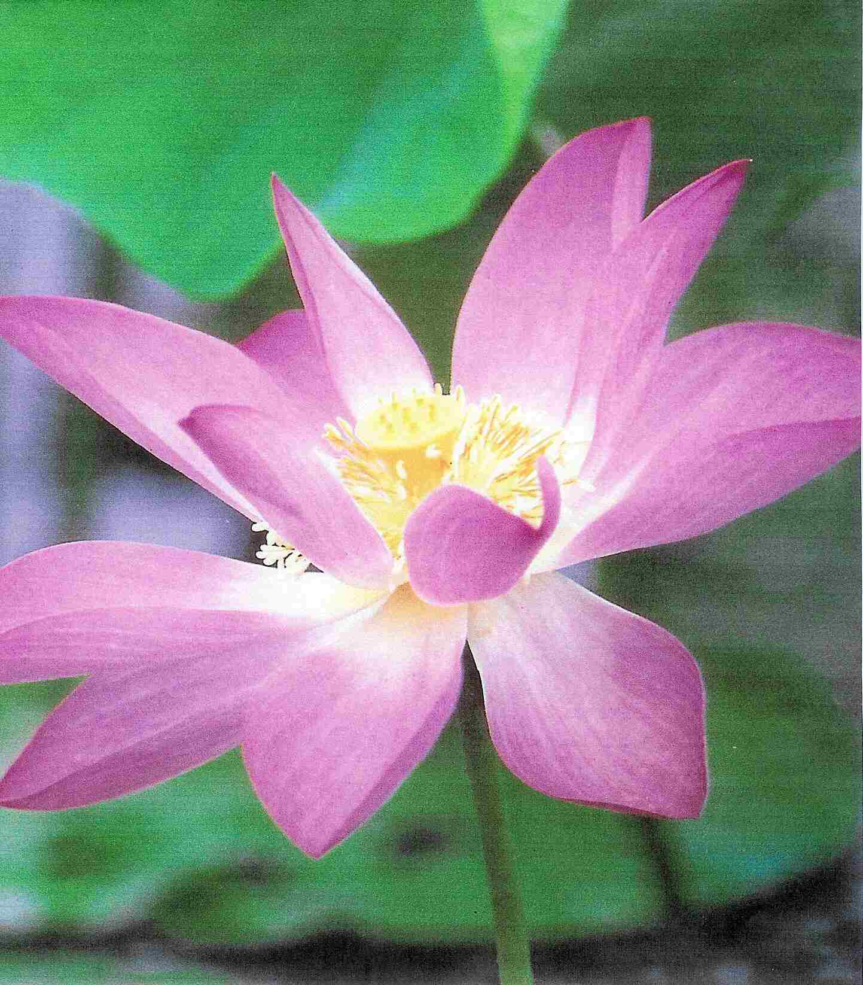
Extant Plant Diversity
Ferns, 4.0%
Liverworts, 2.3%
Gymnosperms, 0.3%
conifers
Mosses, 3.8%
Lycophytes, 0.4%
Flowering plants, 89.4%

Slide 4
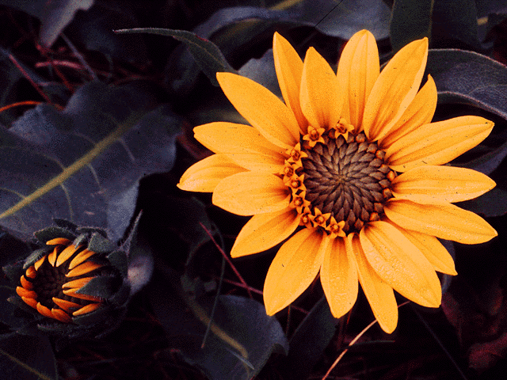
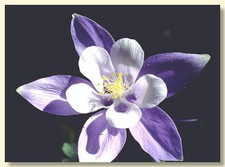
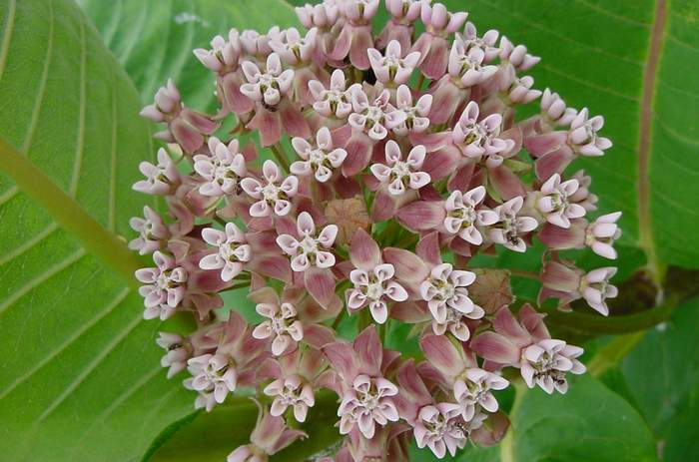
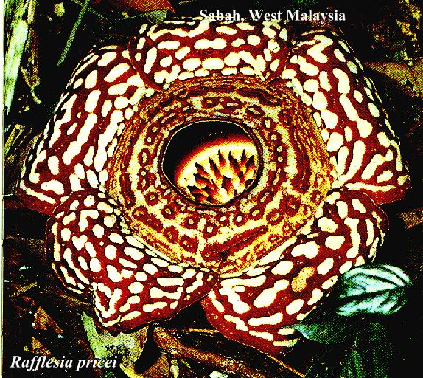
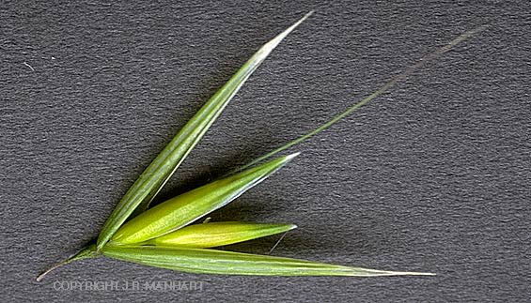
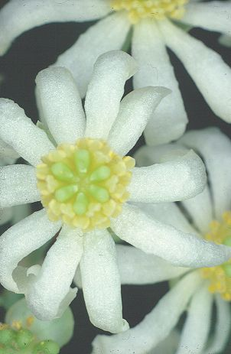
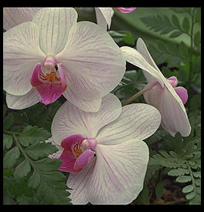
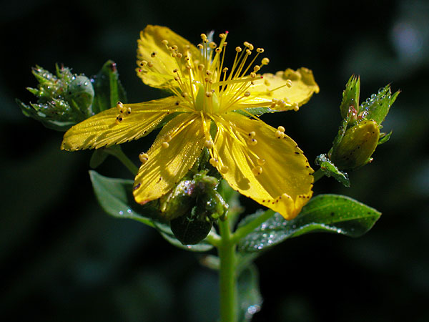
Angiosperms: the flowering plants
ca. 350,000 species!

Slide 5
Outline
I. Introduction to the Angiosperms
II. Flower Structure
III. Flowering Plant Life Cycle
IV. Pollination
Polygaloides pauciflora, fringed polygala

Slide 6
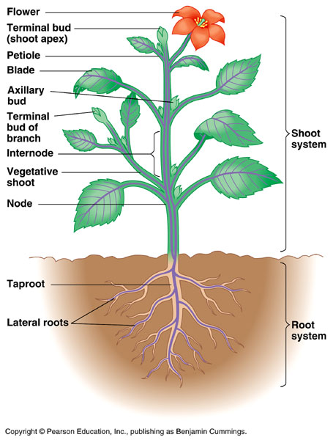
Reproductive
Body
Vegetative
Body

Slide 7
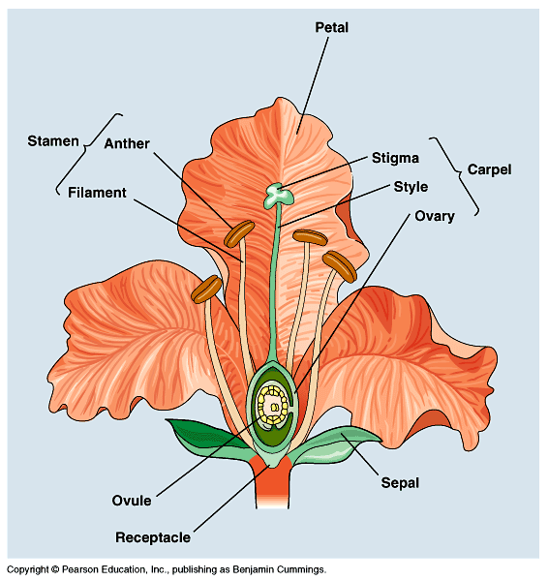
Parts of a Flower
Pistil

Slide 8
Four whorls of the flower:
set of sepals = Calyx
set of petals = Corolla
set of stamens = Androecium
pistil (or set of pistils) = Gynoecium
Androecium, from Greek: andros: male, and oikos: house.
The androecium is ”the house of the male.”

Slide 9
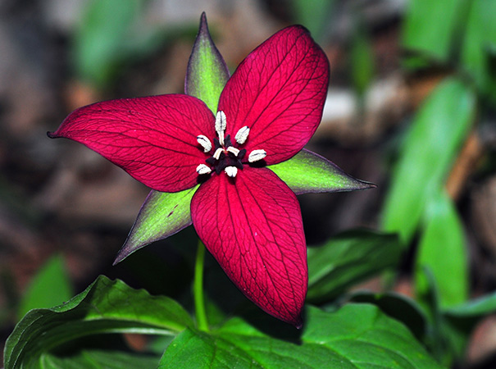
A flower that has both stamens and pistils is said to be perfect

Slide 10
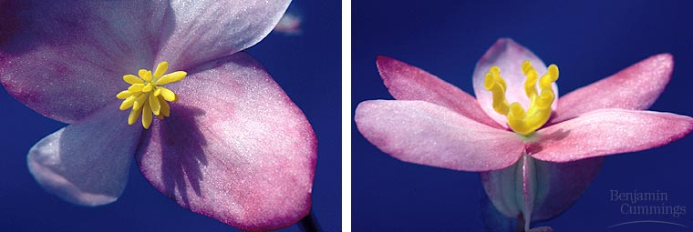
A flower lacking either stamens or pistils is imperfect
staminate (male)
Begonia
carpellate
(female)

Slide 11
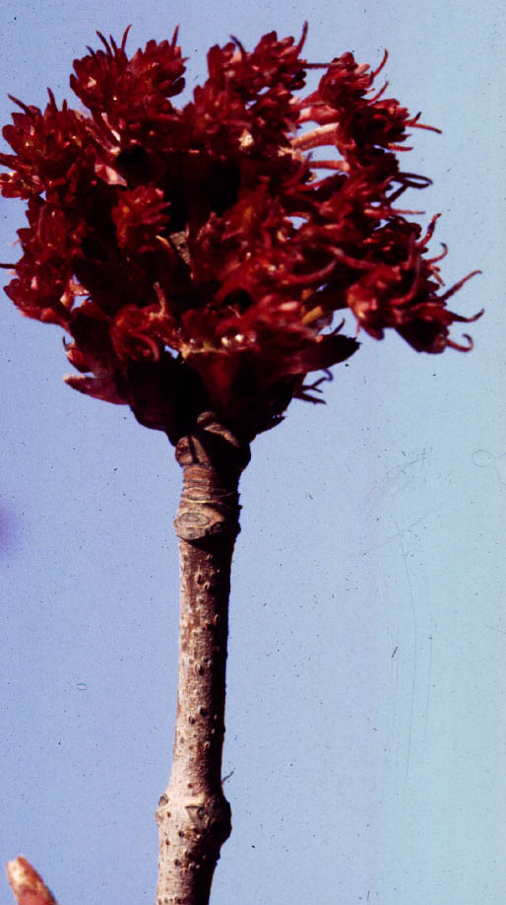
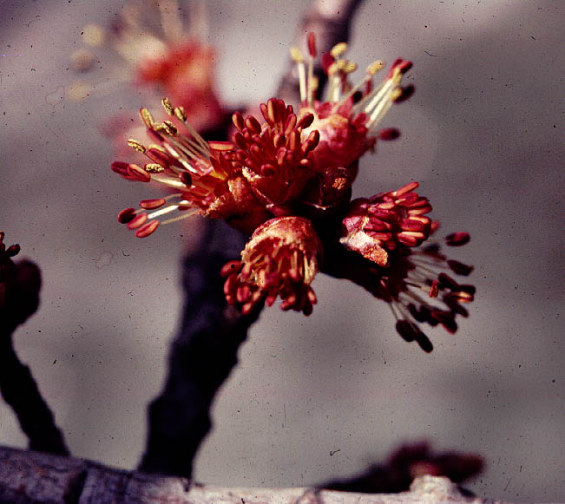
Red Maples are dioecious
staminate
dioecious:
‘two houses’
pistillate

Slide 12
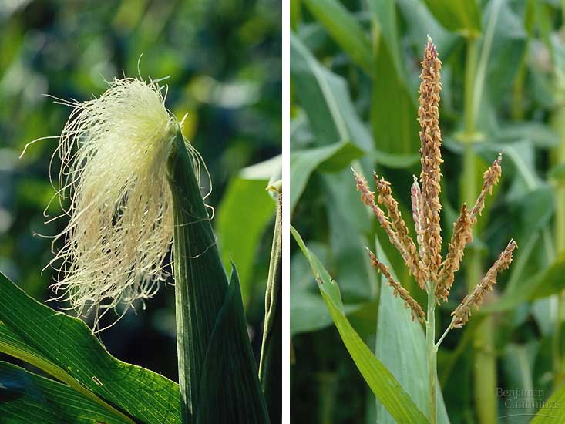
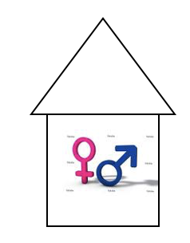
Corn is monoecious
monoecious: ‘one house’

Slide 13
Petals may be separate ...

Slide 14
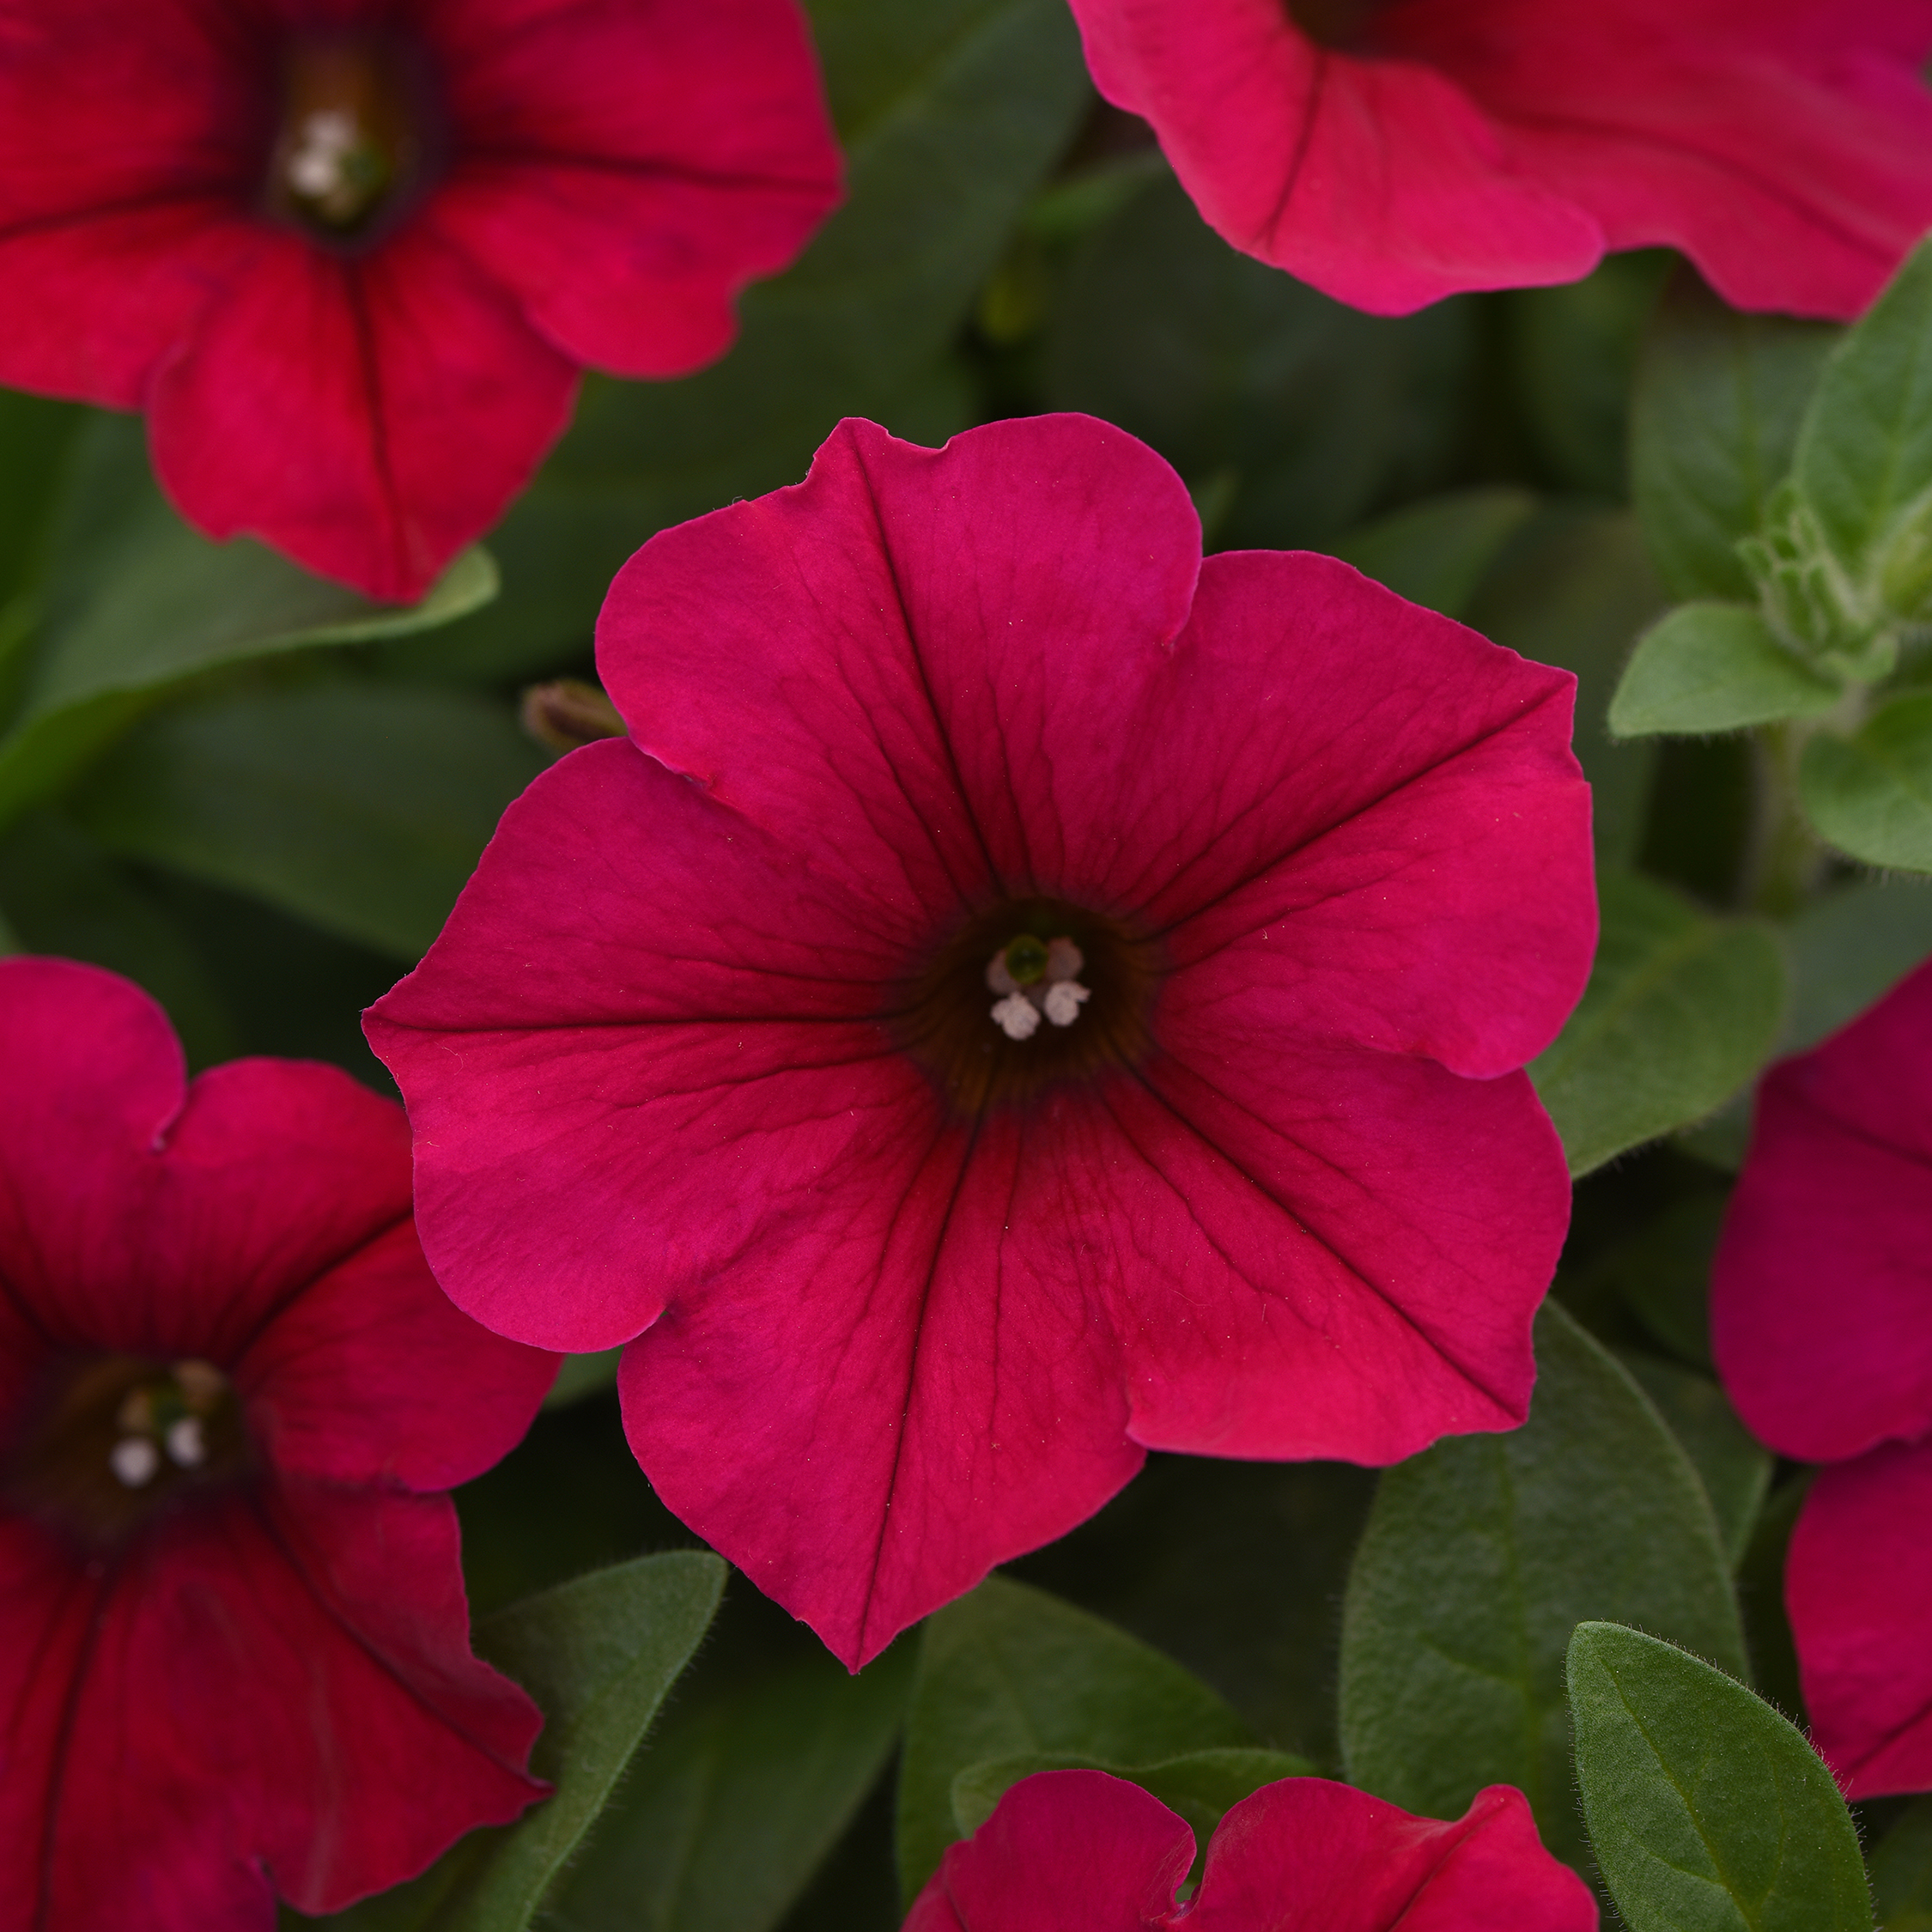
or they may be fused

Slide 15
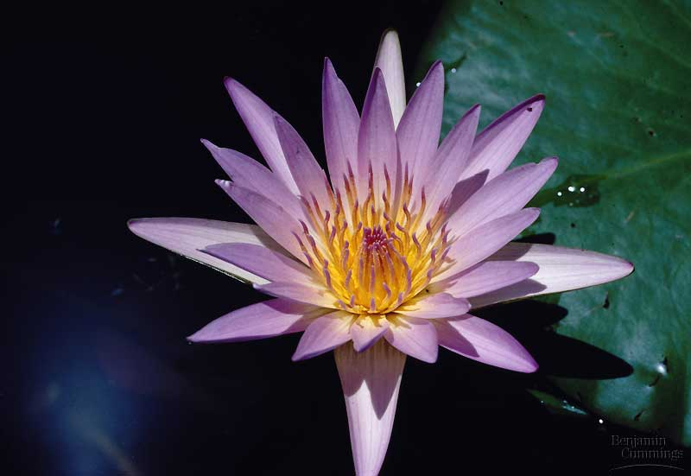
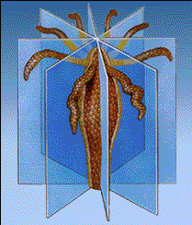
Symmetry
Water lily: symmetry is radial

Slide 16
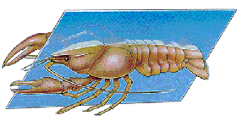
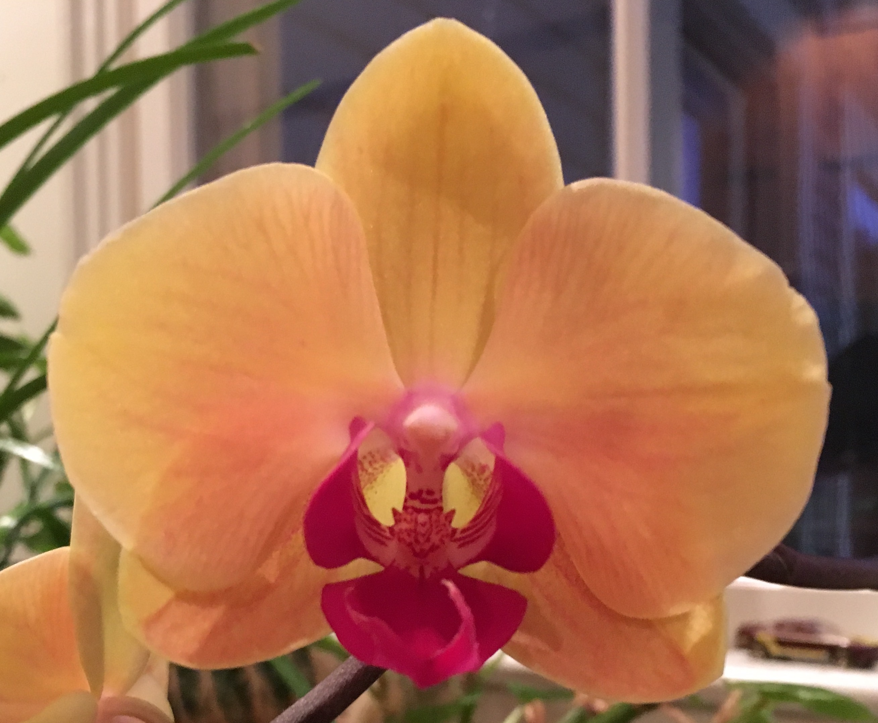
Symmetry
orchid: symmetry is bilateral
Moth orchid: symmetry is bilateral

Slide 17
Gynoecium Structure

Slide 18
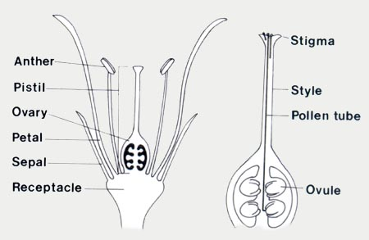
Carpel
Ovary
The terms pistil and carpel are often used interchangeably, but …

Slide 19
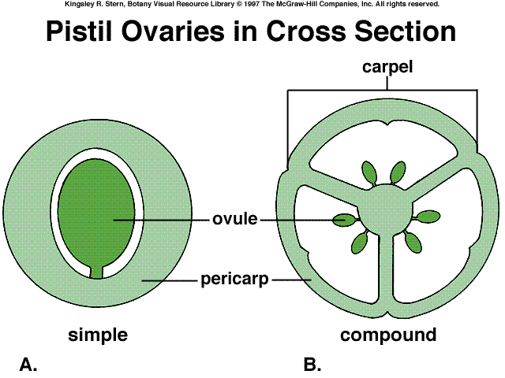
If the pistil is simple,
carpel = pistil
(and the terms can be used
interchangeably)
If the pistil is compound, the
carpel is a subunit of the pistil

Slide 20
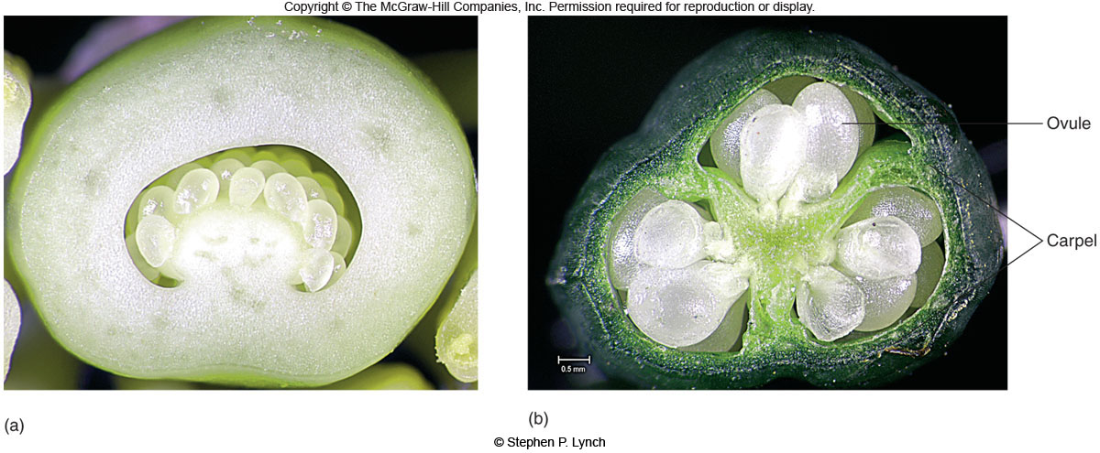
simple pistil
compound pistil
Notes:
lev70065_05_02.jpg

Slide 21
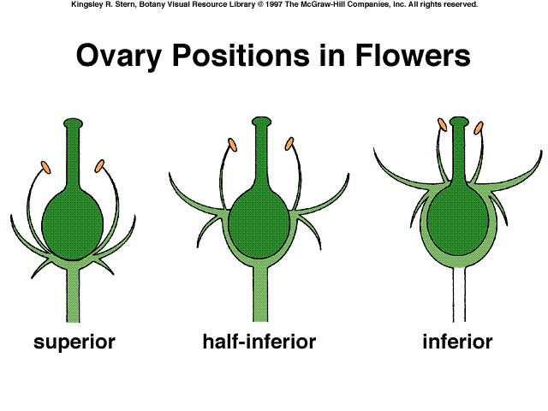
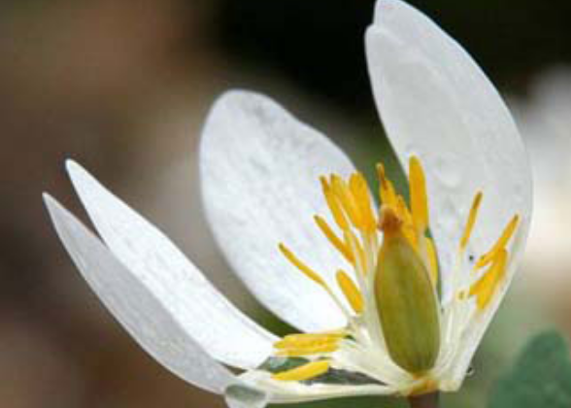
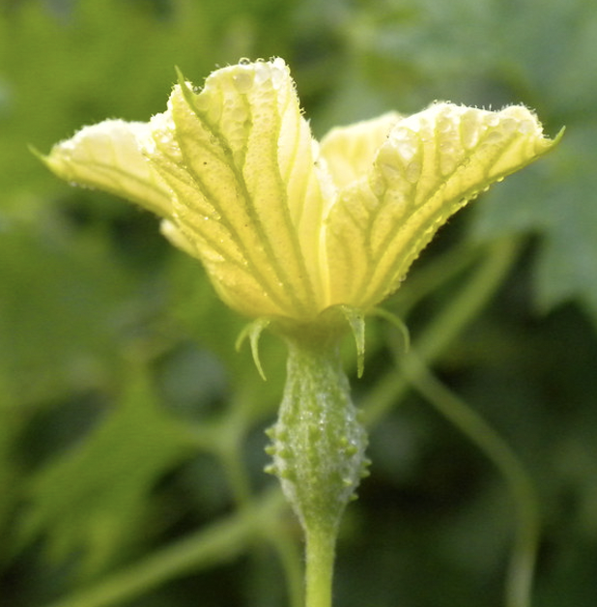
pistil
stamens
petals
sepals
Notes:
Begin here on Thursday, September 13

Slide 22
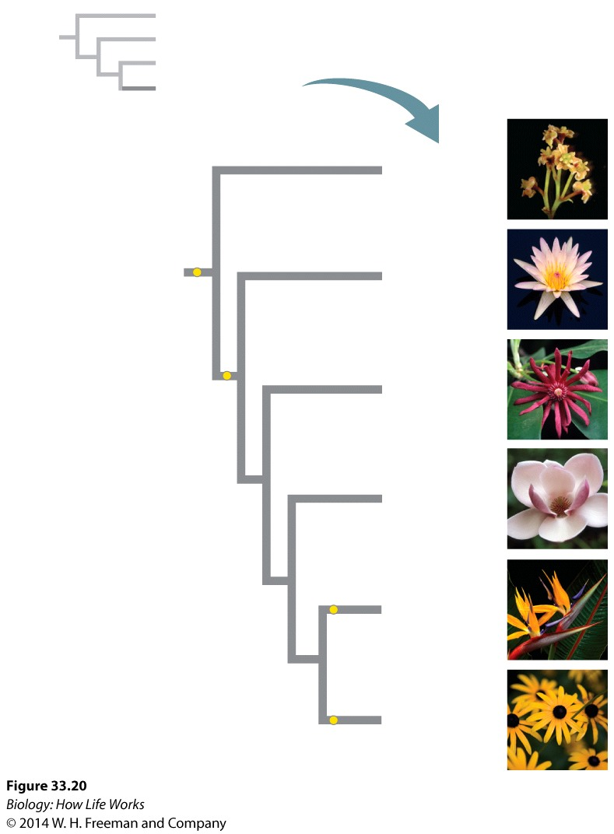
The major clades of flowering plants
Amborella
(1 species)
Flowers; double
fertilization; fruits
Water lilies
(<1%)
Star anise and relatives (<1%)
Xylem
vessels
Magnoliids (2%)
Monocots
(23%)
One cotyledon
Eudicots
(75%)
Pollen with three apertures

Slide 23
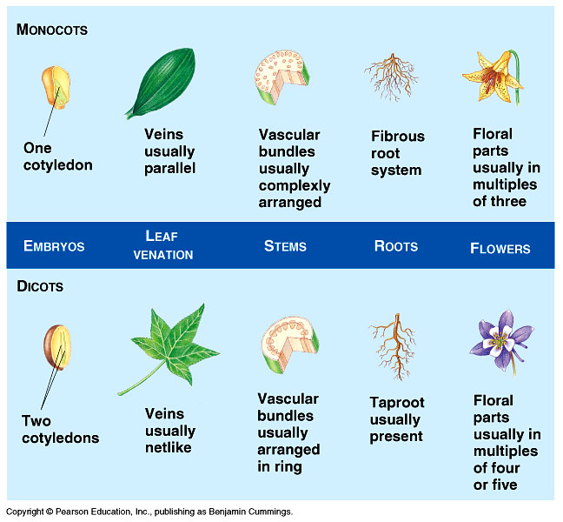
Monocots
Eudicots

Slide 24
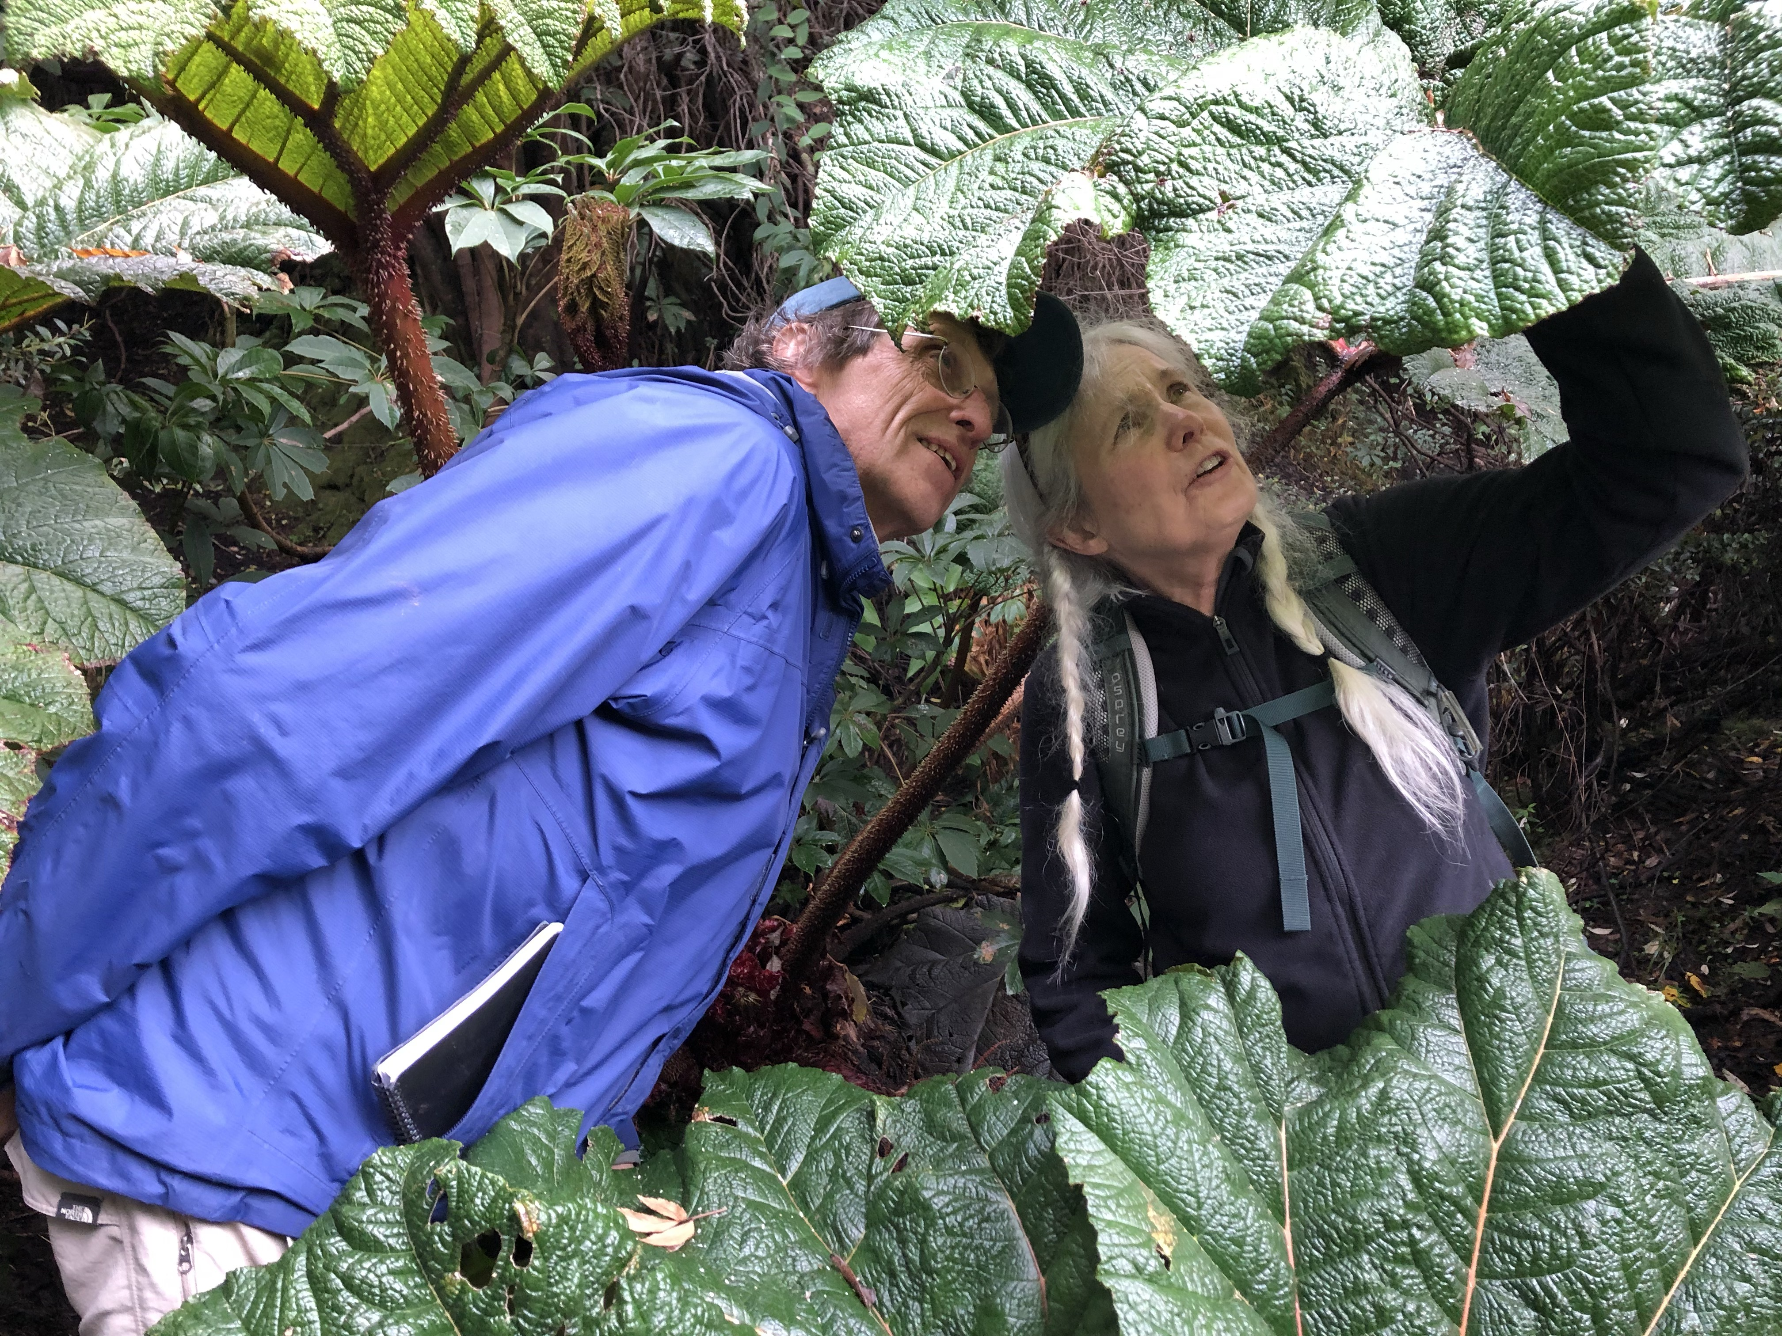
Paris and Barrington discover reticulate venation
in the leaves of Gunnera, Volcan Irazu, Costa Rica

Slide 25
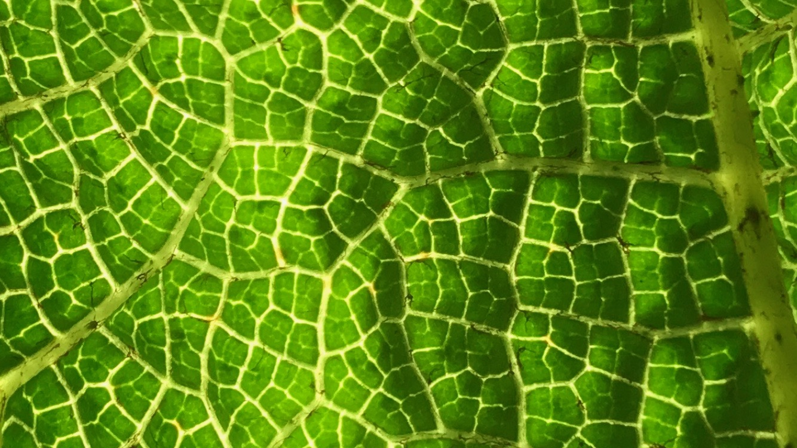
Reticulate venation with blind vein endings (eudicots)

Slide 26
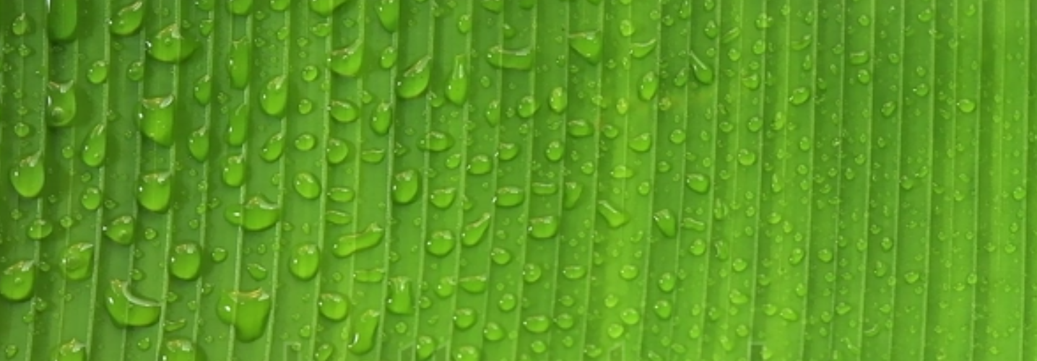
Parallel venation (monocots)
water droplets beading up on a banana leaf

Slide 27
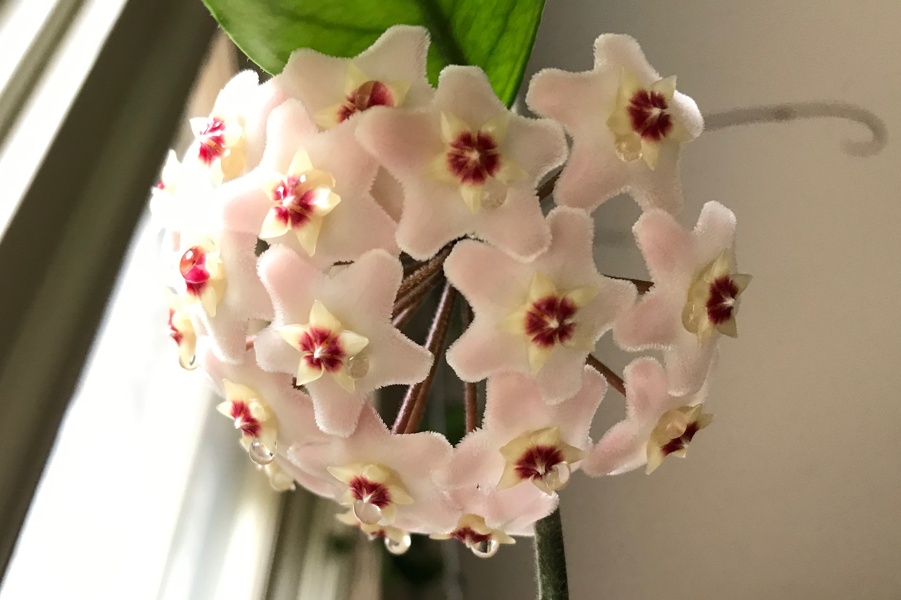
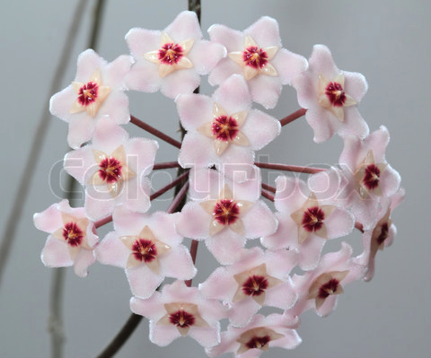

Slide 28
Outline
I. Introduction to the Angiosperms
II. Flower Structure
III. Flowering Plant Life Cycle
IV. Pollination
Polygaloides pauciflora, fringed polygala

Slide 30
Meiosis is a special type of cell division that results
in the halving of the chromosome number

Slide 32
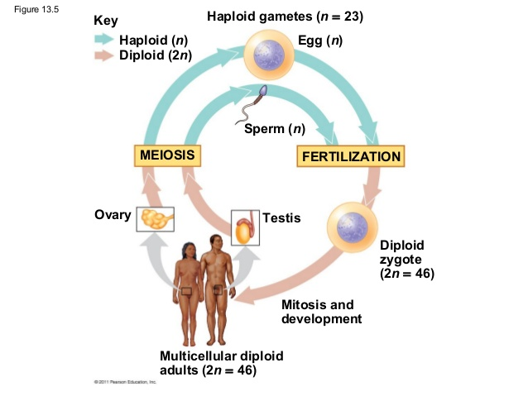
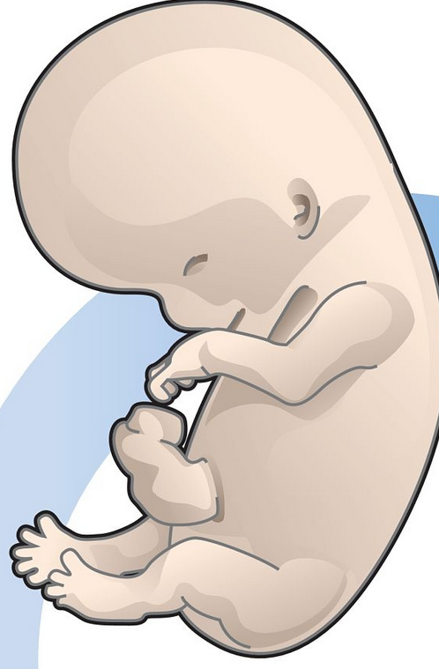
MEIOSIS
MITOSIS

Slide 33
Alternation of phases, the plant life cycle

Slide 34
Similarities Between Plant and Animal Life Cycles
In both kingdoms, meiosis and fertilization are the key life cycle events. Haploid gametes unite to form a diploid zygote.
In both kingdoms, the gamete and the zygote are single cells.

Slide 35
Key Differences Between Plant and Animal Life Cycles
In plants, the products of meiosis are spores, whereas in animals, the products of meiosis are gametes
Plants have a haploid gametophyte phase and animals don’t

Slide 36
The plant life cycle is characterized by alternation between a
diploid sporophyte phase and haploid gametophyte phase
MEIOSIS
Diploid: the Sporophyte Phase
MITOSIS
FERTILIZATION
MEIOSIS
Haploid: the Gametophyte
Phase

Slide 37
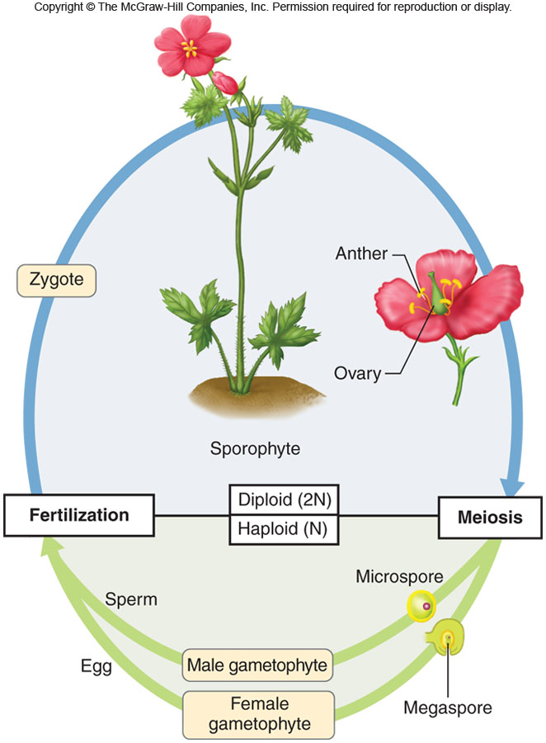
The Flowering Plant
Life Cycle
Notes:
lev70065_05_06.jpg

Slide 38
A flower is the reproductive structure of angiosperms
Pistil
Embryo sac
pollen is the male gametophyte
the embryo sac (within the ovule) is the female gametophyte

Slide 39
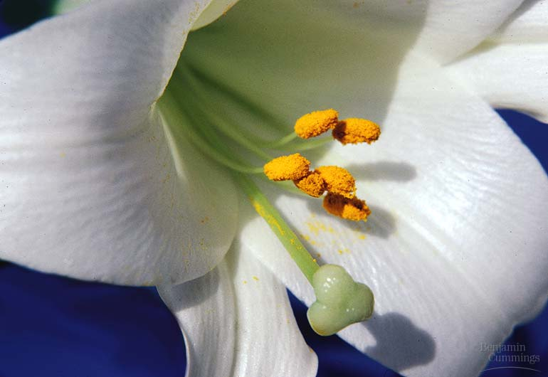
Figure 38.3ax2 Lily
The male gametophyte (pollen)

Slide 40
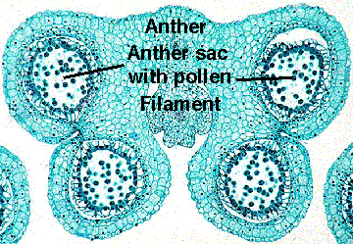
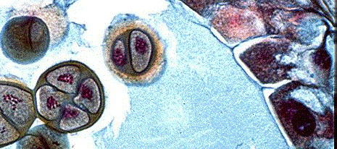
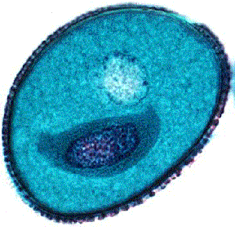
4 Microspores
A pollen grain con-
sists of two cells:
a generative cell
surrounded by a
tube cell
Tube Cell
Generative Cell
Dispersed Pollen Grain
Pollen Coat

Slide 41
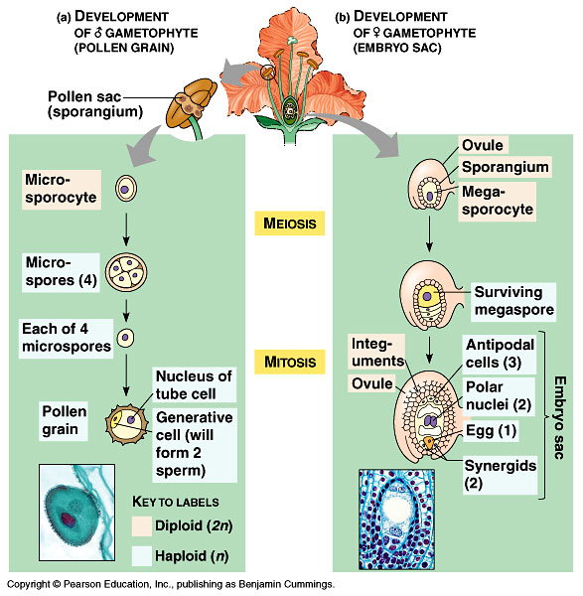
2-celled
pollen grain

Slide 42
Figure 38.5 Pollen grains have tough, ornate, and distinctive walls

Slide 43
Development of the female gametophyte (embryo sac)
lily ovary, x.s.

Slide 44
Cross Section of an Ovary
One ovule just before meiosis

Slide 45
7-celled
embryo sac

Slide 46
Double fertilization in the angiosperms
1
2
3
Stigma
Pollen grain
Pollen tube
Ovule
Endosperm
2 sperm
Polar nuclei
Style
Ovary
Egg
Zygote (2n)
Ovule
Polar nuclei
2 sperm
Seed coat (derived from integument)
Egg
Endosperm (food supply)
During the passage down the
style through the pollen tube,
the generative cell divides to
produce two sperm cells.
Food supply (female gametophyte tissue) (n)
pollen grain,
SEM
Zygote develops into the embryo
(c) Gymnosperm seed
Notes:
Figure 38.6 Growth of the pollen tube and double fertilization.

Slide 47
Pollen Tube
Germination
and Growth

Slide 48
Double fertilization in the angiosperms
1
2
3
Stigma
Pollen grain
Pollen tube
Ovule
Endosperm
2 sperm
Polar nuclei
Style
Ovary
Egg
Zygote (2n)
Ovule
Polar nuclei
2 sperm
Seed coat (derived from integument)
Egg
Endosperm (food supply)
Food supply (female gametophyte tissue) (n)
Zygote develops into the embryo
(c) Gymnosperm seed
Notes:
Figure 38.6 Growth of the pollen tube and double fertilization.

Slide 49
Double fertilization in the angiosperms
1
2
3
Stigma
Pollen grain
Pollen tube
Ovule
Endosperm
(3n)
2 sperm
Polar nuclei
Style
Ovary
Egg
Zygote (2n)
Ovule
Polar nuclei
2 sperm
Egg
Notes:
Figure 38.6 Growth of the pollen tube and double fertilization.

Slide 50
Double fertilization in the angiosperms
(in
central cell)
cell

Slide 51
Life cycle of the orange lily
Anther
Sporophyte (2n)
MEIOSIS
Microspore (n)
Generative cell
Tube cell
Pollen
grains
Key
Haploid (n)
Diploid (2n)
Notes:
51
Figure 30.10 The life cycle of an angiosperm.

Slide 52
Life cycle of the orange lily
Anther
Sporophyte (2n)
MEIOSIS
Microspore (n)
Ovule (2n)
Generative cell
Male
gametophyte
(in pollen
grain) (n)
Tube cell
Ovary
Pollen
grains
MEIOSIS
Megaspore
(n)
Female
gametophyte
(ovule)
(Embryo sac)
Egg (n)
Key
Haploid (n)
Diploid (2n)
Notes:
52
Figure 30.10 The life cycle of an angiosperm.

Slide 53
Life cycle of the orange lily
Anther
Sporophyte (2n)
MEIOSIS
Microspore (n)
Ovule (2n)
Generative cell
Male
gametophyte
(in pollen
grain) (n)
Tube cell
Ovary
Pollen
grains
MEIOSIS
Stigma
Pollen
tube
Sperm
Megaspore
(n)
Female
gametophyte
(ovule)
Style
(Embryo sac)
Pollen
tube
Egg (n)
Egg
nucleus (n)
Sperm
(n)
FERTILIZATION
Key
Haploid (n)
Diploid (2n)
Discharged sperm nuclei (n)
Notes:
53
Figure 30.10 The life cycle of an angiosperm.

Slide 54
Life cycle of the orange lily
Anther
Sporophyte (2n)
MEIOSIS
Microspore (n)
Ovule (2n)
Generative cell
Male
gametophyte
(in pollen
grain) (n)
Tube cell
Germinating
seed
Ovary
Pollen
grains
MEIOSIS
Stigma
Embryo (2n)
Pollen
tube
Sperm
Endosperm (3n)
Seed
Megaspore
(n)
Seed coat (2n)
Female
gametophyte
(ovule)
Style
(Embryo sac)
Pollen
tube
Endosperm
(3n)
Egg (n)
Egg
nucleus (n)
Sperm
(n)
Zygote (2n)
FERTILIZATION
Key
Haploid (n)
Diploid (2n)
Discharged sperm nuclei (n)
Notes:
54
Figure 30.10 The life cycle of an angiosperm.

Slide 55
After pollination and fertilization, ovaries ripen to become fruits;
ovules ripen to become seeds
Notes:
Begin here on December 8

Slide 57
Flowering plant reproduction differs from the rest of the seed plants
Double fertilization leads to the development of a food source (endosperm) to nourish the embryo
Seeds are enclosed in fruits, which afford protection and facilitate dispersal.
In many species pollen is moved by faithful animal pollinators.

Slide 58
Outline
I. Introduction to the Angiosperms
II. Flower Structure
III. Flowering Plant Life Cycle
IV. Pollination
Polygaloides pauciflora, fringed polygala

Slide 59
Pollination: the Transfer of Pollen to the Stigma

Slide 60
Pollination is an example of a mutualism
Cacao flowers
To produce the fruits that are used to make chocolate, flowers must first be pollinated by midges.
Fruits (pods) of the chocolate tree
(Theobroma cacao)

Slide 61
Plants provide …
Hummingbird sipping nectar
Pollen (protein and lipids)
Nectar (water, sugar, amino acids)
Oils (lipids, anti-fungal agent)
pollen
Resin-gathering bee

Slide 62
… and animals provide efficient dispersal of pollen
Monarch butterfly and milkweed

Slide 63
Animal pollinators also move pollen between genetically different
individuals of the same species, thereby promoting outcrossing

Slide 64
Animals Also Play a Major Role in the Dispersal of Fruits and Seeds
Eurasian blackbird and mountain ash

Slide 65
In wind-pollinated plants like conifers, a huge number of
pollen grains are produced for every ovule.
Animal pollinators provide flowering plants
with a huge advantage!

