Slide 1
Plant Life Cycle: Fruits and Seeds
Chapter 6
PBIO 006
Fall 2021

Slide 2
Outline
I. Fruit Types
II. Fruit Dispersal
III. Seed Structure and Germination

Slide 3
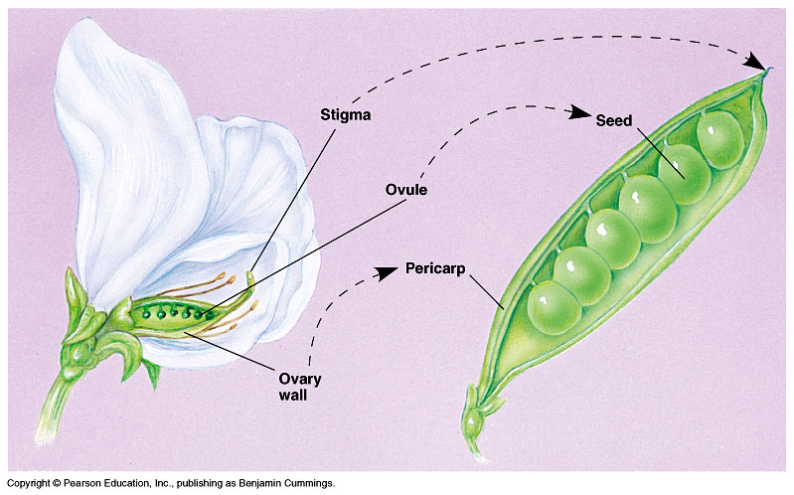
Fruits

Slide 5
Fruit Types
Simple Fruits
Fleshy
Dry
Dehiscent
Indehiscent
Accessory Fruits
Aggregate Fruits
Multiple Fruits

Slide 6
Simple Fruits
pericarp = fruit wall
A simple fruit develops from a single ovary of a single flower.

Slide 7
Fleshy fruits Fleshy fruits are indehiscent (which is to say they don’t open up to release their seeds)

Slide 8
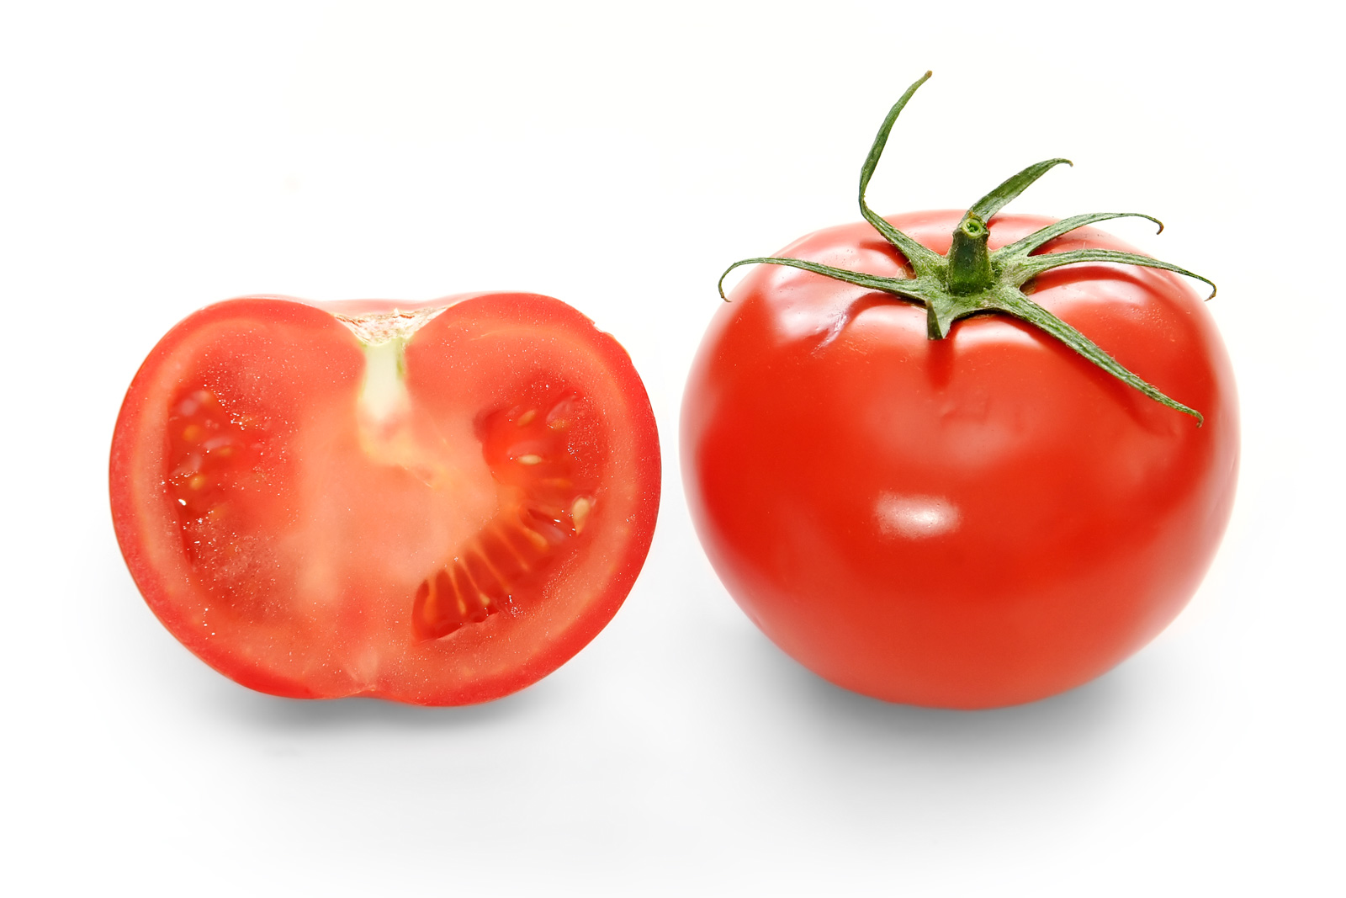
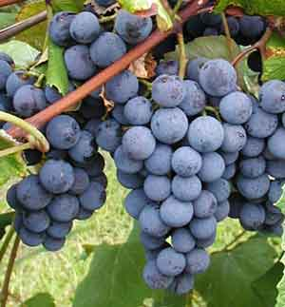
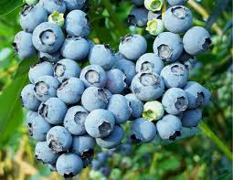
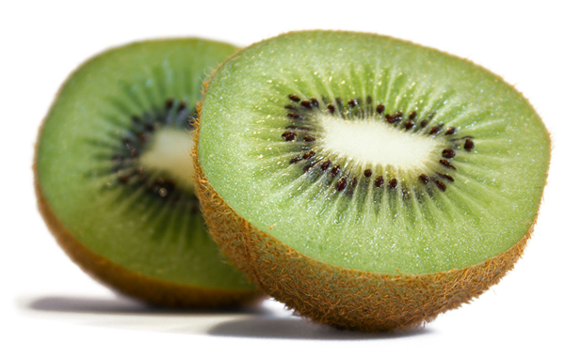
Berry: the entire pericarp is soft
Grapes
Tomato
www.ecigexpress.com
Blueberry
Kiwifruit

Slide 9
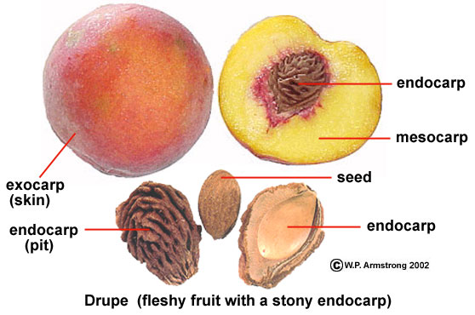
Drupe: the pericarp is divided into three layers
Peach, Prunus persica

Slide 10
Dry dehiscent fruits

Slide 11
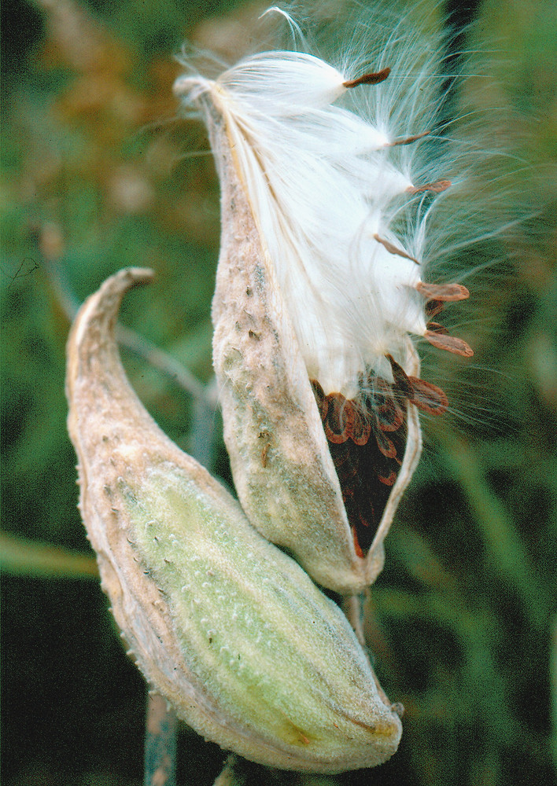
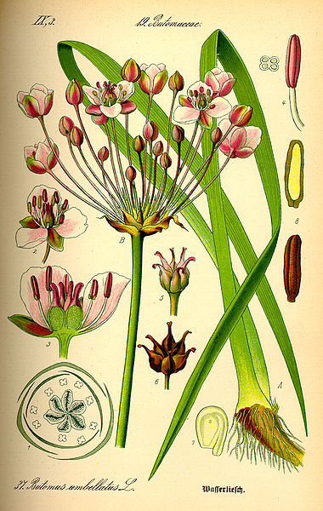
Follicle: a dry, dehiscent fruit from a simple pistil
A follicle is a dry fruit that splits open
to release its seeds (it’s dehiscent).
milkweed fruit
fruit, flowering rush

Slide 12
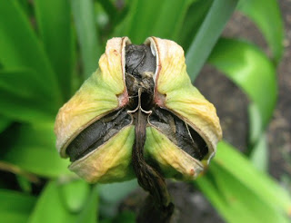
lily fruit
Capsule: a dry, dehiscent fruit from a compound pistil

Slide 13
Dry indehiscent fruits

Slide 14
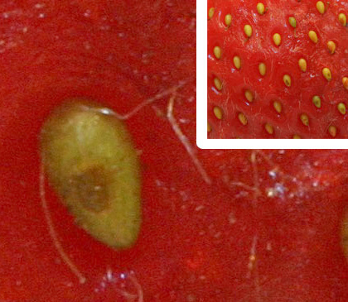
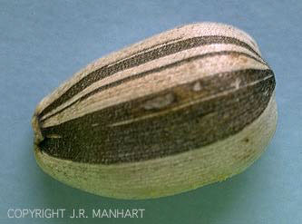
Achene: a dry, indehiscent, single-seeded fruit
sunflower
strawberry

Slide 15
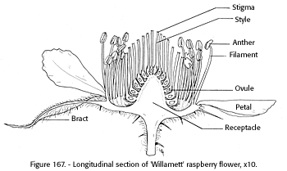
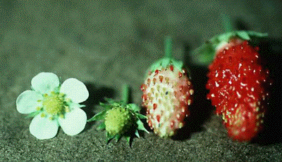
Accessory fruit
strawberry achene
The strawberry is an accessory fruit: the sweet, juicy part is receptacle, not ovary wall! The true fruit part is the achene.

Slide 16
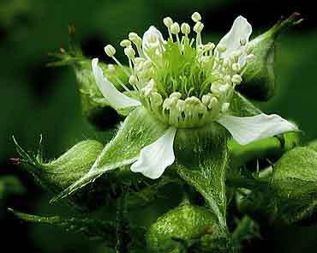
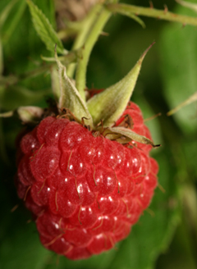
Aggregate fruit
A raspberry is an aggregate fruit: each little “drupelet” is the product of a separate ovary. Each drupelet contains a single seed.

Slide 17
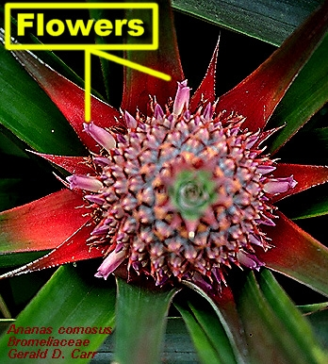
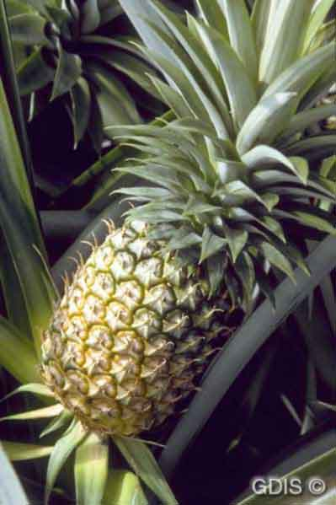
Multiple fruit
The pineapple is an example of a multiple fruit: the fruit is derived from the fusion of an entire inflorescence.

Slide 18
Fruit Structure is determined by two things:
The structure of the pistil(s) from which it formed

Slide 19
Fruit Dispersal
Eurasian blackbird, Turdus merula

Slide 20
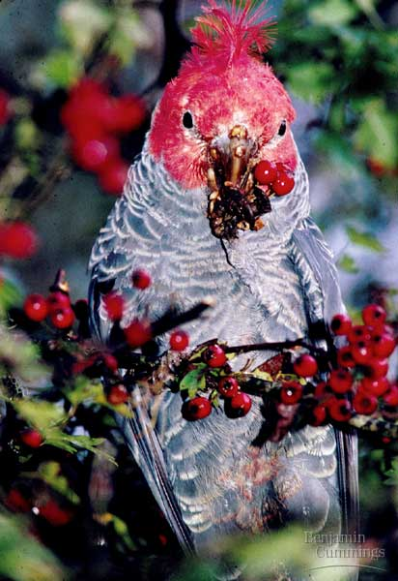
Fleshy fruits are dispersed by birds and other frugivorous animals.

Slide 21
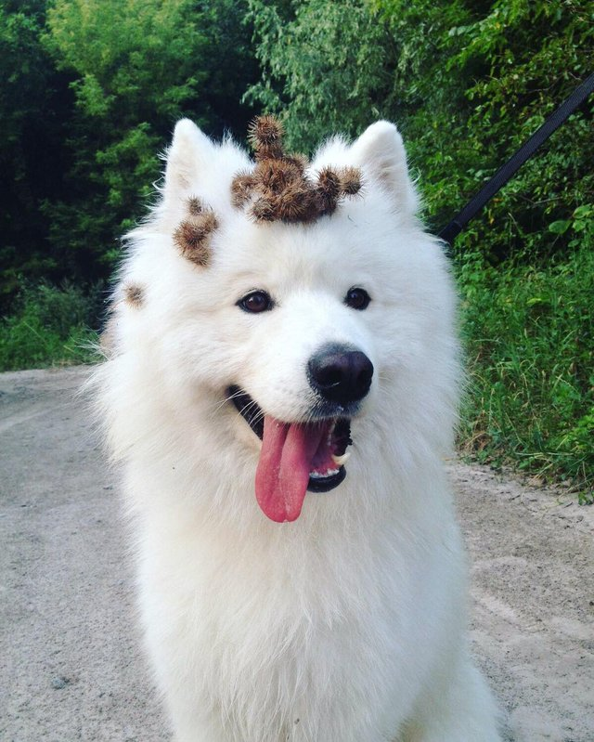
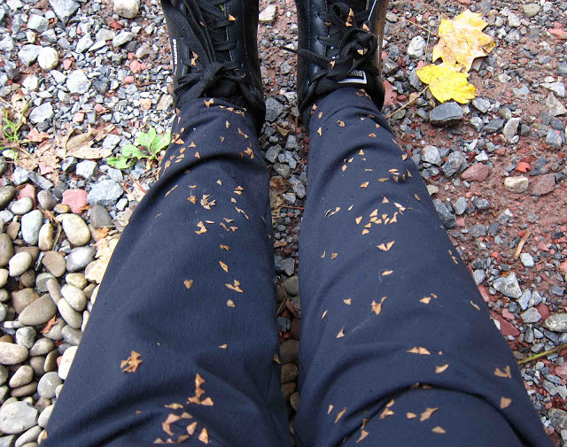
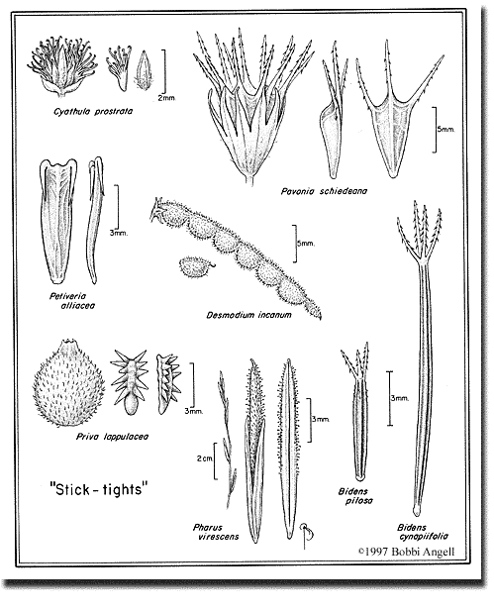
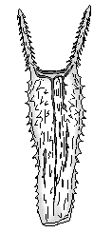
Some fruits are designed
to be dispersed by
unwitting animals

Slide 22
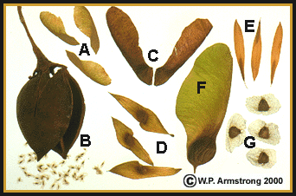
Winged fruits are dispersed by the wind

Slide 23
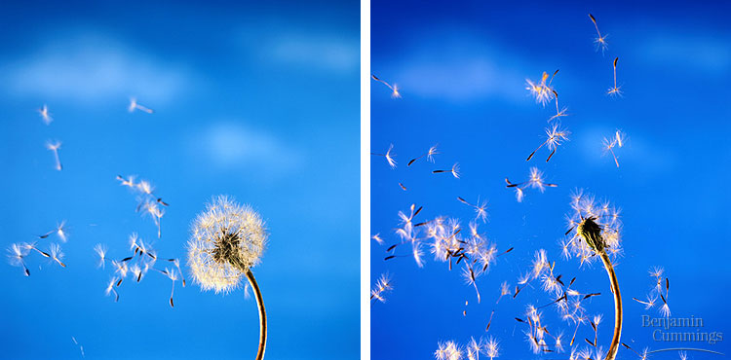
So are the fruits of dandelions

Slide 24
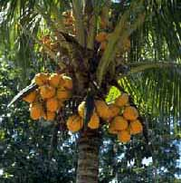
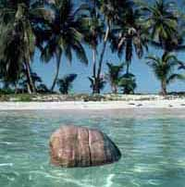
Coconuts are dispersed by water

Slide 25
Fruit Structure is determined by two things:
The structure of the pistil(s) from which it formed.
Adaptations for dispersal of the fruit and the seeds.

Slide 26
Outline
I. Fruit Types
II. Fruit Dispersal
III. Seed Structure and Germination

Slide 27
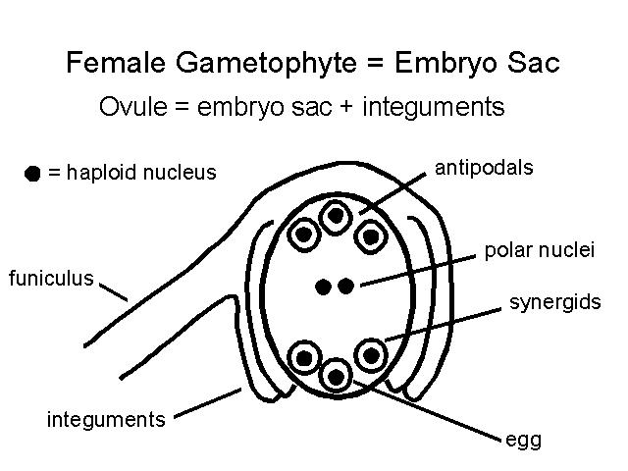
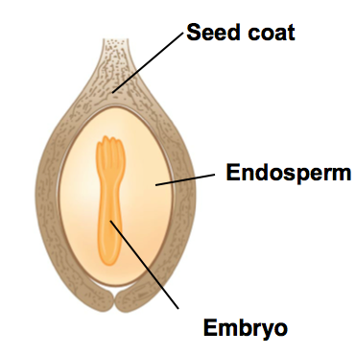
Double fertilization in the angiosperms
(in
central cell)
cell

Slide 28
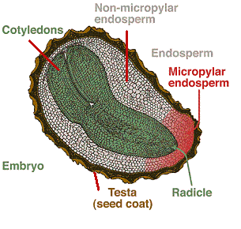
Seed Structure

Slide 29
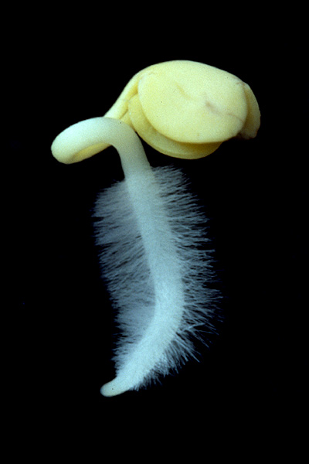
S
E
E
D
G
E
R
M
I
N
A
T
I
O
N
cotyledons
hypocotyl
epicotyl
(not visible)
radicle
Eudicot embryo

Slide 30
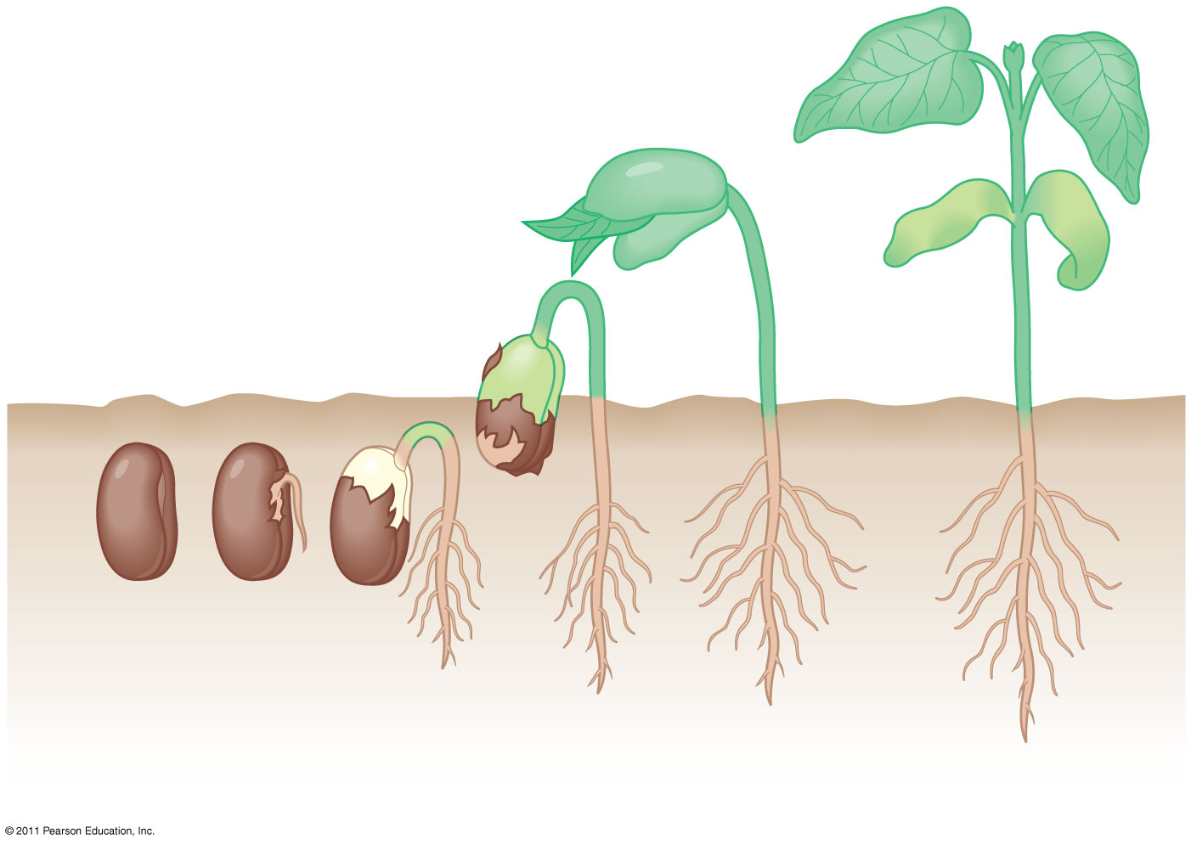
Foliage leaves
Cotyledon
Cotyledon
Cotyledon
Radicle
Seed coat
Seed germination in the common garden bean, a eudicot

Slide 31
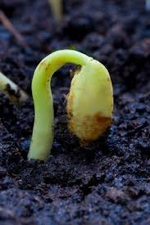
The sturdy seedling with arched body comes
Shouldering its way and shedding earth crumbs.
Robert Frost
Putting in the Seed

