Slide 1
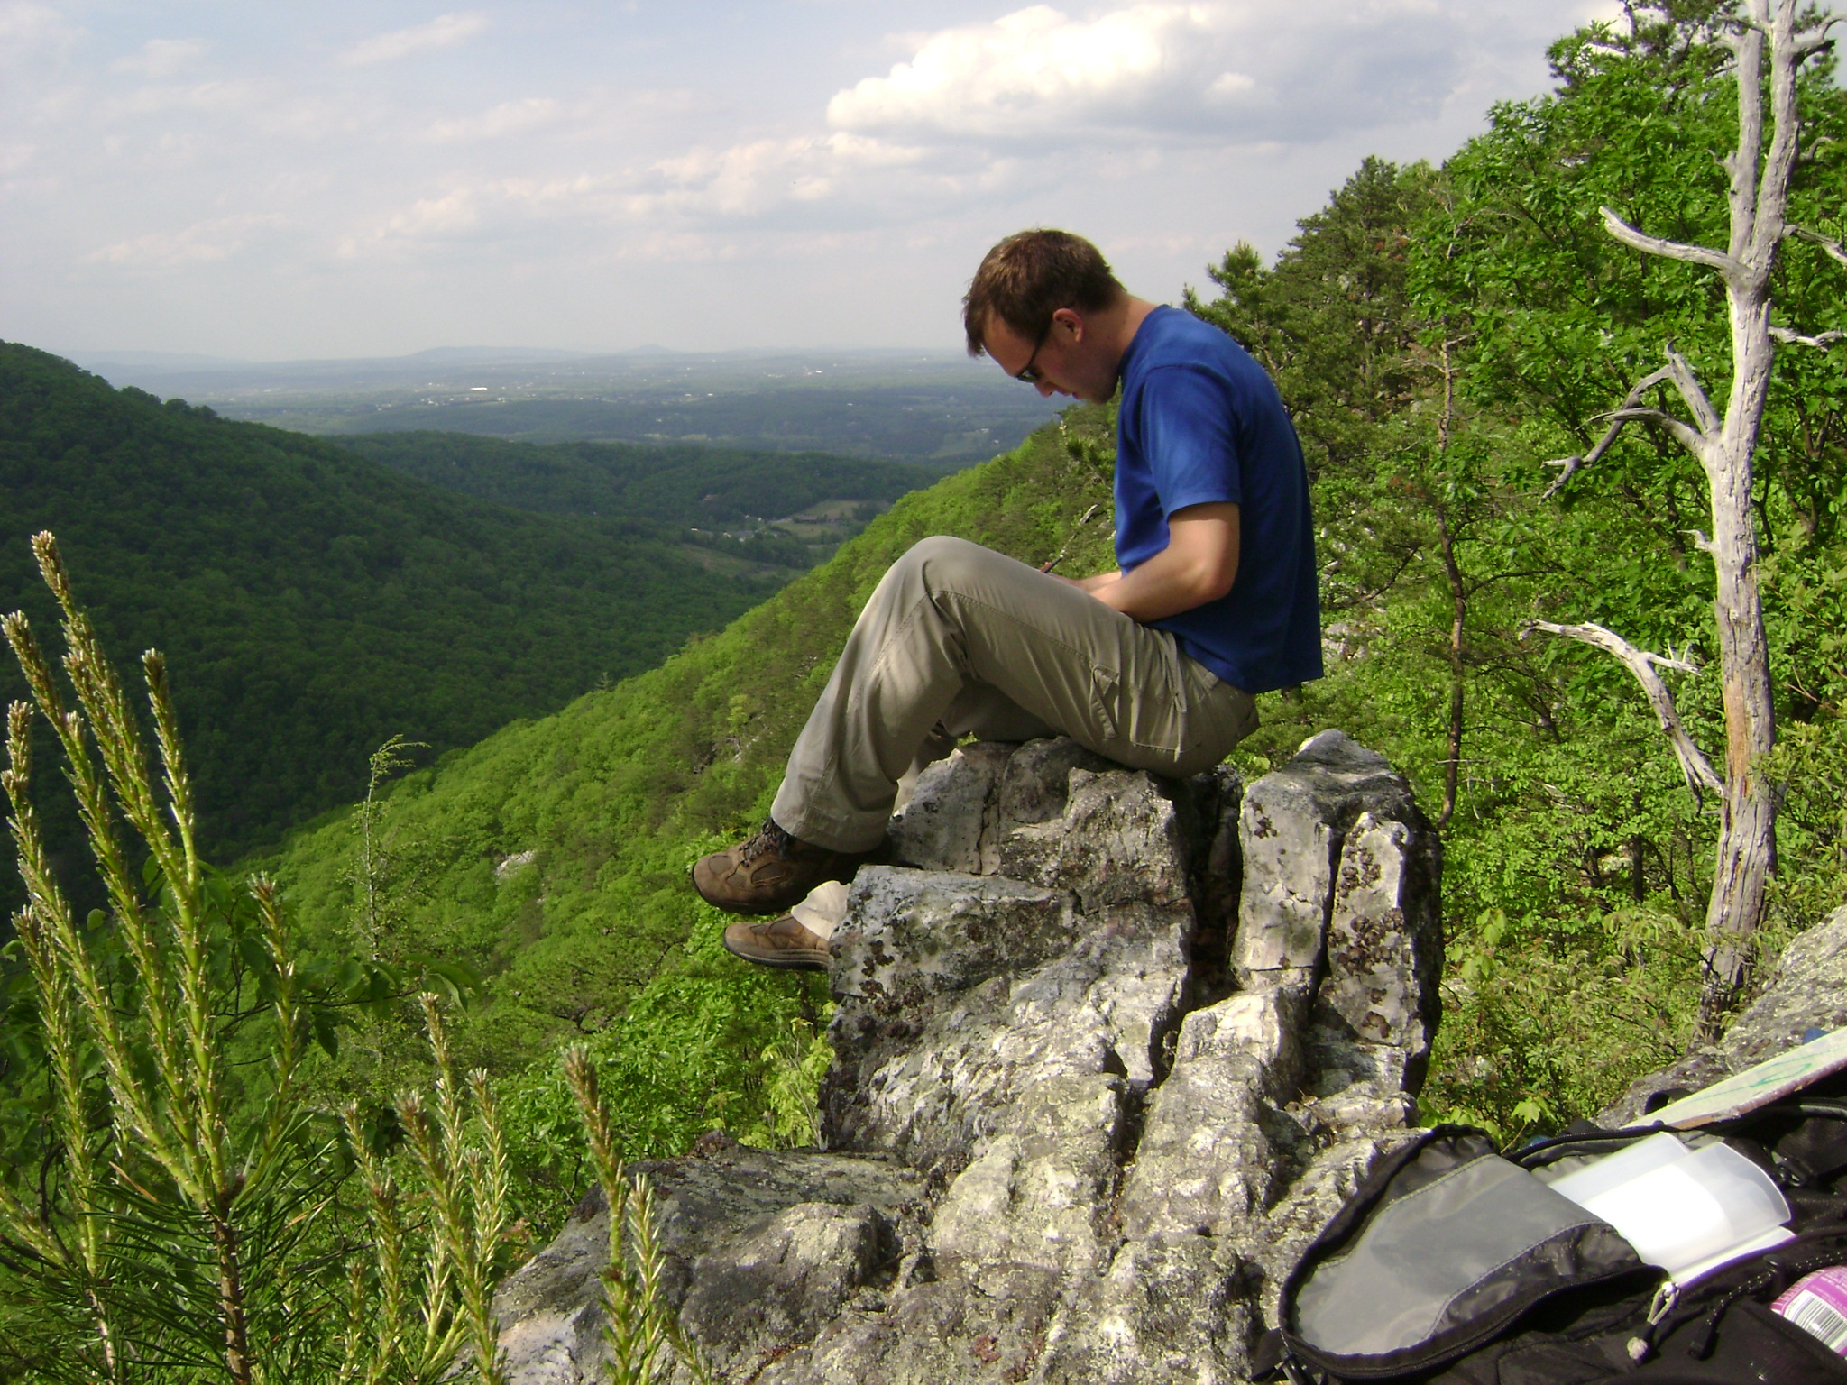
Using ¹⁰Be to constrain erosion rates of bedrock outcrops globally and in the central Appalachian Mountains
A Thesis Presentation by
Eric W. Portenga

Slide 2
Outline of Talk
Thesis Objectives
¹⁰Be Background
Appalachian Outcrop Study
Global Erosion Rate Compilations
Appalachians and Global Comparison
Conclusions

Slide 3
Thesis Objectives
Measure erosion rates of bedrock outcrops along ridgelines in the central Appalachian Mountains
Create global database of erosion rates to create a context to which central Appalachian rates can be compared
Determine what factors exert control over erosion rates
Compare outcrop erosion rates to rates determined through other methods

Slide 4
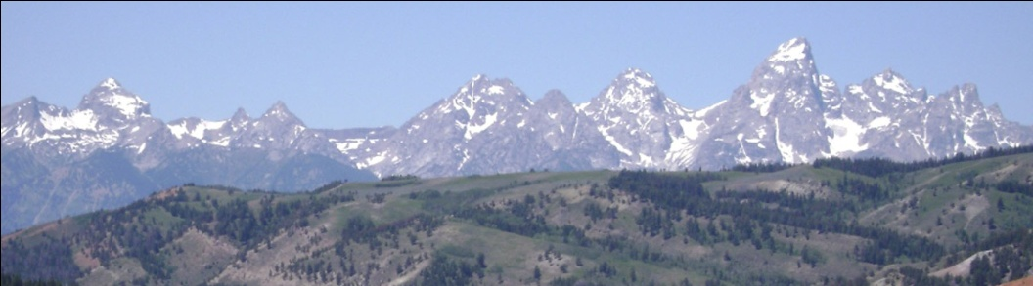
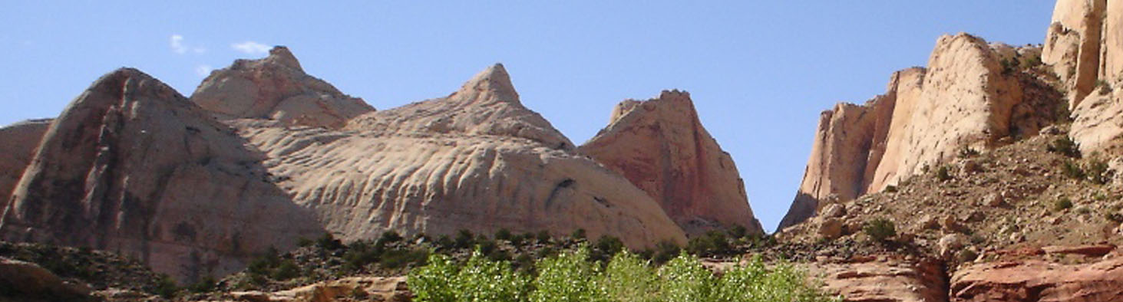
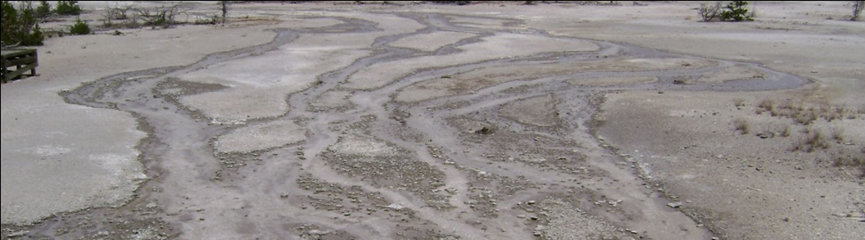
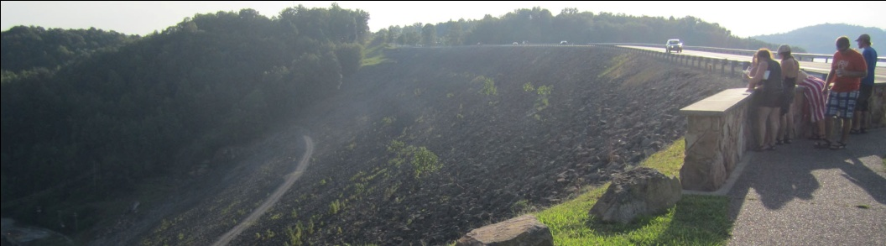

The “Why?” Factor – Outcrop Erosion
Backbones of mountain ranges and dominant landscape features
Little is known about outcrop erosion rates; data is under-represented in literature
One of the many sources from which sediment is produced
Sets the pace of pre-human landscape change to evaluate our impacts on environment
Weathering of silicates acts as a sink in the carbon cycle – climate change implications

Slide 5
Why Use ¹⁰Be?
Other methods of measuring erosion rates incorporate often-violated assumptions
  Sediment Yield: Short-term measurements are indicative of long-term rates
  Humans have little impact on the modern sedimentation rate
Long-term denudation methods are not appropriate for more recent timescales
  Fission-track thermochronology
  (U-Th)/He methods
Kirchner et al., 2001
Trimble, 1977

Slide 6
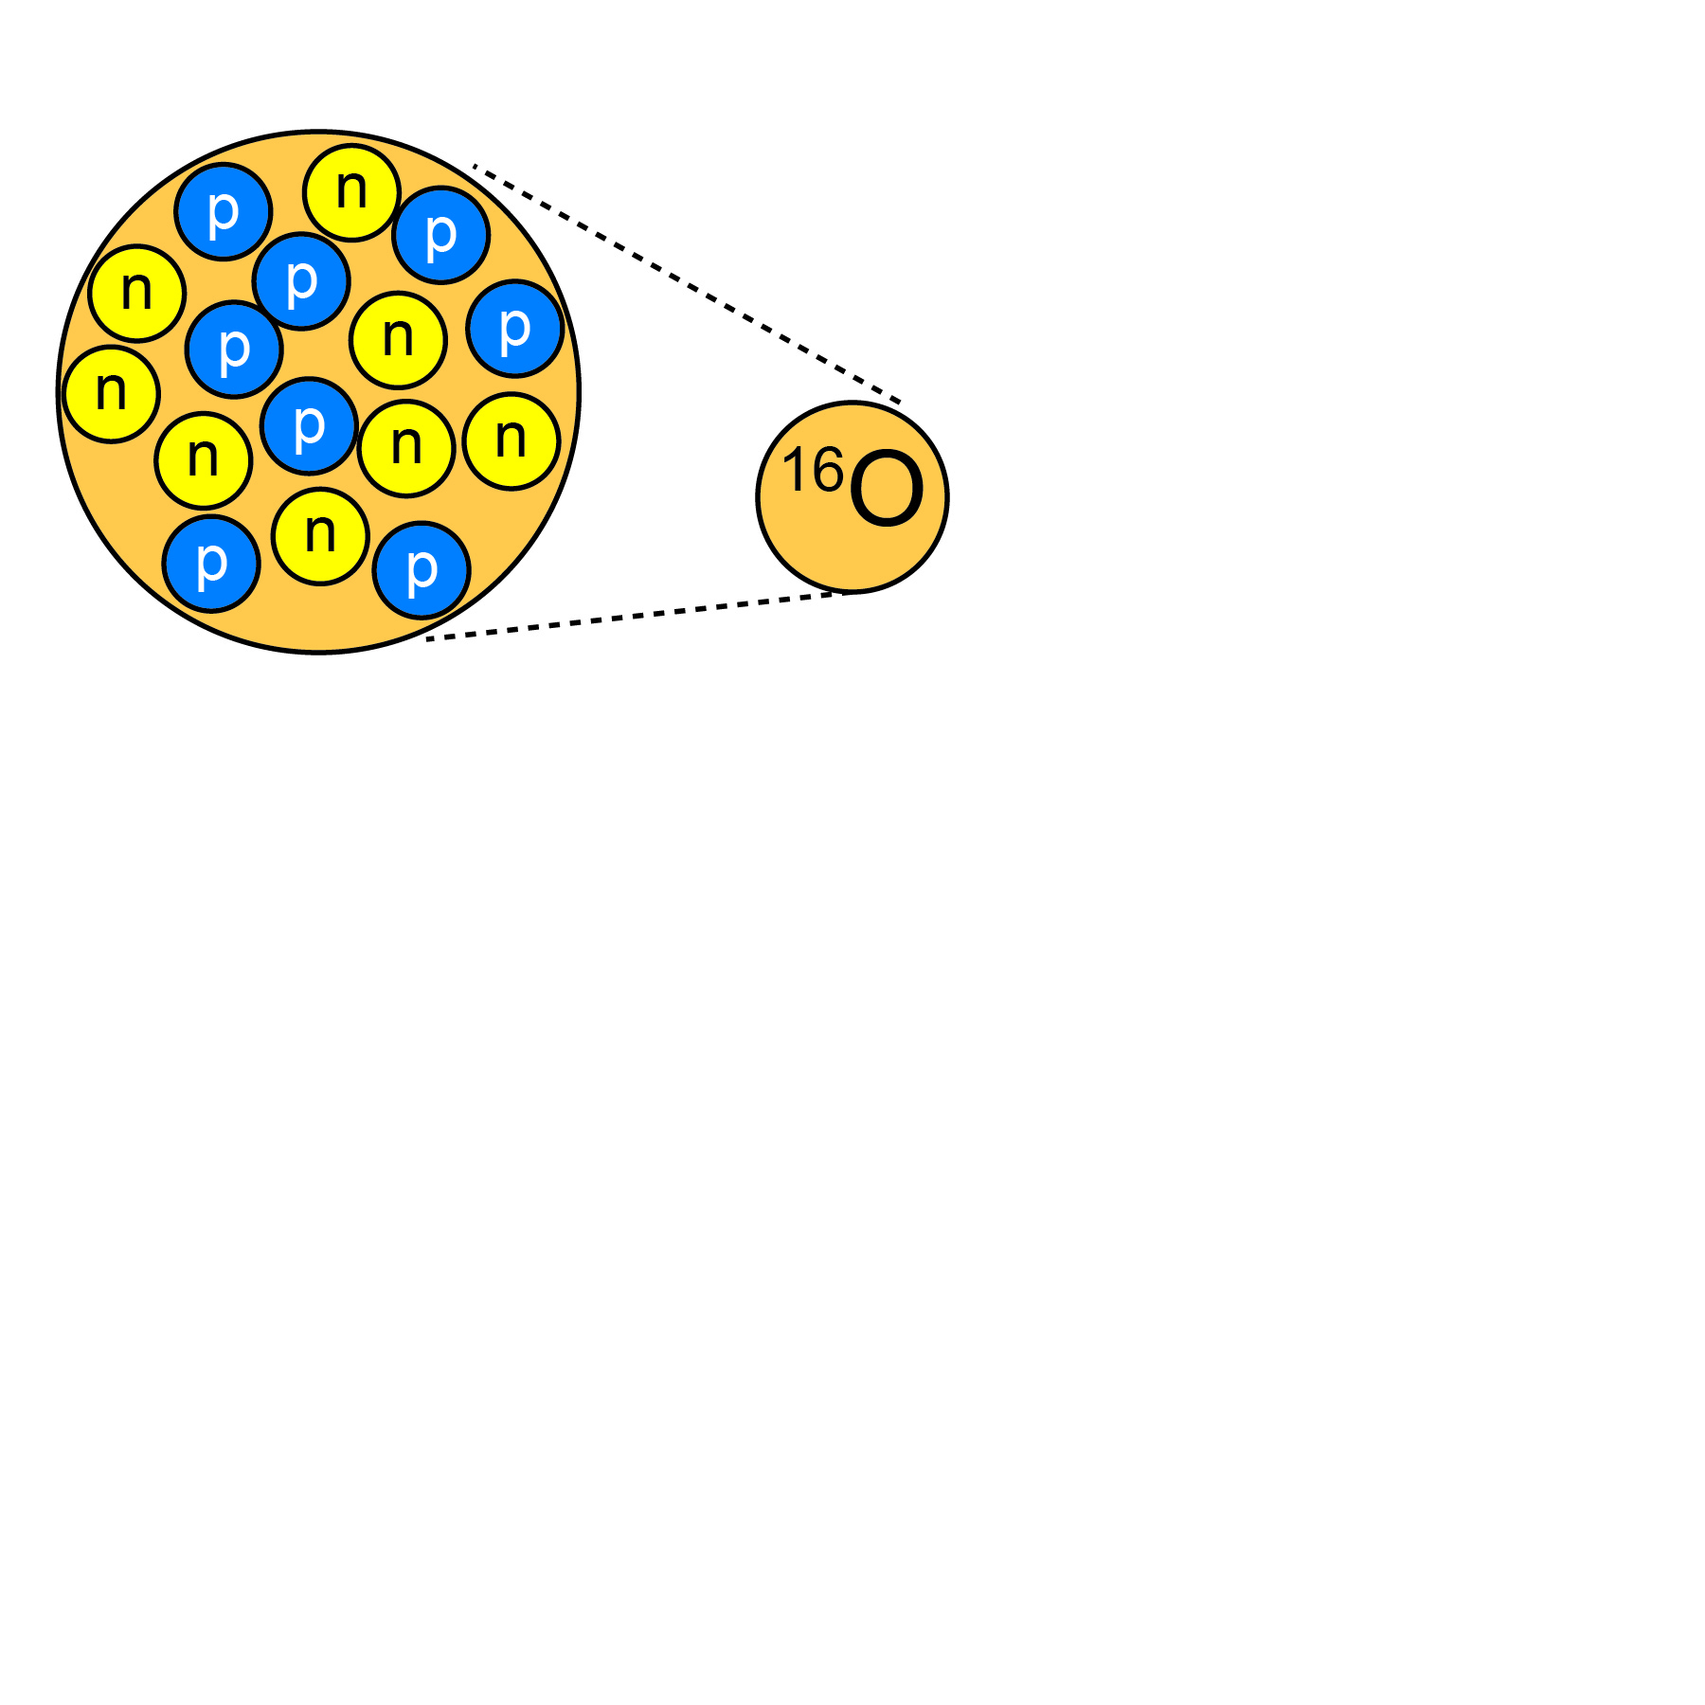
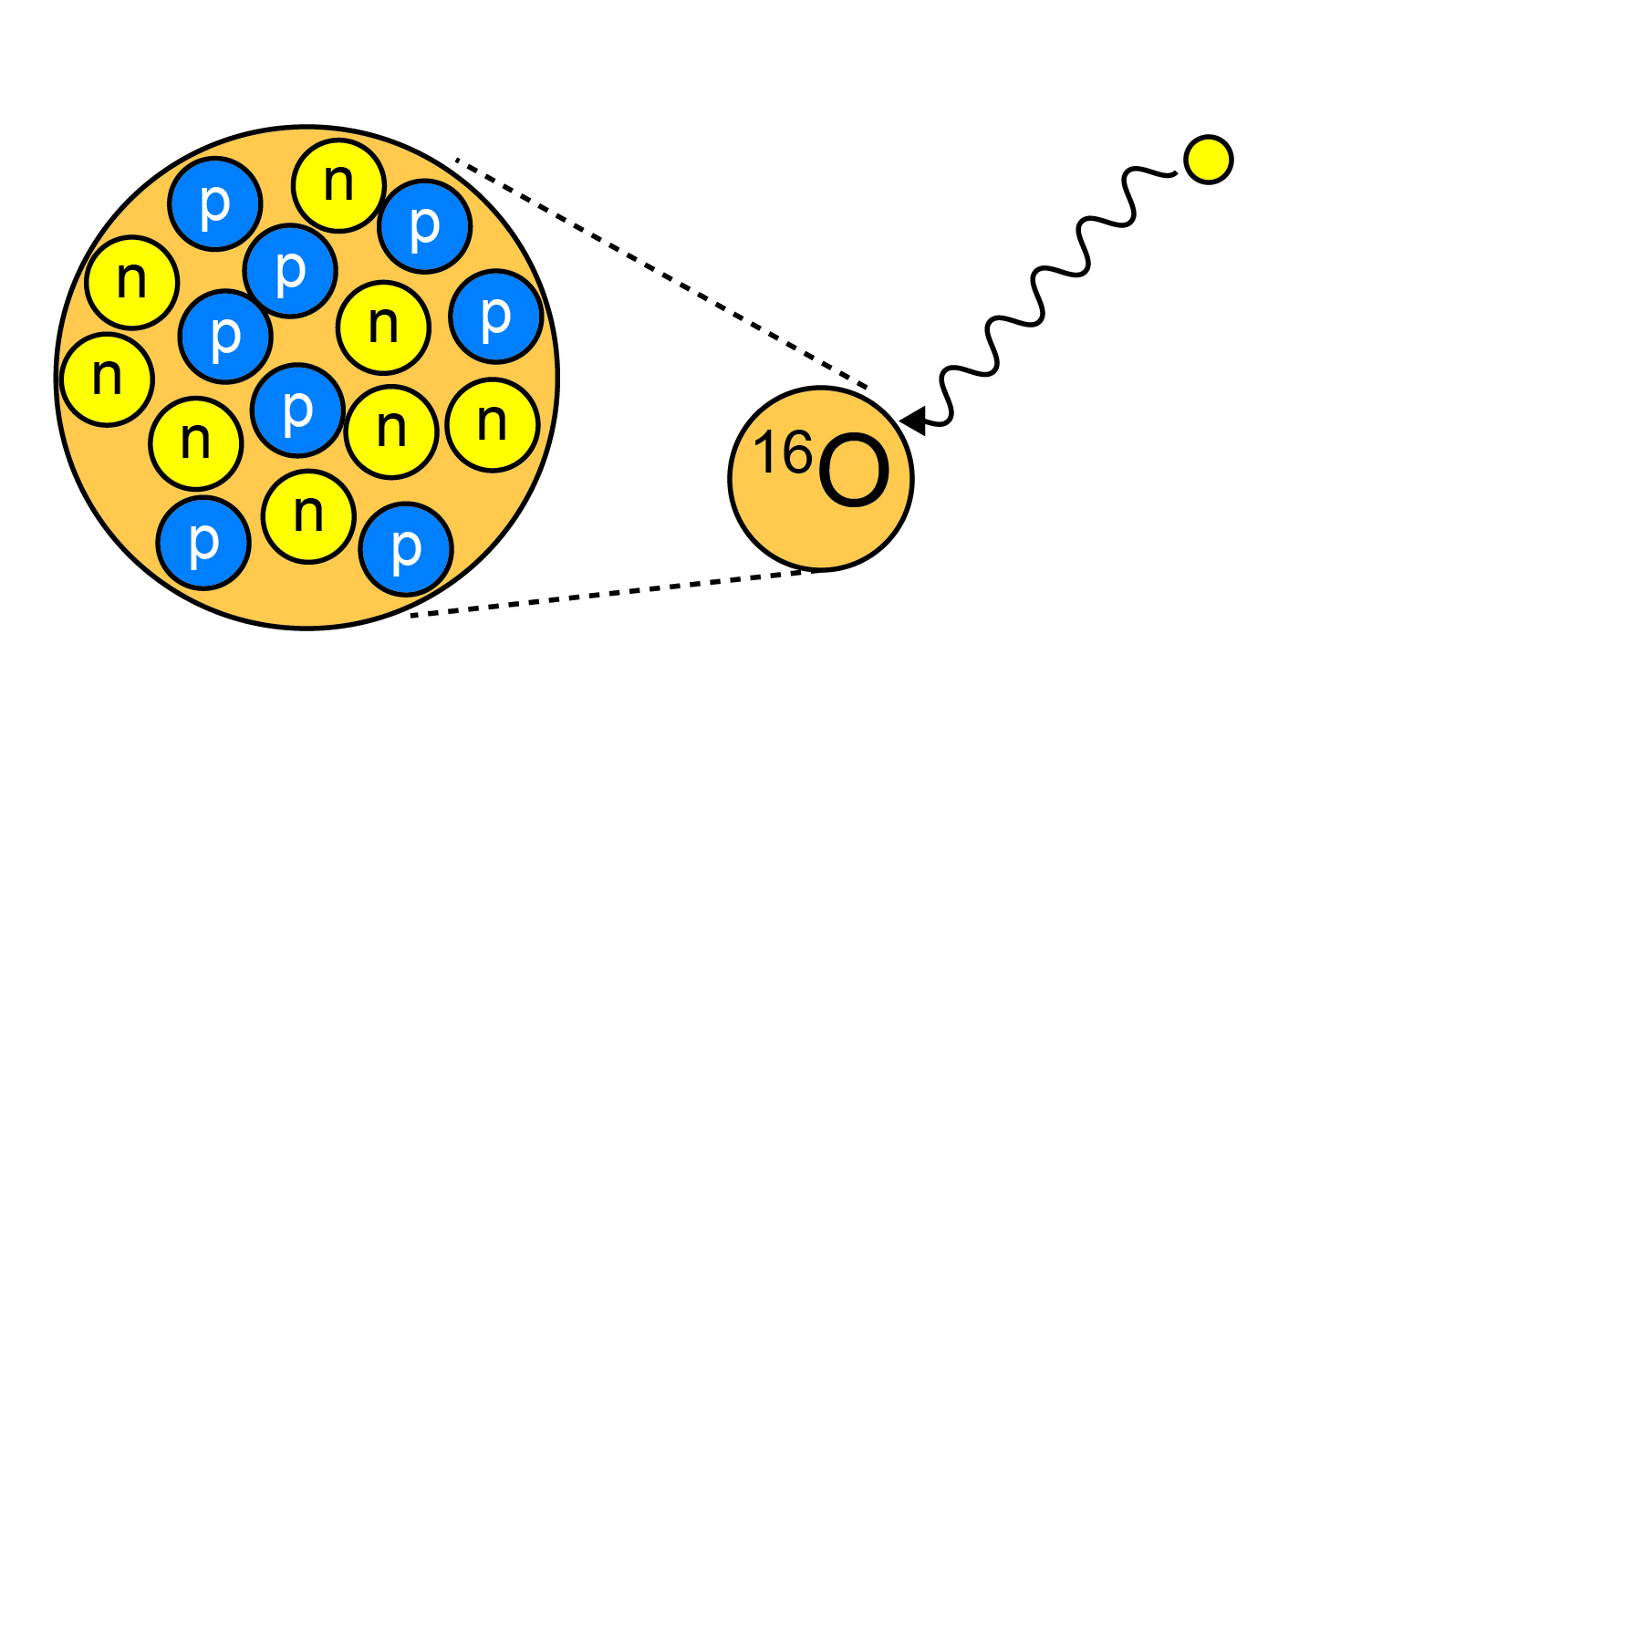
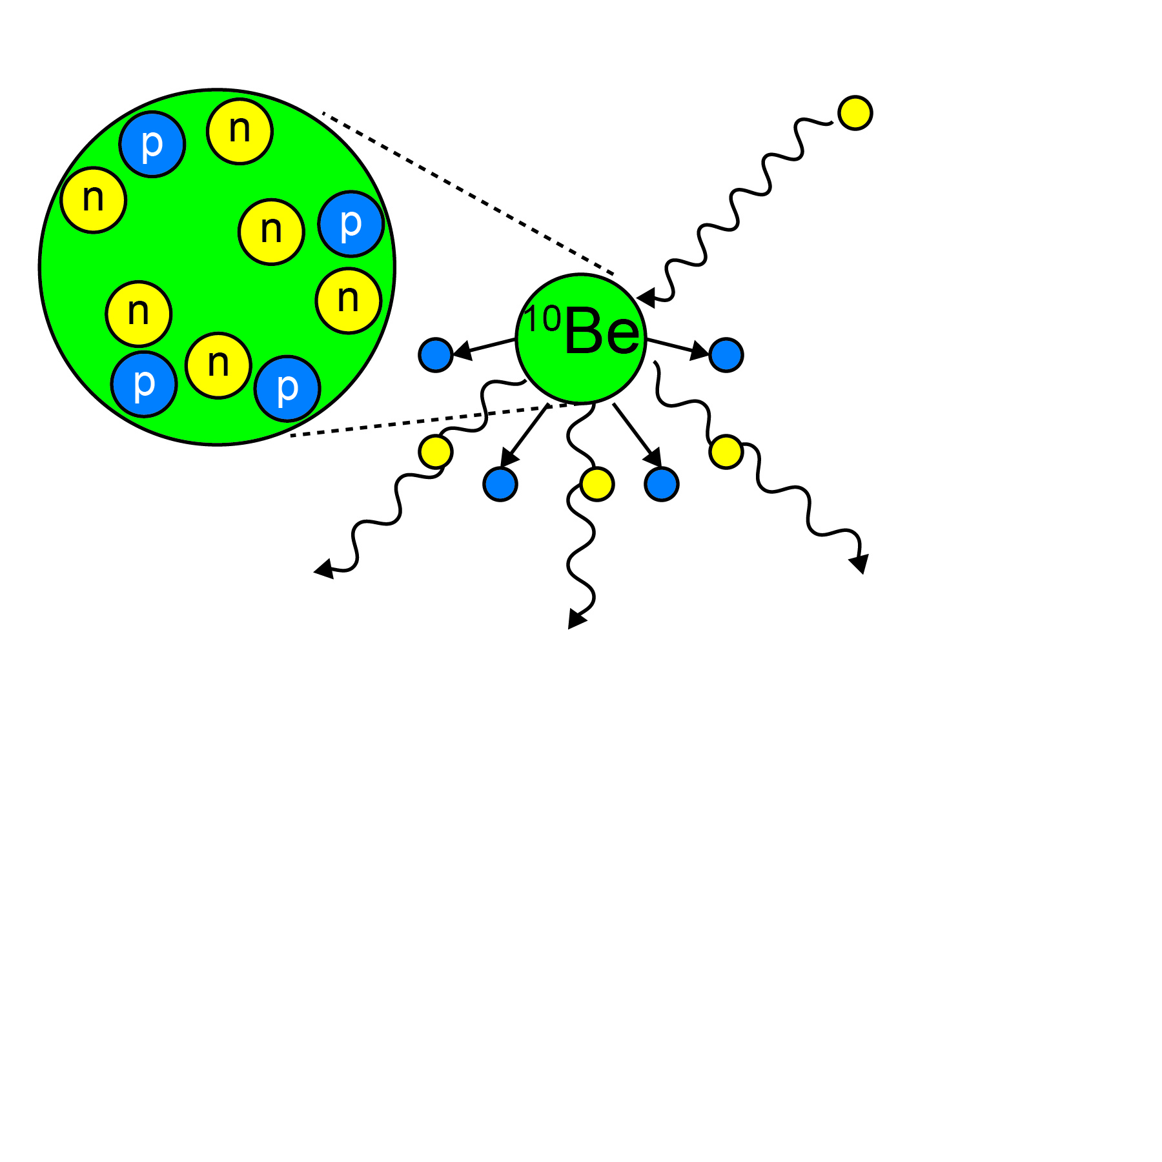
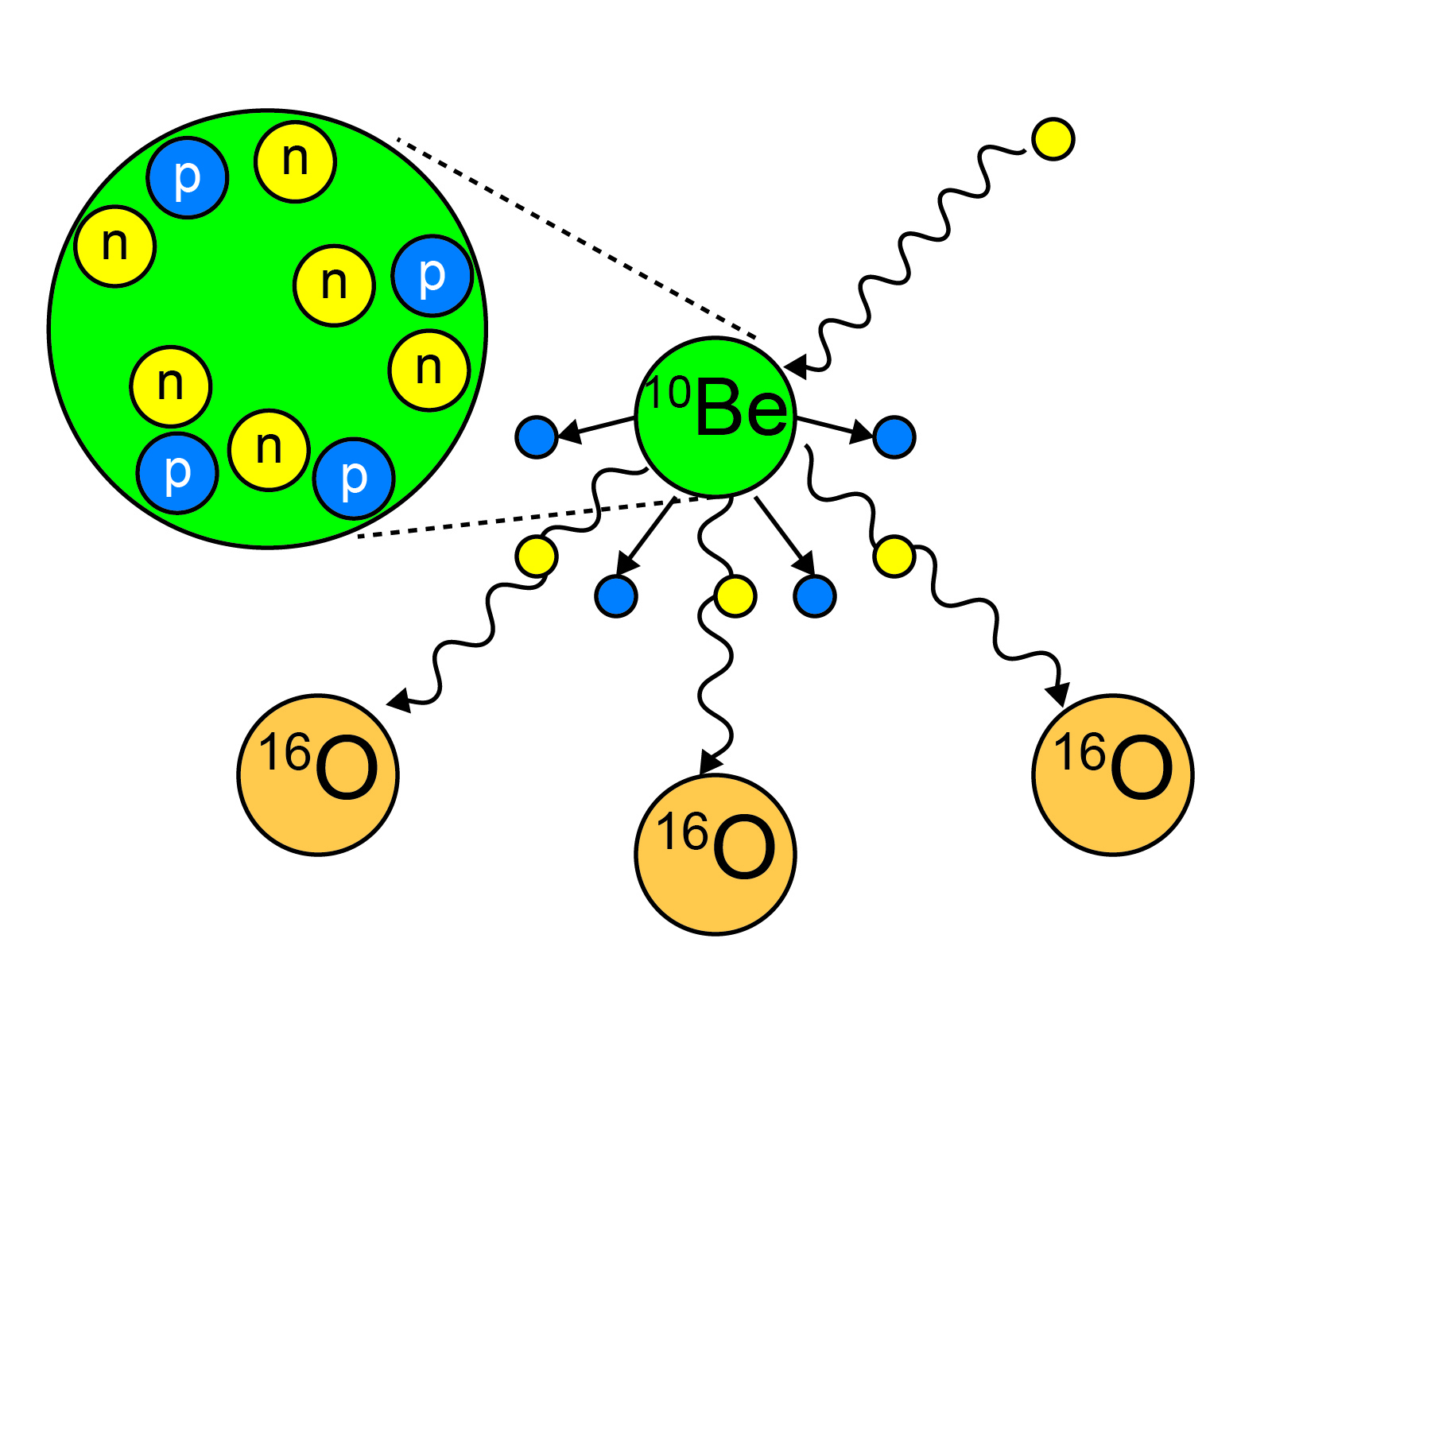
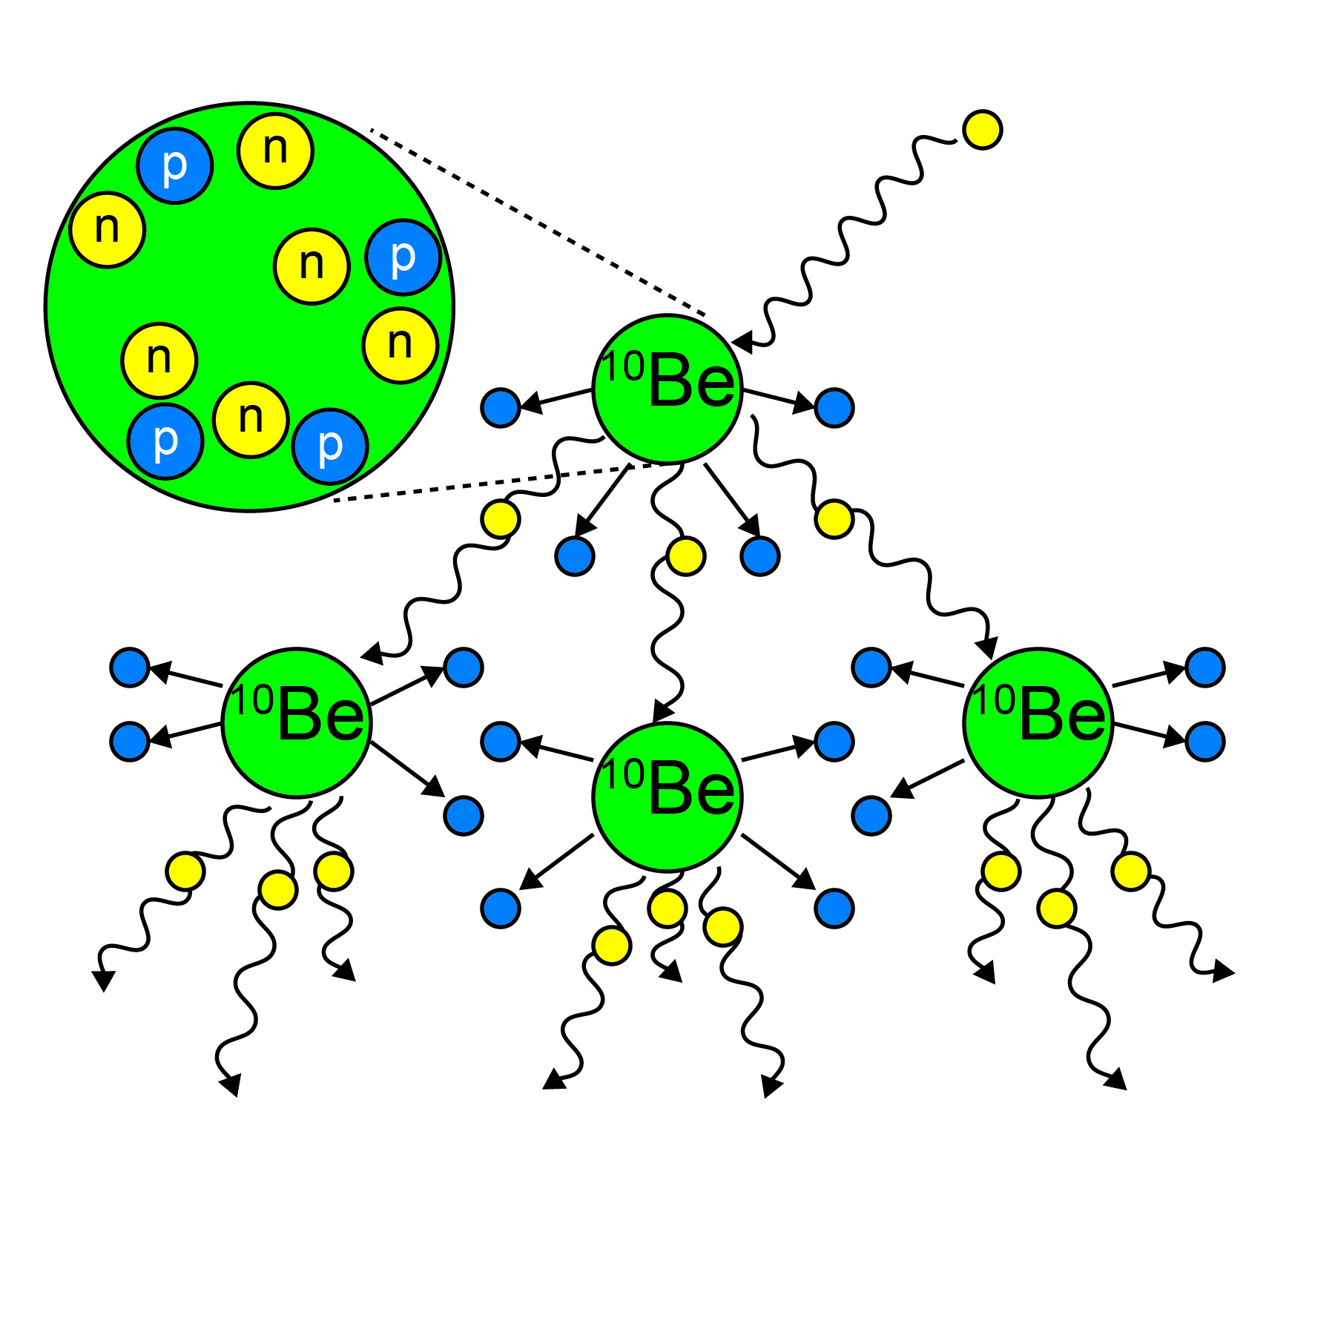
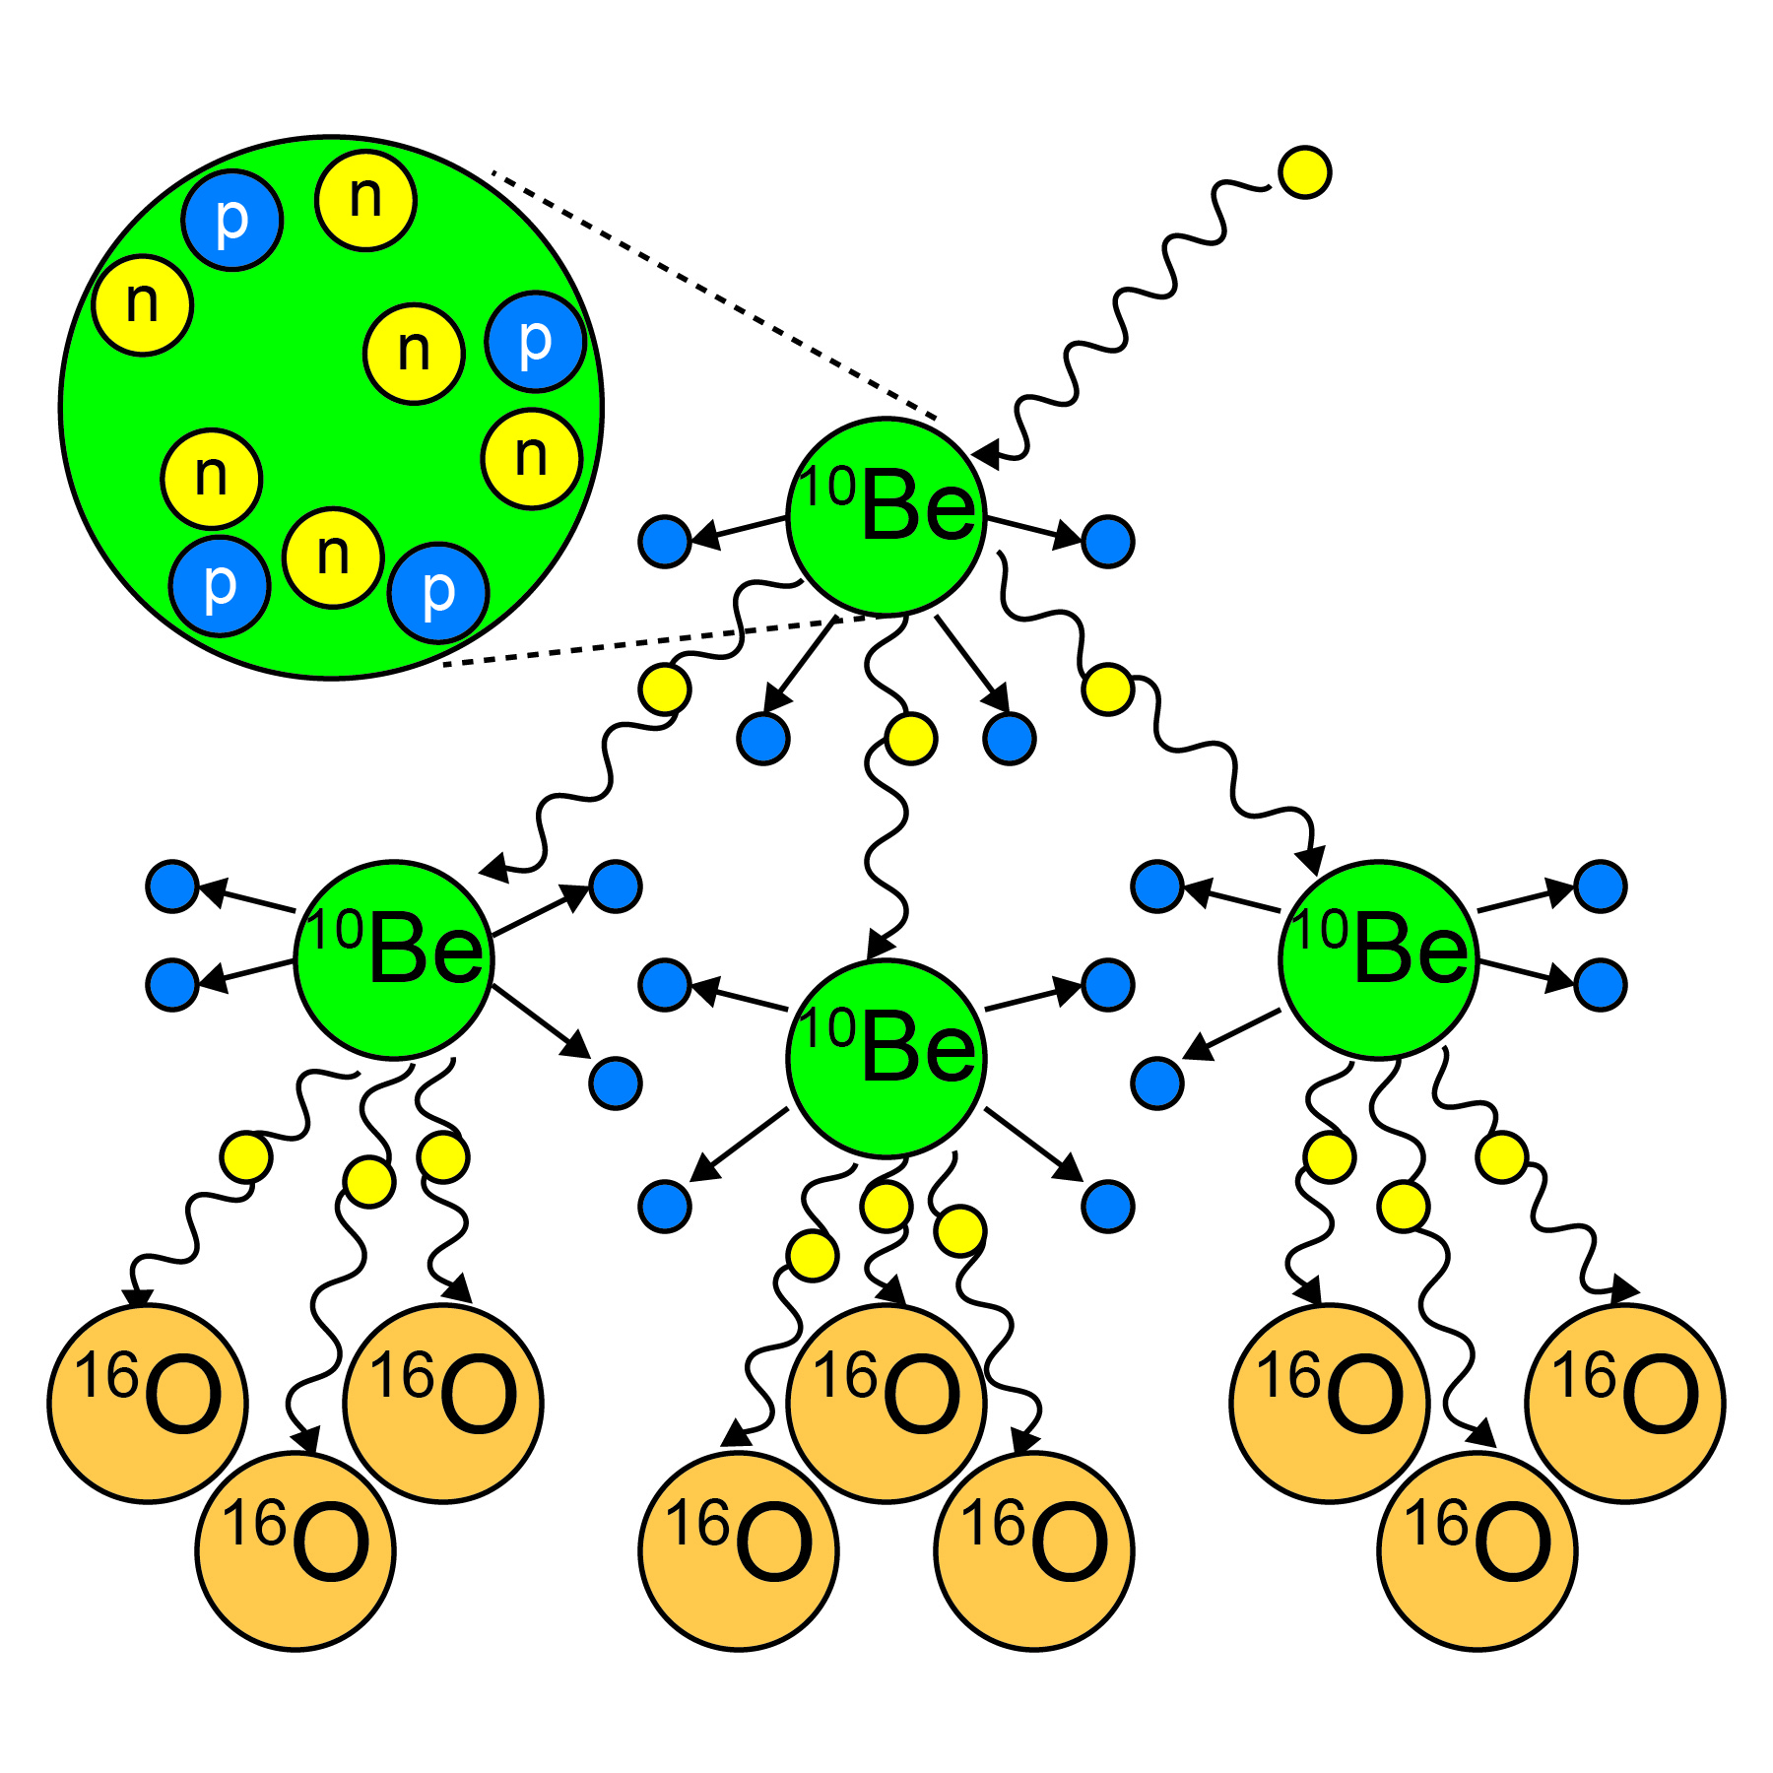
¹⁰Be Production
Cosmic ray bombardment by fast neutrons
Nuclear spallation reactions
Occurs naturally
  Atmosphere (meteoric)
  Minerals (in situ)
Quartz
  Ubiquitous
  Simple chemical formula (SiO₂)
  Meteoric ¹⁰Be is easily removed
  Resistant to acid etching

Slide 7
¹⁰Be Production in a Bedrock Outcrop
Assumptions
  Constant Bombardment
  Continuous exposure
  No Erosion
0
xρ
P_{x} = P₀e
(- )
2
Depth (m)
Λ
P = Production Rate
x = Depth
ρ = Density
Λ = Attenuation Depth
4
100%
0%
Nuclide Production
(Adapted from Bierman and Nichols, 2004)

Slide 8
Erosion Rates from ¹⁰Be Concentrations
¹⁰Be concentration integrates production as its depth from the surface decreases
  Constant Erosion Rate
  Simple Exposure History
  Granular disintegration
P
xρ
______
( )
N = e
Λ
ρε
( + λ)
Λ
N = Nuclide Concentration
P = Production Rate
ε = Erosion Rate
λ = Half-life
x = Depth
ρ = Density
Λ = Attenuation Depth

Slide 9
¹⁰Be in River Sediment
Constant erosion of bedrock produces sediment
Quartz grains in sediment come from all points within a basin
River systems naturally mix sediment so it is representative of entire basin

Slide 10
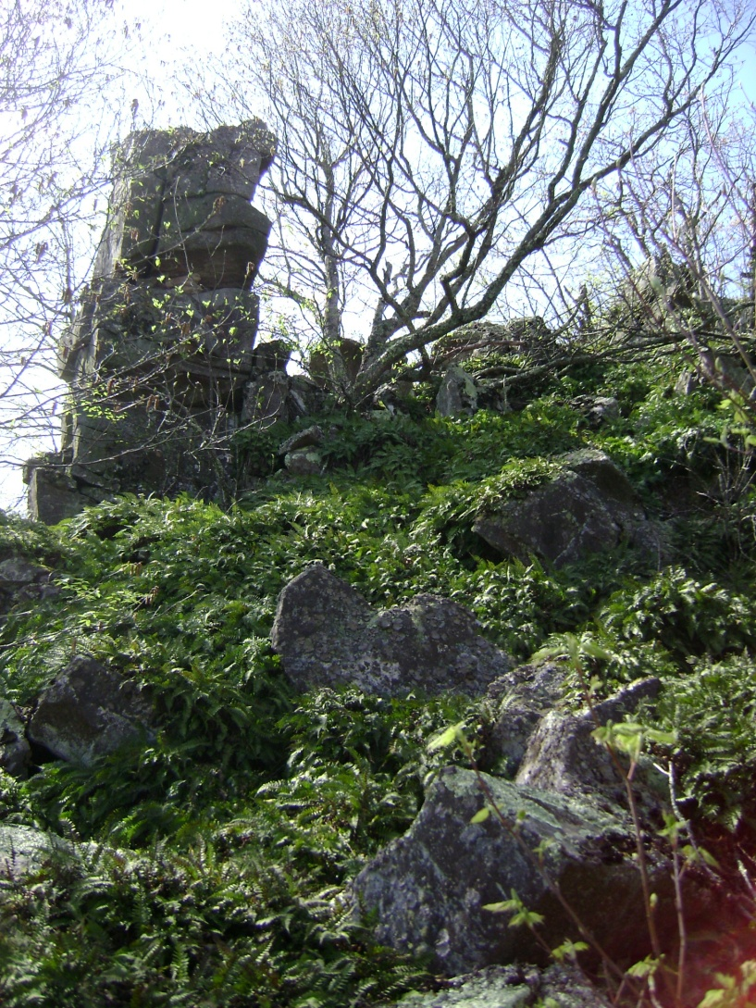
Erosion Rates in the Central Appalachian Mountains using ¹⁰Be
Measure erosion rates from bedrock outcrops
Determine factors controlling erosion rates
Numerous basin-averaged erosion rates come from this region

Slide 11
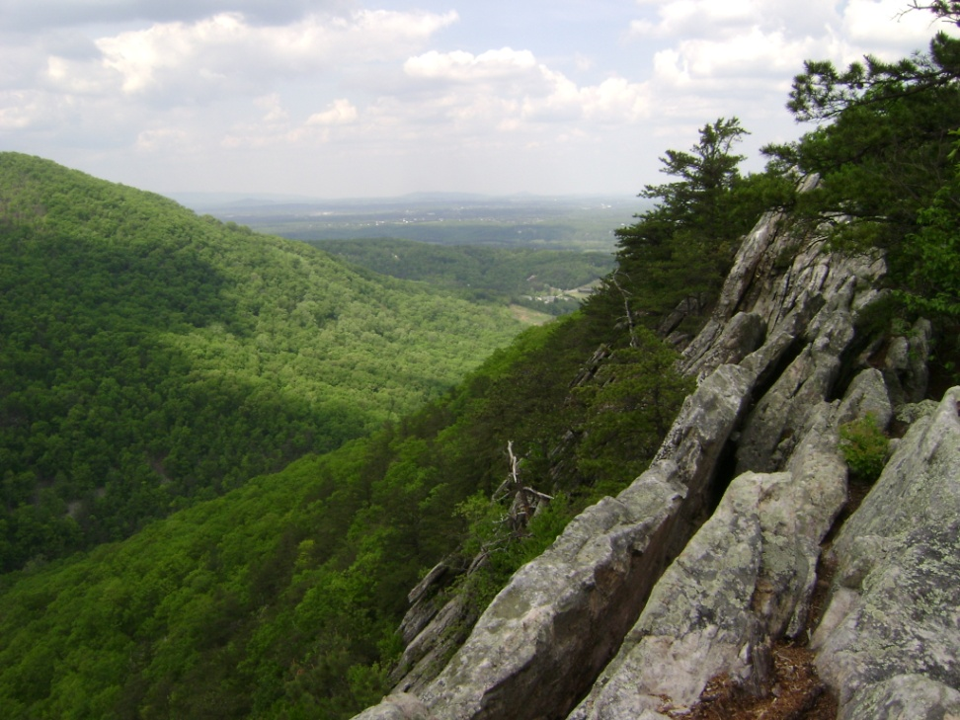
History of Central Appalachian Mountains
Devonian sediments
  Sandstones, arenites, limestones, shales
Permian mountain building – Alleghenian Orogeny
  Deforms sedimentary units into plunging anticlines and synclines
  Metamorphoses siliclastic rocks into hard quartzites
Triassic rifting
  Regional uplift

Slide 12
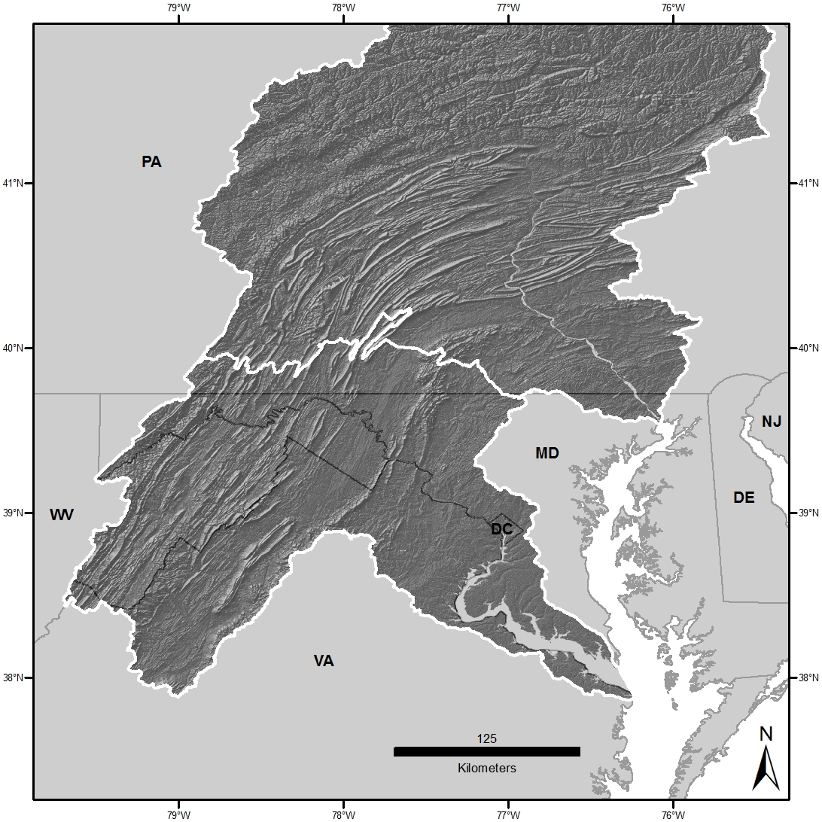
Physiographic Provinces
Appalachian Plateau
Valley and Ridge
Piedmont
Blue Ridge
Coastal Plain

Slide 13
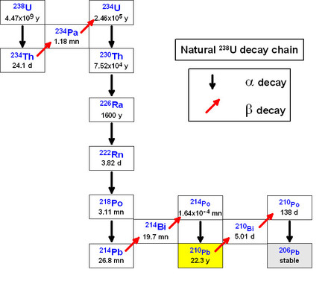
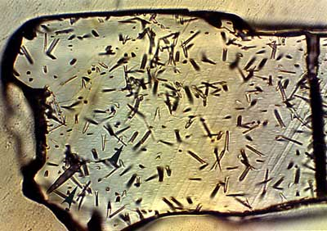
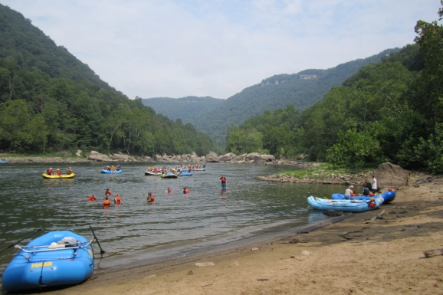
Methods Used to Measure Landscape Change in the Central Appalachians
Fission-track Thermochron.
(U – Th)/He
Thermochron.
¹⁰Be Basin and Cave Methods
16 – 33 m My⁻¹
(Naeser et al., 2001, 2004, 2005; Blackmer et al., 1994; Roden, 1991)
7 – 25 m My⁻¹
(Reed et al., 2005; Spotila et al., 2003)
10 – 27 m My⁻¹
(Granger et al., 1997; Reuter, 2005; Duxbury, 2009; Trodick et al., 2010)
Photo: pangea.stanford.edu
Photo: oliviermegand.com

Slide 14
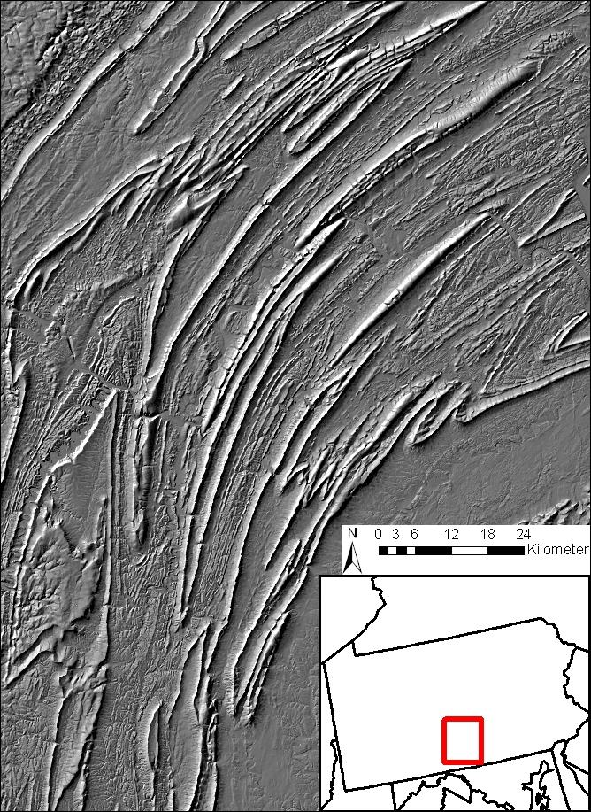
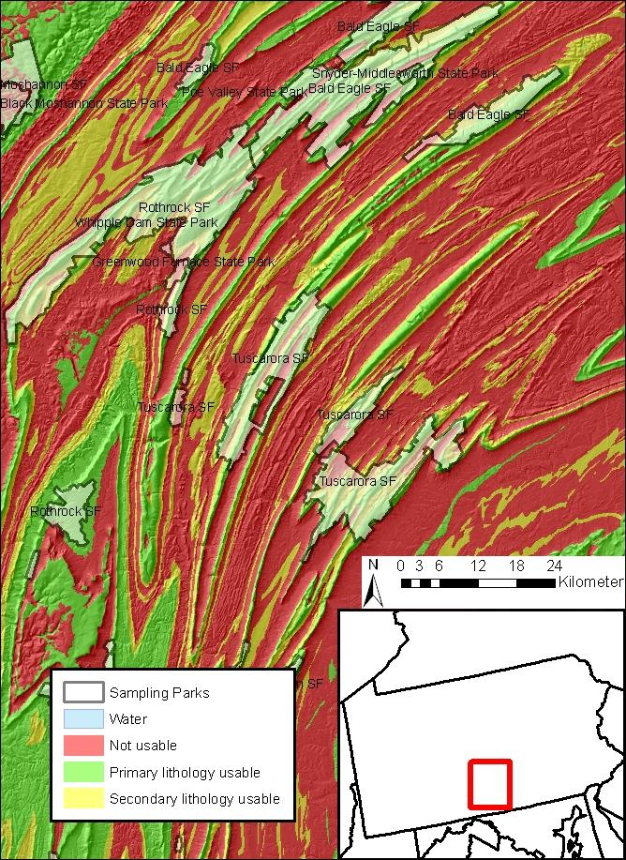
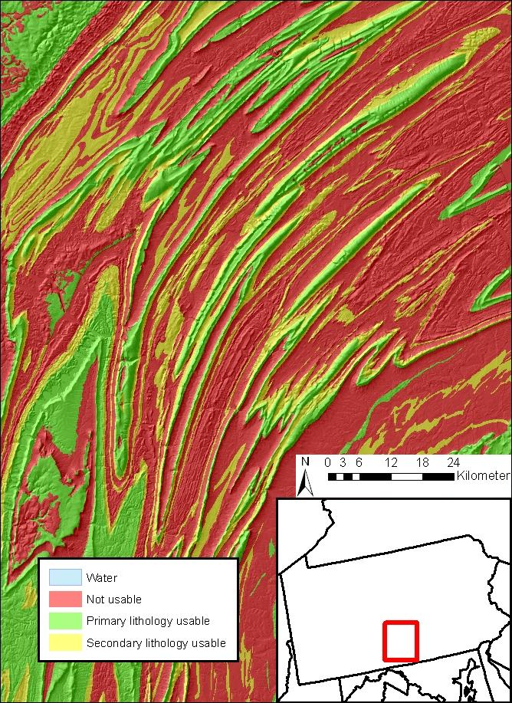
Sampling Strategy
Optimization of time in field requires knowledge of sampling sites beforehand
ArcGIS
  Topography
  Lithology
  Ease of Access
Google Earth and internet image search verification

Slide 15
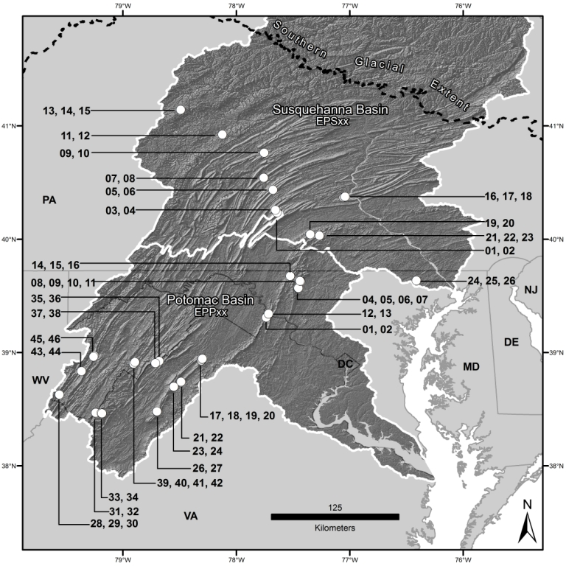
Field Methods
South of Glacial Extent
n_{total} = 72
  n_{Pot} = 46
  n_{Sus} = 26
Sample Types
  Main Ridge
  Spur Ridge
  Near Cliff
4 Regions
  App. Plateau
  Valley & Ridge
  Blue Ridge
  Piedmont

Slide 16
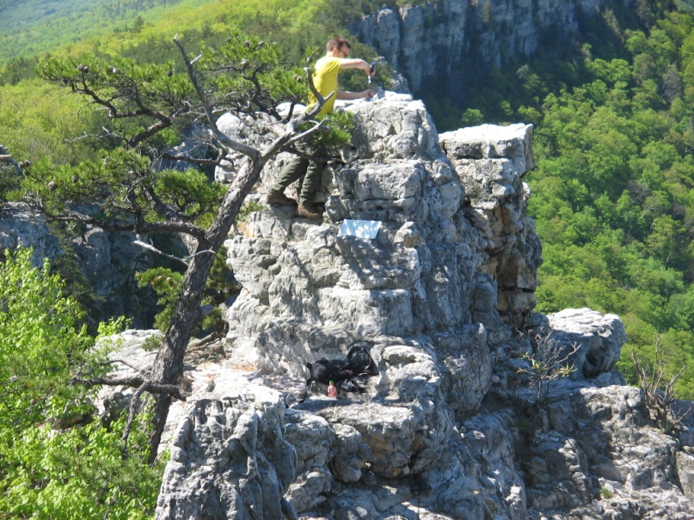
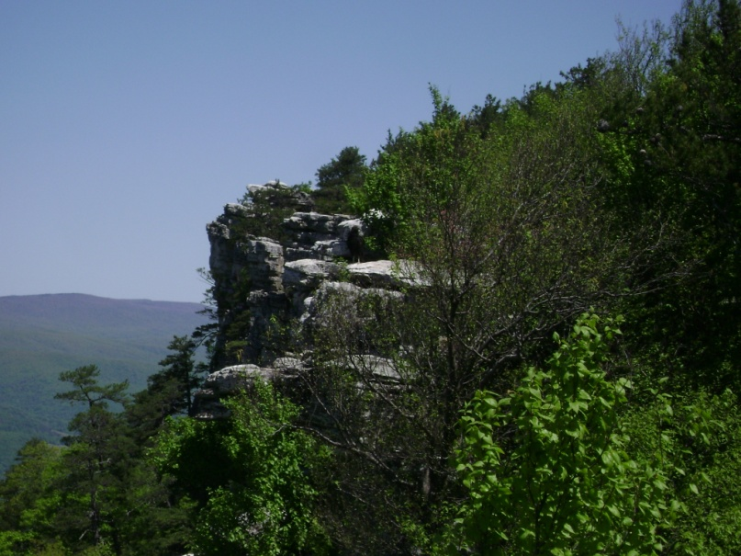
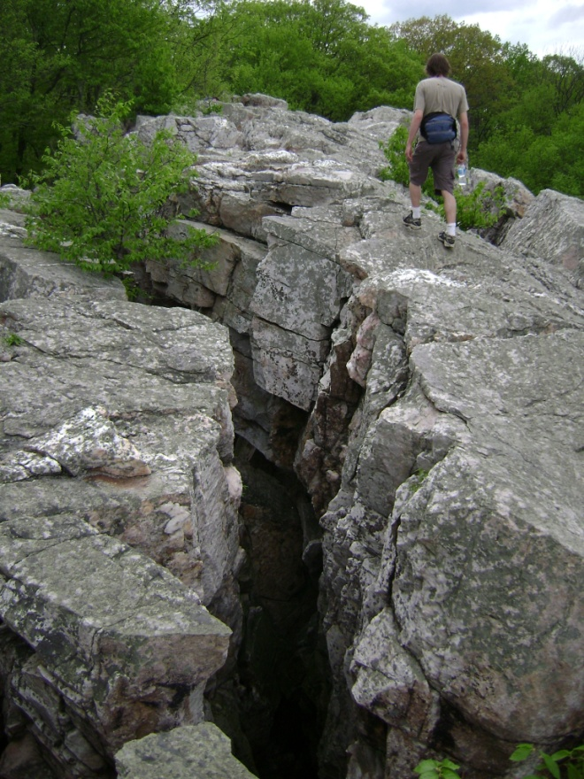
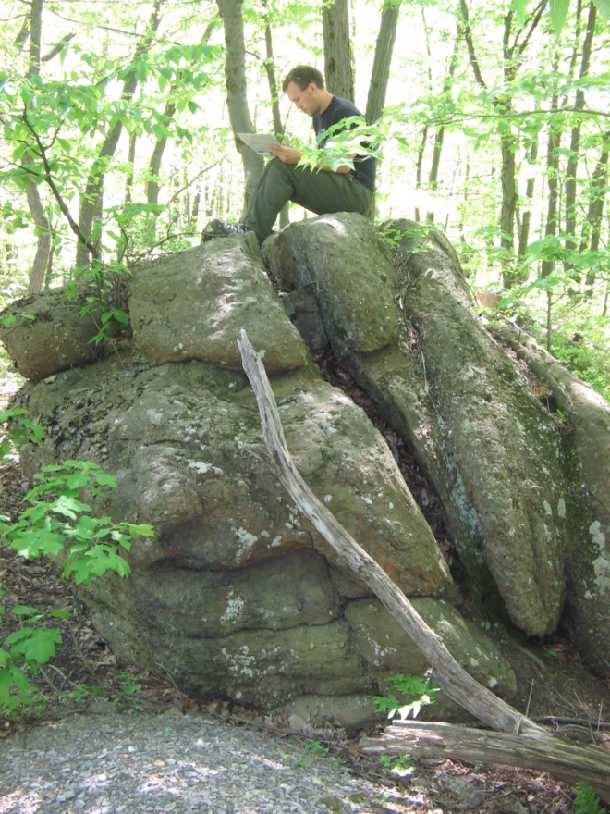
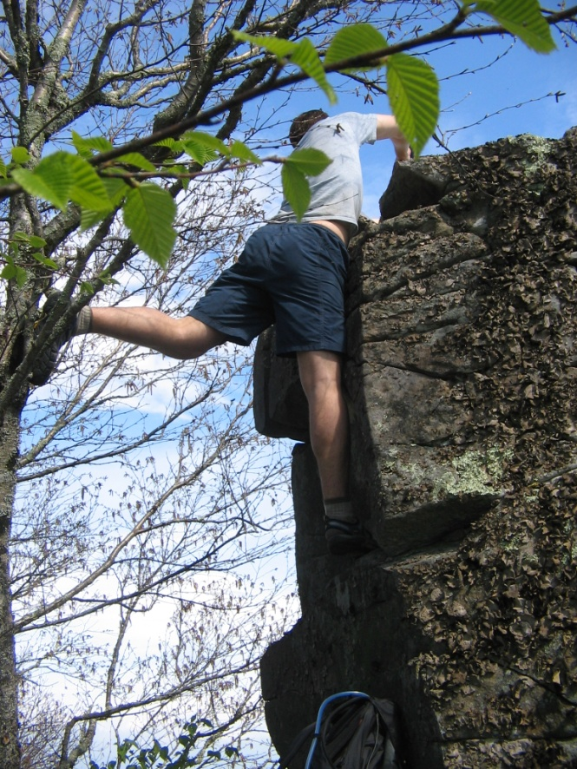
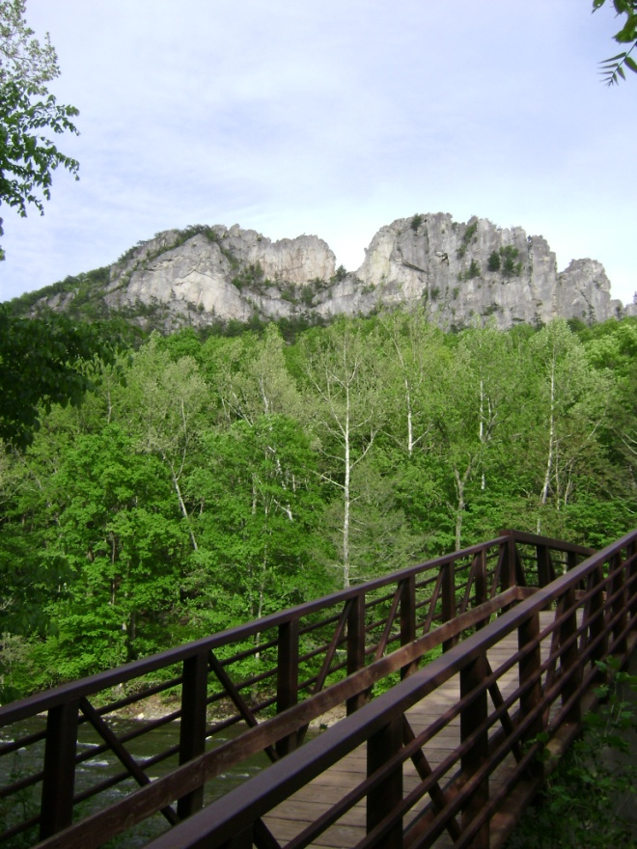
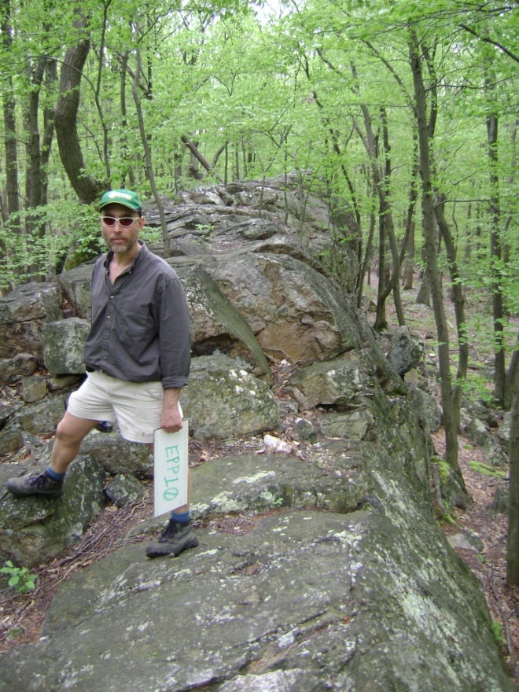
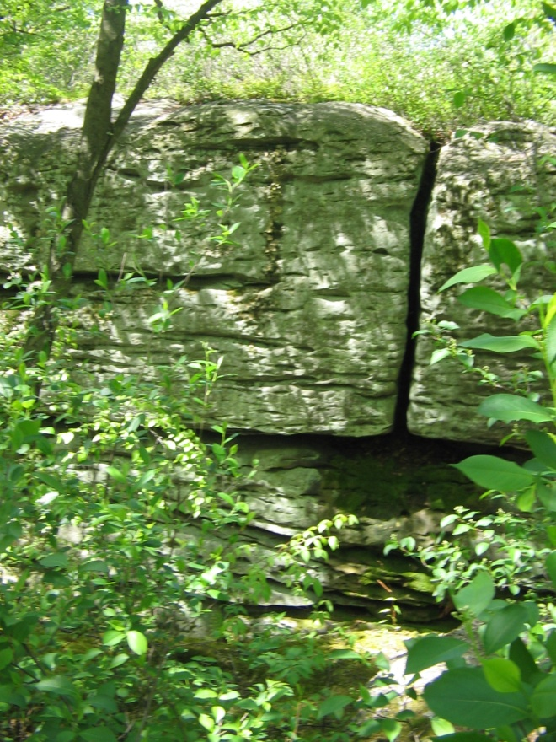
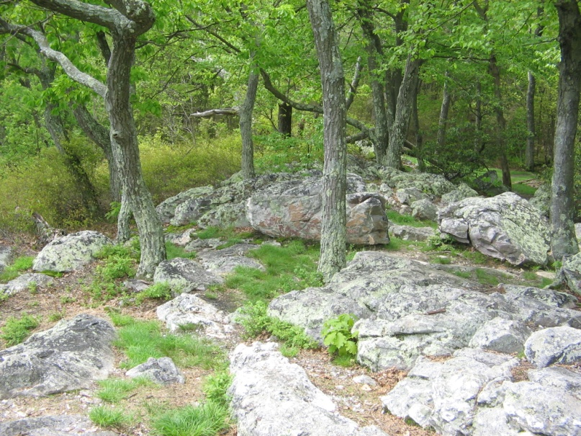
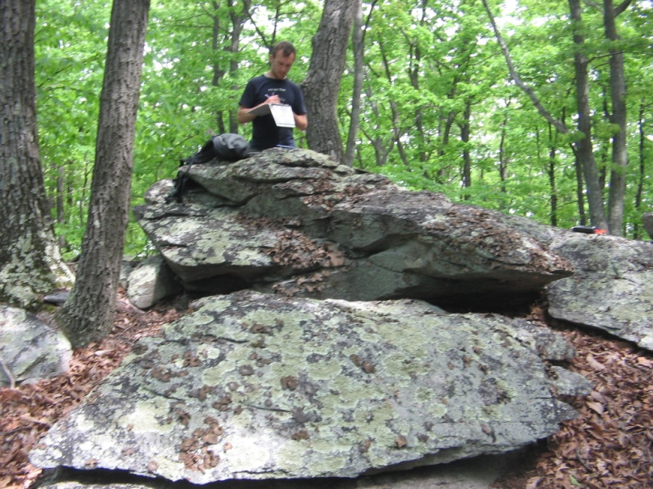
Field Methods

Slide 17
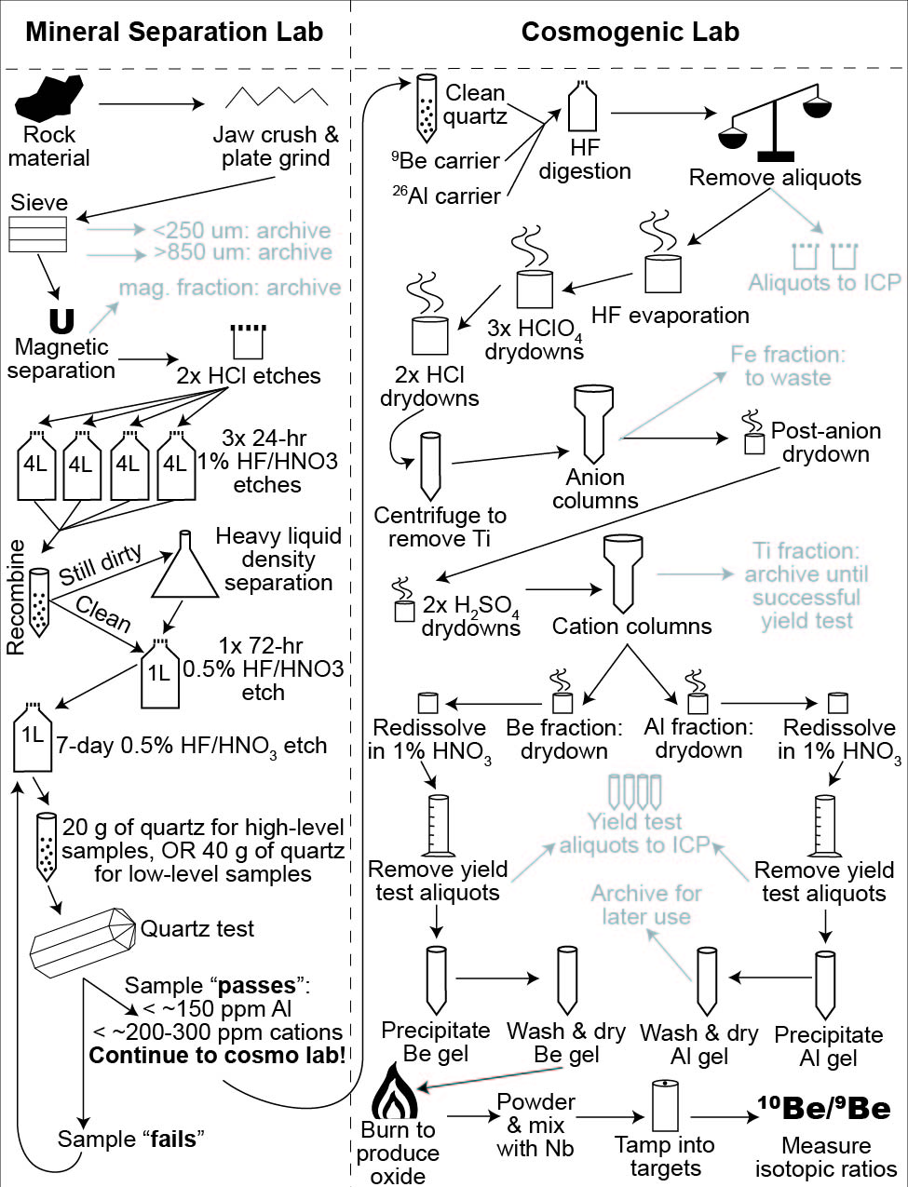
Laboratory Methods
4 Processes
  Rock Room
  MinSep Lab
  Cosmo Lab
  AMS (LLNL)
Source: Lee Corbett

Slide 18
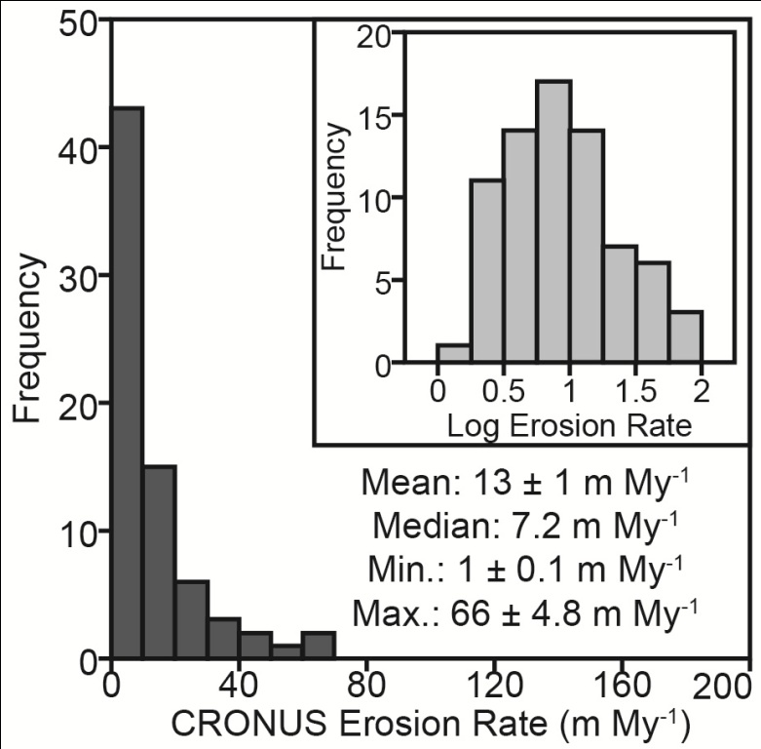
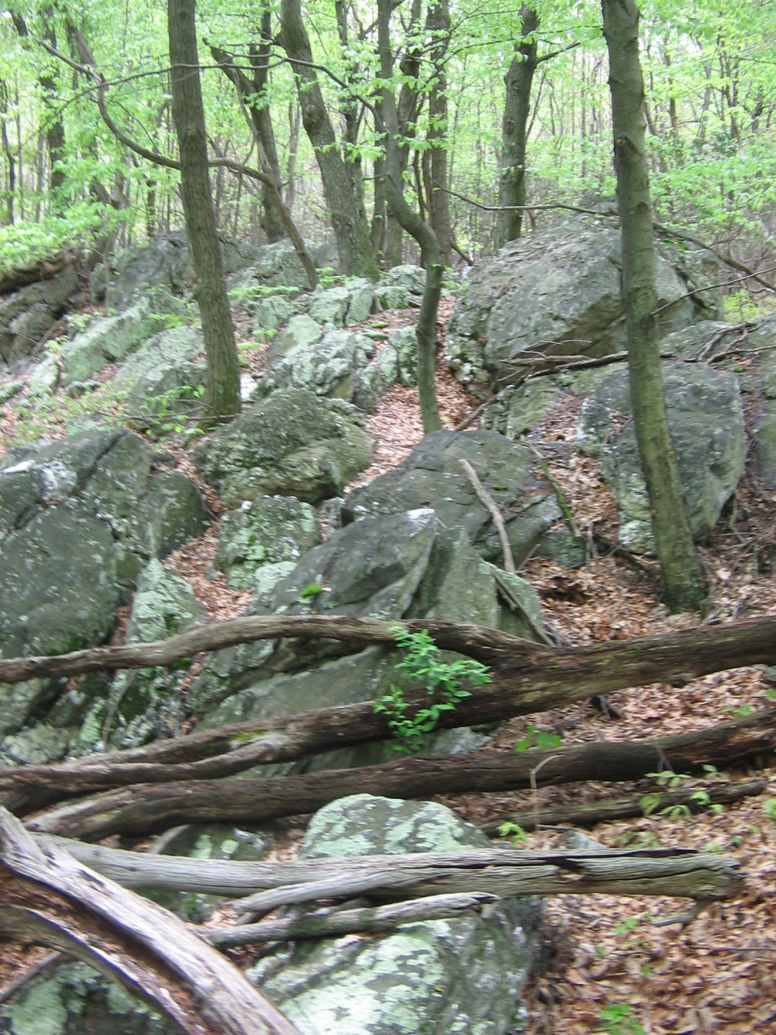
New Appalachian Erosion Data
Skewed distribution requires log-transform

Slide 19
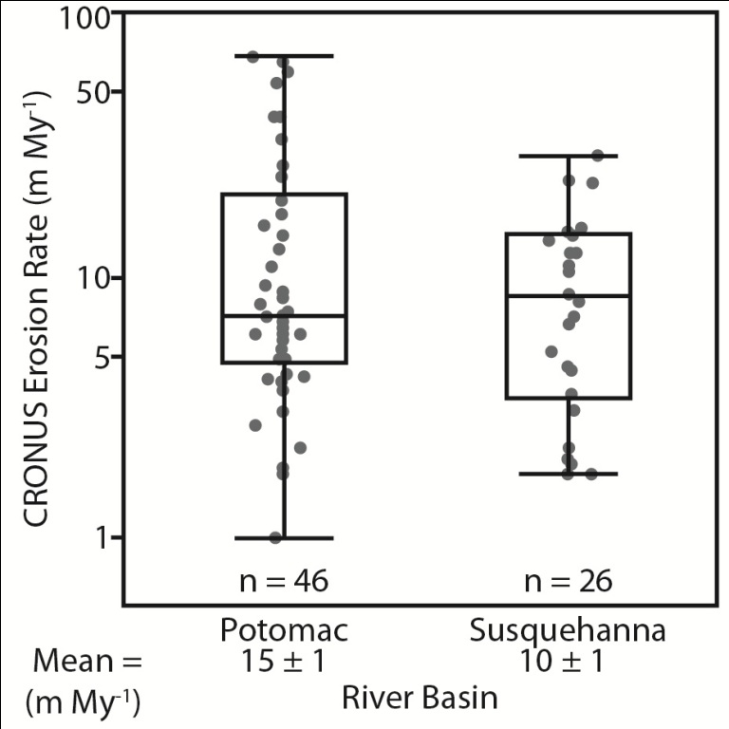
Outcrop Erosion Rates from Each Basin
Potomac River
Susquehanna River
Mean
15 ± 1 m My⁻¹
Median
7.1 m My⁻¹
Range
1.0 – 66 m My⁻¹
Mean
10 ± 1 m My⁻¹
Median
8.3 m My⁻¹
Range
1.8 – 28 m My⁻¹
Means from basins are inseparable at the 95% confidence interval (p = 0.32)

Slide 20
Mean Provincial Outcrop Erosion Rates
Piedmont
  6.2 m My⁻¹
Blue Ridge
  8 m My⁻¹
Appalachian Plateau
Valley & Ridge
  16 m My⁻¹
App. Plateau
Pot. = 53 m My⁻¹
Sus. = 2.4 m My⁻¹
Valley and Ridge
Piedmont
Blue Ridge
Coastal Plain

Slide 21
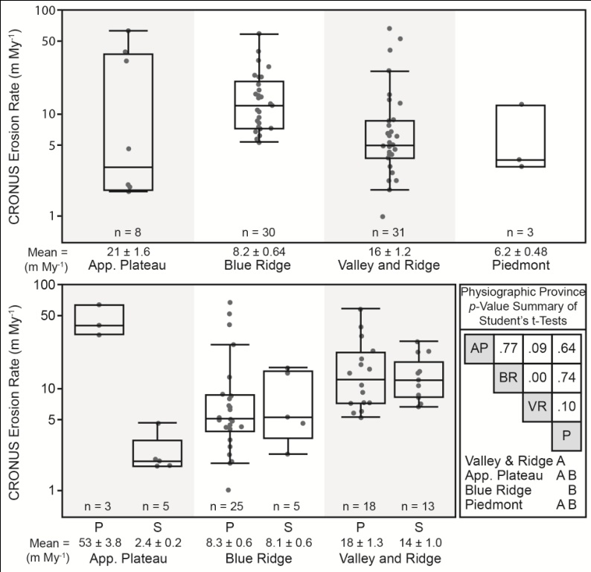
Mean Provincial Outcrop Erosion Rates

Slide 22
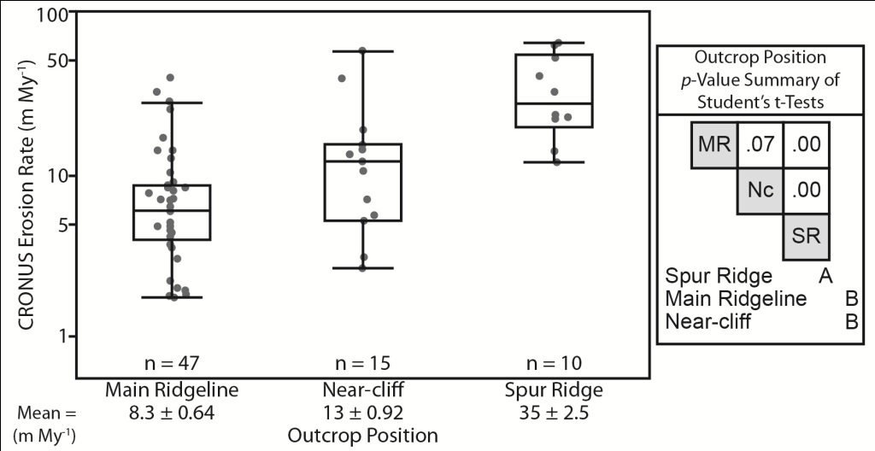
Mean Positional Erosion Rates
Spur-ridges erode faster than other types (p < 0.001)
Ridge-line and near-cliff samples erode similarly (p = 0.07)

Slide 23
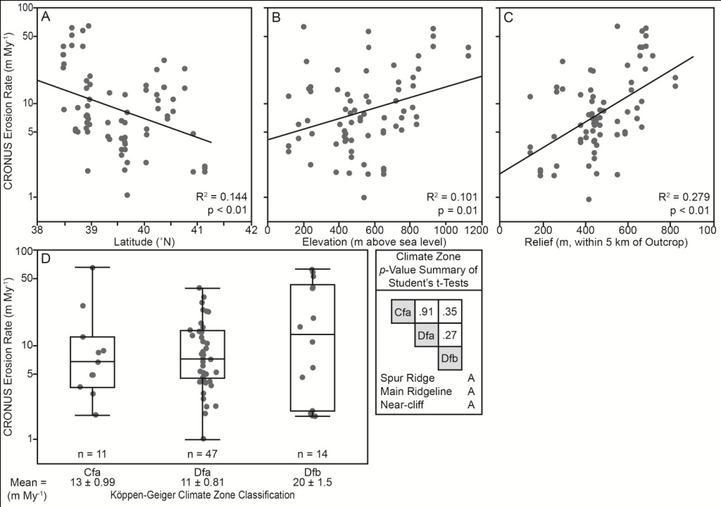
Statistical Relations between Outcrop
Erosion Rates and Environmental Parameters in Central Appalachians
Cfa = Temperate: hot summer without a dry season
Dfa = Cold: hot summer without a dry season
Dfb = Cold: warm summer without a dry season
Temperate
  T_{hot}>10; 0<T_{cold}<18
Cold
  T_{hot}>10; T_{cold}≤0

Slide 24
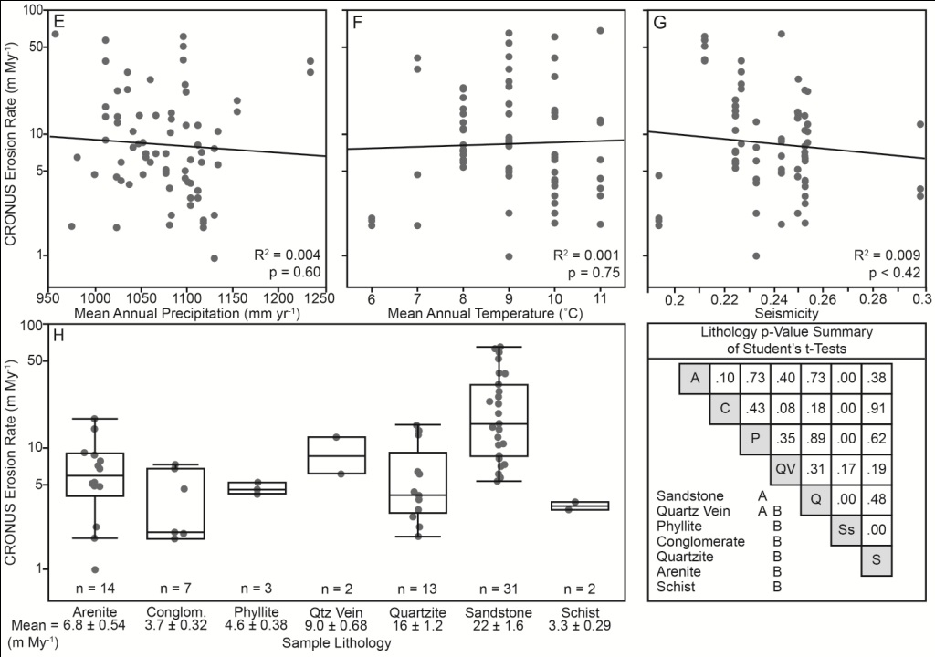
Statistical Relations between Outcrop
Erosion Rates and Environmental Parameters in Central Appalachians

Slide 25
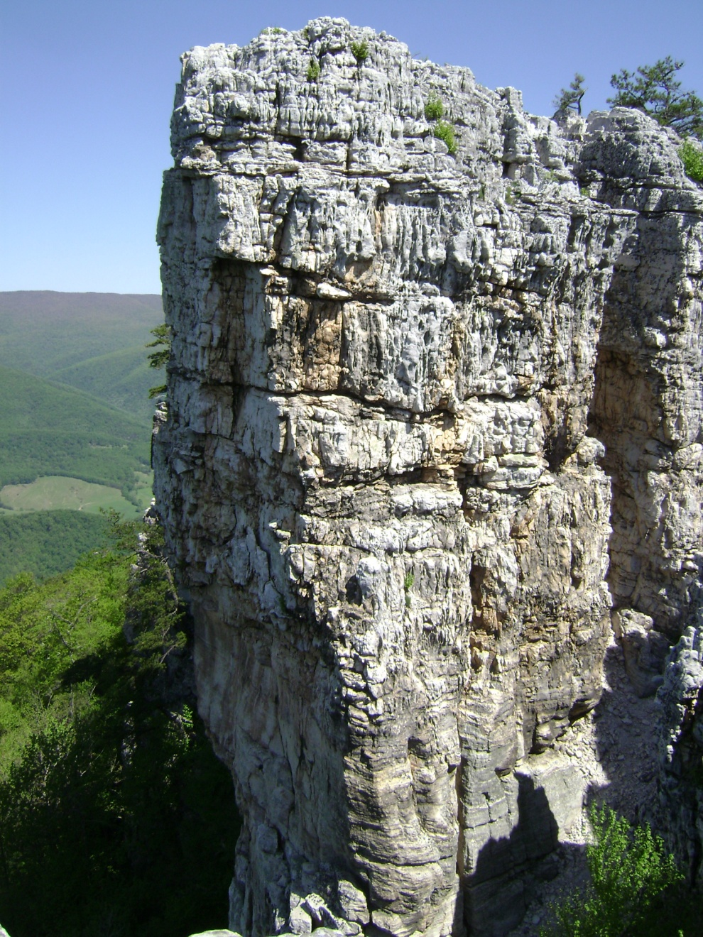
Principle Component Analysis
Variables may be correlated to one another and are thus not independent of each other
PCA removes these dependencies by creating three new variables
  Seismic-physiography
  Latitude-Temperature
  Precipitation
Multivariate regression of PCA variables explains 25% of erosion rates in the study area

Slide 26
Relative Standard Deviations at Each Site
Relative Standard Deviations for each site
  Avg.: 0.39
  Range: 0.03 – 0.98
  Sites with RSD > 0.50 may include samples which violate cosmogenic method assumptions

Slide 27
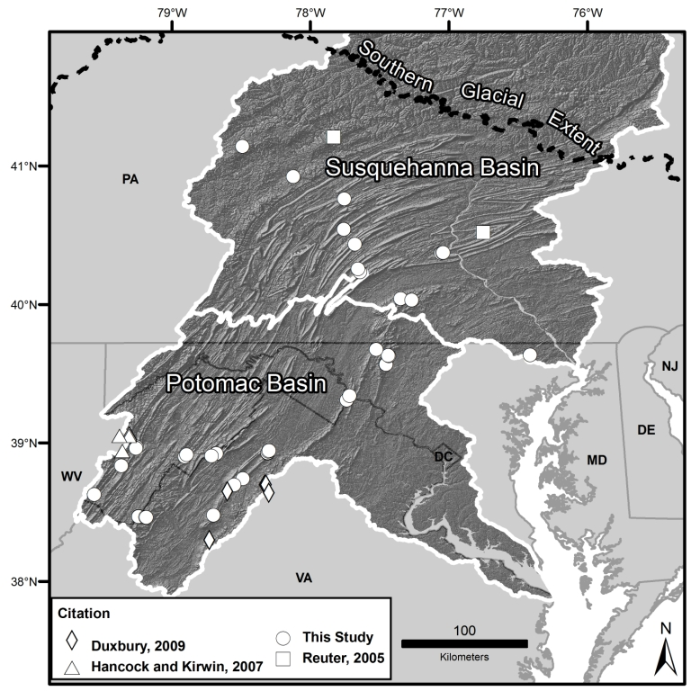
Other Regional Outcrop Erosion Rates

Slide 28
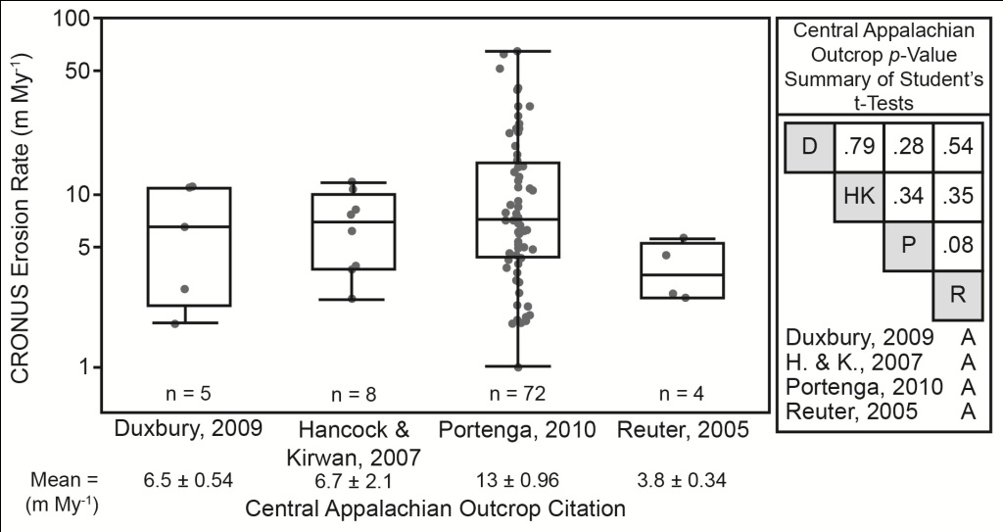
Other Regional Outcrop Erosion Rates

Slide 29
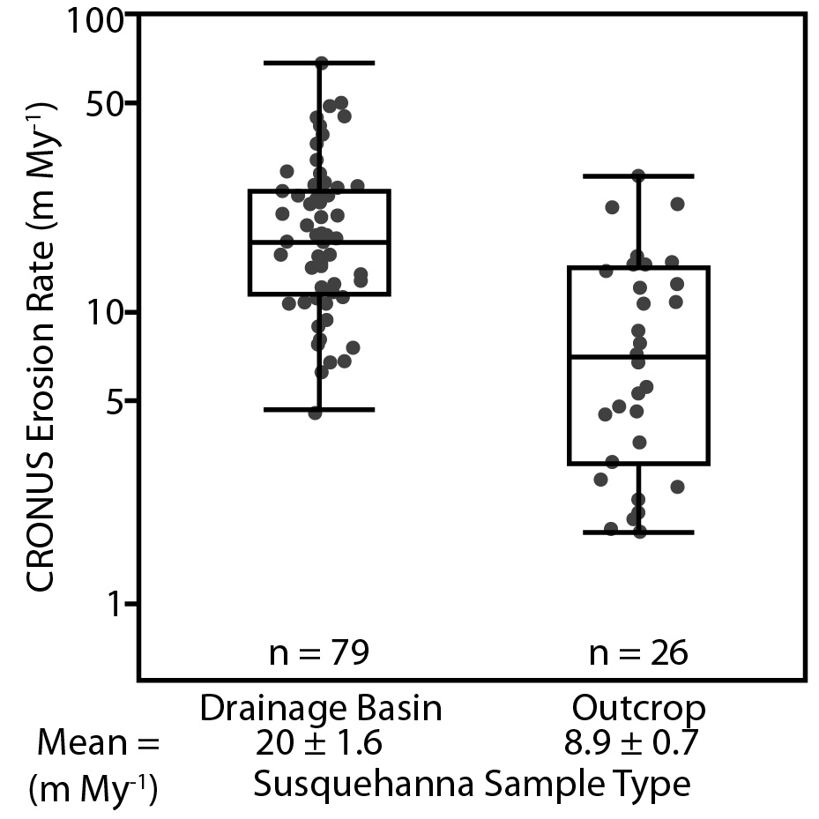
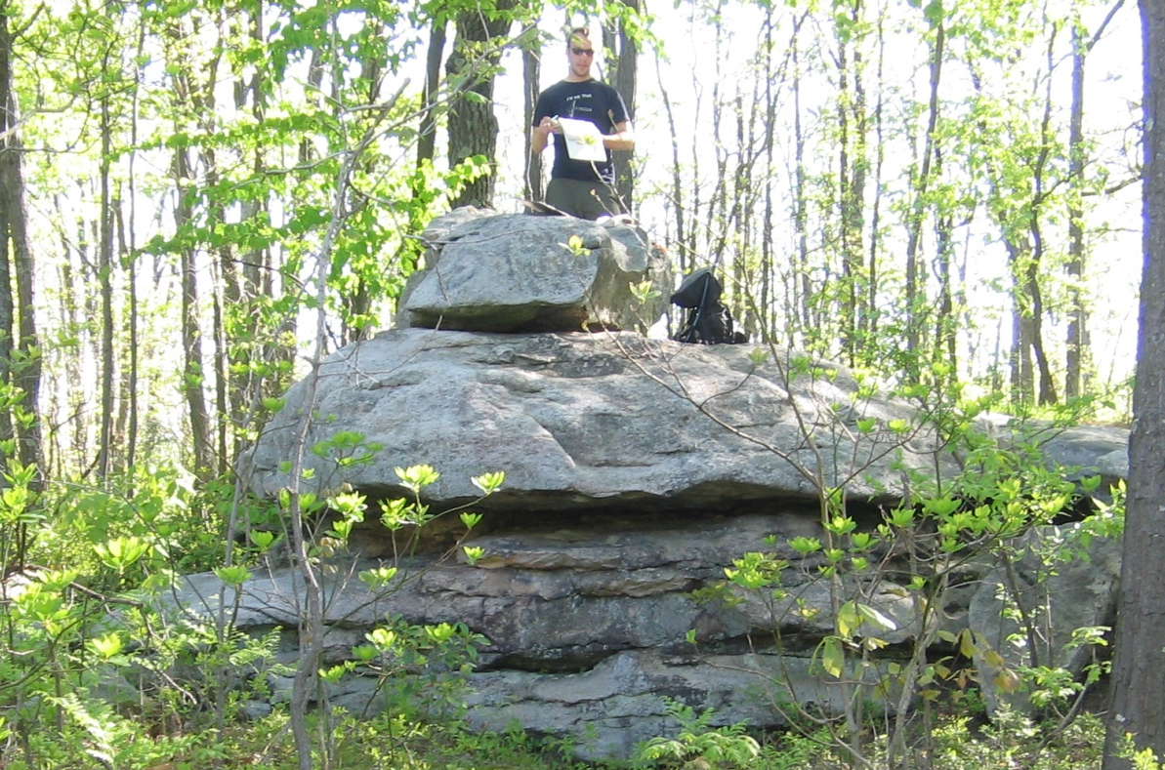
Higher Basin Erosion Rates in the Susquehanna River Basin
Susquehanna
Basins (n = 79)
Mean = 20 ± 1.6 m My⁻¹
Median = 17 m My⁻¹
Susquehanna
Outcrops (n = 26)
Mean = 8.9 ± 0.7 m My⁻¹
Median = 8 m My⁻¹
Means are not similar at the 95% confidence interval (p = 1)

Slide 30
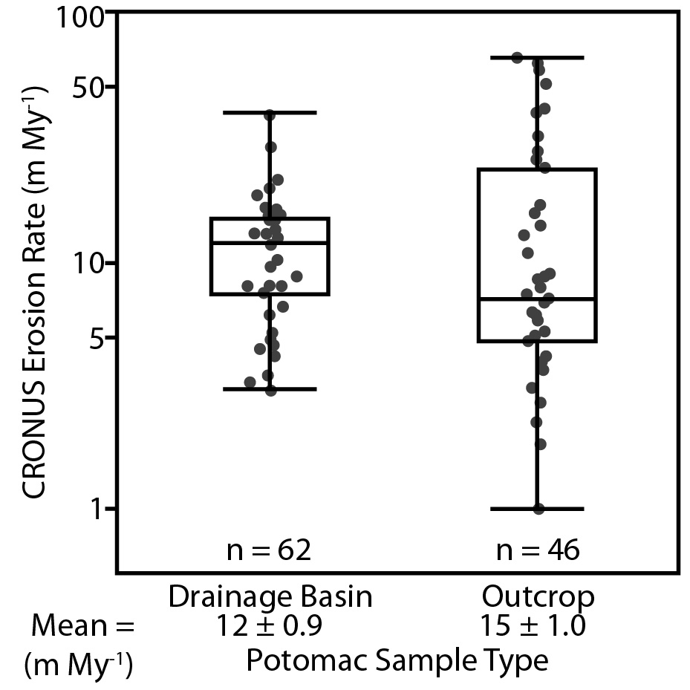
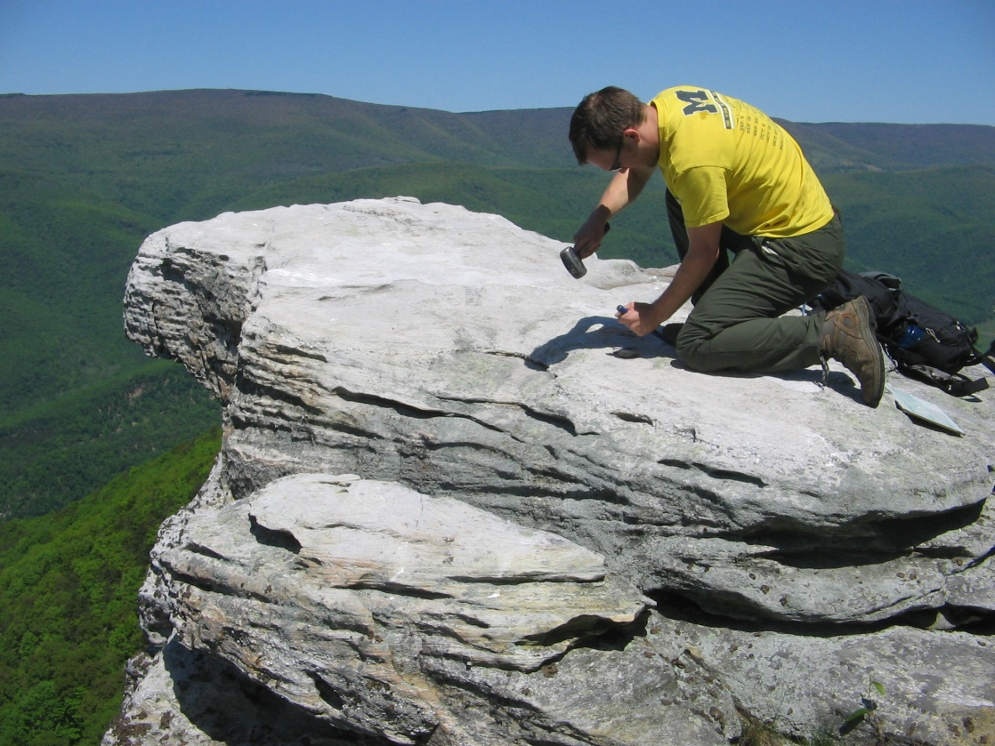
Similar Basin and Outcrop Erosion Rates in the Potomac River Basin
Potomac Basins (n = 62)
Mean = 12 ± 0.9 m My⁻¹
Median = 12 m My⁻¹
Potomac Outcrops (n = 46)
Mean = 15 ± 1 m My⁻¹
Median = 7.1 m My⁻¹
Means for outcrops and basins are inseparable at the 95% confidence interval (p = 0.40)

Slide 31
Putting Erosion Rates into Global Context
Cosmogenic erosion rates are similar to erosion rates determined from other studies, which introduces a question:
Is 13 m My⁻¹ fast or slow?
We now need a global context to compare these erosion rates

Slide 32
A Global Compilation of ¹⁰Be Erosion Rates
What?
  Create a global context in which regional studies can be set
  Analyze relationship between bedrock outcrop and drainage basin erosion rates
  Understand relationship between erosion rates and metrics quantifying environmental parameters
How?
  Compile all publically available erosion rate data
  Summarize behavior of erosion rates in various climatic, tectonic, and physical settings
  Use statistics to analyze relationships between erosion rates and environmental parameters
Why?
  Most studies are small, geographically, and this allows trends in similar environments to be observed on a much larger scale
  Reveals whether method observations are consistent in numerous study sites
  Different parameters may exert varying amounts of control over erosion rates

Slide 33
Compilation Methods
Gather publically available ¹⁰Be data
  Original ¹⁰Be concentrations
  Production rates, scaling schemes, corrections
  ¹⁰Be Analysis standard material
  Published erosion rates
Recalculate erosion rates from published ¹⁰Be concentrations – CRONUS on-line Calculator
  First true normalization of erosion rates between studies
    Outcrops
      Determine actual sampling sites
    Drainage Basins
      Determine where sample was taken
      Redelineate watershed boundaries

Slide 34
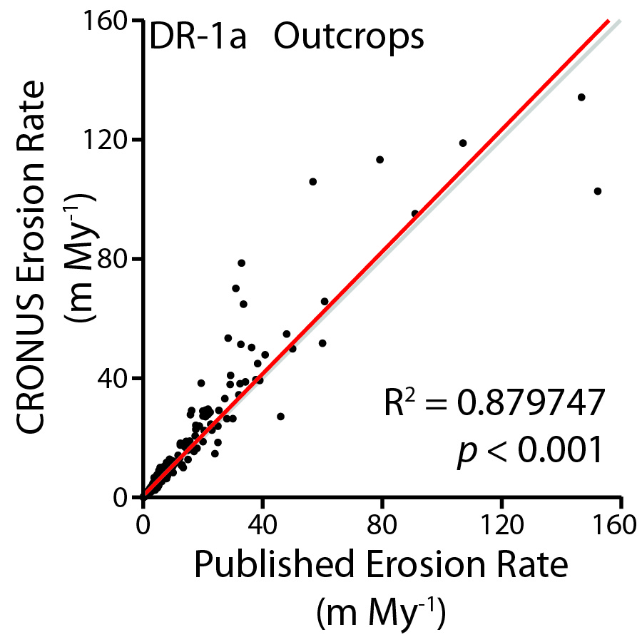
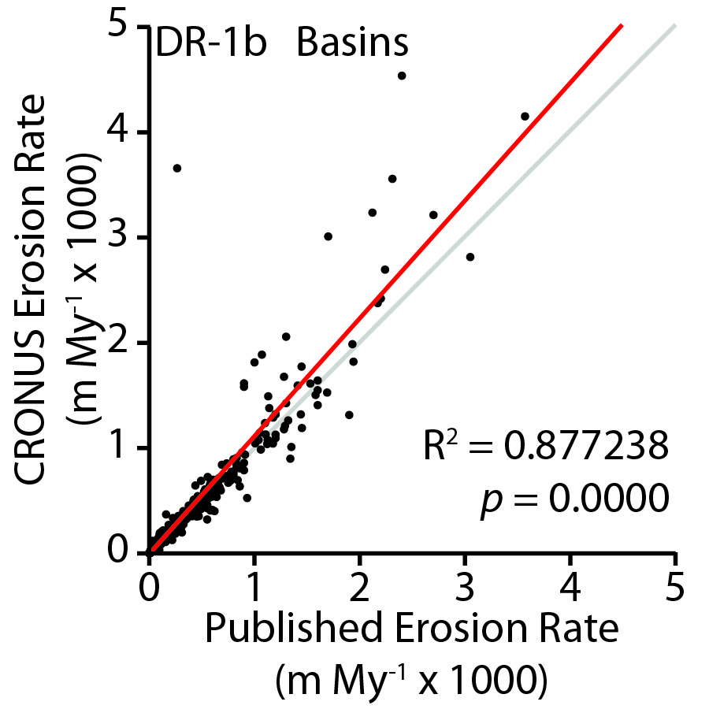
Published v. CRONUS Erosion Rates
n = 418
n = 1110

Slide 35
Compilation Methods
Assign physical and environmental parameter values from global datasets
  Elevation/Relief/Slope → Digital Elevation Models (DEMs)
  Mean Annual Precipitation/Temperature → WorldClim Global Acquisition
  Seismicity → Global Seismic Hazard Assessment Map
  Vegetation → Percentage tree cover map
  Climate Zone → Köppen-Geiger Classification System
  Lithology → publication references

Slide 36
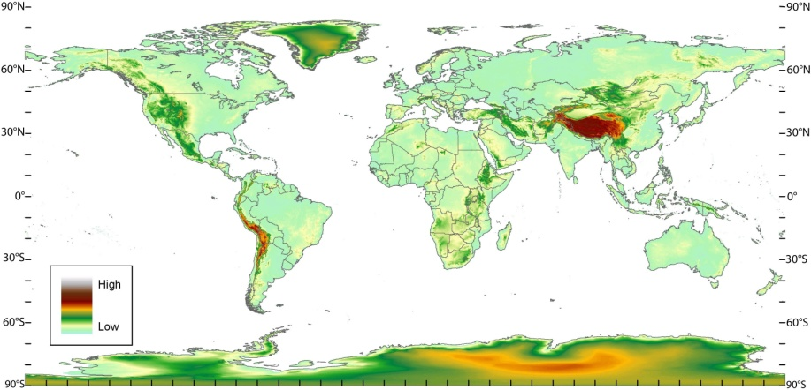
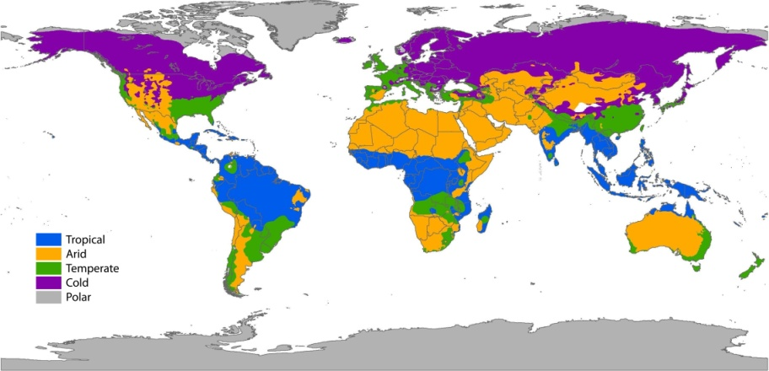




Data Coverages
Elevation
Climate Zone
US Geol. Survey
Peel et al., 2007
M.A. Temp.
M.A. Precip.
Hijmans et al., 2005
Hijmans et al., 2005
Seismicity
Vegetation
Giardini et al., 1999
Defries et al., 2000

Slide 37
Compilation Methods
Statistical Analyses
  Bivariate relationships
    Simple linear regressions
    ANOVA
  Multivariate relationships – forward stepwise regressions
    Significant parameters entered into regression one at a time
    Parameters which significantly strengthen the regression remain in the analysis; those that do not are ejected

Slide 38

Erosion Rate Sample Locations

Slide 39

Distribution of Sample Types
Outcrops
Drainage Basins

Slide 40






Outcrop Bivariate Analyses
Geographic Sampling Gaps between 0-10 and 50-70° Latitude
  Ice Cover
  Southern Ocean
MAP and Relief produce strongest relationships with outcrop erosion rate
Erosion peaks with a MAT of ~10°C

Slide 41



Outcrop Bivariate Analyses
Igneous rocks erode more slowly than any other rock type
Erosion rates are similar in active and inactive seismic settings
Outcrops in temperate climates erode the fastest; polar outcrops erode the slowest

Slide 42









Drainage Basin Bivariate Analyses
Sampling gaps also observed at high and low latitudes
More parameters yield strong relationships with drainage basins than outcrops
No relation with basin area means cosmogenic erosion rates are not affected by the sediment delivery ratio

Slide 43



Drainage Basin Bivariate Analyses
Basins underlain by mixed lithologies erode faster than those underlain by all metamorphic or igneous lithologies
Basins in seismically active settings erode faster than those in inactive settings
Basins in polar climates erode the fastest while those in arid climates erode the slowest

Slide 44

Multivariate Regressions
56% of Basin Erosion Rate variability is explained by 8 parameters
Explainable erosion rates for other subdivisions are high, even if the sample population is large
Average Basin Slope is the consistently the most relevant regressor for the global and nearly all sub-categories; those which is it not the most relevant, it is still high
All other parameters are highly variable in terms of their relevance
33% of Outcrop Erosion Rate variability is explained by 5 parameters
Explainable erosion rate variability for other subdivisions is inconsistent
  Subdivisions with high R² values also have smaller sample populations
Latitude is not always a relevant regressor, but it is the most frequent dominant regressor
Elevation, Relief, Mean Annual Precipitation, Mean Annual Temperature, and Seismicity are significant at times, but their level of significance is greatly variable

Slide 45
Multivariate Regressions
Means for Drainage Basins are almost always at least ~1 order of magnitude higher than the mean for Outcrops
Medians for Drainage Basins in the global analysis and subdivisions are also at least ~1 order of magnitude her than medians of Outcrops

Slide 46

Outcrop vs. Drainage Basins

Slide 47

Geographic Scale Dependency
Smaller study areas provide stronger relationships with parameters
Parameters important at a local scale may be unimportant at a larger scale
Multivariate methods are required for larger scales as more parameters are introduced

Slide 48
Summary of Global Compilations
Global erosion rates are slow (<140 m My⁻¹)
Large geographic sampling gaps exist
  Easily accessible locations
  Not all regions are quartz dominated
Basins erode more quickly than outcrops
  True for both means and medians
Observations made at a local scale may not be the same on the global scale. Inverse, also.
More than one factor controls erosion rates; thus, multivariate methods are more appropriate than bivariate methods

Slide 49

“Where do I fit in?” says the Appalachians
With a sufficient summary of how outcrops erode globally, rates of outcrop erosion in the central Appalachians can now be compared

Slide 50

Appalachian Erosion in the Global Context
Appalachian outcrops erode significantly faster than global outcrops from similar settings (p < 0.01), but are still low
Narrower distribution of erosion rates in the central Appalachian Mountains
Distributions are skewed similarly toward low erosion rates

Slide 51

Regional History of Central Appalachian Landscape Evolution
Similar thermochronologic denudation and cosmogenic erosion rates confirm a slow denudational history of the central Appalachian Mountains since post-Alleghenian rifting
Avg. outcrop erosion rates are similar to basin erosion rates
Avg. outcrop erosion rates are lower than AFT Thermochron.
Avg. outcrop erosion rates within range of (U-Th)/He dating

Slide 52
Conclusions
Erosion rates of bedrock outcrops in the central Appalachian Mountains are slow (13 m My⁻¹)
Independent environmental and physical parameters explain 25% of outcrop erosion variability
Outcrops from this study erode neither faster nor slower than other outcrops in the region measured using the same methods
The Potomac River Basin is generally lowering at an even rate, preserving landscape features
Relief is increasing in the Susquehanna River Basin
Outcrops in the central Appalachian Mountains erode slightly faster than global outcrops

Slide 53
Conclusions
418 bedrock outcrop and 1110 drainage basin erosion rates show outcrops erode more slowly than the basins in which they are situated
33% of Outcrop and 56% of Drainage Basin erosion rate variability is explained through multivariate statistics – the rest is held up in factors and processes left unmeasured or not well understood
Parameters exerting control over erosion rates on small scales do not always exert similar control on large scales

Slide 54

Conclusions
Erosion rates in the Central Appalachian Mountains on millennial timescales are similar to denudation rates on longer timescales (>10⁶ yrs)
The region shows consistently low rates of exhumation since post-Alleghenian rifting of Pangea in the early Triassic (<30 m My⁻¹)

Slide 55






Acknowledgements
Committee
  Paul Bierman
  Laura Webb
  Donna Rizzo
Grad Students
  Lee Corbett
  Luke Reusser
  Charles Trodick
Dylan Rood (LLNL)
Grants
  NSF: EAR-310208
  USGS: 08ERSA0582
  LLNL Contract: DE-AC52-07NA27344

Slide 56

Questions?

