Slide 1
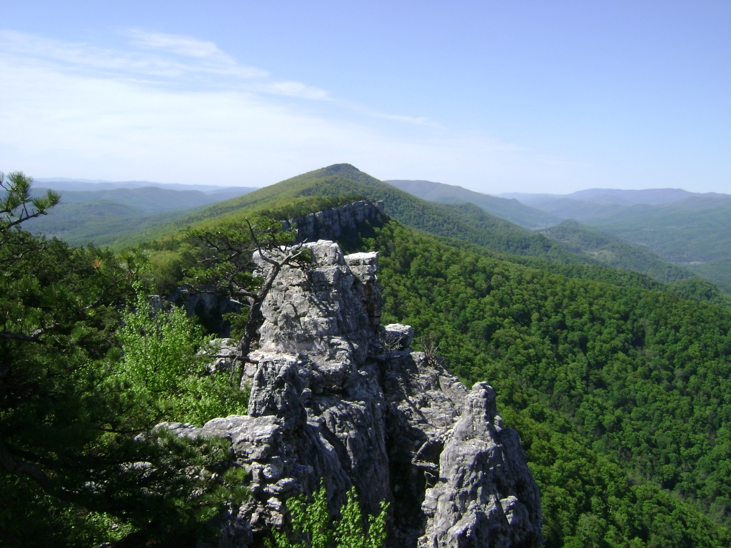
Using ¹⁰Be to constrain erosion rates of bedrock outcrops, globally and in the Appalachian Mountains
Eric W. Portenga
Paul Bierman, Advisor

Slide 2
Outline
Why bedrock?
Work completed
  Field work
  Lab work
  Global ¹⁰Be erosion rate dataset compilation
Initial results
  Statistical analyses of global compilation
Work to be done
  Global compilation
  Appalachian Sample lab work

Slide 3
Bedrock Erosion Rates
Little is known about erosion rates
  Slow → difficult to constrain
  Focal point of few studies (focus on basin-averaged erosion rates)
Ubiquitous features of landscapes, globally
Sets the pace of landscape change

Slide 4
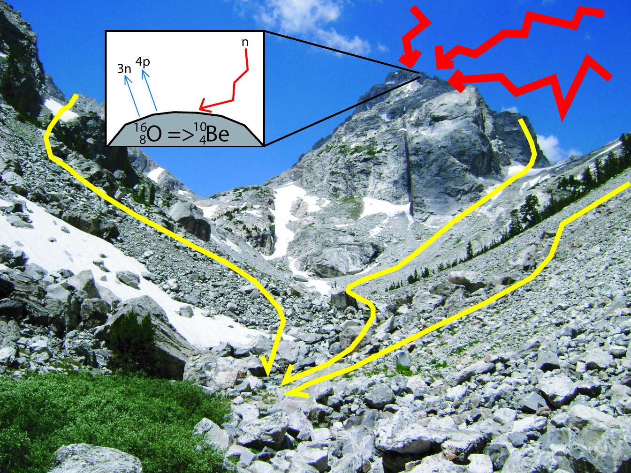

Slide 5
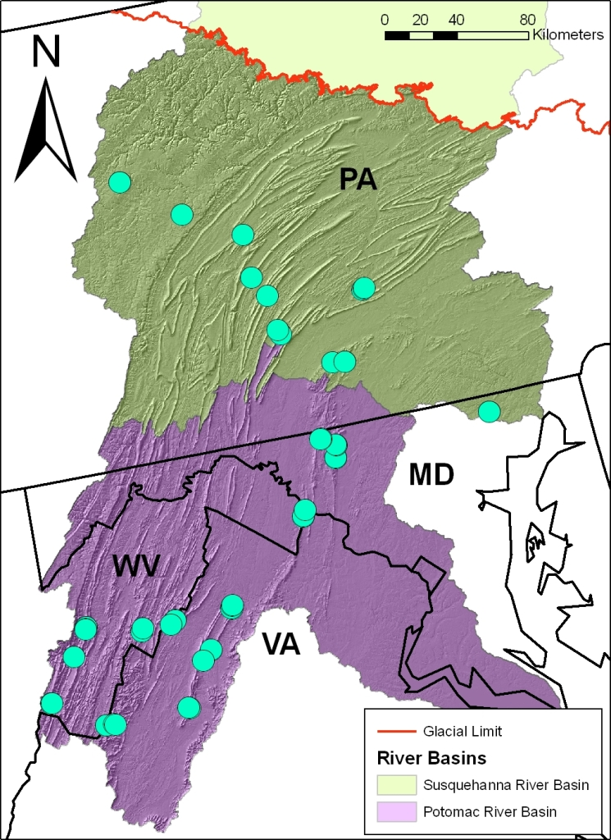
Field Work
River basins in central Appalachian Mtns. studied with ¹⁰Be on basin-scale
  Potomac (n=48; Trodick/Duxbury)
  Susquehanna (n=26; Reuter)
Samples from 30 sites
Multiple samples per site to study variance
Unglaciated ridges outside glacial margin

Slide 6
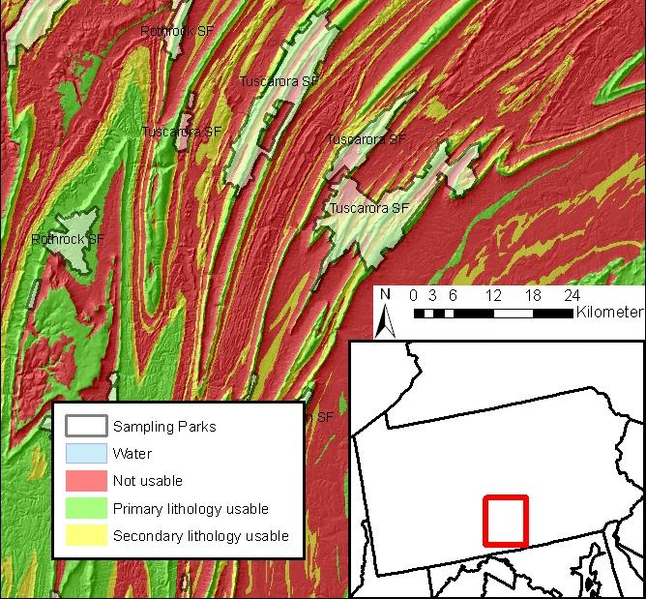

Slide 7
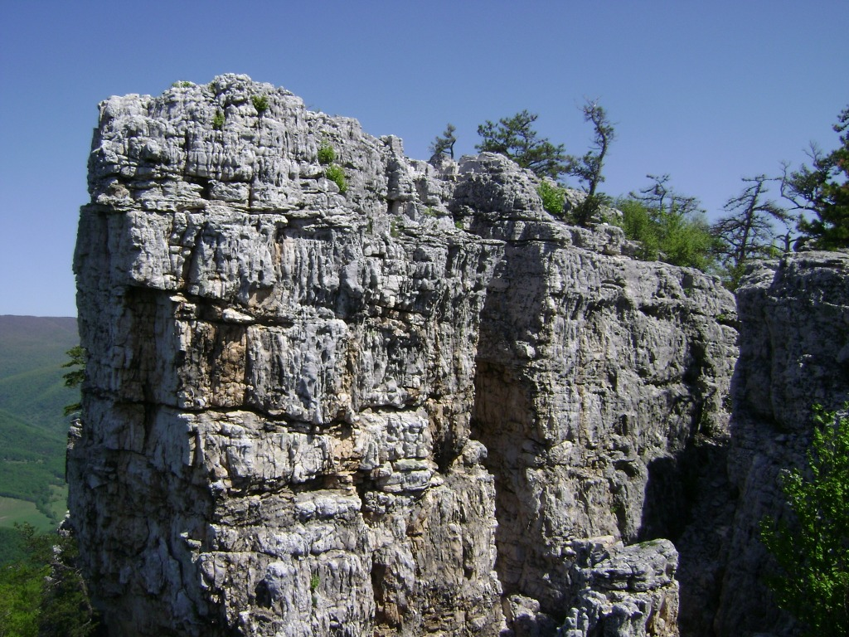
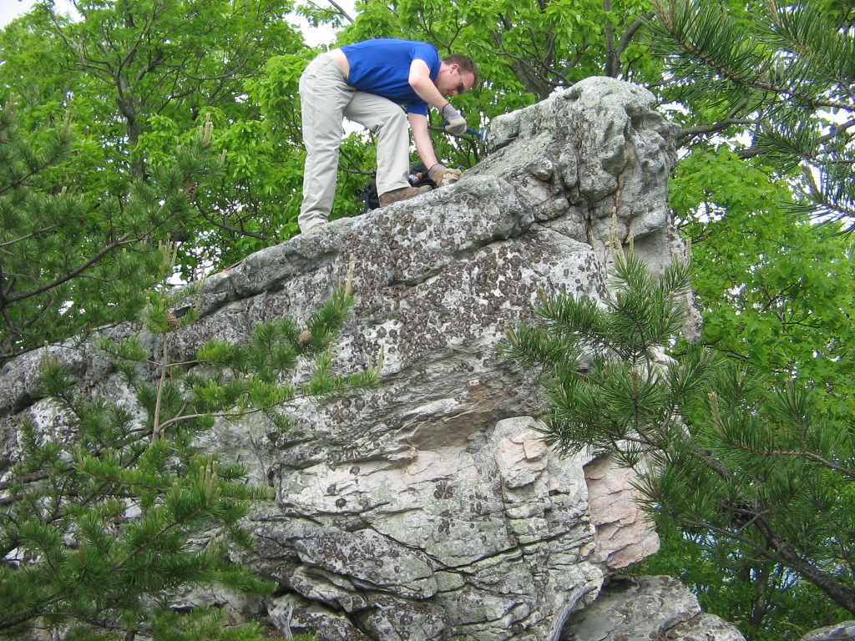
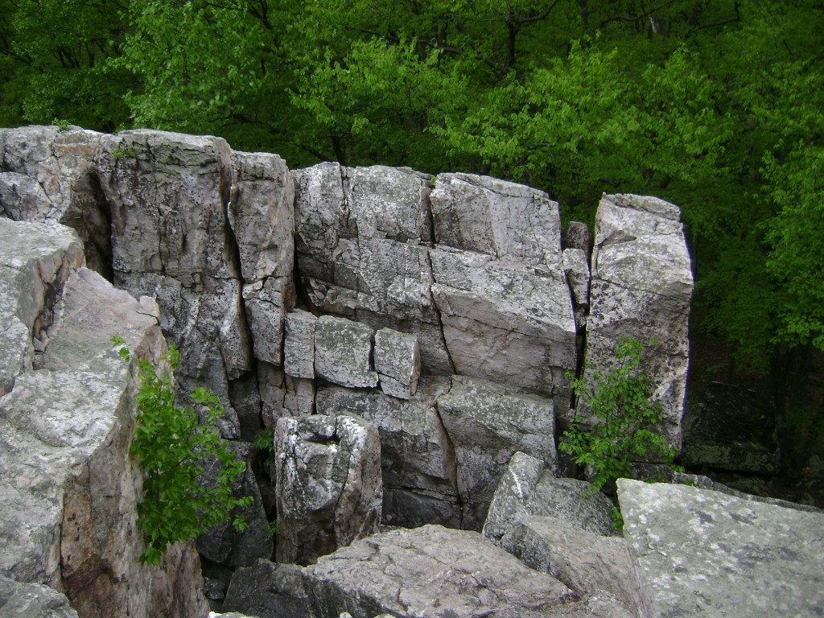
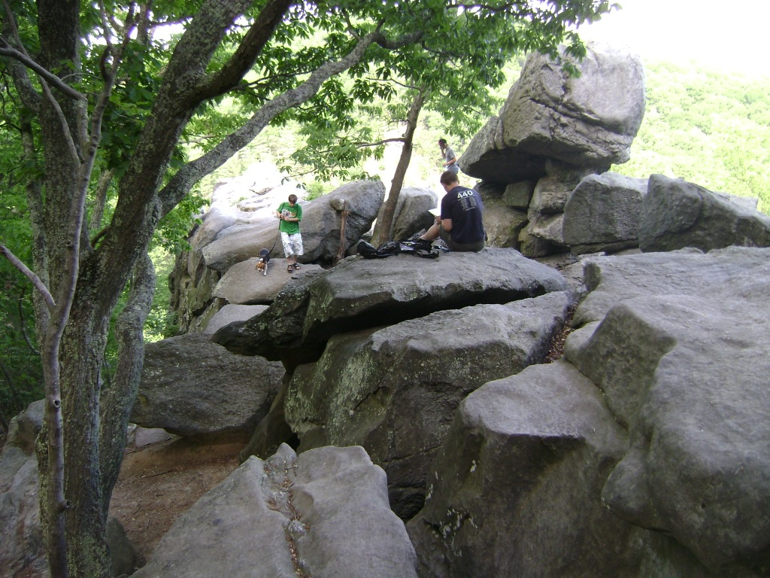

Slide 8
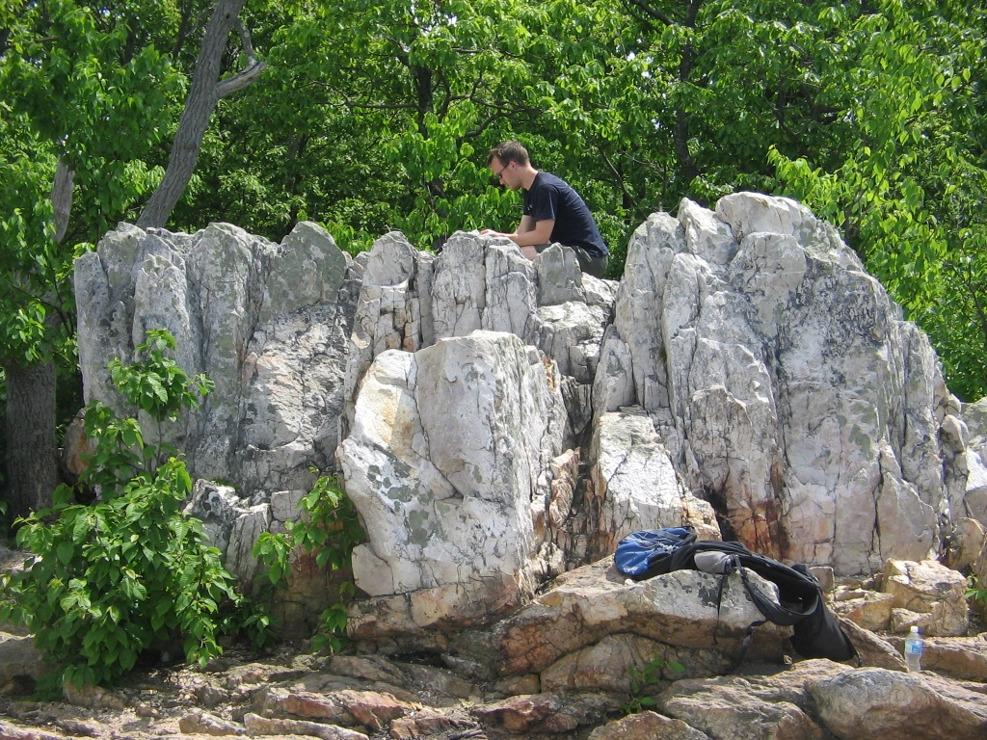
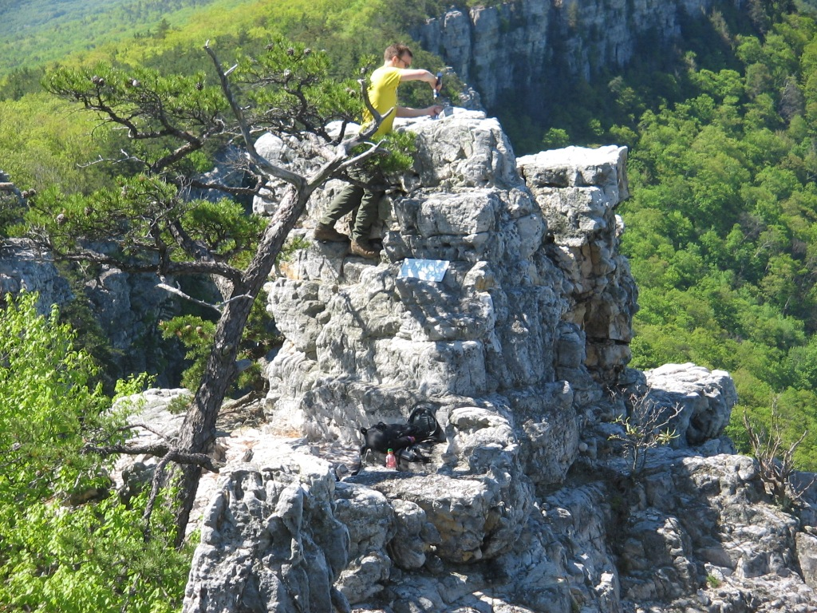
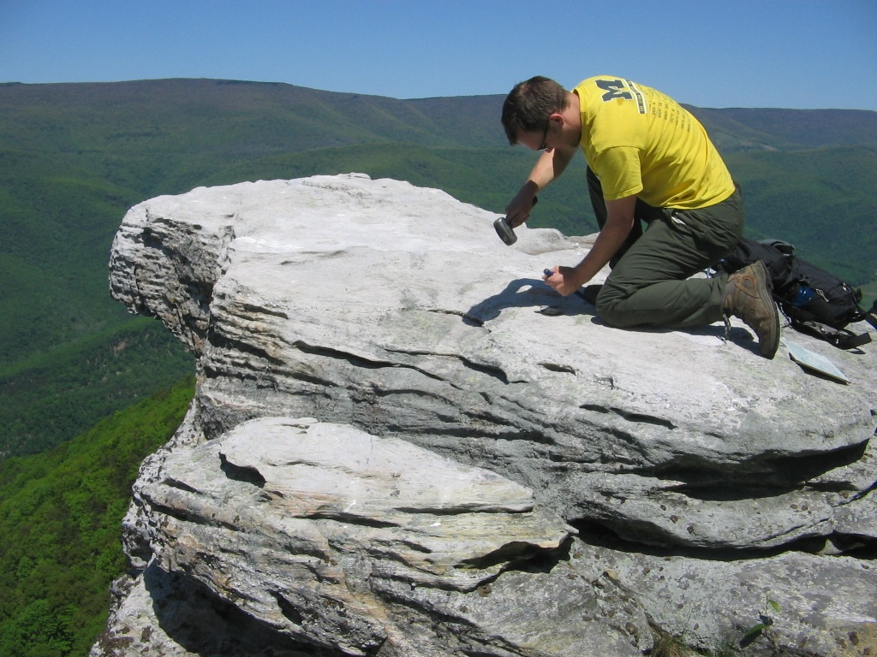
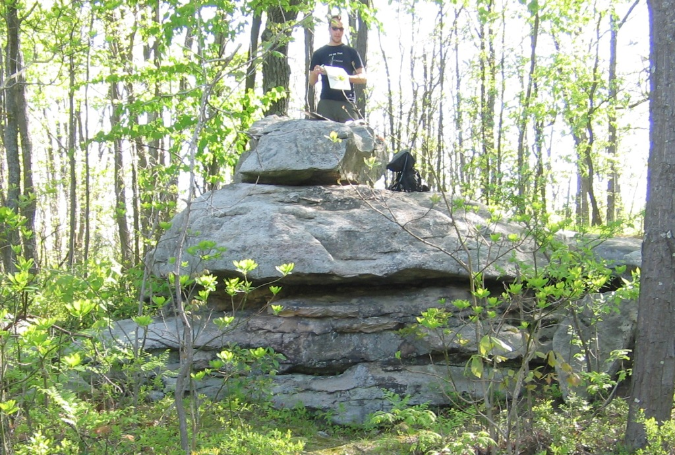

Slide 9
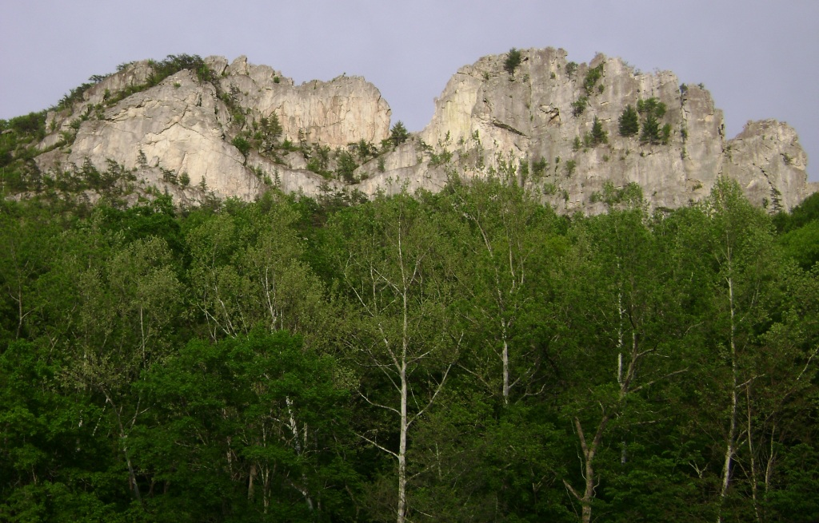
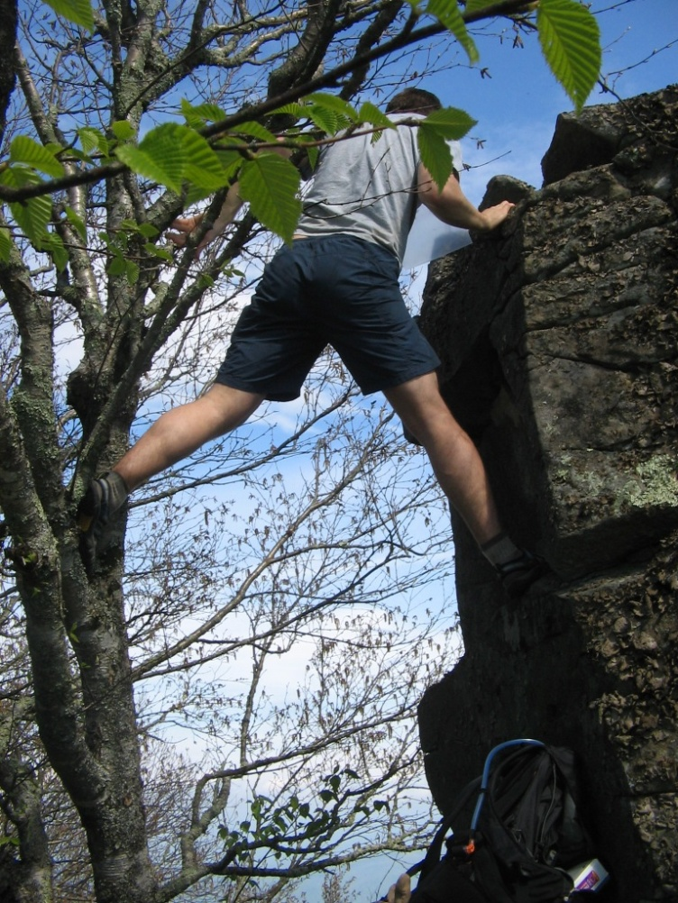
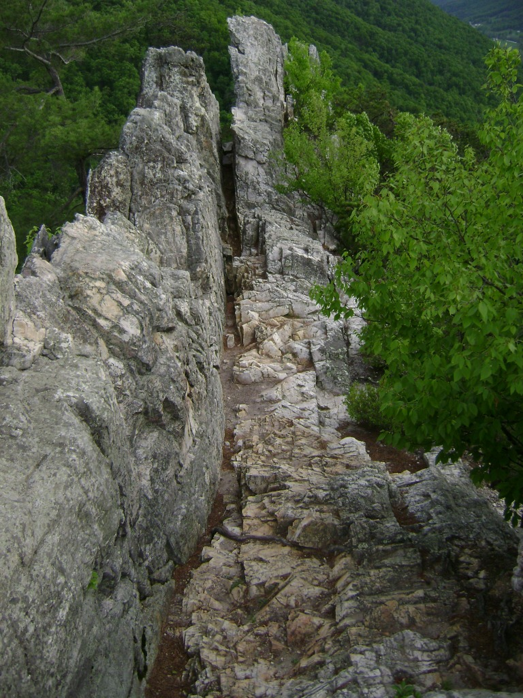
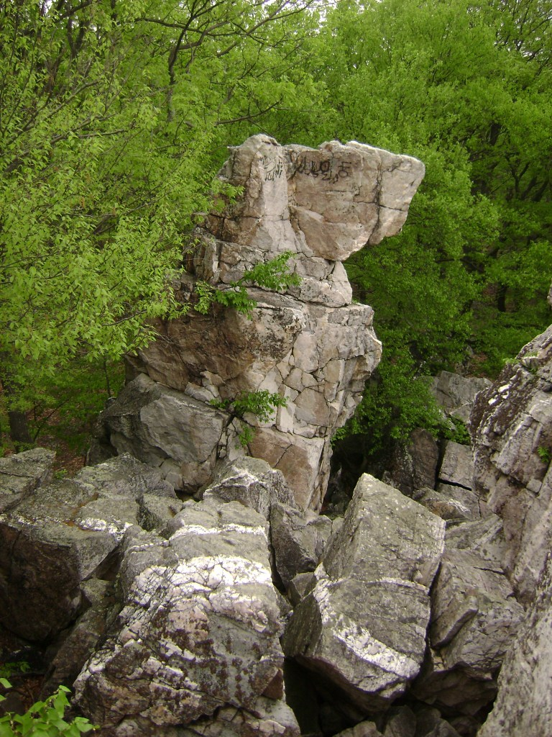

Slide 10
Work Completed: Lab Work
Rock Room – produce monomineralic grains
  Crush/Grind
  Sieve (<250µm, 250-850µm, >850µm)
  250-850µm fraction magnetically separated
Mineral Separation Lab – remove non-quartz minerals
  24hr etch in 6N HCl (2x – or 3x if needed)
  24hr etch in 1% HF/HNO₃ (3x)
  Heavy-liquid density separation
  36hr etch in 0.5% HF/HNO₃
  Week-long etch in 0.5% HF/HNO₃
Meteoric Beryllium Lab – test quartz purity
  0.250g aliquot of each sample digested in HF/H₂SO₄
  HF evaporates overnight
  Bring up H₂SO₄ to 1%
  Run on ICP-OES

Slide 11
Work to be Done: Appalachian Sample
Laboratory Work
66 samples have passed quartz purity tests
  6 samples in week-long 0.5% HF/HNO₃ etch
  Will be tested once more
In-situ Laboratory
  Sample Digestion
  Cation/Anion exchange columns
Overall, 66 samples will be prepared for AMS at Lawrence Livermore National Laboratory

Slide 12
Work Completed
Global ¹⁰Be erosion rate compilation
  Data from 31 sources
    Raw ¹⁰Be concentrations
    Lithology
  Global datasets
Variable | Dataset
Elevation | Gtopo_30: provided by ESRI Software at University of Vermont
Local Relief | Same as Elevation
Peak Ground Acceleration | Global Seismic Hazard Assessment Program (Giardini et al., 1999)*
Climate Zone | Köppen-Geiger Climate System (Peel et al., 2007)
Mean Annual Precipitation | WorldClim Climate Model (Hijmans et al., 2005) †
Mean Annual Temperature | Same as Mean Annual Precipitation†

Slide 13
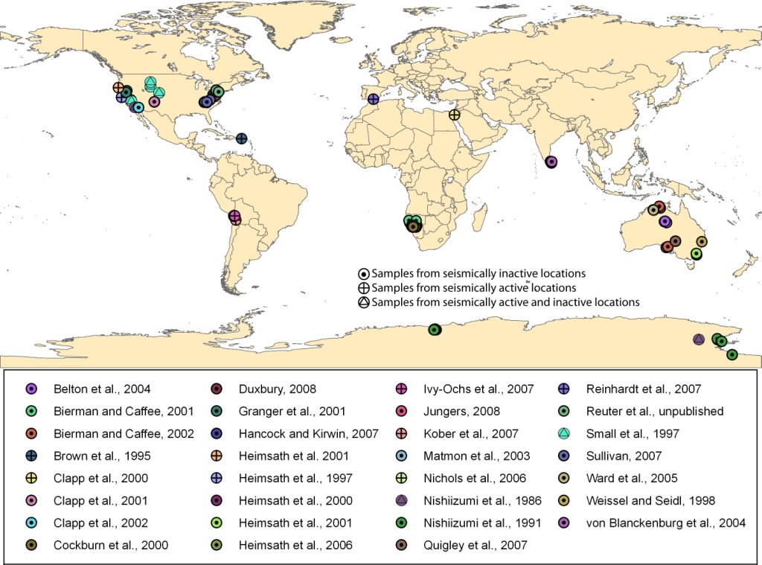

Slide 14
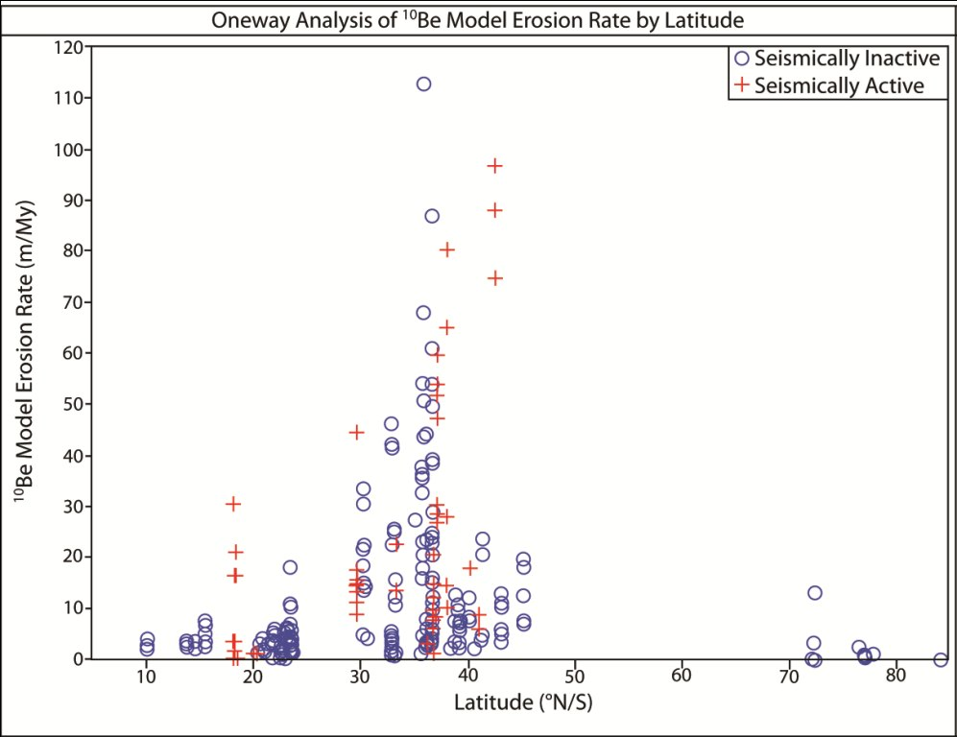
Initial Results: Latitude
Erosion rates peak between 30-50°
Sampling gap between 50-70°
  Glacial complications in the north
  Presence of Southern Ocean in the south

Slide 15
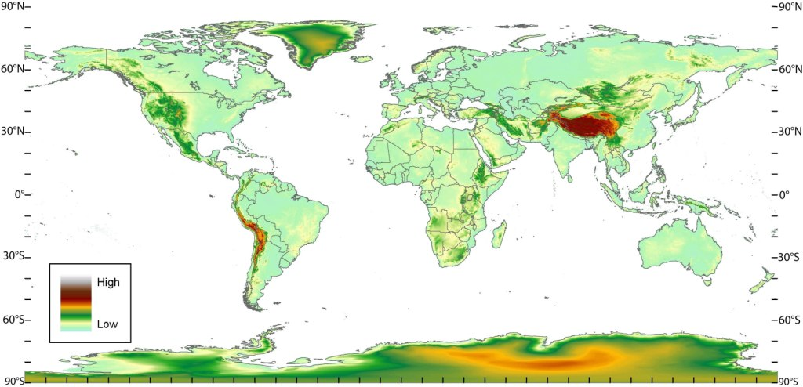
Gtopo_30 elevation dataset

Slide 16
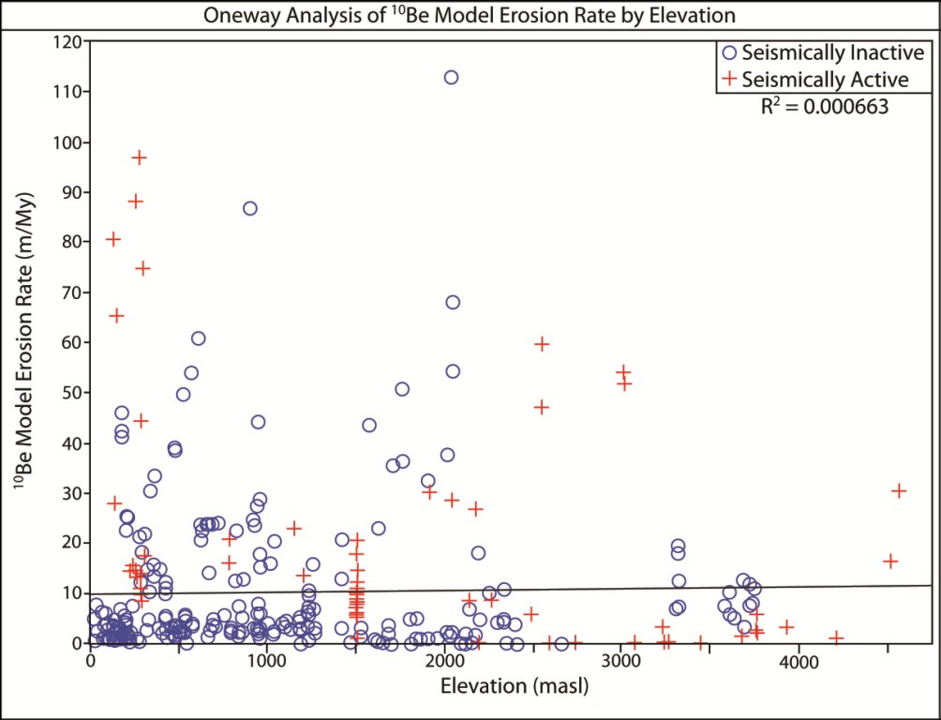
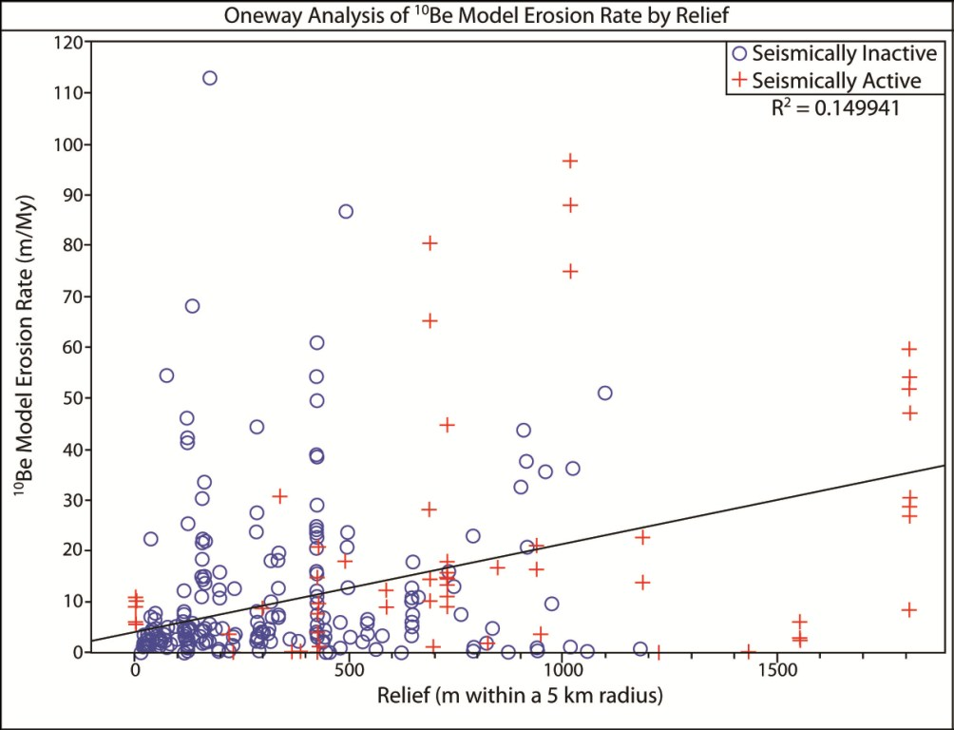
Initial Results: Elevation & Relief
Elevation yields the weakest
correlation with erosion rate
Local relief (r=5km) yields
a weak correlation
(R²=0.001; p=0.6176)
(R²=0.150; p<0.0001)

Slide 17
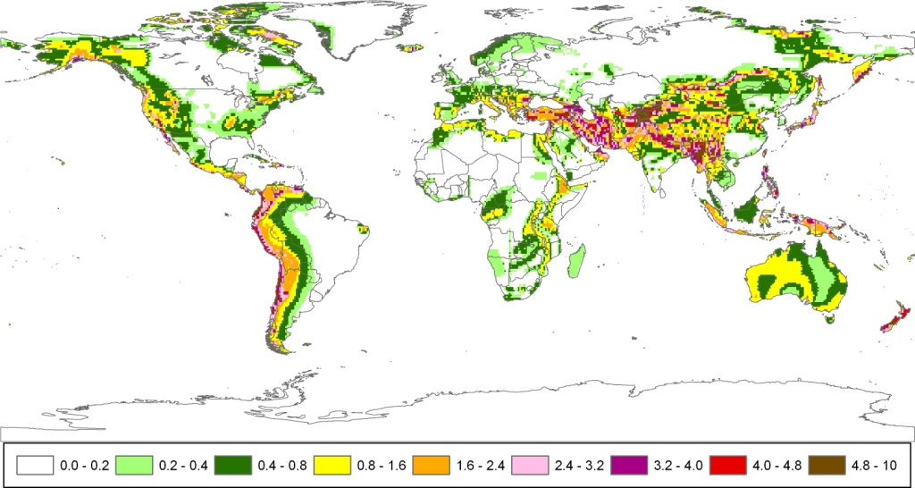
Peak Ground Acceleration
(Giardini et al., 1999)

Slide 18
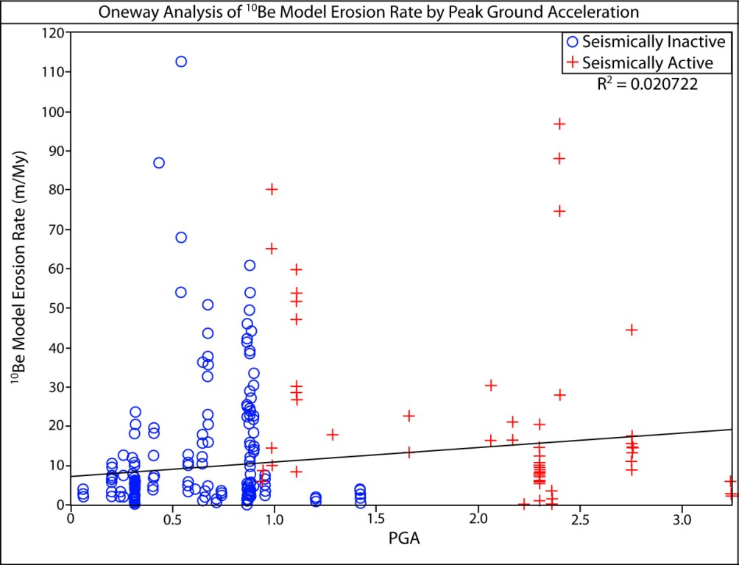
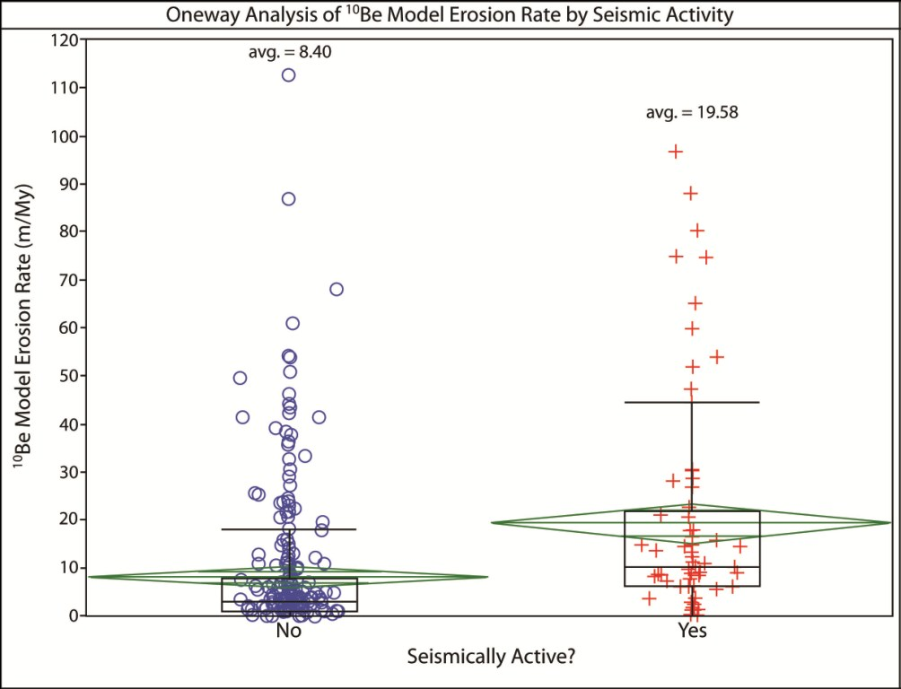
Initial Results: Seismicity
(R²=0.021; p=0.007)
Active (n=69): 19.6±3.0 m My⁻¹
Inactive (n=309): 8.4±1.2 m My⁻¹

Slide 19
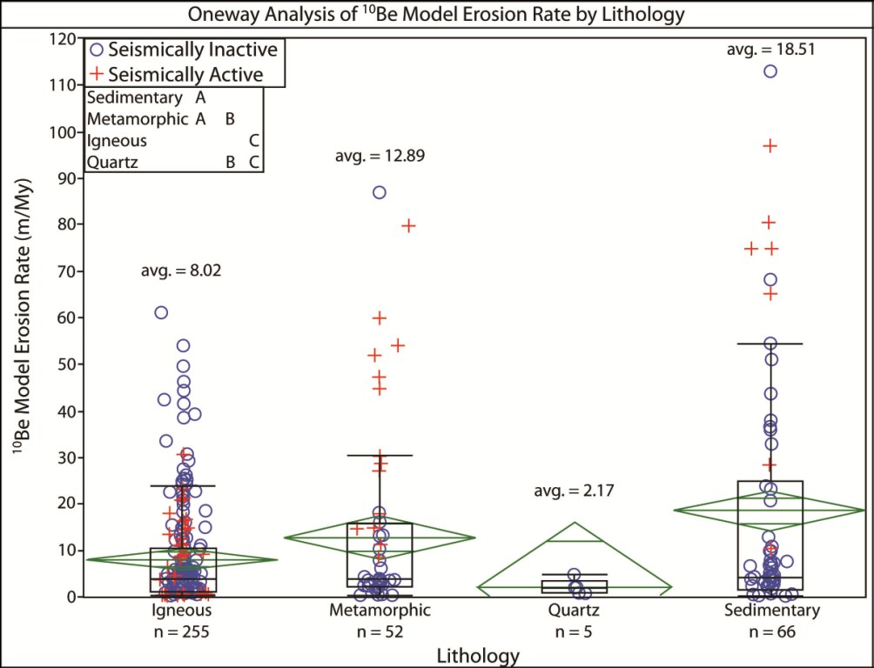
Initial Results: Lithology
Specific lithologies generalized to four categories
Weaknesses along bedding and foliation planes
Note: sample populations vary
Igneous (n=255): 8.0±1.2 m My⁻¹
Metamorphic (n=52): 12.9±1.9 m My⁻¹
Quartz (n=5): 2.2±0.3 m My⁻¹
Sedimentary (n=66): 18.5±2.8 m My⁻¹

Slide 20
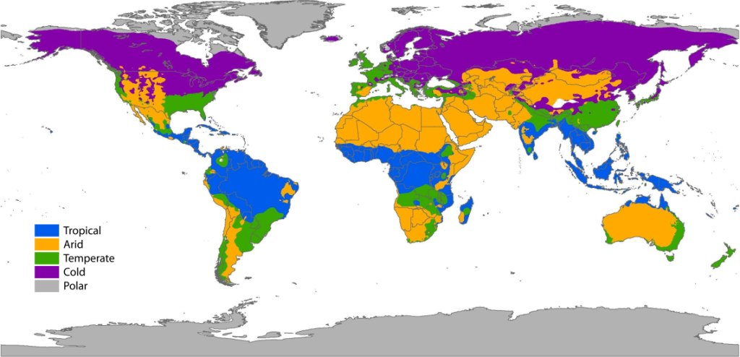
Köppen-Geiger Climate Classification
(Peel et al., 2007)

Slide 21
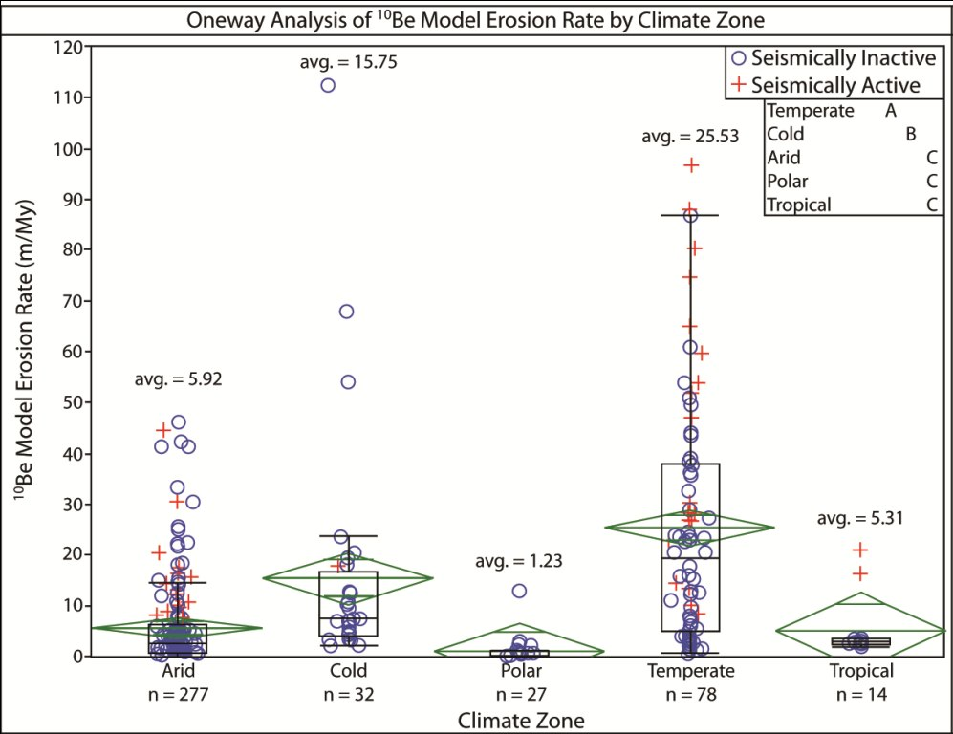
Initial Results: Climate Zone
Utilize five generalized zones
Note: sample populations vary
Climates with temperature fluctuations see highest erosion rates
Arid (n=277): 5.9±0.9 m My⁻¹
Cold (n=32): 15.8±2.4 m My⁻¹
Polar (n=27): 1.2±0.2 m My⁻¹
Temperate (n=78): 25.5±3.7 m My⁻¹
Tropical (n=14): 5.3±0.3 m My⁻¹

Slide 22
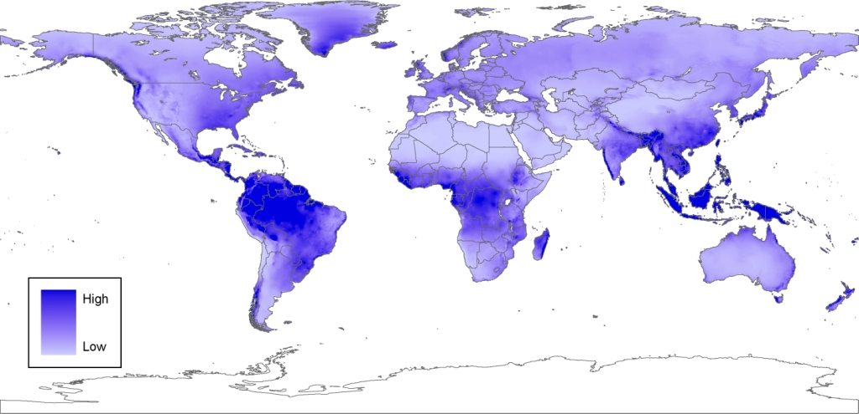
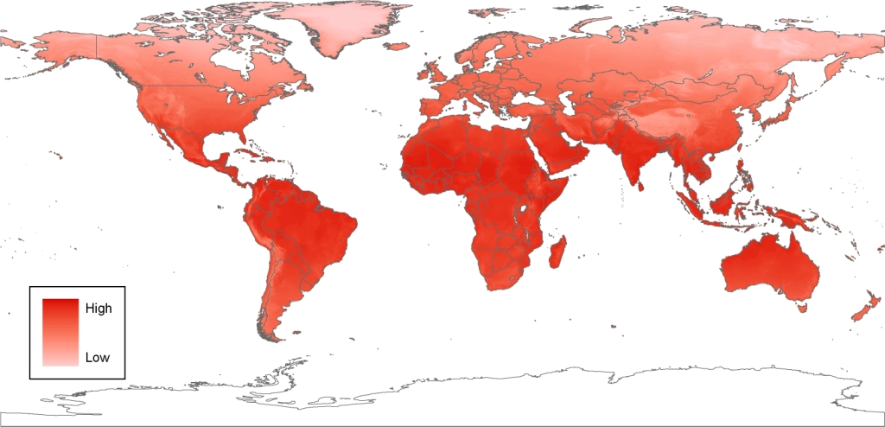
Individual Climate Components
Mean Annual Precipitation (mm/yr)
Mean Annual Temperature (°C)
WorldClim model (Hijmans et al., 2005)

Slide 23
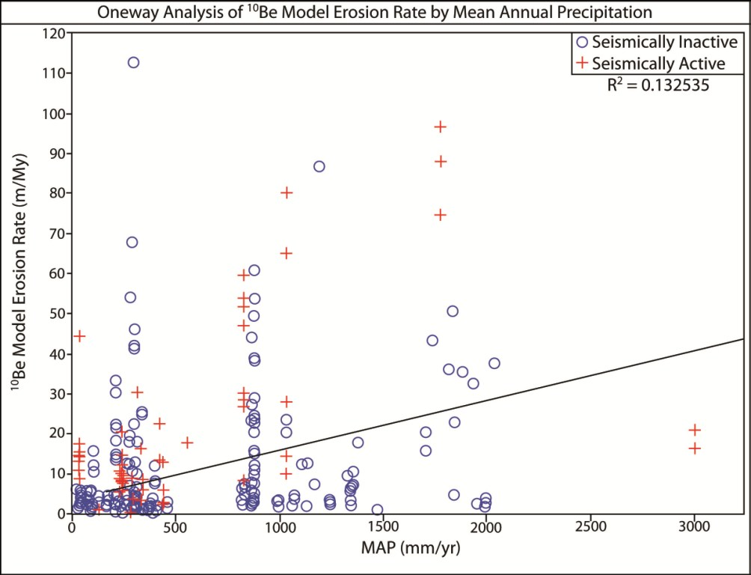
Initial Results: MAP
MAP shows a weak correlation with erosion rates
  Freeze-thaw cycling (Cold & Temperate)?
  Chemical weathering (Temperate & Tropical)?
(R²=0.133; p<0.0001)

Slide 24
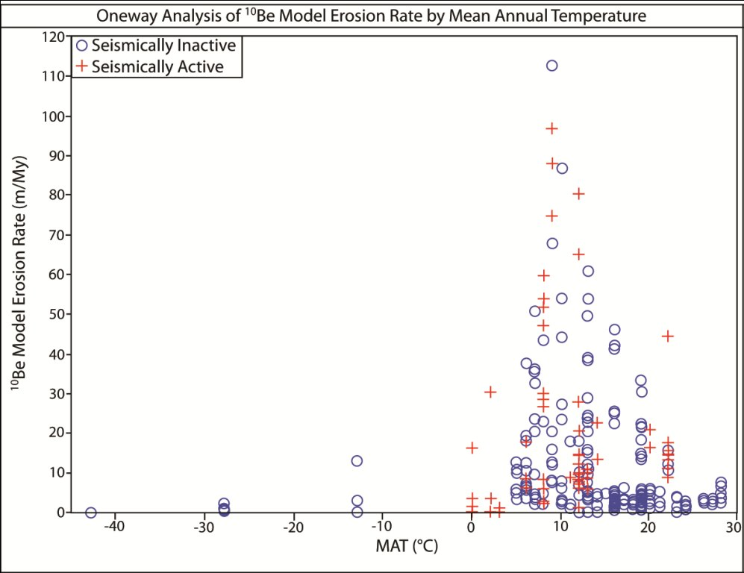
Initial Results: MAT
Erosion rates spike between 0-25°C
  Where Cold and Temperate climates are dominant
  Extremely high and low temperatures are not favorable for retaining moisture

Slide 25
Initial Results: Multivariate Regression
Forward Step-wise Regression
  Categorical data
    Lithology
    Climate Zone
    Seismic Activity
  Global Scale
p-values are ranked
If p<Probability to Enter →variable is entered into regression
Variables entered one at a time
New p-values generated
If p>Probability to Leave →variable is removed

Slide 26
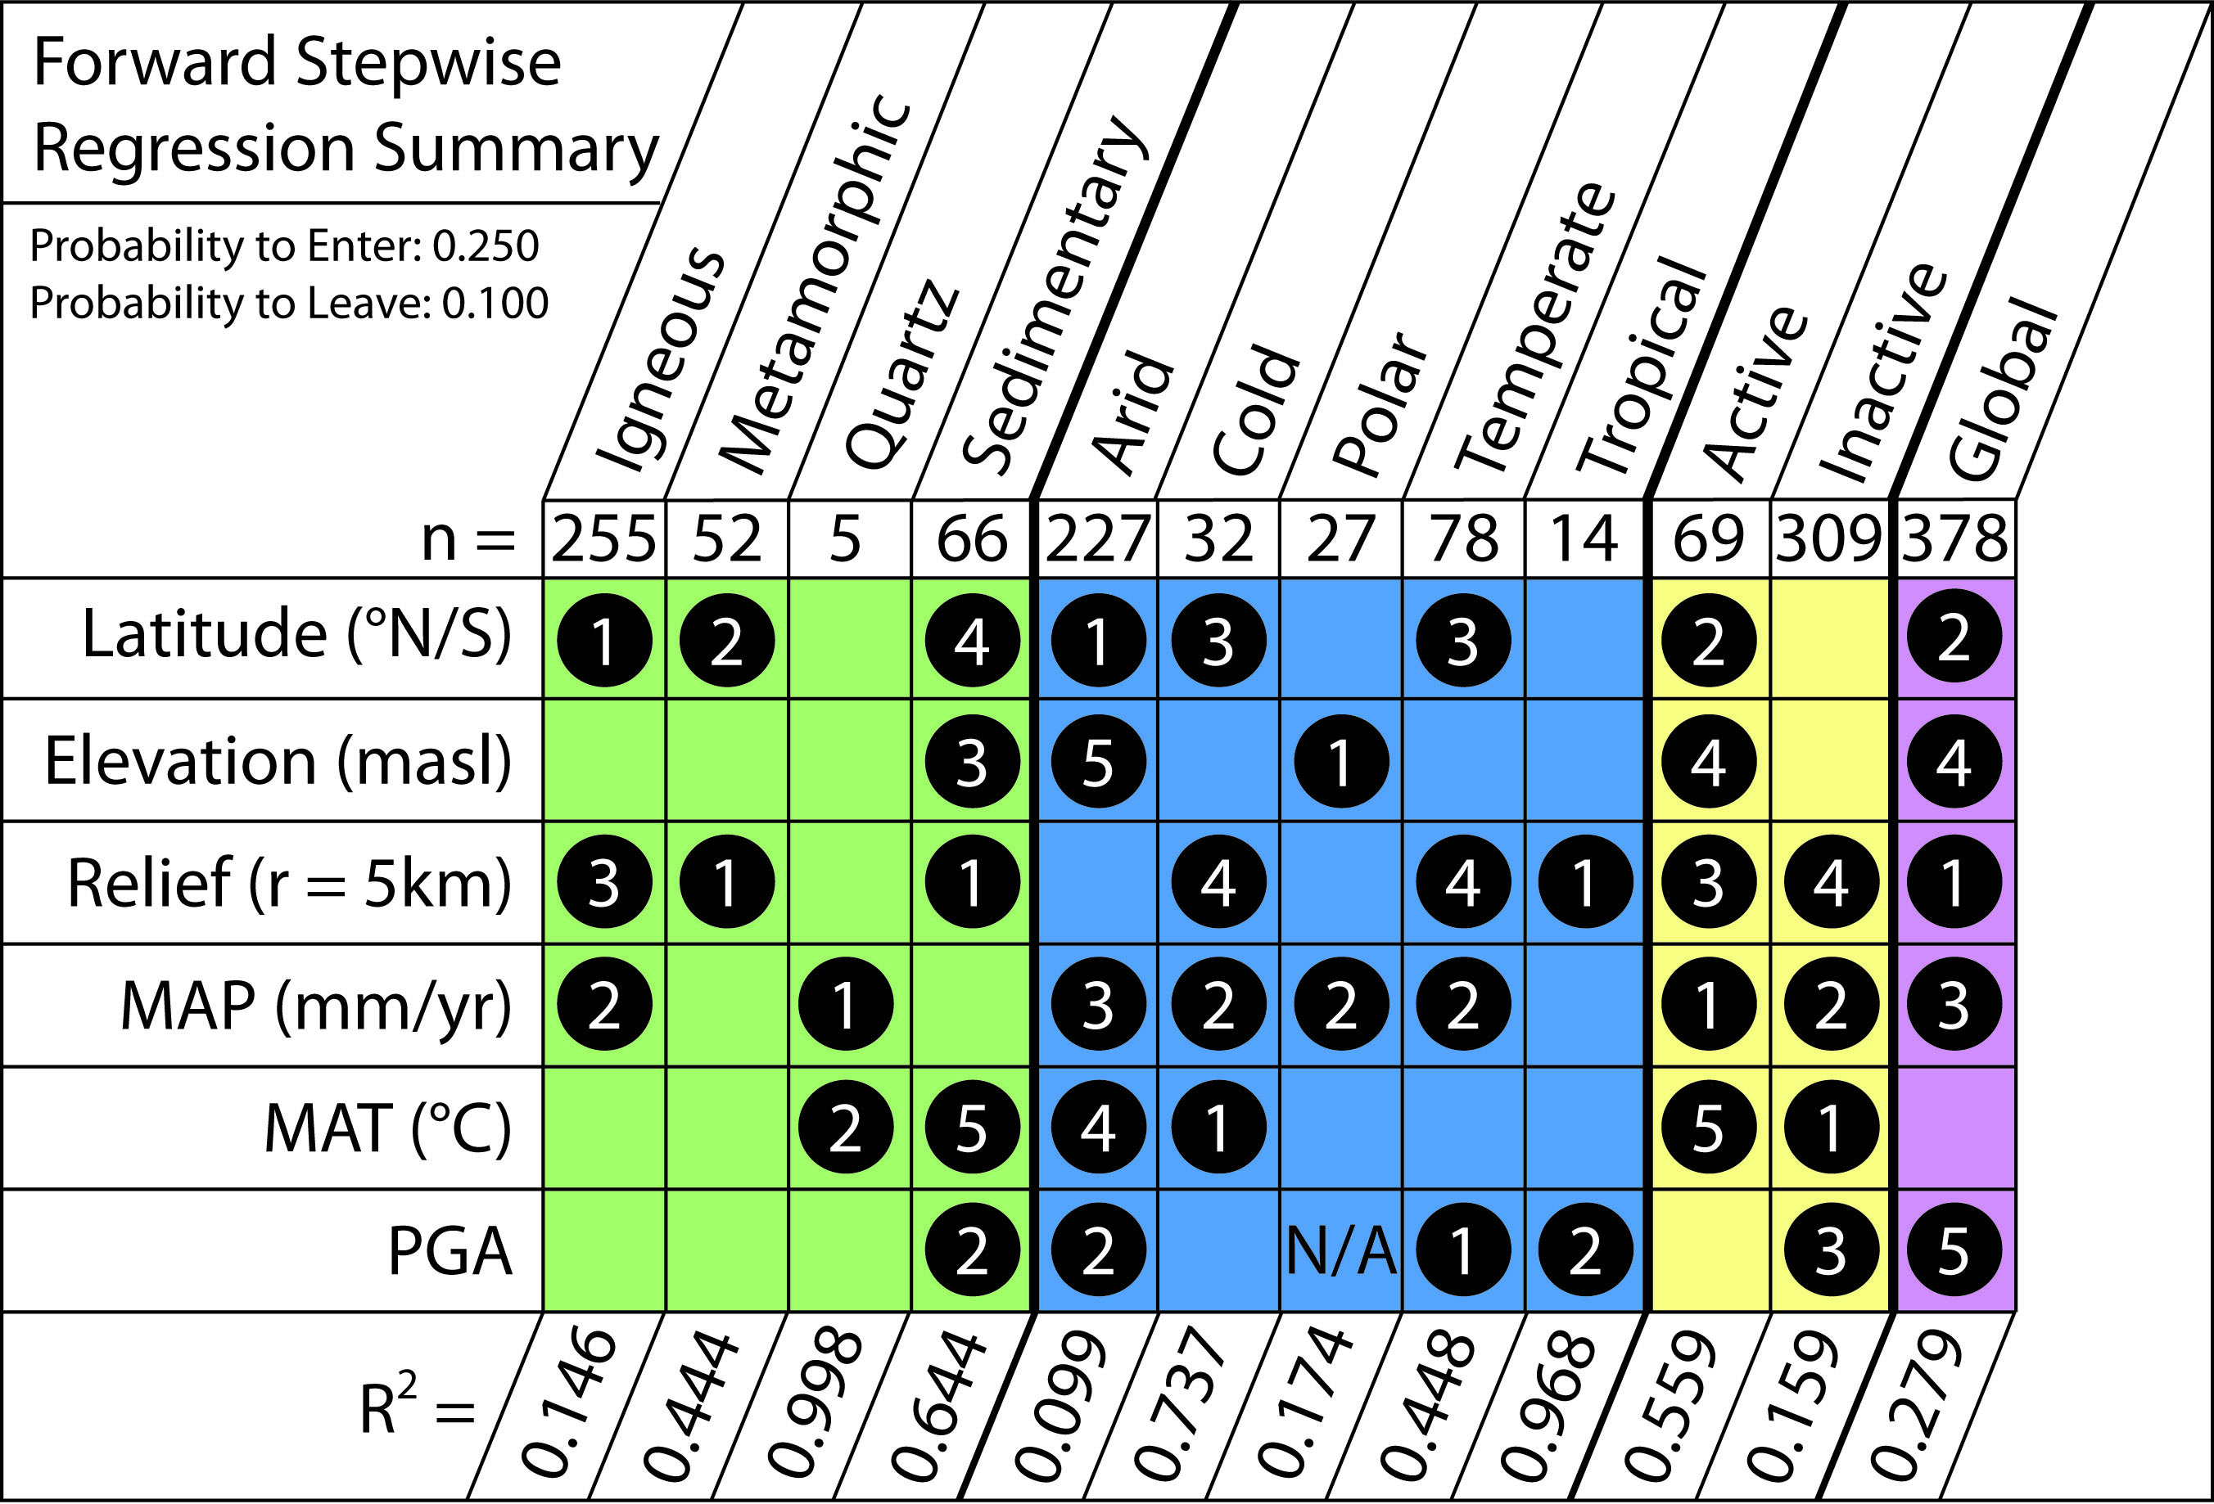

Slide 27
Initial Results: Multivariate Regression
Stratification of global erosion rates by categorical data improves the regression
Important parameters stand out
  Relief, MAP, Latitude also best-fit one-way parameters
Six variables used do well explaining variation in some categories but not others

Slide 28
Biases Inherent to the Data
Glaciation limits ¹⁰Be interpretive power
Limited data for regions of political unrest and weak economies
Quartz-bearing lithologies limits distribution of potential sampling sites
Climate Zones and Lithologies are underrepresented
Joint spacing and fracture density information is not provided

Slide 29
Work to be Done: Global Erosion Publication
Update database with few missed publications providing more bedrock samples
Update basin-averaged ¹⁰Be erosion rate summary compiled by Joanna Reuter (2005)
Synthesize two global compilations as basis of first publication

Slide 30
Timeline
December 2009 | Finish bedrock and basin-averaged data compilation and begin writing manuscript Continue quartz purity tests
January 2010 | Begin in situ laboratory methods Submit global summary manuscript (journal TBA)
February 2009 | Finish in situ laboratory work
March 2010 | Run samples using AMS at Lawrence Livermore National Laboratory Receive data
April 2010 | Data Analysis
Summer 2010 | Write thesis Write manuscript for Appalachian bedrock paper
Fall 2010 | Defend thesis in early Fall Submit Appalachian bedrock manuscript Prepare for/give talk at GSA

Slide 31


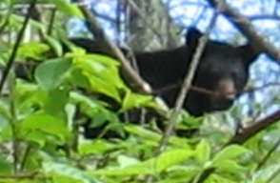
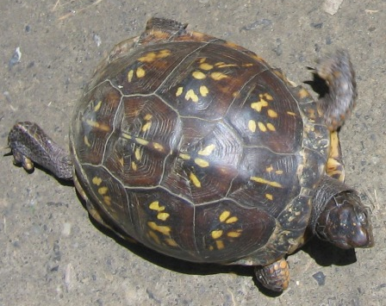
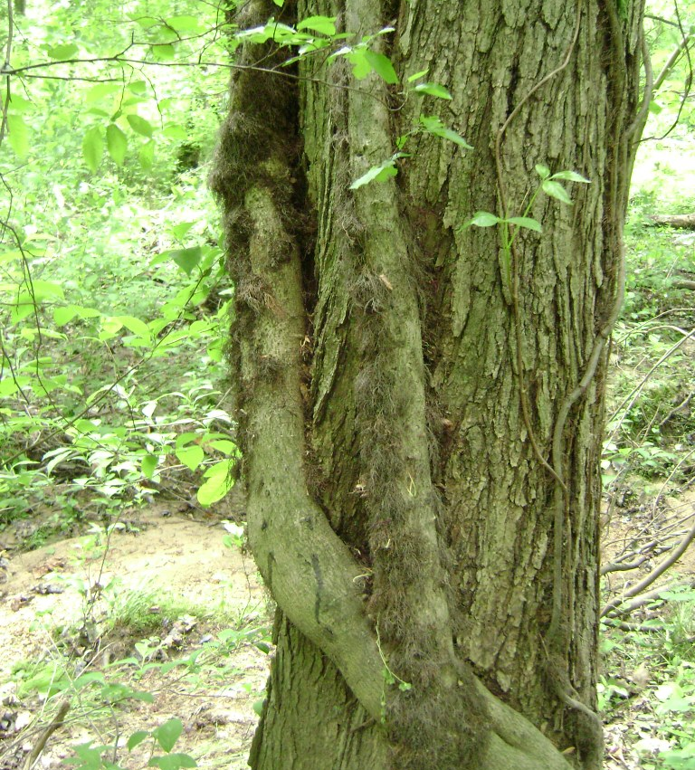
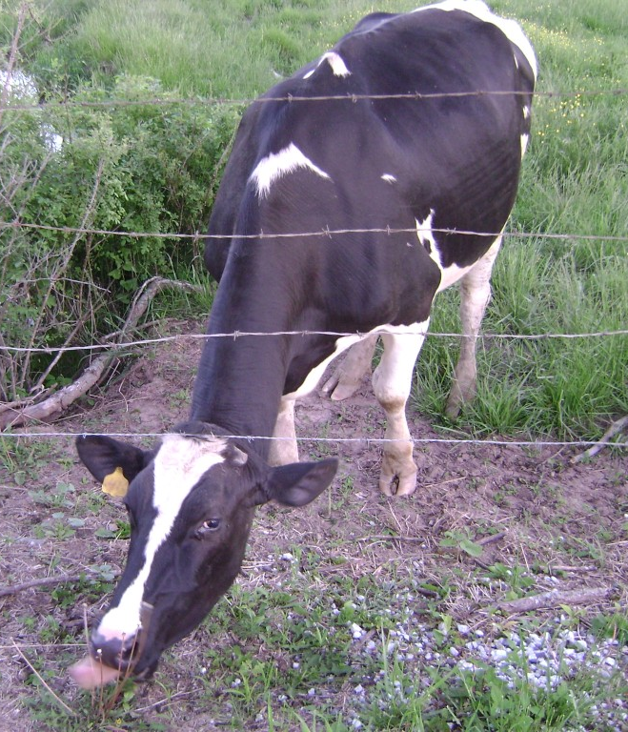
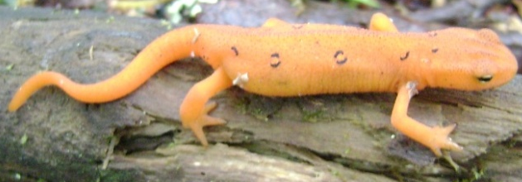
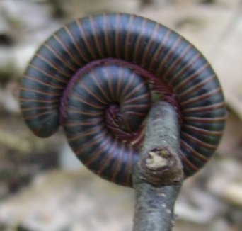
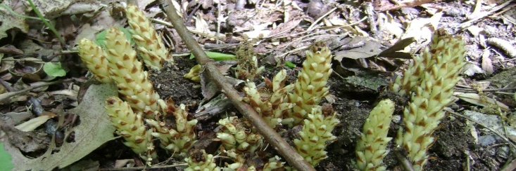
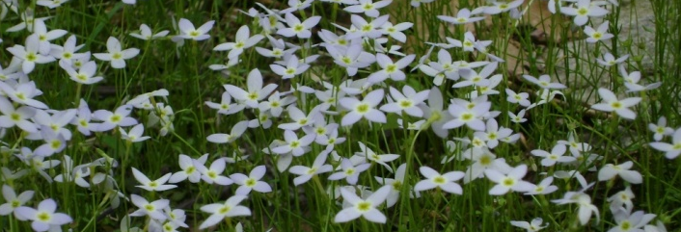
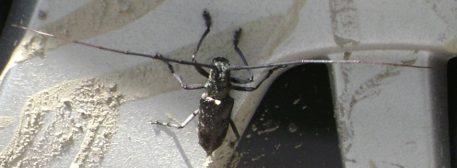
Thank You

