Slide 1
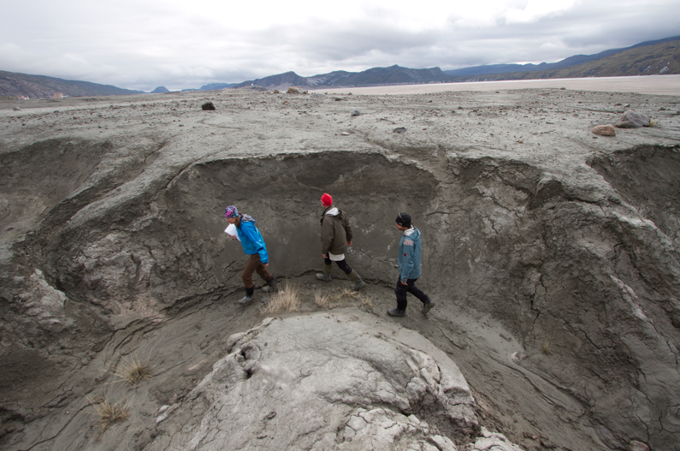
Using in situ ¹⁰Be as a sediment source tracer in Greenland’s paraglacial environment
Alice Nelson
May 24th, 2013

Slide 2
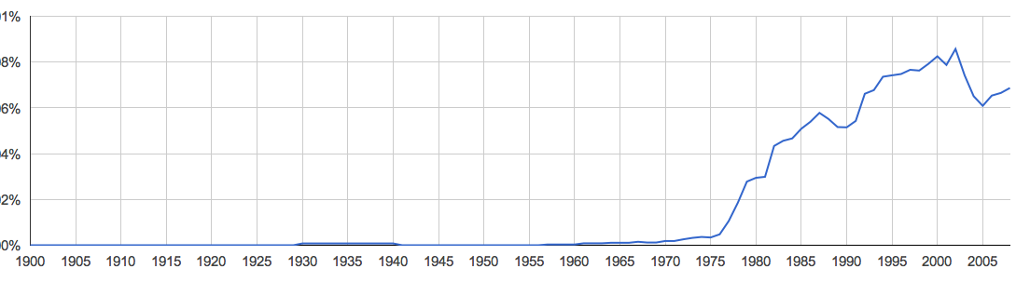
the paraglacial environment
An exposed landscape subject to rapid change by
glacial and non-glacial processes acting upon a
landscape conditioned by glaciation
-Church and Ryder, 1972
…existing within a timeframe over which glacially
conditioned sediment is either released from the
landscape or reaches an equilibrium,
non-glacial state
-Ballantyne, 2002
Church and Ryder

Slide 3
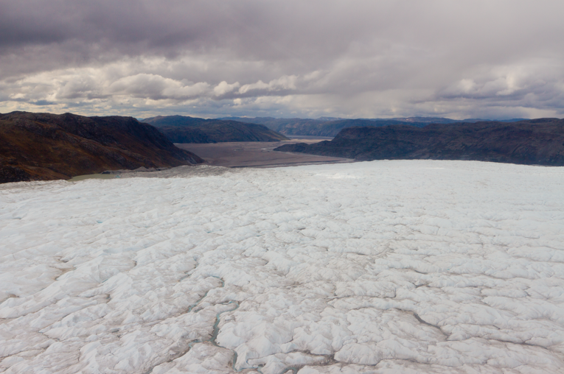
Research Goals
1. What is the ¹⁰Be concentration in sediment sourced from the exposed landscape?
3. What is the relative contribution of glaciers versus exposed hill slopes to Greenland’s paraglacial sediment budget?
2. What is the ¹⁰Be concentration
in glacial sediment?
Photo: Josh Brown

Slide 4
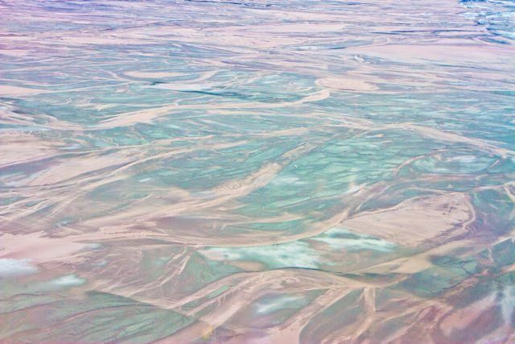
Talk Outline
Background
  In situ produced cosmogenic ¹⁰Be
  Glacial history of Greenland
  Sediment sources on Greenland
Methods
  Field sites
  Sample collection and processing
Data analysis/Results
  Part I: ¹⁰Be as a source tracer
  Part II: ¹⁰Be as a dosimeter of exposure
Interpretations
Conclusions
Implications for future research

Slide 5
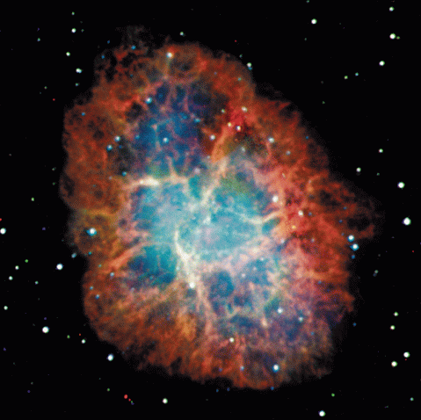
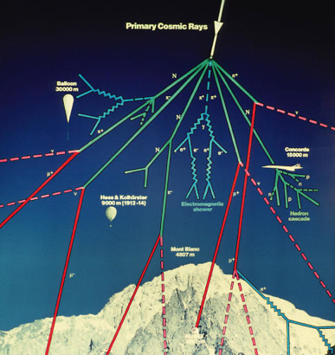
Background: in situ cosmogenic ¹⁰Be
What are cosmic rays?
High speed particles (mostly protons)
that originate in super novas
As they approach the earth they
collide with one another – creating a
shower of protons, neutrons, and
muons
Many are attenuated in Earth’s
atmosphere, some reach the Earth
where they change matter
isotopically
Nasa.gov
Diagram from CERN

Slide 6


Background: in situ cosmogenic ¹⁰Be
¹⁰Be is produced in near surface rocks and sediments because
of terrestrial exposure to cosmic rays
Production by spallation:
3.98 atoms g⁻¹ a⁻¹
Production by muons:
~0.1 atoms g⁻¹ a⁻¹
2 km
2 m
¹⁰Be is not produced because of shielding by ice
300+ m

Slide 7
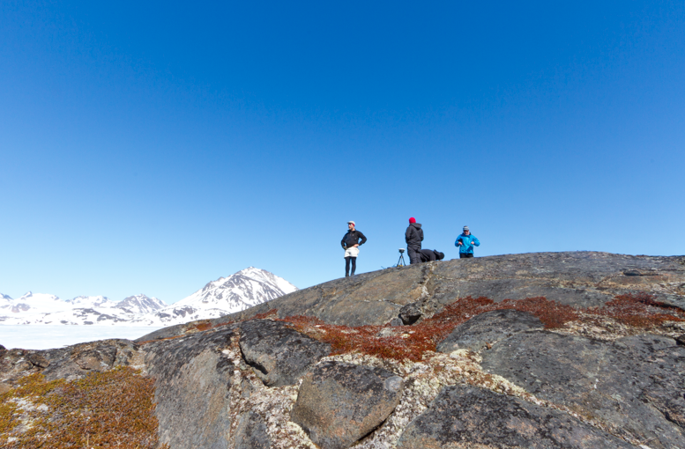
Background: in situ cosmogenic ¹⁰Be
In bedrock and boulders
¹⁰Be concentration can be used to date ice retreat

Slide 8
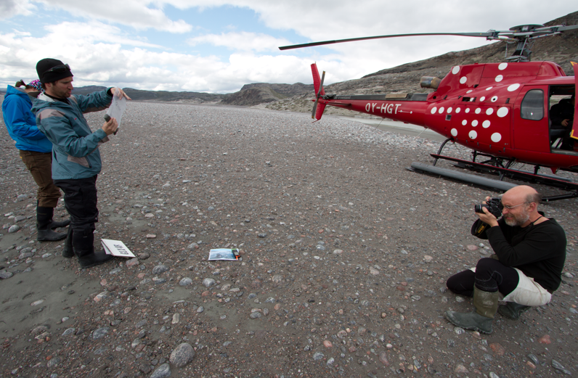
Background: in situ cosmogenic ¹⁰Be
In sediment
¹⁰Be concentration is a cosmic ray dosimeter - if different sediment sources have different characteristic concentrations of ¹⁰Be, isotope concentration can be used as a tracer

Slide 9
Background: Glacial history of Greenland
Pliocene
Pliestocene
warmer
Pleistocene
100 ky cycles
δ¹⁸O
Onset of Northern Hemisphere Glaciation
colder
Millions of years before present
Data from (Lisiecki and Raymo, 2005)

Slide 10
Background: Glacial history of Greenland
Pliocene
Pliestocene
warmer
Pleistocene
100 ky cycles
δ¹⁸O
Onset of Northern Hemisphere Glaciation
colder
Millions of years before present
Data from (Lisiecki and Raymo, 2005)

Slide 11
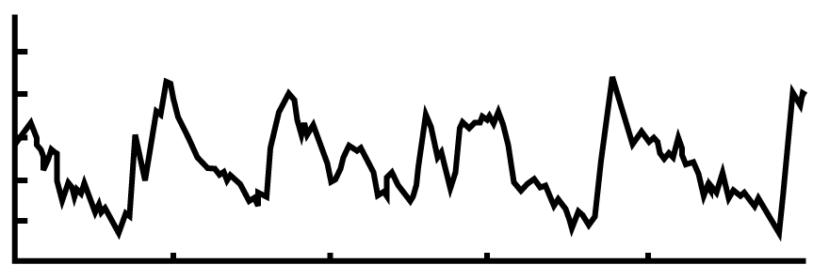
Background: Glacial history of Greenland
10–20 m
6–13 m
Sea level rise
~2 m
3
11
9
5E
1
7
2
Ocean Temperature (°C)
1
3
0
-1
10
8
6
4
2
0.5 0.4 0.3 0.2 0.1 0
Millions of years before present

Slide 12
Background: Glacial history of Greenland
10–20 m
6–13 m
Sea level rise
~2 m
3
11
9
5E
1
7
2
1
3
Ocean Temperature (°C)
0
-1
10
8
6
4
2
0.5 0.4 0.3 0.2 0.1 0
Millions of years before present

Slide 13
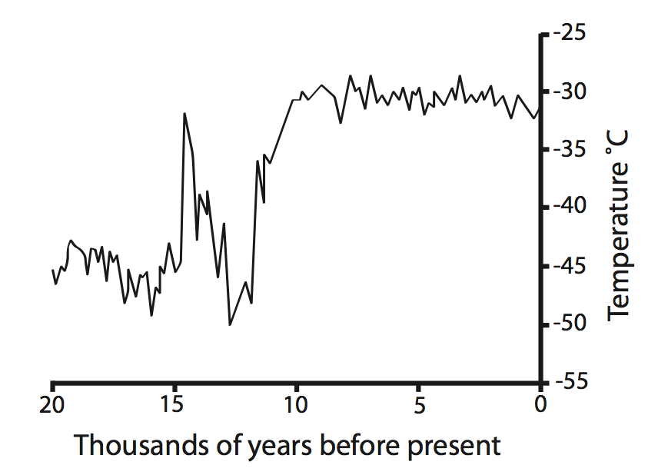
Background: Glacial history of Greenland
The Holocene (~12 ka to present)
Ice sheet readvances
Current land margins become ice-free
Ice retreats inland (??)
Ice retreats to the current ice margin

Slide 14
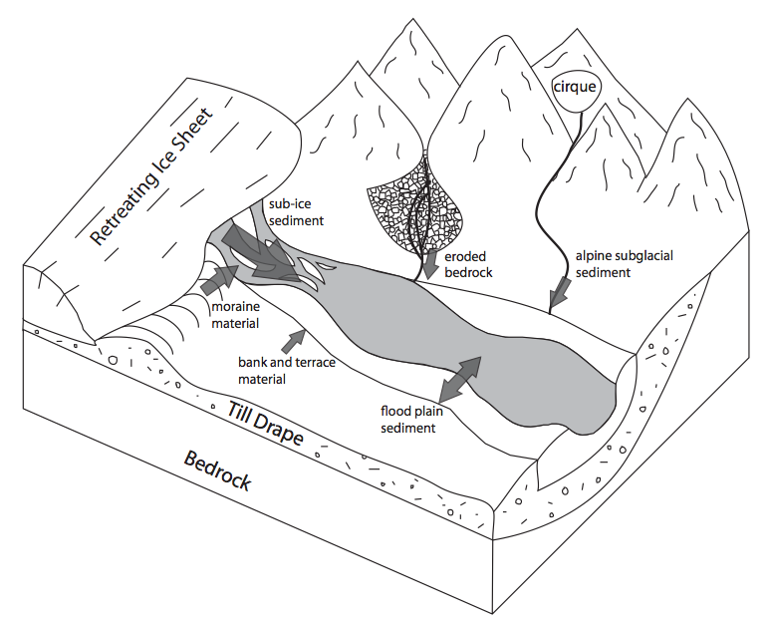
Background: sediment sources

Slide 15
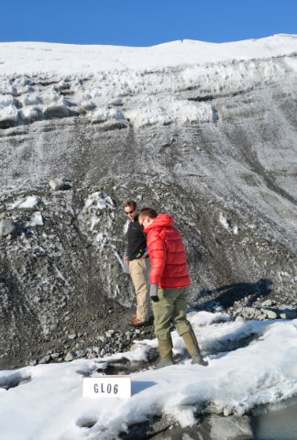
Background: sediment sources
from beneath the ice

Slide 16
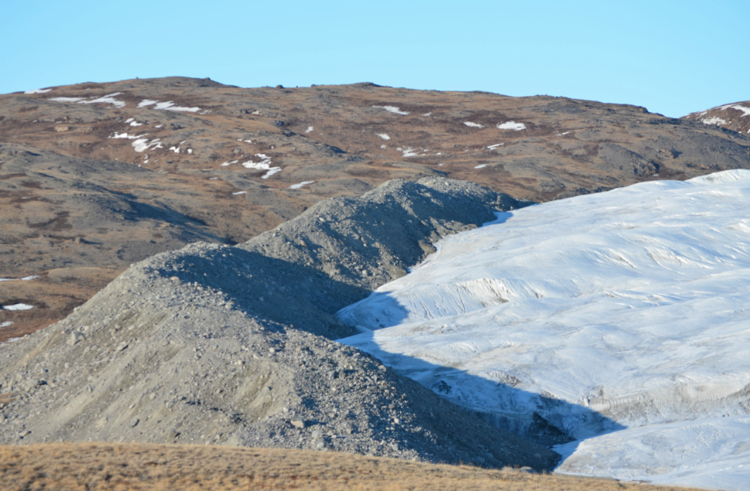
Background: sediment sources
mobilized from moraines

Slide 17
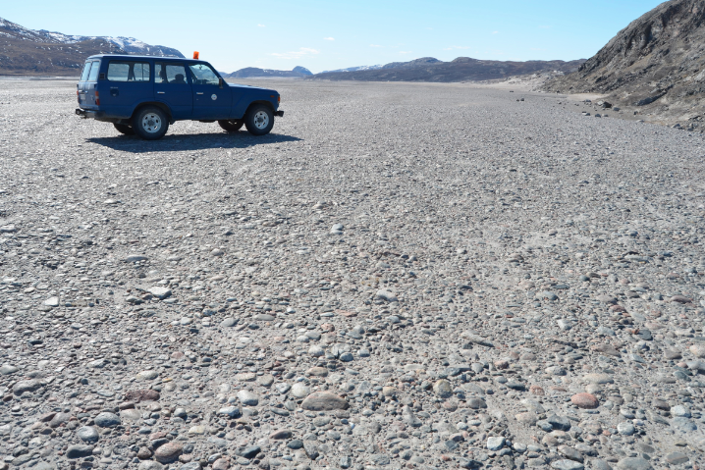
Background: sediment sources
long-term storage in terraces

Slide 18
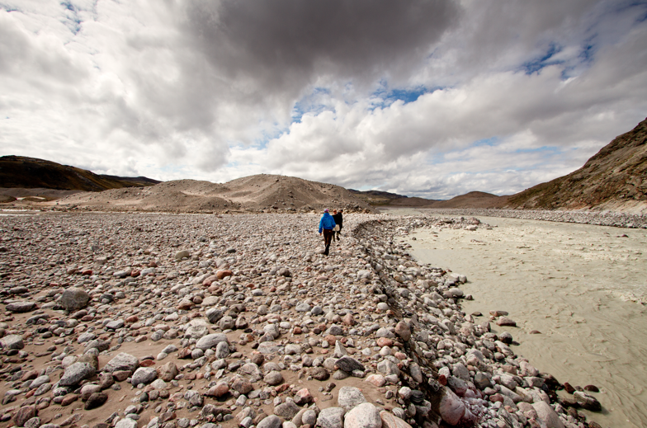
Background: sediment sources
temporary storage in flood plains

Slide 19
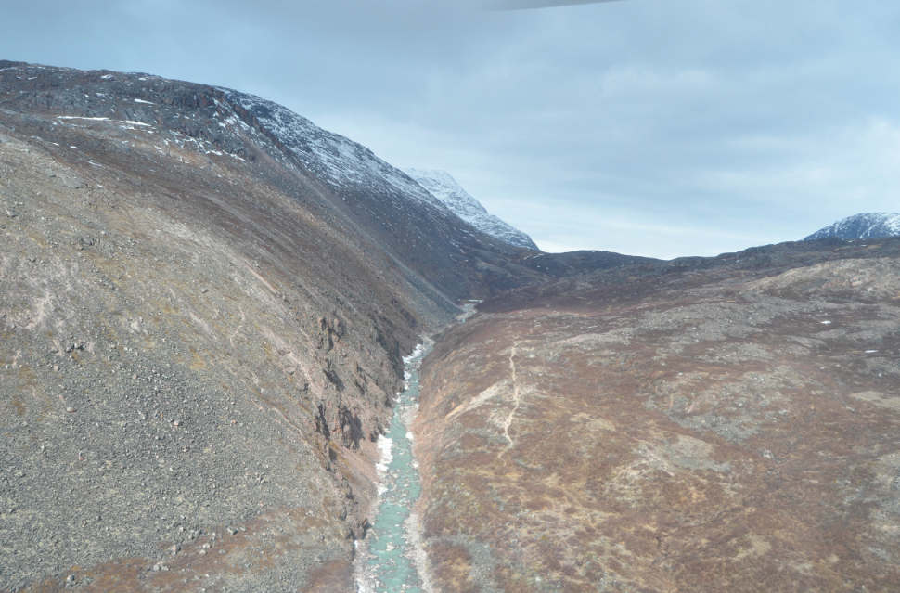
Background: sediment sources
eroded from exposed slopes

Slide 20
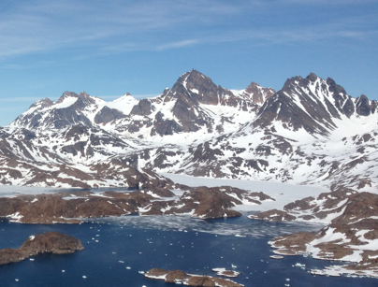
Background: sediment sources
sourced from alpine glaciers

Slide 21
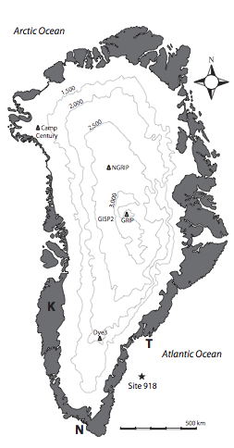
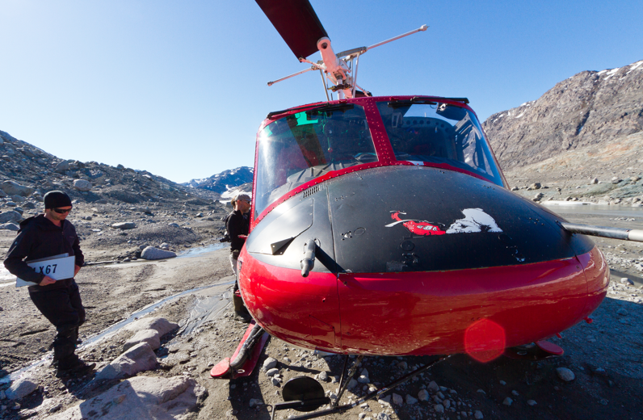
Methods: Field Sites
Kangerlussuaq
Tasiilaq
2011, 2012
2012
Narsarsuaq
2011

Slide 22
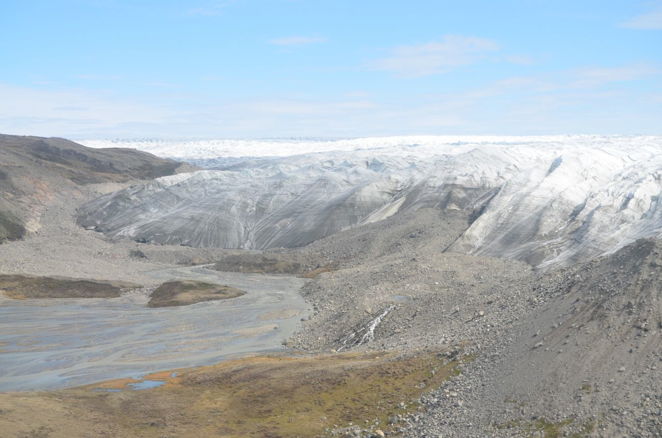
Methods: Field Sites
Kangerlussuaq
Ice margin is at low elevations
~180 km inland of the coast

Slide 23
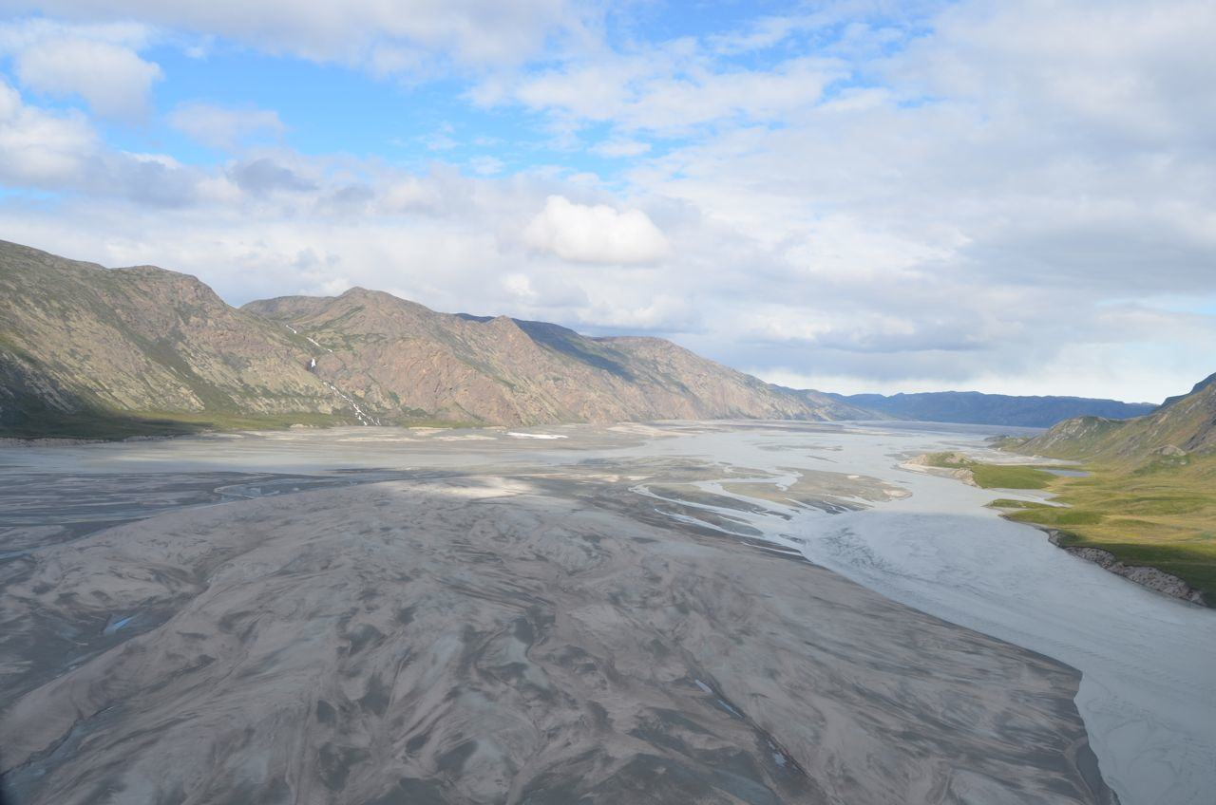
Methods: Field Sites
Kangerlussuaq
Outwash flows through wide valleys, ~20 km to the fjord head

Slide 24
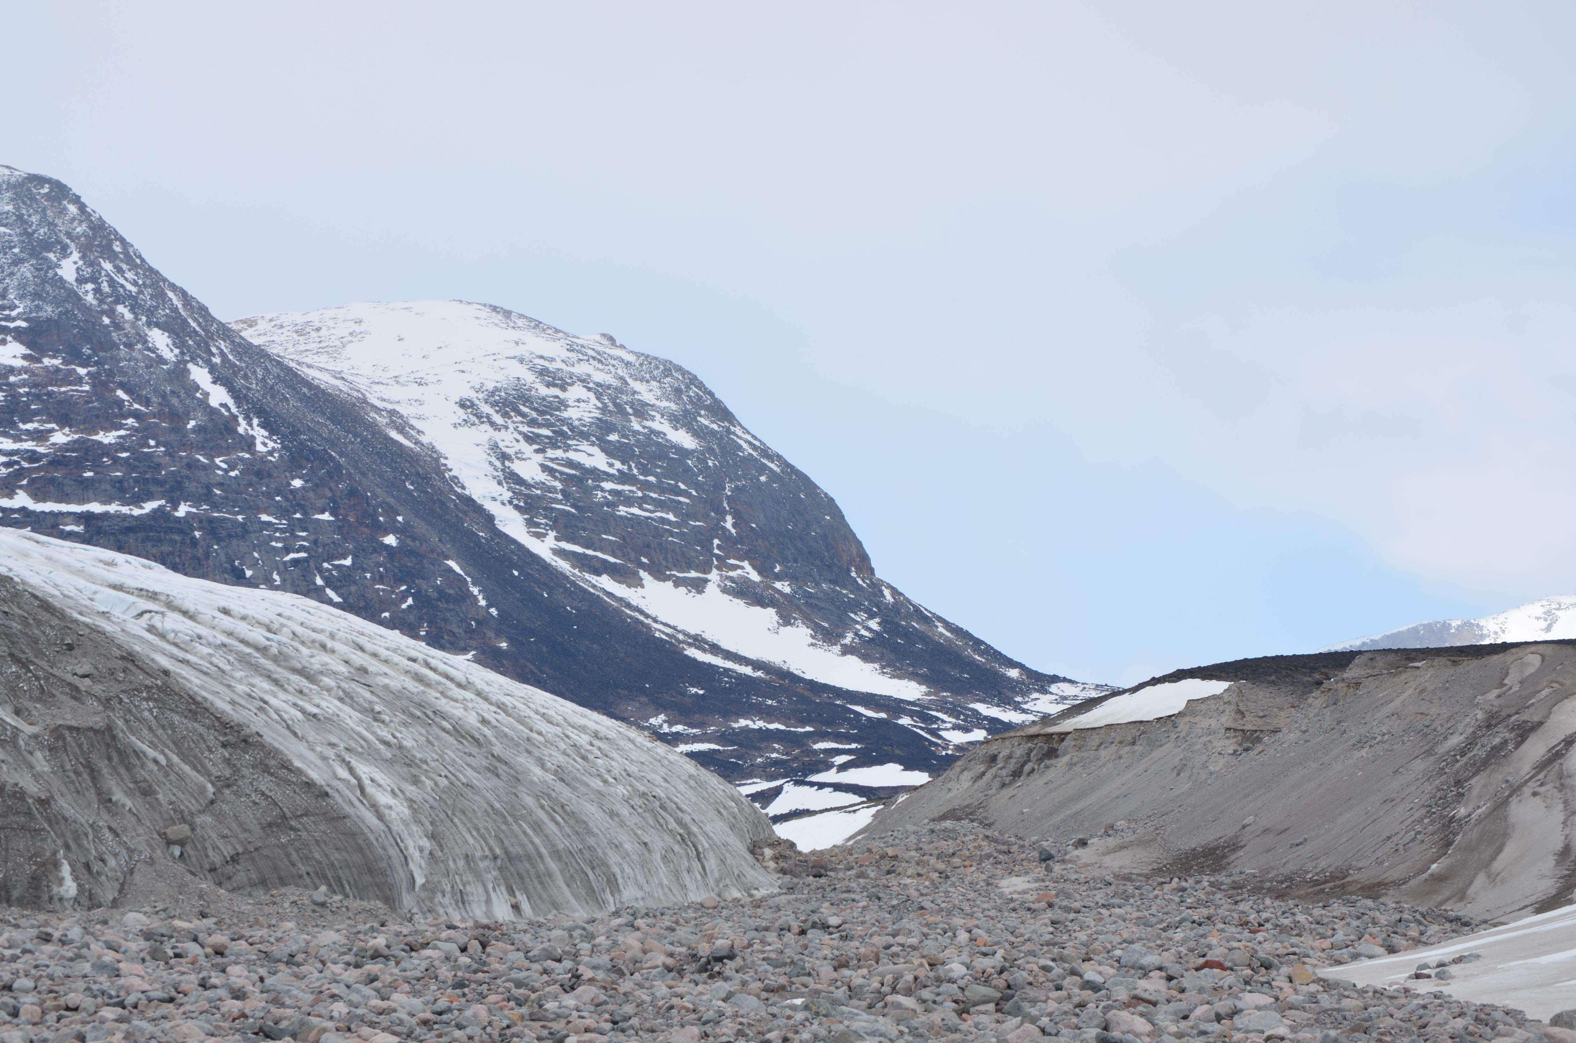
Methods: Field Sites
Narsarsuaq
Ice margin is mostly at high elevations (500 to 800 m above sea level)

Slide 25
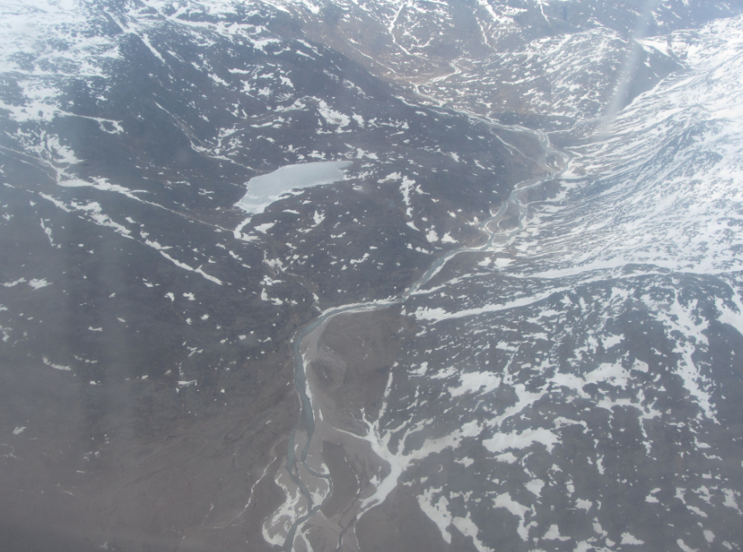
Methods: Field Sites
Narsarsuaq
Ice-free landscape has high relief, and outwash flows through narrow channels

Slide 26
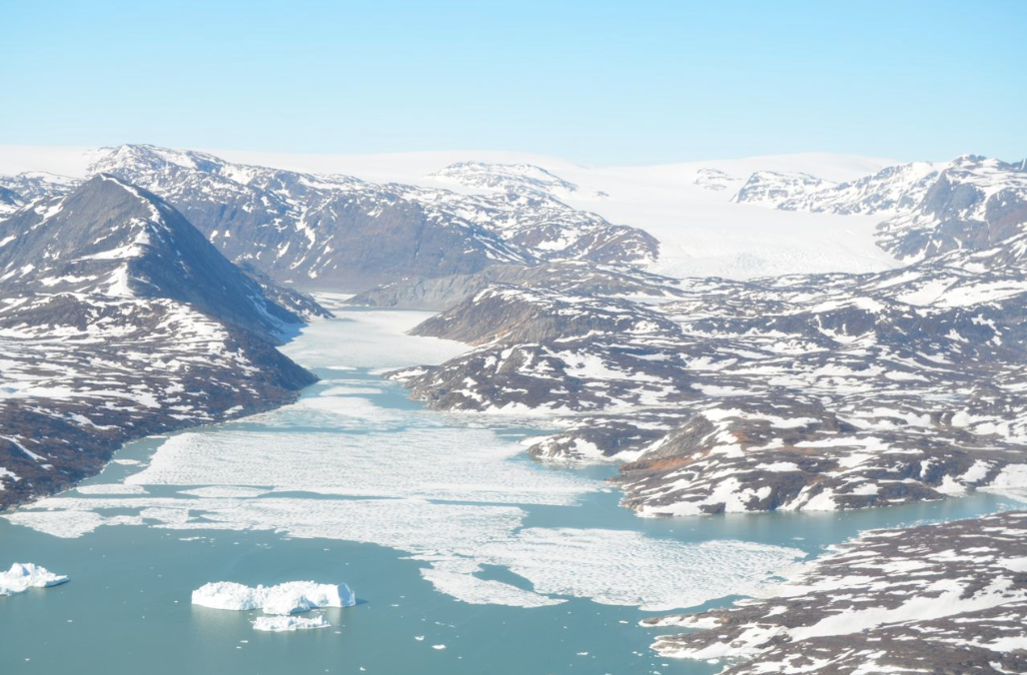
Methods: Field Sites
Tasiilaq
Ice margin is relatively close to the coast

Slide 27
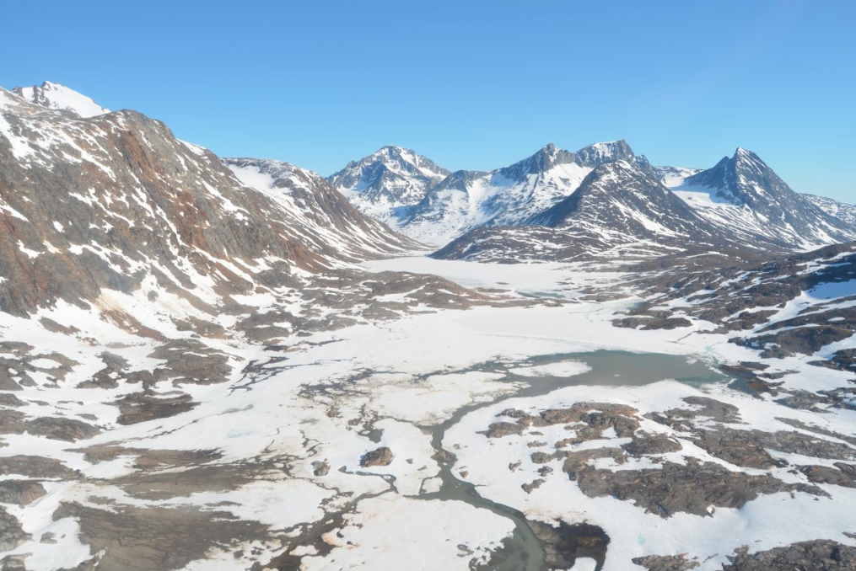
Methods: Field Sites
Tasiilaq
Glaciers on coastal islands are not attached to the mainland ice sheet

Slide 28
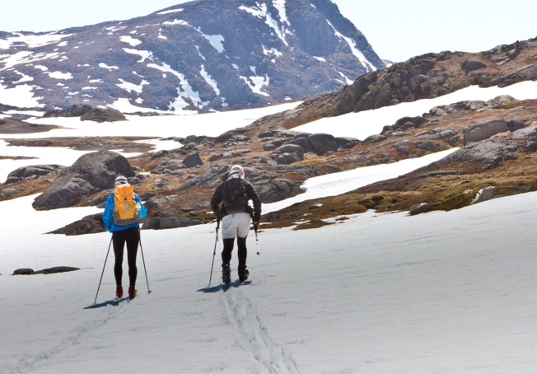
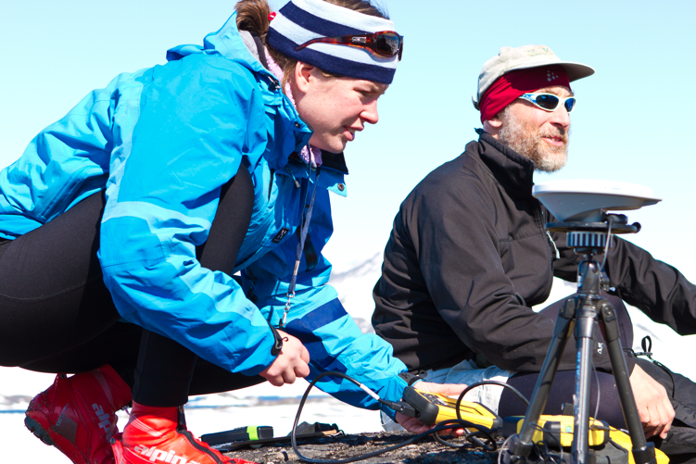
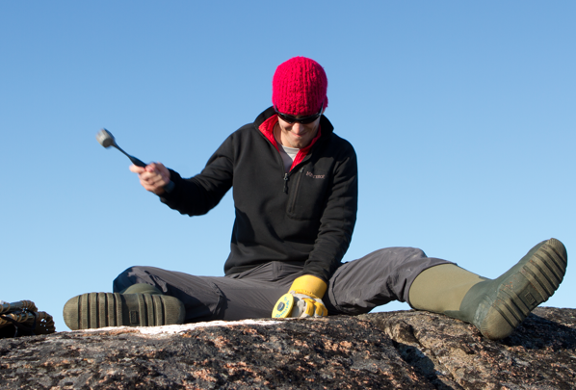
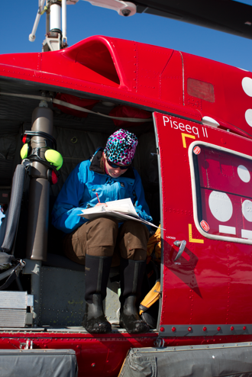
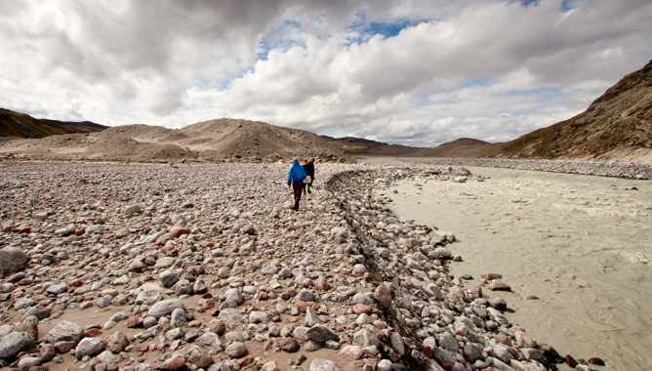
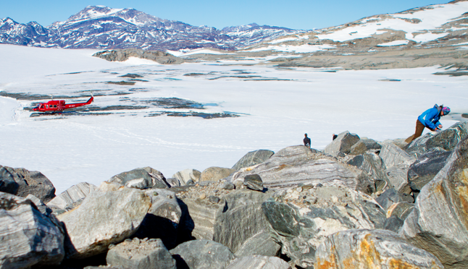
Methods: Field Work
Getting to the sample sites
Collecting elevation data
Sampling bedrock
Sampling moraine material
Sampling outwash
Taking field notes
Photos: Josh Brown

Slide 29
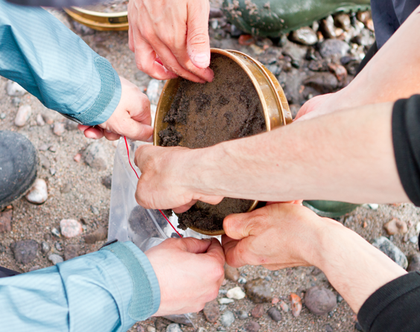
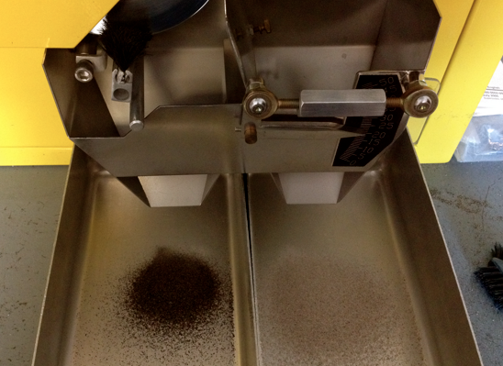
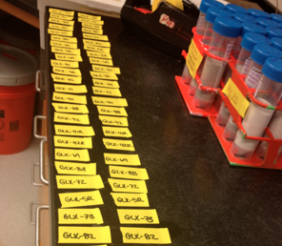
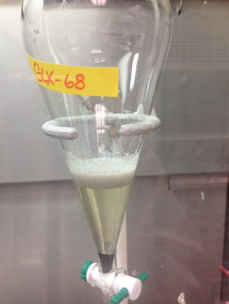
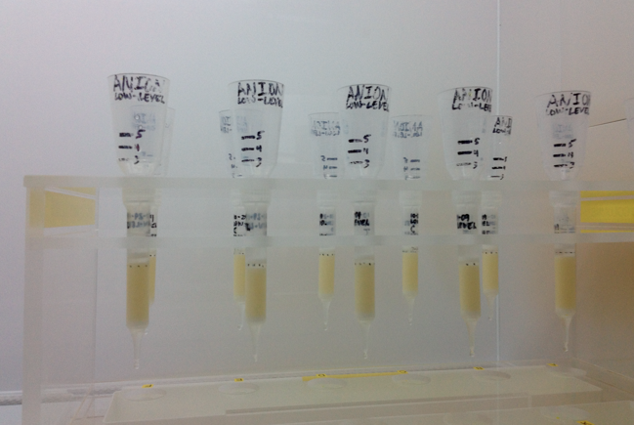
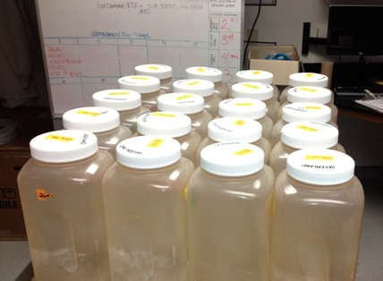
Methods: Lab Work
sieving
magnetic separation
labeling
acid etches
density separation
¹⁰Be extraction

Slide 30
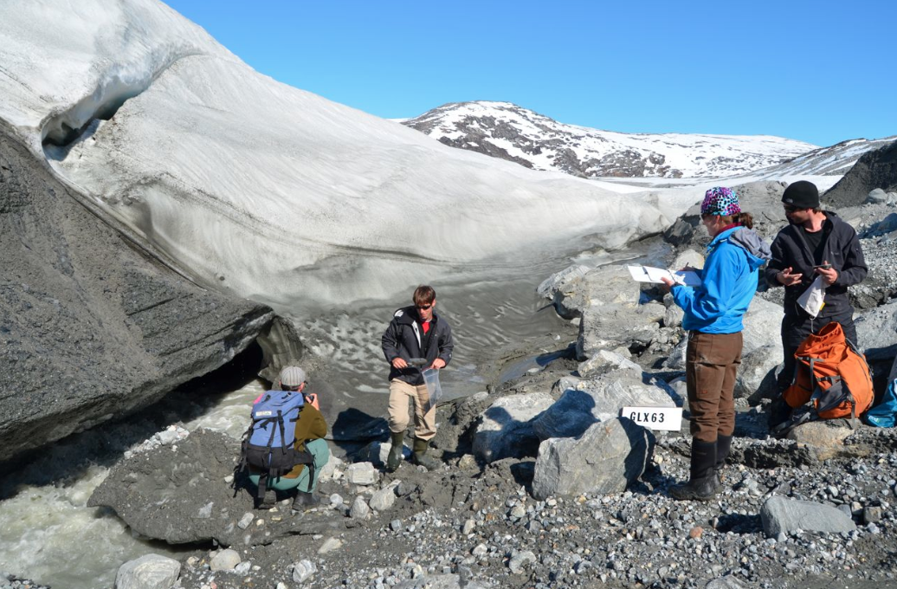
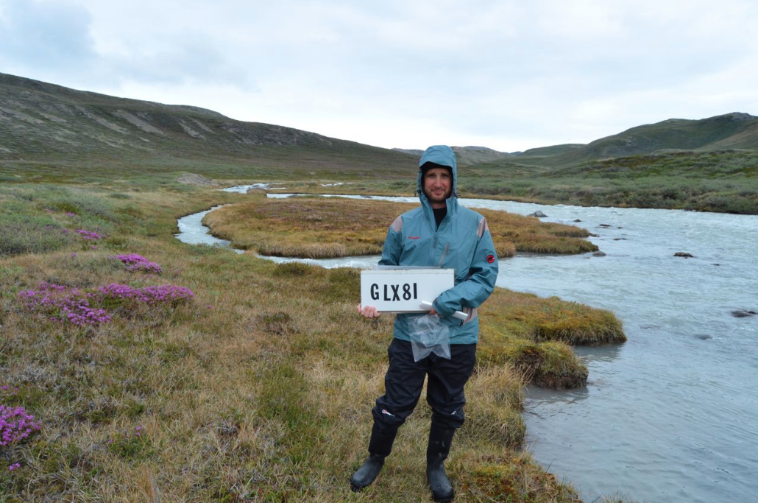
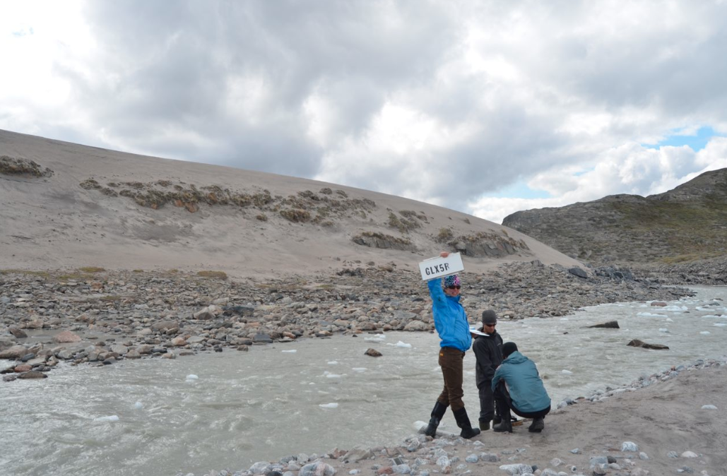
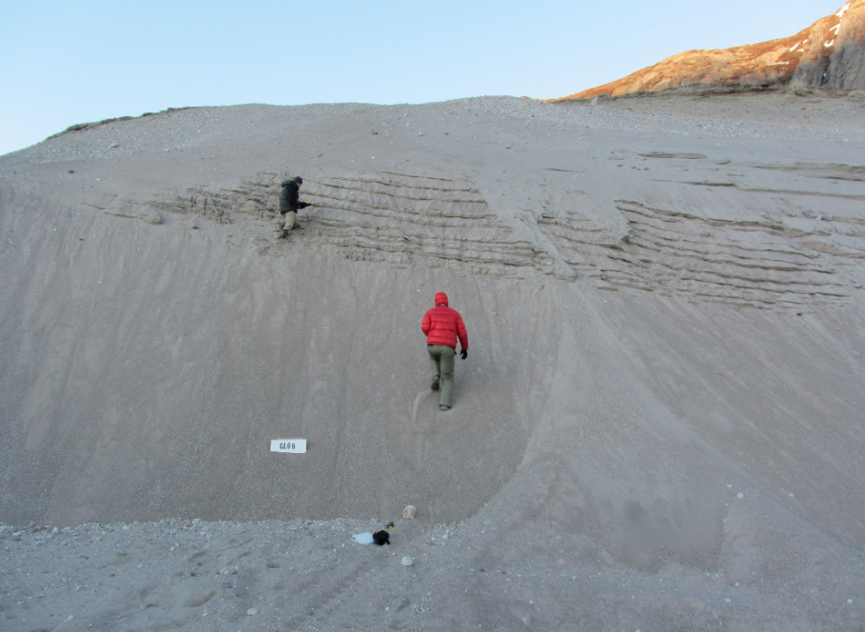
Methods: Data Analysis
glacial
ice-free
glacial
mixed
ice-free
mixed
terrace
terrace

Slide 31
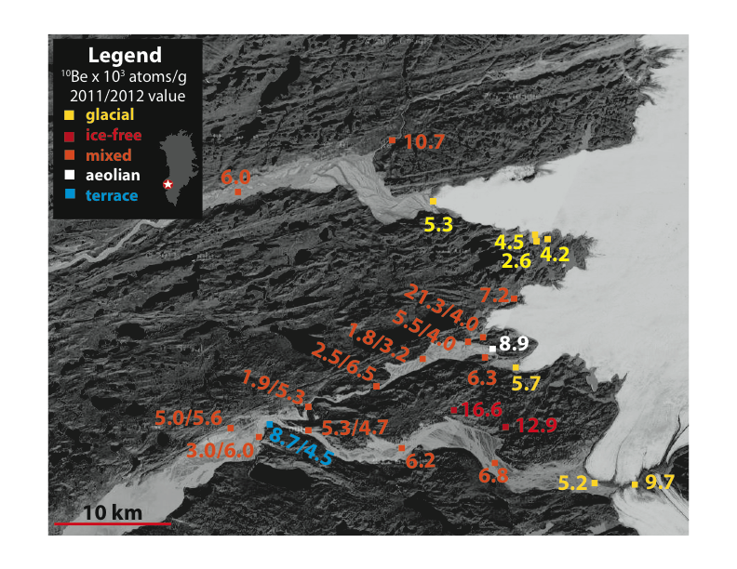
Kangerlussuaq

Slide 32
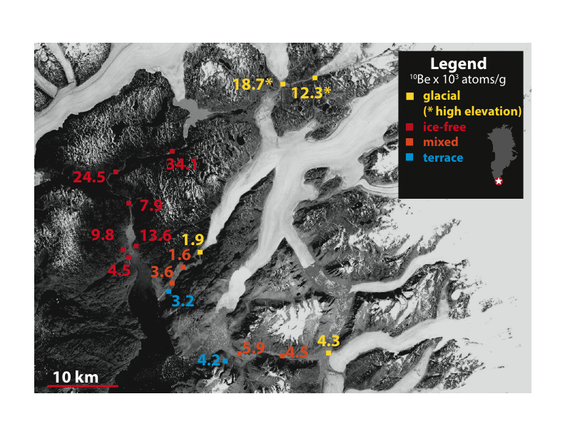
Narsarsuaq

Slide 33
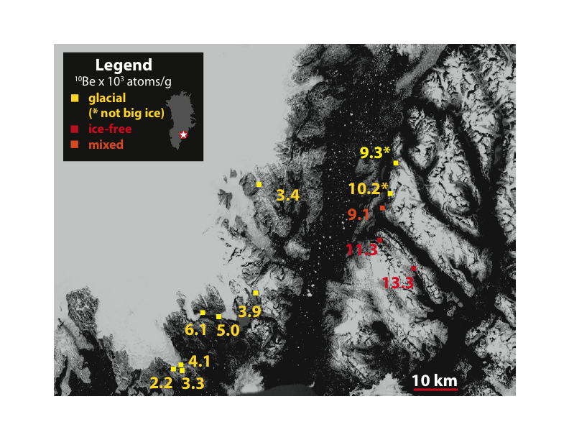
Tasiilaq

Slide 34
Results
¹⁰Be concentration x 10³ atoms per gram
Region | Ice-free | Glacial | Mixed | Terrace | Aeolian | Median
K | 14.8 ± 2.6 n=2 | 5.2 ± 2.0 n=7 | 5.9 ± 1.8 n=14 | 6.6 ± 3.0 n=1 | 8.9 n=1 | 5.9 n=26
N | 15.7 ± 11.3 n=6 | 11.7 ± 7.2 n=3 | 3.5 ± 1.8 n= 5 | 3.7 ± 0.7 n=2 |  | 5.2 n=16
T | 12.3 ± 1.4 n=2 | 5.3 ± 2.8 n=9 | 9.1 n=1 |  |  | 5.6 n=12
All | 14.9 ± 8.6 (13.1) n=10 | 6.5 ± 4.1 (5.2) n=19 | 5.5 ± 2.2 (5.3) n=20 | 5.2 ± 2.4 (4.4) n=3 | 8.9 n=1 | 5.9 n=54

Slide 35
Results
¹⁰Be concentration x 10³ atoms per gram
Region | Ice-free | Glacial | Mixed | Terrace | Aeolian | Median
K | 14.8 ± 2.6 n=2 | 5.2 ± 2.0 n=7 | 5.9 ± 1.8 n=14 | 6.6 ± 3.0 n=1 | 8.9 n=1 | 5.9 n=26
N | 15.7 ± 11.3 n=6 | 11.7 ± 7.2 n=3 | 3.5 ± 1.8 n= 5 | 3.7 ± 0.7 n=2 |  | 5.2 n=16
T | 12.3 ± 1.4 n=2 | 5.3 ± 2.8 n=9 | 9.1 n=1 |  |  | 5.6 n=12
All | 14.9 ± 8.6 (13.1) n=10 | 6.5 ± 4.1 (5.2) n=19 | 5.5 ± 2.2 (5.3) n=20 | 5.2 ± 2.4 (4.4) n=3 | 8.9 n=1 | 5.9 n=54

Slide 36
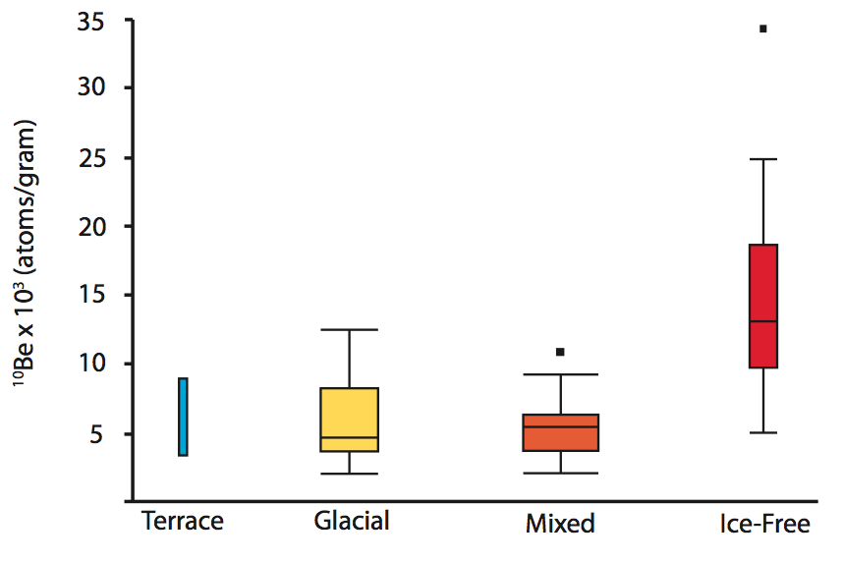
Data Analysis and Results: Part I
¹⁰Be concentration as a sediment source tracer
Is the concentration of ¹⁰Be in sediment from different sources characteristically different?
¹⁰Be concentration in ice-free sediment is significantly higher than in glacial sediment

Slide 37
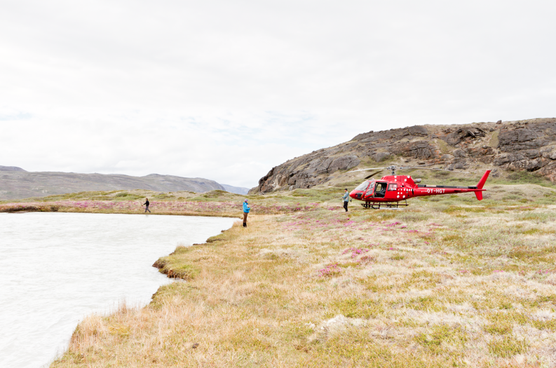
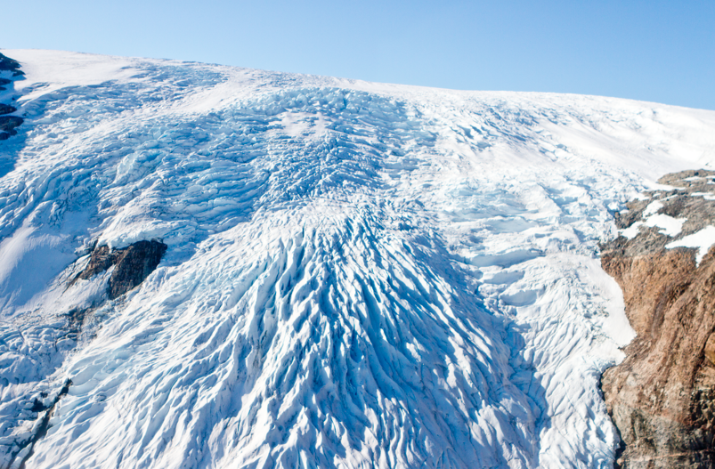
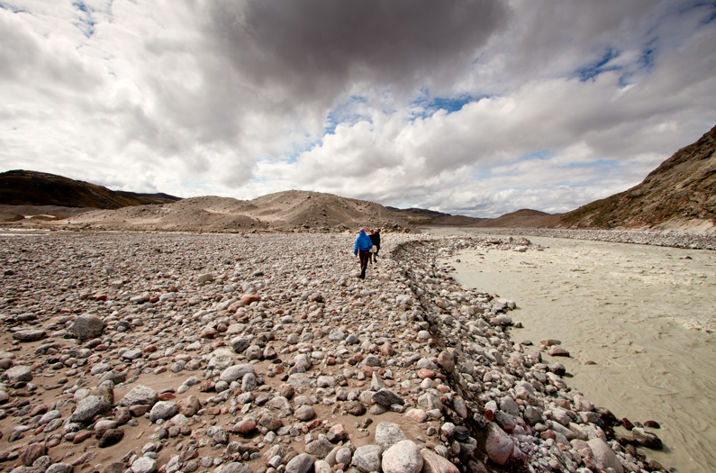
Data Analysis and Results: Part I
¹⁰Be concentration as a sediment source tracer
What is the relative contribution of sediment from ice-free versus glacial sources?
C_{if}X
+
C_{g}Y
=
C_{m}
~90% of mixed category sediment in channels is glacial in origin

Slide 38
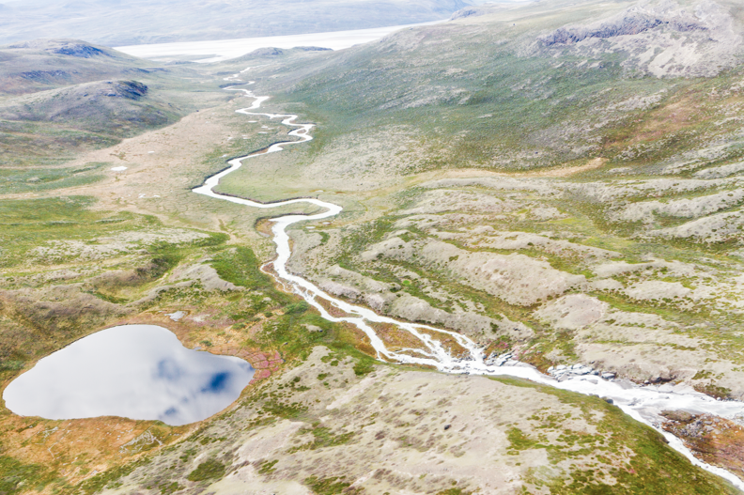
Implications I: ¹⁰Be as a tracer
there isn’t enough sediment from ice-free terrain to affect downstream channel concentration
glacial sediment also dominated the fluvial system in the early Holocene (terrace concentration)
ice-free slopes in the paraglacial landscape are not as unstable as previous research suggests

Slide 39
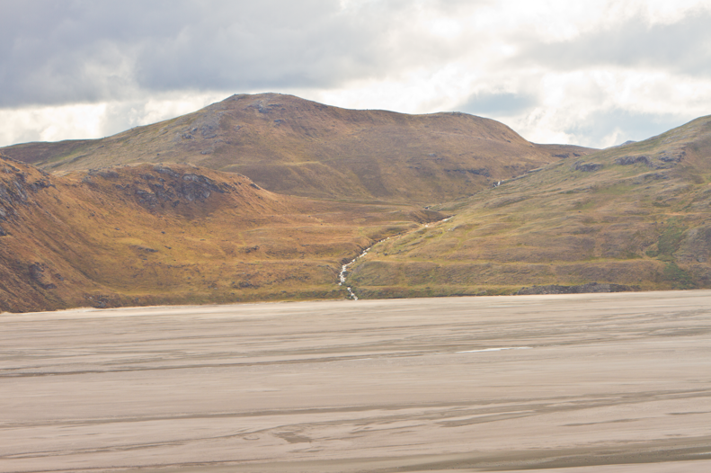
Data Analysis and Results: Part II
¹⁰Be as a dosimeter of cosmic ray exposure
How did relatively high concentrations of ¹⁰Be accumulate in ice-free sediment?
      Surficial production on an eroding surface

Slide 40


Data Analysis and Results: Part II
¹⁰Be as a dosimeter of cosmic ray exposure
Ice-free sediment – glacial sediment exposed on the landscape since Holocene ice retreat
1. Ice-free landscape blanketed by unconsolidated material
2. Inherited ¹⁰Be concentration: ~5 x 10³ atoms per gram (glacial concentration)
3. Additional ~7 to 13 ky of exposure
4. ¹⁰Be concentration is consistent with regolith erosion rates from 0.4 to 0.9 mm per year

Slide 41


Data Analysis and Results: Part II
¹⁰Be as a dosimeter of cosmic ray exposure
Glacial sediment - some prior cosmogenic exposure
Testable hypothesis:
1) mid-Holocene retreat (~7 ka)
2) last interglacial (~115 ka)
3) before ice sheet inception (~3.5 Ma)

Slide 42


Data Analysis and Results: Part II
¹⁰Be as a dosimeter of cosmic ray exposure
How did low concentrations of ¹⁰Be in glacial sediment accumulate?
OR
Recent (Holocene or last interglacial) surficial exposure?
Pre ice sheet, deep production by muons?

Slide 43
Data Analysis and Results: Part II
¹⁰Be as a dosimeter of cosmic ray exposure
Glacial sediment - some prior cosmogenic exposure:
-mid-Holocene retreat (~7 ka)
-last interglacial (~115 ka)
-before ice sheet inception (~3.5 Ma)
1. During the mid-Holocene, surficial sediment would have accumulated 10 x 10³ to 30 x 10³ atoms per gram of ¹⁰Be
2. Glacial sediment ¹⁰Be concentration: ~5 x 10³ atoms per gram
3. Terrace sediment, which was not exposed, has the same ¹⁰Be concentration as glacial sediment

Slide 44
Data Analysis and Results: Part II
¹⁰Be as a dosimeter of cosmic ray exposure
Glacial sediment - some prior cosmogenic exposure:
-mid-Holocene retreat (~7 ka)
-last interglacial (~115 ka)
-before ice sheet inception (~3.5 Ma)
1. Terrace and glacial sediment would have both been exposed (~15 ky)
2. Sediment ¹⁰Be concentration of ~5 x 10³ atoms per gram would have accumulated in the upper 2 m of bedrock
3. This sediment is probably gone – erosion in the last glacial cycle has been > 2 m

Slide 45
Data Analysis and Results: Part II
¹⁰Be as a dosimeter of cosmic ray exposure
Glacial sediment - some prior cosmogenic exposure:
-mid-Holocene retreat (~7 ka)
-last interglacial (~115 ka)
-before ice sheet inception (~3.5 Ma)
1. Glacial sediment must be sourced deeply
2. ¹⁰Be must have accumulated by muogenic production
3. ¹⁰Be in glacial sediment is inherited from long-term exposure before the ice sheet was established
4. Measured concentrations are consistent with steady-state accumulation, 20 to 30 m below the surface

Slide 46

Implications II: ¹⁰Be as a dosimeter
Holocene retreat was not great enough or long enough for significant ¹⁰Be accumulation in surficial sediment OR
The volume of sediment sourced deeply, that was not exposed, far exceeds the volume of sediment that was exposed

Slide 47



Conclusions
We can use ¹⁰Be concentration as a sediment tracer because concentrations in glacial and ice-free sediment are characteristically different
¹⁰Be concentration in glacial sediment is LOW - relict of long-term exposure pre Greenland Ice Sheet
¹⁰Be concentration in ice-free sediment is HIGHER - but there is not enough sediment sourced from ice- free terrain to affect mixed concentration in channels

Slide 48

Future Research
Fjord sediment gets evacuated to the deep ocean during periods of glacial advance
Fjord sediment concentration = glacial sediment concentration

Slide 49

Future Research
¹⁰Be in the off-shore marine record controlled by:
  efficacy and timing of glacial erosion NOT
  duration and extent of paraglacial landscape exposure UNLESS
  past ice sheet retreat was significantly greater then it is today

Slide 50

Acknowledgements
Paul
Jeremy
Dylan
Josh
Andrea and Jason
NSF Greenland Grant, UVM
Geology department faculty and staff
Fellow graduate students
My family!

Slide 51

Questions?

Slide 52
      Surficial production on an eroding surface
C= concentration (atoms g⁻¹)
C_{i} = inherited concentration
P_{s,m}= production rate (3.98 atoms g⁻¹ a⁻¹)
S_{e}= scaling factor (elevation)
Λ= attenuation (160 g cm⁻²)
ε= erosion (g cm⁻² a⁻¹)

Slide 53
Spallation production at depth
P_{s,m}= production rate (atoms g⁻¹ a⁻¹)
S_{e}= scaling factor (elevation)
Λ= attenuation (160 g cm⁻²)
Ρ = density (2.7 g cm⁻³)
t = exposure duration
x = depth (cm)

Slide 54
steady-state production by muons
C= concentration (atoms g⁻¹)
P_{uf}= production rate (0.093 atoms g⁻¹ a⁻¹)
Λ= attenuation (4,320 g cm⁻²)
ε= erosion (g cm⁻² a⁻¹)
λ = decay constant (4.9867 x 10⁻⁷)

