Slide 1



Tracking erosion with sediment associated isotopes in Yunnan, china
Thesis Defense Presentation
Thomas B. Neilson

Slide 2
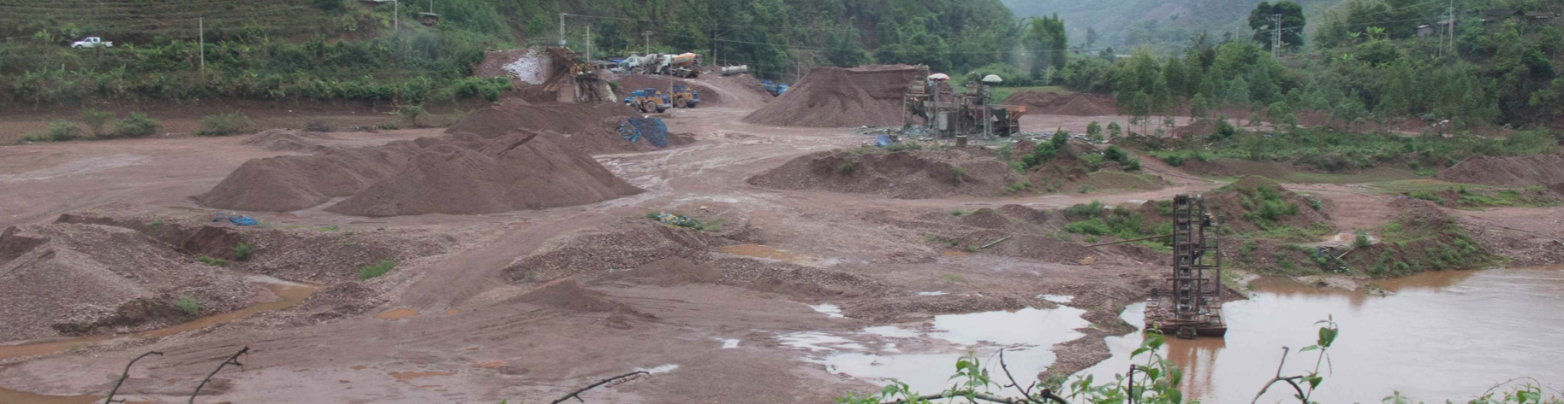
Introduction
Humans are one of the most effective geomorphic agents on the planet
  Humans have been estimated to move more earth material annually than any other geomorphic or geologic process
Erosion and sediment disturbance that results from human activity directly impacts fluvial systems as well as communities reliant on river resources

Slide 3
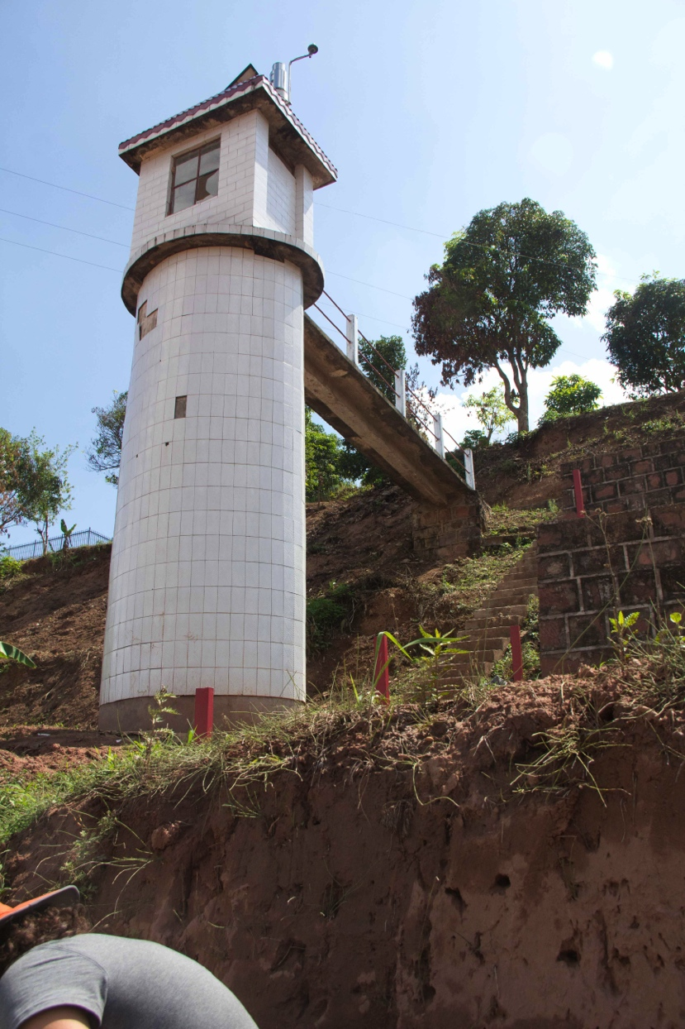
Introduction
Long history of human influence on the landscape
  First recorded in 11th century AD
  Communism and subsequent opening and development severely impacted erosion
Since the 1950’s, China has maintained sediment yield monitoring stations throughout the country
Data from these stations do not show a systematic increase in sediment yield as a result of land-use

Slide 4
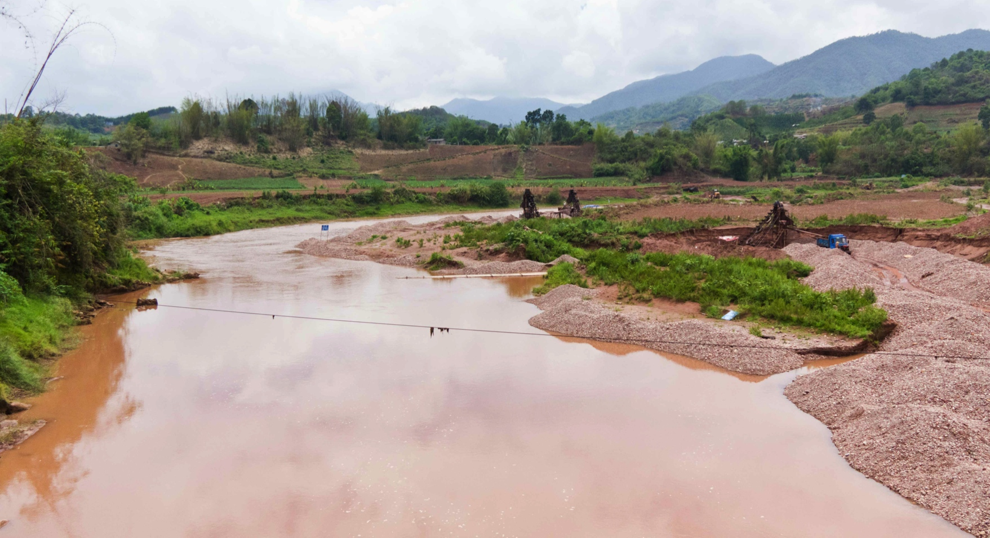
Question
Have humans increased erosion over the long-term average through land-use change?

Slide 5
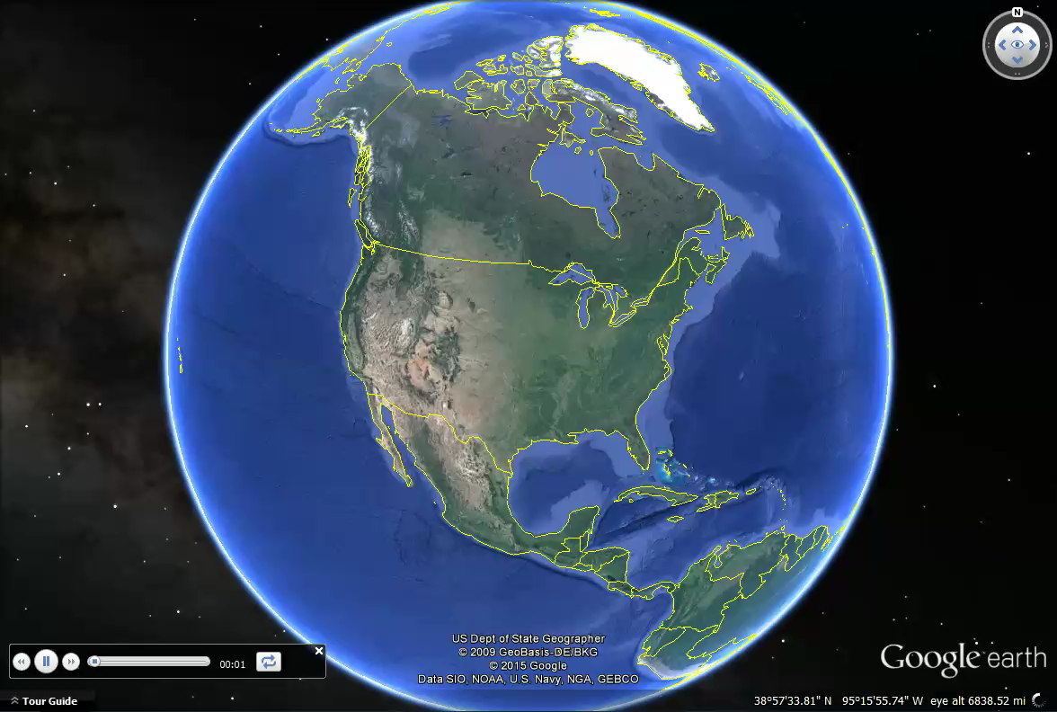

Slide 6
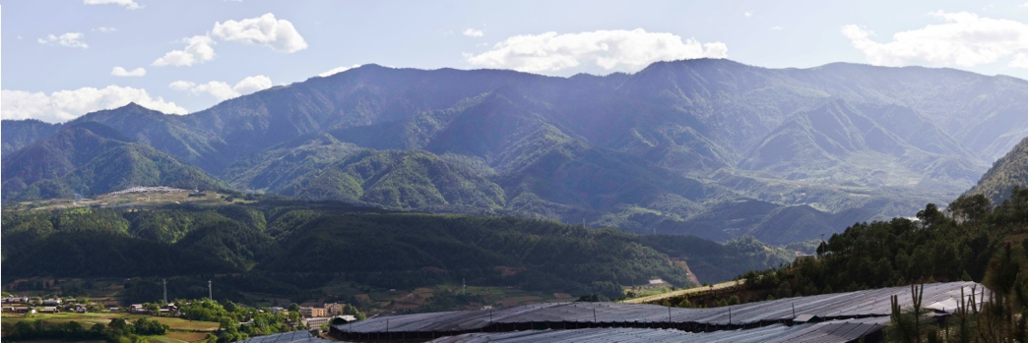
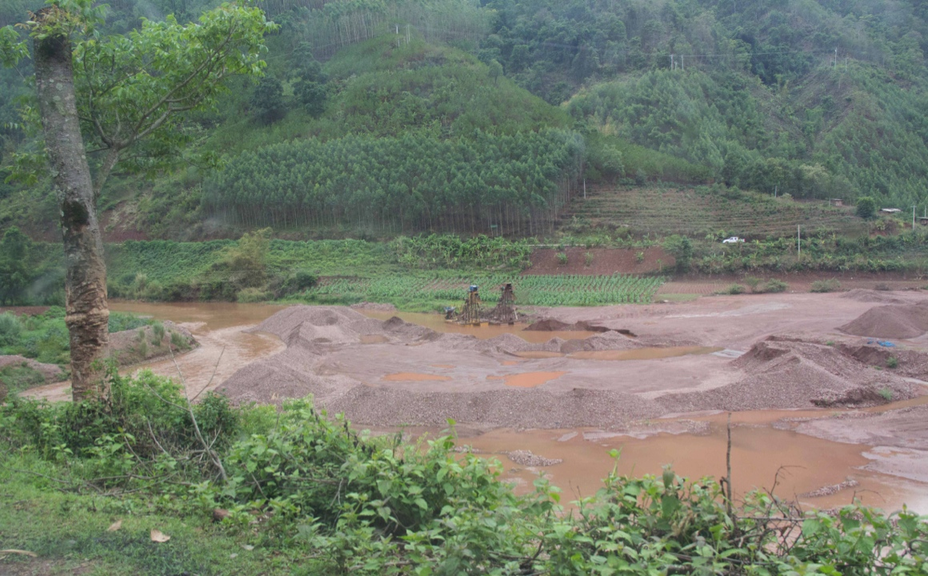
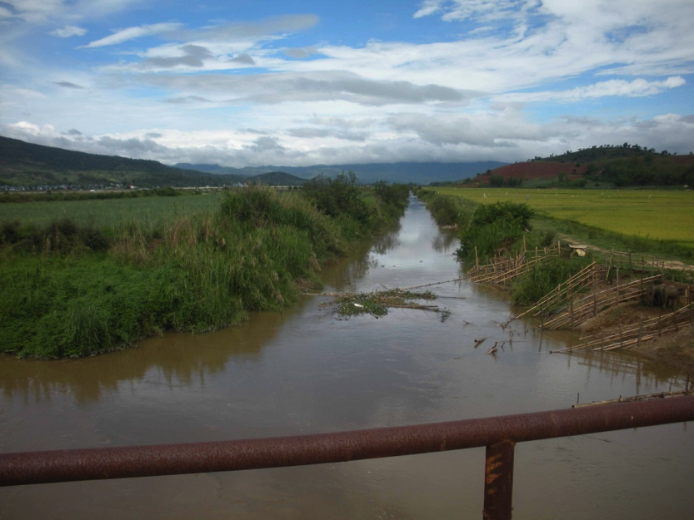
Field Sites
3 tributaries to Mekong River
Range from 200 – 2500 km²
Have a variety of topographic, geologic, and land-use characteristics
Notes:
----- Meeting Notes (9/2/15 14:49) -----
screeen video from google earth

Slide 7
Experimental Approach
Goals
Tools
Determine long-term (~1,000 – 50,000 yr) average erosion rate
Assess contemporary rates of erosion
Determine what factors drive erosion
  Tectonic and lithologic controls
  Slope, rainfall, channel steepness, etc.
  Agriculture vs. Forest
In situ ¹⁰Be
Meteoric ¹⁰Be
Excess ²¹⁰Pb
¹³⁷Cs
Sediment Yield
Topographic analysis of DEM’s
Analysis of land-use data
Field observations

Slide 8
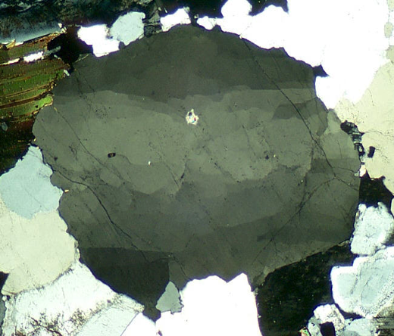
In situ-produced ¹⁰Be
n
t_{1/2} = 1.39 myr
Produced within quartz grains from interaction between cosmic rays and oxygen
Permanently entrained in mineral grain
~290 atoms/cm² y⁻¹ production rate
Useful for estimating basin-wide rates of erosion when measured in fluvial sediment
¹⁰Be
¹⁶O

Slide 9
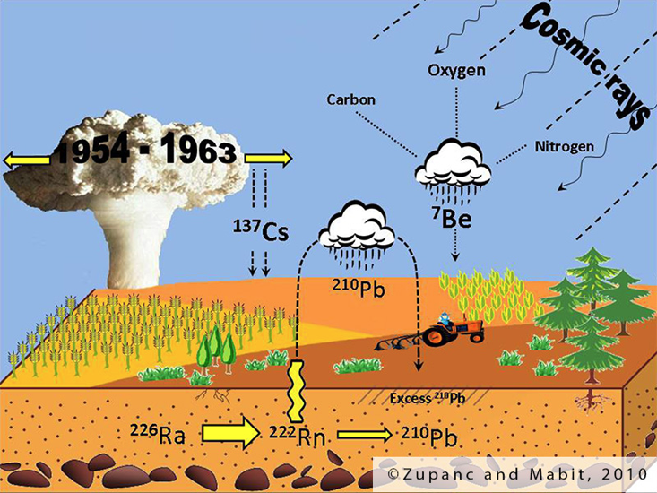
Fallout Radionuclides (¹⁰Be_{m}, ²¹⁰Pb_{ex}, ¹³⁷Cs)
Produced in the atmosphere
Delivered to earth surface via precipitation and dust/dry-fall
Can be mobilized in certain conditions (e.g. pedogenesis), but generally are assumed permanently sorbed to sediment
Preferentially adsorb to finer sediment particles

Slide 10
Fallout Radionuclides (¹⁰Be_{m}, ²¹⁰Pb_{ex}, ¹³⁷Cs)
¹⁰Be_{m} (t_{1/2} = 1.39 myr)
  Atmospheric spallation reaction
  ~1.3 million atoms/cm² y⁻¹ delivery rate
  Useful for assessing long-term erosion
²¹⁰Pb_{ex} (t_{1/2} = 22.2 yr)
  Naturally occurring as part of ²³⁸U decay series
  Fraction of total ²¹⁰Pb in soil derived from ²²²Rn gas that leaves soil
  Delivered back to soil through fallout
  Integrates up to past ~100 years of erosion
¹³⁷Cs (t_{1/2} = 30.2 yr)
  Created from nuclear weapons testing in atmosphere
  Delivered to soil through fallout
  Only deposited globally from 1950’s to 1970’s
  Useful for assess erosion over past 50-60 years
Notes:
----- Meeting Notes (9/2/15 14:56) -----
1000x faster production

Slide 12
Going from ¹⁰Be concentration to erosion rate (or index)
River sediment is average of upstream area
The production (or delivery) rate of ¹⁰Be can be determined for the sampled watershed

Slide 13
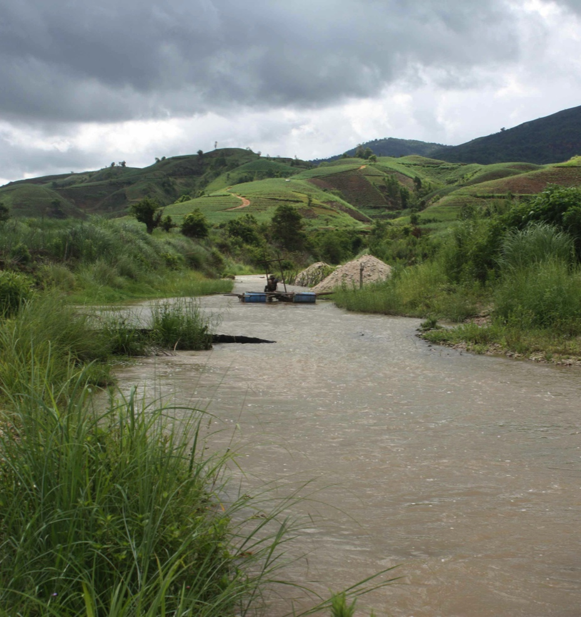
Going from isotopic concentration to erosion rate (or index)
IN
In situ ¹⁰Be (¹⁰Be_{i}):
Isotopic concentration of the sediment is compared to the rate of production, and the difference is attributed to land surface lowering
Meteoric ¹⁰Be (¹⁰Be_{m}):
The export rate of ¹⁰Be_{m} on sediment is compared to the delivery rate, and a ratio is made
>1 indicates more is leaving than being delivered
<1 indicates more is being delivered than leaving
OUT

Slide 14
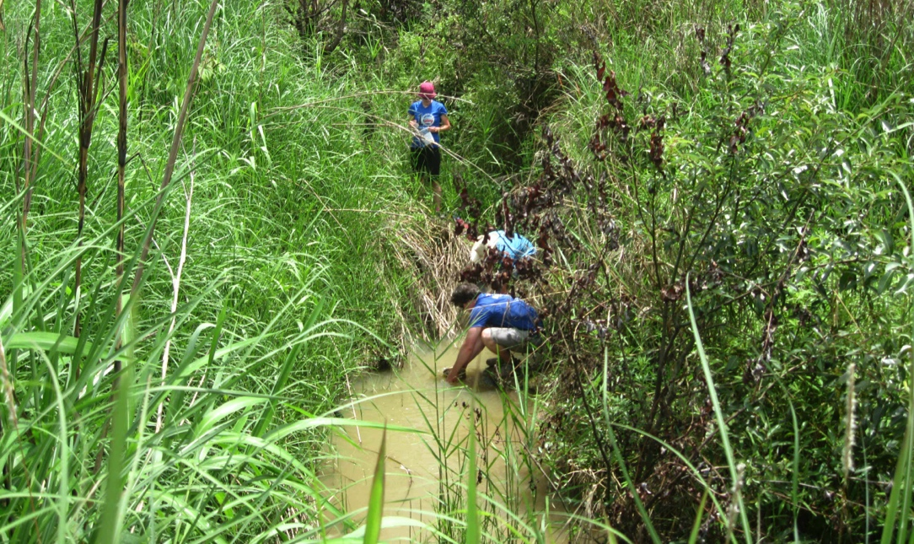
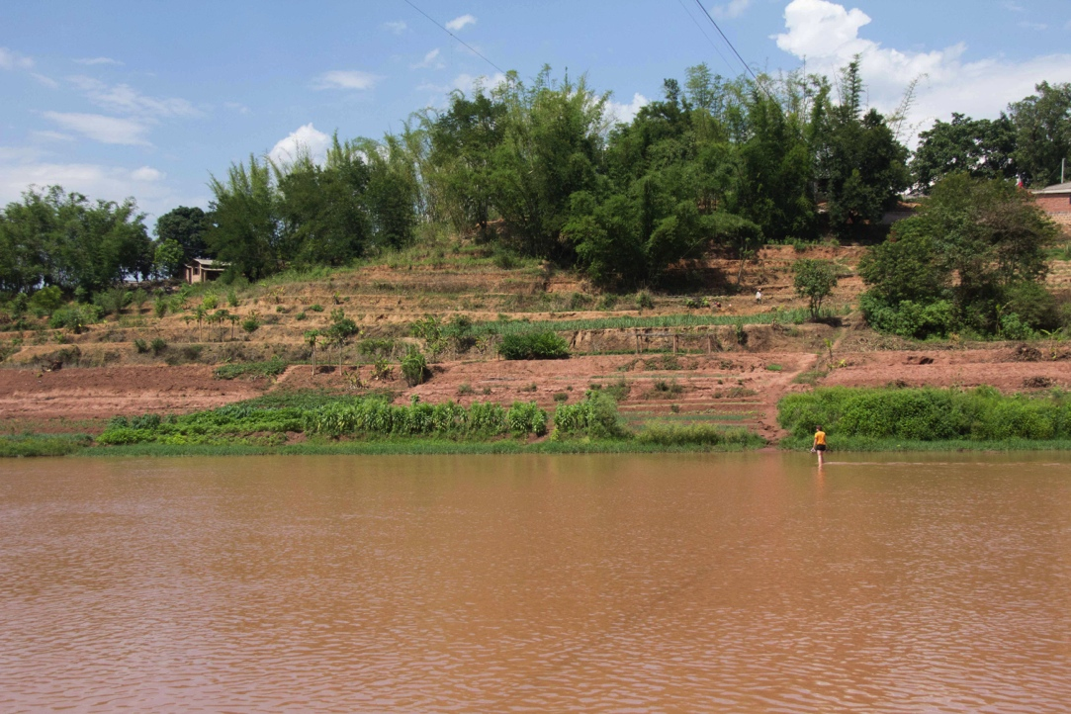
Sampling
Collect active channel sediment from 54 locations throughout three watersheds
Select sample sites to represent:
  Basins that are primarily forested or agricultural
  Natural range of representative slopes in watershed
  Range of basin sizes
  Sediment mixing above and below major junctions

Slide 15

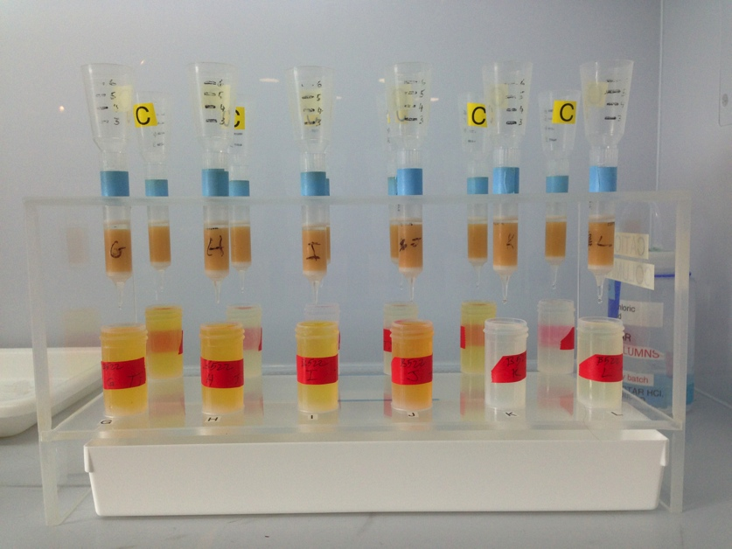
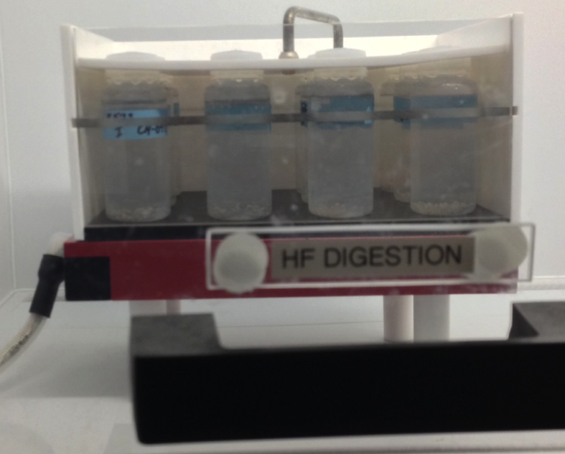
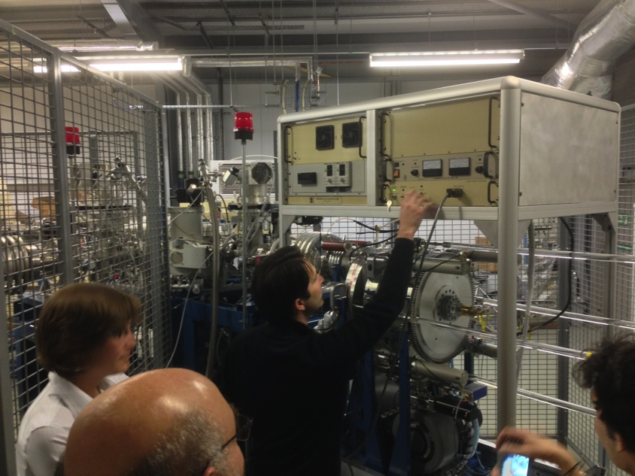
Extracting and measuring Be

Slide 16
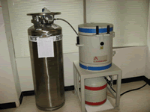
Measuring ²¹⁰Pb_{ex} and ¹³⁷Cs
Measurement done with germanium detector
Counts radioactive decay at given energy levels, which are converted to concentration

Slide 17
Sediment Mixing Results

Slide 18
Sediment Mixing Results

Slide 19
Sediment Mixing Results

Slide 20
Isotopic
Results
?

Slide 21
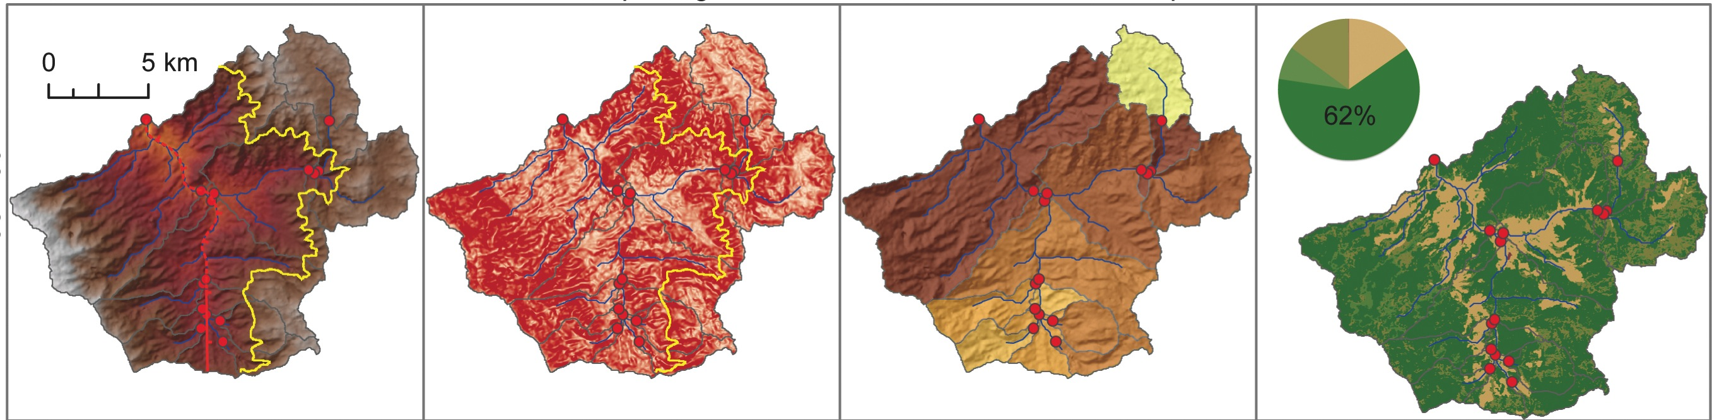
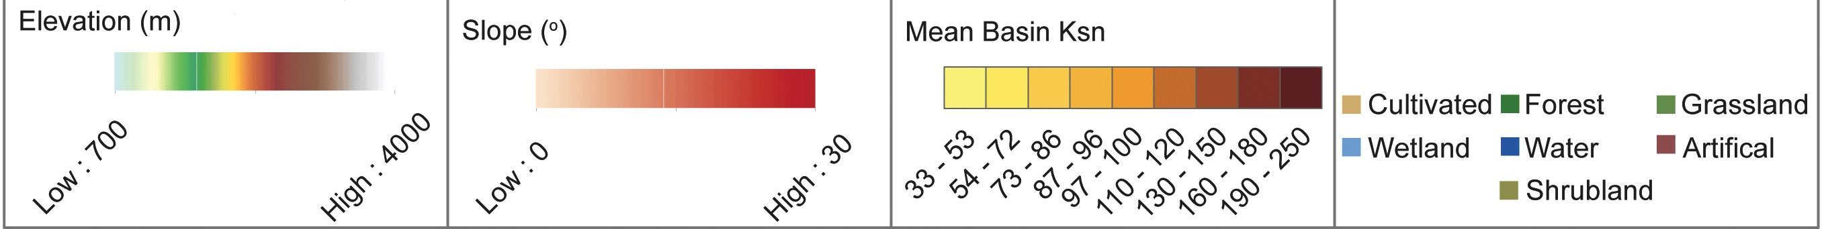
Basin 35: Physical properties

Slide 22
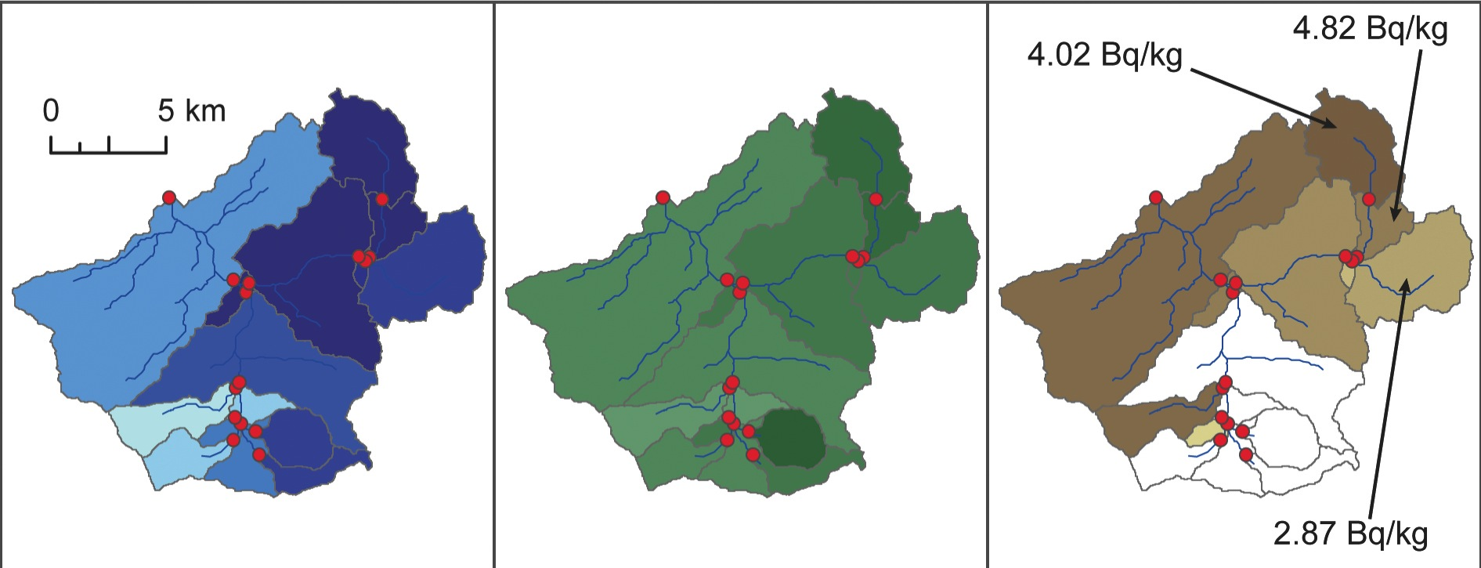
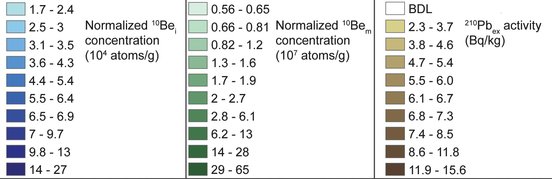
Basin 35: Isotopic Results

Slide 23
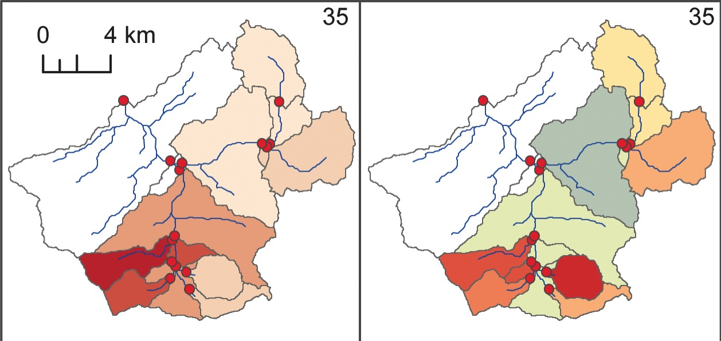
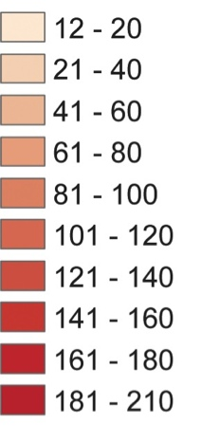
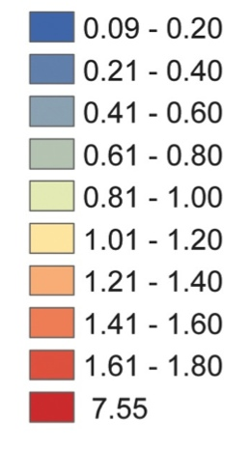
Basin 35: Long-term erosion
¹⁰Be_{i} derived erosion rate (mm/kyr)
¹⁰Be_{m} derived erosion index

Slide 24
Controls of erosion in basin 35
Base level fall is primary control on long- and short-term erosion
Slope steepness determines long-term erosion rate
Erosion rates increase after channels steepen
Contemporary erosion appears to be controlled by uncaptured variable(s)
Notes:
----- Meeting Notes (9/2/15 15:28) -----
make this a bivariate plot of e rate to slope

Slide 25
Controls of erosion in basin 35
Base level fall is primary control on long- and short-term erosion
Slope steepness determines long-term erosion rate
Erosion rates increase after channels steepen and hillslopes respond
Contemporary erosion appears to be controlled by uncaptured variable(s)
Notes:
----- Meeting Notes (9/2/15 15:28) -----
maybe ditch ksn for this section, or tell them about it... change mean basin ksn to channel slope

Slide 26
Controls of erosion in basin 35
Base level fall is primary control on long- and short-term erosion
Slope steepness determines long-term erosion rate
Erosion rates increase after channels steepen and hillslopes respond
Contemporary erosion appears to be controlled by un-measured variable(s)

Slide 27
Controls of erosion in basin 35
Base level fall is primary control on long- and short-term erosion
Slope steepness determines long-term erosion rate
Erosion rates increase after channels steepen and hillslopes respond
Contemporary erosion appears to be controlled by un-measured variable(s)
Erosion Rate

Slide 28
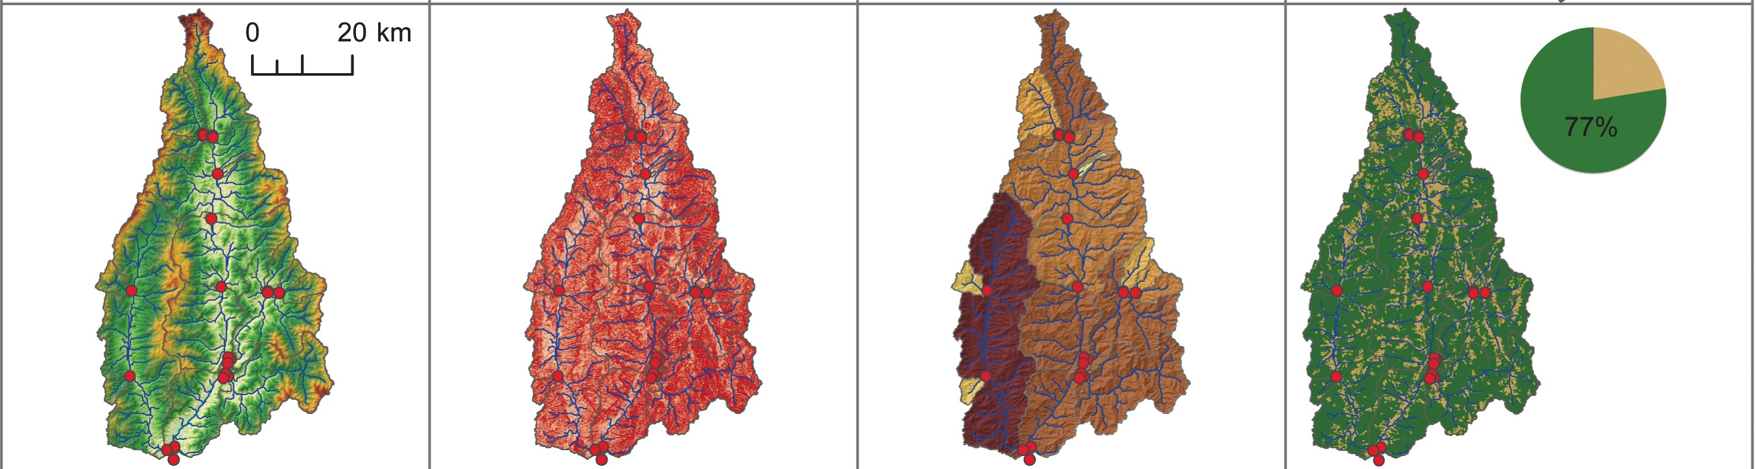

Basin 49: Physical properties

Slide 29
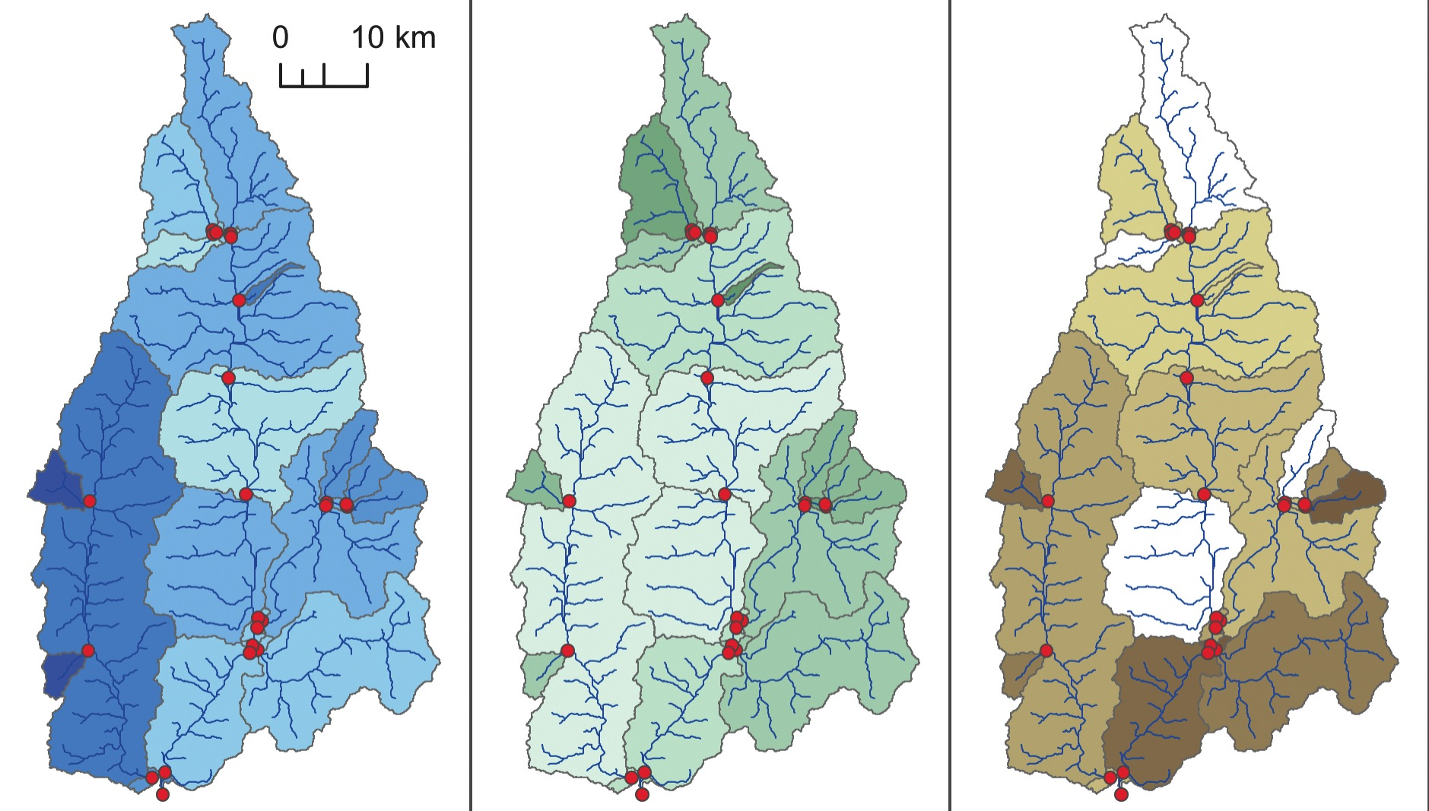
Basin 49: Isotopic Results

Slide 30
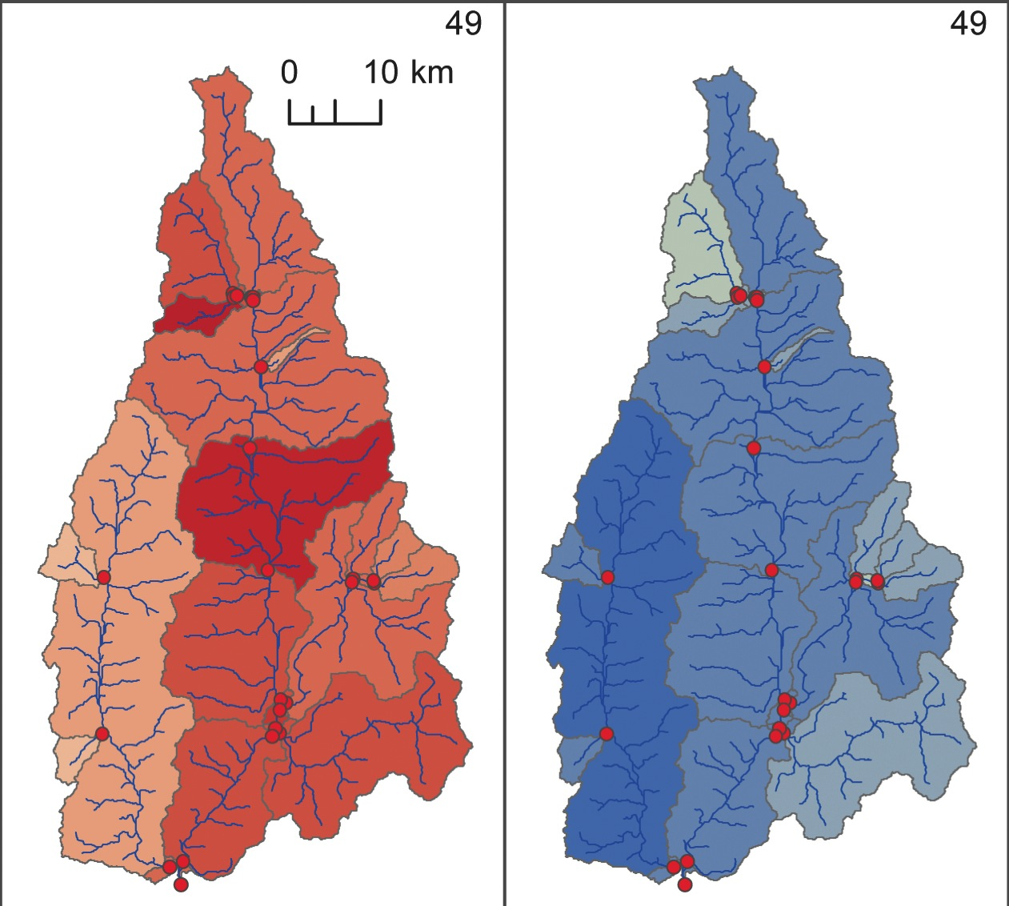

Basin 49: Long-term erosion
¹⁰Be_{i} derived erosion rate (mm/kyr)
¹⁰Be_{m} derived erosion index

Slide 31
Controls of erosion in basin 49

Slide 32
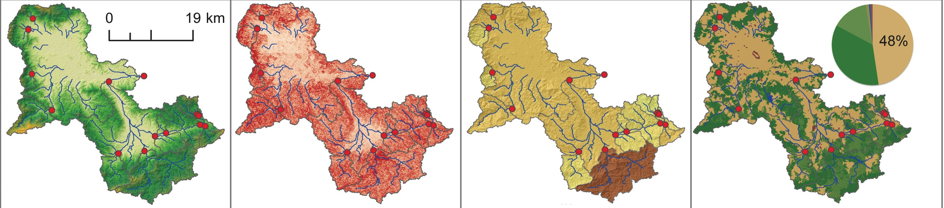
Basin 11: Physical properties

Slide 33
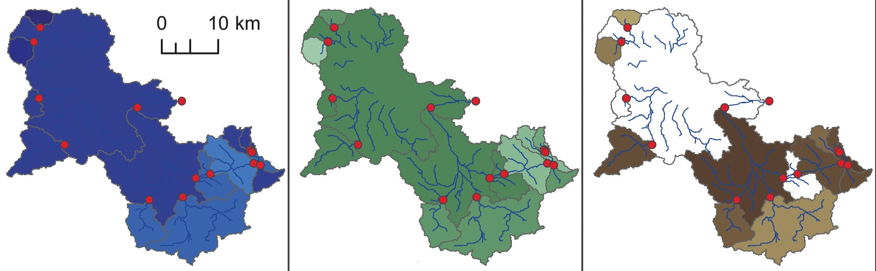
Basin 11: Isotopic Results

Slide 34
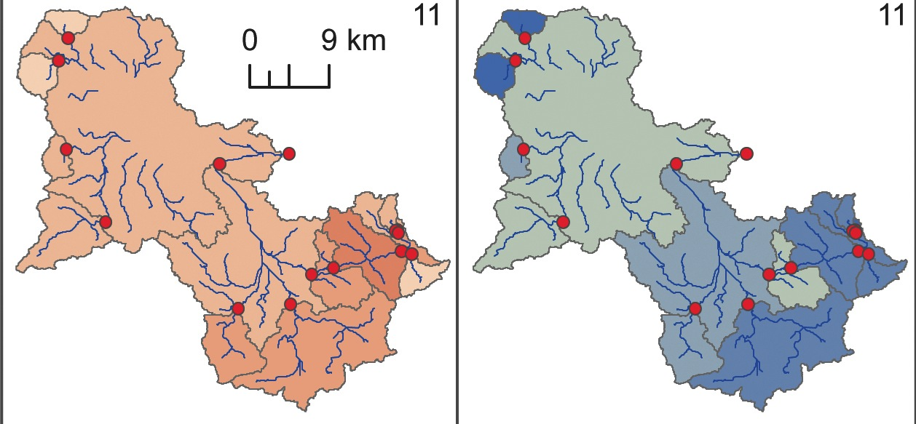
Basin 11: Long-term erosion
¹⁰Be_{i} derived erosion rate (mm/kyr)
¹⁰Be_{m} derived erosion index

Slide 35
Controls of erosion in basin 11
No ¹³⁷Cs
High ²¹⁰Pb_{ex}, except at outlet where channel has been altered
Contemporary sediment yield 50% lower than long-term average
Notes:
----- Meeting Notes (9/2/15 15:28) -----
ditch this figure here

Slide 36

Sediment transport path: working hypothesis
Explain erosion using a conceptual model that follows sediment grains from source to export from the basin.

Slide 37
Sediment transport path: working hypothesis
Begins on hillslope with low ¹³⁷Cs and ²¹⁰Pb_{ex} concentration
Enters agricultural terrace through irrigation diversion or direct transport
Sits near surface as it works through terrace network, from tread to riser to next terrace, accumulating ²¹⁰Pb_{ex} the entire time
Finally enters main river channel and is exported from basin with higher ²¹⁰Pb_{ex} concentration than it began with
1
2
3
4
Notes:
----- Meeting Notes (9/2/15 15:28) -----
rewreite in terms of Pb

Slide 38
Sediment transport path: working hypothesis
Accounts for:
  Absence of ¹³⁷Cs in sediment
  High activity of ²¹⁰Pb_{ex}
  Low contemporary sediment yield
1
2
3
4

Slide 39
Primary Findings
Basin 35: In transient landscape, knickpoint migration in response to base-level fall controls erosion
Basin 49: In landscape that is adjusted to base-level, morphology controls long-term erosion while agriculture dominates contemporary erosion
Basin 11: Diversion of water and sediment to terraces complicates interpretations of erosion
Notes:
----- Meeting Notes (9/2/15 15:28) -----
call out to the specific basins- i.e. 35 has knickpoint issues

Slide 40
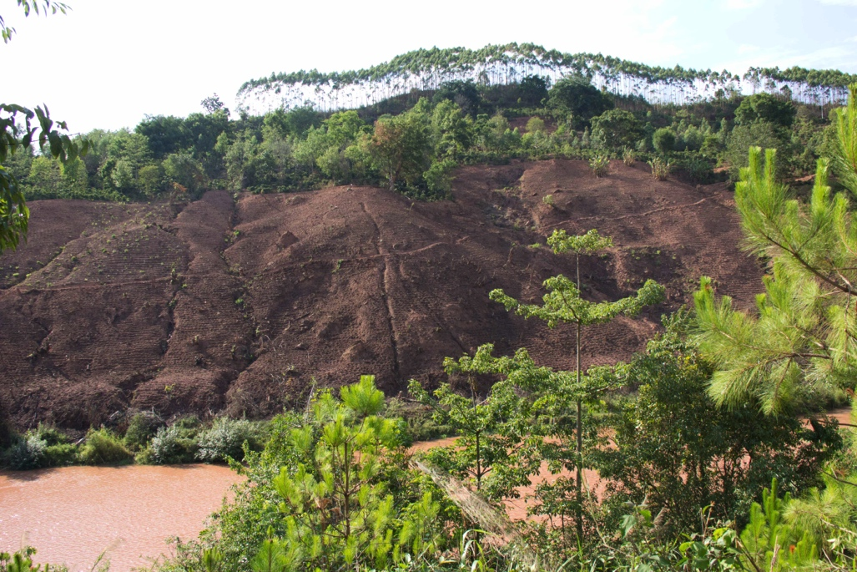
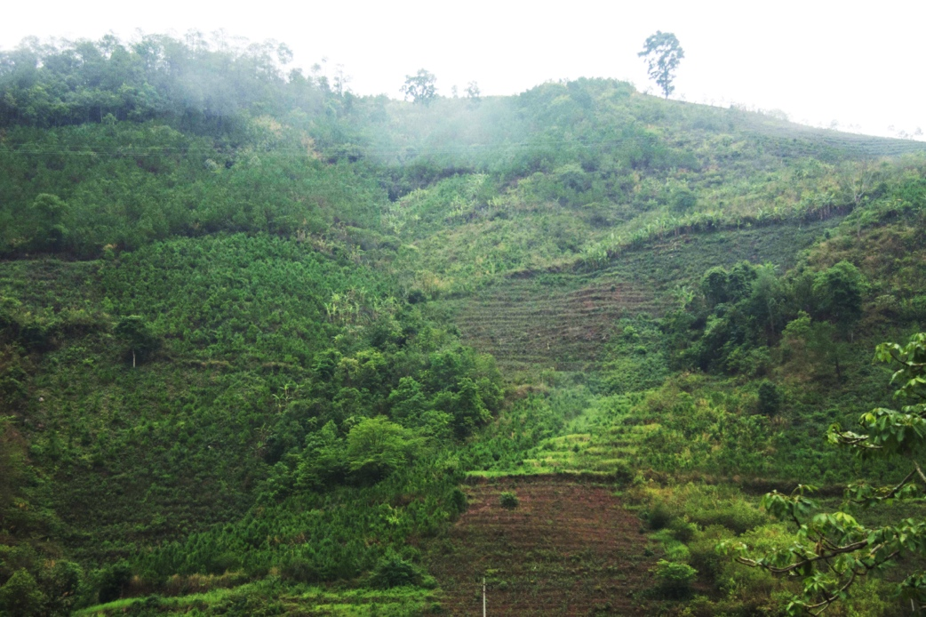
Conclusions: What do we learn about the effects Chinese land-use policy?
Absence of ¹³⁷Cs in all but three samples
Presence of ²¹⁰Pb_{ex} in most samples
Rapid erosion for some period of time in past 60 years
Erosion is slow enough now to allow accumulation of ²¹⁰Pb_{ex}
Change in pace of erosion coincides with extensive deforestation in 1950’s – 1980’s and top-down forest conservation policy from the 90’s to present
Notes:
End here, I found this (previous slide) and
----- Meeting Notes (9/2/15 15:28) -----
end in something punchy...
----- Meeting Notes (9/2/15 15:29) -----
learned about the effects of chinese land-use policy

Slide 41
Conclusions: Does this method work?
Measuring four isotopes on the same samples means better temporal resolution of erosion
  Can address drivers of contemporary and long-term erosion in one study
Not all of the isotopes provide useful information in all settings
Here, in situ ¹⁰Be and ²¹⁰Pb_{ex} are most useful, followed by ¹³⁷Cs
  ¹⁰Be_{m} is difficult to interpret and does not greatly improve our understanding of erosion
Notes:
----- Meeting Notes (9/2/15 15:29) -----
end on this slide,

Slide 42

Acknowledgements
Special thanks to:
Paul Bierman
Amanda Schmidt
Donna Rizzo
Andrea Lini
Veronica Sosa-Gonzalez
Dylan Rood
The UVM Geology Department
National Science Foundation
And many more…

Slide 43
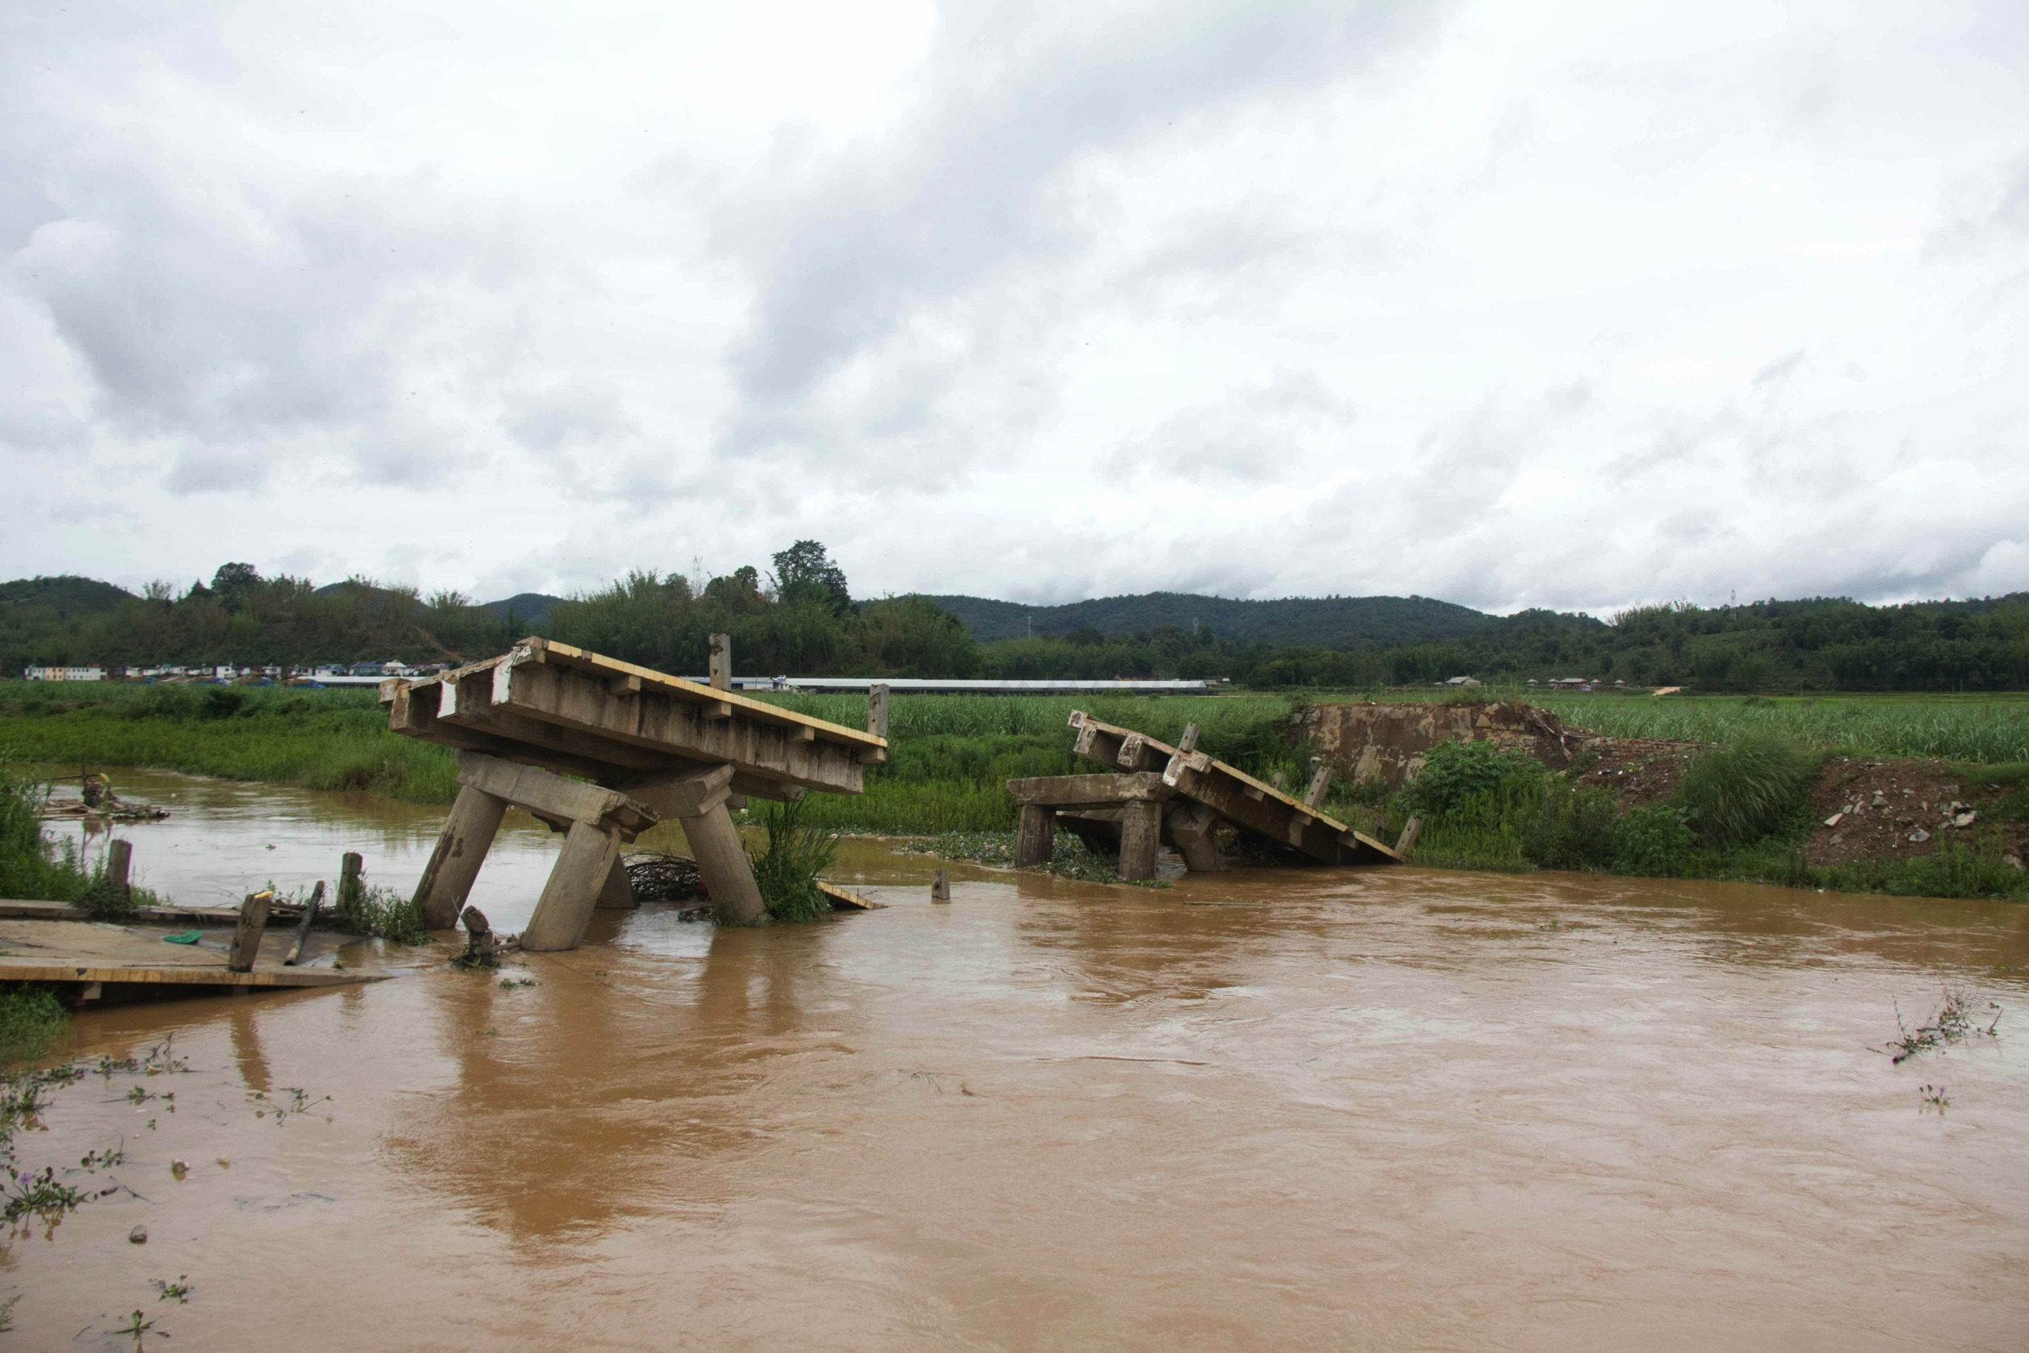
Questions?

Slide 45
In Situ ¹⁰Be
Meteoric ¹⁰Be
produced
delivered
n
n
¹⁶O
¹⁰Be
-
+
-
+
¹⁶O
¹⁶O
?
~3 m
1~10 m?
¹⁰Be
¹⁰Be made and
retained in quartz
¹⁰Be mobile in soil
retained by oxides
?
Production = 2.9 *10² atoms cm⁻² y⁻¹
Delivery = 1.3 x 10⁶ atoms cm⁻² y⁻¹

Slide 46
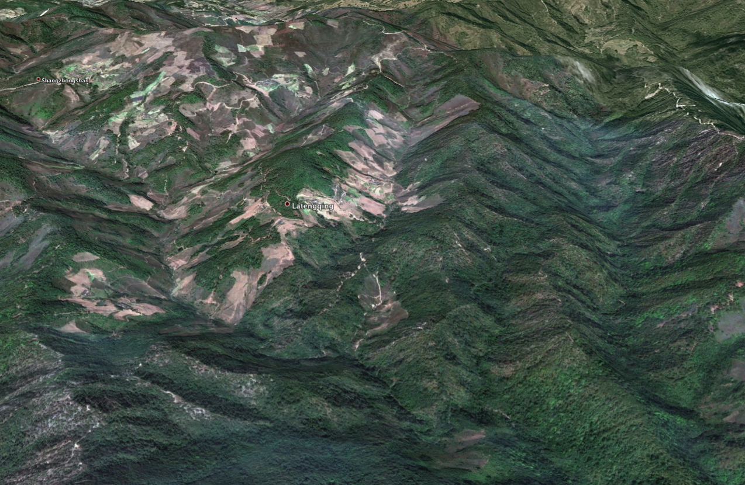
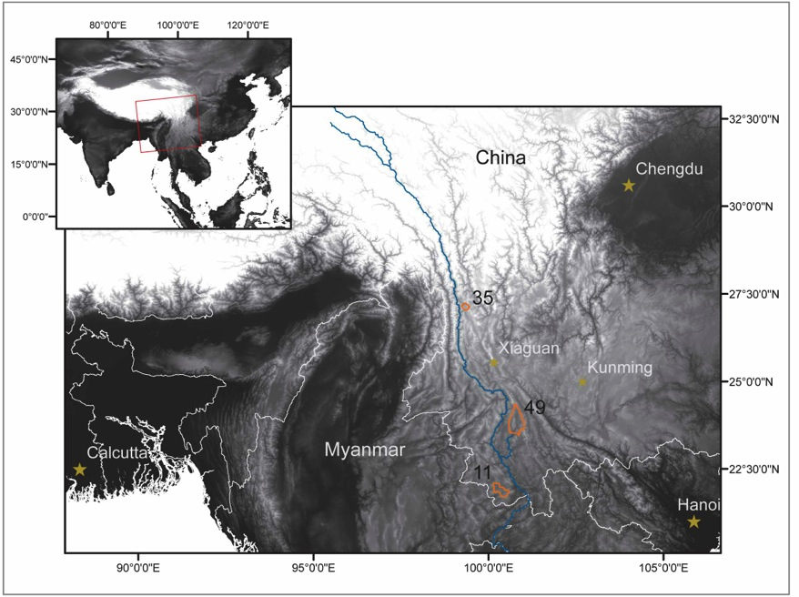
Field area
Three river basins in the Mekong watershed, Yunnan Provence, China
Basins range from 200-2000 km²
Moderate to high relief (Up to ~1800 m)
Intensive land use, primarily agriculture and forestry

Slide 47
Methods
Four sediment associated isotopic systems
  Cosmogenic
    Meteoric ¹⁰Be
    In situ ¹⁰Be
  Short-lived
    Unsupported ²¹⁰Pb
    ¹³⁷Cs
¹⁴C to date terraces and “paleo” in situ ¹⁰Be erosion rates
Daily sediment yield data from Chinese Government hydrology stations (18-23 years)
Remotely sensed land-use classification

Slide 48
Results

Slide 49
¹⁰Be Results

Slide 51
Results

Slide 52
Isotopes used for contemporary erosion
Unsupported ²¹⁰Pb
¹³⁷Cs
t_{1/2} = 22.2 yr
Naturally occurring as part of ²³⁸U decay series
Fraction of total ²¹⁰Pb in soil derived from ²²²Rn gas that leaves soil
Delivered back to soil through fallout
t_{1/2} = 30.2 yr
Created from nuclear weapons testing and accidents
Delivered to soil through fallout
Only deposited globally from 1950’s to 1970’s

Slide 53
Controls of erosion in basin 11
Modest statistically significant relationships between long-term measures of erosion and MAP and relief
Unclear what, if any, processes might be driving these relationships – likely result of extensive agriculture
Notes:
----- Meeting Notes (9/2/15 15:28) -----
could drop this and just say what it shows, otherwise narrate the graphs

Slide 54
Sediment mixing in a river network
Sediment can be collected at a variety of locations in the basin
The sample will be a mixture of sediment derived from all of the tributaries

