Slide 1
Quantifying the response rates of lake ecosystems to Holocene deglaciation through the use of stable isotopes
Presented by Joshua C. Galster
January 30th, 2001

Slide 2
Acknowledgements
Andrea Lini
Paul Bierman
Forrest Janukajtis
Ben Copans
Rachael Howse
Karen Jennings
Drew Lamneck
Simon Rupard
Claude Gaboriault
David Fleming
Anders Noren
Sara Gran
Gretchen Fowles
Carrie Willliams
Christine Massey
John Shane
Stephen Turgeon
Neil Kamman
Gordon Chadburn

Slide 3
Outline
Background
Methods
Results
Summary and comparisons
Interpretations and significance
Future directions

Slide 4
Statement of Problem
To determine the rate that the terrestrial and aquatic ecosystems established themselves following deglaciation.
To determine the factors that influence that establishment rate.

Slide 5
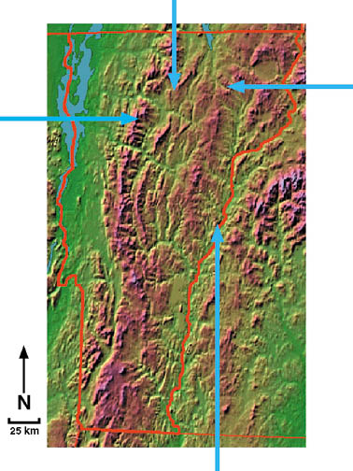
Field area
Ritterbush Pond
Duck Pond
Sterling
Pond
Lake Morey

Slide 6
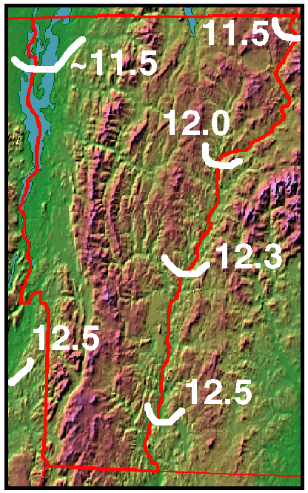
History of Deglaciation in Vermont
White lines represent the glacial extent, in ¹⁴C yBP (from Ridge et al., 1999).
Dates mostly from Lake Hitchcock varves.
Lack of ¹⁴C dates and the mountainous topography complicate the deglaciation history in the central part of the state.

Slide 7
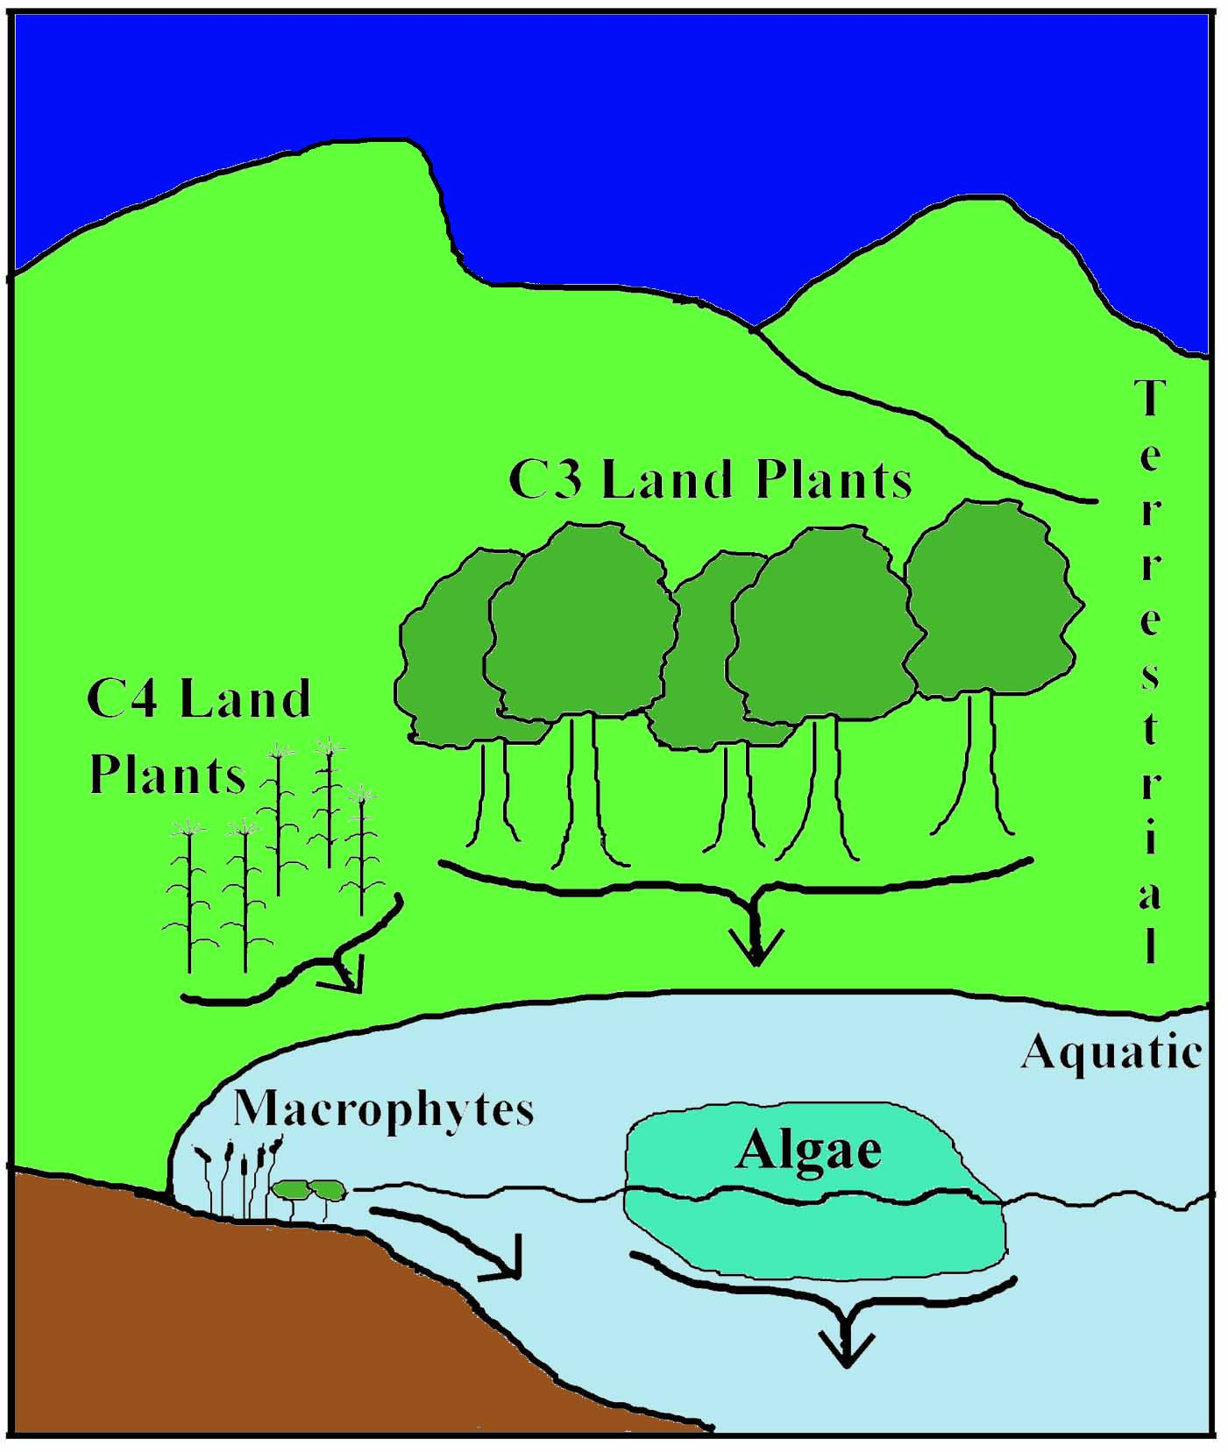
Sources of sedimentary organic matter
Terrestrial sources
Aquatic sources
Aeolian sources minor (<5%)

Slide 8
Stable isotopes
Are naturally occurring
Do not radioactively decay
Reported using the ‘δ notation’
δ‰ = [(R sample/R standard) -1] x 1000
where ‘R’ is the ratio of heavy to light isotopes (e.g. ¹³C/¹²C and ¹⁵N/¹⁴N)
Less of the heavier isotopes
More of the heavier isotopes
- δ ‰
0
+ δ ‰

Slide 9
Composition of OM sources
Terrestrial Plants
High C/N values
High δ¹³C values
Low δ¹⁵N values
Aquatic Macrophytes
High C/N values
High/Low δ¹³C values
High δ¹⁵N values
Aquatic Algae
Low C/N values
Low δ¹³C values
High δ¹⁵N values
Lake Sediment

Slide 10
Methods
Ritterbush Pond
Duck Pond
Sterling
Pond
Lake Morey

Slide 11
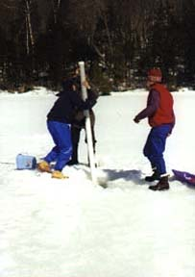
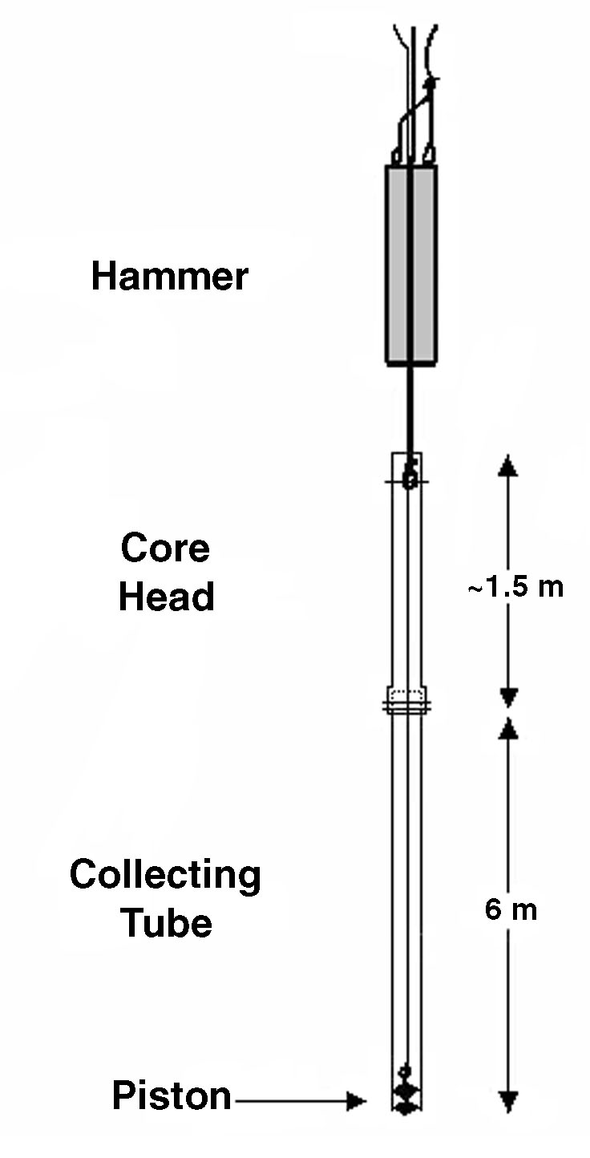
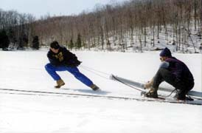
Modified
Reasoner
(1993)
coring
device

Slide 12
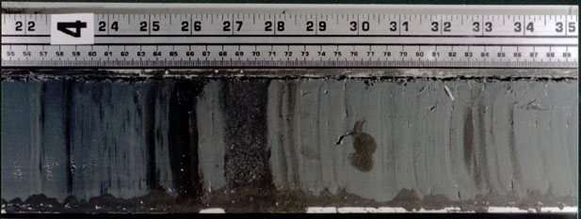
Collect
Cores
X-RAY
Photograph
Visual Log
Sample at 1-cm
resolution
Radiocarbon dating
Acidify
Freeze dry
C/N analyses
Isotope analyses

Slide 13
Duck Pond Lithology
Bottom sediment transitions from coarse sand to gyttja.

Slide 14
Duck Pond

Slide 15
Duck Pond

Slide 16
Lake Morey Lithology
Sediment changes from varved silt to mostly gyttja.

Slide 17
Lake Morey

Slide 18
Lake Morey

Slide 19
Sterling Pond Lithology
Sediment changes from till to gyttja.

Slide 20
Sterling Pond

Slide 21
Sterling Pond

Slide 22
Ritterbush Pond Lithology
Sediment transitions from coarse sand to gyttja.

Slide 23
Ritterbush Pond

Slide 24
Ritterbush Pond

Slide 25
Summary of shift lengths

Slide 26
%C increase represents the establishment of the local ecosystems
The radiocarbon dates from three (Duck, Sterling, and Ritterbush) of the lakes put the beginning of the %C shift soon after deglaciation
The date (10,200 ¹⁴C yBP) of the %C increase in Lake Morey corresponds with the drainage of glacial Lake Hitchcock (10,300 ¹⁴C yBP).

Slide 27
Three interpretations of the shift in δ¹³C values
Increase in pCO₂ caused the shift
Shift from C₄ to C₃ vegetation
A change in the source of the organic matter from relatively less terrestrial matter to more aquatic matter

Slide 28
Timing of the shifts
%C
δ¹³C

Slide 29
Physiographic data

Slide 30
Amount of inorganic inputs
Sterling Pond Lake Morey Duck Pond Ritterbush Pond

Slide 31
Conclusions
%C increases represent the growing ecosystems.
Decrease in δ¹³C shows the aquatic ecosystem establishing itself after the terrestrial one.
Establishment rate of ecosystems determined by elevation and input amount.
Better comparisons between different limnological records.

Slide 32
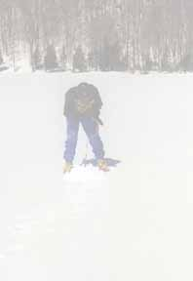
Future directions
Continue coring
Expanded laboratory techniques
Pigment characterization
Hydrogen Index (HI)
Continue coarse δ¹⁵N analyses
Accurately date the oldest sediment

