Slide 1
Enhancing Teacher’s
Classroom Management: Efficient and Effective
Evidence-Based Strategies
Cassandra Townshend
Amy Wheeler-Sutton
VTPBiS State Team Members
Notes:
CASSANDRA

Slide 2



Adapted From….
Brandi Simonsen, PhD
Kathleen Lane, PhD
www.pbis.org
www.cber.org
Notes:
CASSANDRA

Slide 3
Survey Says! Sampling of Responses
Effective:
Individual and group rewards
Alternative spaces, room set-up
PBIS, Responsive Classroom, Olweus, CPS, LSCI
Goal setting
Modeling
Communication w/ parents (+&-)
Multi-sensory instruction
Offering choice
Building community
Challenging:
Timely parental contact for students doing well
Whole group rewards that includes students with problem behaviors
Defiance, seeking peer attention, task avoidance, side conversations
Punishment
5:1 reinforcement
Unstructured time, transitions
Notes:
AMY
Collectively you all have approximately 134 years of experience!
This slide shows a compilation of what you are saying is effective and challenging.
You all have at least a basic understanding of function of behavior. A few experts.
Your hopes include: More tricks in your bag, positive classroom mgt practices, support around problem behaviors.
This is going to be a workshop model, where we will be presenting information, but you should also feel welcome to share any examples, tips, or strategies as we go along.
We are going to be focusing on things that you can do at the classroom level. Some of you are looking for tools and tips you can use for your kids who are needing Tier 2 and Tier 3 interventions. Our hope is that by solidifying your Tier 1 systems, data, and practices, you will see fewer students needing Tier 2 and 3 supports. Some still will, but we aren’t able to cover Tier 2 and 3 interventions in this half day training. We do have an upcoming FBA/BSP training.
Also, this training is geared mainly to classroom teachers, but all of this can be applied to special educators, integrated arts teachers, counselors, etc. If you need help seeing how a certain practice would apply in your specific situation, please speak up.

Slide 4
Learning Objectives:
By the end of this training, you will have:
Discussed classroom management within the context of PBIS
Reflected on and assessed current strategies
Discussed foundational systems
Learned and applied several low-intensity classroom management practices
Learned the importance of understanding the function of behavior
Learned how to use data to improve classroom management
Had a really great time together!
Notes:
AMY

Slide 5
SWPBS
Systems
School-wide
Classroom
Non-classroom
Family
Student
Notes:
AMY

Slide 6
Framework
SYSTEMS
DATA
PRACTICES
Notes:
AMY

Slide 7
What does the research say?
Teachers typically receive little pre- or in-service training in classroom management
(Begeny & Martens, 2006; Freeman, Simonsen, Briere, & MacSuga, under review; Markow, Moessner, & Horowitz, 2006; Special Education Elementary Longitudinal Study, 2001, 2002, 2004; Wei, Darling-Hammond, & Adomson, 2010)
Multi-component training packages (didactic training + coaching + performance feedback + etc.) result in desired behavior change, especially when trained skills are effective
  (e.g., Abbott et al., 1998; Allan & Forman, 1984; Hiralall & Martens, 1998; Madsen, Becker, & Thomas, 1968; The Metropolitan Area Child Study Research Group & Gorman-Smith, 2003; Rollins et al., 1974; Simonsen, Myers, & Deluca, 2010).
Bottom line: “Training by itself does not result in positive implementation…or intervention outcomes”
(Fixen, Naoom, Blasé, Friedman, & Wallace, 2005, pp. 40-41)
Notes:
AMY

Slide 8
Share:
Did you receive pre-service training in classroom management?
Do you receive in-service training in classroom management?
Have you ever received coaching and performance feedback around classroom management?
Notes:
AMY

Slide 9

Why Focus on
Classroom Management?
Improves classroom climate
Creates shared ownership of the classroom
Develops students’ self-discipline
Decreased disruptive problem behaviors
Decreased teacher redirection
Increased instructional time
Increased academic learning time
Increased academic success
Notes:
AMY
When students can predict the events throughout their school day, they are more likely to be engaged and less likely to display problem behavior. One way to increase predictability in a classroom is to establish routines, particularly early in the school year (Kern & Clemens, 2007, p. 67).
Research tells us… (Read slide)

Slide 10

What “kind” of students can display problematic behavior?
ALL
Regular Ed
Special Ed
All students can display problematic behavior.
This is not a special education issue. It is an education issue.
Notes:
AMY
Continuum of developmental level of students- Using a multi-tired system of support within the classroom for all developmental levels and individual accommodations. This includes having a system for managing individual behavior plans that students might be on.

Slide 11
6 Critical Features of
Evidence-Based
Classroom Management
From the work of Brandi Simonsen, Ph.D
Notes:
CASSANDRA

Slide 12
Evidence Based Practices: Classroom Management
Maximize structure in your classroom.
Establish and teach expectations.
Actively engage students in observable ways.
Establish a continuum of strategies to acknowledge expected behavior.
Establish a continuum of strategies to respond to unexpected behavior.
Use self reflection and behavior data to progress monitor and problem solve
Notes:
CASSANDRA

Slide 13
Evidence Based Practices: Classroom Management
Maximize structure in your classroom.
Establish and teach expectations.
Actively engage students in observable ways.
Establish a continuum of strategies to acknowledge expected behavior.
Establish a continuum of strategies to respond to unexpected behavior.
Use self reflection and behavior data to progress monitor and problem solve
Notes:
CASSANDRA
Think about the layout of the classroom and the nonverbal messages that are communicated as soon as the student enters the classroom door. Is the classroom set up in a way that is welcoming, that feels safe and is predictable? If our classroom expectations include being safe and respectful then we need to ensure that the classroom environment is demonstrating this same message.

Slide 14

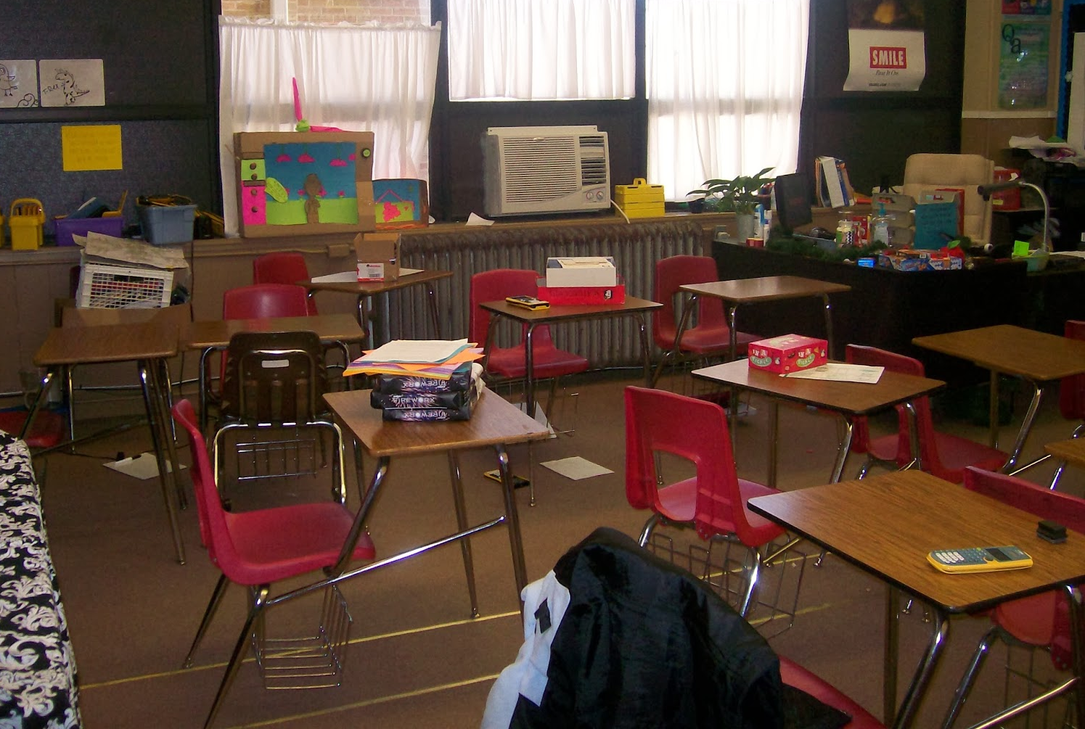
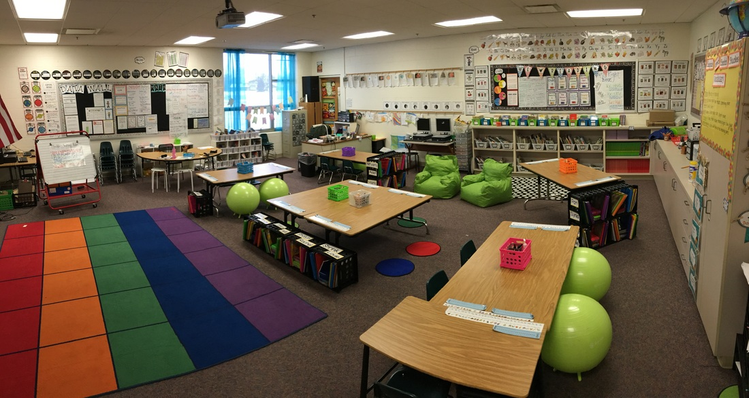
Maximize Structure
Design physical classroom environment to:
  Elicit expected behavior
    Ensure adequate supervision of all areas
    Designate staff & student areas
  Minimize crowding and distraction
    Arrange furniture to allow easy traffic flow
    Strategic seating arrangements
      Groups, carpet, etc.
Notes:
CASSANDRA
Ensure that the environment is safe, physically and emotionally. Do the environmental structures allow the students to practice the classroom expectations or is the classroom environment set up in a way that conflicts with the classroom expectations? Have you considered ways to incorporate sensory integration for students who might need that level of support? Sensory tools, sensory corner
Have you considered trauma sensitive accommodations?
Can you assign students jobs to allow the teacher to have more available time for students (attendance, lunch, homework, notes to office, etc.)

Slide 15
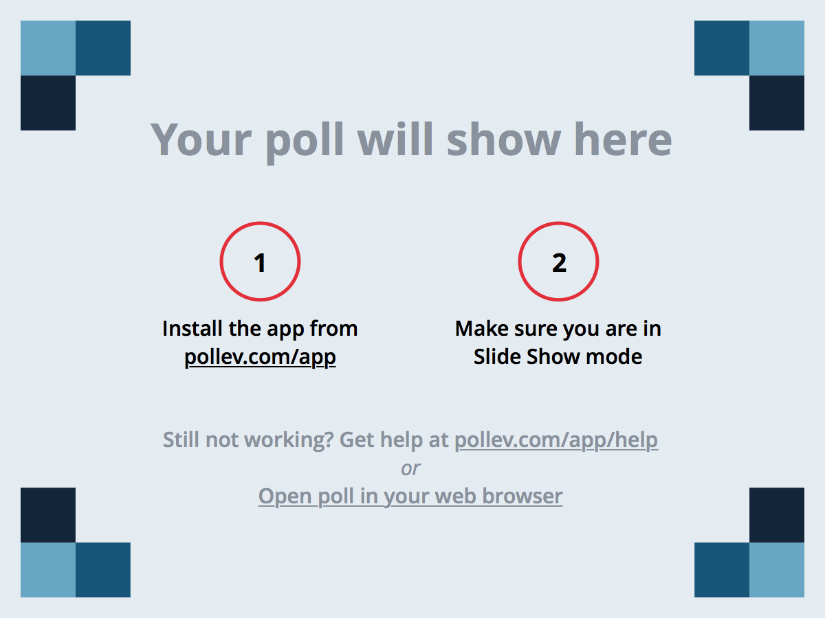
Notes:
AMY
What one word would you like your students to use when describing your classroom?
https://www.polleverywhere.com/free_text_polls/iF3NkbIydkSM6N5

Slide 16
Develop Predictable Routines
Establish and explicitly teach smooth, efficient routines
  General classroom behavior
  Morning arrival/beginning of class period
    Homework drop box
    Attendance
    Lunch count
  Asking to use the bathroom/get a drink
  Asking for help
  What to do when done
  **Transitions
  Interruptions
  Use of materials/equipment
  Morning Meeting
  Work settings
    Instructional
    Independent
    Group
  Dismissal/end of class period
Did we miss any?
**Transitions are often named by teachers as the most difficult time of day
Notes:
AMY
Are the routines structured, predictable, transparent? (Routines become habits)
Every routine requires explicit teaching/guided discovery

Slide 17
Examples of Effective Routines
Using Sign Language
Content-Based Transitions
Green, yellow, red cups (cafeteria/group work volume)
Sing song until everyone gets to the rug
What else?
Notes:
AMY

Slide 18

Activity!
With your neighbor…...
Identify 3 examples of what routines exist that allow for uninterrupted learning time
Discuss what routines might need to be added in order to maximize time for learning
Notes:
AMY
The best learning occurs when we have opportunities to problem solve with colleagues. After today’s session get together with a colleague or colleagues, (perhaps team or grade level meeting) and discuss the routines that currently exist in your classroom(s). What needs to be added?

Slide 19
Evidence Based Practices: Classroom Management
Maximize structure in your classroom.
Establish and teach expectations.
Actively engage students in observable ways.
Establish a continuum of strategies to acknowledge expected behavior.
Establish a continuum of strategies to respond to unexpected behavior.
Use self reflection and behavior data to progress monitor and problem solve
Notes:
CASSANDRA

Slide 20
5 P’s of Teaching Expectations
Pre-
Teach
Practice
Prompt
Positively
Reinforce
Progress
Monitor
6th P Teacher Planning
Notes:
CASSANDRA
Pre-Teach: Establish Expectations, Teach with Matrix-lesson plans, Model, Assess current student level of understanding
Practice: Daily, In Natural Setting
Prompt: Have visuals and reminders, Use Oral Scripts, System to communicate to student when needing to be redirected or reminded, Setting the stage
Positively Reinforce: Frequent acknowledgement and recognition from adults and peers
Progress Monitor: Through acknowledgement system, points system, etc, monitoring of grades, ODRs, student self assessment, etc. (Reinforcement is a form of feedback. Feedback can come from peers, teacher and student, either verbally or through written reflection)

Slide 21
Pre-
Teach
Behavioral Expectations
Establish 3-5 Positively Stated Expectations
  Connected to School-Wide Expectations
  Clear
  Fair
Make Visible
Define and explicitly teach what they look and sound like
  Expectations Matrix
  Lesson Plans (games, role play, etc.)
Don’t forget to teach the why of the expectation – Why is it important for students to follow this expectation?
What are your classroom expectations?
Notes:
CASSANDRA
Visible- think about age group
Teach- Who will teach, When, Where, How

Slide 22
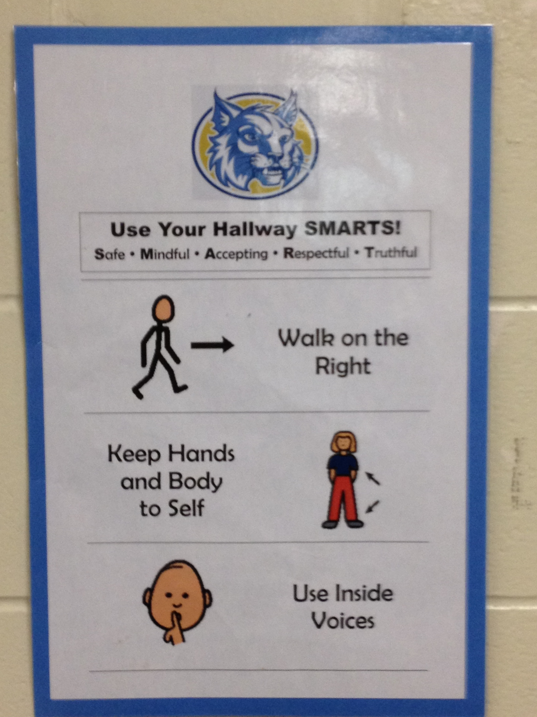
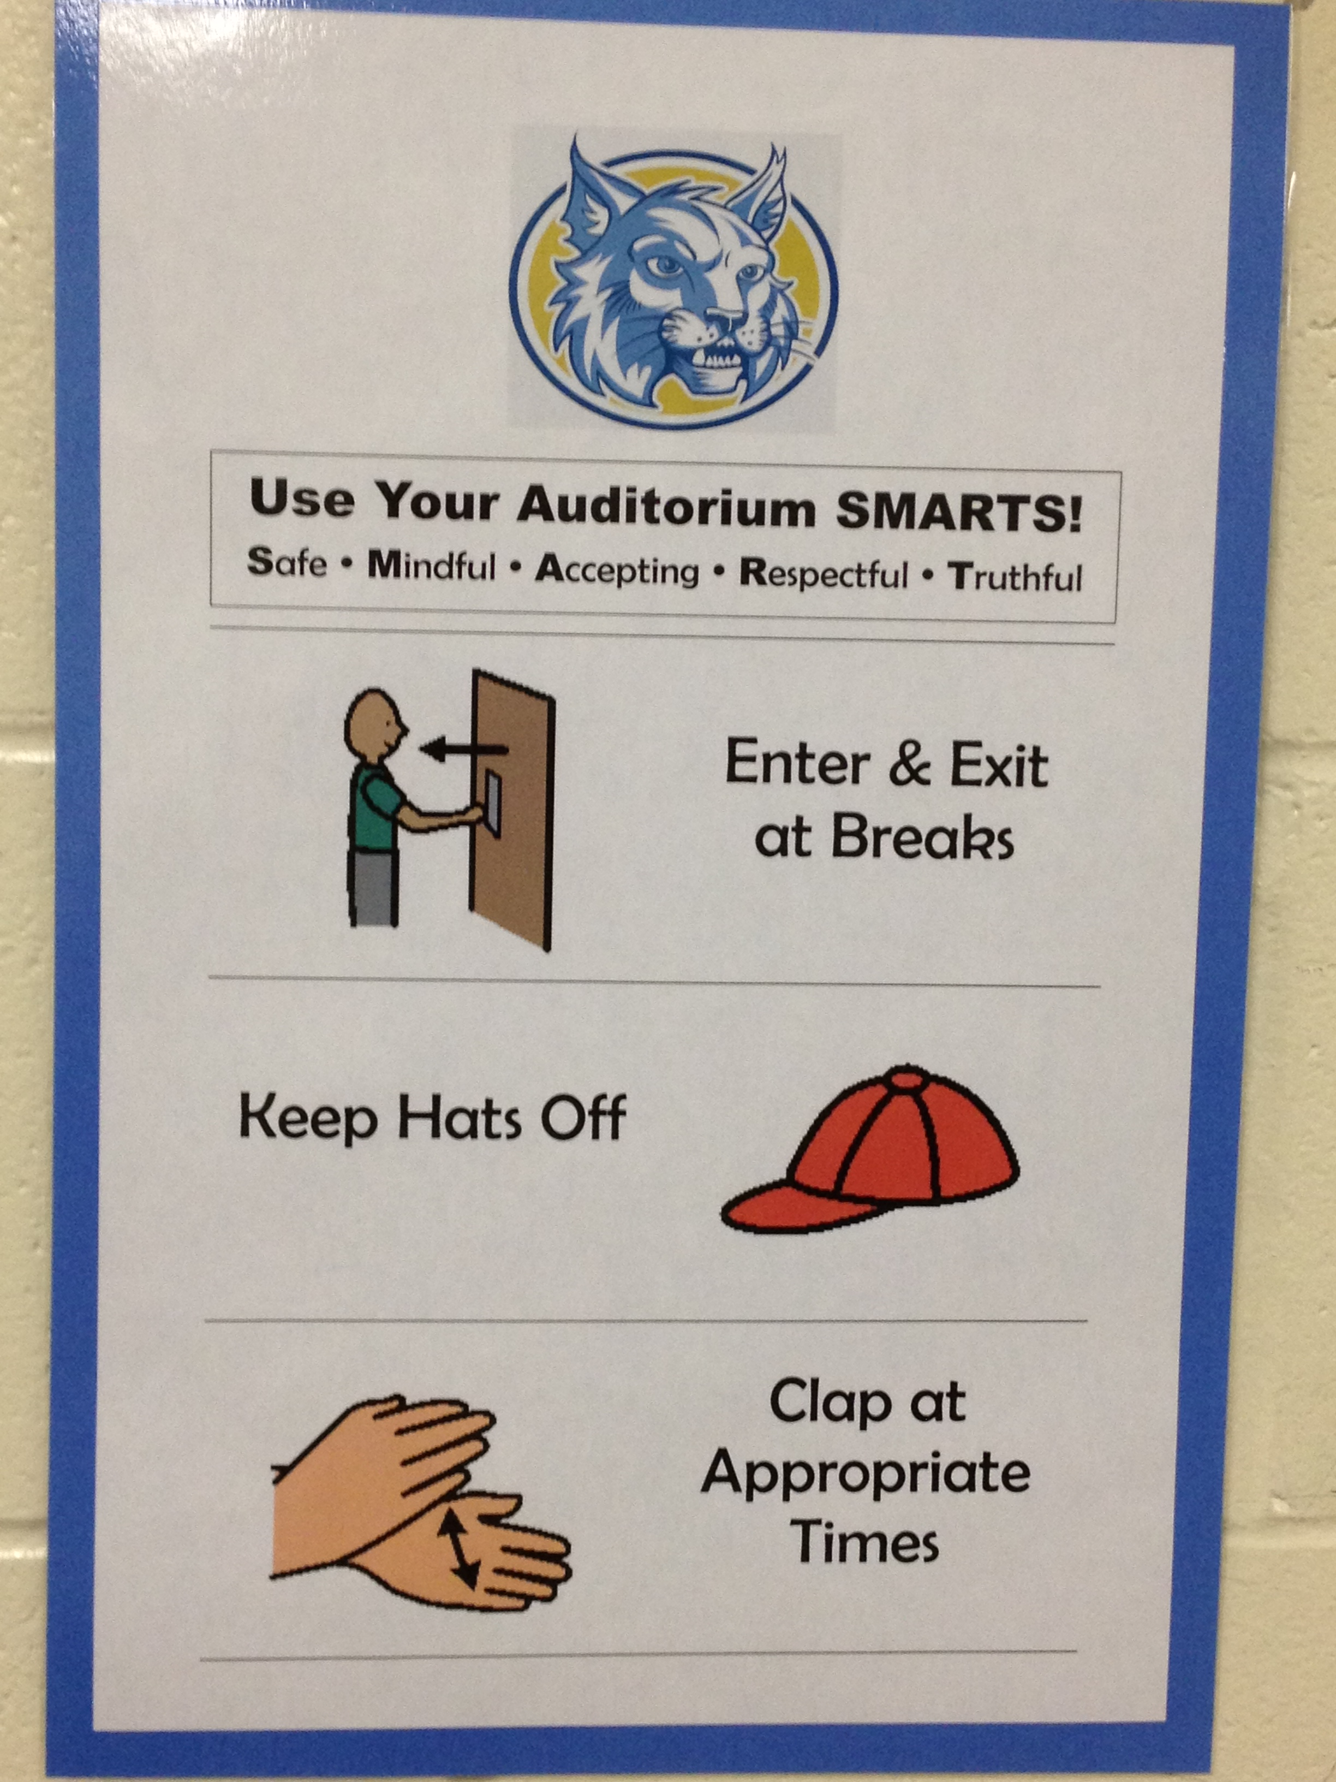
Post Expectations
Posted Expectations
Notes:
CASSANDRA
Pre-teach expectations for transitions and other settings prior to leaving the classroom. Think about adding visual images for students

Slide 23
Teaching Matrix |  | SETTING
 |  | All Settings | Hallways | Playgrounds | Cafeteria | Library/ Computer Lab | Assembly | Bus
 | Respect Ourselves | Be on task. Give your best effort. Be prepared. | Walk. | Have a plan. | Eat all your food. Select healthy foods. | Study, read, compute. | Sit in one spot. | Watch for your stop.
 | Respect Others | Be kind. Hands/feet to self. Help/share with others. | Use normal voice volume. Walk to right. | Play safe. Include others. Share equipment. | Practice good table manners | Whisper. Return books. | Listen/watch. Use appropriate applause. | Use a quiet voice. Stay in your seat.
 | Respect Property | Recycle. Clean up after self. | Pick up litter. Maintain physical space. | Use equipment properly. Put litter in garbage can. | Replace trays & utensils. Clean up eating area. | Push in chairs. Treat books carefully. | Pick up. Treat chairs appropriately. | Wipe your feet. Sit appropriately.
setting
expectation/
social skill
Expectations
behavior examples
Notes:
CASSANDRA
Examples are positively stated! All your school rules in your handbook can be reframed to fit within this matrix.
Identifying the most common behavioral error in that location, and identify the positive alternative.

Slide 24
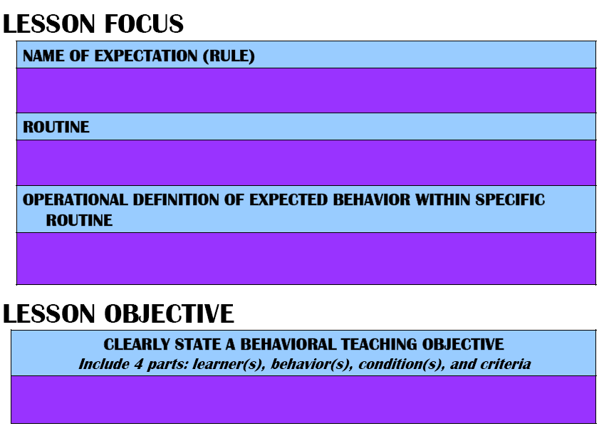
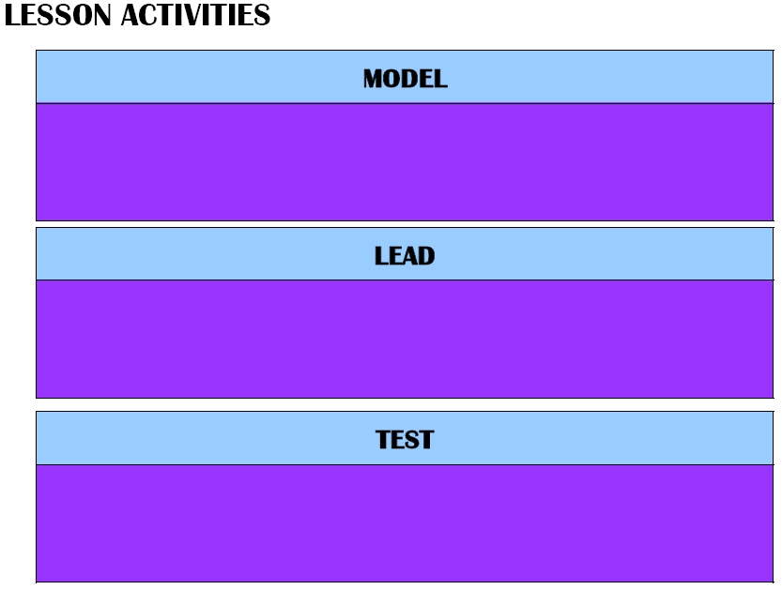
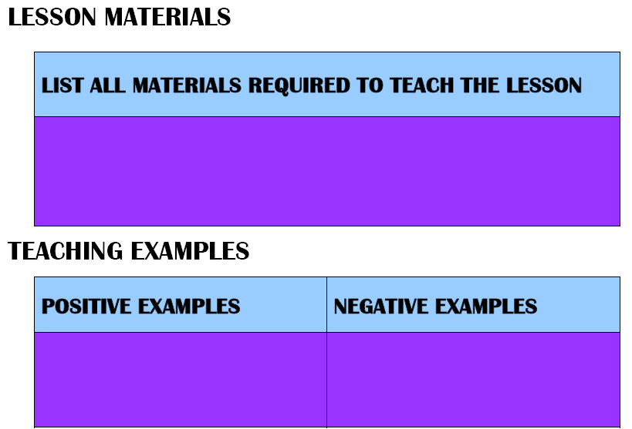
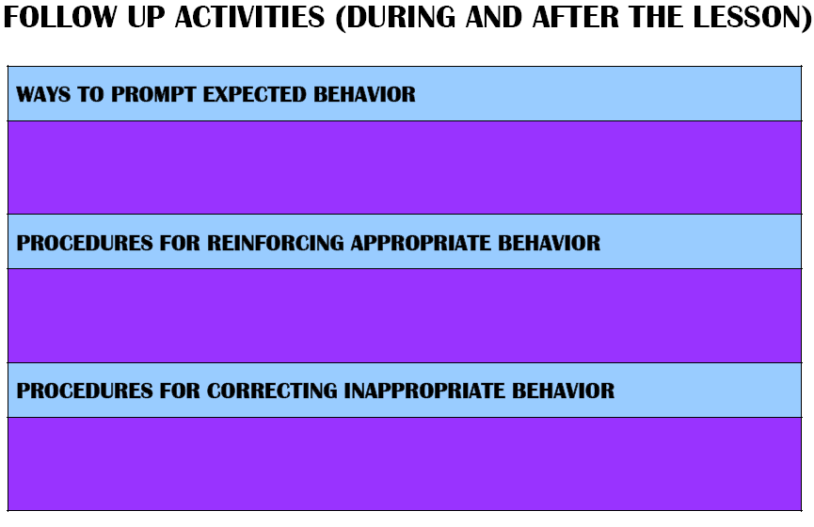
Social Skills Lesson Plan
PROCEDURES FOR MONITORING & EVALUATING
Notes:
CASSANDRA

Slide 25
Practice
Behavioral Expectations
Prompt
Behavioral Expectations
Strategies for Encouraging Positive Behavior
Visual Reminders
Pre-corrections
Provide Choice
Strategies for Discouraging Problem Behavior
Re-direct
Re-teach
Conference
Notes:
CASSANDRA

Slide 26
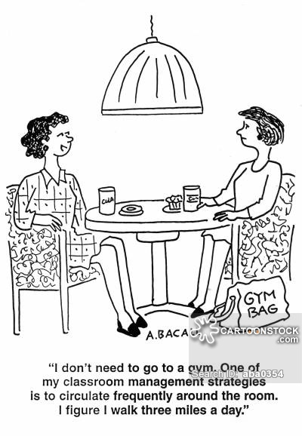
Positively Reinforce
Acknowledging Expected Behavior
Progress
Monitor
Students’ Behavior in Natural Setting
Active Supervision (Colvin, Sugai, Good, Lee, 1997):
            Move around
              Use proximity
            Look around (Scan)
            Interact with students
                Give Acknowledgement
                Give Feedback
Notes:
CASSANDRA

Slide 27
Active Supervision:
Allows for provision of immediate learning assistance
Increases student engagement
Reduces unexpected behavior; increases expected behavior
Provides teacher with knowledge of students’ use of expectations
Allows for encouragement of those using expected behavior
Allows for prompts/pre-corrections and timely correction of social/behavioral errors
Can preempt escalations
Builds positive adult-student relationships
Notes:
CASSANDRA

Slide 28
Active Supervision:
While moving and scanning, you also want to address any unexpected behavior quickly and calmly, using the continuum of strategies including:
1) ignore/attend/praise
2) redirect
3) re-teach
4) provide choice
5) student conference
Notes:
CASSANDRA

Slide 29
Active Supervision:
Greeting Students:
State name
Give one positive statement
Give explicit instruction
Notes:
CASSANDRA
“Hi Billy. I’m glad to see you made it to class on time today. Go ahead and turn your math book to page 110.”

Slide 30
Progress
Monitor
Students’ Behavior in Natural Setting
Collect data
  Are the expectations being followed?
  Have negative behaviors decreased?
    If not:
    who is making errors?
    where are the errors occurring?
    what kind of errors are being made?
Summarize data (look for patterns)
Use data to make decisions
  Do environmental/structural changes need to be made?
  Is the instruction effective or does it need to be redesigned?
Notes:
CASSANDRA

Slide 31
Evidence Based Practices: Classroom Management
Maximize structure in your classroom.
Establish and teach expectations.
Actively engage students in observable ways.
Establish a continuum of strategies to acknowledge expected behavior.
Establish a continuum of strategies to respond to unexpected behavior.
Use self reflection and behavior data to progress monitor and problem solve
Notes:
AMY

Slide 32

How do you achieve engagement?
Effective instructional design, curriculum, delivery, and strategies
  Well-planned lessons – preparation is key!
    During lesson planning, always think: “What could make this lesson more fun/engaging/relevant?”
      The students need to WANT to be there
      Limit lecture-style
Notes:
AMY

Slide 33
Evidence based practices that promote active engagement
Explicit instruction
Differentiated and developmentally-appropriate instruction
Multi-sensory instruction
Computer-assisted instruction
Class-wide peer tutoring
Regular feedback
High rates of opportunities to respond (OTR) (more on handout)
Instructional choice (more on handout)
Opportunities for emotional connection to curriculum
Link engagement with outcome objectives
Notes:
AMY
Regular Feedback through response cards, note cards, on-going progress monitoring, reinforcement system

Slide 34
Activity!
With your neighbor, discuss what you currently do to ensure that your students are engaged (e.g., practices to ensure that students are on task, responding frequently, and producing quality work matched to their ability)?
Notes:
AMY
5 minutes discussion; 2-3 minutes of sharing by volunteers.

Slide 35
Evidence Based Practices: Classroom Management
Maximize structure in your classroom.
Establish and teach expectations.
Actively engage students in observable ways.
Establish a continuum of strategies to acknowledge expected behavior.
Establish a continuum of strategies to respond to unexpected behavior.
Use self reflection and behavior data to progress monitor and problem solve
Notes:
CASSANDRA

Slide 36
Acknowledge Expected Behavior
Frequent Behavior-Specific Praise (BSP) (6:1 ratio) (more on handout)
Group Contingencies
Behavior Contracts
Token Economies
What do you do to acknowledge expected behavior?
What do you do to recognize students who are the ones consistently rising above expectations?
Notes:
CASSANDRA

Slide 37
Evidence Based Practices: Classroom Management
Maximize structure in your classroom.
Establish and teach expectations.
Actively engage students in observable ways.
Establish a continuum of strategies to acknowledge expected behavior.
Establish a continuum of strategies to respond to unexpected behavior.
Use self reflection and behavior data to progress monitor and problem solve
Notes:
CASSANDRA

Slide 38
Respond to Unexpected Behavior
Error Corrections
  Calm, neutral, private (when possible)
Differential Reinforcement
Planned ignoring
Time out from reinforcement
Notes:
CASSANDRA

Slide 39
Understanding Function of Behavior
What does “function of behavior” mean?
  The why of a student’s behavior
Why should you think about it?
  To minimize inadvertent reward of the problem behavior
  Respond in a way that will reduce behavior
  Will help you better understand students’ behavior
Notes:
CASSANDRA

Slide 40
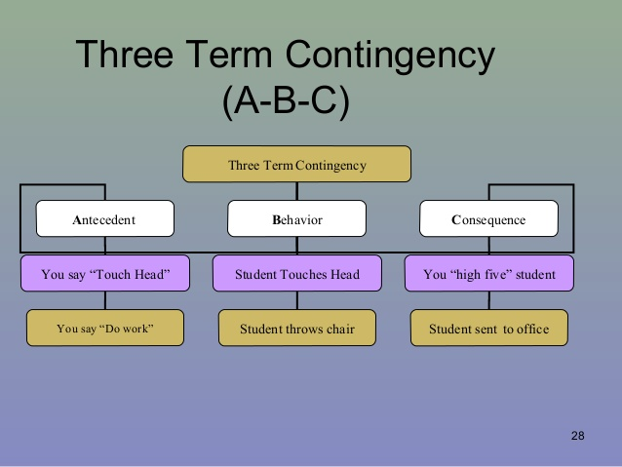
Behavior change occurs when the antecedents and consequences are manipulated effectively, based on function.
Slide from Beautiful Minds of Princeton/Credit: Karen Umstead M.Ed BCBA
Notes:
CASSANDRA

Slide 41
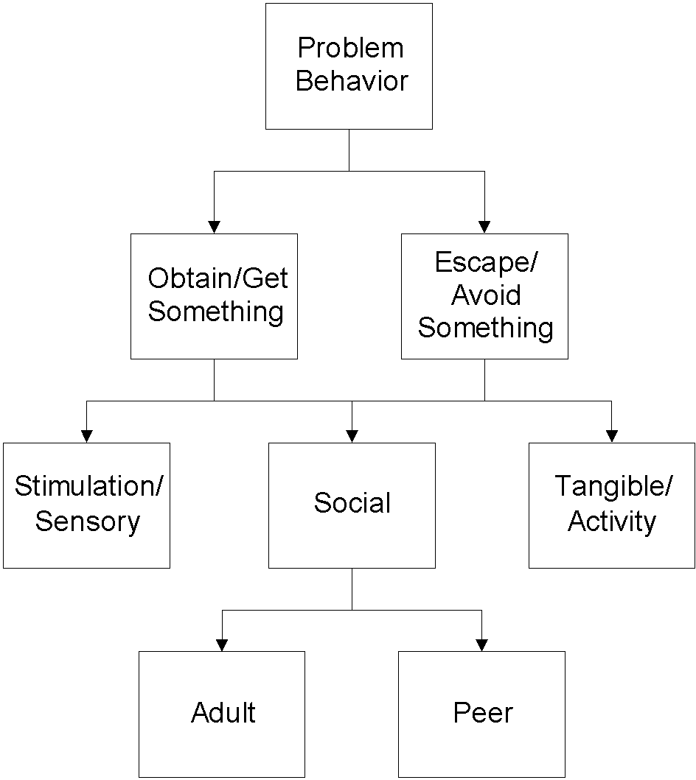


Two Basic Functions
Positive
Reinforcement
Negative
Reinforcement
from Horner & Sugai at www.pbis.org
Notes:
CASSANDRA
For example-
Many students use off topic comments/inappropriate language to obtain
attention from peers through their reactions and to escape the task at hand.
In this example, social reinforcement is obtained from the peers and the
adult.
Remember reinforcement is positive and negative.
NOTE:
When control is offered as a possible function- think about what is underlying that perception.
Control can be a way:
To hide skill deficits; therefore escaping/avoiding a task
To hide fears around social acceptance; therefore escaping/avoiding a situation
For an individual to assert themselves; therefore gaining/obtaining the attention of peers/adults

Slide 42
Examples of Function in Schools
Obtain/Get Reinforcers
  I yell and others look at me
  I fight and others listen to me
  I wander and people talk to me
  I hit in order to get toys from other kids
Escape/Avoid Aversives
  I cry when work gets hard and the teacher tells me to take a time out
  I throw a book during math class and the teacher will send me out of class
  I stand against the wall in PE so my classmates do not throw the ball at me

Slide 43
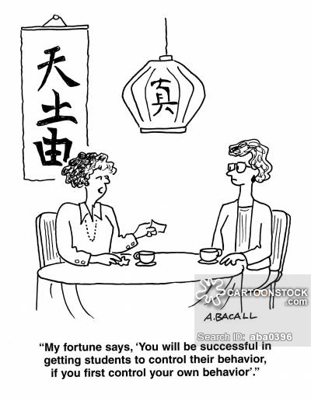

It’s both about you… and not about you
Notes:
AMY

Slide 44
Evidence Based Practices: Classroom Management
Maximize structure in your classroom.
Establish and teach expectations.
Actively engage students in observable ways.
Establish a continuum of strategies to acknowledge expected behavior.
Establish a continuum of strategies to respond to unexpected behavior.
Use self reflection and behavior data to progress monitor and problem solve.
Notes:
AMY

Slide 45
Help teachers to self-reflect…..
7r
Positive Behavior Support
Classroom Management:
Self-Assessment Revised
Brandi Simonsen, Sarah Fairbanks, Amy Briesch, & George Sugai
Center on Positive Behavioral Interventions and Supports
University of Connecticut
Version: April 7, 2006
Notes:
AMY

Slide 46
Classroom Management Practice | Rating
1. I have arranged my classroom to minimize crowding and distraction | Yes No
2. I have maximized structure and predictability in my classroom (e.g., explicit classroom routines, specific directions, etc.). | Yes No
3. I have posted, taught, reviewed, and reinforced 3-5 positively stated expectations (or rules). | Yes No
4. I provided more frequent acknowledgement for appropriate behaviors than inappropriate behaviors (See top of page). | Yes No
5. I provided each student with multiple opportunities to respond and participate during instruction. | Yes No
6. My instruction actively engaged students in observable ways (e.g., writing, verbalizing) | Yes No
7. I actively supervised my classroom (e.g., moving, scanning) during instruction. | Yes No
8. I ignored or provided quick, direct, explicit reprimands/redirections in response to inappropriate behavior. | Yes No
9. I have multiple strategies/systems in place to acknowledge appropriate behavior (e.g., class point systems, praise, etc.). | Yes No
10. In general, I have provided specific feedback in response to social and academic behavior errors and correct responses. | Yes No
Overall classroom management score: 10-8 “yes” = “Super” 7-5 “yes” = “So-So” <5 “yes” = “Improvement Needed” | # Yes___
Actively supervise & precorrect
Maximize active engagement
Maximize opportunities to respond
High rates of positive interactions
https://www.pbis.org/common/cms/files/pbisresources/gsclassman0907.doc
Notes:
AMY

Slide 47
Other Data Sources to Consider…..
Observations
Number of positive acknowledgements received
Office Discipline Referrals
Academic Grades
What else?
Notes:
AMY

Slide 48
Pick a problem time in your classroom
Prevention: Remove/alter “trigger” for problem behavior
Teaching: Define, instruct & model expected behavior
Reward: Expected/alternative behavior when it occurs; prompt as necessary
Extinction: Increase acknowledgement of presence of desired behavior
Corrective Consequence: Use non-rewarding/non-reinforcing responses when problem behavior occurs
Data Collection: Indicate how you know when you have a solution
Notes:
AMY

Slide 49
Example: Disruption in Cafeteria
Prevention: Remove/alter “trigger” for problem behavior | Maintain current lunch schedule, but shift classes to balance numbers.
Teaching: Define, instruct & model expected behavior | Teach behavioral expectations in cafeteria
Reward: Expected/alternative behavior when it occurs; prompt as necessary | Establish “Friday Five”: Extra 5 min of lunch on Friday for five good days.
Extinction: Increase acknowledgement of presence of desired behavior | Encourage all students to work for “Friday Five”… make problem behavior less rewarding than desired behavior
Corrective Consequence: Use non-rewarding/non-reinforcing responses when problem behavior occurs | Active supervision and continued early consequence (ODR)
Data Collection: Indicate how you know when you have a solution | Maintain ODR record and supervisor weekly report

Slide 50
Strategies for Refining Your Craft
Review what you are already doing
  Complete a self-assessment checklist
  Video yourself teaching
  Ask a trusted colleague/mentor to observe you and provide feedback/data
  Ask to observe a teacher who is very strong in classroom management
Identify an area for growth and set a reasonable goal (i.e. I will increase my rate of positive, specific feedback.)
Monitor your progress on your goal
Notes:
AMY

Slide 51
What was missing from Brandi’s
6 Critical Features?
Build classroom community and rapport with students
  Interact in a positive, caring way to develop strong relationships
What do you do to develop relationships with all of your students?
    Morning handshake greeting
    Non-classroom teachers connecting with students outside of classroom (i.e. hallway, recess, lunch room)
    What else?
  Extra opportunities for relationship-building with struggling students
    Library helper volunteer example
    2x10 strategy
    What else?
Notes:
AMY

Slide 52
Closing Activity
Take 5 minutes of private reasoning time to reflect on the 6 Critical Features of Classroom Management
Write down…...
  3 Things I learned……..
    2 Things I want to pursue further……..
    1 Thing I will do immediately……..
Share with your neighbor
We’ll hear a sampling of responses
Notes:
CASSANDRA

Slide 53
Thank You and Next Steps
Visit the following websites for additional resources:
  www.pbisvermont.org
  www.pbis.org
    Evidence-Based Classroom Strategies for Teachers
  http://www.ci3t.org
  www.pbisworld.com
Check out the BEST/VTPBiS PD Calendar
Notes:
CASSANDRA

Slide 54
Additional Classroom Management Resources

Slide 55
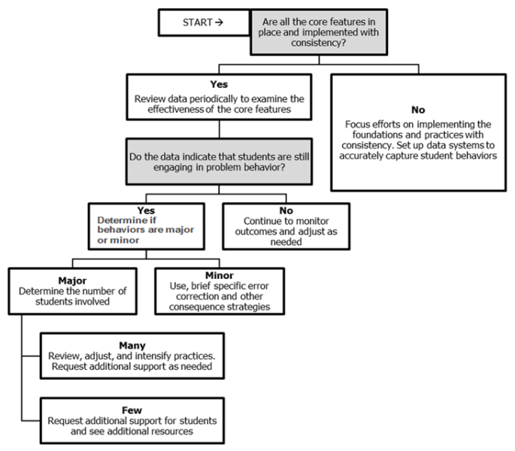
Using Data
https://www.pbis.org/common/cms/files/pbisresources/Supporting%20and%20Responding%20to%20Behavior.pdf

Slide 56
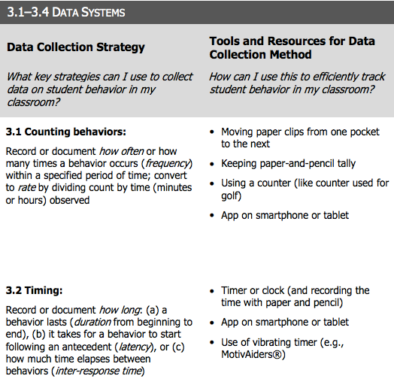
Data
Collection Strategies
https://www.pbis.org/common/cms/files/pbisresources/Supporting%20and%20Responding%20to%20Behavior.pdf

Slide 57
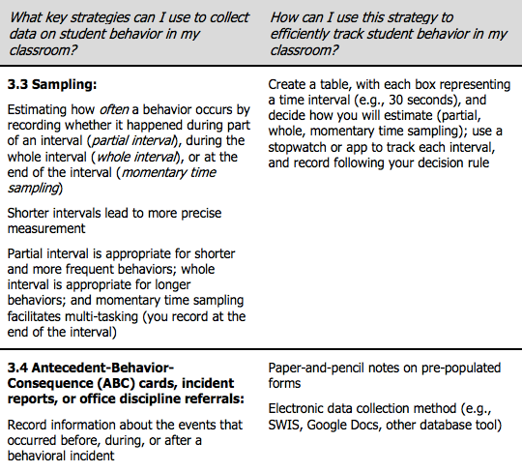
Data
Collection Strategies
https://www.pbis.org/common/cms/files/pbisresources/Supporting%20and%20Responding%20to%20Behavior.pdf

Slide 58
Tips for videoing yourself
Video yourself at least twice:
  Once during a time that is challenging (if you are having trouble deciding on a time, think about when you feel the most frustrated with the students)
  Once during a time that feels successful
Look for:
  Physical environment layout
  Clear expectations
  Opportunities to respond (rate and variability)
  Behavior-specific praise
  Instructional choice
  Active supervision
  Prompts/pre-corrections
  Teacher movement
  Teacher interaction with students
  Error corrections
  Response to problem behavior
  Student engagement

Slide 59
Evidence-based Strategies for Classroom Management:
Opportunities to Respond
Behavior Specific Praise
Instructional Choice

Slide 60
What is OTR?
Opportunities to respond (OTR) is a strategy for students to:
  review material, acquire skill fluency
  commit information to memory
  increase on-task behavior and reduce misbehavior
Allows for frequent opportunities, within a set time period, to respond to teacher questions or prompts about targeted academic materials
Best used when material or concepts have been taught
  Promotes student engagement as they practice the information or skill
Students respond individually or in unison (choral)
(Lane, Menzies, Ennis, & Oakes, 2015)

Slide 61
What is OTR? (cont.)
Verbal Responding
  Choral Response (Haydon et al., 2009)
    Every student answers question/prompt
  Questioning
    Think, Pair, Share
    Partners
Non-Verbal Responding
  Signal
    Thumbs up/down
  Response Card
    Agree/Disagree, A/B/C/D, True/False
  Individual white boards
  Guided Notes
  Student Response Systems (Clickers; Blood & Gulchak, 2013)

Slide 62
Example
Illustration: Activities to demonstrate knowledge using white boards:
Cue: “Class, please solve for the product of 28 X 4.”
Wait: After 10 seconds: “Hold up your whiteboards.”
Prompt “What is the answer?”
Feedback: “I see almost all of you found the correct answer
is 112. Nice work!”
Next Question: “This is individual, solve for the product
of 32 X 3.”

Slide 63
Why is OTR effective?
Whole-group OTR allows teacher to quickly determine:
  students’ proficiency with the material
  if more practice is needed
  which students may require more intensive supports
Promotes fluency and automaticity, freeing students to tackle more complex concepts
Increases active participation, even during whole-group delivery
Feedback is rapid and matter-of-fact, which reduces the pressure of answering correctly: “Correct” or “That is not correct, the answer is X” (Haydon et al., 2010)
(Lane, Menzies, Ennis, & Oakes, 2015)

Slide 64

What does the supporting research for OTR say?
Effectiveness demonstrated from preschool (Godfrey et al., 2003) to middle school (Haydon & Hunter, 2011)
Increasing participation in elementary and secondary classrooms (Haydon & Hunter, 2011; Maheady et al., 2002; Narayan et al., 1990; Wood et al., 2009)
Decreasing disruptive behavior in elementary classrooms (Haydon et al., 2010; Haydon et al., 2009)
Improving academic outcomes for students with emotional and behavioral disorders (Sutherland et al., 2003)
(Lane, Menzies, Ennis, & Oakes, 2015)

Slide 65
What are the benefits and challenges
Benefits
Challenges
Instructional format that is efficient and engaging
Facilitates participation of all students
Review of material or concepts in promoting fluency and engagement
Supports teachers in reaching levels of engagement for effective instruction – 75-80% academic engaged time
Requires relatively little preparation and can be used for a variety of lessons across all grade levels
Teacher’s adjustment to the rapid pacing
Preparation of sufficient number or prompts or questions as part of lesson planning
Monitoring student performance and adjusting level of difficulty for successful practice
(Kounin, 1970; Lane, Menzies, Ennis, & Oakes, 2015; Sutherland & Wright, 2013; Walker & Severson, 1992)

Slide 66

How do I implement OTR in my classroom?
Step 1
Identify the lesson content to be taught and the instructional objective.
Step 2
Prepare a list of questions, prompts, or cues related to the content.
Step 3
Determine the modality by which content will be delivered.
Step 4
Determine the modality by which students will respond.

Slide 67
How do I implement OTR in my classroom?
Step 5
Explain to students how the format works and the rationale for using it.
Step 6
Conduct the lesson with a minimum of three opportunities to respond per minute using either single-student or unison responding.
Step 7
Respond to student answers with evaluative and encouraging feedback.
Step 8
Offer students an opportunity to give feedback.

Slide 68
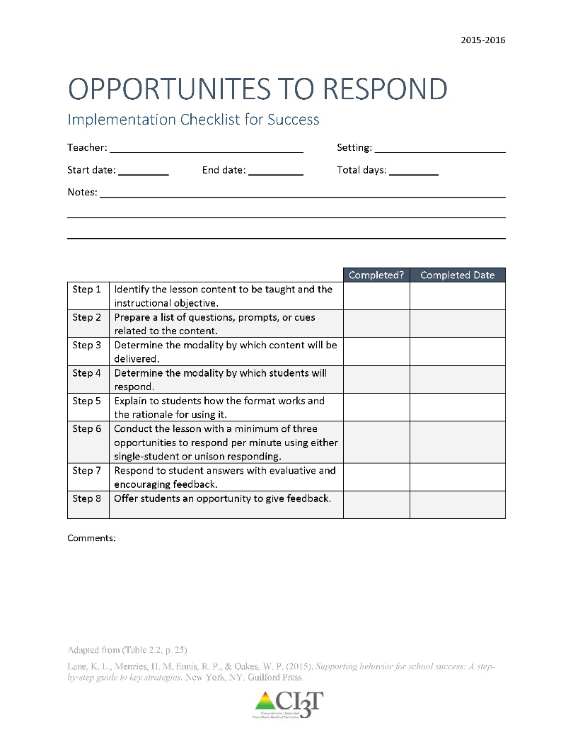
How do I increase OTR in my classroom? Checklist for Success
Step 1: Identify the lesson content to be taught and the instructional objective
Step 2: Prepare a list of questions, prompts, or cues related to the content
Step 3: Determine the modality by which content will be delivered
Step 4: Determine the modality by which students will respond
Step 5: Explain to students how the format works and the rationale for using it
Step 6: Conduct the lesson with a minimum of three opportunities to respond per minute using either single-student or unison responding
Step 7: Respond to student answers with evaluative and encouraging feedback
Step 8: Offer students an opportunity to give feedback
See “OTR Implementation Checklist for Success”

Slide 69
What is Behavior Specific Praise?
Behavior Specific Praise (BSP): Praise statements that include reference to the specific behavior for which the student is being recognized (Brophy, 1981; Sutherland, Wehby, & Copeland, 2000)
Key Components
  Praise statement must be linked to a behavior
  Provide feedback specific to the behavior
  Be sincere
  Reflect skill level
  Evaluate effectiveness
  Praise effort – not ability
  (Haydon, Musti-Rao, 2011, p. 31)
General v. Specific

Slide 70
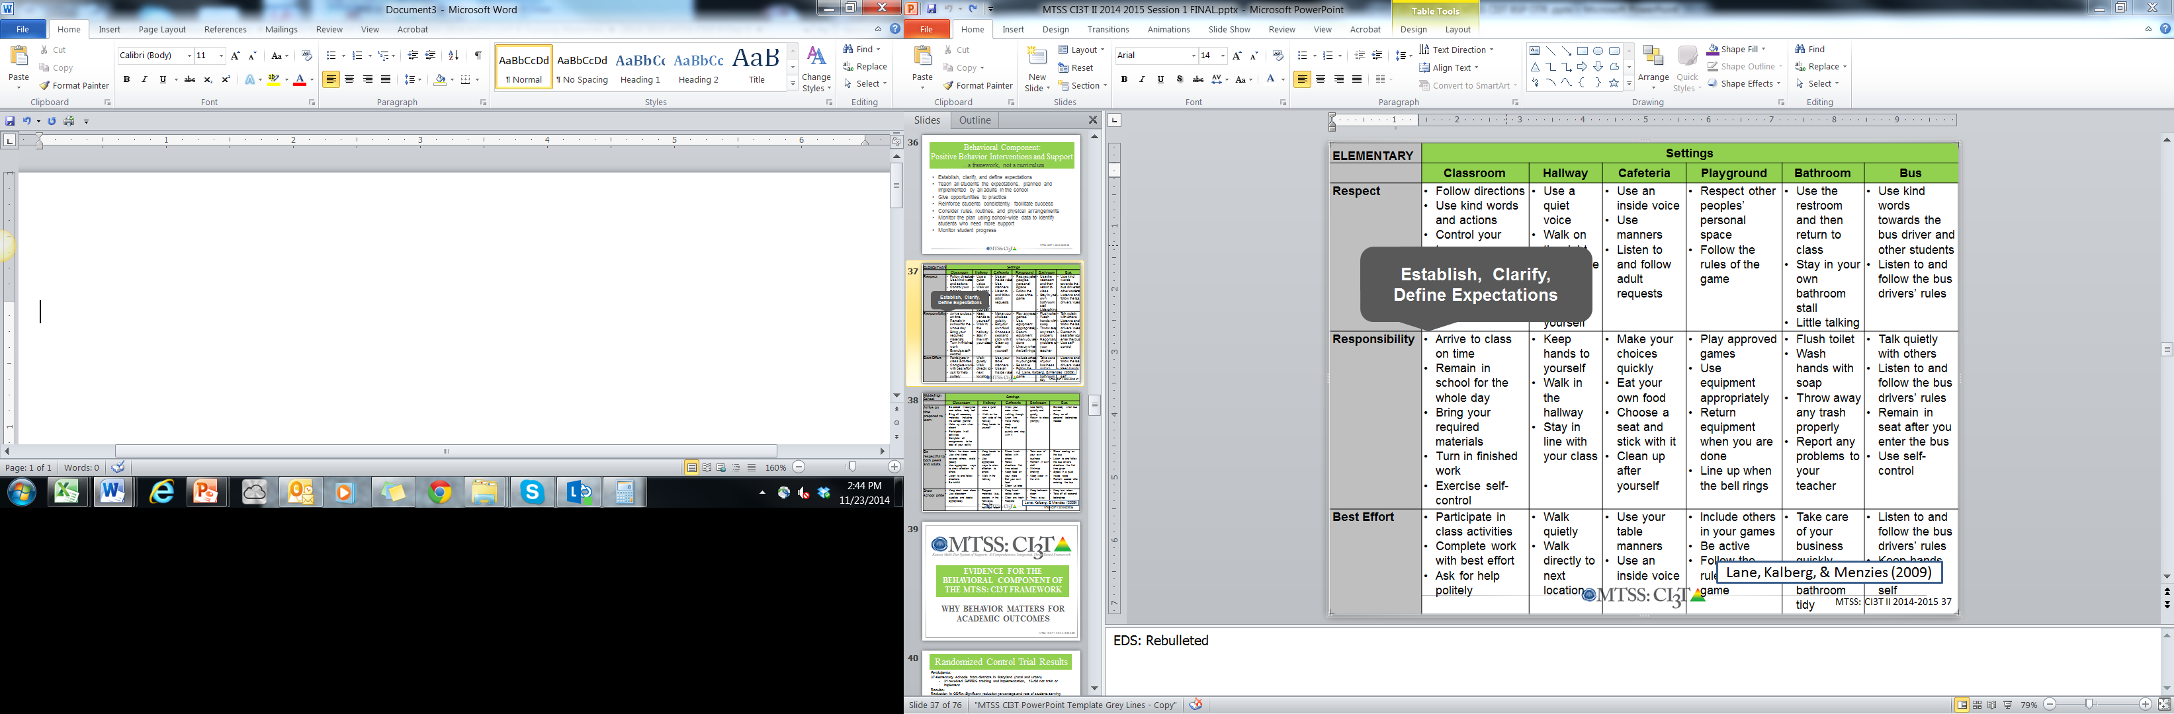
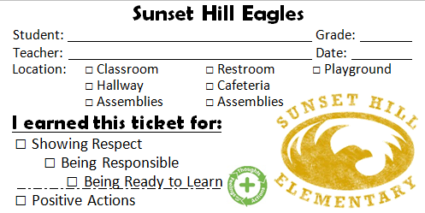
Examples
“Bob, great job showing your work on your math homework.”
“I appreciate how you pushed in your chair on the way to line up for lunch. That keeps the walkways safe.”
BSP is a form of positive reinforcement

Slide 71
Why is Behavior Specific Praise effective?
More effective when
  it is behavior specific rather than general praise
  teachers use strategies to intentionally increase their rate of BSP and target their delivery of BSP to identified students (Thompson, Marchant, Anderson, Prater, & Gibb, 2012).
Simple, effective, requires minimal effort
Instructional feedback delivered at a rate of four positive to one negative (4:1 ratio; Myers, Simonsen, & Sugai, 2011)
Most effective when delivered consistently and immediately after desired behavior
Establishes supportive and positive classroom environment
(Marchant & Anderson, 2012; Kennedy & Jolivette, 2008 ; Stormont & Reinke, 2009)
IFEED-AV
Immediately,
Frequently,
Enthusiasm,
Eye Contact,
Describe,
Anticipation,
Variety
(Rhode, Jenson, & Reavis, 1992)

Slide 72
What does the supporting research for BSP say?
Increasing preschool student’s on-task behavior during transitions in inclusion classrooms (Fullerton, Conroy, & Correa, 2009)
Increasing teachers’ use of behavior specific praise in self-contained classrooms (Hawkins & Helfin, 2011)
Increasing time spent inside the classroom in a residential facility (Kennedy & Jolivette, 2008)

Slide 73
What are the benefits and challenges?
Benefits
Challenges
Takes little effort and costs nothing
Improves student- teacher relationships
Not time consuming or intrusive
Increases on-task behavior and reduces problem behavior
Increases positive social and academic behaviors
(Lampi, Fenty, & Beaunae, 2005; Marchant & Anderson, 2012; Stormont & Reinke, 2009)
Determine students’ preferred method of praise – public or private
Consider the needs of students who are more motivated by escaping tasks or activities rather than accessing teacher attention

Slide 74
How do I implement behavior specific praise in my classroom?
Checklist for Success
Step 1
Evaluate current rates of general and behavior specific praise.
Step 2
Identify behaviors to reinforce.
Step 3
Practice delivery of BSP.
Step 4
Observe student behavior.

Slide 75
How do I implement behavior specific praise in my classroom?
Checklist for Success
Step 5
Provide BSP.
Step 6
Monitor BSP delivery.
Step 7
Seek student input.

Slide 76
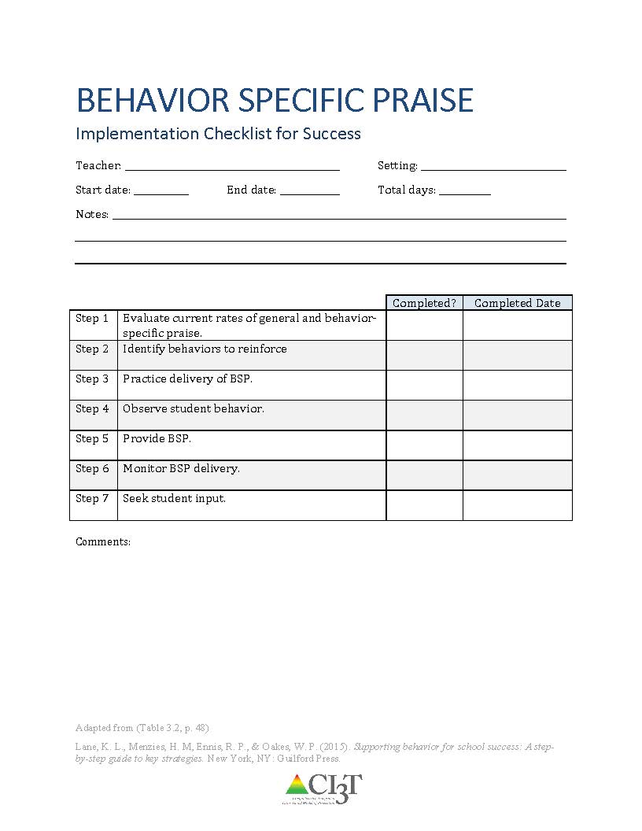
How do I increase BSP in my classroom? Checklist for Success
Step 1: Evaluate current rates of general and behavior specific praise
Step 2: Identify behaviors to reinforce
Step 3: Practice delivery of BSP
Step 4: Observe student behavior
Step 5: Provide BSP
Step 6: Monitor BSP delivery
Step 7: Seek student input
See “Behavior Specific Praise Implementation Checklist for Success”

Slide 77


What is instructional choice?
Instructional Choice
  “…opportunities to make choices means that the student is provided with two or more options, is allowed to independently select an option, and is provided with the selected option" (Jolivette, Stichter, & McCormick, 2002, p. 28)
  Types of instructional choices (Rispoli et al., 2013)
  Across-activity choices
  Within-activity choices

Slide 78
Examples of Instructional Choice
Across-activities Choices
Within-activity Choices
Paper, presentation, or YouTube video to show me what you know?
Which activity would you like to do first?
Pick a learning center?
Make your schedule for the day.
Think-Tac-Toe Boards
Crayons or sparkly markers?
At your desk or in the library?
In the reading corner or at your desk?
Work independently or with a partner?
Which book would you like to read?
Finish in class or at home?
Typed or handwritten?
Even or odds?

Slide 79



Why is instructional choice effective?
Easy
Little time
Offers students control
Promotes decision making and other self-determined behaviors

Slide 80
What does the supporting research for instructional choice say?
Increasing Engagement and Decreasing Disruption in Elementary Self-Contained Classrooms (Dunlap et al., 1994)
Increasing Time On-Task, Task Completion, and Accuracy in Residential Facilities (Ramsey, Jolivette, Patterson,& Kennedy, 2010)
Increasing Task Engagement and Improving Academic Performance in an Inclusive Setting (Skerbetz & Kostweicz, 2013)

Slide 81
What are the benefits & challenges?
Benefits
Challenges
feasible, does not require excessive preparation, is easy to implement, and supports content instruction (Kern & State, 2008; Morgan, 2006; Ramsey et al., 2010).
teaches self-determined behaviors
challenges in preparing independent tasks for the time provided
important to think about procedures for collecting and evaluating different types of assignments

Slide 82
How do I implement instructional choice in my classroom?
Implementation Checklist
!
Step 1
Determine which type of choices you feel comfortable offering and create a menu of choices.
Step 2
Use the menu to determine which type of choice to add to a particular lesson.
Step 3
After choice is built into the lesson, offer the established choices.
Step 4
Ask the student to make his or her choice.

Slide 83
How do I implement instructional choice in my classroom?
Implementation Checklist
Step 5
Provide wait time for the student to select their choice.
Step 6
Listen to (or observe) the student’s response
Step 7
Prompt the student to make a choice from one of the available options if the student has not made a choice within the time allotted.
Step 8
Reinforce the student’s choice, providing them with the option they selected.

Slide 84
How do I implement instructional choice in my classroom?
Implementation Checklist
Step 9
Offer students an opportunity to give feedback on the choice they selected.

Slide 85
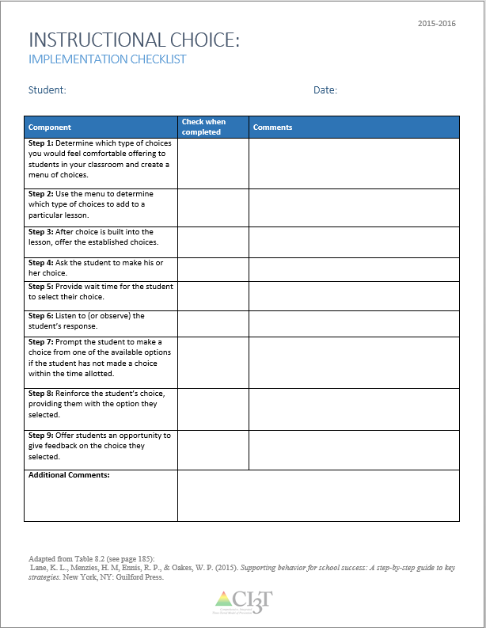
How do I implement instructional choice in my classroom?
Step 1: Determine which type of choices you would feel comfortable offering to students in your classroom and create a menu of choices.
  Consider within activity or across activity choices.
Step 2: Use the menu to determine which type of choices to add to a particular lesson.
Step 3: After choice is built into the lesson, offer the established choices
Step 4: Ask the student to make his or her choice.
See “Instructional Choice Implementation Checklist”

Slide 86
How do I implement instructional choice in my classroom?
Step 5: Provide wait time for the student to select their choice.
Step 6: Listen to (or observe) the student’s response.
Step 7: Prompt the student to make a choice from one of the available options if the student has not made a choice within the time allotted.
Step 8: Reinforce the student’s choice, providing them with the option they selected.
Step 9: Offer students an opportunity to give feedback on the choice they selected.

